Slide 1

Spin Observables in deuteron Electro-Disintegration
Sebastian Kuhn
Old Dominion University (Norfolk, VA)

Slide 2
Overview
What can we learn from d(e,e’p)n?
  Structure of the deuteron
  Reaction mechanism – FSI!
  Check of “deuteron = neutron” experiments
  Calibration reactions
Polarization observables
  Spin-dependent structure of the deuteron
  Complete model of the reaction vs. PWIA
  Predictions for various observables
  Existing data
Results from EG1b in CLAS
Additional and Future analyses?
Summary

Slide 3

Deuteron Structure
Argonne V18 Potential
m_{J} = 0
m_{J} = ±1
ΔProb(p…p+Δp)
Piarulli&Schiavilla 2015
S-state: p_{RMS} = 105 MeV/c
D-state: p_{RMS} = 372 MeV/c
Total: p_{RMS} = 136 MeV/c
CD Bonn
Argonne V18
Nijmegen I
p [GeV]
S-wave
S
D-wave
D

Slide 4
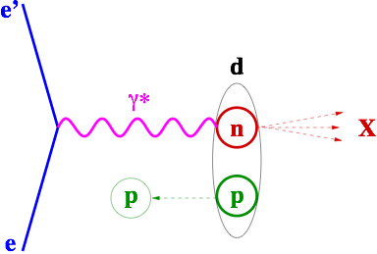

Reaction Mechanism
d(e,e’p)n
E’
p
E
“spectator”
n
θ_{nq}

Slide 5
Spin Structure of the Deuteron
⬆︎ - ⬇︎

Slide 6
PolArization Observables
Integrate out to zero over all φ
… plus terms proportional to h and sinφ (“5th Structure function”)
Compared to data after integration over bins

Slide 7
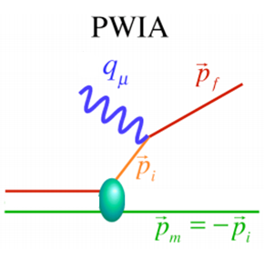
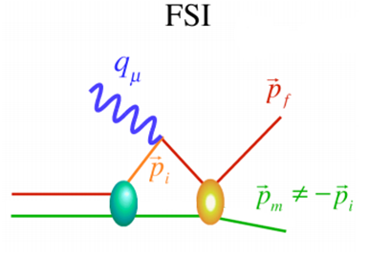
FSI MOdel
Initial state: Solution of Gross Eq.
(fully relativistic)
FSI: Fully spin-dependent phase shifts from SAID
Notes:
Net effect is moving strength from 200 MeV/c to 400 MeV/c thus “polluting” the measured Az with the very different one from lower p

Slide 8
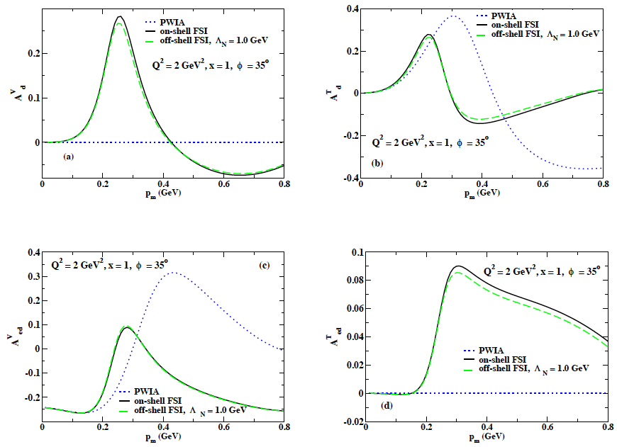
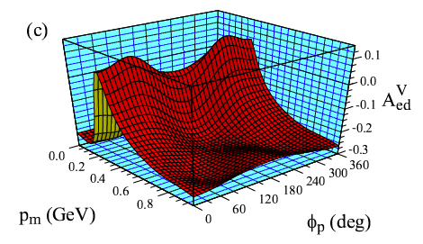
Testing FSI Models in the quasi-elastic channel
W. Van Orden and S. Jeschonnek have developed a fully relativistic description of cross sections, vector and tensor asymmetries for D(e,e’p)n, including (spin-dependent) FSI (based on known phase shifts)
T₂₀
PWIA
A||

Slide 9
Existing Data
Notes:
1) NIKHEF 2) Hall C Q2 = 0.5 pm<180 MeV/c

Slide 10
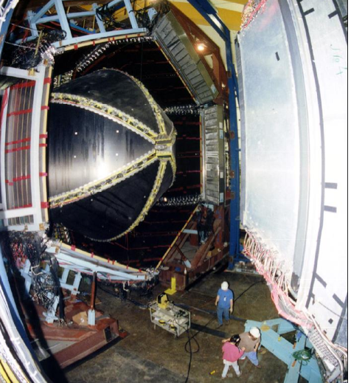
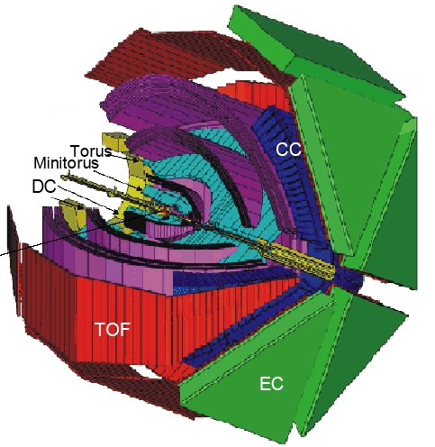
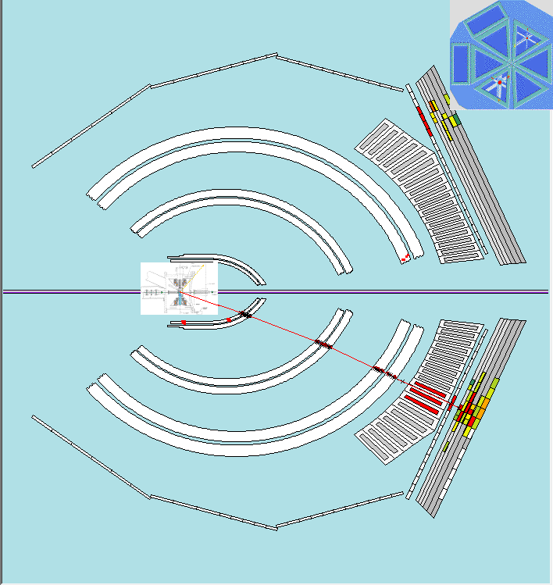
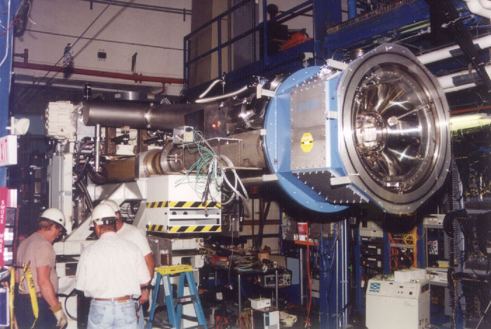
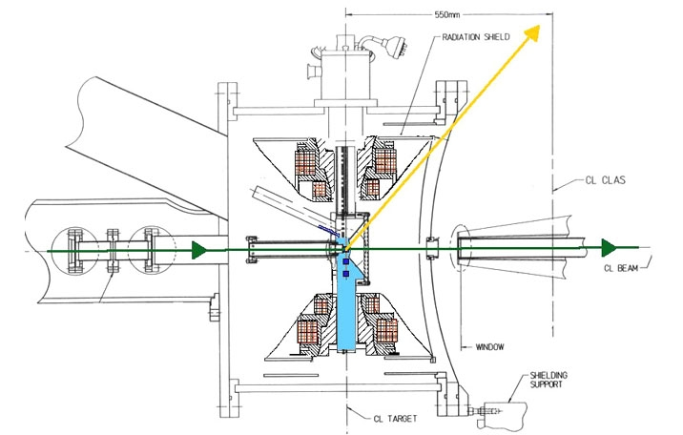
Experiment EG1b in Hall B
Cherenkov
target
beam
drift chambers
e⁻
long. pol. p, d target
Time of flight scintillators
calorimeter
1.6 – 5.8 GeV pol. e⁻
Pol. NH₃, ND₃ and auxiliary targets
6 publications so far, many higher-level analyses (JAM)

Slide 11
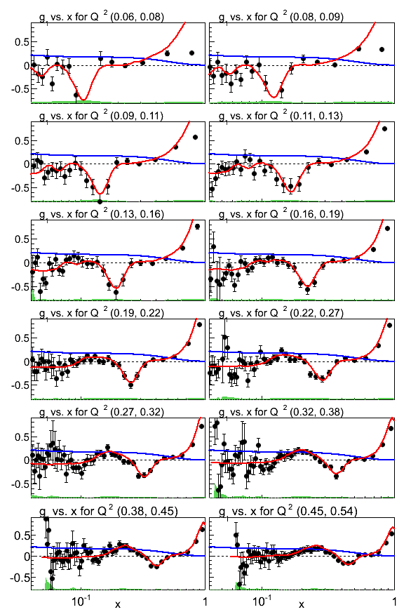
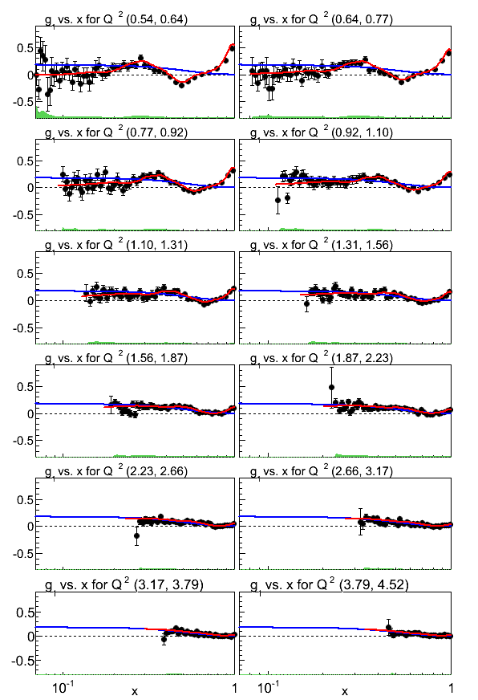
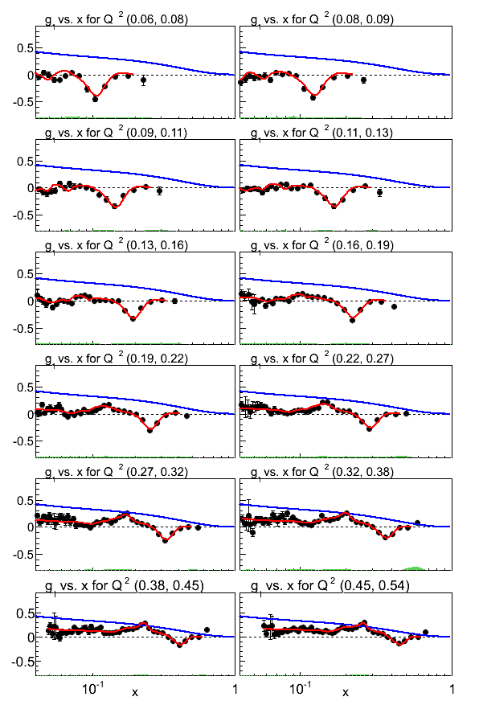
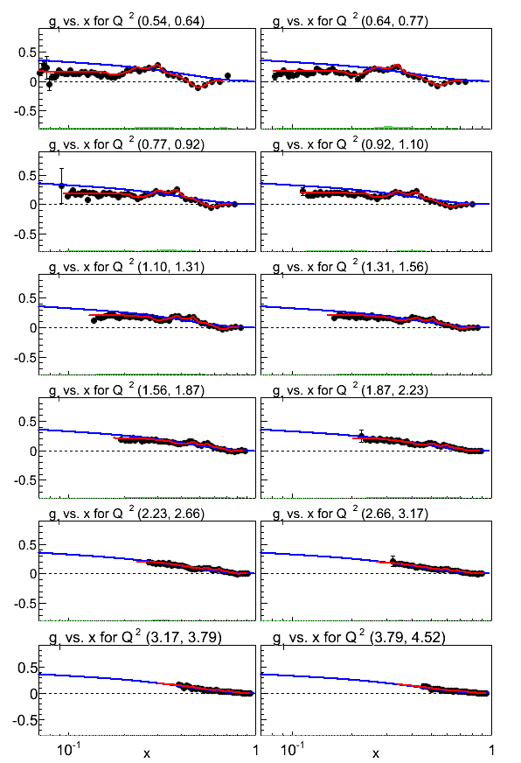
Example: SSFs of the neutron
EG1
Deuteron
EG1
Proton
EG1
Neutron
Requires:
Reliable method to “unfold” neutron from deuteron
Use quasi-elastic d(e,e’p) to measure product of beam and target polarization
☞ need to understand d structure, pn FSI

Slide 12
Submitted to Phys. Rev. C October 21

Slide 13
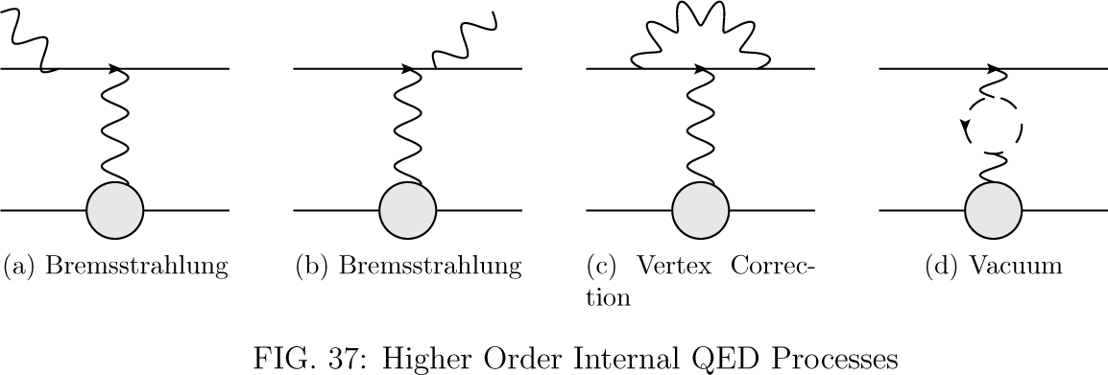
Analysis Details

Slide 14
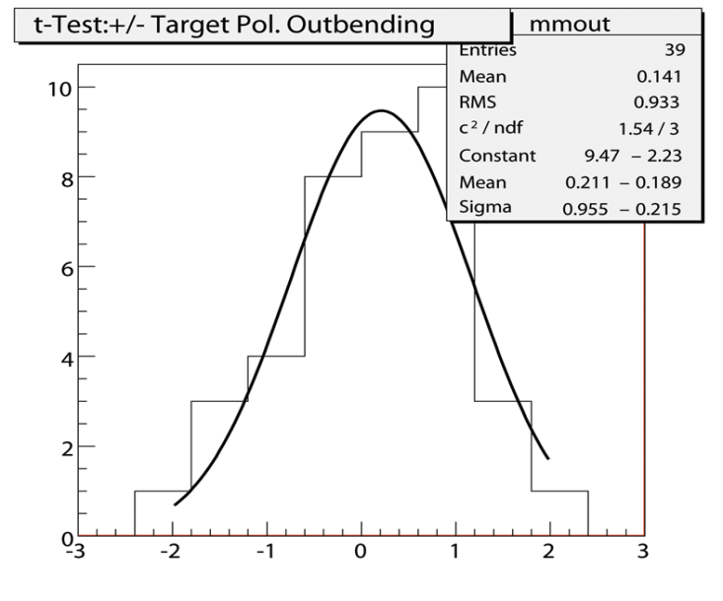
Combining Asymmetries
In-bending Torus
Out-bending Torus
+Target Polarization
-Target Polarization
+Target Polarization
-Target Polarization
In-bending Combined Set
Out-bending Combined Set
Total Combined Data Set
Compatibility of combined data
T-Test
  Difference of asymmetry between each bin normalized to the standard error

Slide 15
REsults
E_{beam} = 1.6…1.7 GeV
Q² = 0.38...0.77 GeV²/c²
E_{beam} = 2.5 GeV
Q² = 0.38...0.77 GeV²/c²

Slide 16
REsults
Tot. χ² (excl. 5.x GeV data):

Slide 17
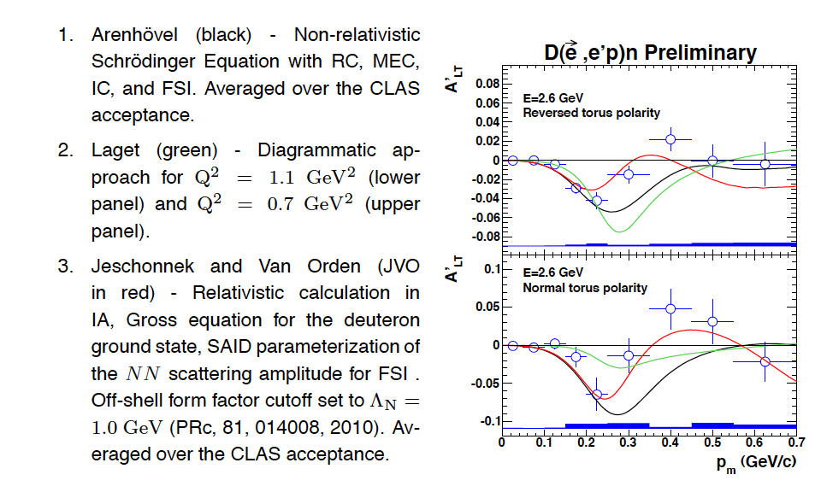
Additional analyses:
5th structure Function in d(e,e’p) – J. Gilfoyle

Slide 18
Further Possibilities
Additional data, in particular from EG4 (low beam energy 1.3 – 2 GeV) and EG1-DVCS (high statistics for highest beam energy so far)
  New calculations for FSI are available from Van Orden et al. extending to higher p-n relative momenta
Future data from EG12?
  Central tracker for much wider kinematic coverage
  Use forward tagger for low-Q²?
Additional observables from EG1b and the others above
  A|| in inclusive d(e,e’) at x > 1: Can probe spin structure of high-momentum tail of the deuteron “wave function”; test various relativistic prescriptions (LC, Gross/Van Orden,…)
Opportunity for new Graduate Students (Data Mining)!

Slide 19
Summary
First measurement of double spin asymmetry in d(e,e’p)n over a wide kinematic range in Q², p_{m} and cosθ_{nq}
Good agreement with expectations from deuteron tensor structure at moderate p_{m} (even within PWIA)
Highest p_{m} require inclusion of FSI to describe measured asymmetries
Model by Van Orden et al. seems to describe all data well
Future tests underway or possible
☞ We are on our way towards a sophisticated, complete description of this reaction with important implications for upcoming spin experiments (polarimetry!) and their interpretation

Slide 20
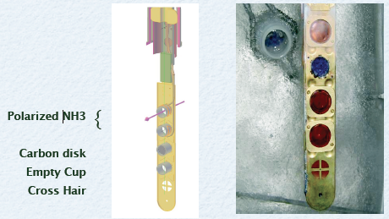
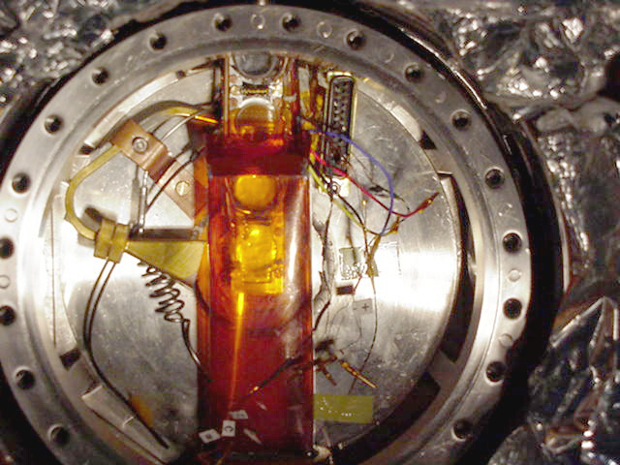
Polarized Proton and Deuteron Solid Targets
Example:
CLAS polarized NH₃/ND₃ target. Typical polarization 0.7-0.9 (p) and 0.3-0.4 (d)

Slide 21
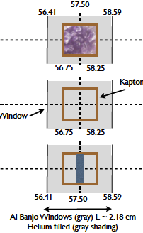
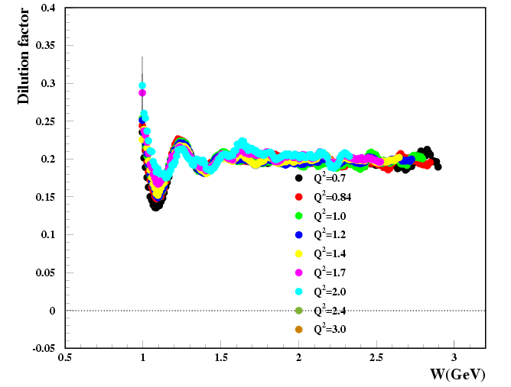
Analysis Steps – Correct for Dilution
“Rest” contains nitrogen, liquid helium and foils for cryogenic DNP targets; Al wires for heat removal in HD ice targets, and contributions from N₂ and glass windows for ³He targets. Note: Some of the above may be slightly polarized! (e.g. nitrogen)
Typical procedure:
Measure distances, thickness/density and composition of all target components as precisely as possible
Develop accurate models for (radiated) cross sections from all elements found in the target
Use auxiliary measurements on well-defined targets (e.g., “empty” cell and a Carbon slab) to calibrate and to fit unknowns (e.g., the packing fraction of ammonia beads inside the cell)
Get smooth representation of n_{Rest} as function of kinematic parameters (E, E’, θ or x and Q²)
Divide measured asymmetry by DF
Note: Plan ahead to have enough auxiliary runs!
Example: EG1 in JLab’s CLAS

Slide 22
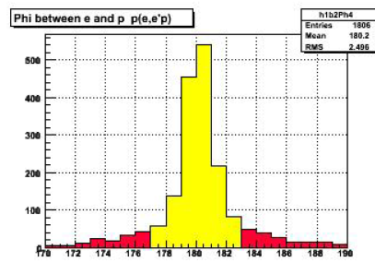
Analysis Steps – Normalize for Polarization
Polarizations must be either measured directly – e.g., beam polarization via Møller or Compton polarimeter, and target polarization via NMR – or inferred from auxiliary measurements.
One example: Exclusive H(e,e’p) reaction has well known double spin asymmetry – measuring it gives product P_{b}P_{t}:
Making use of the fact that the exclusive reaction is 4-fold overdetermined, one can apply tight cuts that reduces the unpolarized (nuclear) background and makes DF close to 1 (and very well-known).

Slide 23
Analysis Steps – Correct for Background
Possible sources of background:
Particles misidentified as electrons
  Most likely π⁻
  Need to carefully evaluate acceptance and rejection efficiency of cuts on EC and CC signals as function of kinematics
Misidentified hadrons
  Need to understand performance of ToF, CC and other PID detectors; most likely problem: separating K⁺’s from both π⁺ and p
Electrons that come from other processes than scattering
  Photons converting into e⁺e⁻ pairs; Dalitz decay π⁰ → γe⁺e⁻
  Charge symmetric → correct by measuring e⁺ rates
Polarized nucleons in the non-H target material (e.g., N in NH₃ is slightly polarized)

Slide 24
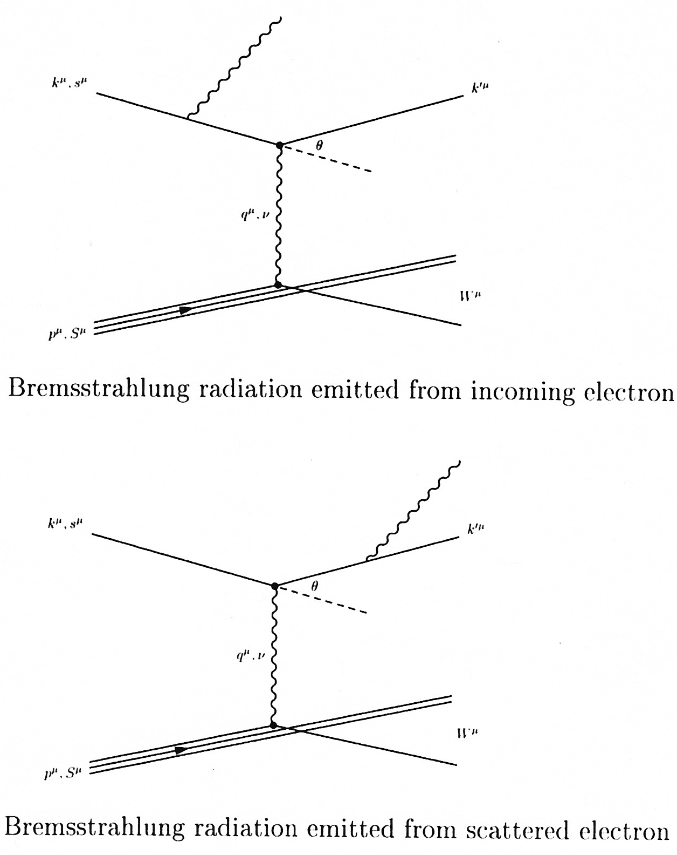
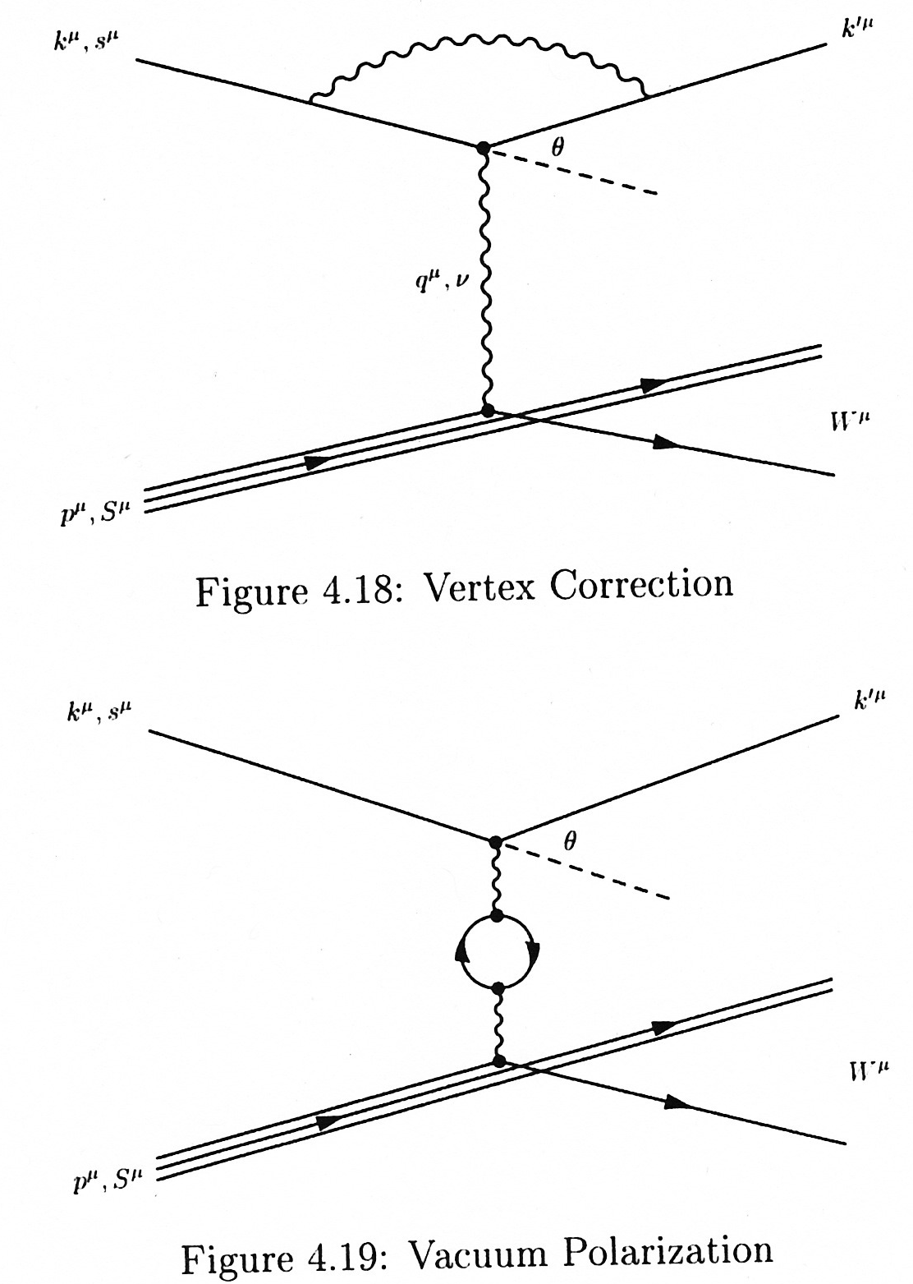
Analysis Steps – Correct for Higher Order QED contributions
Various codes: “RCSLACPOL” developed at SLAC or POLRAD
Internal radiative corrections - Kuchto & Shumeika
External radiative corrections - Tsai
EG1 parameterization
The radiative correction includes an additive piece and a dilution.

Slide 25
Analysis Steps – Model Input
Need parametrizations of cross sections on various nuclear species for dilution factor
Need parametrizations of unpolarized structure functions to convert asymmetries into cross section differences and polarized structure functions
Need model for all types of structure functions for Monte Carlo simulations and radiative corrections (often iterative)

Slide 26
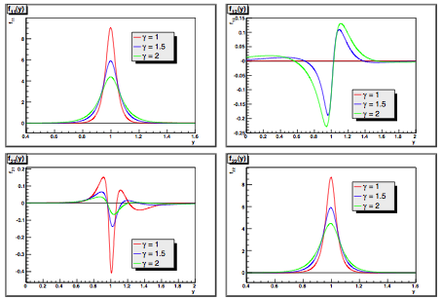
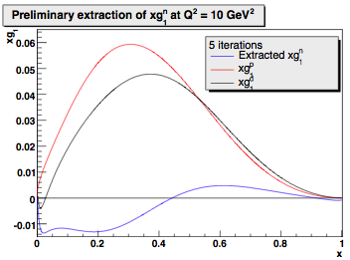
Extracting g_{1n} from g_{1d} and g_{1p}
Y. Kahn and W. Melnitchouk developed convolution algorithm to extract neutron structure functions iteratively from deuteron + proton measurements (Phys.Rev.C79:035205,2009)
To be applied to existing EG1b deuteron and proton data
Smearing functions

Slide 27
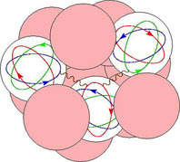
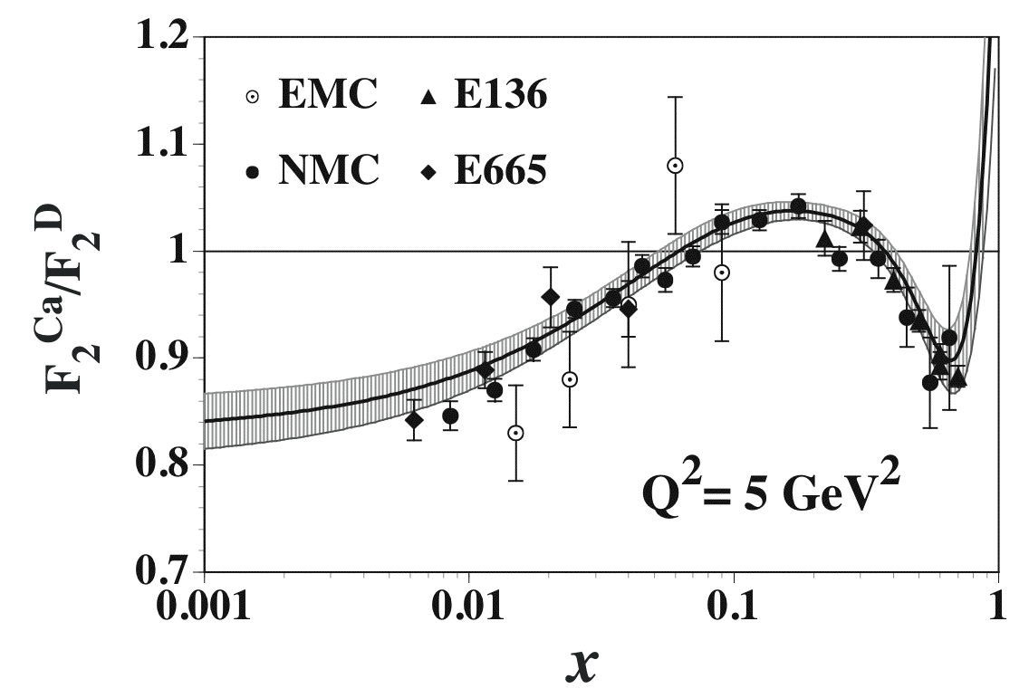
Nuclear Effects
 | Deuteron↑ | ³He↑ (³H)
0th order approximation | p↑n↑ | p↑p↓n↑
D-state and other configurations (S’, P, …) | μ_{D} = μ_{p}+μ_{n} – 0.022 | μ_{He} = μ_{n} – 0.214
Tensor polarization | P_{zz} ≈ 0.1 | Not applicable
Kinematic “smearing” | p_{RMS} = 130 MeV/c | p_{RMS} = 170 MeV/c
Binding and “off-shell”-effect | E_{bound}-E_{free} ≈ -10 MeV | E_{bound}-E_{free}≈ -20 MeV
EMC-effect, final state interaction, coherent processes | A = 2, ρ ≈ 0.063 N/fm³ | A=3, ρ ≈ 0.094 N/fm³
Extra pions? | 2% ? | 5% ?
Contributions from Delta resonances? | P_{ΔΔ} < 0.5% | P_{ΝΝΔ} ≈ 2% ?
Other exotic components? | 6-quark bags? | 6- and 9-quark bags?

