Slide 1


Dibaryons at CLAS
Mikhail Bashkanov

Slide 2






Possible particles
Tetraquark
Meson-Meson molecule
Hexaquark
Baryon-Baryon molecule
Pentaquark
Meson-Baryon molecule
$$f_{0}/a_{0}(980)$$
$$Z^{+}(4430)$$
$$deuteron$$
$$Λ(1405)$$
$$d^{∗}(2380)$$
$$P_{c}^{+}(4450)$$

Slide 3
Deuteron to Deltaron
I(J^{p}) = 0(1⁺)
I(J^{p}) = 0(3⁺)
u
u
u
d
d
d
u
u
u
d
d
d
Threshold
2.2 MeV
p
n
80 MeV
Δ
Δ
deuteron
d*

Slide 4
d*(2380)
The Discovery

Slide 5
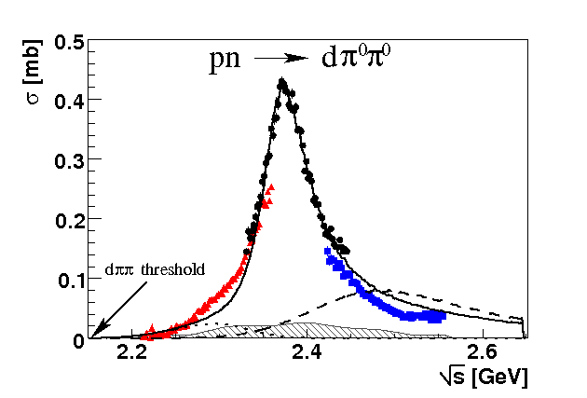
Total cross section pn → dπ⁰π⁰
“d* resonance”
Γ∼70 MeV
ΔΔ
NN*(1440)
P. Adlarson et. al Phys. Rev. Lett. 106:242302, 2011

Slide 6
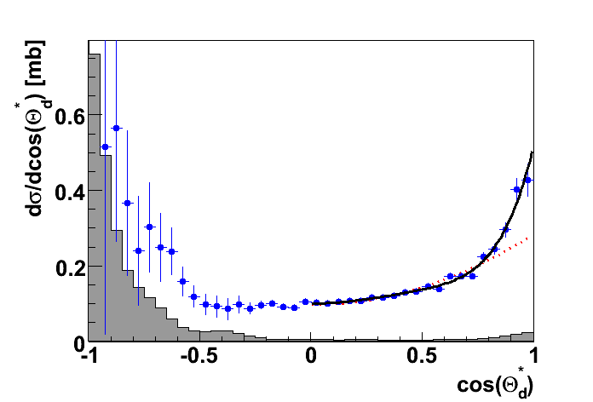
Angular distribution in the peak
J=3
J=1
P. Adlarson et. al Phys. Rev. Lett. 106:242302, 2011

Slide 7
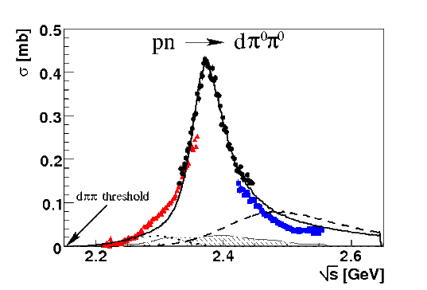

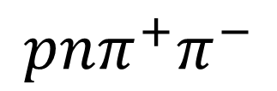

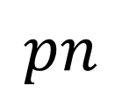
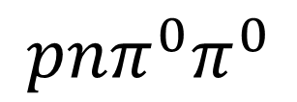
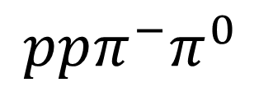
Dibaryon hadronic decays
PRL 106 (2011) 242302
PLB 721 (2013) 229
WASA data
$$dπ^{0}π^{0}$$
$$dπ^{+}π^{−}$$
pn → d*(2380)
$$pn$$
$$ppπ^{−}π^{0}$$
$$pnπ^{0}π^{0}$$
$$pnπ^{+}π^{−}$$
PRL 112 (2014) 202301
PRC 90, (2014) 035204
d*
d*
PRC 88 (2013) 055208
PLB 743 (2015) 325
d*

Slide 8
Argand plot
P. Adlarson et al. Phys. Rev. Lett. 112, 202301, (2014)
P. Adlarson et al. Phys. Rev. C 90, 035204 , (2014)

Slide 9
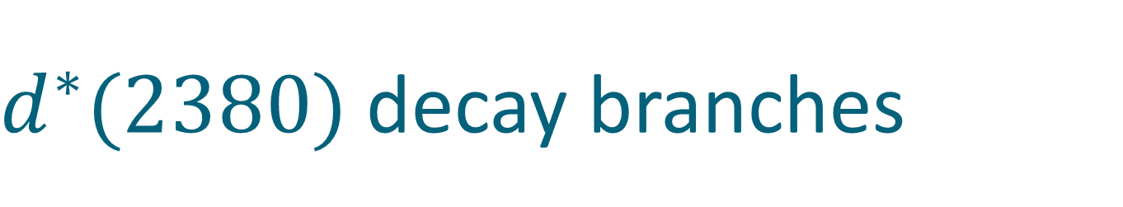
$d^{∗}(2380)$ decay branches
$d^{∗}$ decay channel | Branching ratio, %
$$pn$$ | 12(3)
$$dπ^{0}π^{0}$$ | 14(1)
$$dπ^{+}π^{−}$$ | 23(2)
$$pnπ^{+}π^{−}$$ | 30(5)
$$pnπ^{0}π^{0}$$ | 12(2)
$$ppπ^{0}π^{−}$$ | 6(1)
$$nnπ^{0}π^{+}$$ | 6(1)
$$NNπ$$ | 0(10)
Eur.Phys.J. A51 (2015) 7, 87

Slide 10

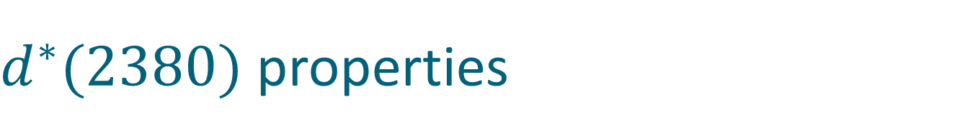

$d^{∗}(2380)$ properties
I(J^{p}) = 0(3⁺)
$$M_{d^{∗}}=2.38 GeV≈2M_{Δ}−80 MeV$$
$$Γ_{d^{∗}}=70 MeV≪Γ_{ΔΔ}=240 MeV$$
$$d^{∗}$$
Δ
90 %
Δ
$$d^{∗}$$
p
10 %
n

Slide 11

$d^{∗}(2380)$ properties
I(J^{p}) = 0(3⁺)
$$M_{d^{∗}}=2.38 GeV≈2M_{Δ}−80 MeV$$
$$Γ_{d^{∗}}=70 MeV≪Γ_{ΔΔ}=240 MeV$$
$$d^{∗}$$
Δ
90 %
Δ
p
Δ
$$d^{∗}$$
? %
$$d^{∗}$$
p
10 %
Δ
n
n

Slide 12
d* photoproduction
Experimental verification

Slide 13
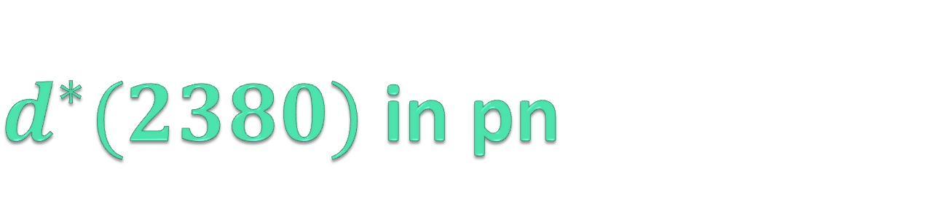
$d^{∗}(2380)$ best decay channels
Isospin filter
pn → dibaryon → dπ⁰π⁰
3-body reaction
pn → dibaryon → pn
PWA
polarization observables
2-body reaction

Slide 14
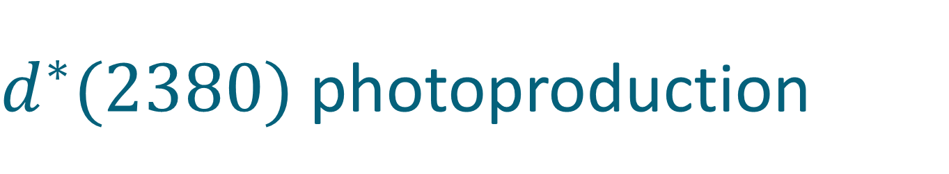
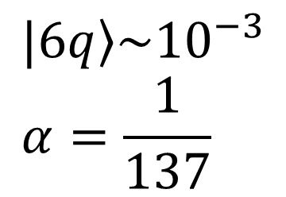

$d^{∗}(2380)$ photoproduction
$$γd→d^{∗}\left(2380\right) ⟹E_{γ}=550 MeV$$
γ
Δ
π
d
d
Δ
π
$$|\left.6q\right\rangle →|\left.6q\right\rangle$$
$$σ(γd→d^{∗}\left(2380\right)→dπ^{0}π^{0})\sim 10nb$$
$$|\left.6q\right\rangle \sim {10}^{−3} \\ α=\frac{1}{137}$$

Slide 15
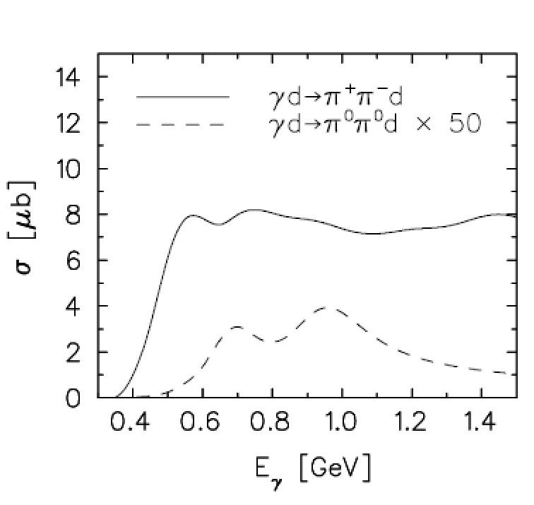
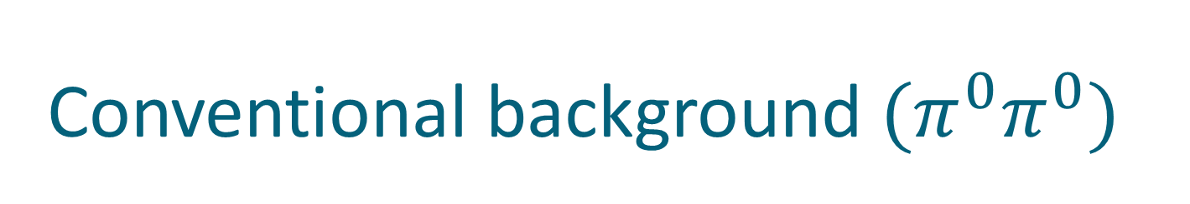
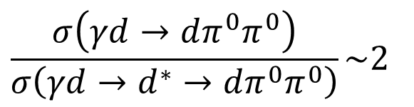
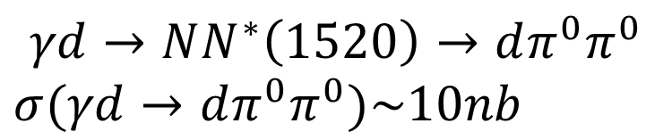
Conventional background $(π^{0}π^{0})$
$$γd→NN^{∗}\left(1520\right)→dπ^{0}π^{0}$$
$$σ(γd→dπ^{0}π^{0})\sim 10nb$$
Conventional background:
Known
Small
$$\frac{σ\left(γd→dπ^{0}π^{0}\right)}{σ\left(γd→d^{∗}→dπ^{0}π^{0}\right)}\sim 2$$
Fix, H. Arenhoevel. Eur. Phys. J. A 25, 115, (2005).
M. Egorov, A. Fix, Nucl.Phys. A933 (2015) 104-113

Slide 16
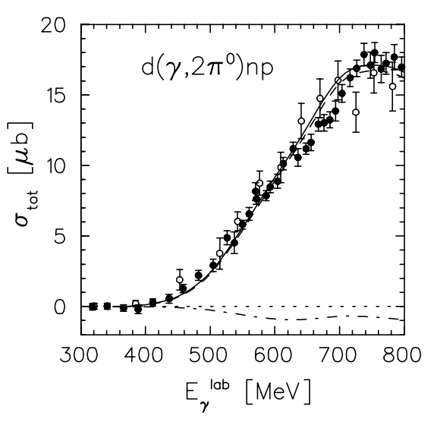





Conventional background – other $ππ$ channels
$$σ(γd→pnπ^{0}π^{0})\sim 8μb$$
$$σ(γd→dπ^{+}π^{−})\sim 8μb$$
$$\frac{σ\left(γd→pnπ^{0}π^{0}\right)}{σ\left(γd→d^{∗}→pnπ^{0}π^{0}\right)}\sim 100$$
$$\frac{σ\left(γd→dπ^{+}π^{−}\right)}{σ\left(γd→d^{∗}→dπ^{+}π^{−}\right)}\sim 100$$
Fix, H. Arenhoevel. Eur. Phys. J. A 25, 115, (2005).
M. Egorov, A. Fix, Nucl.Phys. A933 (2015) 104-113

Slide 17
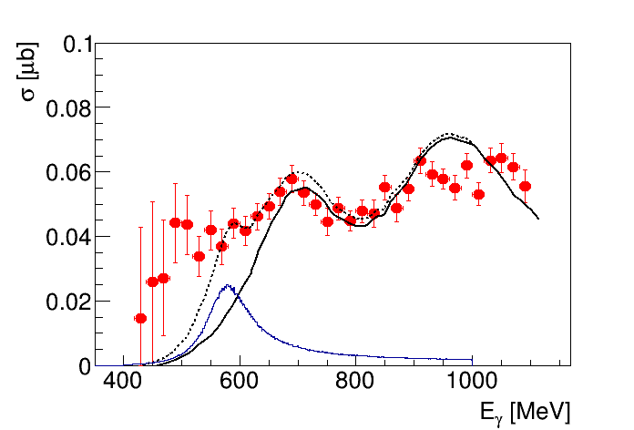


$$γd →d^{∗}→dπ^{0}π^{0}$$
M. Guenther Master Thesis, Basel 2015
Conventional Background
M. Egorov, A. Fix,
Nucl.Phys. A933 (2015) 104-113
$$d^{∗}$$

Slide 18
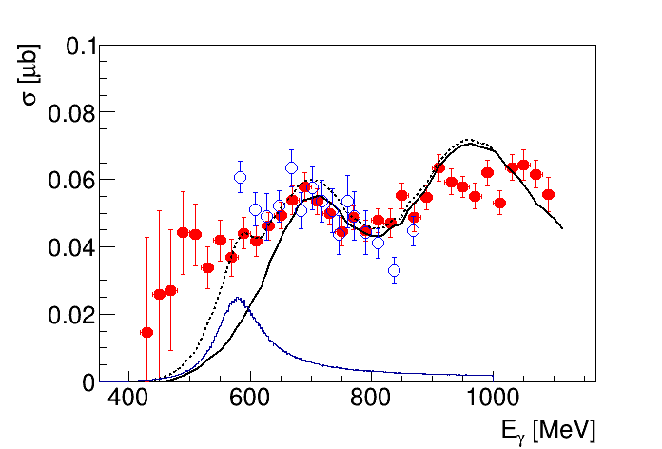
$$γd →d^{∗}→dπ^{0}π^{0}$$
T. Ishikawa et al. arXiv:1610.0553, scaled by 0.5
M. Guenther Master Thesis, Basel 2015
Conventional Background
M. Egorov, A. Fix,
Nucl.Phys. A933 (2015) 104-113
$$d^{∗}$$

Slide 19
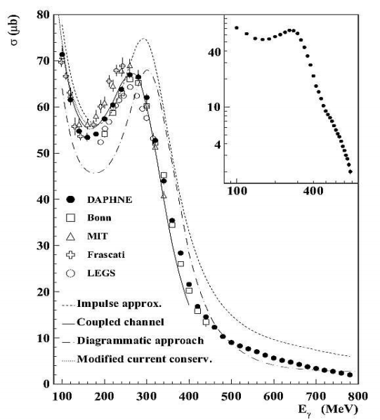


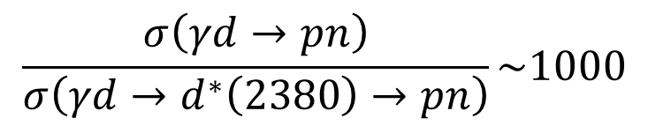

$$γd→d^{∗}→pn$$
Conventional background
$$σ(γd→pn)\sim 8μb$$
$$σ(γd→d^{∗}\left(2380\right)→pn)\sim 10nb$$
$$\frac{σ\left(γd→pn\right)}{σ\left(γd→d^{∗}\left(2380\right)→pn\right)}\sim 1000$$
BUT
Polarization observables
Federico Ronchetti arXiv 1301.5886

Slide 20
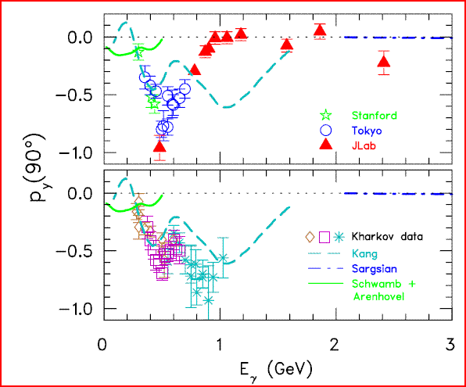

d*(2380) in photoproduction?
R. Gilman and F. Gross nucl-th/0111015 (2001)
d*
γ
p
T. Kamae, T. Fujita Phys. Rev. Lett. 38, Feb 1977, 471
d
n
H. Ikeda et al., Phys. Rev. Lett. 42, May 1979, 1321
I(J^{p}) = 0(3⁺)
$$M=2.38 GeV$$

Slide 21
d* internal structure
Experimental verification

Slide 22




Deltaron vs Hexaquark
0.7 fm
$$≈66\%$$
$$≈33\%$$
$$?$$
Narrow width
L=0
Branching ratios
Dalitz plots
Δ
Δ
Δ
Δ
L=2
$$≈90\%$$
$$≈10\%$$
$M_{ππ}$, PWA
F. Huang et al, Chin.Phys. C39 (2015) 7, 071001

Slide 23


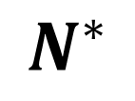
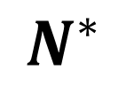
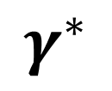
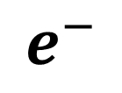
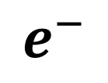
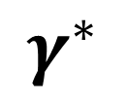
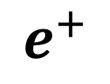
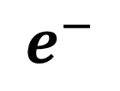
Structure of the resonance. Transition form factor
$$e^{+}$$
$$γ^{∗}$$
$$e^{−}$$
$$N^{∗}$$
$$N$$
$$e^{−}$$
JLab
$$γ^{∗}$$
$$e^{−}$$
$$N$$
$$N^{∗}$$

Slide 24
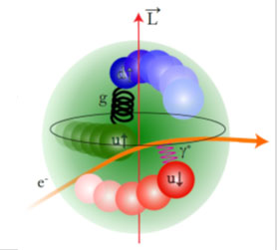
N* internal structure at CLAS
e⁻
e⁻
γ*
N*
N
Transition form factor
Charge distribution
Internal structure

Slide 25
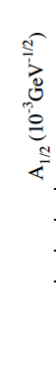
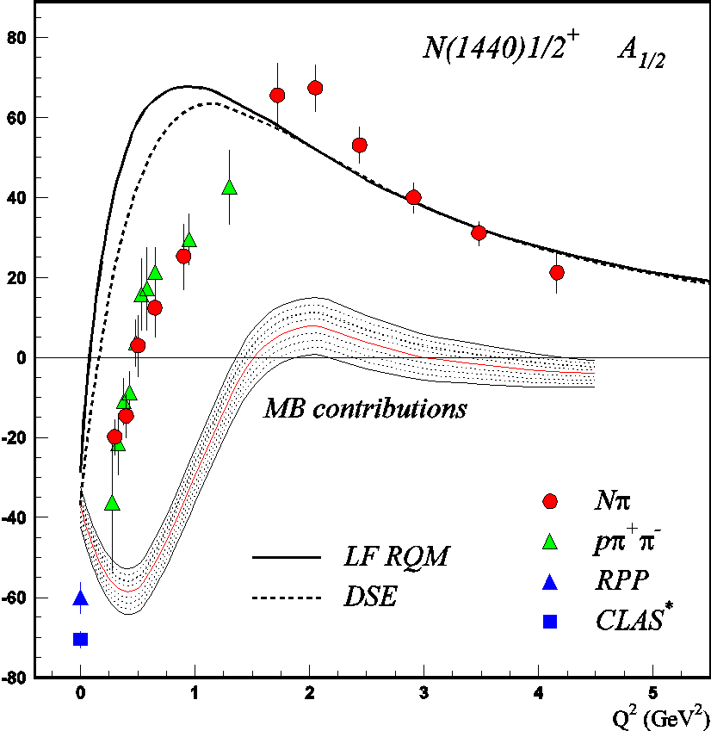
The Roper resonance internal structure
LF RQM: I.G. Aznauryan and V.D. Burkert, arXiv:1603.06692
From V. Mokeev talk at NPQCD2016

Slide 26
Hexaquark vs molecule
e⁻
e⁻
γ*
d*(2380)
d
Transition form factor
Charge distribution
Internal structure

Slide 27

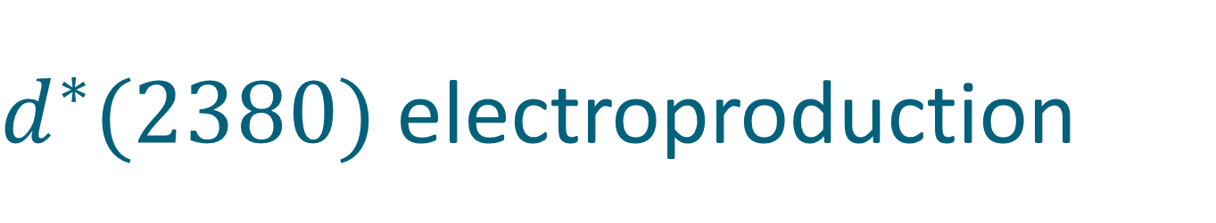

$d^{∗}(2380)$ electroproduction
γ
$$Γ(d^{∗}→γd)\sim 1keV$$
d
γ
Δ
d
$$Γ(d^{∗}→γγd)\sim 1keV$$
Δ
γ

Slide 28
$d^{∗}(2380)$ electroproduction
e⁻
e⁻
γ*
e⁻
γ*
d*(2380)
e⁻
d*(2380)
γ*

Slide 29
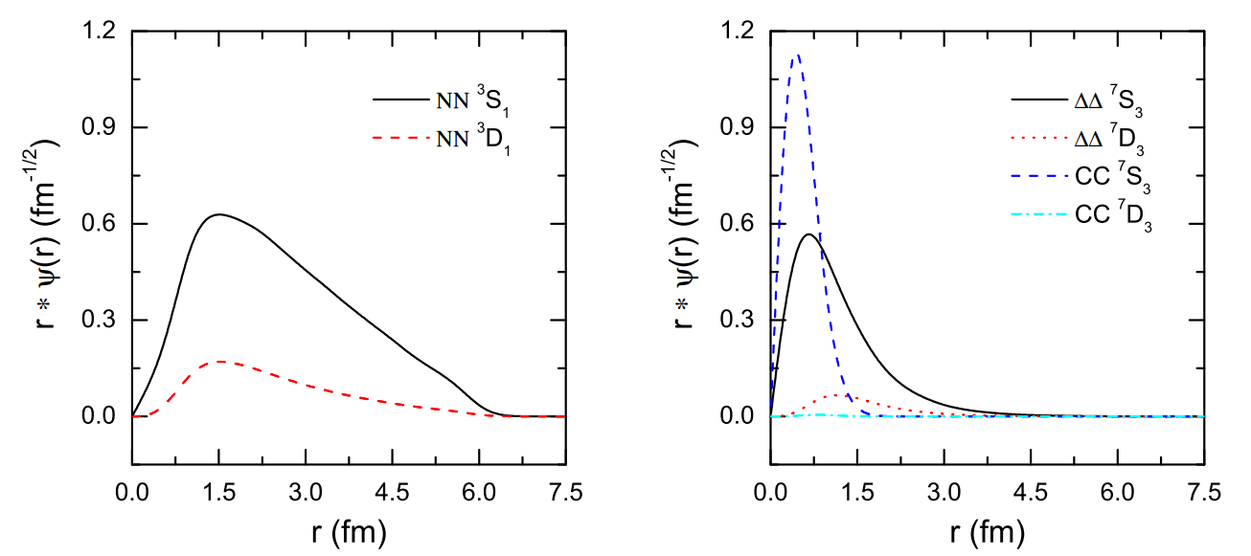
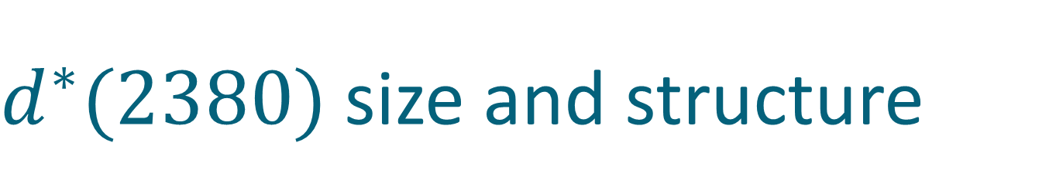
$d^{∗}(2380)$ size and structure
deuteron
d*
F. Huang et al, Chin.Phys. C39 (2015) 7, 071001

Slide 30
The family of dibaryons

Slide 31
Mirror dibaryon
d*
I(J^{p}) = 0(3⁺)
I(J^{p}) = 3(0⁺)
Δ
Δ
Δ
Δ
u
u
u
d
d
d
u
u
u
u
u
u
Freeman J. Dyson, Nguyen-Hue Xuong Phys. Rev. Lett. 13(1964) 815
Avraham Gal, Humberto Garcilazo Nucl. Phys. A928, (2014), 73

Slide 32
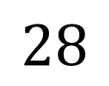
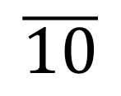

How many ways can you combine 6q?
Isospin
$$J^{P}=3^{+}$$
$$J^{P}=0^{+}$$
Strangeness
$$\overline{10}$$
$$28$$
Δ⁻Δ⁻
Δ⁺⁺Δ⁺⁺
d*
ΔΔ
ΔΣ*
Σ*Σ*+ΔΞ*
Ξ*Σ*+ΔΩ
Ξ*Ξ*+Σ*Ω
Ξ*Ω
ΩΩ

Slide 33
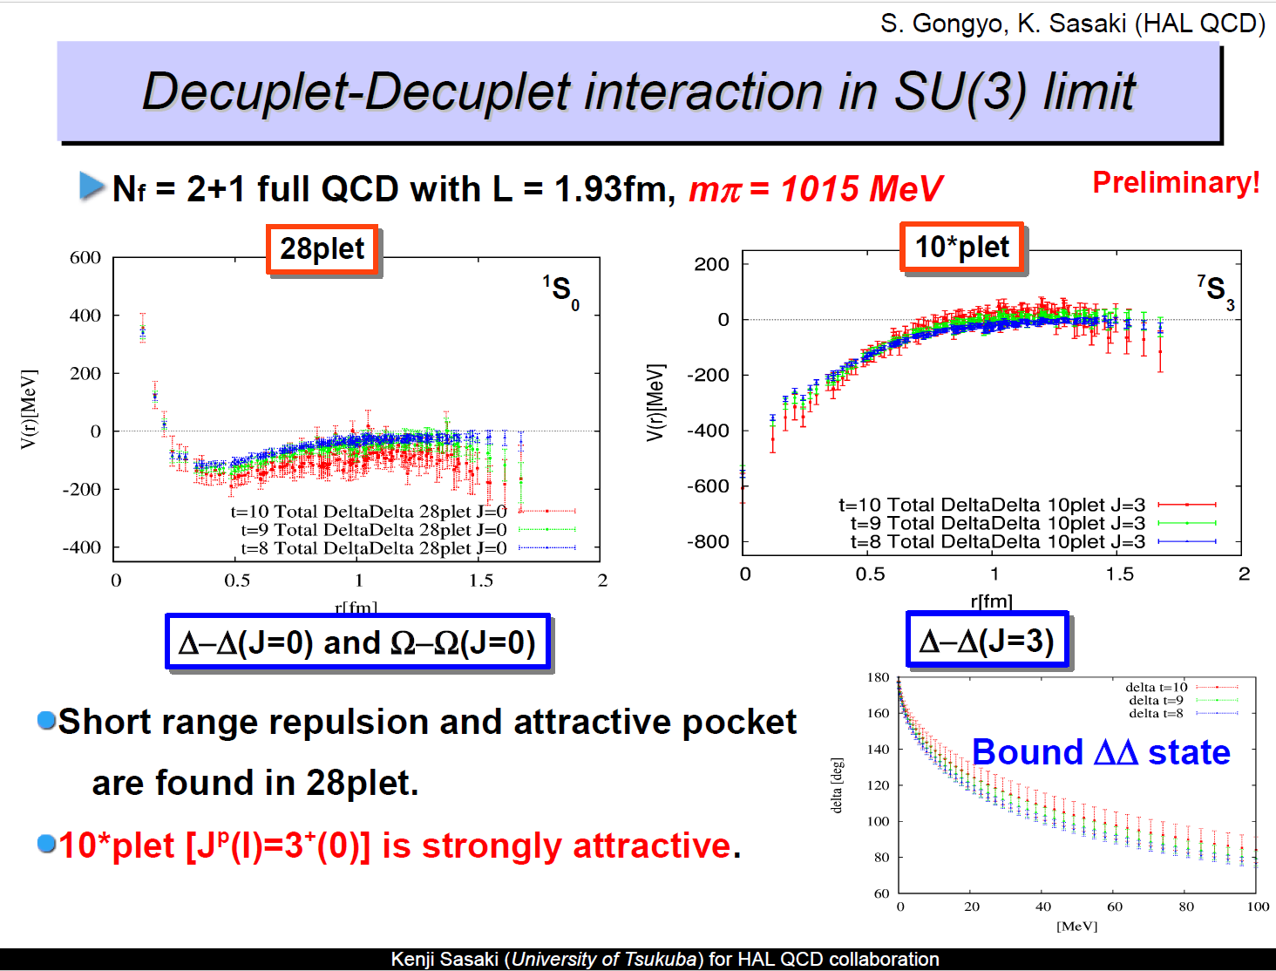
d* in Lattice

Slide 34

NN vs ΔΔ
$${}_{}^{1}{S_{0}}$$
Z=+4
p
n
Δ
Δ
66 keV
Threshold
?
2.2 MeV
p
n
80 MeV
Δ
Δ
deuteron
d*
”Search for an Isospin I =3 Dibaryon”arXiv:1606.02964, accepted for PLB

Slide 35
How many ways can you combine 6q?
Isospin
$$J^{P}=3^{+}$$
$$J^{P}=0^{+}$$
Strangeness
$$\overline{10}$$
$$28$$
Δ⁻Δ⁻
Δ⁺⁺Δ⁺⁺
d*
ΔΔ
ΔΣ*
Σ*Σ*+ΔΞ*
Ξ*Σ*+ΔΩ
Ξ*Ξ*+Σ*Ω
Ξ*Ω
ΩΩ

Slide 36
Strange dibaryon

Slide 37




d*(2380) SU(3) multiplet
J^{p} = 3⁺
ΔΔ
$$d^{∗}(2380)$$
$$M_{d^{∗}}−M_{Δ}+M_{Σ^{∗}}<M_{d_{s}^{∗}}≤M_{Δ}+M_{Σ^{∗}}$$
ΔΣ*
$$d_{s}^{∗}(2.53−2.60)$$
ΔΞ*
$$d_{ss}^{∗}(2.68−2.76)$$
ΔΩ
$$d_{sss}^{∗}(2.82−2.90)$$

Slide 38
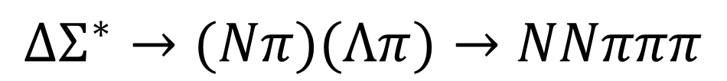
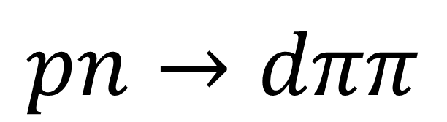
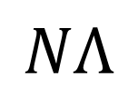

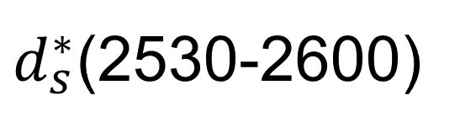
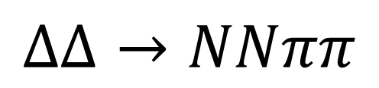
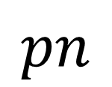
Strange Dibaryon
Isospin
$$pn$$
$$\overline{10}$$
$d^{∗}$(2380)
Strangeness
d*
ΔΔ
ΔΣ*
$$ΔΔ→NNππ$$
Σ*Σ*+ΔΞ*
Ξ*Σ*+ΔΩ
$$NΛ$$
$d_{s}^{∗}$(2530-2600)
$$ΔΣ^{∗}→(Nπ)(Λπ)→NNπππ$$

Slide 39





Reaction
γ
$$π^{+}$$
p
$$Δ^{++}$$
p
d
$$π^{−}$$
p
n
$$Σ^{∗−}$$
$$Λ$$
$$K^{0}$$
$$π^{−}$$
$$π^{−}$$
$$π^{−}$$
$$π^{+}$$

Slide 40





Reaction
$$π^{+}π^{−}$$
$$γd→\left(K^{0}\right)+d_{s}^{∗}→pp2π^{+}3π^{−}$$
$$Δ^{++}Σ^{∗−}$$
$$Λπ^{−}$$
$$pπ^{+}$$
$$pπ^{−}$$

Slide 41


Exploratory search for the $d_{s}^{∗}$
g13 beamtime
${1.5<E}_{γ}<2.5GeV$
7 charged particles in final state
  Similar analysis for 6 charged particles (unmeasured proton)

Slide 42
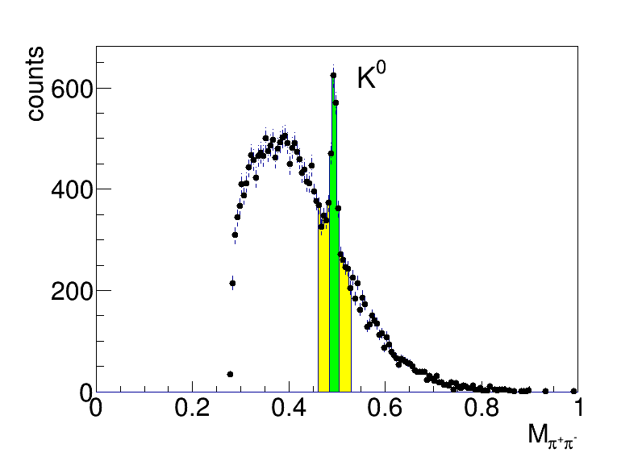
Search for the strange dibaryon

Slide 43
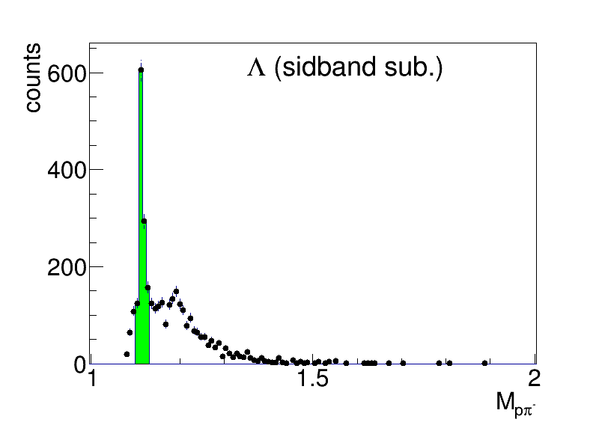
Search for the strange dibaryon

Slide 44
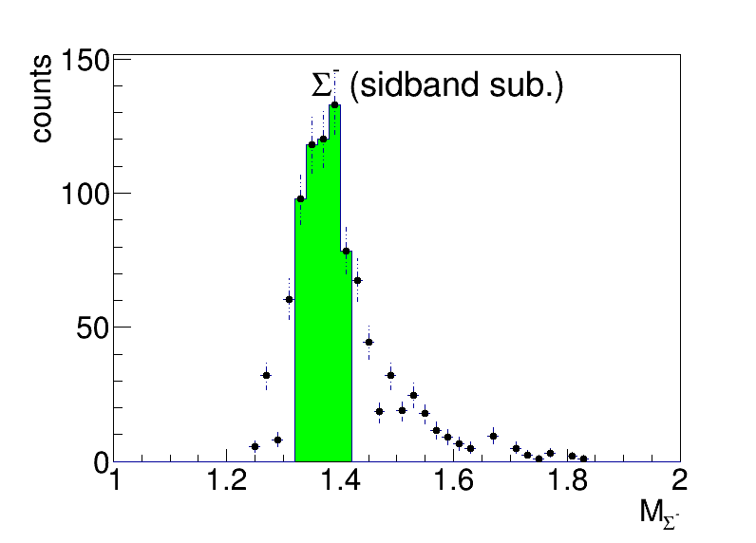
Search for the strange dibaryon

Slide 45


Search for the strange dibaryon
MonteCarlo $Δ^{++}Σ^{∗−}$

Slide 46
Conclusion
The very first dibaryon d*(2380) is established
  Mass, Width, Quantum numbers, Main decay branches
  Hints of d*(2380) photoproduction
Photo-induced reactions
  Structure: Hexaquark vs Molecule?
  Strange dibaryon
Support from theory

Slide 47
ΔΔ
$$d^{∗}(2380)$$
Thank you
ΔΣ*
ΔΞ*
ΔΩ

Slide 48
d*(2380) internal structure

Slide 49




d*(2380) internal structure
pn → d* → ΔΔ → dππ
π
p
Δ
$$N_{1}$$
d
n
$$N_{2}$$
Δ
π
$$\overset{⃑}{{p_{Δ}}_{2}}−\overset{⃑}{{p_{Δ}}_{2}}=\left(\overset{⃑}{p_{N_{1}}}+\overset{⃑}{p_{π_{1}}}\right)−\left(\overset{⃑}{p_{N_{2}}}+\overset{⃑}{p_{π_{2}}}\right)=\left(\overset{⃑}{p_{N_{1}}}−\overset{⃑}{p_{N_{2}}}\right)+\left(\overset{⃑}{p_{π_{1}}}−\overset{⃑}{p_{π_{2}}}\right)≈\left(\overset{⃑}{p_{π_{1}}}−\overset{⃑}{p_{π_{2}}}\right)$$
$$\overset{⃑}{p_{N_{1}}}≈\overset{⃑}{p_{N_{1}}}$$
$$\overset{⃑}{{p_{Δ}}_{2}}−\overset{⃑}{{p_{Δ}}_{2}}≈\left(\overset{⃑}{p_{π_{1}}}−\overset{⃑}{p_{π_{2}}}\right)↔M_{ππ}$$

Slide 50
d*(2380) internal structure and the ABC effect
L=0
Δ
Δ
Δ
Δ
L=2
M. Bashkanov et al, arXiv:1502.07500

Slide 51
Deltaron vs Hexaquark
0.7 fm
$$≈66\%$$
$$≈33\%$$
$$?$$
Narrow width
L=0
Branching ratios
Dalitz plots
Δ
Δ
Δ
Δ
L=2
$$≈90\%$$
$$≈10\%$$
$M_{ππ}$, PWA
F. Huang et al, Chin.Phys. C39 (2015) 7, 071001

Slide 52
Theory

Slide 53

Dibaryon in Skyrme model
David Foster, Nicholas S. Manton, Nucl.Phys. B899 (2015) 513

Slide 54

d* in Lattice

Slide 55
d* in Lattice

Slide 56
$d^{∗}(2380)$ in pn

Slide 57

Expectations
p
p
n
n
SAID with resonance
SAID
A. Pricking, M. Bashkanov, H. Clement: arXiv:1310.5532

Slide 58


$A_{y}$ energy dependence at $83°$
p
p
n
n
SAID
A. Pricking, M. Bashkanov, H. Clement: arXiv:1310.5532

Slide 59

$A_{y}$ energy dependence at $83°$
p
p
n
n
SAID
New SAID
solutions
P. Adlarson et al. Phys. Rev. Lett. 112, 202301, (2014)

Slide 60



Dimensionless partial wave amplitudes
Pole at $(2380±10)−i(40±5) MeV$
Dimensionless partial wave amplitudes
Im
SP14
SP07
Re
$${}_{}^{3}{D_{3}}$$
$$ε_{3}$$
$${}_{}^{3}{G_{3}}$$
Resonance in the pn system
P. Adlarson et al. Phys. Rev. Lett. 112, 202301, (2014)

Slide 61
Total pn cross-section
Devlin et al, PRD8, 136 (73)
LisowskI et al, PRL49, 255(82)
SAID SP07
SAID new solution
P. Adlarson et al. Phys. Rev. Lett. 112, 202301, (2014)
P. Adlarson et al. Phys. Rev. C 90, 035204 , (2014)

Slide 62

Effect of d* on other pn observables
with d*
without d*
SP07
R.L. Workman, W.J. Briscoe, I.I. Strakovsky Phys.Rev. C93 (2016), 045201

Slide 63

The benchmark measurement
γ
p
Measure polarization of both
proton and neutron !
d*
d
n

Slide 64

New Particle identification detector

Slide 65

New Particle identification detector

Slide 66


Polarimeter

Slide 67





Experiment
$$γ$$
n
$$p$$
$$Θ,φ,E$$
Target
$$Θ^{′},φ′$$
$$γd→\vec{p}n$$
Polarimeter

Slide 68


Experiment
$$γ$$
p
$$n$$
$$Θ,φ,E$$
p
Target
$$Θ^{′},φ′$$
$$γd→p\vec{n}$$
Polarimeter

Slide 69
Mirror dibaryon
d*
I(J^{p}) = 0(3⁺)
I(J^{p}) = 3(0⁺)
Δ
Δ
Δ
Δ
u
u
u
d
d
d
u
u
u
u
u
u
Freeman J. Dyson, Nguyen-Hue Xuong Phys. Rev. Lett. 13(1964) 815
Avraham Gal, Humberto Garcilazo Nucl. Phys. A928, (2014), 73

Slide 70
NN vs ΔΔ
$${}_{}^{1}{S_{0}}$$
Z=+4
p
n
Δ
Δ
66 keV
Threshold
?
2.2 MeV
p
n
80 MeV
Δ
Δ
deuteron
d*

Slide 71
How many ways can you combine 6q?
Isospin
$$J^{P}=3^{+}$$
$$J^{P}=0^{+}$$
Strangeness
$$\overline{10}$$
$$28$$
Δ⁻Δ⁻
Δ⁺⁺Δ⁺⁺
d*
ΔΔ
ΔΣ*
Σ*Σ*+ΔΞ*
Ξ*Σ*+ΔΩ
Ξ*Ξ*+Σ*Ω
Ξ*Ω
ΩΩ

Slide 72



Argand plots
P. Adlarson et al. Phys. Rev. Lett. 112, 202301, (2014)
P. Adlarson et al. Phys. Rev. C 90, 035204 , (2014)
$$\frac{Γ_{d^{∗}→pn}}{Γ_{tot}}≈0.12$$
$$Γ_{d^{∗}→pn({}_{}^{3}{D_{3}})}≈10 MeV$$
$$Γ_{d^{∗}→pn({}_{}^{3}{G_{3}})}≈1 MeV$$

Slide 73

S-wave $Δ−Δ$ only?
Δ
N
L=0
L=0,2
Δ
N
Δ
N
L=2
L=0,2,4
Δ
N

Slide 74


S-wave $Δ−Δ$ only?
d* (2380)→ pn
Δ
N
$d^{∗}(2380)$
p
L=0
L=0,2
90%
L=2
Δ
n
N
$d^{∗}(2380)$
p
Δ
N
10%
L=4
n
L=2
L=0,2,4
Δ
N

Slide 75

S-wave $Δ−Δ$ only?
d* (2380)→ pn
Δ
N
$d^{∗}(2380)$
p
L=0
L=0,2
90%
L=2
Δ
n
N
$d^{∗}(2380)$
p
Δ
N
10%
L=4
n
L=2
L=0,2,4
Δ
N
$d^{∗}(2380)$
Δ
Δ

Slide 76


Total cross section pN → dππ
$$dπ^{+}π^{−}$$
$$\frac{1}{2}∙dπ^{+}π^{0}$$
$$2∙dπ^{0}π^{0}$$
P. Adlarson et. al Phys. Lett. B721 (2013) 229

Slide 77
pn → pnπ⁰π⁰
Conventional process +d*
d*
d*
Conventional process
$$\sqrt{s} [GeV]$$
$$\sqrt{s} [GeV]$$
P. Adlarson et al., Phys.Lett. B743 (2015) 325-332

Slide 78




Dibaryon non-fusion decays
$$ppπ^{−}π^{0}$$
$$pnπ^{0}π^{0}$$
$$pnπ^{+}π^{−}$$
d*
d*
PRC 88 (2013) 055208
PLB 743 (2015) 325
HADES
PLB 750 (2015) 184

Slide 79
The decay modes of the dibaryon
Channel | Publications
d π⁰π⁰ | M. Bashkanov et. al Phys.Rev.Lett. 102 (2009) 052301 P. Adlarson et. al Phys. Rev. Lett. 106:242302, 2011 P. Adlarson et. al Phys.Lett. B721 (2013) 229-236
d π⁺π⁻ | P. Adlarson et. al Phys.Lett. B721 (2013) 229-236
ppπ⁰π⁻ | P. Adlarson et. al Phys. Rev. C 88, 055208
npπ⁰π⁰ | P. Adlarson et. al Phys.Lett. B743 (2015) 325
np | A. Pricking, M. Bashkanov, H. Clement. arXiv:1310.5532 P. Adlarson et al. Phys. Rev. Lett. 112, 202301, (2014) P. Adlarson et al. Phys. Rev. C 90, 035204 , (2014)
pn e⁺e⁻ | M. Bashkanov, H. Clement, Eur.Phys.J. A50 (2014) 107
³He ππ | M. Bashkanov et. al Phys.Lett. B637 (2006) 223-228 P. Adlarson et. al Phys. Rev. C 91 (2015) 1, 015201
⁴He ππ | P. Adlarson et. al Phys.Rev. C86 (2012) 032201
+ activities from other groups
M. Bashkanov, Stanley J. Brodsky, H. Clement Phys.Lett. B727 (2013) 438-442

Slide 80

Quark systems
Meson
Baryon
Tetraquark
Pentaquark
Hexaquark
Octaquark?
Meson-Meson
molecule
Meson-Baryon
molecule
Baryon-Baryon
molecule
$$Λ\left(1405\right)+N$$

Slide 81
Molecule vs Hexaquark

Slide 82


Deuteron
L=0
n
p
n
p
L=2
0.9 fm
4 fm
$$≈5\%$$
6q configuration $≈0.15\%$

Slide 83
$d^{∗}(2380)$ - Deltaron?
L=0
Δ
Δ

Slide 84


Deltaron: the width quest
$Δ(1232)$ width

Slide 85


Deltaron: the width quest
$2∗Δ(1232)$ width

Slide 86
Deltaron: the with quest
$2∗Δ(1232)$ width

Slide 87
Hidden color concept
Hexaquark
Deltaron
M. Bashkanov, Stanley J. Brodsky, H. Clement Phys.Lett. B727 (2013) 438-442
F. Huang et al, Chin.Phys. C39 (2015) 7, 071001

Slide 88


Deltaron vs Hexaquark
$$≈33\%$$
L=0
Δ
Δ
0.7 fm
$$≈66\%$$
0.9 fm
0.9 fm
F. Huang et al, Chin.Phys. C39 (2015) 7, 071001

Slide 89
Dibaryons
a paradigm shift

Slide 90

DLS puzzle
Strong dilepton enhancement over hadronic coctails

Slide 91





DLS puzzle @ $T_{N}=1.25 GeV$
$$pp→e^{+}e^{−} X$$
$$pn→e^{+}e^{−} X$$
pp
pn
M. Bashkanov, H. Clement Eur.Phys.J. A50 (2014) 107
Data from G. Agakichiev et al. (HADES Collaboration), Phys. Lett. B 690 (2010) 118

Slide 92






Dibaryon Spectroscopy
$$d^{?}(2800)$$
$$d^{?}(2600)$$
$$d^{∗}(2380)$$

