Slide 1
JLEIC Configuration and Parameter Management
Michael Spata
October 7, 2016

Slide 2
Outline
Synchronous Information Flow
Lattice Configuration Control
JLEIC Requirements and Parameters
Region Definitions
JLEIC Element Database
Conclusion

Slide 3
Synchronous Information Flow
High Level Requirements and Specifications
Accelerator Physics
Lattice Design
Element coordinates
Field strengths
Generic element names
Design Iteration
Simulation Cycle
TWISS Parameters
Elegant Parameters
Nomenclature edits
Non-beam elements
Physical Parameters
Engineering
High Level Applications
Hardware Development:
3-D Models
Survey & Alignment
Magnet Group
Installation Group
Vacuum Group
Electrical Group
Operational Development:
Production Je⁻Di⁺ Database
Song Sheets
Control Screens
Machine Checkout

Slide 4
Synchronous Information Flow
Accelerator Physicist (CASA) responsibilities:
  Develop high level parameter tables for EIC complex consistent with requirements of Nuclear Physics
  Develop beam specification tables for protons and lead for all machine segments
    Ensure seamless flow of parameter space between segments
  Develop lattice files for each segment
    Includes all components that interact with the beam
      Magnets, RF structures, Diagnostics, …
    Version controlled in our subversion repository
  Conduct all relevant simulations to validate designs
  Develop documentation for each machine segment for input into conceptual design report
  Output information to stakeholders
    Mechanical information to Engineering group
    Optics information to High Level Applications group
    Write conceptual design report chapter

Slide 5
Synchronous Information Flow
Mechanical Engineering responsibilities:
  Modify component names from lattice files to have the proper nomenclature for implementation in the Je⁻Di⁺ database
  Compile hardware specific information such as magnet field strength limits, physical lengths, gaps, pole width, powering configurations ….
  Add non-beam components that are not included in lattice files such as vacuum valves, ion pumps, bellows, support structures, …
  Convert element data into 3-dimensional models to identify any potential mechanical interferences
  Update costing information based on updated layouts

Slide 6
Synchronous Information Flow
High Level Applications group responsibilities:
  Develop and implement a comprehensive element database for JLEIC (Je⁻Di⁺) analogous to the CEBAF Element Database (CED)
  Implement optics information in Je⁻Di⁺ from lattice files provided by CASA
  Implement component information in Je⁻Di⁺ provided by Mechanical Engineering group
  Apply proper sequencing to all components
  Maintain device catalog and device definitions in Je⁻Di⁺

Slide 7
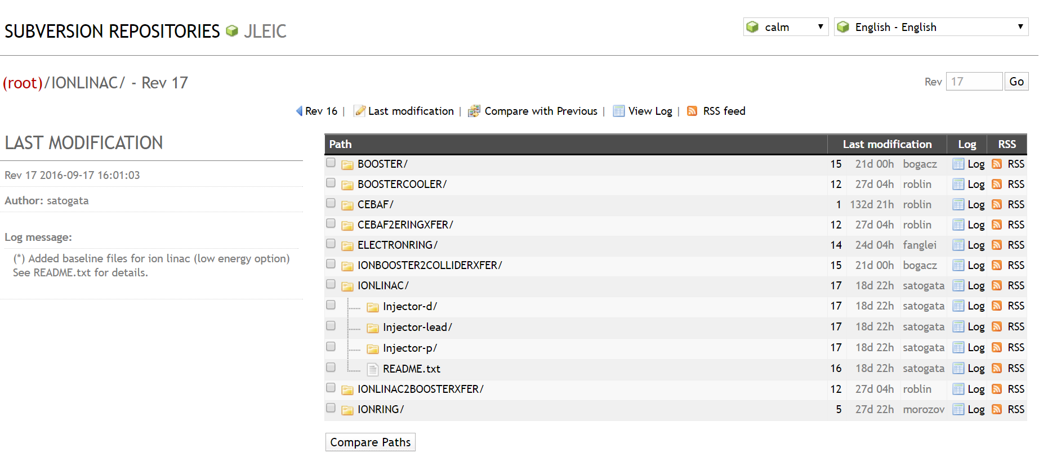
Lattice Configuration Control
All lattice files for the entire complex are managed in a version control environment
Top-level interface shows directory structure for JLEIC, revision numbers for each machine, last modification date, person making the change, and log information
Most directories populated. Need transfer lines and ERL Cooler uploaded to system.

Slide 8
Lattice Configuration Control
Lattice designers import a local copy of files which are kept synchronized with the server
Changes are committed to the server along with a description of changes in a log file
Notification is sent to all lattice designers as modifications to the system are made
System provides capability to view differences between versions and to merge changes

Slide 9
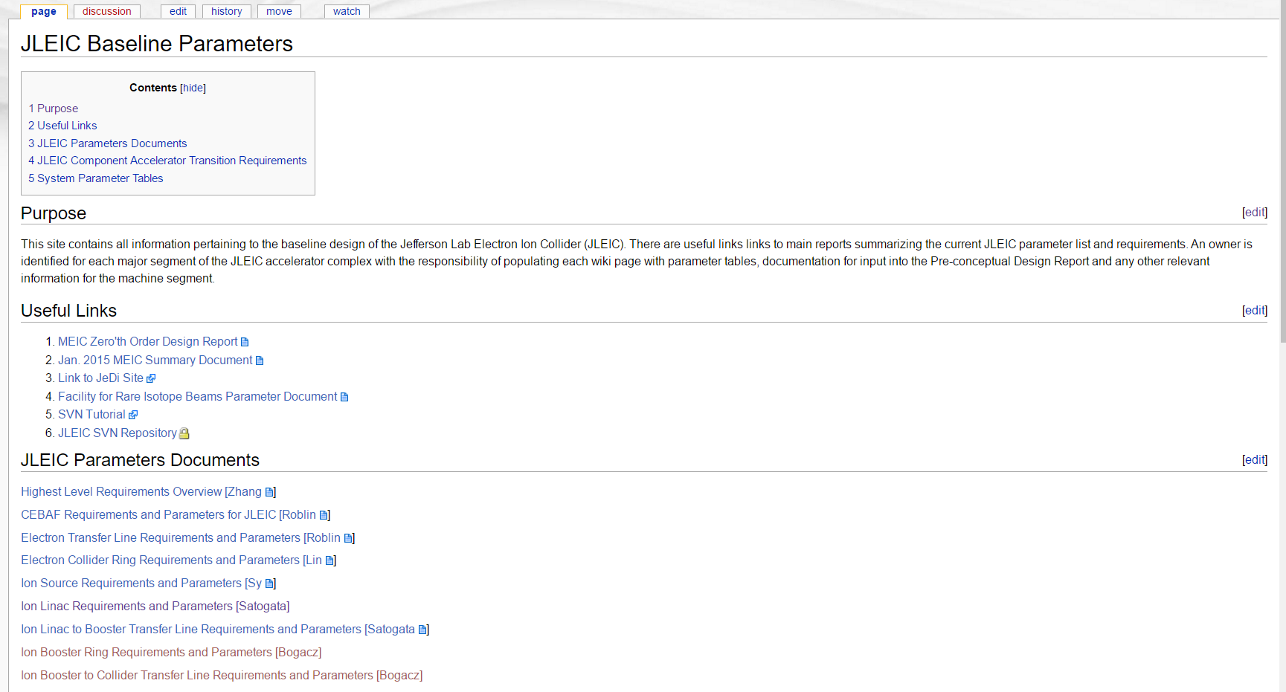
JLEIC Requirements and Parameters
Wiki developed to collect all JLEIC information – Requirements, Parameter Tables, Supporting Documentation, Simulation Results, Conceptual Design Report Draft Chapters

Slide 10
JLEIC Requirements and Parameters
JLEIC Accelerator Complex segmented into logical blocks with identified owners for each:
Highest Level Requirements Overview [Y. Zhang]
CEBAF Requirements and Parameters for JLEIC [Roblin]
Electron Transfer Line Requirements and Parameters [Roblin]
Electron Collider Ring Requirements and Parameters [Lin]
Ion Source Requirements and Parameters [Sy]
Ion Linac Requirements and Parameters [Satogata]
Ion Linac to Booster Transfer Line Requirements and Parameters [Satogata]
Ion Booster Ring Requirements and Parameters [Bogacz]
Ion Booster to Collider Transfer Line Requirements and Parameters [Bogacz]
Ion Collider Ring Requirements and Parameters [Morozov]
Ion Booster DC Electron Cooler Requirements and Parameters [He Zhang]
Collider Electron Cooler Requirements and Parameters [Benson]
Collider Interaction Region I Requirements and Parameters [Morozov]
Detector Requirements and Parameters [Physics TBD]
Conceptual Design Report Document Template [Krafft]

Slide 11
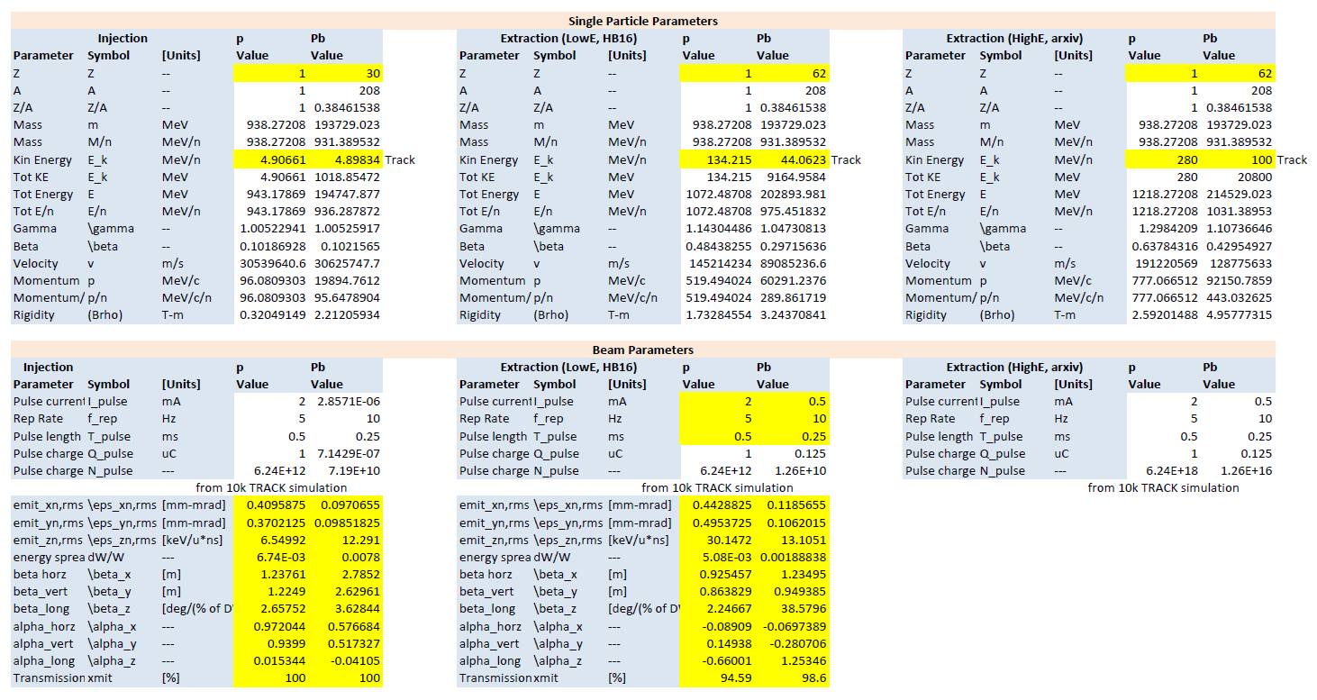
JLEIC Requirements and Parameters
LINAC Parameters for Protons and Lead

Slide 12
JLEIC Machine Region Definition
See next page for NOMENCLATURE
Electron Collider Ring
REGION 2: Straight1;(eS1)
REGION 3: Arc2;( eA2)
REGION 1: Arc1;(eA1)
IP #1
Future IP #2
Region
1 eA1
REGION 4: Straight2;(eS2)
2 e Straight1
3 e Arc2
REGION T1: Transfer Line #1- Electrons;(T1)
4 e Straight2
Electrons from CEBAF
T1 Transfer Line #1- Electrons from CEBAF

Slide 13
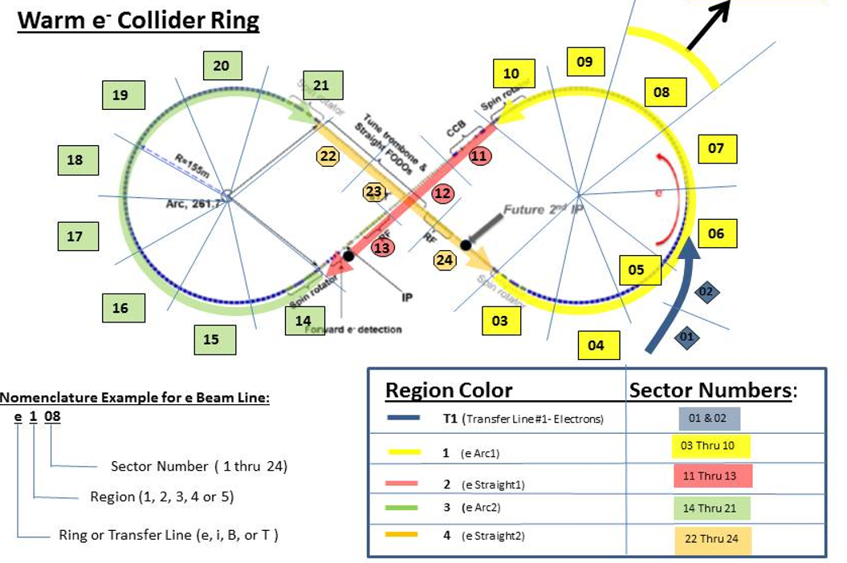
JLEIC Machine Region Definition
Electron Collider Ring Segmentation

Slide 14
JLEIC Machine Region Definition
Quadrupole
Q022
SASD3
(Quadrupole Magnet)
eA1-MQPX-005-X
Q022
SASD1
Q022
eA1-MSAX-001
( Sextapole Magnet)
Disambiguation Code-(alpha Character), e.g. H, V, A, B, etc.
SASD2
Position Monitor
Q022
Element Sequence Number (3 characters)
SASD1
Sextapole
Element Specifics (2 or 3 characters)
eA1-BPMX-002 (Button Position Monitor)
Q022
Element Type(Quad, Dipole, Sextapole, etc.)
Region (A1, S1, A2, S2 or T1, T2, etc.)
Electron Collider Ring Segment
Ring Descriptor (e, i, b or c)

Slide 15
JLEIC Machine Region Definition
Ion Collider Ring
REGION 3: Straight2; (iS2)
REGION 2: Arc1; (iA1)
REGION 4: Arc2; (iA2)
Future IP
REGION T2: Transfer Line #2; (iT2)
REGION 1: Straight1; (iS1)
Region
Ions from Booster
T2 Transfer Line #2 - Ions
1 i Straight1
2 i Arc1
3 i Straight2
4 i Arc2

Slide 16
JLEIC Machine Region Definition
Quadrupole
Q022
SASD3
(Quadrupole Magnet)
iA2-MQPX-005-X
Q022
SASD1
Q022
Disambiguation Code-(alpha Character), e.g. H, V, A, B, etc.
SASD2
Position Monitor
Element Sequence Number (3 characters)
Q022
SASD1
Sextapole
Element Specifics (2 or 3 characters)
iA2-MSAX-001 (Sextapole Magnet)
Q022
Element Type(Quad, Dipole, Sextapole, etc.)
Region (A1, S1, A2, S2 or T1, T2, etc.)
Ion Collider Ring Segment
Ring Descriptor (e, i, b or c)

Slide 17
JLEIC Machine Region Definition
REGION 1: Ion Source and Linac; (bIJ)
REGION 2: Arc1; (bA1)
Ion Linac
Ion Source
REGION T2: Ion Transfer Line; (iT2)
Ion Booster Ring
REGION 5: Straight2; (bs2)
REGION 3: Straight1; (bS1)
Region:
1 ( Ion Injector Source and Linac)
2 (B Arc1)
3 (B Straight1)
4 (B Arc2)
5 (B Straight2)
REGION 4: Arc2
T2 (Ion Transfer Line)

Slide 18
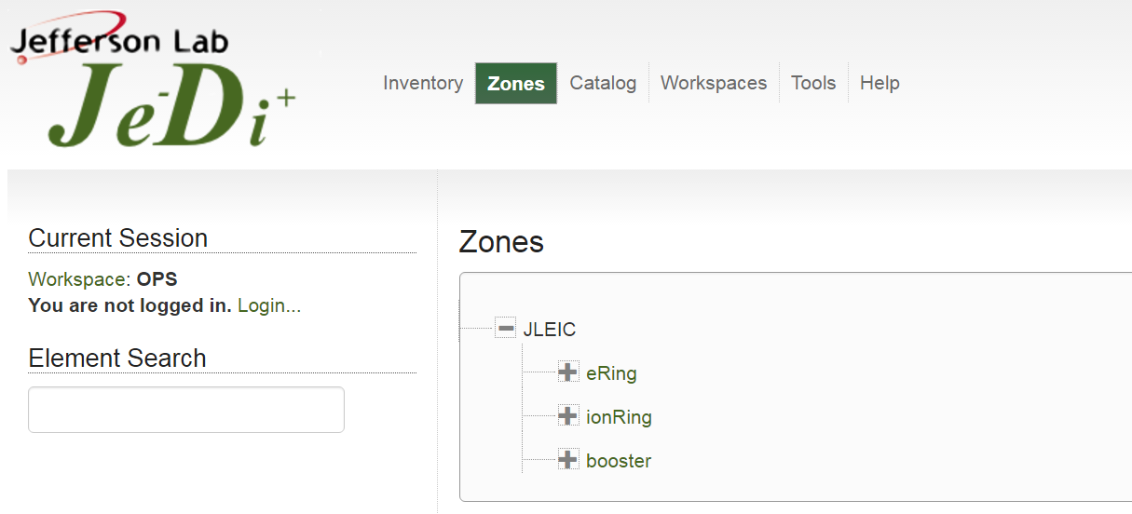
JLEIC Element Database
Je⁻Di⁺ is a comprehensive database containing all machine elements, beam parameters, coordinate information, physical properties, powering scheme, ….
Presently populated with baseline layouts for Ion Ring, Electron Ring and Booster

Slide 19
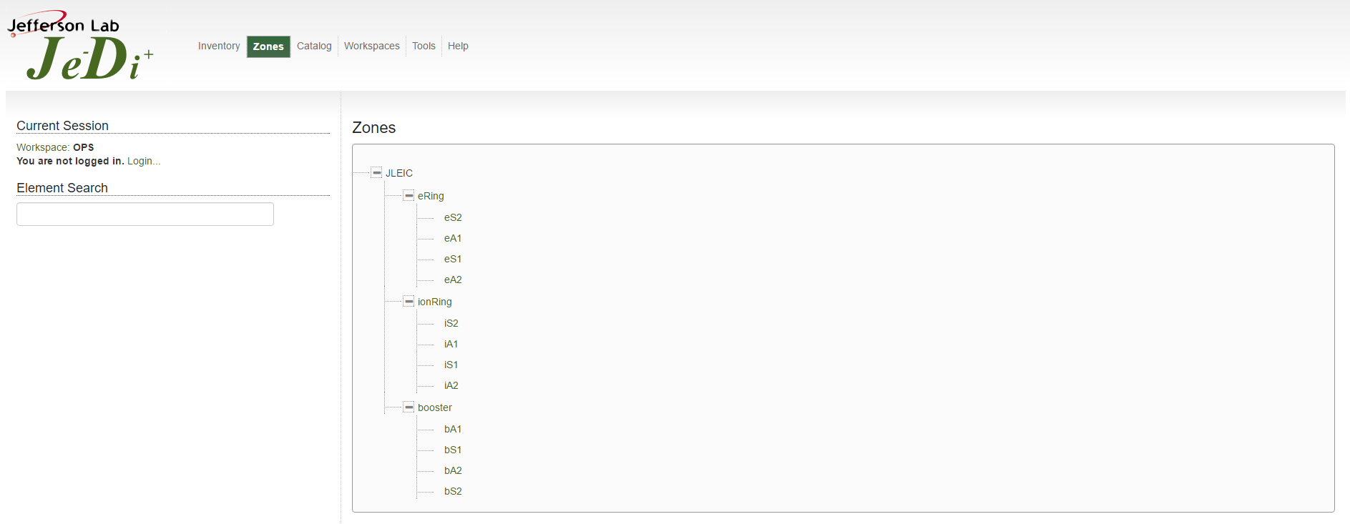
JLEIC Element Database
Je⁻Di⁺ is a comprehensive database containing all machine elements, beam parameters, coordinate information, physical properties, powering scheme, ….
Expanded to show major segments for the three machines that are in the system

Slide 20
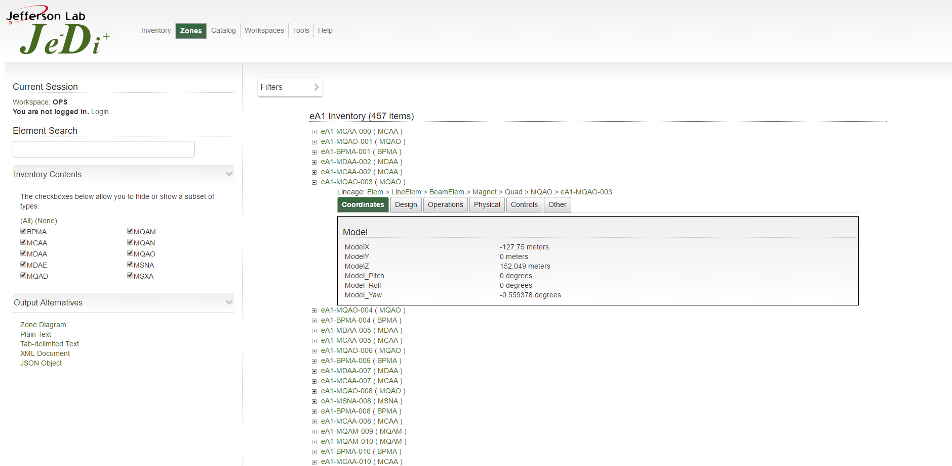
JLEIC Element Database
Je⁻Di⁺ is a comprehensive database containing all machine elements, beam parameters, coordinate information, physical properties, powering scheme, ….
Expanded to show elements for the A1 segment of the Electron Collider

Slide 21
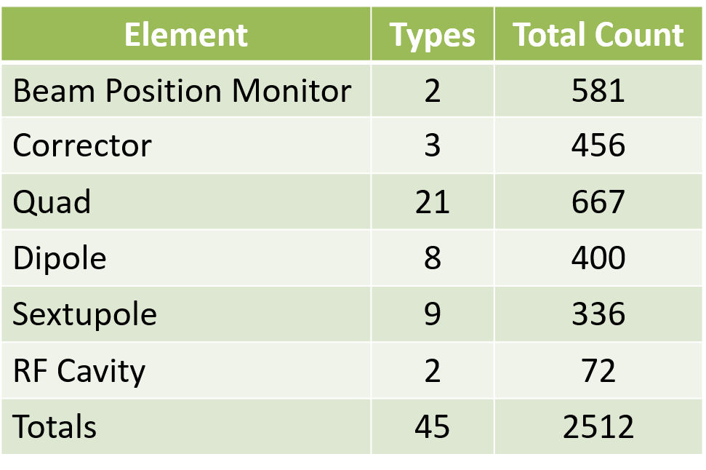
JLEIC Element Database
Je⁻Di⁺ populated with baseline layouts for Ion Ring, Electron Ring and Booster
Component count to date:

Slide 22
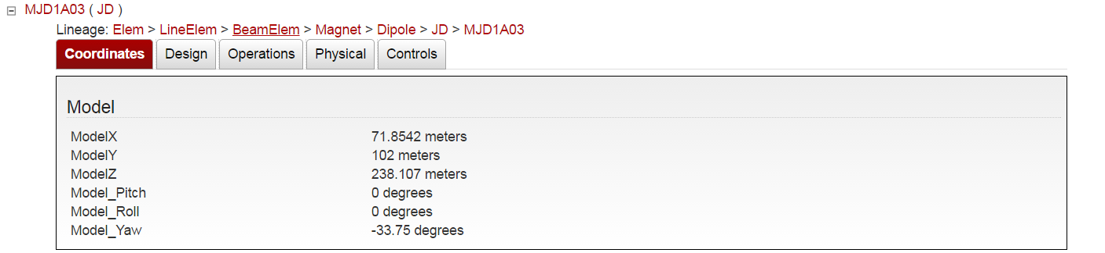
JLEIC Element Database
Example from CEBAF Element Database (CED) of fully populated system:
Coordinates – 6-D positional information of an element

Slide 23
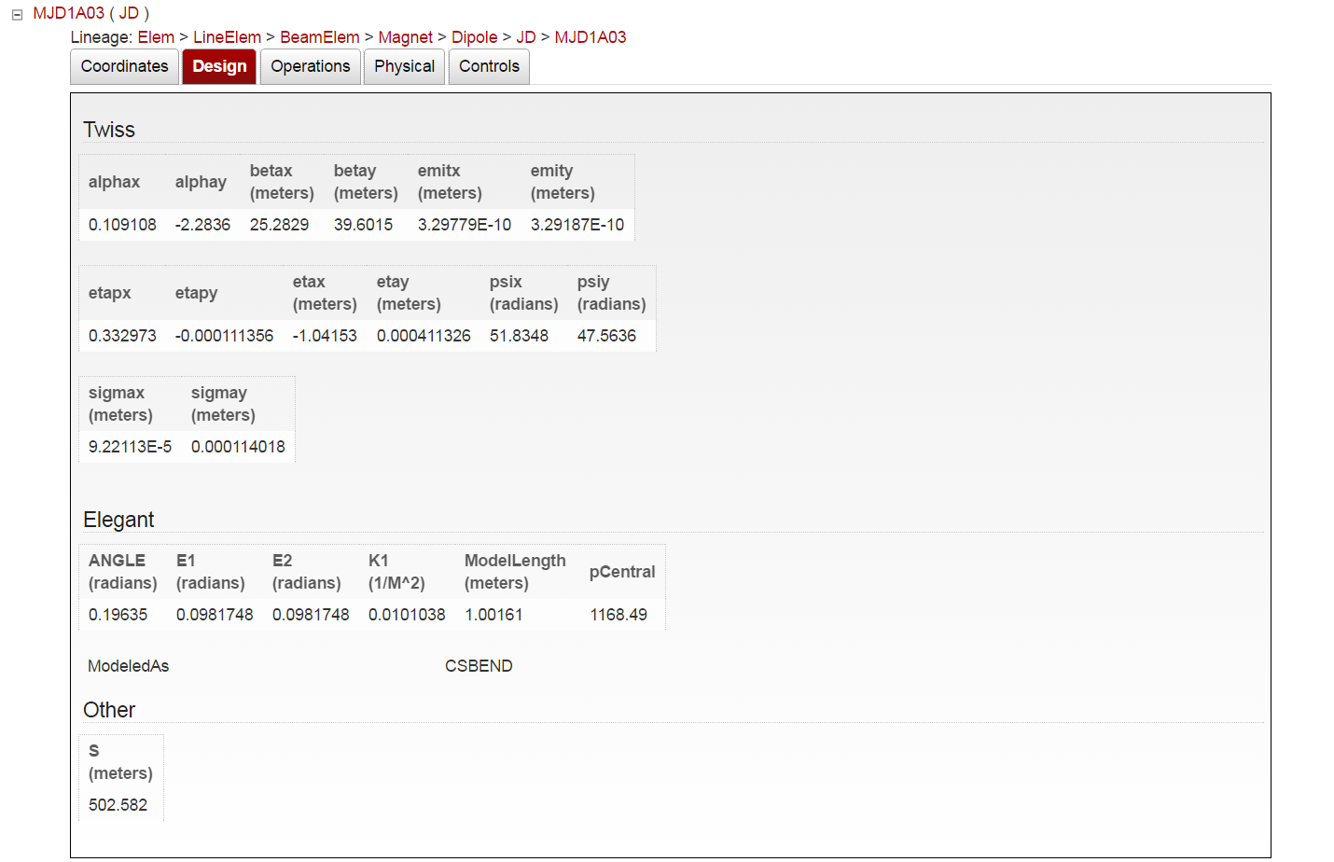
JLEIC Element Database
Example from CEBAF Element Database (CED) of fully populated system:
Design – Twiss parameters, elegant parameters, coordinate in beam following system

Slide 24
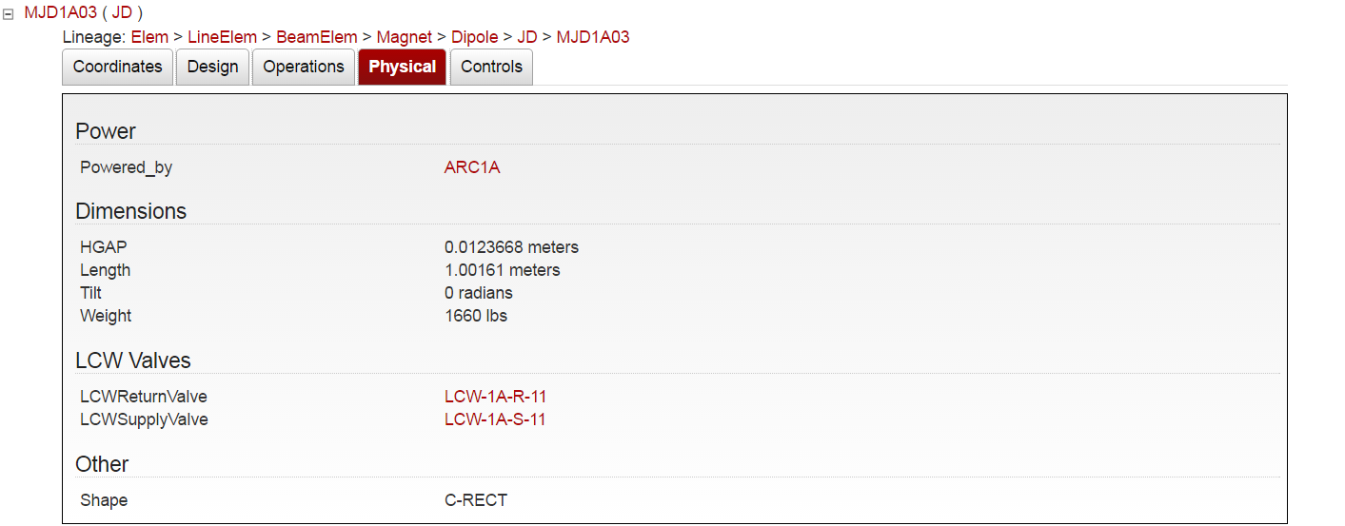
JLEIC Element Database
Example from CEBAF Element Database (CED) of fully populated system:
Physical – Powering, Physical Dimensions, LCW Connectivity, Shape

Slide 25
Conclusion
Synchronous Information Flow from highest level requirements
Subversion repository created to track lattice file development and simulation parameters in a version-controlled environment
Wiki established to collect relevant information about the baseline JLEIC design to ultimately write Conceptual Design Report
Interface to Engineering and High Level Applications to:
  Complete engineering layouts and costing of the JLEIC Accelerator Complex
  Collect all information of the baseline JLEIC design in the Je⁻Di⁺ database
Much work has been done to establish a framework to guide us towards a comprehensive and solid baseline design for JLEIC
Thank You!

