Slide 1
Progress on the Fast Kicker Development and Bench Measurements of a Multi-frequency Prototype Cavity
Yulu Huang^{1,2}
H. Wang¹, R. A. Rimmer¹, S. Wang¹ ,J. Guo¹
1.Thomas Jefferson National Accelerator Facility , Newport News, VA,23606
2.Institute of Modern Physics ,Chinese Academy of Science, Lanzhou, Gansu,730000

Slide 2
Outline
Fast Kicker Requirements for the ERL-CCR Scheme
Cavity Model for Harmonic Wave Generation
Discussion on the Harmonic Kicker Waveform and Required Cavity Number
Multi-Frequency Cavity Design
Copper Prototype Fabrication and Bench Measurement
Conclusion
Acknowledgement

Slide 3
Fast Kicker for the ERL-CCR Scheme
Single-turn ERL-based electron cooler ring for the baseline
~200mA,476.3MHz magnetized electron bunches
challenging ,current baseline design, could be achieved with critical R&D efforts
~1.5 A cooling electron beam current for the future luminosity upgrade
high current magnetized electron source; HOM damping in the SRF ERL
high beam power at the dump
Multi-turn ERL-CCR Scheme
reuse electron bunches for 10~30 turns in the CCR
reduce the beam current (bunch rep. freq.) by a same factor in the ERL and source
Fast kicker for electron bunches exchange between ERL and CCR
multiple harmonic modes generated by a group of QWRs.

Slide 4
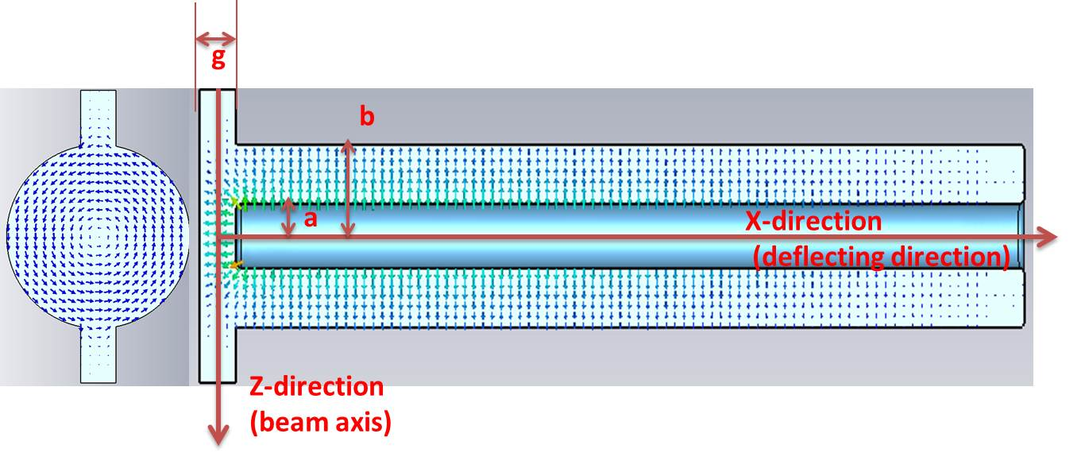
QWR-based Deflecting Cavities
The electron bunches traveling through the cavity will be deflected by both the transverse electric and magnetic fields.
The effective transverse kick voltage of the n^{th} harmonic mode can be calculated from:
The total kick voltage from all harmonic modes is:
The relationship between cavity number M and maximum harmonic number N can be supported as:
Depend on the recirculate turn(10-30,or more) of electron bunches and the harmonic waveform we select!

Slide 5
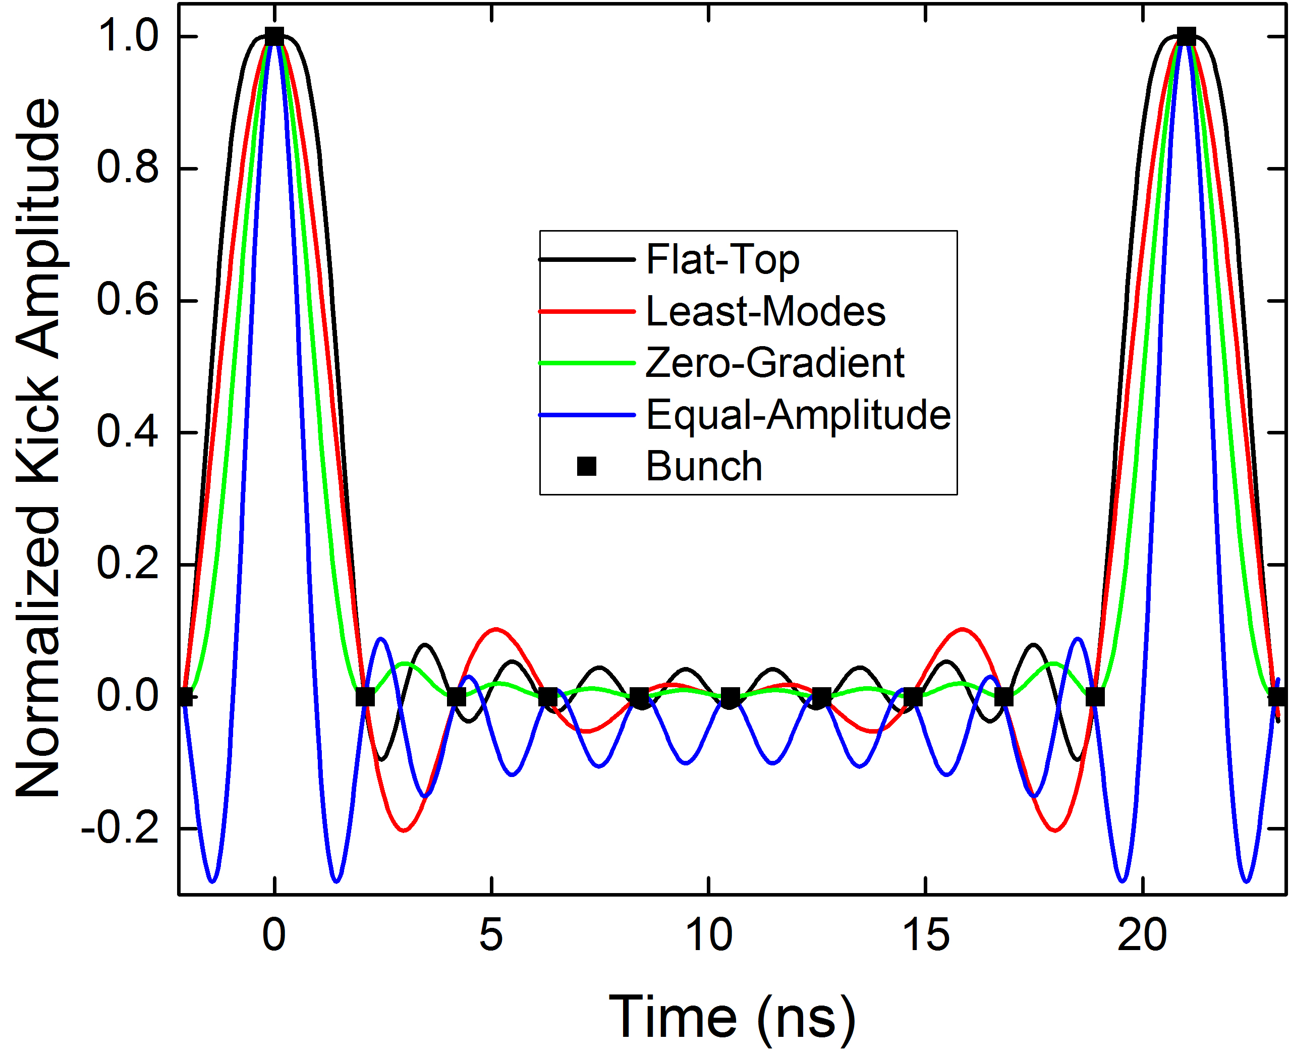
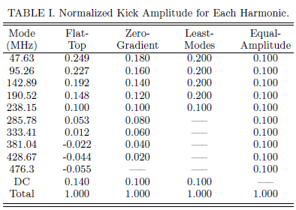
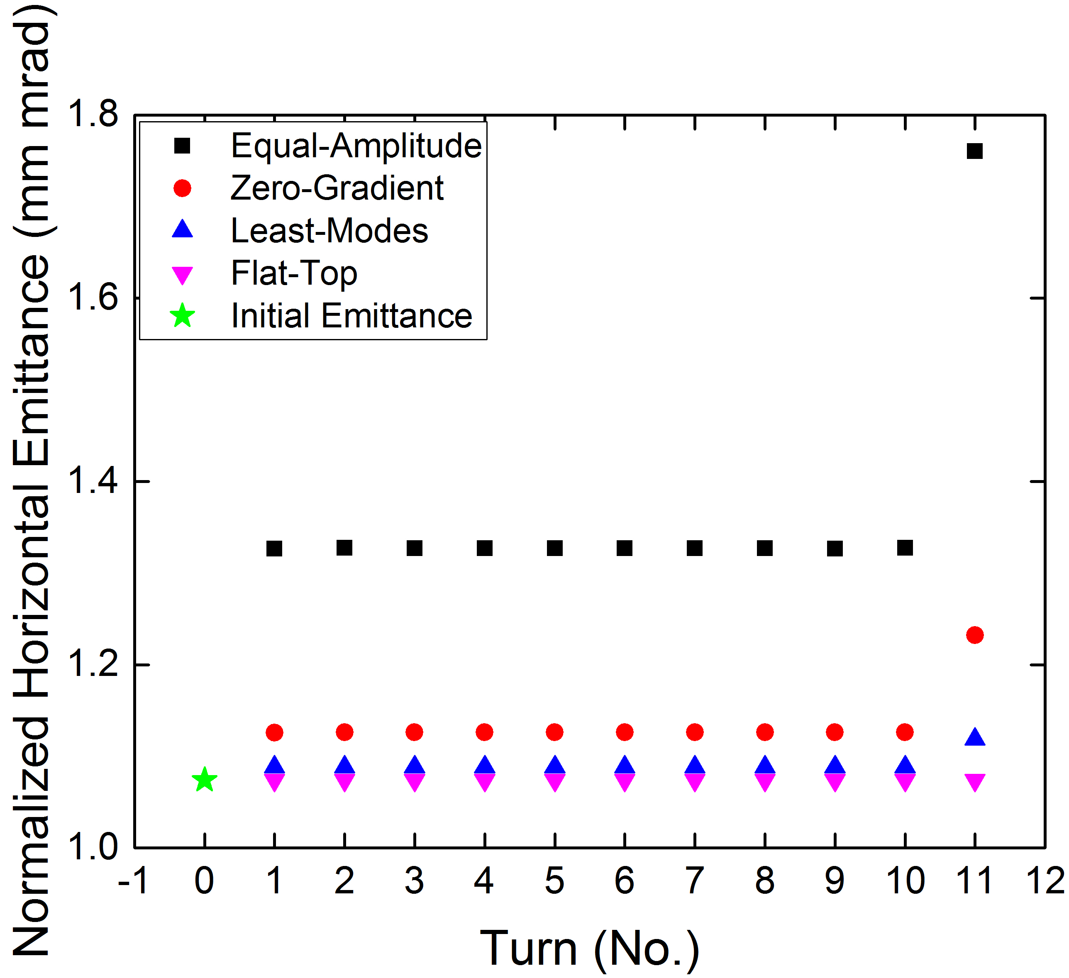
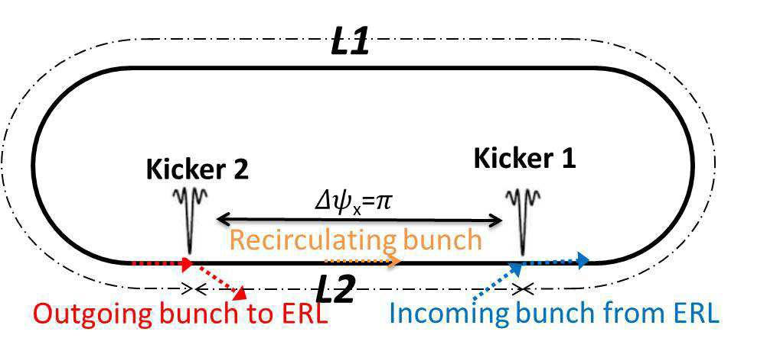
Harmonic Kicker Waveform Synthetization
Ref: Y.Huang, H.Wang, R.A.Rimmer, et al. Phys. Rev. ST Accel. Beams 19, 084201 (2016)
Kick every 10th bunch as example
Correct the pulse curvature of the Least-Mode and then reduce the harmonic number to half!

Slide 6
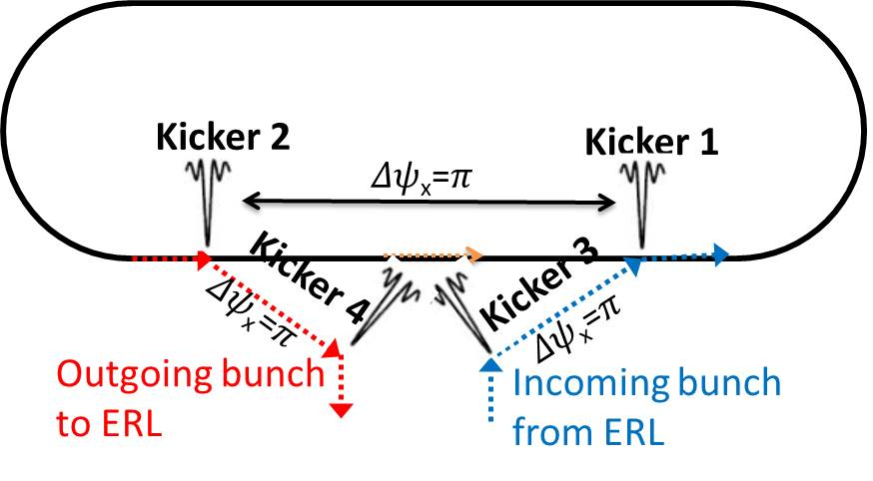
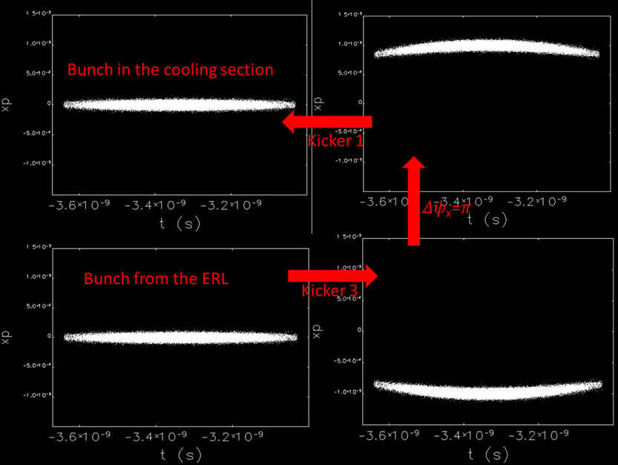
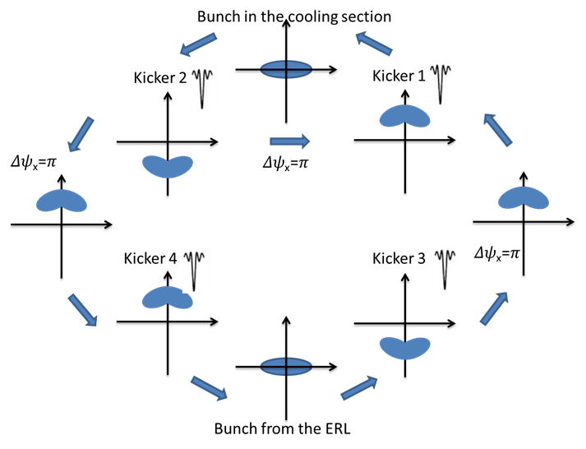
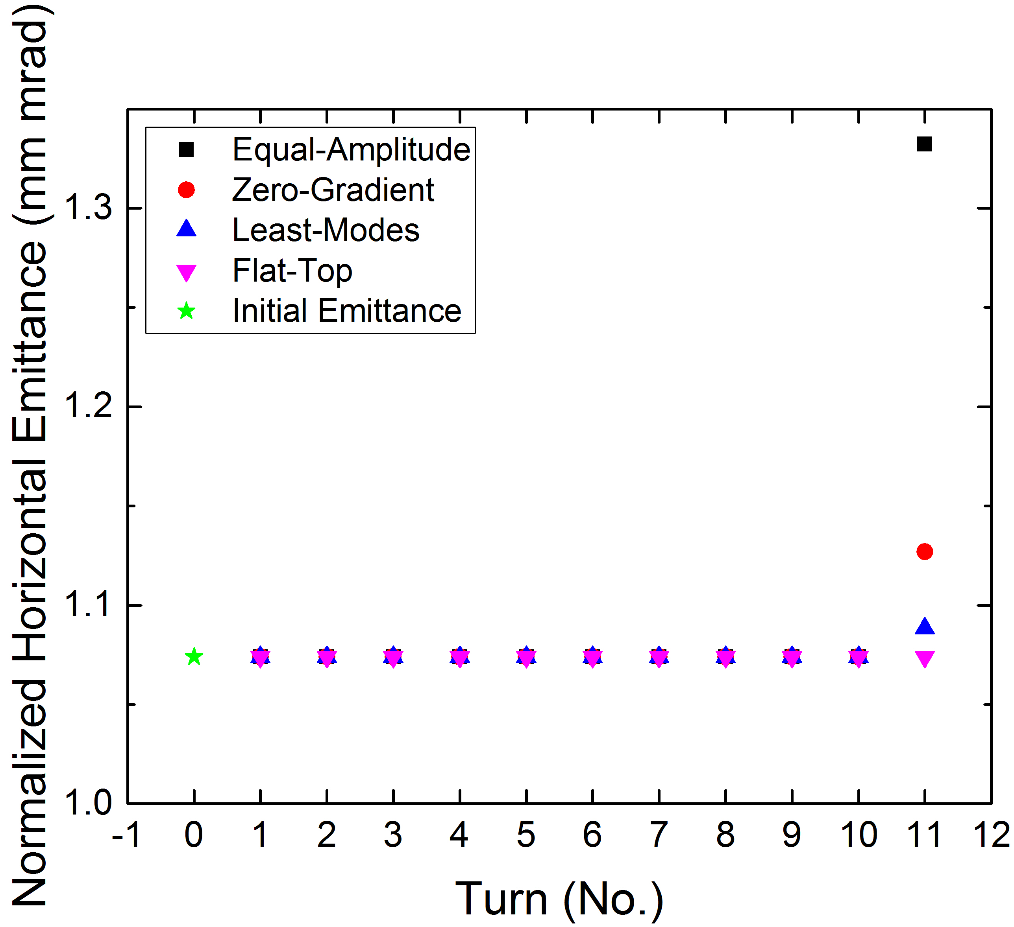
Pre-distortion and Post-distortion Kicker to Compensate the Kicking Pulse Curvature
Tracking result with Kicker 1,2,3.

Slide 7
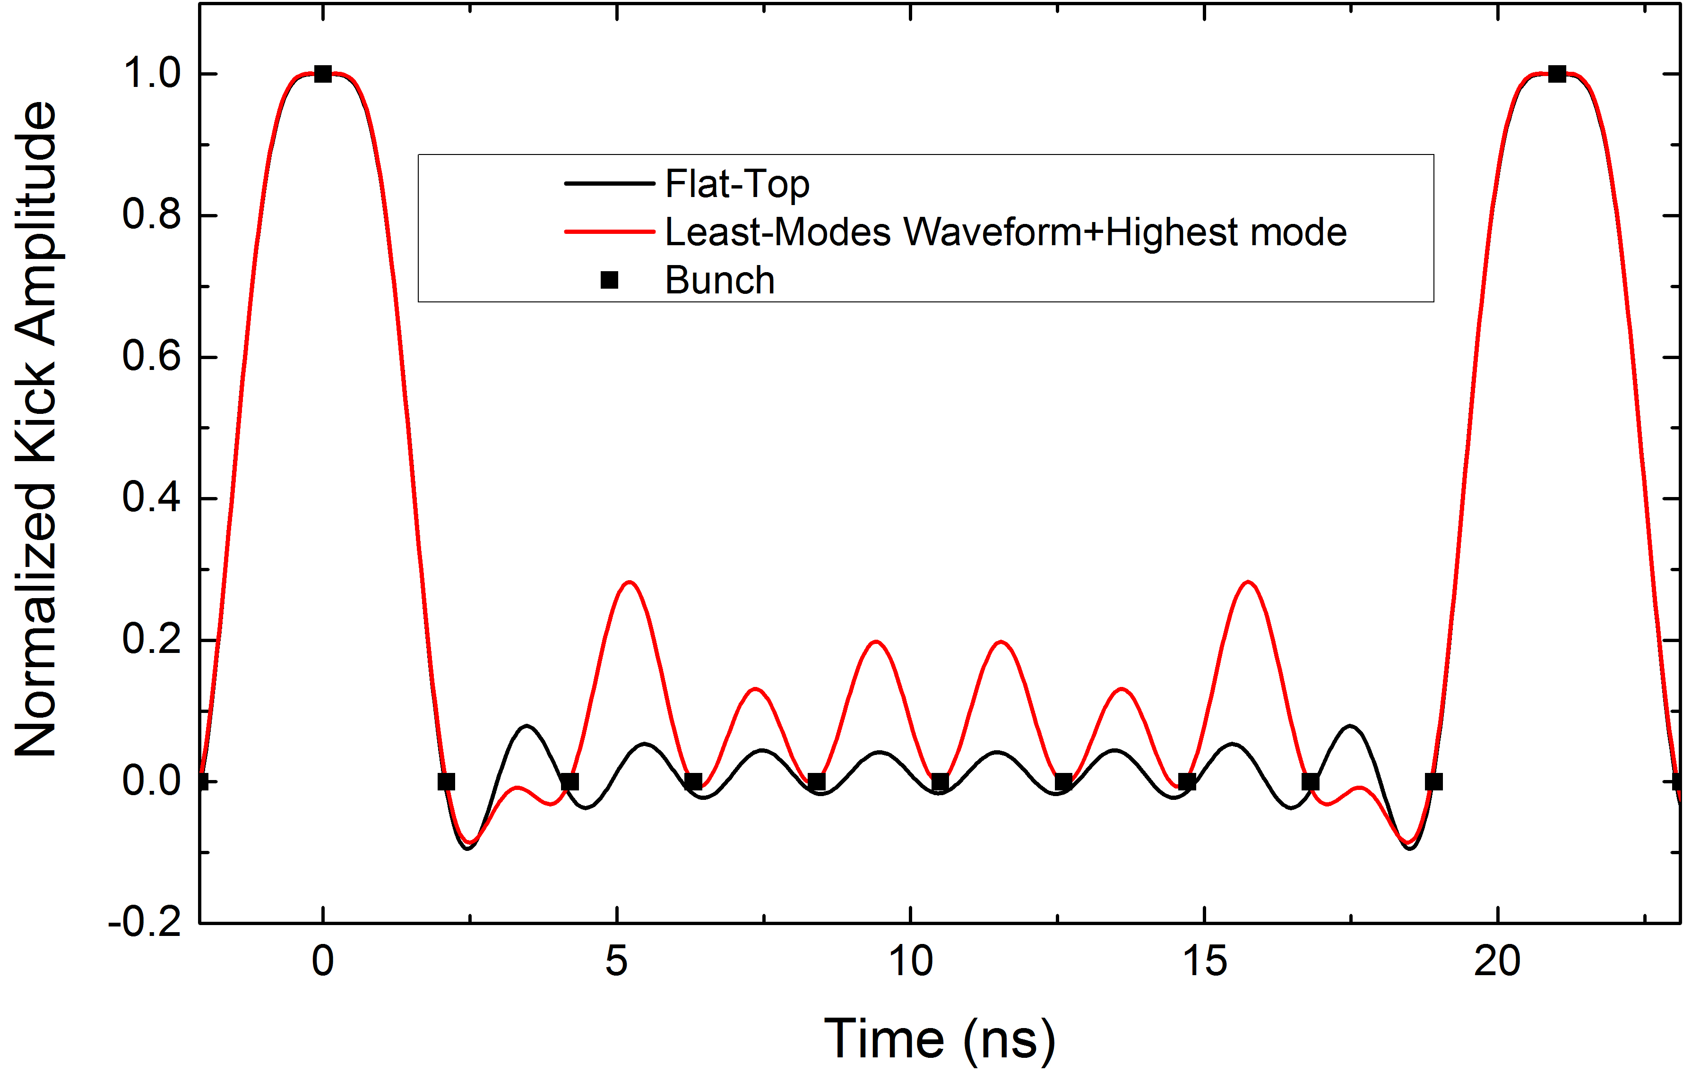
New Progress: the Least-Modes+476.3MHz
Mode（MHz） | Flat-Top | Least-Modes | Least-Modes +476.3MHz
47.63 | 0.249 | 0.200 | 0.200
95.26 | 0.227 | 0.200 | 0.200
142.89 | 0.192 | 0.200 | 0.200
190.52 | 0.148 | 0.200 | 0.200
238.15 | 0.100 | 0.100 | 0.100
285.78 | 0.053 | … | …
333.41 | 0.012 | … | …
381.04 | -0.022 | … | …
428.67 | -0.044 | … | …
476.3 | -0.055 | … | -0.090
DC | 0.140 | 0.100 | 0.190
Total | 1.000 | 1.000 | 1.000
Introducing the highest modes(476.3MHz, at the inverse phase) to the Least-Mode scheme, and adjusting the amplitude of this harmonic and the DC offset.
10 Harmonic +DC
6 Harmonic +DC

Slide 8
Discussion on the Recirculation Number, Harmonic Number, Cavity Number
Flat-Top Scheme
Recirculate Turn | 10 | 15 | 25 | 30
Harmonic Number | 10 | 15 | 25 | 30
Cavity number | 4 | 4 | 5 | 5
Mode distribution | 5:3:1:1 | 8:4:2:1 | 13:6:3:2:1 | 15:8:4:2:1
Mode in Cavity#1 | 1,3,5,7,9 | 1,3,5,7,9,11,13,15 | 1,3,5,7,9,11,13,15,17,19,21,23,25 | 1,3,5,7,9,11,13,15,17,19,21,23,25,27,29
Mode in Cavity#2 | 2,6,10 | 2,6,10,14 | 2,6,10,14,18,22 | 2,6,10,14,18,22,26,30
Mode in Cavity#3 | 4 | 4,12 | 4,12,20 | 4,12,20,28
Mode in Cavity#4 | 8 | 8 | 8,24 | 8,24
Mode in Cavity#5 |  |  | 16 | 16
Least-Mode +476.3MHz
Cavity design and optimization is based on this 10 modes scheme
Recirculate Turn | 10 | 15 | 25 | 30
Harmonic Number | 6 | 8 | 13 | 16
Cavity number | 3 | 3 | 4 | 4
Mode distribution | 3:2:1 | 5:2:1 | 7:3:2:1 | 8:5:2:1
Mode in Cavity#1 | 1,3,5 | 1,3,5,7,15 | 1,3,5,7,9,11, 25 | 1,3,5,7,9,11,13,15
Mode in Cavity#2 | 2,10 | 2,6 | 2,6,10 | 2,6,10,14, 30
Mode in Cavity#3 | 4 | 4 | 4,12 | 4,12
Mode in Cavity#4 |  |  | 8 | 8

Slide 9
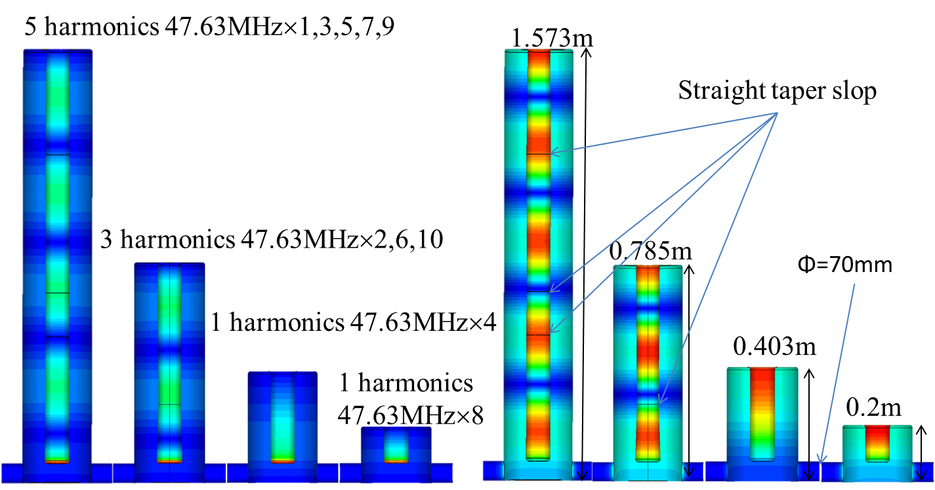
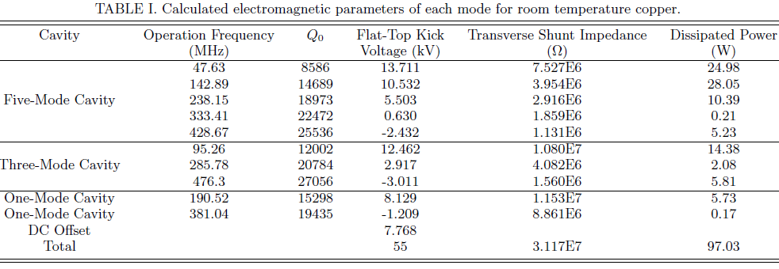
4-Cavity Model Based on Flat-Top Scheme

Slide 10
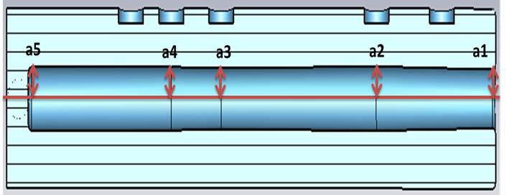
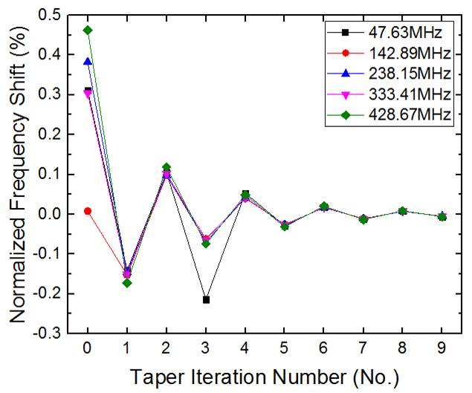
Straight Taper and Stub Tuner Design
Select the taper point
Get the taper matrix M_{taper}
Adjust the cavity model
Get the frequency of each mode f_{n} in CST
Solve the taper matrix equation, get the taper value a_{n} at each point
Calculate the frequency shift 𝛥f_{n}
False
𝛥f_{n}/f_{n}⩽0.001%
True
Done
With the taper design, the frequencies of all harmonic modes can be optimized to exact odd multiple harmonics, the errors are within +/- 0.001% from their targets.
Manufacturing errors and other errors can be tuned back by the stub tuners with a similar process.
Stub tuners insert 25mm as the baseline of taper to get a bi-directional tuning range.

Slide 11
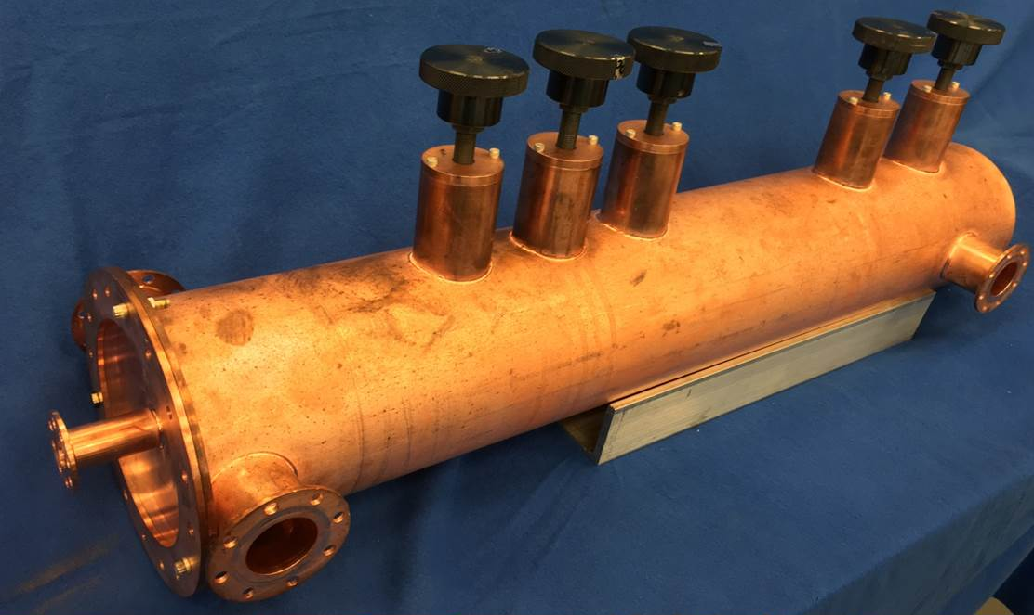
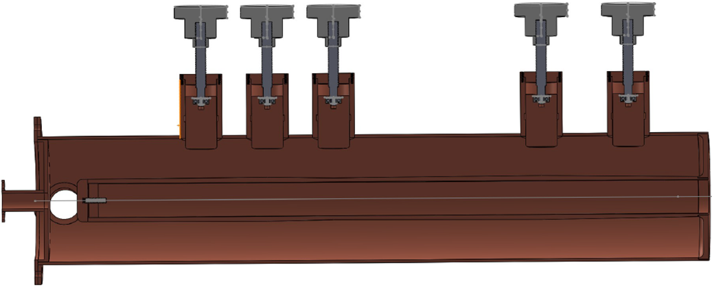
Half Scale Copper Prototype
Half scale copper prototype with 5 odd harmonic mode
95.26 MHz
285.78MHz
476.3MHz
666.82MHz
857.34MHz
Stub tuners
Pickup port
Beam pipe
Input coupler port
31.5 inch
2 inch
6 inch

Slide 12
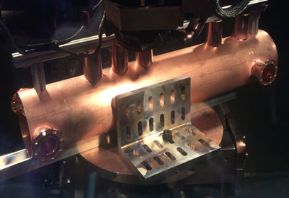
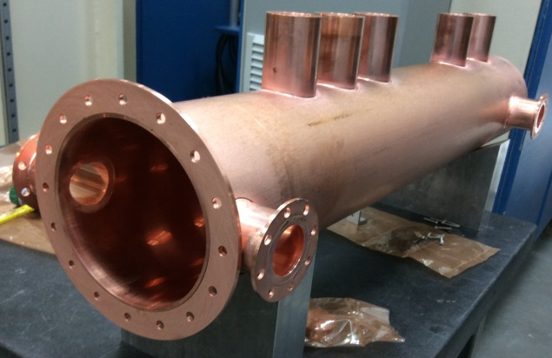
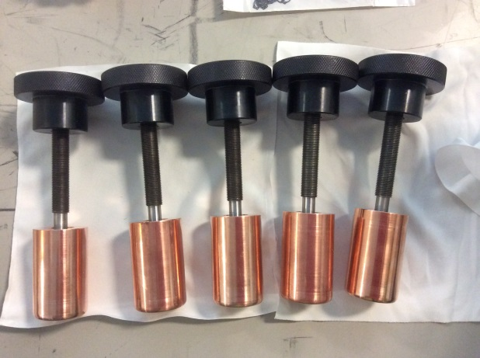
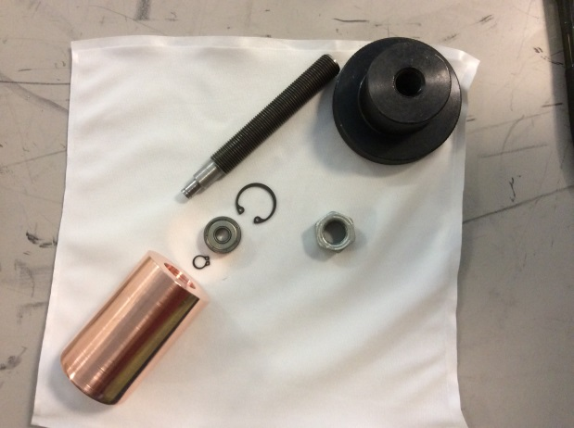
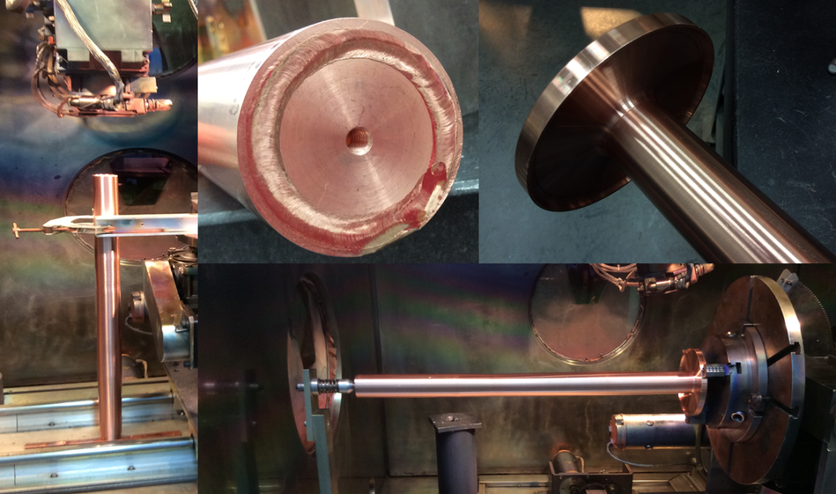
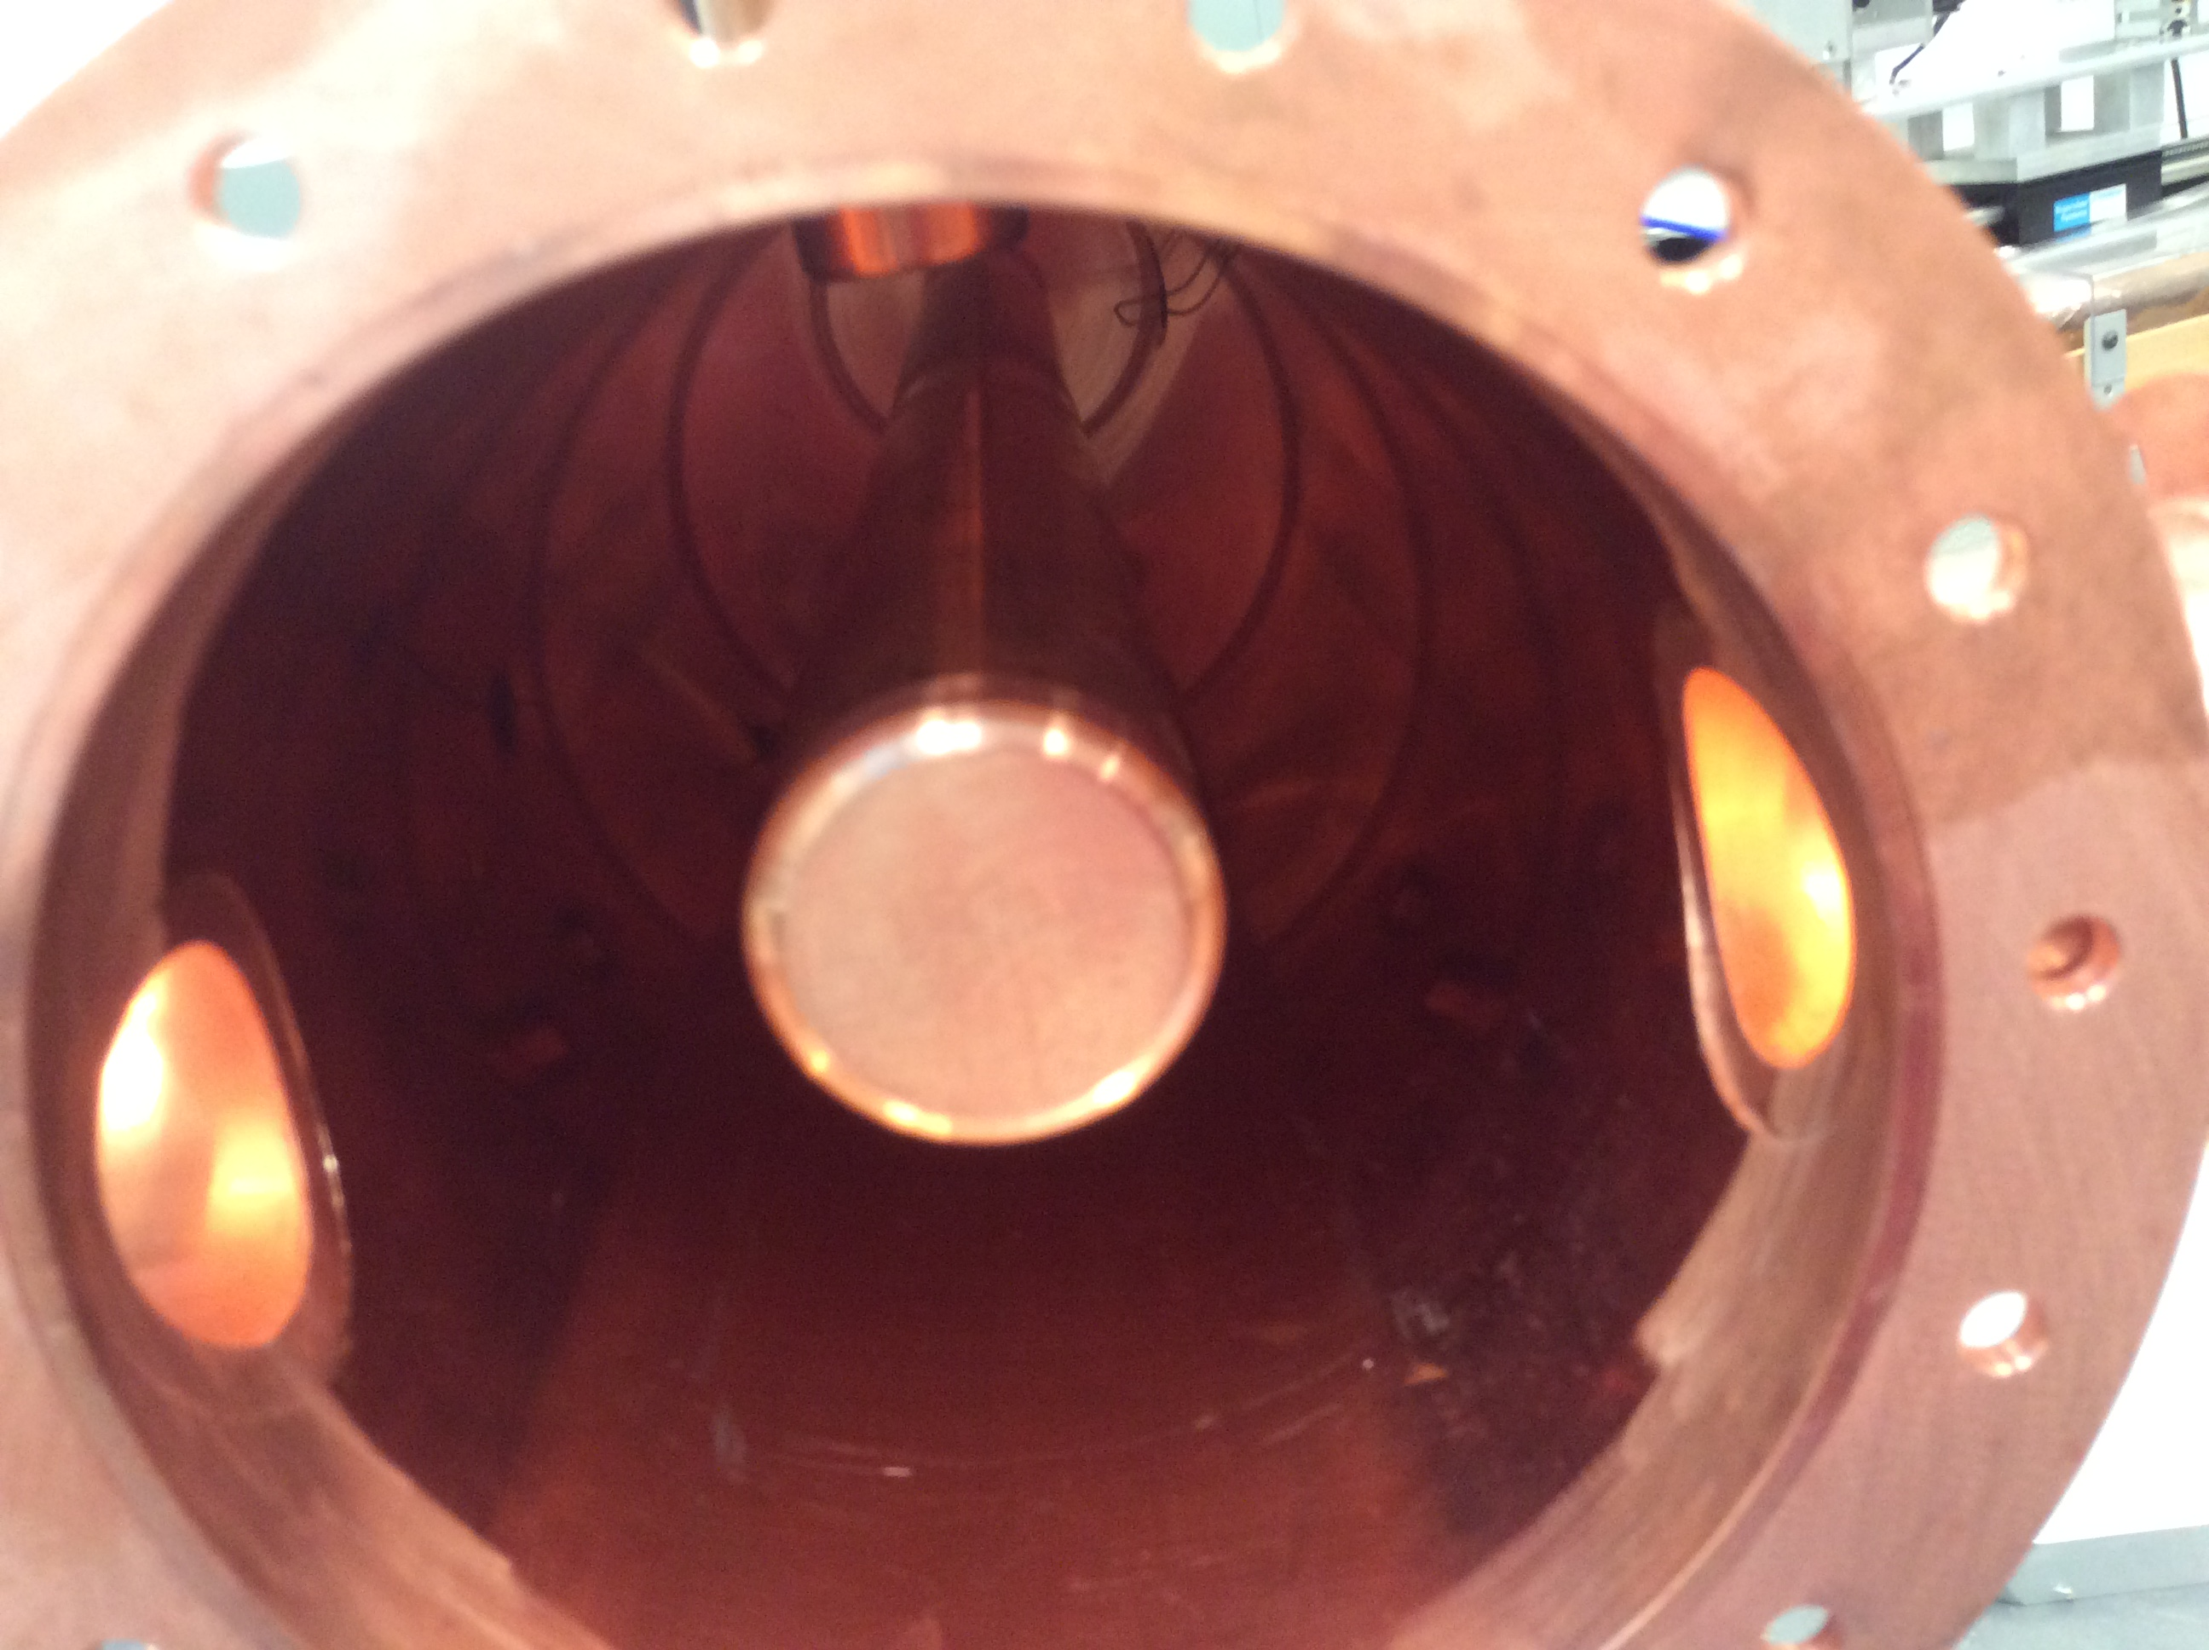
Several Fabrication Detail
EBW of the outer conductor with the tuner pipes
EBW of the outer conductor with electric end flange
Stub tuners detail
inner conductor cap threaded to the inner conductor bar
EBW of the inner conductor to the Magnetic End flange
Loop coupler and pickup antenna

Slide 13
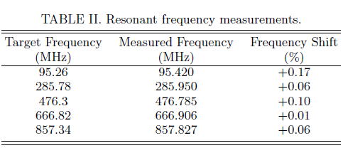
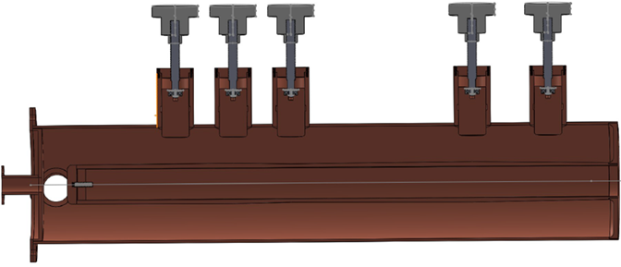
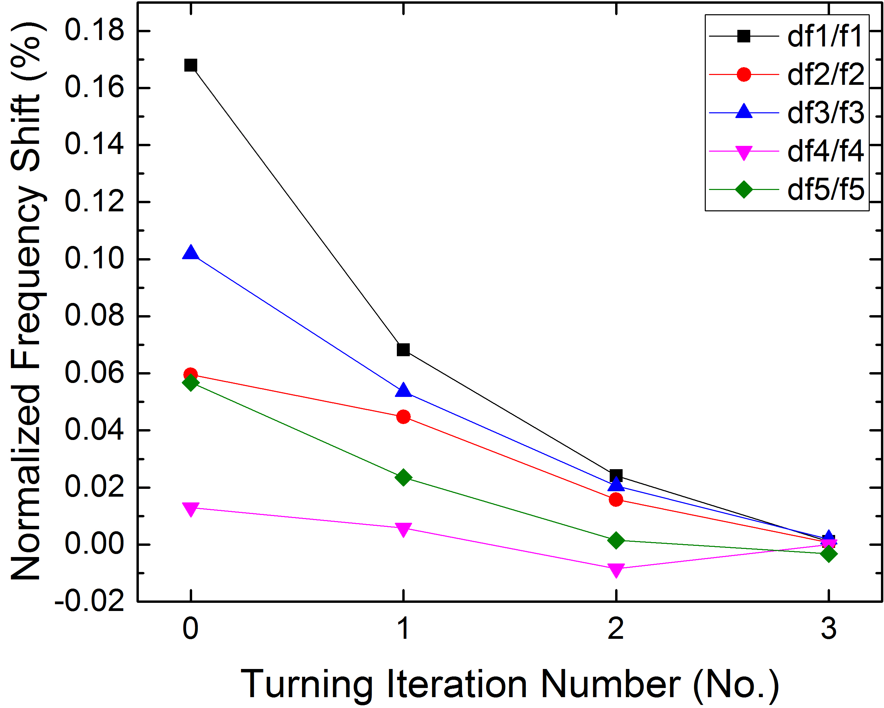
Resonant Frequencies and Tuning Process
Tuning matrix from measurement, m_{ij} is the 1rst order (linear) frequency response of mode i to tuner j in units of kHz/mm.
Get the tuning matrix M_{tuner}
Adjust the stub tuners
Get the frequency of each mode f_{n} in VNA
Solve the tuning matrix equation, get the tuning value h_{n} at each stub tuner
Calculate the frequency shift 𝛥f_{n}
False
𝛥f_{n}/f_{n}⩽0.001%
True
Done

Slide 14
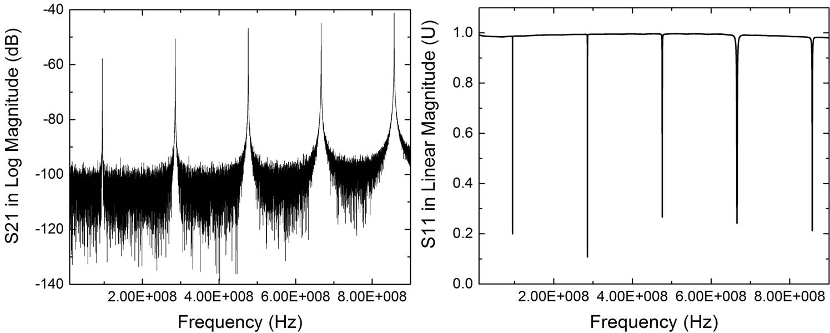
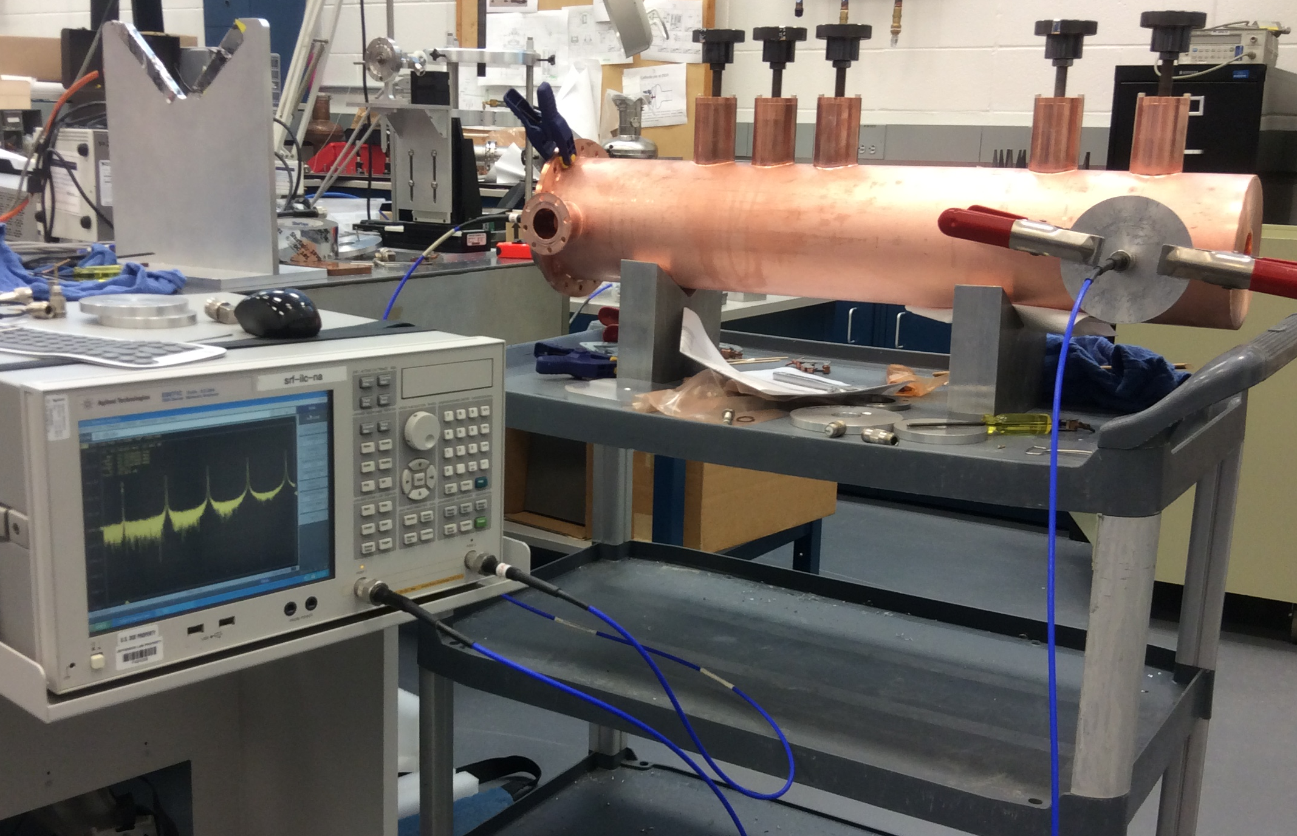
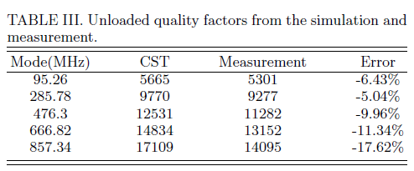
Transmission and Reflection Coefficients, Unloaded Quality Factor Q Measurement

Slide 15
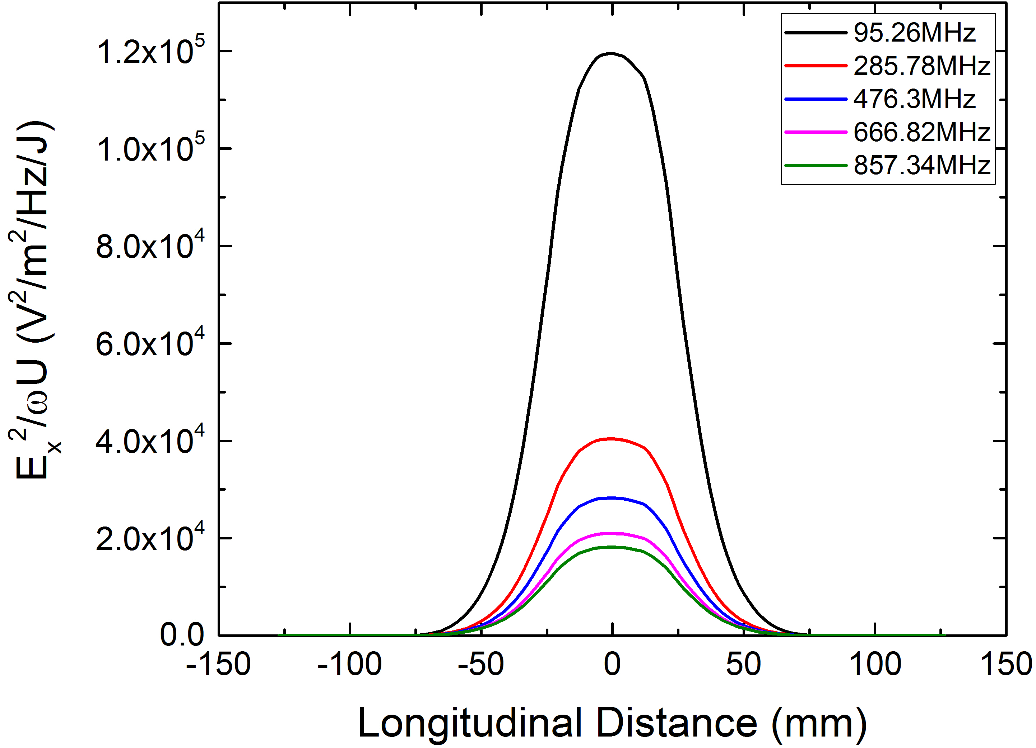
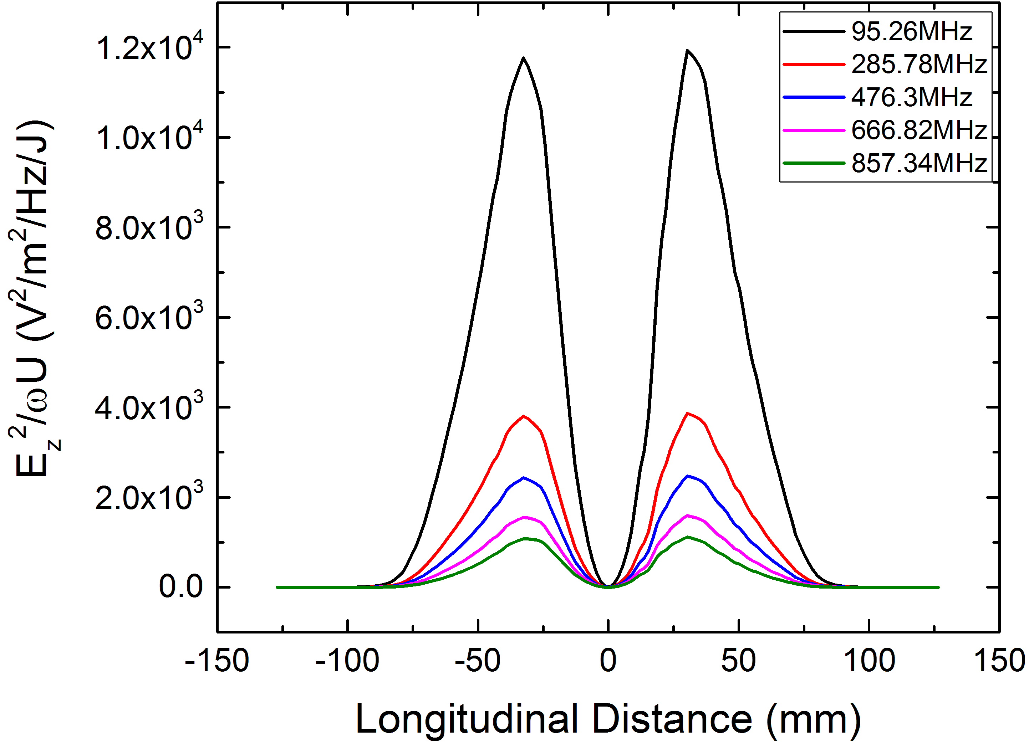
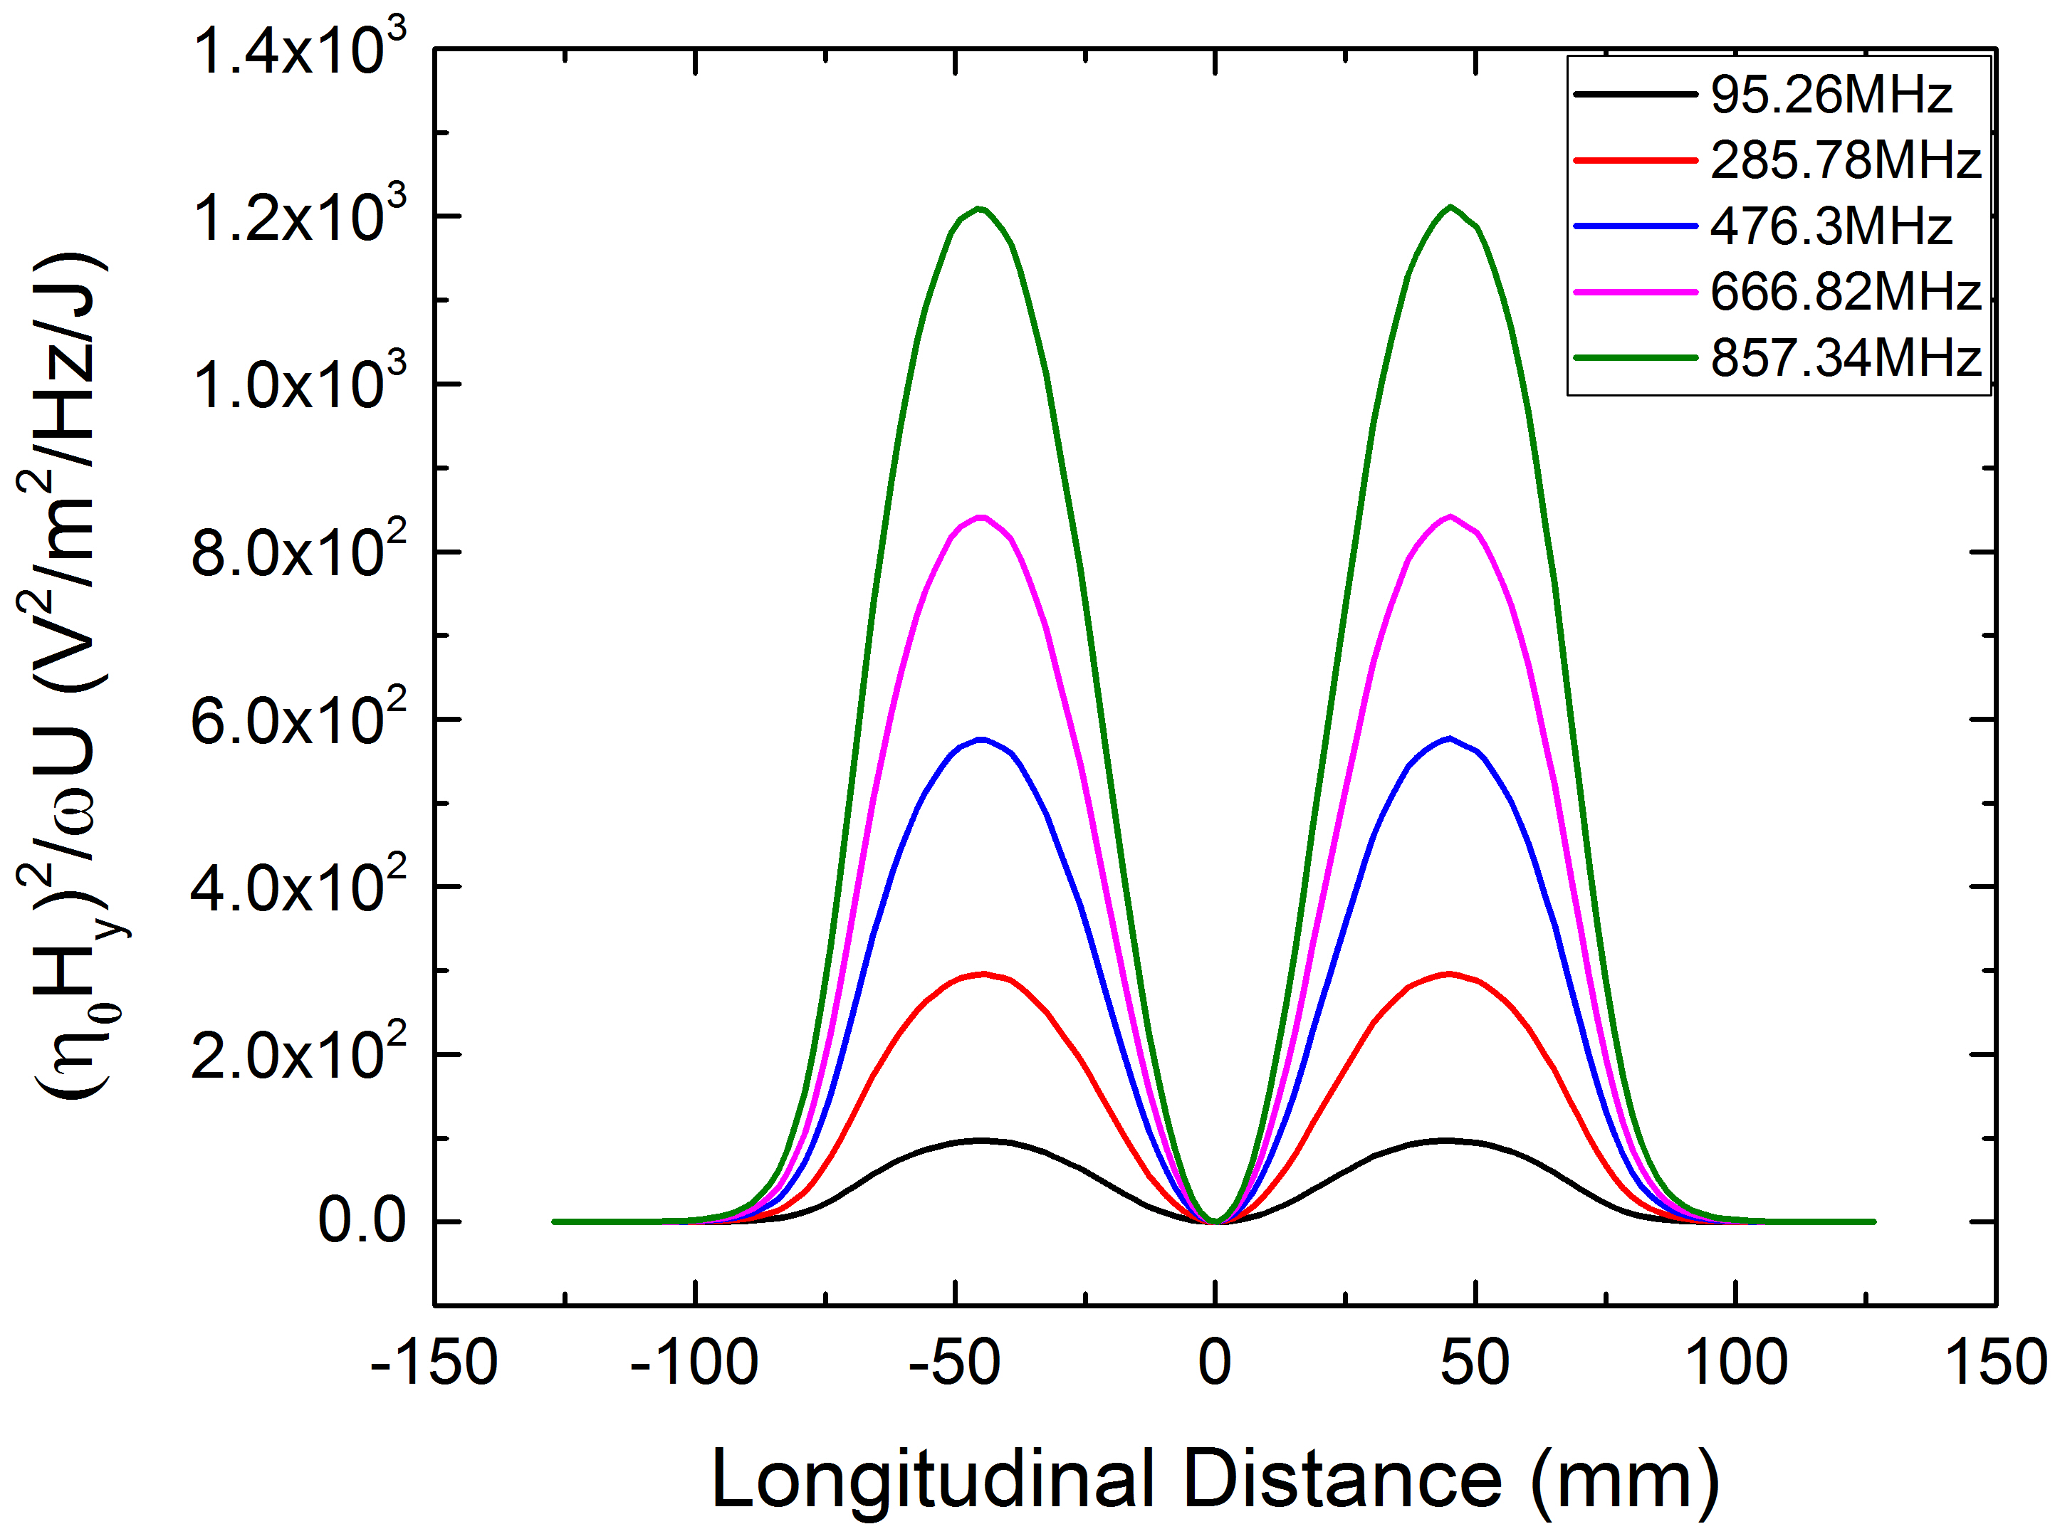
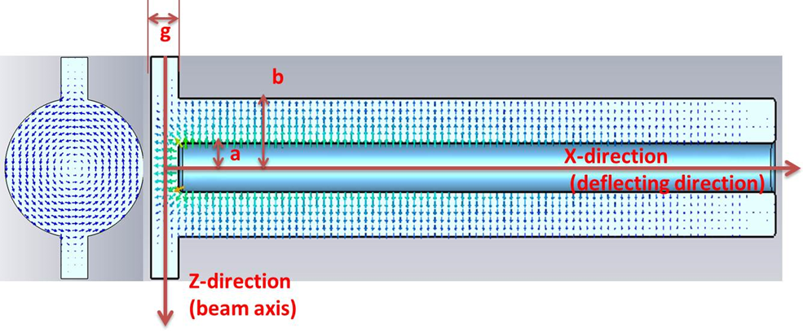
Distribution of Different Field Components Along the Beam Axis From CST
Ex
Ez
Hy
The dominant Field component is the deflecting electric field Ex
The longitudinal field Ez is much smaller than the deflecting field(maximum 10% in magnitude squared).
The magnetic field Hy is much weaker, and much smaller for the lowest harmonic mode (0.1% in magnitude squared) and relatively larger for the highest harmonic mode (6% in magnitude squared).

Slide 16
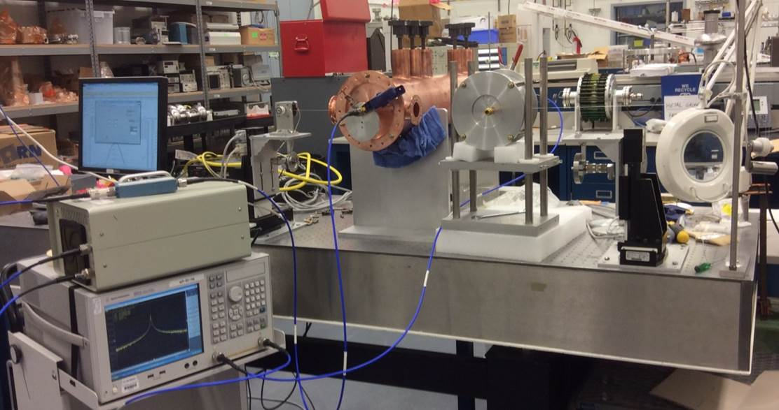
Bead-pull Setup
Obtain the electromagnetic field distribution and mode orientation in the cavity
A small metallic or dielectric object attached to a string is pulled through the RF structure, while a small amount of RF power is fed into the structure at the frequency of the resonant mode.
The frequency shift due to the insertion of the perturbing object is measured during the passage of the bead.
The relative change in resonant frequency is proportional to the relative change in stored energy and can be expressed as a function of the local electric and magnetic field strength:
$$\frac{Δω}{ω}={−F}_{E}\frac{ε_{0}{|E|}^{2}}{U}+F_{H}\frac{μ_{0}{|H|}^{2}}{U}$$

Slide 17
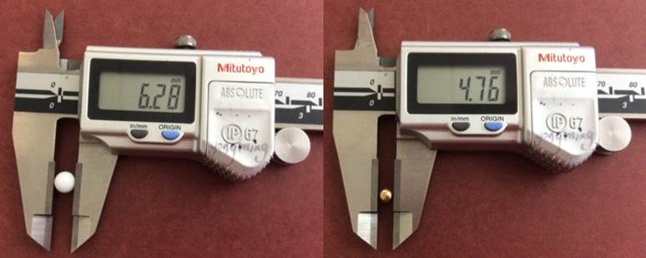
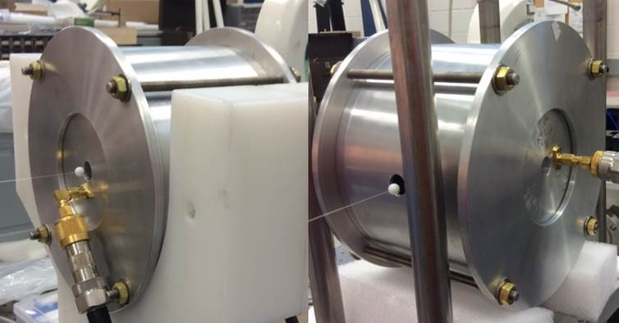
Bead Calibration
Bead | F_{E} | F_{H}
Dielectric Bead
Metallic Bead
Bead | F_{Ex} | F_{Ez} | F_{Hy}
Dielectric Bead | 2.21E-8 | 2.23E-8
Metallic Bead | 3.60E-8 | 3.18E-8 | 1.91E-8
Bead form factor calibration:
aluminum pillbox cavity in TM010 mode
Left:
Teflon Longitudinal : F_{Ez-die,}
Brass Longitudinal :F_{Ez-met,}
Right:
Teflon Transverse : F_{Ex-die,}
Brass Transverse : F_{Ex-met,}
Two types of perturbing objects
Dielectric bead (Teflon):
electric field
Metallic bead (Brass):
both the electric and magnetic fields
F_{Hy-met}

Slide 18
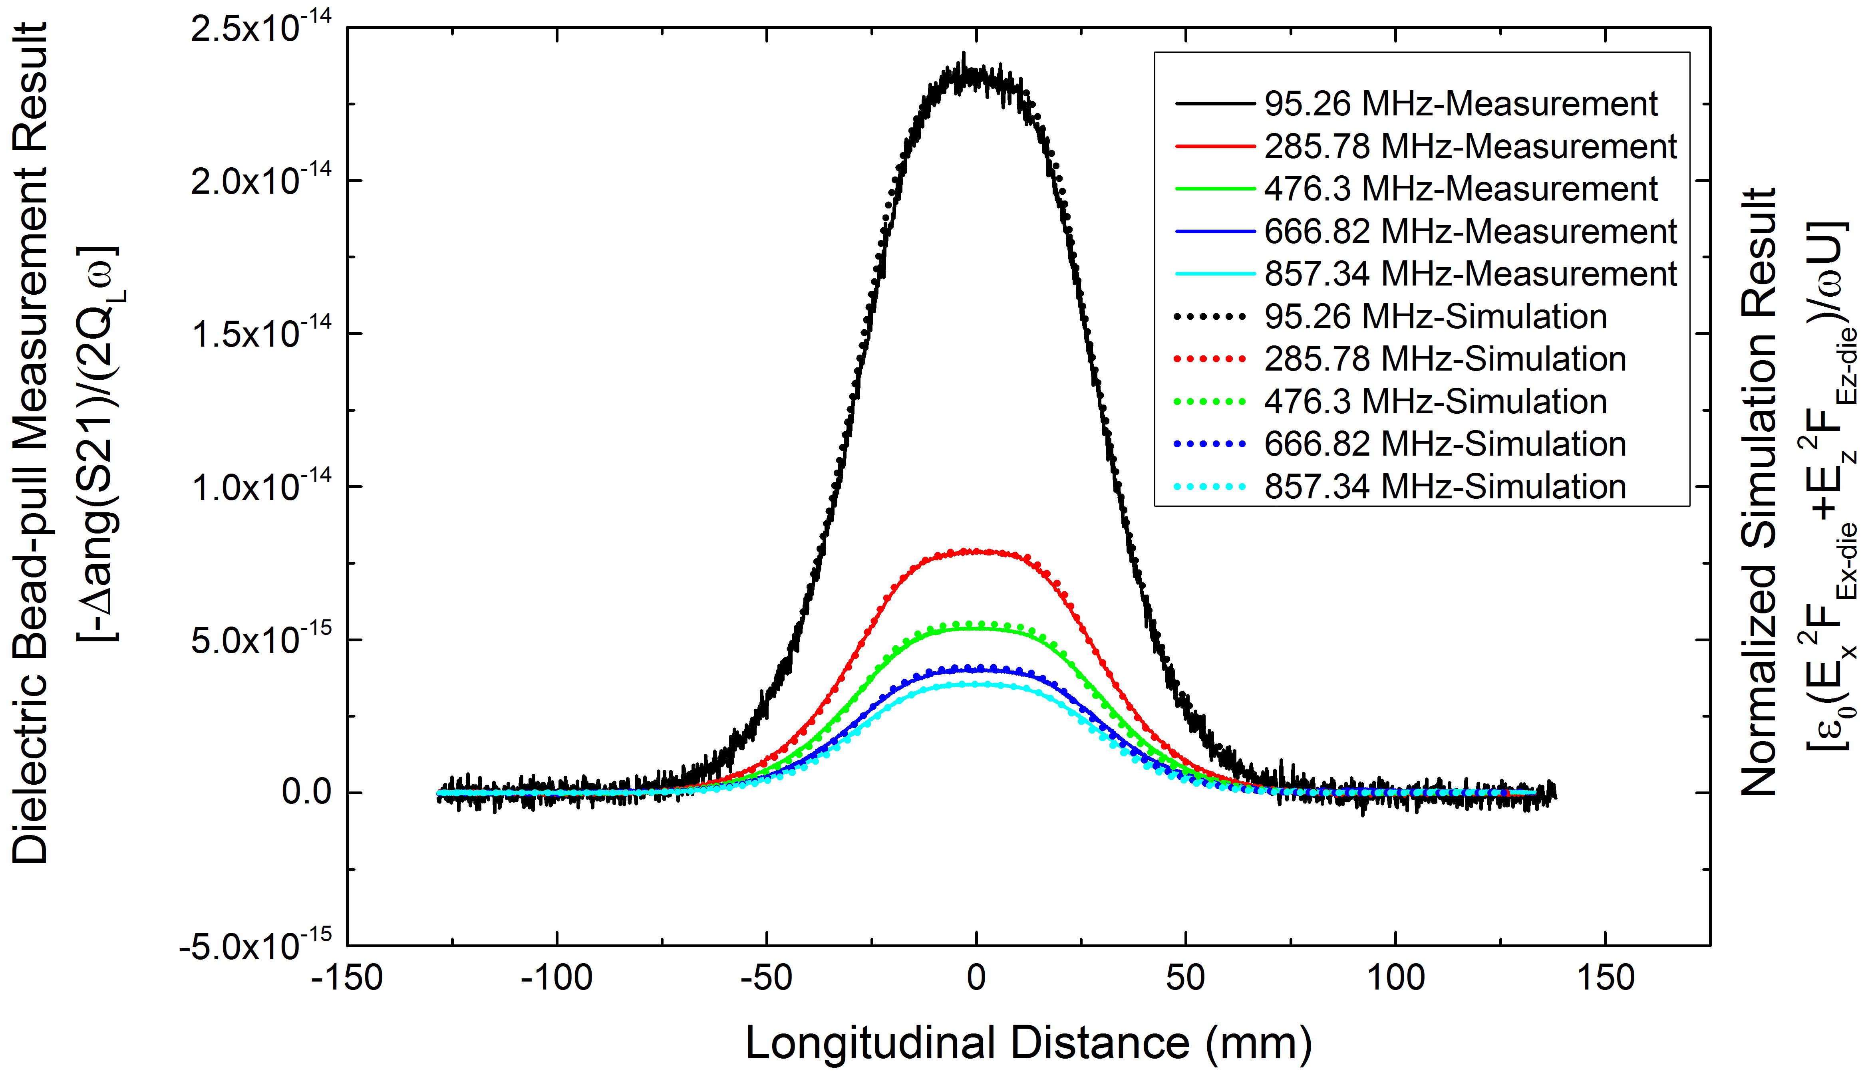
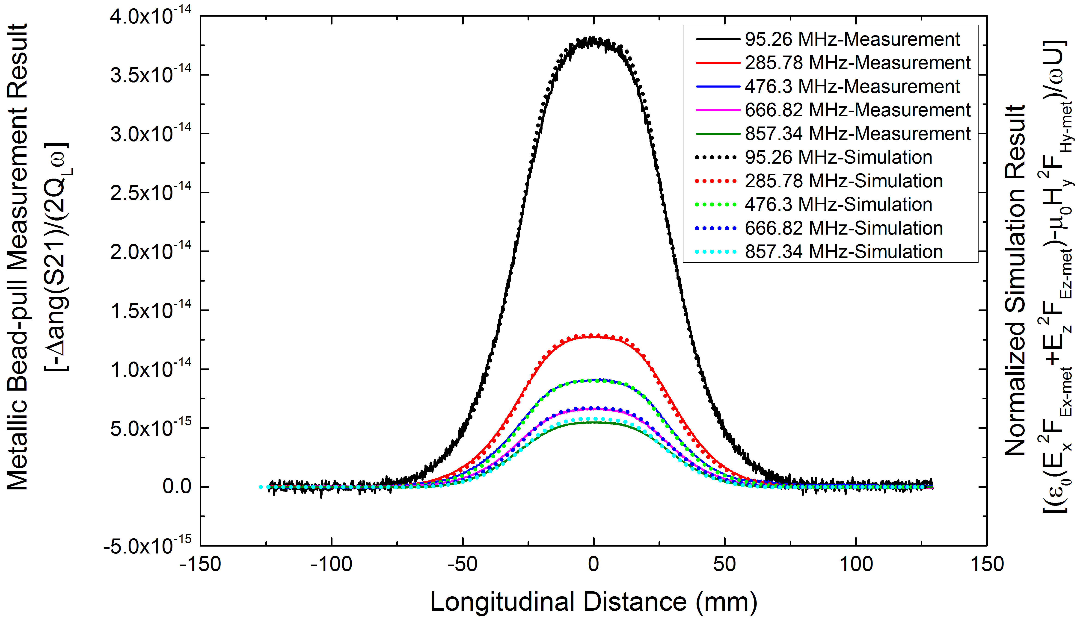
Bead-pull Results Compared with the Simulation Results
Measurement results agree well with the simulation results.
The longitudinal electric field and the magnetic field are too weak to be separated out.

Slide 19
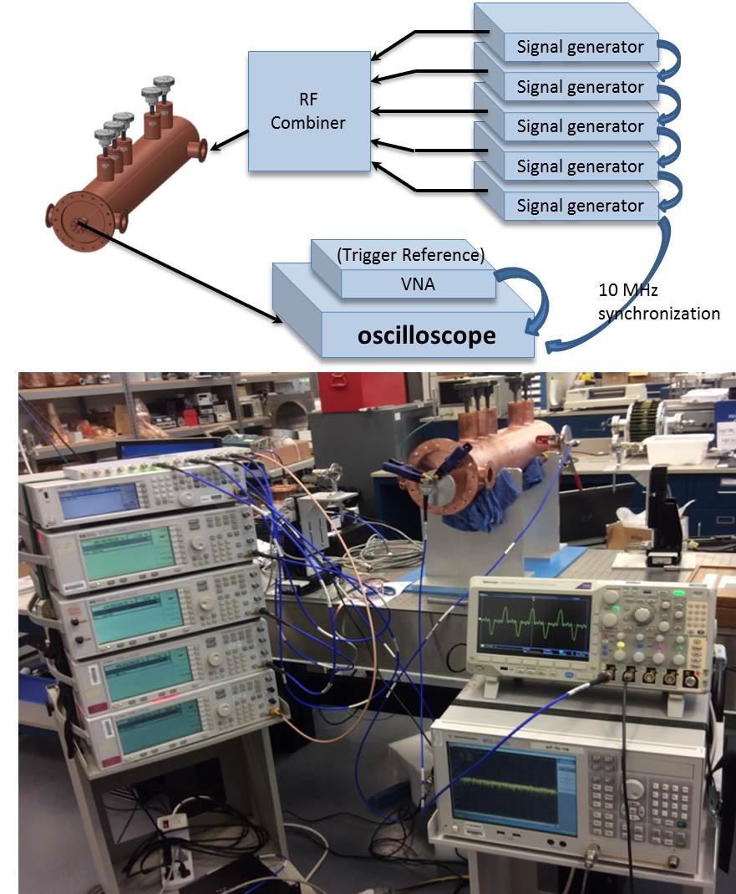
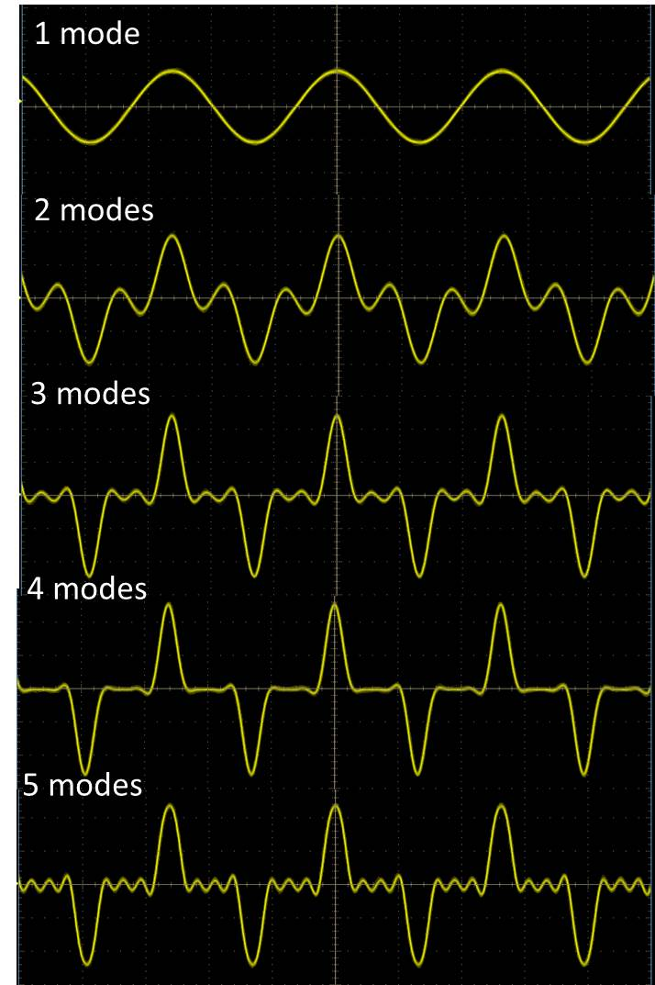
Modes Combination Experiment
The mode combination results with each mode added in turn starting with the lowest mode.
Comparison of the combined kick pulse captured from the oscilloscope display with the simulation

Slide 20
Conclusions
An ultrafast RF kicker concept suitable for the JLEIC bunched beam electron cooler ring has been demonstrated.
By using four QWR based deflecting cavities, 10 harmonic modes with the distribution 5:3:1:1 and an additional DC offset, a Flat-Top kicking pulse can be synthesized.
The cavity was designed and optimized to get high transverse impedances so the sum of the RF wall losses in all four cavities is less than 100 W for a kicking voltage of 55 kV.
A half scale 5-mode prototype copper cavity was fabricated and bench measurements were taken on this prototype cavity. Measurement results showed good agreement with the simulation results.
Further investigations on the HOM damping for high current operation is under way.
Real vacuum compatible cavities are planned to be designed and fabricated in the near future to measure the actual kicking effect on an electron bunch train.

Slide 21
Acknowledgement
The authors acknowledge all the assistance received during the development of this fast harmonic kicker cavity.
Especially we would like to thank Larry Turlington, Steven Castagnola, Jim Follkie and Teena Harris, Bill Clemens, Damon Combs and Robert Martin, Stephen Dutton, Curt Hovator, John Musson and Ramakrishna Bachimanchi for help during the construction and bench measurements on this harmonic kicker prototype cavity.

