Slide 1
Demonstration of Cooling of Ions by A Non-DC Electron Beam
Yuhong Zhang
For the JLab-IMP Cooling Collaboration
JLEIC Collaboration Meeting Fall 2016
October 5 to 7, 2016

Slide 2
The JLab-IMP Cooling Collaboration
Andrew Hutton, Kevin Jorden, Tom Powers, Michael Spata, Haipeng Wang, Shaoheng Wang, He Zhang, Yuhong Zhang (Jefferson Lab)
Jie Li, Xiaomin Ma, Lijun Mao, Youjin Yuan, He Zhao, Hongwei Zhao, (Institute of Modern Physics, Chinese Academy of Science)
Supported by JLab LDRD (2015) and CEBAF Operation Fund, and
Chinese Academy of Science International Collaboration Fund
JLEIC Collaboration Meeting, Fall 2016
2

Slide 3
Outline
Introduction
Evolution of the Idea of Proof-of-Principle Experiment
Experimental Setup: Making of A Pulsed Beam
Experimental Results
Interpretation of the Data
What is the Next?
Summary
JLEIC Collaboration Meeting, Fall 2016
3

Slide 4
Introduction: Bunched Beam Cooling Is Essential for JLEIC
JLEIC relies on electron cooling of proton/ion beams for delivering ultra high luminosities (exceeding 10³⁴ cm⁻²s⁻¹ at each detector)
It is essential to perform cooling during collision in order to compensate IBS induced emittance growth. The electron energy is up to 55 MeV which can only be provided by a SRF linac, thus the cooling electron beam is bunched
All electron cooling to this day were performed using a DC electron beam. The technology is mature.
It is generally believed ions can be cooled by a bunched electron beam, however this has never been demonstrated experimentally before, nor its physics has been systematically studied
We proposed and carried out an experiment at Institute of Modern Physics (IMP) of China to demonstrate cooling in a new parameter region. Success of this experiment will retire one major technical uncertainty of the JLEIC design
JLEIC Collaboration Meeting Fall 2016
4

Slide 5
Development of An Idea of Proof-of-Principle Test
Presently, there is no existing bunched beam electron cooler for a proof-of-principle (P-o-P) experiment. BNL is constructing a multi-MeV bunched beam cooler for the low energy RHIC operation, however, the expected completion date of construction is beyond 2018, and no P-o-P experiment has been planed.
An idea of utilizing an existing DC cooler for a P-o-P experiment was proposed (A. Hutton). It suggested replacing a thermionic gun by a photo-cathode gun, using the driven laser to control the bunch length (very short) and bunch rep. rate (very high).
A collaboration was initiated between JLab (A. Hutton) and IMP (H. Zhao).
The idea further evolved to utilizing a method of modulating the grid voltage of a thermionic gun to generate a pulsed electron beam with pulse length as short as ~100 ns (H. Zhao). The advantages are least invasive to the IMP DC cooler and requiring a minimum funding.
We received a JLab LDRD grant (Y. Zhang as the PI) to further develop and design the experiment. At the same time, IMP received a grant from Chinese Academy of Science (CAS) for supporting international collaboration (L. Mao as the PI)
JLEIC Collaboration Meeting Fall 2016
5

Slide 6
Prediction of Bunching Effect by Cooling
Though electron cooling is fundamentally a thermodynamically phenomena (flow of heat/entropy), for bunched beam cooling, there could be intriguing effects associated to ultra-relativisitic motion and phase space distribution
One such an effect, grouping of ions, was suggested (A. Hutton). It is due to reduction of ion beam longitudinal emittance. We would like to verify this effect
A coasting ion beam cooled by a bunched electron beam
A bunched ion beam cooled by a bunched electron beam
Electron bunch
Electron bunch
Electron bunch
Electron bunch
Particle density
Particle density
Before cooling
Before cooling
Must be synchronized
Particle density
Particle density
After cooling
After cooling
JLEIC Collaboration Meeting Fall 2016
6

Slide 7
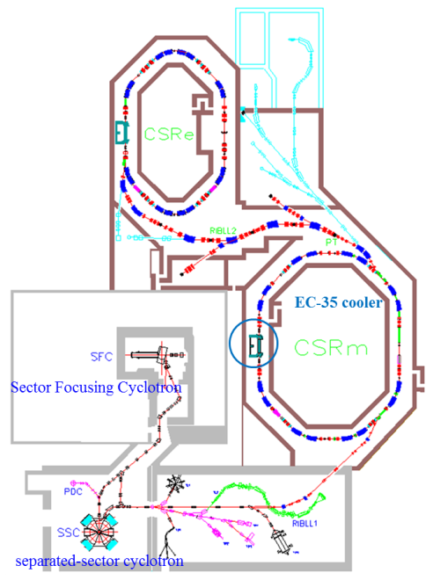
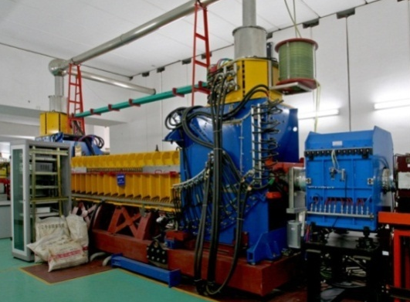
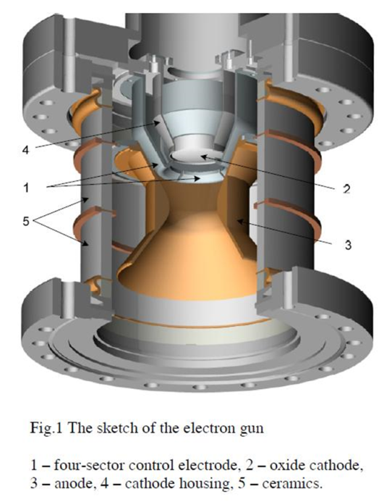
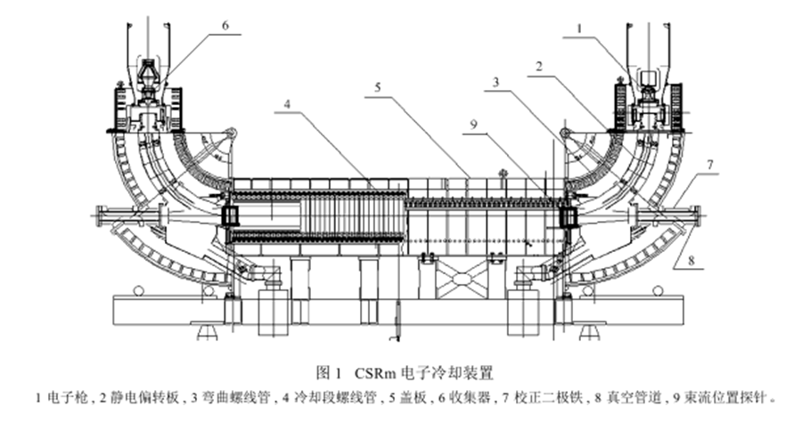
IMP DC Cooler on CSRm
HIREL@IMP
DC cooler
Thermionic gun
CSRm ring
electrode
cathode
Pulser
JLEIC Collaboration Meeting Fall 2016
7

Slide 8
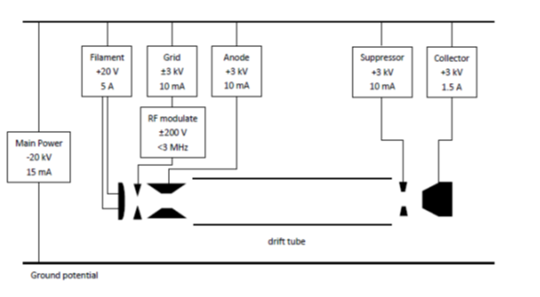
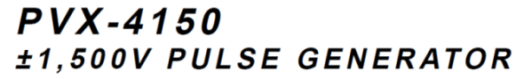


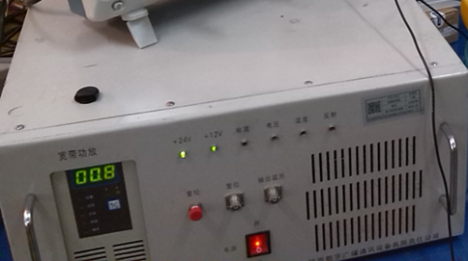
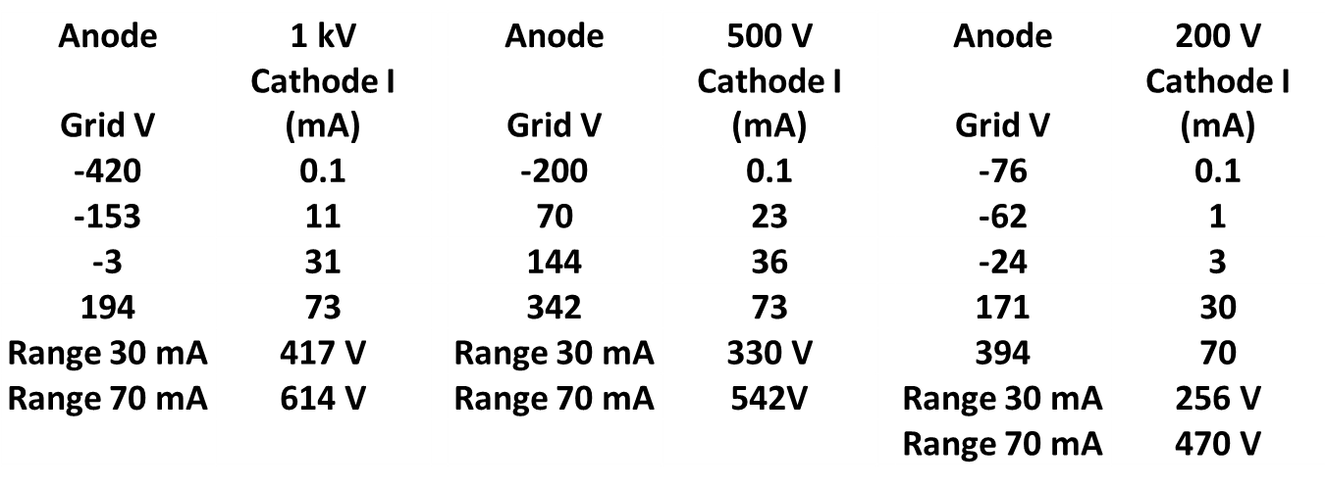
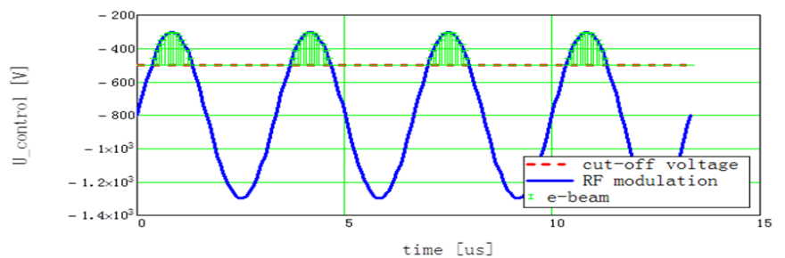
Making of Pulsed Electron Beam
Pulse modulation + DC Bias Scheme
Option 1: A HV pulser (JLab)
Option 2: An RF amplifier (IMP)
JLEIC Collaboration Meeting Fall 2016
8

Slide 9
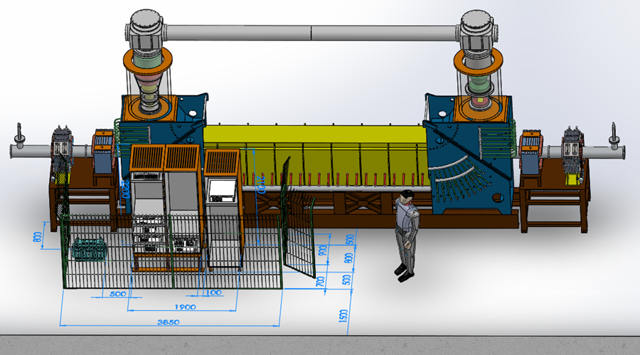
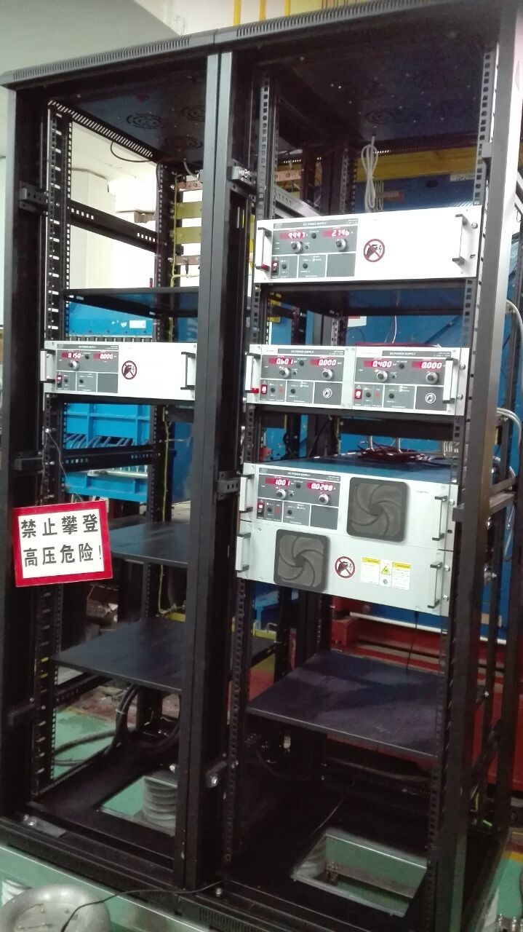
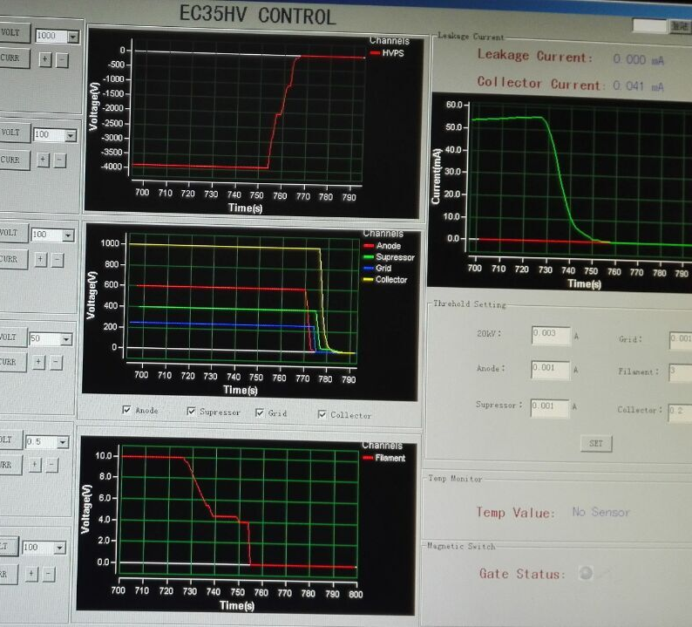
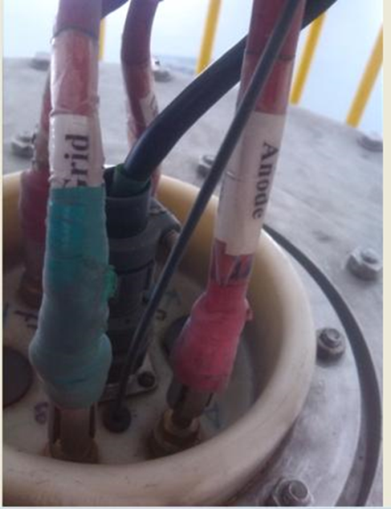
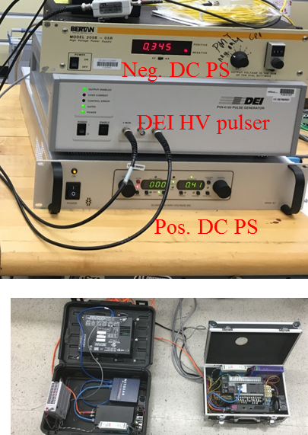
The Experiment Setup
Place for JLab pulser
Cathode filament
DC grid
anode and suppressor
collector
>95% beam transmission
JLEIC Collaboration Meeting Fall 2016
9

Slide 10
Experiment Design Parameters
 | Variables | Value | Value | Unit
¹²C6⁺ | Kinetic energy | 7 | 30 | MeV/u
 | Particle γ | 1.007 | 1.032
 | Particle β | 0.121 | 0.247
 | Geometric emittance | 5 | 5 | µm
 | Bunch length | Coasting or 13.4 (RMS) |  | m
 | Energy spread | 4 | 4 | 10⁻⁴
e⁻ | Number of particles | 5 | 5 | 10⁸
 | Kinetic energy | 3.8 | 16.3 | keV
 | Radius | 2.5 | 2.5 | cm
 | Average current | 30 | 70 | mA
 | Pulse length | DC to 60 (FWHM) |  | ns
 | Temperature | 0.05 | 0.1 | eV
Rap Rate | For h=2 synch w/ delay | 0.45 | 1.38 | MHz
JLEIC Collaboration Meeting Fall 2016
10

Slide 11
Beam Diagnostic for Cooling Experiment
Measurement | EC35-electron | CSRm-ions | Data-acquisition
average beam current | dc readings on PSs, sampling resistors | DCC(current)T (transformer)s | existing calibra. and DAS
peak beam current and pulse length | mod. freq. f_{m} Pearson coil on e-collector | rf or harmonic freqs n*f₀ | fiber optical link readout
Beam position | capacitive BPMs | capacitive BPMs | Re-calibra. and DAS put new attenuator
Beam trans.-profile | capacitive BPMs (off-line screen) | residual gas BPMs | DAS
Beam long.-profile | BPMs on BPMs | BPMs on BPMs or DCCTs Stochastic cooling pickup | fast scope and on-line DAS
Cooling rates | n.a. | Schorttky resonator and pickups | fast scope and on-line DAS Off-line side-band signal analysis
existing
Modified for the experiment
new installation (in 2016)
JLEIC Collaboration Meeting Fall 2016
11

Slide 12
1st Bunched Beam Cooling Experiment
(IMP, May 17-22, 2016)
Beam cycle
  Carbon (¹²C⁶⁺) ions were injected at 7 MeV/u from a cyclotron and stored in the CSRm ring
  The ion beam was either coasting or captured into two long bunches h=2 by a RF w/ 450 kHz;
  each bunch occupied about 1/2 of the CSRm ring
  The pulsed electron beam was turned on
  Pulsed beam cooling proceeded very fast in time scale of 1 second
  At 7 second, the stored beam was dumped, then restarted the cycle
Cooling tests:
  Pulsed electron beam cooled the coasting ion beam, both beams were not synchronized
  Pulsed electron beam cooled the coasting ion beam, both beams were synchronized
  Pulsed electron beam cooled the bunched ion beam, both beams were synchronized
Cooling electron beam
  Pulse length varies from 2.2 µs (half of the ring circumference) to 60 ns (limit of the pulser),
  Corresponding to 79.2 m to 2.2 m FWHM pulse length (relativistic β = 0.12)
  The pulse current was kept constant, thus the average current decreased with the pulse length
JLEIC Collaboration Meeting Fall 2016
12

Slide 13
Experiment Observations
Test 1: Long pulsed (~5 µs) electron beam cools a coasting ion beam, two beams were not synchronized
We observed a rapid ion loss at beginning of cooling;
Loss was too fast such that cooling effect could not be observed
Exact mechanism of the ion loss is still unknown, but it is suspected raise/fall of the electron pulse might act as a large transverse kicker which knocks ions out piece-by-piece
It is also suspected the electron beam and ion beam were not perfectly aligned
Test 2: Long pulsed electron beam cools a coasting ion beam, two beams were synchronized
We observed a modest to small ion loss
We observed a rapid cooling effect (longitudinal cooling)

Slide 14
Experiment Observations
Test 3: Pulsed (~2 µs) electron beam cools a bunched ion beam, two beams were synchronized
Only one of two ion bunches were cooled
Electron bunches are longer than the ion bunches;
Ion loss is very small; we postulate the raise/fall of pulsed electron beam did not see ions so no ions were kicked out
We observed cooling effect (longitudinal cooling)
Test 4: Pushing short pulse length of electron beam and use it to cool a coasting ion beam, two beams were synchronized
The electron (FWHM) pulse length was pushed as short as 100 ns (~3.6m)
No cooling were observed with electron pulse length short than 150 ns (~5.4 m); Longitudinal diffusion is too slow to spread cooling along the coasting beam
With a little longer electron pulse length, we observed cooling effect.
At 400 ns pulse length, ions were lost rapidly which could not be explained. It is suspected the ion beam had hit some instability
JLEIC Collaboration Meeting Fall 2016
14

Slide 15
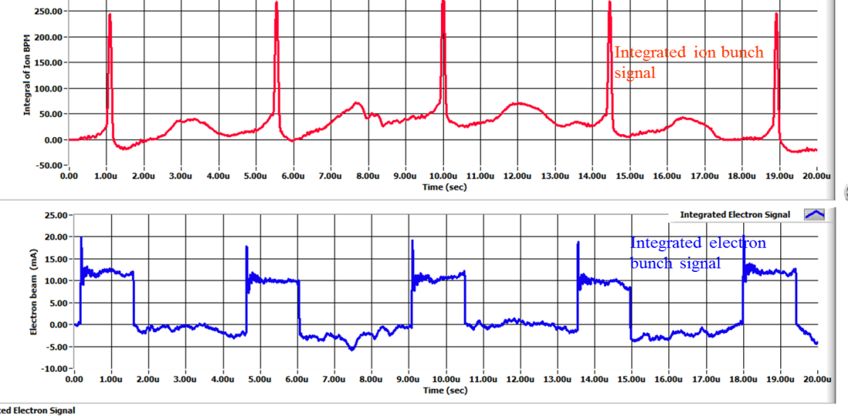
Observation of Cooling of Bunched Ion Beam by a Pulsed Electron Beam
cooled ion bunches
uncooled ion bunches
Experiment data observation on BPMs
Ring circumference
Electron bunches
Two long ion bunches in the ring, only one of them was cooled
After cooling, the cooled ions has a much smaller energy spread, then the ions were more concentrated around center of the RF bucket
JLEIC Collaboration Meeting Fall 2016
15

Slide 16
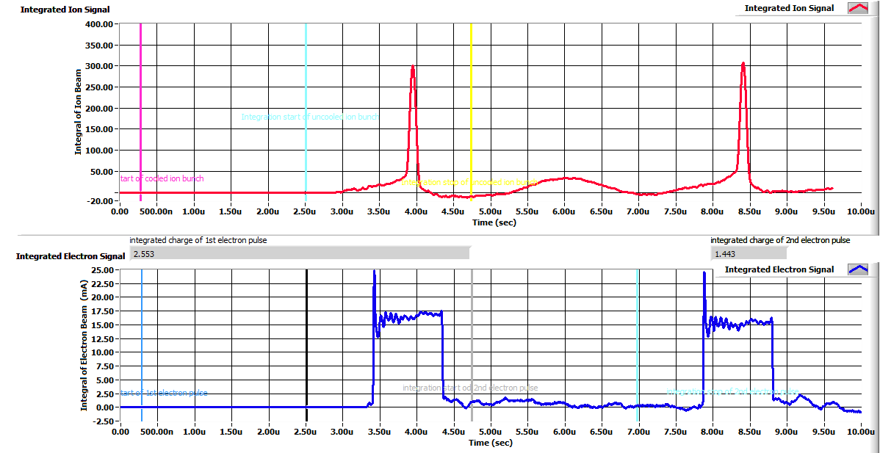
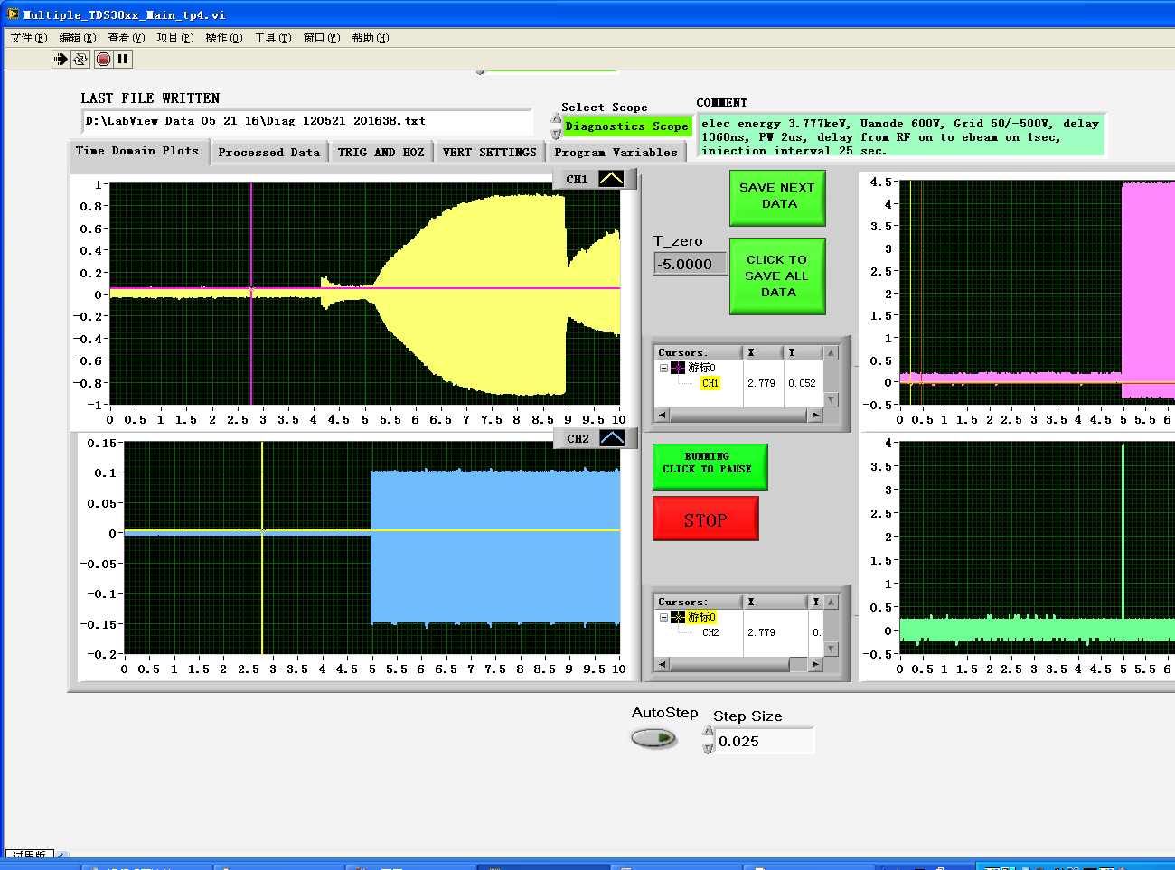
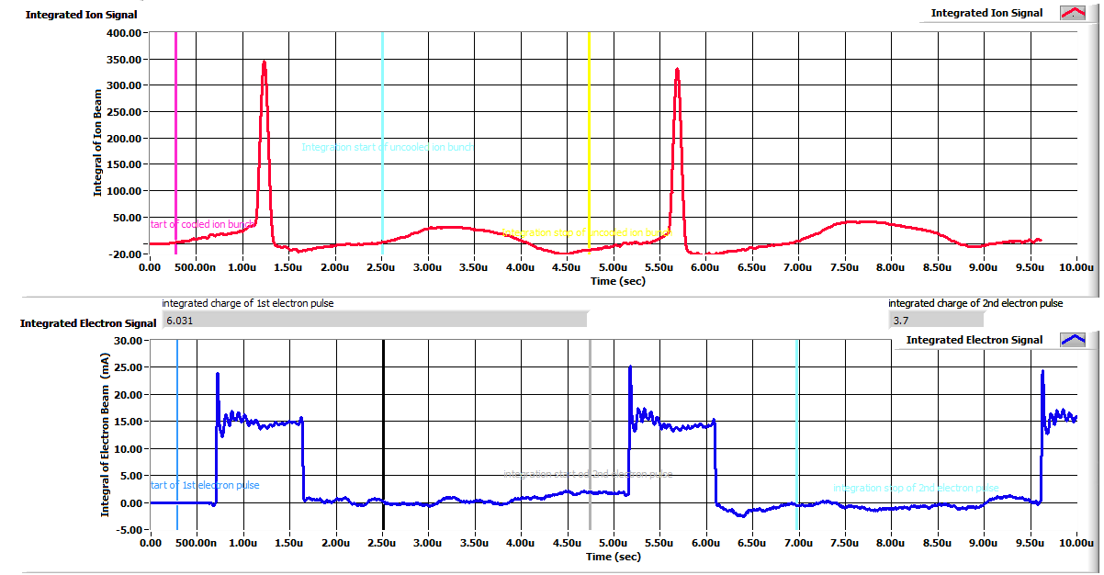
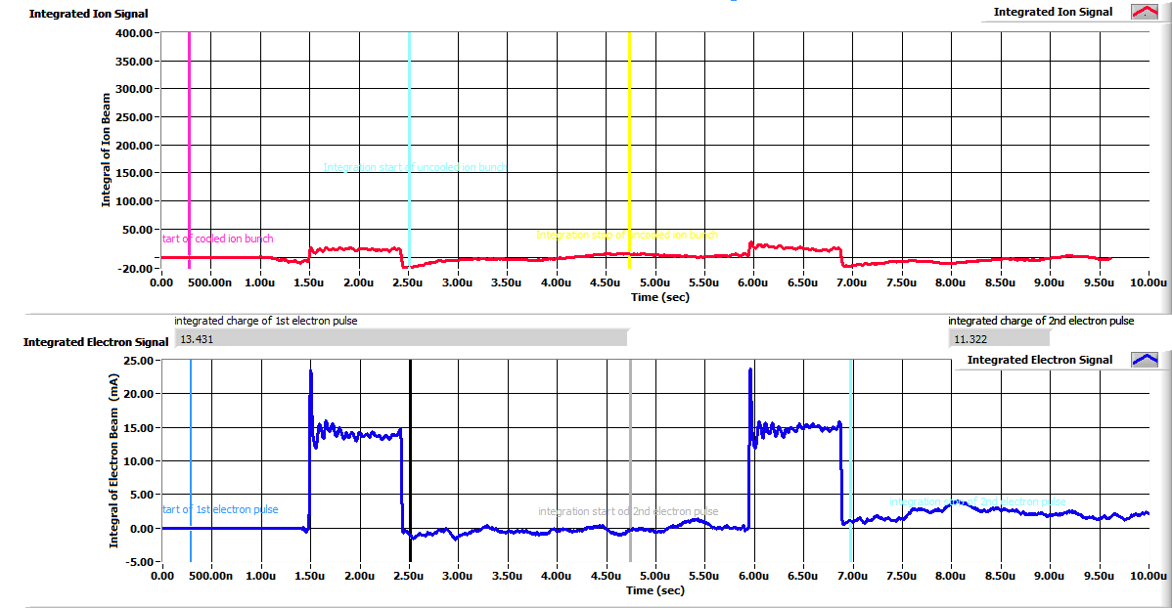
Evolution of Ion Longitudinal Density Profile
Ion BPM dI/dt → integration → I_{ion}
Sum of BPM Signals are Used to Show Longitudinal Ion Density Profile
dI/dt peak envelop signal of ion BPMs
A
12C⁺⁶
Uncooled bunch
Cooled bunch
1µs
I_{e}=15 mA
B
A
B
C
I_{e}=15 mA
1µs
V_{rf} = 600 V
C
RF on
5 s
RF off
e-pulse on
1µs
I_{e} =15 mA
1 s
RF OFF
JLEIC Collaboration Meeting Fall 2016
16
A
B
C

Slide 17
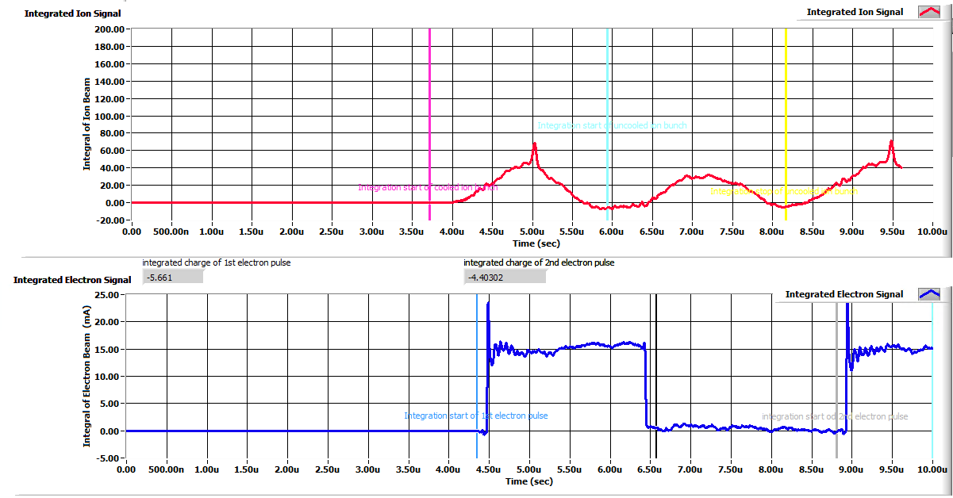
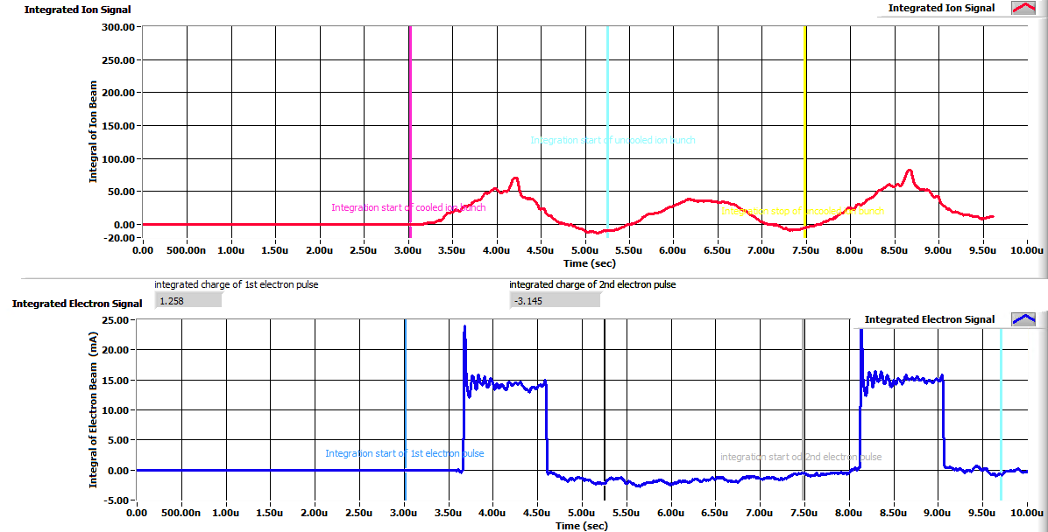
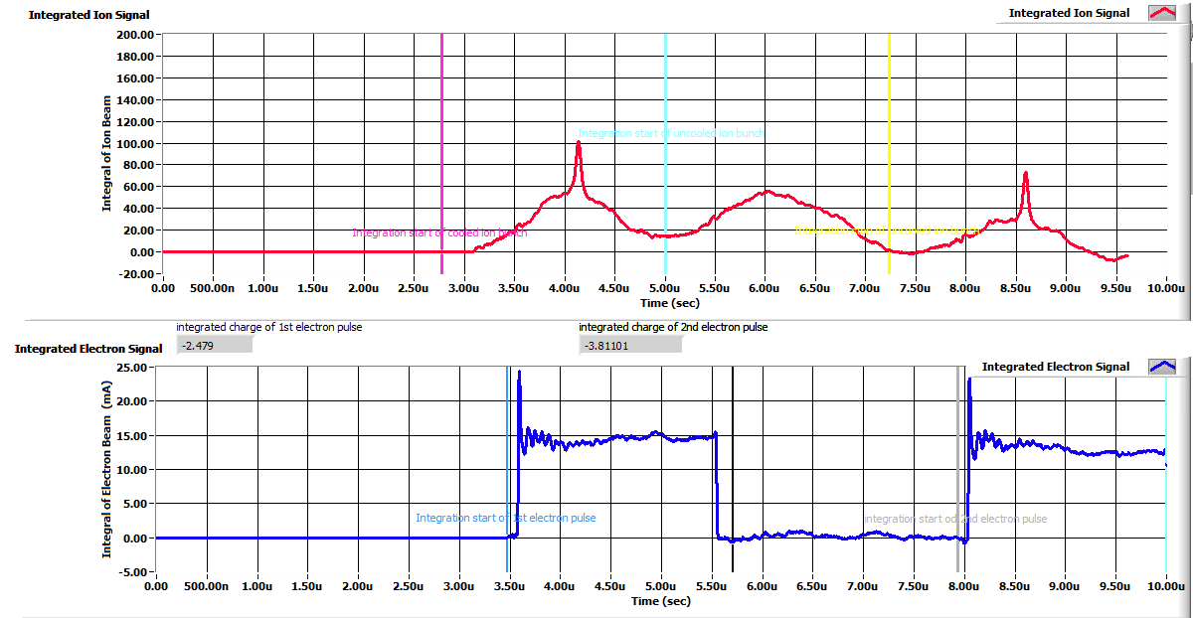
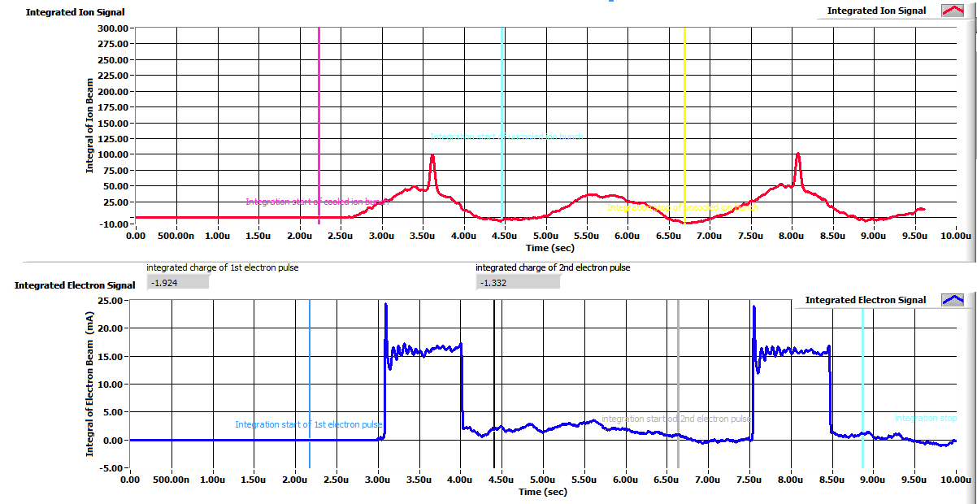
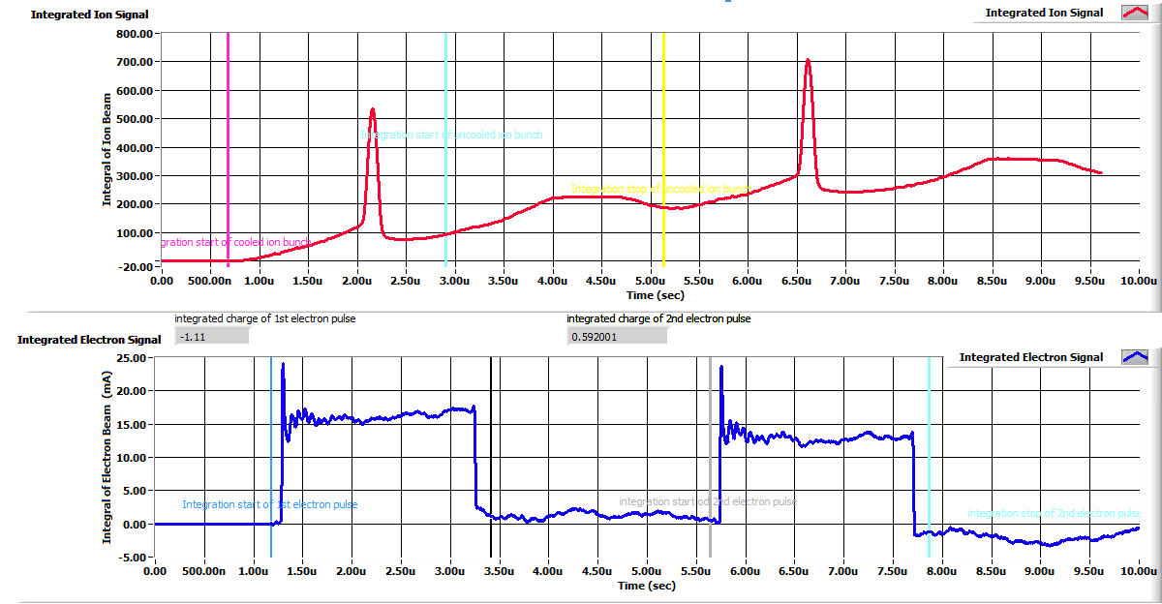
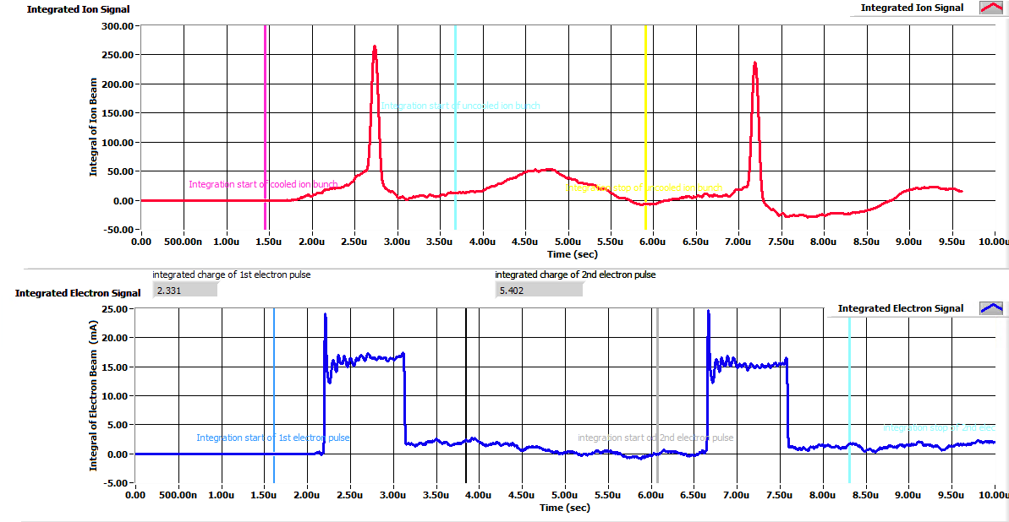
A Closed Look of Pulsed Beam Cooling
0.5s
cooled
We must admit that these figures are not from one beam store (data have lot of noises)
These figures illustrate reduction of the energy spread
0.4s
Un cooled
2 µs
1 µs
0.75s
0.6s
cooled
Un cooled
2 µs
1 µs
2s
2.2s
time
2 µs
1 µs
JLEIC Collaboration Meeting Fall 2016
17

Slide 18
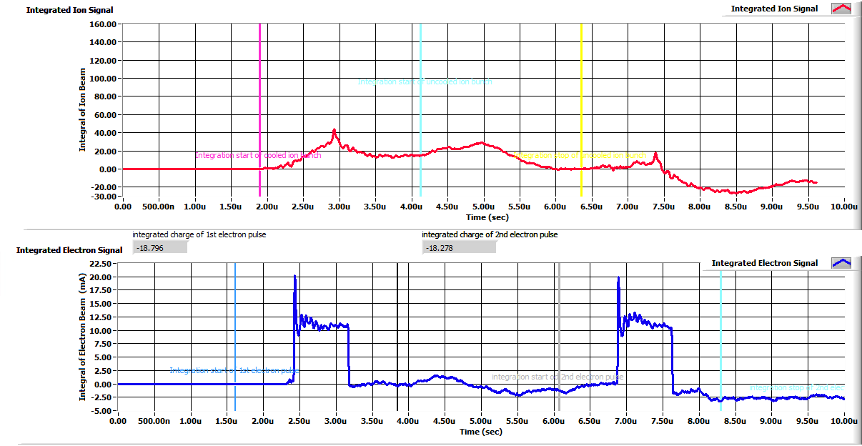
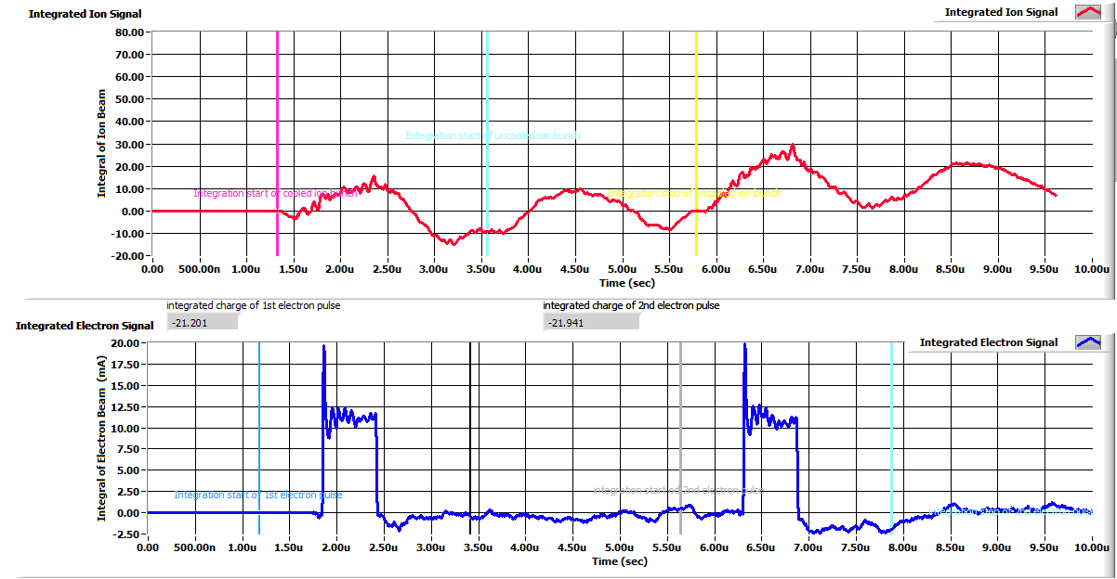
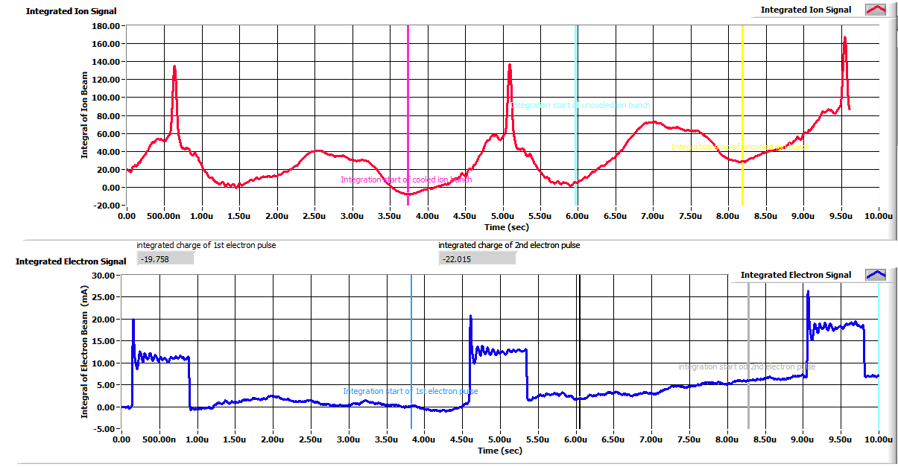
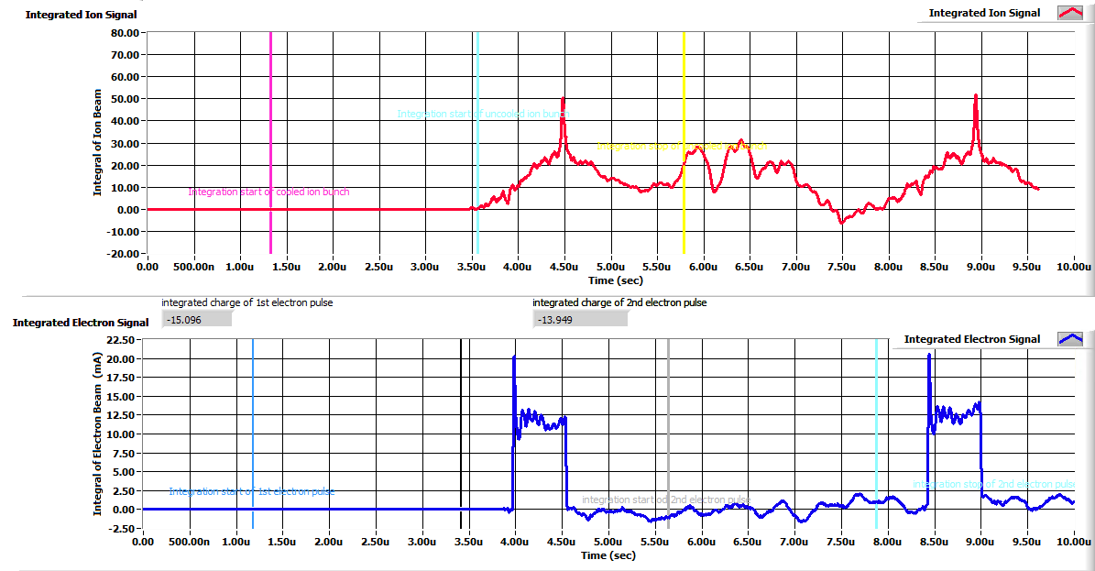
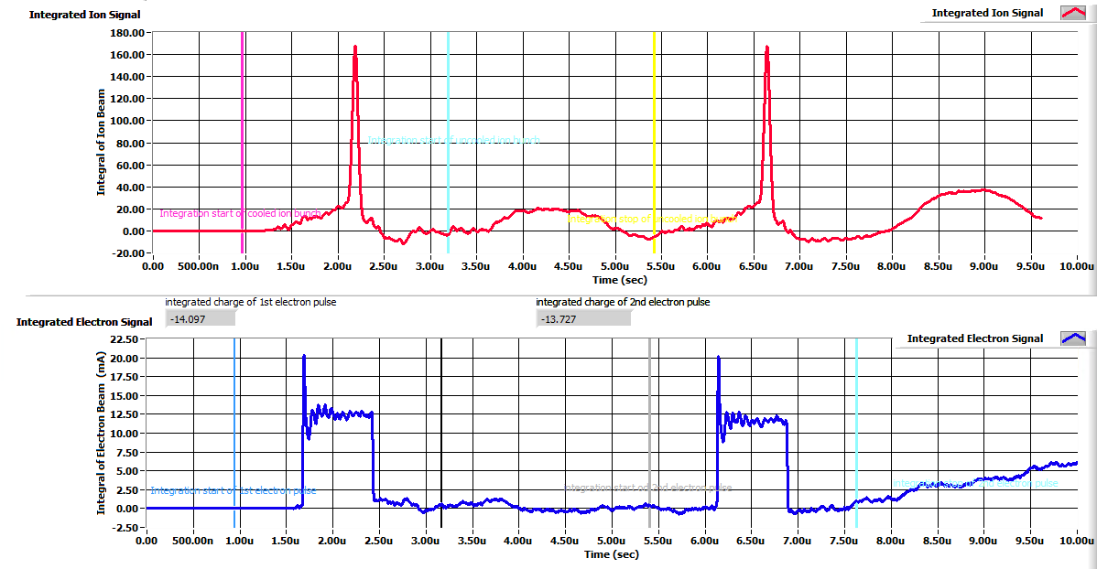
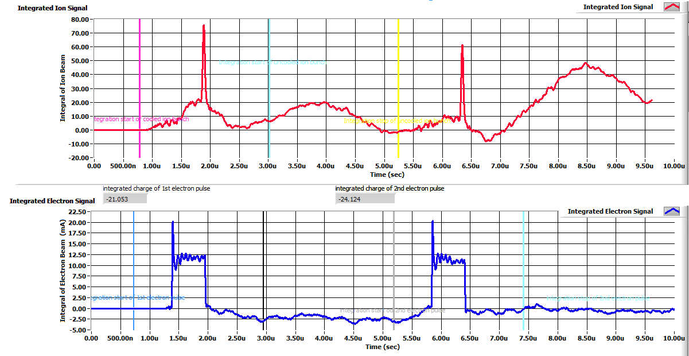
A Closed Look of Pulsed Beam Cooling
0.875s
0.55s
0.8 µs
0.6 µs
cooled
Uncooled
0.675s
2.825s
0.8 µs
0.6 µs
cooled
3.05s
Uncooled
3.30s
time
0.8 µs
0.6 µs
JLEIC Collaboration Meeting Fall 2016
18

Slide 19
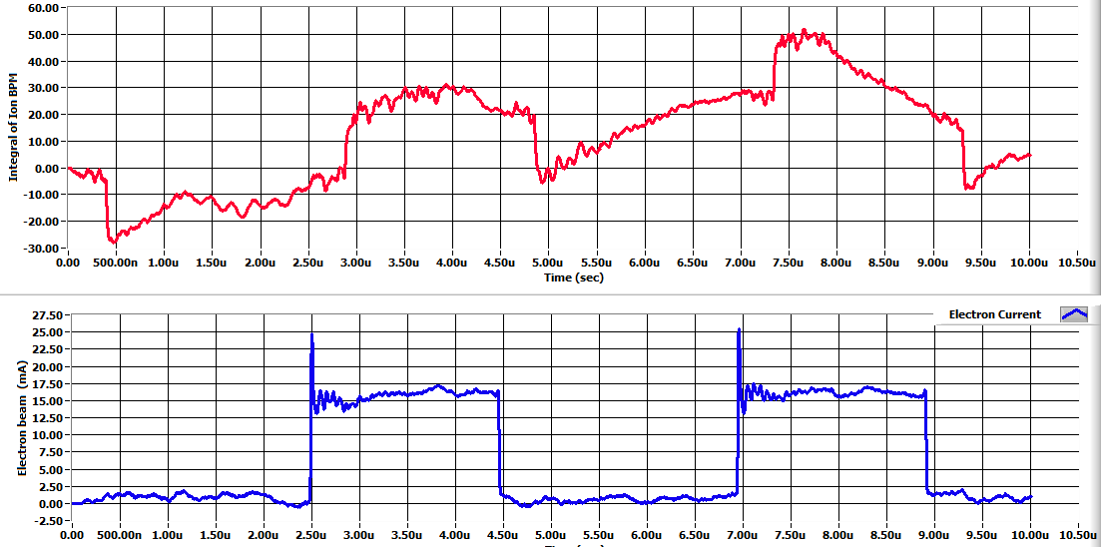
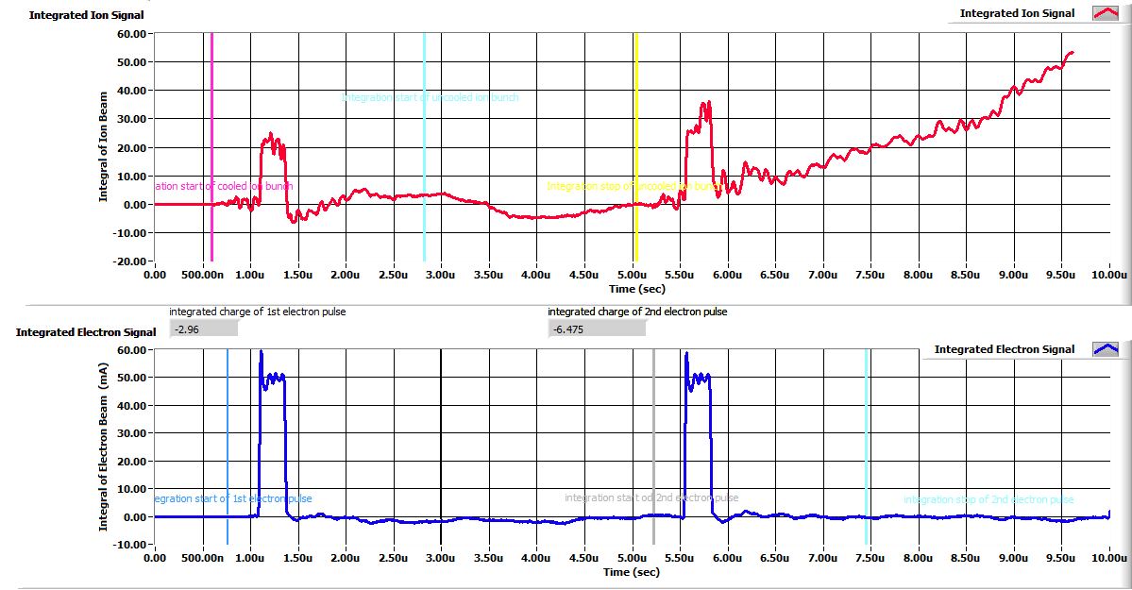
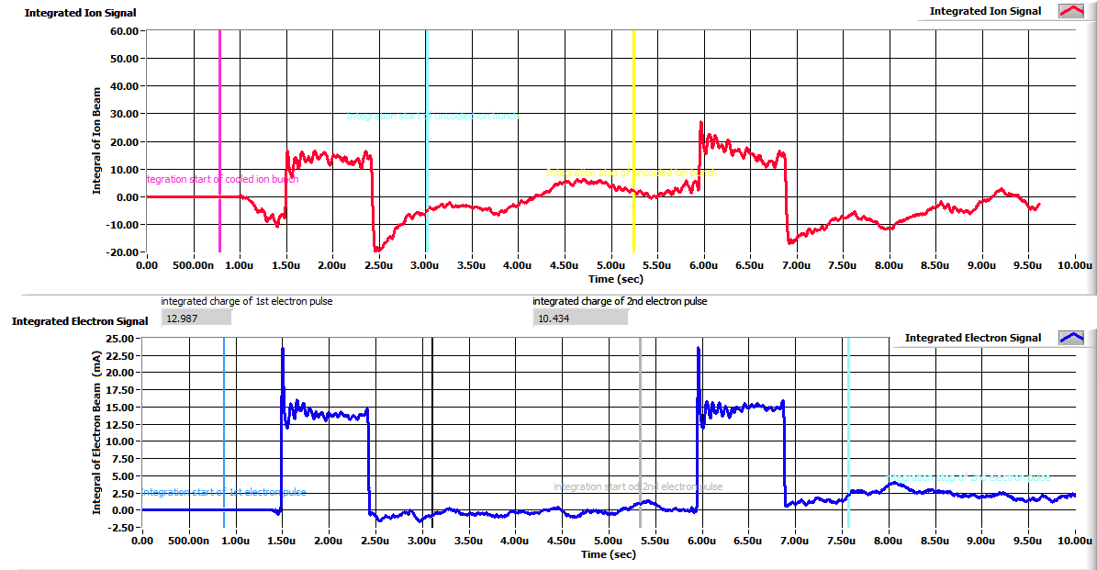
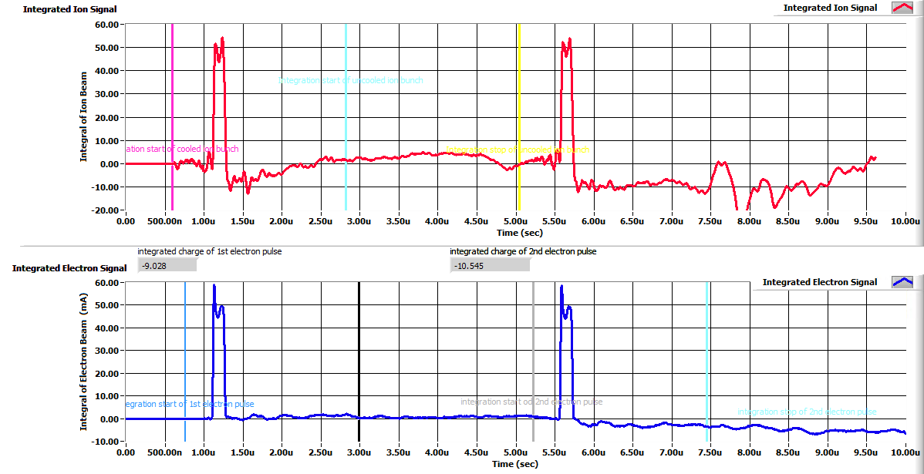
Observation of Cooling of A Coasting Beam and Bunching Effect By A Pulsed Electron Beam
ions
4.30s
electrons
2 µs
0.3 µs
4.20s
0.15 µs
1 µs
Ion beam profile follows electron pulse profile, ions can see only electron potential well
This potential has a flat bottom, so no narrow core spike will appear
JLEIC Collaboration Meeting Fall 2016
19

Slide 20

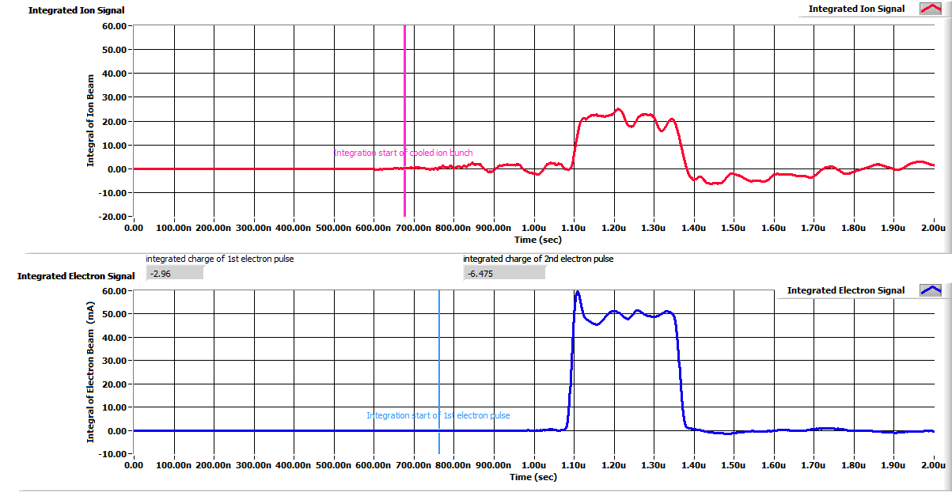
Observation of Cooling of Coasting Beam By A Very Short Pulsed Electron Beam
ions
electrons
150 ns
zoom in
Beam synchronization between electron pulse and ion bunch is critical
Both electron and cooled ion have the same bunch length ~150ns
Without fine tune the electron pulser’s frequency with the ion revolution frequency, the cooling effect can be lost
150 ns
JLEIC Collaboration Meeting Fall 2016
20

Slide 21
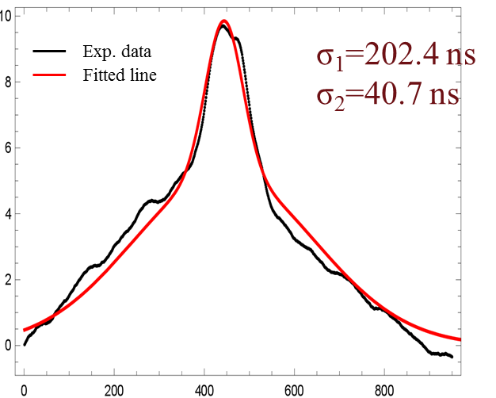
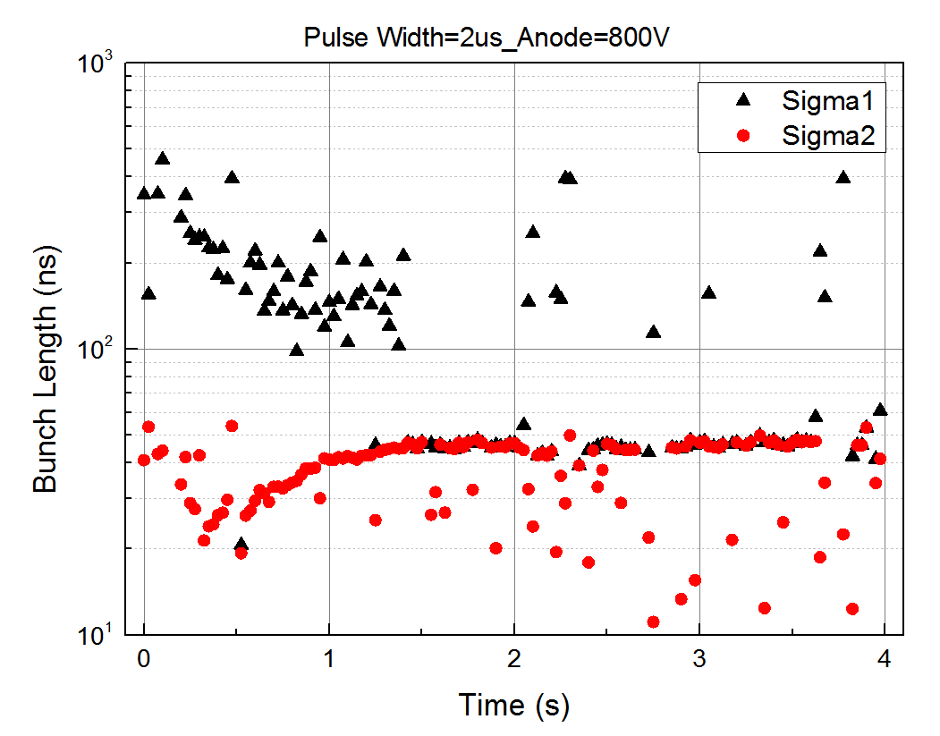
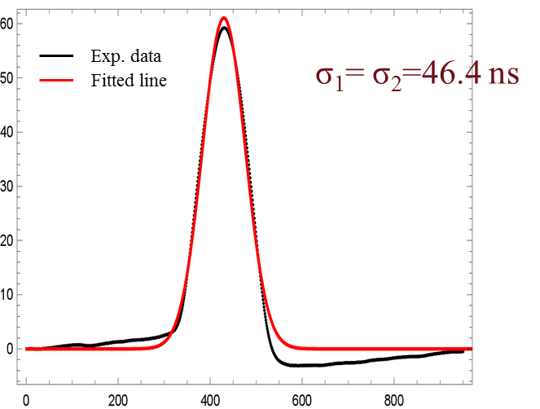
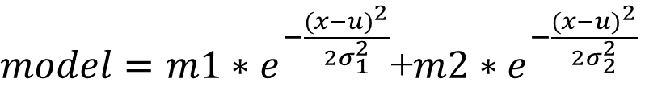
Data Analysis And Modeling
Fit by a Bi-Gaussian distribution
RMS bunch length definition
$model=m1∗e^{−\frac{{(x−u)}^{2}}{{2σ}_{1}^{2}}}$+$m2∗e^{−\frac{{(x−u)}^{2}}{{2σ}_{2}^{2}}}$
May 21’s data with RF on
RMS bunch length needs to be standardized
JLEIC Collaboration Meeting Fall 2016
21

Slide 22
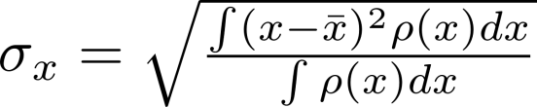
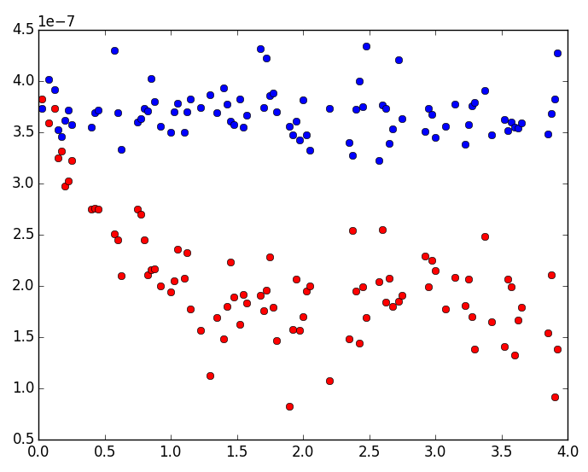
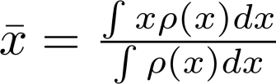

Evolution of the RMS Bunch Length
JLab Algorithm
Use the first integral of the BPM signal as the beam density function.
Make the start and the end point of the first integral to be zero to remove DC slope.
If any value is less than zero after the slope adjustment, make it zero.
The rms bunch length is calculated using the following formula:
May 21’s data with RF ON
dz (s)
Cooling reach equilibrium at about 1.5 s.
Blue: uncooled ion bunch
Red: cooled ion bunch
t (s)
JLEIC Collaboration Meeting Fall 2016
22

Slide 23
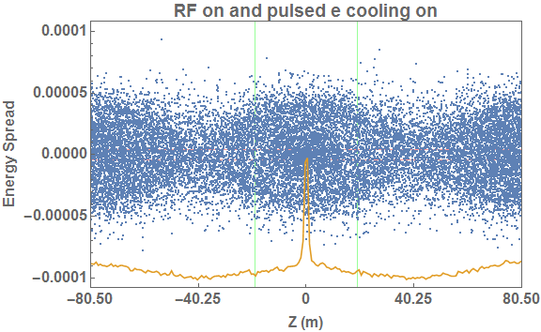
Preliminary Results and Explanations
Ion synchrotron motion enhances effectiveness of cooling since it is much fast than cooling process, therefore cooling works even electron pulse is shorter than ion bunch length;
With cooling, ion bean energy spread becomes smaller and smaller. RF potential well constrains those cooled ions around the center of the bucket, thus a core spike in the density profile is formed
Height and width of the core spike is determined by a balance of IBS and cooling, it also depends on the electron temperature;
Although width of the electron pulse does not affect width of the cooled core spike, it does affect the cooling rate with given peak electron beam current;
1D beam dynamic modeling
The cooled ions are trapped at the RF potential well bottom, forms the spike core. In this simulation, RF voltage is on with electron bunch cooling.
Space charge force of the electron pulse does form an additional potential, but it is quite small (10% compared the RF voltage at 600 V). Therefore it shouldn’t blur the pulsed cooling process. In the IMP experiments, it only manifest itself when V_{RF} is turned off.
JLEIC Collaboration Meeting Fall 2016
23

Slide 24
Consideration for the 2nd Stage Experiment
The second bunched e-cooling experiment is planned (5 days) near end of Nov.
The primary goal of this second experiment is machine studies, including hardware (beam diagnostics) improvement and software development, tentatively, they are
  Preparation of ion BPMs on bench and in situ calibrations
  Software and hardware for BPM, DCCT and Schottky signals data acquisition systems
  Software and hardware improvement for the gun trigger and RF synchronization of high rate of data recording during single injection cycle
  Beam instrumentation checkup with 40Ar⁺¹⁵ beam at CSRm in high energy
We also plan to demonstrate pulsed beam cooling at 30MeV/u to study the weak effect of electron bunch potential well both with and without RF
JLEIC Collaboration Meeting Fall 2016
24

Slide 25
Summary
The first experiment of cooling of ions by a non-coasting electron beam was carried this May at a DC Cooler at IMP by a JLab-IMP collaboration team
The pulsed electron beam with 2 µs to 60 ns FWHM pulse length was generated in the thermionic gun of the IMP DC cooler using a method of modulating the grid voltage
In this experiment, cooling of ions (either bunched or coasting) by a pulsed electron beam was observed through BPM measurements.
The grouping/bunching effect of pulsed beam electron cooling was also observed in the case of coasting ion beam
The team has collected a large amount of experiment data, they are primarily BPM data. Analyses of these experiment data is in progress.
1D longitudinal dynamic modeling with/without RF and the pulsed electron cooling is under development with promised results to explain observed experiment data
JLEIC Collaboration Meeting Fall 2016
25

Slide 26
Acknowledgements
I want to thank Haipeng Wang and Shaoheng Wang for their assistance in preparing for this presentation

Slide 27
Backup Slides

Slide 28
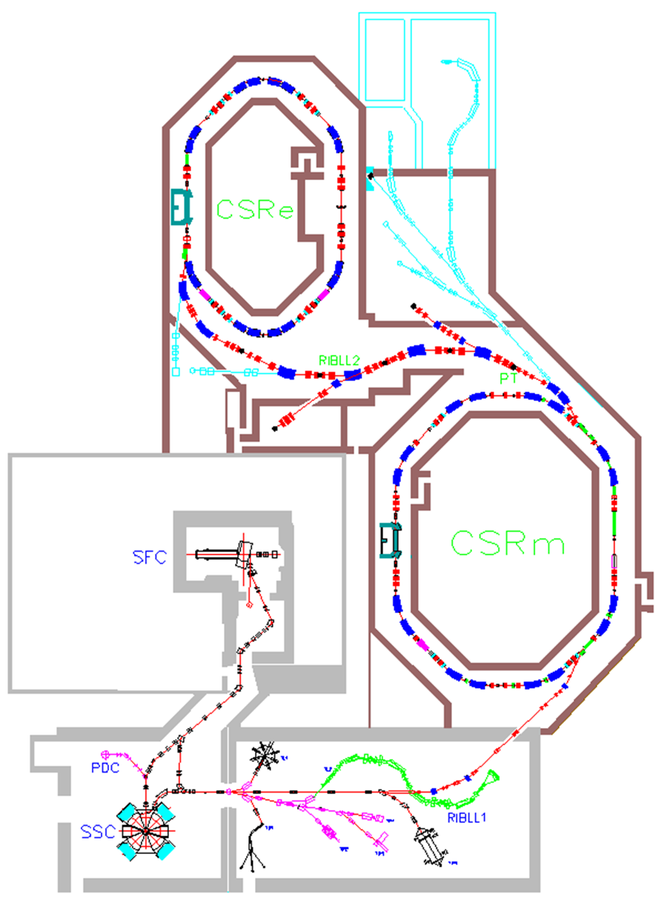
HIREL-CSR Layout & Performance Specification
EC-35 cooler
Sector Focusing Cyclotron
separated-sector cyclotron

Slide 29
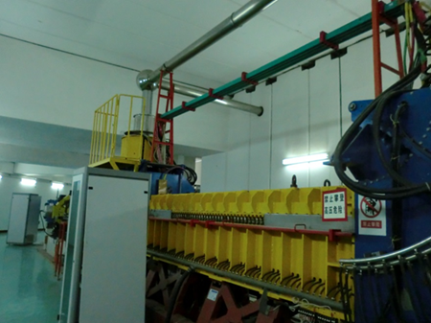
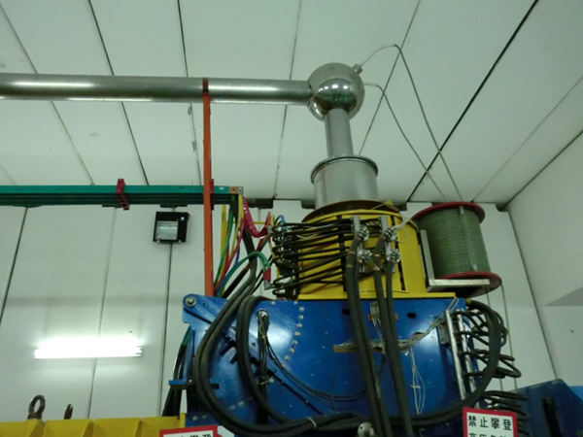
EC-35 DC Cooler and Commissioned Performance
Single plate of this BPM has been used for the bunched e-beam measurement
1—electron gun, 2—electrostatic bending plates, 3—toroid, 4—solenoid of cooling section, 5—magnet platform, 6—collector for electron beam, 7—dipole corrector, 8—vacuum ﬂange for CSRm. Two BPMs placed in the cooling station, one is at upstream of electron beam at gun side in position 9, another one is at downstream collector side in the mirror symmetric position relative to 9.
Recommissioned in March 2016
vacuum 2×10¹¹ mbar,
high voltage 20 kV,
electron beam current 1.5 A,
collector efﬁciency >99.99%,
angle of magnetic ﬁeld line in cooling section <2×10⁻⁵

Slide 30
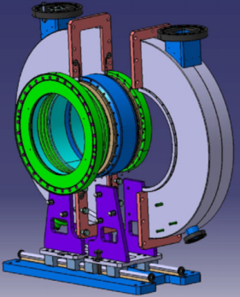
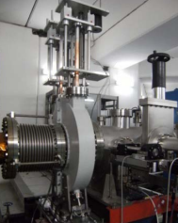
Cavity Schottky Pickup RF harmonic signal

Slide 31
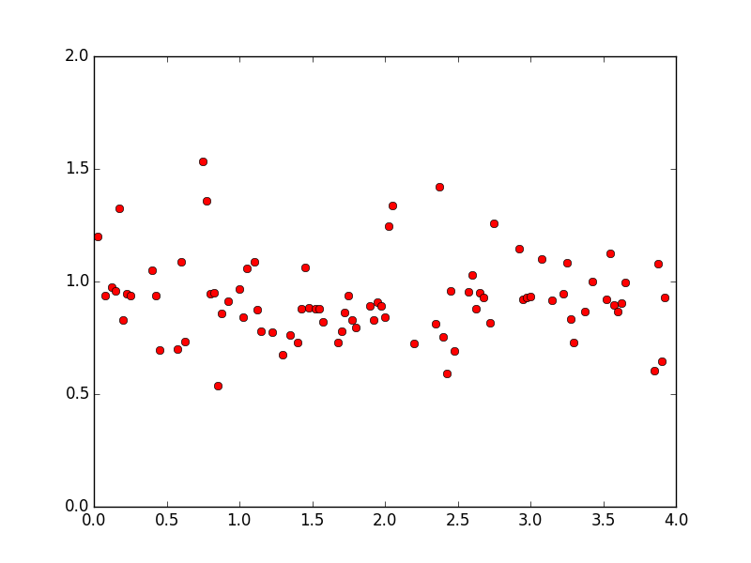




Evolution of the RMS Bunch Length
Algorithm:
Integrate the BPM signal and find the peak of the cooled beam.
Select the range of half period, centered at the peak, as the whole cooled beam.
Make the start and the end point of the first integral to be zero to remove DC slope, and calculate the second integral.
Select the following half period as the uncooled beam, and calculate the second integral in the same way.
Calculate the rate between two second integrals of the cooled and the uncooled beam.
First integral of the BPM signal $∝$ charge density function
Second integral of the BPM signal $∝$ total charge
1st Integral
1st Integral
1st Integral
Rate
Rate of the two 2nd integrals
t=0.025 s
t=0.45 s
t=1.7 s
t (s)
t (s)
t (s)
t (s)
JLEIC Collaboration Meeting Fall 2016
31

