Slide 1
Update on Development of High Current Bunched Electron Beam from Magnetized DC Photogun
JLEIC Collaboration Meeting
October 6, 2016
Riad Suleiman and Matt Poelker

Slide 2
Magnetized Cooling
JLEIC bunched magnetized electron cooler is part of Collider Ring and aims to counteract ion emittance degradation induced by intra-beam scattering, to maintain ion beam emittance during collisions and extend luminosity lifetime.
Electrons helical motion in strong magnetic field increases electron-ion interaction time, thereby significantly improving cooling efficiency. Electron-ion collisions that occur over many cyclotron oscillations and at distances larger than cyclotron radius are insensitive to electrons transverse velocity.
Cooling rates are determined by electron longitudinal energy spread rather than electron beam transverse emittance as transverse motion of electrons is quenched by magnetic field
This cyclotron motion also provides suppression of electron-ion recombination

Slide 3
Electron beam is being used inside cooling solenoid where it suffers an azimuthal kick when it enters. This kick is cancelled by an earlier kick at exit of cathode solenoid
Electrons born in strong uniform B_{z}
Upon exit of Cathode Solenoid
Upon entering Cooling Solenoid
r_{e}= 0.7 mm
B_{cool} = 1 T
$a_{0}$= R_{laser} = 1.56 mm
B_{z} = 2 kG
= 36 µm

Slide 4
JLEIC Magnetized Beam LDRD
Generate magnetized electron beam and measure its properties
Explore impact of cathode solenoid on photogun operation
Simulations and measurements will provide insights on ways to optimize JLEIC electron cooler and help design appropriate source
JLab will have direct experience magnetizing high current electron beam

Slide 5
Magnetized Bunched Electron Beam Requirements
Bunch length | 60 ps (2 cm)
Repetition rate | 476.3 MHz
Bunch charge | 420 pC
Peak current | 7.0 A
Average current | 200 mA
Transverse normalized emittance | 10s microns
Cathode spot radius – Flat-top ($a_{0}$) | 1.56 mm
Solenoid field at cathode (B_{z}) | 2 kG

Slide 6
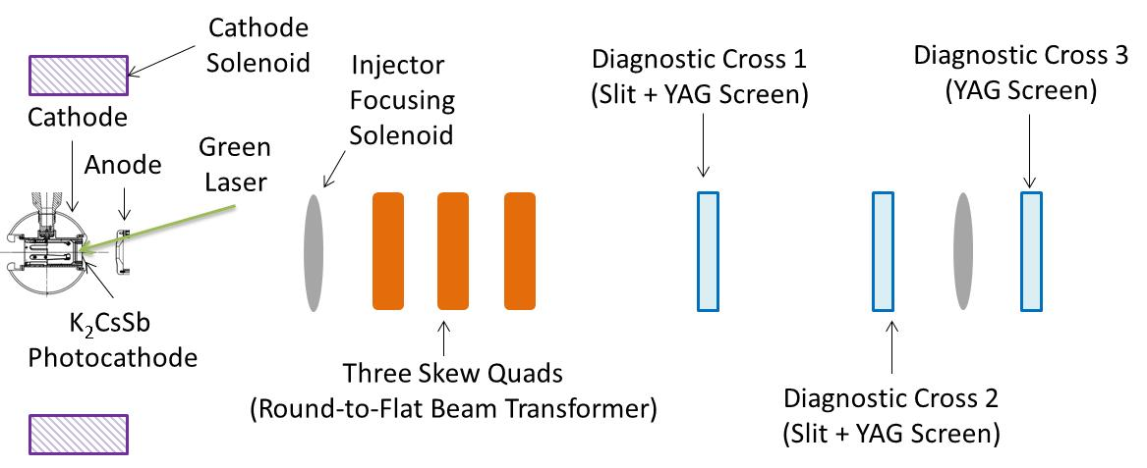
Experimental Overview
Generate magnetized beam:
$a_{0}$ = 1 – 5 mm, B_{z} = 0 – 2 kG
Bunch charge: 1 – 500 pC
Frequency: 15 Hz – 476.3 MHz
Bunch length: 10 – 100 ps
Average beam currents up to 32 mA
Gun high voltage: 200 – 350 kV

Slide 7
Planned Measurements
Measure mechanical angular momentum (magnetization)
Measure photocathode lifetime versus solenoid field at high currents (up to 32 mA) and high voltages (200 – 350 kV) limited by in-house HV supplies
Study beam halo and beam loss versus magnetization
Use skew quads – RTFB Transformer – to generate flat beam and measure horizontal and vertical emittances using slit method
Generate very high currents magnetized beam and study beam transport and RTFB versus electron bunch charge
New supply capable of 200 mA and 300 kV costs about $600,000 (such supplies typically cost $10 per Watt)

Slide 8
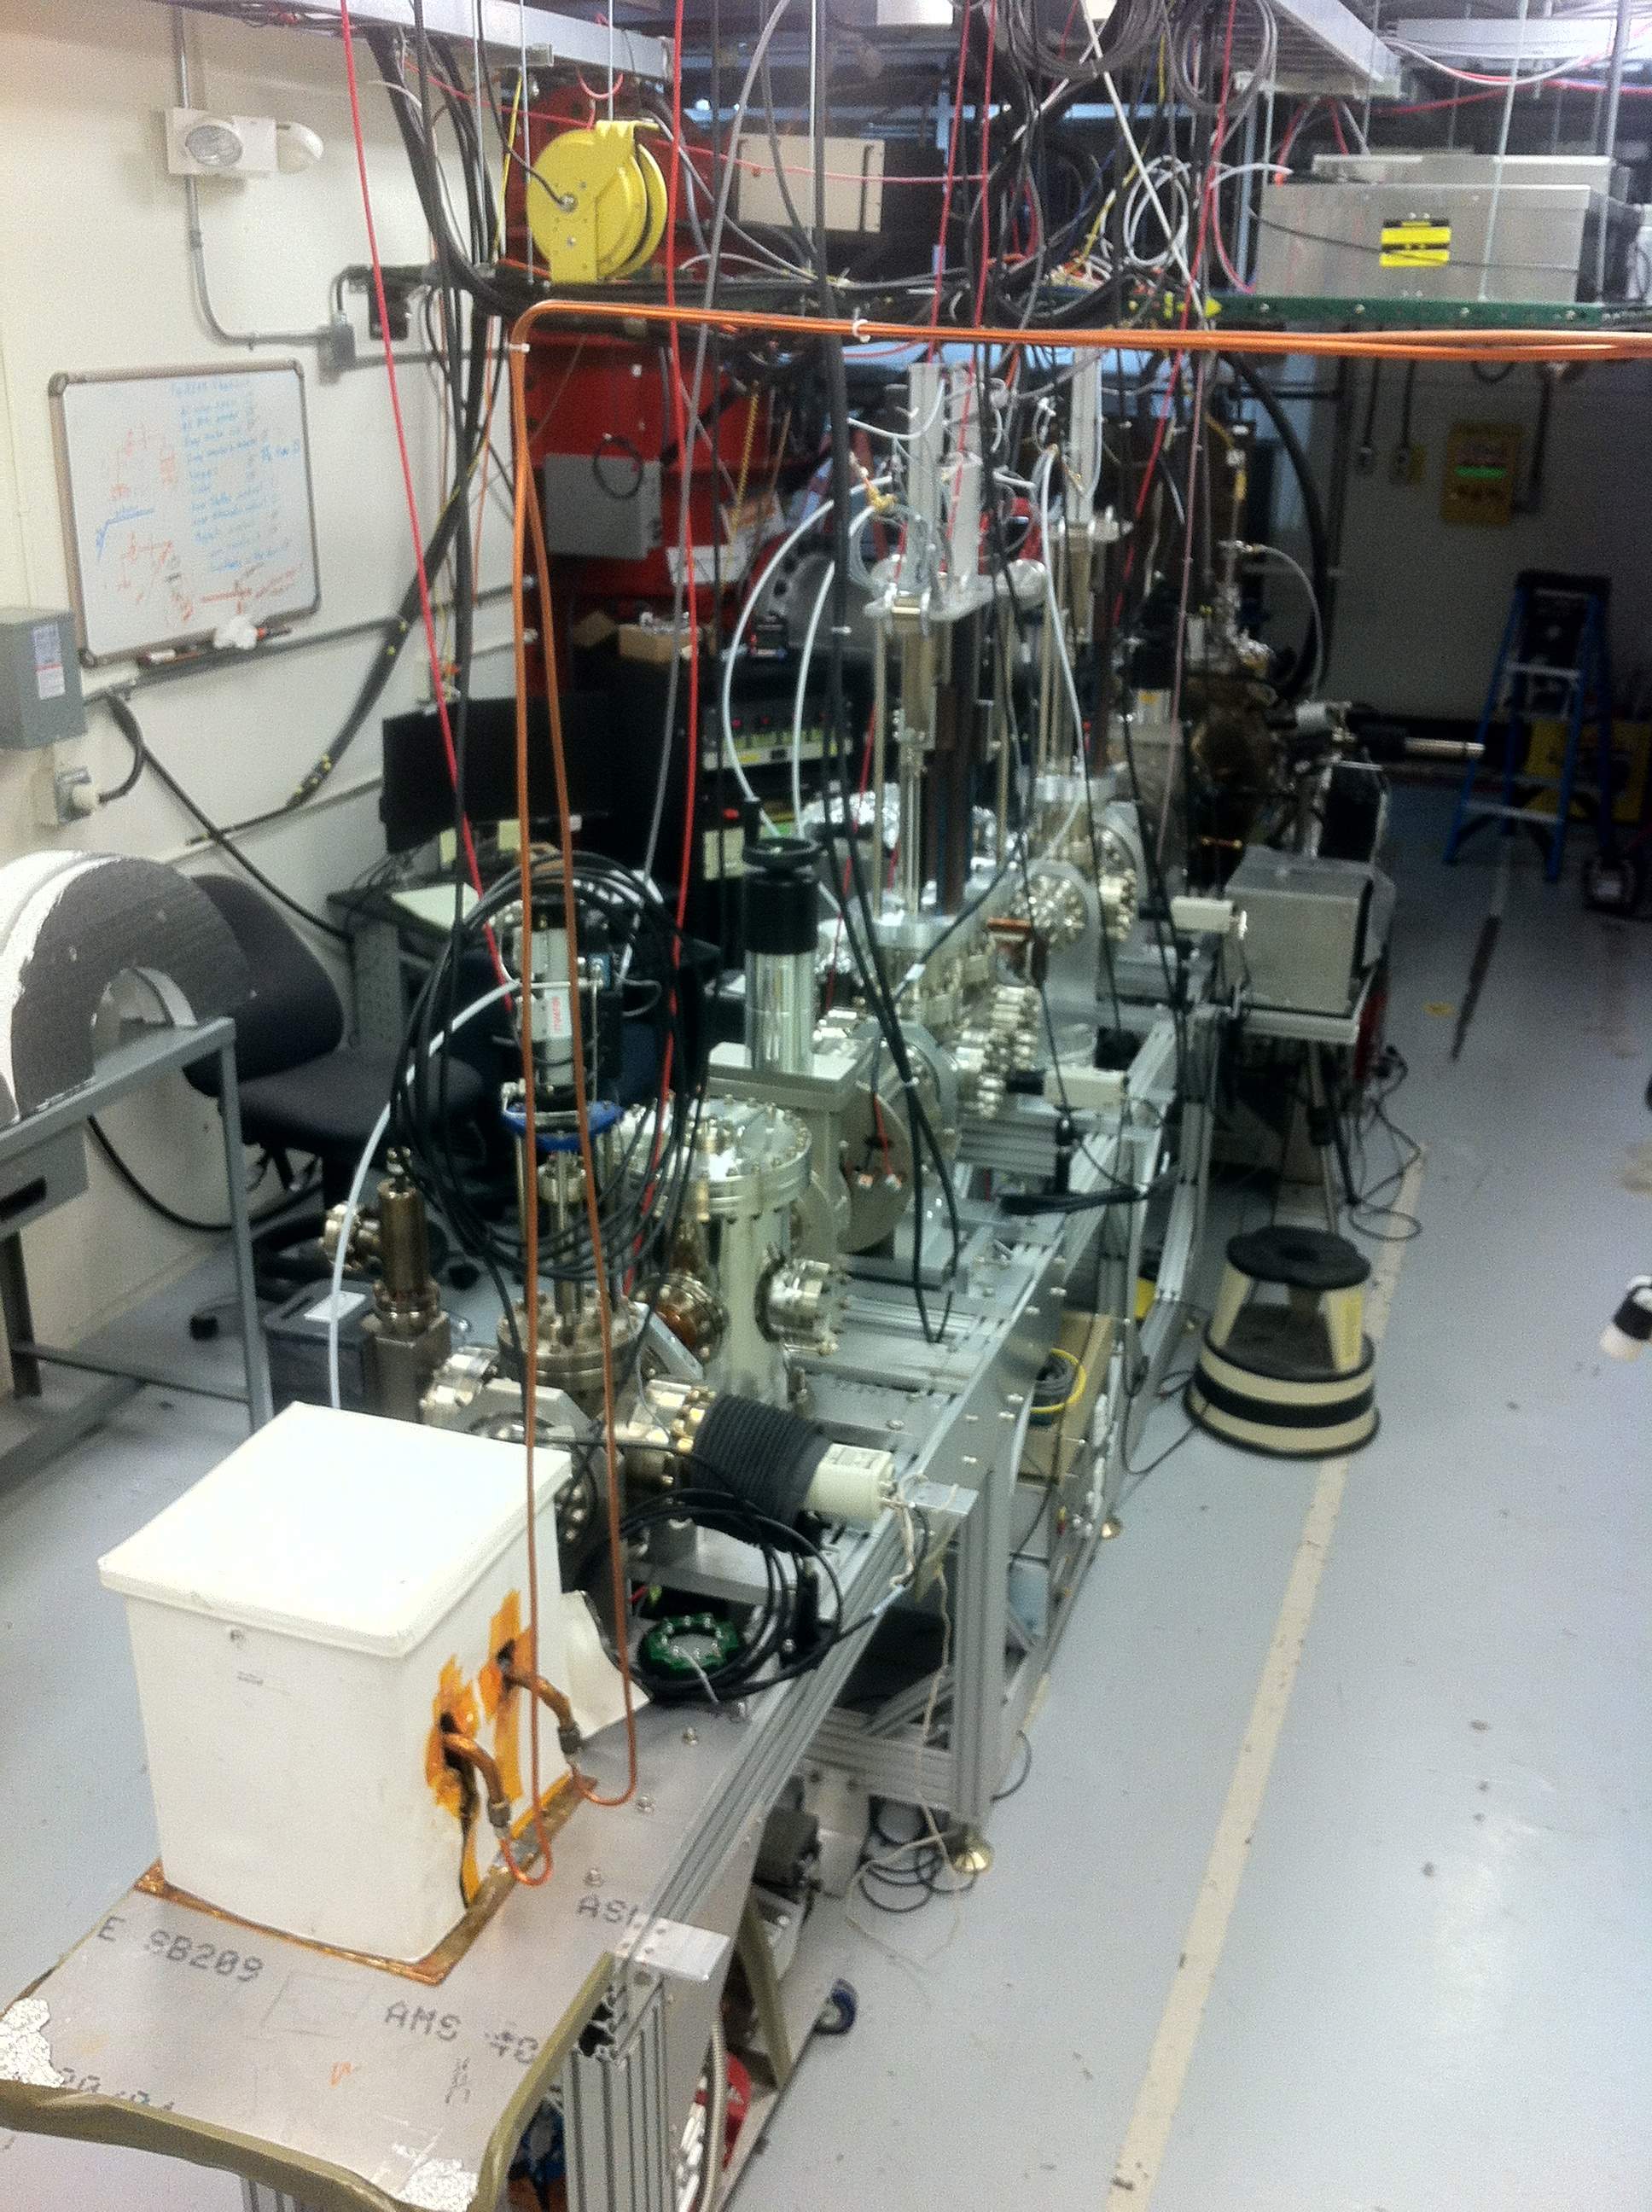
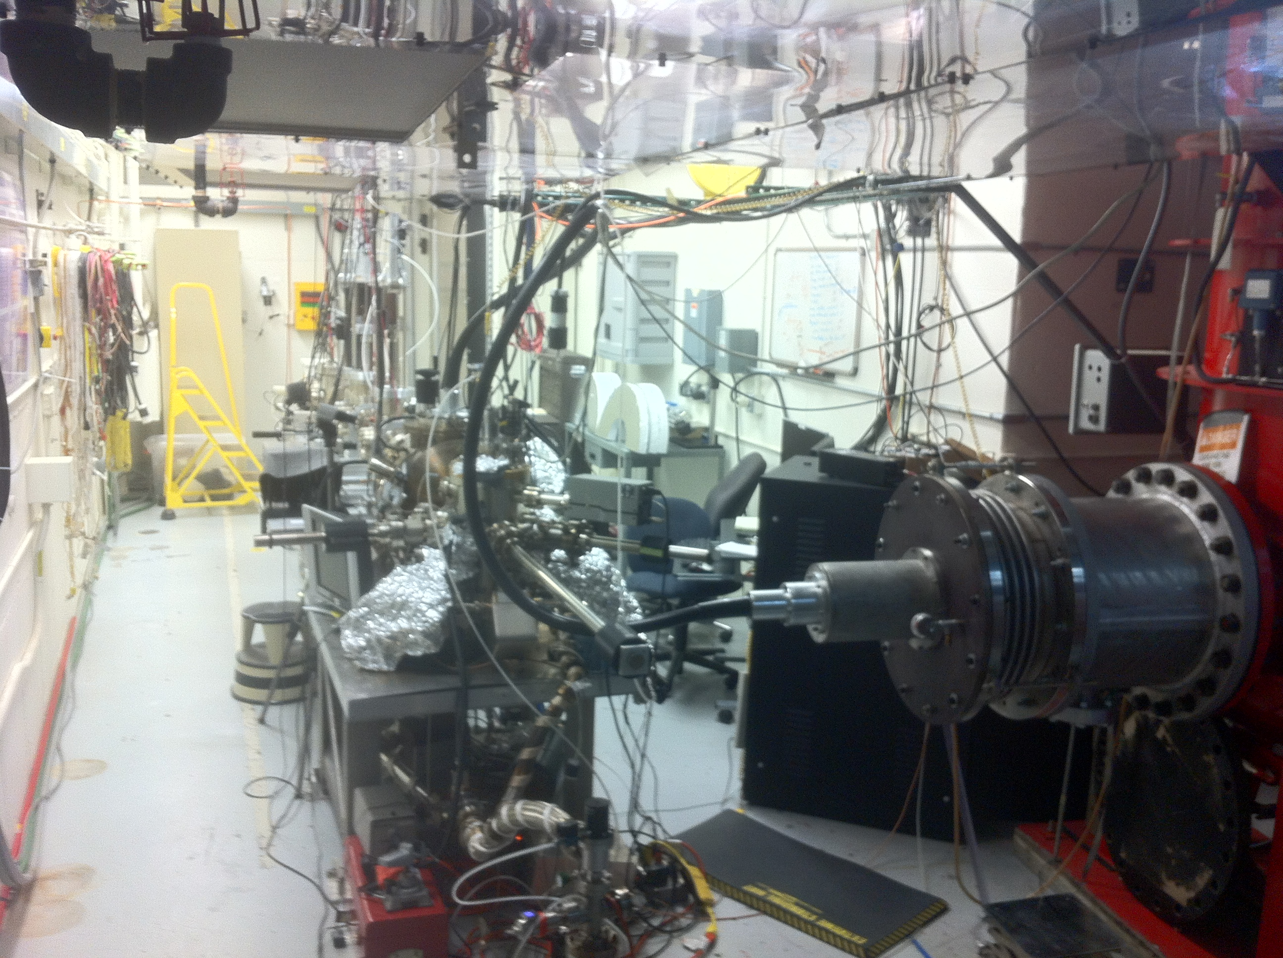
LERF Gun Test Stand

Slide 9
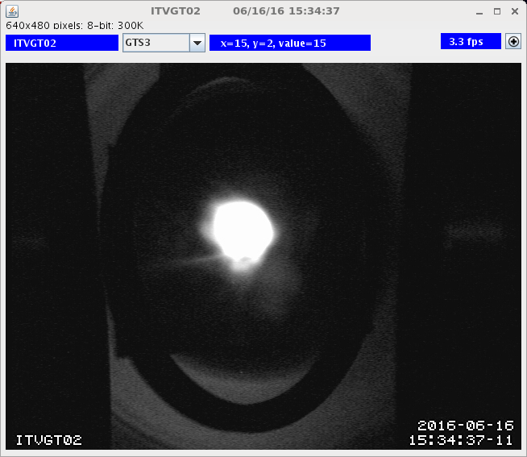
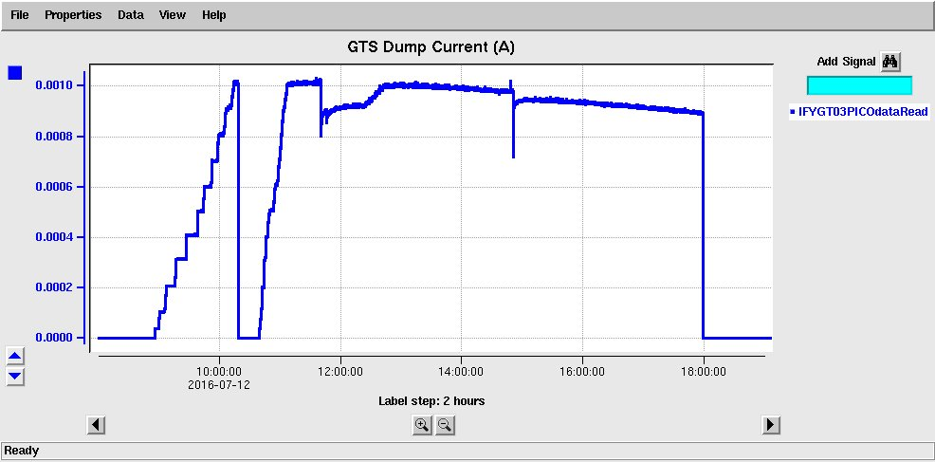
GTS Beam: 1 mA
300 kV
(not magnetized)

Slide 10
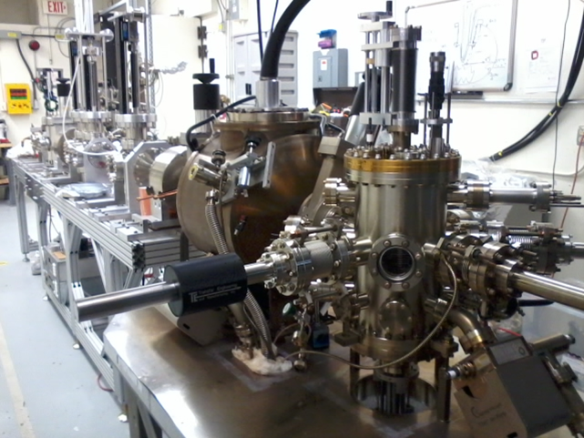
Prior Year Accomplishments
K₂CsSb Photocathode Preparation Chamber, Gun and Beamline: delivered 1 mA to dump
Simulation (Fay Hannon):
Used ASTRA and GPT simulation to design beamline and to locate magnets and diagnostics at optimum positions
Simulated magnetized electron beam properties along beamline for various starting conditions
Simulated a round to flat transformer

Slide 11
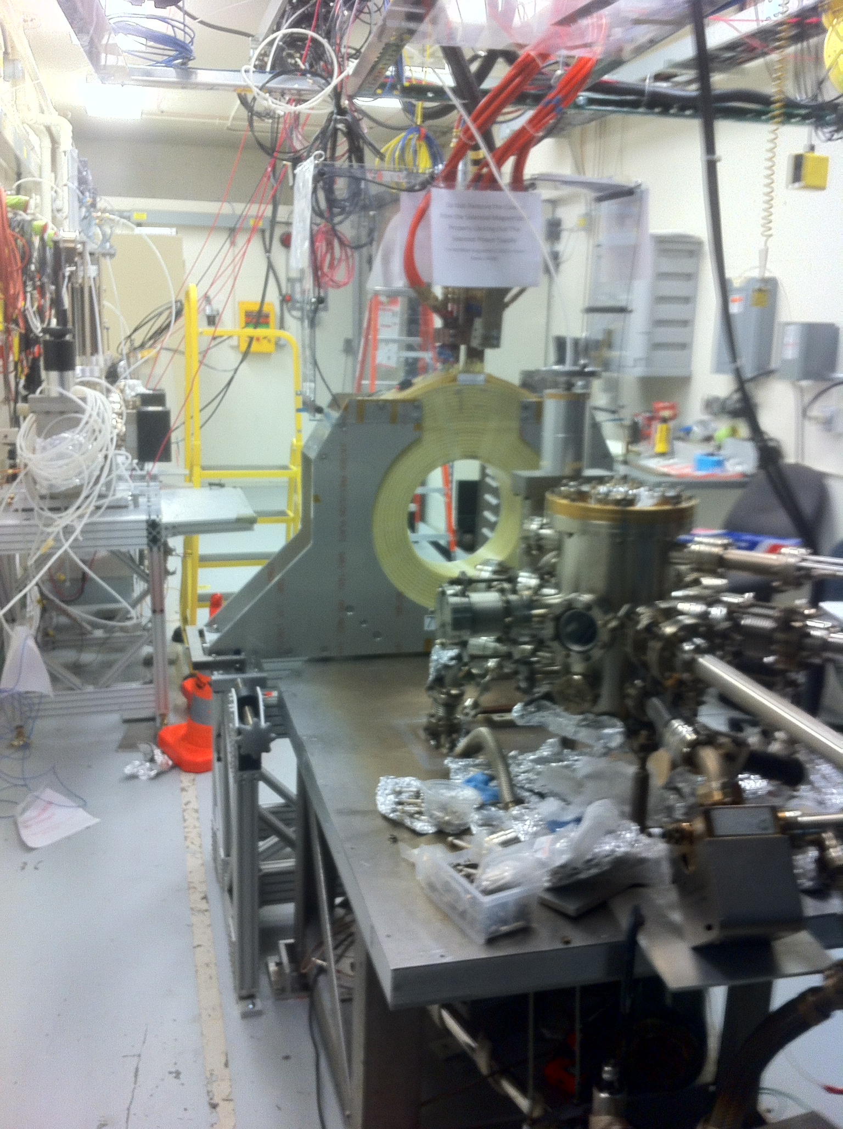
Cathode Solenoid Magnet
Size | 11.811" ID, 27.559" OD, 6.242" Z
Conductor | L=500 m, A=0.53 cm² 16 layers by 20 turns
Coil Weight | 254 kg (560 lbs)
Resistance | 0.183 Ω
Field at Photocathode | 1.4 kG
Voltage | 73 V
Current | 400 A
Mapped and installed at GTS
Cathode Solenoid Power Supply: Use new spare CEBAF Dogleg magnet power supply (500A, 80V)

Slide 12
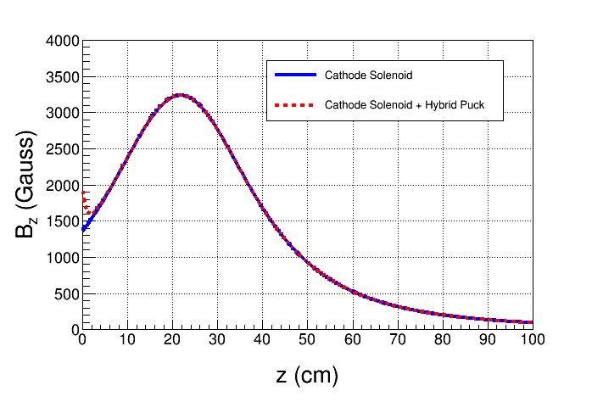
Molybdenum
Steel
Steel
New Steel Pucks
Enhance field to 2.0 kG at cathode. Two types:
Molybdenum and carbon steel hybrid puck
Carbon steel puck

Slide 13
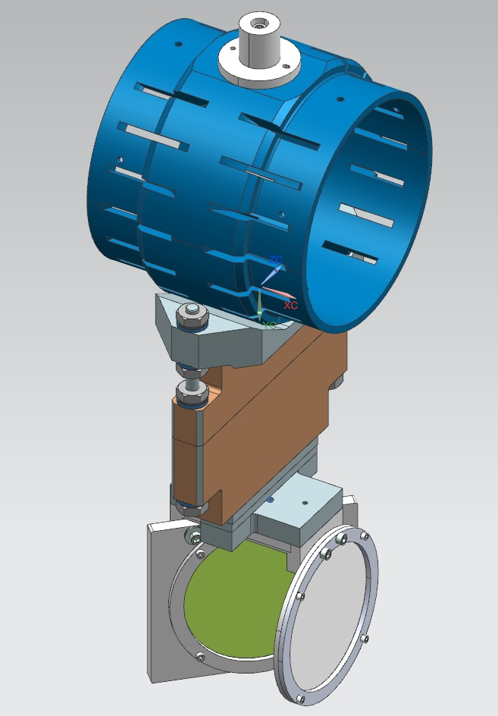
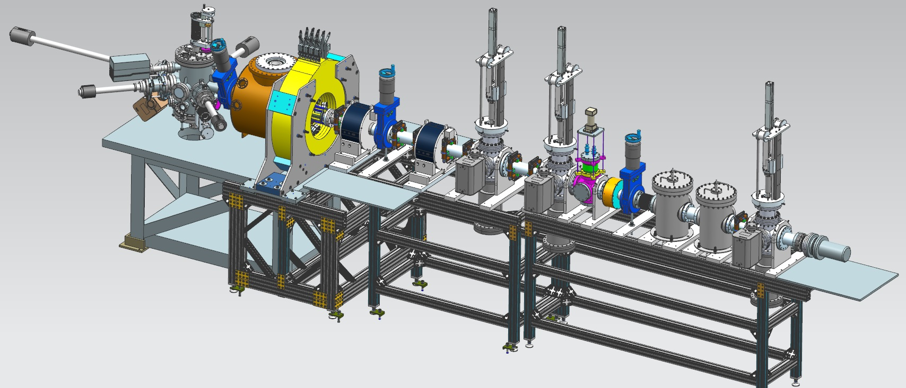
Plans – October 2016
Upgrade Preparation chamber to enable K₂CsSb activation with a mask – limit photocathode active area to reduce beam halo
Load new pucks into Preparation Chamber
Upgrade HV Chamber with new doped ceramic insulator and newly designed HV shed
Upgrade beamline and install slits and a Faraday Cup
Slit
YAG Screen

Slide 14
Budget
FY16 | $339,211
FY17 | $265,850
FY18 | $212,025
Total | $817,086
Materials and Supplies:
Cathode solenoid magnet and pucks
Three skew quadrupoles
Beamline hardware: steering magnets and slits for beam emittance and magnetization measurements
Laser components
Labor:
Cathode magnet design and procurement
Cathode magnet mapping and installation
Relocate new CEBAF spare dogleg power supply (500A/80V) and provide 480VAC and LCW
Mechanical designer for cathode magnet support
Mechanical designer for pucks, slits and beamline
ASTRA and GPT modeling (Fay Hannon)
Postdoc – years 2 and 3
Funded

Slide 15
Milestones

Slide 16
Year 1 Milestones
Q1 (Oct, Nov, Dec):
HV condition gun to 350 kV and build K₂CsSb preparation chamber ☑
Design beamline, locate magnets and diagnostics at optimum positions ☑
Design cathode solenoid magnet ☑
Q2 (Jan, Feb, Mar):
Connect existing beamline to gun and instrument beamline ☑
Procure cathode solenoid magnet ☑
Design and procure slits ☑
Q3 (Apr, May, Jun):
Commission exiting beamline with beam ☑
Measure lifetime at 5 1 mA and 350 300kV (not magnetized) ☑
Relocate new spare CEBAF dogleg power supply to GTS ☑
Q4 (Jul, Aug, Sep):
Install cathode solenoid magnet ☑
Assemble new beamline and commission with beam ☒ October 2017
Design and procure three skew quads ☒ Postponed to year 2

Slide 17
Year 2 Milestones
Q1 (Oct, Nov, Dec):
Generate magnetized beam
Measure mechanical angular momentum vs magnetization and laser size
Benchmark simulation against measurements
Q2 (Jan, Feb, Mar):
Measure mechanical angular momentum vs bunch charge and bunch length
Benchmark simulation against measurements
Q3 (Apr, May, Jun):
Generate very high currents magnetized beam and study beam transport vs electron bunch charge
Q4 (Jul, Aug, Sep):
Measure photocathode lifetime vs magnetization at 5 mA and 350 kV
Study beam halo and beam loss vs magnetization

Slide 18
Year 3 Milestones
Q1 (Oct, Nov, Dec):
Install three skew quads
Generate flat beam with skew quads – RTFB Transformer – and measure horizontal and vertical emittances using slit method
Q2 (Jan, Feb, Mar):
Measure RTFB transformation versus electron bunch charge
Use simulation to quantify how good or complete RTFB transform
Q3 (Apr, May, Jun):
Change to HV Supply of 32 mA and 200 kV
Q4 (Jul, Aug, Sep):
Measure photocathode lifetime vs magnetization at 32 mA and 200 kV
Study beam halo and beam loss vs magnetization

