Slide 1
Electron collider ring Chromaticity Compensation and dynamic aperture
Yuri Nosochkov, Yunhai Cai (SLAC)
Fanglei Lin, Vasiliy Morozov, Guohui Wei (JLab)
Min-Huey Wang
JLEIC Collaboration Meeting Fall 2016 Thomas Jefferson National Accelerator Facility Newport News, VA

Slide 2
Introduction
Strong final focus (FF) quadrupoles near IP, where β-functions are very high, create large non-linear chromatic perturbations (~βKL)
Large momentum tune spread increases exposure to betatron resonances
reduced momentum range, beam dynamic aperture and lifetime
Large momentum variation of β functions causes beam smear at IP
may limit luminosity
Correction strategy
Chromatic sextupoles placed at optimal phase near the FF for a local correction
Special optics (e.g. –I sections) to cancel sextupole non-linear geometric (amplitude dependent) aberrations for maximum dynamic aperture
Minimal impact on beam emittance
Previously studied
Correction schemes based on the arc cell configuration
preserves ring geometry
Adequate chromaticity compensation and dynamic aperture
Contribution to emittance is not small
New study
Correction schemes for lower emittance
Using electron ring design with 108° arc FODO cells

Slide 3
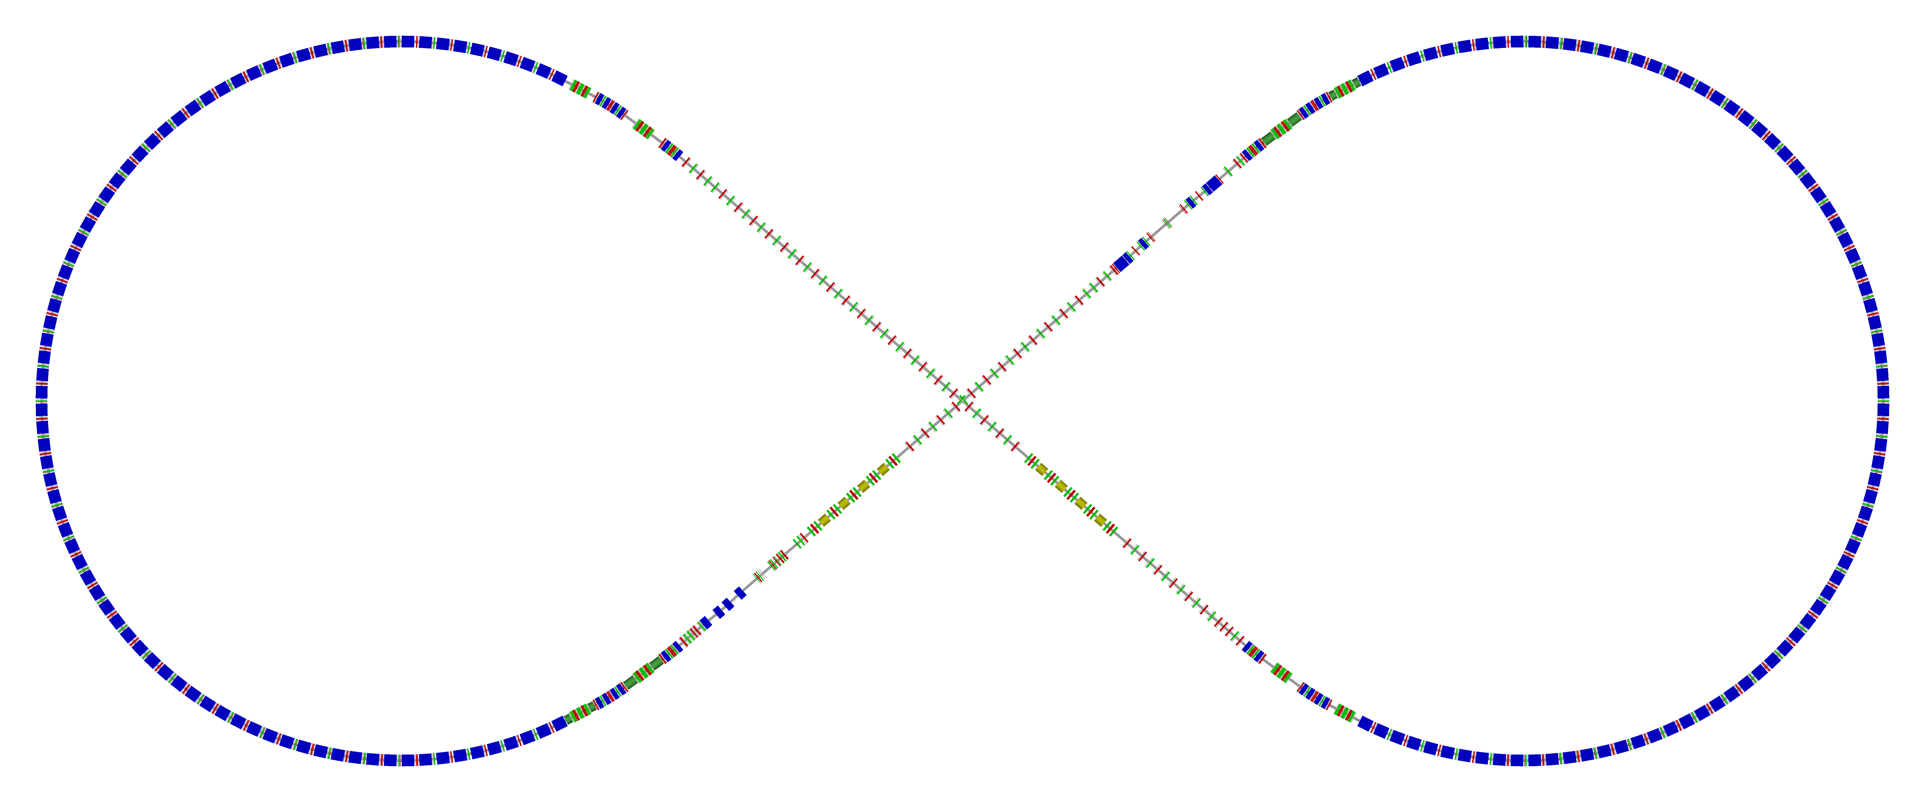
Chromatic sextupoles in electron ring
Two dedicated chromaticity correction blocks (CCB) replace several arc cells nearest to the FF on either side of IP for local FF chromaticity correction
Two-family arc sextupoles arranged in groups of multiple of 10 cells (unit matrix) to cancel the remaining linear chromaticity while compensating sextupole geometric effects in 108° arc FODO cells
CCB
Spin rotator
Spin rotator
Original CCB
Tune trombone & Straight FODOs
R=155m
Arc sextupoles
e⁻
81.7°
Arc sextupoles
Arc, 261.7°
Future 2nd IP
RF
RF
Spin rotator
IP
Spin rotator
CCB
Forward e⁻ detection

Slide 4
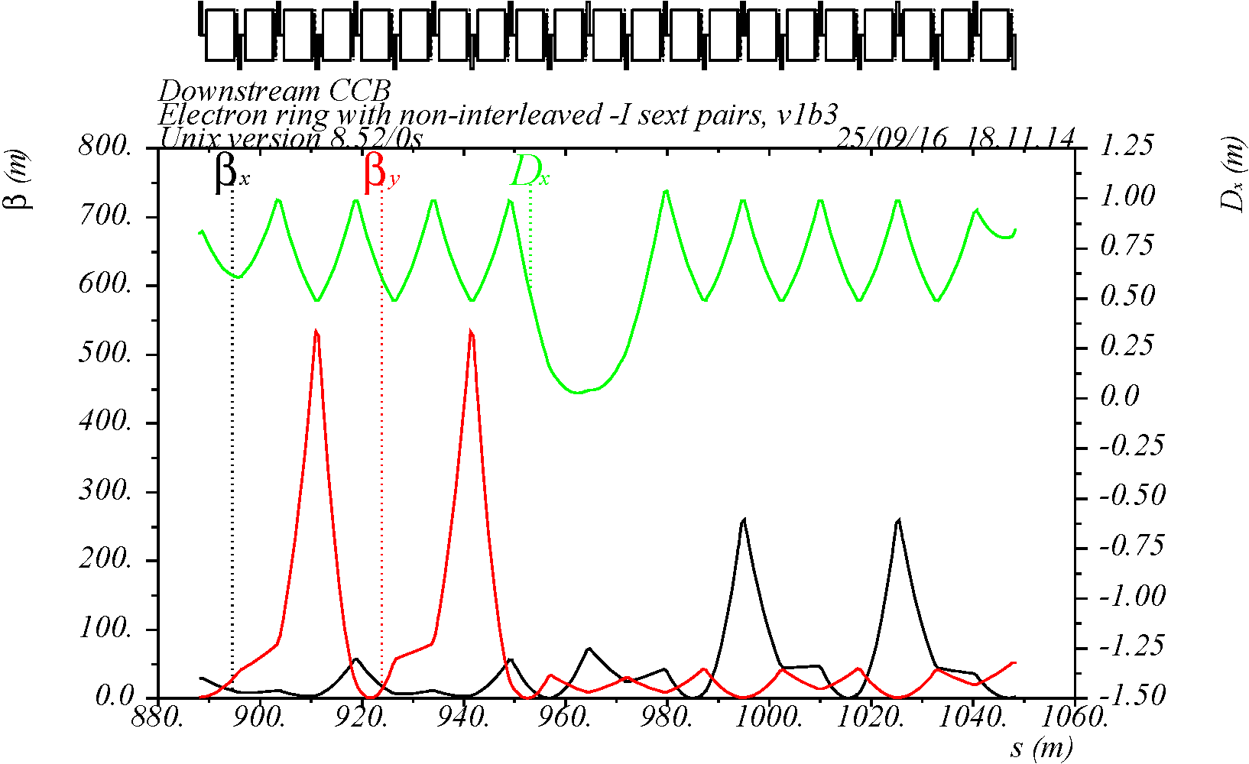
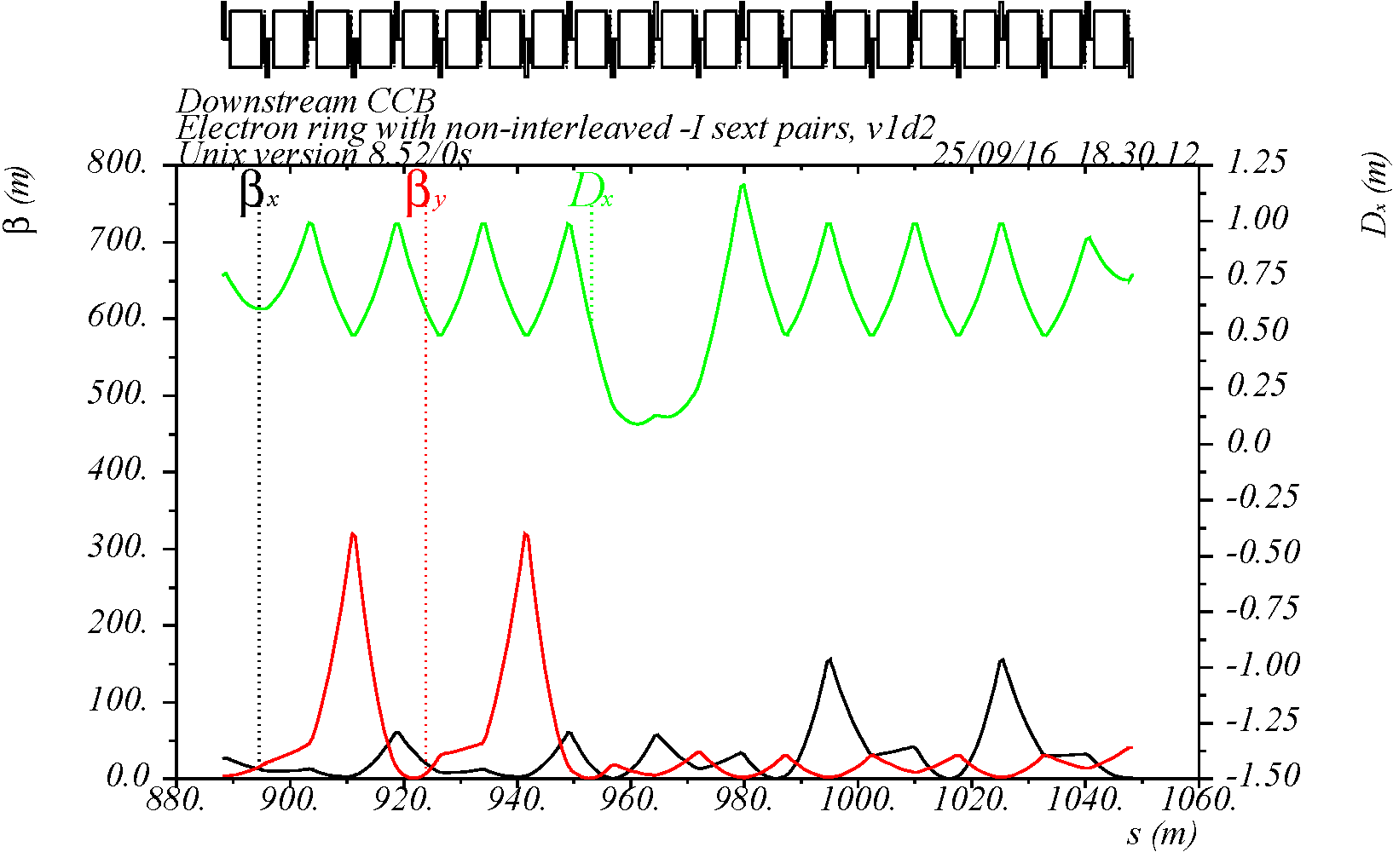
Previously studied schemes
Several schemes: 1) original compact CCB with interleaved X & Y sextupoles, 2) non-interleaved –I sextupole pairs, 3) interleaved –I pairs, 4) no CCB
Based on arc cell configuration with the same dipoles → preserves geometry
Scheme with non-interleaved –I pairs provides a better performance
Adequate chromaticity compensation and reasonable dynamic aperture
But emittance increases from 8.9 nm (w/o CCB) to >15-20 nm at 5 GeV
ε_{x} = 19.4 nm with CCB β = 250/500 m
ε_{x} = 15.5 nm with 40% lower β
SY
SY
-I
-I
SX
SX
Scheme A
Scheme B

Slide 5
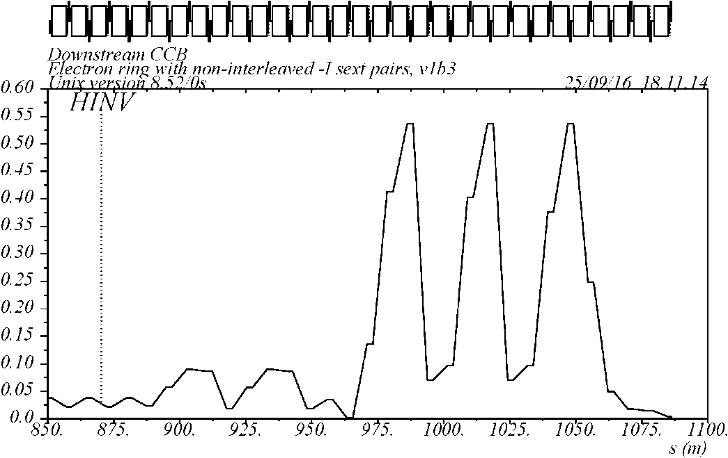
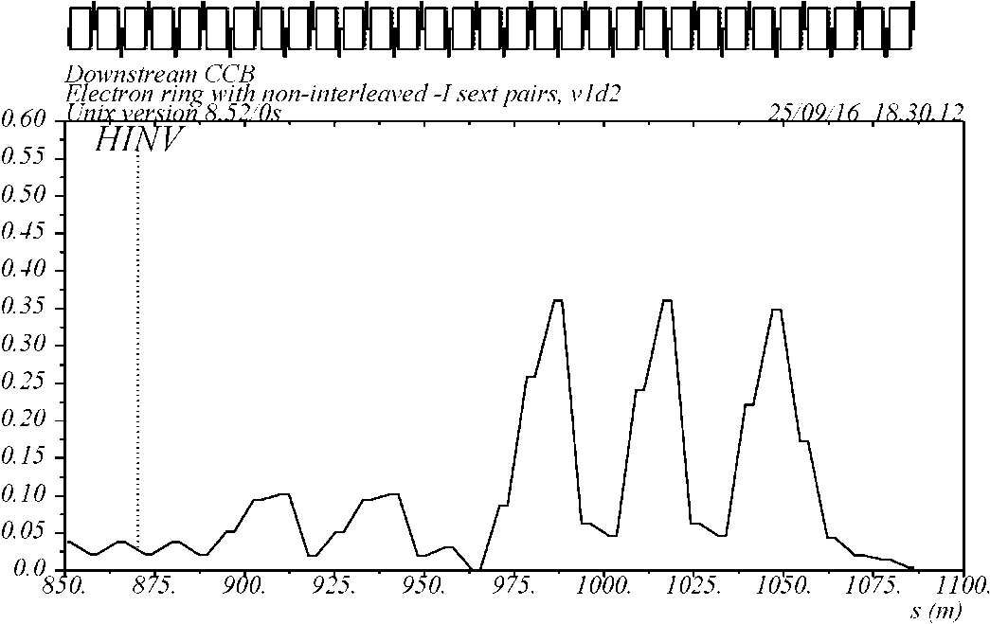
Emittance
→ Preservation of low emittance requires small CCB bending angles θ_{b} and small H-function (i.e. β_{x}, η_{x}) at the CCB dipoles
But CCB sextupoles require high dispersion and β functions → large H-function at dipoles leads to large contribution to emittance
H-function in scheme-A
H-function in scheme-B with 40% lower β
ε_{x} = 19.4 nm
ε_{x} = 15.5 nm
arc
arc

Slide 6
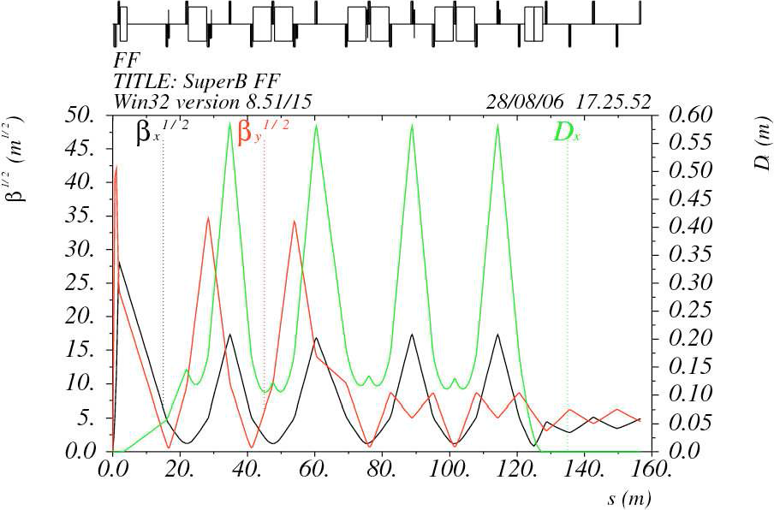
SuperB type sextupole scheme
Remove dipoles from cells with high dispersion and β_{x}
Low H-function at the remaining dipoles if angle per dipole is not changed
If the total CCB angle is kept the same as in the arc cells, then the dipole angle θ_{b} would increase a factor of 2 (to compensate for missing dipoles) increasing dispersion and the H-function
A compromise is needed between the emittance, the CCB bending angles and ring geometry
SuperB IR
SY
SY
SX
SX

Slide 7
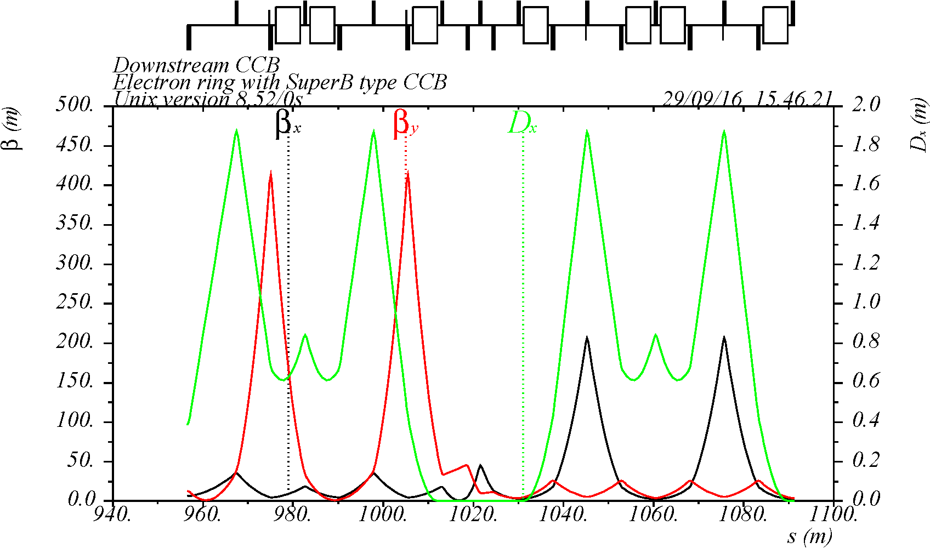
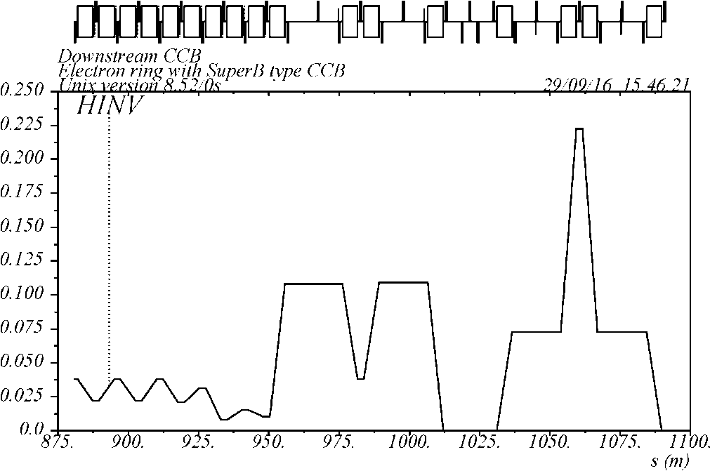
Scheme-2
Two non-interleaved –I sextupole pairs per CCB with large β = 200 / 400 m at the sextupoles and nπ phase advance from the FF
Seven regular length CCB dipoles (L_{b} = L_{b0} as in arc cells)
Increased angle per CCB dipole θ_{b} = 2.286 θ_{b0} (B = 2.286 B₀) relative to the arc dipole → to preserve the total bending angle
A larger CCB H-function compared to the arc due to strong dipoles
ε_{x} = 22.8 nm at 5 GeV (MAD8 calculation) → too large compared to 8.9 nm without CCB → need to reduce the bending angle per dipole
-I
match
-I
SY
SY
SX
SX
H-function
arc

Slide 8
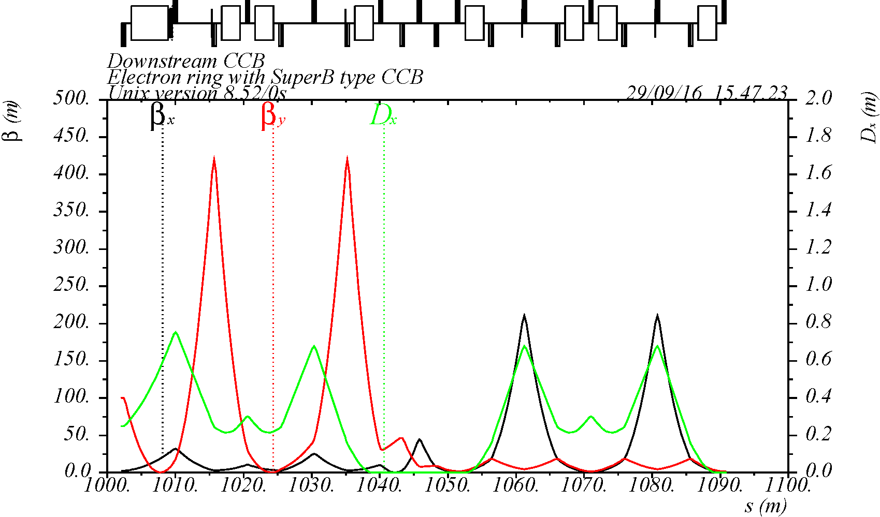
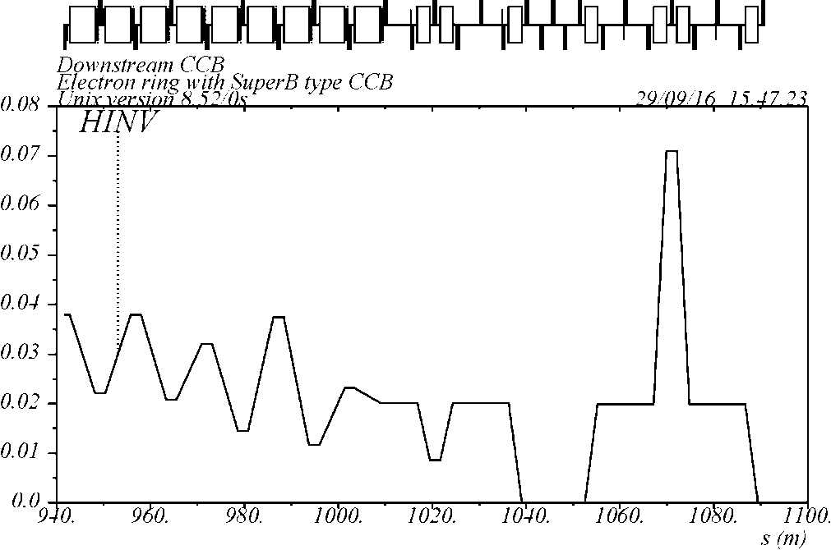
Scheme-4
Seven short half-length dipoles (L_{b} = 0.5 L_{b0}) plus one regular arc dipole
Shorter CCB with a smaller angle per dipole θ_{b} = 1.286 θ_{b0} relative to scheme-2 (still a strong field B = 2.572 B₀) → same total bending angle as in the arc
Factor of 3 smaller dispersion and H-function relative to scheme-2
nπ phase advance from FF to CCB sextupoles and β = 200 / 400 m at CCB x/y sextupoles
ε_{x} = 10.3 nm at 5 GeV → a factor of 2 reduction compared to scheme-2
Scheme-4 optics
H-function
arc

Slide 9
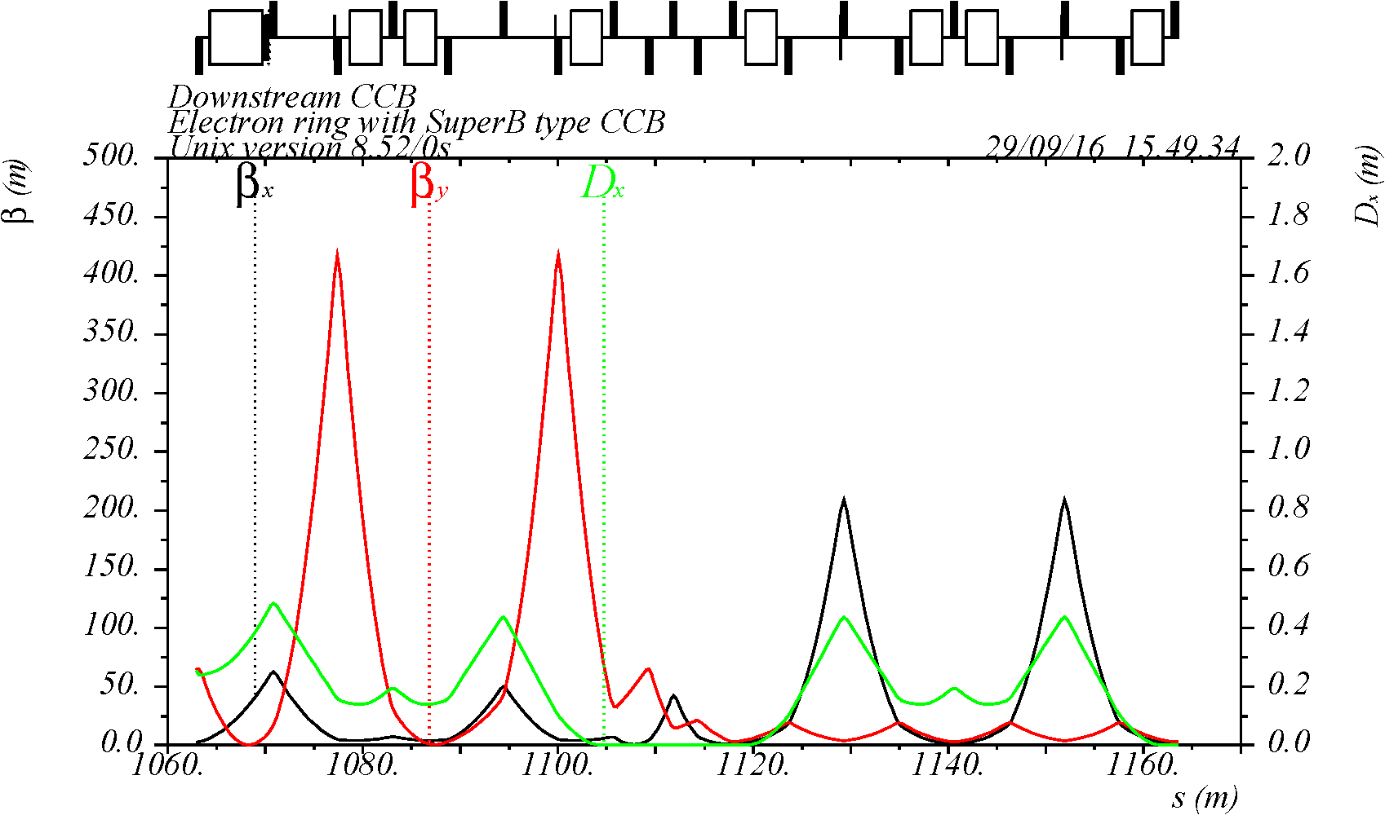
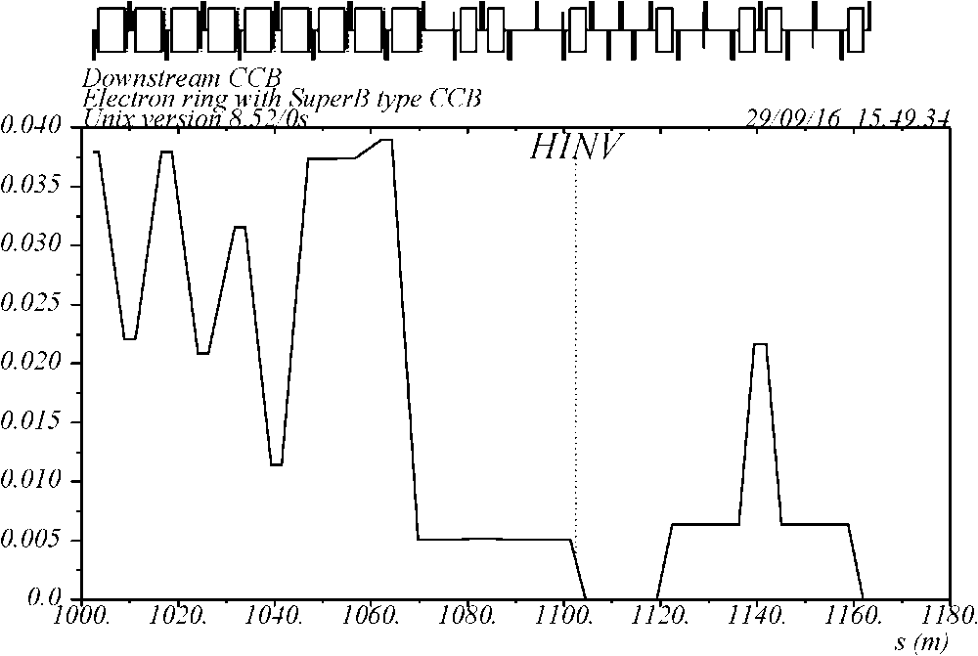
Scheme-6
Seven short dipoles (L_{b} = 0.592 L_{b0}) plus one regular arc dipole
Smaller angle per dipole θ_{b} = 0.714 θ_{b0} (B = 1.206 B₀) compared to scheme-4 → very small dispersion and H-function → smaller bending angle compared to the arc → affects ring geometry
Make similar angle reduction on the other side of arc (for symmetry) and add 4 regular cells in each arc to restore the total arc angle → longer circumference
β = 200 / 400 m at CCB x/y sextupoles
Optimized phase advance (nπ + Δμ) between FF and CCB sextupoles
ε_{x} = 8.3 nm at 5 GeV → smaller than without CCB
Scheme-6 optics
H-function

Slide 10
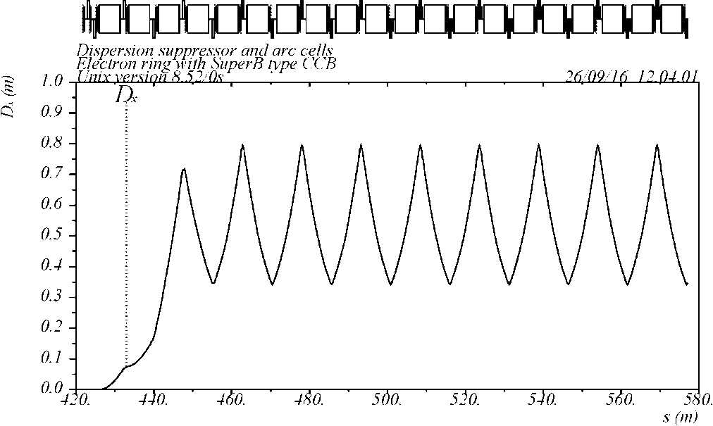
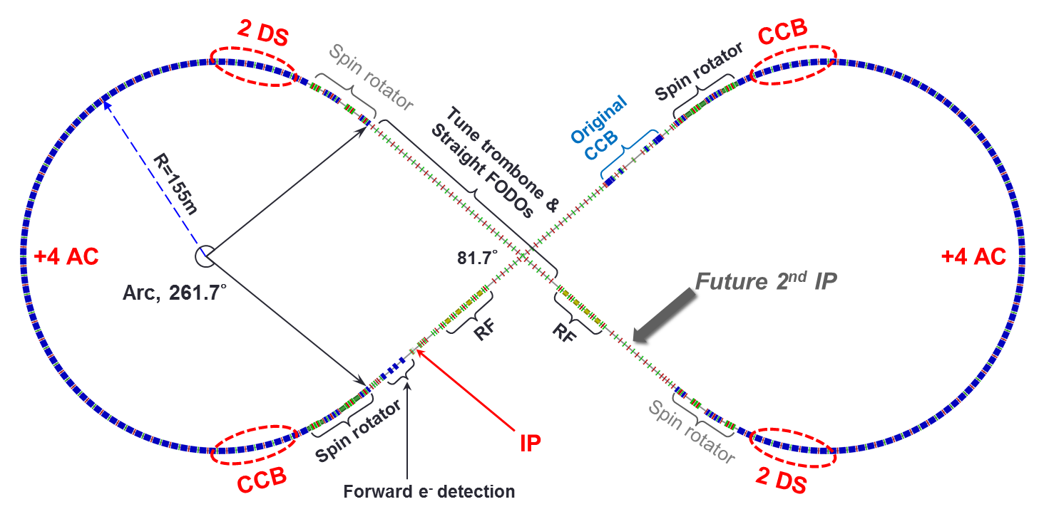
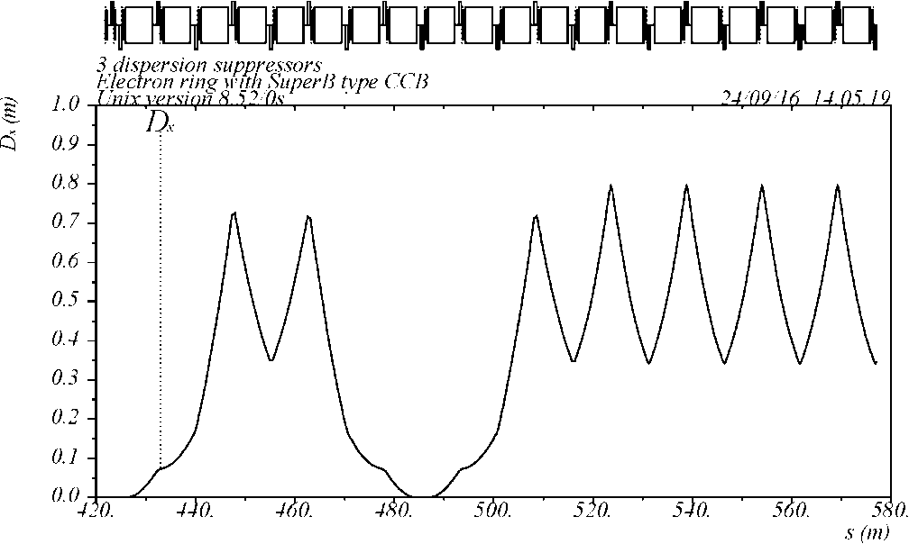
Arc adjustment in scheme-6
Original end of arc: DS + 4 arc cells
Scheme-6 CCB has a smaller bending angle than in the original arc optics → this makes arc asymmetric
To minimize asymmetry, a similar angle reduction is made at the other arc end by replacing 4 regular arc cells with 2 dispersion suppressors (with half-angle) which are optically already matched
To restore the full arc angle, 4 regular cells are added to each arc
→ ~140m longer circumference
DS
2 AC
2 AC
Arc Cells
Modified: 3 dispersion suppressors
DS
-DS
DS
Arc Cells

Slide 11
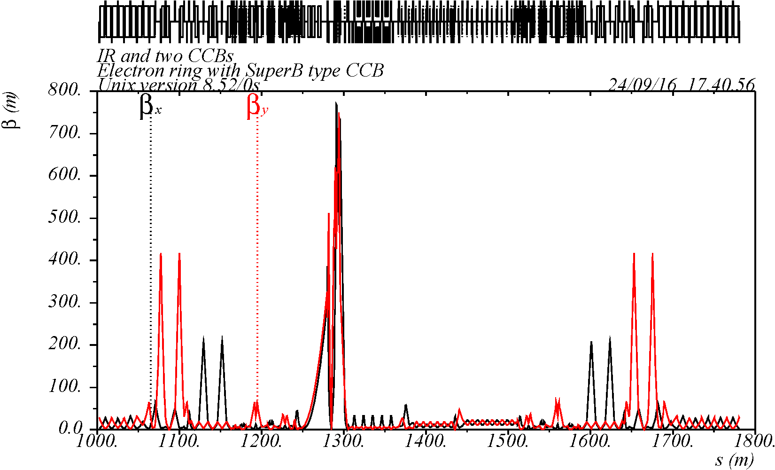
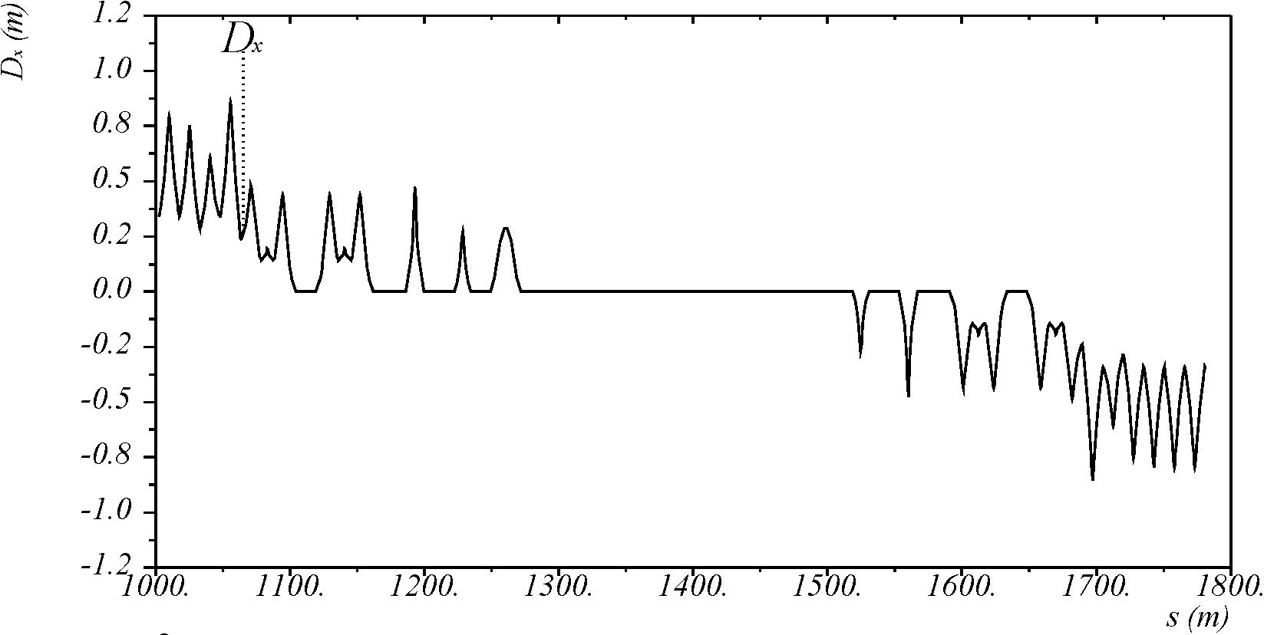
IR optics with two CCBs (scheme-6)
CCB
FF
FF
CCB
μ_{y}=9π
μ_{y}=18π
μ_{x}=7π
μ_{x}=13π

Slide 12
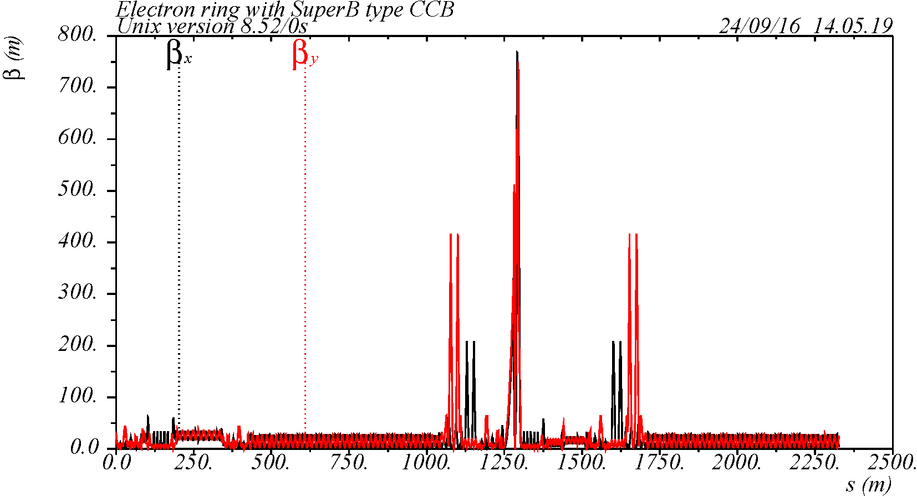
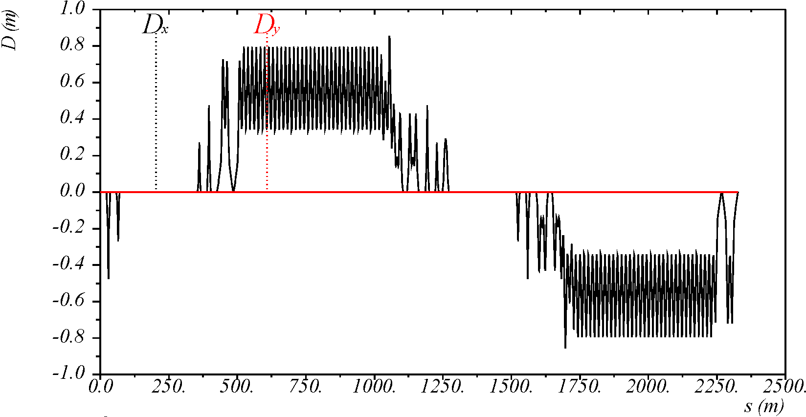
Complete electron ring optics (scheme-6)
CCB
CCB
arc
arc
IP
* Ring geometry is not yet matched

Slide 13
Schemes summary
Scheme | No CCB | 1 | 2 | 3 | 4 | 6
ε_{x} (nm) @ 5 GeV | 8.9 | 29.3 | 22.8 | 12.2 | 10.3 | 8.3
θ_{b} / θ_{b0} | 1 | 2.286 | 2.286 | 1.429 | 1.286 | 0.714
L_{b} / L_{b0} | 1 | 1 | 1 | 0.5 | 0.5 | 0.592
β at CCB sext, x/y | --- | 300 / 600 | 200 / 400 | 200 / 400 | 200 / 400 | 200 / 400
K₂L_{max} (m⁻²) CCB | 0 | 0.78 | 1.04 | 3.06 | 3.44 | 3.53
K₂L_{max} (m⁻²) arcs | 3.09 | 2.94 | 2.84 | 1.87 | 1.90 | 2.53
Natural ξ, x/y | -113 / -120 | -129 / -147 | -123 / -136 | -132 / -155 | -132 / -156 | -135 / -152
Tune, x/y | 44.22 /47.16 | 44.22 /45.16 | 44.22 /45.16 | 45.22 /47.16 | 46.22 /47.16 | 48.22 /50.16
C (m) | 2185.5 | 2182.8 | 2182.4 | 2181.7 | 2181.7 | 2327.2
Comment | 60x2 arc sextupoles | Thin trombones for match, 40x2 arc sextupoles | Thin trombones for match, 40x2 arc sextupoles | Thin trombones for match, 60x2 arc sextupoles | Thin trombones, for match, 60x2 arc sextupoles | No trombones, longer arc, 60x2 arc sextupoles
* Ring geometry is not yet matched in these CCB schemes

Slide 14
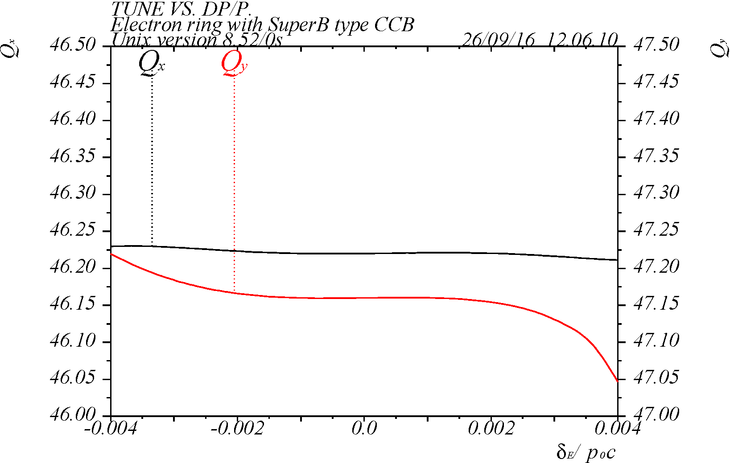
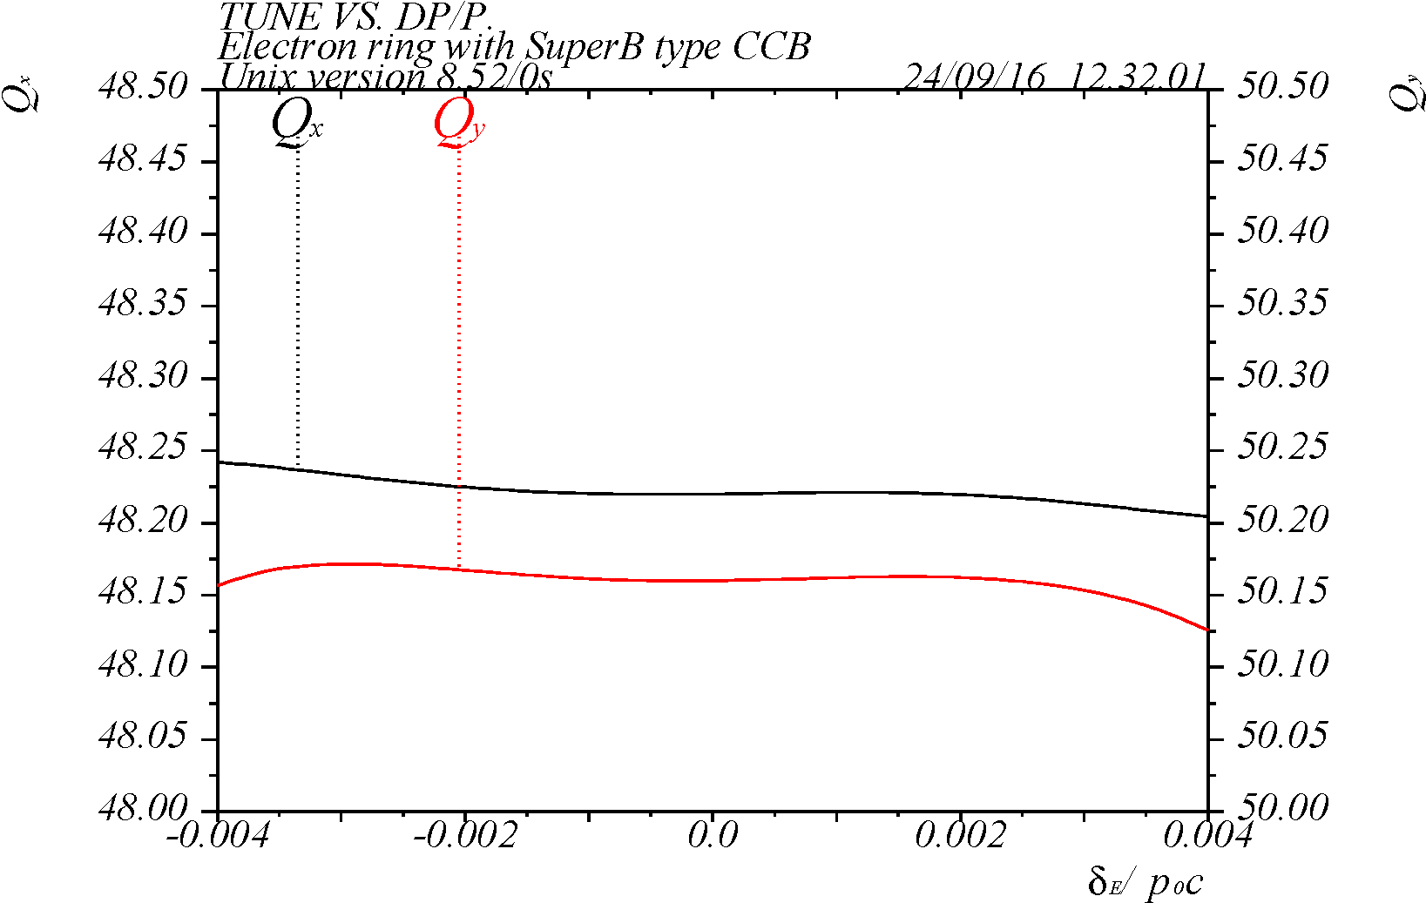
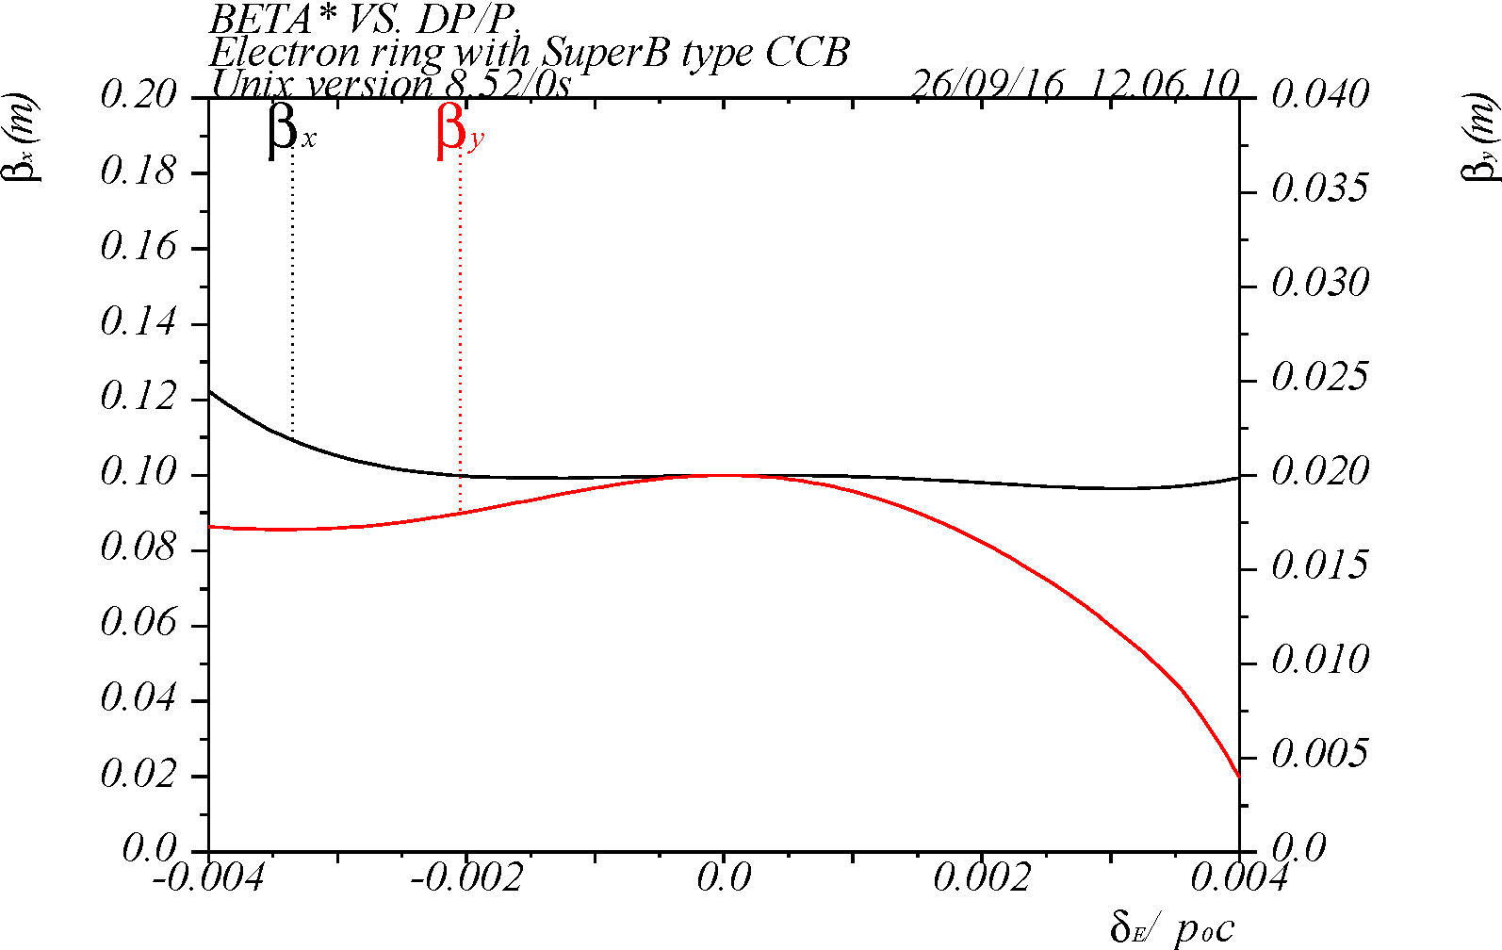
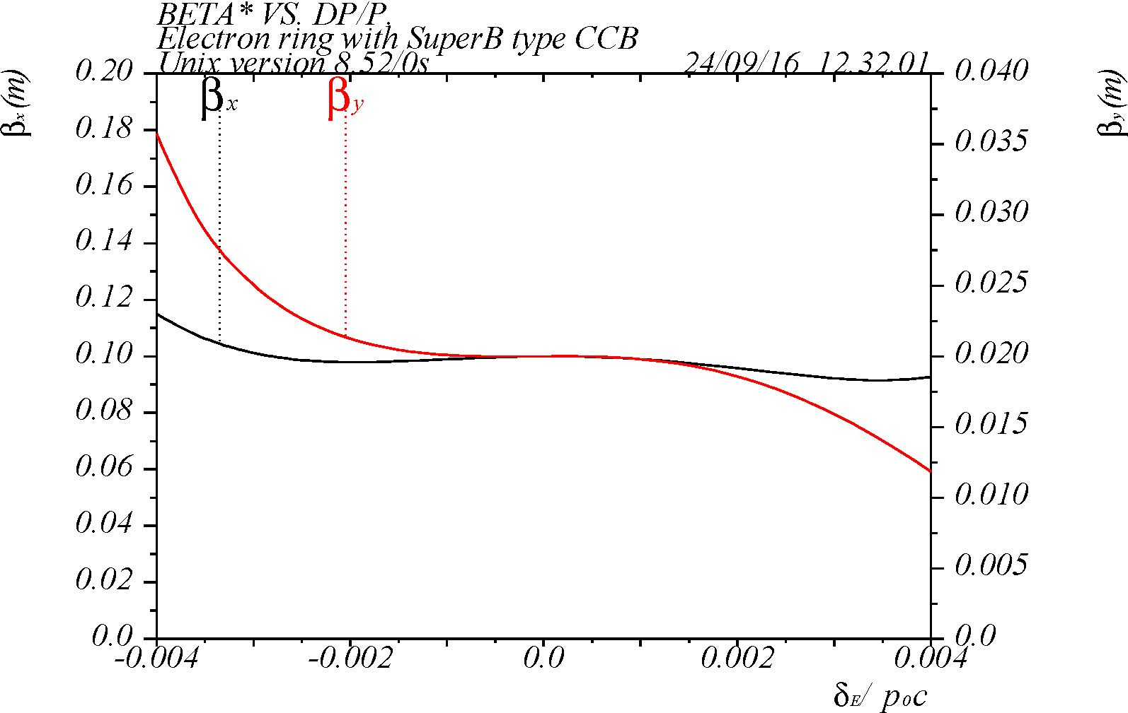
Chromaticity correction performance
Momentum range ~10σ_{p} with optimization of CCB-to-FF phase advance
Scheme-4, ε_{x} = 10.3 nm
with exact nπ CCB-to-FF phase
Scheme-6, ε_{x} = 8.3 nm
with phase adjustment

Slide 15
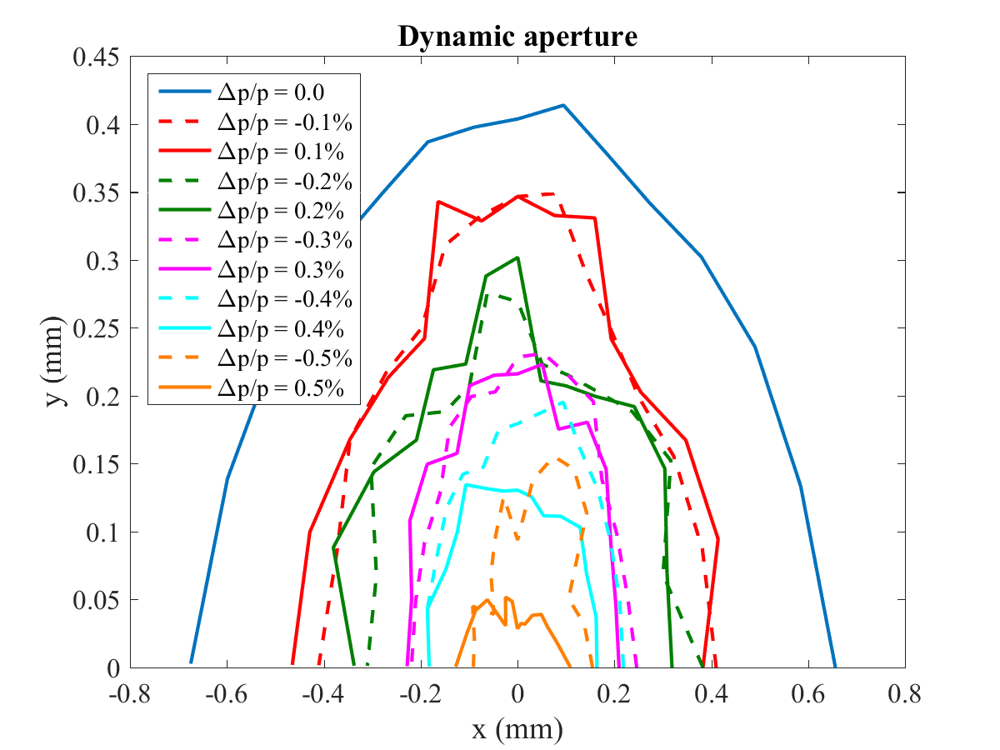
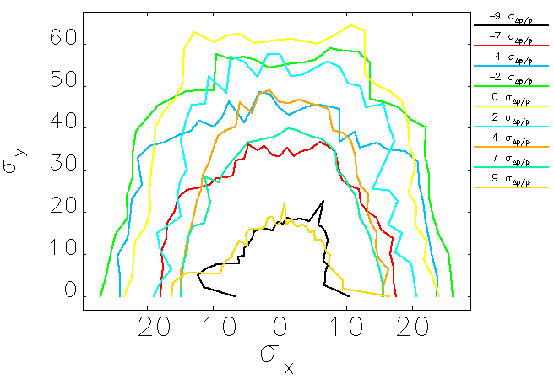
Dynamic aperture
Comparable chromaticity correction performance in studied CCB schemes
Adequate dynamic aperture and momentum range
No magnet errors yet included
Scheme-3, ε_{x} = 12.2 nm
Scheme-6, ε_{x} = 8.3 nm
(should be similar to scheme-4, ε_{x} = 10.3 nm)
Elegant
LEGO
72σ_{y}
±23σ_{x}
Δp/p from 0 to ±9σ_{p}
Δp/p from 0 to ±11σ_{p}

Slide 16
Summary & conclusions
Low emittance schemes for FF chromaticity correction have been studied, based on SuperB IR design, using non-interleaved –I sextupole pairs
A low emittance is achieved using shorter CCB with smaller bending angles (still comparable to arc dipole angles)
Chromaticity compensation is adequate providing momentum range of ~10σ_{p}, with optimization of CCB-to-FF phase advance
A sufficient dynamic aperture of >20σ is achieved without magnet errors
Different positions of the CCB dipoles, as compared to the arc, result in some geometry mismatch which was not fixed in this study
The lowest emittance scheme required ~140 m longer ring due to smaller CCB bending angle than in the arc
Next steps:
Match ring geometry
Select CCB scheme
Study dynamic aperture with magnet errors

Slide 17
Thank you for your attention!

