Slide 1

Ion Collider Ring Chromatic Compensation and Dynamic Aperture
G.H. Wei, V.S. Morozov, Fanglei Lin
Y. Nosochkov (SLAC), M-H. Wang
JLEIC Collaboration Meeting Fall 2016

Slide 2
Outline
IR (Interaction Region) requirement and challenges
Study on these challenges
especially on chromatic issue and dynamic aperture
Summary

Slide 3
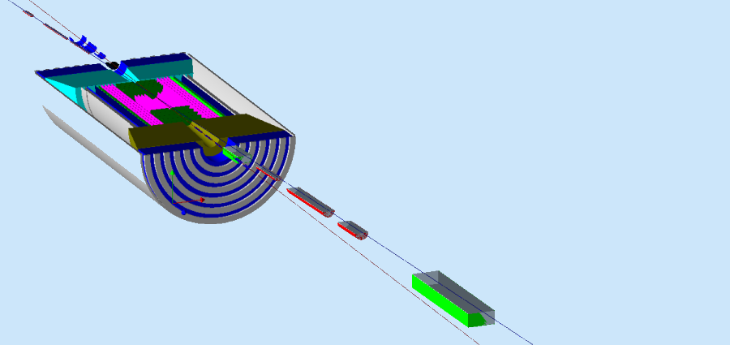
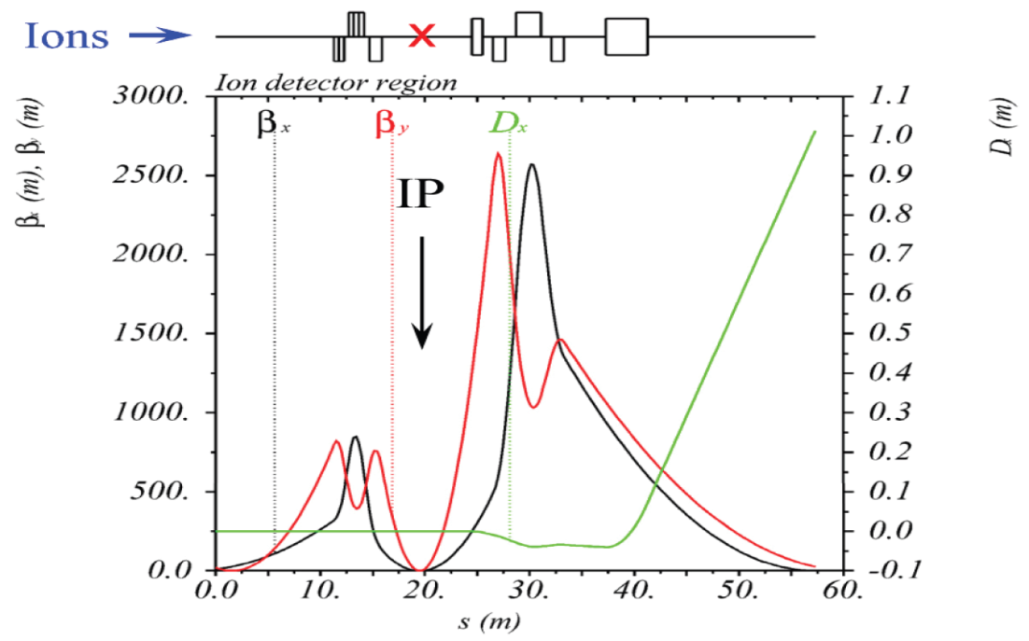
IR requirement and challenges
Neutrals detected in a 25 mrad (total) cone down to zero degrees
Recoil baryon acceptance:
  up to 99.5% of beam energy for all angles
  down to at least 2-3 mrad for all momenta
  full acceptance for x > 0.005
Challenges:
  Chromaticity issue
  Detector solenoid issue
  Misalignment issue
  Magnet multipole field
  Beta squeeze
  Ground Motion

Slide 4


Chromaticity Issues
FF quads with large beta functions (β_{q}) make a strong chromatic kick to the β-function in δ=Δp/p.
3 main problems:
beam smear at IP due to momentum dependence of β*
Large tune footprint due to momentum dependence of betatron tune and therefore exposure to resonances
Limited dynamic aperture due to nonlinear effects
A common solution:
sext
Δβ/β (δ)
FF
FF
sext
IP
$$\frac{∆β}{β} \sim −β_{s}{η_{s}K}_{2}lδ$$
$$\frac{∆β}{β} \sim β_{q}K_{1}lδ$$
μ = nπ

Slide 5
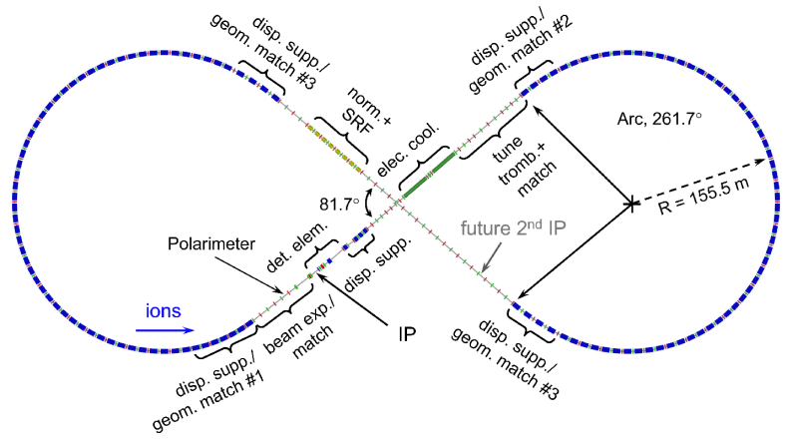
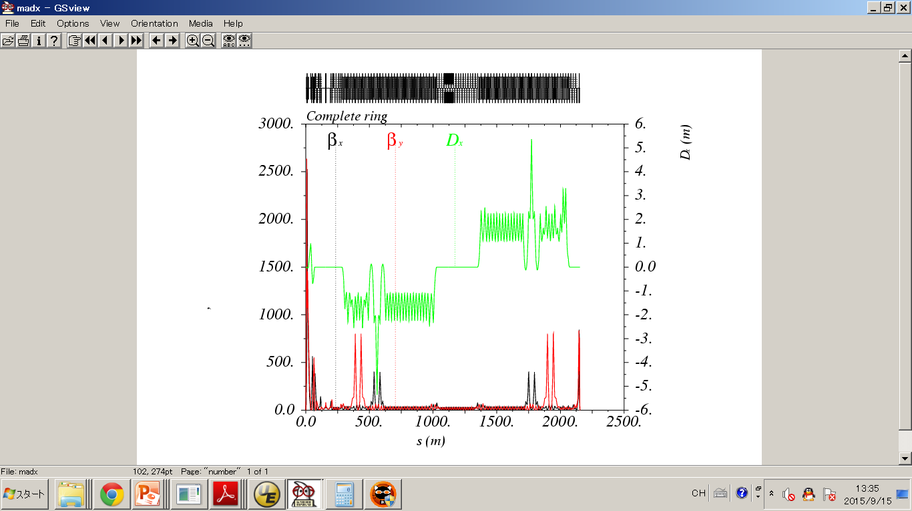
Chromaticity Compensation Scheme
-I
nπ(x)
FF
…….
12 (x) + 12 (y)
sextupoles
1 (x) + 1 (y)
–I pairs
IP
-I
mπ(y)
1 (x) + 1 (y)
–I pairs
12 (x) + 12 (y)
sextupoles
Two non-interleaved –I sextupole pairs (X & Y) to compensate Δβ/β(δ).
The remaining linear chromaticity is canceled using two-family sextupoles in arc section

Slide 6
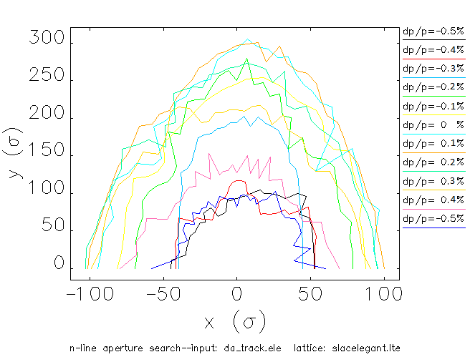
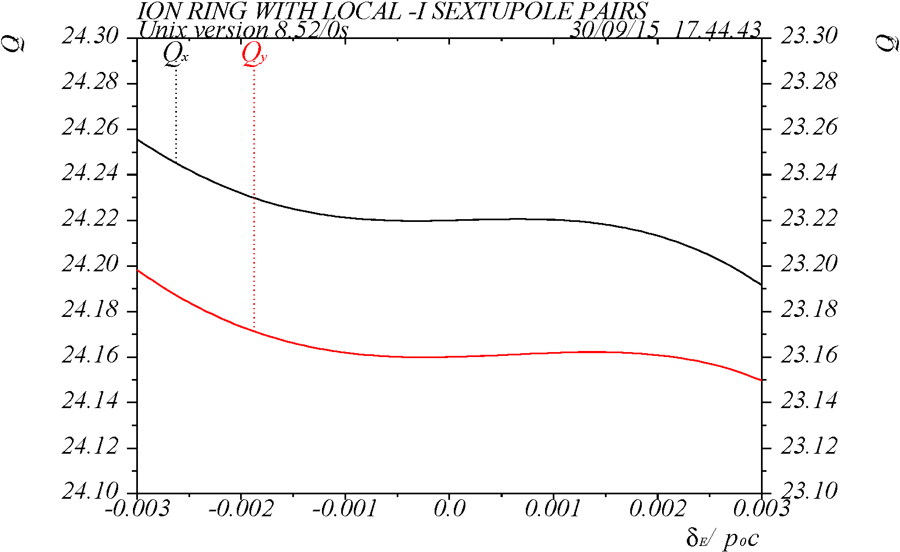
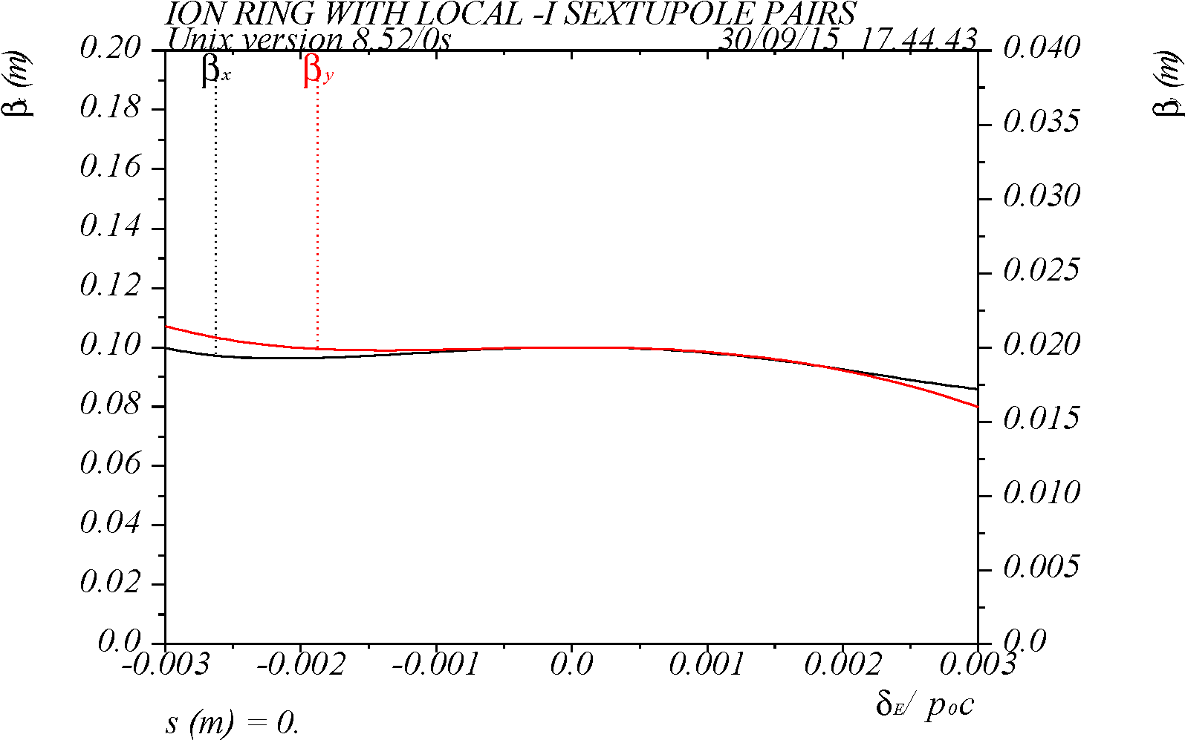
Dynamic Aperture & Chromatic Tune Shift
Dynamic Aperture at IP
Q_{x,y} = 24.22 / 23.16
Non-interleaved –I sextupole scheme provides a DA (~ 90 σ) without magnet errors.
Further reduction of non-linear dependence may be possible with fine tuning of the sextupole phase advance → reduction of 3rd and higher order terms.
for δ = ±0.3% ≈ ±10σ_{δ}

Slide 7
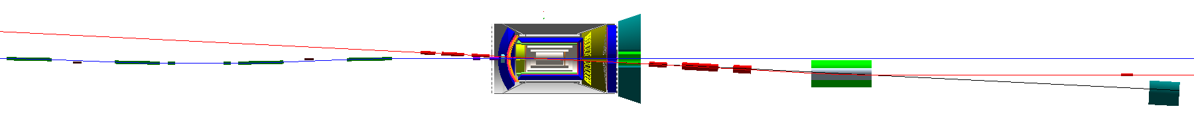
Detector Solenoid Issues
Ion
JLEIC Detector solenoid
Length | 4 m
Strength | < 3 T
Crossing Angle | 50 mrad
e
Effects | e ring | ion ring
Coherent orbit distortion | N | Y
Coupling resonances | Y | Y
Rotates beam planes at the IP | Y | Y
Breaks H & V dispersion free | N | Y
Perturbation on lattice tune & W function | Y | Y
Breaks figure-8 spin symmetry | Y | Y

Slide 8
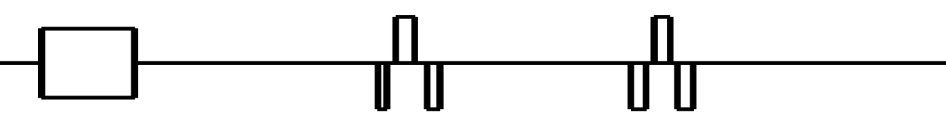



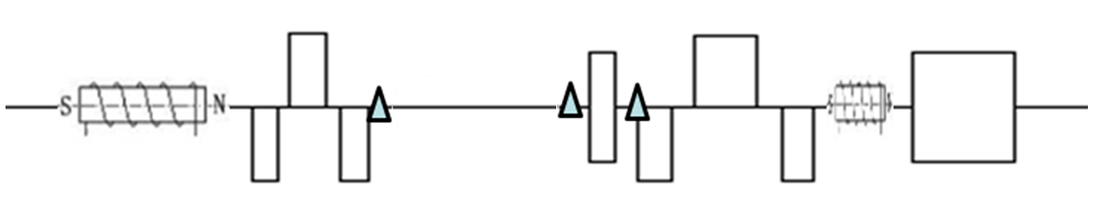
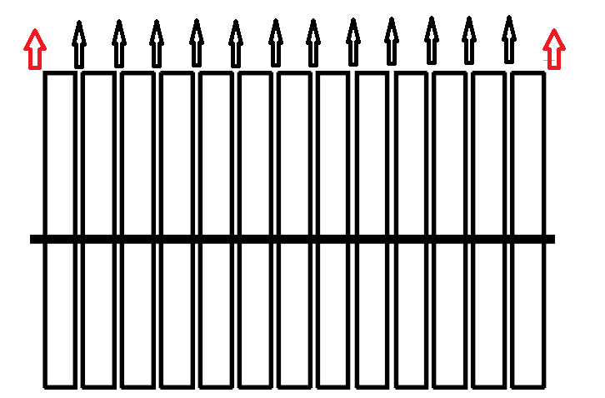
JLEIC Considerations & a Solution
A solution: Solenoid + Quads(normal+skew) + Anti-Solenoid
e-ring
Ion ring
Detector solenoid model:
IP
: Orbit corrector
: Vertical Kick
: Edge effect
Notes:
8

Slide 9
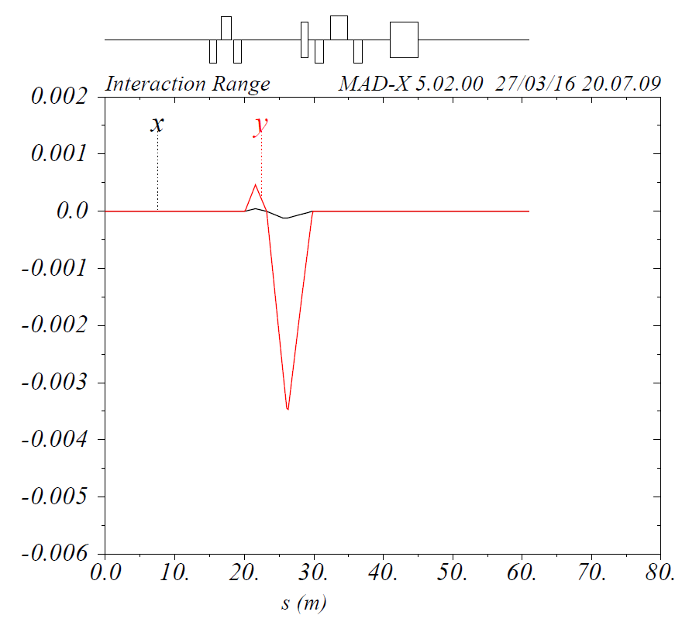



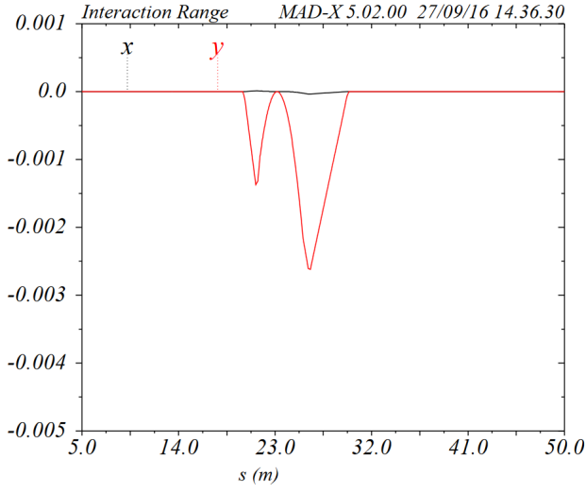
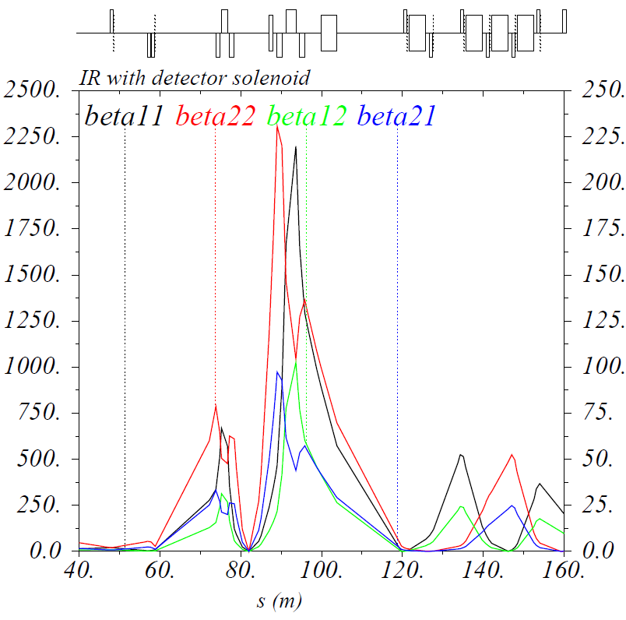
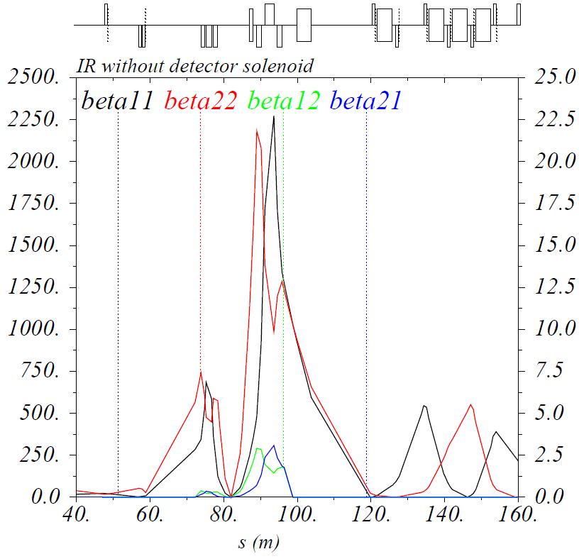
Coherent Orbit & Decoupling
Two dipole correctors on each side of the IP are used to make closed orbit correction. Here not only the orbit offset but the orbit slope is corrected at the IP.
The coupling effects are controlled locally.

Slide 10
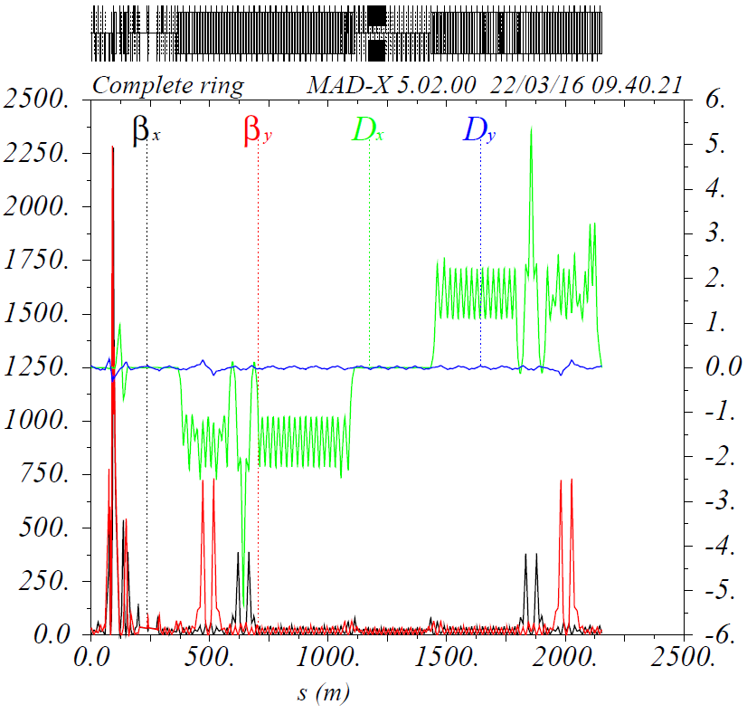
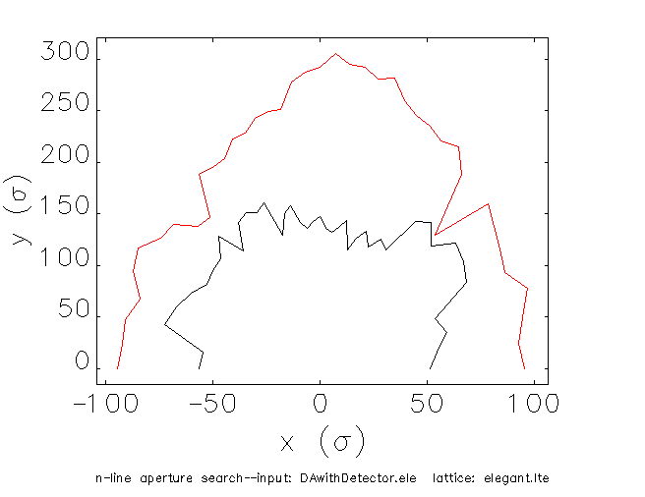
Rematching and Dynamic Aperture
Rematching for twiss parameters, dispersions, and tune correction. The vertical dispersion of < 0.2 m can be ignored. Chromaticity compensation of w function is studying with detector solenoid but not finished.
Dynamic aperture has a shrinking to 50 σ, but large enough

Slide 11
Error Issue
  Assume conservative errors
  σ values of Gaussian distribution
 | Dipole | Quadrupole | Sextupole | BPM (noise)
x displacement(mm) | 0.3 | 0.3, FFQ0.03 | 0.3 | 0.05
y displacement(mm) | 0.3 | 0.3, FFQ0.03 | 0.3 | 0.05
x-y rotation(mrad) | 0.3 | 0.3, FFQ0.05 | 0.3 | -
s displacement(mm) | 0.3 | 0.3, FFQ0.03 | 0.3 | -
Strength error(%) | 0.1 | 0.2, FFQ0.03 | 0.2 | -

Slide 12
Correction
Orbit Correction, especially at IP and IR triplets
Tune correction (Tune measured accuracy < 0.001)
  Tune error : < 0.1 %
Beta-beat correction:
  Beta error at IP & Beta > 500 : < 1 %
  Beta error at Beta < 500 : < 5 %
Chromaticity correction
  Linear Chromaticity (+1, +1)
  W function at IP = (0, 0), not yet in ELEGANT
Decoupling by skew quads

Slide 13
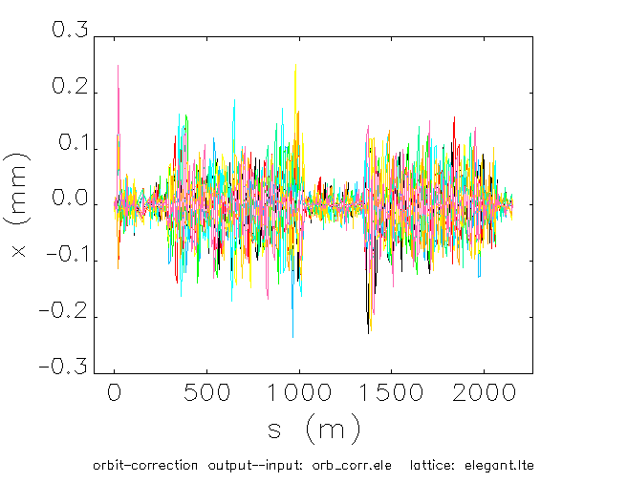
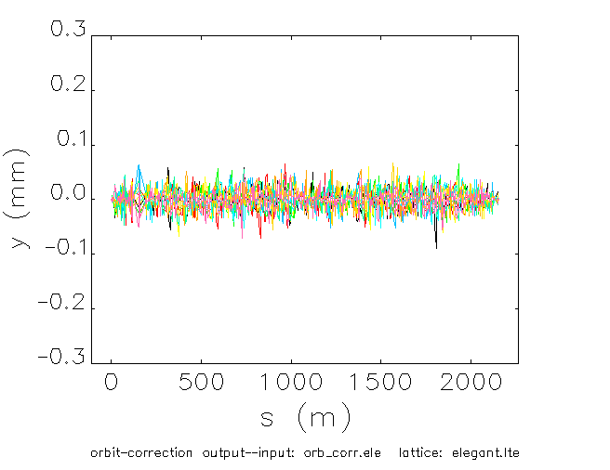
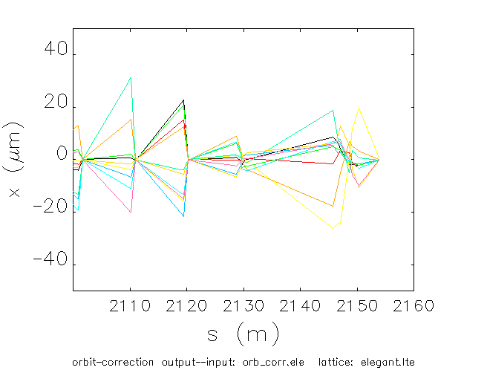
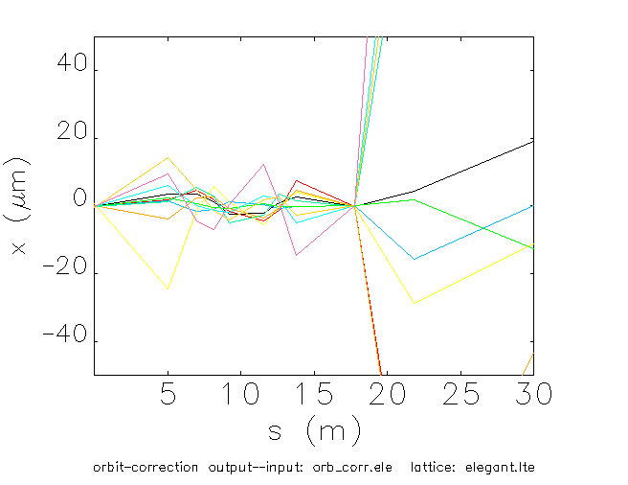
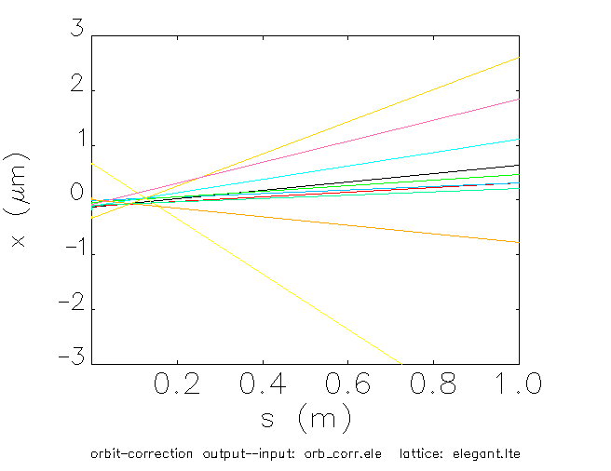
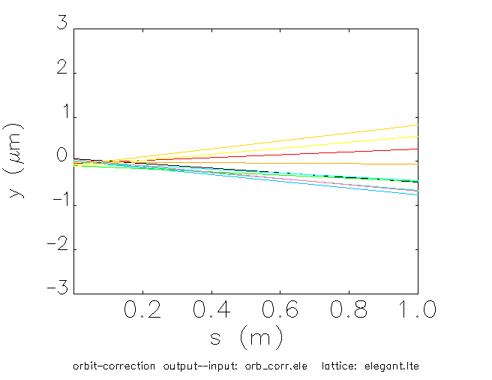
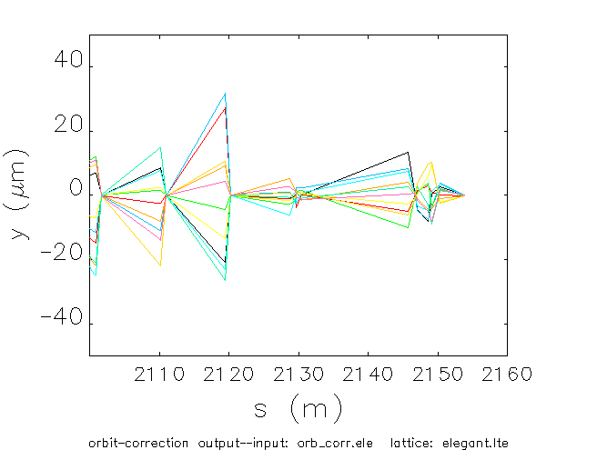
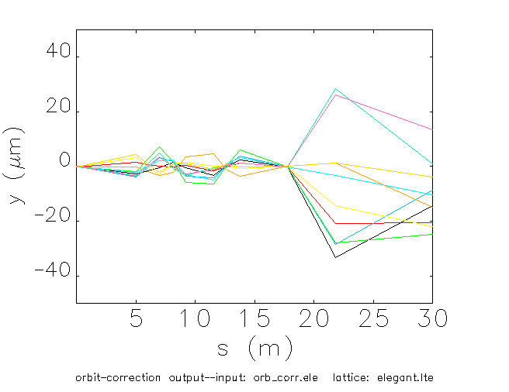
Closed Orbit Distortion after correction
Start from IP
 | ex/ey(nor. mm-mrad) | Δx/Δy @ IP | Δx/Δy @ FFQ
Case 1, strong cooling | 0.35/0.07 | < 1 σ | < 0.01 σ
Case 2, large emittance | 1.2/1.2 | < 0.6 σ | < 0.006 σ
Δx/Δy @ IP didn’t include local orbit correction

Slide 14
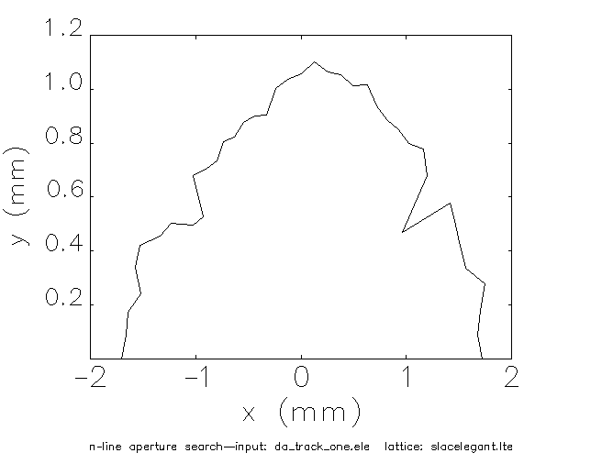
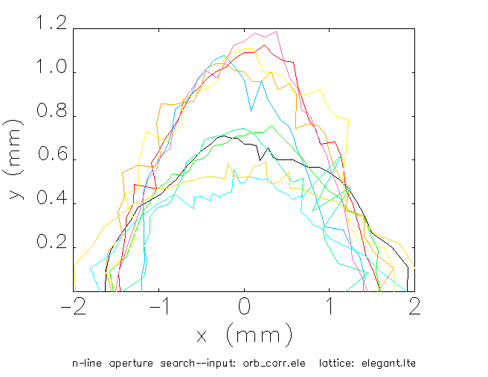
Dynamic Aperture after Correction
Without error
With error & correction
10 seeds
90 σ
60 σ
100 GeV proton | ex/ey(nor. mm-mrad) | DA origin | DA with error
Case 1, strong cooling | 0.35/0.07 | ~ 90 σ | ~ 60 σ
Case 2, large emittance | 1.2/1.2 | ~ 48 σ | ~ 32 σ

Slide 15
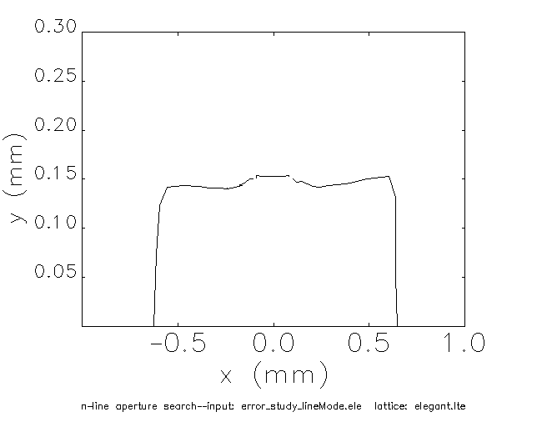
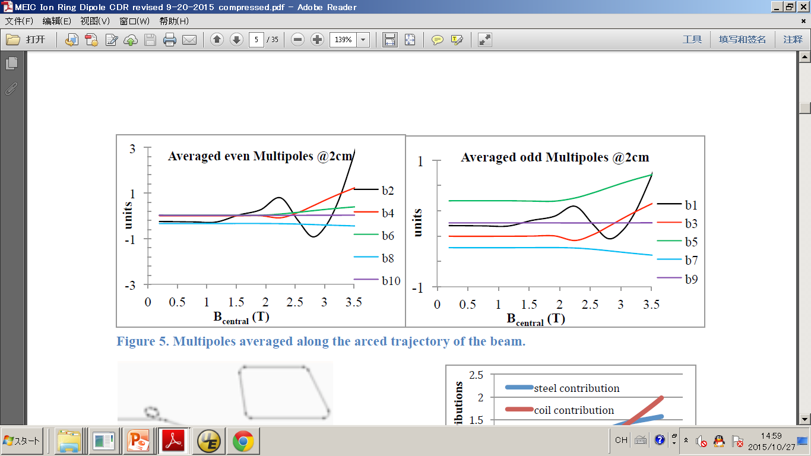
Multipoles of Super-Ferric arc dipoles
Simulated multipole data from Texas A&M University
Dynamic Aperture
100 GeV, Proton | ex/ey(nor. mm-mrad) | DA right figure
Case 1, strong cooling | 0.35/0.07 | ~ 30 σ
Case 2, large emittance | 1.2/1.2 | ~ 16 σ

Slide 16
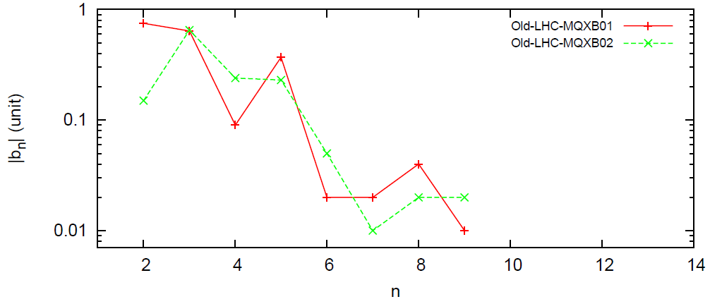
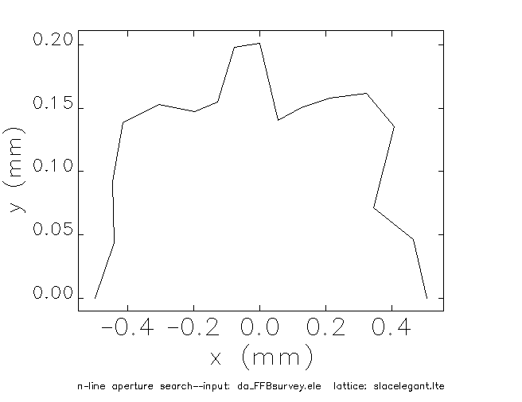
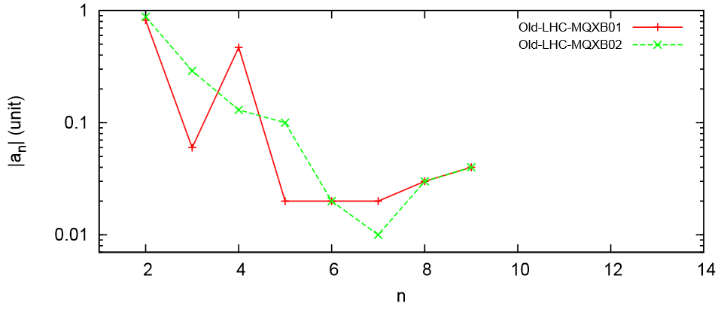
Multipoles of FFQs
LHC FFQ
 | ex/ey(nor.) | DA
Case 1 | 0.35/0.07 | ~ 16 σ
Case 2 | 1.2/1.2 | ~ 10 σ
Top-down approach by using
LHC FFQ data
DA results are OK for 100 GeV proton case.

Slide 17
Bottom-up Estimation
Single Multipole:
Normal
DA~ 20 σ at IP
Combined result: Normal
DA~ 12 σ at IP
Multipoles
Normal + Skew
to get a DA of 10 σ at IP
Single Multipole: Skew
DA~ 20 σ at IP
Combined result:
Skew
DA~ 12 σ at IP

Slide 18
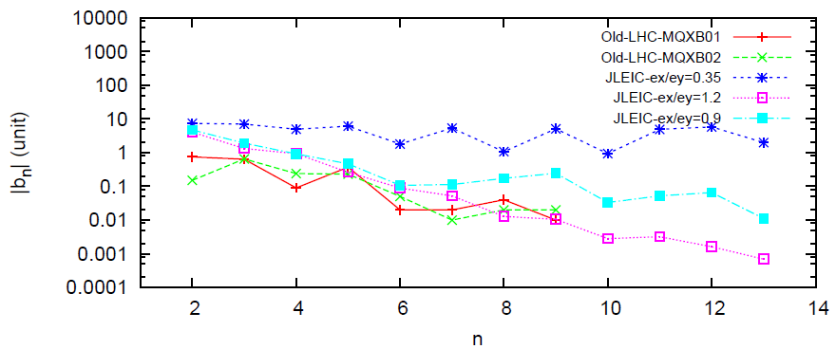
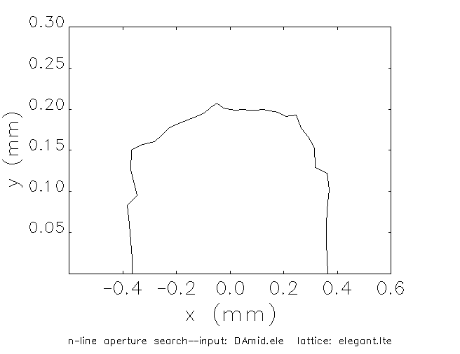
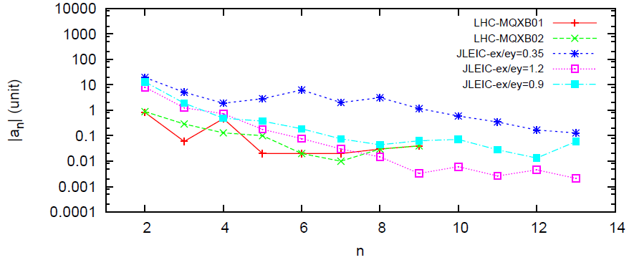
Multipole Survey
DA: 10 σ for 60 GeV proton
& 12 σ for 100 GeV proton
DA
Larger beam emittance with week cooling results in the tighter limit multipole
Multipole survey with 0.9/0.9 mm-mrad of emittance gives a balance between multipole field of IR triplet and dynamic aperture.

Slide 19
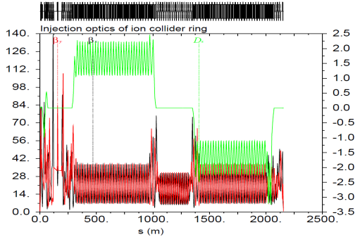
Beam squeeze
A factor of 32 is difference between the geometric emittances at 8 and 100 GeV. β* at IP is enlarged in lattice design for 8-GeV proton injection.
Dynamic aperture is good with magnet multipole components.

Slide 20
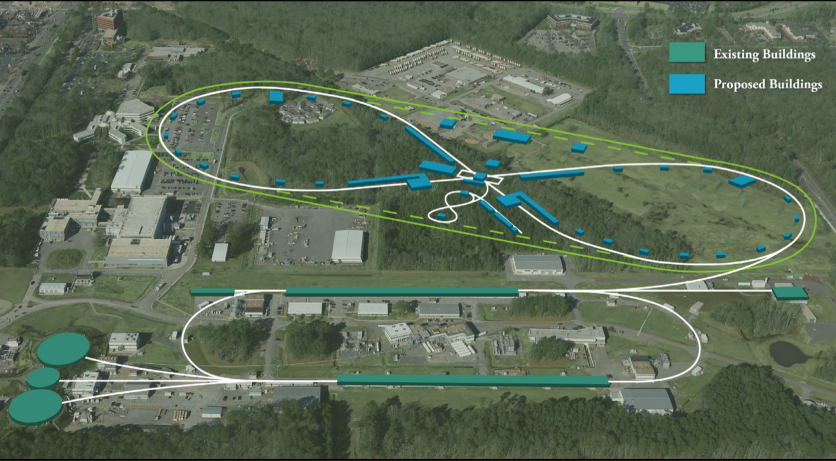
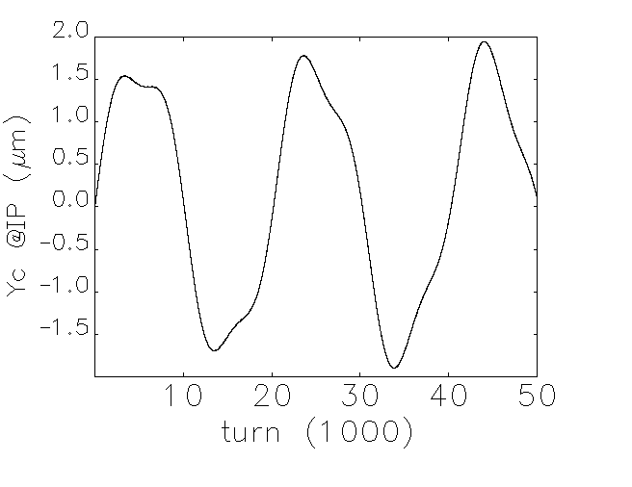
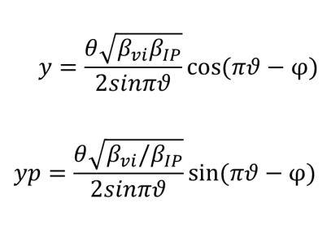
Ground Motion
storage building
Canon Blvd
Sources on ground motion: 1. Liquid N₂ delivery to storage building by a truck everyday. 2. Traffic
No impact is on emittance. Main impact is on beam vertical orbit oscillation at IP, which is not a problem considering feedback system

Slide 21
Summary
IR design gives follow challenges: Chromaticity issue, Detector solenoid issue, Misalignment issue, Magnet multipole field, Beta squeeze and Ground Motion issue.
Chromaticity Compensation has been studied. A non-interleaved –I pairs scheme is selected, and dynamic aperture is 90 σ with bare lattice and strong cooling.
Other issues has been also studied. The most limit to the dynamic aperture is multipole field components of IR triplets. IR triplets with LHC measured data is good for any cooling schemes. If cooling is better, we can release the multipole requirement.

Slide 22
Thank you

Slide 23
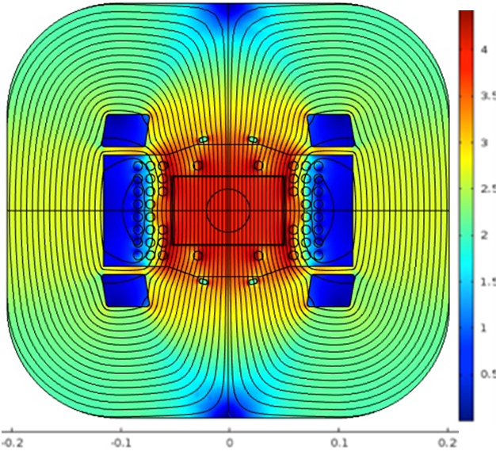
Multipoles of Super-Ferric dipole
From Peter McIntyre

Slide 24
Study Plan
  Require skew multipole data of super-ferric dipole in arc section to study dynamic aperture with super-ferric dipole of beta > 200 meters
  Require skew multipole data of QIF (FFQ model) to study influence on dynamic aperture
  Require data of super-ferric dipole in ramping time to study whether we need a sextupole in the middle of dipole or not.
  Dynamic aperture study on arc quads & 2 IR dipoles
  Dynamic aperture study at injection
  Put misalignment error, strength error, magnet multipoles, detector solenoid effects together to make design of multipole corrector packages.
  Study influence from grab cavity and round-beam mode

Slide 25
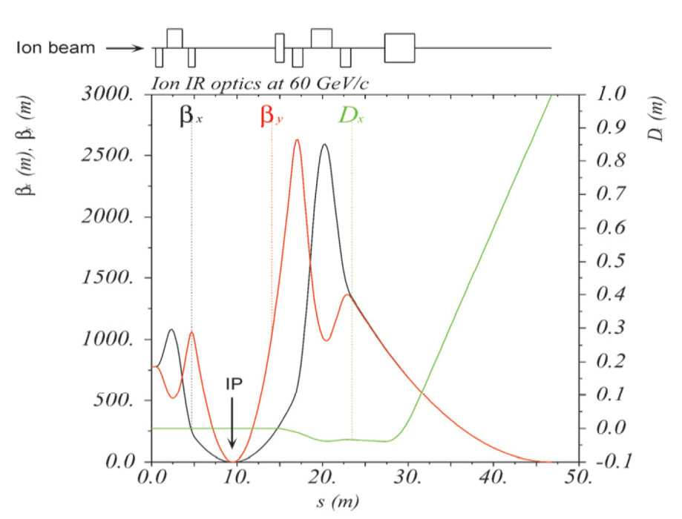
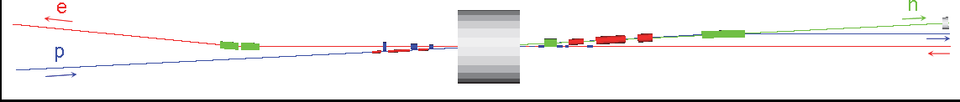
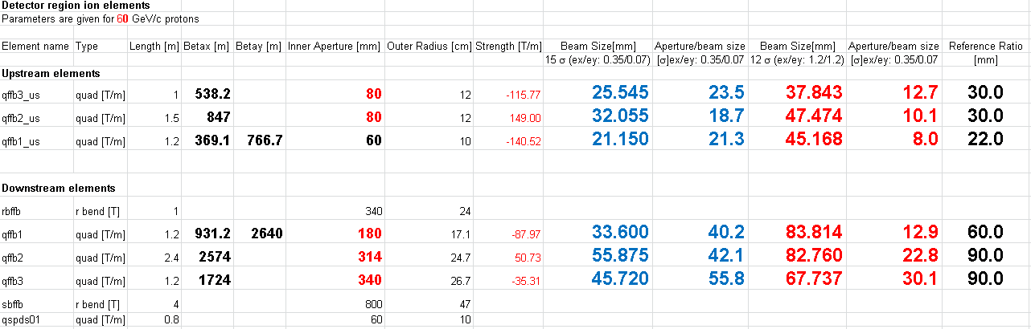
Simulation setup & method

Slide 26
Error Study at Machines
 | Displacement | Tilted angle | Strength Error
 | mm | mrad | 10⁻²
PEP-II | 1(Dipole) 0.1(Q&S) | 0.3(Dipole) 0.5(Q&S) | 0.1(D&Q) 0.2(S)
KEKB | 0.1(D,Q&S) | 0.1(D,Q&S) | 0.2(D), 0.1(Q&S)
SuperB | 0.2(dipole) 0.3(Q) 0.15(S) | 0.3(Q)
NSLS-II | 0.1(Dipole) 0.03(Q&S) | 0.5(Dipole) 0.2(Q&S) | 0.1(D) 0.2(Q&S)
RHIC | 0.5(Dipole) 0.25(Q),0.13(S) | 1(Dipole) 1(Q)
J-PARC | 0.1(meas.dipole) 0.03(meas.Q&S) | 0.03(meas. D,Q,&S) | 0.1(D) 0.1(Q&S)

Slide 27
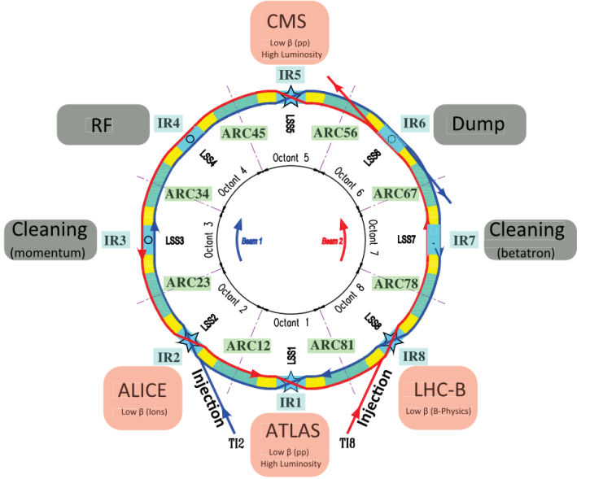
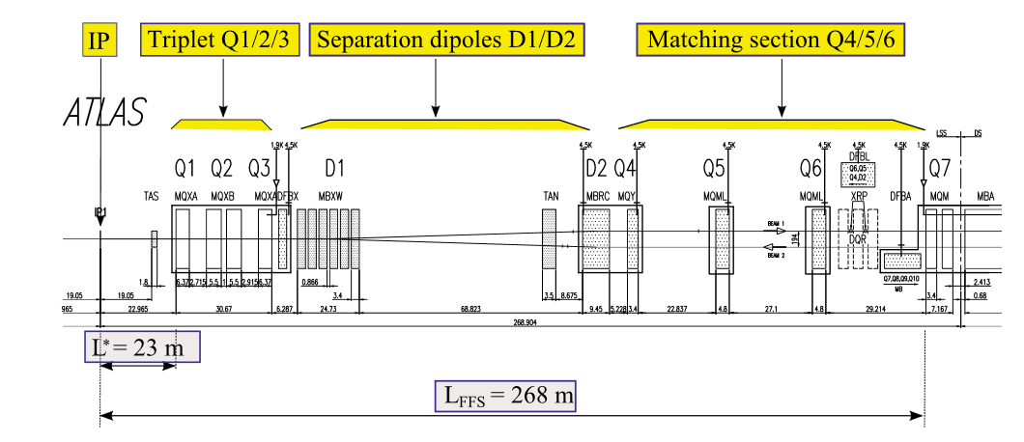
Multipoles of FFQ in LHC
Old LHC
β* =
55/55 cm
HL-LHC β* = 15/15 cm
β_{max}~ 21.5km
β_{max}~ 4.5km

Slide 28
Multipoles of FFQ in LHC
Old LHC
β* =
55/55 cm
HL-LHC β* = 15/15 cm
β_{max}~ 21.5km
β_{max}~ 4.5km
 | Old LHC | HL-LHC
Gradient | ~210 T/m | ~140 T/m
Aperture | 70 mm | 150 mm
Reference | 17 mm | 50 mm
JLEIC-FFQ | upstream | downstream

Slide 29
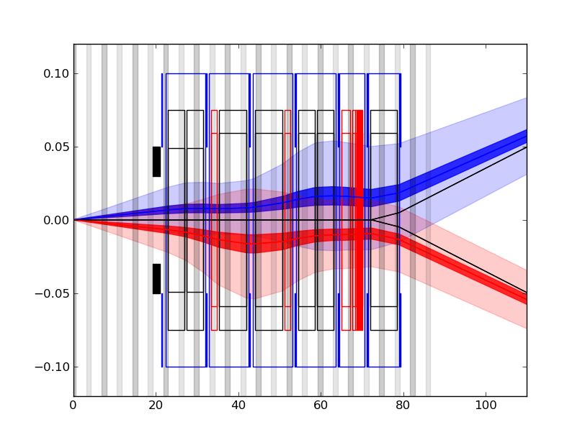
Multipoles of FFQ in LHC
Beam halo: 12σ
Aperture definition
Inner aperture
  beam envelope (10 σ per beam),
  beam separation (10 σ),
  β-beating (20%),
  peak orbit excursion (2 mm)
  mechanical tolerance (1.6 mm),
  spurious dispersion orbit d (1 mm)
  Q1: 98 mm
  Q2-Q3-D1: 118 mm
With Beam screen, Coil Aperture: 150mm
Reference radius = Coil Aperture/3 = 50mm

Slide 30
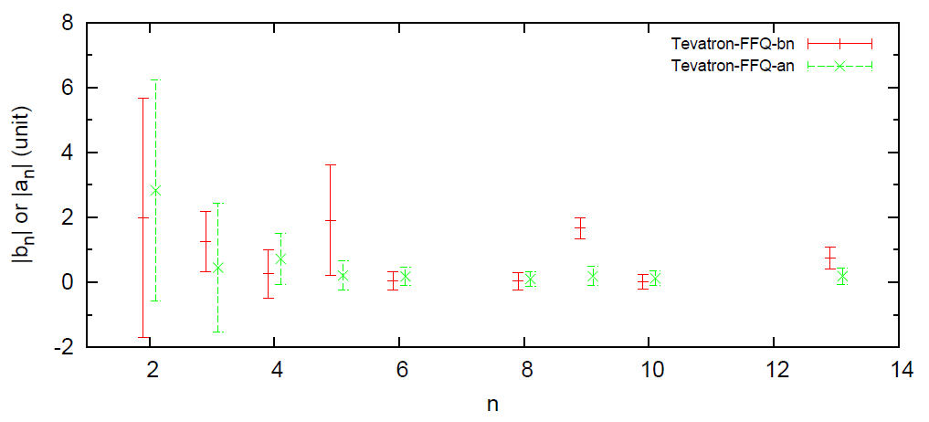
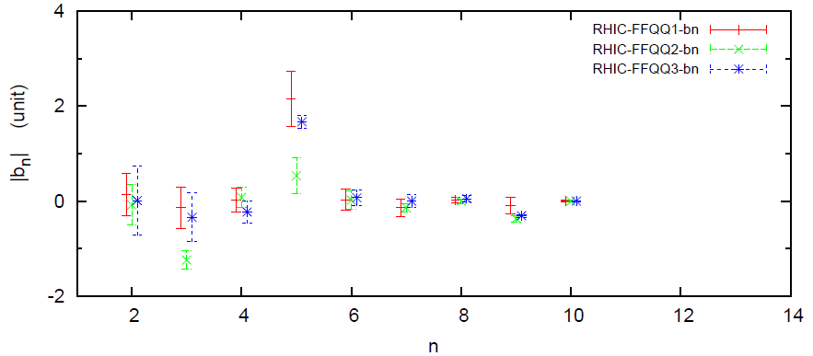
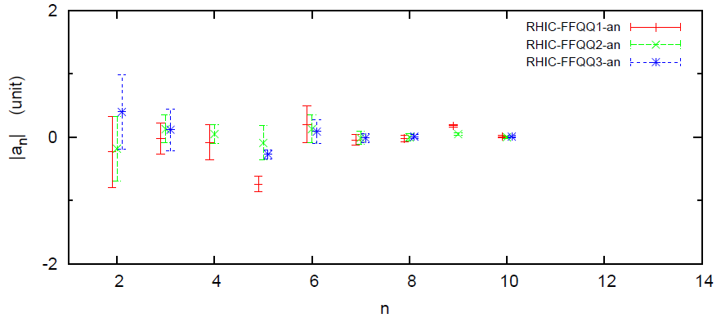
Multipoles of FFQ in 3 accelerators
1. Tevatron
3. LHC
2. RHIC
Reference radius: 1/3 aperture
Multipoles have been improved one machine by one machine.

