Slide 1
Electron Cooling Code Development and Simulation Studies
He Zhang, He Huang, Rui Li, Jie Chen, Li-Shi Luo
JLEIC Collaboration Meeting, 10/06/2016
Newport News, VA

Slide 2
Outline
Two–stage electron cooling scheme for JLEIC
A new electron cooling simulation program
Electron cooling simulation for JLEIC
Particle tracking simulation for electron cooling
Summary

Slide 3
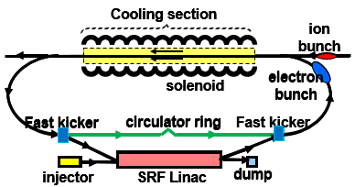
JLEIC Staged Cooling Scheme
Multi-phased scheme takes advantages of high electron cooling efficiency at low energy and/or small 6D emittance $τ_{cool}\sim γ^{2}\frac{Δγ}{γ}σ_{z}ε_{4d}$
Low energy DC cooler (Within state-of-art) at the booster:
Reduce the emittance
2GeV/u ion beam, 1.6 MeV electron beam
High energy bunched beam cooler (needs R&D) at the collider ring:
Maintain the emittance
Up to 100 GeV/u ion beam, 55 MeV electron beam
ERL single pass cooler (Q_{e} = 420 pC/buncn, baseline design, no circulator ring)
ERL circulator cooler (Q_{e} = 2 nC/bunch, lower emittance, higher luminosity)
JLEIC ion complex layout

Slide 4
A New Electron Cooling Simulation Code
Goals:
Fulfill the specific needs for JLEIC electron cooling scheme
Different scenarios: DC cooling, bunched beam cooling
More flexibility, higher efficiency.
Use for electron cooling simulation and further code development
Approaches:
Following the models in BETACOOL whenever applicable
Revise the models whenever needed
Improve the efficiency by strategically arrange the computation
Adaptive to the modern multi-core platform
Formulas and models implemented:
IBS: Martini model (no vertical dispersion lattice)
Friction force: Parkhomchuk formula (magnetized cooling)
Cooling rate: single particle model, Monte Carlo model
Cooling dynamics: Four-step procedure
Other formulas and models can be added in future
Codes and a tutorial are available online:
https://github.com/zhanghe9704/electroncooling

Slide 5
Electron Cooling Rate
Single particle model: sample the ion beam with particles with the same dynamic invariant (single particle emittance)
Sample the ion beam on a regular grid
Calculate the electron charge density around each ion
Convert into beam frame
Calculate the friction force on each ion (Parkhomchuk formula)
Convert back to lab frame
Each ion feels a kick as $dp=F⋅dt$.
Calculate the new dynamic invariant $I$ and thus the emittance for each ion (as in the previous page) and take average on all of them.
Calculate the cooling rate (the change of emittance in a unit time)

Slide 6
Electron Cooling Rate
Monte Carlo model : sample the ion beam with particles of Gaussian distribution
Sample the ions as described in the previous page
Calculate the electron charge density around each ion
Convert into beam frame
Calculate the friction force on each ion
Convert back to lab frame
Each ion feels a kick as $dp=F⋅dt$.
Emittace is calculated statistically as
Calculate the cooling rate (the change of emittance in a unit time)

Slide 7
Cooling Dynamic
Four-step procedure:
Create sample ions
Calculate the expansion rate under the IBS and/or electron cooling effect
Update the beam parameters and the sample ions, and
repeat from the second step till the end time
The RMS dynamic method and the model beam method in BETACOOL fit into this four-step procedure.

Slide 8
Cooling Dynamic
RMS dynamic method in the four-step procedure:
Create sample ions (using the single particle model or Monte Carlo model) w.r.t. the given emittance
Calculate the expansion rate under the IBS and/or electron cooling effect
Update the beam parameters using $ε_{new}=ε_{old}⋅e^{dt/τ}$, create new sample ions w.r.t. the new emittance, and
repeat from the second step till the end time

Slide 9
Cooling Dynamic
Model beam method in the four-step procedure:
Create sample ions with the given initial distribution
Calculate the IBS rate and/or the friction force.
Apply the IBS kick on each particle as
$〈θ^{2}〉=\frac{ε}{β_{⊥}}\frac{dt}{τ_{IBS}}$, $Δθ=\sqrt{〈θ^{2}〉}⋅ξ$,
Gaussian random number $ξ, σ_{ξ}=1$; apply the electron cooling kick as
$dp=F⋅dt⋅f⋅t_{cooler}⋅N_{cooler}$;
apply a random phase advance for each particle; calculate new emittance and expansion rate; and
4. repeat from the second step till the end time.

Slide 10
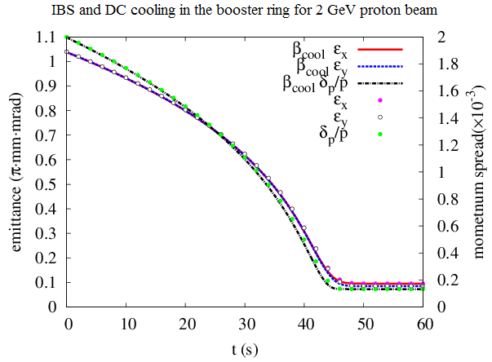
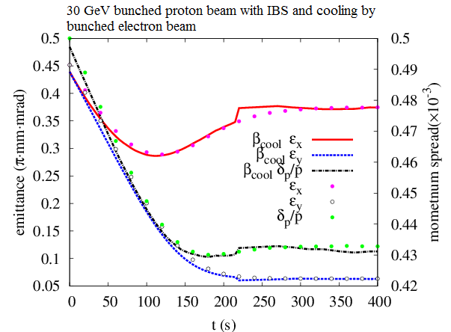
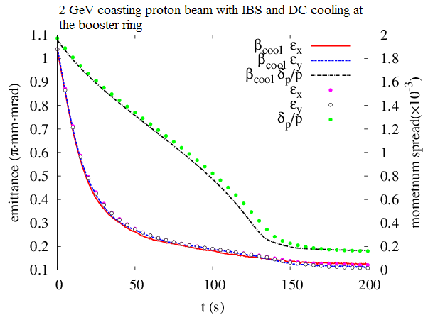
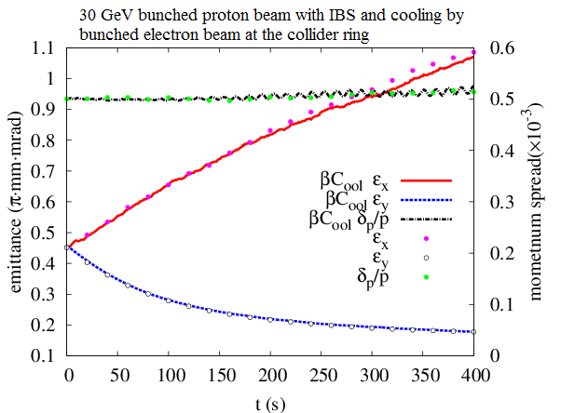
Benchmark with BETACOOL
Thoroughly benchmarked with BETACOOL (a few examples below)
RMS dynamic
Monte Carlo
RMS dynamic
Single particle
Model beam
Model beam

Slide 11
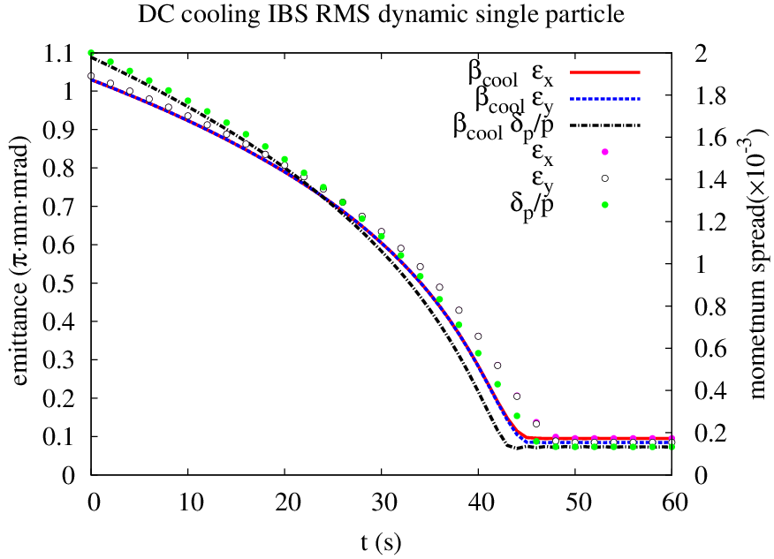
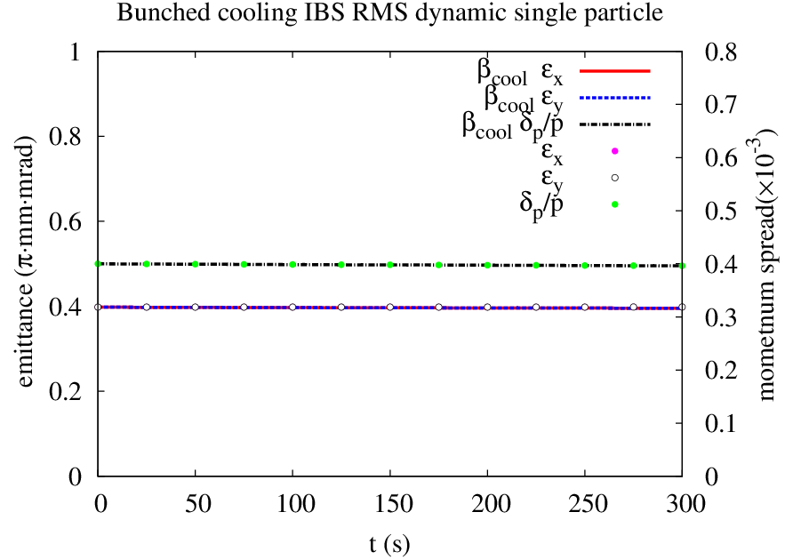
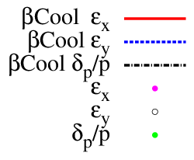
Benchmark
DC cooling and IBS for JLEIC booster ring with KE = 800 MeV
Time cost 133 s (BETACOOL 3060 s)
Bunched cooling and IBS for JLEIC collider ring with KE = 100 GeV
Time cost 30.7 s (BETACOOL 422 s)

Slide 12
Parallelization
Good efficiency of the serial code, so not necessary to run the code on a cluster machine.
Further improve the efficiency for shared memory structure hardware: GPU, Intel Xeon Phi, or just a multi-core PC.
Parallelization is based on thrust, a parallel algorithm library that supports CUDA, TBB (Threading Building Blocks) and OpenMP.
IBS calculation, 100$×$100$×$100 grid:
NVidia GTX 660 ti GPU: 7.76 s
CPU AMD Phenom™ II X4 840T Processor 2.9GHz: 62 s
Electron cooling
200,000 samples: GPU 0.03 s CPU 0.151 s
40,000 samples: GPU 0.024 s CPU 0.023 s

Slide 13
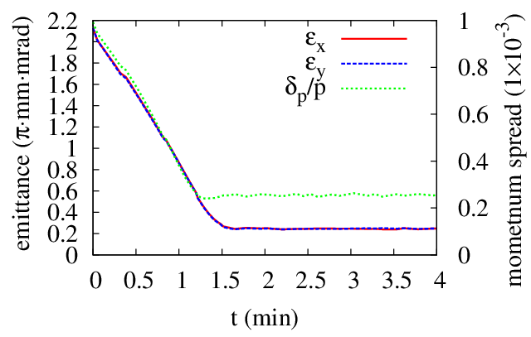
DC Cooling at the Booster
Proton beam:
KE = 2 GeV
Emit = 2.15 mm mrad
dp/p = 0.001
N = 2.8E12
Electron beam:
I = 2 A
T_{tr} = 0.1 eV, T_{s} = 0.1 eV
DC cooler:
L = 10 m
B = 1 T
 |  | IBS | ECOOL | IBS+ECOOL
R_{H} | 1/s | 3.86E-4 | -9.05E-3 | -9.10E-3
R_{V} | 1/s | 3.86E-4 | -9.00E-3 | -8.71E-3
R_{L} | 1/s | 2.27E-4 | -15.3E-3 | -15.3E-3

Slide 14
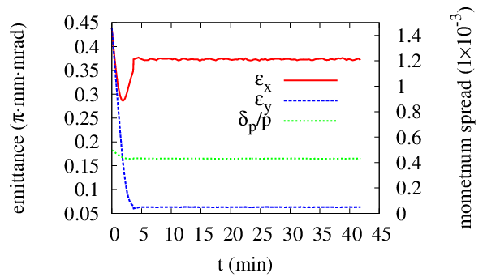
Strong Cooling at the Collider Ring (Q_{e} = 2 nC)
Proton beam:
KE = 30/60/100 GeV
Emit = 0.45/0.35/0.35 $μ$m$⋅$rad
dp/p = 5/4/4 $×{10}^{−4}$
$σ_{s}$ = 2.5/2.75/2.75 cm
N = 6.56E9
Electron beam:
Q_{e} = 2 nC
T_{tr} = 0.5 eV, T_{s} = 0.1 eV
Bunched cooler:
L = 30$×$2 m
B = 1 T
 |  | IBS | ECOOL
R_{H} | 1/s | 4.74E-3 | -8.05E-3
R_{V} | 1/s | -1.59E-5 | -8.05E-3
R_{L} | 1/s | 2.10E-3 | -1.31E-2
KE_{p}=30 GeV

Slide 15
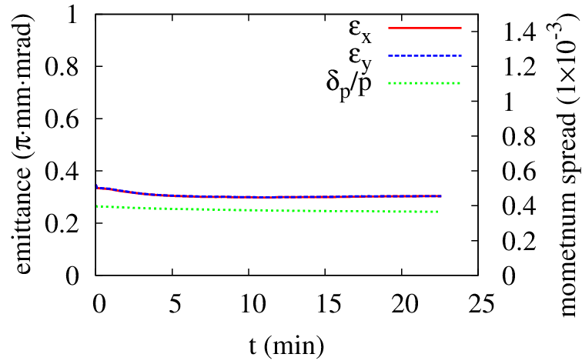
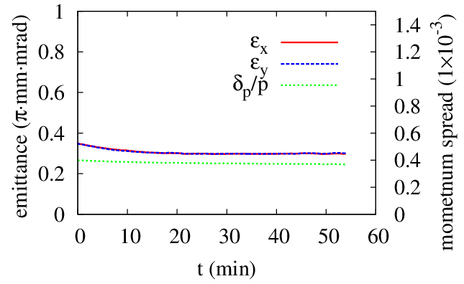
Strong Cooling at the Collider Ring (Q_{e} = 2 nC)
 |  | IBS | ECOOL |  | IBS | ECOOL
R_{H} | 1/s | 6.21E-3 | -3.78E-3 |  | 4.43E-3 | -2.65E-3
R_{V} | 1/s | -4.08E-5 | -3.75E-3 |  | -1.53E-5 | -2.60E-3
R_{L} | 1/s | 2.00E-3 | -8.65E-3 |  | 0.97E-3 | -7.29E-3
KE_{p}=60 GeV
KE_{p}=100 GeV

Slide 16
Weak Cooling at the Collider Ring (Q_{e} = 420 pC)
Lower electron beam current, within the state-of-art technique.
Electron bunch smaller than the proton bunch.
Higher proton beam emittance, lower IBS.
Larger proton beam momentum spread.
Proton beam:
KE = 100 GeV
Emit_x = 1.2 $μ$m$⋅$rad
Emit_y = 0.6 $μ$m$⋅$rad
$σ_{s}$ = 2.5 cm
N = 6.56E9
Electron beam:
Q = 420 pC
T_{tr} = 0.5 eV, T_{s} = 0.1 eV
$σ_{x,y}$ = 0.035 cm
$σ_{s}$ = 0.84 cm
Bunched cooler:
L = 60 m
B = 1 T
Proton beam: Parkhomchuk formula
Horizontal expansion rate decreases as dp/p increases, with $σ_{s}$ = 2.5 cm
dp/p (1E-4) | 5 |  |  | 8 |  |  | 12
IBS (1E-4 1/s) | 5.03 | 0 | 2.26 | 3.39 | 0.01 | 0.63 | 2.35 | 0.01 | 0.20
Cool (1E-4 1/s) | -1.01 | -1.40 | -4.14 | -0.85 | -1.25 | -2.45 | -0.71 | -0.98 | -1.34
Total (1E-4 1/s) | 4.02 | -1.40 | -2.10 | 2.54 | -1.24 | -1.82 | 1.64 | -0.97 | -1.14

Slide 17
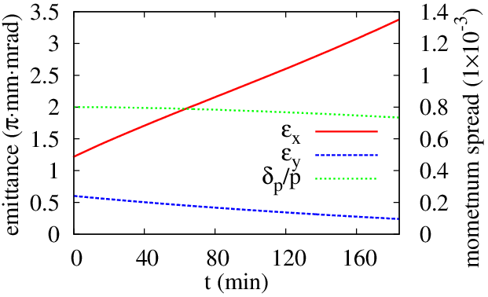
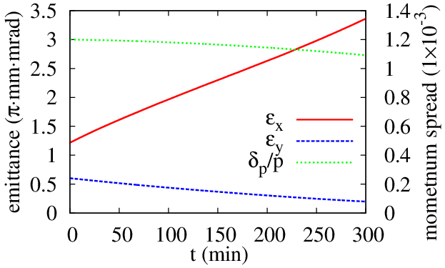
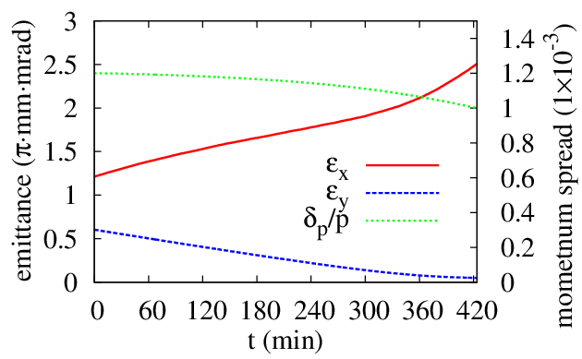
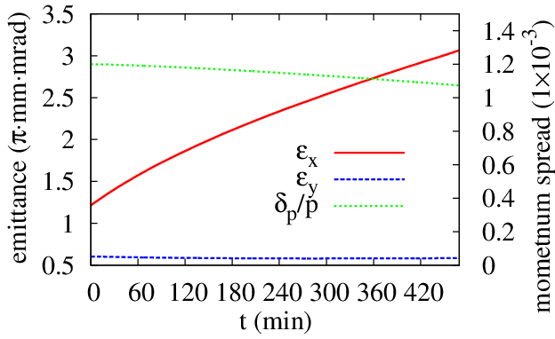
Weak Cooling at the Collider Ring (Q_{e} = 420 pC)
$τ∼$ time to double $ε_{x}$
$τ∼$ 1.5h
$τ∼$ 2.8h
dp/p=8E-4
dp/p=1.2E-3
Lower proton beam current or 20% transverse coupling
N_{p} = 4.4E9
$τ∼$ 6.6h
$τ∼$ 4.0h
dp/p=1.2E-3
dp/p=1.2E-3

Slide 18
Issues with Bunched Beam Cooling
Cooling with correlated electron beam
The momentum of the electron is correlated with its longitudinal position, modeled as $δp=Asin(\frac{z}{3σ}π)$
Friction force is calculated in the electron beam frame. Ions got a various velocity shift according to their positions.
Assume $A=2σ_{p}$.
$$σ_{p}$$ |  | Non-correlated |  |  | Correlated
$$×{10}^{−4}$$ | eV | $$R_{x}(×{10}^{−3})$$ | $$R_{y}(×{10}^{−3})$$ | $$R_{z}(×{10}^{−2})$$ | $$R_{x}(×{10}^{−3})$$ | $$R_{y}(×{10}^{−3})$$ | $$R_{z}(×{10}^{−2})$$
1 | 0.00511 | 1.59 | 1.59 | 1.66 | 1.60 | 1.60 | 1.60
2 | 0.02044 | 1.54 | 1.54 | 1.50 | 1.53 | 1.53 | 1.30
3 | 0.04599 | 1.48 | 1.48 | 1.34 | 1.43 | 1.43 | 1.02
4 | 0.08176 | 1.41 | 1.41 | 1.19 | 1.33 | 1.33 | 0.79
5 | 0.12775 | 1.34 | 1.34 | 1.06 | 1.23 | 1.23 | 0.61

Slide 19
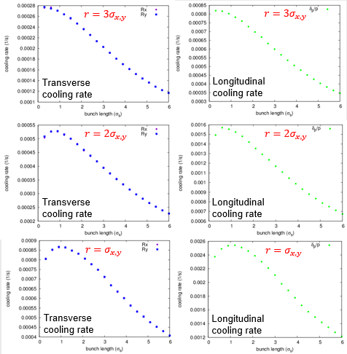
Issues with Bunched Beam Cooling
Cooling rate vs. electron bunch size
Electron number per bunch is limited by the capacity of the cathode and the instability during transport
Two competing parameters affect the cooling rate: how many ions covered by the electron bunch & local electron density around an ion.
Calculate cooling rate for Gaussian ion bunch with cylindrical electron bunch of various sizes.
Best cooling rate at $r=σ_{x,y}, l=σ_{s}$.

Slide 20
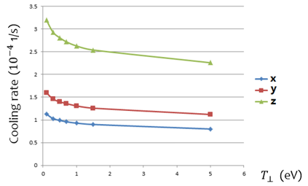
Issues with Bunched Beam Cooling
Cooling rate vs Larmor emittance
Magnetic electron beam $ε=\sqrt{ε_{L}ε_{d}}$
Drift emittance $ε_{d}$, relates to the transverse bunch size
Larmor emittance $ε_{L}$, relates to the transverse temperature
Important parameter for cooler and electron source design

Slide 21
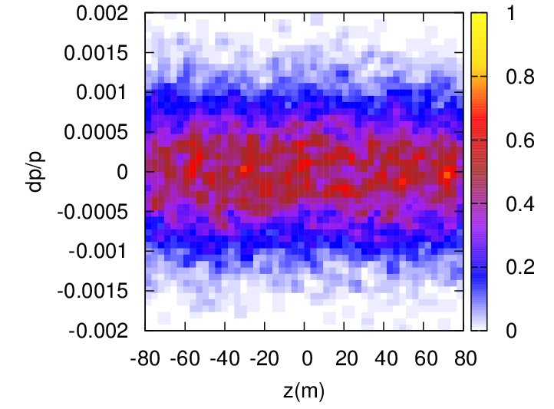
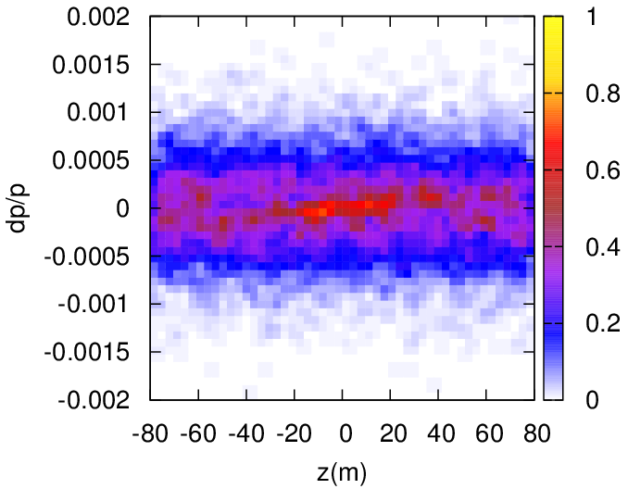
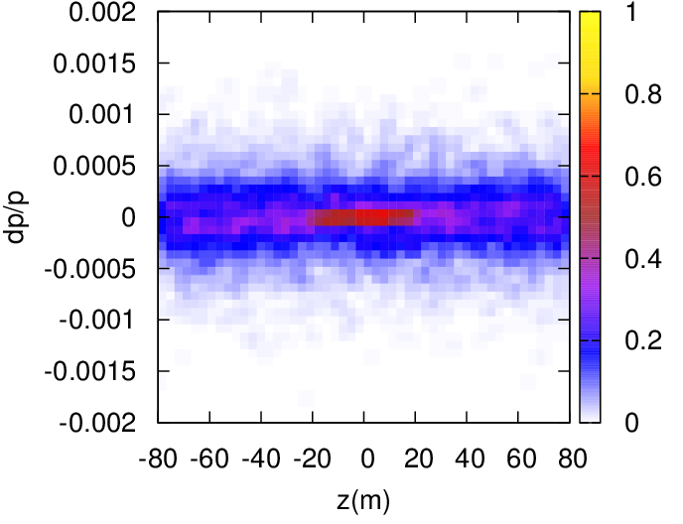
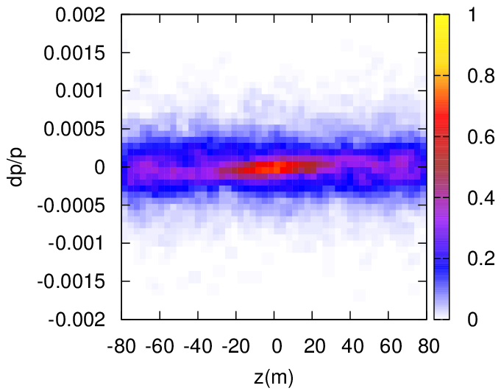
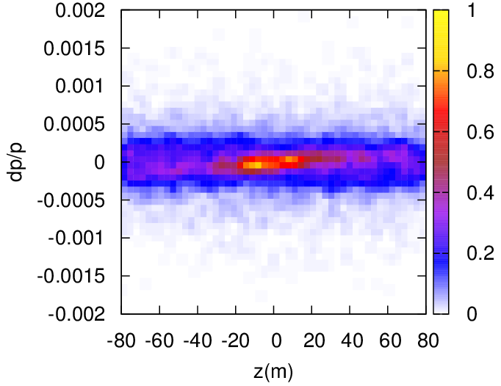
Turn by Turn Simulation
Initial distribution
10,000 turn
20,000 turn
40,000 turn
80,000 turn

Slide 22
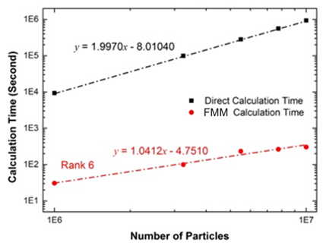
Particle Tracking Simulation (in progress)
Simulate the motion of ions and electrons inside the cooler based on the first principles.
Focus on the interactions between individual particles.
Single pass, not the whole cooling process.
Friction force calculation.
Fast multipole method for Coulomb interaction using Cartesian tensor.
Fast multipole method for other non-oscillating interaction.
MPI based parallel integrators: (RK4 and Hermite)
Order | Relative error
2 | $$3.93×{10}^{−2}$$
4 | $$1.08×{10}^{−2}$$
6 | $$3.83×{10}^{−3}$$
8 | $$1.48×{10}^{−3}$$
10 | $$6.71×{10}^{−4}$$
Linear scale with particle number

Slide 23
Summary
A new electron cooling and IBS effect simulation program has been developed. Code available on online
Benchmarked with BETACOOL.
Significant improvement in efficiency, which brings the possibility for more sophisticated physical model or algorithm
Actively implemented in JLEIC electron cooling simulations
Lowe energy DC cooling is within the state of art.
Bunched beam cooling at the collision energy is challenging, but possible.
A particle tracking program is in development

