Slide 1
Design and Implementation of New Cleanroom for Tunnel Work

Slide 2
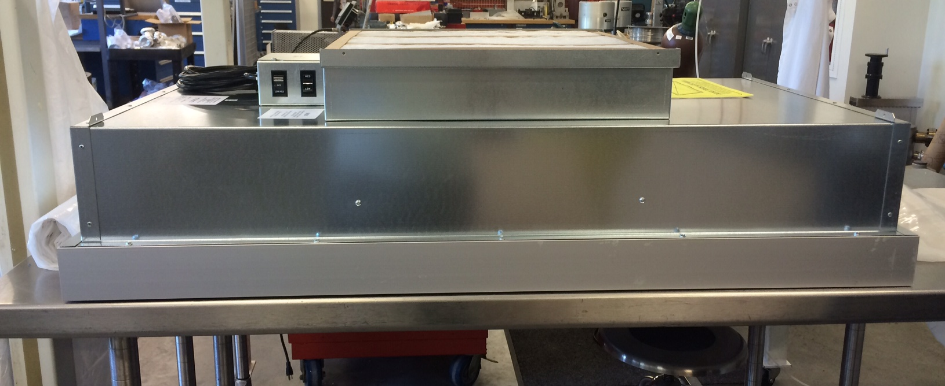
Currently in use for the last 2.5 decades at JLAB are the 4 ft x 2 ft Portable Laminar flow module which are 0.3 micron, 708 CFM, 100 FPM velocity, 99.99 Efficiency and Filter class K according to the manufacturer (Clean Air Products).

Slide 3
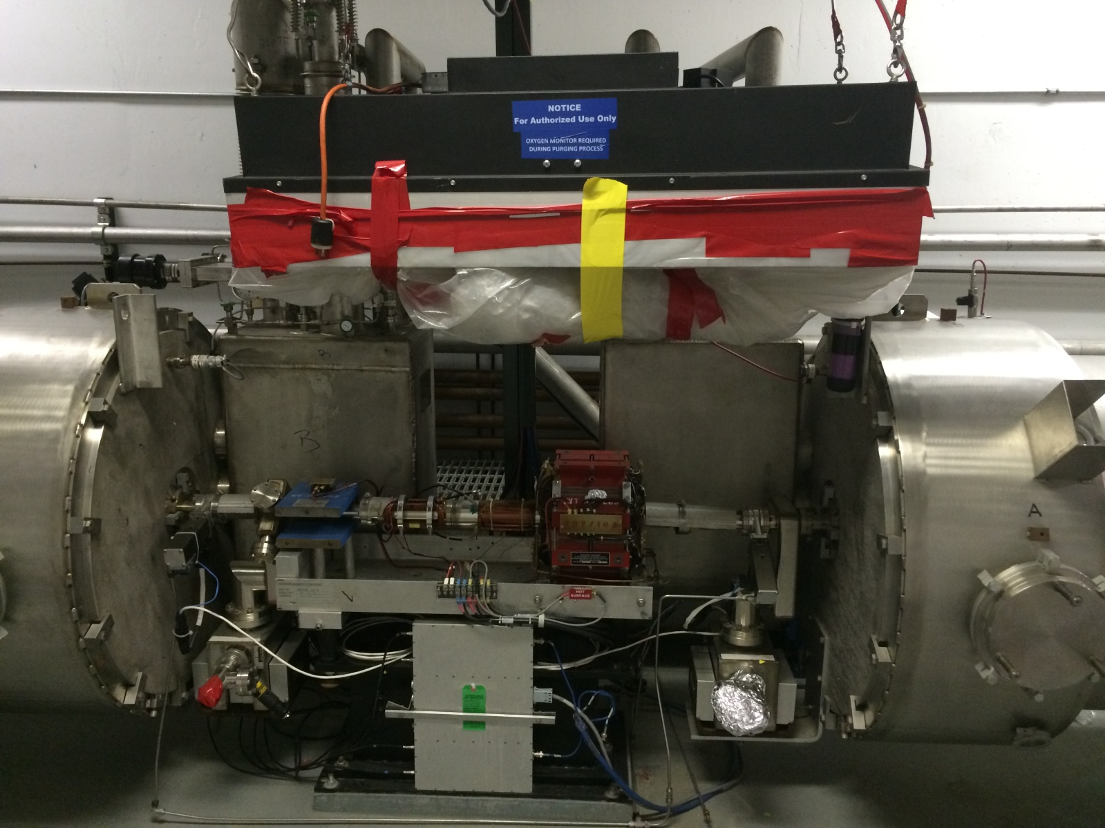
In the Past we used this set-up of Laminar Flow Hood that hung from the cable tray and the plastic curtains were taped around the girder to expose the beam line.

Slide 4
In order to improve on portable cleanroom vacuum beam line hook-ups it was determined that we needed to have a gowning-out and tool set-up area within the cleanroom enclosure. We did this by using two laminar flow hood modules, one for the gowning and tool set-up area and one covering the warm region beam line girder which is between two adjacent Cryomodules.
Both areas are connected via a plastic curtain partition. The flow hood over the warm region girder sits lower to fit under the cable tray where the Technician will perform the work kneeling.
The floor is covered and taped in plastic sheets and the walls and all surfaces are cleaned using SRF Procedures etc.

Slide 5
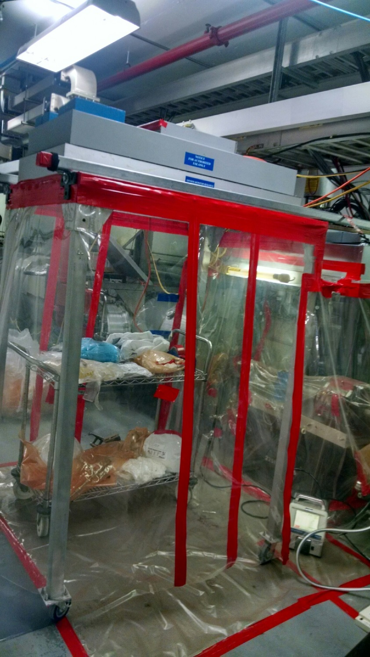

Slide 6
Dimensions of the Flow hood
Large side 65”H x 40”W x 50”L
Small side perpendicular to larger side
54”H x 36”W x 40”L
Tunnel from Wall to Waveguide is 68” Wide

