Slide 1
Summary of NEG material, installation configuration
Marcy Stutzman and Kurt Macha

Slide 2
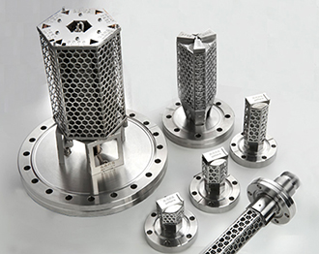
NEG materials
P-Gun uses laminated strips: known dust issue
Sintered material ST172
Newer sintered material: ZAO
  Lowest dust for NEG materials
  Designed to run warm, High capacity
  We will operate at room temperature
    Better base pressure
Installed CapaciTorr HV 200, ZAO, Ti-Zr-V-Al alloy
  No pump housing, no heater, ~350 L/s for hydrogen
ZAO-UHV being developed
  Designed for room temperature operation
  May have more dust than ZAO-HV?
  Requires testing – likely candidate for future

Slide 3
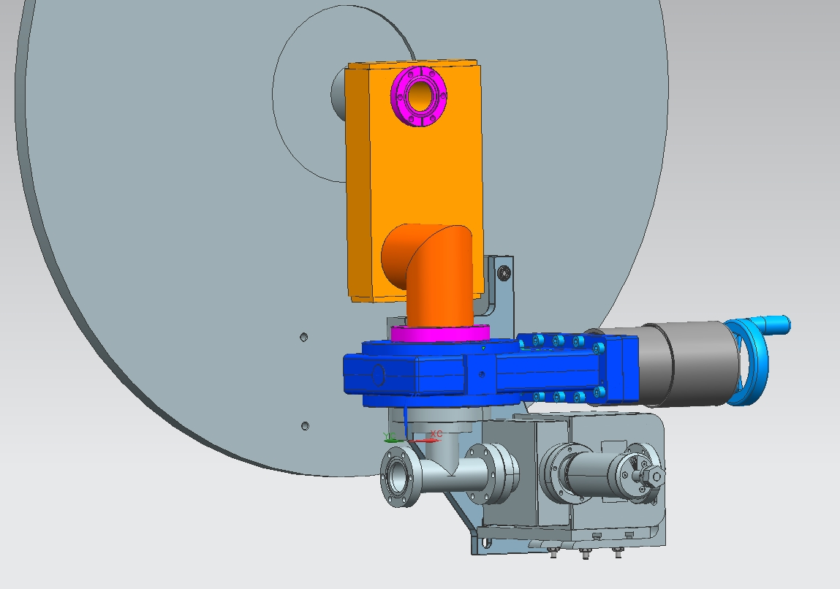
As installed: Cryomodule
NEG to be installed here

Slide 4
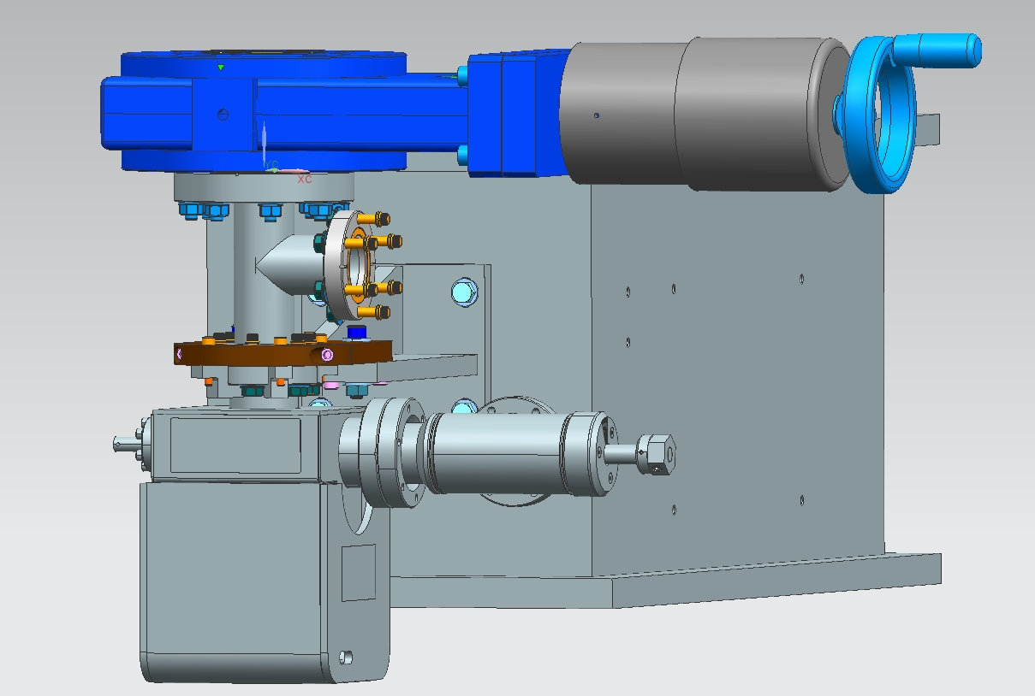
As installed: Girder
NEG to be installed into a CF nipple
Then installed here

Slide 5
Calculated pump speeds
Before:
  35 L/s ion pump at pump drop
After:
  gate valve, tee, 25 L/s ion pump and 350 L/s NEG
  2.75” Tee: Speed ~ 75 L/s for hydrogen
  4.5” Tee: Speed ~ 116 L/s for hydrogen

