Slide 1
C50 Cavity pair Assembly Changes
Presented by Danny Forehand

Slide 2
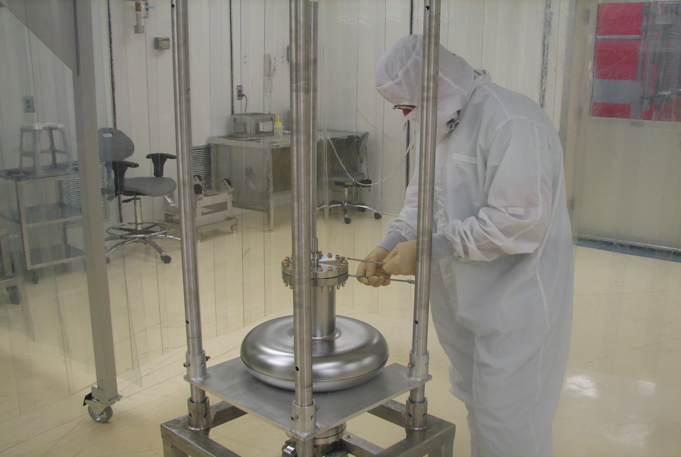
Biggest change since original C50 assembly comes from the facility changes
  The clean room had solid floors with return flow on the sides. Many areas had horizontal laminar flow
  Class 10 sub-assembly clean room area was a small curtained off area with extra filtration and vertical laminar flow in a class 100 space

Slide 3
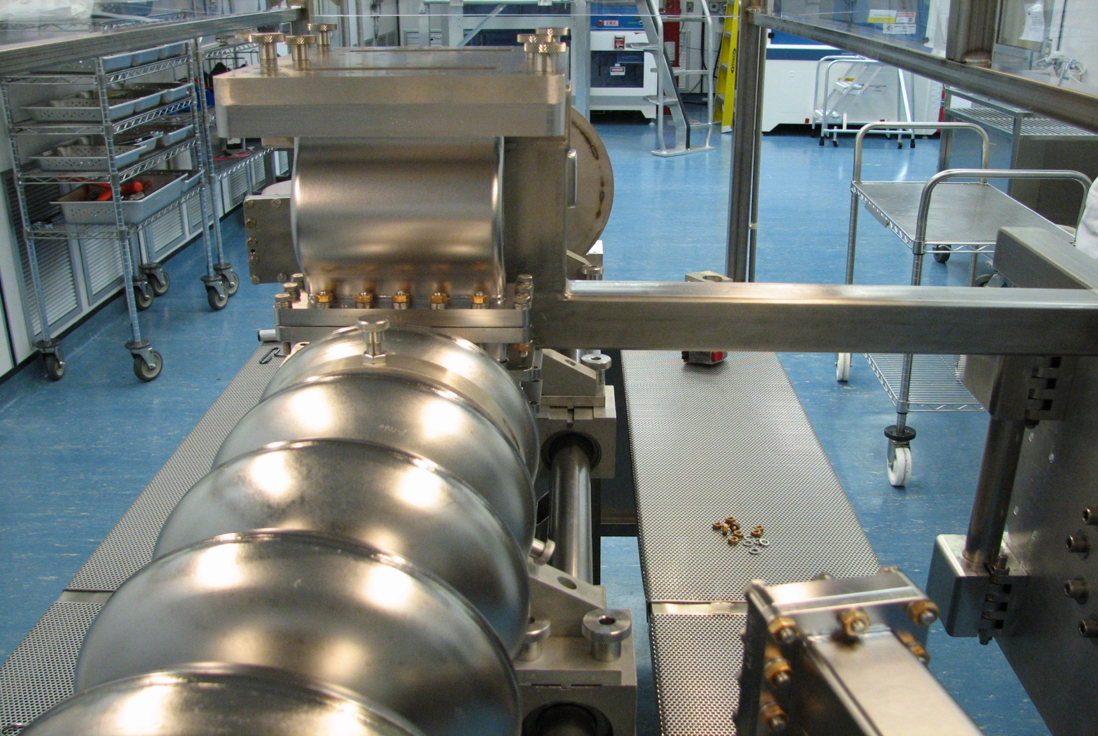
  Pairs were assembled in a class 100 area with the use of a “salad bar” style laminar flow assembly stand. This provided good vertical laminar flow, but was limited on space for the technicians performing the assemblies
  HPR and BCP machines lived in the space at the other end of the room

Slide 4
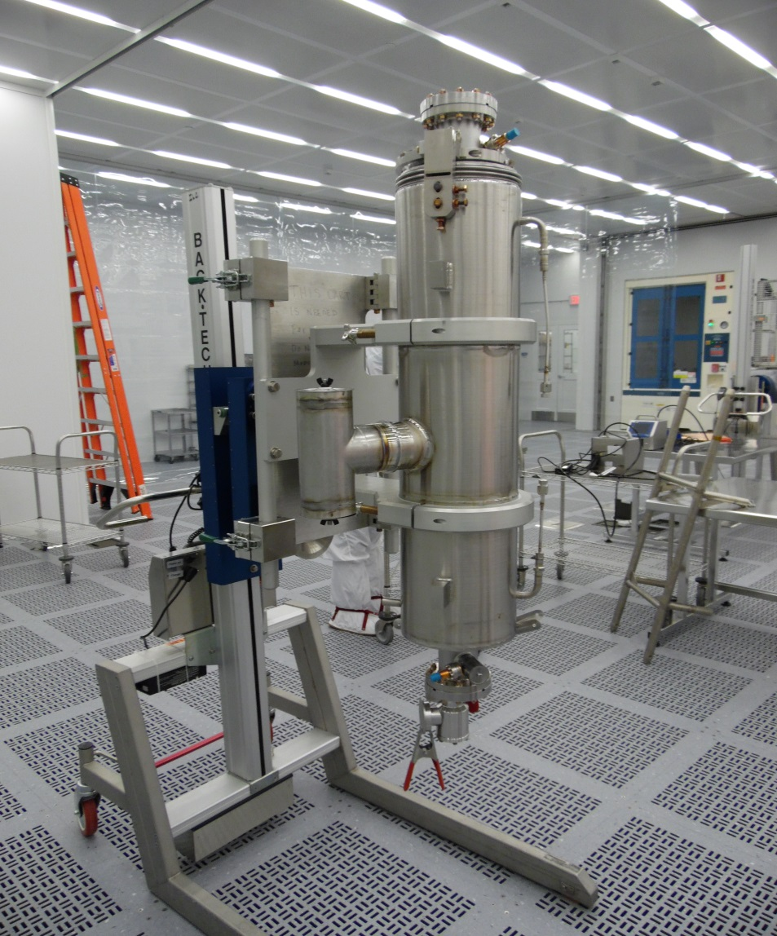
  The new facility has vertical laminar flow with open grated floor tiles, allowing the flow to continue into the return plenum .
  Only the front of the BCP and HPR machines are exposed to the room. All the mechanics of the machines are outside the clean space.
  The entire space could be considered “class 10”

Slide 5
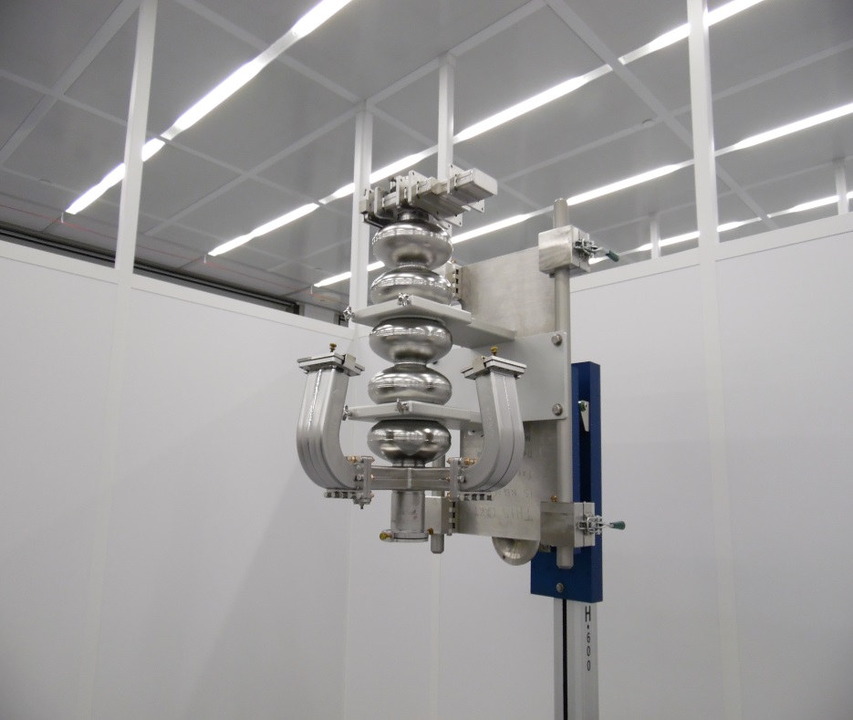
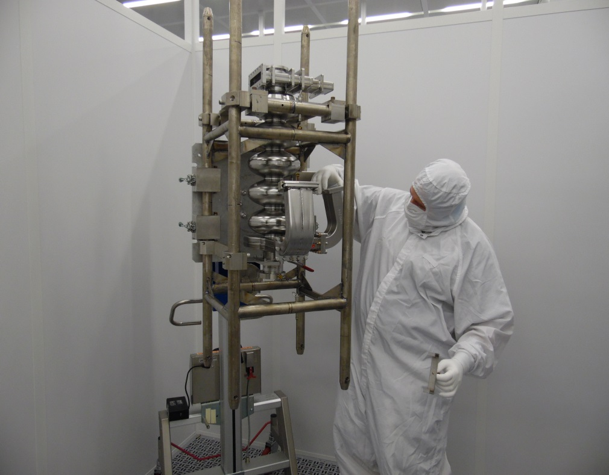
This facility allows all preparation of parts and sub-assemblies to take place in a class 10 environment as well
Procedural changes are made if we feel the new procedure will improve the level of cleanliness during assemblies
  One example of this would be removing the cavities from their cages only with the cage several feet above the ground
We continue to make tooling changes and upgrades to allow for a “cleaner” assembly
  A new two armed fixture for the back techs allow for a much “cleaner” removal of cavity from its cage
  We can also do some of the pre-assembly work in this fixture allowing for less particle contamination

Slide 6
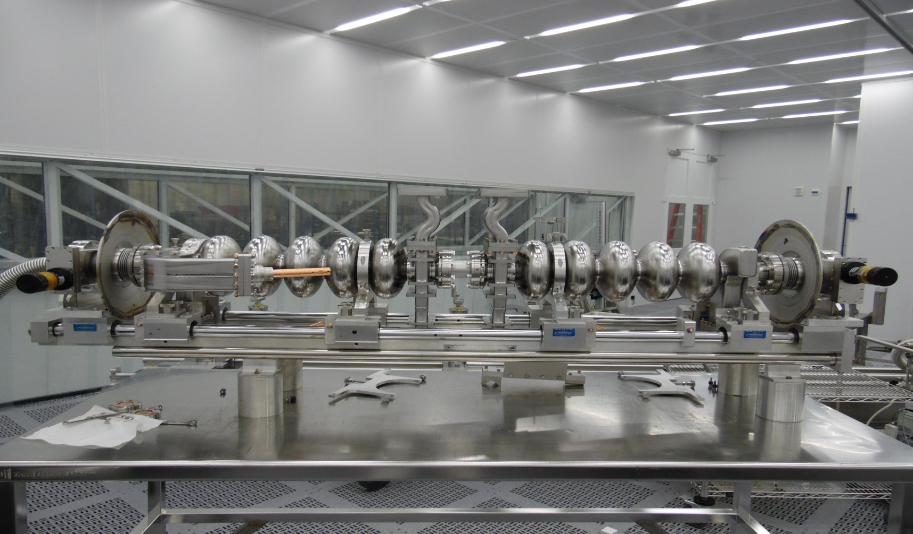
We have also develop a fixture for holding and aligning the inner adapter during pair assembly, which will minimize the need to have hands near any open cavities flanges
We have developed an alignment tool for the doglegs and windows.
This tool is still being tweaked for finite alignment performance.
This tool will allow for much less time having the cavity FPC flanges open during assembly and will also allow the techs to stay further away from open cavities during assembly

Slide 7
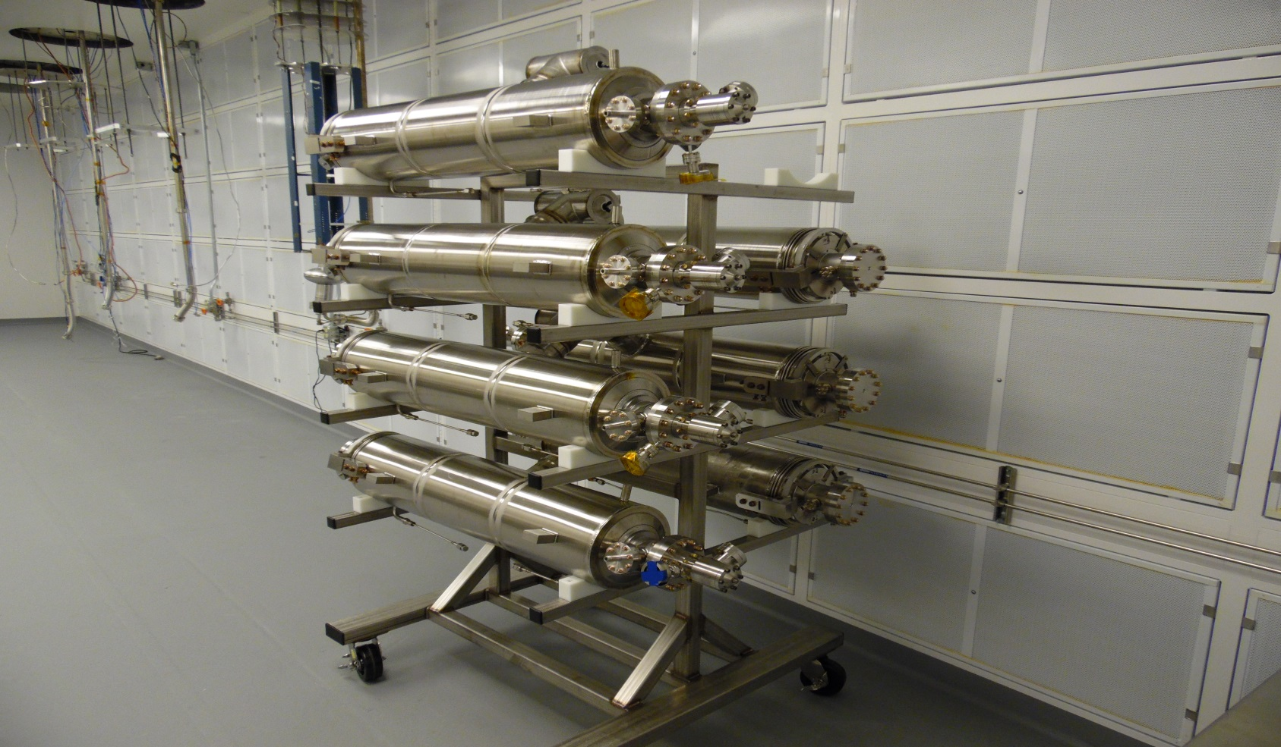
The pairs are pumped down and leak checked before moving to the Vertical Attachment Area to be placed on a test stand
We are using a pump cart outfitted with the slow-pump down metered needle valve ( I will cover this a little more in the girder presentation)
The VAA is an improved facility as well. We could probably consider this at least a class 100 clean room.
We developed the use of risers for the test stands to sit on while hanging in the VAA, allowing the vacuum attachment to take place several feet above the ground

Slide 8
We are making use of the new slow bleed-up system if we have a small component leaking or needing to be replaced for any reason
This allows us to bleed-up the pair and make the change-out without having to disassemble the entire pair and start over
We typically have installed an ion pump to each pair after the successful vertical test, allowing the pair to continue pumping during the entire process of being placed into a cryostat
C50-12 had an ion pump on only the first pair
The other three pairs in this cryomodule had a gauge installed to monitor vacuum but no active pumping when handed off to the cryomodule group

