Slide 1
Post-mortem investigation of leaky gate valves condition of Viton O-ring in terms of particulate shedding and nature of failure
Greg Marble, Rongli Geng
Six-Month Follow-Up on Action Items of Feb 2016 CEBAF Field Emitter Workshop
September 12, 2016, JLAB

Slide 2
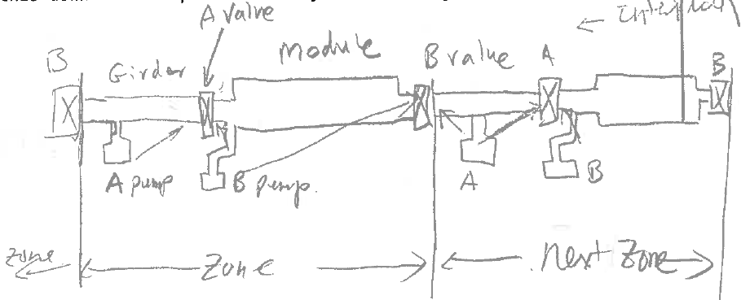
Beamline Valves Removed from CEBAF during NL12 Cryomodule Swap
VBV1L11B
VBV1L13A
NL12
Both had known leak
Both removed and replaced during SAD 2016

Slide 3
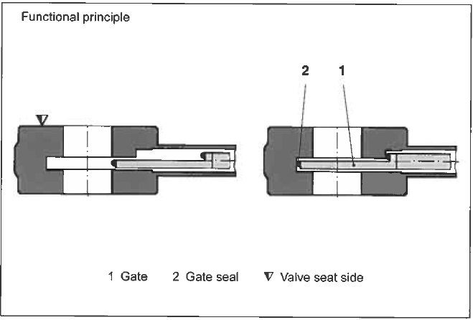
VAT Mini UHV Gate Valve
Sealing Mechanism

Slide 4
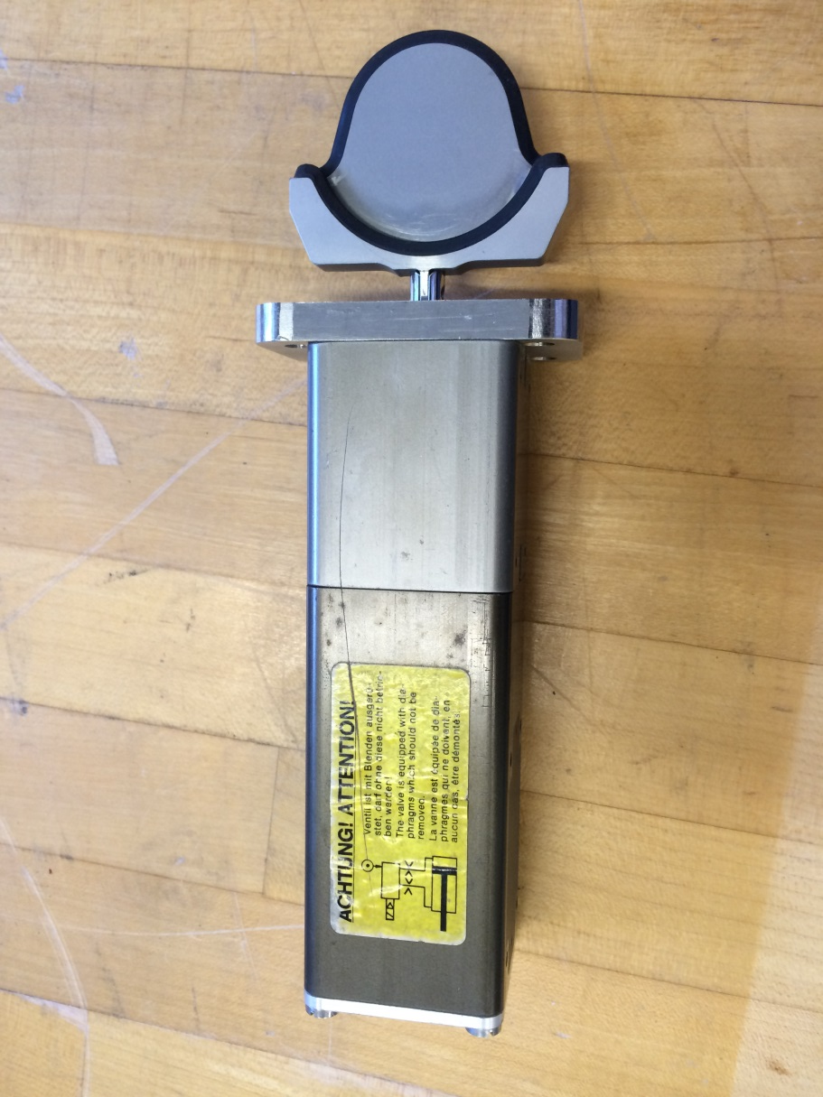
1A Large particle
1B Cav side/large “drop”
1C Gird side/small “drop”
1D Seal surface/track and particles
#1

Slide 5
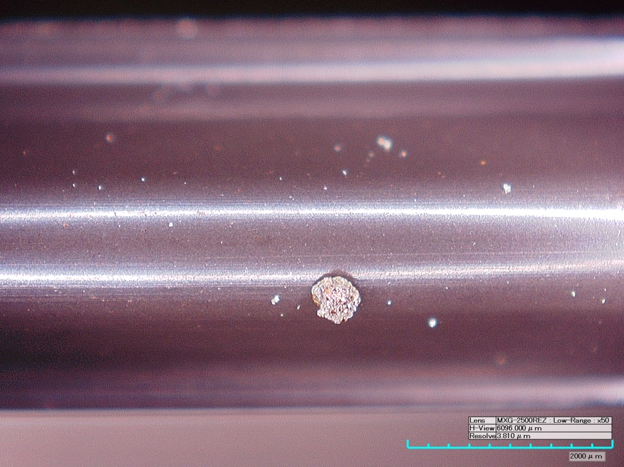
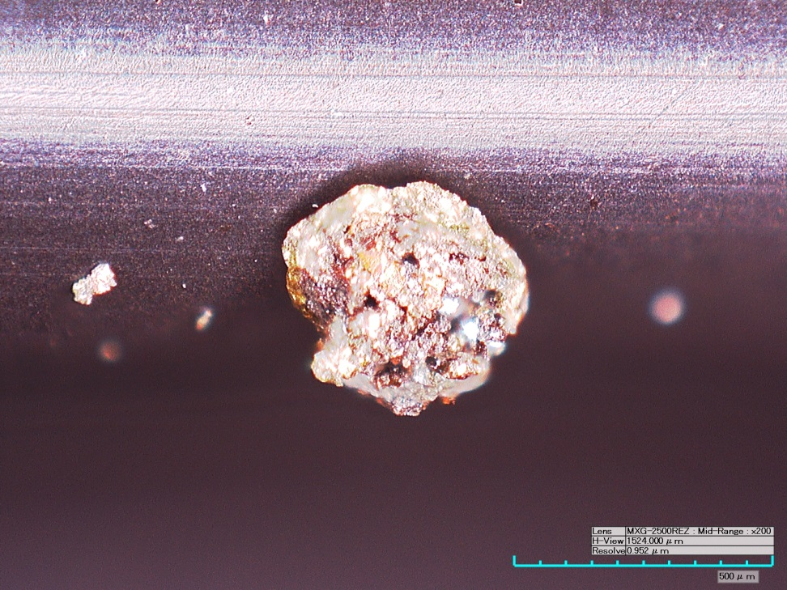
1A Large Particle
This particle is partially embedded into O-ring, it survived air blowing by mouth

Slide 6
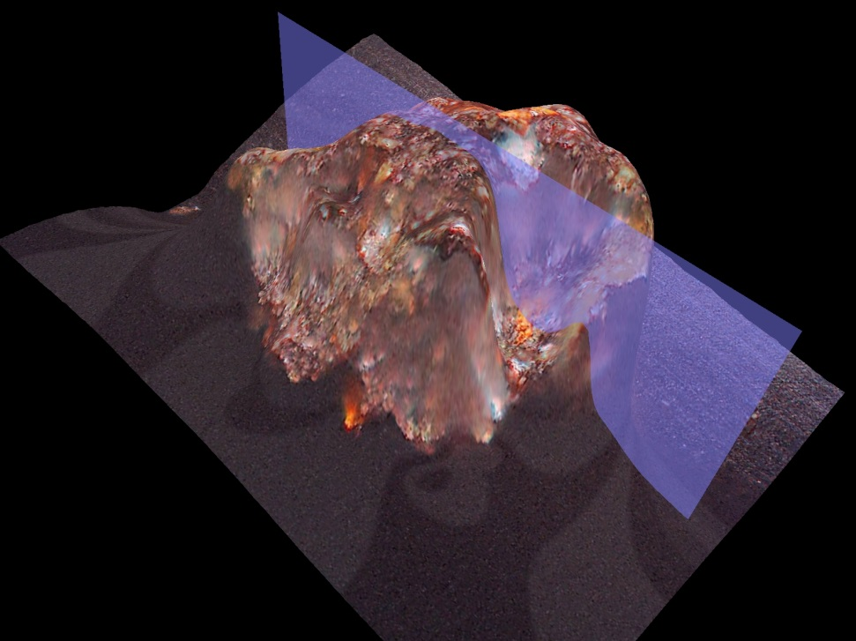
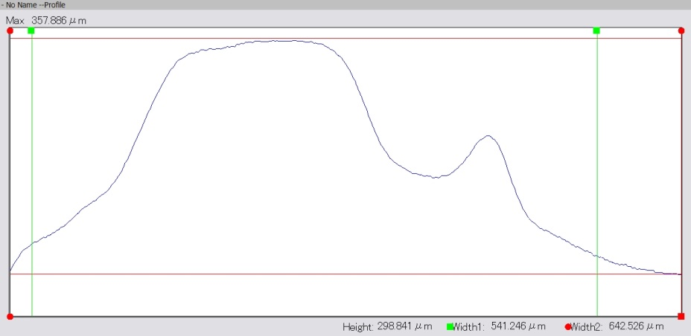
Large Particle Profile
~ 0.5 mm wide, ~0.4 mm height

Slide 7
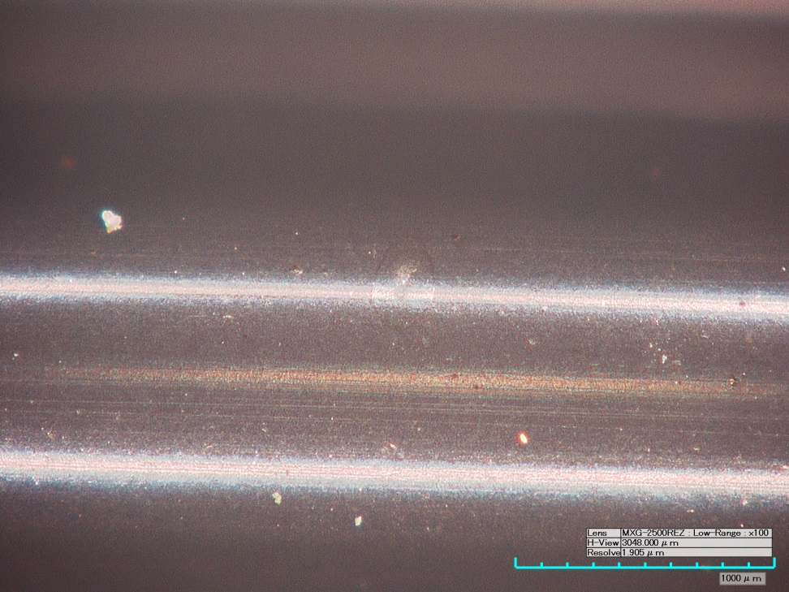
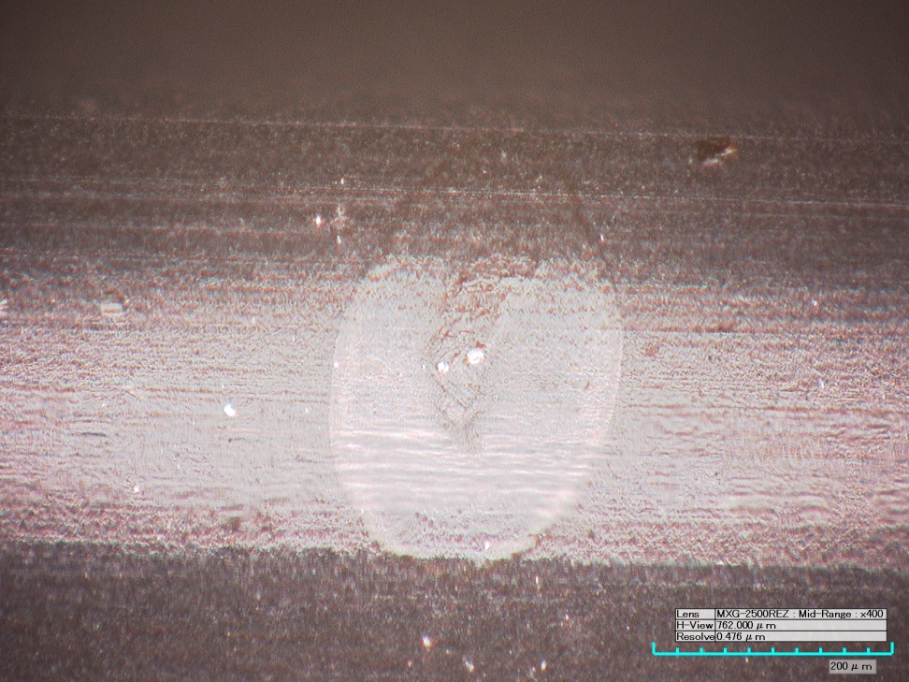
1B Cav side/large “drop”

Slide 8
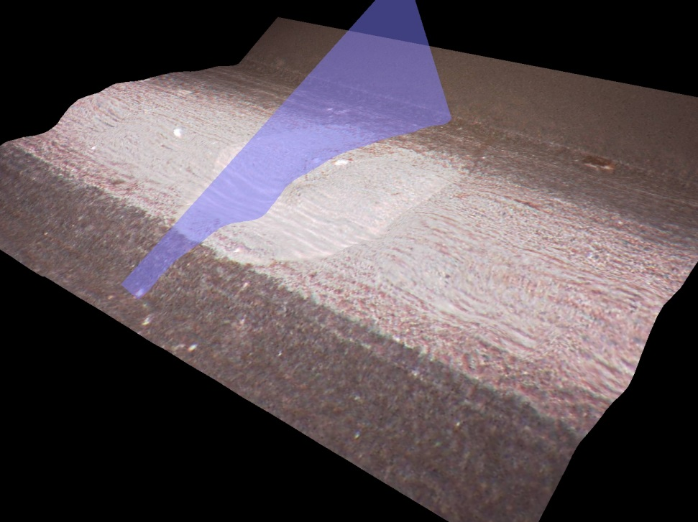
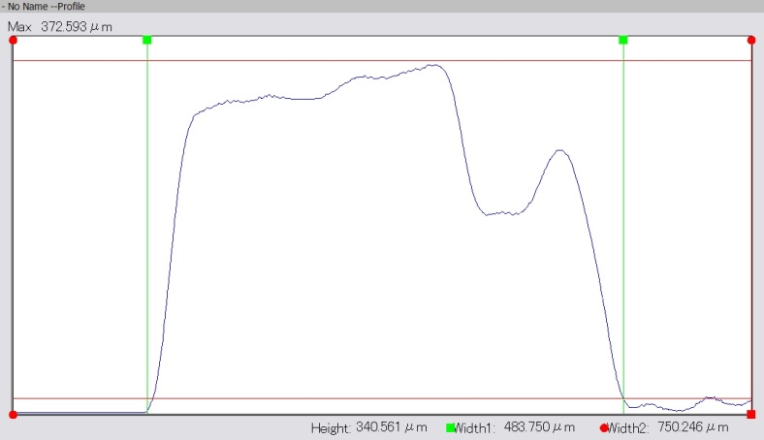
Large “drop” profile
~ 0.5 mm wide, Peak height 0.37 mm

Slide 9
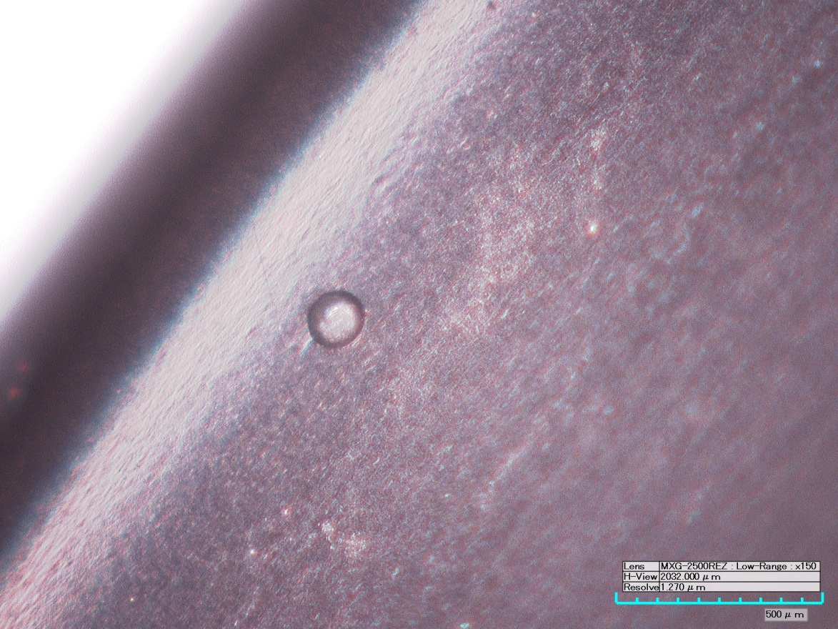
1C Gird side/small “drop”

Slide 10
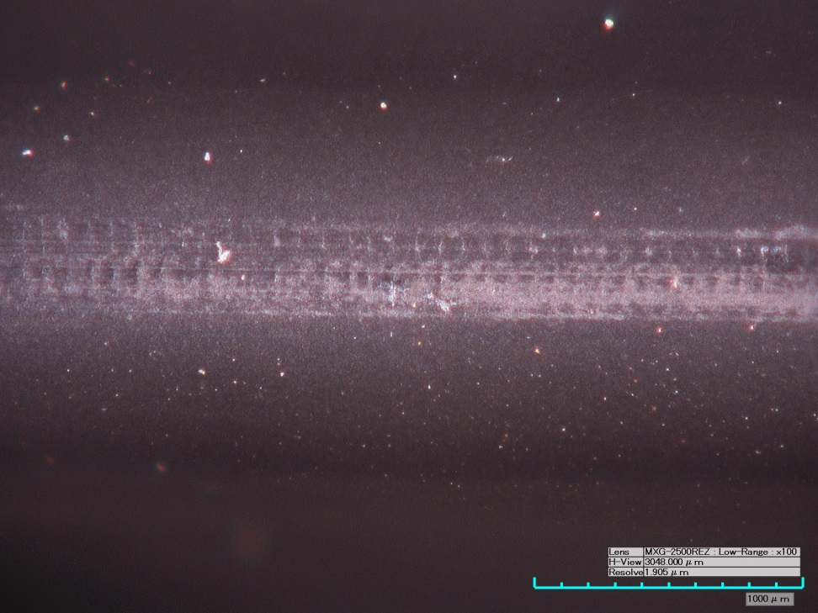
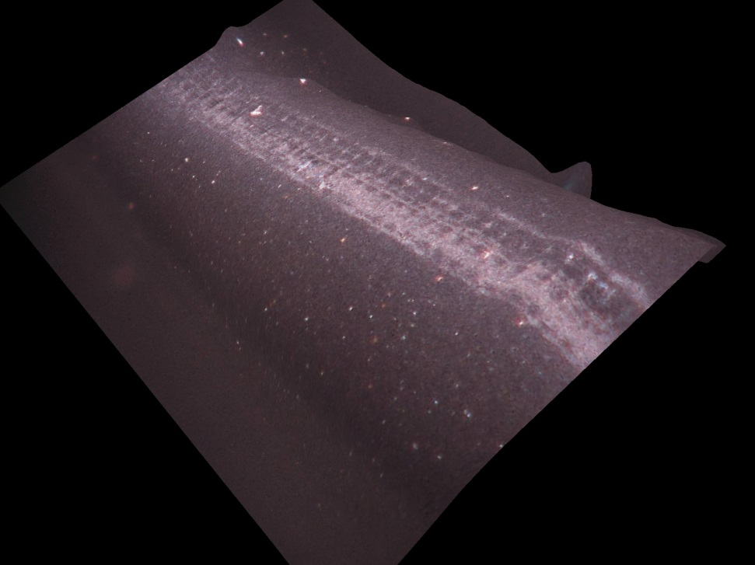
1D Seal surface/track and particles
Many particles remain on and near sealing surfaces even after blowing with air gun

Slide 11
2A Seal surface/ multi particles
2B Seal surface/track
#2

Slide 12
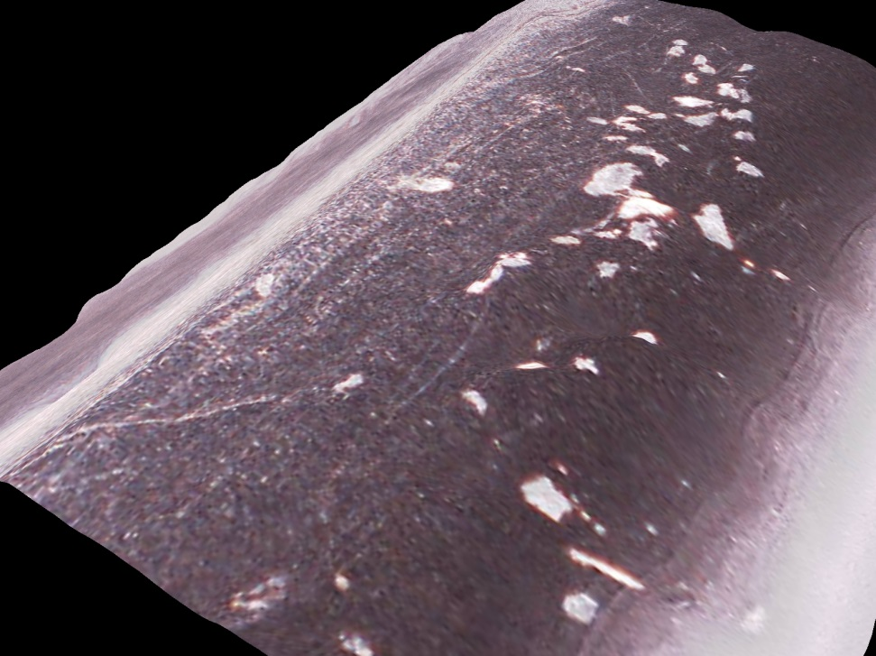
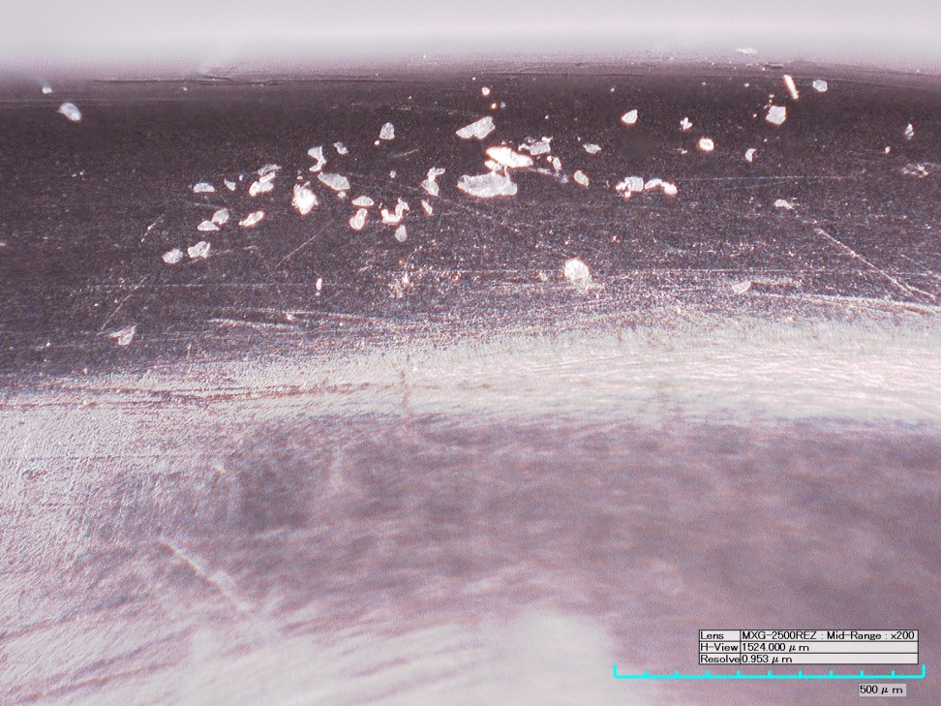
2A Seal surface/ multi particles
In three areas, multiple particles are embedded into O-ring along sealing surface

Slide 13
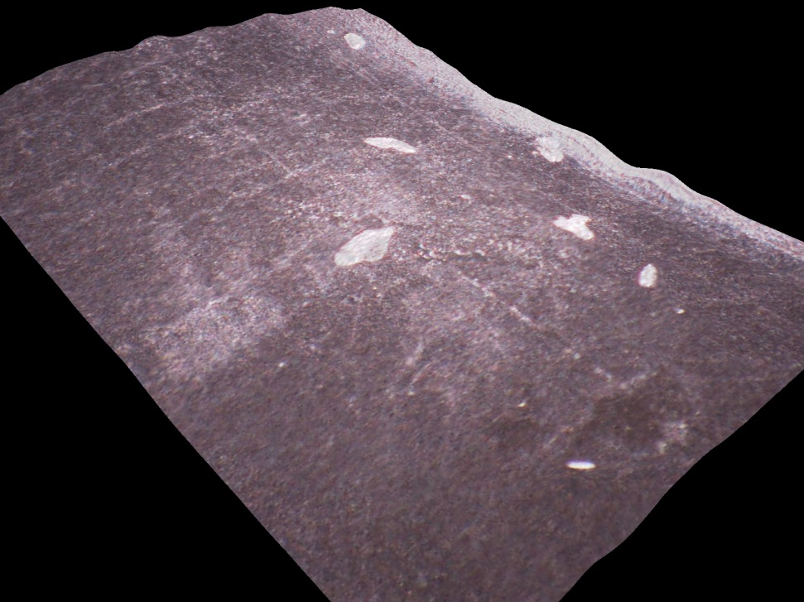
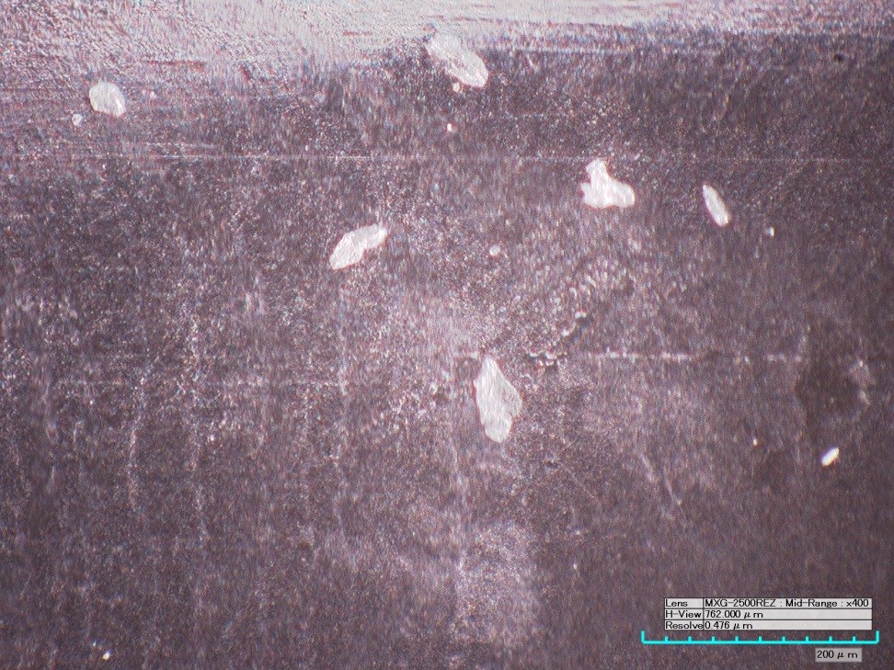
2B Seal surface/track

Slide 14
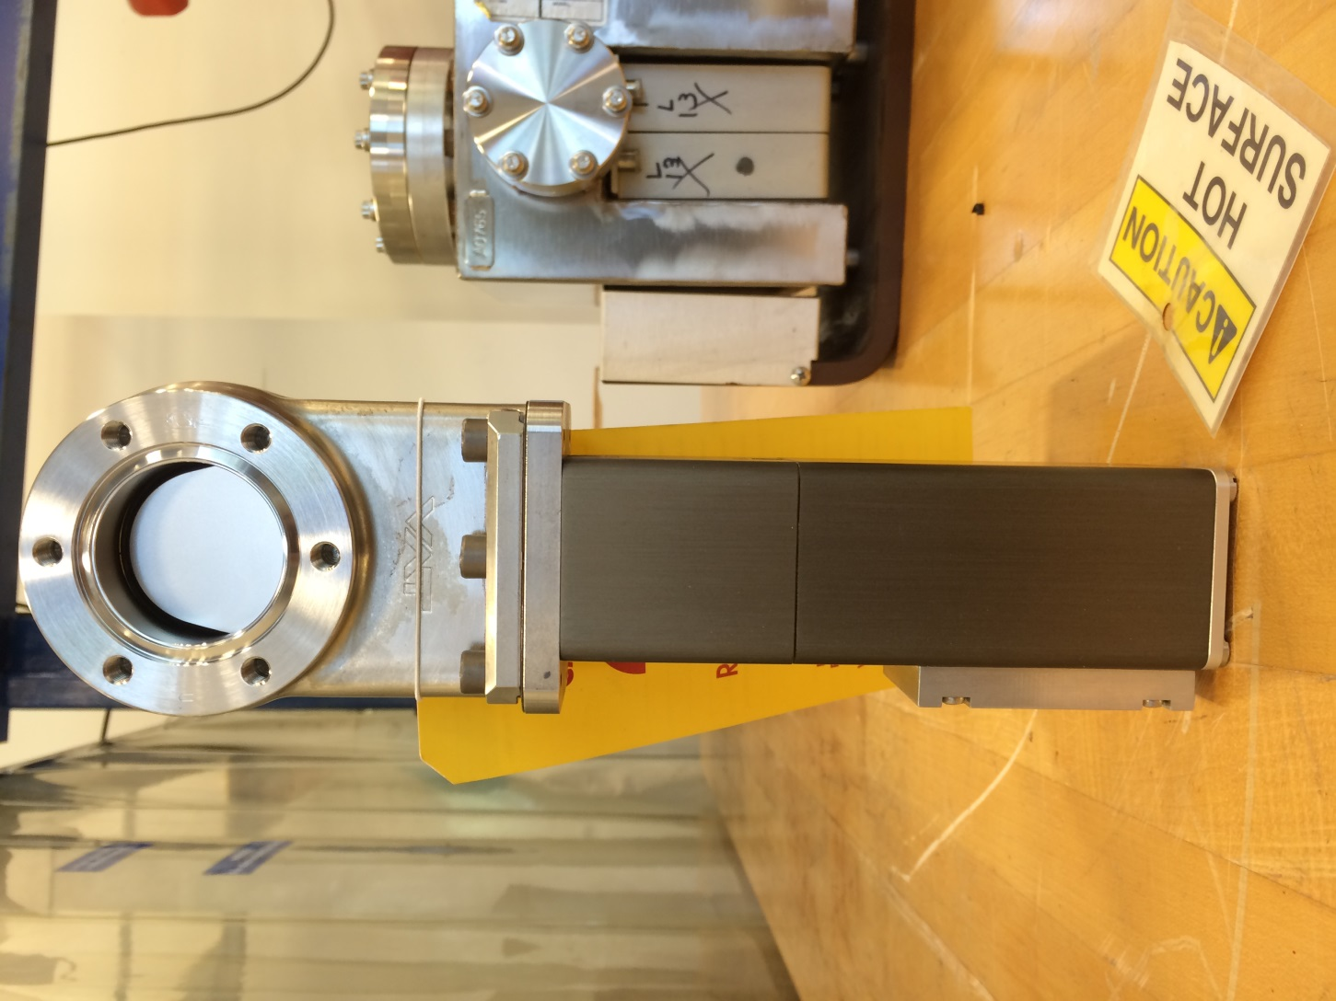
Gate inside valve Body

Slide 15
Current Understanding
O-rings visually appear to be normal – no cracking or fragmentation observed (contrary to the claim of radiation damage?)
Particulate embedment into the sealing surface seems to be the root cause for leak.

