Slide 1
LCLS-II 9 cell production update and change of recipe update
Ari D. Palczewski
JLab
11/03/2016

Slide 2
History
~ late 2015 it was suggested to look at flux trapping in LCLS-II material. FNAL data from OTIC Ninxia material suggest OTIC material would not meet LCLS-II spec.
~ spring 2016 - 16 sheets of LCLS-II material was delivered to JLab to make 4 cavities to looking at flux trapping and the LCLS-II recipe (9 cell already underway) - Data to follow.
~ June, 2016, flux trapping is a major issue, Ningxia material re-EP 100 more microns and retested, all material did not meet spec (2.7e10 in 5mG field) but there were manufacturing issues.
~July 2016, JLab results confirmed by FNAL and 900°C modified recipe was tried on Tokyo Denkai material with success. Ningxia material did not change as much, and needs further research. Project decided to fast track all Tokyo Denkai material and push Ningxia off. Project had 4 cavities made with modified 900°C recipe. And then ~2 weeks all TD material was switch to 900C recipe before 9 cell results.
~ Aug 2016, 9-cells arrive with 800°C recipe confirming that flux trapping is a issue, but low magnetic field environments meet spec 2.5e10@ 16MV/m @ JLab– data to follow.
~ Oct 2016, 9 cell TD material arrives and cavity test are good and meet spec in 5mG field– data to follow – I hope FNAL will show.
Now- NX material recipe change is deemed necessary, higher temperature annealing is needed for short term fix, sample studies are proposed and one cavity will be annealed at 950°C as a shot in the dark recipe change. (FNAL)
Now – We do not know how to spec material to get good flux expulsion from any vender

Slide 3
contributions
Material analysis – Frank Marhauser, Jacek Sekutowicz (DESY), and Gigi Ciovati
RF/Flux expulsion data test from FNAL – Anna Grassellino, Alex Melnychuk, Sam Posin
9 cell testing data - Kirk Davis, Liang Zhao, Christiana Grenoble JLab

Slide 4
LCLS-II material spec
Parameter | Unit | E-XFEL / LCLS II
Year | - | 2007&2010 / 2014
RRR | - | > 300
CHEMICAL COMPOSITION
Ta | % or weight ppm | ≤ 0.05 %
W | % or weight ppm | ≤ 0.007%
Ti | % or weight ppm | ≤ 0.005%
Fe | % or weight ppm | ≤ 0.003%
Si | % or weight ppm | ≤ 0.003%
Mo | % or weight ppm | ≤ 0.005%
Ni | % or weight ppm | ≤ 0.003%
H₂ | % or weight ppm | ≤ 2 w-ppm
N₂ | % or weight ppm | ≤ 10 w-ppm
O₂ | % or weight ppm | ≤ 10 w-ppm
C | % or weight ppm | ≤ 10 w-ppm
MICROSTRUCTURE |  | 100% recrystallized. Uniform size and equal-axed grains
Grain size | ASTM µm | Predominantly ≥ 6 ≤ 45
Maximal grain size | ASTM µm | > 4 < 90
MECHANICAL PROPERT.
Tensile strength, Rm * | N/mm² | > 140
Yield strength, Rp0.2 * | N/mm² | 50 < Rp0.2 < 100
Elongation, AL 30 * | % | ≥ 30
Hardness, HV (min. load 10 N) | - | ≤ 60
26 Total heat lots from Tokyo Denkai (TD) material - 3155 sheets
16 heat lots from Ningxia orient tantalum industry co ltd (OTIC or Ningxia or NX) - 2745 sheets
From Jacek

Slide 5
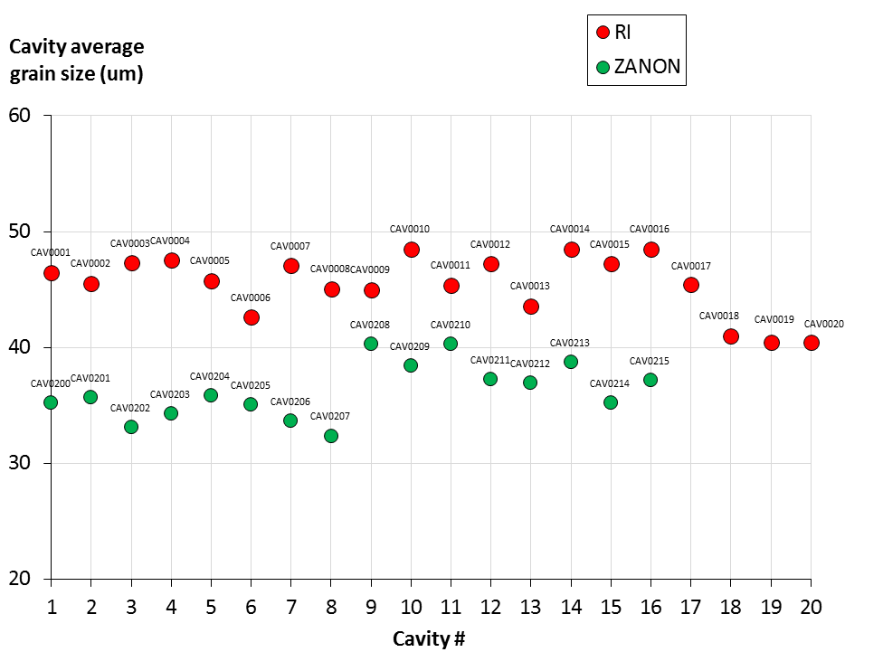
Cavities welded so far
RI was using TD and Zanon was using NX, now all TD

Slide 6
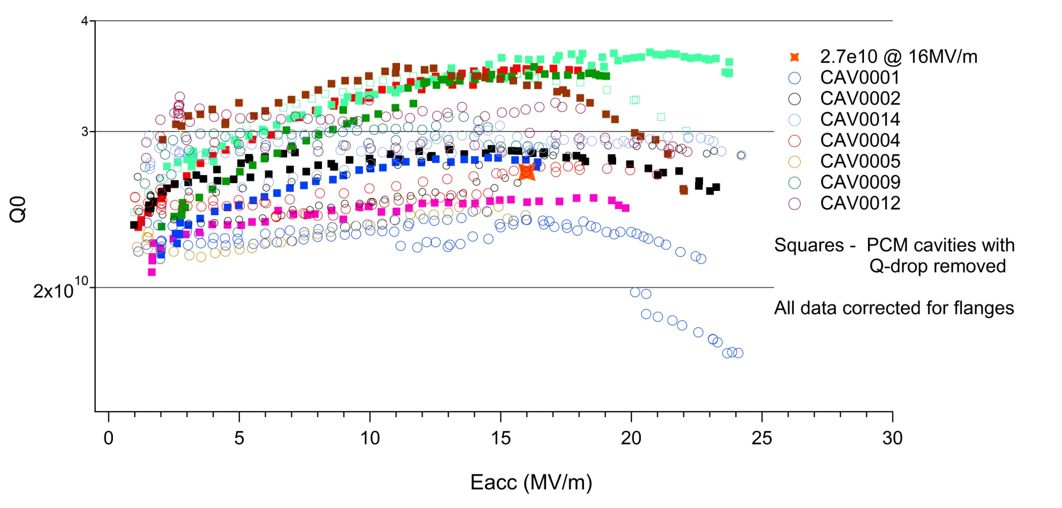
9 cell production cavities - TD
Baseline recipe 150 bulk EP(current) 800°C 3 hours, 2N6, EP 7(current)

Slide 7
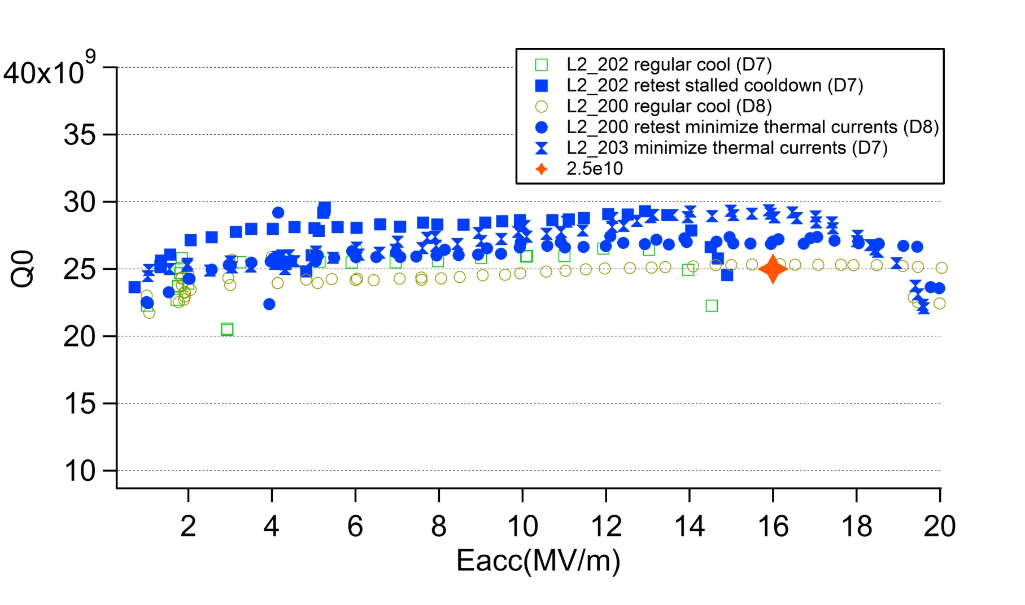
9 cell – NX material from Zanon (first 3)
Initial results suggest the thermal currents in the HV account for 1-1.5ηΩ of losses – slow cooling is better if fields are low enough ~0.7 to 1.5mG average because material traps all the flux.

Slide 8
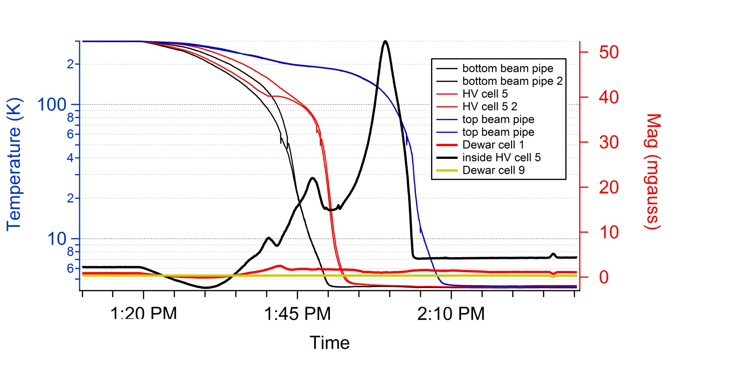
Thermal currents in 9 cell – 202 fast cool
Thermal current @ return chimney are trapped ~ 3mG extra

Slide 9
Data sampled – only had half data sheets at time?
Not sampled?
RDTNX-1,4*
RDTNX-2,3
RDTTD-2,4**
RDTTD-1,3
*FNAL data suggest I only took from astm 6 sheets, so could be mis-sampling material towards right.
** FNAL data suggest I may have slightly oversampled to left with ASTM 6.75 and not fully 7.

Slide 10
Change to 900°C recipe
Flux expulsion change 800°C to 900°C
Sample measurements – mechanical stability
RF tests new cavities

Slide 11
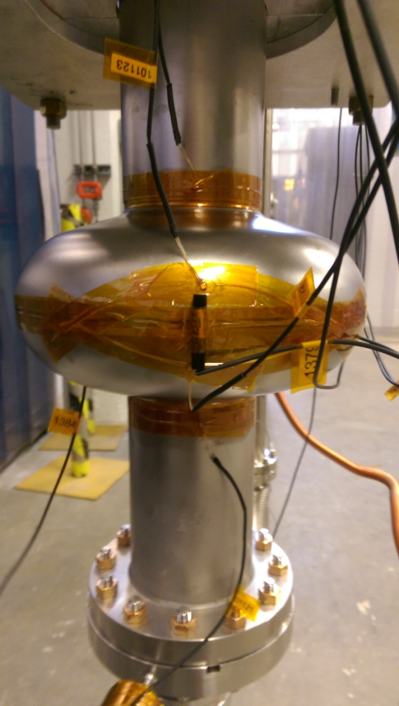
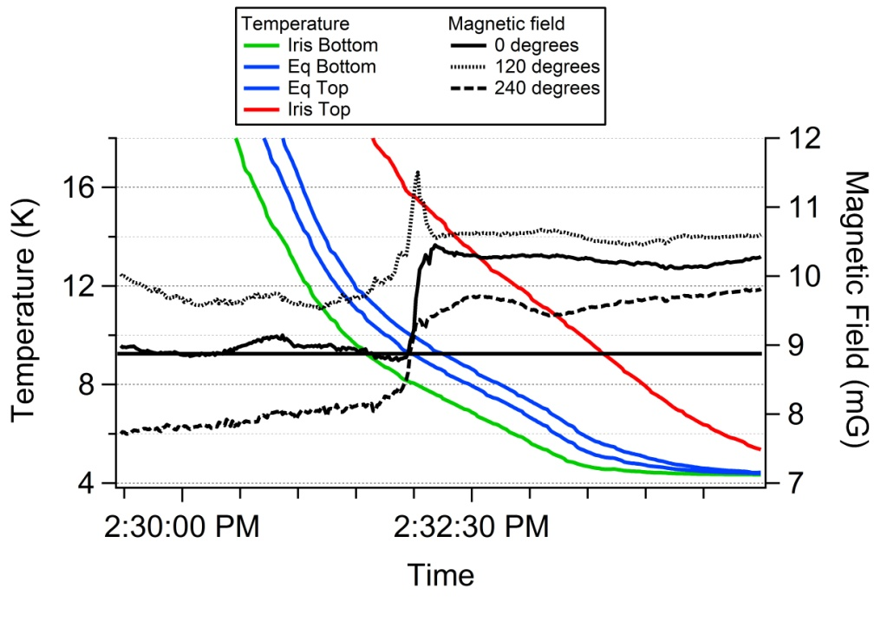
JLab setup – flux expulsion
Comp coils integrated into dewar at JLab → Evaluates flux expulsion in same manner as at FNAL
1 - Cernox 1cm above iris
2 - Cernox 2cm above equator
3 - Cernox 2cm below equator
4 - Cernox 1cm below iris
1
Flux gate (3X @ 0, 120 and 240°) all axial
2
3
4

Slide 12
Flux expulsion ratio – Delta T/cm

Slide 13
Flux expulsion 800°C vs 900°C
Ningxia 1 | Flux expulsion baseline 800°C (Jlab data) | Flux expulsion post 900°C 3 hours (FNAL data) | Ningxia 2 | Flux expulsion baseline 800°C (FNAL data) | Flux expulsion post 900°C 3 hours (FNAL data) | Tokyo Denkai 2 | Flux expulsion baseline 800°C (FNAL data) | Flux expulsion post 900°C 3 hours (FNAL data) | Tokyo Denkai 1 | Flux expulsion baseline 800°C (JLAB data) | Flux expulsion post 900°C 3 hours (JLAB data)*
ΔT |  |  | ΔT |  |  | ΔT |  |  | ΔT
2K | 10% | 46% | 2K | 2% | 5% | 2K | 23% | 69% | 2K | 14% | 71%
6K | 21% | 70% | 6K | 15% | 35% | 6K | 30% | 95% | 6K | 26% | 90%
10K | 30% | 80% | 10K | 20% | 42% | 10K | 34% | 100% | 10K | NA | NA
Absolute value between different labs and different test setups have not been fully calibrated, look at relative changes.
Both TD material show excellent expulsion after 900°C
Highest RRR/largest crystal size NX material shows “ok” expulsion after 900°C
Lowest RRR/smallest crystal size NX material shows minimal expulsion after 900°C
*Different test setup than 800°C data (800°C D7 and 900°C D3)
Table initially compiled by Anna Grassellino FNAL

Slide 14
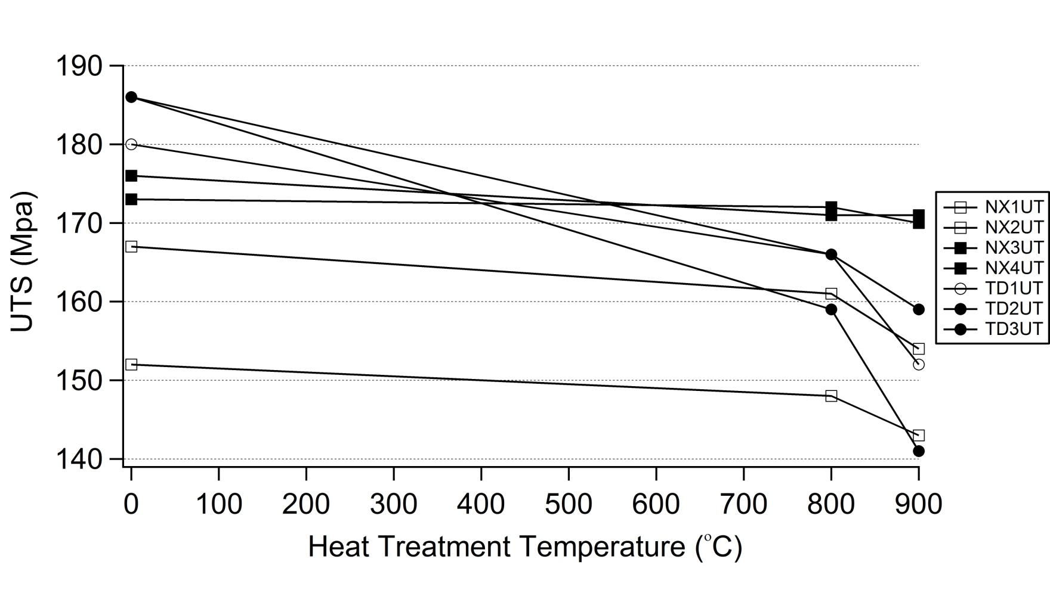
Tensile strength measurements (UTS)
No change in harder NX material

Slide 15
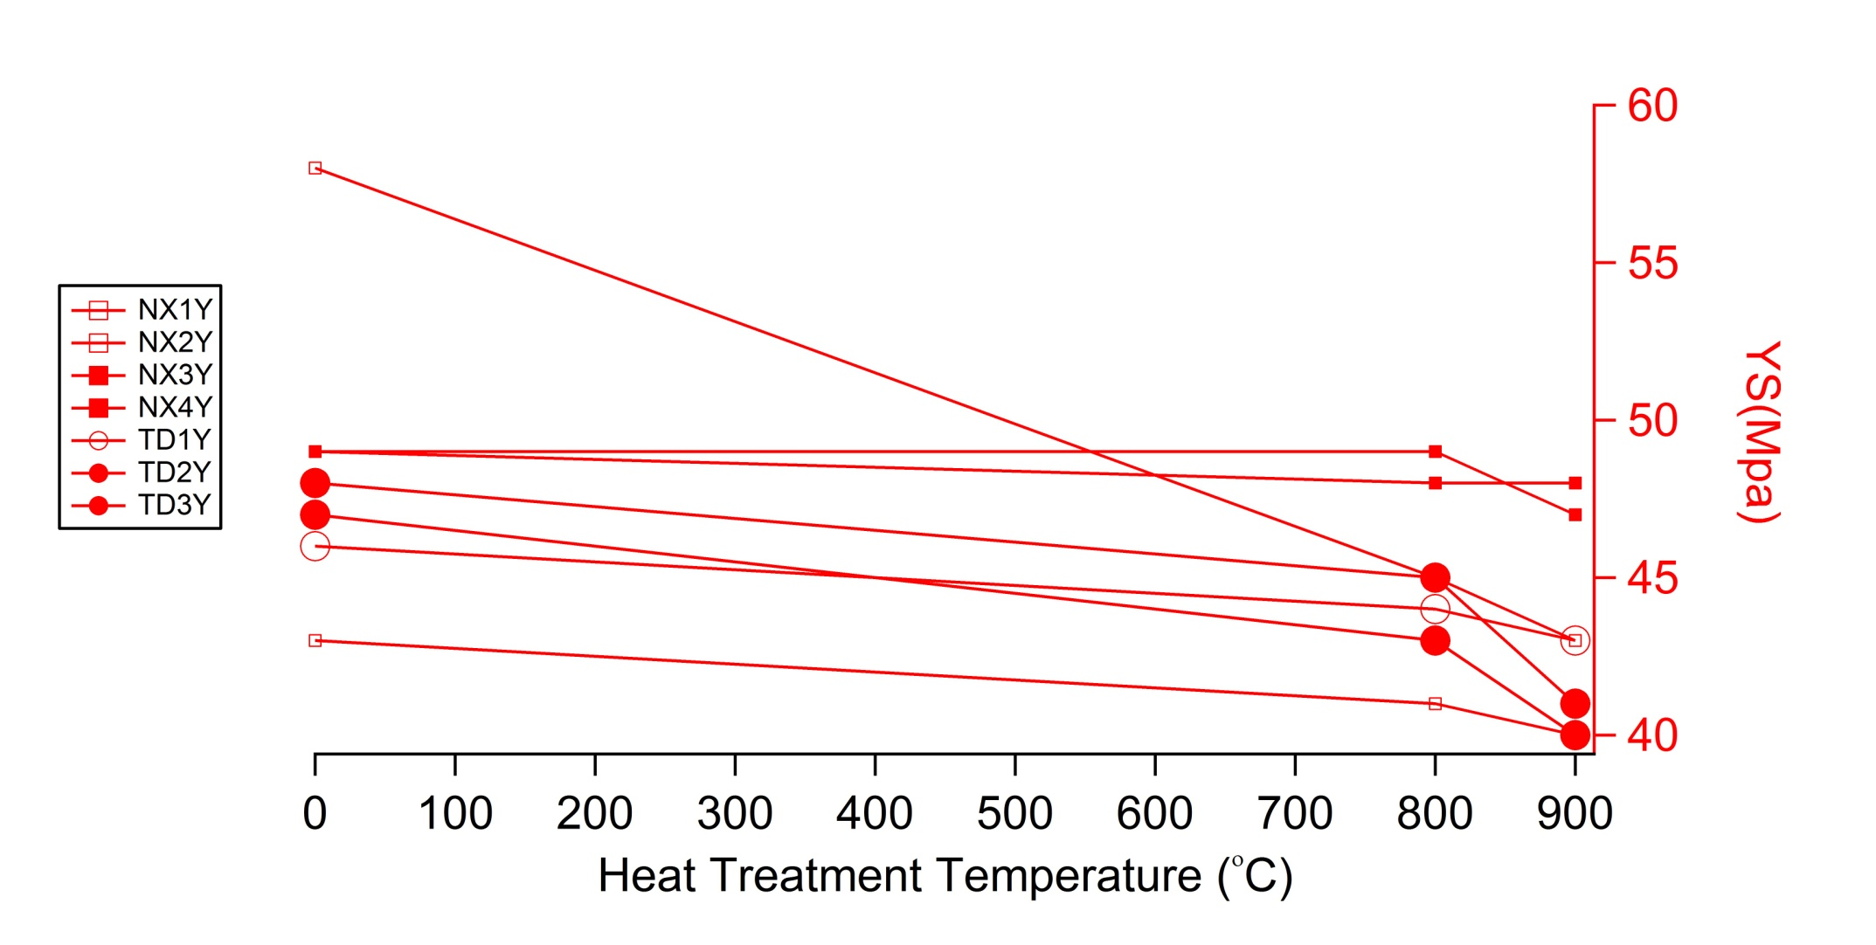
Tensile strength measurements (UTS)
Very small change in harder NX material

Slide 16
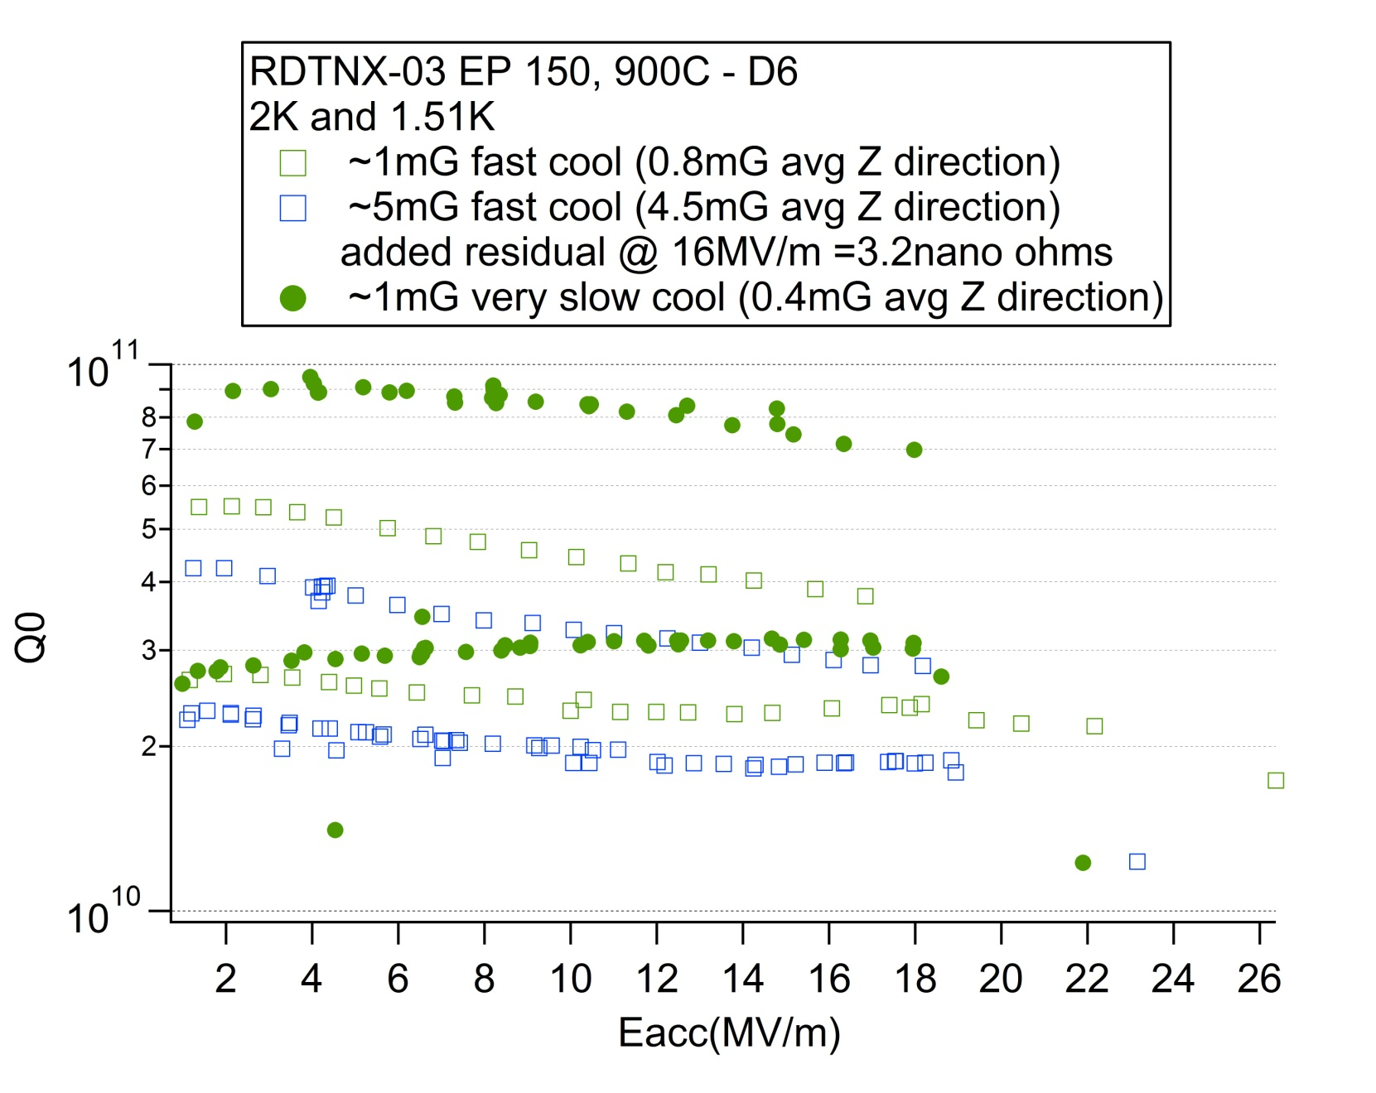
RDTNX-03 2k and 1.5K – EP 150 900°C 3h (Dewar 6)
Slow cooling always better if material traps all flux, because thermal currents are always generate and will be trapped along with background field

Slide 17
Backup

Slide 18
Tensile strength measurements (UTS)
No change in harder NX material

Slide 19
Tensile strength measurements (UTS)
Very small change in harder NX material

Slide 20
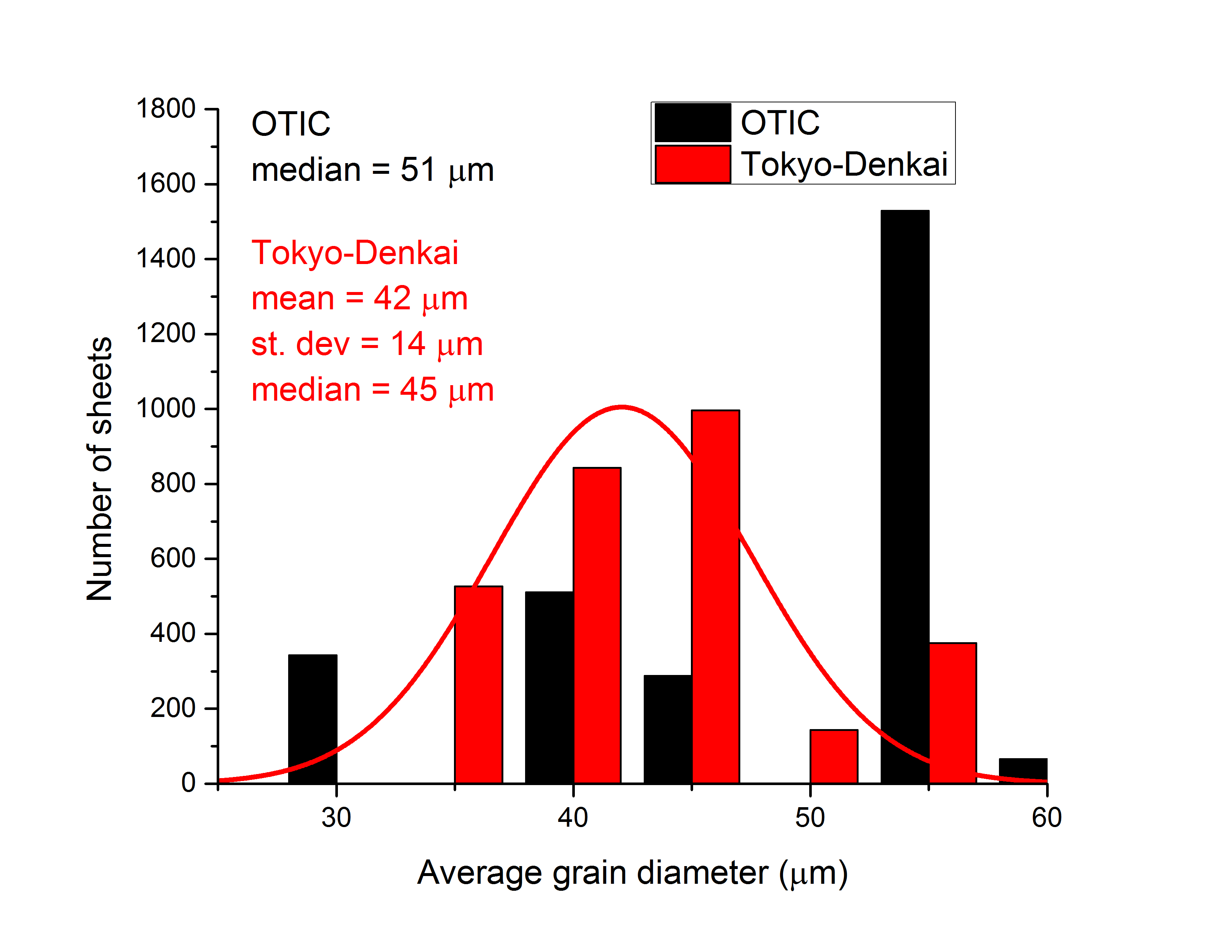
LCLS-II material distribution
Gigi’s plots

Slide 21
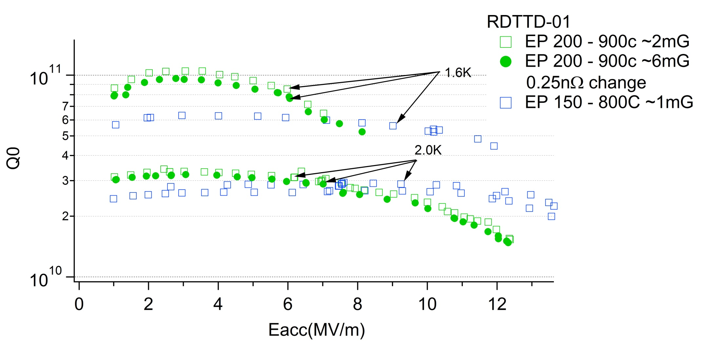
RDTTD-01
For some reason this cavity turned out very bad after second EP
But flux expulsion is good.

Slide 22
TD04 Q vs E, 2 K – EP 150 900°C 3h
Data measured by Alex Melnychuk - FNAL

Slide 23
TD04 Q vs E, 1.5 K – EP 150 900°C 3h
Data measured by Alex Melnychuk - FNAL

Slide 24
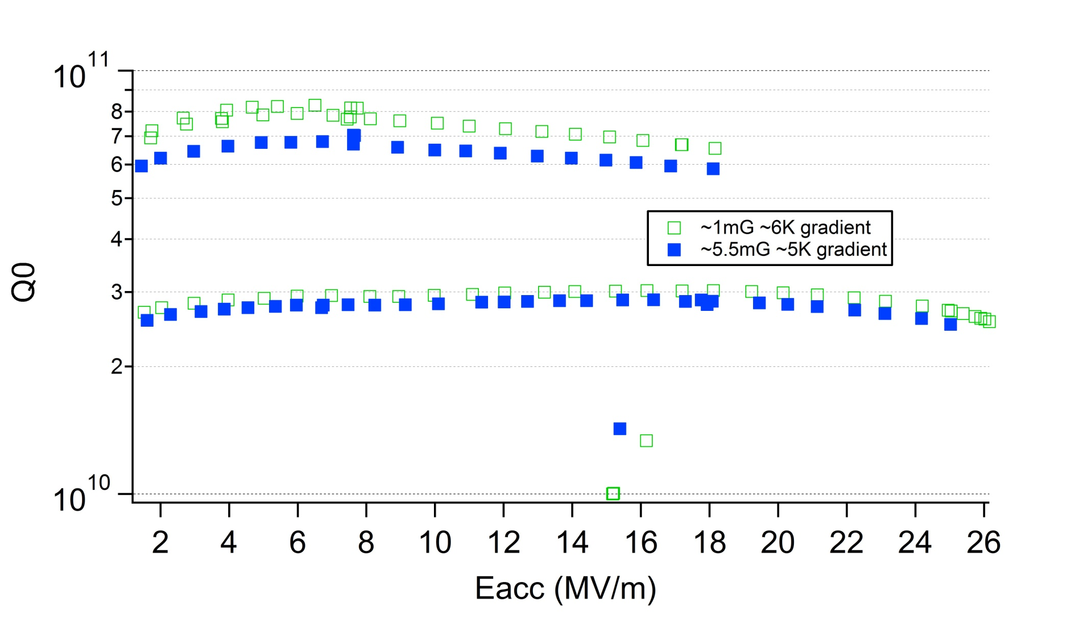
RDTTD-03 - 2k and 1.5K – EP 150 900°C 3h (Dewar 3)
Flux expulsion good

Slide 25
Cavities welded so far
RI was using TD and Zanon was using NX, now all TD first

Slide 26
Status of discerning Nb material flux pinning variability on LCLS-II material
1- Review of LCLS-II material/history
2 - Material selected for testing single cells
3 - 800C vs. 900C and recipe changes
4 - 9 cell update
Ari D. Palczewski, SRF Scientist
Jefferson Lab, USA
10/31/2016

Slide 27
contributions
Material analysis – Frank Marhauser, Jacek Sekutowicz (DESY), and Gigi Ciovati
RF/Flux expulsion data test from FNAL – Znna Grassellino, Alex Melnychuk, Sam Posin
9 cell testing data - Alex Melnychuk FNAL, Kirk Davis/Liang/Christiana Jlab
Crystallography data from FNAL

Slide 28
Cavity ID to material specs – single cells
 |  | LCLSII serial number | Vendor serial number | Vendor | <HV> | ASTM | ASTM | µm | µm | NX-RRR-hard | NX-RRR-soft | <GS> | NX-J | Ingot
 |  |  |  |  |  | min | max | min | max
RDTNX-01 | 1 | N10786 | 321107 | Ningxia OTIC | 39.9 | 5.0-5.5 | 5.5-6.0 | 49.2 | 58.5 | 380.0 | 412 | 53.85 | 396 | ENT-132
RDTNX-01 | 2 | N10787 | 321108 | Ningxia OTIC | 40.8 | 5.0-5.5 | 5.5-6.0 | 49.2 | 58.5 | 380.0 | 412 | 53.85 | 396 | ENT-132
RDTNX-04 | 3 | N10788 | 321109 | Ningxia OTIC | 39.4 | 5.0-5.5 | 5.5-6.0 | 49.2 | 58.5 | 380.0 | 412 | 53.85 | 396 | ENT-132
RDTNX-04 | 4 | N10790 | 321111 | Ningxia OTIC | 40.5 | 5.0-5.5 | 5.5-6.0 | 49.2 | 58.5 | 380.0 | 412 | 53.85 | 396 | ENT-132
RDTNX-03 | 5 | N11297 | 342104 | Ningxia OTIC | 45.4 | 7.0-7.5 | 8.0 | 22.5 | 29.3 | 315.0 | 301 | 25.9 | 308 | ENT-134
RDTNX-02 | 6 | N11301 | 342108 | Ningxia OTIC | 45.3 | 7.0-7.5 | 8.0 | 22.5 | 29.3 | 315.0 | 301 | 25.9 | 308 | ENT-134
RDTNX-02 | 7 | N11302 | 342109 | Ningxia OTIC | 42.3 | 7.0-7.5 | 8.0 | 22.5 | 29.3 | 315.0 | 301 | 25.9 | 308 | ENT-134
RDTNX-03 | 8 | N11304 | 342111 | Ningxia OTIC | 42.2 | 7.0-7.5 | 8.0 | 22.5 | 29.3 | 315.0 | 301 | 25.9 | 308 | ENT-134
 |  |  |  |  |  |  |  |  |  | TD-RRR-hard | TD-RRR-soft |  | TD-J
RDTTD-01 | 9 | T10205 | 243 | Tokyo Denkai | 41.8 | 5 | 5 | 63.5 | 63.5 | 357 | 322 | 63.5 | 339.5 | NC-1991
RDTTD-01 | 10 | T10206 | 244 | Tokyo Denkai | 40.2 | 5 | 5 | 63.5 | 63.5 | 357 | 322 | 63.5 | 339.5 | NC-1991
RDTTD-03 | 11 | T10207 | 245 | Tokyo Denkai | 41.9 | 5 | 5 | 63.5 | 63.5 | 357 | 322 | 63.5 | 339.5 | NC-1991
RDTTD-03 | 12 | T10243 | 281 | Tokyo Denkai | 41.0 | 5 | 5 | 63.5 | 63.5 | 357 | 322 | 63.5 | 339.5 | NC-1991
RDTTD-02 | 13 | T10971 | 1108 | Tokyo Denkai | 43.0 | 6 | 7 | 31.8 | 44.9 | 347 | 347 | 38.35 | 347 | NC-2022
RDTTD-02 | 14 | T10974 | 1111 | Tokyo Denkai | 42.5 | 6 | 7 | 31.8 | 44.9 | 347 | 347 | 38.35 | 347 | NC-2022
RDTTD-04 | 15 | T10976 | 1113 | Tokyo Denkai | 42.2 | 6 | 7 | 31.8 | 44.9 | 347 | 347 | 38.35 | 347 | NC-2022
RDTTD-04 | 16 | T11007 | 1145 | Tokyo Denkai | 41.9 | 6 | 7 | 31.8 | 44.9 | 347 | 347 | 38.35 | 347 | NC-2022

Slide 29
JLab setup – flux expulsion
Comp coils integrated into dewar at JLab → Evaluates flux expulsion in same manner as at FNAL
1 - Cernox 1cm above iris
2 - Cernox 2cm above equator
3 - Cernox 2cm below equator
4 - Cernox 1cm below iris
1
Flux gate (3X @ 0, 120 and 240°) all axial
2
3
4

Slide 30
Flux expulsion - JLab

