Slide 1
LTB in N2
Pashupati Dhakal

Slide 2
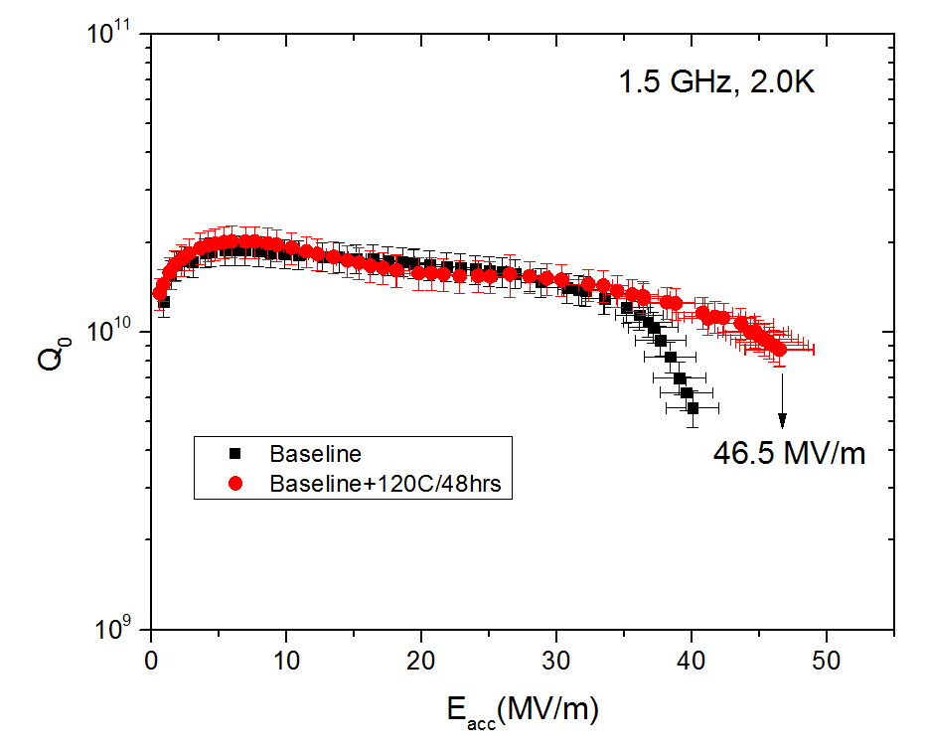
120C/48hrs bake
No Q-change <30 MV/m
FG, RRR ~ 250

Slide 3
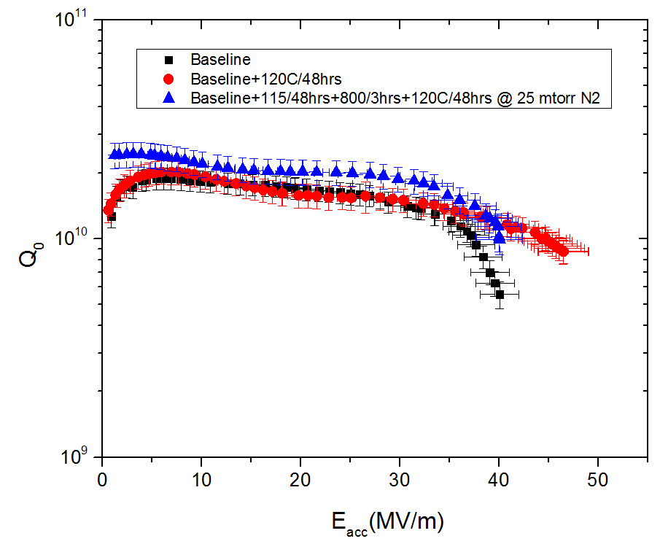
120C/48hrs bake @ 25 mTorr N2
~ 25% Q improvement at 30 MV/m

Slide 4
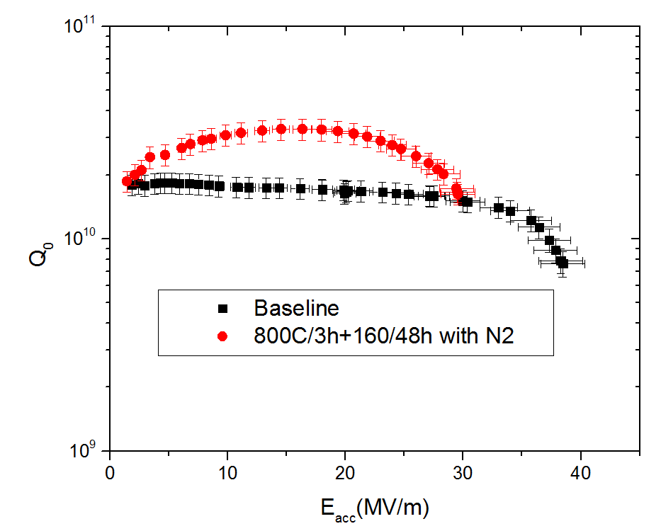
120C/48hrs bake @ 25 mTorr N2
No Q-improvement @ 30MV
Factor of 2 improvement @ 18MV/m

Slide 5
Conclusions
LTB in N2 works
Why? What is the mechanism?
Does N2 diffuse? Infuse? Or is it just a surface impurity effect.
Sample study underway.

