Slide 1
JLEIC and Electron Cooling: An Introduction
Yuhong Zhang
JLEIC Discussion Forum, August 3, 2016

Slide 2
Collider Luminosity
Luminosity formula L = (f/2π) N_{e}N_{p}/Σ_{x}Σ_{y}, Σ_{x}=(σ_{xe}²+σ_{xp}²)^{1/2}, Σ_{y}=(σ_{ye}²+σ_{yp}²)^{1/2}
General design rule: σ_{xe}=σ_{xp} σ_{ye}=σ_{yp} (for beam-beam effect)
Beam spot size at a collision point σ_{x}=(ε_{x}β*_{x})^{1/2}
β-function characterizes the beam optics
It describes focusing/defocusing of the beam in the beam transport system (a ring),
It is determined by distribution and strength of quadrupoles (dipoles guide particle motion)
β* is the value of β-function at a collision point
ε_{x} is called beam emittance, it characterizes the volume a particle beam (bunch) occupies in the phase space.
Luminosity optimization: making the beam spot size at IP as small as possible
➔ small β* ➔ better optics design ➔ limited by many factors (magnet imperfection, etc)
➔ small beam emittance ε_{x} ➔ damping by cooling

Slide 3
Reduction of Emittance
There are many different definitions:
geometry (RMS) emittance
normalized emittance: geometric emittance multiplied by βγ (a relativistic invariant)
95% emittance: 4 sigma phase space volume for a Gaussian distribution
According to Liouville's theorem, the phase space volume in a classical Hamiltonian system is an invariant; The magnet system (dipoles and quads) is a Hamiltonian system
To achieve a reduction of beam emittance (phase space volume), one must introduce a dissipative force such that the extended system is no longer a Hamiltonian system
This process of emittance reduction is called beam cooling
The JLEIC electron beam has synchrotron radiation damping (strong and rapid)
For the JLEIC proton/ion beams, energy is too low so there is no radiation damping
Typical values of proton normalized emittance: no cooling ~ 2 to 3 mm mrad
after cooling ~ 0.1 to 0.5 mm mrad

Slide 4
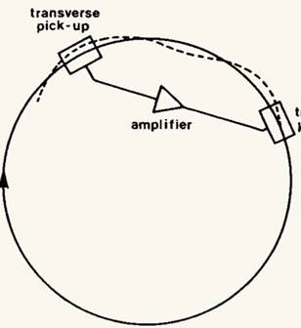
Beam Cooling
Two types of beam cooling
Through feedback ➔ stochastic cooling
Through particle-particle (including photons) interactions/collisions
➔ electron cooling, laser cooling and muon cooling
One important parameter is cooling time
Stochastic cooling (pickup-kicker)
Cooling time ~ number or particles / signal amplifier bandwidth
Good for heavy ions (for RHIC, and likely JLEIC Pb)
Not good for protons (p vs. ²⁰⁸Pb⁺⁸², 82 times more particles)
Coherent Electron Cooling: increasing bandwidth through SASE FEL
Electron cooling
Arrange co-moving of cold electron and hot proton/ions
Like cold water cools hot water, cold gas cools hot gas
Heat diffusive motion through particle-particle interaction (Coulomb collisions)
Highly efficient (especially if the beam emittance is not very large, ~ a few mm mrad)

Slide 5
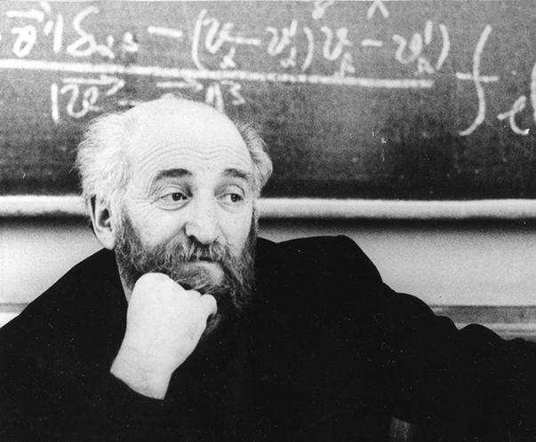
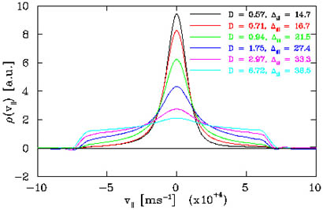
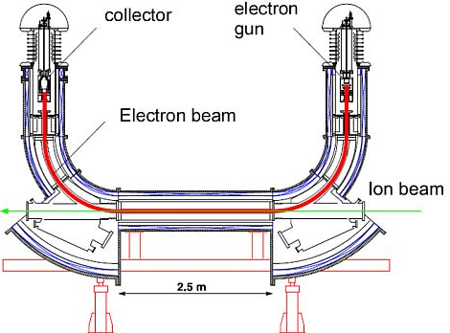
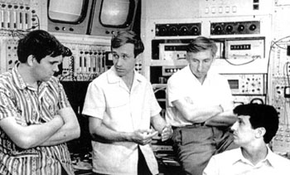
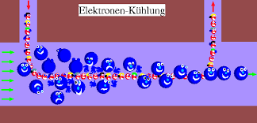
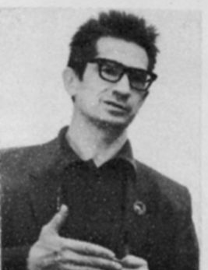
Electron Cooling: An Illustration
Inventor
Pioneers
Theorist
magnetized cooling

Slide 6
Multi-Step Cooling for High Performance
Cooling of the JLEIC protons/ions
achieves a small emittance
achieves a short bunch length of 1 to 2 cm (with strong SRF)
enables ultra strong final focusing and crab crossing
suppresses intra-beam scatterings (IBS), maintaining beam emittance
expands luminosity lifetime
Cooling time
It is advantage to cool at
Low energy
When emittance is not big
Multi-step scheme
taking advantages of high cooling efficiency at low energy or/and with small emittance
6

Slide 7
JLEIC Multi-Step Cooling Scheme
ion sources
DC cooler
BB cooler
ion linac
Booster
(0.285 to 8 GeV)
collider ring
(8 to 100 GeV)
Ring | Cooler | Function | Ion energy | Electron energy
 |  |  | GeV/u | MeV
Booster ring | DC | Injection/accumulation of positive ions | 0.11 ~ 0.19 (injection) | 0.062 ~ 0.1
 |  | Emittance reduction | 2 | 1.1
Collider ring | Bunched Beam (BB) | Maintain emittance during stacking | 7.9 (injection) | 4.3
 |  | Maintain emittance | Up to 100 | Up to 55
DC cooling for emittance reduction
BB (bunched beam) cooling for emittance preservation
We anticipate up to 2 orders of magnitude increase of combined cooling rate

Slide 8
DC Cooling at 2 GeV
Simulation:
Cooling time: ~30 min at 8 GeV (from 2 𝜇m rad to 0.5 𝜇m rad)
DC cooler: 10 m and 2 A
DC cooling at 8 GeV,
2 A electron current,
10 m cooling length

Slide 9
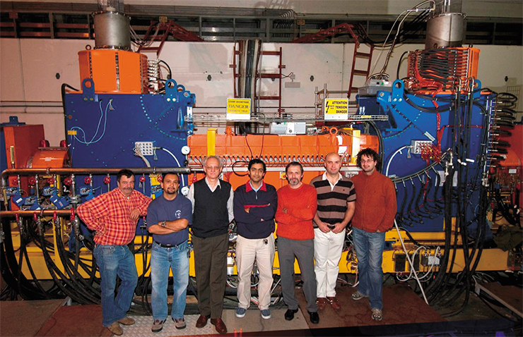
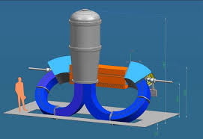
Such DC Cooler is Available
flip-over
2 MeV DC Cooler at COSY, Juelich, Germany

Slide 10
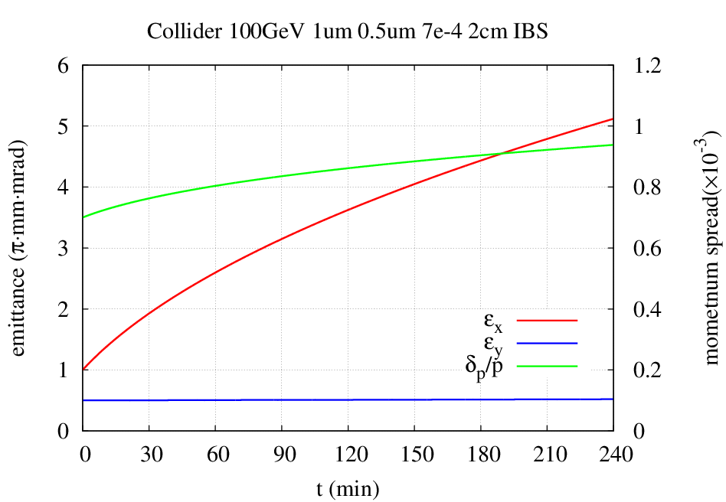
What Happens if No Cooling During Beam Store (Collision)?
Intra-beam scattering (IBS) causes rapid emittance growth
240 min
180 min
150 min
120 min
210 min
90 min
60 min
30 min

Slide 11
JLEIC Bunched Beam ERL e-Cooler
Requirement and technology challenges
Proton collision energy up to 100 GeV
➔ energy of the cooling electron beam is up to 55 MeV
(for meeting the condition of co-moving with same velocity)
➔ can not be a DC cooler, must use a SRF linac
➔ Both proton and cooling electron beams are bunched with very short RMS length
Need several ampere current (orders of magnitude beyond state-of-art)
High beam power: ~100 MW
Technology choices
Energy-recovery-linac (ERL)
Magnetized beam/photo-gun
Circulator cooler ring
ion bunch
electron bunch
Cooling section
solenoid
Fast kicker
circulator ring
Fast kicker
Bunch revolutions in CCR |  | ~25
Current in CCR/ERL | A | 1.5/0.06
Electrons/bunch | 10¹⁰ | 1.25
Bunch repetition in CCR/ERL | MHz | 476/30
energy recovery
injector
dump
SRF Linac
Notes:
11

Slide 12
Accelerator R&D
High energy bunched beam electron cooling is essential for achieving ultra high luminosity for JLEIC, without it we loss about 3 to 5 times luminosity
This is the No. 1 technology risk of JLEIC, hence the highest priority R&D
We are conducting aggressive R&D on high energy electron cooling
Conceptual/analytic and simulation studies: design optimization and accurate production of cooling rate
Design of a bunched beam ERL based e-cooler (by a working group)
Development of key technology for this cooler: magnetized photo-cathode electron gun (LDRD), fast kicker
Experiment to demonstrate cooling of ions by a bunched electron beam
Development of a test facility using JLab LERF (formally ERL FEL) for testing a circulator electron cooler
We have engaged in collaborations with other US lab and international institutions, and are making efforts to expend this collaborations

