Slide 1

Physics Driving the Design of the EIC Detectors
Yulia Furletova
GHP meeting, Washington DC, Feb 1-3, 2017
Notes:
Title Page
1

Slide 2


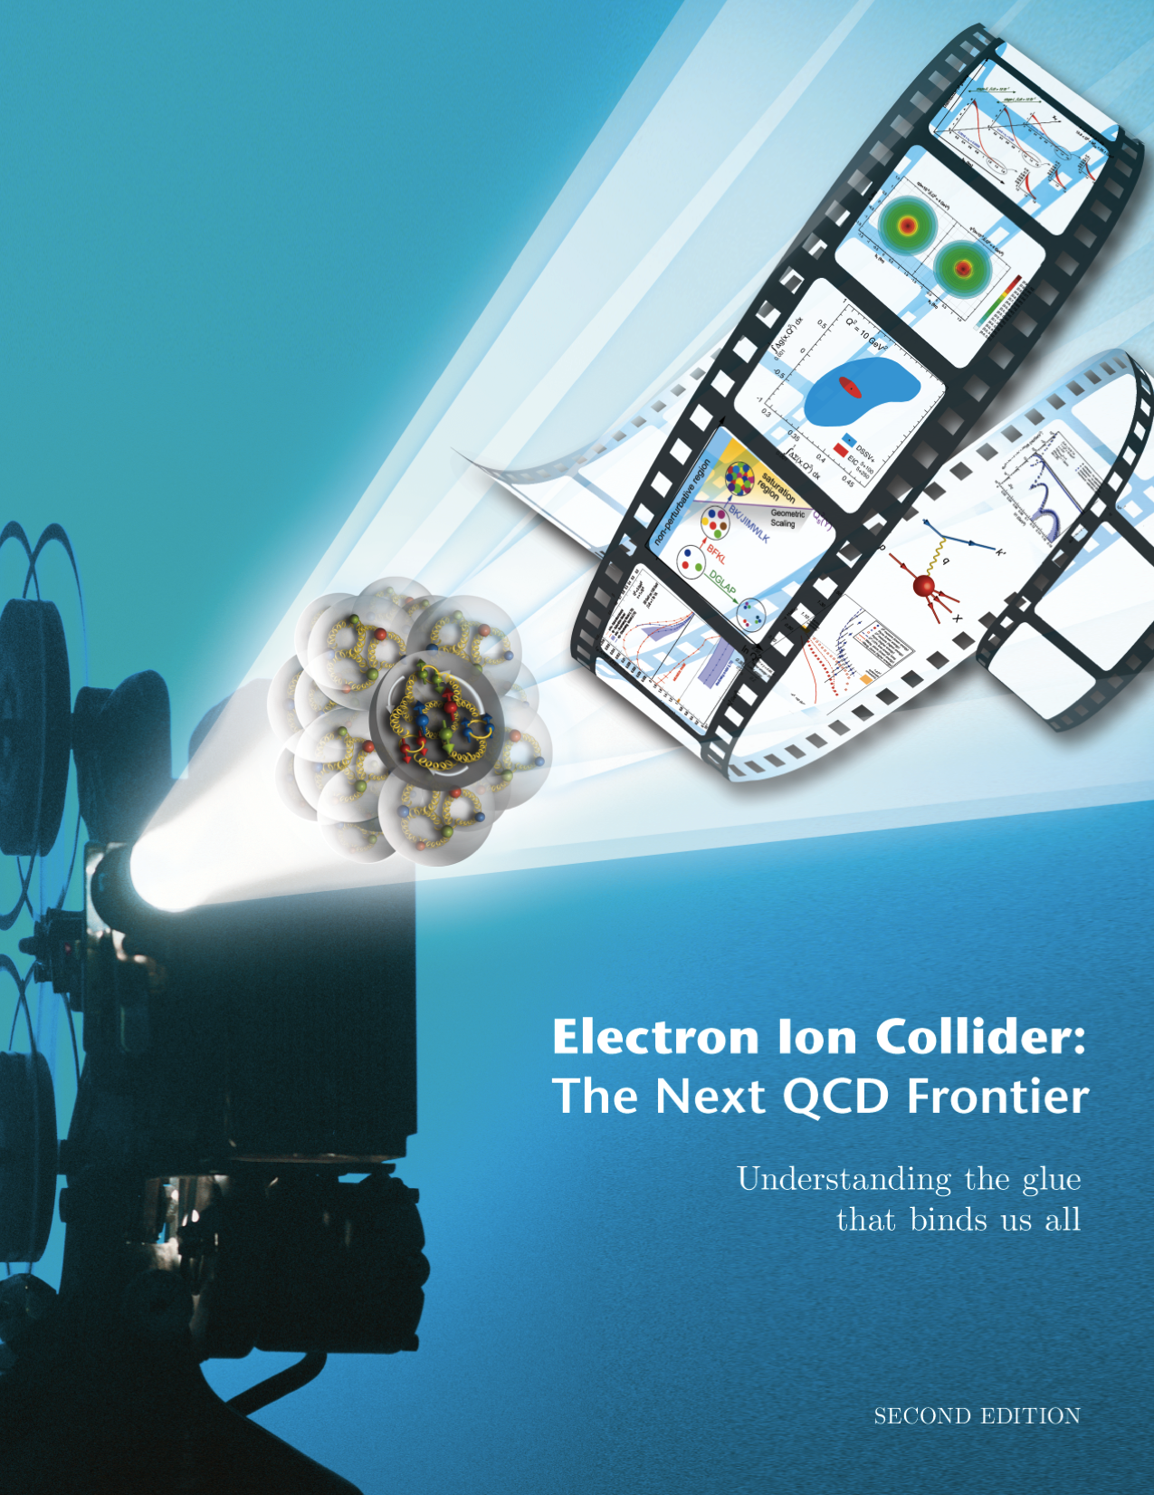

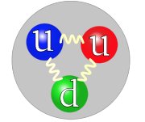
Long Range Plan
The NSAC recommend “a high-energy
high-luminosity polarized Electron-Ion Collider (EIC) as the highest priority for new facility construction..”
The Next QCD Frontier
Understanding of nucleon and nuclear structure and associated dynamics (3D structure)
Probe the nucleon and nuclei in different interaction regimes.
Extend our understanding of QCD (saturation, propagation of quarks/jets in cold nuclear matter)
1212.1701.v3
A. Accardi et al
Yulia Furletova
Notes:
Interior Page Design 2
2

Slide 3
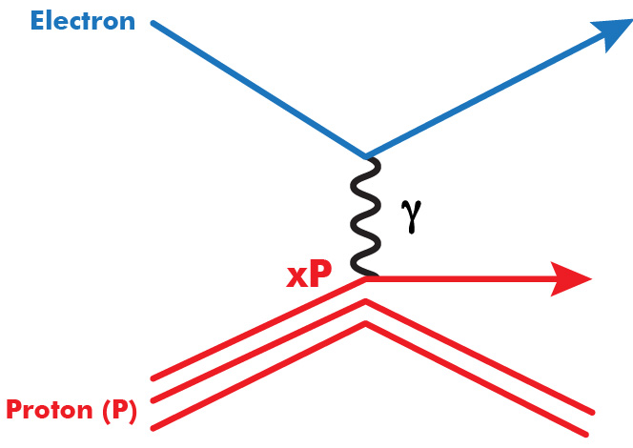
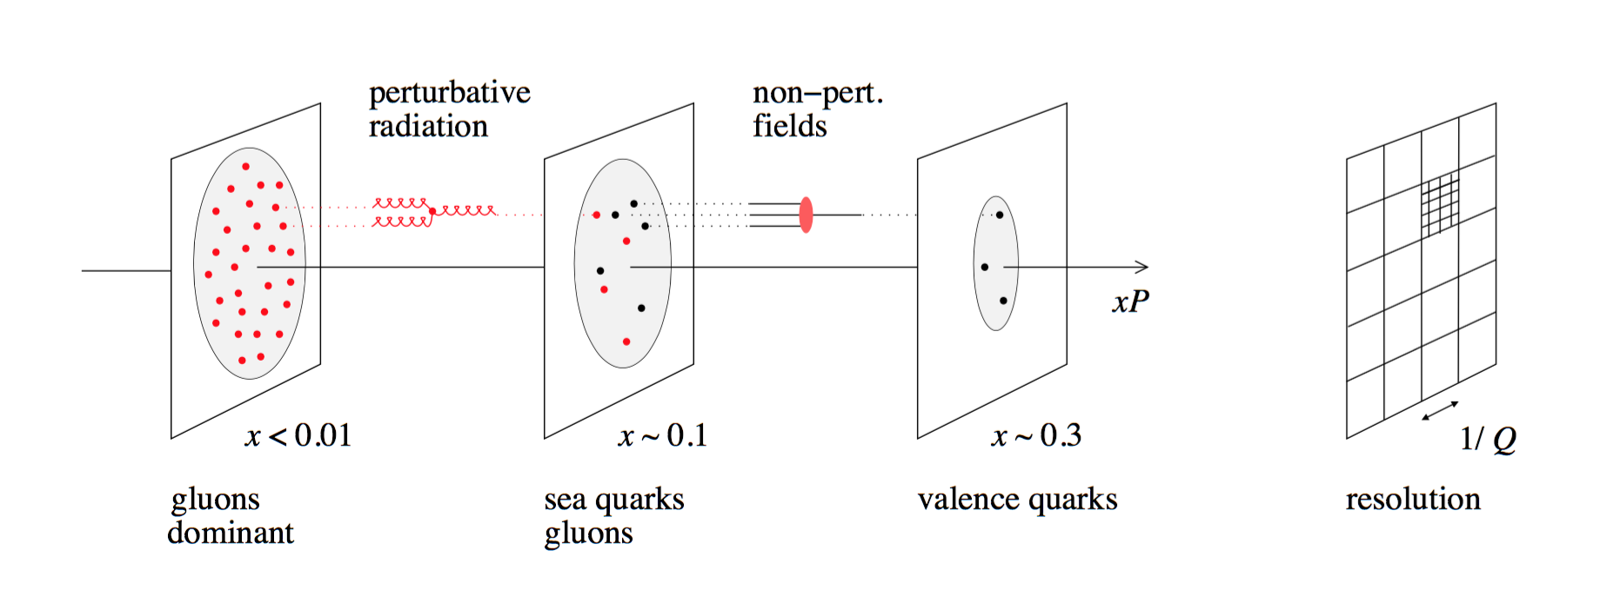
Electron proton scattering
Ability to change Q² changes the resolution scale
Q² = 400 GeV²
=> 1/Q = 0.01 fm
(Q²)
Ability to change x projects out different configurations where different dynamics dominate
Yulia Furletova
Notes:
Interior Page Design 2
3

Slide 4
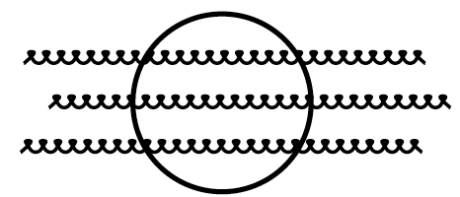
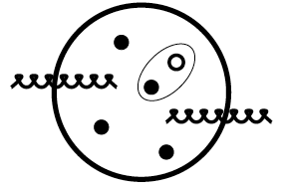

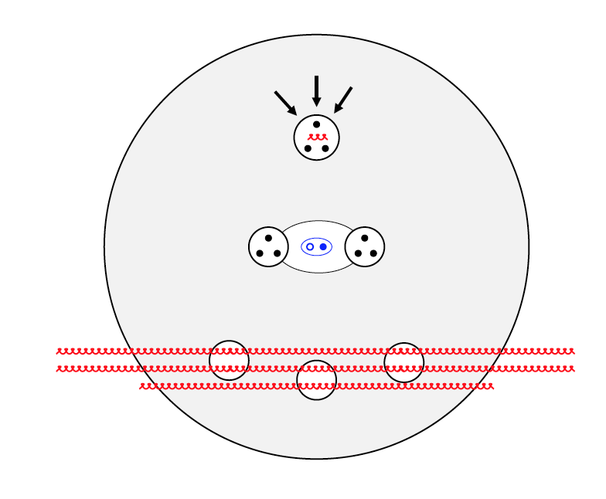
Electron-Ion Collider range (x)
Radiative Regime:
mostly gluons
Many-body Regime:
Valence and sea quarks,
gluons
Few-body Regime:
valence quarks,
Some gluons
Saturation
Regime:
Needs to be
Accessed via Ions
Fraction of
momentum
carried by the
parton
x
(for proton)
10⁻⁴
10⁻³
10⁻²
10⁻¹
1
QCD Radiation Dominated (Studied at HERA)
Hadron Structure Dominated
Main interest for EIC
Nucleon/Nuclear Program: Spin, TMD, GPD…
Nucleon interactions
x > 0.3 “EMC effect”
Modified single-nucleon structure? Non-nucleonic degrees of freedom?
x ∼ 0.1 “Antishadowing”
QCD structure of pairwise NN interaction, exchange mechanisms
x < 0.01 “Shadowing”
QM interference, collective gluon fields
4
Yulia Furletova
Notes:
Interior Page Design 2
4

Slide 5
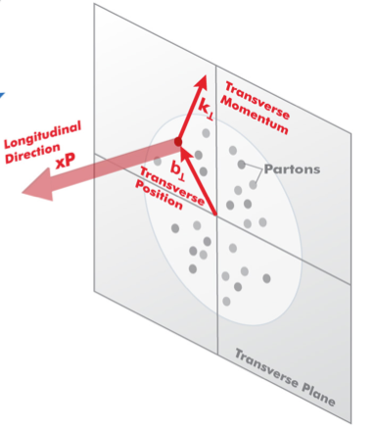
3D Structure of Nucleons and Nuclei
3D Structure of Nucleons and Nuclei:
Need to measure positions and momenta of the partons transverse to its direction of motion.
These quantities (k_{T}, b_{T}) are of the order of a few hundred MeV.
Transverse Momentum Dependent Distributions (TMD): k_{t}
Generalized Parton Distributions (GPD): b_{t}
e’
e
r
γ*(Q²)
Polarizaton
Understanding hadron structure cannot
be done without understanding spin:
• polarized electrons and
• polarized protons/light ions
Yulia Furletova
Notes:
Interior Page Design 2
5

Slide 6
Electron-Ion Collider range (Q2)
Q²
x > 10⁻³,10⁻² to 1
Include non-perturbative, perturbative and transition regimes
Provide long evolution length and up to Q² of ~1000 GeV² (~.005 fm)
Overlap with existing measurements
GeV²]
HERA high-x
Perturbative
Regime
Saturation regime at EIC
Electron-Ion Collider
At very low x, cross-section will saturate.
could be investigated in transition region
10⁻¹
1
10
10²
10³
?=?
Transition
Region
HERMES, COMPASS, JLAB 6 and 12
Non-perturbative
Regime
Yulia Furletova
Notes:
Interior Page Design 2
6

Slide 7
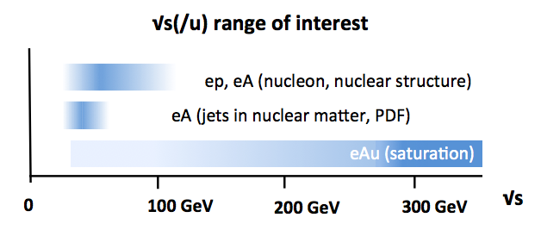
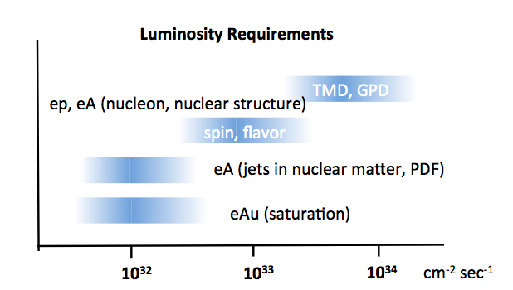
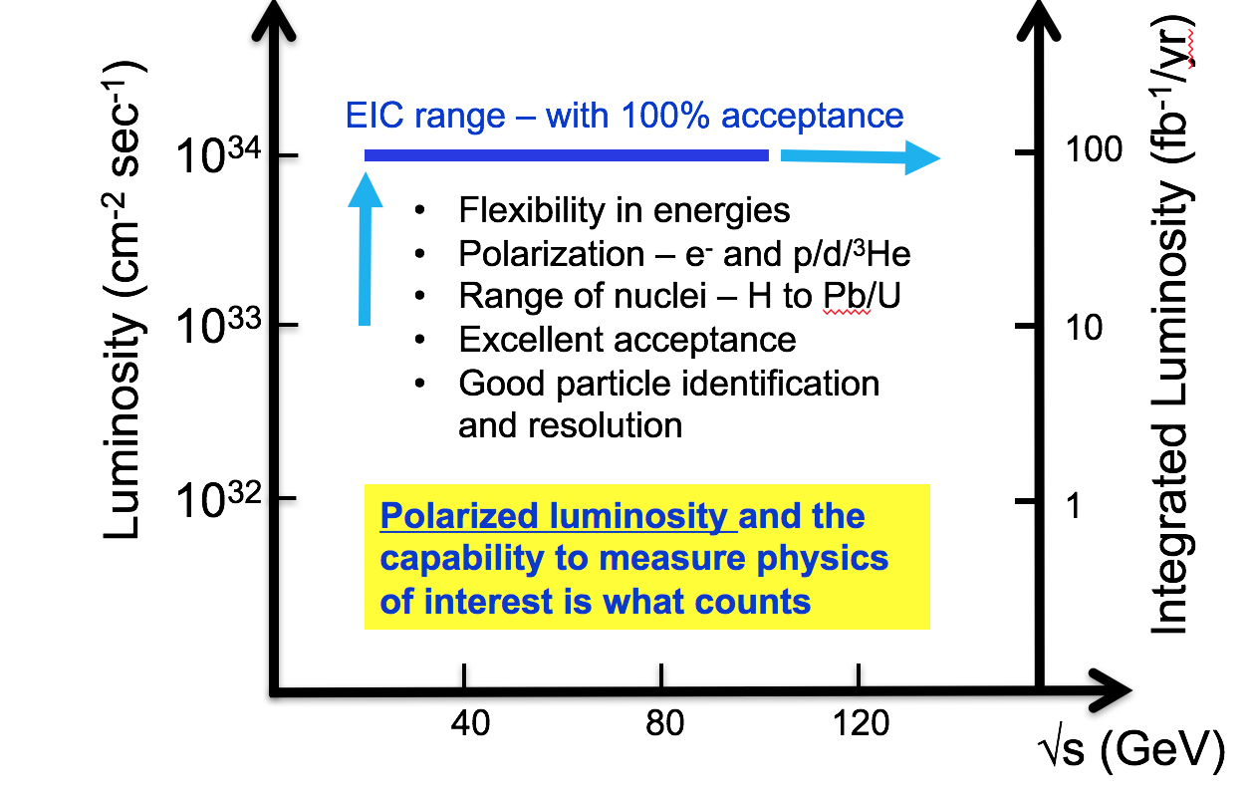

Electron-Ion Collider: $√s$ range and luminosity
Beam energy:
Various center of mass energy (low, medium, high)
High luminosity :
high precision physics
rear physics
various measurements/configurations: (different ions, different center of mass energies, different polarizations)
A high luminosity is needed to carry out the EIC physic program
Yulia Furletova
Notes:
Interior Page Design 2
7

Slide 8
Deep inelastic scattering and
General detector design considerations
Yulia Furletova
Notes:
Interior Page Design 2
8

Slide 9
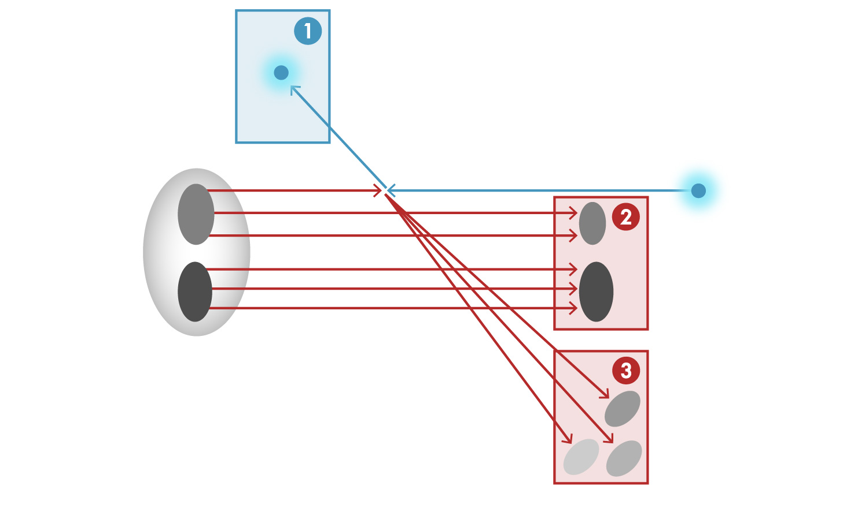

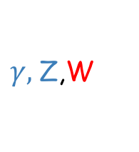
Total acceptance detector
e
e’, $ν$
Aim of EIC is nucleon and nuclear structure beyond the longitudinal description.
This makes the requirements for the machine and detector different from all
previous colliders including HERA.
$γ,$Z,W
p/A
q
p remnant
“Statistics”=Luminosity × Acceptance
EIC Physics demands ~100% acceptance for all final state particles (including particles associated with initial ion)
e’
e
p/A
Ion remnant is particularly challenging
not usual concern at colliders
Higher the Ion Beam energy, more difficult to achieve.
Scattered electron
Particle associated with initial Ion
Particle associated with struck quark
Yulia Furletova
Notes:
Interior Page Design 2
9

Slide 10

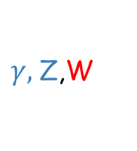
Total acceptance detector
e
e’, $ν$
Beam elements limit forward acceptance
Beam crossing angle creates room for forward dipoles and gives a space for detectors in the forward regions
$γ,$Z,W
p/A
q
p remnant
Central detector - limitation in size:
-in R – size of solenoid magnet
-in L - a distance between ion quadrupoles which inverse proportional to luminosity
Need a Total acceptance detector (and IR) also for variable beam energies.
10
Yulia Furletova
Notes:
Interior Page Design 2
10

Slide 11
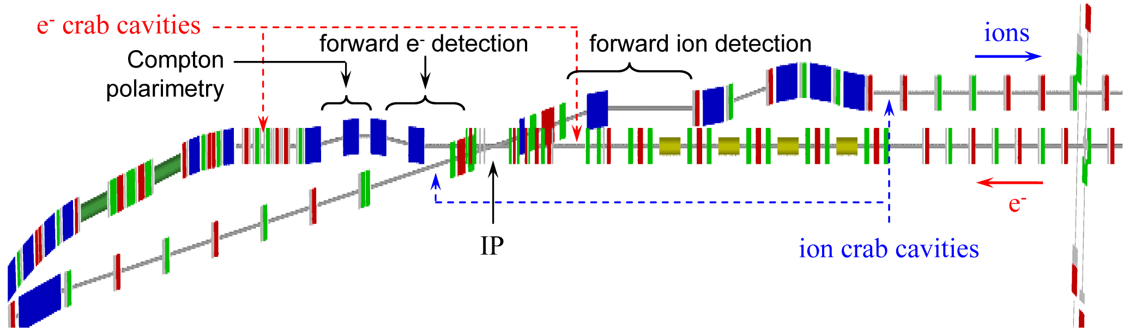
Integration with accelerator
Total size ~80m
1.Central detector ~10m
2.Far-forward electron detection ~30m
3.Forward hadron spectrometer ~40m
IP placement (to reduce a background)
-Far from electron bending magnets (synchrotron)
-close to proton/ion bending (hadron background)
Extended detector: 80+ m
Example from JLEIC design
2.
3.
1.
Yulia Furletova
Notes:
Interior Page Design 2
11

Slide 12
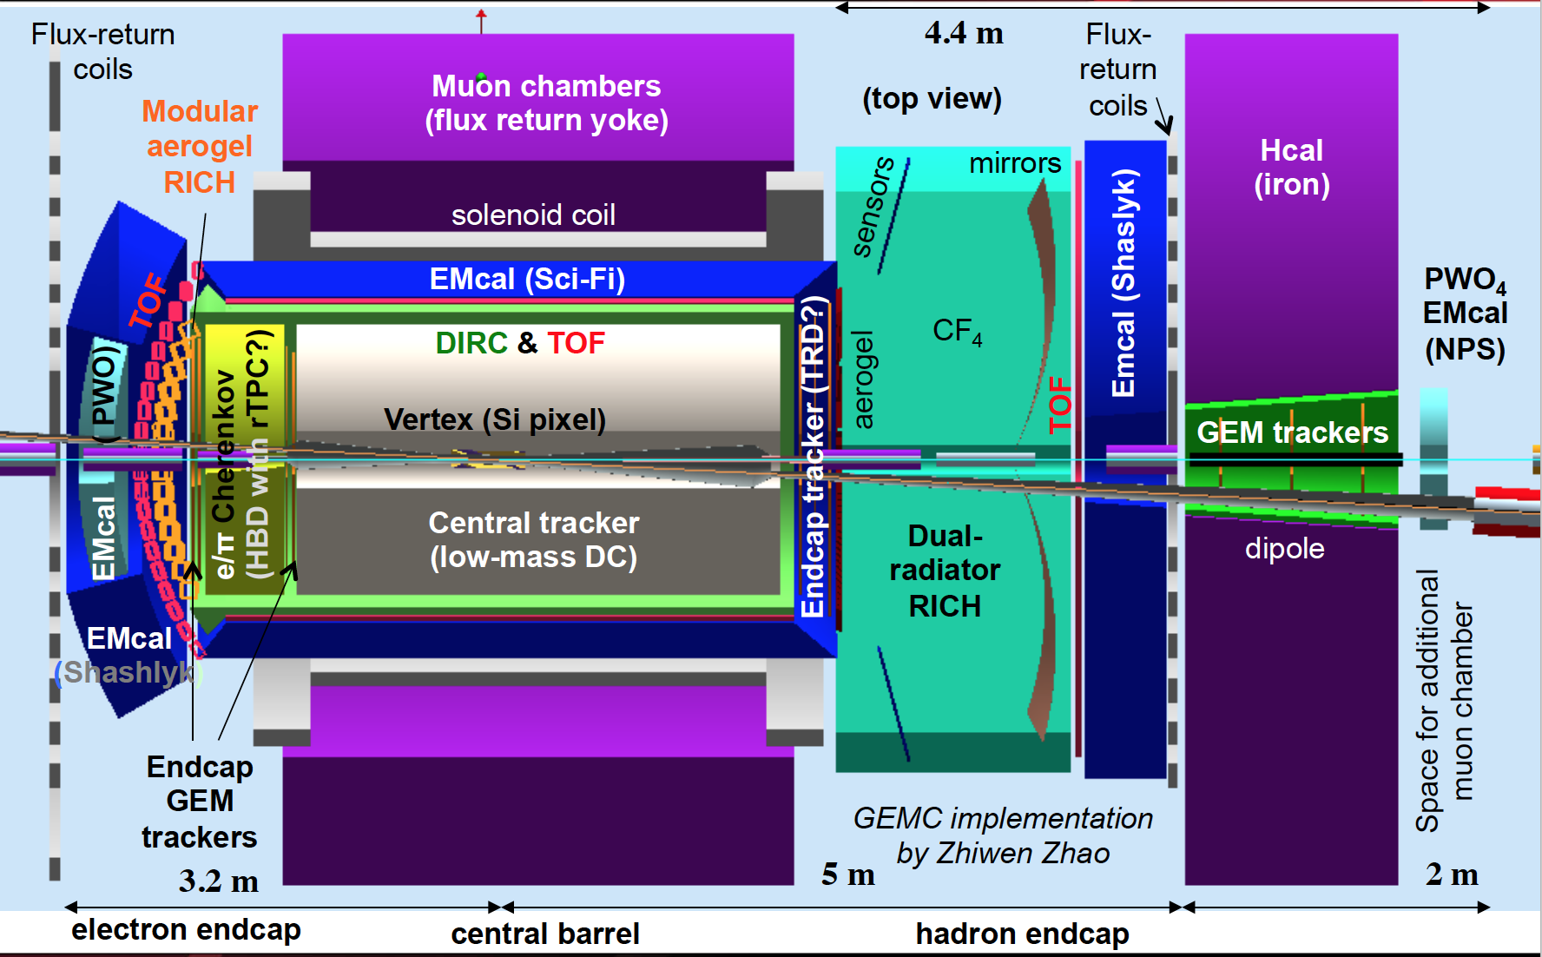
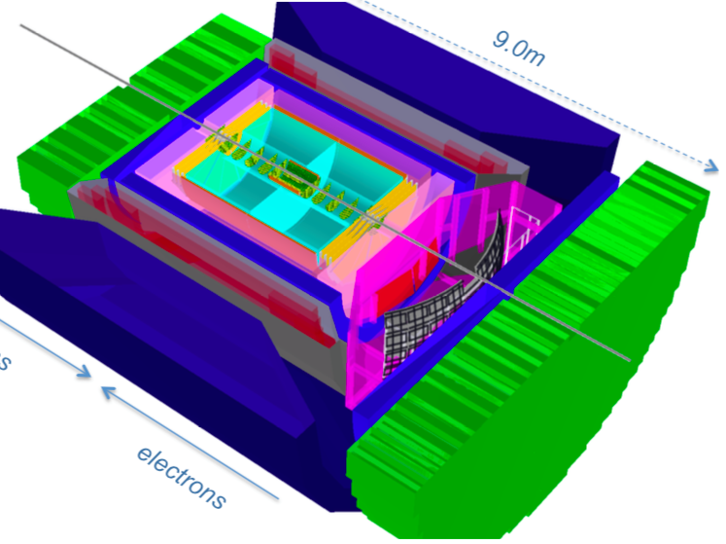
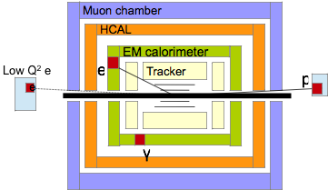
EIC Central detector overview
Jefferson Lab
Brookhaven
BeAST
2nd IP for jets
Modular design of the central detector
Yulia Furletova
Notes:
Interior Page Design 2
12

Slide 13
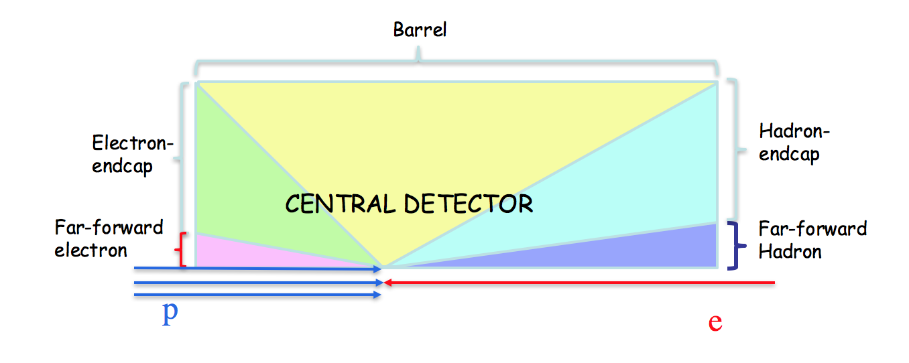

General structure of detectors
Stable particles ( e,μ,π,K,p, jets(q,g), gamma, ν - Pt^{miss}):
Momentum/Energy, Type(ID), Direction, vertex
e
e’, $ν$
vertex
tracking
PID
EMCAL
HCAL
muon
$γ,$Z,W
e
p/A
q
γ
K/π/p
p remnant
absorber
jets
μ
ν
P_{T}miss
bunch crossing is every ~2ns
Pythia Minbias EIC (Q2> 10⁻⁶ ) σ ~ 200 µb (HERA ~165 µb )
N events = σ•L ~ 2· 10⁶ ev. per sec (2MHz) ~ 2 events / μs
ZEUS/HERA(ep) ~3kHz
(100 GeV)
(10 GeV)
In order to reconstruct the kinematic x and Q² it is, in principle, sufficient to measure any two of these E’_{e’,}θ_{e’ ,}E_{q ,}θ_{q}
Yulia Furletova
Notes:
Interior Page Design 2
13

Slide 14
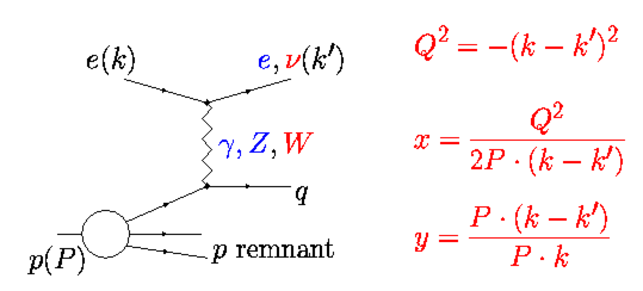
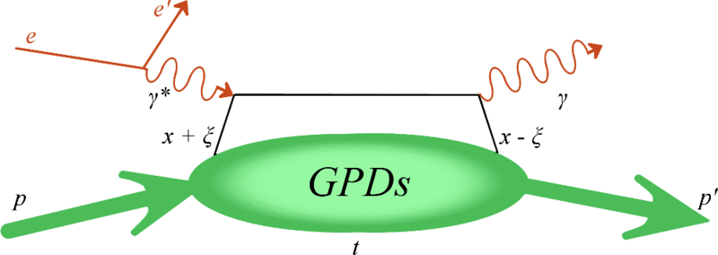
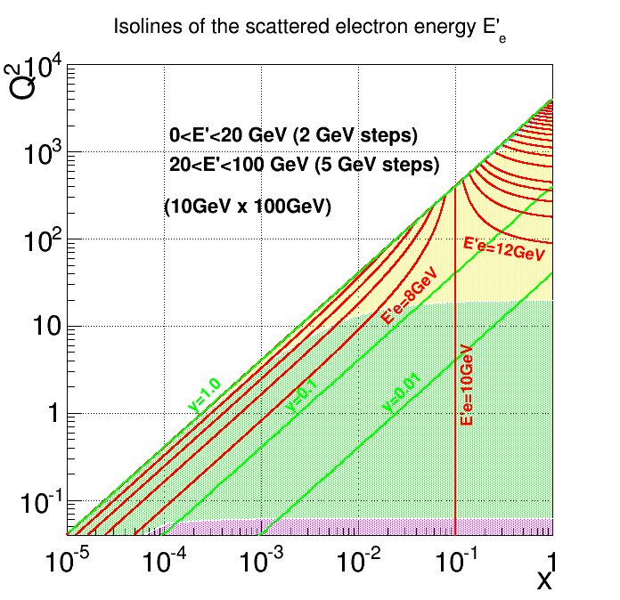
EM Calorimeter
DIS
DVCS
Electromagnetic Calorimeters
measure EM showers and
early hadron showers:
Energy, position, time
PbWO₄ Crystal EM Calorimeter
-Tungsten glass, similar to CMS or PANDA
Time resolution: <2 ns
Energy resolution: <2%/√E(GeV) + 1%
Cluster threshold: 10 MeV
Produced at two places (China, Russia)
For CMS it took 10 years to grow all crystals !!!
Barrel
Electron end-cap
Sampling EM Calorimeter
Shashlyk (scintillators +absorber)
-WLS fibers for readout
-Sci-fiber EM(SPACAL):
Compact W-scifi calorimeter, developed at UCLA
Spacing 1 mm center-to-center
Resolution ~12%/√E
On-going EIC R&D
Far-forward electron
PWO for e-endcap - close to the beam – more precise and more radiation hard.
Shashlyk for barrel– less expensive
Yulia Furletova
Notes:
Interior Page Design 2
14

Slide 15
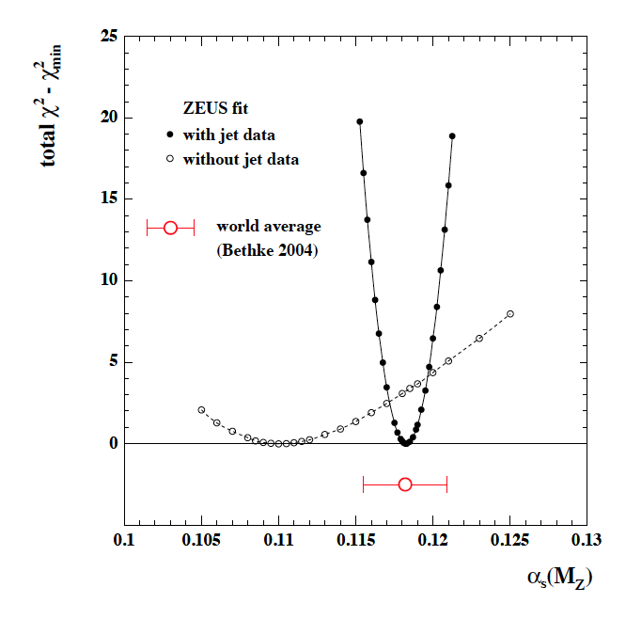




Jets at EIC and HCAL
Jets evolution and dynamics ( jet == struck quark )
Jets as a probe of partonic initial state
Jets in medium
(cold nuclear matter)
    energy loss, quenching
    broadening
    multiple-scattering.
Determination of $α$_{s} from the inclusive jet cross section in DIS
ZEUS/HERA
Including JETs data
Could EIC data improve $α$_{s} measurements?
Need a new method for jet energy measurements!
=> Particle Flow Calorimeter
At EIC for the first time will be able to study in-medium propagation and hadronization of heavy quarks (charm and beauty)
In a typical jet :
60 % of jet energy in charged hadrons
30 % in photons (mainly from $π0−>γγ$ )
10 % in neutral hadrons (mainly n, K_{L} )
Traditional calorimetric approach:
-E_{JET}=EMCAL+HCAL
-70% of energy measured in HCAL with poor resolution : $σE /E$~60%/$√E$
Uranium Calorimeter at ZEUS: $σE /E$~35%/$√E$
Particle Flow Calorimetry:
E_{JET} =E_{track}+E$γ$+E_{n}
-charged particles measured in tracker (essentially perfectly)
-Photons in ECAL: : $σE /E$~2-10%/$√E$
-Neutral hadrons (ONLY) in HCAL =>
Only 10 % of jet energy from HCAL
much improved jet resolution!!!
Charged current DIS
Neutrino in the final state =>
Could use only jets to reconstruct a kinematics(x,Q2)
Need 4$π$ HCAL coverage for P_{T}miss
Yulia Furletova
Notes:
Interior Page Design 2
15

Slide 16
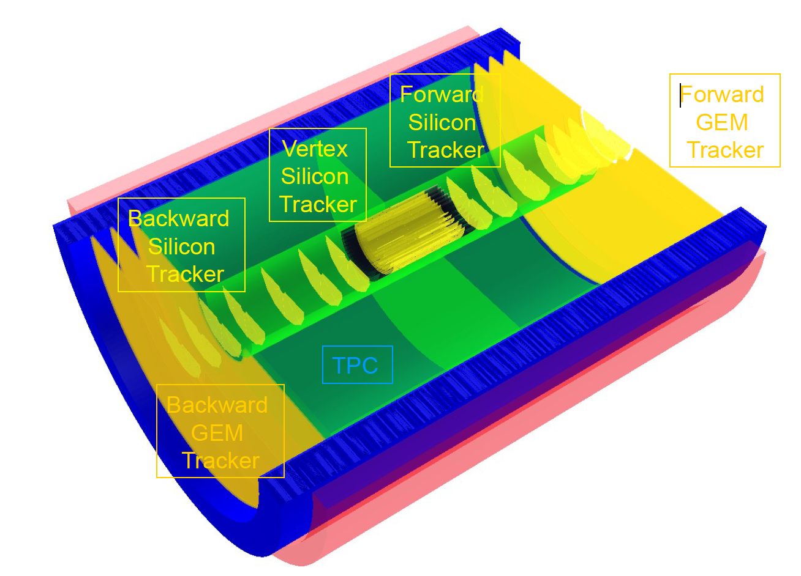
Tracking
Main purpose of tracking:
-reconstruct charged tracks and measure their momenta precisely (~few %)
-dE/dx (PID) for low momentum tracks.
Barrel: TPC or drift chambers
relatively fast detector,
minimal multiple scattering
limited PID
Endcaps: GEM
A. Kiselev, eRHIC detector
High multiplicity in forward region – we need a high granularity tracker
  resolution ~50 μm.
Radiation hardness
Yulia Furletova
Notes:
Interior Page Design 2
16

Slide 17
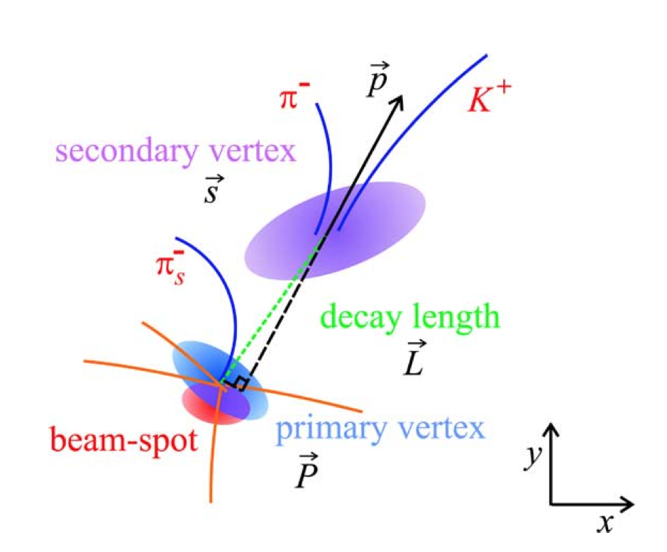
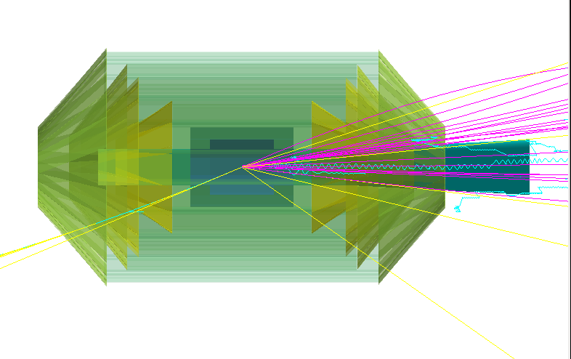
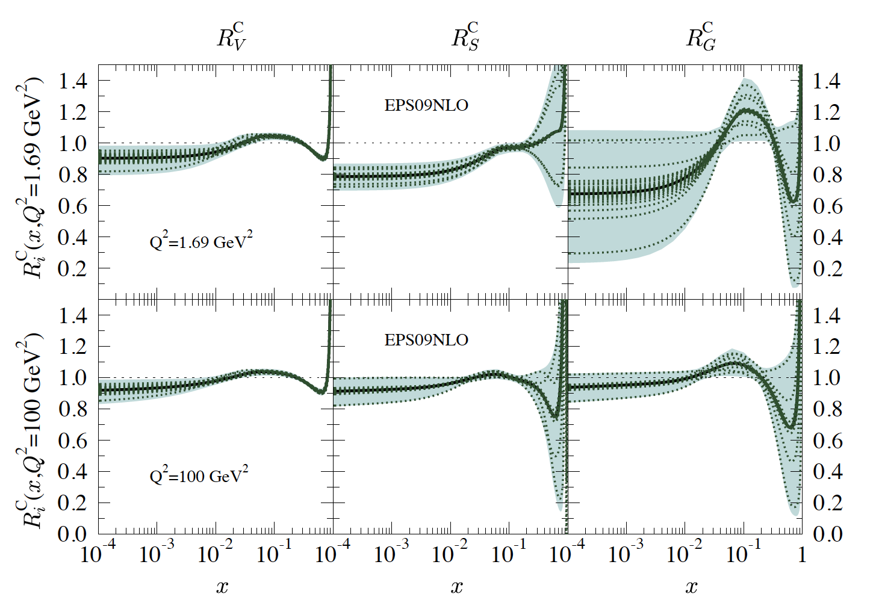
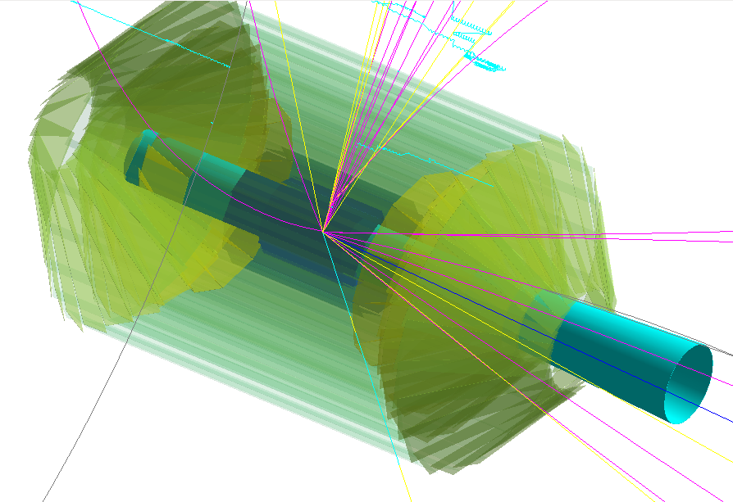
Vertex
Heavy quarks
Boson (photon)- Gluon Fusion (BGF)
Main purpose of vertex detector:
-Reconstruction of a primary vertex
-Reconstruct secondary vtx:
Tagging of c and b quarks (decay length ~100-500µm)
-improve momentum resolution of outer tracker
-provide stand-alone measurements of low-Pt particles
-dE/dx measurements for PID
Charm high-Q2 event in the vertex detector
Nuclear PDF parametrization EPS09 Eskola et al. 2009
enhancement
shadowing
EMC?
Vertex detector is a closest to IP detector.
Background increase an occupancy.
High granularity detector is needed (pixels)
Beam related background could cause a radiation damage.
Yulia Furletova
17
Notes:
Interior Page Design 2
17

Slide 18
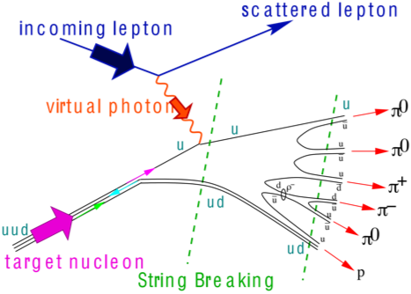
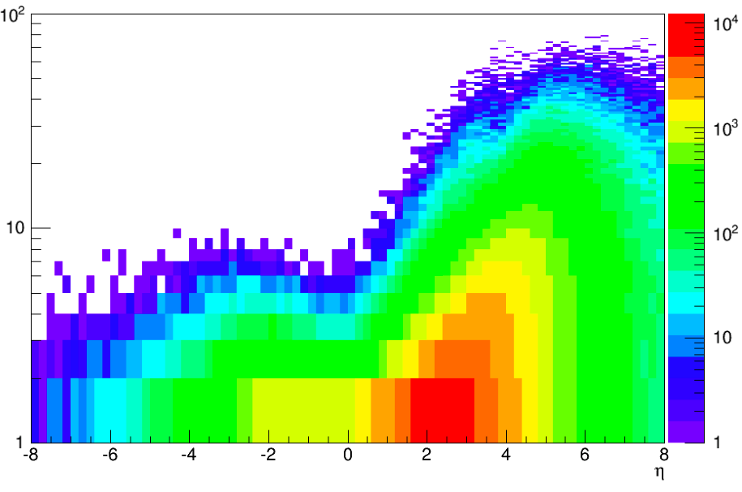
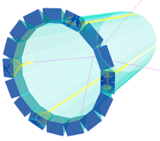
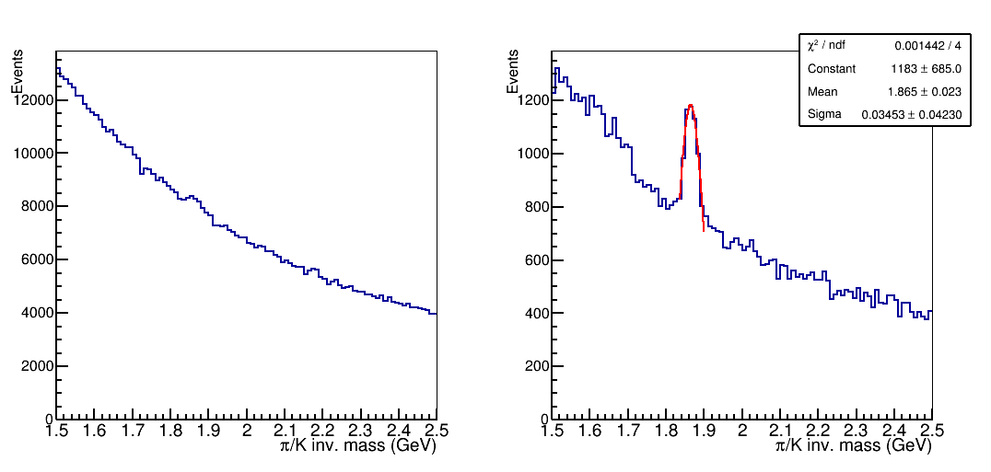


Hadrons Identification
Semi-inclusive DIS: involves measurements of one or more final-state hadrons in addition to the detection of the scattered lepton.
Time of Flight: MRPC
Multi-gap Resistive Plate Chamber (MRPC) R&D: achieved ~18 ps resolution with 36-105 μm gap glass MRPC
π/K <3.5GeV
Electron end-cap: Modular RICH
Pythia MC
E
Modular aerogel RICH (eRD14 detector R&D)
π/K separation up to ~10 GeV
$$π±$$
Barrel: DIRC
radially compact (2 cm)
Particle identification (3σ) p/K < 10 GeV, π/K < 6 GeV, e/π < 1.8 GeV
$$η$$
Exclusive processes:
Hadron end-cap: dual-radiator RICH
D0 mass plots:
JLEIC design geometry constraint: ~160 cm length
Aerogel in front, followed by CF4
covers energy for π/K up to 50GeV
Sensitive to magnetic field=> New 3T solenoid minimized a field in RICH region
No PID
No vertex
With PID
No vertex
$$Λ$$
Pythia BGF
Yulia Furletova
Notes:
Interior Page Design 2
18

Slide 19
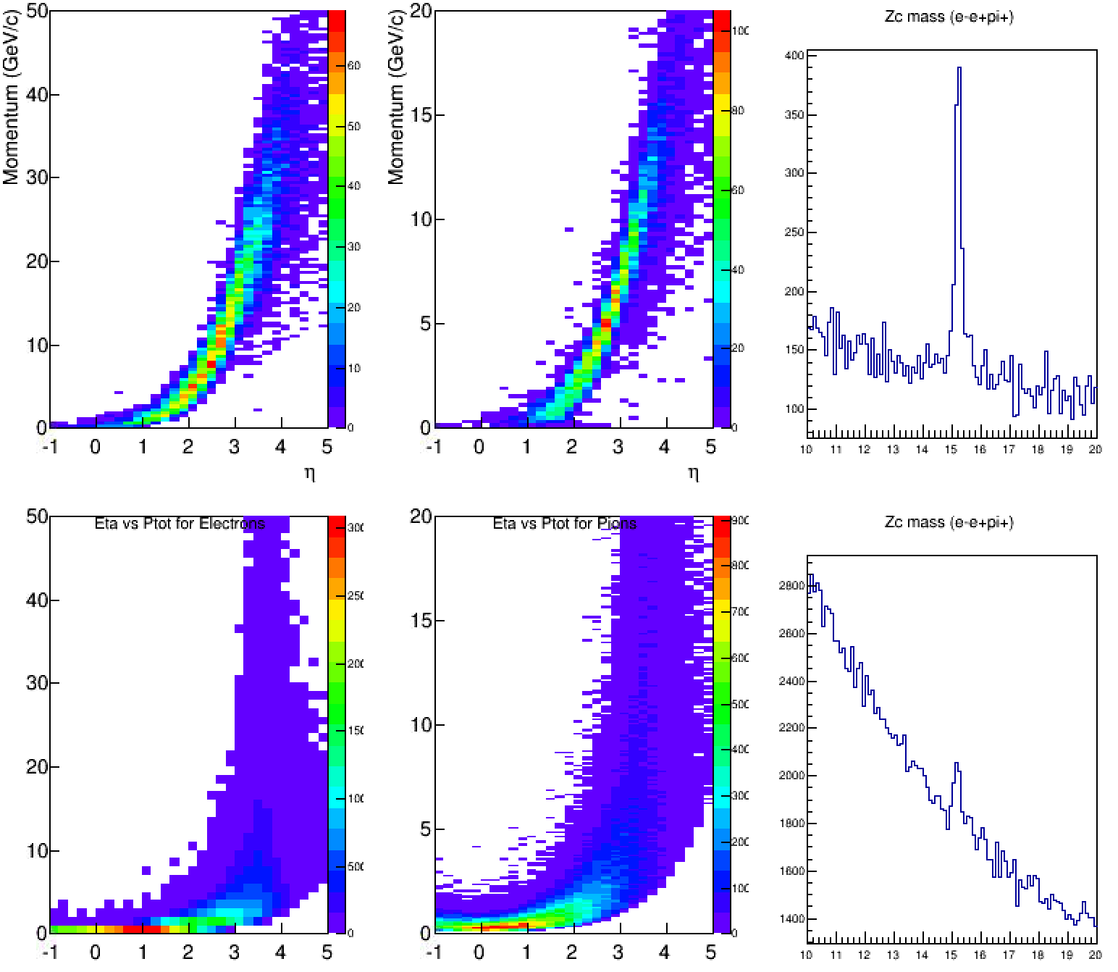
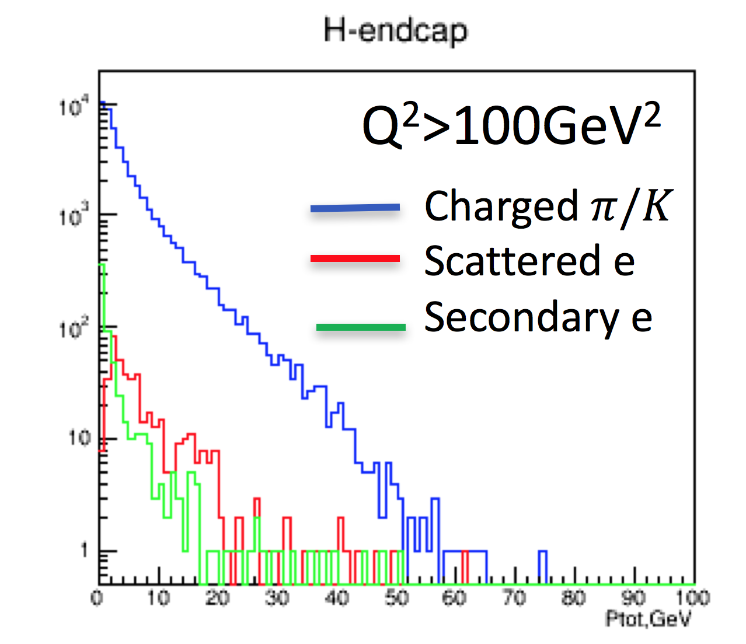




Electron Identification
σ(Zc[3900]) ~5 nb
σ(PhP, Q²<1GeV) ~ 10⁴nb
New XYZ stage Zc[3900]
Zc[3900]
m² (e+e-π+)
Physics:
  For rare physics, based on electron identification
  Charmonium, light vector mesons (ρ,ω,φ)
  Tetraquarks and Pentaquarks ( and other XYZ states)
  Open Charm and Beauty physics
  Di-lepton production
  Scattered electron identification at Large-x, large-Q2
$$e±$$
$$π±$$
ideal PID
Hadron end-cap
PhP background
$$Λ$$
$$π±$$
CAL PID
Transition radiation (TRD)
for electron/hadron rejection: GEM/TRD
combined high granularity tracker and PID.
cover energy range 1-100GeV.
provide additional e/hadron rejection factor 10-100.
Excellent e/π PID in the hadron endcap region is needed for electrons with energy 1-100GeV
Yulia Furletova
19
Notes:
Interior Page Design 2
19

Slide 20
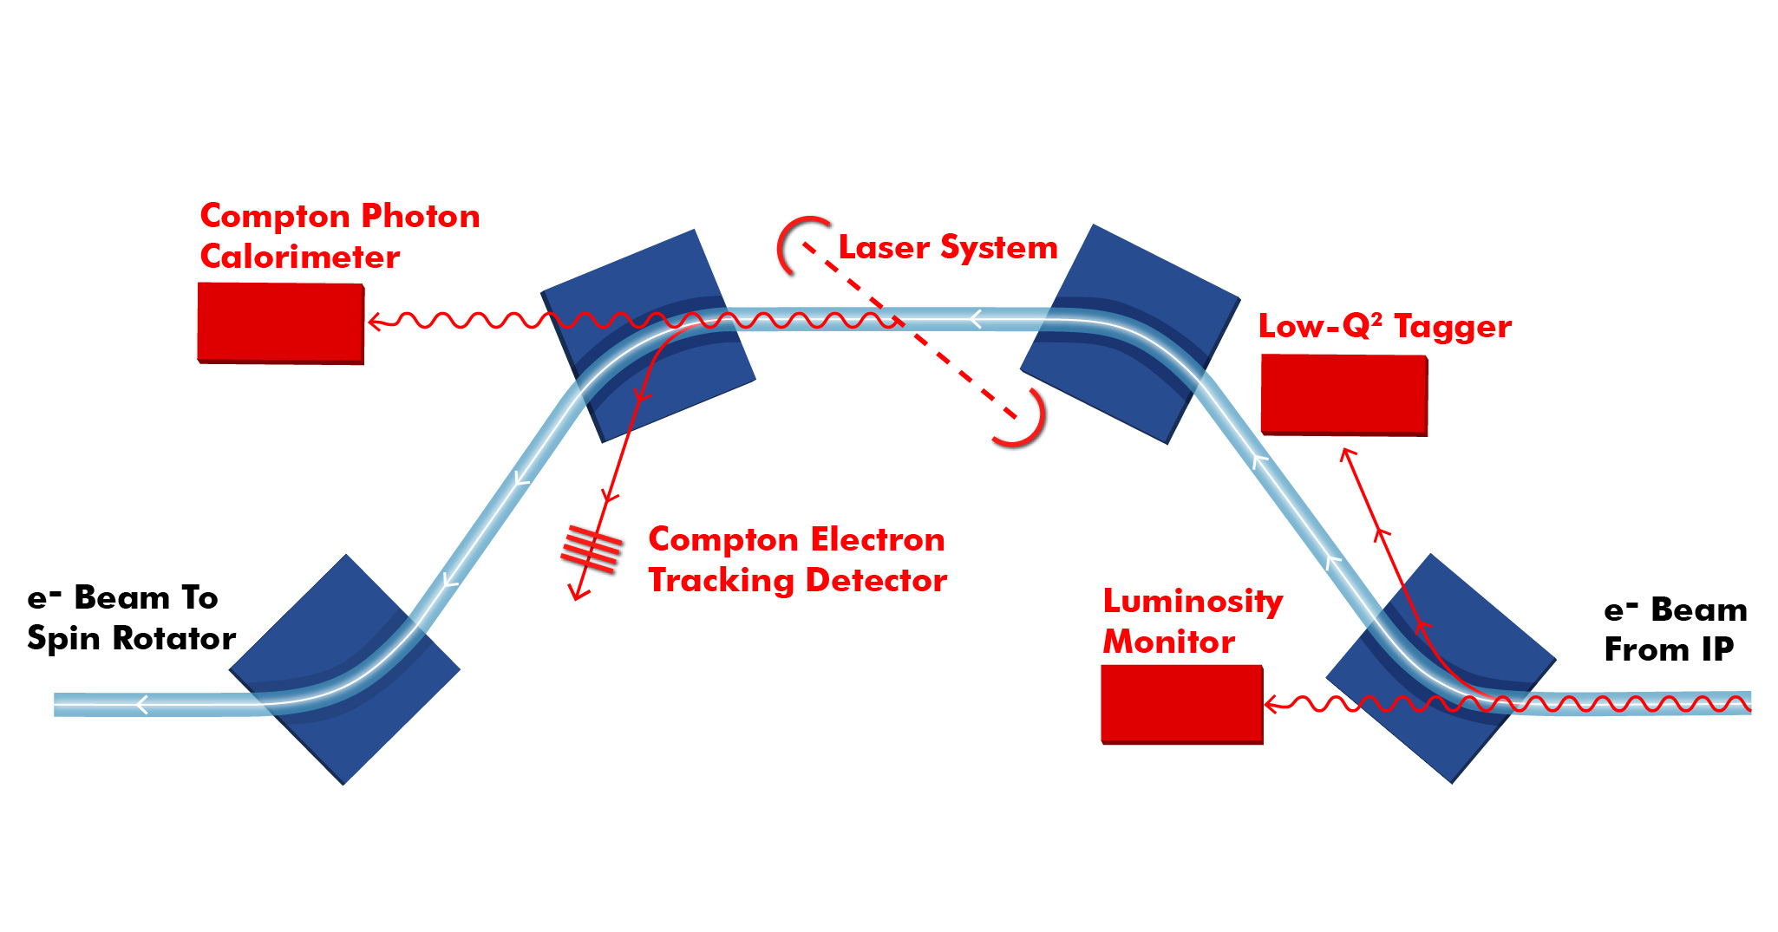
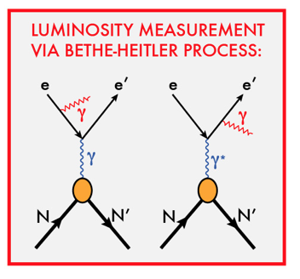
Chicane for Electron Far-Forward Area
Example from JLEIC design
Low Q2 tagger
For low Q² electrons
Luminosity monitor:
Luminosity measurements via Bethe-Heitler process
First dipole bends electrons
Photons from IP collinear to e-beam
Polarization measurements
First two Dipoles compensate each other
The same polarization as at IP
Minimum background and a lot of space.
Measurements of both Compton photons and electrons
Yulia Furletova
Notes:
Interior Page Design 2
20

Slide 21
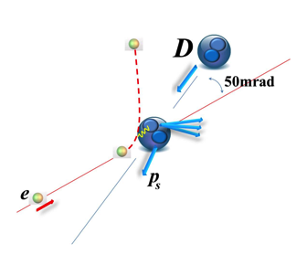
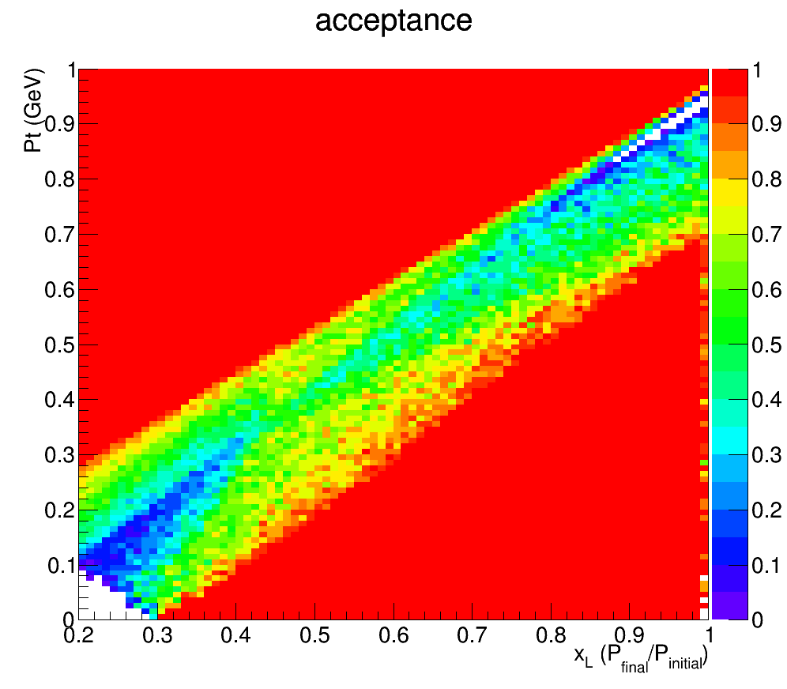
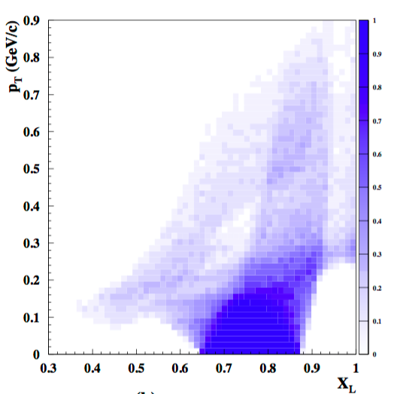
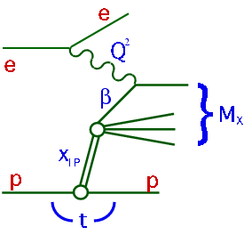
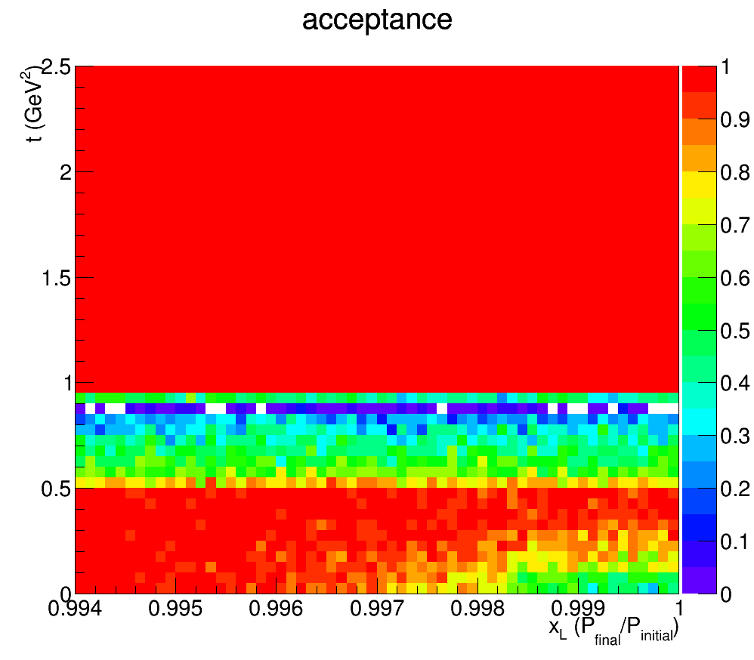
Far-forward ion direction area
Example from JLEIC design
Ion remnant
1
JLEIC
P_{t}
(GeV)
Region 1
ZEUS
Leading Proton Spectrometer
Diffraction
Region 2 (Hi. Res)
x_{L}
t, GeV²
X_{L}
Acceptance in diffractive peak (x_{L}>0.98):
ZEUS ~2%
JLEIC ~100%
0.994
1
Yulia Furletova
Notes:
Interior Page Design 2
21

Slide 22
One detector or two?
Combine results for precision measurements
Increase scientific productivity
Cross-checks on discoveries and important physics results
Provide complementary measurements
Yulia Furletova
Notes:
Interior Page Design 2
22

Slide 23
Summary
Physics of nucleon and nuclear structure must drive the design.
High luminosity and polarization are essential for EIC physics program.
EIC physics program demands a total acceptance detector. This means excellent forward/rear coverage in addition to the central coverage.
R&D for accelerator, interaction region and detectors are progressing in a good collaboration among Accelerator Physicists, Experimentalists, and Theoreticians. Machine parameters, interaction region and detector design must go hand in hand, paying close attention to the emerging physics program of the EIC.
It’s important that many labs and universities - not only from within the Nuclear Physics community - get involved.
Yulia Furletova
Notes:
Interior Page Design 2
23

Slide 24

Backup
Yulia Furletova
Notes:
Interior Page Design 2
24

