Slide 1

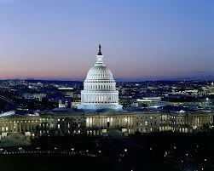


Sivers Program @ STAR
Salvatore Fazio (Brookhaven National Lab)
STAR Collaboration
APS topical group on Hadronic Physics 2017 Washington DC, Feb 01-03 2017

Slide 2
Plan of the talk
Physics motivations
STAR results for A_{N}(W±/Z⁰)
Discussion of our recent results
Future plans (Drell-Yan, weak bosons, direct-γ)
Conclusions

Slide 3
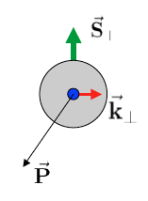
The Sivers function
8 TMDs are allowed by gauge invariance
The TMD knows as Sivers function is
sensitive to proton spin – parton transverse motion correlations
predicted not to be universal between SIDIS & pp
Sivers fct.
S_{P}
k_{T,q}
Tools to measure Sivers:
transverse single-spin asymmetry amplitude
Measure A_{N} for weak boson (W^{+/-}, Z⁰) and Drell-Yan (DY) processes
p
p

Slide 4
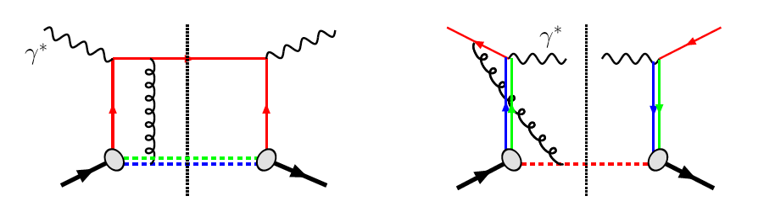
The sign change of the Sivers function
Motivations – Transverse Single Spin Asymmetry (A_{N})
QCD:
DIS: γq scattering
attractive FSI
pp: annihilation
repulsive ISI
NSAC performance milestone (HP13)
Sivers_{DIS} = - Sivers (DY or W or Z)
a fundamental prediction from the gauge invariance of QCD
Experimental test is critical test for our understanding of TMD’s and TMD factorization
Test through Drell-Yan process: COMPASS (CERN), proposed SeaQuest (FermiLab)
Strong background suppression, high lumi
@ STAR in run 2017(PostShower upgrade)
Polar. weak boson production (only at RHIC)
Very low background
Very high Q²-scale (~ W/Z boson mass)

Slide 5
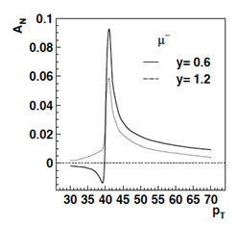
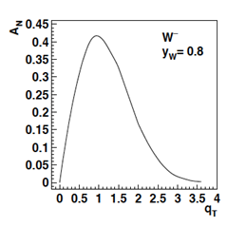
A_{N} for weak bosons
Lepton’s transverse momentum
Boson’s transverse momentum
Asymmetry from lepton-decay is small → Full kin. reconstruction of the boson needed
  Z⁰ easy to reconstruct (but small cross-section)
  W kin. can be reconstructed from the hadronic recoil (first time at STAR)

Slide 6
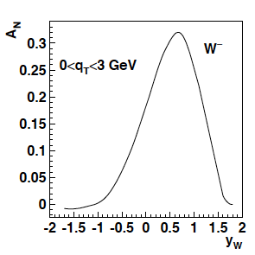
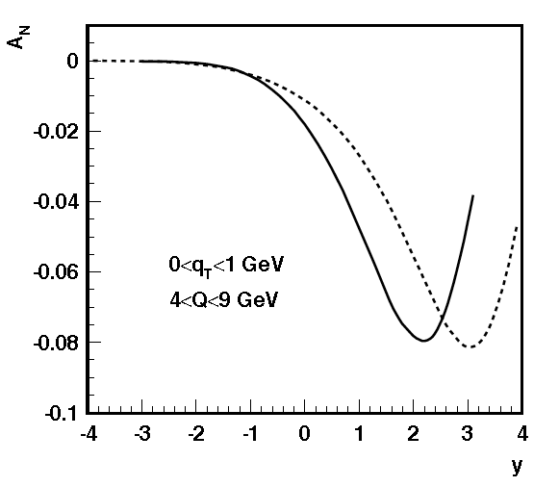
The TMD evolution & sea-quarks Sivers
Z.-B. Kang & J.-W. Qui arXiv:0903.3629
Z.-B. Kang & J.-W. Qui Phys.Rev.D81:054020,2010
before evolution
before evolution
Size of the TMD evolution effect still under discussion in theory community
For details see
J. Collins, T. Rogers,
Phys.Rev. D91 (2015) 7, 074020
200 GeV
500 GeV
Drell-Yan
What is the sea-quark Sivers fct.?
  Sea quarks are mostly unconstrained from existing SIDIS data... but they can give a relevant contribution!
  W’s ideal → rapidity dependence of A_{N} separates quarks from antiquarks
W± data can constrain the sea-quark Sivers function

Slide 7
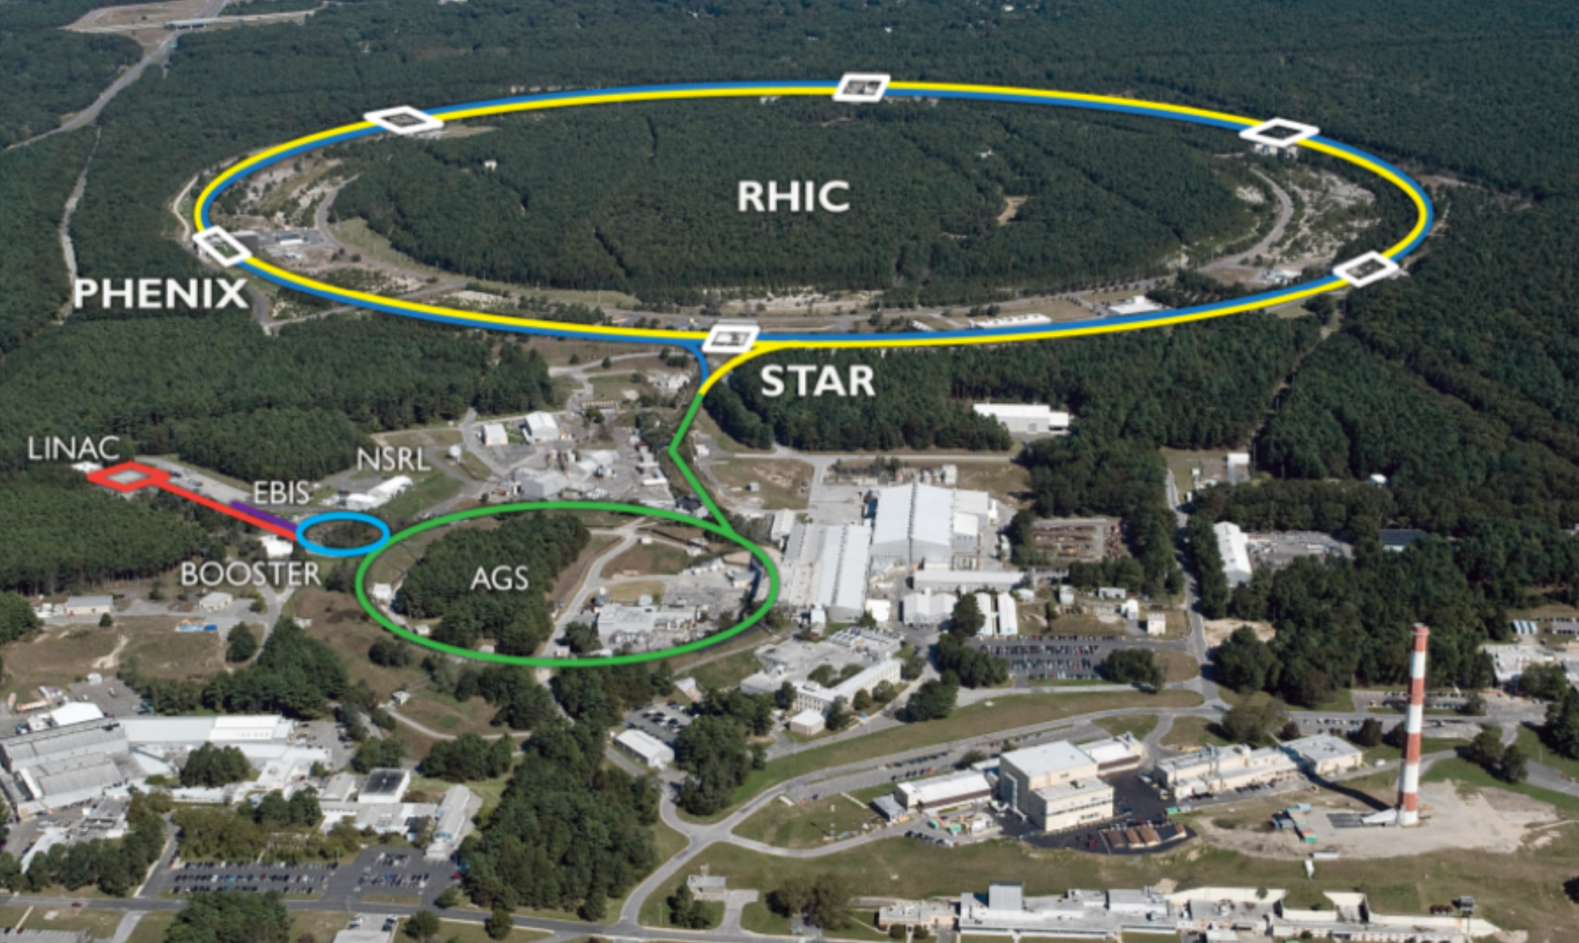
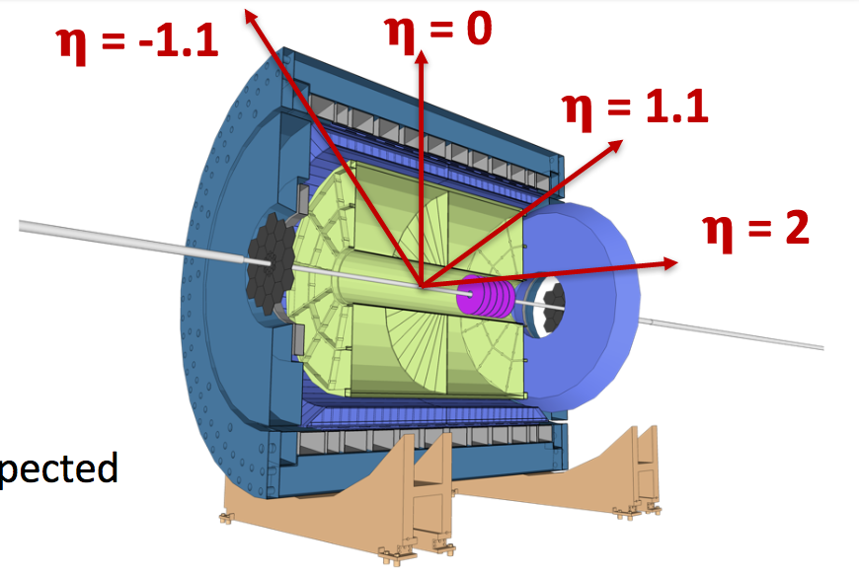
The Relativistic Heavy-Ion Collider
RHIC is the world’s first and only polarized hadron collider
2π coverage Electromagnetic Calorimeter
  Barrel: -1 < η< 1
  End-cap: 1.1 < η < 2
Main tracker – Time projection chamber (TPC): |η| < 1.3
Its top energy is enough to produce weak bosons

Slide 8
RHIC – a unique opportunity!
Till today TMDs come only from fixed target low scale, high x
measurements should establish concept at high √s and different x
→ polarised pp / pA at RHIC

Slide 9
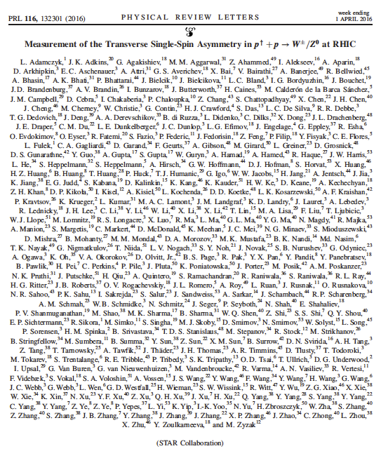
Measurement of TSSA for weak bosons @ STAR
New paper from STAR
Phys. Rev. Lett. 116, 132301 (2016)
Editor’s suggestion
[arXiv:1511.06003]
World’s first direct experimental test of the sign change in the Sivers function
RHIC is the only polarized p+p collider. Its top energy is enough to produce weak bosons
Selection of weak bosons well established at STAR
  Long. spin asymmetries:
  Phys. Rev. Lett. 113, 072301 (2014)
  Phys. Rev. Lett. 106, 062002 (2011)
  unpolarized xsec:
  Phys. Rev. D 85, 092010 (2012)
This measurement is STAR’s first attempt to reconstruct the produced boson’s kinematics

Slide 10
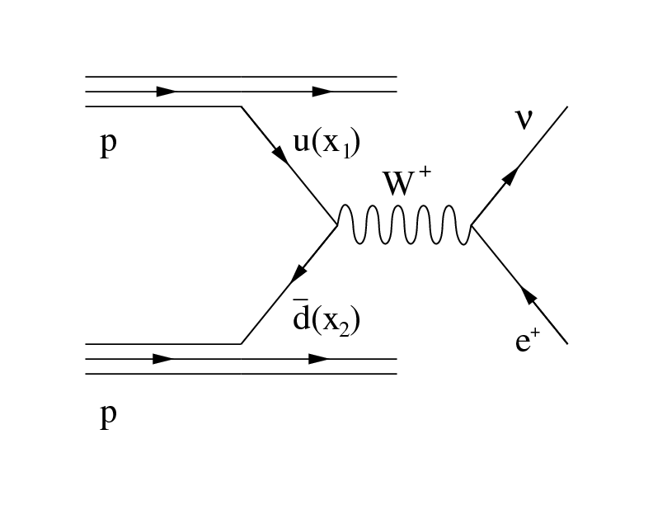
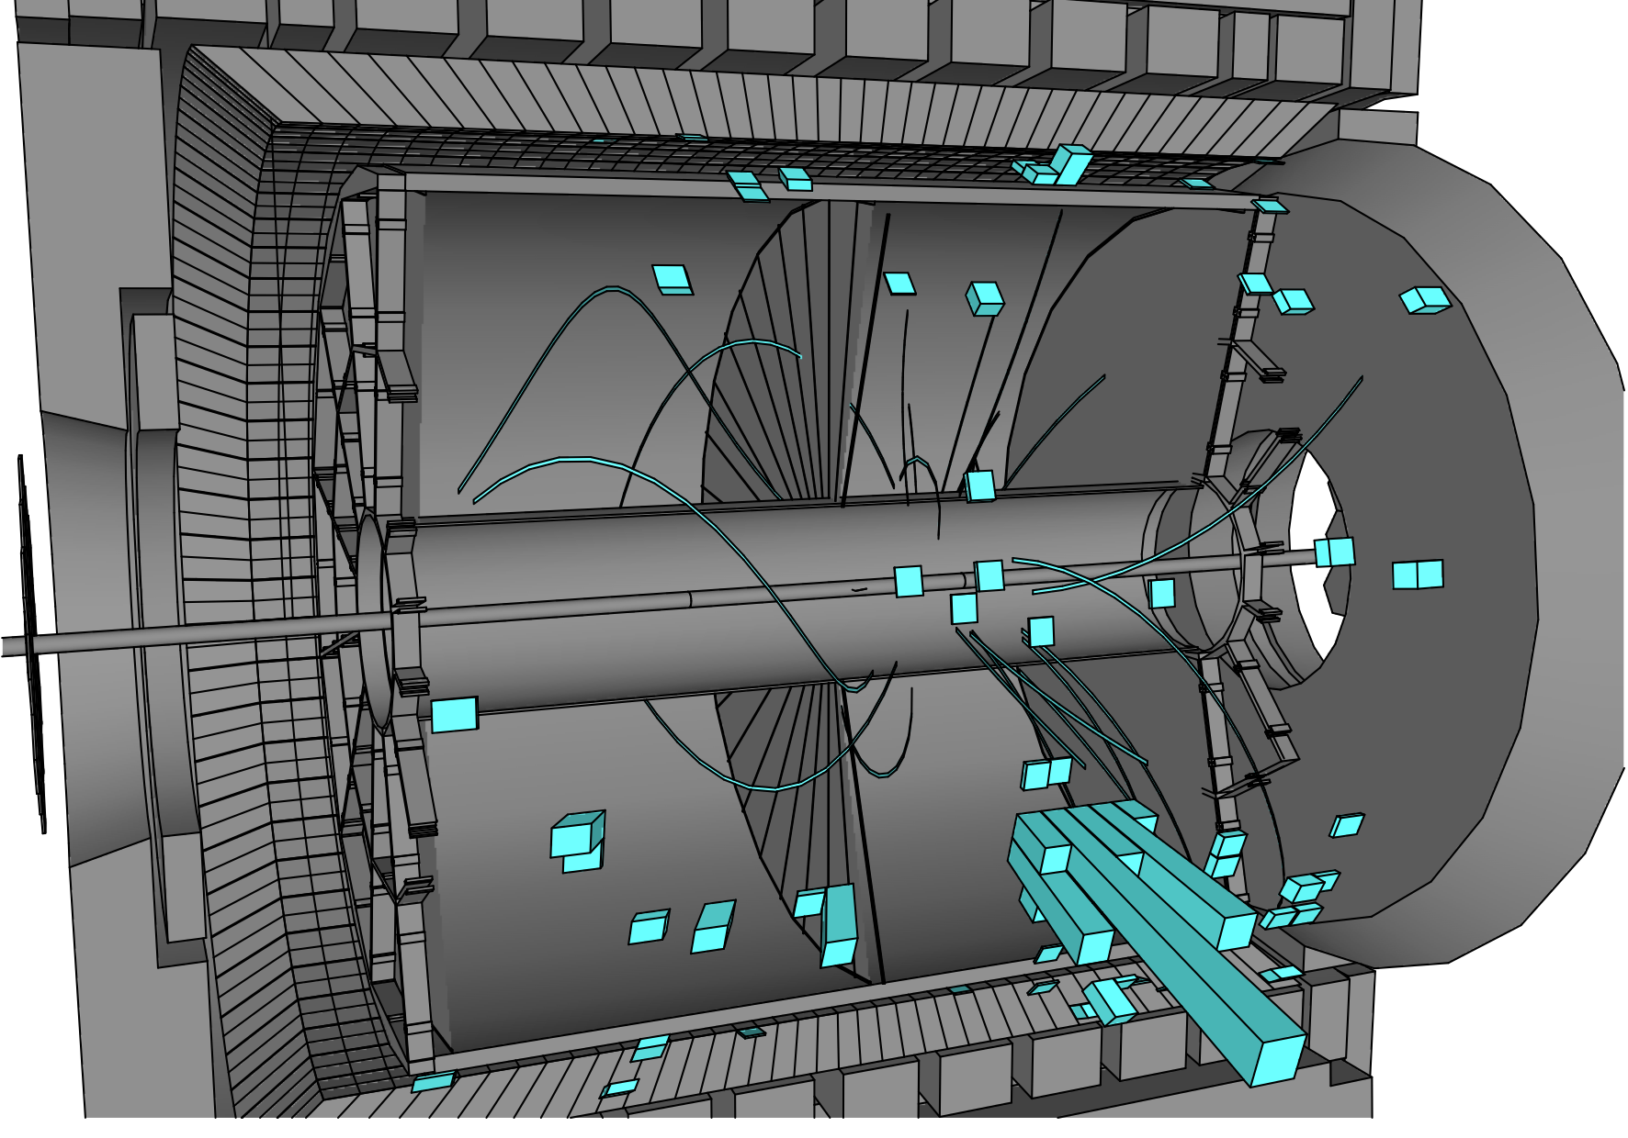
Strategy
Ingredients for the analysis
Isolated electron
neutrino (not measured directly)
Hadronic recoil
W boson momentum reconstruction technique well tested at FermiLab and LHC
[CDF: PRD 70, 032004 (2004); ATLAS: JHEP 1012 (2010) 060]
Select events with the W-signature (STEP 1)
  Isolated high P_{T} electron
Neutrino transverse momentum is reconstructed from missing P_{T} (Step 2)
Neutrino’s longitudinal momentum is reconstructed from the decay kinematics (Step 3)
The STAR detector @ RHIC
TPC (|η| < 1.4)
Barrel EMCAL (|η| < 1)

Slide 11
W boson kinematics – Data/MC
GOOD data/MC agreement

Slide 12
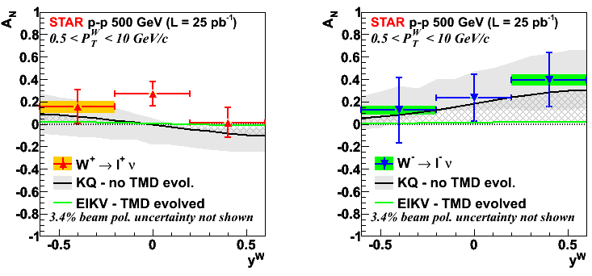
A_{N} vs W-rapidity
Average RHIC
polarization
(p+p run 2011 tran.)
<P> = 53%
We use the “left-right” formula to cancel dependencies on geometry and luminosity
Results versus rapidity are compared with:
KQ model [Z.-B. Kang and J. -W. Qiu, Phys. Rev. Lett. 103, 172001 (2009)]
  It does not include TMD evolution
  Grey band is the theory uncertainty
EIKV model [M. G. Echevarria, A. Idilbi, Z.-B. Kang, I. Vitev, Phys. Rev. D89, 074013 (2014)]
  Includes the largest prediction for TMD evolution
Grey hatched area represents the current theoretical uncertainty on TMD evolution

Slide 13
The Sivers’ sign change (no TMD evol.)
A global fit to the (unevolved) KQ prediction was performed:
solid line: assumption of a sign change in the Sivers function → Chi2/d.o.f. = 7.4/6
dashed line: assumption of no sign change in the Sivers function → Chi2/d.o.f. = 19.6/6
If there are no evolution effects,
our data favor the hypothesis of Sivers sign change

Slide 14
Z⁰ Asymmetry
Clean experimental momentum reconstruction
Negligible background
electrons rapidity peaks within tracker accept. (|η|< 1)
Statistics limited
A_{N} measured in a single y, P_{T} bin

Slide 15
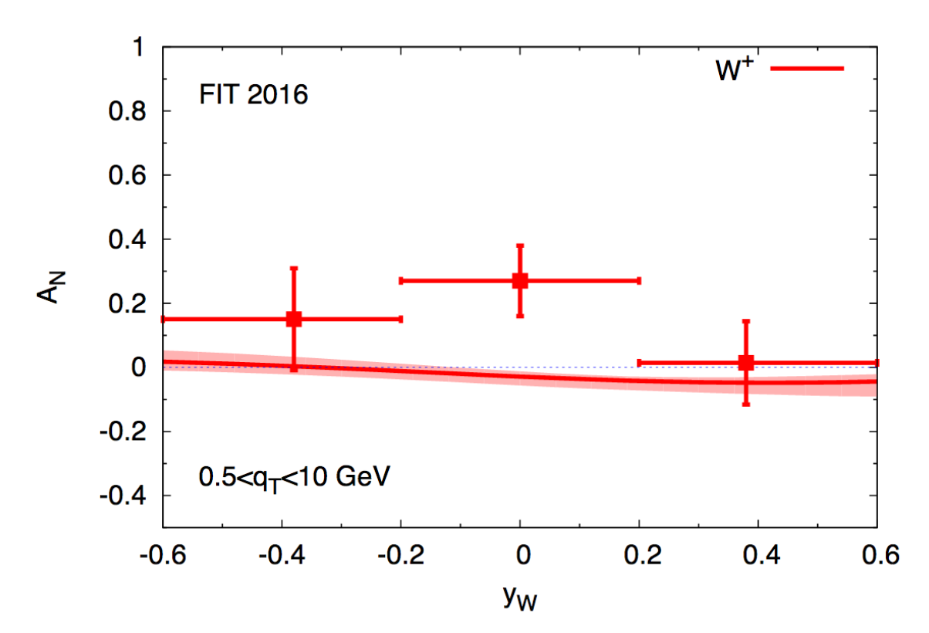
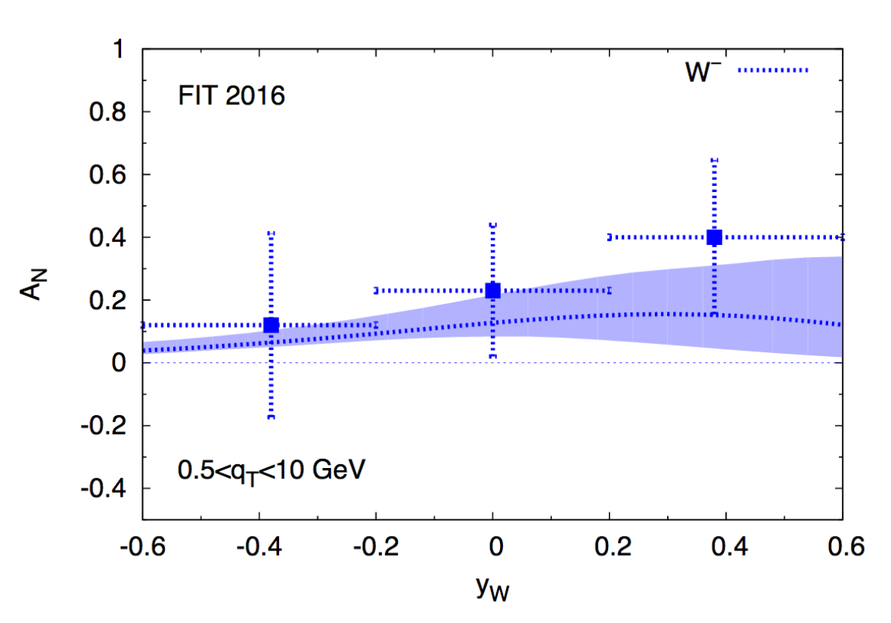
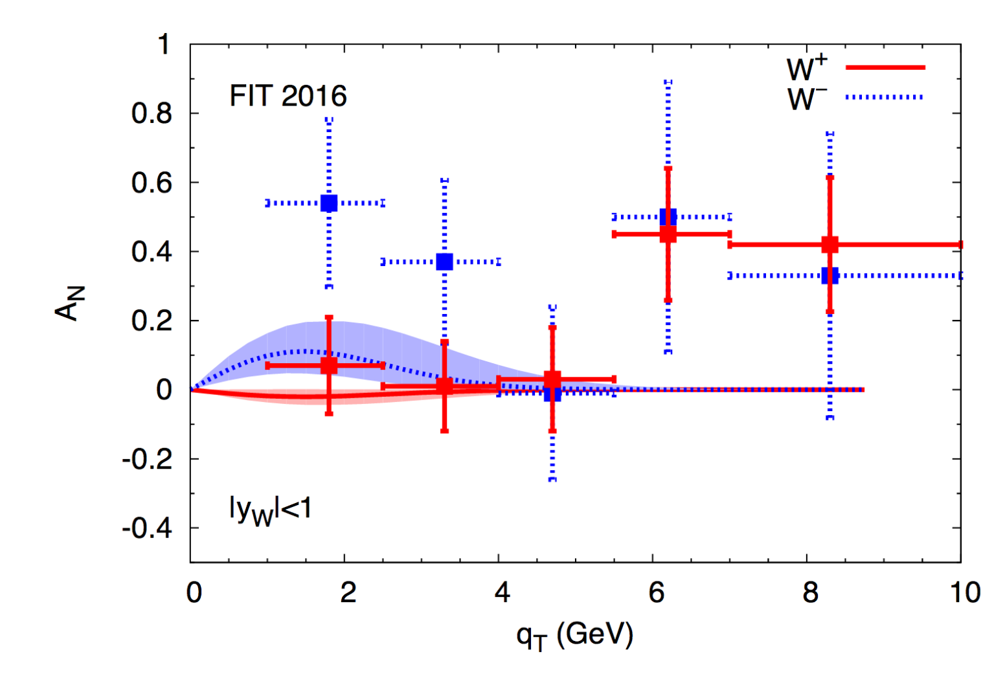
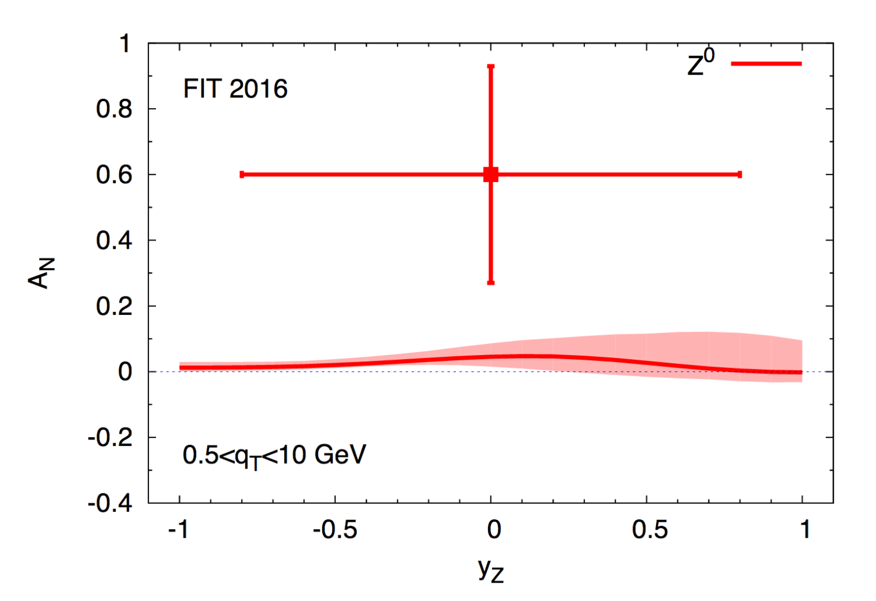
An independent test of sign-change
M. Anselmino, M. Boglione, U. D'Alesio, F. Murgia, A. Prokudin
arXiv:1612.06413
Parameters trained on SIDIS data from: COMPAS, HERMES, JLAB
-> latest fit of Sivers
-> different kine. region
No evolution effects included in the predictions
Global fit on our W⁺ and W⁻ data

Slide 16
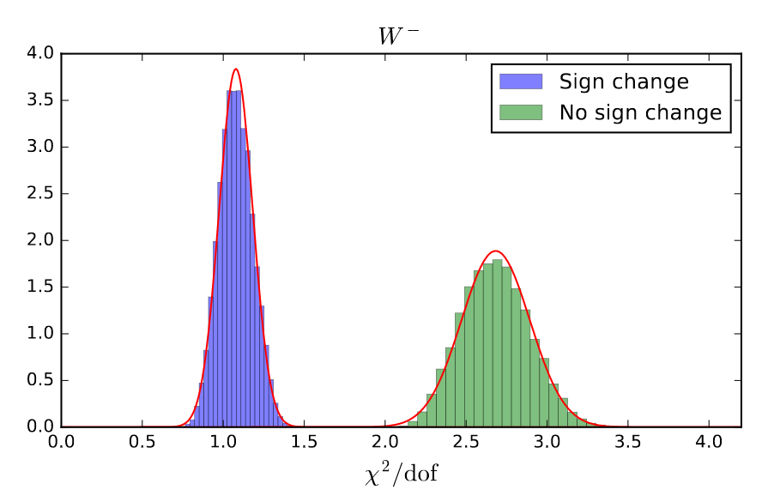
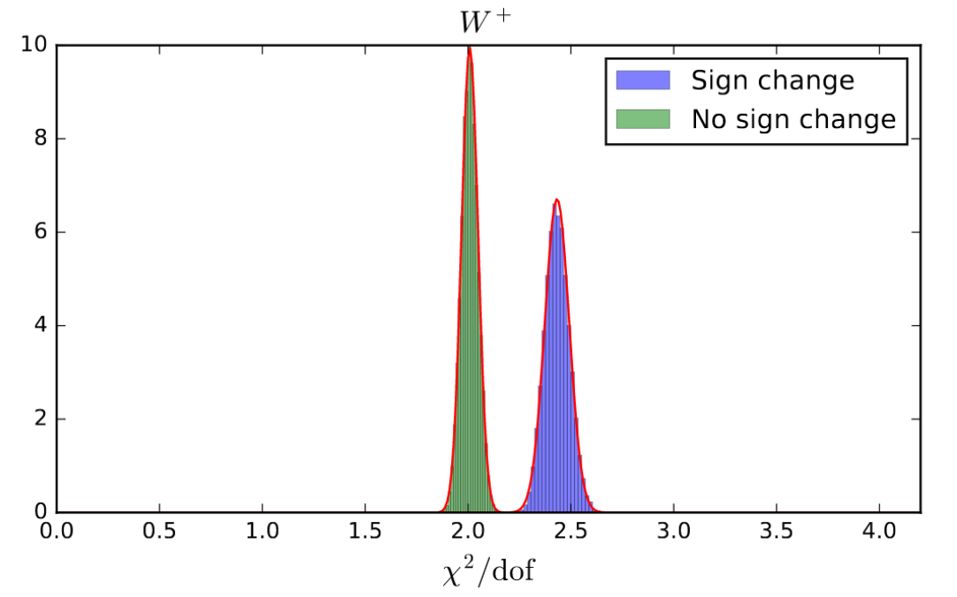
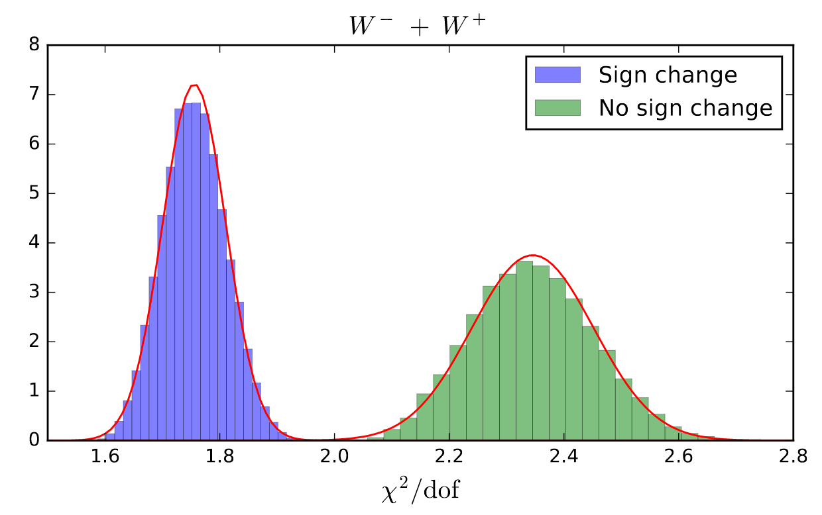
An independent test of the sign-change
M. Anselmino, M. Boglione, U. D'Alesio, F. Murgia, A. Prokudin
arXiv:1612.06413
probability density functions
d.o.f = 8 (# points)
parameters of the model tested on A_{N} of W+ and W-
2x10⁴ sets of param.
W⁻
W⁺
W⁺ + W⁻
The model with sign change hypothesis agrees with W- asym. data
Globally data give a hint in favor of sign change
generally the agreement of the model is poor
Authors conclude for the need of more precise data

Slide 17
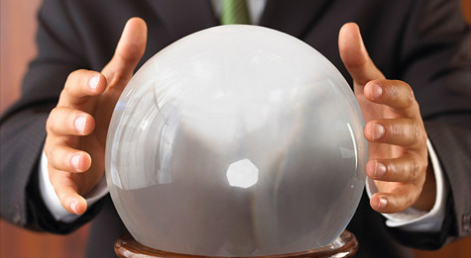
... and the future?
Present results, obtained with a pilot sample of 25 pb⁻¹ show a proof-of principle
Full kinematic reconstruction of weak bosons is possible at STAR
Main physics goals:
How strong is the TMD evolution?
What is the contribution to the Sivers function from sea-quarks?
Conclusive test of the Sivers’ sign change
Precise measurements suitable for 3D imaging of protons in momentum space
All we need is more data!
Run 17 - Assumptions:
integrated delivered luminosity of 400 pb⁻¹
12 weeks transversely polarized p+p at 510 GeV
electron lenses are operational and dynamic β-squeeze is used throughout the fill
  smoothed lumi-decay during fills
  reduced pileup effects in TPC → high W reconstruction efficiency
How?
  Measure A_{N} for direct-γ, W±, Z⁰, DY
  DY and W±, Z⁰ give Q² evolution
  W± give sea-quark Sivers
  All four processes give sign change

Slide 18
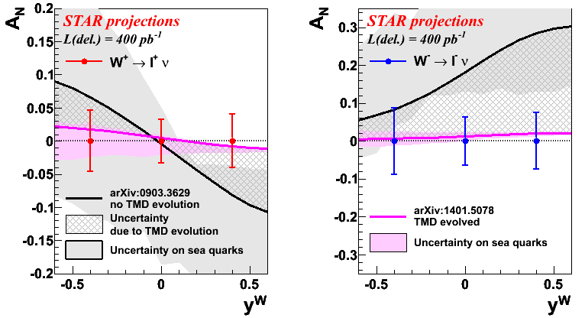
Weak bosons – run 17
Large statistics will allow us to
Precisely measure A_{N} for Ws within a few % in several P_{T}, y bins.
Measure the very clean Z⁰ channel.
Test sign change if evolution is less than factor ~5
RHIC plans to deliver ~400 pb⁻¹ transverse p+p in 2017

Slide 19
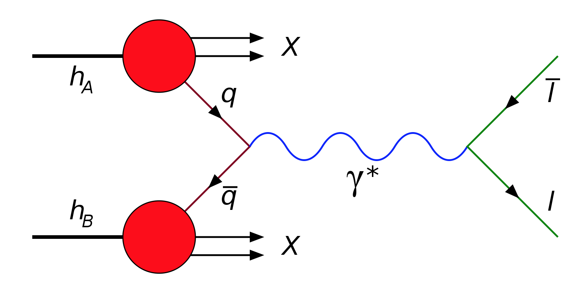
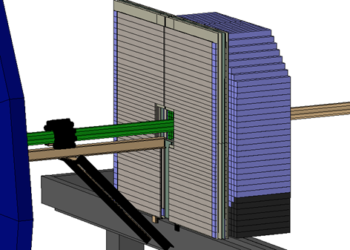
The future: A_{N} of Drell-Yan at STAR
Very Challenging: (RHIC QCD WP arXiv:1602.03922)
  QCD background ~10⁵-10⁶ larger than DY cross-section
  Probability of wrongly identifying a decay electron to be suppressed to ~0.01% while maintaining efficiency in identifying electrons
COMPASS (CERN) and proposed E-906/SeaQuest (FNAL) pursue the investigation of TMD through this process
STAR can measure it... after an upgrade
  We have just installed forward Post-Shower detector behind the the FMS detector and its Pre-Shower
Peshower Detector (FPS): 3 layers of scintillator stripes with SiPMT-based read-out in front of the FMS,
distinguish photons and electrons/positrons
Installed for RUN-15
FPS
FMS
Postshower Detector (FPost): similar to the FPS but located behind the FMS,
distinguish electrons and hadrons
Installed and ready to take data in upcoming RUN-17
post-shower upgrade

Slide 20
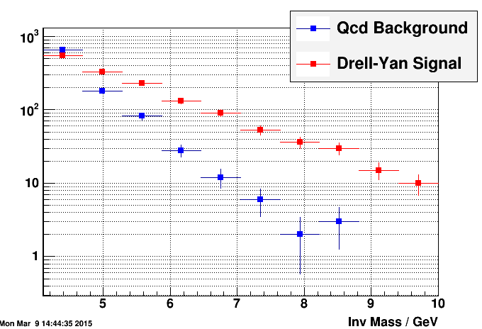
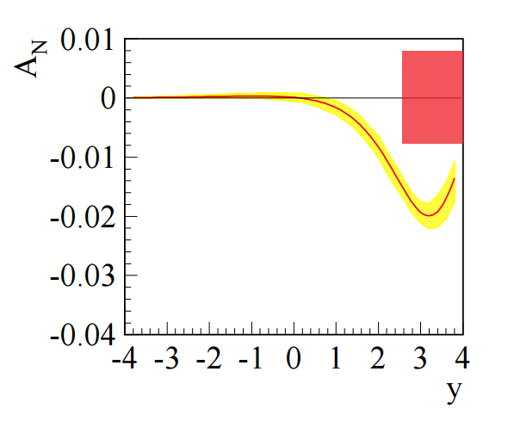
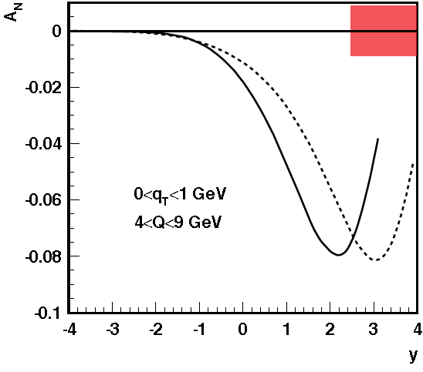
Drell-Yan at STAR – Background suppression
With TMD Evolution
STAR projected uncertainty
No TMD Evolution
The expected yields of DY events and background after the upgrade
Drell-Yan
The proposed forward-detector system (FPS + FMS + FPost) provides the needed rejection factor for measuring DY
STAR can measure DY to ± 0.008 in run-17 for ∫L_{del}=400 pb⁻¹
500 GeV
200 GeV
KQ: Phys.Rev.D81:054020,2010

Slide 21
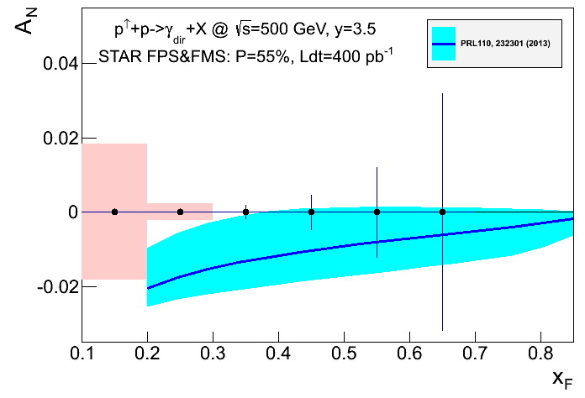
The future: A_{N} of direct-photons at STAR
A_{N} for direct photon production:
sensitive to sign change, but in TWIST-3 formalism
not sensitive to TMD evolution
no sensitivity to sea-quarks; mainly u_{v} and d_{v} at high x
collinear objects but more complicated evolutions than simple DGLAP
indirect constraints on Sivers fct.
How do we access the sign change?
If the correlation due to different color interactions for initial and final state between the Sivers fcn and the twist-3 correlation fcn in the k_{T} integral would be violated, the asymmetry would be positive but the same magnitude
Not a replacement for a A_{N}(W^{+/-}, Z⁰, DY) measurement
but an important complementary piece in the puzzle

Slide 22

White Papers
arXiv: 1501.01220
arXiv:1602.03922

Slide 23
Conclusions
First measurement of A_{N} for W± and Z⁰ production at RHIC by reconstruction of the boson kinematics, using a sample of 25 pb⁻¹ transverse p-p data @ √500 GeV collected by STAR
  World’s first experimental test of the non-universality of the Sivers function
RHIC run 17 data (up to L~400 pb⁻¹) can give statistical significance to
  Pin down TMD evolution
  Investigate the contribution from sea-quarks to the Sivers fcn.
  Ultimate test of the Sivers’ sign change
STAR is the only experiment that can measure A_{N} for γ, W±, Z⁰, DY, all in one venue, simultaneously!

Slide 24
BACKUP

Slide 25
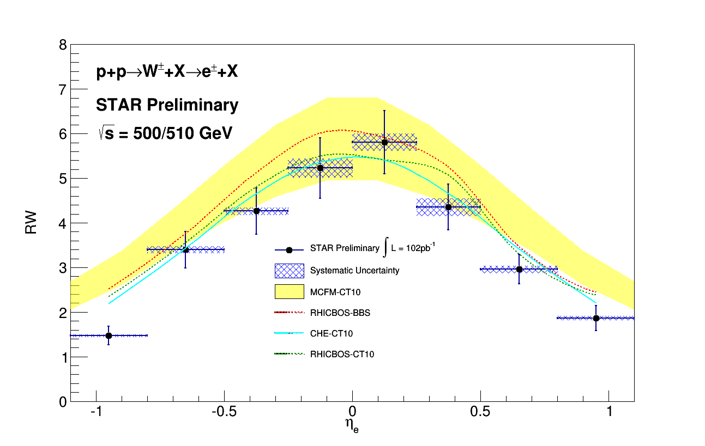
W+/W- unpolarized x-sec ratios
Collected Luminosity (run 11 + 12) = 102 pb⁻¹
σ(W+) / σ(W-)
σ(W+) / σ(W-)
Decay Electron - PseudoRapidity
W Boson - Rapidity
Run 13 will add ~ 250 pb⁻¹
STAR Run 17 is expected to add ~ 400 pb⁻¹

Slide 26
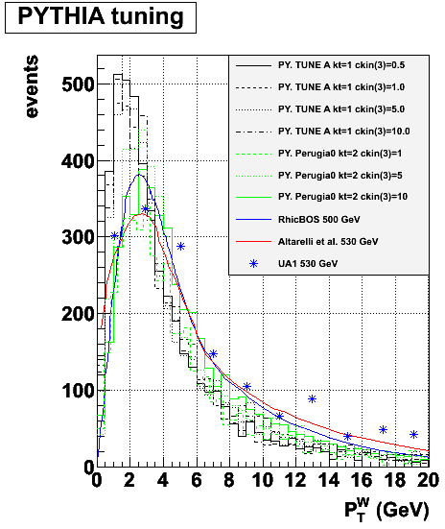
Data & MC
Monte Carlo
PYTHIA reconstructed trough GEANT simulated STAR detector
Perugia tune with hard P_{T} > 10 GeV
PYTHIA embedded into real zero-bias pp events
Data sample
pp – transverse (collected in 2011)
@ √500 GeV
Integrated luminosity: ~ 25 pb⁻¹
Events triggered in Barrel EMCAL
Signal
W → ev_{e}
Background
W → tv_{t} → ev_{e}v_{t}
Z → ee
QCD events

Slide 27
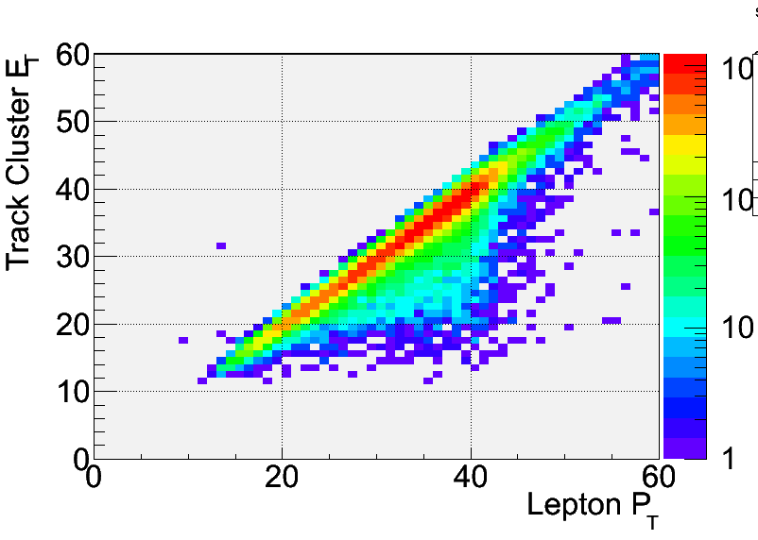
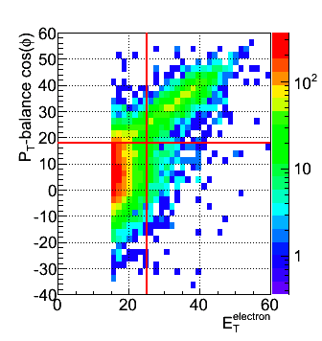
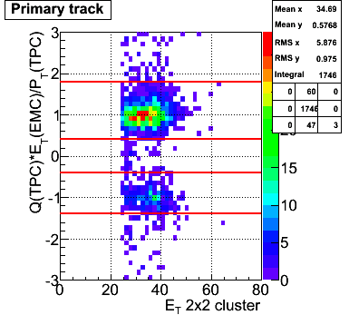
Electron identification
Isolation: (P^{track}+E^{cluster}) / Σ[P^{tracks} in R=0.7 cone] > 0.8
Imbalance: no energy in opposite cone (E<20 GeV)
E_{T} > 25 GeV
Track |η| < 1
|Z-vertex|<100 cm
Charge separation (avoids charge misidentification):
0.4 < |Charge (TPC) x E_{T} (EMC) / P_{T} (TPC)| < 1.8
Signed P_{T} balance > 18 GeV/c (rejects QCD Background)
0.5 GeV/c < P_{T}^{W} < 10 GeV /c
We calculate energy from the cluster
MC
SIGNAL
QCD

Slide 28
Background estimation
Background from W and Z boson decays estimated via Monte Carlo
PYTHIA 6.4 with Perugia 0 tune
normalized to recorded data luminosity
Data-driven QCD background estimation
Reverse of P_{T}-balance cut [PT-balance < 15 GeV] → Selects QCD events
Plot lepton-P_{T} > 15 GeV
QCD sample normalized to the first P_{T}-bin [15-19 GeV]
Positive-charge signal 1016 events
Z⁰ → ee [B/S = 0.79% ± 0.03%]
W⁺ → tv_{t} [B/S = 1.89% ± 0.04%]
QCD [B/S = 1.6% ± 0.09%]
Negative-charge signal 275 events
Z⁰ → ee [B/S = 2.67% ± 0.1%]
W⁻ → tv_{t} [B/S = 1.77% ± 0.1%]
QCD [B/S = 3.39% ± 0.23%]
Backgrounds under control!

Slide 29
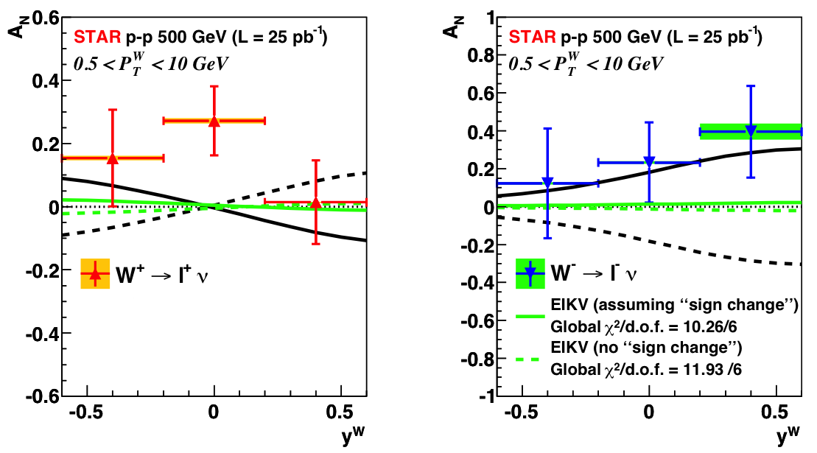
The Sivers’ sign change (strong TMD evol.)
Size of the TMD evolution still uncertain
-> terms calculable from QCD + non-perturbative terms (need data)
A global fit to the EIKV prediction (largest predicted evolution effect):
solid line: assumption of a sign change in the Sivers function → Chi2/d.o.f. = 10.26/6
dashed line: assumption of no sign change in the Sivers function → Chi2/d.o.f. = 11.93/6
Our uncertainties are still too high to compare with predictions

Slide 30
Summary table
 | A_{N}(W^{+/-},Z⁰) | A_{N}(DY) | A_{N}(γ)
sensitive to sign change through TMDs | yes | yes | no
sensitive to sign change through Twist-3 T_{q,F}(x,x) | no | no | yes
sensitive to TMD evolution | yes | yes | no
sensitive to sea-quark Sivers fct. | yes | yes | no
need detector upgrades | no | yes at minimum: FMS postshower | yes pre-showers installed for run-15
biggest experimental challenge | integrated luminosity | background suppression & integrated luminosity | need to still proof analysis on data
A_{N}(W^{+/-},Z⁰) clean probe sensitive to all questions without the need for upgrades

