Slide 1

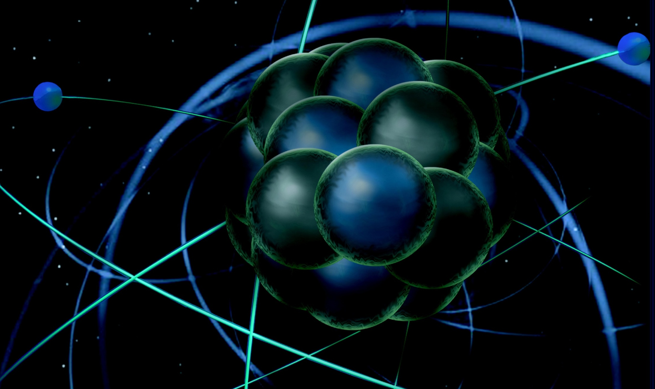
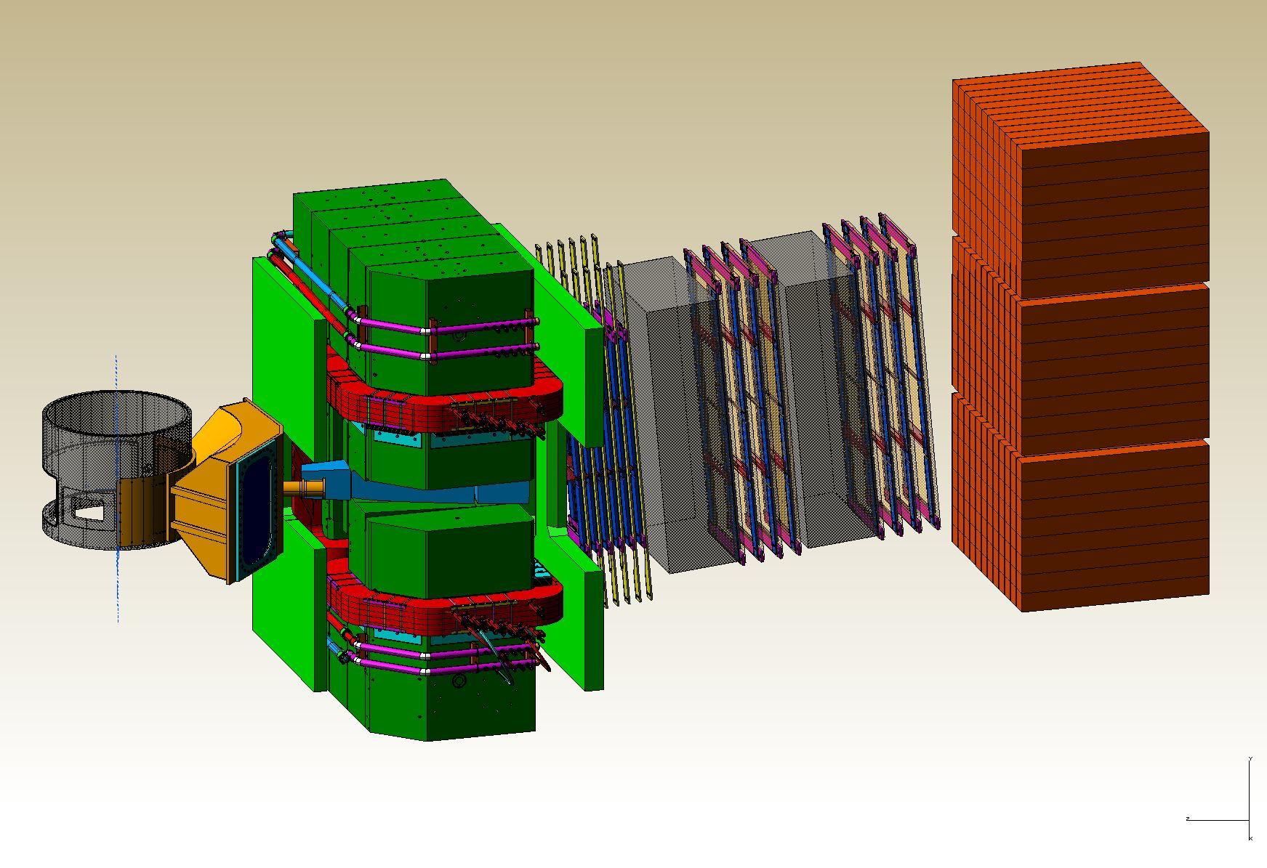
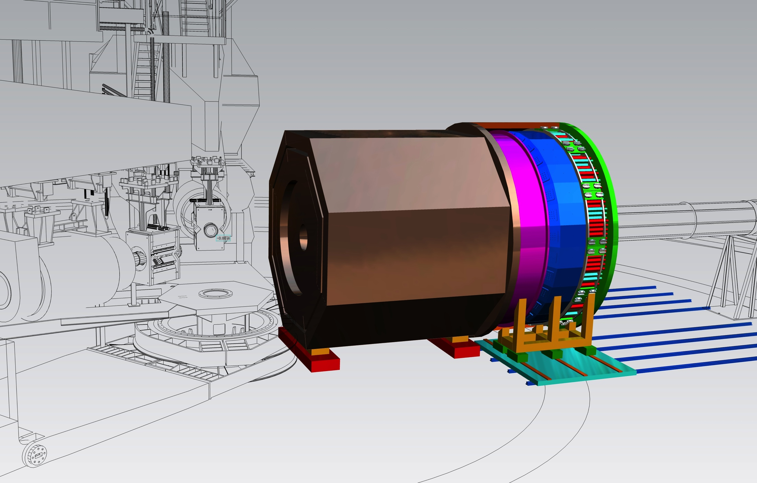
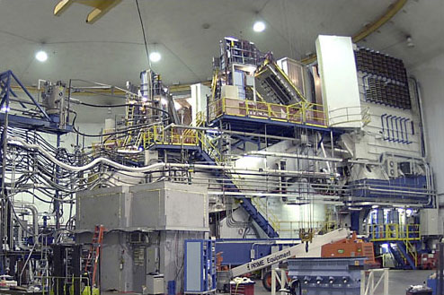
Hall A Update
Thia Keppel
Program Advisory Committee 44
July 2016

Slide 2
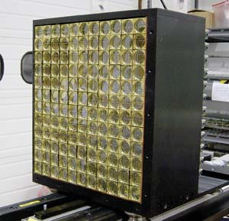
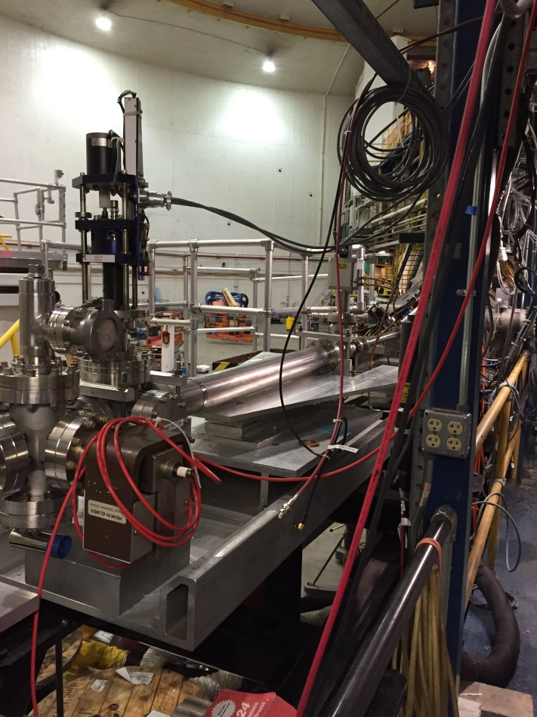
DVCS / G_{M}^{p} Experiments in the Hall now
Started experiments Fall 2014
Spring 2016 run with 20 uAmp, 11 GeV beam, resistive “SOS” quad on right arm
Multiple optics studies, resistive quad acceptable
Higher current (~60 uAmps) achieved
First Compton polarimetry accomplished in Spring 2016 Run
New high field Moller commissioning in Spring 2016 run
Arc beam energy measurement – and spin dance
Additional parity beamline instrumentation tested with parallel, dedicated DAQ
Notes:
F2 and C12 scans good for acceptance studies

Slide 3
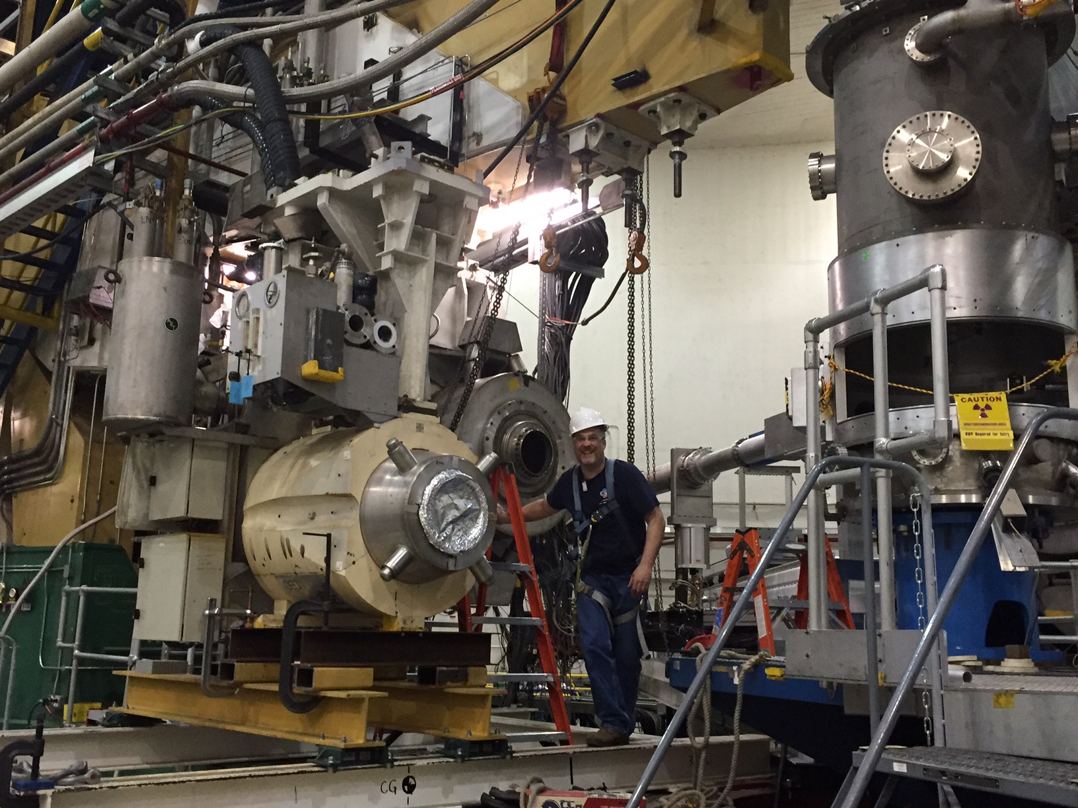
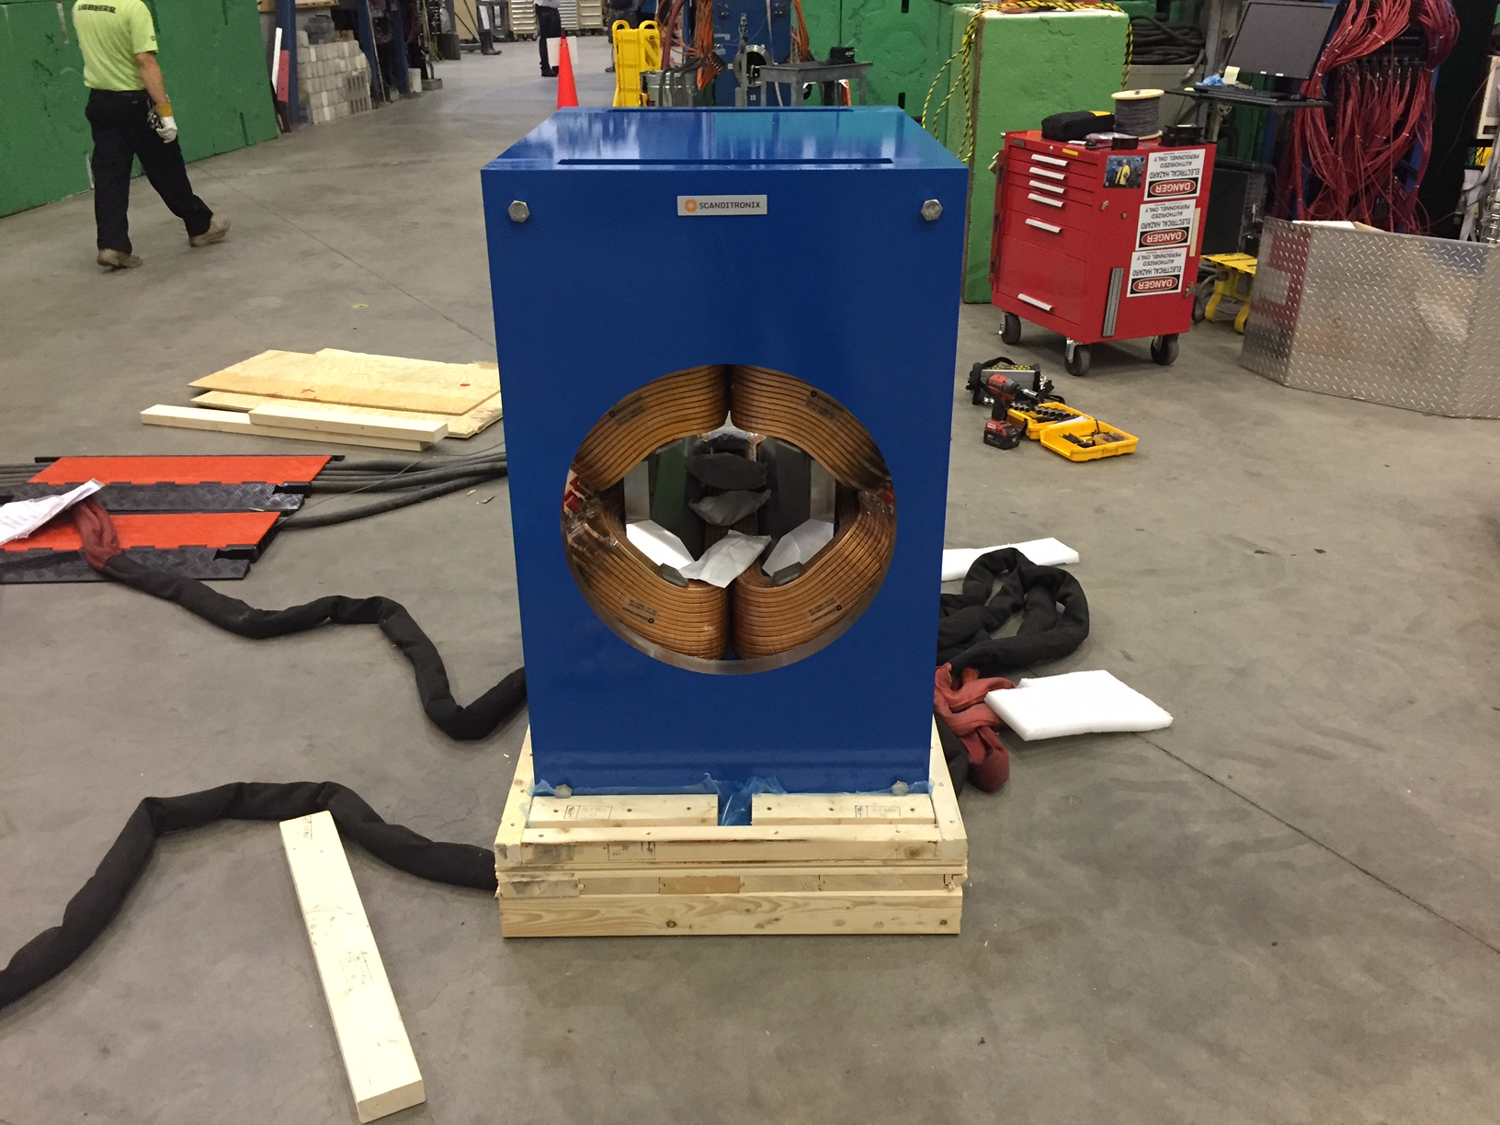
“New” Resistive Q1 Magnets
    SOS quad functioned well on HRS-R
    Problems with HRS old superconducting Q1-L limited momentum
    HRS-L new SOS twin arrived last week
      Will permanently replace superconducting quads
    Mounts to allow forward/backward movement
    Power, water upgrades to Hall underway this Summer 2016
    - helpful also for septum experiments, SBS, MOLLER

Slide 4
DVCS-I and G_{M}^{p}: Concurrent Experiments in Hall A at 11 GeV
Original projections for 10 calendar weeks in Spring’16
High impact experiment for 3D nucleon imaging
  Deeply Virtual Compton Scattering (DVCS) provides access to Generalized Parton Distributions (GPDs)
Will provide highest available Q² measurement of the DVCS cross section
  Demonstration of scaling critical to full JLab 12 GeV GPD program
DVCS
6.6
8.8
11 GeV
Fall’14
x
x
x
2
3
1 days
G_{M}^{p}
x
x
x
x
6.6
8.8
11 GeV
5 days
4
4
4
x
x
x
x
8.8
11 GeV
13
16 days
13
20
High Q² Form Factors
  Reducing G_{M}^{p} uncertainties will enable Super BigBite high impact program of Form Factor Measurements

Slide 5
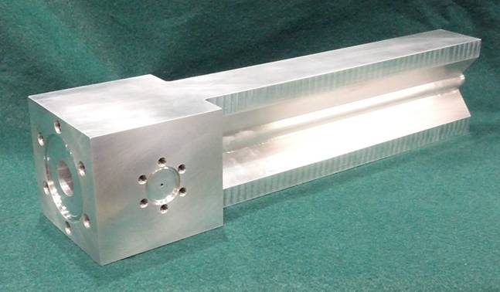
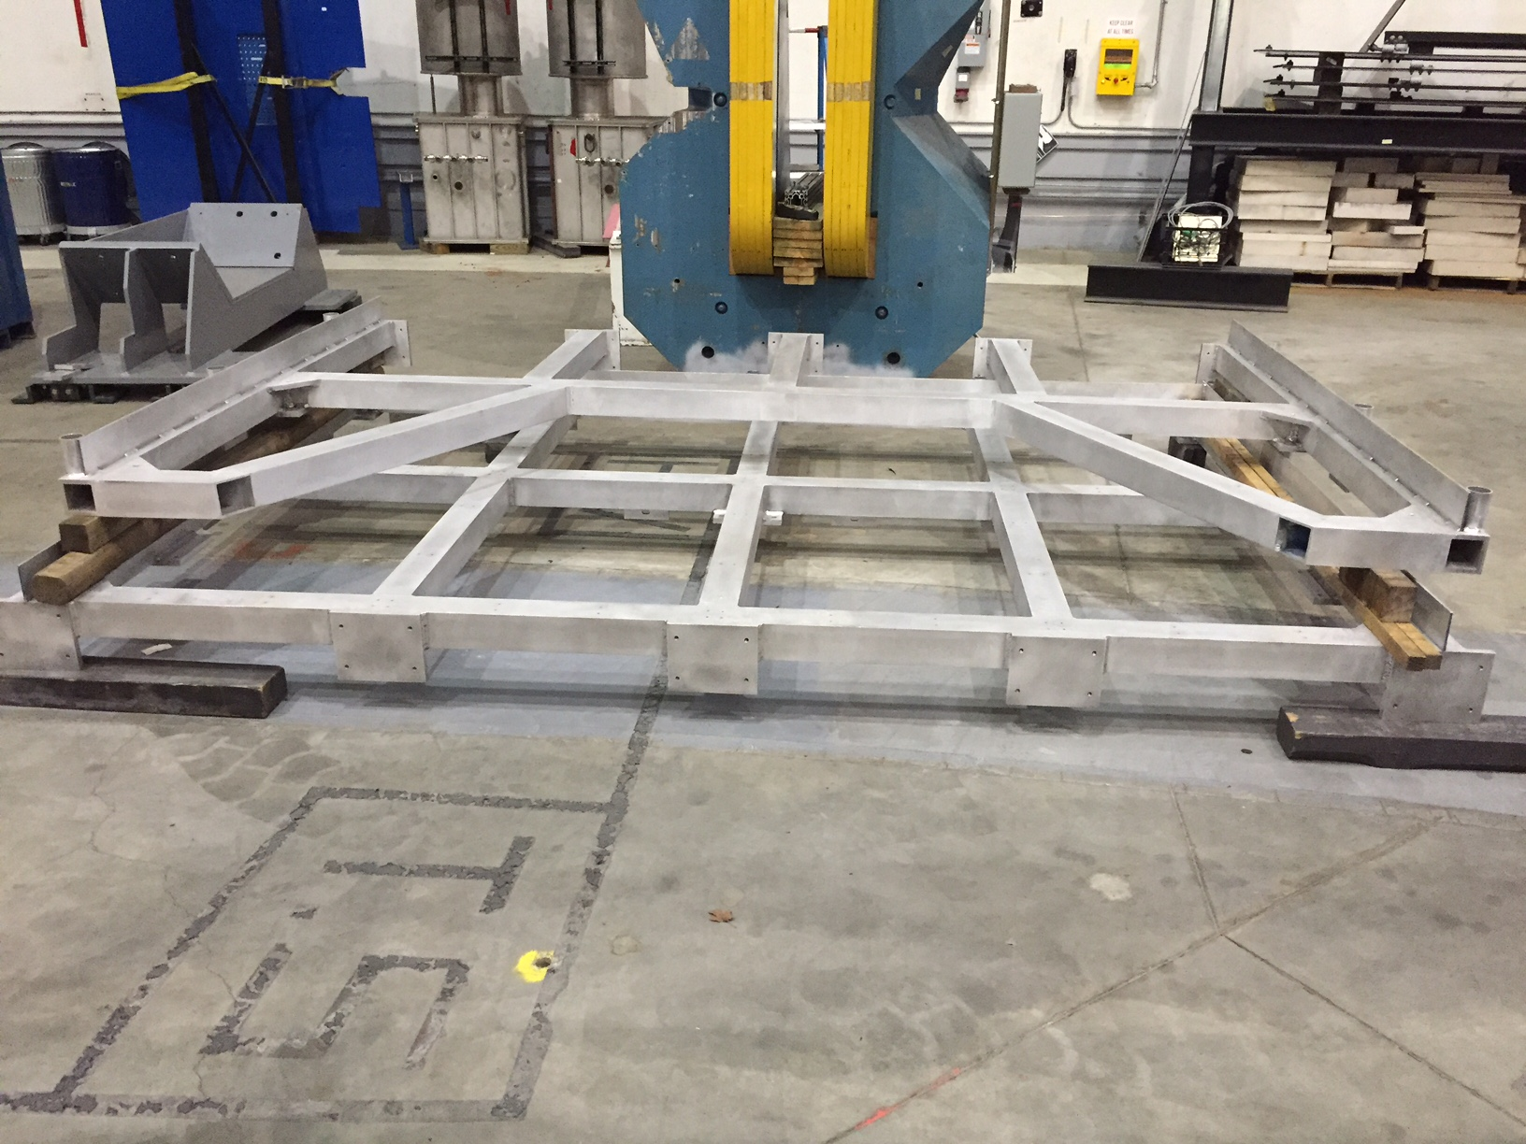
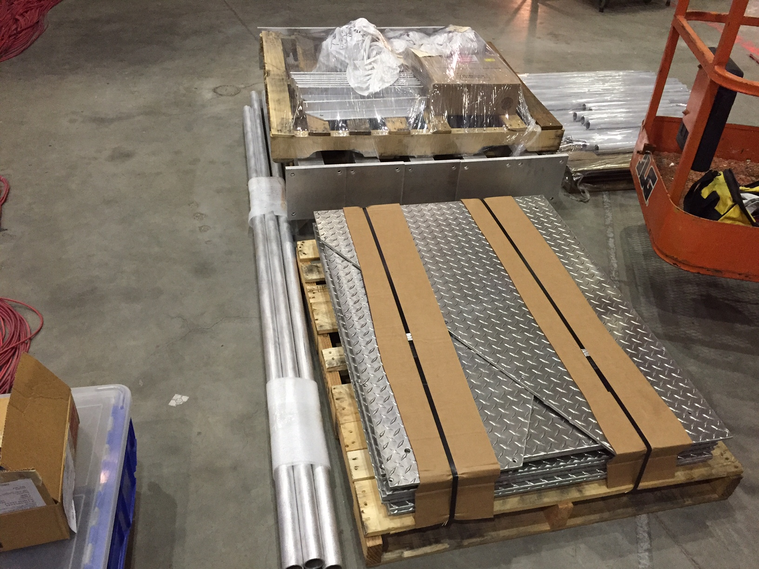
Tritium Experiment Preparations
Four experiments approved, 2 PAC 40 high impact
Successful target safety/design review September 2015
Successful ERR March 2016
BigBite no longer planned for use
  Can instrument for SBS
Installation currently underway
  Hall vent system
  Power, water upgrades
  Target engineering
  Target installation platform

Slide 6
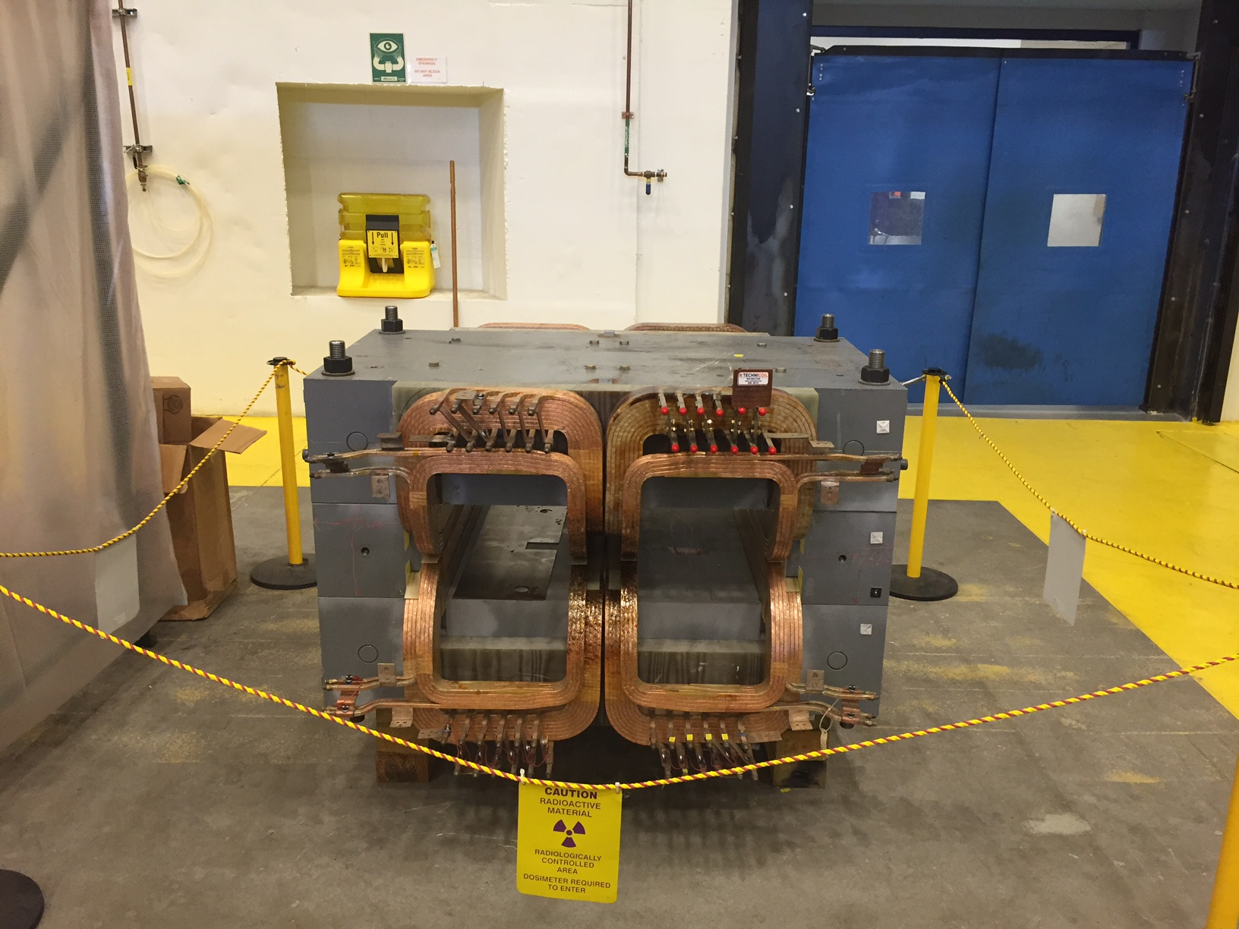
Beyond ³H Hall Activities/Experiment Preparation
    Polarized ³He target improvements and continued development
        Convection, new lasers, metal windows, …
        Phase I upgrade of existing target – implementable in either Hall A or C
        Phase II (high polarization SBS GEn type)
        Design now frozen, design report to be completed this month
    PREX/CREX
        Pb and diamond targets, new coils purchased
        Combined target chamber, shielding designs underway
        Computation fluid dynamics for target design
        Beamline upgrades
          Second x,y,Q girder (from Hall C), new “Musson” cavity electronics, Hall C halo
          monitor installed in A, lumi monitors installed and first pass tests started
        Polarimetry upgrades underway
          Superconducting Moller, Compton electron
    APEX
        New septum magnet purchased by collaboration now in test lab, added fittings and
        manifold
        Computation fluid dynamics for target design
        Shielding design

Slide 7
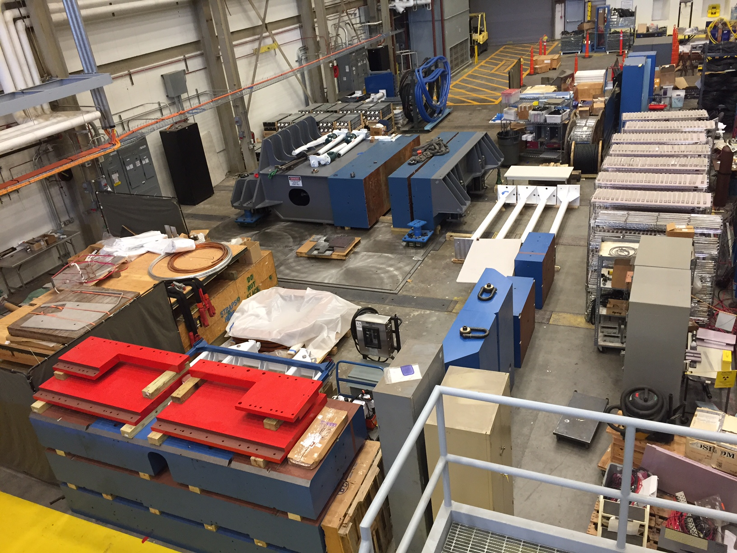
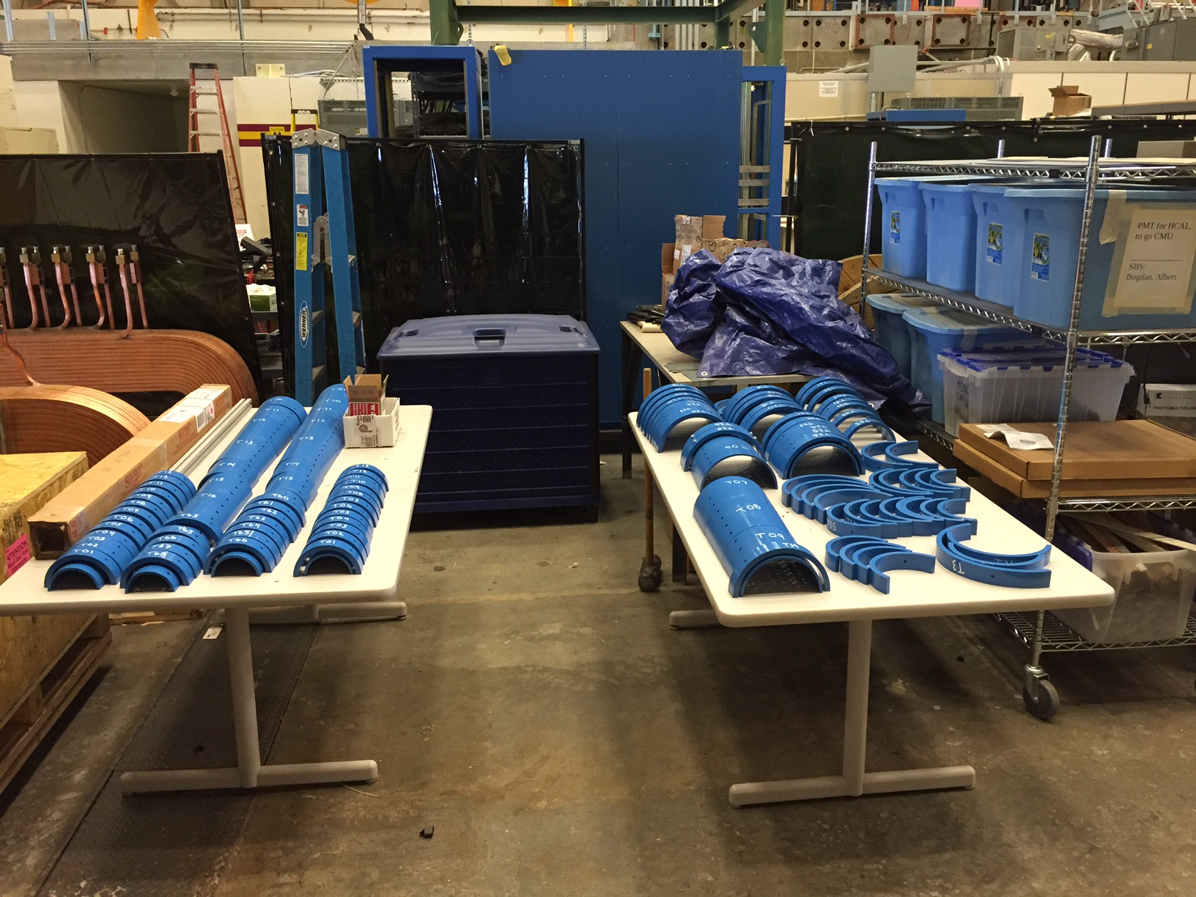
SBS Construction
Project started FY2013
  Successfully passed third annual review November 2015
  Final Review planned for November 7,8 2016
  Last time some concerns about thermal annealing/design of ECAL and 3He target timeline

Slide 8
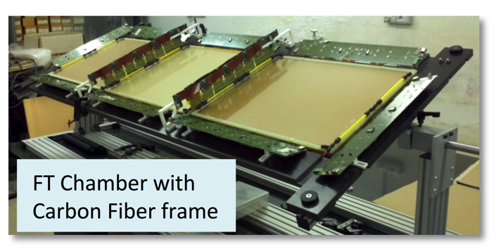
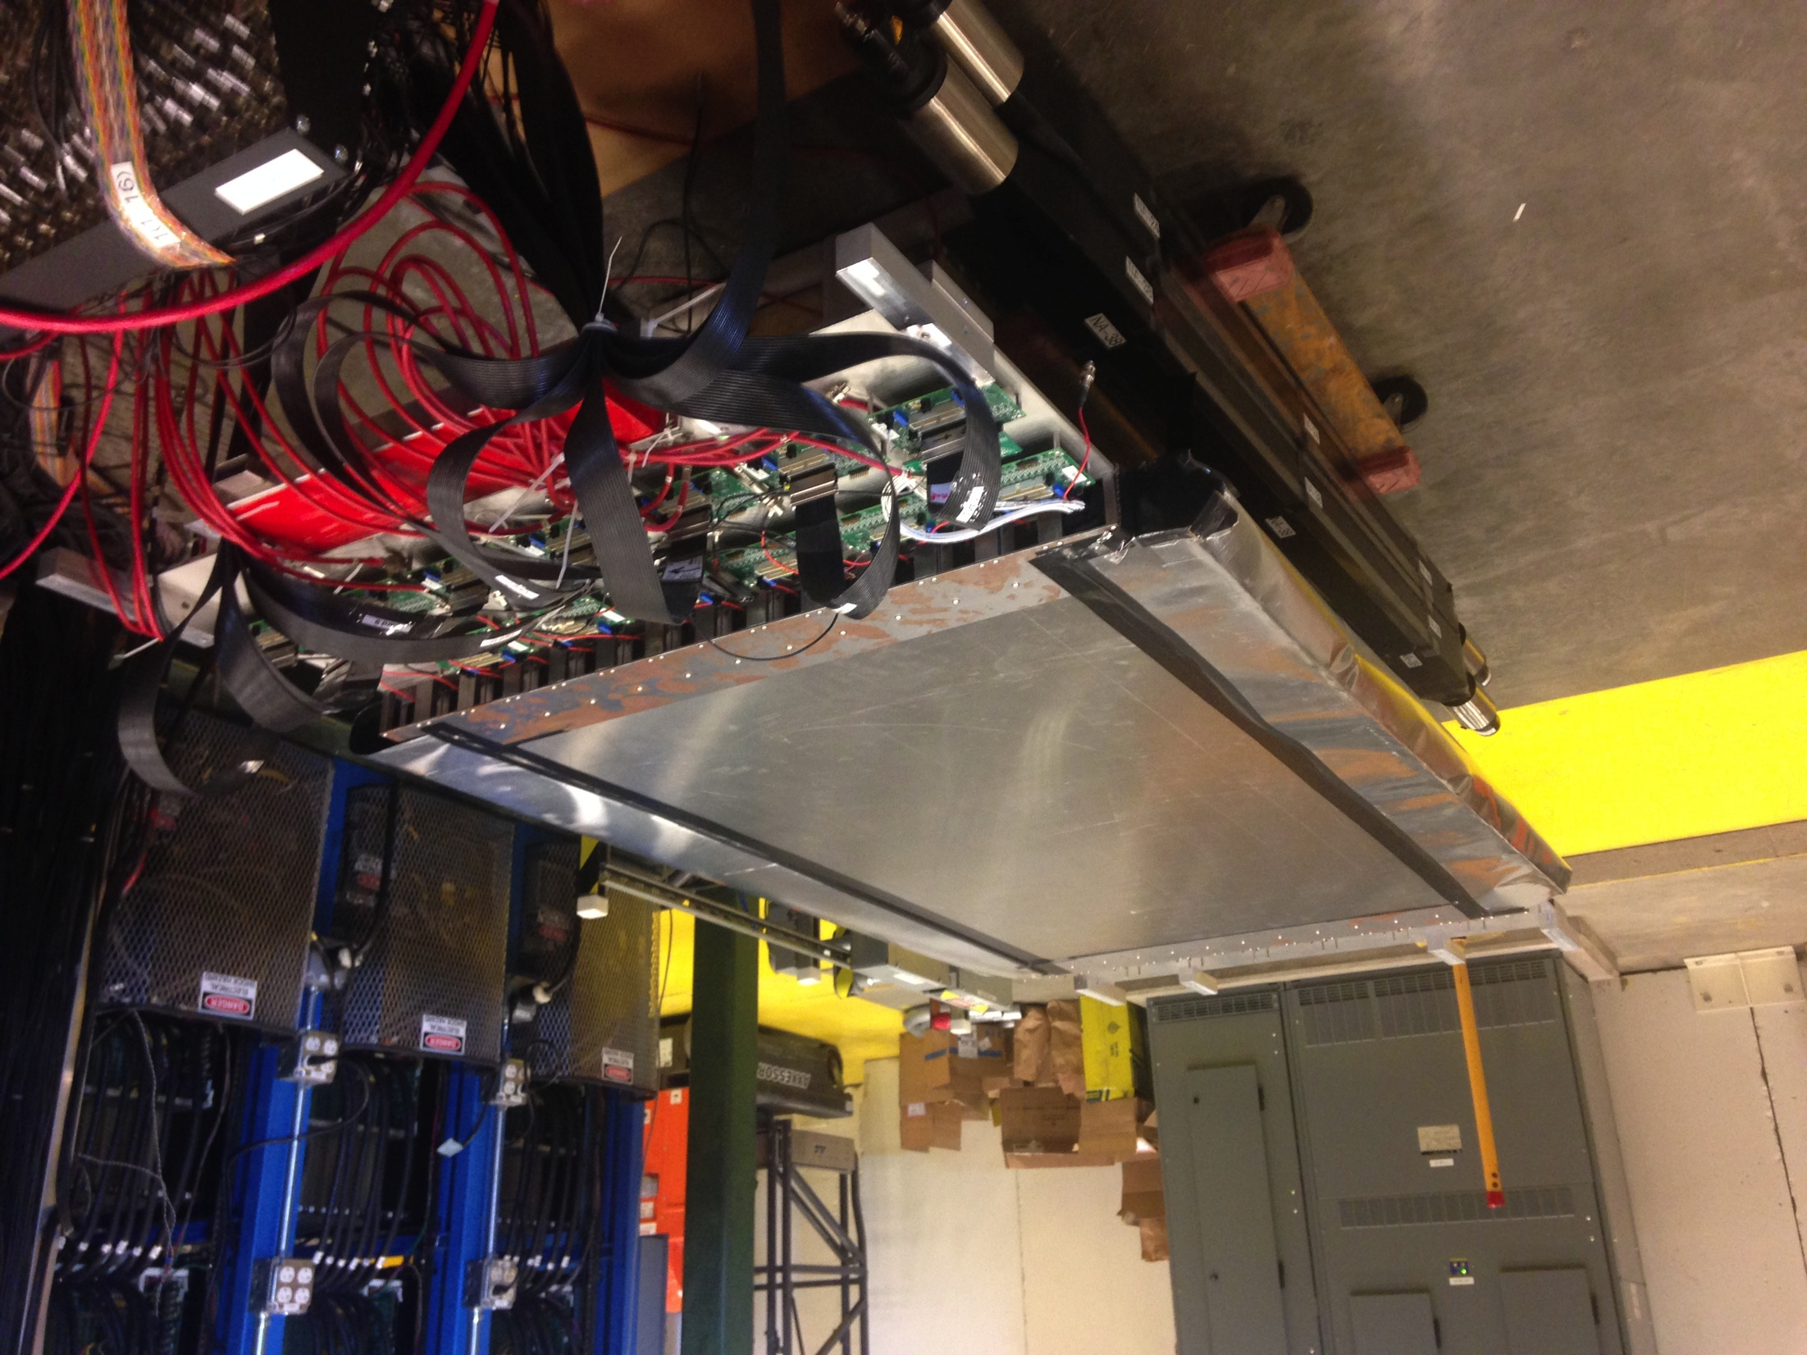
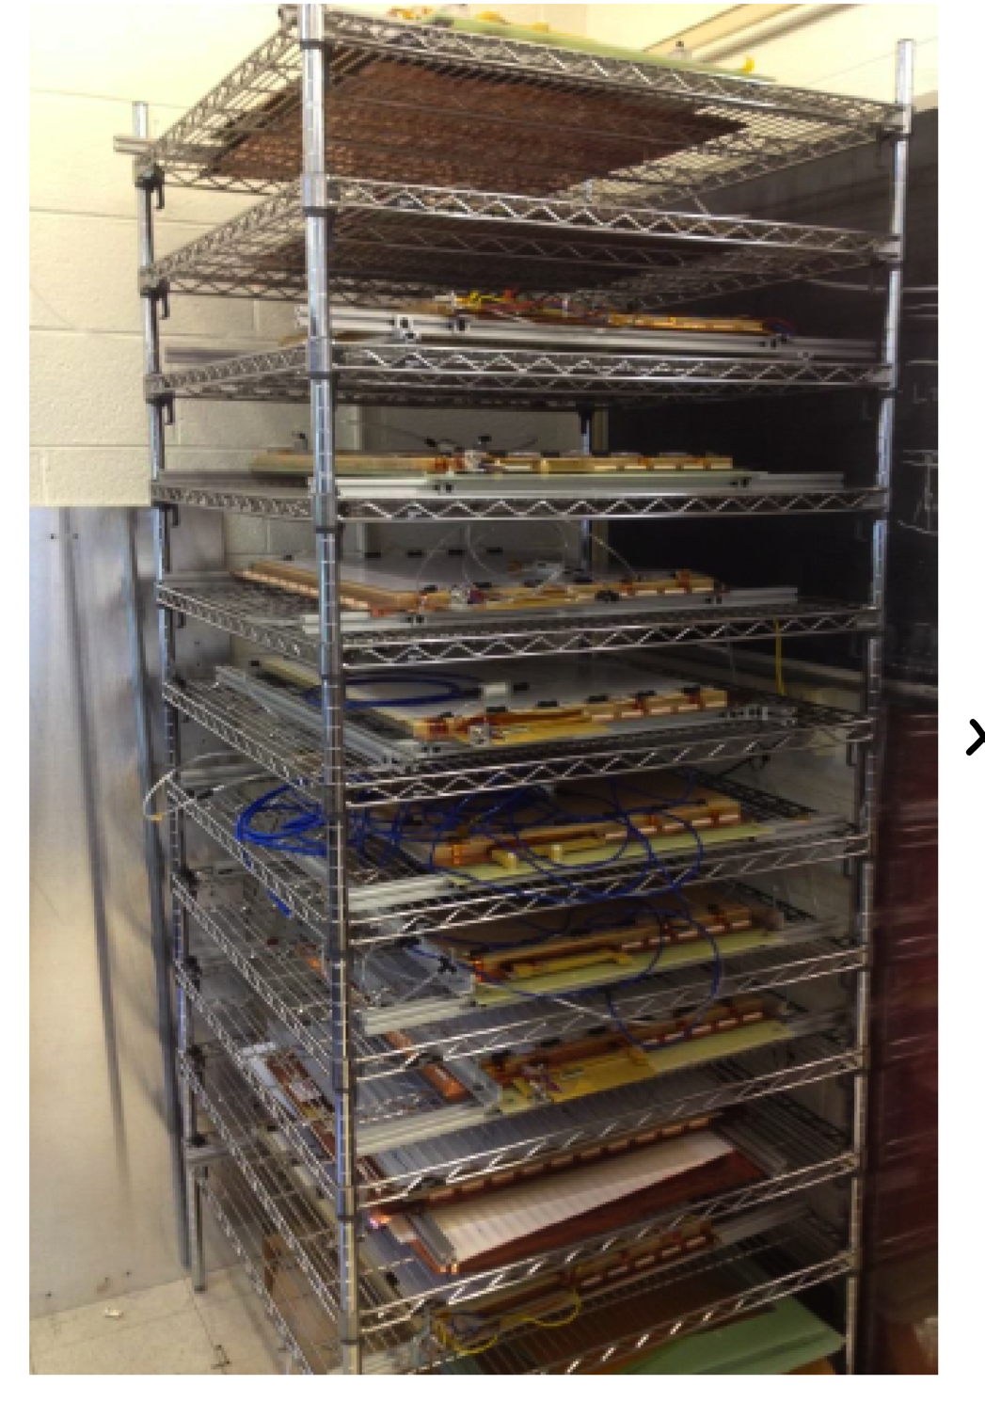
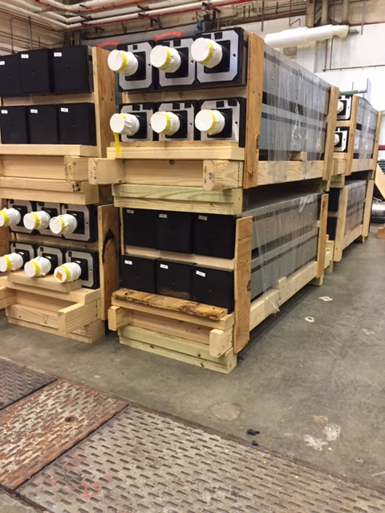
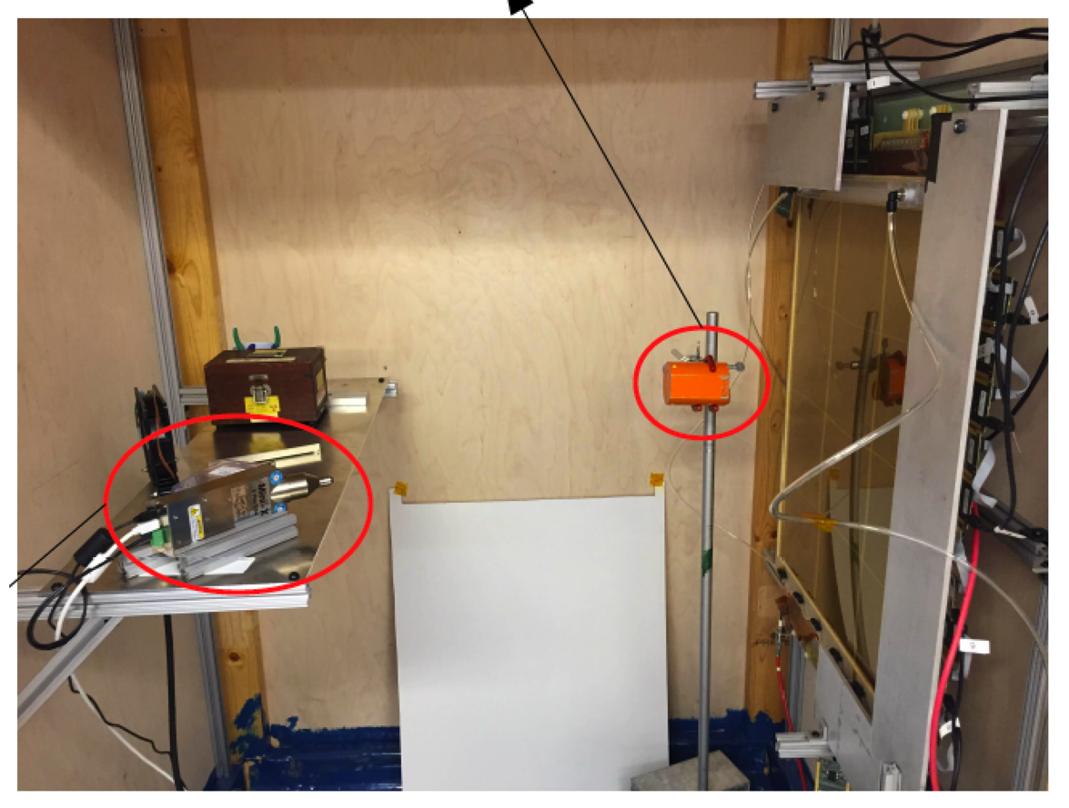
Super Bigbite Spectrometer (SBS) Detectors
CDET module 1 ready for cosmic testing with full data acquisition
INFN Front Tracker GEM chamber with carbon fiber frame at JLab
Rear GEM tracker modules at UVA, 32 constructed + 28 tested
UVa High rate X-ray testing setup for GEMs
168 out of 288 CMU Hadron Calorimeter modules at JLab

Slide 9
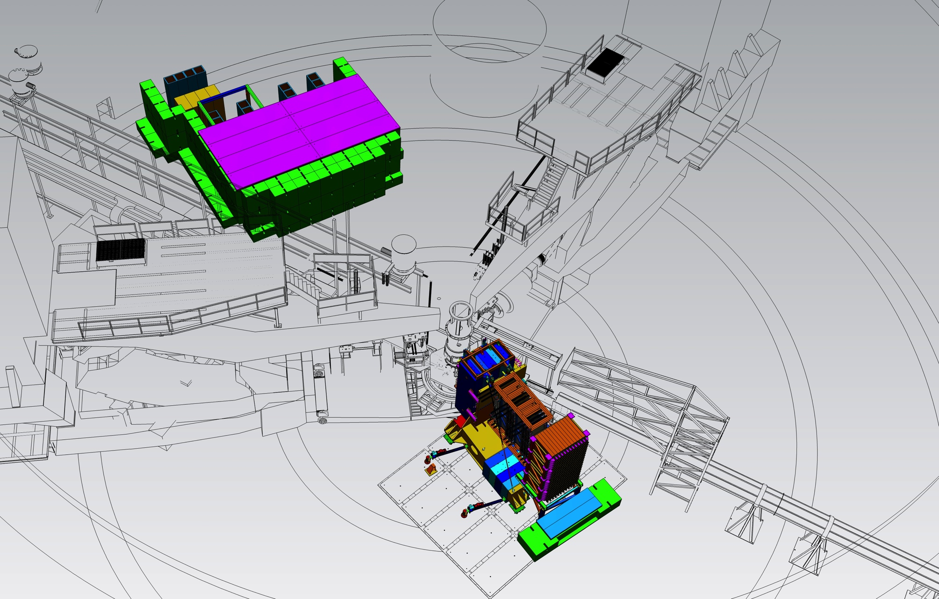
Installation – Hall Infrastructure Planning and Development
SBS
Electronics “Hut”
GEM electronics
Layout for maximal use of Hall, defines cable lengths, service requirement planning, installation concerns…..

Slide 10
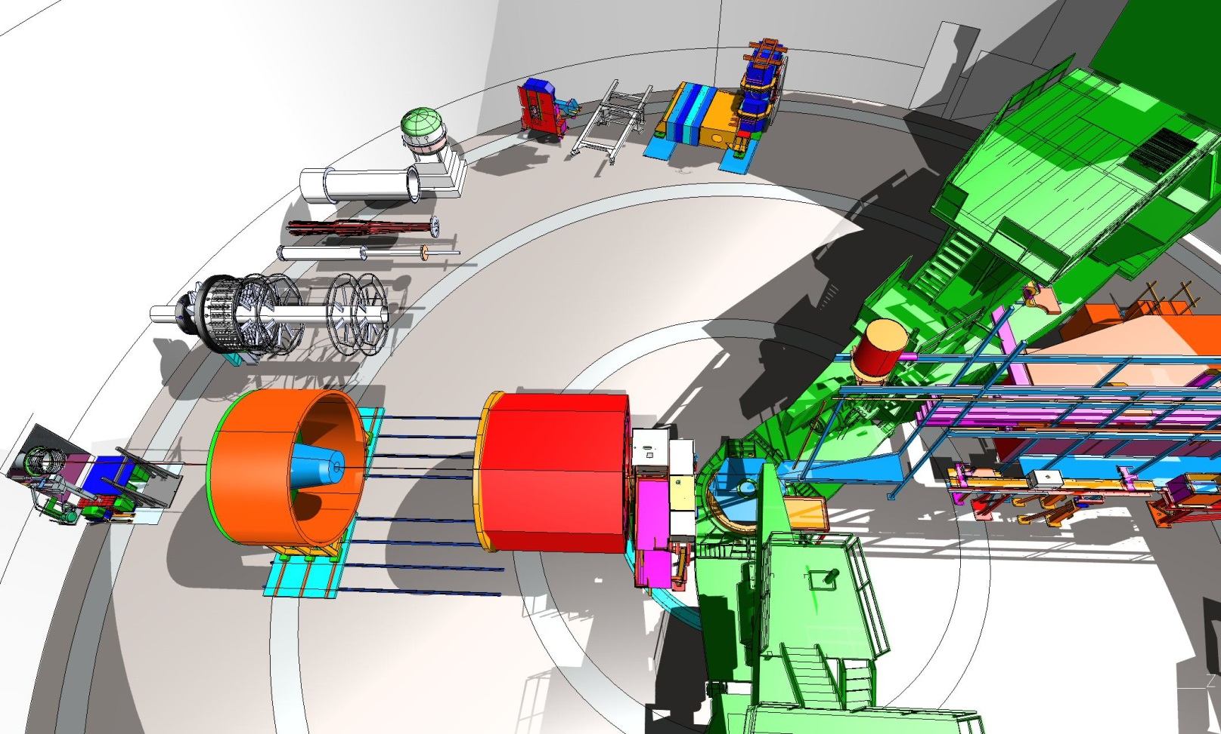
Moving to more future installations – MOLLER and SoLID

Slide 11
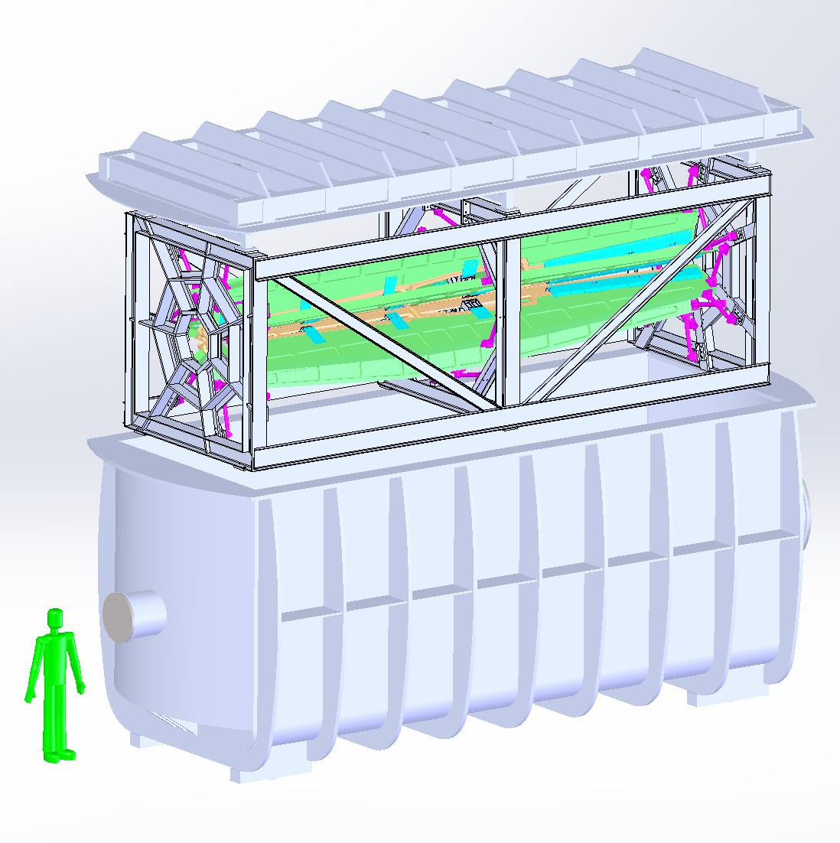
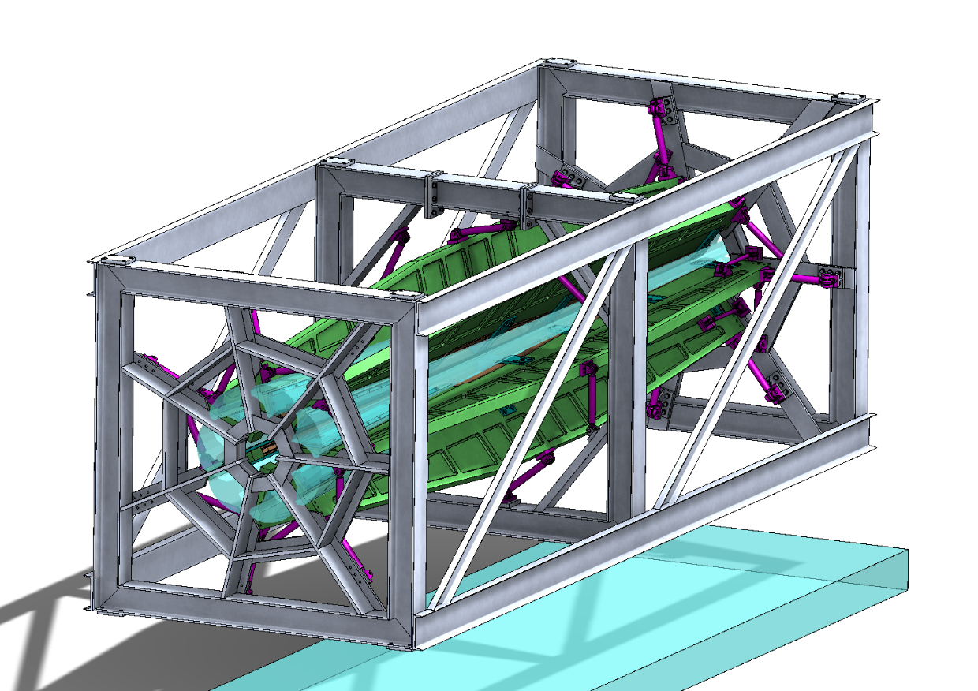
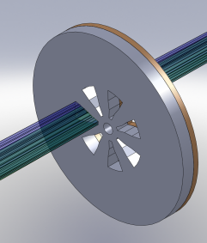
MOLLER
    Successful Science Review September 2014
    Supporting ongoing magnet and collimator development work at MIT
      July 2016 informal on site (at JLab) report
    New Moller polarimeter and parity beamline instrumentation in place, initial use in DVCS
    Anticipate Director’s cost, schedule, technical review late in 2016
      Working on updating documentation
    Looking towards CD0 2018

Slide 12
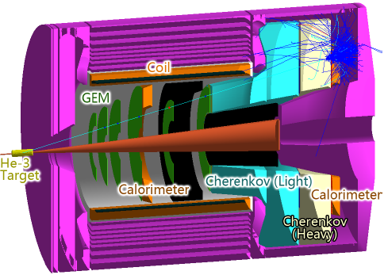
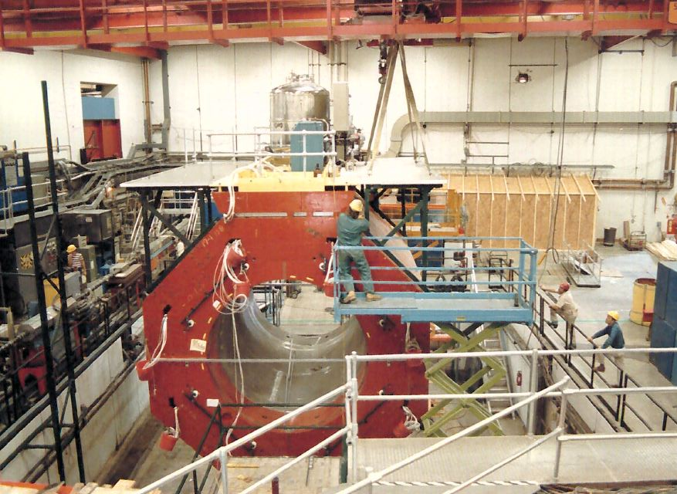
SoLID
    Director’s Review February 2015
    DOE-NP Update November 2015
    Looking towards Science Review in 2017, CD0 in 2019
    Continued detector optimization
      Background studies
      Magnetic fields
    Cost and manpower

Slide 13
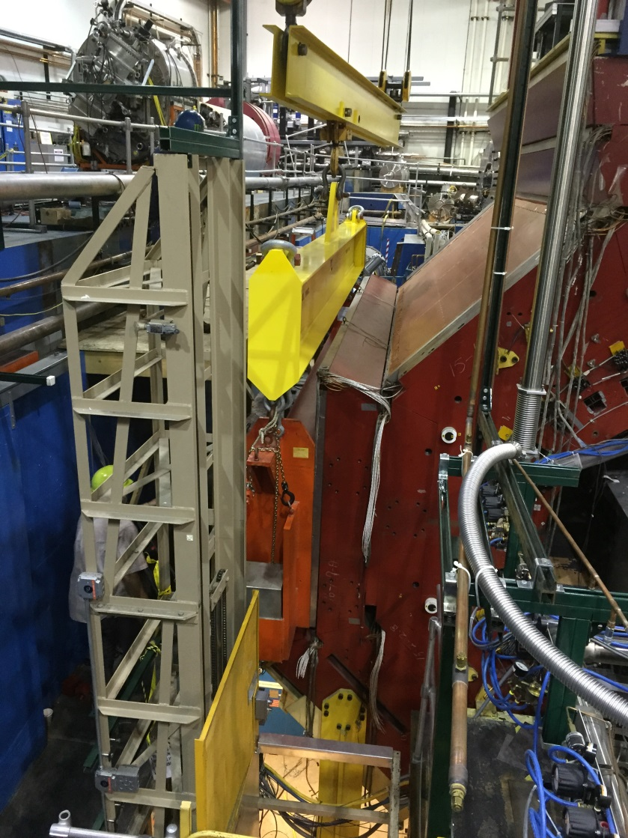
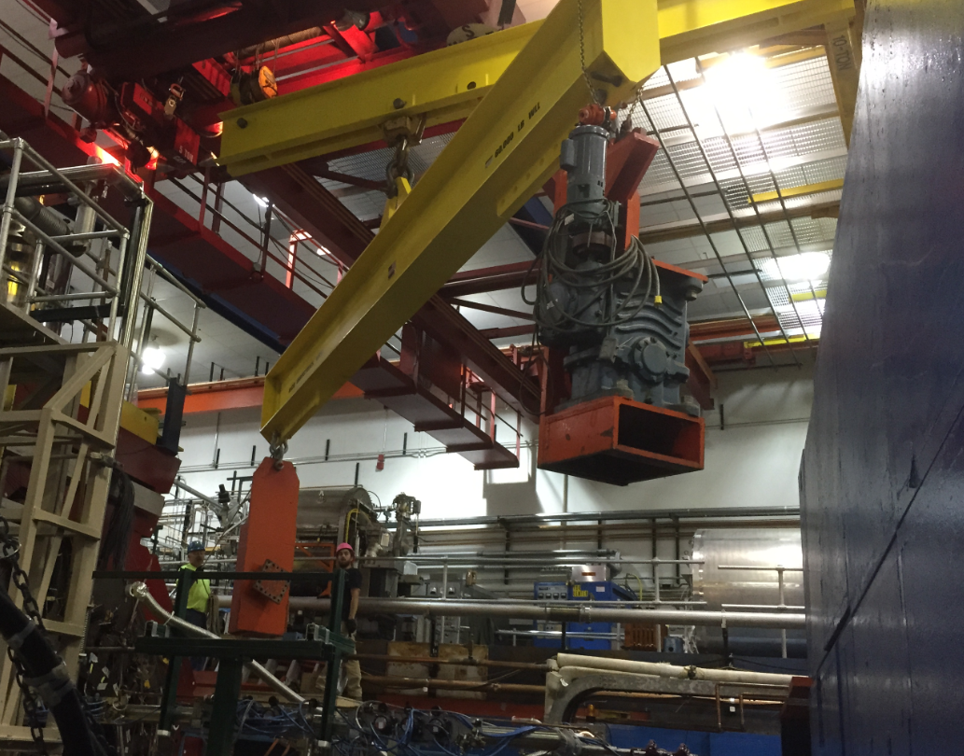
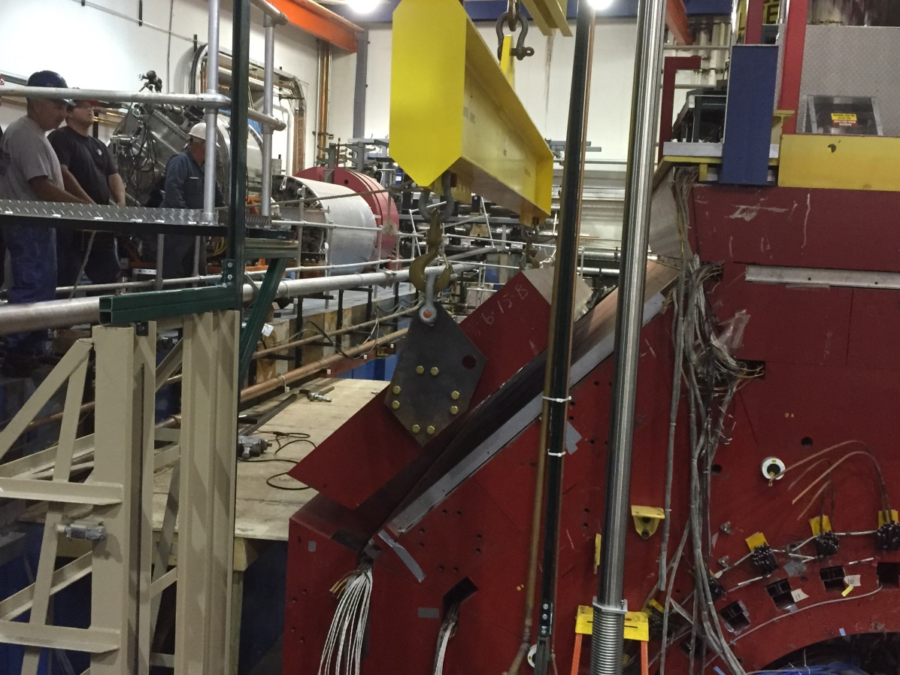
Transport and Storage of CLEO II
Disassembled and loaded on trucks for shipping by the Cornell personnel with oversight by Jefferson Lab this Summer/Fall CY 2016.
Will require 52 trucks to transport the magnet and related equipment.
Anticipating a need for storage of these parts at Jefferson Lab starting FY 2016, total weight of 1,053k lbs.
The cryostat (44k lbs) needs to be stored in an environment-controlled area of ~400 square feet - space in the Test Lab and utility needs have been identified.

Slide 14
New Staff Scientist I position!! Please encourage applications!!

Slide 15
Thanks!
Questions?

Slide 16

Hall A Projected Experiment Schedule, updated 7/2016
Experiments in red represent PAC42 high impact experiments
Spring | Fall | Spring | Fall | Spring | Fall | Spring | Fall
DVCS –I/ GMp | DVCS –I/ GMp
 |  | DVCS –I/ GMp | DVCS –I/ GMp
 |  |  |  | ³H/³He group | ³H/³He group Ar(e,e’p)*
 |  |  |  |  |  | TBD: APEX PREX12 CREX A₁^{n} DVCSII | SBS MOLLER SoLID →→→
CY
2015
X
CY 2016
CY
2017
CY
2018
*possible best effort

Slide 17
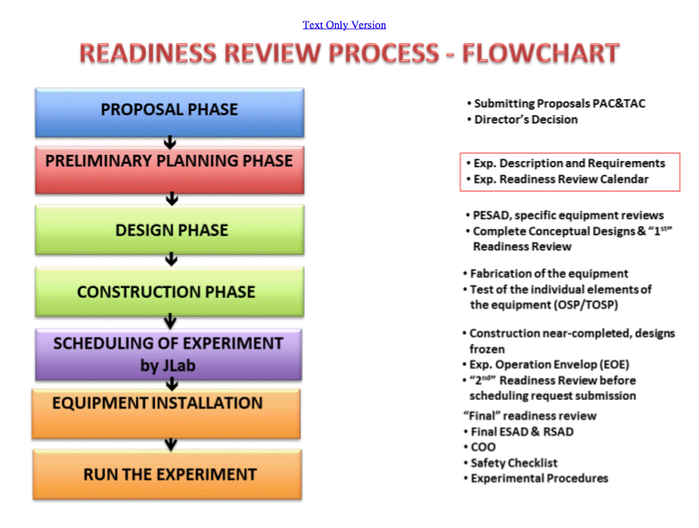
A lot of Hall A ERRs this year!!
Base equipment
DVCS/GMp
³H – OK to schedule, ~one more review
APEX – OK to schedule, ~one more review
PREX2/CREX – not yet OK to schedule, requires at least one more review
Ar(e,e’p) - July 21!!
http://www.jlab.org/div_dept/physics_division/experiments/scheduling.html

