Slide 1



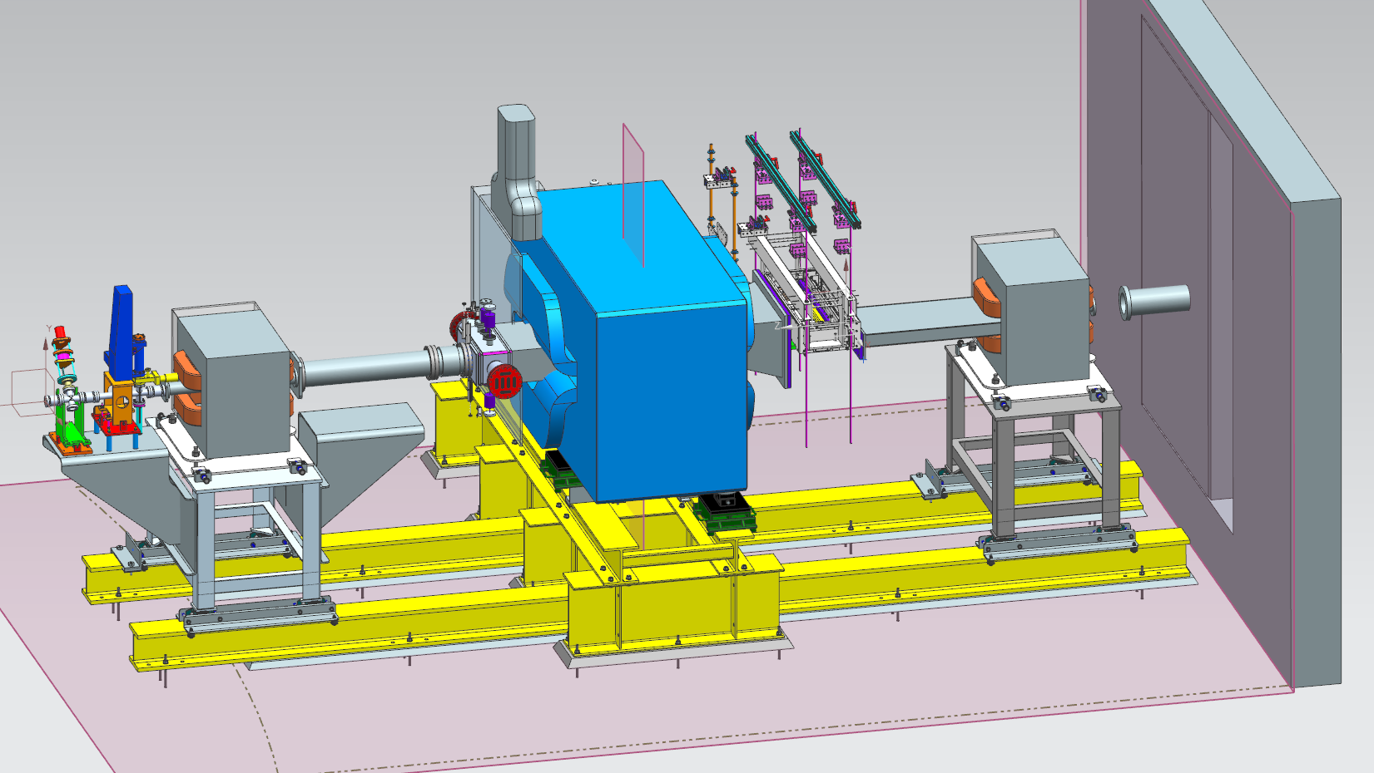
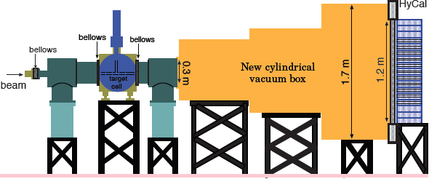
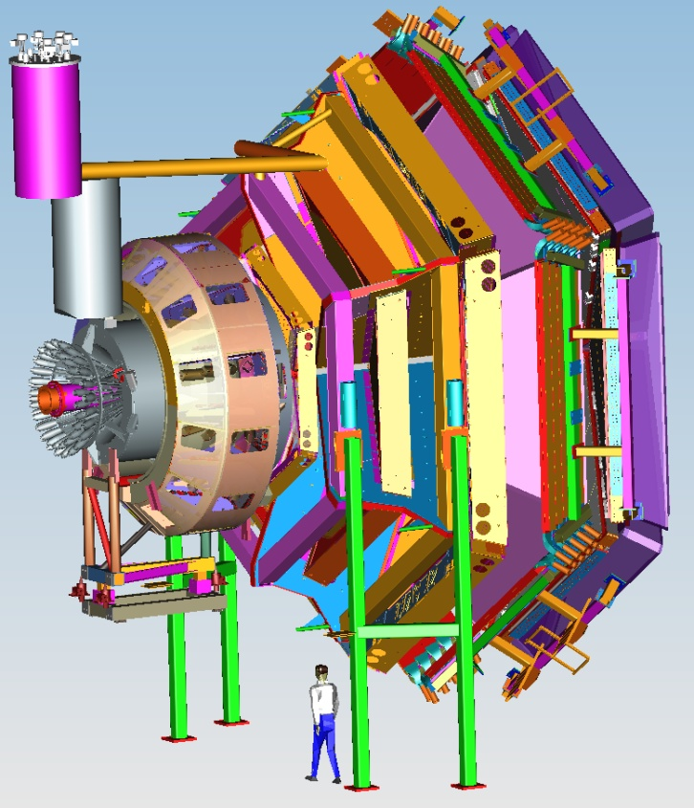


Status of Hall B
Volker D. Burkert
CLAS12
Pubs since PAC43
HPS update
PRAD status
CLAS12 & Upgrades
Schedule
Conclusions
PAC44 Meeting
July 25, 2016

Slide 2
Publications since PAC43
Hall B
Hadron Spectrocopy
C.A. Paterson et al., Photoproduction of Λ/Σ0 using linearly polarized photons , PRC93 065201, 2016
I. Senderovich et al., First measurement of hel. asym. E inη photoproduction on proton, PLB755 (2016) 64
R. Dixon et al., Photoproduction of the f1(1285) Meson, Phys. Rev. C 93.065202, 2016
S. Strauch et al. First Measurement of E asymmetry in p(g,π+)n up to 2.25GeV, PLB 750, 53, 2015
Nucleon Structure
V. Mokeev et al., New results from N* studies from ep-> eppi+pi-, PRC93, 025206, 2016
P. Bosted et al., Spin Asymmetries in Excl. π+ and π−Electroproduction at 1.6 to 5.7 GeV, 1604.04350 (2016)
K. Park et al., Measurement of p(e,e’π+)n at 1.6<W<2.0GeV & N* coupl., PRC 91 045203, 2015
K.P. Adhikari et al., Towards resolving the proton FF problem w/ new e+e- data, PRL 114 6, 062003, 2015
I. Aznauryan, V.Burkert, Extracting meson-baryon contributions to N(1675)5/2⁻excitation, PRC92:015203, 2015
I. Aznauryan, V.Burkert, Electroexcitation ofΔ(1232) and Δ(1600) in LC RQM, PR C92 (2015) 3, 035211
GPDs & TMDs
H. Matevosyan et al., Sivers SSA in hadron e-production for CLAS12 and EIC, PRD 92 (2015) 5, 054028
H.S. Jo et al., Exclusive Photon Electroproduction and GPDs, PRL 115, 212003, 2015
A. Kim et al., Target and Double Spin Asymmetries for DVπ0P on pol. target, arXiv:1511.03338, 2015
I. Niculescu et al., Direct observation of q-h duality in the F2n structure function, PRC 91, 055206, 2015
Nuclear Correlations
O. Hen, et al., Symmetry energy of nucleonic matter with tensor correlations, PRC 91, 025803, 2015
C. Colle et al., Mass dep. and Q.N. of SRC pairs from A(e,e’p) and A(e,e’pp), PRC92, 024604, 2015
Other
M. McCracken et al., Search for baryon- and lepton-number violating decays of Λ, PRD92, 072002, 2015

Slide 3

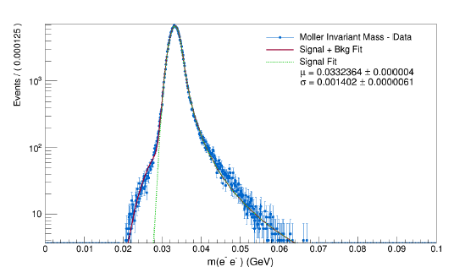
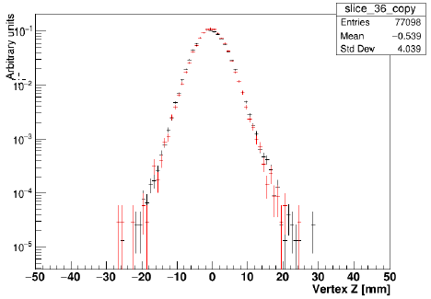
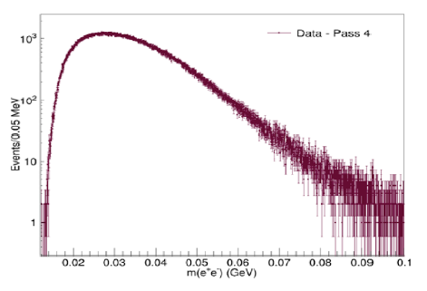
HPS Update
Hall B
HPS searches for an electro-produced hidden sector photon (A’) decaying to e⁺e⁻ pairs
A’s could mediate dark matter annihilations and interactions with our matter
HPS identifies A’s with invariant mass and separated vertices
2015 Engineering Run at 1.05 GeV
Successfully ran with SVT just 500 μm from electron beam!
Physics Readiness Documented: HPS works as designed
JLab has granted approval for full HPS run request (180 days – 15 used so far)
Bump Hunt Results from the 2015 run coming soon!
Mass Resolution ~ Design Vertex Tails as Simulated Measured e⁺e⁻ Masses

Slide 4
A’ Search Underway
Hall B
First results at 1.05 GeV (~1.6 PAC days)
* Bump hunt due late summer will
cross-check well trod region.
* Vertex search end of 2016 will cover
virgin territory. New physics?
Results at 2.3 GeV (~ 5 PAC days)
* Both bump hunt and vertex search
analyses cover a higher mass window
* More new territory!
* Hope for results in 2017
HPS Future
* Hope to install upgrade before 2018
which will boost reach considerably
* Extended run at 4.4 GeV (2018?)
* More runs at 1.1 and 2.3 GeV
2 PAC days at 1 GeV
Bump
Vertex
1 GeV
2.2 GeV
4.4 GeV
1 week 1.1 GeV
1 week 2.2 GeV
2 week 4.4 GeV

Slide 5
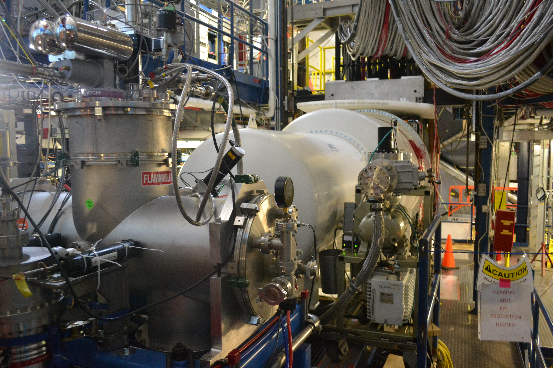
Proton Radius Experiment
Hall B
Goal: Understand the 7 s.d. discrepancy of electric proton radius measurements using a non-magnetic setup.
Components:
Open cell gas target, vacuum drift space, GEM tracker, HyCal
1.1 & 2.2 GeV Runs:
Over 1,300M events

Slide 6
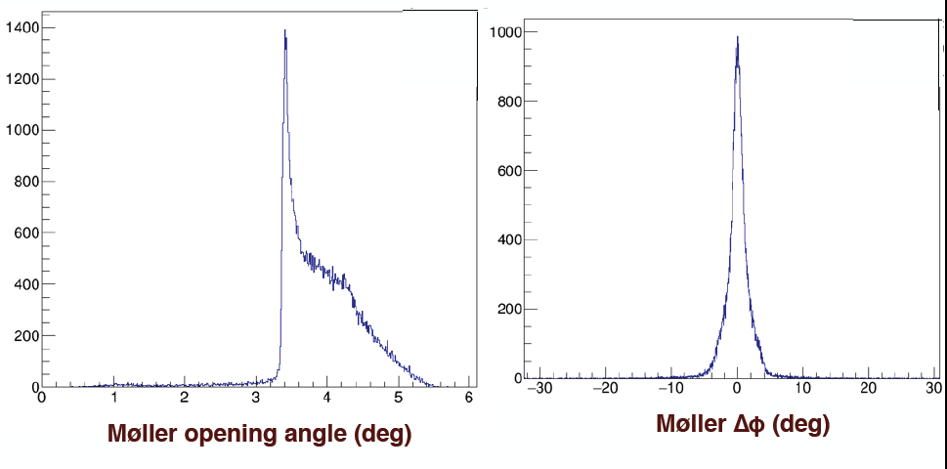
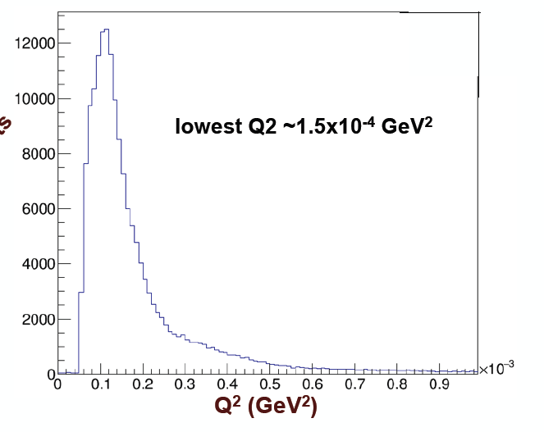
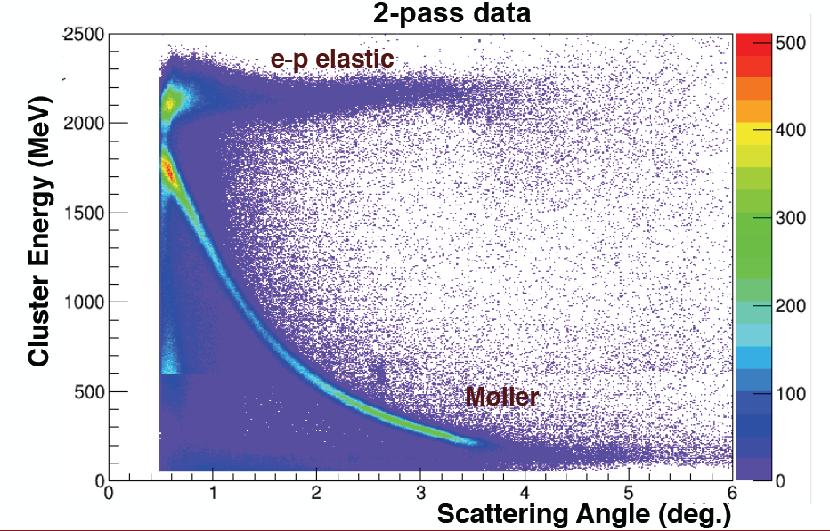
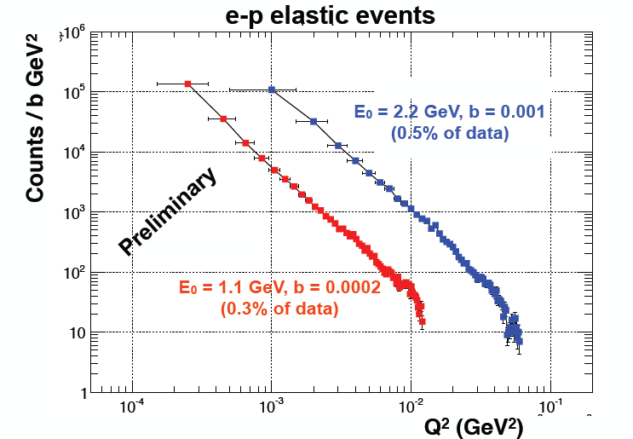
Moller e⁻e⁻ & Elastic ep
Hall B
Moller opening angle & co-planarity

Slide 7

Equipment
CLAS12
Hall B
Forward Detector (FD)
  - TORUS magnet
  HT Cherenkov Counter
  Drift chamber system
  LT Cherenkov Counter
  Forward ToF System
  Pre-shower calorimeter
  E.M. calorimeter
Central Detector (CD)
  SOLENOID magnet
  Silicon Vertex Tracker
  Central Time-of-Flight
Beamline
  Cryo Target
  Moller polarimeter
  - Shielding
  Photon Tagger
MM
CND
FT
Upgrade to the baseline
- Central Neutron Detector
  MicroMegas
  Forward Tagger
  RICH detector
  Polarized target
RICH

Slide 8
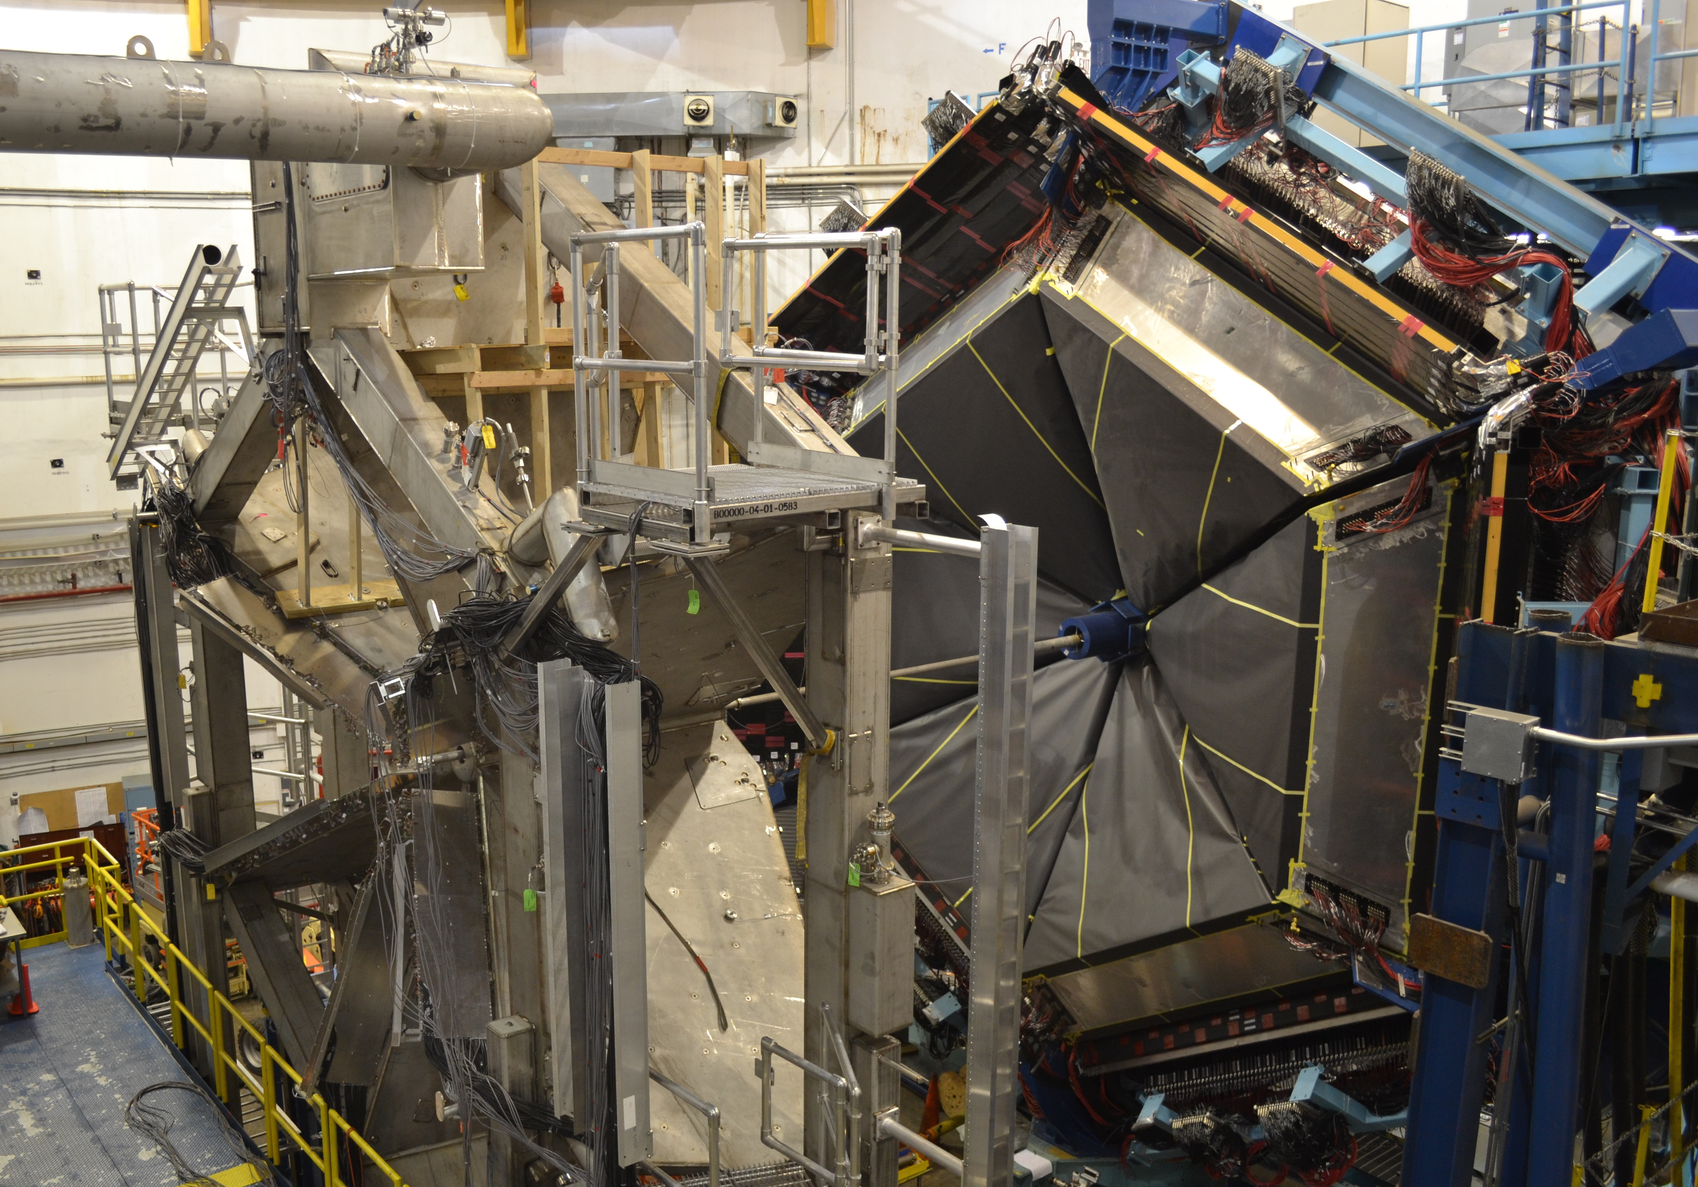
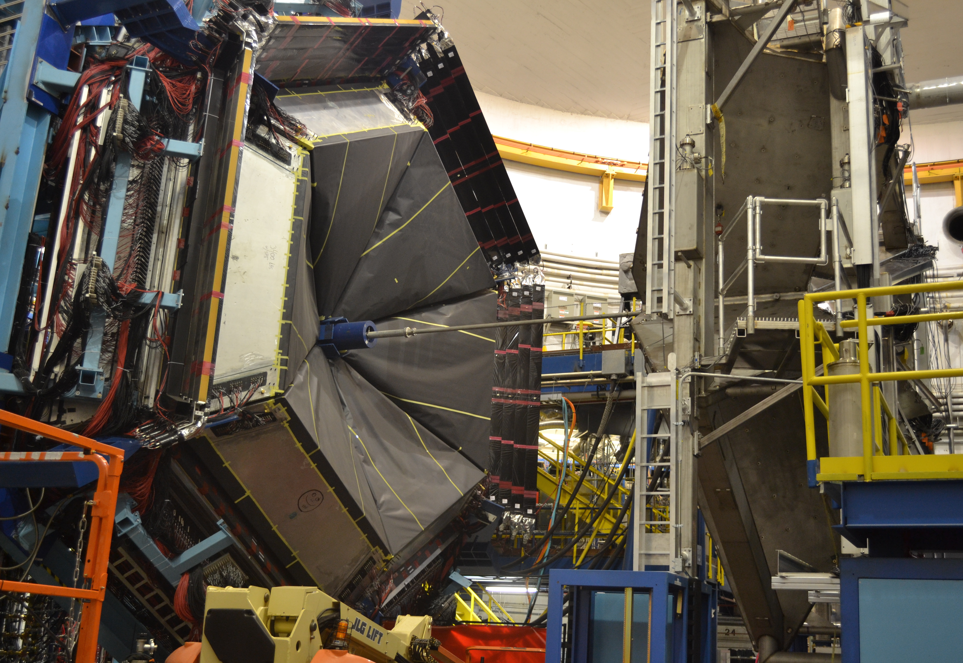
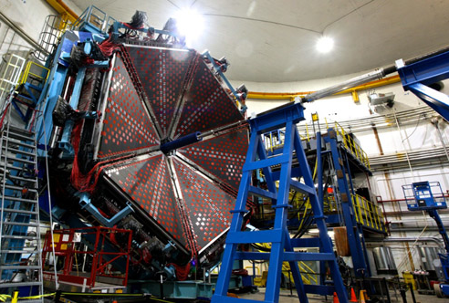
CLAS12
Hall B in February 2015
Hall B in July 2016
Hall B
July/August 2016
Torus Magnet
Cool-down
August 2016
Power tests
Mapping

Slide 9
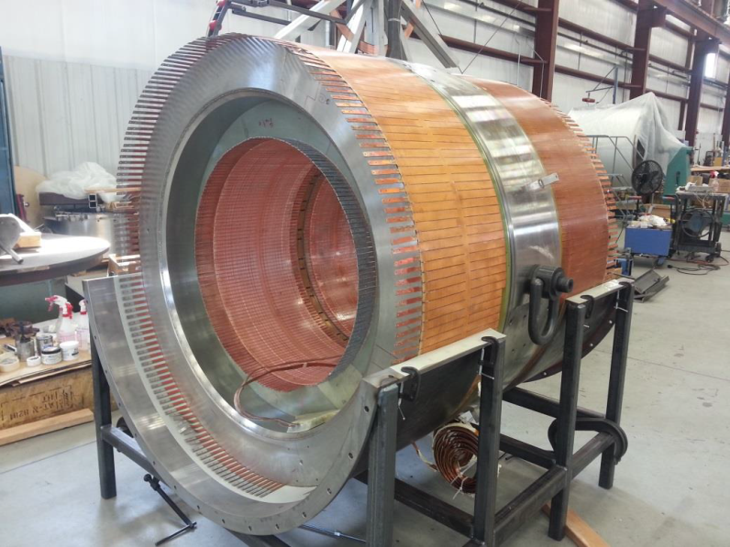
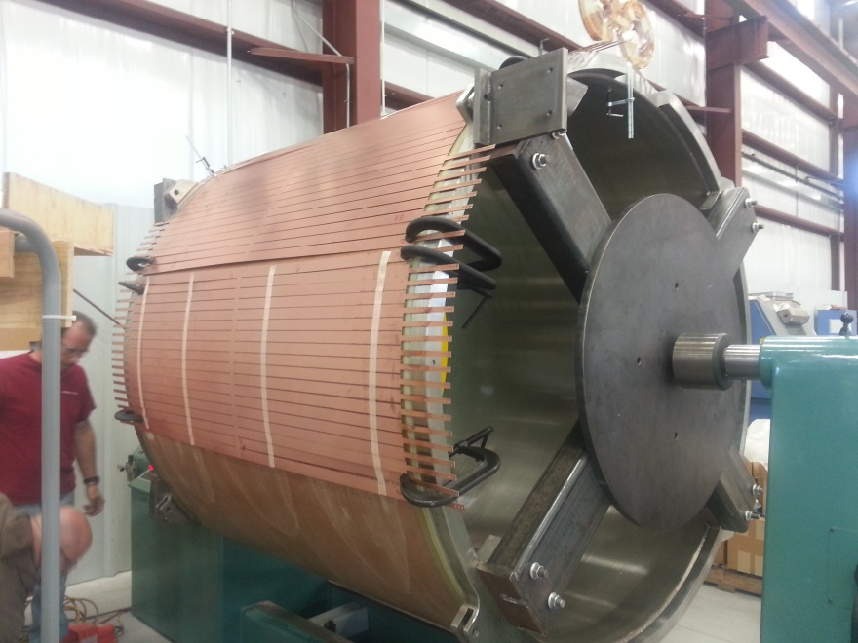
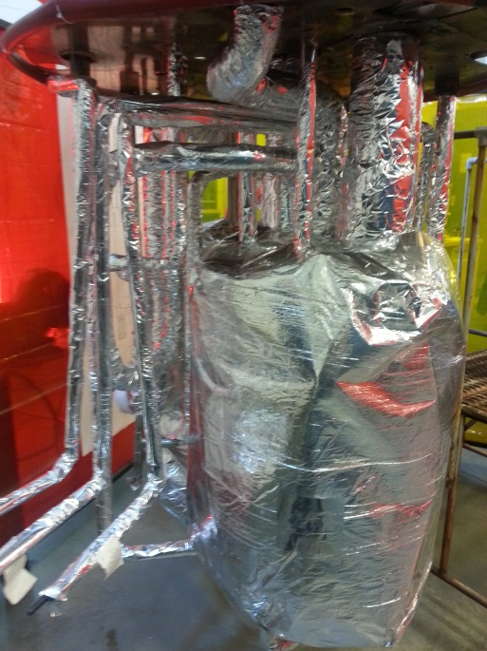
Solenoid Magnet Status
CLAS12
Hall B
Inner coil 1-4 assembly
Shield coil 5
6-10/2016: Cold mass assembly, 5 coils, thermal shield, MLI
11/2016: Final assembly, Installation of coils into cryostat; welding
12/2016: Tests at vendor; Ship to JLab
01/2017 – 3/2017: Add cryotower, Instrumentation and controls
3–4/2017: Cool-down, power tests

Slide 10
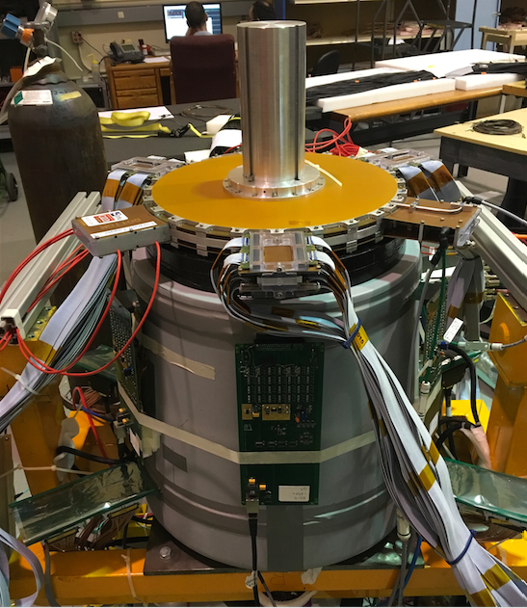
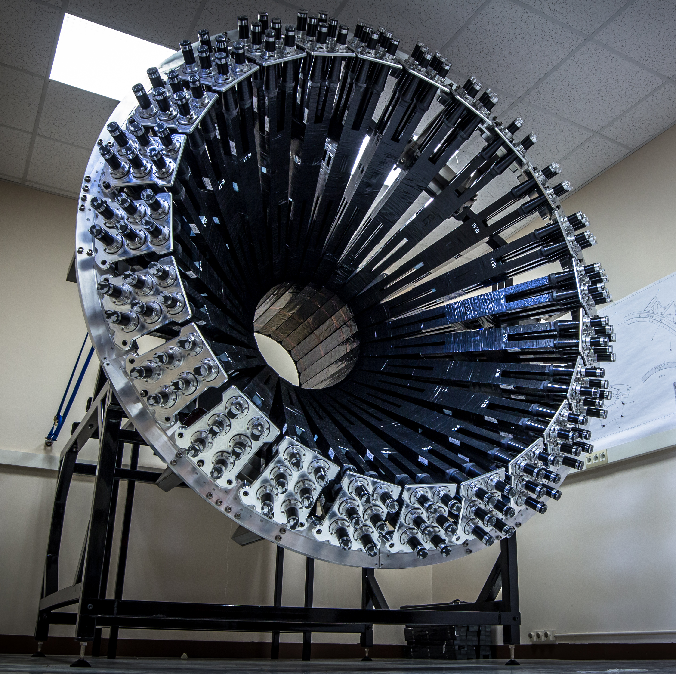
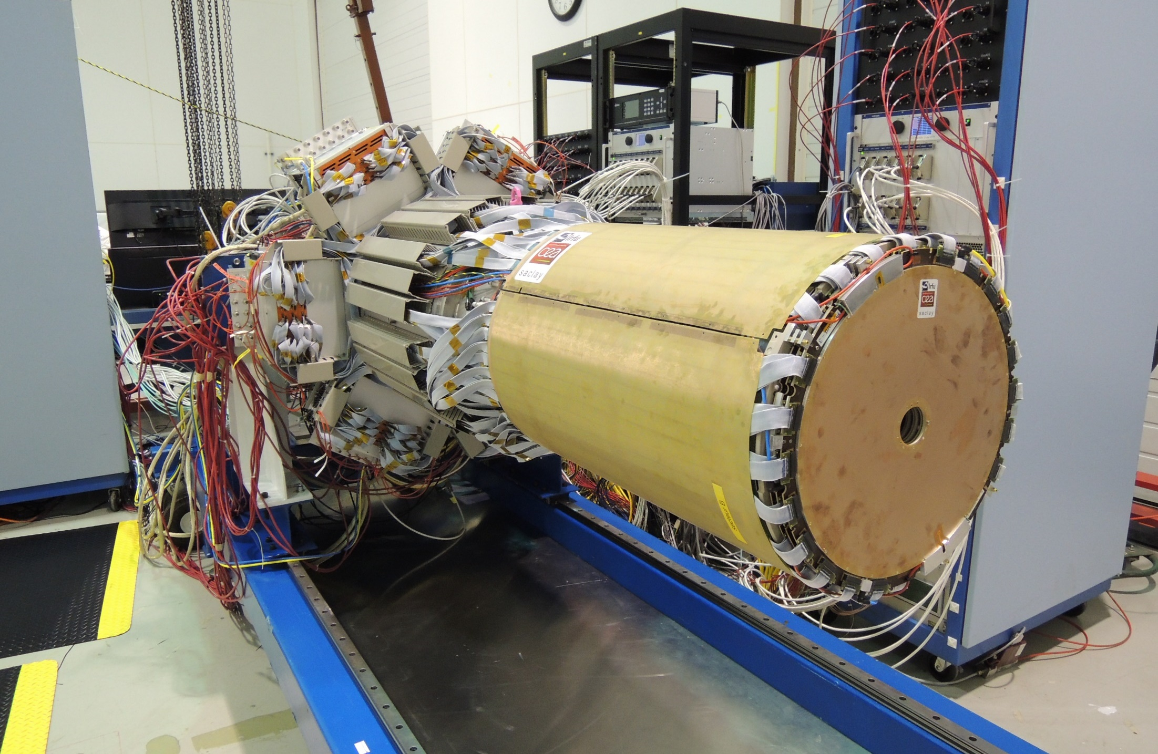
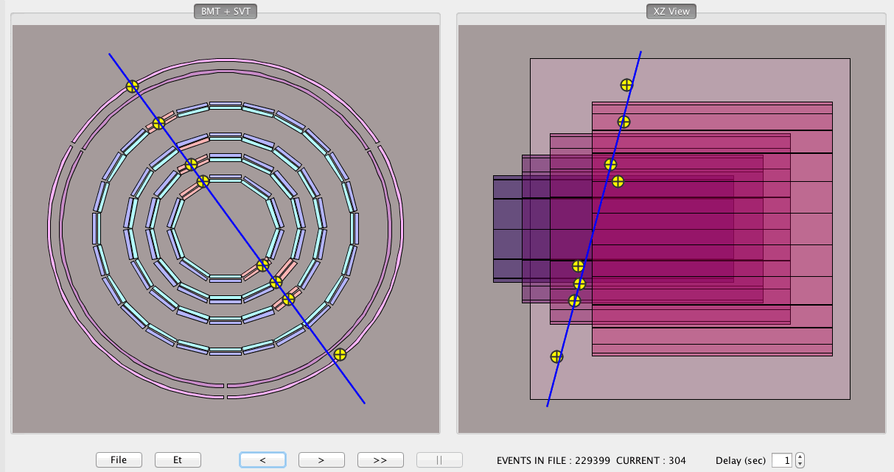
Detector Upgrades
CLAS12
Hall B
Central Neutron Detector
Forward Tagger
MVT+SVT at Jlab 12/15
1st cosmic ray events in SVT+MVT

Slide 11
Hall B Project Schedule
CLAS12
Hall B
2016 |  |  | 2017
J | J A S | O N D | J F M | A M J | J A S | O N D
Torus Leak Checking
Torus Pumpdown
Torus Cooldown
Torus Magnet Ramp Up
Install DC
Install FT
Solenoid Install & Test
Central Detector Install
Install HTCC
Cosmic Testing
Beamline Commissioning
KPP Commissioning
CVT Configure & Install
RICH Install
Engineering Run
Physics Run Group A
Physics
RG A
CLAS12 Commission

Slide 12
Hall B Proposals for PAC44
RG A E12-06-108B Transition FF of the η’ Meson wit CLAS12 (M. Kunkel)
RG C E12-06-109A Deeply virtual Compton scattering w/ long. pol. deuterium (S. Niccolai)
New RG K (Confinement & Strong QCD)
- PR12-16-010 A search for Hybrid Baryons in Hall with CLAS12 (A. D’Angelo)
- PR12-16-010A Nucleon resonance structure via KY electroproduction (D. Carman)
- PR12-16-010B DVCS w/ CLAS12 at 6.6 and 8.8 GeV (L. Elouadrhiri)
New RG L (ALERT – Light Nuclei Tagging)
- PR12-16-011 Tagged EMC measurements on Light Nuclei (R. Dupre)
- PR12-16-011A Partonic Structure of Light Nuclei (Z.-E. Meziani)
- PR12-16-011B Tagged DVCS on Light Nuclei (W. Armstrong)
- PR12-16-011C Other Physics Opportunities with the ALERT Run Group
New RG M (Polarized Neutron DVCS))
- C12-15-004 DVCS on the neutron with long. polarized deuteron target (S. Niccolai)
- C12-15-004A DIS on longitudinally polarized deuterium (S. Kuhn)
- C12-15-004B SIDIS on long. polarized deuterium (S. Pisano)
LOI-16-004 Electroproduction of muon pairs: Double DVCS & J/ψ (S. Stepanyan)

Slide 13
Run Group Schedule – Tentative
Run Group | Days | 2015 | 2016 | 2017 | 2018 | 2019 | 2020 | 2021 | Remain
All Run Groups | 936 |  | CND | FT RICH MM |  |  | Trans. PT | 481 | 455
HPS | 180 |  | 15 ✔ |  | 35 | 35 |  |  | 95
PRad | 15 |  | 15 ✔ |  |  |  |  |  | ---
CLAS12 KPP |  |  |  | 15
RG-A (proton) | 139* |  |  | 30/16 | 20 35 |  |  |  | 69*
RG-F (BoNuS) | 42* |  |  |  | 40 |  |  |  | 2
RG-B (deut.) | 90* |  |  |  |  | 45 |  |  | 45*
RG-C (NH₃) | 120 |  |  |  |  | 35 | 25 |  | 50
RG-C-b (ND₃) | 65 |  |  |  |  |  | 35 |  | 30
RG-E (Hadr.) | 60 |  |  |  |  |  | 35 |  | 25
RG-H (TT) | 110* |  |  |  |  |  |  | 45 | 65
RG-D (CT) | 60 |  |  |  |  |  |  | 30 | 30
RG-G (LiD) | 55 |  | RG has High Impact component |  |  |  |  | 20 | 35

Slide 14
Summary
Hall B
Data collected with CLAS continue to generate important physics results
HPS and PRAD experiments producing High Impact (PC41) physics results
CLAS12 on track for KPP verification in Spring 2017
Full complement of ancillary detectors on track for installation before the engineering run in Fall 2017
Run group A expected to take first physics data late 2017

