Slide 1
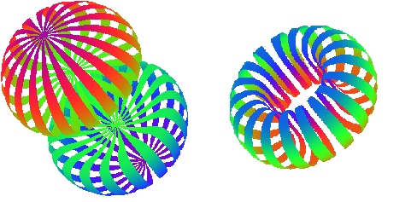
C12-15-005: Measurement of the Quasi-Elastic and Elastic Deuteron Tensor Asymmetries
Elena Long
On behalf of Donal Day, Douglas Higinbotham, Dustin Keller, Karl Slifer, Patricia Solvignon
Jefferson Lab PAC44
July 27th, 2016

Slide 2
Highlights
$A_{zz}$ will lay the foundation for future tensor polarized experiments
Identical equipment & technique as approved $b_{1}$ (A- rating)
Huge 10-100% asymmetry
Access to short-distance, high-momentum dynamics
$$50$$
Theory Calcs
$$34$$
14+ competing theories at 6 Q²,
No Data!
# of Tensor Data Pts
$b_{1}$
HERMES
$T_{20}$
>5 Labs
$A_{zz}$
No current or planned measurements
$$6$$
$$<0.5$$
$$0.8−1.8$$
$$2$$
$$x$$

Slide 3
Brief Primer on Tensor Polarization
For tensor polarization, need spin-1 particles
-
( + )-2
Spin-1
System
“Normal” Polarization:
Vector $P_{z}=p_{+}−p_{−}$
Tensor $P_{zz}={(p}_{+}+p_{−})−2p_{0}$
m = +1
A high luminosity tensor polarized target has promise as a novel probe of nuclear physics
$$>$$
$$→{0<P}_{zz}≤1$$
m = 0
m = -1
$$=$$
$$=$$
$$→P_{zz}=0$$
$$<$$
$$→−2≤P_{zz}<0$$

Slide 4
Conditions and Progress

Slide 5
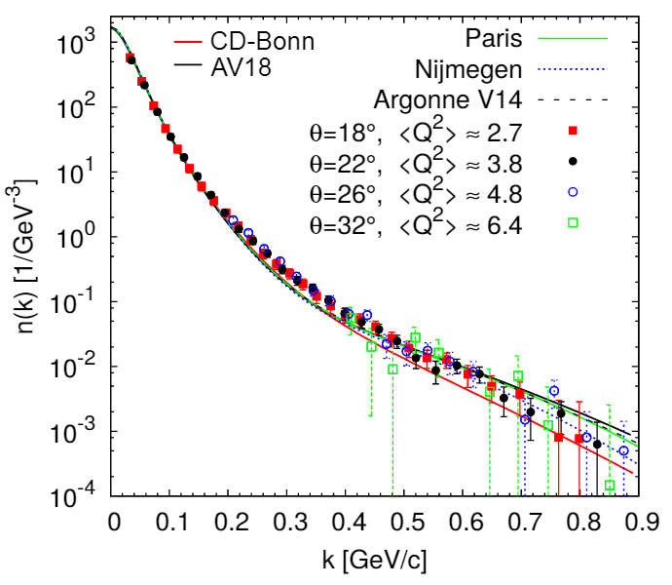
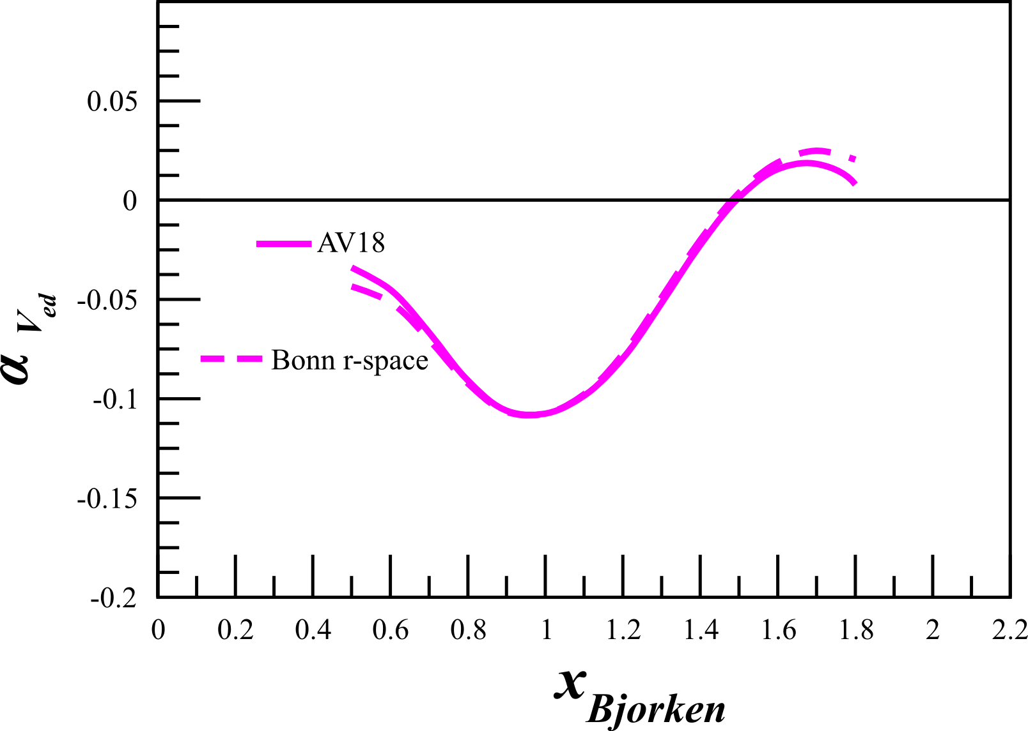
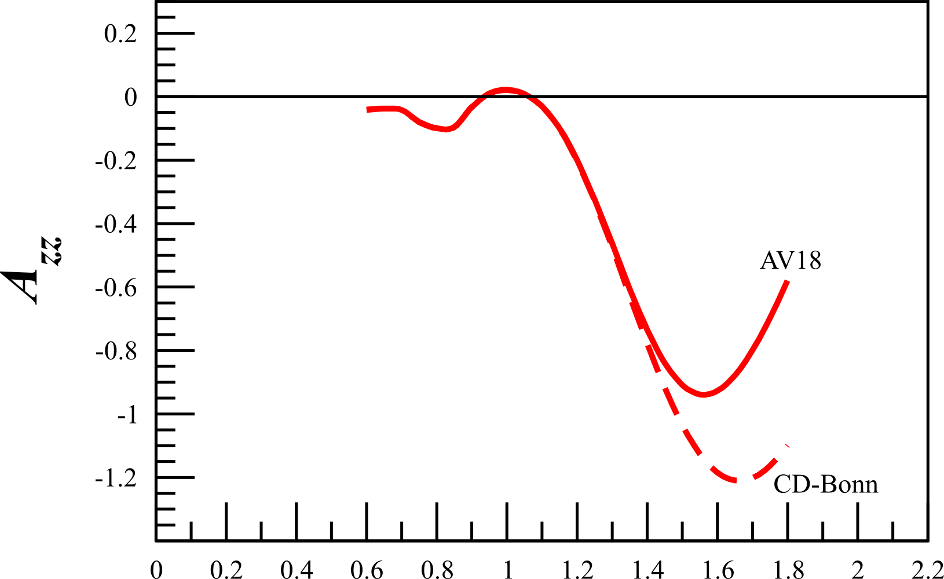
Conditions and Progress
1. Compare tensor asymmetry to unpolarized measurements for NN potential sensitivity
Tensor Polarized:
>4σ NN potentials
>6σ Relativistic models
Unpolarized: ~<1σ
Vector Polarized: ~1σ
~1%
~60%

Slide 6
Conditions and Progress
2. Investigate ${−P}_{zz}$ to reduce systematics
$P_{zz}<0$explored, but unfortunately impossible with DNP
Still, with $P_{zz}>0$ we are only statistics-limited
Can flip vector $P_{z}$ to reduce systematics
( + )-2
$$P_{zz}>0$$
$$P_{zz}>0$$
$$P_{zz}>0$$
$$P_{zz}={(p}_{+}+p_{−})−2p_{0}$$
$$P_{z}>0$$
$$P_{z}<0$$
$$P_{z}>0$$

Slide 7
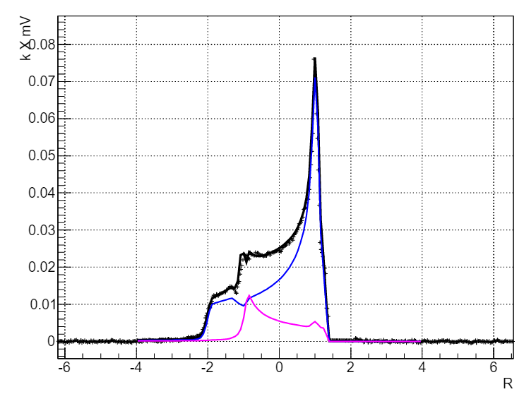
Conditions and Progress
^{[1]} D. Keller, Eur.J.Phys. A (In review)
^{[2]} D. Keller, B. Norum, HIGS-P-12-16 (Proposed)
3. NMR line shape analysis needs to be further developed
Progress made & work on-going
Developed promising new tensor enhancement and measurement method^{[1]}
Preliminary $P_{zz}>30\%$ on butanol (5T/1K)
Cross-calibrate with $T_{20}$ and TUNL data^{[2]}
Same as $b_{1}$ experiment (C1-approved, A- rating)
Preliminary

Slide 8
Conditions and Progress
3. NMR line shape analysis needs to be further developed
Progress made & work on-going
$$P_{zz}\sim 15\%$$
$b_{1}$ Approved
Condition: Reach $30\%$
$P_{zz}>30\%$
(Butanol+ND₃)
$P_{zz}>30\%$
(Butanol)
$P_{zz}$ for 1K & 5T
$A_{zz}$ C2
$P_{zz}>20\%$
(Butanol)
$$′90s−2010$$
$$2013$$
$$2015$$
$$2016$$
$$2017?$$
$$t$$

Slide 9
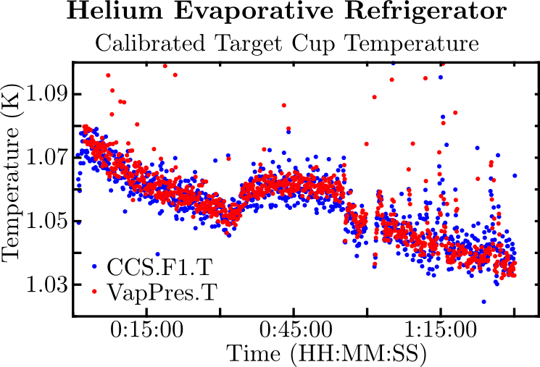
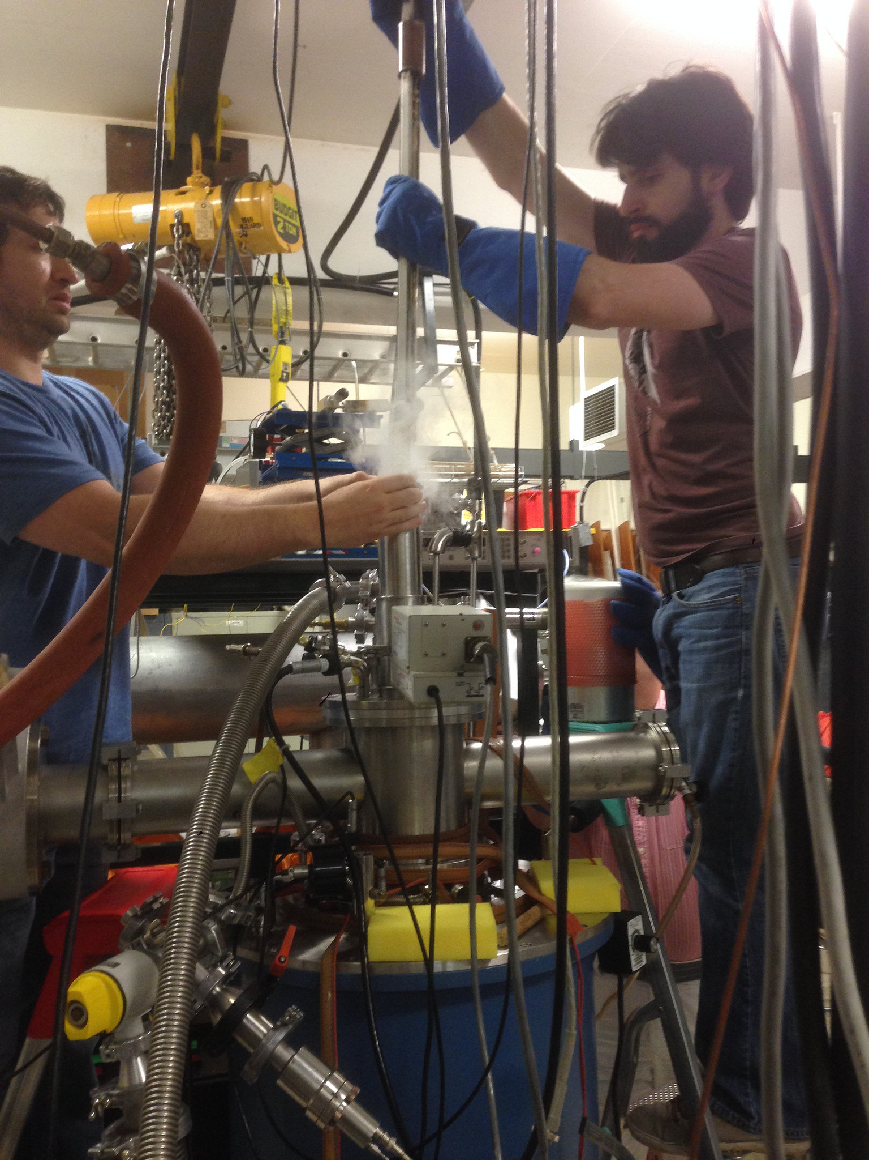
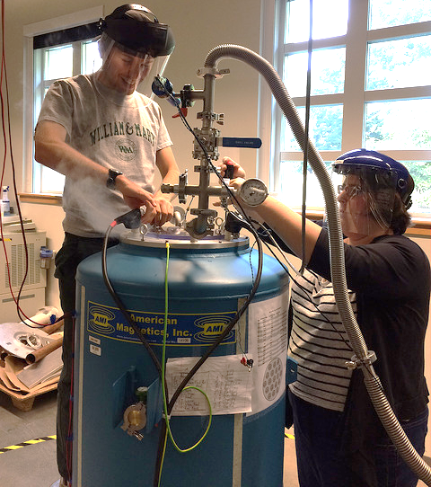
Target Status Update
Results from UVA are promising, preliminary $P_{zz}>30\%$ recently achieved on butanol. ND3 in progress.
UNH target lab is nearing complete, successfully tested magnet, NMR, and helium fridge. Currently developing 3D printed target sticks.
Preliminary
D Keller, Eur.Phys.J.A., in review (2016)
D Keller, PoS, PSTP2015:014 (2016)
D Keller, J.Phys.Conf.Ser., 543(1):012015 (2014)
D Keller, Int.J.Mod.Phys.Conf.Ser., 40(1):1660105 (2016)

Slide 10
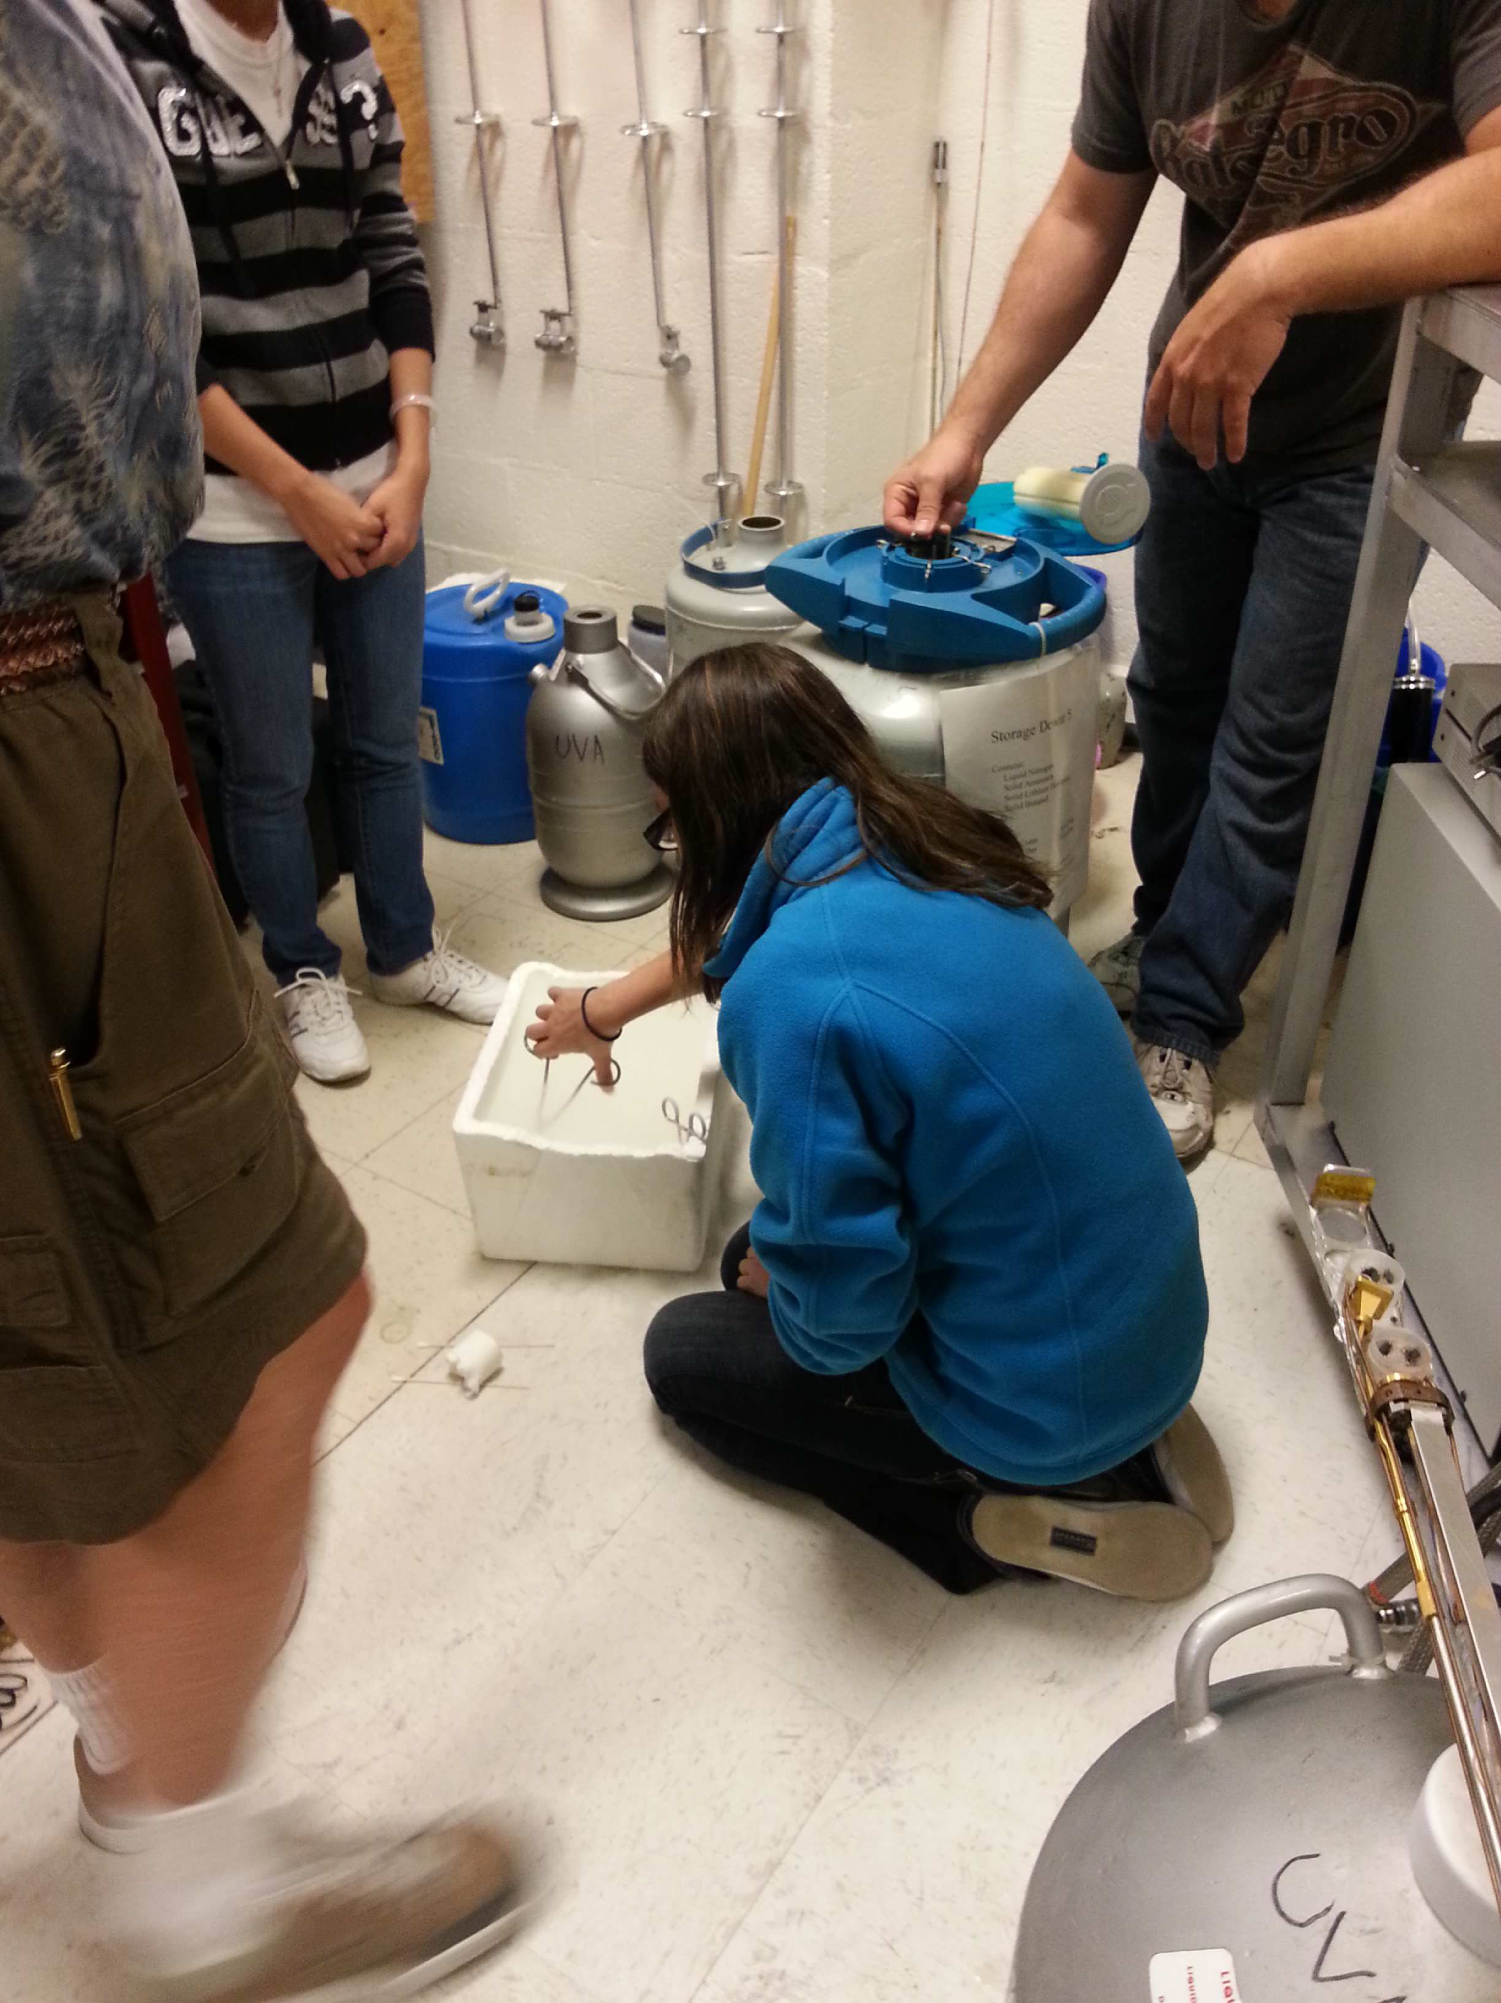
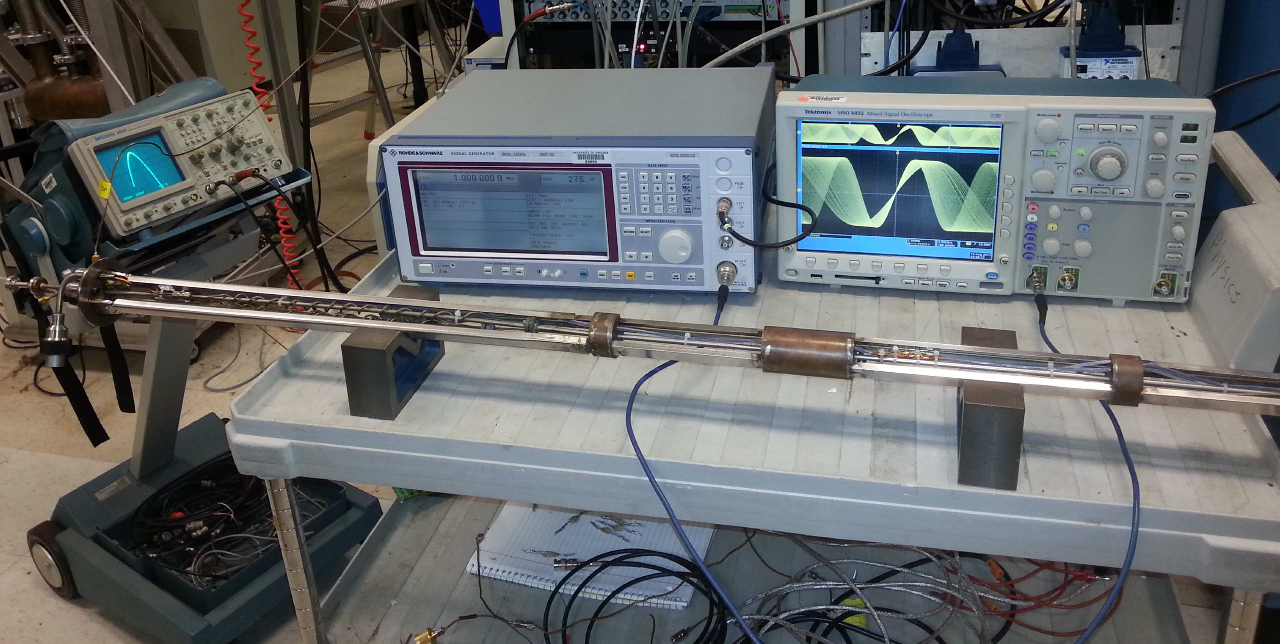
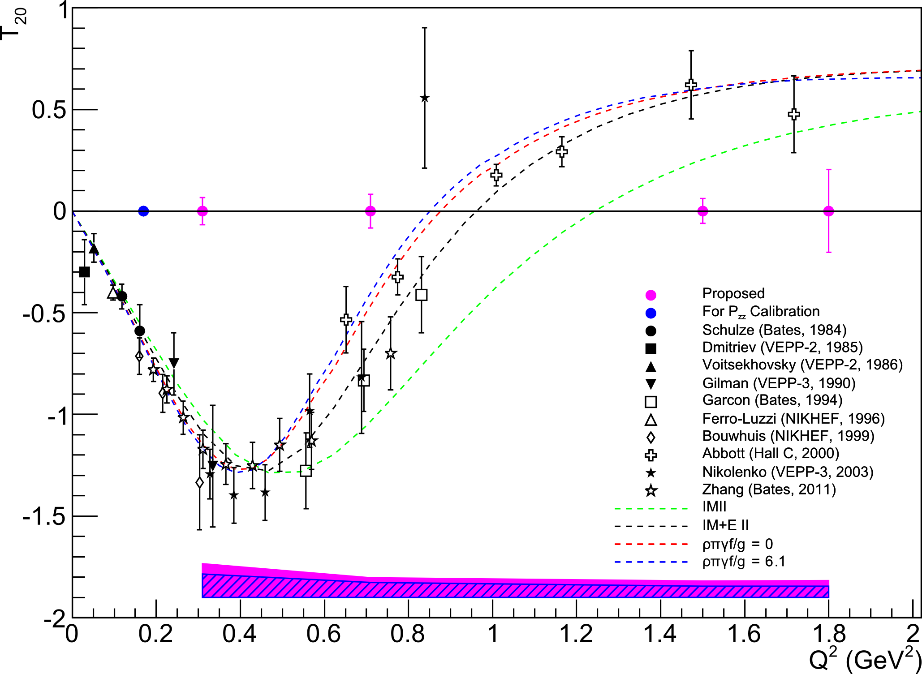
Target Status Update
Progress made on measuring $P_{zz}$ through NMR line-shape analysis
Line-shape $P_{zz}$ measurement will be confirmed with elastic $T_{20}$
$$P_{zz}∝\frac{1}{T_{20}}$$
$$P_{zz}>30\%$$
Preliminary
Completely independent check
Only 1 day at low $Q^{2}$
D Keller, Eur.Phys.J.A., in review (2016)

Slide 11
Onto the physics!

Slide 12
Deuteron
Simplest composite nuclear system
However, big questions remain!
(Especially at short-distances & high-momentum)
Tensor interactions
Short-range correlations
pn dominance
Short-range, high p structure probed with:
$x>1$ kinematics
Enhancing tensor polarization
We combine both techniques
J Forest, et al, PRC 54 646 (1996)

Slide 13
Deuteron Wavefunction
“There is a strong need for models of the deuteron wave function that are both realistic ...”
- J. Terry, G. Miller, arXiv:1603.07032 (2016)
N Fomin, et al, PRL 108 092502 (2012)
Is the deuteron wavefunction hard or soft?
AV18 is an example of a moderate-hard WF
CDBonn is an example of a soft WF
Unpolarized deuterons need to be probed at $k>400 MeV$ to distinguish between hard & soft WFs
Not practical
Currently no unambiguous experimental evidence for which is more valid (~<1σ)
Tensor polarization enhances S/D sensitivity, allowing hard and soft WFs to be distinguished at lower momenta
Up to >4σ possible!

Slide 14
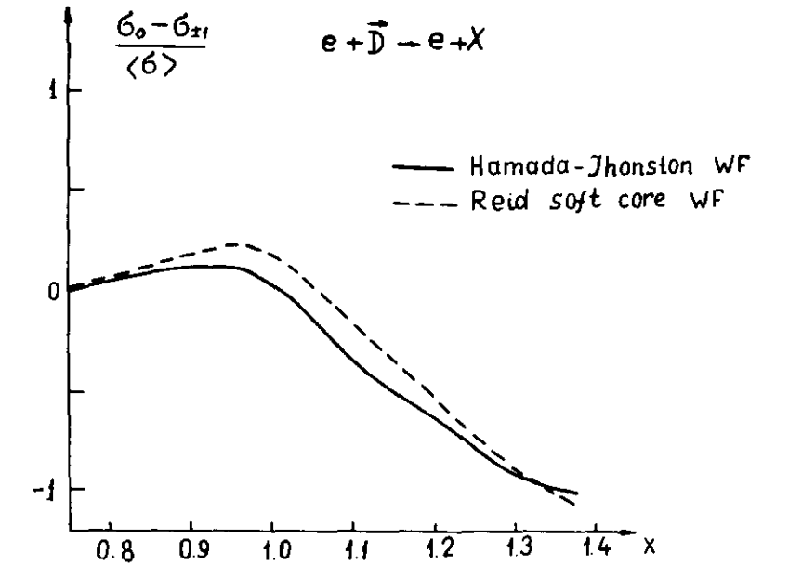
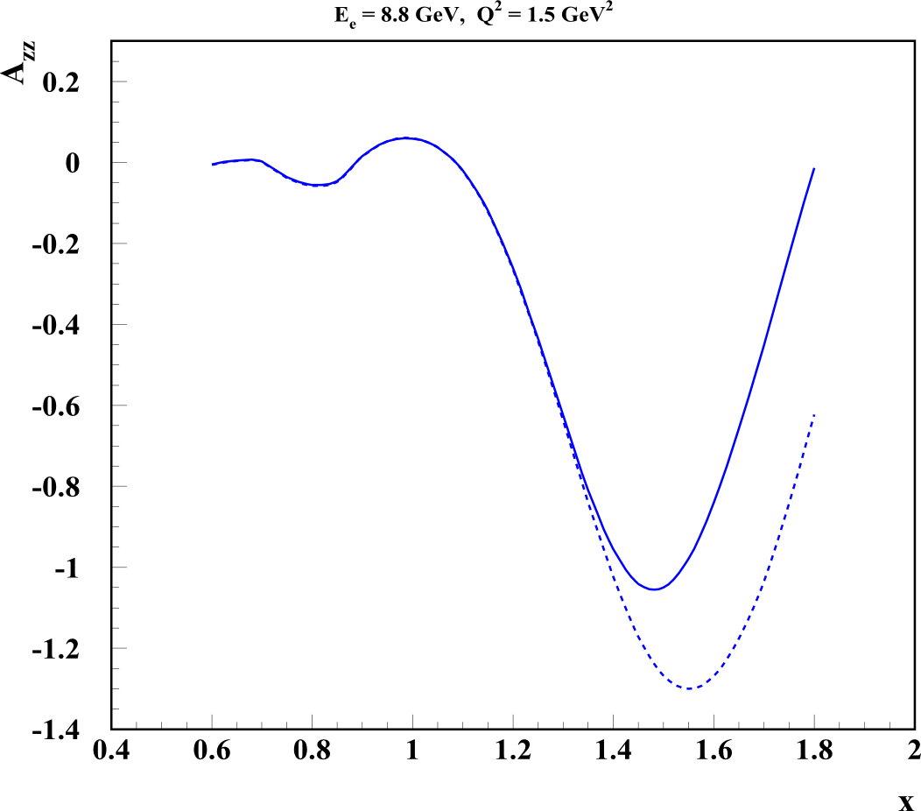
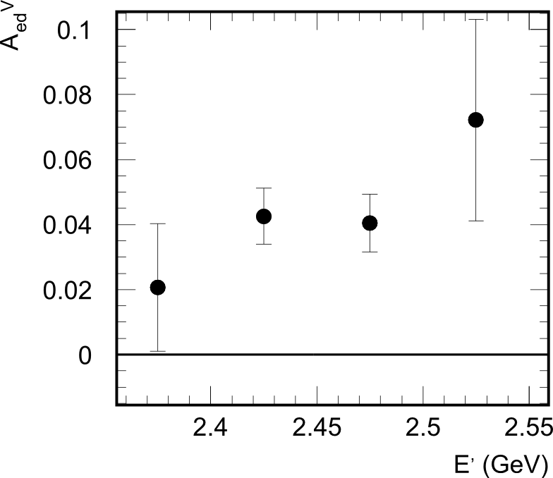
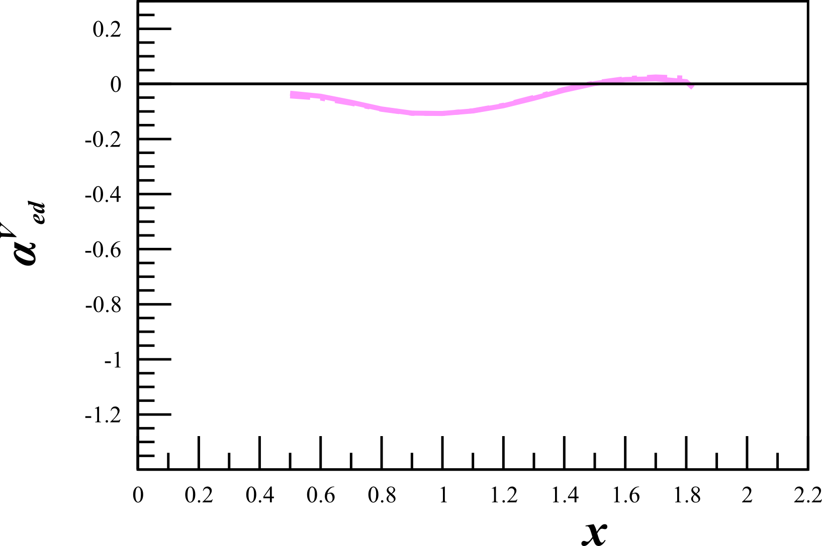
Deuteron Wavefunction
“There is a strong need for models of the deuteron wave function that are both realistic ...”
- J. Terry, G. Miller, arXiv:1603.07032 (2016)
Vector Polarized
First calculated in the ‘70s, $A_{zz}$ can be used in to discriminate between hard and soft wavefunctions
$A_{zz}=\frac{2}{fP_{zz}}\left(\frac{σ_{p}−σ_{u}}{σ_{u}}\right)$
In the impulse approximation, $A_{zz}$ is directly related to the S- and D-states
Modern calculations indicate a large separation of hard and soft WFs begins just above the quasi-elastic peak at $x>1.3$
AV18
~1%
0%
~60%
~1%
-100%
CDBonn
H Zhu, Ph. D Thesis. (2000)
H Arenhovel
L.L. Frankfurt, M.I. Strikman, Phys. Rept. 76 215 (1981)
M Sargsian

Slide 15
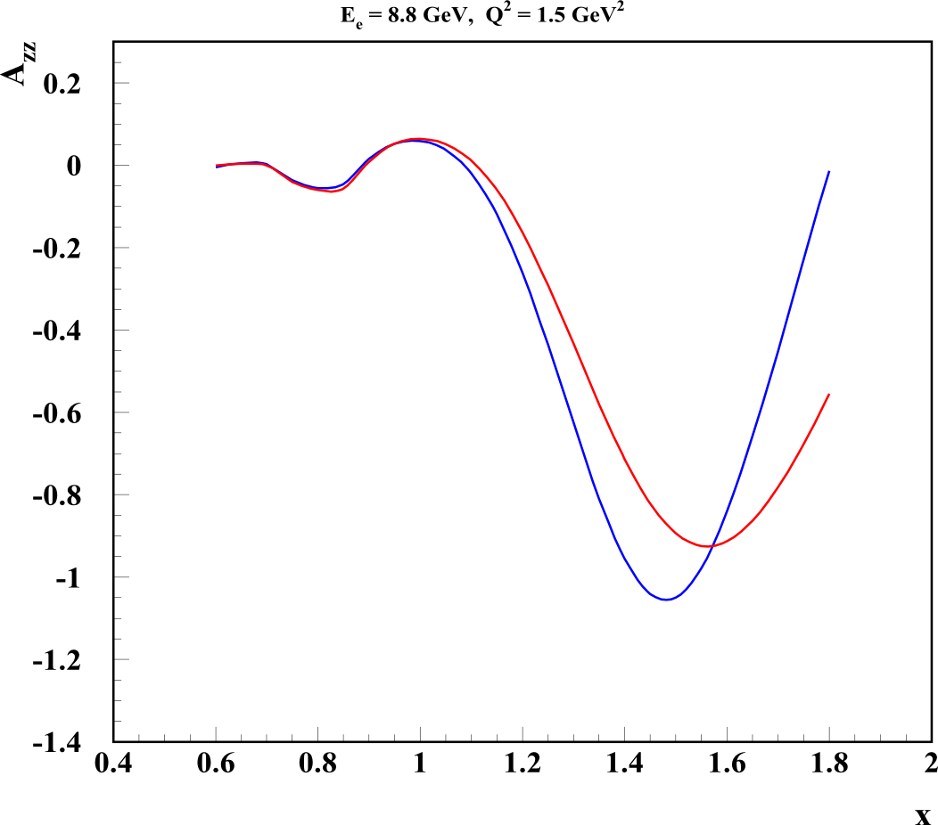
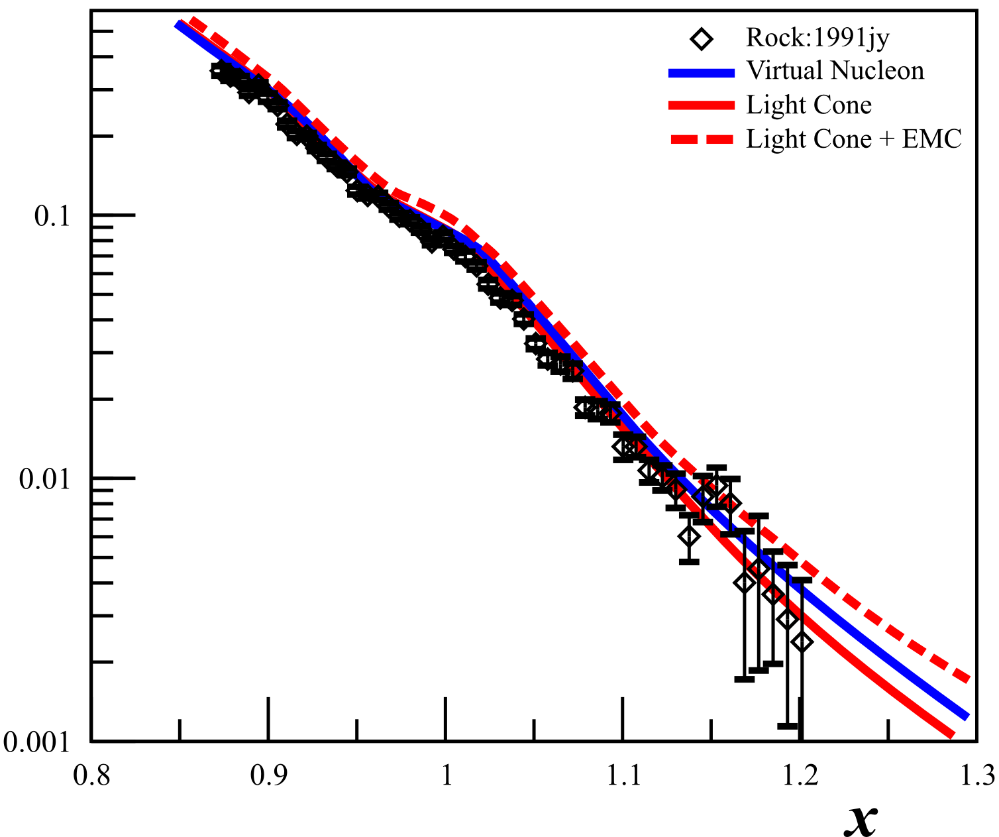
Relativistic NN Bound System
“There is a strong need for models of the deuteron wave function that are both realistic and relativistic.”
- J. Terry, G. Miller, arXiv:1603.07032 (2016)
Tensor Polarized
Unpolarized
Understanding SRCs requires relativistic calculations at high p
Currently two methods:
Light Cone (LC)
Virtual Nucleon (VN)
Large $p>500 MeV/c$ needed to discriminate with unpolarized deuterons
Extremely difficult!
With tensor $A_{zz}$, significant difference at much lower $p>300 MeV/c$ and$x>1.1$
>6σ possible!
σ
Light
Cone
Virtual
Nucleon
M Sargsian, Tensor Spin Observables Workshop (2014)

Slide 16
Theoretical Interest
First Calculations:
New Calculations:
J Terry, G Miller, Phys.Rev. C94 014002 (2016)
M Sargsian, M Strikman, J.Phys.Conf.Ser. 543 012009 (2014)
- 49 Unique Calculations!
W Cosyn, M Sargsian, J.Phys.Conf.Ser. 543 012006 (2014)
S Jeschonnek, JW Van Orden, arXiv:1606.04072 (2016)
H Arenhovel, private communication
“Azz will provide important information on whether the deuteron wavefunction is hard or soft, as well as on relativistic effects. … [This has] relevance ranging from short-range correlations to the equations of state of neutron stars.” - M. Sargsian
“$A_{zz}$ is a unique method to measure the ratio of S- and D-waves in the deuteron at short distances and test the spin structure of short-range correlations. It is also the most sensitive observable to test different approaches to the description of relativistic dynamics.” – M. Strikman
“What interests me most in this proposal is that it can teach us about the nature of the nucleon-nucleon force at short distances and with an observable sensitive to non-nucleonic contributions there is also room for surprising results.” -W. Cosyn
“Previous low $Q^{2}$ measurements seemed to indicate that the asymmetries are far less sensitive to reaction mechanisms than the cross sections; so while the new calculations are not yet available, it is clear that the asymmetries will produce unique constraints on our understanding of the deuteron.” - W. Van Orden
“Presently there is a strong need for models of the deuteron wave function that are both realistic and relativistic. This need is driven by several experiments that aim at either determining deuteron structure or using known deuteron wave functions to determine neutron structure.” - G. A. Miller

Slide 17
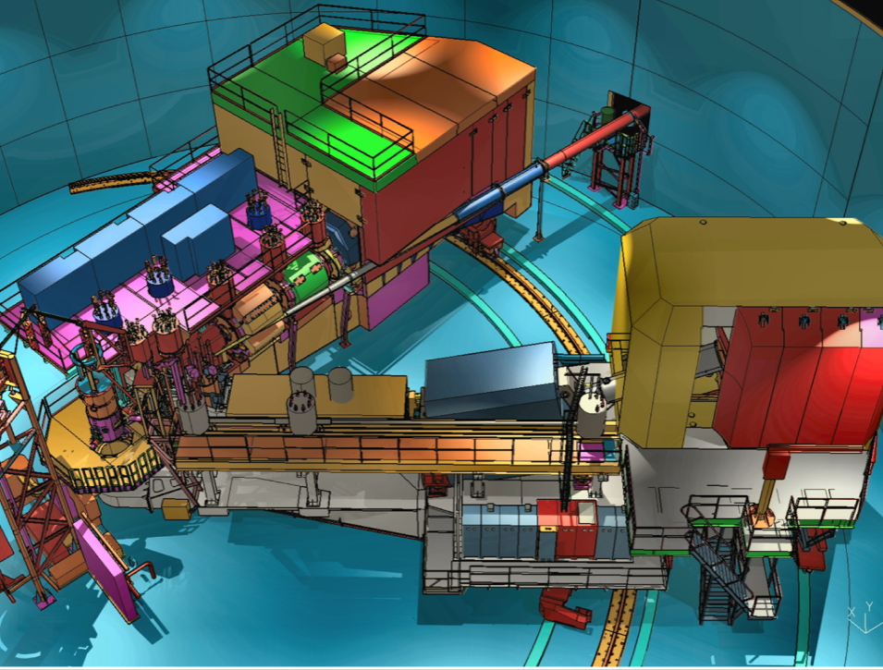
$A_{zz}$ Experimental Set-Up
Hall C with HMS & SHMS
Identical equipment and technique as $b_{1}$ (E12-13-011)
SHMS
Longitudinally
Polarized
Target
SHMS
Fast
Raster
Faraday Cup
Unpolarized
Beam
Lumi
Temp-
Controlled
BCMs
Slow
Raster
HMS

Slide 18
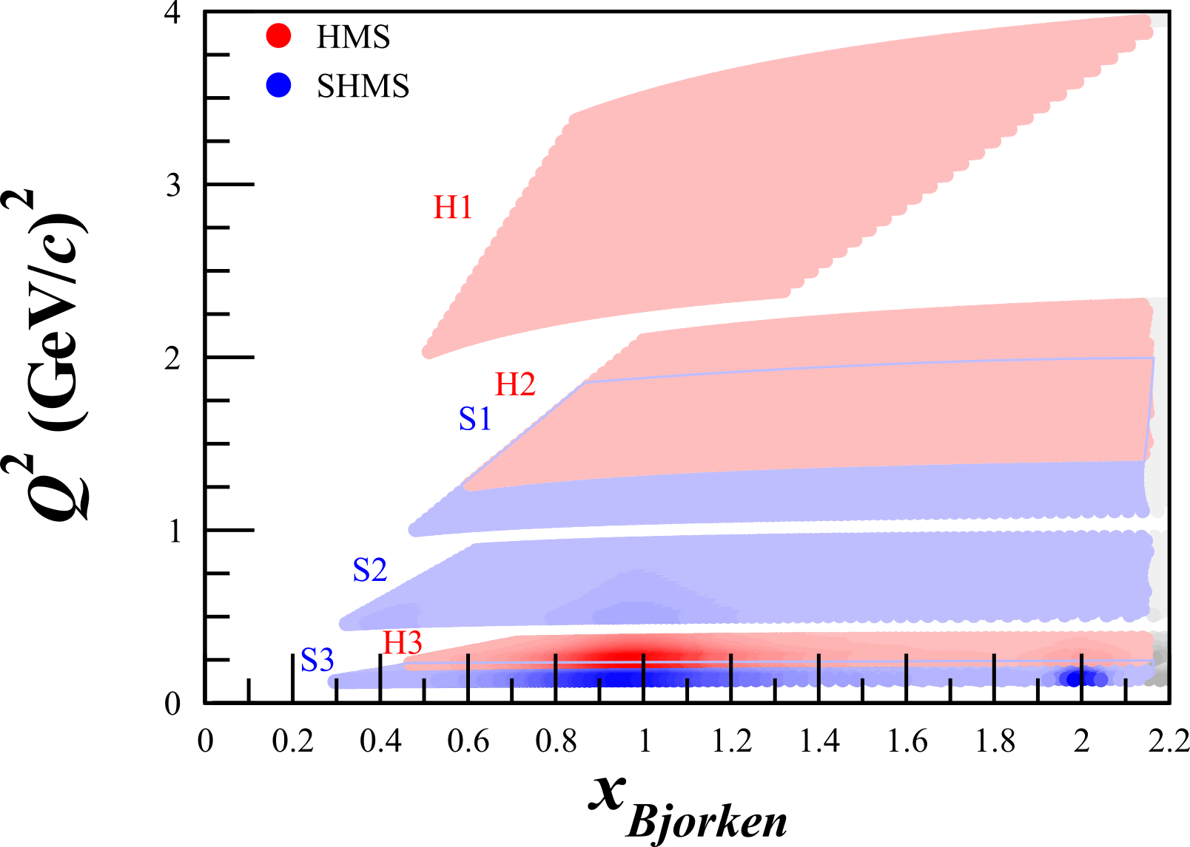
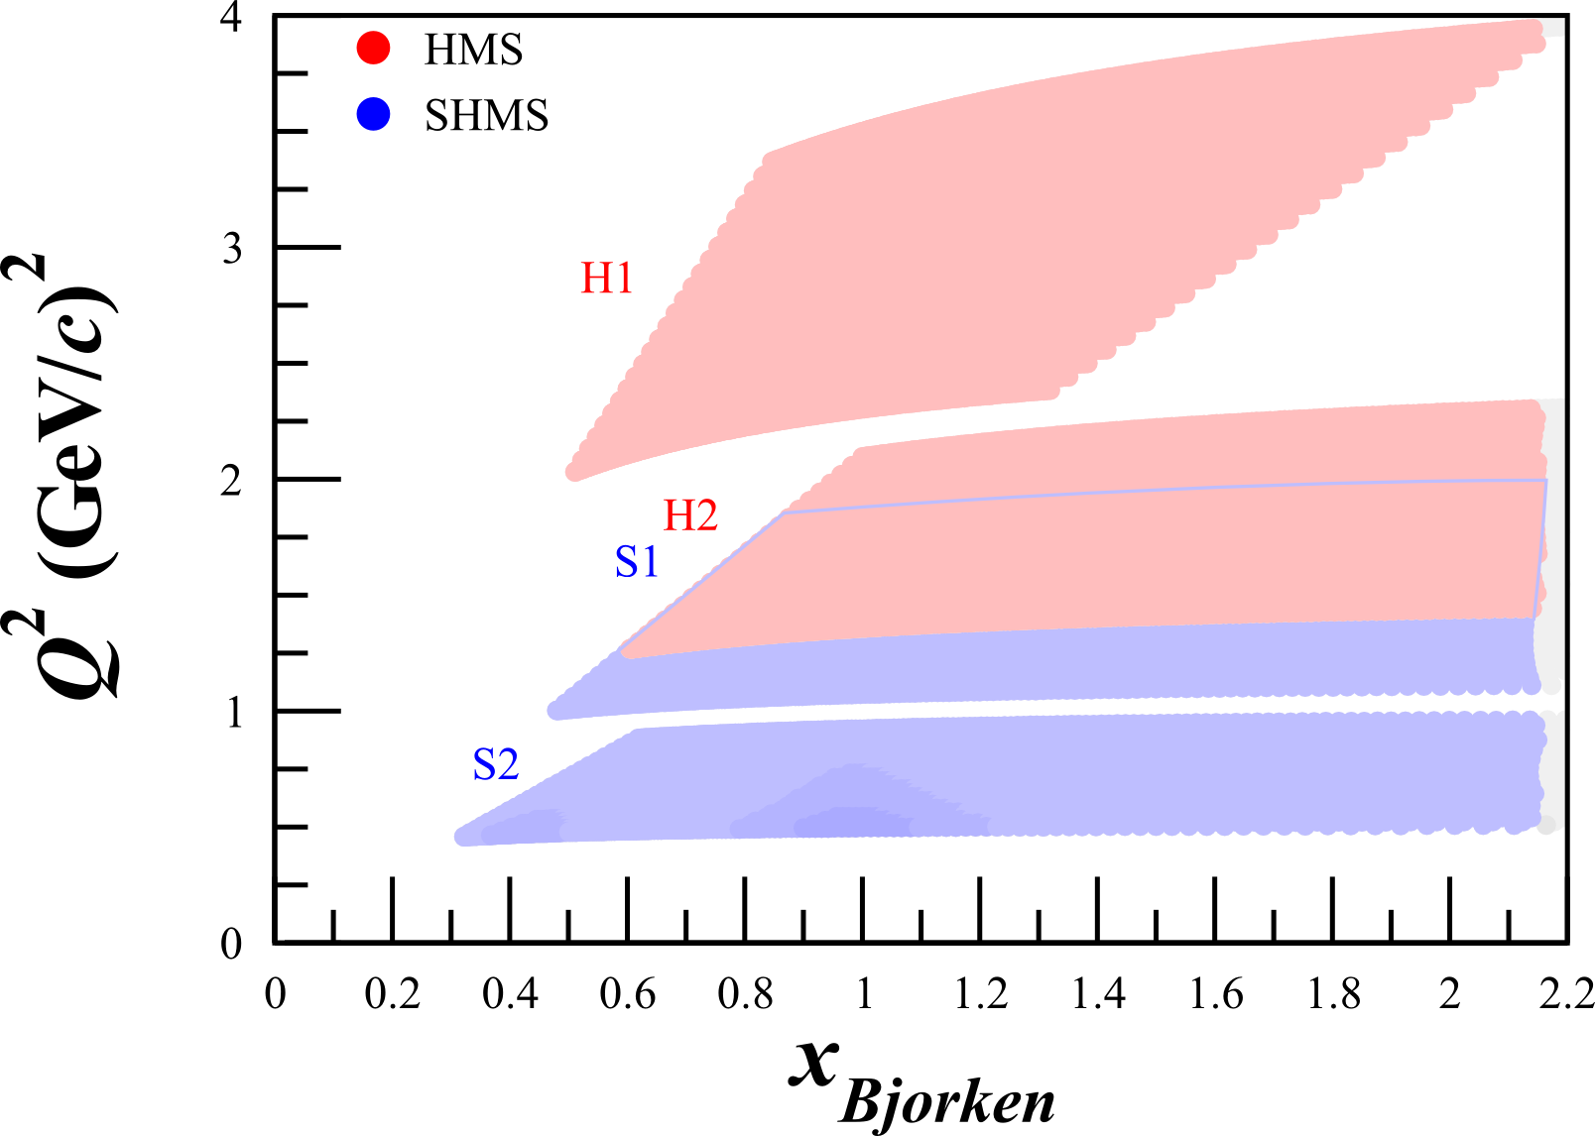
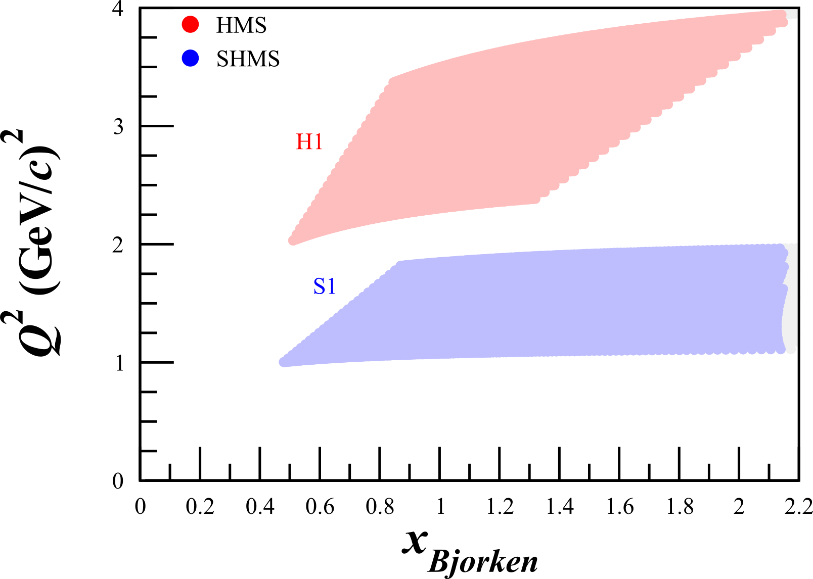
Kinematics
$ℒ_{D}=1.2×{10}^{35} {cm}^{−2}s^{−1}$
$I=80−100 nA$
Similar to SANE, RSS, and GEN
25 Days
8 Days
1 Day

Slide 19
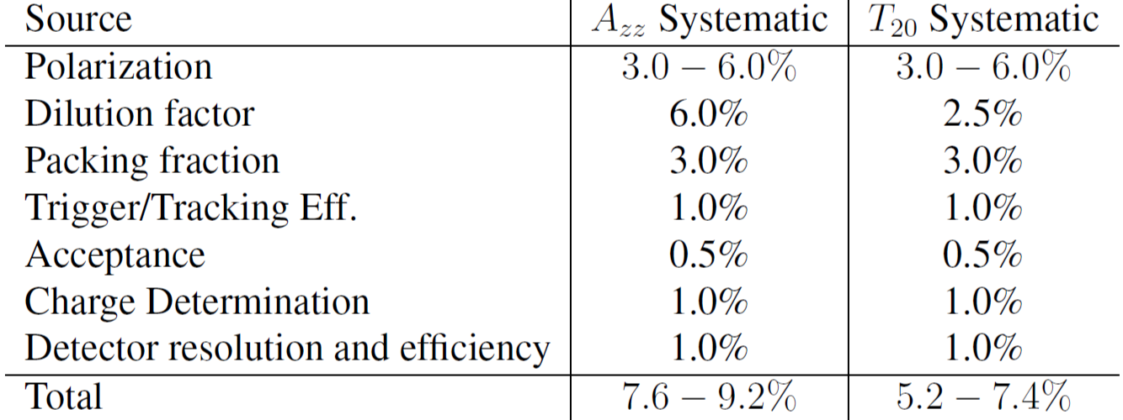
Systematics
8-9% Rel.
5-7% Rel.

Slide 20
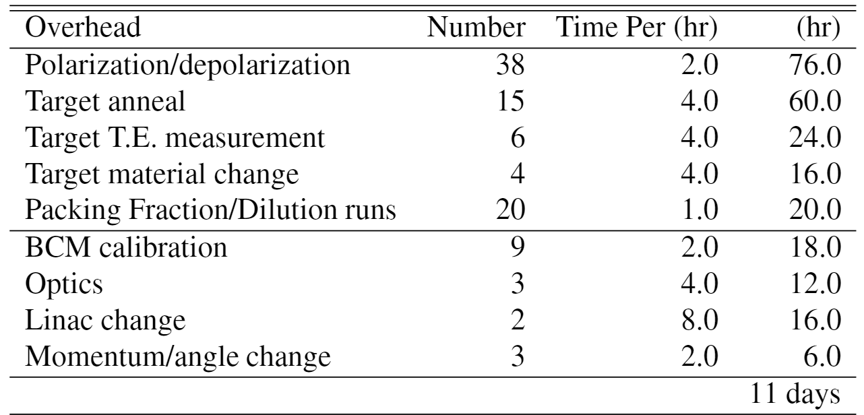
Overhead

Slide 21
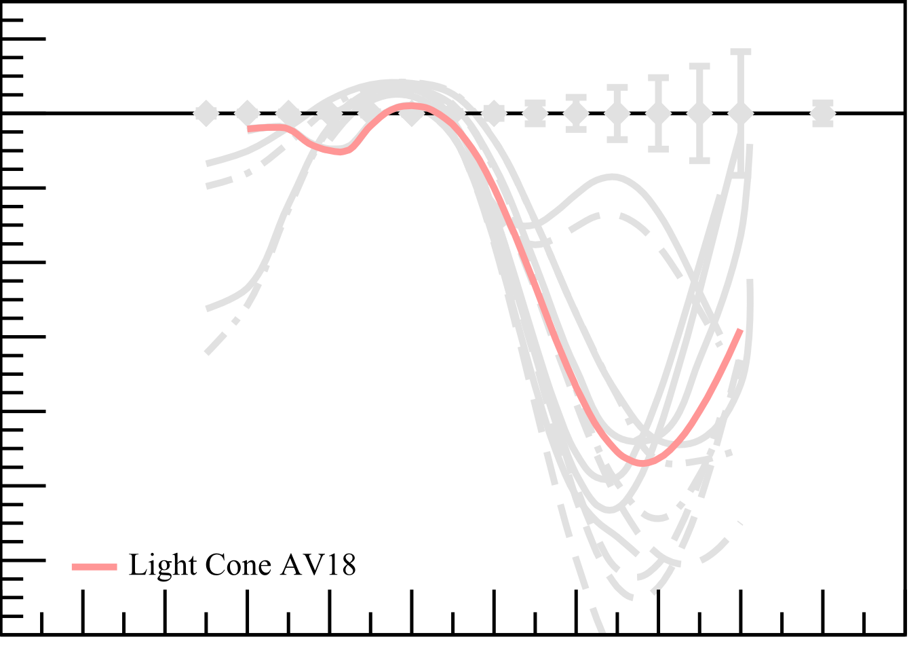
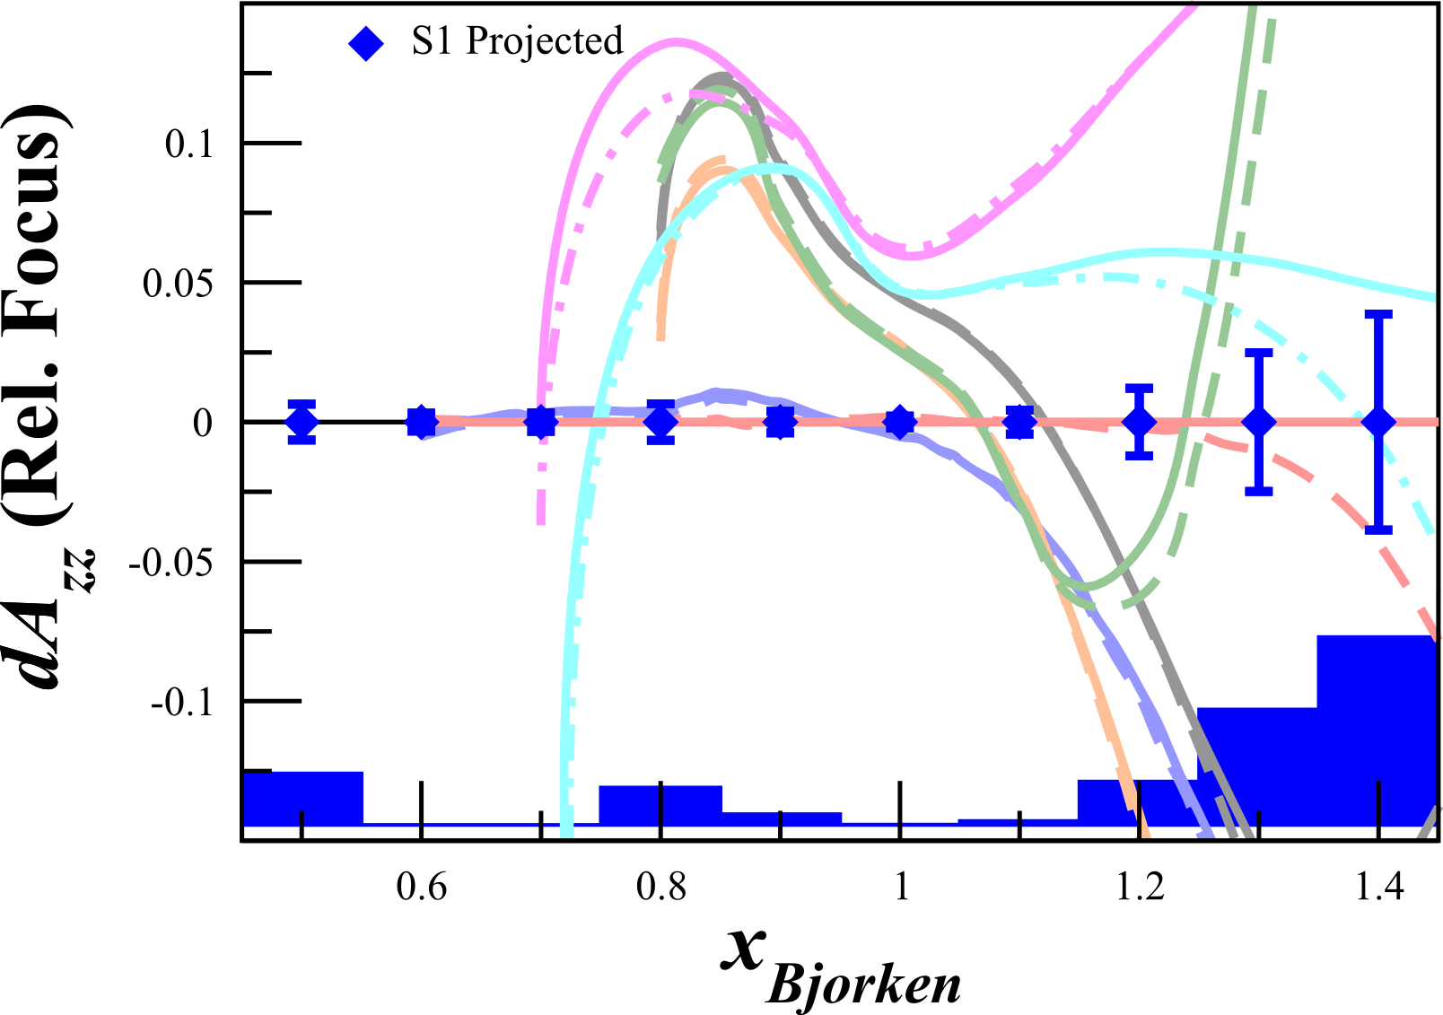
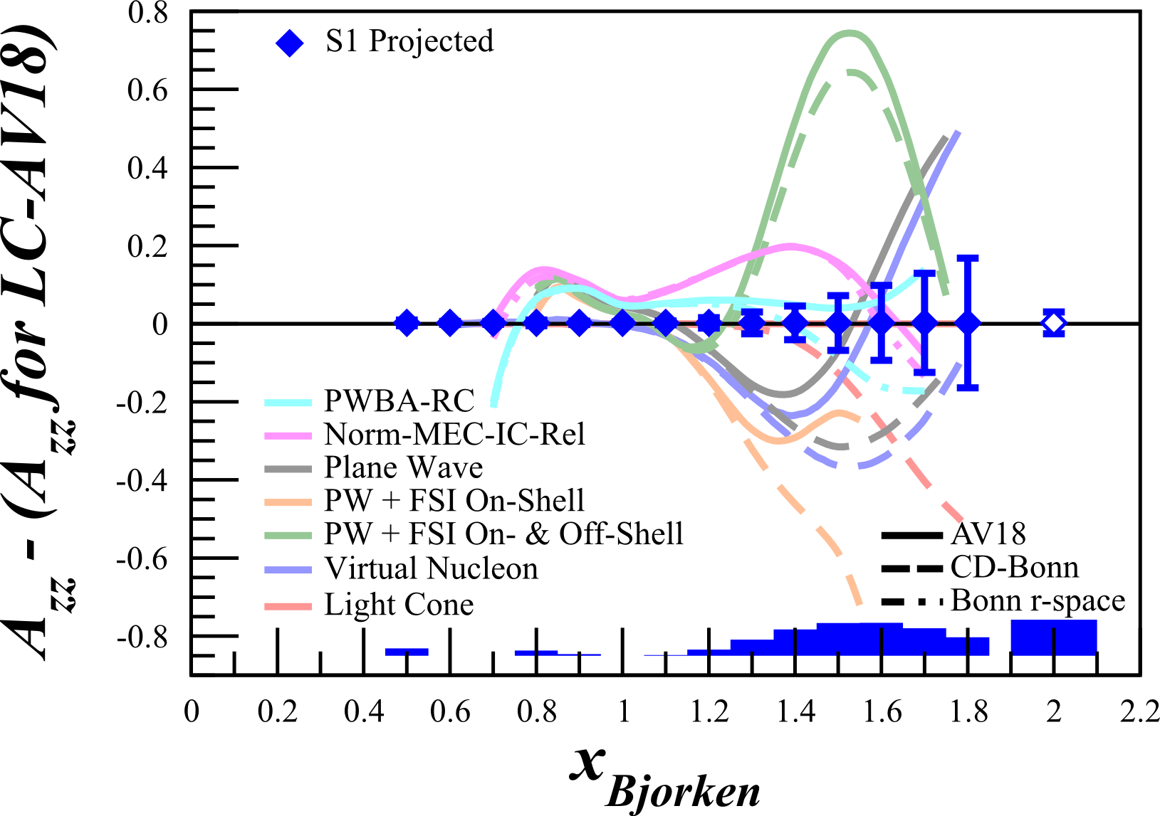
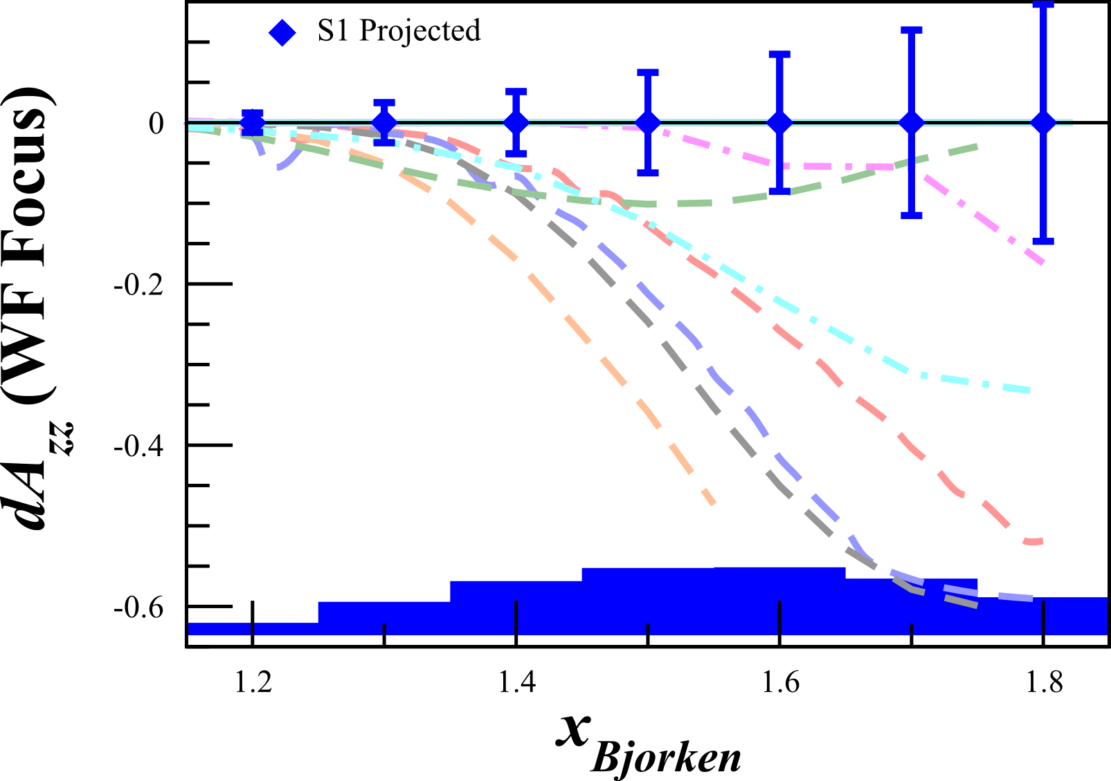
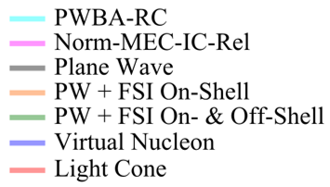
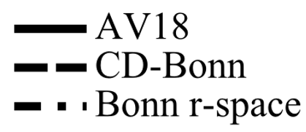
Discriminating Power
Relativistic Model Discrimination >6σ
Wave Function Discrimination up to >4σ
- LC_{AV18} =
Solid = Quasi-elastic
Open = Elastic
E Long, et al, Upcoming PAC44 Prposal

Slide 22
Solid = Quasi-elastic
Open = Elastic
$$Q^{2}=0.2 {GeV}^{2}$$
$$Q^{2}=0.3 {GeV}^{2}$$
$$Q^{2}=0.7 {GeV}^{2}$$
$$Q^{2}=1.5 {GeV}^{2}$$
$$Q^{2}=1.8 {GeV}^{2}$$
$$Q^{2}=2.9 {GeV}^{2}$$

Slide 23
Free Measurement: Elastic $T_{20}$
$T_{20}∝A_{zz}$
Simultaneous measurement of the elastic tensor analyzing power $T_{20}$
$T_{20}$ in the widest range and highest $Q^{2}$ ever done in a single experiment
Import cross-check of Hall C high $Q^{2}$ data

Slide 24
Tensor $A_{zz}$ Collaboration
E. Long, K. Slifer, P. Solvignon, T. Badman, L. Hammed, M. Holtrop, N. Lajoie, S. Li, K. McCarty, R. Paremuzyan, D. Ruth, S. Santiesteban, B. Yale, R. Zielinski University of New Hampshire
D. Day, D. Keller, D. Crabb, S. Liuti, O.A. Rondon, V. Sulkowsky, J. Zhang University of Virginia
D. Higinbotham, A. Camsonne, J. Bericic, J.P. Chen, S. Covrig Dusa, D. Gaskell, C. Keith, P. Nadel-Turonski, K.J. Park, G. Smith, S. Wood Jefferson Lab
Z. Ye Duke University
W. U. Boeglin, M. Sargsian, P. Markowitz Florida International University
W. Cosyn Ghent University
B. Dongwi, N. Kalantarians, M. Kole, A. Liyanage, J. Nazeer Hampton University
T. Brecelj, S. Sirca, S. Stajner Jozef Stefan Institute and University of Ljublijana
B. Bertozzi, S. Gilad MIT
K. Adhikari Mississippi State University
A. Ahmidouch, S. Danagoulian North Carolina A&T State University
W. Tireman Northern Michigan University
M. Strikman Pennsylvania State University
R. Gilman Rutgers University
M. Elaasar Southern University
W. van Oers University of Manitoba
G.A. Miller University of Washington
D. Androic University of Zagreb

Slide 25
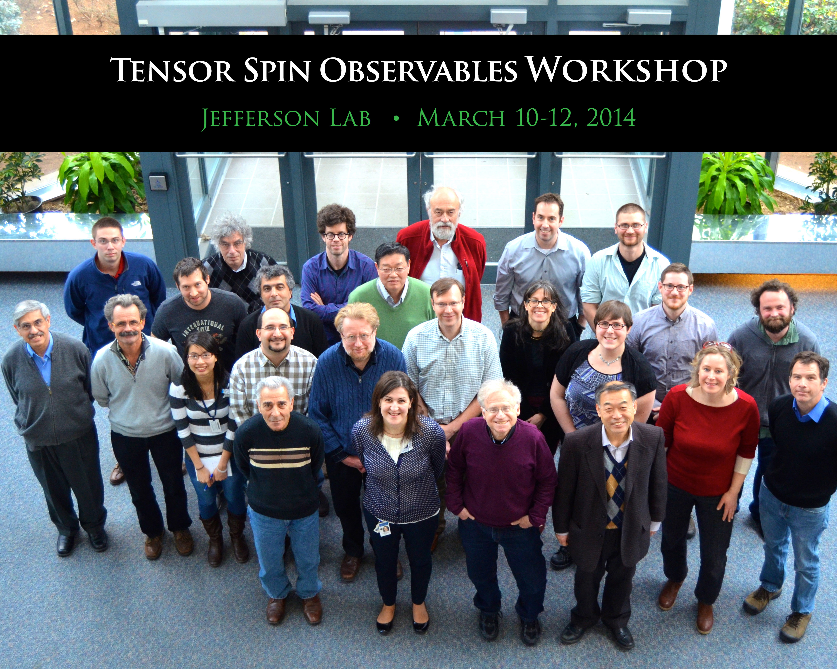
Part of a Growing Tensor Program
J. Phys.: Conf. Ser. 543 011001-012015 (2014)
http://iopscience.iop.org/1742-6596/543/1
Growing tensor program:
This experiment (C12-15-005)
DIS $b_{1}$ already approved (C12-13-011)
Exotic gluon states through $∆$ (LOI12-14-001)
Physics accessible with a tensor polarized target:
Orbital Angular Momentum & Spin Crisis
Gravitomagnetic Form Factors
Pionic Effects
Polarized Sea Quarks
Tensor polarized antiquarks
Linking traditional nuclear physics and quark-gluon picture
Final State Interactions
Gluonic Effects
New tensor structure functions → $b_{2}$, $b_{3}$
Tensor DVCS → Test sum rules, new helicity term
Tensor Drell-Yan → 60 new structure functions
…and more!

Slide 26
First Measurement of Quasi-Elastic $A_{zz}$
“The measurement proposed here arises from a well-developed context, presents a clear objective, and enjoys strong theory support. It would further explore the nature of short-range pn correlations in nuclei, the discovery of which has been one of the most important results of the JLab 6 GeV nuclear program.”
-JLab PAC42, PAC43, & PAC44 Theory TACs
(C. Weiss, R. Schiavilla, J.W. Van Orden)
2021
$$80$$
$$A_{zz}$$
$$T_{20}$$
# of Tensor Data Points
$$35$$
$$b_{1}$$
$$10$$
2016
$$<0.5$$
$$0.8−1.8$$
$$2$$
$$x$$

Slide 27
First Measurement of Quasi-Elastic $A_{zz}$
Beam Request: 34 PAC Days
1 PAC Day @ 2.2 GeV, 8 @ 6.6 GeV, 25 @ 8.8 GeV, + 11 Overhead Days
2021
No current quasi-elastic tensor measurements
Sensitive to effects that are very difficult or impossible to measure with unpolarized or vector polarized deuterons
Huge 10-100% asymmetry
Decades of theoretical interest that we can only now probe with a high-luminosity tensor-polarized target (same as approved $b_{1}$)
Importance ranges from understanding short-range correlations to the equations of state of neutron stars
Bonus: $T_{20}$ over widest $Q^{2}$
$$80$$
$$A_{zz}$$
$$T_{20}$$
# of Tensor Data Points
$$35$$
$$b_{1}$$
$$10$$
2016
$$<0.5$$
$$0.8−1.8$$
$$2$$
$$x$$

Slide 29
Backup Slides

Slide 30
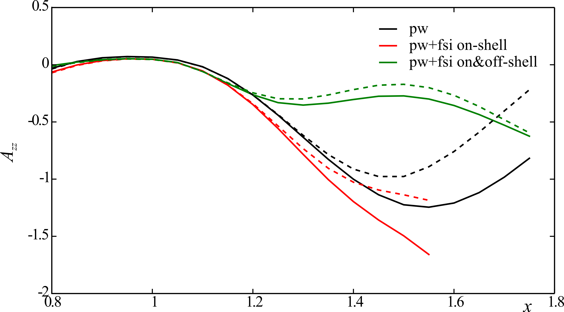
Final State Interactions
FSI must be understood & minimized to get NN potential information
Minimum/maximum FSI on $A_{zz}$ calculated by W. Cosyn^{[1]}
FSIs minimized in kinematic choice (large $x≥1.35$ and medium p_{m})
Best suited for attempting to extract information on D-wave content^{[2]}
AV18
CDBonn
^{[2]} S Jeschonnek, JW Van Orden, arXiv:1606.04072 (2016)
^{[1]} W Cosyn

Slide 31
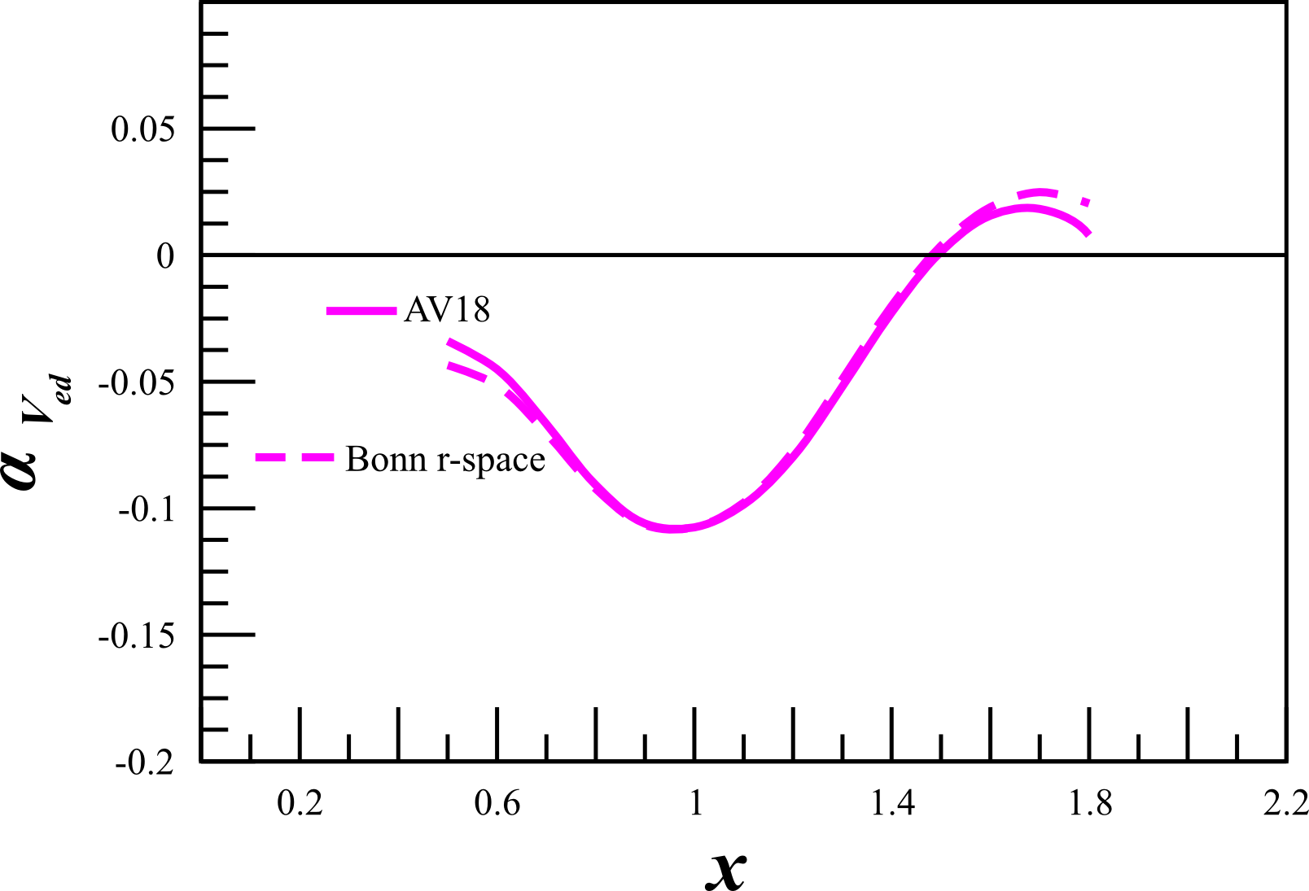
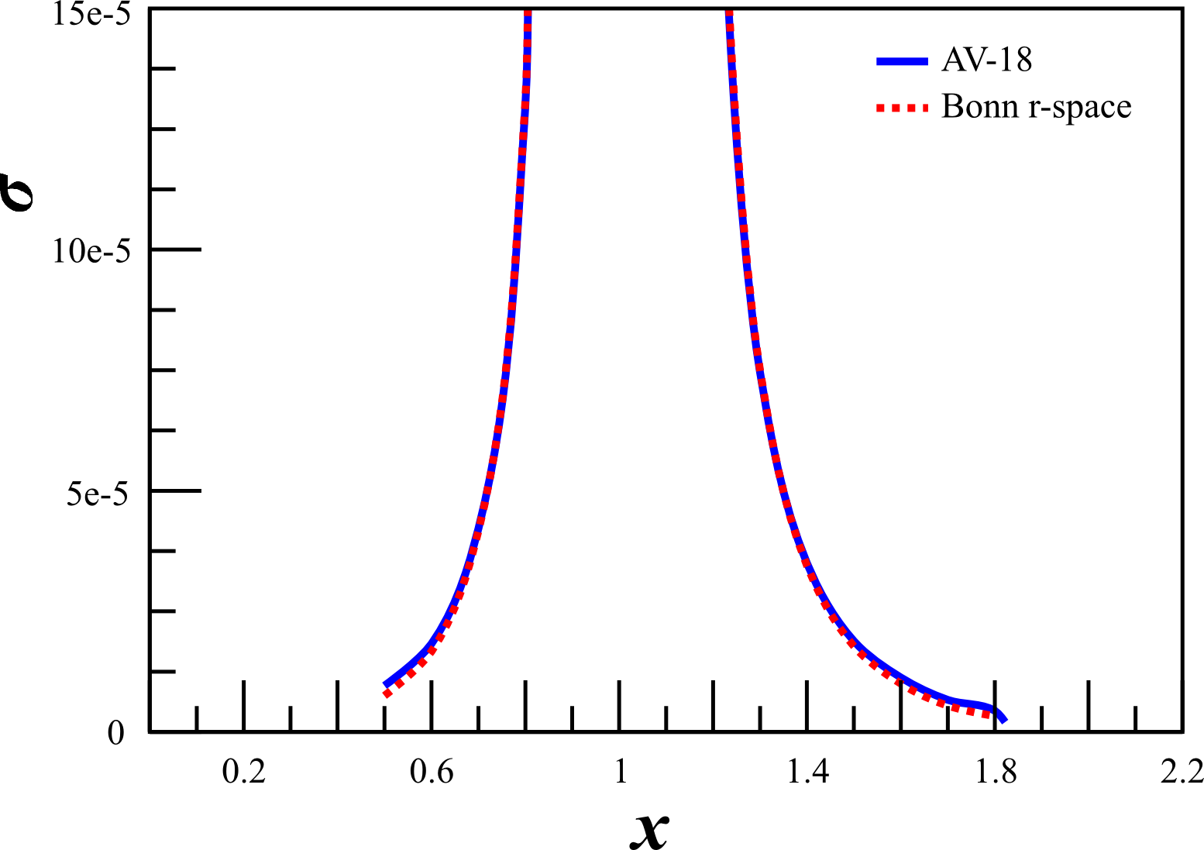
Deuteron Wavefunction
“There is a strong need for models of the deuteron wave function that are both realistic ...”
- J. Terry, G. Miller, arXiv:1603.07032 (2016)
Unpolarized
Vector Polarized
First calculated in the ‘70s, $A_{zz}$ can be used in to discriminate between hard and soft wavefunctions
$A_{zz}=\frac{2}{fP_{zz}}\left(\frac{σ_{p}−σ_{u}}{σ_{u}}\right)$
In the impulse approximation, $A_{zz}$ is directly related to the S- and D-states
Modern calculations indicate a large separation of hard and soft WFs begins just above the quasi-elastic peak at $x>1.3$
AV18
0%
0%
~1%
~60%
~1%
-10%
-100%
CDBonn
H Zhu, Ph. D Thesis. (2000)
H Arenhovel
L.L. Frankfurt, M.I. Strikman, Phys. Rept. 76 215 (1981)
M Sargsian

Slide 32
Polarization Cycle
Each polarization cycle is an independent measurement of $A_{zz}$
Annealing and target motion only at the start of a new cycle
Any issues from annealing or material shifts will be isolated to a single cycle
Dilution/packing fraction runs at the beginning and end of each cycle can recover data surrounding a material shift event
Doubled the number of cycles for the lowest $Q^{2}$ measurement

Slide 33
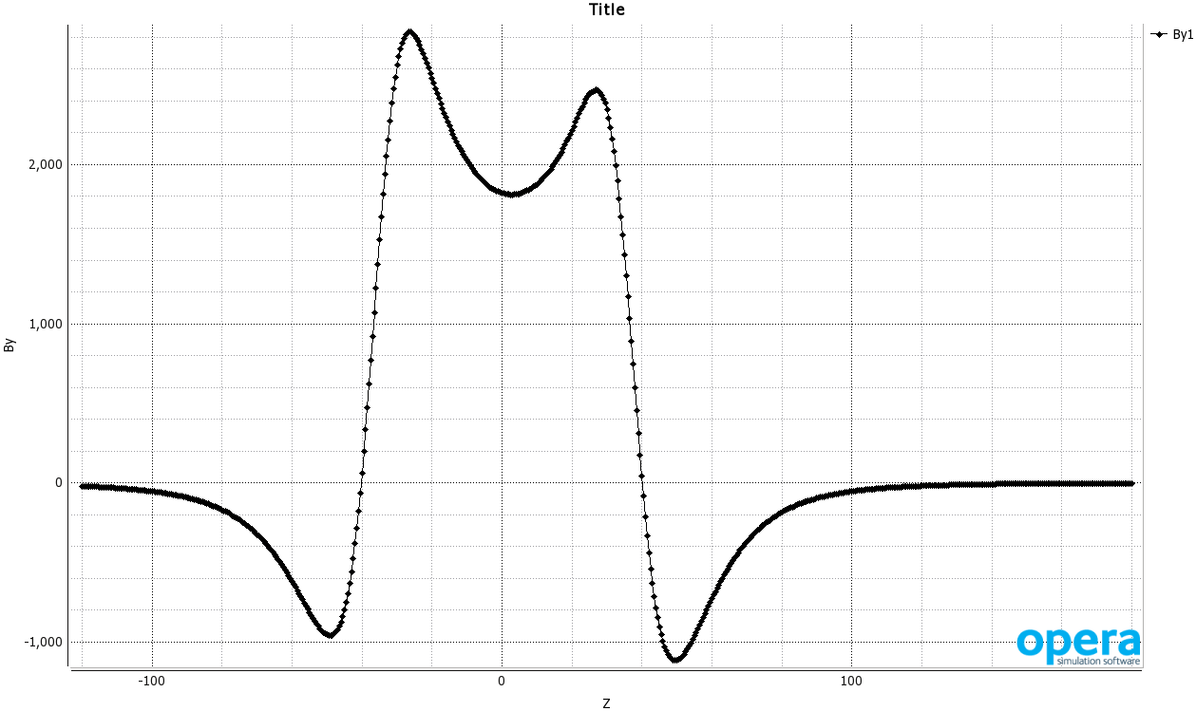
Target Magnet and Horizontal Bender
TOSCA results^{[1]} indicate <5 G on target material from HB
~0.2 G/cm gradient on target
Maximum 12ppm effect on target material
Well within required 100ppm target field stability
1.75m from center
of target to
3T HB
Typical Strength
of Refrigerator Magnet
^{[1]} MH Moore, et al, arXiv:1406.7856

Slide 34
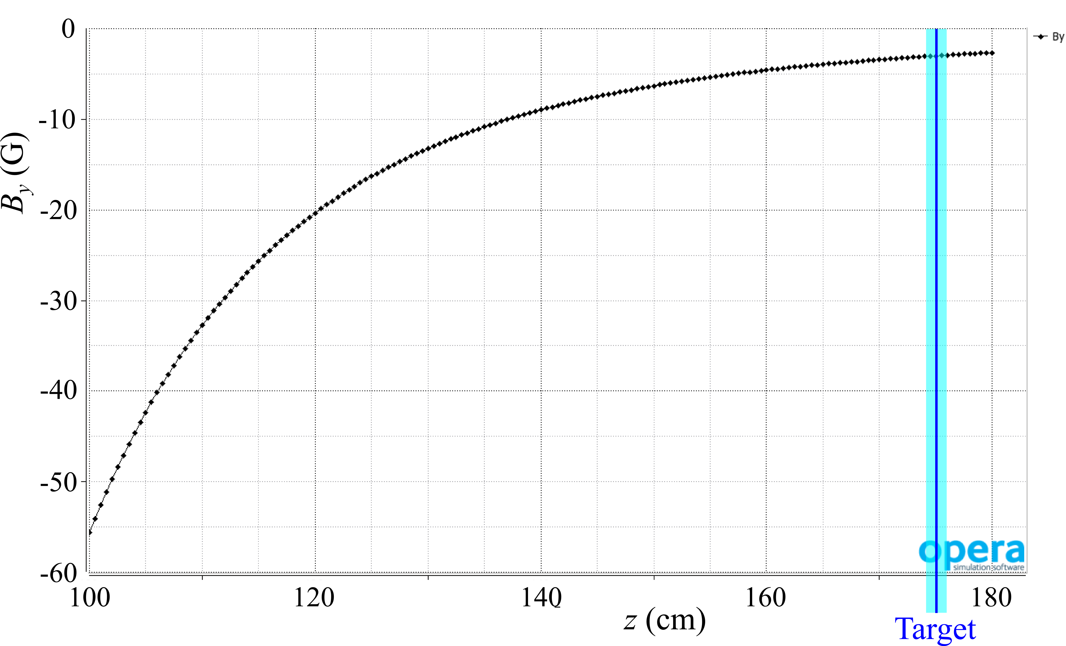
Target Magnet and Horizontal Bender
TOSCA results^{[1]} indicate <5 G on target material from HB
~0.2 G/cm gradient on target
Maximum 12ppm effect on target material
Well within required 100ppm target field uniformity
1.75m from center
of target to
3T HB
Typical Strength
of Refrigerator Magnet
^{[1]} MH Moore, et al, arXiv:1406.7856

Slide 35
Target Magnet and Horizontal Bender
Hall A g2p had similar configuration
1.5T septa placed 1.58m from center of solid NH₃ target
TOSCA study agreed very well with field mapping
Septa was shown to have negligible coupling on the target magnet
Even during a catastrophic failure of the septa, the target field maintained a <100ppm stability
1.75m from center
of target to
3T HB

Slide 36
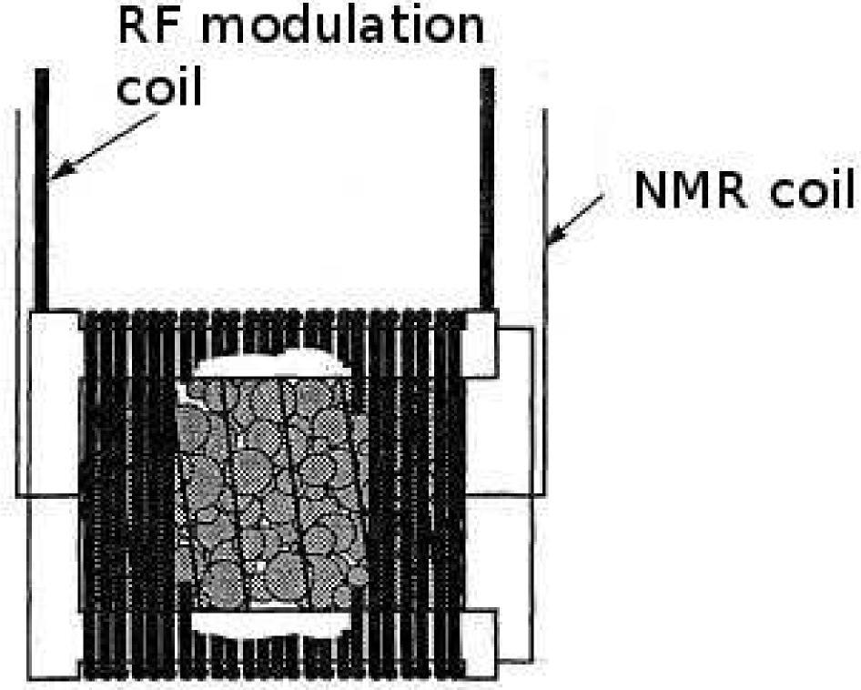
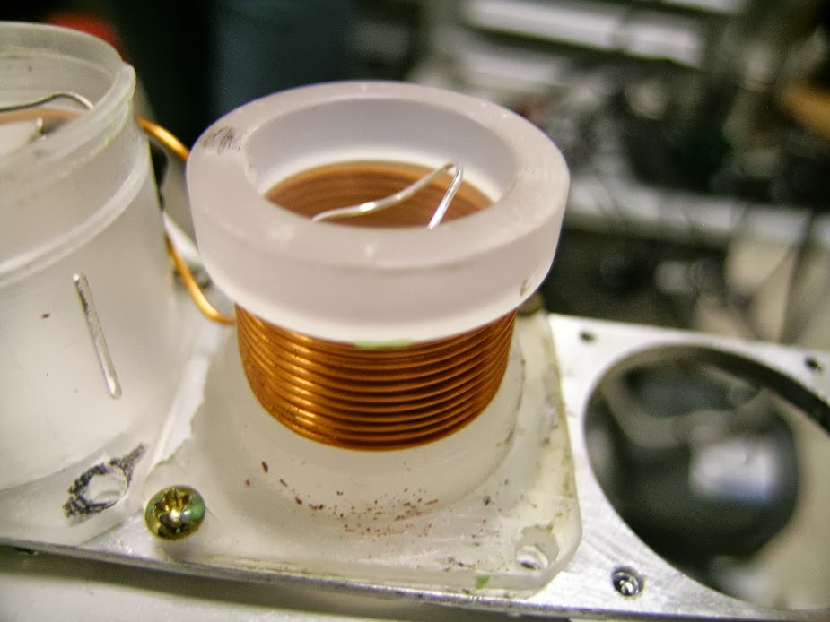
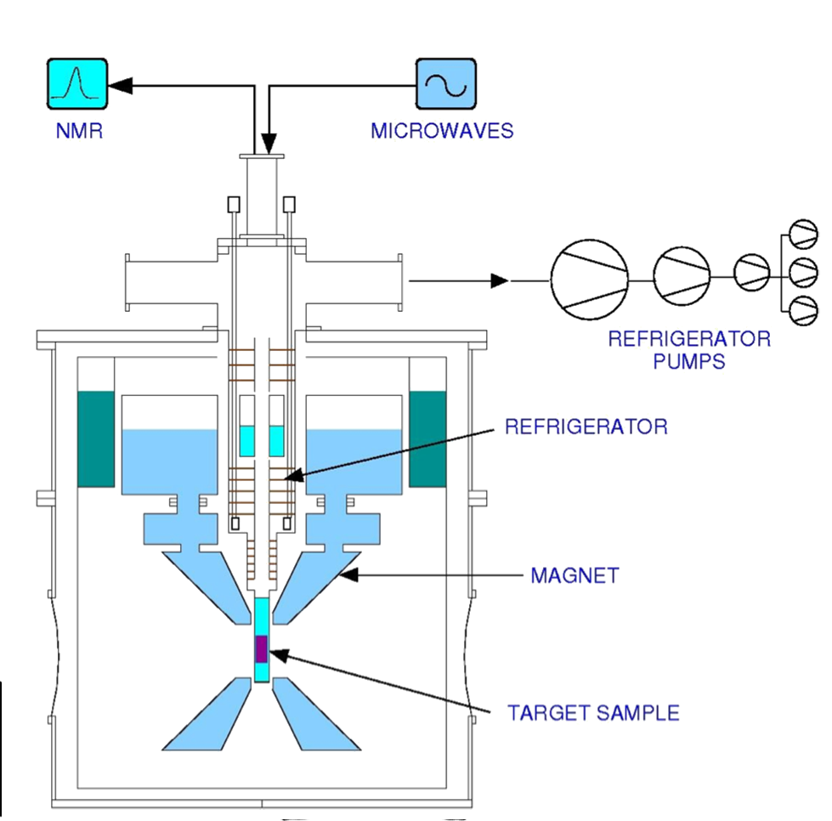
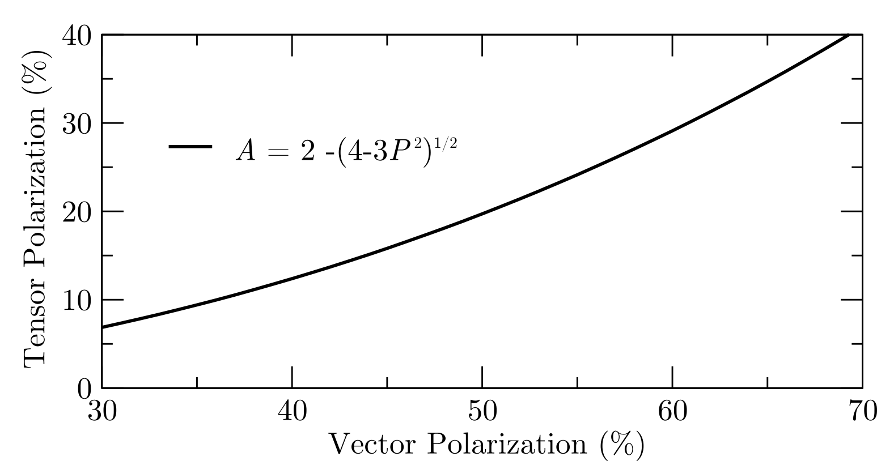
Tensor Polarized Target
Dynamic Nuclear Polarization of ND₃
$P_{zz} \sim 30\%$
5 Tesla at 1 K
3cm Target Length
$p_{f} \sim 0.65$
$f_{dil} \sim 0.27$
UVA Techniques in R&D:
Selective Semi-Saturation
Time Dependence of Sample Rotation
Material Crystallization
Alternative Materials
Tensor Polarization by Vector Polarization

Slide 37
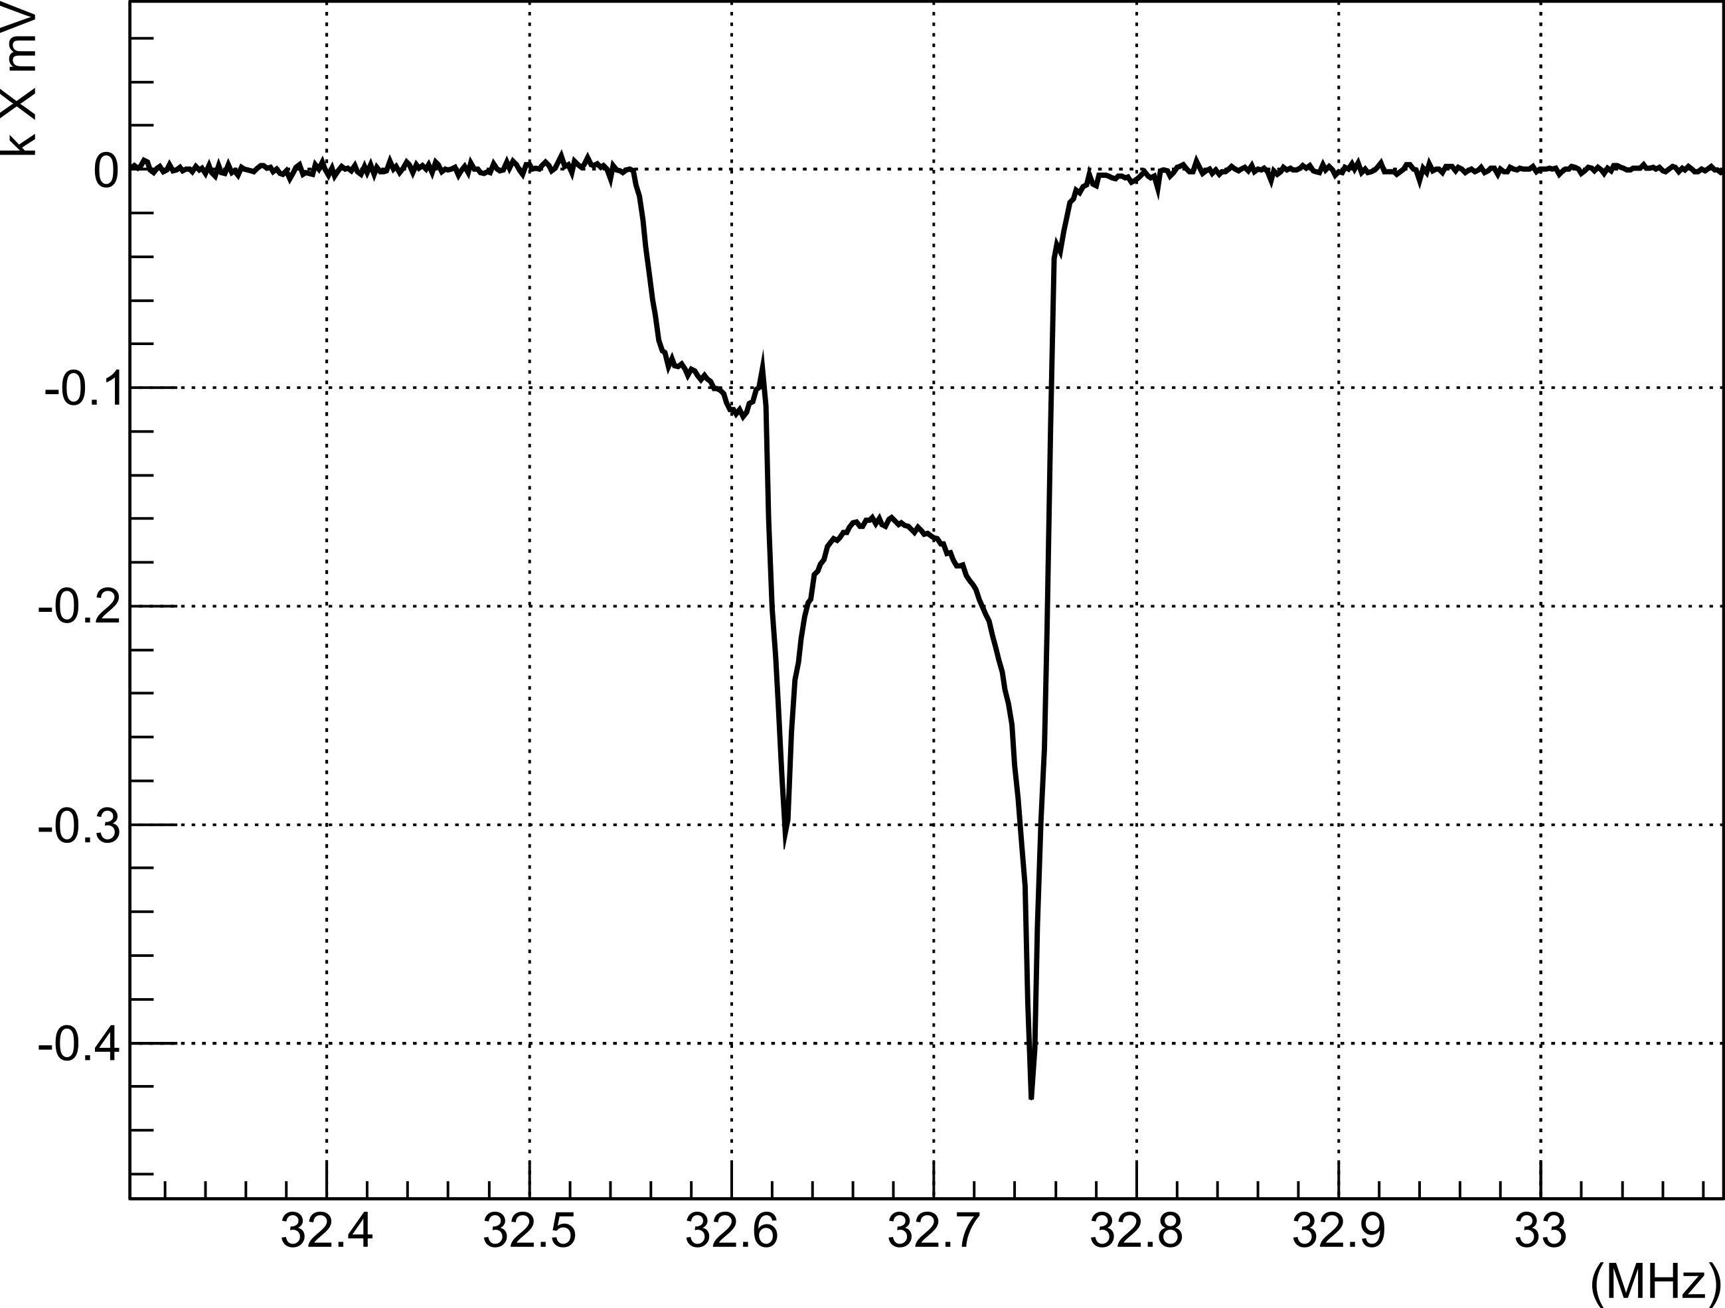
Tensor Polarized Target
Dynamic Nuclear Polarization of ND₃
$P_{zz} \sim 30\%$
5 Tesla at 1 K
3cm Target Length
$p_{f} \sim 0.65$
$f_{dil} \sim 0.27$
UVA Techniques in R&D:
Selective Semi-Saturation
Time Dependence of Sample Rotation
Material Crystallization
Alternative Materials
RF Saturation Tensor Enhancement
32.4
32.5
32.6
32.7
32.8
32.9
MHz
-0.4
-0.3
-0.2
-0.1
$k∙$ mV
0.0
D Keller, HiX Workshop (2014)
UVA Tensor Enhancement on Butanol (2014)
$$υ_{D}−3υ_{D}$$
$$υ_{D}+3υ_{D}$$

Slide 38
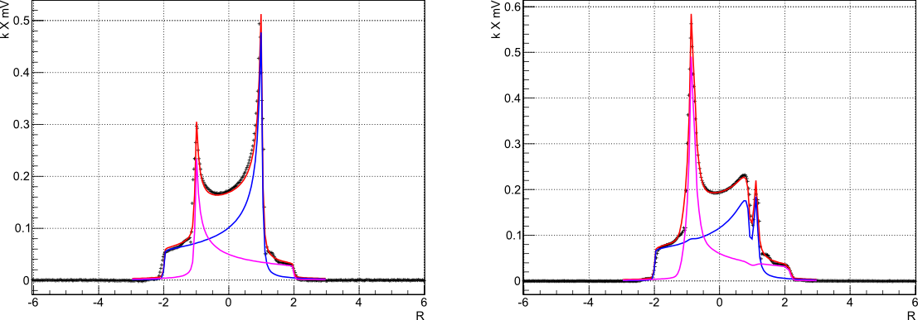
Target Development in Progress
Selective Semi-Saturation
Fitting measurements only minimally dependent on relaxation rates
Tensor enhancement unrelated to area lost ($∆P_{zz}≠−3∆P_{z}$)
Spin diffusion can help spread enhancement
Solid-state NMR $P_{zz}$ can be confirmed with elastic scattering ($T_{20}$)

Slide 39
Diluting Asymmetries
With an unpolarized beam and a longitudinally polarized target,
$h=0$
$φ_{d}=0$
$\sin{φ_{d}}=0$
0
0
0
0
0
0
0
$$σ=σ_{0}\left[1+P_{2}^{d}α_{d}^{T}\right]=σ_{0}\left[1+P_{zz}A_{zz}\right]$$
W Leidemann, et al, PRC 43, 1022 (1991)

Slide 40
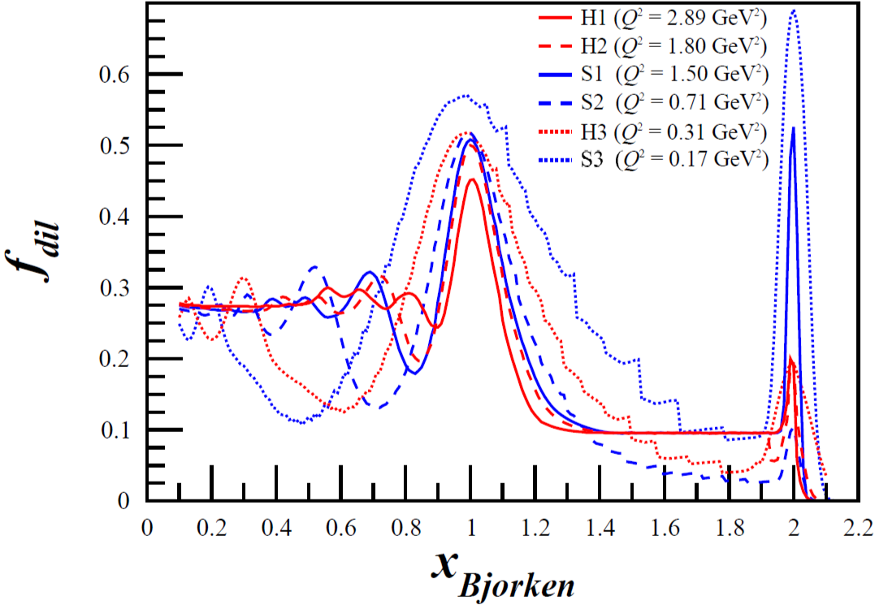
Dilution Factor
“…the background from interaction with nuclei increases as $α(x)$ increases. For example, for a D¹²C target the ratio of the cross sections $σ_{A}$ for A=¹²C and A=D is of the order of 40 for $x\sim 1.3$ and increases with $x$.” - L.L. Frankfurt, M.I. Strikman, Phys. Rept. 160 (1988) 235
$f_{dil}=\frac{ℒ_{D}σ_{D}}{ℒ_{N}σ_{N}+ℒ_{He}σ_{He}+ℒ_{D}σ_{D}+\sum{ℒ_{A}σ_{A}}}$
With the 12 GeV upgrade and the new SHMS, this measurement becomes possible even with the low dilution factor at high $x$

Slide 41
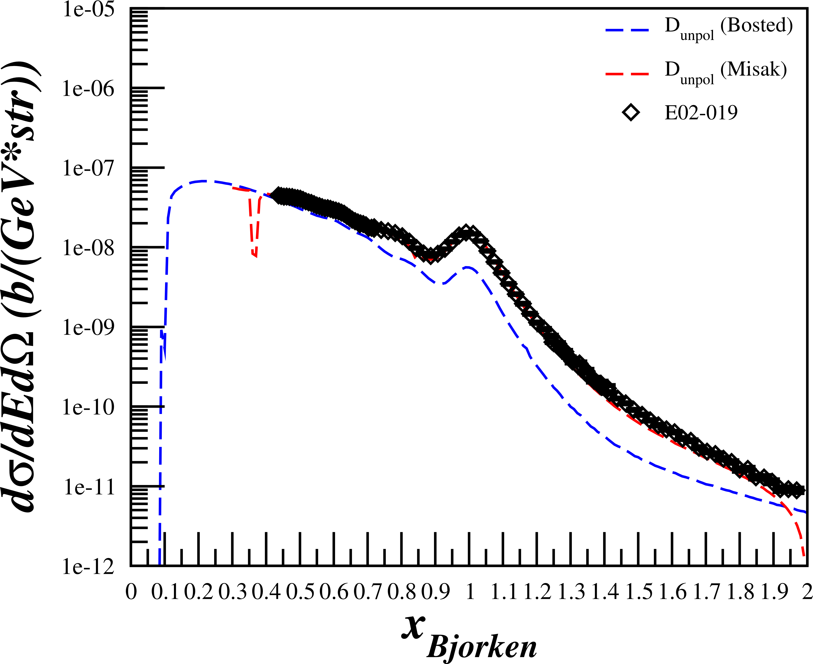
Rates for D(e,e’)X
Assumptions:
$$P_{zz}=30\%$$
$$p_{f}=65\%$$
$$z_{tgt}=3 cm$$
P.E. Bosted, V. Mamyan, arXiv:1203.2262
M. Sargsian, Private Communication
N. Fomin, et al., Phys. Rev. Lett. 108 (2012) 092502
N. Fomin, et al., Phys. Rev. Lett. 105 (2010) 212502
$R_{Pol}=𝒜\left[ℒ_{He}σ_{He}^{u}+ℒ_{N}σ_{N}^{u}+ℒ_{D}σ_{D}^{u}\left(1+\frac{1}{2}P_{zz}A_{zz}\right)\right]$
$R_{Unpol}=𝒜\left[ℒ_{He}σ_{He}^{u}+ℒ_{N}σ_{N}^{u}+ℒ_{D}σ_{D}^{u}\right]$
$N=Rt$
$A_{zz}=\frac{2}{f_{dil}P_{zz}}\left(\frac{N_{Pol}}{N_{Unpol}}−1\right)$
$δA_{zz}^{stat}=\frac{2}{f_{dil}P_{zz}}\sqrt{{\left(\frac{1}{N_{Unpol}}\sqrt{N_{Pol}}\right)}^{2}+{\left(\frac{N_{Pol}}{N_{Unpol}^{2}}\sqrt{N_{Unpol}}\right)}^{2}}$
Used combination of P. Bosted and M. Sargsian code to calculate unpolarized cross sections
Compared with data similar to Azz range
$E_{0}=5.766 GeV$
$E′=4.8 GeV$
$θ_{e′}={18.0}^{∘}$
E. Long, Technical Note, JLAB-TN-13-029

Slide 42
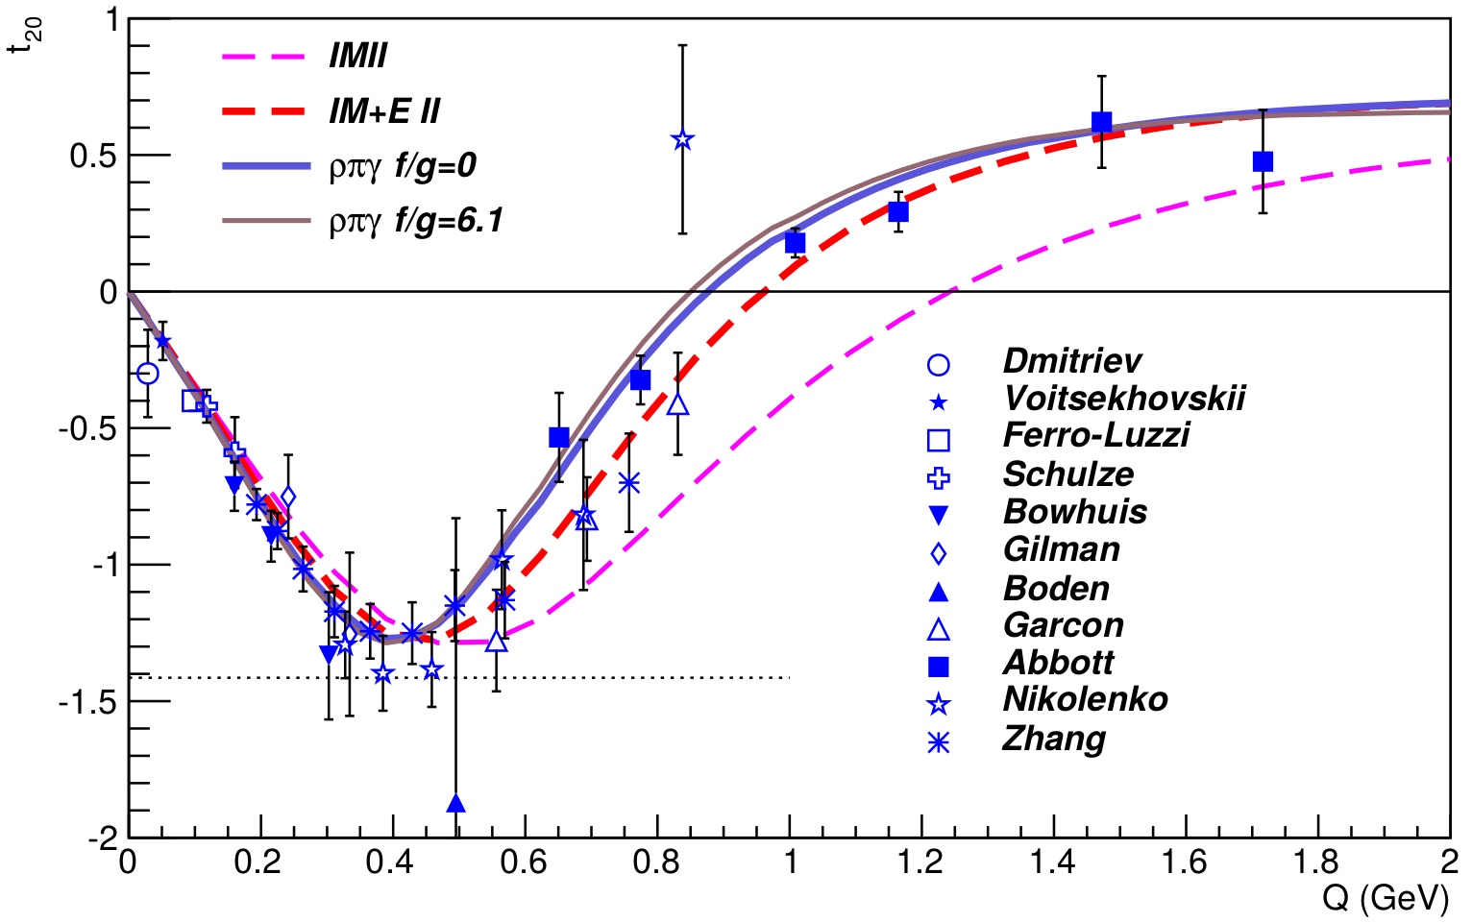
Elastic Tensor Observables
0.20
0.39
0.59
0.79
0.99
1.18
Q (GeV)
RJ Holt, R Gilman, Rep. Prog. Phys. 75 086301 (2012)
C Zhang, et al, PRL 107 252501 (2011)

Slide 43
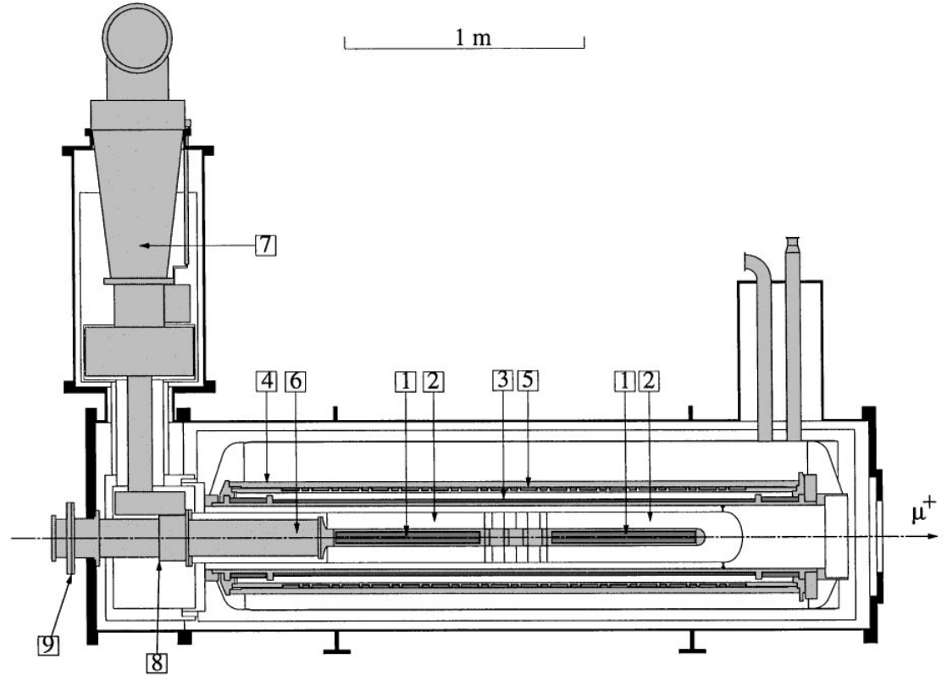
Possible New Target Configuration – Extended or Multiple Cells
$FOM=n_{t}f^{2}P_{zz}^{2}$
b1 PAC condition with $z=3cm$ and $P_{zz}=0.3$,
$n_{t}=\left(5.913×{10}^{22}\frac{1}{{cm}^{3}}\right)∙3 cm=1.77×{10}^{23}\frac{1}{{cm}^{2}}$
$FOM=f^{2}(0.159×{10}^{23}\frac{1}{{cm}^{2}}$)
With $z=3cm$ and $P_{zz}=0.2$,
$FOM=f^{2}(0.071×{10}^{23}\frac{1}{{cm}^{2}}$)
With $z=6 cm$ and $P_{zz}=0.2$,
$n_{t}=3.54×{10}^{23}\frac{1}{{cm}^{2}}$
$FOM=f^{2}(0.141×{10}^{23}\frac{1}{{cm}^{2}}$)
Preliminary Study in O.A. Rondon, J.Phys.Conf.Ser. 543 (2014) 1, 012013

