Slide 1


Daniel S. Carman
Jefferson Laboratory
PR12-16-010A
Experimental Support
D.S. Carman, V. Mokeev, H. Avakian, V. Burkert, K. Park,
E. Pasyuk (Jefferson Laboratory)
G. Fedotov, R. Gothe, I. Skorodumina (Univ. of South Carolina)
B. Briscoe (The George Washington University)
D. Ireland (University of Glasgow)
B. Raue (Florida International University)
E. Golovach, B. Ishkhanov, E. Isupov (Moscow State University)
H. Lu (University of Iowa)
K. Hicks (Ohio University)
A. D’Angelo, L. Lanza (Universitá di Roma Tor Vergata)
Theoretical Support
R.G. Edwards, M.R. Pennington, D.G. Richards,
A.P. Szczepaniak (Jefferson Laboratory Theory Center)
H. Kamano (KEK Theory Center)
M. Döring, I. Strakovsky, R. Workman
(The George Washington University)
T.-S.H. Lee, C.D. Roberts
(Argonne National Laboratory)
J. Ryckebush (Ghent University)
E. Santopinto (INFN Sezione di Genova)
C.Fernández-Ramírez
(Universidad Nacional Autónoma de México)

Slide 2
Physics Goals
Measure differential cross sections, separated structure functions (σ_{U}, σ_{LT}, σ_{TT}, σ_{LT’}), and recoil and beam-recoil
polarization observables for K⁺Λ and K⁺Σ⁰ electroproduction
W: 1.6 → 3.0 GeV, Q²: 2.0 →7.0 GeV², cos θ_{K}*: -1 →1
Extract electrocouplings of prominent excited nucleon states (N*, Δ*) to considerably extend the database on transition form factors to higher-lying N* states
Phase 1
Phase 2
This proposal represents an important extension of the existing N* program with CLAS12

Slide 3

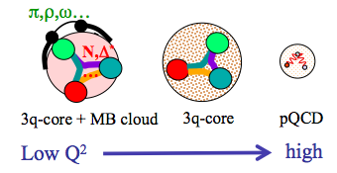
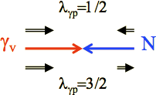
Excited Nucleon Structure
Nucleon structure is more complex than what can be described accounting for quark degrees of freedom only
  - Low Q²:
  High Q²:
  structure well described by adding an external MB cloud to inner quark core
  quark core dominates; transition from confinement to pQCD regime
(Q² < 5 GeV²)
(Q² > 5 GeV²)
Electroproduction studies from low to high Q² probe the detailed structure of the N* states through the γ_{v}NN* electrocoupling amplitudes
Elucidate relevant degrees of freedom and their evolution with distance scale
- Only source of information on many facets of the non-perturbative strong interaction in the generation of N* states from quarks and gluons
e’
K
γ_{v}
e
N*,△*
Q²
N
Y
A_{1/2}, A_{3/2}, S_{1/2}
helicity amplitudes
A_{1/2} , A_{3/2} – transverse
S_{1/2} - longitudinal

Slide 4
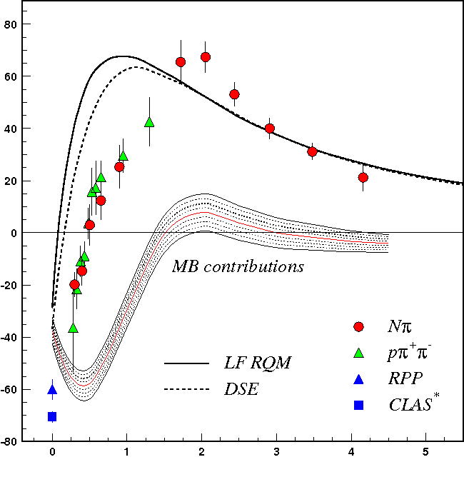
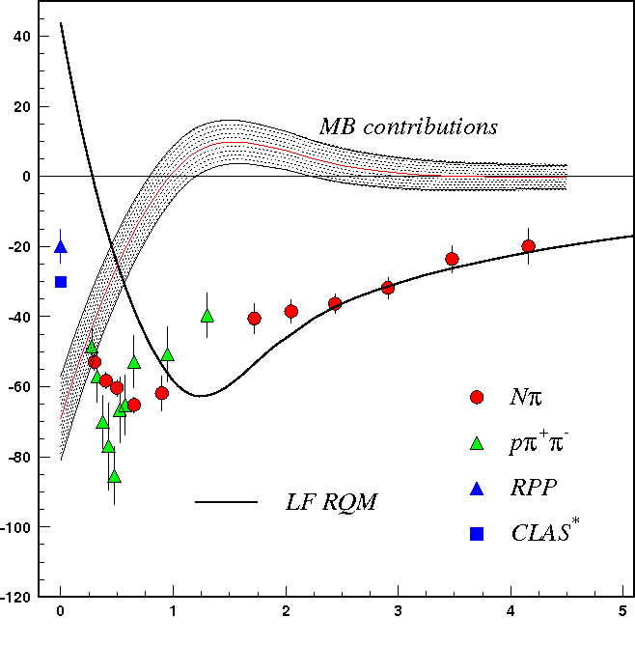
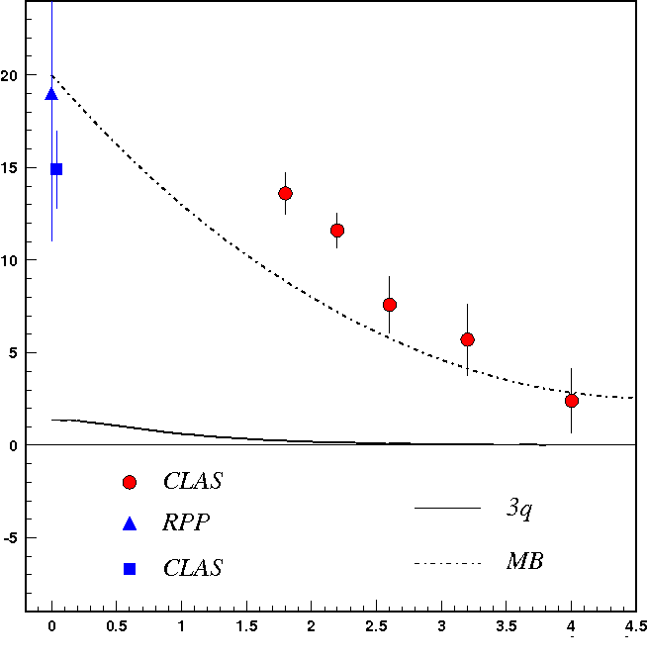
Lower-Lying N* States
A_{1/2}
N(1440)1/2⁺
A_{1/2}
N(1520)3/2⁻
A_{1/2}
N(1675)5/2⁻
Q² (GeV²)
Q² (GeV²)
Q² (GeV²)
Electrocouplings reveal different interplay between quark core and MB cloud
Important to study different N* states vs. distance scale
Good agreement of the extracted N* electrocouplings from Nπ and Nππ
Compelling evidence for the reliability of the results
Channels have very different mechanisms for the non-resonant background
Structure studies of low-lying N* states have advanced due to agreement of results from independent analyses of the Nπ and Nππ final states

Slide 5
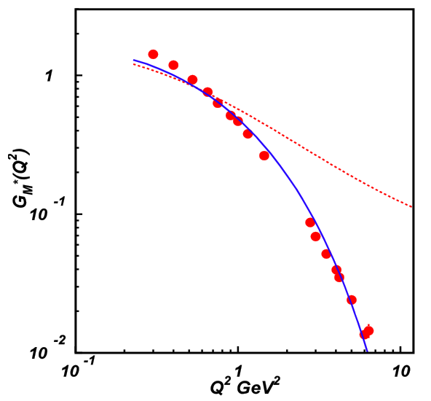
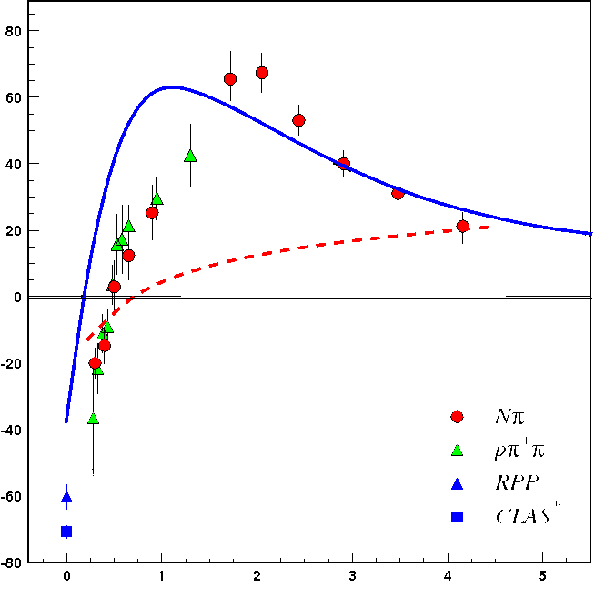
Connections to QCD
G_{M}*
N→Δ(1232)3/2⁺ Magnetic FF
80
60
40
20
0
-20
-40
-60
-80
A_{1/2}
N(1440)1/2⁺
quark core dominance
Dyson-Schwinger Eq. Calculations
Substantial contributions from MB cloud
quark mass:
frozen
running
Q² (GeV²)
0 1 2 3 4 5
Q² (GeV²)
[DSE: Segovia, Few Body Syst. 57, 461 (2015); LF RQM: Aznauryan/Burkert, arXiv:1603.06692, (2016)]
DSE calculations of form factors for both ground and excited N* states using the same running dressed quark mass function describe the data for Q²>2.0 GeV^{2 –} this provides strong evidence for:
- the relevance of dressed quarks with dynamically generated masses
- the dressed-quark mass function can be “measured” because it influences and determines experimental observables
DSEs relate these observables to QCD

Slide 6
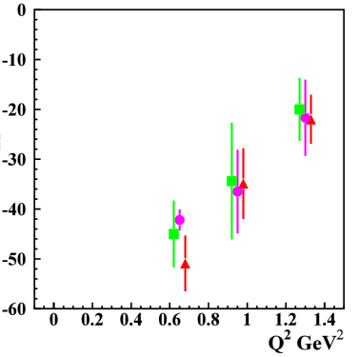
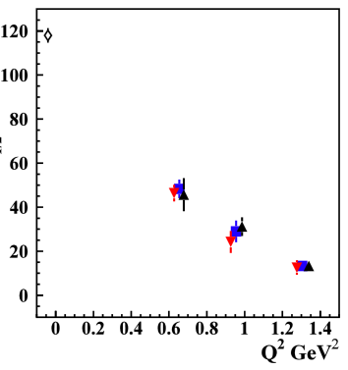
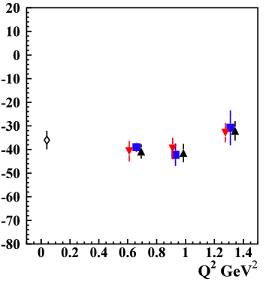
Higher-Lying N* States
Nππ channel gave first electrocoupling results on higher-lying states up to 1.7 GeV:
Δ(1620)1/2⁻, N(1650)1/2⁻, Δ(1700)3/2⁻, N(1720)3/2⁺
Note: Most high-lying N* states (M > 1.6 GeV) decay mainly to Nππ with much smaller strength to Nπ
Δ(1620)1/2⁻
Δ(1700)3/2⁻
N(1720)3/2⁺
1.61-1.71 GeV
1.66-1.76 GeV
1.71-1.81 GeV
1.46-1.56 GeV
1.56-1.66 GeV
1.61-1.71 GeV
S_{1/2}
A_{1/2}
A_{3/2}
[Mokeev, Aznauryan, Int. J. Mod. Phys. Conf. Ser. 26, 1460080 (2014)]
Data from the KY channels is critical to provide an independent
extraction of the electrocoupling amplitudes for the high-lying N* states

Slide 7
Evidence for New N* in KY Final State
State N(mass)J^{P} | PDG pre 2010 | PDG 2016 | KΛ | KΣ | Nγ
N(1710)1/2⁺ | *** | **** | **** | ** | ****
N(1880)1/2⁺ |  | ** | ** |  | **
N(1895)1/2⁻ |  | ** | ** | * | **
N(1900)3/2⁺ | ** | *** | *** | ** | ***
N(1875)3/2⁻ |  | *** | *** | ** | ***
N(2150)3/2⁻ |  | ** | ** |  | **
N(2000)5/2⁺ | * | ** | ** | * | **
N(2060)5/2⁻ |  | ** |  | ** | **
Extend these studies to higher masses and to electroproduction

Slide 8
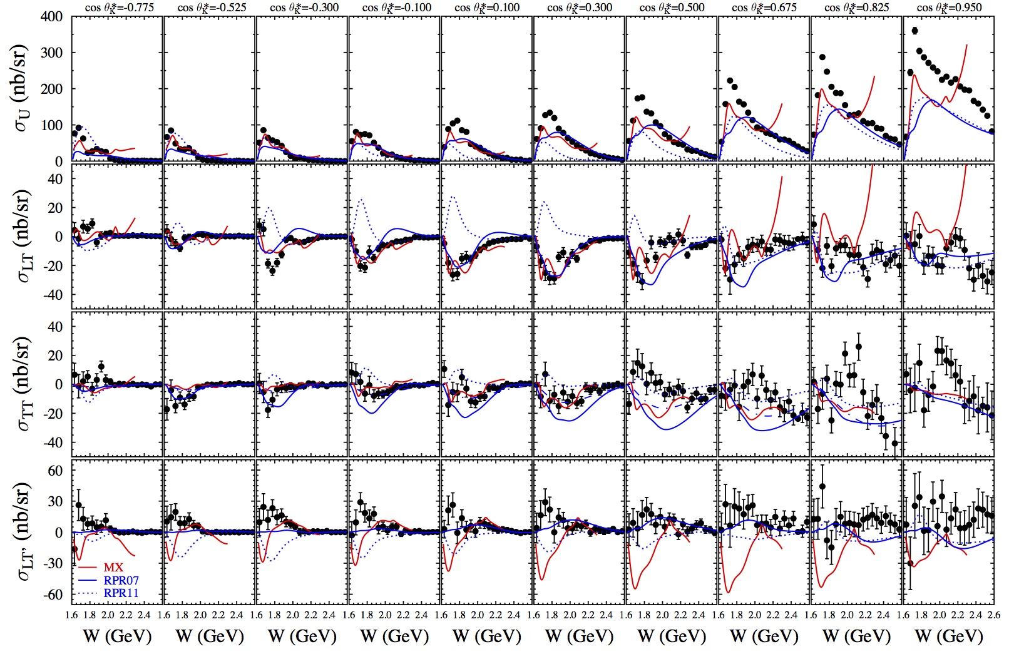
K⁺Λ Structure Functions
E = 5.5 GeV, W: thr – 2.6 GeV, Q² = 1.80, 2.60, 3.45 GeV²
[Carman et al., PRC 87, 025204 (2013)]

Slide 9
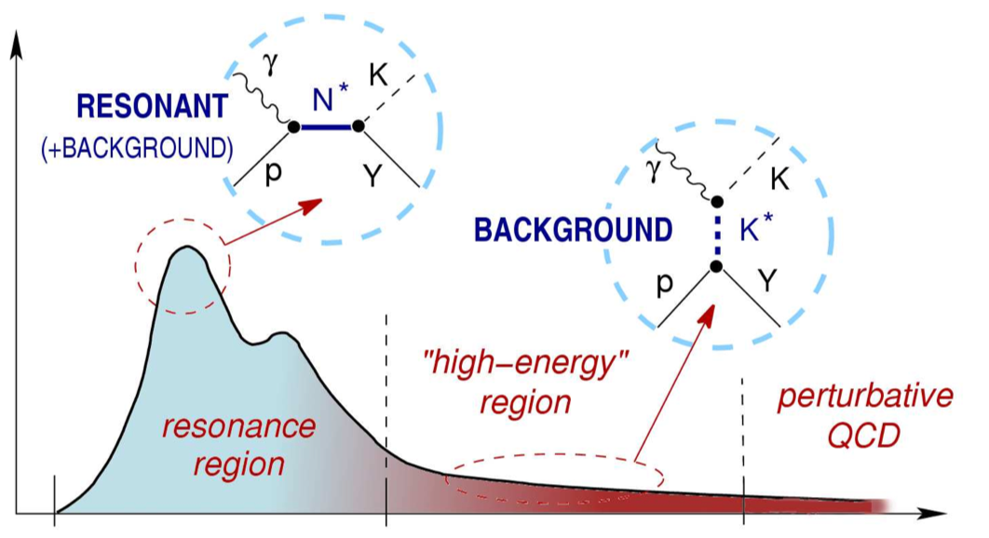
KY Reaction Model
A model that describes the data is necessary to extract the electrocoupling parameters from the existing lower Q² CLAS data and the forthcoming higher Q² CLAS12 data
At present no such KY reaction model exists!!
Work is underway to develop the Ghent Regge plus Resonance (RPR) model:
cross section
Update RPR electrocoupling parameters
Refit model to CLAS γp and γ_{v}p data:
W → 2.6 GeV, Q² → 4 GeV²
Extend model to CLAS12 kinematics:
W → 3 GeV, Q² → 12 GeV²
[DeCruz et al., PRC 86, 015212 (2012)]
W
Ultimately need analysis within global multi-channel model
(e.g. ANL-Osaka, Bonn-Gatchina)

Slide 10
CLAS12 N* Program
E12-09-003 | E12-06-108A
Nucleon Resonance Studies with CLAS12 | KY Electroproduction with CLAS12
Burkert, Cole, Gothe, Joo, Mokeev, Stoler | Carman, Gothe, Mokeev
Measure exclusive electroproduction cross sections from an unpolarized proton target with longitudinally polarized electron beam for Nπ, Nη, Nππ, KY:
  E_{b} = 11 GeV, Q² = 5 → 12 GeV², W → 3.0 GeV, cos θ_{m}* = [-1:1]
Key Motivations:
Study spectrum and structure of all prominent N* states vs. Q²
- A unique opportunity to explore the nature of confinement that is responsible for the dominant part of N* masses and their emergence of N* states from QCD
KY data complement the Nππ data as independent information for high-mass states inaccessible with Nπ final states
- Promising way to confirm signals of new N* states observed in photoproduction using search in multiple independent Q² bins

Slide 11
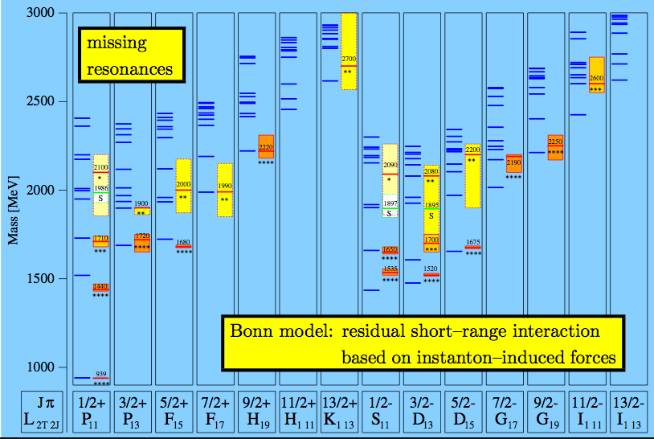
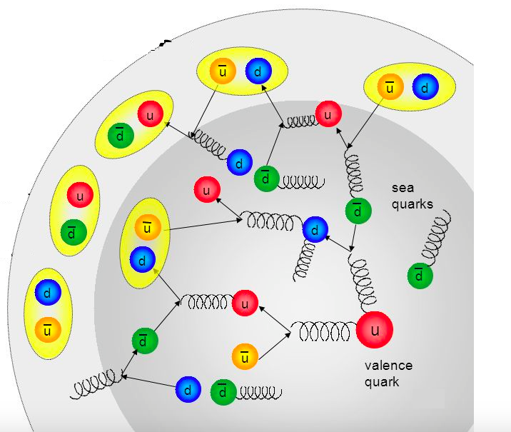
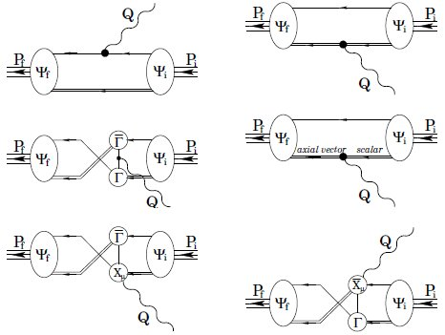
Physics Opportunities
Study higher-lying states in N* spectrum:
important precision tests to confirm signals of new baryon states observed in KY photoproduction
require consistency between photo- and electroproduction data
Understand the effect of N* structure from MB cloud:
use transition regime to explore the emergence of the external MB cloud from the core of confined quarks and gluons
check the theoretical expectations on the MB cloud generation from the confinement regime
Access di-quark correlations in N* structure:
important part of N* structure and γ_{v}NN* transition amplitudes
determined by dressed quark mass function through DCSB
dependent on N* quantum numbers
sizable for Q² < 5 GeV²; reduced contributions from MB cloud in range from Q² = 2 → 5 GeV²
non-point-like diquarks

Slide 12
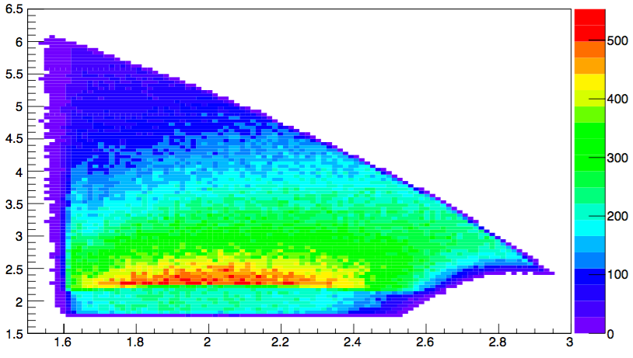
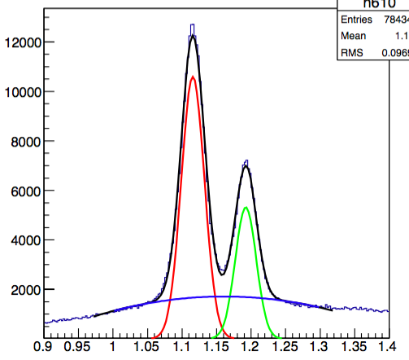
Run Conditions
MC @ 6.6 GeV, I=-3375 A
Run Conditions:
100 days of running at two beam energies binning in (Q², W, cos θ_{K}*, Φ)
E_{b}=6.6 GeV | Q²: 2 → 5 GeV² W: 1.6 → 2.4 GeV
E_{b}=8.8 GeV | Q²: 4 → 7 GeV² W: 1.6 →3.0 GeV
B=B_{max} (torus) | Full field for optimal Λ/Σ⁰ separation
P_{b} > 80% | Max. beam polarization
L=1x10³⁵ cm⁻²s⁻¹ | Nominal CLAS12 luminosity
Observables:
dσ/dΩ σ_{U}, σ_{LT}, σ_{TT}, σ_{LT’} | Cross sections Separated structure functions
P⁰, P’ | Recoil/beam-recoil polarization
Q² (GeV²)
W (GeV)
summed over
all Q²/W
MM(e’K⁺) (GeV)
fastMC

Slide 13
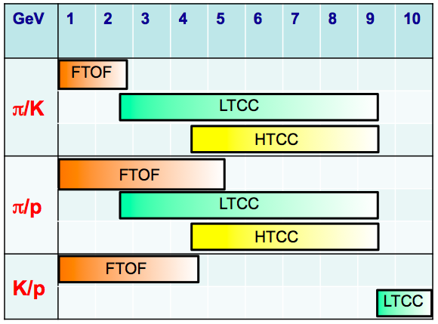
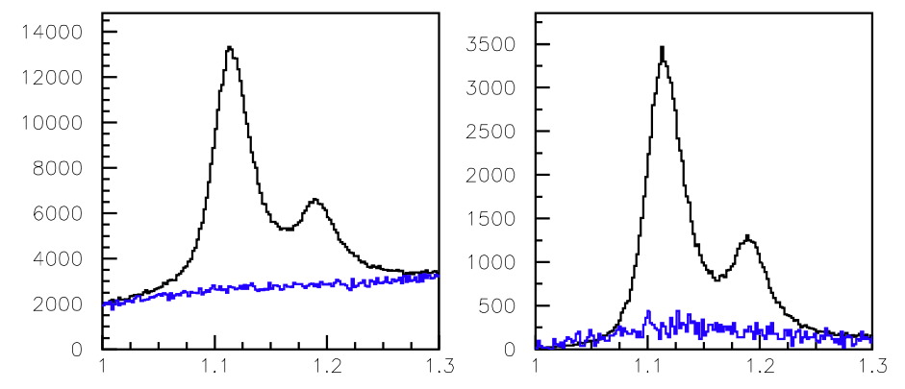
K⁺ Particle Identification
CLAS12 K⁺ Identification Issues:
The finite time resolution of the FTOF system cannot distinguish π⁺ and K⁺ tracks when Δt_{πK} ~ dT_{counter}
π⁺ tracks from earlier or later beam buckets can fake K⁺ tracks regardless of timing resolution
PID Mitigations:
FTOF system resolution is about a factor of 3 better than for CLAS TOF
HTCC, LTCC, RICH are 95%-99% efficient for p > 3 GeV
Exclusive event reconstruction from e’K⁺p final state used to quantify systematics
Tracking vertex resolution 10x better for CLAS12 vs. CLAS
e’K⁺
e’K⁺p
MM(e’K⁺) (GeV)

Slide 14
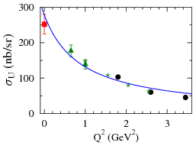
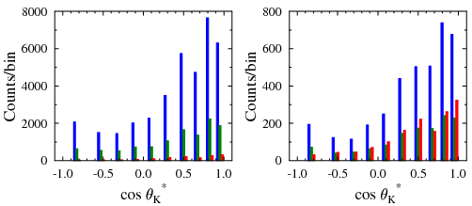


Statistical Estimates
W=1.925 GeV
Representative Binning
ΔQ² | 1 GeV²
ΔW | 50 MeV
Δcos θ_{K}* | 10 bins
ΔΦ | 8 bins
e’K⁺ topology
Over full kinematic range:
<ACC>: 40% → 60%
CLAS K⁺Λ
Expected Statistics vs. Q² to CLAS Data at Q²=1.8 GeV²
E_{b}=6.6 (GeV) | F_{e1f} | E_{b}=8.8 (GeV) | F_{e1f}
Q²=2 (GeV²) | x25 | Q²=4 (GeV²) | x4
5 (GeV²) | x3 | 7 (GeV²) | x1
Q²=2.0 GeV²
Q²=5.0 GeV²
eK⁺
eK⁺p
eK⁺ e1f
Φ averaged

Slide 15
Systematic Uncertainties
Category | Sys. Uncertainty
1. Yield Extraction
Fiducial cuts | 0.5-3%
Electron ID | 0.5%
2. Detector Acceptance
MC model dependence | 2-5%
Tracking efficiencies | 5%
Close track efficiencies | 1%
CC efficiency function | 0.5-2%
3. Radiative Corrections | 2%
4. Bin Centering | 0.5%
5. Scale Uncertainties
Beam polarization | 2%
Beam charge asymmetry | <0.2%
Photon flux factor | 3%
Luminosity | 3%
Total | 10%
Conservative Estimate
level TBD for CLAS12
Phase 1
Expected statistics for KY electroproduction in this experiment similar to CLAS Nππ datasets. Systematics of electrocoupling extraction will be driven by extraction model. (level TBD)
Phase 2

Slide 16
Summary
The study of N* states is one of the key foundations of the Hall B physics program with CLAS:
Electrocouplings of most N* states < 1.7 GeV have been extracted from the CLAS data for Nπ and Nππ for Q² from 0 to 5 GeV²
KY data important for spectrum and structure studies - working to develop reaction models to extract electrocoupling amplitudes
The CLAS12 N* program will extend these studies for 2 GeV² < Q² < 12 GeV²:
This new proposal to study the spectrum and structure of N* states through the KY channels at E_{b}=6.6 GeV and 8.8 GeV will provide new and unique opportunities
These studies will allow for insights into the strong interaction dynamics of dressed quarks and their confinement in baryons over a broad Q²/W range
These data will address key questions of the Standard Model on the nature of hadron mass, confinement, and the emergence of the N* states from QCD

Slide 17


Slide 18
Hybrid vs. KY Proposals
Hybrid Proposal: focused on search for hybrid baryons in range of Q²< 2 GeV² and the determination of their properties
KY Proposal: focused on N* spectrum and structure studies for Q² from 2 to 7 GeV²
verify N* →KY states for W < 2 GeV seen in B-G analysis of CLAS γp data; search for N* states that couple to KY for W to 3 GeV
extract electrocouplings vs. Q² of N* states that couple to KY
probe transition region of MB cloud to quark core domination with focus on emergence of MB cloud from q-g confinement (with E12-06-108A)
access to di-quark correlations in the high-lying N* structure
Develop reaction models to understand dynamics of KY production
Probe hadronic couplings in decays N* →K*Y and KY* final states
Commonality: There is overlap of both experimental and theoretical support for both proposals, especially with regard to the collection and processing of data and the development of KY reaction models, fitting tools, and interpretation of the data

Slide 19
Dynamical Mass of Light Dressed Quarks
DSE and LQCD predict the dynamical generation of the momentum dependent dressed quark mass that comes from the gluon dressing of current quark propagator.
These dynamical contributions account for more than 98% of the dressed light quark mass.
DSE: lines and LQCD: triangles
per dressed quark
[Q² = 2 12 GeV² : p = 0.5 1.5 GeV = sqrt(Q²)/N_{q}]
The data on N* electrocouplings at 2 < Q² < 12 GeV² will allow us to chart the momentum evolution of dressed quark mass, and in particular, to explore the transition from dressed to almost bare current quarks.

Slide 20
N* History / Milestones
Workshop on “Electromagnetic N-N* Transition Form Factors” (JLab, Oct. 2008)
White Paper: “Theory Support for the Excited Baryon Program at the JLab 12 GeV Upgrade” (I. Aznauryan et al., arXiv:0907:1301)
Overview Paper: “Studies of Nucleon Resonance Structure in Exclusive Meson Electroproduction” (I. Aznauryan et al, Int. J. Mod. Phys. E22, 1330015 (2013)
ECT* Workshop: “Nucleon Resonances From Photoproduction to High Photon Virtualities” (Trento, Italy, Oct. 2015)
INT Seattle Workshop: “Spectrum and Structure of Excited Nucleons from Exclusive Electroproduction” (Seattle, Nov. 2016)
NSTAR Workshops (10): N*2000, N*2001, N*2002, N*2004, N*2005, N*2007, N*2009, N*2011, N*2013, N*2015
There has been significant progress in the studies of N* states over the past several years as the electrocouplings of most N* states < 1.7 GeV have been extracted for the first time from CLAS data for Q² from 0 to 5.0 GeV²

Slide 21
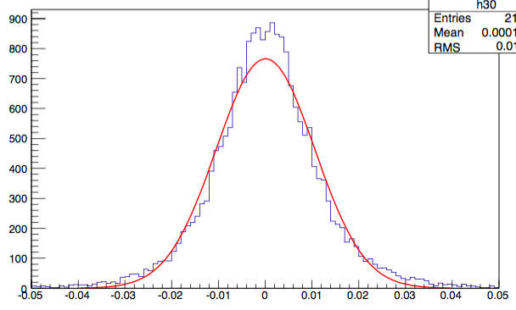
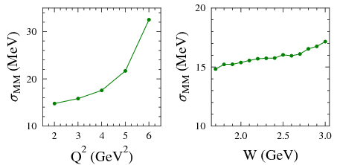
CLAS12 Resolution
CLAS12 energy resolution is more than adequate for ΔW=50 MeV given typical Γ_{res}~150-300 MeV
CLAS12 MM resolution at full torus field is adequate to effectively separate K⁺Λ/K⁺Σ⁰ final states
(with spectrum fits)
10 MeV resolution @ E_{b}=6.6,8.8 GeV
ΔW (= W_{gen} – W_{rec}) (GeV)
fastMC
summed over
all Q²/W
⇒
full torus field
MM(e’K⁺) (GeV)

Slide 22
N* Spectrum
missing N* states
Nππ,
KY
sensitive to higher mass states
RCQM
[Löring, Metsch, Petry, Eur. Phys. J. A 10, 395 (2001)]

Slide 23
N*,Δ* → KY Landscape
Old
New
N* → KY |  |  |  | Δ* → KΣ
State | Rating | BR %(KΛ) | BR % (KΣ) | State | Rating | BR % (KΣ)
N*(1650) | **** | 3–11 | - | Δ*(1700) | **** | -
N*(1675) | **** | < 1 | - | Δ*(1750) | * | -
N*(1680) | **** | - | - | Δ*(1900) | ** | -
N*(1700) | *** | < 3 | - | Δ*(1905) | **** | -
N*(1710) | *** | 5–25 | - | Δ*(1910) | **** | 9
N*(1720) | *** | 1–15 | - | Δ*(1920) | *** | 2.1
N*(1875) | *** | - | - | Δ*(1930) | *** | -
N*(1900) | *** | 0-10 | 5 | Δ*(1940) | ** | -
N*(1990) | ** | - | - | Δ*(1950) | **** | -
N*(2000) | ** | - | - | Δ*(2000) | ** | -
N* → KY |  |  |  | Δ* → KΣ
State | Rating | BR % (KΛ) | BR %(KΣ) | State | Rating | BR % (KΣ)
N*(1650) | **** | 10±5 | - | Δ*(1620) | **** | -
N*(1675) | **** | - | - | Δ*(1700) | **** | -
N*(1680) | **** | - | - | Δ*(1750) | * | -
N*(1700) | *** | - | - | Δ*(1900) | ** | 5±3
N*(1710) | *** | 23±7 | - | Δ*(1905) | **** | -
N*(1720) | **** | - | - | Δ*(1910) | **** | 9±5
N*(1875) | *** | 4±2 | 15±8 | Δ*(1920) | *** | 4±2
N*(1880) | ** | 2±1 | 17±7 | Δ*(1930) | *** | -
N*(1895) | ** | 18±5 | 13±7 | Δ*(1940) | *** | -
N*(1900) | ** | 16±5 | 5±2 | Δ*(1950) | **** | 0.4±0.1
N*(1990) | ** | - | - | Δ*(2000) | ** | -
N*(2000) | ** | - | -
[Beringer et al. (PDG), PRD 86, 010001 (2012)]
[Anisovich et al., EPJ A 48, 15 (2012)]
Essentially nothing is known regarding N*,Δ* states for M > 2 GeV

Slide 24

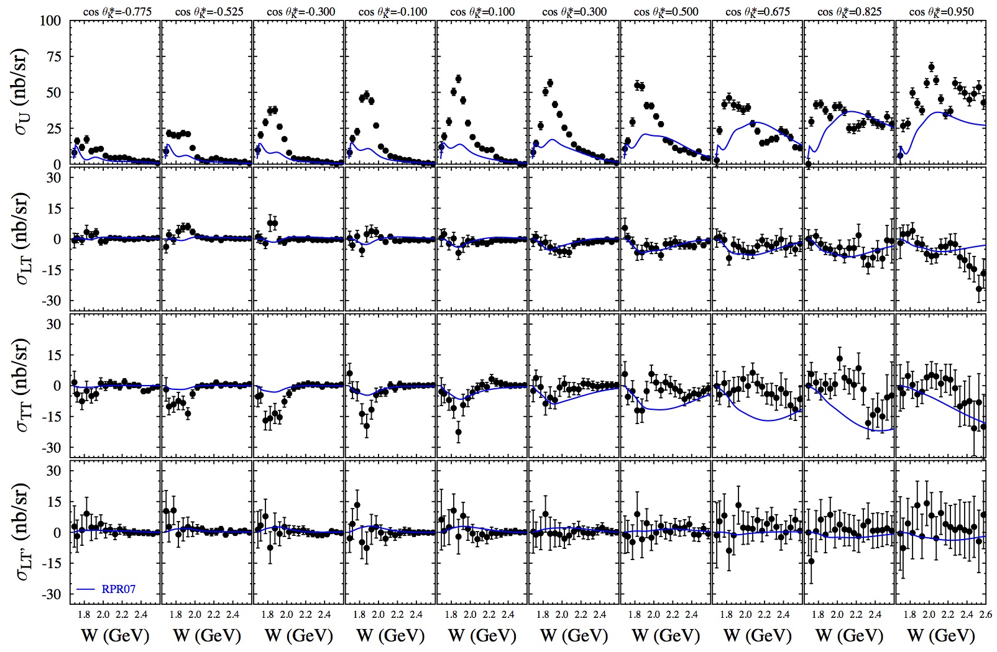
K⁺Σ⁰ Structure Functions
E = 5.5 GeV, W: thr – 2.6 GeV, Q² = 1.80, 2.60, 3.45 GeV²
[Carman et al., PRC 87, 025204 (2013)]

Slide 25
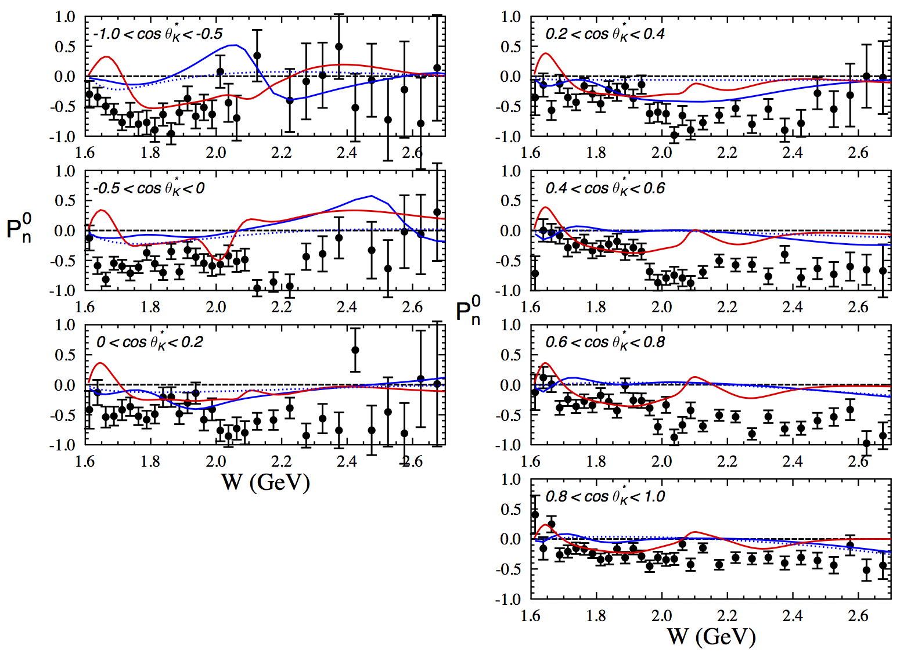
Recoil Polarization ep → e’K⁺Λ
<Q²> ~ 1.9 GeV²
MX, RPR-2011 (full)
(nores)
[Gabrielyan et al., PRC 90, 035202 (2014)]
Notes:
Replace with figure including photoproduction; Remove Kaon-Maid curve

Slide 26
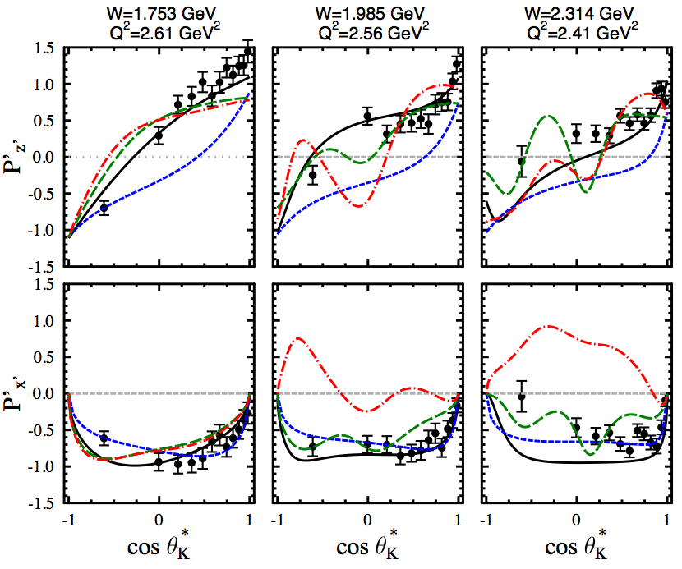

Transferred Polarization ep → e’K⁺Λ
5.754 GeV
Summed over Q², Φ
Data not included in fits
Rule out P₁₁(1900) assignment
D₁₃(1900) not ruled out via P’ data but with S.F. data
Isobar Model – Mart
Regge Model – GLV
RPR07 w P₁₁(1900) - Ghent
RPR07 w D₁₃(1900) - Ghent
RPR background + S₁₁(1650), P₁₁(1710), P₁₃(1720), P₁₃(1900)
[Carman et al., PRC 79, 065205 (2009)]

Slide 27
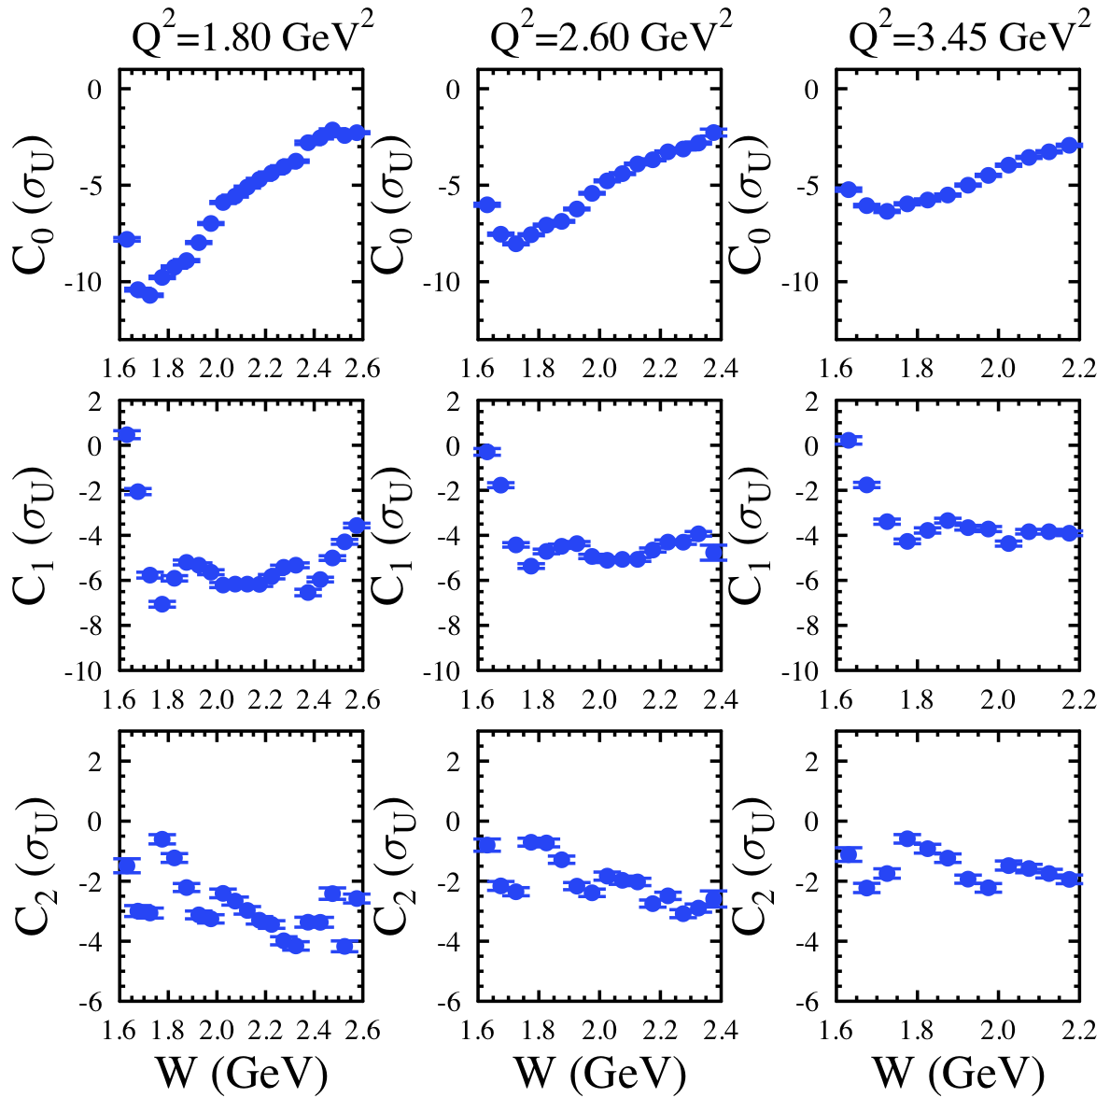
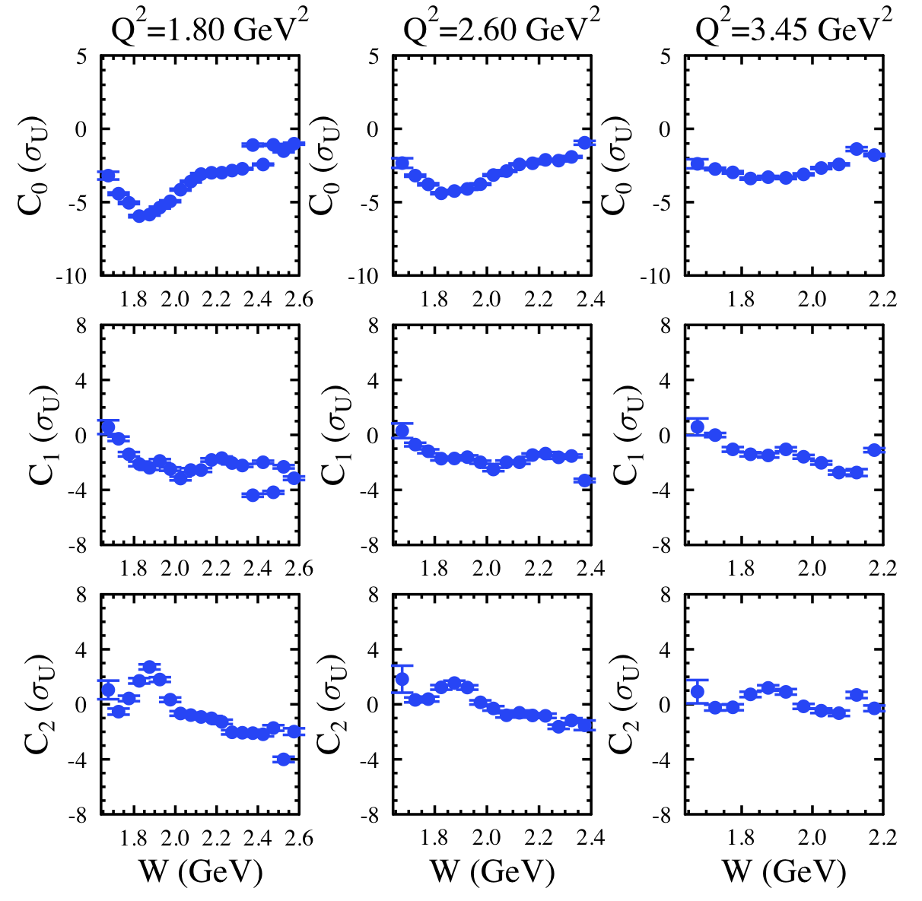

Legendre Analysis ep → K⁺Y
Coherent Legendre fit:
K⁺Λ
K⁺Σ⁰
Structures in W dependence of C_{L} moments at the same W in all Q² bins are consistent with s-channel resonance contributions.
Reaction model is needed for the extraction of the N* parameters.
[Carman et al., PRC 87, 025204 (2013)]
Notes:
Better label dominant states

Slide 28
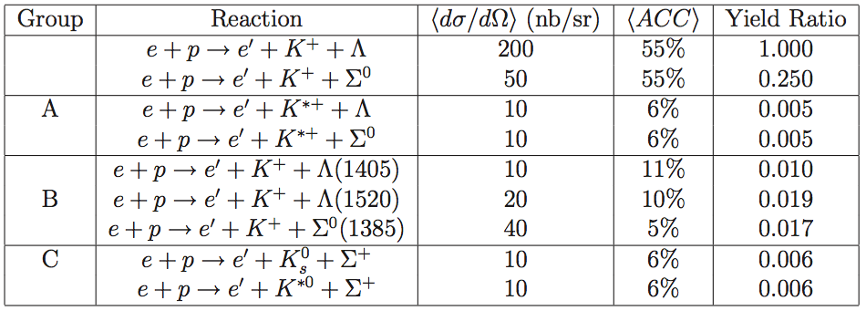
Extending the Analysis
New datasets at 6.6 GeV and 8.8 GeV will allow for the opportunity to measure K*Y and K*Y electroproduction.
Measurements will be limited to rather coarsely binned differential cross sections due to lower cross sections and smaller acceptances to reconstruct exclusive final states.

