Slide 1
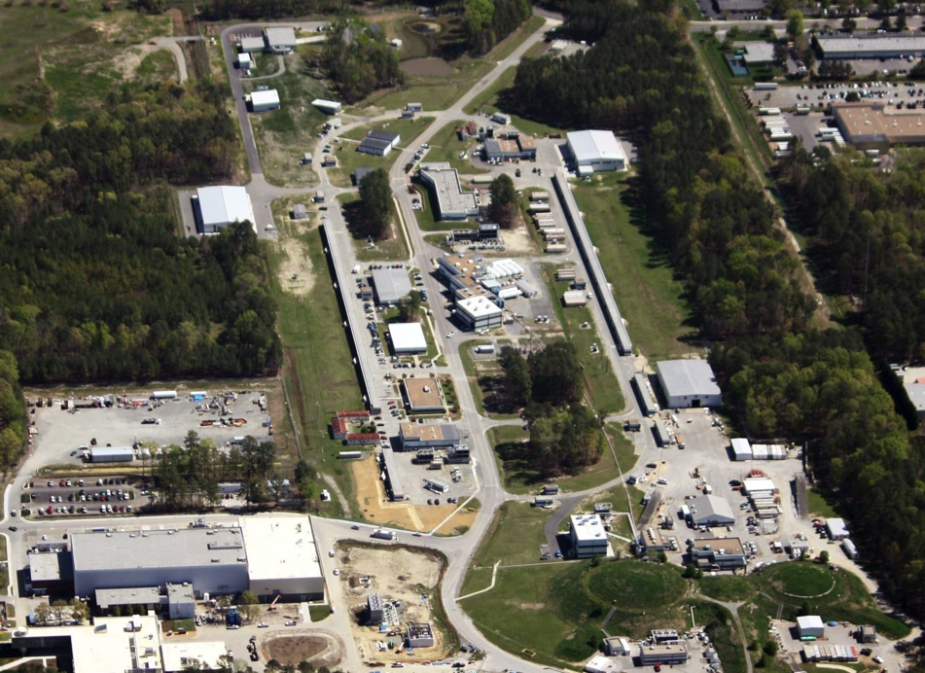
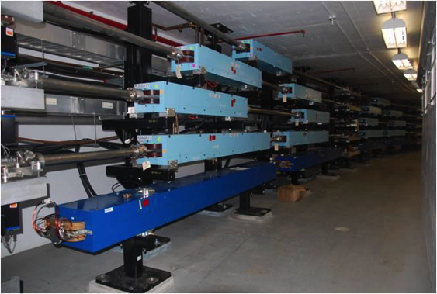
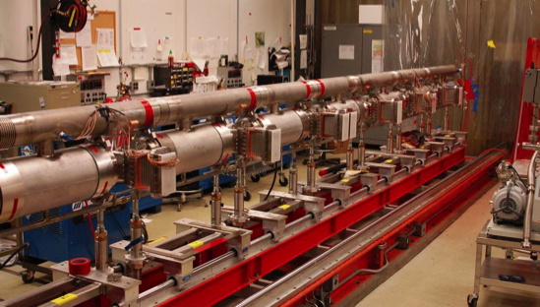
ER@CEBAF: A Test of 5-Pass Energy Recovery at CEBAF
Todd Satogata / Center for Advanced Studies of Accelerators
PAC44 PR12-16-008 July 26, 2016

Slide 2
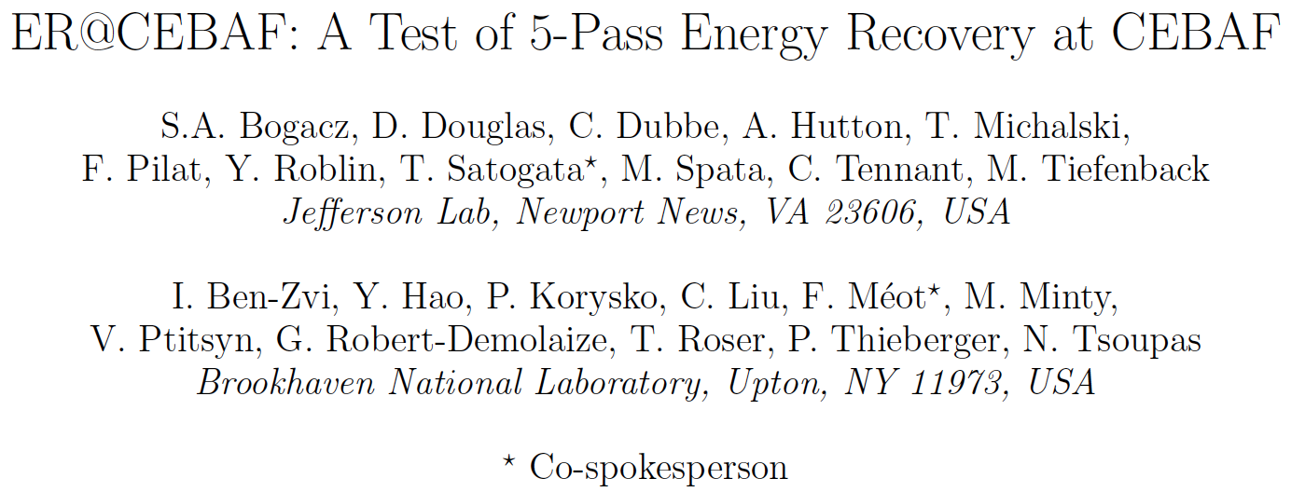
Collaboration
A collaborative proposal between Jefferson Lab and BNL
(Also an amusing football game)

Slide 3
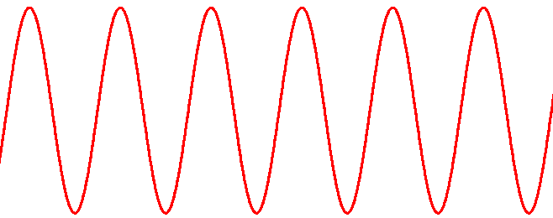
Energy Recovery Linacs: CEBAF
CEBAF (a traditional recirculating linear accelerator)
  Applied RF power in linacs drives beam power
    Up to MW of beam power at A/C beam dumps
  Disadvantages:
    Cost / contamination of MW class beam dumps
    MW of power: RF ➔ beam ➔ dump full power
    Very high power beam operation cost prohibitive
accelerating
Linac RF voltage (1 pass)
Beam only removes power from RF

Slide 4
Energy Recovery Linacs: CEBAF
CEBAF (a traditional recirculating linear accelerator)
  Applied RF power in linacs drives beam power
    Up to MW of beam power at A/C beam dumps
  Disadvantages:
    Cost / contamination of MW class beam dumps
    MW of power: RF ➔ beam ➔ dump full power
    Very high power beam operation cost prohibitive
accelerating
Linac RF voltage (5 passes)
Beam only removes power from RF

Slide 5
Energy Recovery Linacs: ER@CEBAF
ER@CEBAF: 1-Pass Energy Recovery at CEBAF
  Decelerating beam provides part of RF drive power
    Can be very efficient with superconducting RF
  Advantages
    MW of power: RF ➔ beam ➔ dump injector power
    RF drive power nearly independent of beam current
  A prerequisite for multi-MW electron coolers
accelerating
decelerating
λ/2 pathlength chicane
Linac RF voltage (1 pass)
Beams exchange power with RF
Low power beam dump

Slide 6
Energy Recovery Linacs: ER@CEBAF
ER@CEBAF: 5-Pass Energy Recovery at CEBAF
  Decelerating beam provides part of RF drive power
    Can be very efficient with superconducting RF
  Advantages
    MW of power: RF ➔ beam ➔ dump injector power
    RF drive power nearly independent of beam current
  A prerequisite for multi-MW electron coolers
accelerating
decelerating
λ/2 pathlength chicane
Linac RF voltage (5 passes)
Beams exchange power with RF
Low power beam dump

Slide 7
ER@CEBAF
Add pathlength chicane
Add low energy dump line
Do not interfere with existing
CEBAF 12 GeV capabilities
Failure of new magnets does
not affect 12 GeV capability
Δs = λ/2

Slide 8
ER@CEBAF: Accelerating
0.75 GeV/pass
0.75 GeV/pass
85 MeV
Energy gain per pass limited by
disruption of beam energy
spread σ_{E} due to synchrotron
radiation
Δs = λ/2
7.585 GeV

Slide 9
ER@CEBAF: Slip Half RF Wavelength
Δs = λ/2

Slide 10
ER@CEBAF: Decelerating
90:1
98.9% ERL
Challenge: decelerating
beam (and synchrotron
radiation-driven energy
spread) adiabatically
anti-damps
Small energy losses to
synchrotron radiation
Δs = λ/2
84 MeV

Slide 11
ERLs at Jefferson Lab
Jefferson Lab has a history of world leadership in ERLs
  1993: CEBAF front end ERL test
  1998-2001: IR FEL demo
    First demonstration of ERL-based light source
  2002-3: PR-02-102 CEBAF one-pass energy recovery experiment
    Remains world leader in ERL beam energy
  2002-10: UV FEL
    Remains world leader in beam power (2 MW)
  Present: Electron-ion collider ERL collaborations
ER@CEBAF will make Jefferson Lab a world leader in large-scale ERL beam studies at modest cost

Slide 12
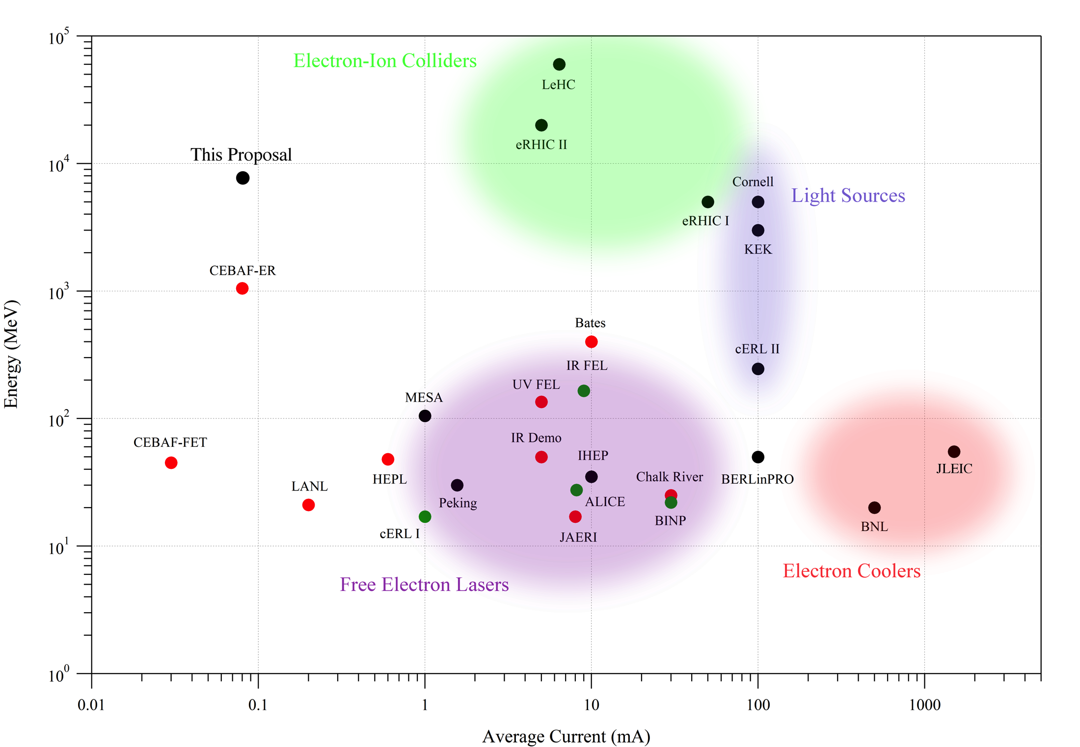
World ERL Landscape
10⁵
Existing
Commissioning
Proposed
Beam Energy (MeV)
10⁰
0.01
1000
Average Current (mA)

Slide 13
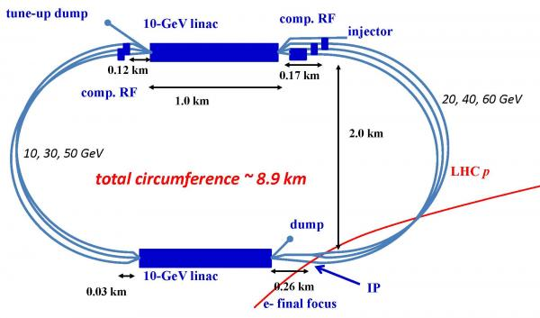
LHeC Electron-Ion Collider ERL
S.A. Bogacz (JLab), O. Bruning,
M. Klein, D. Schulte,
F. Zimmermann (CERN), et al.
Collides 6.4 mA 60 GeV e- with LHC protons ➔ 384 MW!

Slide 14
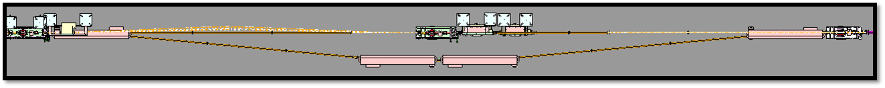
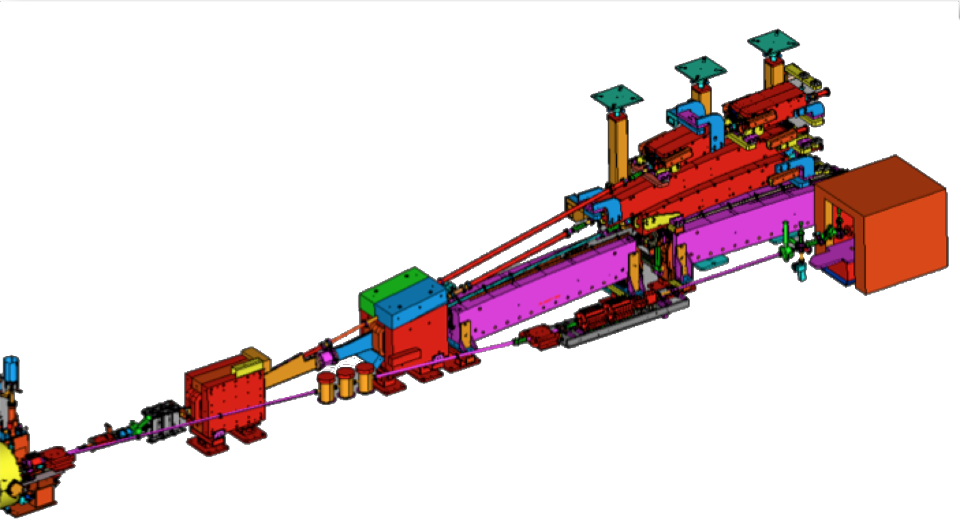
CEBAF Hardware Modifications
Extends 1m into aisle
λ/2 pathlength chicane: Add four 3m dipoles in AE region
  Optics solution designed, only magnet strength changes
Low energy dump: Add quadrupole girder, low energy dump
  Located at end of south linac next to SL spreader
  Maintains vacuum isolation
Use existing CEBAF designs
  Small costing uncertainty
  Summer SAD installation
New Low
Energy Dump
New
Quadrupole
Girder
Extraction Area

Slide 15
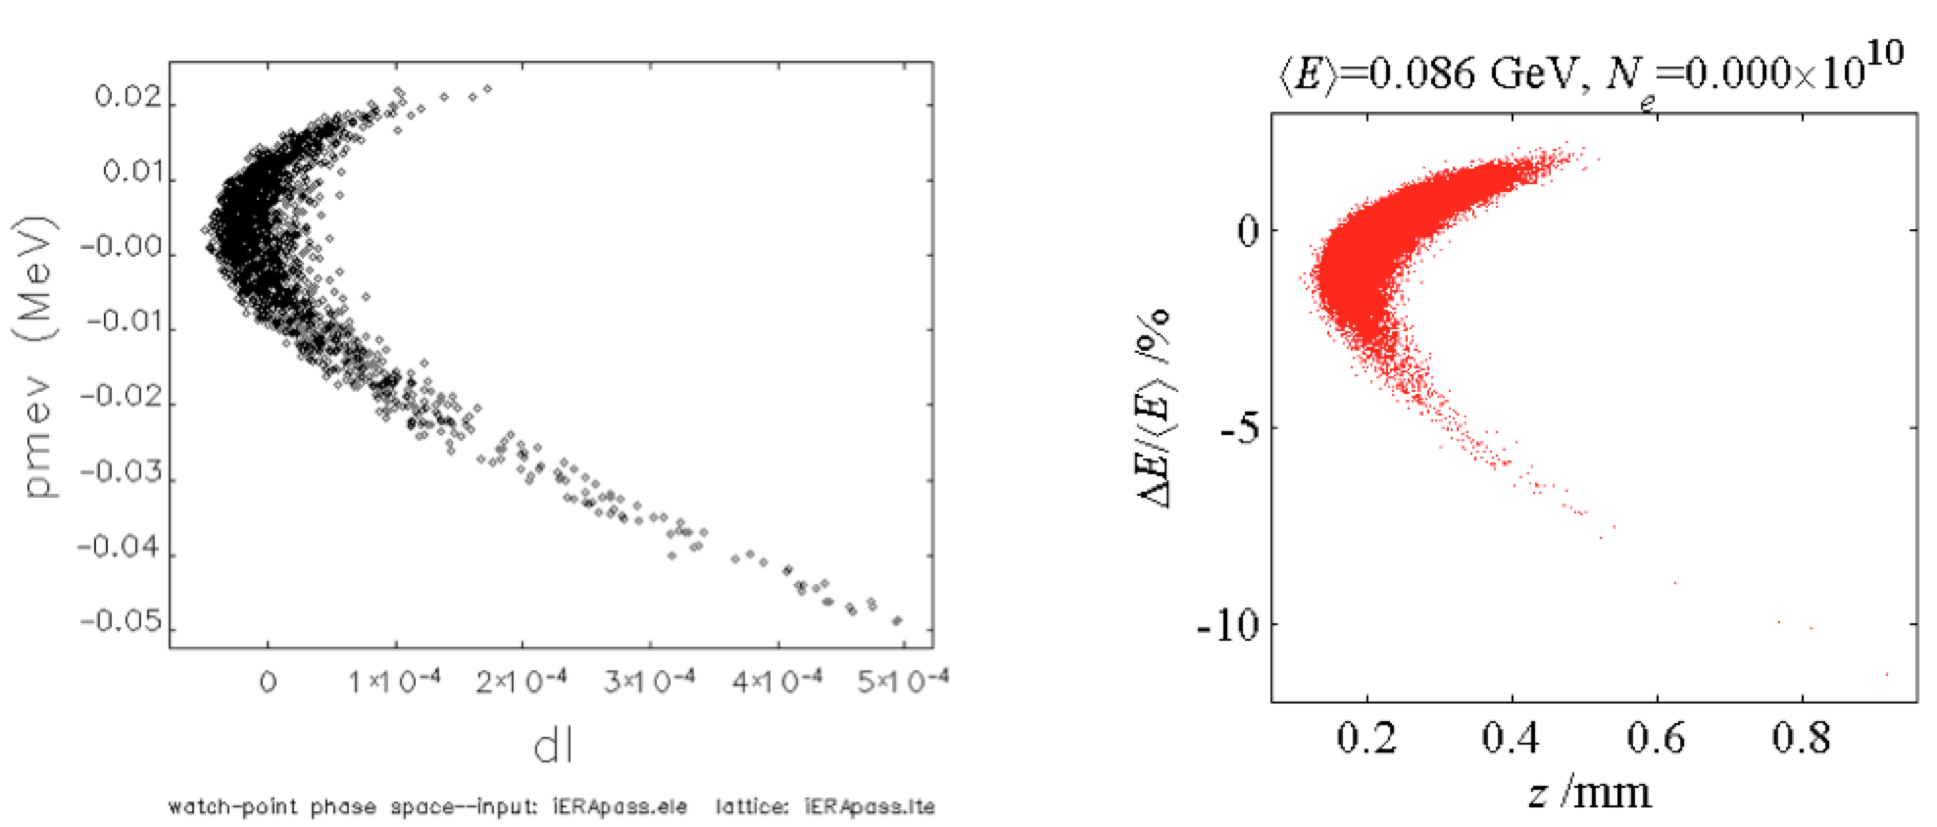
Longitudinal Simulations and Match
Collaboration with BNL using four accelerator simulation codes to verify optics design
  Manipulate bunch length and compression
  Collaborative benefits to CEBAF parity quality program, CEBAF energy spread control
elegant
LiTrack
Beam energy/longitudinal position distributions after energy recovery

Slide 16
Reader/TAC Comment: Modeling
Reader comment: it is… very nice to see cross-checks with different codes being done. The absence of any request for computing for data analysis/simulations is a bit disturbing though… like to see a short discussion of the plans for data analysis and for simulation improvements based on these data.
TAC comment: The model should be used to explore the expected range of transport errors (magnets and RF related) and demonstrate that the adjustments required by the CEBAF transport for 5-pass ER are within the range of the CEBAF system.
  CASA has adequate computing resources
  Purchased 4 notes (96 CPUs) on LQCD cluster (15a)
  Parallel version of elegant simulation code operating
  Transverse match design consistent with CEBAF
  Pierre Korysko (BNL) evaluating match tolerances
    60° linac optics selected to maintain reasonable match
  Experiment data archiving consistent with CEBAF archiving

Slide 17
Optimized Linac Optics
Acceleration/Deceleration
‘Drift Linac’
E_{inj}
E₁
E₂
E₃
E₄
E₅
E₆
E₇
E₈
E₉
E₁₀
60⁰ FODO
E_{inj}
E₁
E₂
E₃
E₄
E₅
E₆
E₇
E₈
E₉
E₁₀

Slide 18
Diagnostics and Measurements: BPMs
Linac SEE BPM extension
  Current linac SEE BPMs temporally multiplex 5-6 passes of beam
  Feasible to extend to 10 passes with software and beam pulse structure modification
3 GHz BPMs
  Six modified SEE BPMs (3 each Arcs 1 and 9)
  Establishes accelerating/decelerating energy ratios
  Wire scanners resolve both accelerating and decelerating beams
  No other decelerating arc BPMs
    no steering degrees of freedom

Slide 19
Diagnostics and Measurements: Dump
Extraction beam measurements
  Leverage well-calibrated Hall A dipole system
  IHA1C12 and viewer provide energy spread
  Emittance measurements in zero-dispersion 2C line
  All measurements feasible each even pass up/down
Dump line includes full diagnostics suite
  Three BPMs for steering
  Two quadrupoles for focus/emittance measurements
  MPS BCM for total beam transmission
  Viewer for dump beam images

Slide 20
Cost
 | Procurements (k$) | Labor (k$)
Extraction region | 96 | 20
Dump line | 169 | 125
Pathlength chicane | 290 | 46
3 GHz BPMs | 56 | 23
Total | 611 | 214+17
Itemized procurement and labor costs listed above
  Based on 12 GeV project actuals / 10% contingency
  All equipment consistent with CEBAF 12 GeV
    Only significant uncertainty: 3 GHz BPMs
  Labor includes design/procurement/QA
BNL has provisionally agreed to take responsibility for pathlength chicane costs (excluding installation)
Collaboration committed to seeking external funding
Notes:
Reader comment: 10% contingency “not realistic”. Noted that contingency is based on costing of recent 12 GeV actuals of identical items.

Slide 21
Phased Hardware Commissioning
½ pass: NL accelerating, SL decelerating
  Commission dump line extraction, diagnostics
  Compare injection / dump line beam characterization
  1-2 days
1 pass: reproduce 2003 ER experiment results
  Requires first pass beam passing through Arc A
  Commission pathlength chicane, Arc 1 3 GHz BPMs
  Demonstrate intermediary beam diagnostics
  Evaluate MOMOD pathlength control tolerances
  3-4 days (took 1.5 days in 2003 experiment)
  Preferably E_{inj} = 56 MeV (same as 2003), E_{linac}=500 MeV
  Does not require changes to arc optics

Slide 22
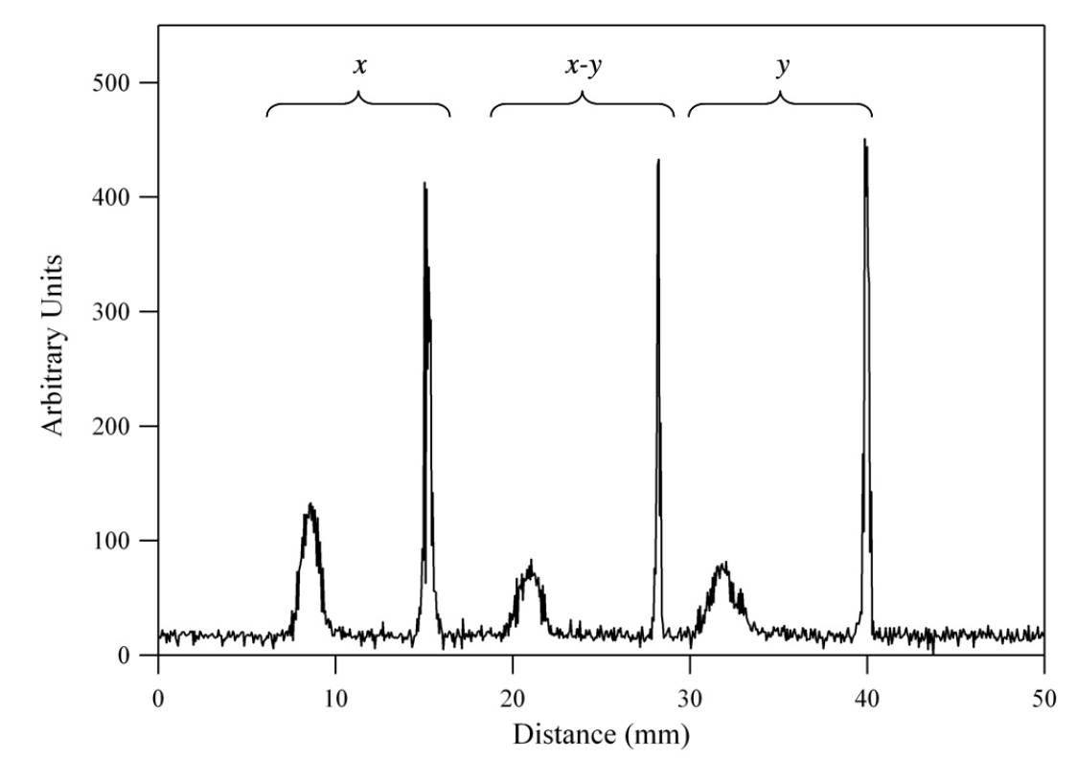
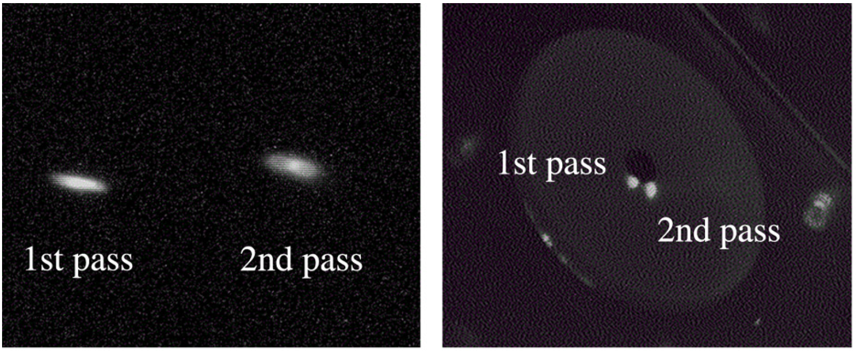
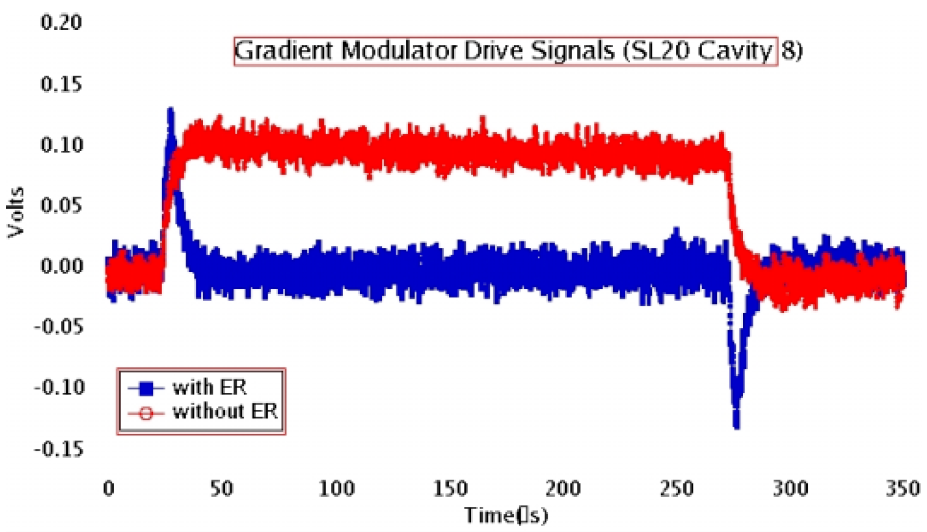
2003 CEBAF-ER Measurements
Arc 1
South linac
1056 MeV
56 MeV
2003 2-pass viewer images
2003 2-pass harp scan (2L24)
Injector energies: E_{inj}=20 MeV and 56 MeV
Viewers and harps discriminated multiple pass beams
12 GeV era emittance measurements much improved
  Dispersion control and matching also much improved
RF Drive Power: ER on and Off

Slide 23
Phased Hardware Commissioning
5 pass (E_{linac} up to 750 MeV, E_{inj} up to 85 MeV)
  Commission new arc optics, longitudinal beam manipulations
  Commission Arc 9 3 GHz BPMs, 10-beam BPM software
  Further demonstrate intermediary beam diagnostics
    Use 500 MHz separators at start of west arcs
  Perform tuning tolerance studies
  Demonstrate full decelerating beam transport
  Perform RF tuning studies
  Demonstrate CW energy recovery
  ~14 days of tuning and characterization

Slide 24
Beam Breakup (BBU)
Recirculating beam breakup
  Positive feedback loop between beam power and higher order mode RF power
  Couples through beam transport
  Many RF higher order modes communicate with beam, each other in near-exponential complexity
  Limits total beam current
Open questions in current literature
  Hofstaetter/Bazarov PRL: Scale as N_{pass} or N_{pass}² ?
  May only be answerable experimentally
  ER@CEBAF SRF scale is ideal test bed

Slide 25
Summary and Request
High energy ERLs are a required technology for affordable, high-quality, high power electron beams
  Required for future EIC designs, electron cooling with multi-MW beam power
CEBAF is a unique facility to study energy recovery of high energy, disrupted beams in a large installation
  Synchrotron radiation: graceful energy scaling
  Design in hand to add capability to CEBAF 12 GeV facility without affecting base program
We are requesting PAC support to seek external funding for construction, and 18 days of beam time to fully commission this capability

Slide 26
Backup Slides ==============

Slide 27
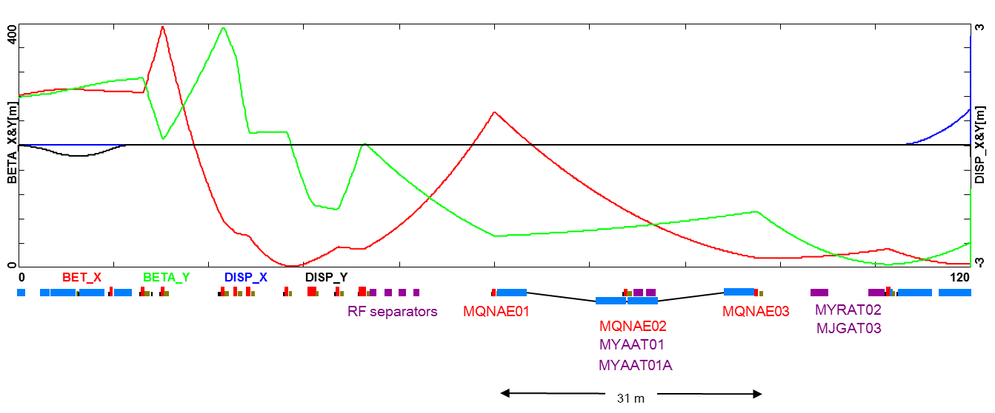
Backup: Pathlength Chicane Details
L_{b}
L_{b}
−θ
−θ
L_{b}
5°
5°
L_{b}
θ
θ
MQNAE01
MQNAE02
MQNAE03
31m

Slide 28
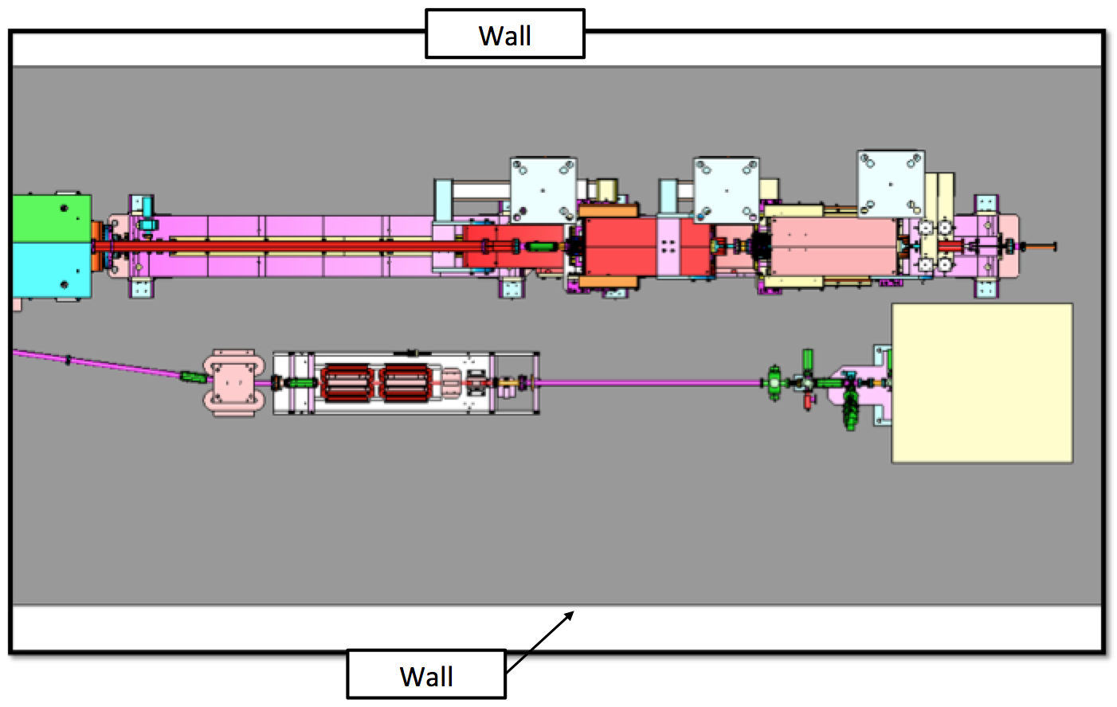
Backup: Dump Traffic Clearance
41”
Dump line maintains clearance for magnet carriage clearance
  Cryomodule carriage clearance not required in this area
  ER@CEBAF would not interfere with expected tunnel traffic

Slide 29
Backup: Optimized Linac Optics
Acceleration/Deceleration
‘Drift Linac’
E_{inj}
E₁
E₂
E₃
E₄
E₅
E₆
E₇
E₈
E₉
E₁₀
60⁰ FODO
E_{inj}
E₁
E₂
E₃
E₄
E₅
E₆
E₇
E₈
E₉
E₁₀

Slide 30
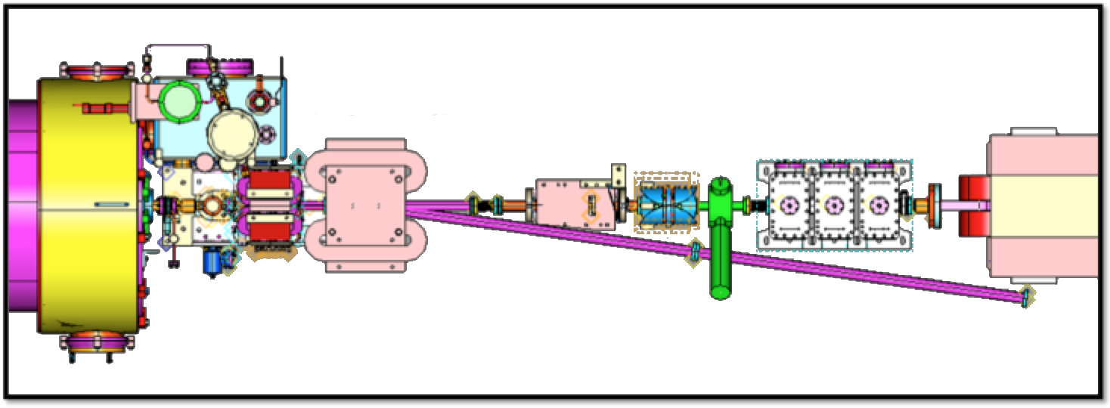
Backup: Dump Extraction Detail
BPM + H/V Correctors
BL magnet
CA magnet
DP station
8° bend
MQL quad
Pathlength cavity
Existing area has corrector / BPM / quad downstream of 2L27 C100 cryomodule
  No additional apertures or points of failure created
  Dump line diagnostics angled away from C100 cone
  BL magnet failure only affects ER@CEBAF capability

Slide 31
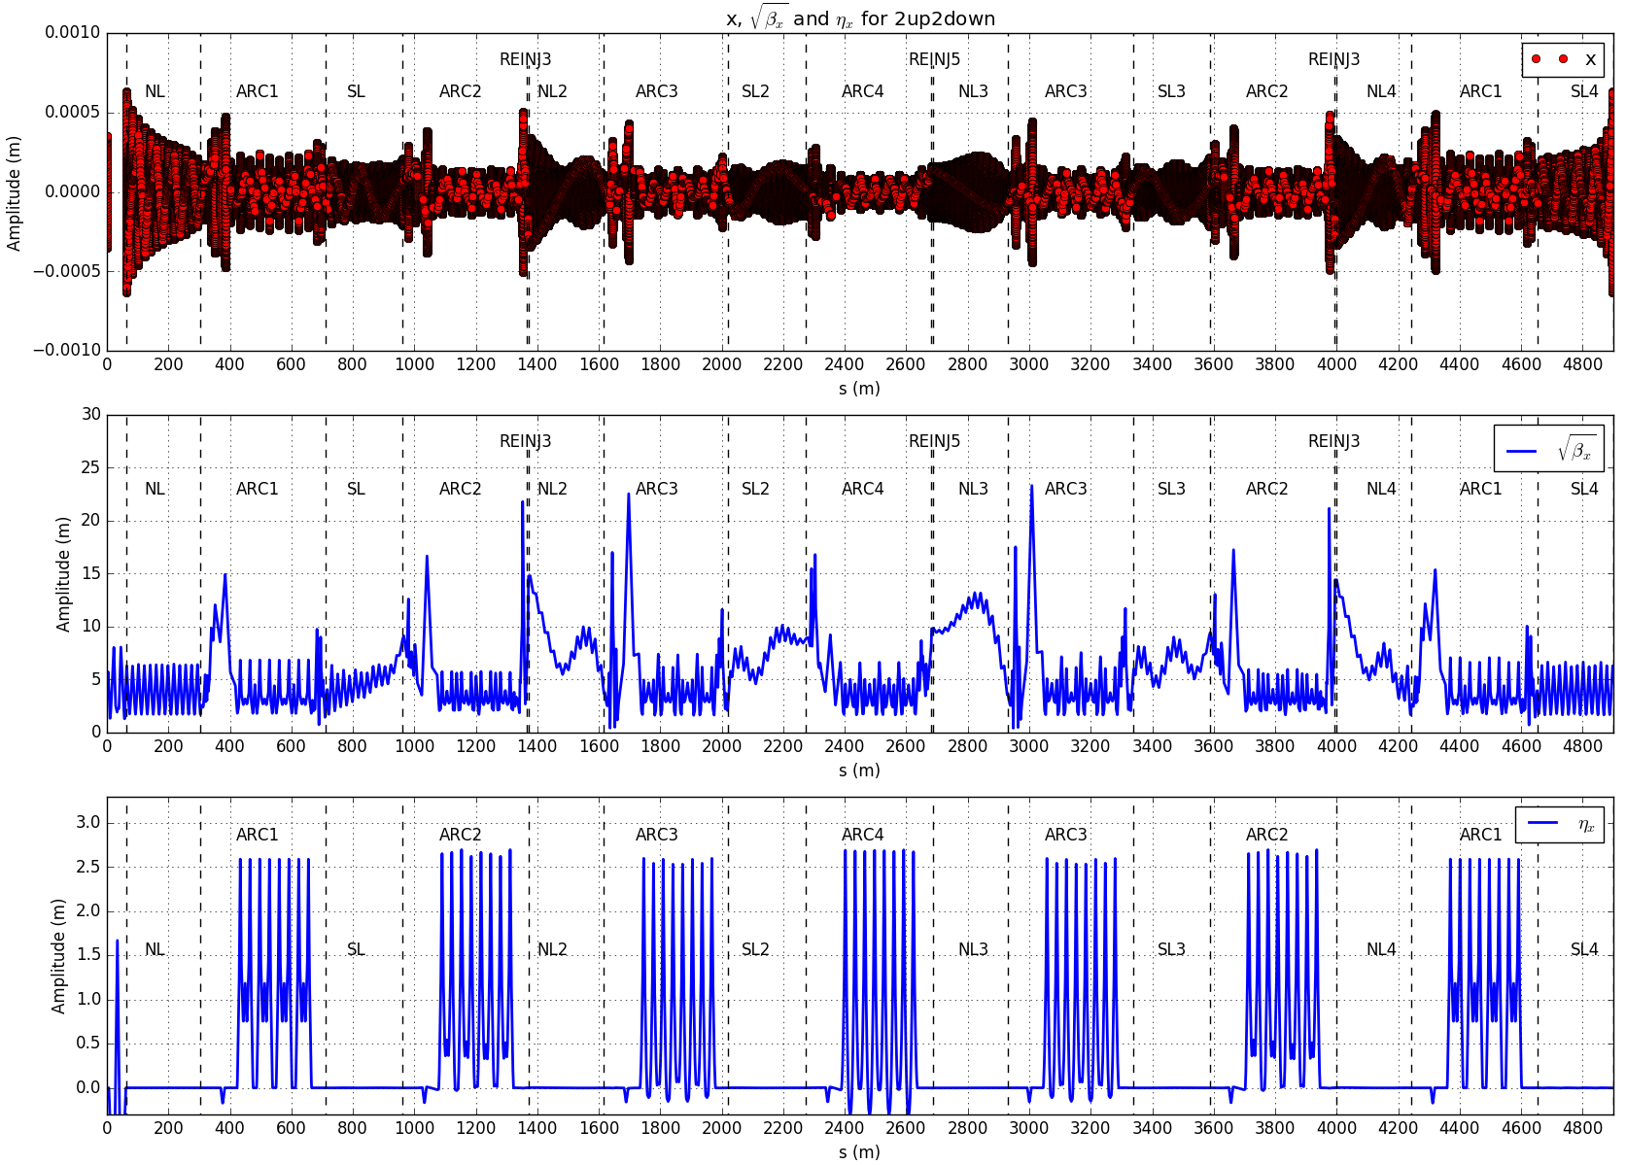
Backup: BNL 2-Up/2-Down Matching
Pierre Korysko

Slide 32
Backup: Reader/TAC Comment: BLMs
Reader comment: Do additional (beam loss) monitors need to be added both for protection and as data for the study?
  CEBAF BLMs will work equally well with accelerating and decelerating beams.
  Discriminating accelerating/decelerating beams requires challenging temporal signal separation
  Plan to discriminate losses by evaluating how losses change with intermediate extraction/dumplette insertion
    Similar to how multi-pass losses are evaluated in normal CEBAF operations

