Slide 1
PHADE/ACES
A PHosphorescent Afterglow DETECTOR
&
A Chameleon Experimental Search
A PAC44 Proposal*
James R. Boyce
College of William & Mary and Jefferson Lab
For the
PHADE/ACES TEAM:
(in alphabetical order)
Andrei Afanasev, George Washington University & JLab
George Biallas, Jefferson Lab
James R. Boyce, Spokesperson, CW&M and JLab
Mahlon Long, JLab
Dennis Manos, College of William & Mary
Brianna Thorpe, Arizona State University & JLab SULI Student
Carl Zorn, JLab

Slide 2
What are Chameleons?
Hypothetical "particles”, proposed to be mediators of “fifth force”, responsible for dark energy (Khouri, Weltman, PRL 93, 171104 (2004))
A chameleon's effective mass depends on its environment: very light in vacuum, heavy in dense medium. Due to this property “fifth force” is too short-range in matter, evading in the lab tests, but it drives the Universe expansion (via dark energy) – the force is long-range between the galaxies
Chameleons couple to electromagnetic fields via a mechanism similar to Higgs or neutral pions, therefore they can be generated by photons in static magnetic fields via Primakoff mechanism
If created in a vacuum chamber, e.g., chameleons cannot escape.
They can only convert back to photons, which can escape.
Afterglow detection would be positive evidence of chameleons and coupling of Dark Sector with Standard Model.

Slide 3
CHASE ESSENTIALS*
In terms of afterglow half-life
*From: Chou et al., PhysRevLett.102.030402.pdf

Slide 4
CHASE's 3 shortcomings
High background for 0 < t <120 sec.
Focused on βγ = 10¹²
Data acquisition did not begin until ~120 sec after source laser was turned off.

Slide 5
Afterglow Half-life
Half-life t_{½} vs. Photon coupling constant β_{γ}
90% decay
window

Slide 6
CHASE afterglow calculated prediction and search focus
Huge background independent of B-field.
CHASE data collection starts at t = 120 sec. No data for 0 < t < 120 sec.
If β_{γ} = 10¹² => Half-life = ~ 2.8 hours.
(100 counts in 1st half life in 2.8 hours. Data is buried in background!)
If β_{γ} = 10¹⁴ => Half-life = ~ 1 sec.
(chameleons all decayed before data collection started.)
*Chou et al., PhysRevLett.102.030402.pdf

Slide 7
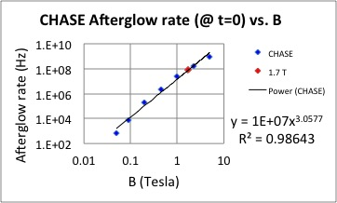
Afterglow Predictions (β_{γ} = 10¹⁴)
CHASE*
Plot of CHASE afterglow rate at t=0.
CHASE afterglow at t=0 for B=1.7 T.
(1.7 T is maximum B field for ACES.)
Afterglow rate (t=0) = 1E+8.
Use value for ACES-CHASE comparison.
*A. Upadhye, J. Steffen, and A.S. Chou, Designing dark energy afterglow experiments.
arXiv: 1204.5476 [hep-ph] 26 April 2012.

Slide 8
Half-life t_{½} vs. Photon coupling constant β_{γ}
90% decay
window

Slide 9
IF
Big ifs
Dark Energy exists, and
DE theory predicts chameleons, and
CHASE Group's calculations are valid, and
PHADE's detection solid angle is ~ π,
THEN
The following comparison can be made:

Slide 10
ACES–CHASE Comparison (β_{γ} = 10¹⁴)
Parameter | CHASE | ACES
B (T) | 1.7 | 1.7
L (m) | 6 | 1
(BL)⁴ | 1.10E+04 | 8.40E+00
Ω | 1.00E-04 | 3.10E+00
(BL)⁴ Ω | 1.10E+00 | 2.60E+01
ACES / CHASE = 26 / 1.1 => |  | 24
 | CHASE | ACES
If at t = 0, number of chameleons is | 1.0E+08 | 2.4E+09
Detectable afterglow | 1.0E+04 | 6.0E+08
Assuming the afterglow of CHASE at t=0 to be approximately F(t=0) = 10⁸ /sec,
ACES configuration should yield a count rate on the order of 10⁹ /sec. (24*1E+8).
Key to this approach is lining vacuum chamber with glass tube or fibers.
Bonus feature: glass separates afterglow photons from chameleons.

Slide 11
PHADE block diagram layout
Sealed laser pipe
Pre-chamber
Phosphorescent target
Pen pointer
laser
Shutter
Camera
Camera
Shutter &
Camera
Chamber
Camera
Camera

Slide 12
PHADE Pre-chamber assembly. Rev. 5/25/16
Glass sleeve inside
vacuum chamber
Adaptor
Vacuum
chamber
Parabolic Mirror
Laser
beam
Glass viewport
Shutters
Adjustable 3-flange section
ISO-100 flange
modified for
camera.
Shutter
NOTE: Pre-chamber is at
atmosphere. Vacuum is needed
only in parts with glass tube.
Camera

Slide 13
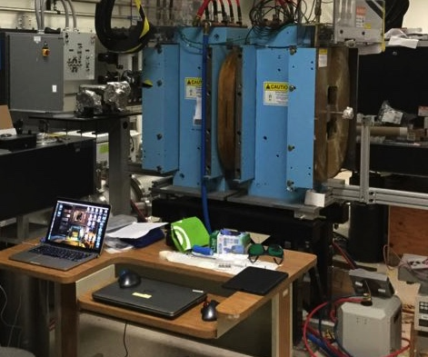
Laboratory Setting
Vacuum chamber
Pre-chamber
Dipole

Slide 14
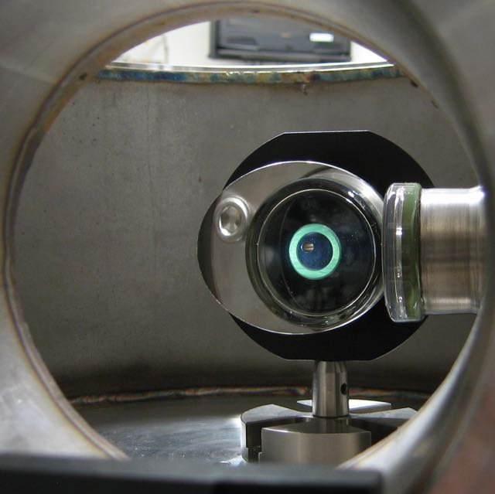
View through camera port

Slide 15
PHADE: Data Acquisition Procedures.
0. Complete assembly, including alignment and establish light tight-ness.
PHADE Calibration Measurements using laser pen pointers:*
Insert phosphorescence (a.k.a. glow-in-the-dark) target in vacuum chamber.
Using a laser pen pointer, expose target for, say, 10 seconds.
Turn laser OFF and take a series of sequential images, each 1 sec long exposure.
Measure intensities as a function of target distance along the vacuum chamber. (central and ring intensities). No glass liner.
Repeat with thick wall glass liner in vacuum chamber.
Repeat with thin wall glass tube in vacuum chamber.
Determine which glass liner gives highest count rate.
*This is the Project for Brianna Thorpe (Arizona State University),
SULI Summer Student for 2016. (Mentors: Jim Boyce and George Biallas.)

Slide 16
PHADE -> ACES: Add Table top Laser & Dipole
Vacuum
chamber
View port
Pre-chamber
B = 1.7 T
Source
laser
Shutter
Dipole
Camera
Camera
Laser
dump
Shutter
Camera
Power supply
Light tight seal
Ion pump
Note: when laser is on, camera shutter is closed.
And when laser is off, camera shutter is opened for each frame's exposure.
Vacuum
gage
Roughing
Pump
port
Camera
Camera

Slide 17
ACES Procedures: Set-up, Data Acquisition, & Analysis
Set-up:
Replace laser pen pointer with 10 Watt table-top laser.
Remove phosphorescent target.
Pump out vacuum chamber (< 10-9 torr) & valve OFF.
Data Acquisition:
Measurements (B = 0 Tesla): With Dipole B-field = 0.0 Tesla, accumulate a series of image sequences to establish background rates.
Measurements (B = 1.7 Tesla): With Dipole B-Field = 1.7 Tesla,
accumulate a series of image sequences corresponding to above.
Analysis
Compare results of corresponding image frames (B=0 with B=1.7)

Slide 18
ACES search range:
Half-life t_{½} vs. Photon coupling constant β_{γ}
90% decay
window
ACES lower limit
ACES upper limit
due to camera shutter speed

Slide 19
Possible Outcomes:
1. Insufficient data to draw any valid conclusion.
We see nothing and can prove we see nothing thereby confirming conclusions of other experiments. (See next slide.)
We see something and we can repeat results.
First manifestation of Dark Energy in earth Lab setting.
Extremely exciting outcome, but least likely.
Provides justification for full proposal to NSF or DOE.
Possibly determine photon coupling constant, β_{γ .}
Raises questions of polarization.
Possibility of Chameleon factory

Slide 20
Chameleon Parameter Space
ACES
Un-explored

Slide 21
Budget
The proposed PHADE/ACES budget (equipment & labor) is summarized in the Tables 1A. 1B. and 1C. Equipment needed is in two categories: JLab equipment (currently not in use) and new items (purchased by CW&M). Staﬃng and level of eﬀort are also shown.

Slide 22
PHADE/ACES PAC44 Proposal Synopsis
PHADE/ACES proposal is submitted under the Scientific Categories for Nuclear Physics Proposals: Low-energy tests of the Standard Model and Fundamental Symmetries.
PHADE/ACES requires no CEBAF or LERF beam time.
Uses equipment that is not being used.
Ultra-low budget with potential for game-changing discoveries.
Excellent educational opportunity: Not too small, not too big, incorporates multiple disciplines, and how to recover from set-backs.
Chameleon afterglow detection would be the first earth-based laboratory evidence of Dark sector interactions with Standard Model.
The PHADE/ACES Team requests PAC44 approval of this research effort.

Slide 23
References
[0] Khouri, Weltman, PRL 93, 171104 (2004
[1] A. S. Chou et al., "A search for chameleon particles using a photon regeneration technique," Phys.Rev.Lett., vol. 102, p. 030402, 2009.
[2] H. H. Jae and A. L. Miller, "the fates of electronic excitation energy",
J. Chem. Educ., vol. 43, p. 469, 1966.
[3] D. Cooke and B.L.Bennette, "Long-lived luminescence from commonly used apiezon compounds," Journal of Luminescence, vol. 65, pp. 83{288), 1996.
[4] J. R. Boyce, "Phile: A photon induced luminescence experiment." Tech Note in progress, 2015.
[5] A. Upadhye, J. H. Steen, and A. S. Chou, "Designing dark energy afterglow experiments," Phys.Rev., vol. D86, p. 035006, 2012.
We are grateful for the support from the College of William & Mary, Office of Vice Provost for Research and for the many useful discussions with Jefferson Lab staff.

