Slide 1

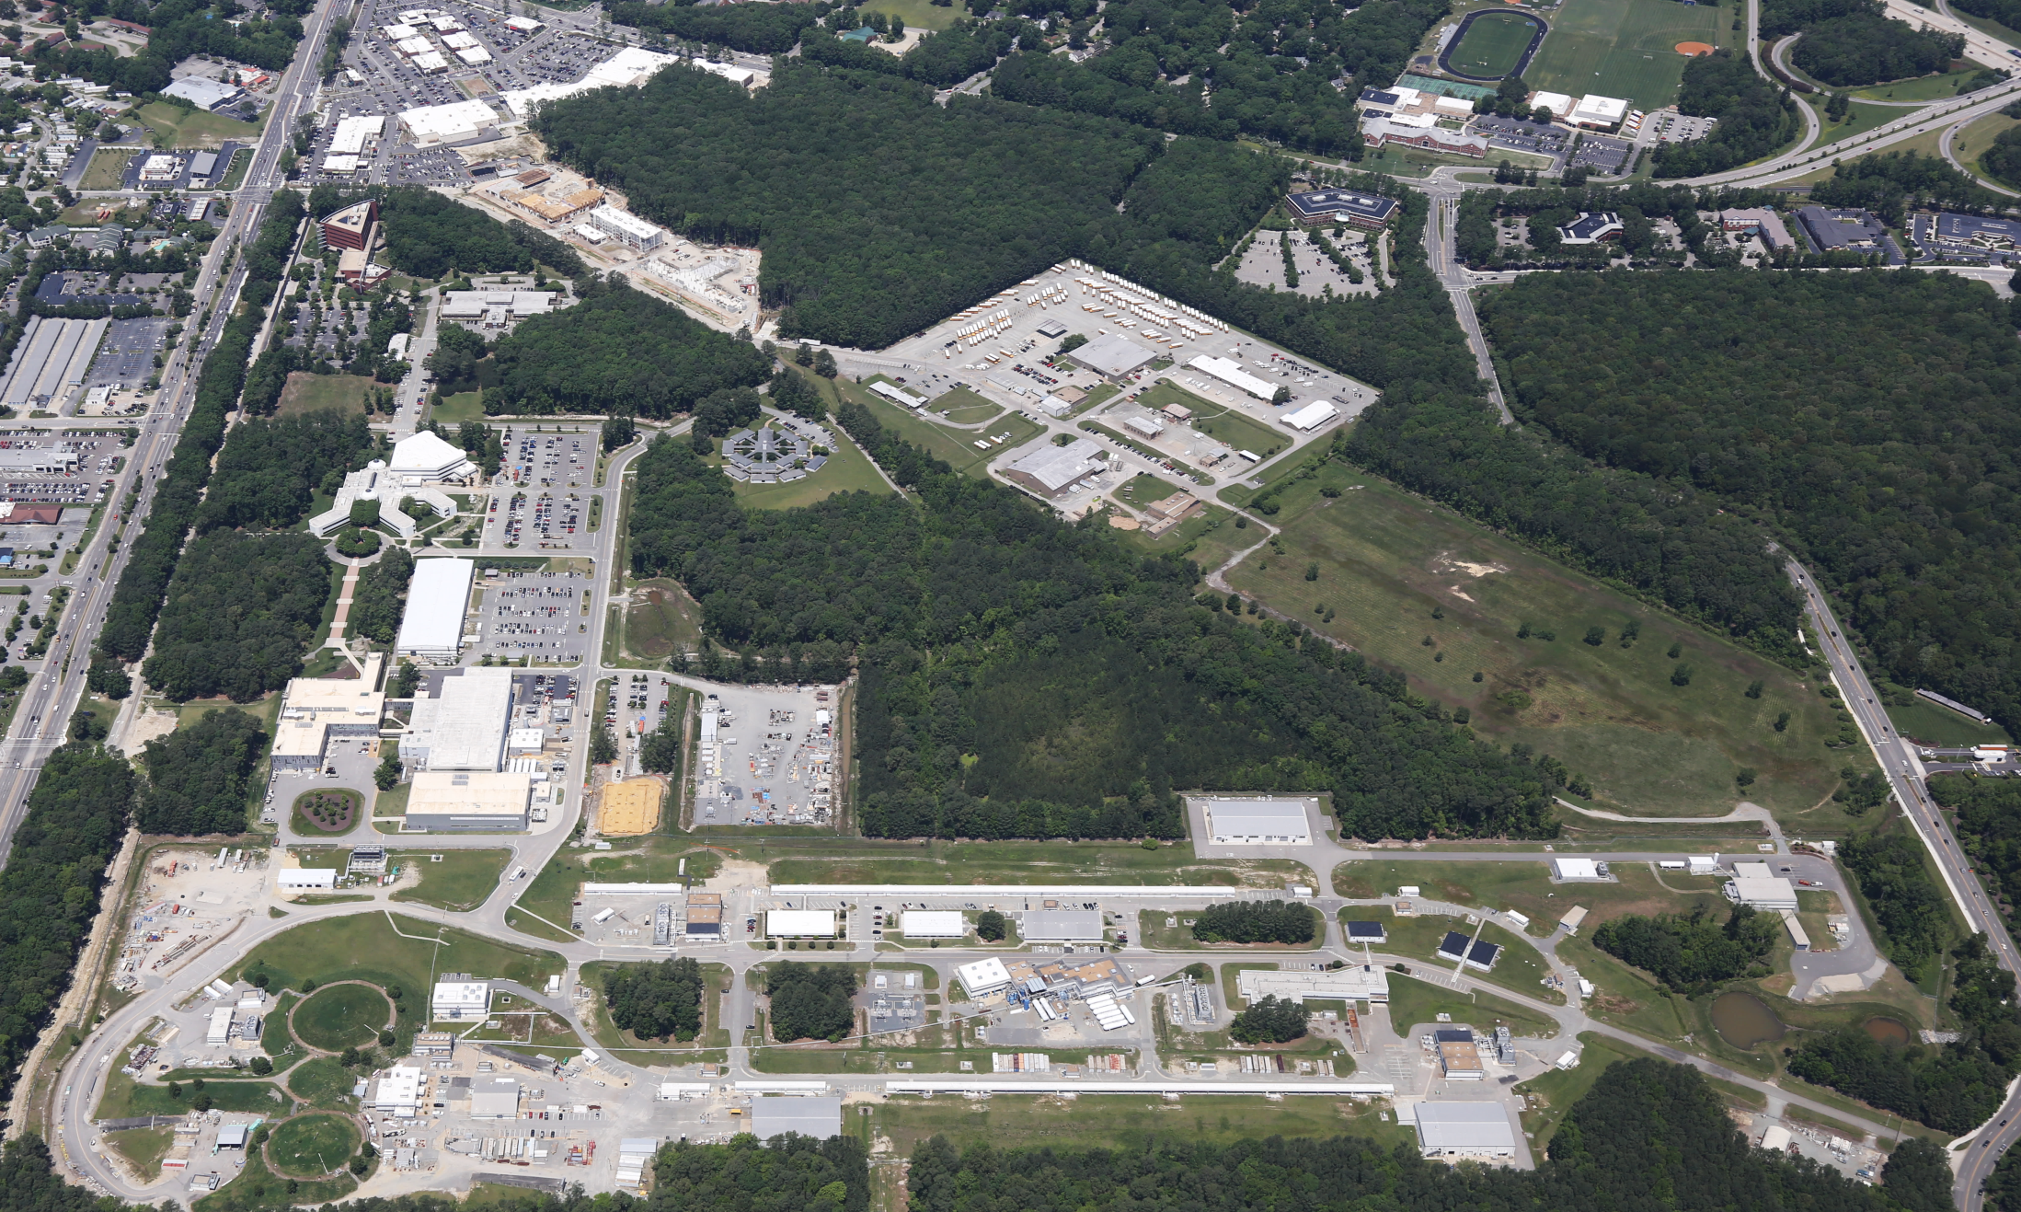
Jefferson Lab Status
Hugh Montgomery
Presentation to PAC44
July 25, 2016

Slide 2
Outline
Highlights & News
Upgrade
Technology
Infrastructure
Conclusion

Slide 3
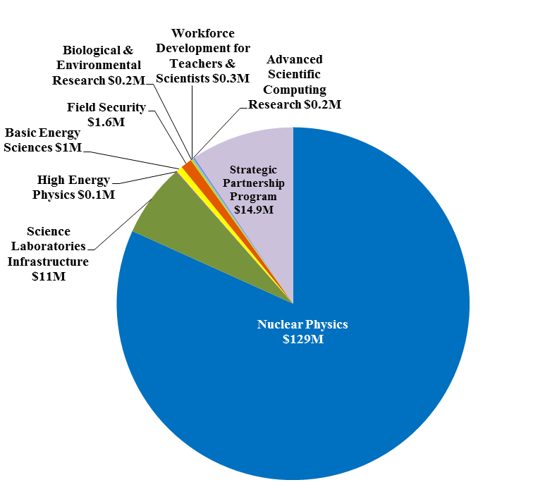
Jefferson Lab At-A-Glance
Created to build and Operate the Continuous Electron Beam Accelerator Facility (CEBAF), world-unique user facility for Nuclear Physics: Mission is to gain a deeper understanding of the structure of matter Through advances in fundamental research in nuclear physics Through advances in accelerator science and technology In operation since 1995 1,510 Active Users 178 Completed Experiments to-date Produces ~1/3 of US PhDs in Nuclear Physics (531 PhDs granted to-date; 195 in progress) Managed for DOE by Jefferson Science Associates, LLC (JSA) Human Capital: 686 FTEs 24 Joint faculty; 21 Post docs; 7 Undergraduate students; 37 Graduate students K-12 Science Education program serves as national model Site is 169 Acres, and includes: 70 Buildings & Trailers: 876K SF Replacement Plant Value: $397M
FY 2015:
Total Lab Oper. Costs: $158M
Non-DOE Costs: $14.9M
Notes:
Note from Dry Run – verbalize that early science of the 12 GeV-era research program has begun.

Slide 4
Jefferson Lab Safety History
1.5 Million + Hours Worked without Recordable Injury (October 2014 – January 2016)
Recent events serve as reminders to report injuries in a timely fashion, stay focused on situational awareness, and when conditions change, pause and re-evaluate

Slide 5
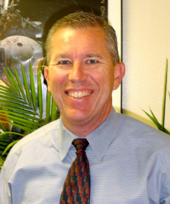
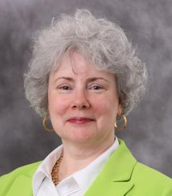
    Leadership Enhancement
PEMP Objective 4.2 Notable Outcome achieved:
Select a New Chief Operating Officer (COO) by the end of FY16
        Michael Maier, formerly PAE Vice President for Space System Operations, has accepted the position of COO effective May 2, 2016.
        Allison Lung, 12 GeV Upgrade Deputy Project Manager, has accepted the position of Chief Planning Officer effective May 2, 2016 → a new position generated as a result of the recruitment process to strengthen the directorate and facilitate JLab expansion.
        Both DOE Approved Key Contractual Positions

Slide 6
Personnel News
Electron Ion Collider Physics Leadership
  Rik Yoshida (ex ZEUS, ATLAS, ANL) joined Jefferson Lab as leader of our EIC Physics Group
Head of Theory
  Search
  Co-chairs Joe Carlson, LANL & Bob McKeown, Jefferson Lab.
  Members were Charlotte Elster (Ohio U.), Franz Gross (Jefferson Lab emeritus), Frithjof Karsch (Bielefeld U. & BNL), Krishna Rajagopal (MIT), and Feng Yuan (LBNL)
  Interviews Complete
  Acting Theory AD: Robert Edwards

Slide 7
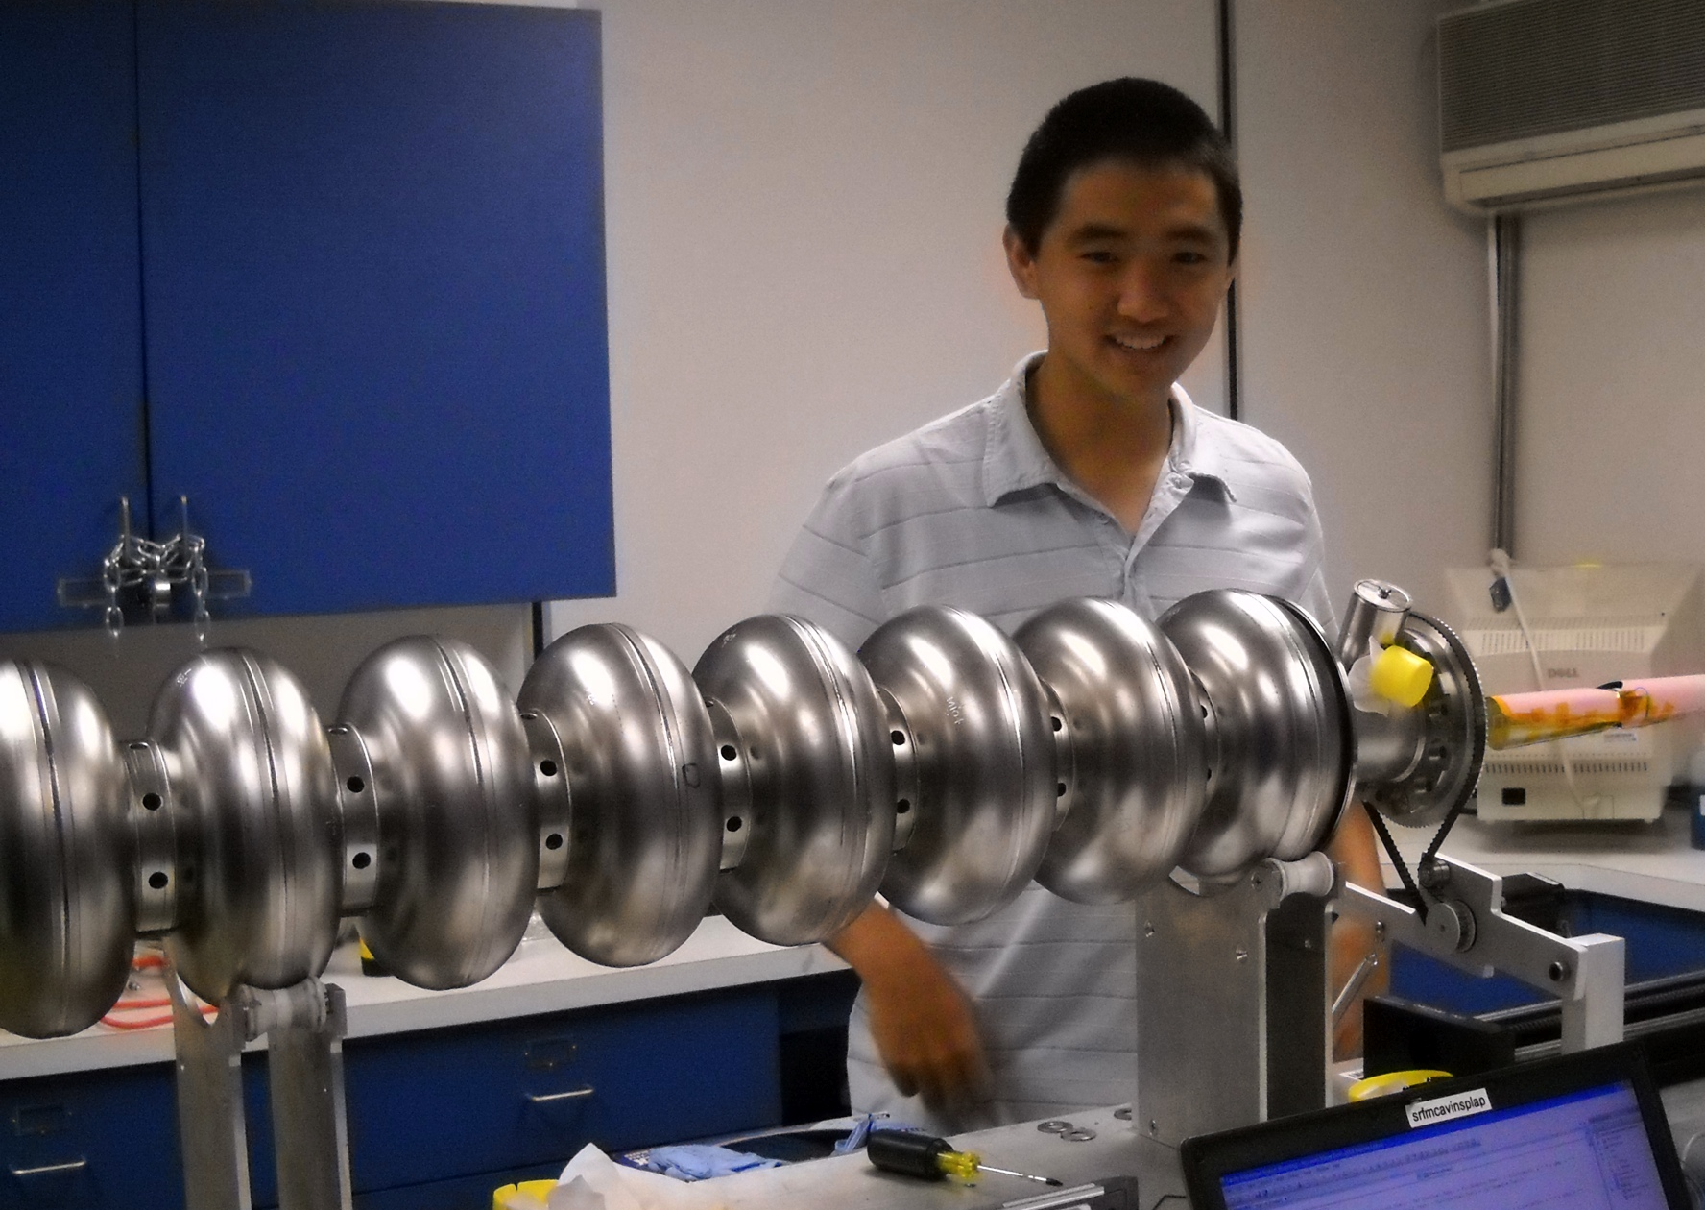
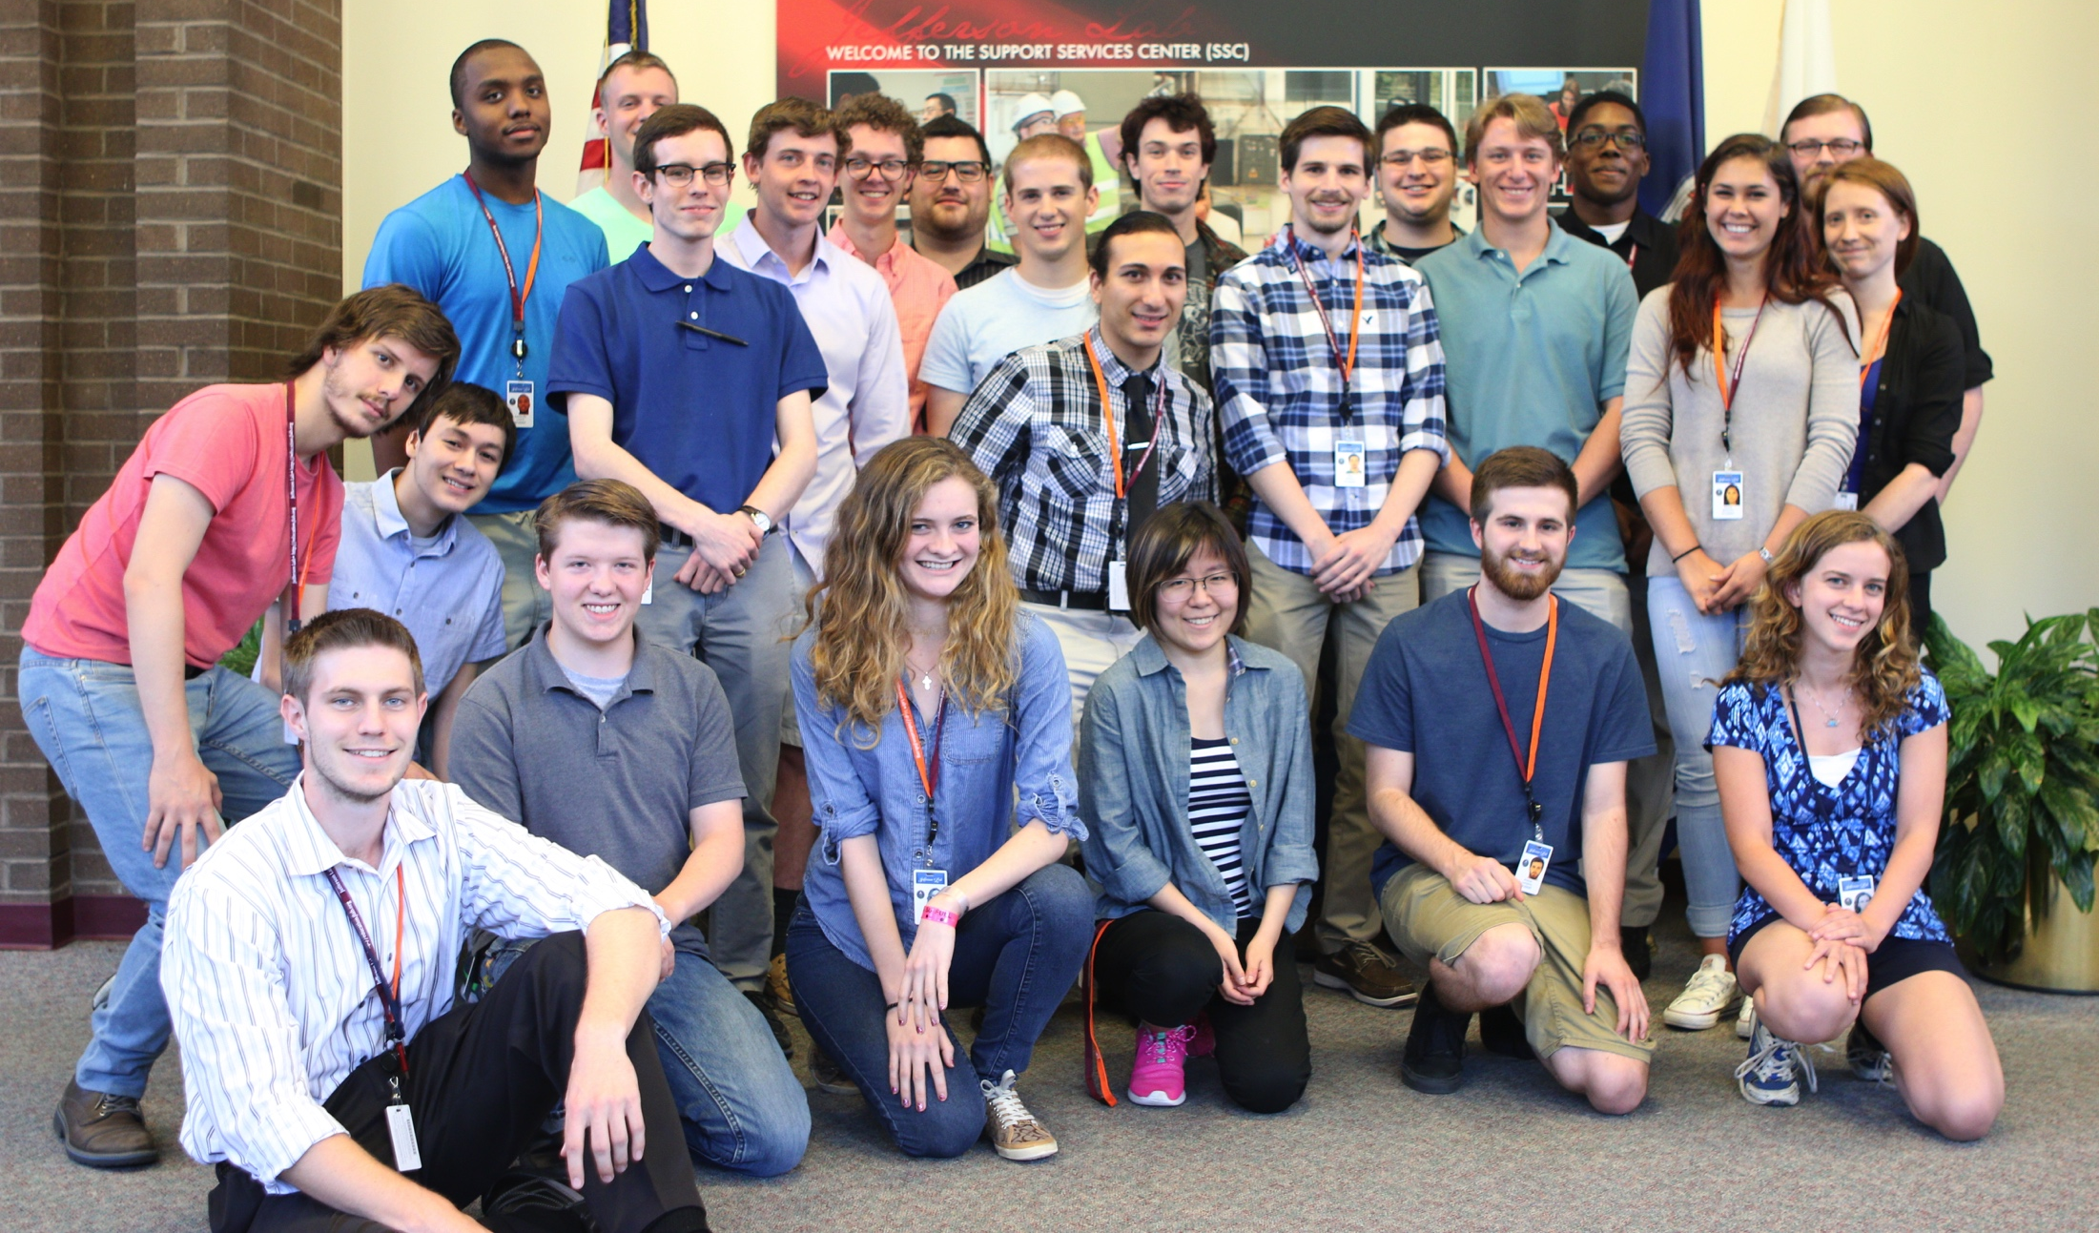
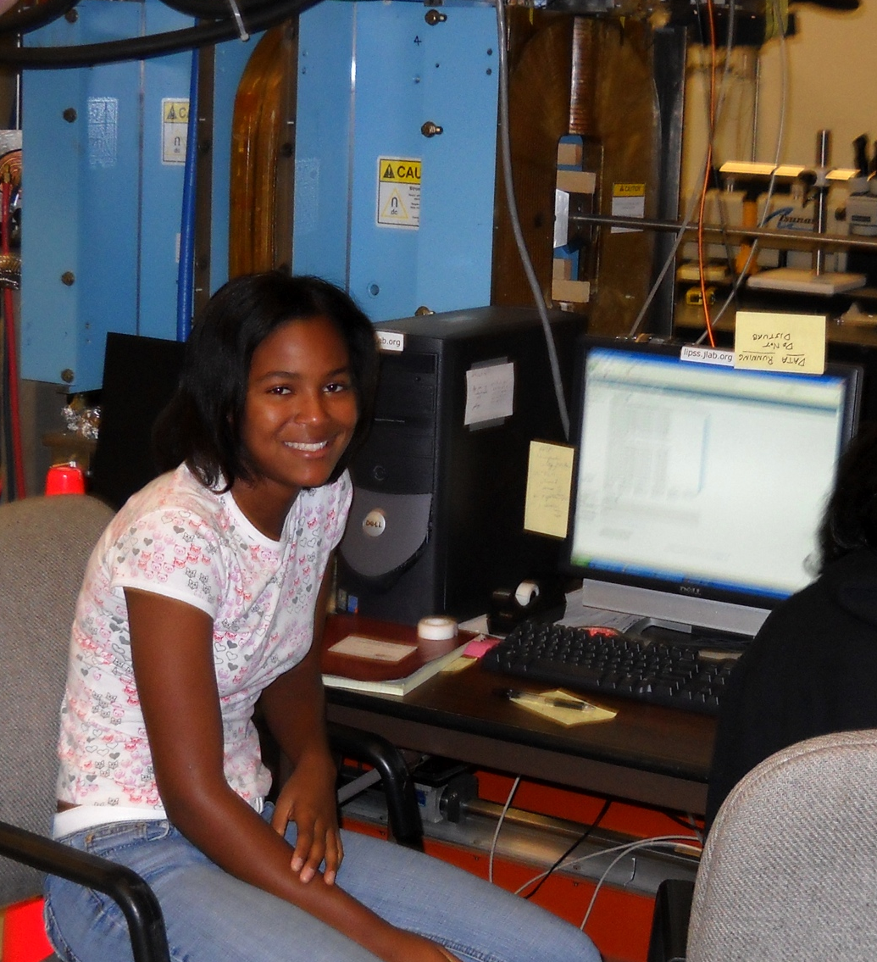
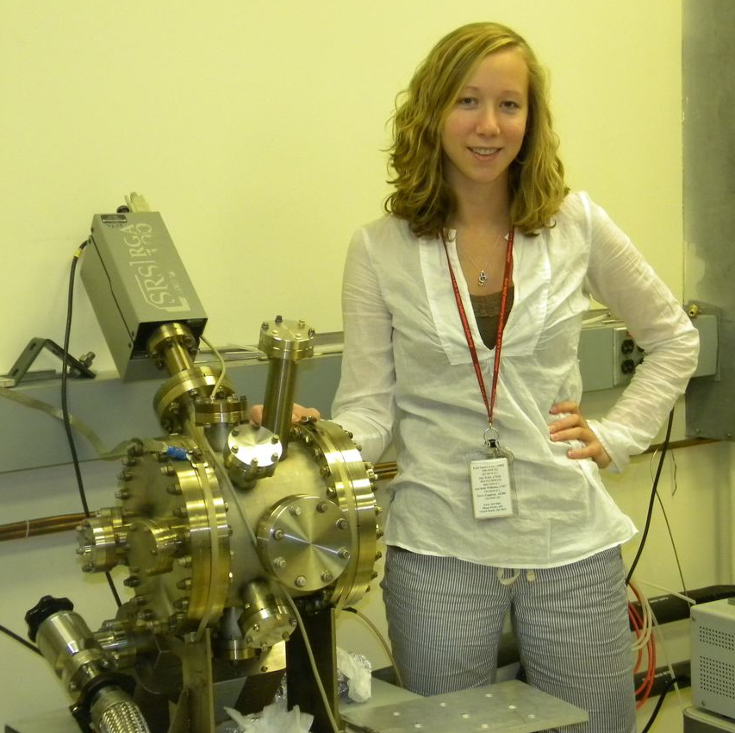
Workforce Development for Teachers and Scientists
Jefferson Lab supports ~40 undergraduate students/year
  JLab staff and users encourage and prepare undergraduate students to pursue advanced degrees in experimental/theoretical physics and accelerator science
  19 Science Undergraduate Laboratory Internship (SULI) students for summer 2016
  8 NSF-funded Research Experiences for Undergraduates (REU) via Old Dominion University
  Initiatives Fund Supports: Minority/Female Undergraduate Research Assistantship (MFURA), JLab Co-op Program for Engineers, Undergraduate Support in Jefferson Lab Research, Accelerator Physics Education Outreach w/ Mexican Universities
2015 SULI & REU Students

Slide 8

Integrated Diversity & Inclusion Management
Overarching goal: develop innate understanding of how to implement and reinforce (within oneself) Integrated Diversity & Inclusion Management
What is meant is how to implement IDIM in people’s activities
These activities can for example be:
  A hiring process
  A meeting
  A conversation
  Workforce planning
    Succession planning
    Professional development
  New employment orientation

Slide 9
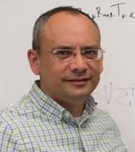
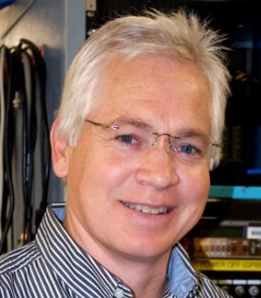
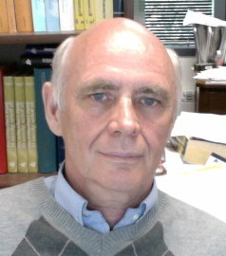
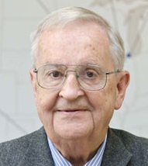

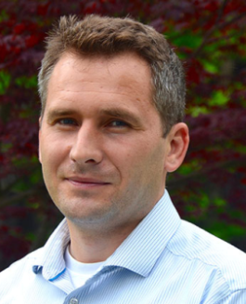
Awards
APS Fellowships:
SESAPS 2015 Jesse W. Beams Research Prize
APS DNP
Mentoring Award
Kostas Orginos (Jefferson Lab & College of W&M)
Matt Poelker
(Jefferson Lab)
Anatoly Radyushkin
(Jefferson Lab & ODU)
Dirk Walecka
(Jefferson Lab Emeritus
& College of W&M)
2016 Breakthrough Prize in Fundamental Physics
9
DOE
Early Career Award
Robert McKeown
(Jefferson Lab
Deputy Director for Science)
    Grigory Eremeev
    (Jefferson Lab
    Staff Scientist)

Slide 10
Advocacy
Nuclear Physics Day on the Hill (March 14)
  Facilitated by government representatives from BSA, MSU, SURA
  Material provided by laboratories
  Several tens of users of RHIC-BNL, CEBAF-Jefferson Lab, and NSCL/FRIB-Michigan State
  Meetings with Office of Science and Legislators and their staff
National Labs Day on the Hill (April 20)
  Organized by the National Laboratory Directors’ Council and their Chief Research Officers
  Material provided by labs; this one will emphasize discovery science
  Strongly encouraged by DOE
  Secretary’s participation, VIP groups (eg Senator Warner)
  Associated visits by teams of Lab Directors, facilitated by GRs

Slide 11
Accelerator Advisory Committee
Charter
The Jefferson Lab Accelerator Advisory Committee is asked to look at activities related to CEBAF Operations, the Jefferson Lab EIC proposal, and accelerator-related R&D. There are three primary topics for review and discussion:
1. CEBAF Operations
2. Jefferson Lab EIC
3. Accelerator-related R&D
Committee
Chair: Norbert Holtkamp (SLAC, Chair)
Oliver Bruning (CERN)
Wolfram Fischer (BNL)
[Richard Milner (MIT)] Kent Paschke (U. Va) Yoshishige Yamasaki (MSU-FRIB)
Eric Prebys (FNAL)
Marion White (ANL)
Considerable Emphasis on
Points of Failure and Reliability

Slide 12

NSAC 2015 LRP
RECOMMENDATION I
The progress achieved under the guidance of the 2007 Long Range Plan has reinforced U.S. world leadership in nuclear science. The highest priority in this 2015 Plan is to capitalize on the investments made.
RECOMMENDATION II
We recommend the timely development and deployment of a U.S.-led ton-scale neutrinoless double beta decay experiment.
RECOMMENDATION III
We recommend a high-energy high-luminosity polarized EIC as the highest priority for new facility construction following the completion of FRIB.
RECOMMENDATION IV
We recommend increasing investment in small-scale and mid-scale projects and initiatives that enable forefront research at universities and laboratories.
Manifest impact on Electron Ion Collider
Users Organization/Meetings
National Academy Study
Enhanced explicit EIC Accelerator R&D
Increased interest in collaboration
with Jefferson Lab
Something for Jefferson Lab in every chapter

Slide 13
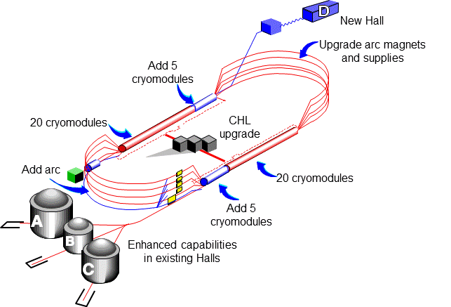

CEBAF Upgrade
TPC = $338M
ETC = ~$8M
“With the imminent completion of the CEBAF 12-GeV Upgrade, its forefront program of using electrons to unfold the quark and gluon structure of hadrons and nuclei and to probe the Standard Model must be realized”
Project Scope (~98% complete):
Doubling the accelerator beam energy - DONE
New experimental Hall D and beam line - DONE
Civil construction including utilities - DONE
Upgrades to Experimental Halls B & C - ~96%
  Halls B & C Detectors – DONE

Slide 14
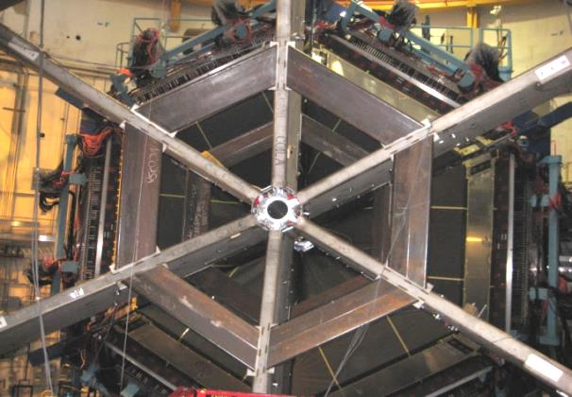
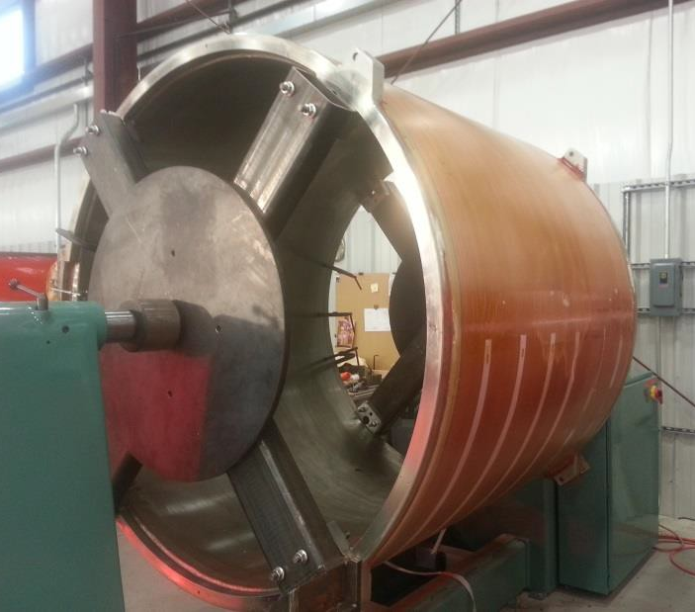
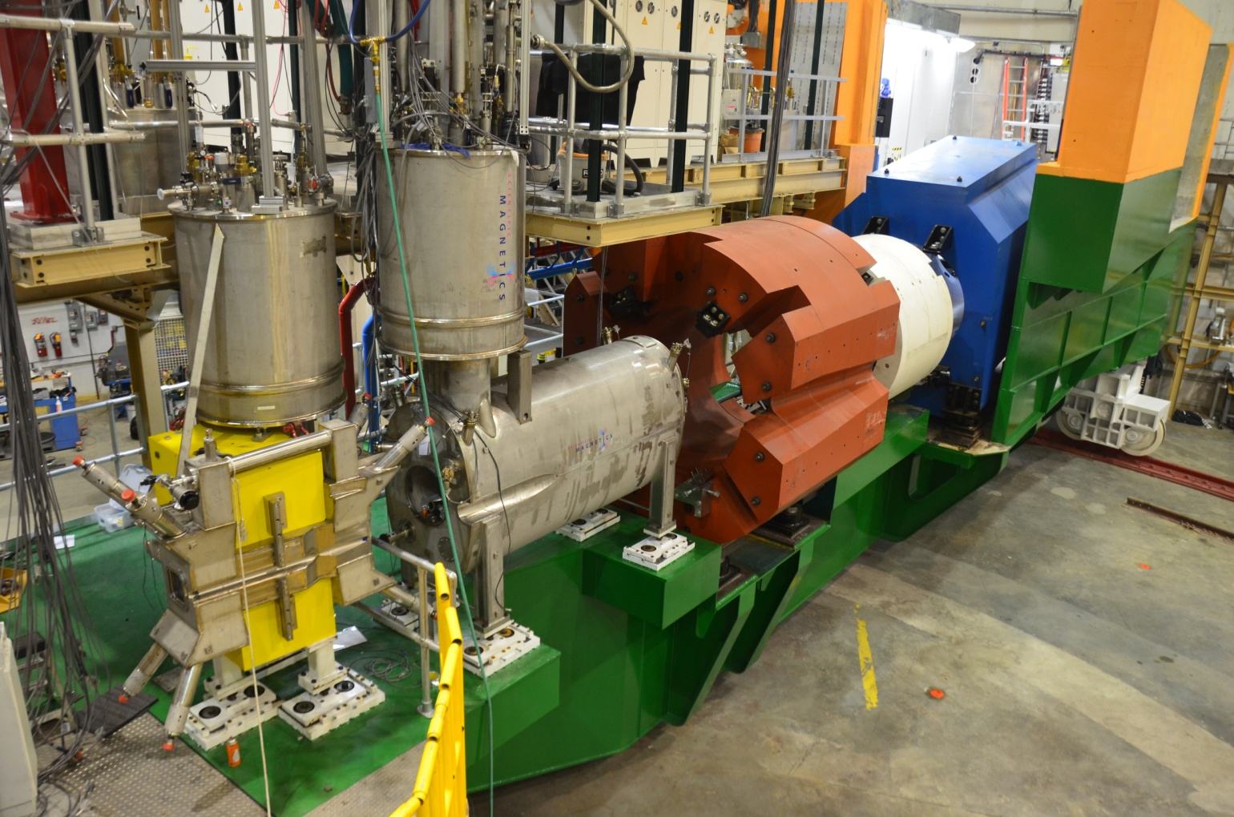
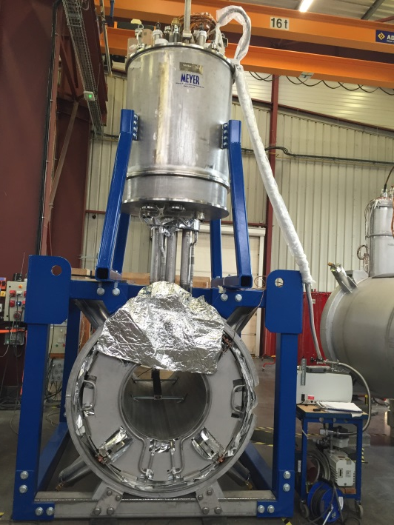
12 GeV Upgrade Project
Remaining scope & status:
Hall C superconducting dipole, 2 quads
  All magnets in cryostats, leak-checking & welding in progress
  Next magnet delivery in mid-September
Hall B superconducting torus, solenoid
  Torus ready to start cool-down
  Solenoid: all coils wound & potted; coils 1 through 4 shrink-fitted
Most key technical risks retired.
Proactively managing work at vendors to minimize schedule delays.

Slide 15
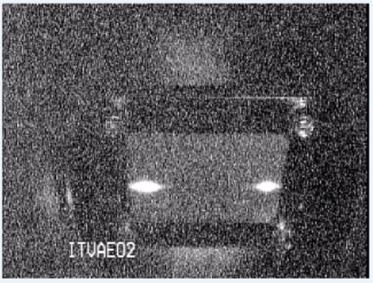
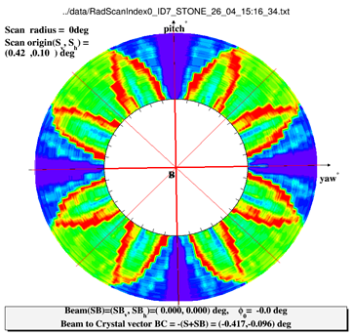
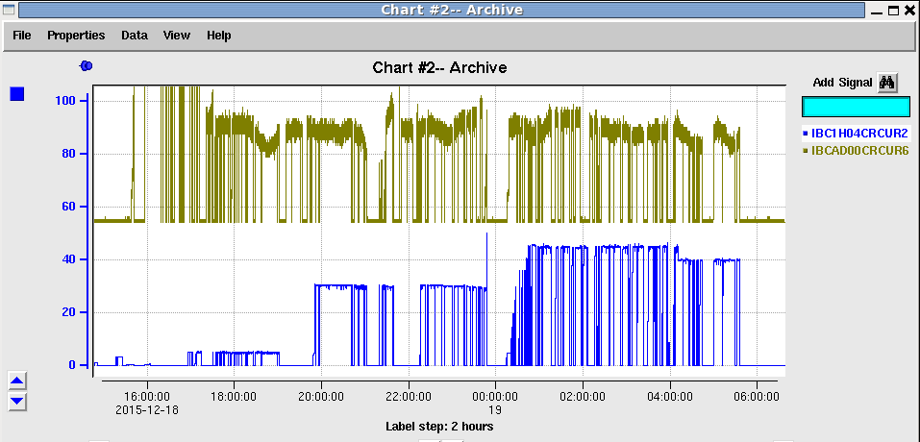
CEBAF Commissioning Highlights
A & D beam separated on 5th pass at 9.6 GeV
Spring 2015:
First simultaneous Hall A/D operations
Successful commissioning runs:
Hall B (Heavy Photon Search) and Hall D (GlueX)
Fall 2015:
First operation of CEBAF at design energy
D: 1st production polarized photons
Spring 2016:
Hall D engineering run complete
Hall A commissioning and early physics run
Hall B HPS on weekends, extended run
Summer 2016:
Proton Radius Experiment (PRad)
First completed experiment in 12 GeV era!
Accelerator ready for 12 GeV physics program

Slide 16
CEBAF Three-Year Schedule
Feb 2016
Calendar Year
2016
2017
2018
Fiscal Year
2016
2017
2018
Accelerator
Activity
Opportunistic
Physics
Physics
Physics
Beam
Activity
SBS Construction
Opportunistic
Physics
Problem is weeks of running
Optimal: 37
Request: 30
Budget (FY17): 23 + 3
Hall A
Activity
Physics
Physics
Beam
CLAS12 Construction/Installation
Hall B
Activity
Activity
Non-CLAS12 Ops*
Physics
Physics
Beam
Hall C
Activity
SHMS Construction/Installation
Activity
Comm.
Physics
Physics
Beam
Opportunistic
Physics
Physics
Physics
Hall D
Activity
Beam
* Potential PRad Summer 2016 run
Beam for Commissioning
Beam for Physics
Non-CLAS12 Ops

Slide 17
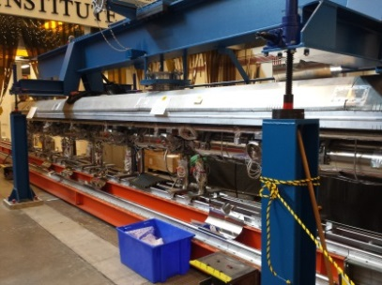
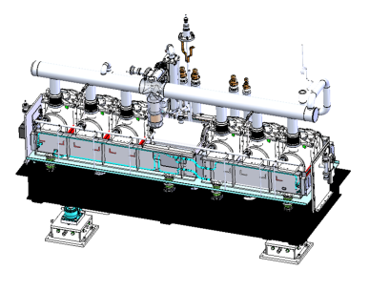
Collaborative Projects
 | LCLS II | FRIB
Description | 4 GeV superconducting linac in existing SLAC tunnel | New user facility at MSU for rare isotope studies
Collaboration | ANL, Cornell, FNAL, LBNL, SLAC, Jefferson Lab | MSU, State of Michigan, DOE SC, Jefferson Lab
Jefferson Lab Scope | Cryoplant design and acquisition Cryomodule and cavities for half of linac Qo R&D, LLRF, machine physics | Cryogenic system design, procurement, fabrication, and integration Cryomodule engineering and design finalization
Status | ✓ CD 2/3A complete ✓ First two cryoplant procurements placed ✓ Several SRF contracts placed including cavities - vendors performing well ✓ All procurements for prototype cryomodule complete, assembly started | ✓ FDR for 2K cold compressors complete ✓ Beta 0.041 design complete - Beta 0.29 design underway
Prototype Cavity String
β=0.29 Cryomodule

Slide 18
Core Capability (Proposed):
Advanced Computer Science, Visualization & Data Management
Advanced Imaging
LQCD
GPU/CPU
Expertise
Accelerator Modeling
Data Acquisition/Analysis
Enhanced HPC competence: LQCD program expertise and synergies with other TJNAF mission areas
Pioneering Beam Dynamics Simulations on GPUs for accelerator modeling
Pioneering parallelized workflows and algorithms for 12 GeV experimental program
Detector imaging - iterative image reconstruction algorithms and visualization of biological systems with molecules labeled with radioisotopes

Slide 19
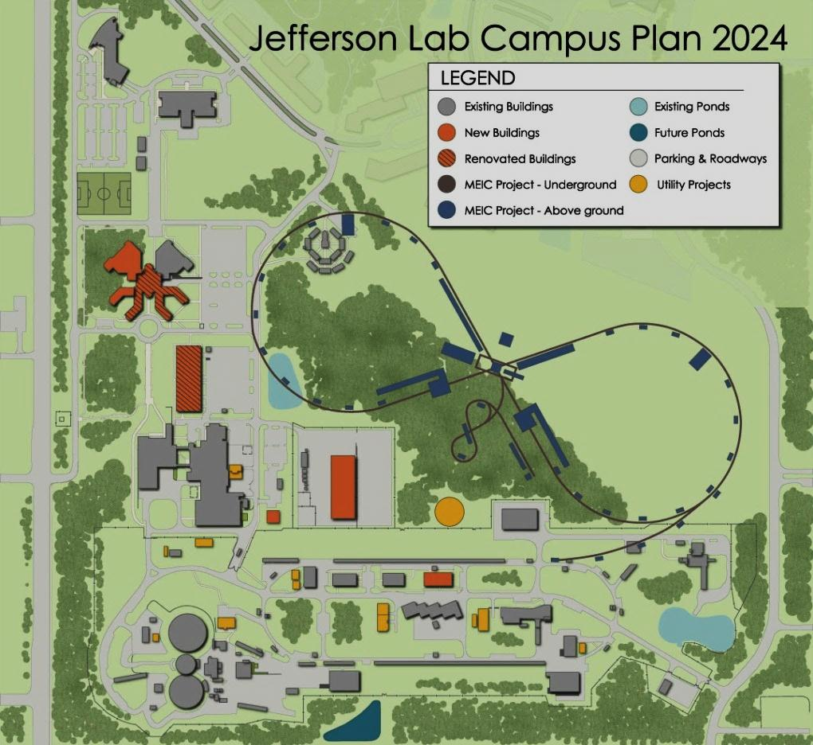
Electron Ion Collider at Jefferson Lab
JLab EIC Figure 8 Concept
Initial configuration:
  3-10 GeV on 20-100 GeV ep/eA collider
  Optimized for high ion beam polarization:
    polarized deuterons
  Luminosity:
    up to few x 10³⁴ e-nucleons cm⁻² s⁻¹
    Low technical risk
    Upgradable to higher energies
    250 GeV protons + 20 GeV electrons
    Flexible timeframe for Construction
    consistent w/running 12 GeV CEBAF
    Thorough cost estimate completed
    presented to NSAC EIC Review
    Cost effective operations
    Fulfills White Paper Requirements
Current Activities
Site evaluation (VA funds)
Accelerator, detector R&D (DOE and VA funds)
Design optimization (examine alternatives)
Cost reduction

Slide 20
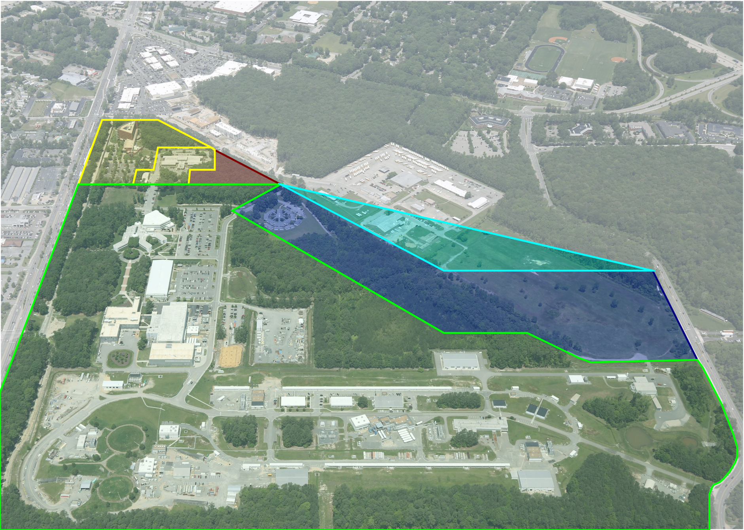
Existing Infrastructure – Overview
Ownership | Gross Square Feet | Facility Count
DOE Owned | 876,084 | 70
DOE Leased | 37,643 | 2
Contractor Leased | 37,093 | 3
Totals | 950,820 | 75
JLAB (DOE Owned)
JLAB (Leased)
SURA Land
VA Tech Land
Reserved for JLAB Expansion
Other (Private & Public)

Slide 21
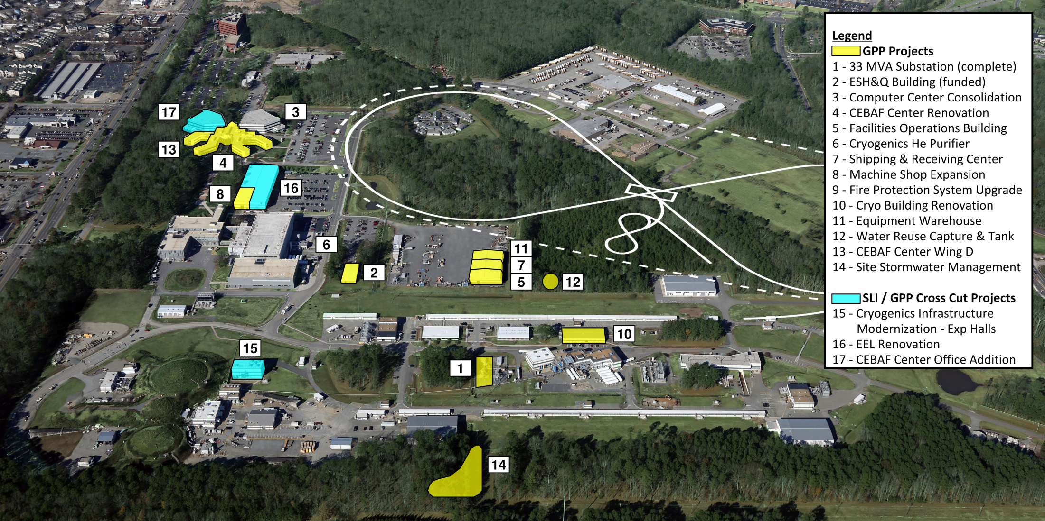
Jefferson Lab 2025 Campus Plan

Slide 22


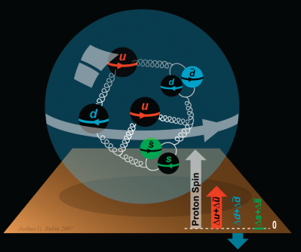
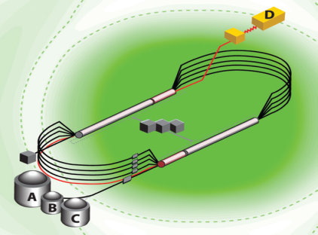
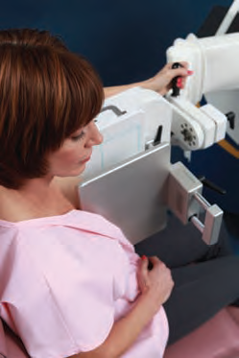
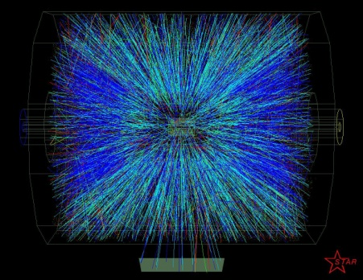


A Laboratory for Nuclear Science
The Jefferson Lab electron accelerator is a unique world-leading facility for nuclear physics research and related applications
  Physics program with 12 GeV Upgrade spans the breadth of nuclear physics with many opportunities for discovery
  High priority in NSAC Long Range Plan
  Early high-impact physics underway - results emerging
Advanced computation pervades the present and future program
  Data acquisition, analysis and management
  LQCD, experiment analysis, accelerator modelling
  Imaging of complex quantum systems and classical objects
Technology partnerships
  FRIB for MSU
  LCLS-II for SLAC
EIC, a future construction project for nuclear physics
  Recommended by NSAC LRP
  Strong community interest, national and international
  Developing a design based on CEBAF as injector
The Jefferson Lab Campus Plan, making tangible progress, towards support of long-term mission needs by integrating diverse funding streams:
  Providing updated facilities and site utilities
  Eliminating substandard, temporary and leased space
Lab is in a very strong position going forward, with great promise for scientific and technical advances.

Slide 23
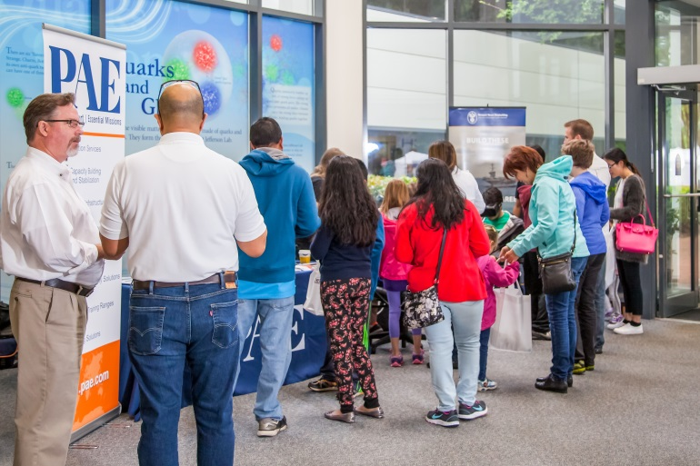
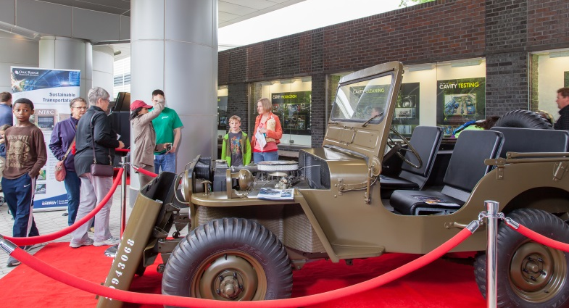

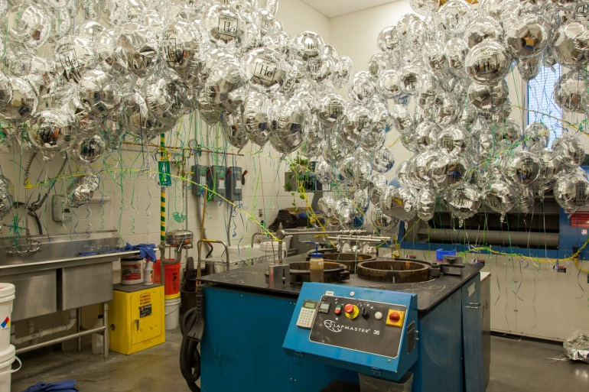

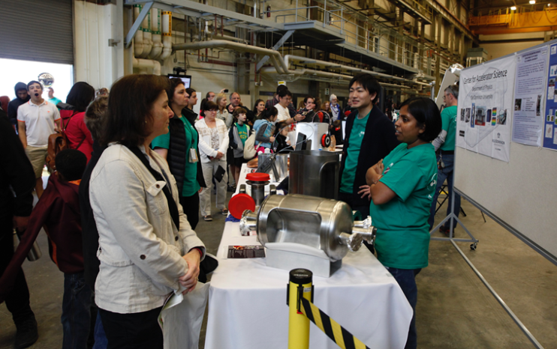
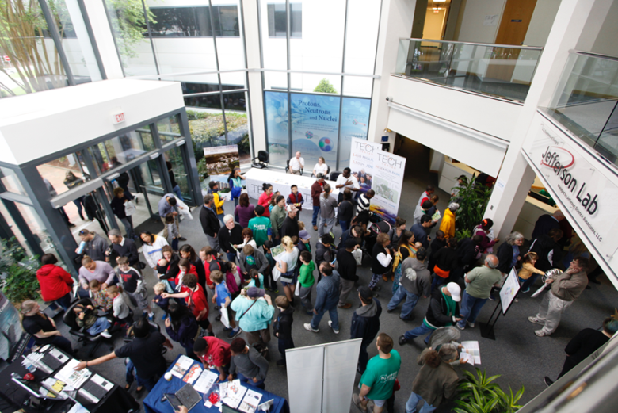
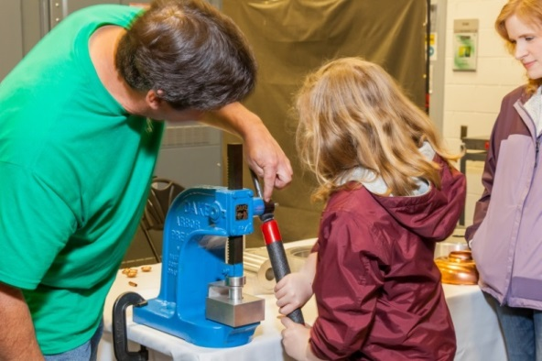
JLab Open House – April 30, 2016
~12,000 visitors!

Slide 24
Backup

Slide 25
EIC Timeline
Activity Name | 2010 | 2011 | 2012 | 2013 | 2014 | 2015 | 2016 | 2017 | 2018 | 2019 | 2020 | 2021 | 2022 | 2023 | 2024 | 2025
12 GeV Operations
12 GeV Upgrade
FRIB
EIC Physics Case
NSAC LRP
NAS Study
CD0
EIC Machine Design and R&D
CD1(Down-select)
CD2/CD3
EIC Construction
CD0 = DOE “Mission Need” statement; CD1 = technology and site selection (VA/NY)
CD2/CD3 = establish project baseline cost and schedule

