Slide 1
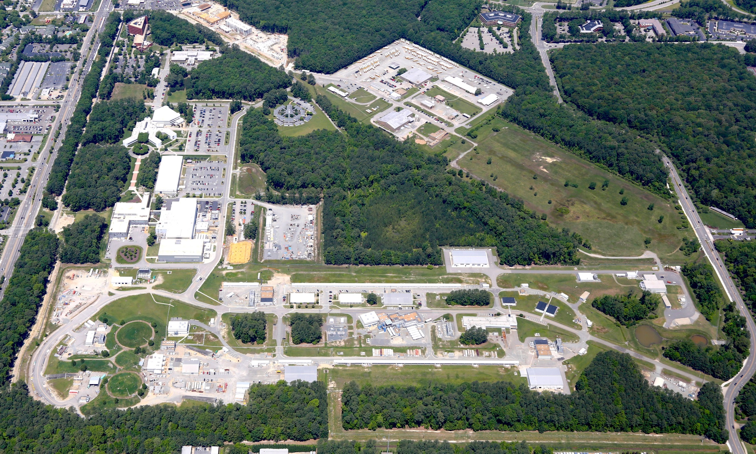
PAC44 Charge
R. D. McKeown
Jefferson Lab
PAC44
July 25, 2016

Slide 2
12 GeV Approved Experiments by Physics Topics
Topic | Hall A | Hall B | Hall C | Hall D | Other | Total
The Hadron spectra as probes of QCD (GluEx and heavy baryon and meson spectroscopy) |  | 1 |  | 3 |  | 4
The transverse structure of the hadrons (Elastic and transition Form Factors) | 5 | 3 | 2 | 1 |  | 11
The longitudinal structure of the hadrons (Unpolarized and polarized parton distribution functions) | 2 | 3 | 6 |  |  | 11
The 3D structure of the hadrons (Generalized Parton Distributions and Transverse Momentum Distributions) | 5 | 9 | 7 |  |  | 21
Hadrons and cold nuclear matter (Medium modification of the nucleons, quark hadronization, N-N correlations, hypernuclear spectroscopy, few-body experiments) | 6 | 3 | 7 |  | 1 | 17
Low-energy tests of the Standard Model and Fundamental Symmetries | 3 | 1 |  | 1 | 1 | 6
TOTAL | 21 | 20 | 22 | 5 | 2 | 70
2
10
69

Slide 3
12 GeV Approved Experiments by PAC Days
Topic | Hall A | Hall B | Hall C | Hall D | Other | Total
The Hadron spectra as probes of QCD |  | 119 |  | 540 |  | 659
The transverse structure of the hadrons | 145.5 | 85 | 102 | 25 |  | 357.5
The longitudinal structure of the hadrons | 65 | 230 | 165 |  |  | 460
The 3D structure of the hadrons | 409 | 872 | 212 |  |  | 1493
Hadrons and cold nuclear matter | 180 | 175 | 201 |  | 14 | 570
Low-energy tests of the Standard Model and Fundamental Symmetries | 547 | 180 |  | 79 | 60 | 866
Total Days | 1346.5 | 1661 | 680 | 644 | 74 | 4405.5
Total Days – Without MIE Days | 697.5 | 1661 | 680 | 644 | 28 | 3710.5
Total Approved Run Group Days (includes MIE) | 1346.5 | 826 | 637 | 424 | 74 | 3307.5
Total Approved Run Group Days (without MIE) | 528.5 | 826 | 637 | 424 | 28 | 2443.5
Total Days Completed | 20 | 15 | 0 | 25 | 0 | 60
Total Days Remaining | 508.5 | 811 | 637 | 399 | 28 | 2383.5
30
75
796
2368.5

Slide 4
Jeopardy
Process
Requested a proposal from UGBOD at January 2016 meeting. UGBOD gave some guidance, but not consensus.
Generated a proposal in April, sent to hall leaders and UGBOD. Got email feedback from UGBOD.
Added explanatory text to address feedback from UGBOD.
May 2016 – reached consensus on present draft for discussion at user meeting.
Rationale
Use normal yearly PAC for ~4 years to address all presently approved proposals that have not been scheduled, plus new proposals in the next few years. Estimate ~5-10 proposals per meeting
Will start in 2019 to reach steady state in 2024 - proposals that have been approved for 4 years or more but are not scheduled will be considered in Jeopardy.
Detailed policy document to be posted for comment in the near future.

Slide 5
PAC44
3 returning C2
9 new proposals
1 returning C2 run group
2 new run groups (Hall B)
3 run group additions
9 LOI’s
Scheduled for week of July 25
Proposals were due Monday, June 6, 2015
Charge:
Review new proposals, previously conditionally approved proposals, and letters of intent for experiments that will utilize the 12 GeV upgrade of CEBAF and provide advice on their scientific merit, technical feasibility and resource requirements.
Identify proposals with high-quality physics that, represent high quality physics within the range of scientific importance represented by the previously approved 12 GeV proposals and recommend for approval.
Also provide a recommendation on scientific rating and beam time allocation for proposals newly recommended for approval.
Identify other proposals with physics that have the potential for falling into this category pending clarification of scientific and/or technical issues and recommend for conditional approval. Provide comments on technical and scientific issues that should be addressed by the proponents prior to review at a future PAC.

Slide 6
Conditional Approval
Two types:
C1 – Approval pending technical review,
no need to return to PAC
C2 – Approval pending further review by
future PAC

Slide 7
Proposals with Parallel Running
Parallel running procedure
Intent is to encourage new proposals of “run groups”
– Summary only of additions to existing run group (PAC to comment)

Slide 8
Policy on Equipment Availability
New categories for resource availability:
– Stage I: resources need to be identified/obtained
– Stage II: resources are essentially available
This will be considered a Laboratory issue
(not for PAC).

Slide 9
High Impact
For newly approved Stage II PAC44 proposals, PAC should consider if any of these should be included in the “High Impact” category to receive priority for scheduling in the early (first 3-5 years) running.

Slide 10
PAC Report
Draft report text must be complete before closeout on Friday. We will review all the draft text after lunch before the closeout.
Susan Brown will assemble the draft text into a report for a final round of edits by email during 2 weeks following the PAC meeting.

Slide 11
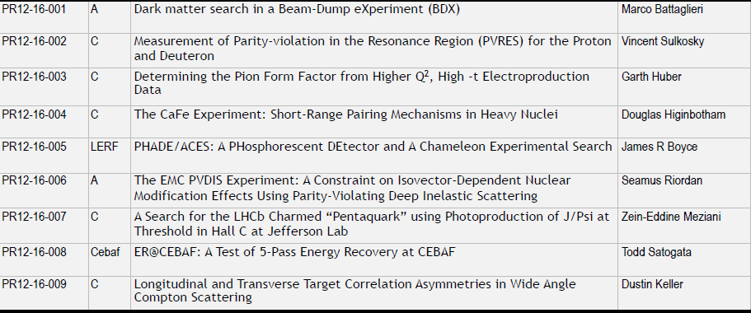
New Proposals for PAC44
Only 12-16-002,003,004,007, would be Stage II if approved

Slide 12
New Run Group Proposals
PR12-16-010 would be Stage II if approved

Slide 13
Conditional Returning for Approval
These would be Stage II if approved

Slide 14
Parallel Running Additions
These run in parallel with previously approved proposals. So they are considered already approved and are presented by collaborations – the PAC will provide a written comment for each of these in the report.

Slide 15
Letters of Intent
Letters of intent will be given the same “rights” to their scientific ideas as are
currently afforded to deferred experiments: LOI has established a claim to a physics measurement that lasts for the next two successive PAC meetings.

