Slide 1
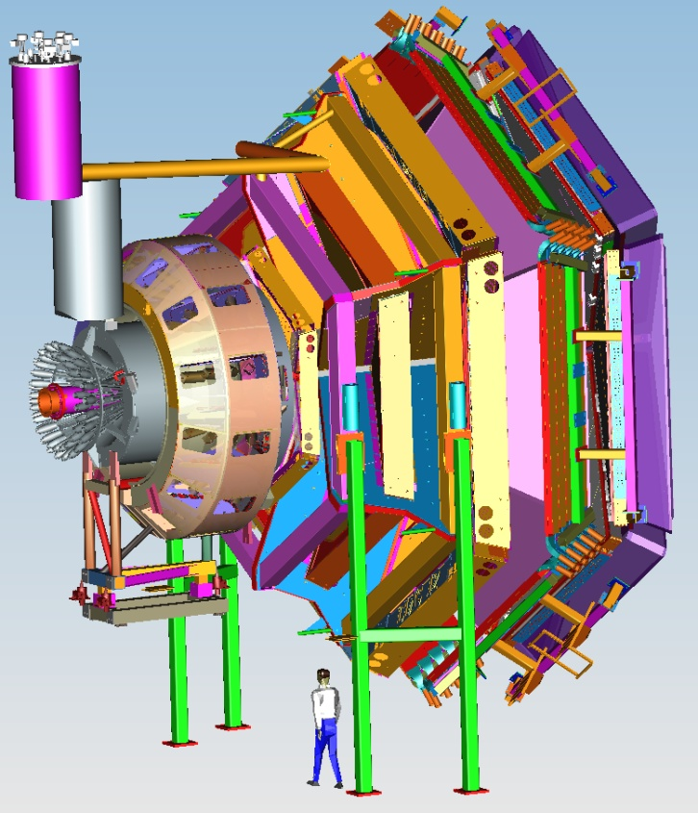



Hall B Run Group Additions
Volker D. Burkert
Hall B Run Groups
E12-06-108B
E12-06-109A
CLAS12

Slide 2
Hall B Proposals for PAC44
RG A E12-06-108B Transition FF of the η’ Meson wit CLAS12 (M. Kunkel, IKP Juelich)
RG C E12-06-109A DVCS w/ long. pol. deuterium (S. Niccolai, Orsay U.)
New RG K (Confinement & Strong QCD)
- PR12-16-010 Nucleon resonance structure via KY electroproduction (D. Carman)
- PR12-16-010A A search for Hybrid Baryons in Hall with CLAS12 (A. D’Angelo)
- PR12-16-010B DVCS w/ CLAS12 at 6.6 and 8.8 GeV (L. Elouadrhiri)
New RG L (ALERT)
- PR12-16-011 Tagged EMC measurements on Light Nuclei (R. Dupre)
- PR12-16-011A Partonic Structure of Light Nuclei (Z.-E. Meziani)
- PR12-16-011B Tagged DVCS on Light Nuclei (W. Armstrong)
- PR12-16-011C Other Physics Opportunities with the ALERT Run Group
New RG M (tbd)
- C12-15-004 DVCS on the neutron with long. polarized deuteron target (S. Niccolai)
- C12-15-004A DIS on longitudinally polarized deuterium (S. Kuhn)
- C12-15-004B SIDIS on long. polarized deuterium (S. Pisano)
LOI-16-004 Electroproduction of muon pairs: Double DVCS & J/ψ (S. Stepanyan)

Slide 3
Hall B – Run Groups
Proposal | Physics | Contact | Rating | Days | Group | New equipment | Energy | Run Group | Target
E12-06-108 | Hard exclusive electro-production of π⁰, η | Stoler | B | 80 | 139 | RICH (1 sector) Forward tagger | 11 | A F. Sabatié | liquid H₂
E12-06-108A | Exclusive N*->KY Studies with CLAS12 | Carman |  | (60)
E12-06-108B | Transition Form Factor of the η’ Meson with CLAS12 | Kunkel |  | (80)
E12-06-112 | Proton’s quark dynamics in SIDIS pion production | Avakian | A | 60
E12-06-112A | Semi-inclusive Λ productiuon in target fragmentation region | Mirazita |  | (60)
E12-06-112B | Colinear nucleon structure at twist-3 | Pisano |  | (60)
E12-06-119(a) | Deeply Virtual Compton Scattering | Sabatie | A | 80
E12-09-003 | Excitation of nucleon resonances at high Q² | Gothe | B+ | 40
E12-11-005 | Hadron spectroscopy with forward tagger | Battaglieri | A- | 119
E12-11-005A | Photoproduction of the very strangest baryon | Guo |  | (120)
E12-12-001 | Timelike Compton Scatt. & J/ψ production in e+e- | Nadel-Turonski | A- | 120
E12-12-007 | Exclusive φ meson electroproduction with CLAS12 | Stoler, Weiss | B+ | 60
E12-07-104 | Neutron magnetic form factor | Gilfoyle | A- | 30 | 90 | Neutron detector RICH (1 sector) Forward tagger | 11 | B K. Hafidi | liquid D₂ target
E12-09-007(a) | Study of partonic distributions in SIDIS kaon production | Hafidi | A- | 30
E12-09-008 | Boer-Mulders asymmetry in K SIDIS w/ H and D targets | Contalbrigo | A- | 56
E12-09-008A | Hadron production in target fragmentation region | Mirazita |  | (60)
E12-09-008B | Colinear nucleon structuer at twist-3 | Pisano |  | (60)
E12-11-003 | DVCS on neutron target | Niccolai | A | 90
E12-11-003A | In medium structure functions, SRC, and the EMC effect | Hen |  | (90)
Beam time partial sum |  |  |  | 765 (1275) | 229
Experiment ending with A or B are run group experiments approved by the CLAS collaboration. They are running parallel to the experiments with same experiment number. Experiments ending with (a) and (b) take data with both run groups.

Slide 4
Hall B – Run Groups
E12-06-109 | Longitudinal Spin Structure of the Nucleon | Kuhn | A | 80 | 185 | Polarized target RICH (1 sector) Forward tagger | 11 | C S. Kuhn | NH₃ ND₃
E12-06-109A | DVCS on the neutron with polarized deuterium target | Niccolai |  | (60)
E12-06- 119(b) | DVCS on longitudinally polarized proton target | Sabatie | A | 120
E12-07-107 | Spin-Orbit Correl. with Longitudinally polarized target | Avakian | A- | 103
E12-09-007(b) | Study of partonic distributions using SIDIS K production | Hafidi | A- | 80
E12-09-009 | Spin-Orbit correlations in K production w/ pol. targets | Avakian | B+ | 103
E12-06-106 | Color transparency in exclusive vector meson production | Hafidi | B+ | 60 | 60 |  | 11 | D
E12-06-117 | Quark propagation and hadron formation | Brooks | A- | 60 | 60 |  | 11 | E | Nuclear
E12-06-113 | Free Neutron structure at large x | Bueltman | A | 40 | 42 | Radial TPC | 11 | F | Gas D₂
E12-14-001 | EMC effect in spin structure functions | Brooks | B+ | 55 | 55 | Pol. LiH target | 11 | G | _{LiH}
TOTAL CLAS12 run time (approved experiments) |  |  |  | 1466 (1976) | 631
Proposal | Physics | Contact | Rating | Days | Group | Equipment | Energy | Group | Target
C12-11-111 | SIDIS on transverse polarized target | Contalbrigo | A | 110 | 110 | Transverse target | 11 | H | HD
C12-12-009 | Transversity w/ di-hadron on transvere target | Avakian | A | 110
C12-12-010 | DVCS with transverse polarized target in CLAS12 | Elouadrhriri | A | 110
All CLAS12 transverse target proposals |  |  |  | 330 | 110
C12-11-006 | Heavy Photon Search at Jefferson Lab (HPS) | Jaros | A | 180 | 180 | Setup in alcove | 2.2, 6.6 | I | Nuclear
E12-11-106 | High Precision Measurement of the Proton Charge Radius | Gasparian | A | 15 | 15 | Primex | 1.1, 2.2 | J | H2 gas
Beam time request from CLAS12 C1 experiments + non-CLAS12 experiments |  |  |  | 525 | 305
Beam time from approved CLAS12 experiments (from previous table) |  |  |  | 1466 (1976) | 631
Beam time for Hall B experiments table 1 + table 2 |  |  |  | 1991 (2501) | 936

Slide 5
Transition FF of the η’ Meson with CLAS12
Open Questions in the Standard Model (SM)
Predictions of the amount of matter surviving annihilation after the Big Bang
  many orders of magnitude less than observed
Masses of particles are parameters in SM
  SM does not provide understanding why values of masses span many orders of magnitude
Phenomena like Dark Matter and Dark Energy are not explained within SM
Many other issues suggest physics beyond the SM
  Currently a promising candidate for a signal for new physics is the muon anomaly a_{μ} = (g-2)/2

Slide 6
The muon anomaly
a_{μ} = (g-2)/2
Low energy observable
  Can be measured and computed to high precision
  Present value a_{μ} = 1 165 920 89 (63) x 10⁻¹¹
  Deviates from predictions by 3σ, depending on how leading order hadronic corrections are evaluated
    Δa_{μ} = (287 ± 80) x 10⁻¹¹
    Δa_{μ} = (261 ± 18) x 10⁻¹¹
  Deviations not large enough to claim failure of SM
    Currently the largest deviation of a SM prediction from what is observed
  Largest uncertainty arise from hadronic quantum corrections
    Hadronic vacuum polarization (HVP)
    Hadronic light-by-light scattering (HLbL)

Slide 7
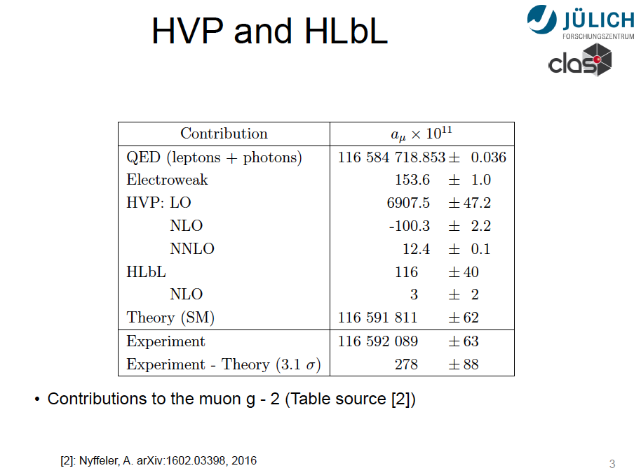
The muon anomaly
HVP and HLbL

Slide 8
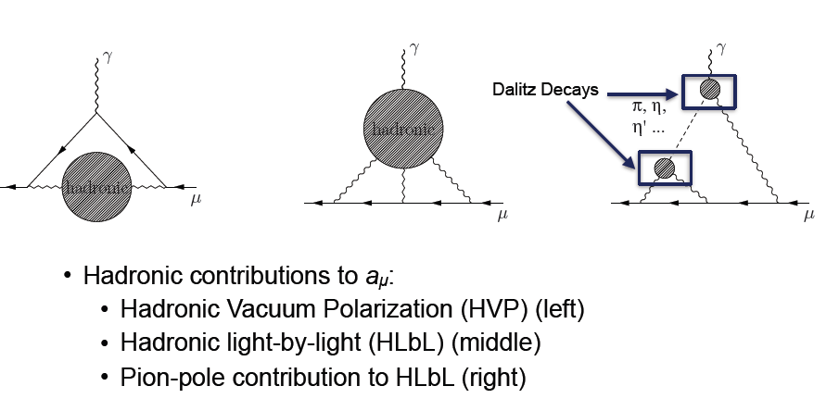
The muon anomaly
HVP and HLbL

Slide 9
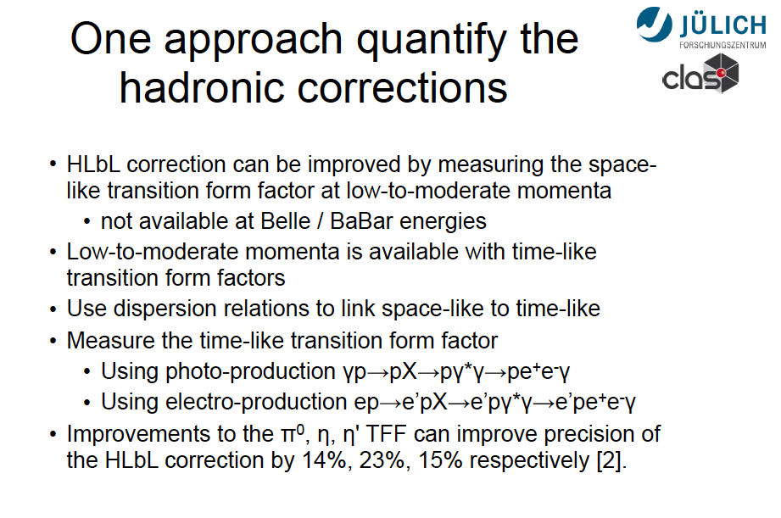
Hadronic corrections

Slide 10
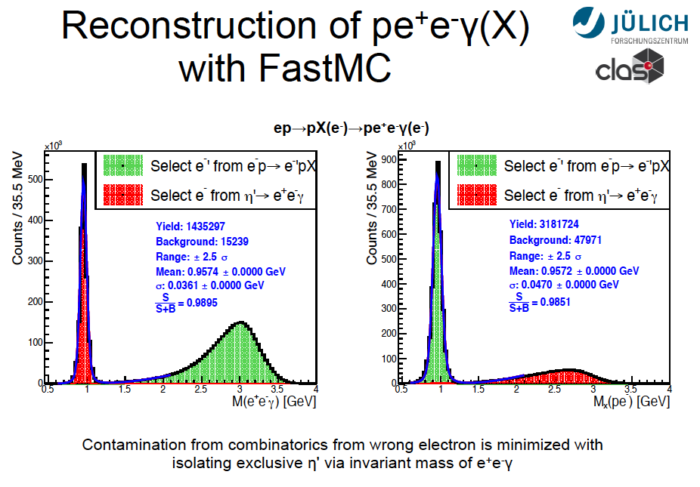
Experimental Aspects

Slide 11
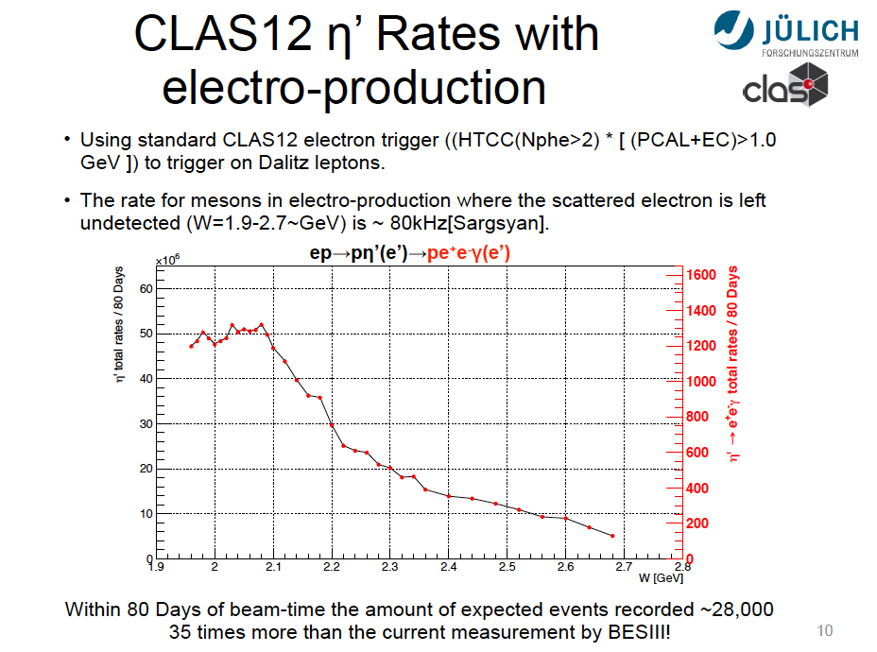
Expected Rates

Slide 12
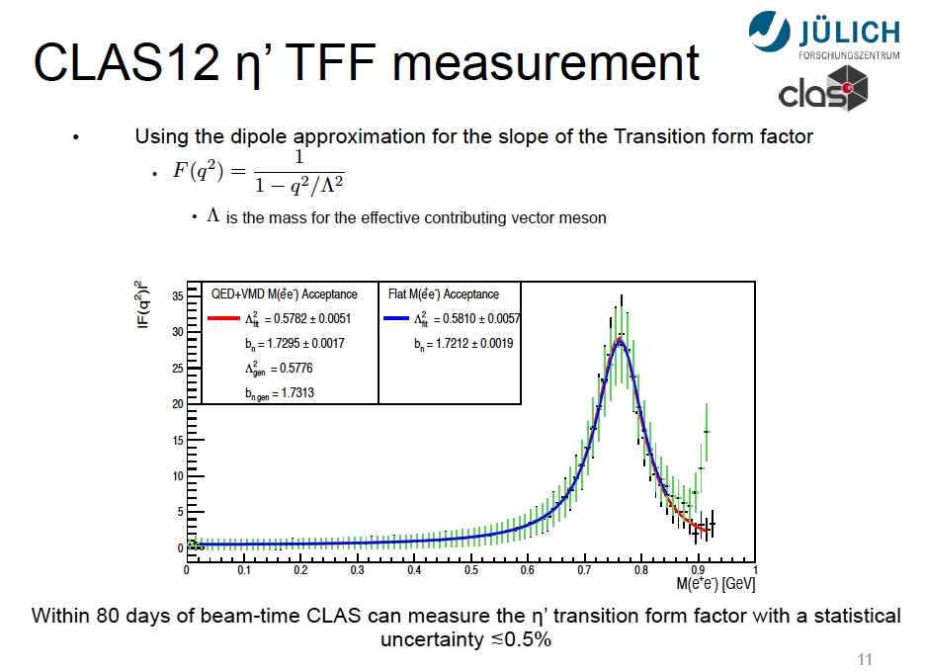
Expected Results

Slide 13
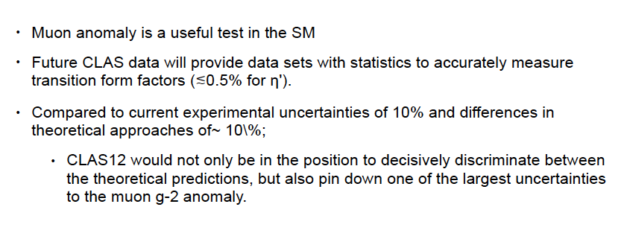
Summary

Slide 14
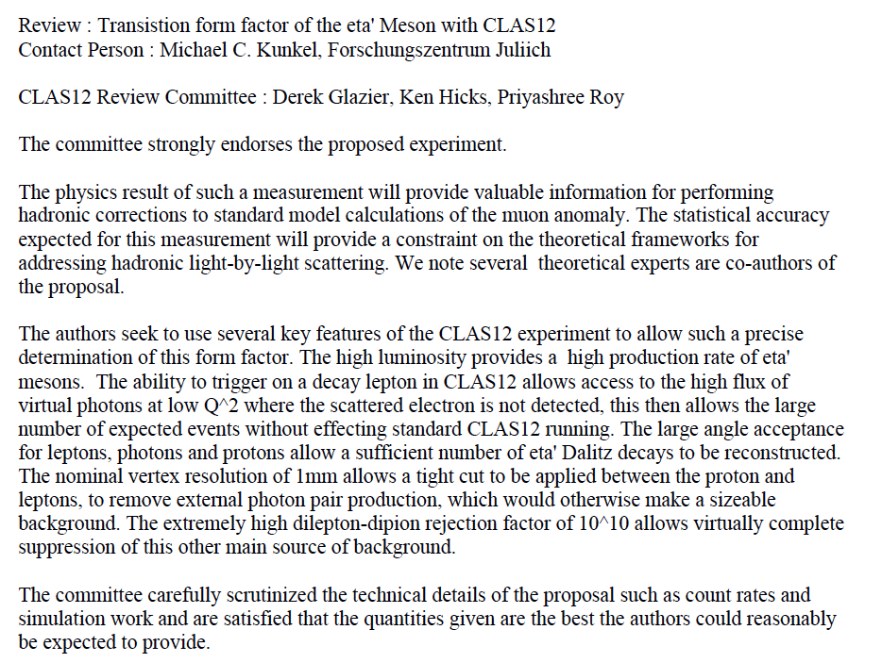
E12-06-108B
Report of CLAS collaboration Evaluation Committee

Slide 15
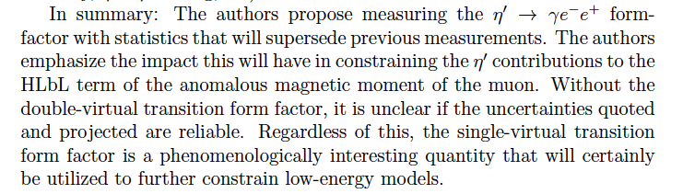
Theory Comments

Slide 16
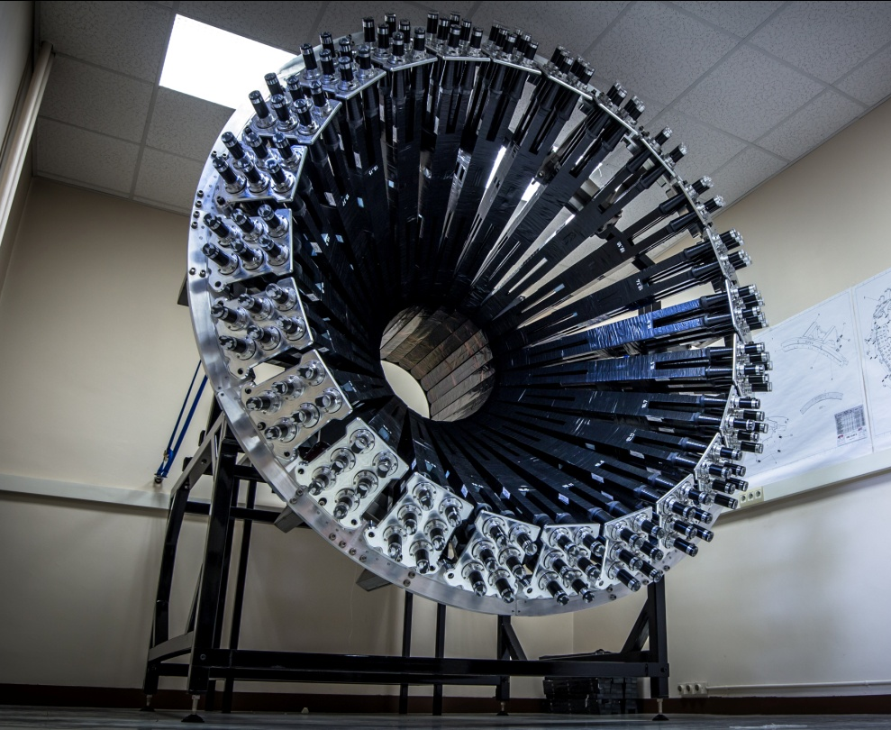
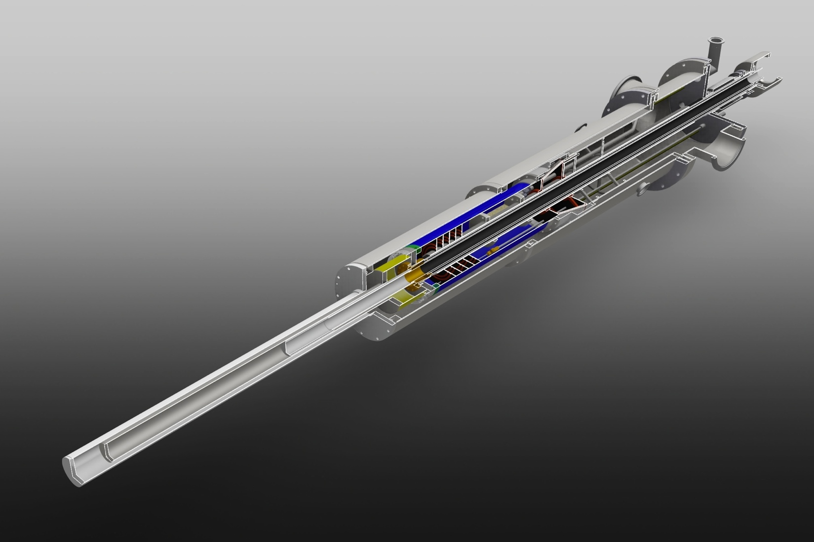
E12-06-109A
Deeply Virtual Compton Scattering on the neutron with a longitudinally polarized deuterium target
CLAS12 Run group Cb
A. Biselli, C. Keith, S. Pisano, S. Niccolai, D. Sokhan, et al.
A CLAS Collaboration Proposal

Slide 17
Deeply Virtual Compton Scattering and GPDs
e’
e
t
γ
γ*
(Q²)
factorization
x+ξ
x-ξ
~
~
H, H, E, E (x,ξ,t)
N(p)
N(p’)
Polarized beam, unpolarized target:
~
Proton
Neutron
Im{H_{p}, H_{p}, E_{p}}
~
Δσ_{LU} ~ sinφ Im{F₁H + ξ(F₁+F₂)H -kF₂E}
~
Im{H_{n}, H_{n}, E_{n}}
Unpolarized beam, longitudinal target:
~
Im{H_{p}, H_{p}}
~
~
Δσ_{UL} ~ sinφIm{F₁H+ξ(F₁+F₂)(H + x_{B}/2E) –ξkF₂ E+…}
Im{H_{n}, E_{n}}
Polarized beam, longitudinal target:
~
Re{H_{p}, H_{p}}
~
Δσ_{LL} ~ (A+Bcosφ)Re{F₁H+ξ(F₁+F₂)(H + x_{B}/2E)…}
Re{H_{n}, E_{n}}
Unpolarized beam, transverse target:
Im{H_{p}, E_{p}}
Im{H_{n}}
ξ= x_{B}/(2-x_{B})
k=-t/4M²
Δσ_{UT} ~ cosφsin(φ_{s}−φ)Im{k(F₂H – F₁E) +… }

Slide 18
Flavor separation of GPDs
Proton and neutron GPDs (and CFFs) are linear combinations of quark GPDs
A combined analysis of DVCS observables for proton and neutron targets is necessary to perform the flavor separation of the GPDs
Measurements of DVCS on neutron target are crucial for the completion of a comprehensive GPD program for JLab@12 GeV
We propose to extend the JLab experimental program for
nDVCS, started with the beam-spin asymmetry (E12-11-003), by measuring for the first time target-spin single and double asymmetries
We will use the 50 days of beam on longitudinally polarized ND3 of Run Group Cb.

Slide 19
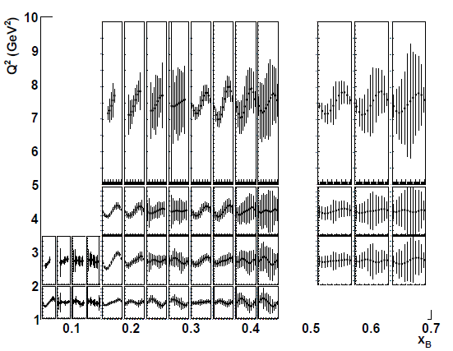
Projected results: target-spin asymmetry
L = 3/20∙10³⁵cm⁻²s⁻¹, Time = 50 days , P_{t} = 0.4
1
0
-t
1.2
TSA ~ 0.2
Count rates computed with nDVCS+BH event
generator + CLAS12 acceptance using FastMC + CND efficiency from GEANT4 simulation
Asymmetries computed with VGG model.
First time measurement
0
-1
• 4 bins in Q²
• 4 bins in −t
• 4 bins in x_{B}
• 12 bins in φ
(Same as E12-11-003)

Slide 20
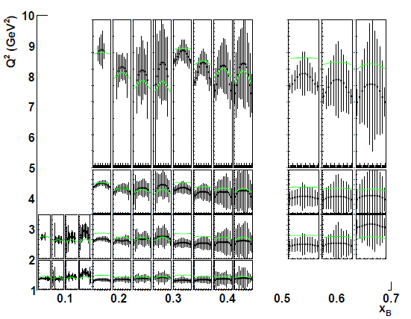
Projected results: double spin asymmetry
L = 3/20∙10³⁵cm⁻²s⁻¹ , Time = 50 days , P_{t} = 0.4; P_{b} = 0.85
Count rates computed with nDVCS+BH event generator
+ CLAS12 acceptance from FastMC + CND efficiency from GEANT4 simulation
Asymmetries computed with VGG model
1.2
0
-t
1.2
DSA up to 0.8
0
First time measurement
-0.6
• 4 bins in Q²
• 4 bins in −t
• 4 bins in x_{B}
• 12 bins in φ
(Same as E12-11-003)
Green curves:
Bethe-Heitler

Slide 21
Combined analysis of E12-06-109a and E12-11-003
ImH_{n}
Extraction of neutron CFFs using M. Guidal fitting code. Fit of TSA, DSA (E12-06-109a) and BSA (E12-11-003)
7 CFFs as free fit parameters
ImE = 0
~

Slide 22
Combined analysis of E12-06-109a and E12-11-003
ImE_{n}
Extraction of neutron CFFs using M. Guidal fitting code. Fit of TSA, DSA (E12-06-109a) and BSA (E12-11-003)
7 CFFs as free fit parameters
ImE = 0
~

Slide 23
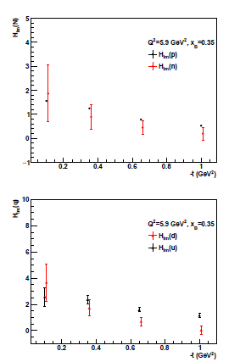
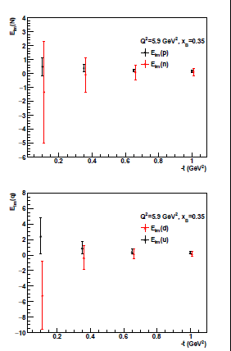
Projections for flavor separation (ImH, ImE)
Nucleon CFFs
Fit using all the projected pDVCS asymmetries of the CLAS12 program
Fit using the projected nDVCS asymmetries of E12-06-109a and E12-11-003
Quark CFFs

Slide 24
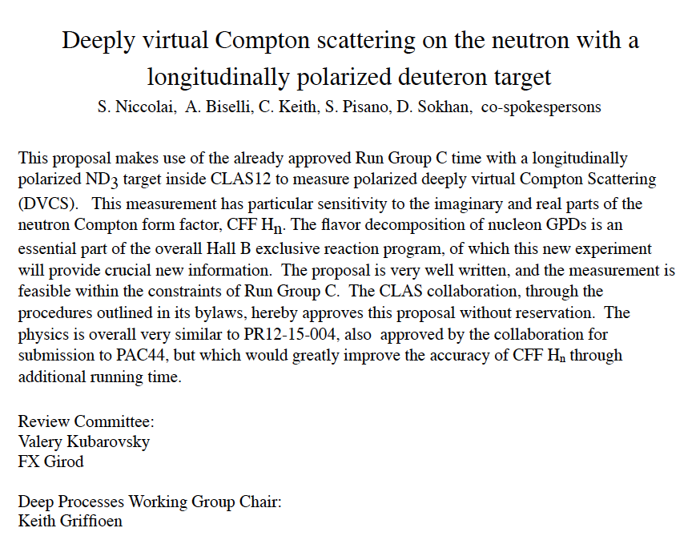
E12-06-109A
Report of CLAS collaboration Evaluation Committee

