Slide 1
Building 1.3 Ghz SRF Copper Substrate Cavities for SRF Applications
J. Spradlin, A. Palczewski, L. Phillips, H. Tian, B. Clemens, & C. Reece
Jefferson Lab – SRF Institute – Process & Materials Analysis Group
7th International Workshop on Thin Films and New Ideas for Pushing the Limits of RF Superconductivity

Slide 2
Copper Cavity Fabrication Scope
Produce Cu cavities as deposition substrates
1.3 GHz “Low Surface Field” (LSF) cell geometry
Started with initial batch of eight cavities
Minimalist approach to parts handling and acceptance criteria
Issues arose with fabrication, both EBW and chemistry
Reworked process for weld prep and weld parameters
Used reject parts as development tools
Salvaged cavity now serving as a prototype - in CBP
Started the next batch of cavities with vetted procedures

Slide 3
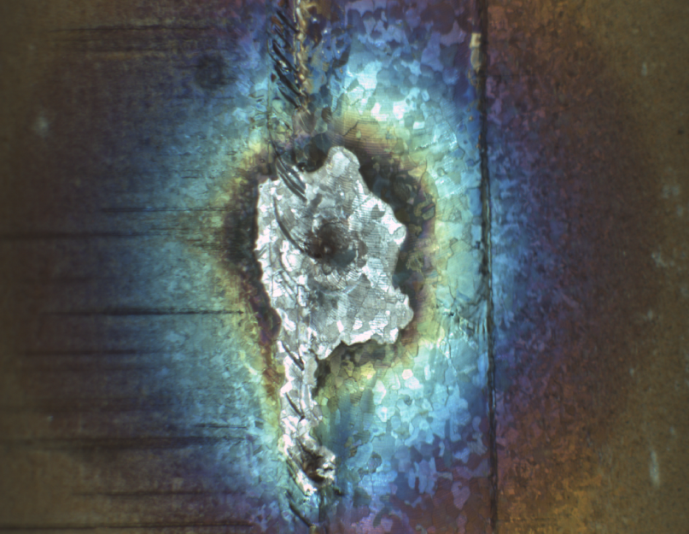
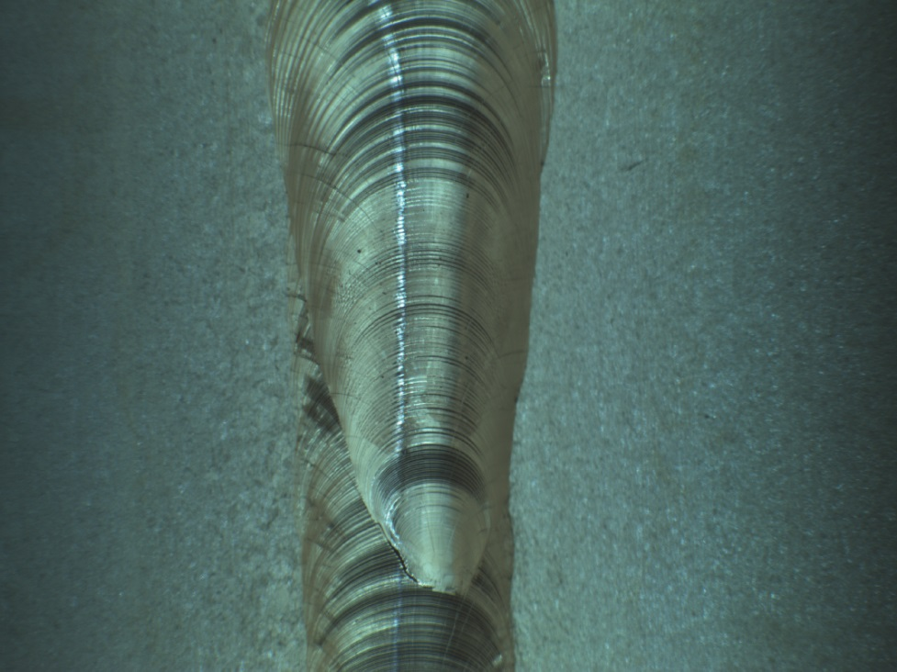
What went wrong?
Welds had an array of “features” that are not desirable for an RF cavity or substrate
Voids, pits, uneven HAZ, and lack of part joining
Poor Weld
Good Weld
With residues present in the weld region, or insufficient weld spot energy, cracks / voids / features result, which subsequently trap species from chemistry compounding problems

Slide 4
Diagnosis & Corrective Actions
Contamination in the weld region was identified as the root cause of “features”
Implemented methods used for Nb cavity fabrication
Weld trim back & Inspections for burs and surface imperfections
Aggressive parts etch and strict handling procedures leading into EBW
Optimized weld parameters
Weld is sensitive to thermal history and part mass
Pre-heating parts prior to welding provides consistent reproducible seams

Slide 5
Cu Cavity Fabrication Process (1/2)
Process Step
Quality Control
Corrective Action
Stock Selection
Resource Stock
Q/C on Pedigree
Cut and Shape Beam Tubes and ½ Cells
Reject or Repair
Q/C on Dimensions
Weld Trim Back
Reject or Repair
Q/C on Dimensions & Appearance
Braze SS316 Transitions to Beam Tubes
Reject or Repair
Q/C on Braze
EBW SS316 Flanges to Beam Tube Transitions
Reject or Repair
Q/C on EBW
Iris Weld Prep Etch
½ Cell Iris to Beam Tube with Flange
Re-etch or Reject
Q/C on Appearance
Weld ½ Cell Iris to Beam Tube
Reject or Repair
Q/C on Appearance
Equator Weld Prep Etch
½ Cell with Beam Tube & Flange
Re-etch or Reject
Q/C on Appearance
Weld ½ Cells @ Equator
Reject or Repair
Q/C on Appearance
Reject or Repair

Slide 6
Cu Cavity Fabrication Process (2/2)
Process Step
Quality Control
Corrective Action
CBP Step 1
Repeat CBP Step 1, Repeat Cu BCP, or Reject
Q/C on Appearance
Etch Cavity
Cu BCP 30 µm
Re-etch or Reject
Q/C on Appearance
CBP Step 2
Repeat CBP Step 2, Repeat Cu BCP, or Reject
Q/C on Appearance
Etch Cavity
Cu BCP 30 µm
Re-etch or Reject
Q/C on Appearance
CBP Step 3
Repeat CBP Step 3, Repeat Cu BCP, or Reject
Q/C on Appearance
Etch Cavity
Cu BCP 30 µm
Re-etch or Reject
Q/C on Appearance
Tune Cavity
Reject or Repair
Q/C on Appearance
HPR Cavity
Repeat HPR, Re-etch, or Reject
Q/C on Appearance
EP Cavity
Re-etch, Re-CBP, or Reject
Q/C on Appearance

Slide 7
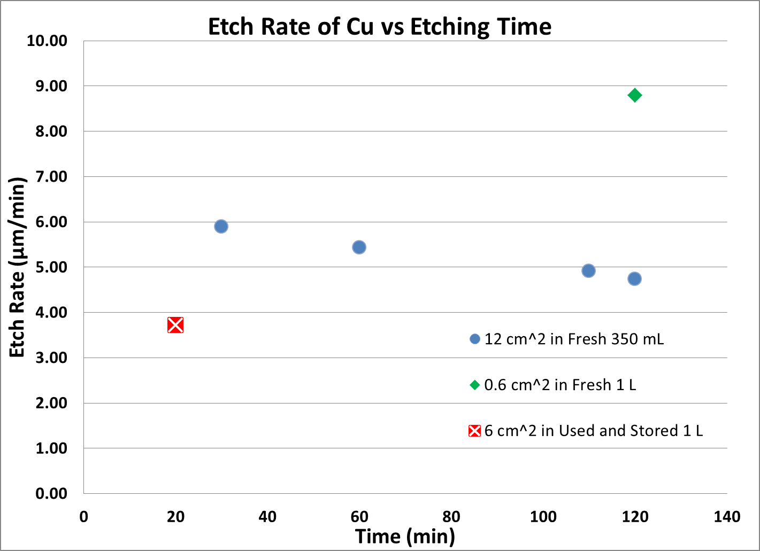
Copper Buffer Chemical Polish
Transene Aluminum Etch A / Cu BCP
H₃PO₄ : HNO₃ : HAc : H₂O (18:1:1:2)
4.5 to 6 µm / min @ 23 °C for conditions comparable to a cavity
Reported 2.4 µm / min @ 50 °C
12 cm³ Cu Fresh 350 mL 2 hr
0.6 cm³ in Fresh 1 L for 2 hr
25kX
25kX
Best Case /
Highest Etch Rate
8.8 µm / min
0.47 g / L
Closest to Cavity Conditions
5.5 µm / min
17 g / L
5kX
5kX
Bad!
3.72 µm / min
0.4 g / L

Slide 8
Weld Preparation Chemistry Process
Process Step
Quality Control
Corrective Action
Clean Parts
Correct Dimensions, Braze, or Weld Issues
then Re-clean, De-bur, & Re-clean
Q/C on Appearance & Burs
DI Rinse
Q/C on Appearance
Methanol Rinse
Q/C on Appearance
Anti-Static N₂ Dry
Q/C on Appearance
Cu BCP Etch
HPO₄ + HNO₃ + HAc + DI (16:1:1:2)
Q/C on Appearance
DI Rinse
1st Drag Retain then to Resistivity
Re-etch for 10 – 15 µm
Q/C on Appearance
Sulfamic
Q/C on Appearance
DI Rinse
1st Drag Retain then to Resistivity
Re-etch for 10 – 15 µm
Q/C on Appearance
Methanol Rinse
Q/C on Appearance
Anti-Static N₂ Dry
Re-etch for 10 – 15 µm

Slide 9
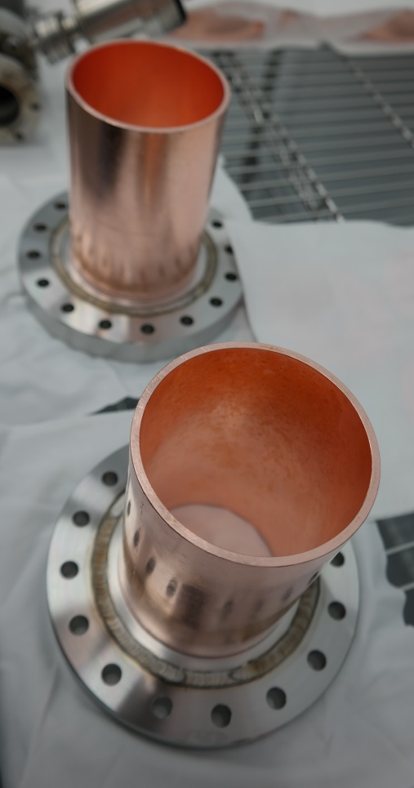
Weld Prep
As-Welded Beam Tube
Cleaned Beam Tube
(2) Cu Cavity’s Etched Parts Awaiting Assembly for EBW
Cu BCP Weld Prep Fixture

Slide 10
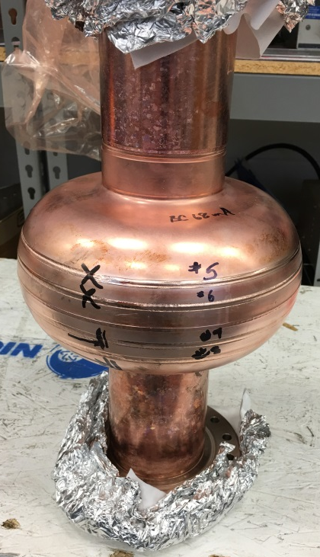
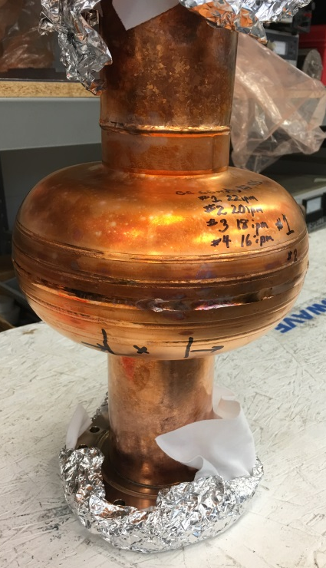
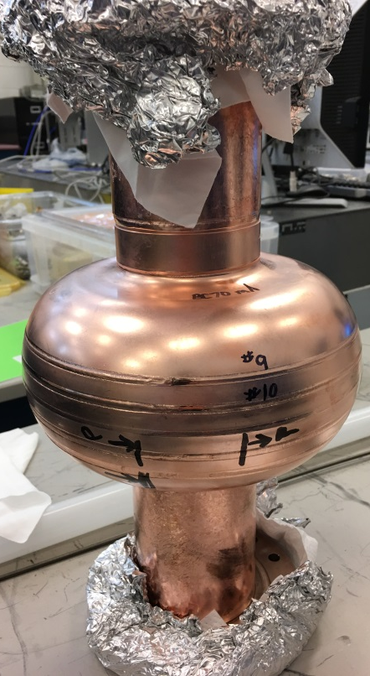
Finding the Right Weld Parameters
We experimented with a variety of current and feed speed combinations with full-mass test cavities.

Slide 11
Welding Cu Cavities
We use 1/8” (~3.175 mm) Cu sheet
Same forming dies as for bulk Nb cavities
We sought a full-thickness, full-penetration weld parameter
Cu EBW is very different from Nb EBW
Much lower melting temperature
Much higher thermal conductivity
Found that the part starting temperature greatly affects attaining full penetration
Residual EBW heat in the Cu parts significantly affects Cu weld penetration even after 1 hour!
Managed pre-heating is necessary to realize consistent results
Amount of required pre-heat scales with total part mass

Slide 12
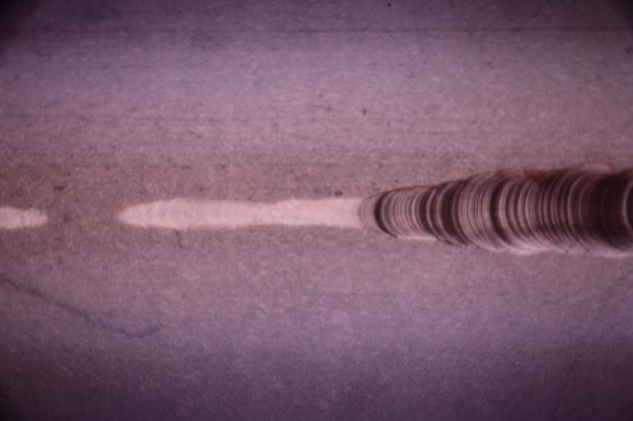
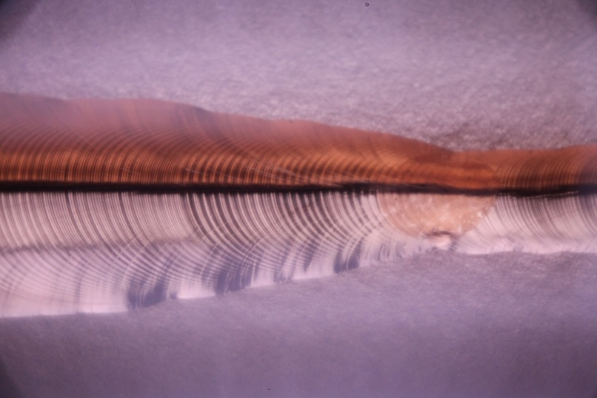
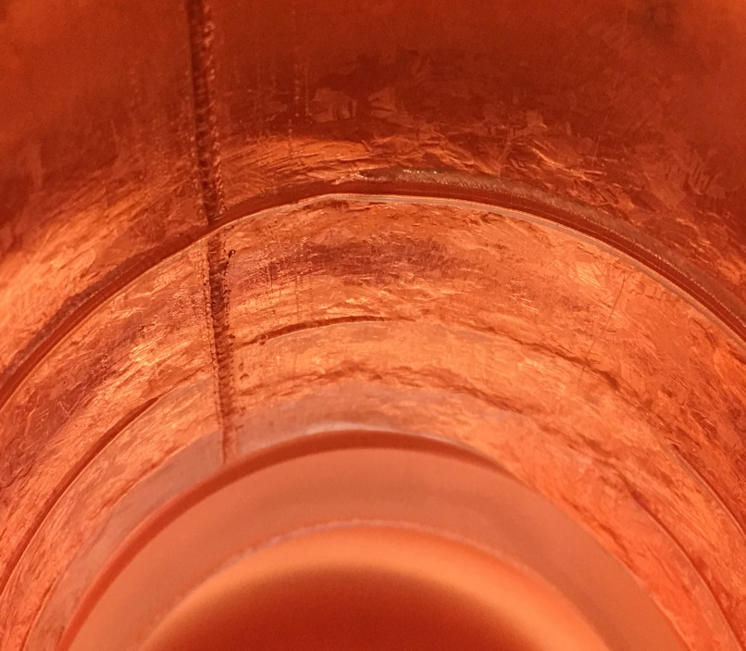
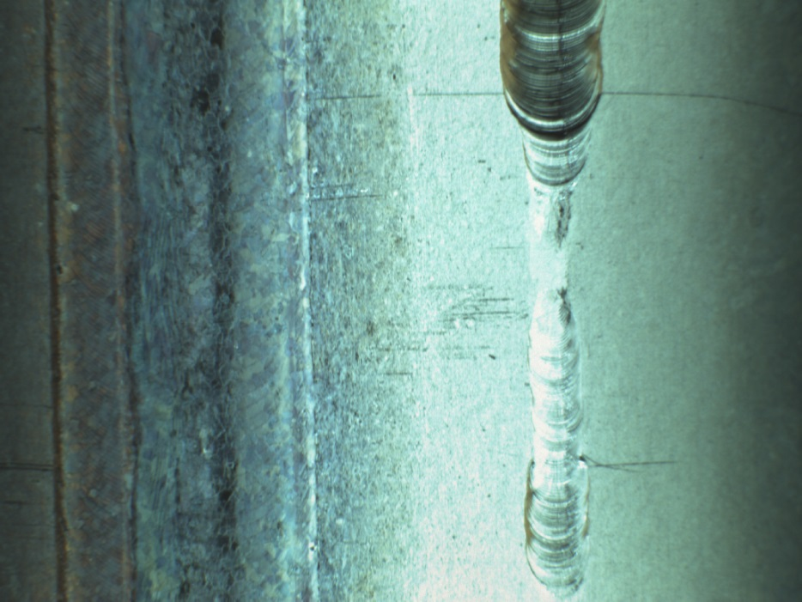
Weld Quality Examples
Uneven HAZ
Incomplete Penetration
Full Penetration
Full Penetration
Full Penetration
Inadequate preheat yields inadequate weld penetration.
Incomplete Penetration
Incomplete Penetration
Semi-Full Penetration

Slide 13
Welding Parameters
Further refinement is quite possible, but this is what we are working with now.
Our current weld parameters:
Gun voltage – V = 50 kV
Beam current – I_{weld} = 74 mA
Weld speed – 20 ipm (50.8 cm/m)
Oval puddling raster - approx. 0.055" x 0.125“
Focus point above the surface
Immediately precede this weld with a pre-heating sealing-pass weld with total energy deposition sufficient to bring whole-part equilibrium temperature to ~118°C.
From development cavity weld studies: ~280 kJ is required to raise whole cavity, 8 kg Cu, from 27 °C to ~118°C neglecting radiant heat losses
I_{preheat} = 48 mA, other parameters the same

Slide 14
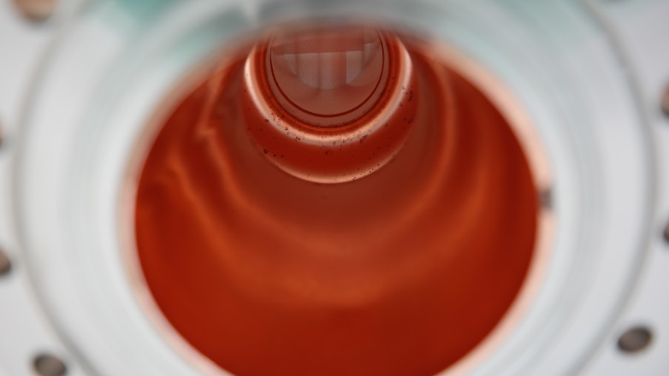
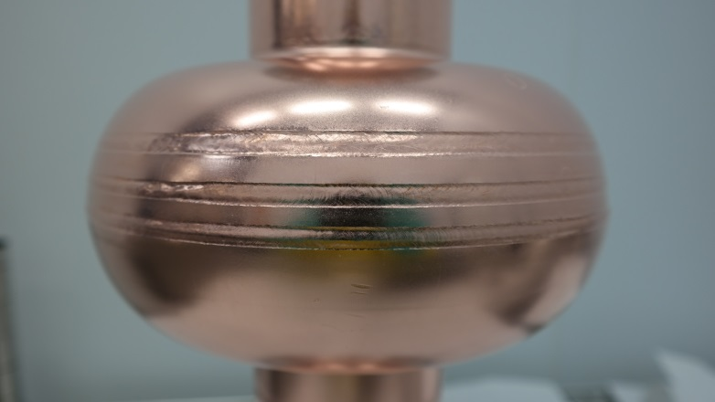
Cu Cavity CBP 1st Step + Cu BCP Etch
Slight Water Staining on Cell
Slight Water Staining on Cell
Clean Finish on Beam Tube Interior
Clean Finish on Beam Tube Interior

Slide 15
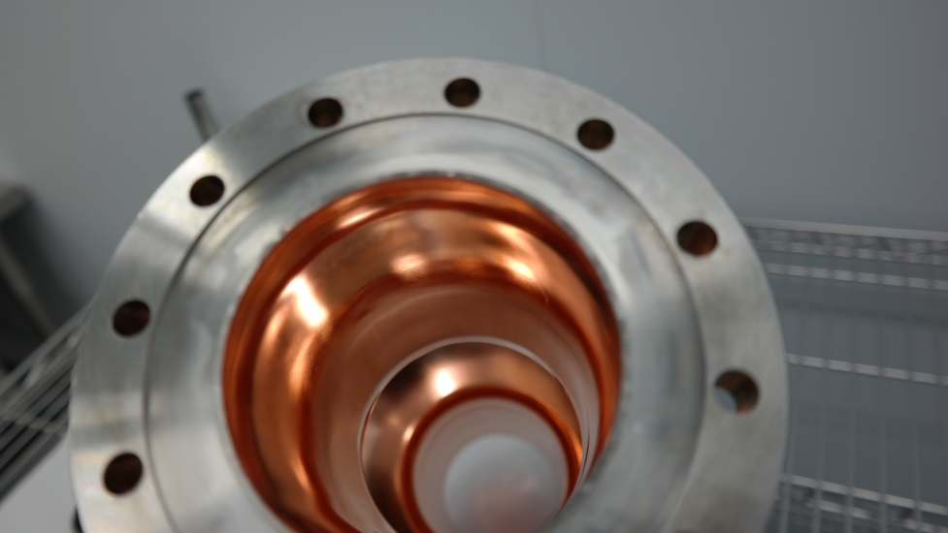
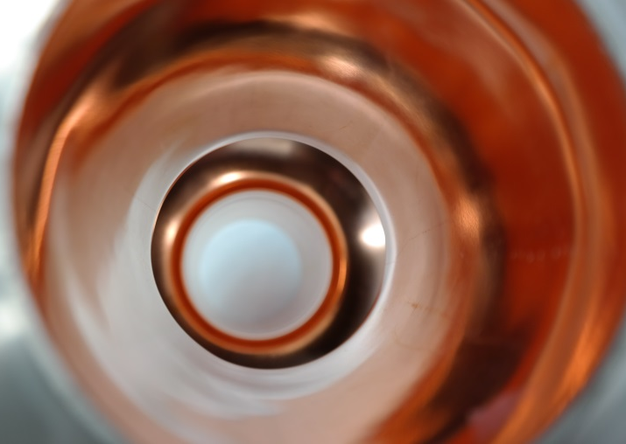
Cu Cavity Final EP Surface
CBP + EP – Stain Free after Sulfamic Rinse

Slide 16
Cu Cavity Fabrication Status
Had some minor delays in fabrication of Cu cavities due to poor quality EBW seams
Weld consistency / reproducibility was poor
Across a single join and comparing between joins of similar parts
Visible arcing in the welding process!
Aligned weld pre-process with Nb cavity fabrication
Emphasis on cleanliness!
Optimized weld parameters for consistent results
Part thermal character / history is crucial!
Once residues in the seam were removed… it was found that the thermal mass and history of parts influence weld quality
Cu has higher thermal conductivity and heat capacity compared to Nb → heat removed from HAZ faster and subsequently requires more local energy (i.e. beam power & / or part pre-heat)
Started second batch of cavities this week!

Slide 17
Acknowledgements
This work is supported by the U.S. Department of Energy, Office of Science, Office of Nuclear Physics under contract: DE-AC05-06OR2317
Jefferson Lab SRF Operations & R&D:
Parts Machining, Forming, & Brazing: S. Williams
Welding: K. Worland & A. Auston
Chemistry & CBP: J. Follkie, T. Harris, A. Anderson, & C. Johnson
Dimensioning: B. Carpenter & A. G. DeKerlegand
Tuning: D. Forehand, R. Overton, & C. Dreyfuss
AASC Collaboration

Slide 18
Cu BCP Etch Rate Surface Morphology Comparison
12 cm² in Fresh 350 mL Cu BCP for 2 hours
0.6 cm² in Fresh 1 L Cu BCP for 2 hours
6 cm² in Used & Stored 1 L Cu BCP for 20 min

Slide 19
Cu BCP Etch Rate Surface Morphology Comparison
0.6 cm² in Fresh 1 L Cu BCP for 2 hours

Slide 20
Cu BCP Etch Rate Surface Morphology Comparison
12 cm² in Fresh 350 mL Cu BCP for 2 hours

