Slide 1
Status Report on Reactive Ion Etching of SRF Cavities in an RF Ar/Cl₂ Discharge
Jeremy Peshl,ª J. Upadhyay,ª A. Palczewski,^{b} D. Im,ª S. Popovic,ª
A.-M. Valente-Feliciano,^{b} L. Philips,^{b} and L. Vuskovicª
ªDepartment of Physics, Center for Accelerator Sciences
Old Dominion University, Norfolk, VA
^{b}Thomas Jefferson National Accelerator Facility, Newport News, VA

Slide 2
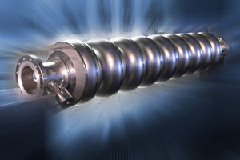
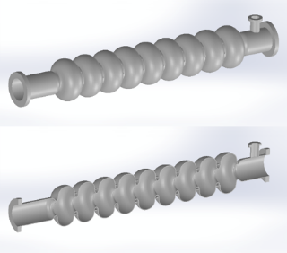
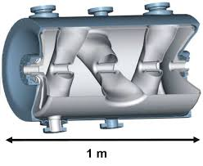
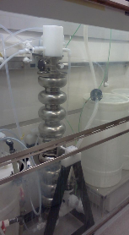
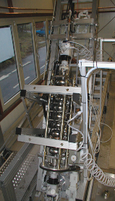
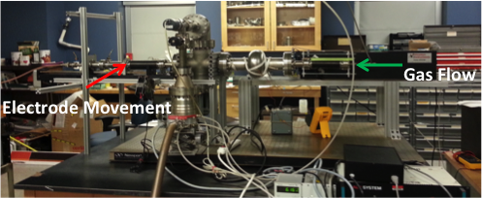
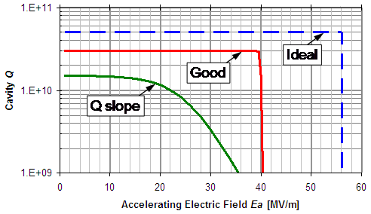
Superconducting Radio Frequency Cavity
Elliptical SRF cavity made of Niobium,
Superconducting material at 9.2K
9 cell Elliptical SRF cavities are 1m long and 1.5 GHz has approx. 15 cm diameter
Complex shaped crabbing cavity
BCP and EP of the cavity with
The help of HF and other acids
Experimental Set-up for Plasma Etching of Single Cell SRF Cavity
Q₀ Versus E_{acc} Graphs for SRF Cavity

Slide 3
Motivation and Challenges
Challenges
Etching of inner surface of a three dimensional object
Removal of 10-150 microns of material from large surface area
Transportation of the removed material outside of the vacuum system
Uniform plasma surface interaction on inner surface of a long cylindrical object with constant or varying diameter
Characterization and modeling of the coaxial plasma, specifically the electronegative coaxial plasma
Establish correlation between process parameters and observables
Increasing the etching rate and reducing the surface roughness
Motivation
Low cost in both setup and operation
No wet chemistry (specially no HF)
Environment and people friendly
(compare to wet etching process)
Full control on the final surface (A variety of surfaces can be intentionally created through plasma processing, such as pure niobium pent oxide, doping of any material or thin films like superconducting niobium nitride…)

Slide 4
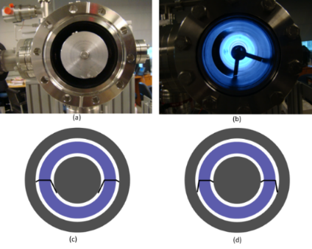
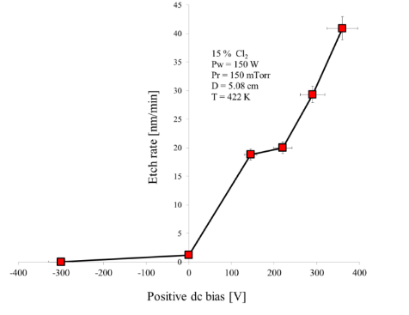
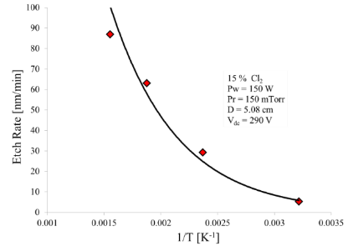
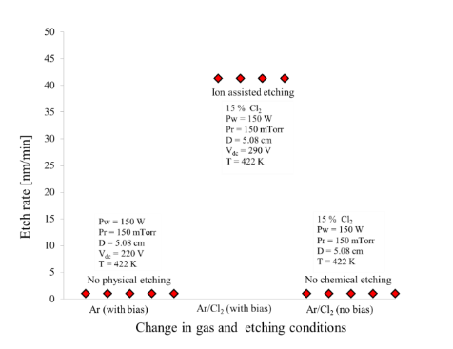
Etching Mechanism of Niobium in Ar/Cl₂ Plasma
Establish correlation between process parameters and observables
Sheath Voltage in Coaxial Plasma with dc Bias
Etch Rate as a Function of Nb Temperature
Etch Rate as a Function of dc Bias
Etch Rate as a Function of Gas and Etching Conditions
J. Upadhyay et al., J. Appl. Phys. 117, 113301 (2015).

Slide 5
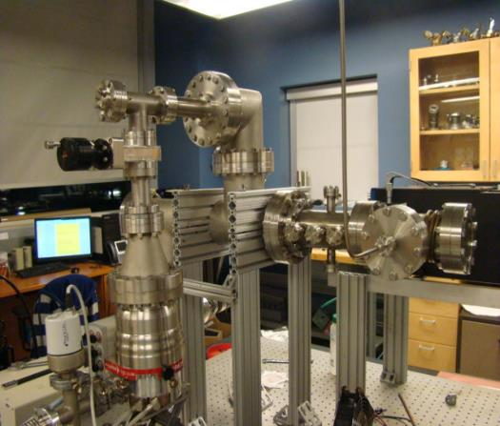
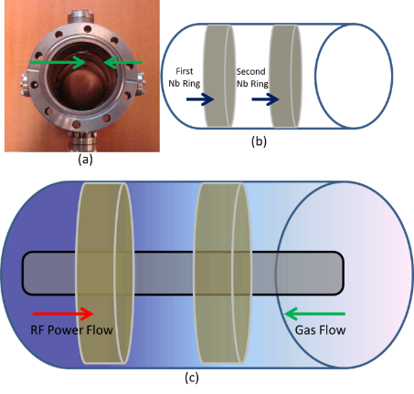
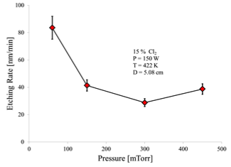
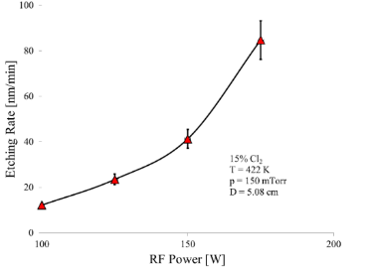
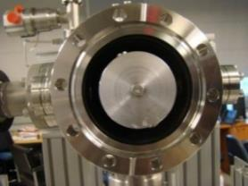
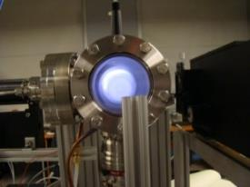
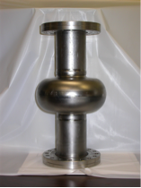
Experimental Setup for Cylindrical Cavity
RF Power
Gas Flow
Etch Rate of Nb as a function of pressure
Experimental Set-up for Cylindrical Cavity
Cylindrical Cavity with ring samples, color gradient shows depletion of radicals at first sample
Front View of Coaxial Electrode Set-up and Plasma in Cylindrical Cavity
Etch Rate of Nb as a function of rf power
Single cell SRF cavity
J. Upadhyay et al., Phys. Rev. ST Accel. Beams. 17, 122001(2014).
Etching of inner surface of three dimensional object (dc bias)

Slide 6
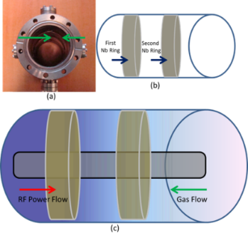
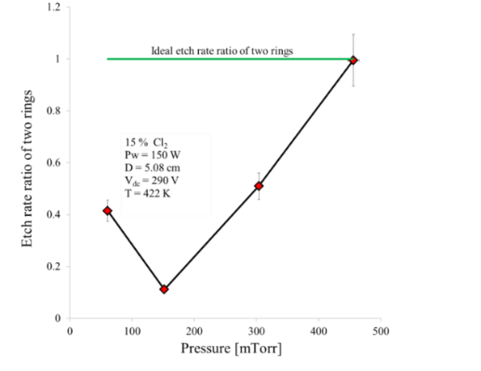
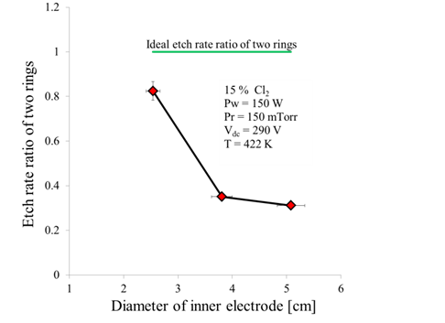
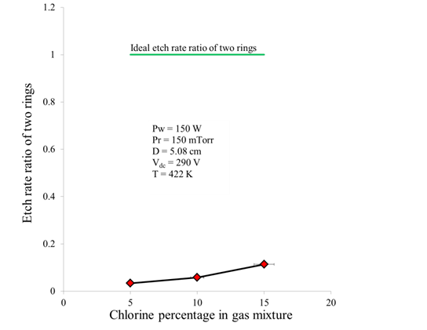
Etch Rate Uniformity Dependence
Uniform plasma surface interaction on inner surface of a long cylindrical object
with constant or varying diameter
Etch Rate Uniformity as a Function of Pressure
Etch Rate Uniformity as Function of Diameter of Electrode
Etch Rate Uniformity as a Function of Chlorine Concentration
J. Upadhyay et al., J. Appl. Phys. 117, 113301 (2015).

Slide 7
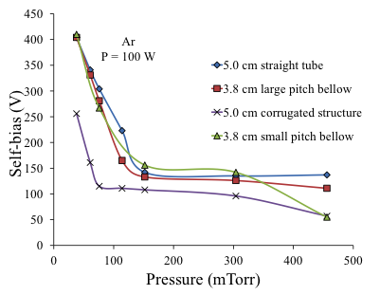
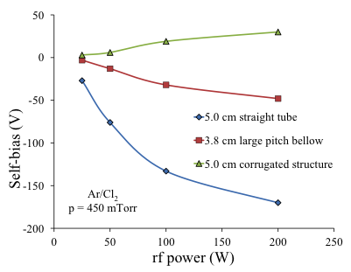
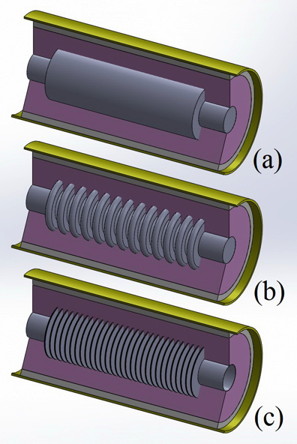
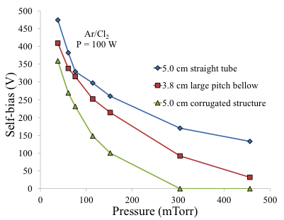
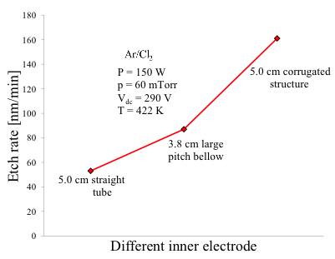
Self-Bias Dependence on Geometry of Electrode
Self-Bias as a Function of Pressure with Different Surface Area Electrode
Self-Bias as Function of Power with Different Surface Area Electrode
Self-Bias as a Function of Pressure with Different Surface Area Electrode
Etch rate variation as a Function of
Different Surface Area Electrode
Different Surface Area Electrode
Reversal of Asymmetry with Disk Loaded Electrode
J. Upadhyay et al., J. Vac. Sci. Technol. A 33, 061309 (2015).

Slide 8
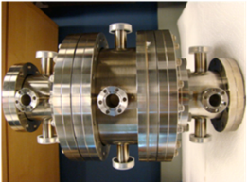
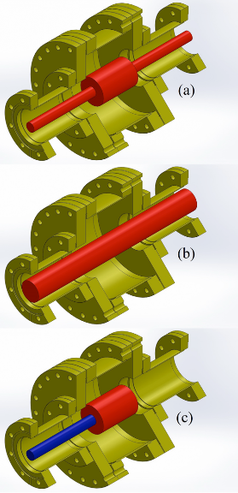
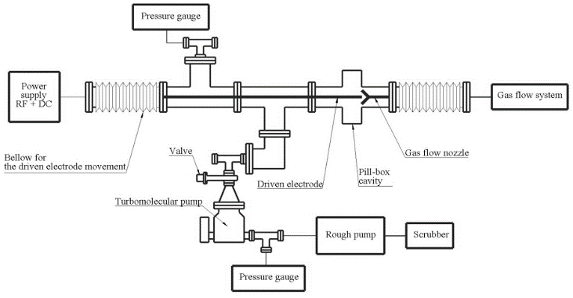
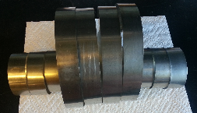
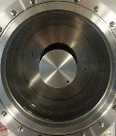
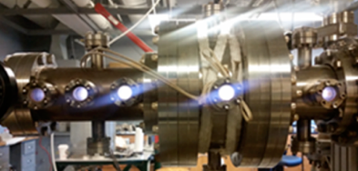
Single Cell Pill Box Cavity
Uniform plasma surface interaction on inner surface of a long cylindrical object with constant or varying diameter
Single cell cavity with pill box cavity
Schematic of Single cell cavity plasma processing experimental setup
Complex plasma asymmetry configuration for pill box cavity plasma processing
Niobium ring samples with plasma inside pill box cavity

Slide 9
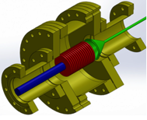
Single Cell SRF Cavity
Experimental Set-up for Plasma Etching of Single Cell SRF Cavity
Pill box cavity with electrode and conical gas flow inlet

Slide 10
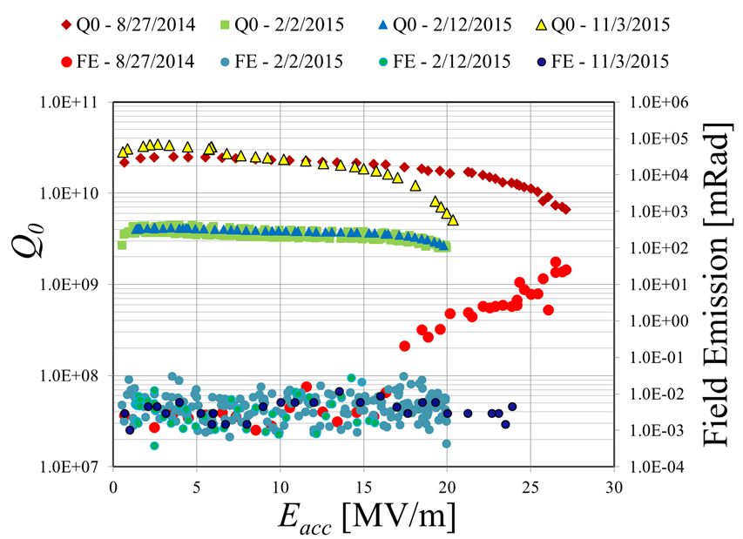
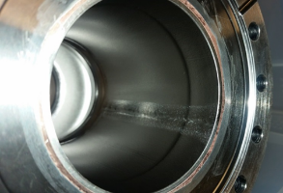
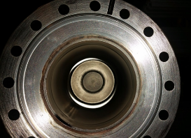
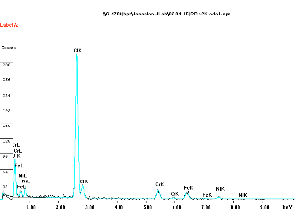
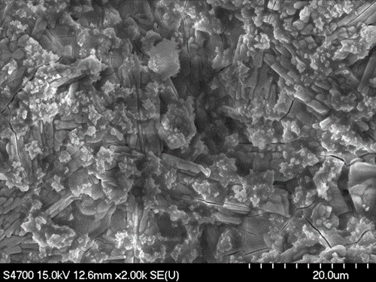
First RF Test of Plasma Etched SRF Cavity
8/27/2014: BCP, 600⁰ C 10-hr bake, degreased, and high water rinsed.
2/2/2015: 24-hr plasma etch, high water rinsed, ultrasonic cleaning.
2/12/2015: 90⁰-140⁰ C 14 bake.
11/03/2015: Chemical aqua regia solution, phosphoric acid rinse. (No HF!)
J. Upadhyay et al, arXiv:1605.06494 (2016).
BCP Single Cell Cavity (8/27/14)
Plasma Etched Single Cell Cavity (2/2/15)
Elemental analysis of the residues
Image of the residues

Slide 11
Induced Field Emission for FE Suppression

Slide 12
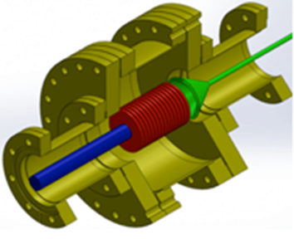
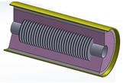
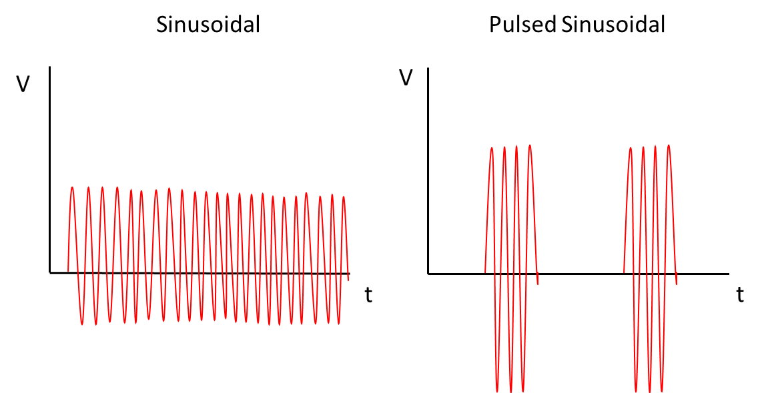
Increasing Q₀, Efficiency and Etch Rate
Increasing Q₀: All Niobium System
Efficiency: Pulsed Operation
Etch Rate: Tailoring the AIEDF
Sinusoidal: No Bias
Sinusoidal: Bias
Pulsed Sinusoidal: Bias
Pulsed Periodic: Nonsinusoidal
IEDF
IEDF
IEDF
IEDF
E_{act}
E
E_{act}
E
E_{act}
E
E_{act}
E
No Etching
Etching, High surface roughness
Faster etching, Less surface roughness
Faster etching, Minimal surface roughness

Slide 13
Concluding Remarks
Accomplishments
Etching of inner surface of three dimensional object
Removal of 10-150 microns of material from large surface area
Establish correlation between process parameters and observables
Uniform plasma surface interaction on inner surface of a long cylindrical object with constant or varying diameter
Current and Future Work
Transportation of the removed material outside of the vacuum system
Characterization and modeling of the coaxial plasma, specifically the electronegative coaxial plasma: OES Diagnostics
Converting all working parts to Niobium: Increasing Q₀
Pulsed RF power source: Efficiency
AIEDF tailoring: Etch Rate and Surface Roughness

Slide 14
Thank You
Work support by DOE, Grant No. DE-SC0007879

Slide 15
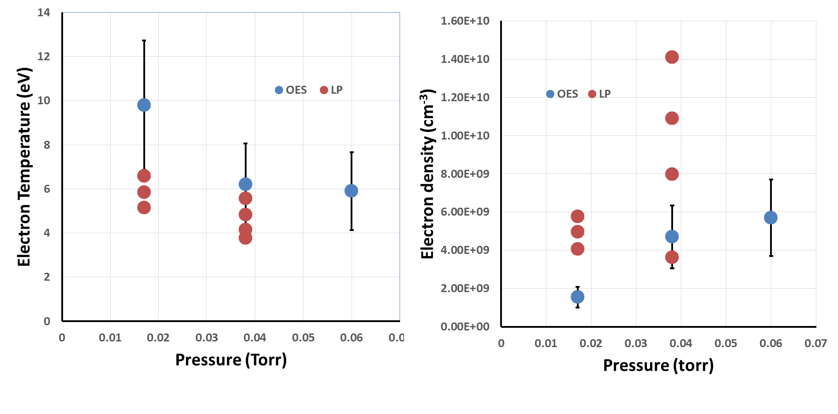
Diagnostics: Langmuir Probe vs. OES
Electron temperature and election density trends using Langmuir Probe and Optical Emission Spectroscopy measurements.

Slide 16
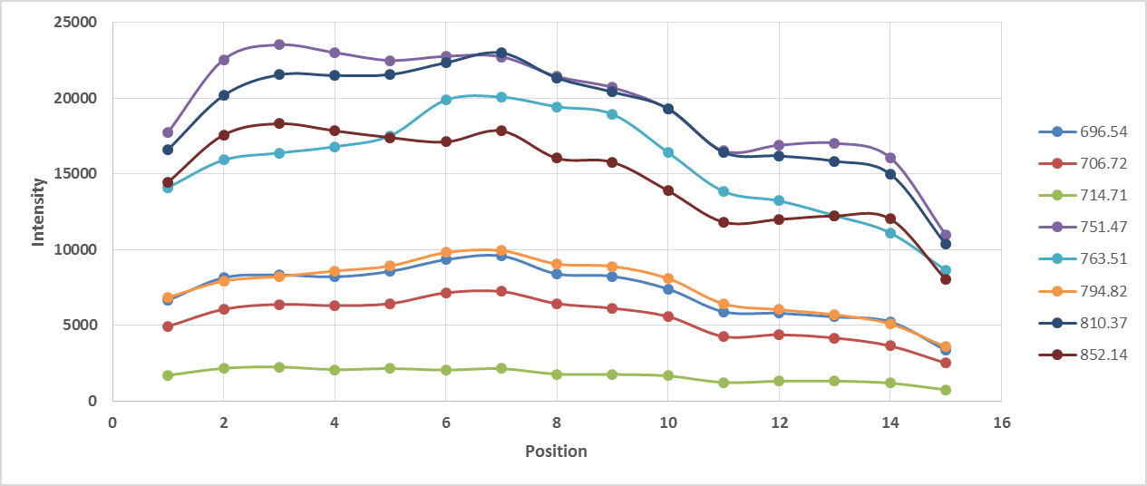
Diagnostics: Optical Emission Spectroscopy
Spectrometer Slit
F.O. Viewing Holes
Fiber Optic
Experimental setup for collection of spectral data in the radial direction.
Intensity profile of each line with respect to radial position at 30 mTorr pressure, 50 W rf power, and no positive DC bias.
Notes:
To ensure consistent measurements along radial positions a lens cap was 3-D printed with equally spaced holes.
A fiber optic cable is used to transfer the light from the discharge to the spectrometer.
Three pressures: 15 mTorr, 30 mTorr, 50 mTorr. 8 spectral lines for each position (15) at 50 W, 100 W, and 150 W. Repeated for no positive DC bias, 0 V total bias, and 200 V total bias.

Slide 17
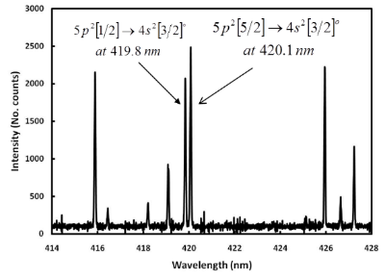
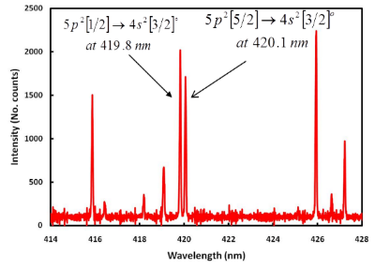
Diagnostics: Optical Emission Spectroscopy
Work by Boffard et al. opens the door to an interesting diagnostic alternative using the kinetic model.
Argon Plasma
Argon/Chlorine Plasma
Ar: $\frac{Φ_{420.1}}{Φ_{419.8}}≥1$Ar/Cl₂: $\frac{Φ_{420.1}}{Φ_{419.8}}≤1$
J. B. Boffard et al., J. Phys. D: Appl. Phys. 45, 045201 (2012).

