Slide 1
μ
Muons, Inc.
GEM*STAR:
ACCELERATOR-DRIVEN SUBCRITICAL REACTOR
FOR IMPROVED SAFETY, WASTE MANAGEMENT,
AND PLUTONIUM DISPOSITION
Rolland P. Johnson
Muons, Inc. (http://www.muonsinc.com/)
Designing a new kind of Accelerator-Driven Subcritical Nuclear Reactor (ADSR)
  intrinsically safe, with large profits
  producing synthetic diesel from natural gas and carbon for the US Navy
Destroy and utilize weapons-grade plutonium
  under 2000 U.S.-Russian Pu Management and Disposition Agreement
Proposed to design GEM*STAR Pilot Plant to DOE NE for $50M
  With very strong team - 4 industries, 2 National Labs, 2 Universities
Mu*STAR a new company has been formed to fund a $800M pilot plant

Slide 2
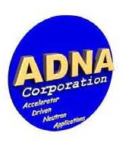
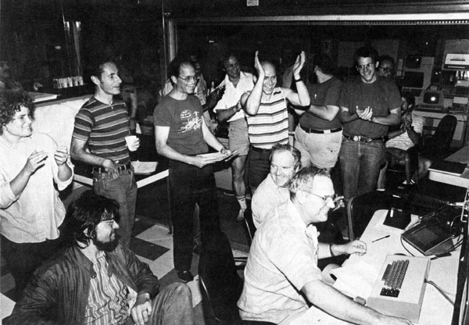
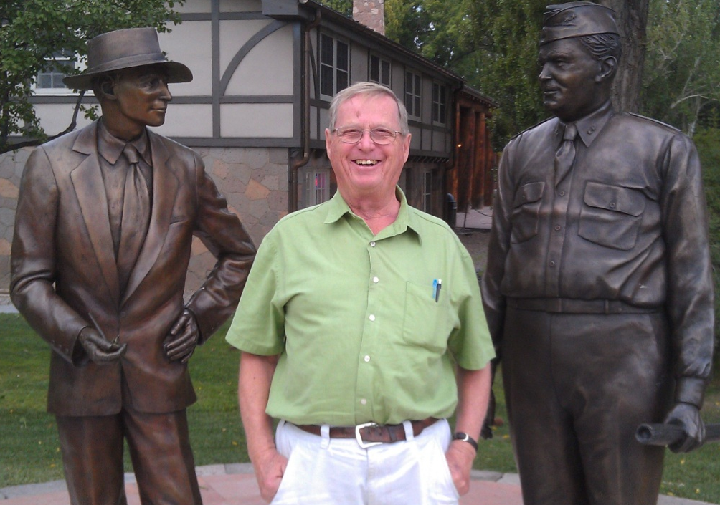
Muons, Inc.
GEM*STAR
Goal: Develop Intrinsically Safe Power
First Customers: NNSA, DOD
μ
Rolland P. Johnson, Ph. D.
President , Muons Inc.
Charles D. Bowman, Ph. D.
President ADNA Corporation
Accelerator-Driven Neutron Applications
512 GeV at Fermilab
Charlie at LANL

Slide 3
GEM*STAR
Reinventing Nuclear Power by Combining Accelerator Technology with Molten Salt Reactor Technology
GEM*STAR
Green Energy Multiplier-Subcritical Technology for Advanced Reactors was first described in the 2010 Handbook of Nuclear Engineering:
Charles D. Bowman, R. Bruce Vogelaar, Edward G. Bilpuch, Calvin R. Howell, Anton P. Tonchev, Werner Tornow, R.L. Walter, “GEM*STAR: The Alternative Reactor Technology Comprising Graphite, Molten Salt, and Accelerators,” Handbook of Nuclear Engineering, Springer Science+Business Media LLC (2010).
GEM*STAR is enabled and extended by recently developed and demonstrated superconducting radio-frequency particle accelerator technology:
Powerful – Affordable – Efficient – Reliable – Still Improving

Slide 4
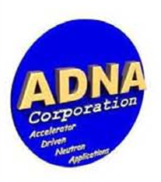
μ
Muons, Inc.
New Nuclear Technology to Produce Inexpensive
Diesel Fuel from Natural Gas and Renewable Carbon
Charles Bowman Rolland P. Johnson
ADNA & CLF Corps Muons, Inc.,
The long-range goal is to sell intrinsically safe and versatile nuclear reactors to address world energy needs.
The first application is an Accelerator-Driven Subcritical Reactor that burns non-enriched Uranium, Thorium, spent fuel from conventional nuclear reactors (SNF), or excess weapons-grade plutonium in a molten salt fuel to produce high-temperature heat to convert Natural Gas and renewable Carbon into liquid fuel for vehicles.
Requires development and interfacing between known technologies that
-use an SRF accelerator to produce an intense source of neutrons to
-generate process heat in GEM*STAR, a molten-salt-fueled subcritical reactor, to
-prepare methane and carbon for the Fischer-Tropsch generation of diesel fuel.

Slide 5
However!
Muons, Inc.
μ
The price of diesel fuel has fallen dramatically in 4years - >$4/g to as low as $1.65
Using nuclear power to produce fuel reduces its carbon footprint, especially if it can be made from natural gas and renewable carbon (e.g. forest fire remnants or urban trash). But without a carbon tax, this is not an incentive yet.
So we have changed our proposal to emphasize profitably burning up weapons-grade plutonium.

Slide 6
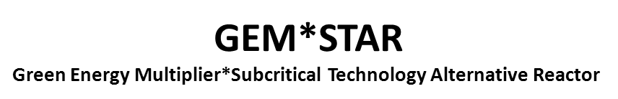
μ
Muons, Inc.
GEM*STAR burns the w-Pu and renders it permanently unusable for nuclear weapons
one 10 MW, 1 GeV proton accelerator feeding four GEM*STAR units burns 34T w-Pu to provide the US DOD with 42Bg green diesel fuel, half of that needed for next 30 years
Profits from producing (renewable) diesel fuel at <$2.00/gallon will inspire funding for a Conceptual Design Report prior to a 3-year demo construction project
DOD (US Navy) interest in 40 billion gallons of green diesel from burning 34 tons of w-Pu on a DOE site could expedite the project

Slide 7
μ
Muons, Inc.
What is new:
  SRF Proton Linacs can now provide extraordinary neutron flux and
    ADSR - safer than BRs,
      That operate at criticality, with many critical masses of fissile material, and fewer delayed neutrons
    ADSR - more weapons proliferation resistant than BRs
      which require enrichment and reprocessing
    ADSR - probably less expensive than BRs
  Molten salt fuel is an advantage over solid fuel pins
    allows continuous purging of volatile radioactive elements
    without zircaloy, that can lead to hydrogen explosions
  Molten salt fuel eases accelerator requirements – no solid fuel fatigue
  Subcritical ADSR operation has always been appreciated
    fission stops when the accelerator is switched off

Slide 8
μ
Muons, Inc.
An intrinsic safety problem for conventional reactors is enclosed solid fuel.
a natural solution is to use molten-salt fuel
that is also well suited to accelerator-driven subcritical reactors.
  A major difficulty is fatigue of UO₂ fuel in rods caused by accelerator trips – no such problem for molten salt fuel
The technology of molten-salt fuel was developed in the 1960s in the Molten-Salt Reactor Experiment (MSRE) at ORNL.
  Use of molten salt fuel was later abandoned
    not enough Pu-239 for bombs?
    President Nixon?
  (See MSRE on wikipedia for nice summary)

Slide 9
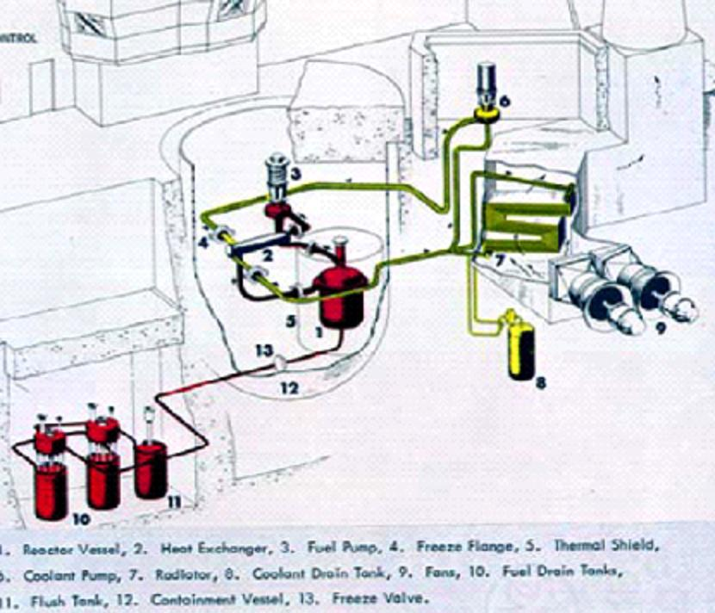
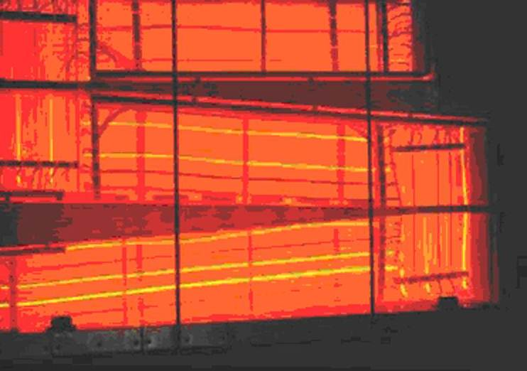
μ
Muons, Inc.
Molten-Salt Reactor Experiment
Glowing radiator

Slide 10
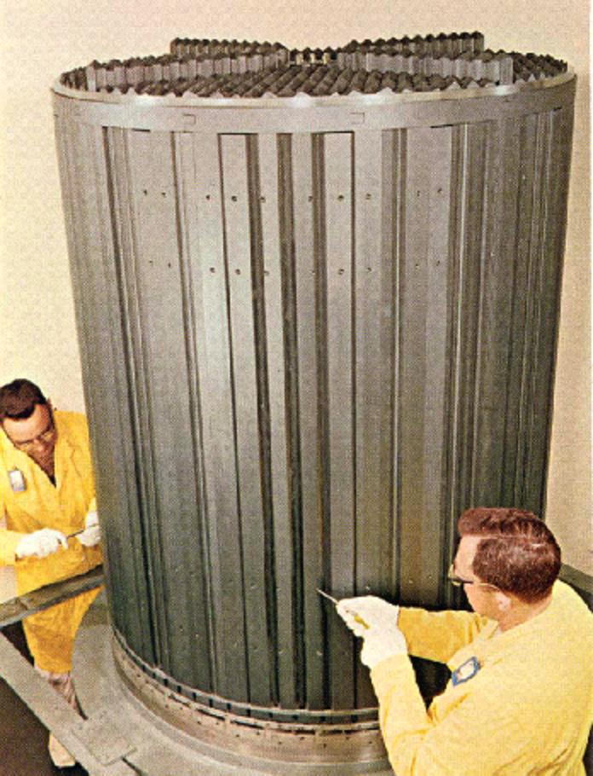
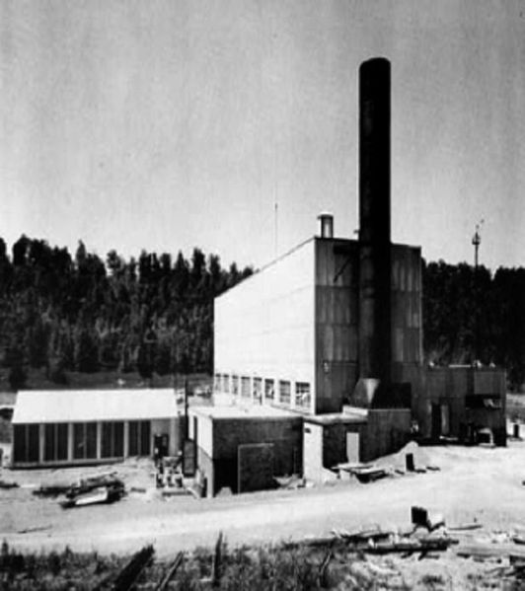
μ
Muons, Inc.
Molten-salt Reactor Experiment

Slide 11
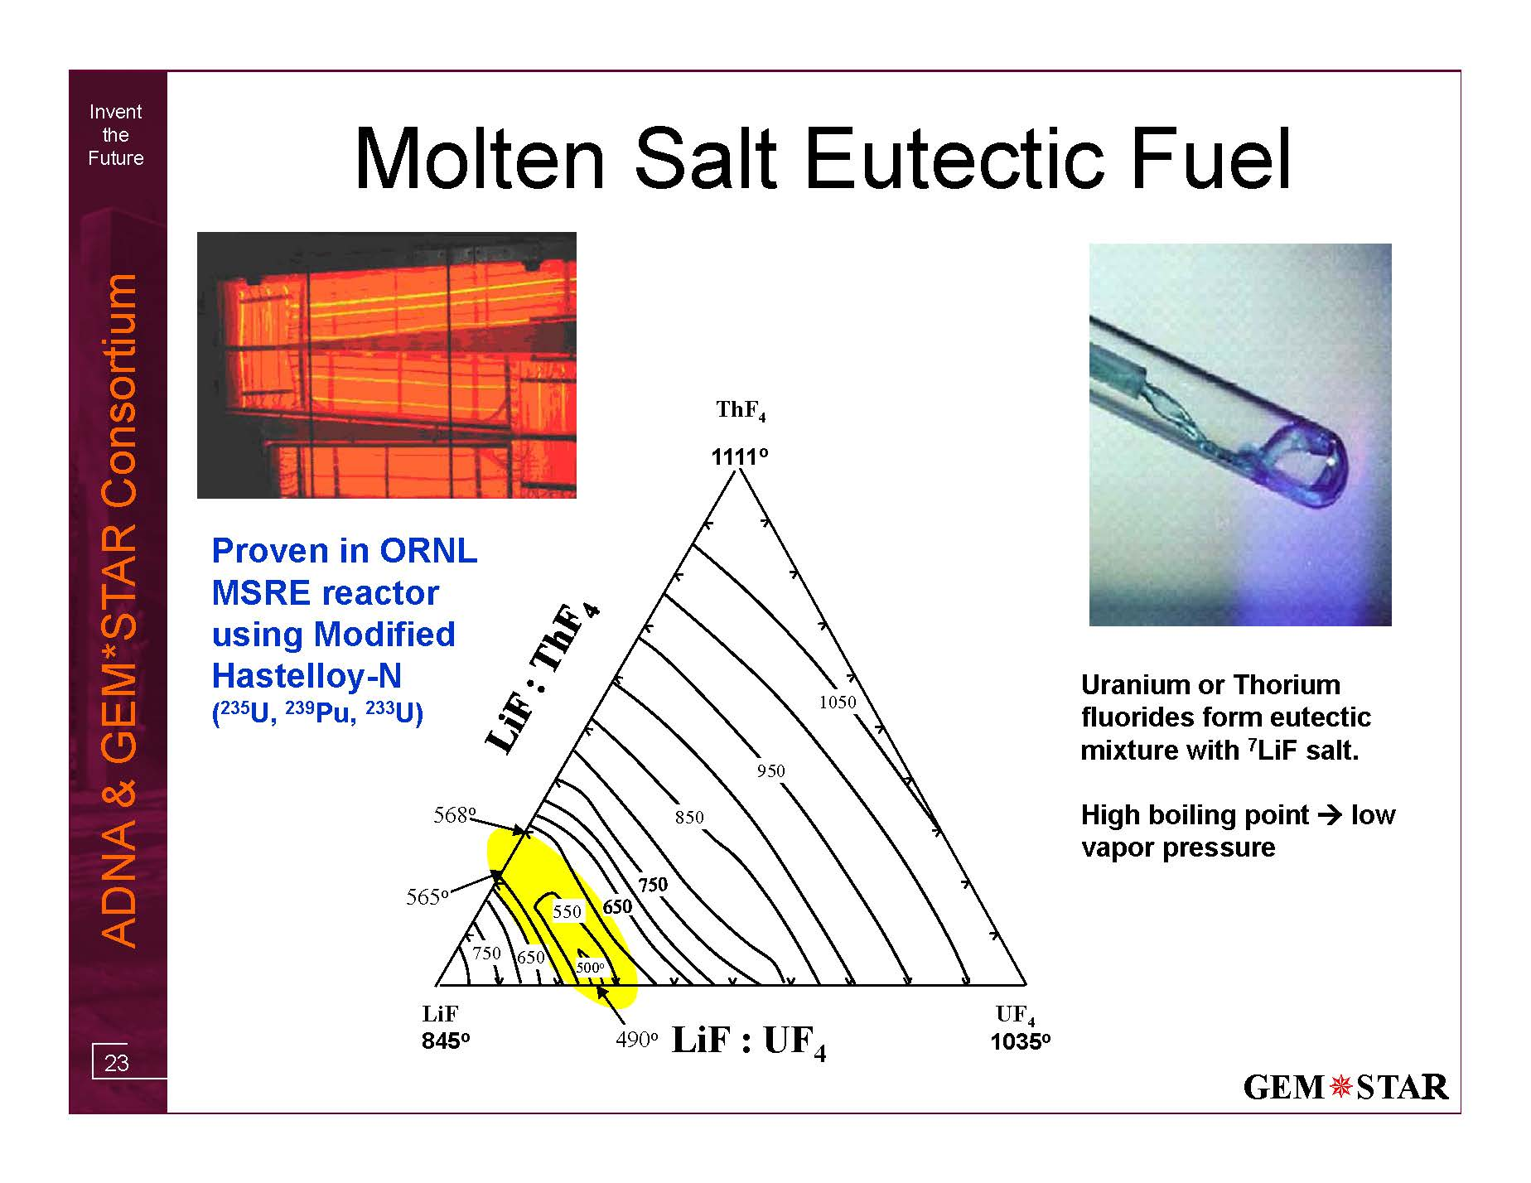

Slide 12
From 1969 MSRE Report Abstract
“The MSRE is an 8-MW(th) reactor in which molten fluoride salt at 1200°F (650 C) circulates through a core of graphite bars. Its purpose was to demonstrate the practicality of the key features of molten-salt power reactors.
Operation with 235U (33% enrichment) in the fuel salt began in June 1965, and by March 1968 nuclear operation amounted to 9,000 equivalent full-power hours. The goal of demonstrating reliability had been attained - over the last 15 months of 235U operation the reactor had been critical 80% of the time. At the end of a 6-month run which climaxed this demonstration, the reactor was shutdown and the 0.9 mole% uranium in the fuel was stripped very efficiently in an on-site fluorination facility. Uranium-233 was then added to the carrier salt, making the MSRE the world's first reactor to be fueled with this fissile material. Nuclear operation was resumed in October 1968, and over 2,500 equivalent full-power hours have now been produced with 233U.
The MSRE has shown that salt handling in an operating reactor is quite practical, the salt chemistry is well behaved, there is practically no corrosion, the nuclear characteristics are very close to predictions, and the system is dynamically stable. Containment of fission products has been excellent and maintenance of radioactive components has been accomplished without unreasonable delay and with very little radiation exposure.
The successful operation of the MSRE is an achievement that should strengthen confidence in the practicality of the molten-salt reactor concept.”
NOW FAST FORWARD 50 YEARS and add an accelerator

Slide 13
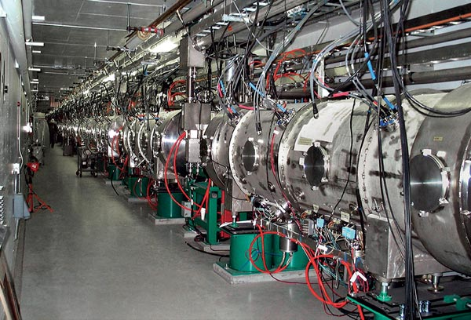
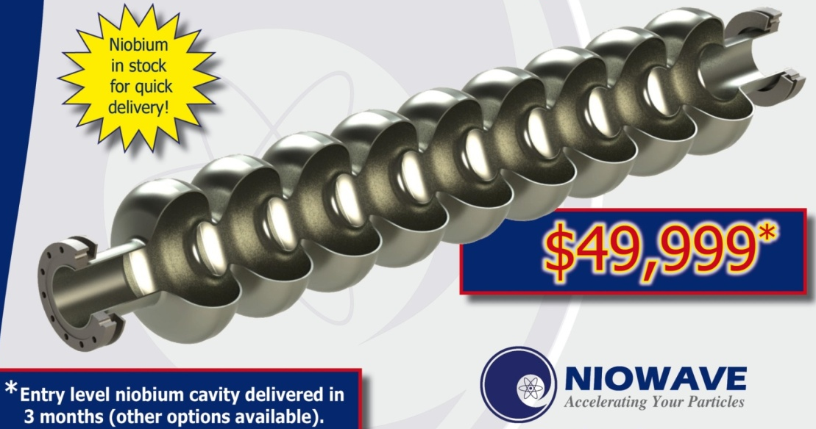
μ
Muons, Inc.
New Accelerator Technology Enables GEM*STAR
OAK RIDGE, Tenn., Sep. 28, 2009 — The Department of Energy's 1 GeV Spallation Neutron Source (SNS), breaks the one-megawatt barrier! Operating at <10% duty factor, this corresponds to >10 MW at CW.
Based on Superconducting RF Cavities, available from U.S. Industry:

Slide 14
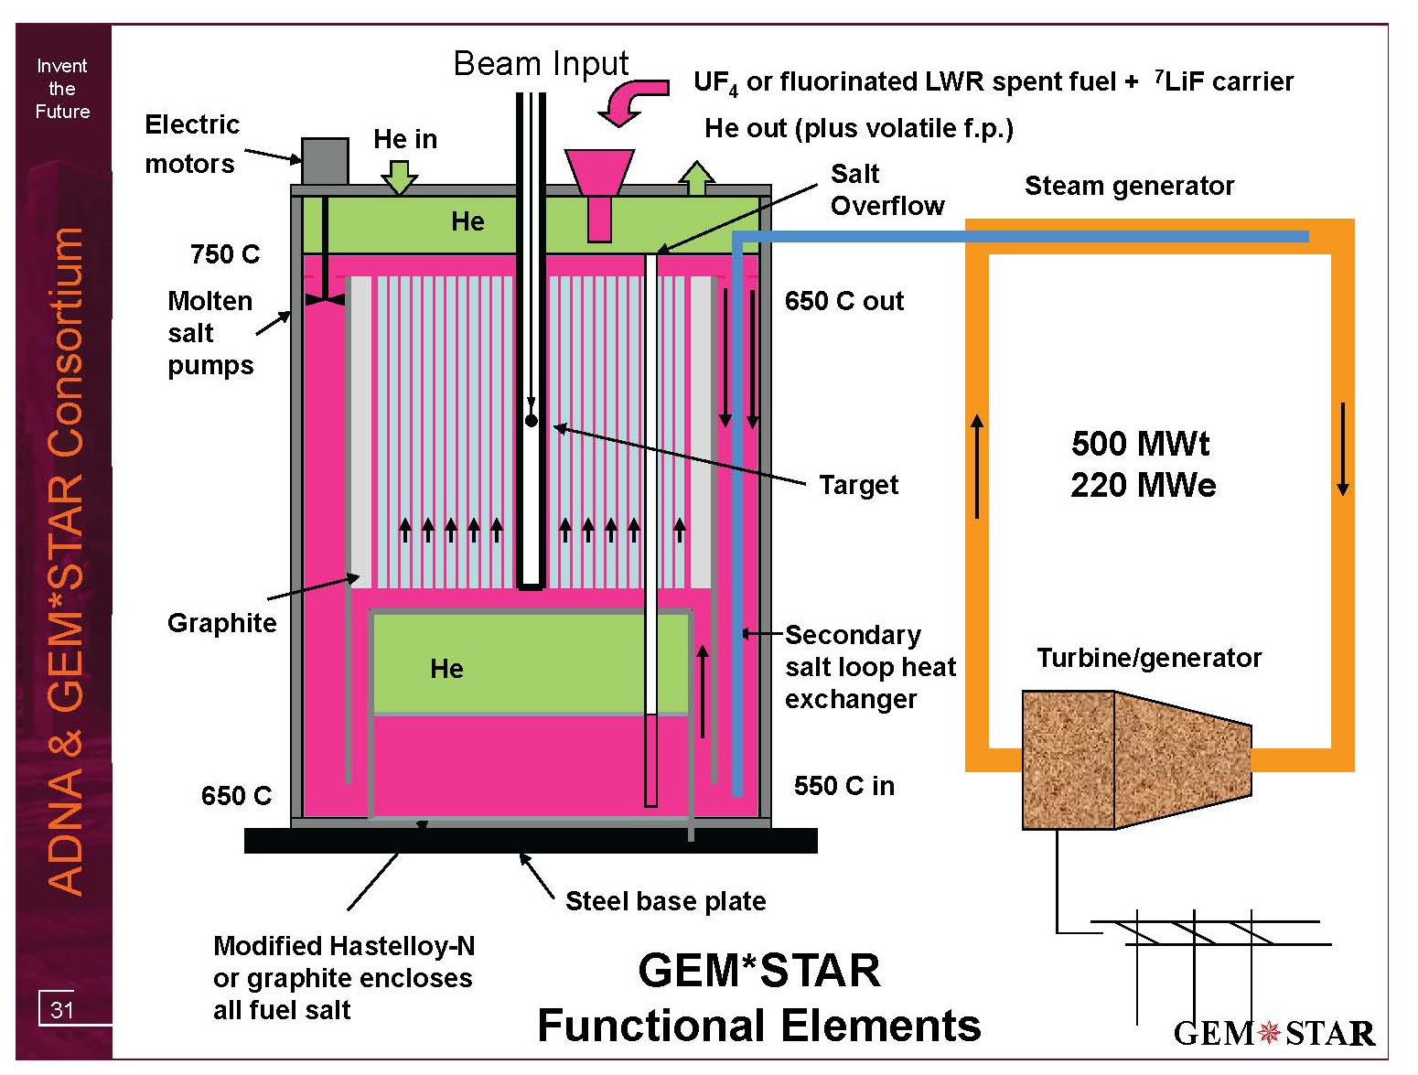
W-Pu as PuF₃ (30 g/h) plus carrier salt
2.5 MWb provides

Slide 15
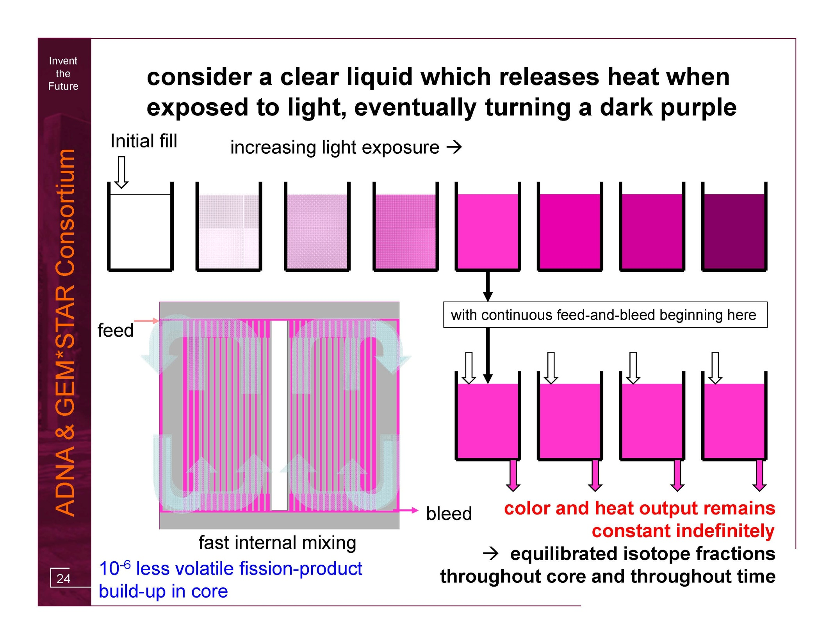

Slide 16
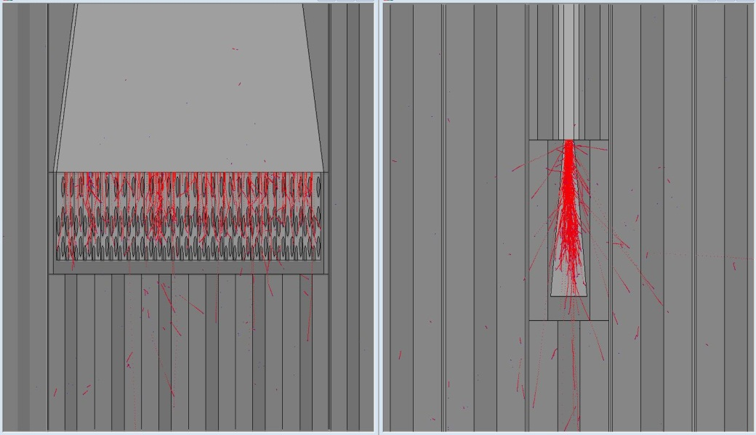
Target Considerations
Work of Bruce Vogelaar
of Virginia Tech (co-author of GEM*STAR article in HB of NE)
GEM*STAR Internal Target
diffuse (or multiple) beam spots
molten salt used for heat removal
high neutron yield from uranium
(but minimize target fission)
spent target fluorinated and used as fuel
minimize impact on local reactivity

Slide 17
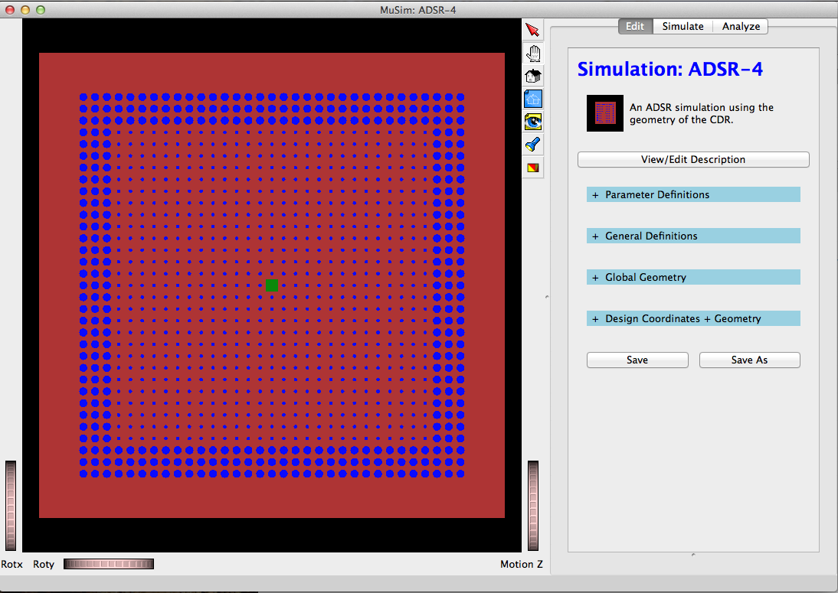
First MuSim Application -GEM*STAR
μ
Muons, Inc.
Screen shot of MuSim: carbon is brown, salt is blue, the spallation target (natural uranium) is green; the right side is an editing pane: ADSR-4 is the name of this simulation, and the blue headers are categories to specify the simulation that can be edited; Parameters are for parametrizing the simulation; Definitions define general things like materials; GlobalGeometry includes all objects, solids, sources, and detectors (except objects placed via design coordinates); DesignCoordinates are for a beamline and define its centerline for placing objects.

Slide 18
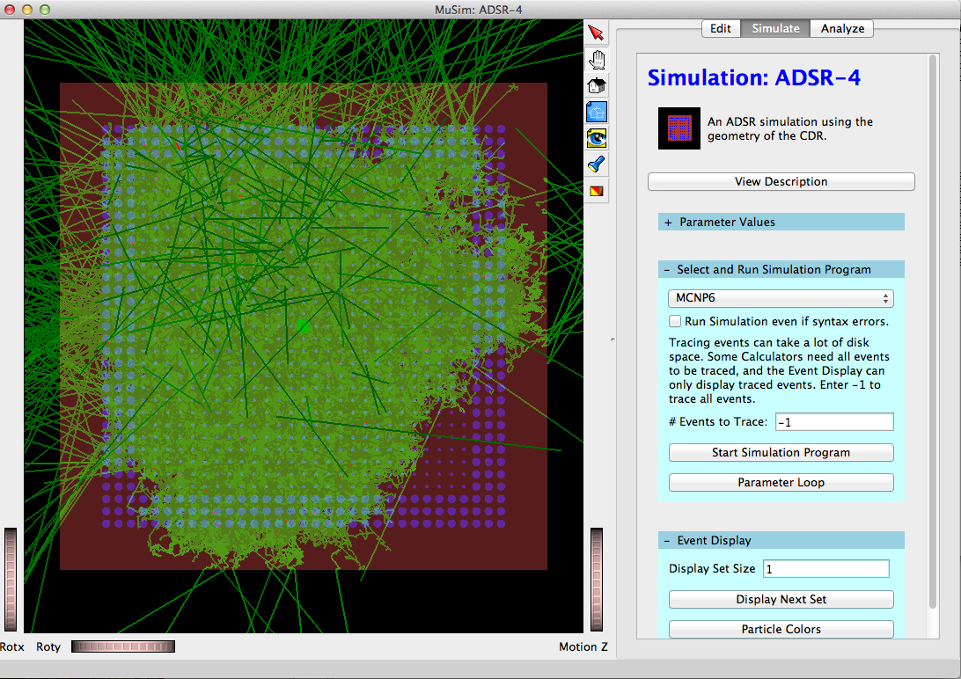
MuSim MCNP6 single event display
μ
Muons, Inc.
Here is a single event, green=neutron, darkgreen=gamma. This single proton generated 402,138 tracks (not counting e- < 0.5MeV). I used a "transparency slider" to make the solids mostly transparent, so tracks inside them can be seen. This makes the solids darker, because the black background show through; tracks inside them affect their color.

Slide 19
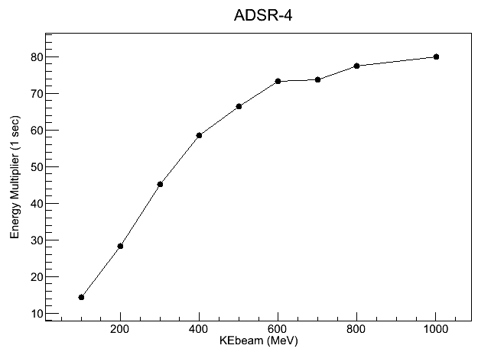
Optimum Beam Energy
μ
Muons, Inc.

Slide 20
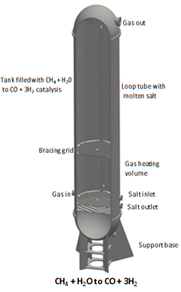

Slide 21
Is W-Pu a Killer Application?
34 metric tons of excess weapons-grade plutonium slated to be destroyed by the troubled 2000 U.S.-Russian Plutonium Management and Disposition Agreement (PMDA)[2]
GEM*STAR allows a better solution than either MOX (US) or BR (Russia)
<7% Pu240 vs >19%

Slide 22
GEM*STAR Burns W-Pu Without U or Th
34 Tons in 30 Years
Hourly fill:
30 g W-Pu
as PuF₃ +
carrier salt
Superconducting
Accelerator
2.5 mA, 1 GeV
Magnet
W-Pu
Inflow W-Pu:
93 % ²³⁹Pu
7 % ²⁴⁰Pu
Volatile f. p. removed by
closed cycle He flow
Free
surface
K_{eff}
0.98-0.99
Overflow
pipe
Target
Hourly overflow:
7.5 g as PuF₃ +
carrier salt +
22.5 g of fission product
93 % graphite
7 % salt
Non-W-Pu
W-Pu transformed
to permanent
non-weapons Pu
immediately upon
adding and mixing
Non-weapons Pu Outflow:
52.4 % ²³⁹Pu
25.4 % ²⁴⁰Pu
10.6 % ²⁴¹Pu
11.7 % ²⁴²Pu
Salt Overflow
tank
Fission power 500 MWt

Slide 23
FB BN800 MOX-LWR GEM*STAR
²³⁹Pu | α | 24,110 years
²⁴⁰Pu | α,sf | 6,561 years
²⁴¹Pu | β | 14.325 years
²⁴²Pu | α,sf | 373,300 years

Slide 25
Benefits of GEM*STAR for W-Pu
Burned W-Pu never useful for weapons
Burned W-Pu never decays to back to weapons useful material
Conversion to non-W-Pu in minutes
Pu isotopic mixture can be reduced from 34 tons to 0.2 tons if desired
Also converts C-Pu to-non-weapons-useful material
Never requires a critical mass so no control rods
No reprocessing or enrichment required
No conversion to MOX; simple conversion of Pu metal and PuO₂ to PuF₃
Fission energy converted to diesel and sold as green fuel to DOD
No stored large volatile fission product inventory as in LWRs (Fukushima)
Liquid fuel moved by He pressure; no radiation exposure to humans
No pressure vessel
Passive recovery from loss of coolant (LOCA)
Eliminating problems
avoids the need for
Defense in Depth

Slide 26
Magnetron Power Sources
μ
Muons, Inc.
Magnetron is a good RF source for SRF
  Inexpensive (<$2/W vs $5 to $10/W for klystron or IOT)
  Efficient (~85% vs 50-60% for klystron or IOT)
  Frequency and phase stabilization are an issue for accelerators
  Muons, Inc. has several magnetron projects underway that are relevant to ADS
    350 MHz CW 120 kW for radioisotope production
    650 MHz for medical application
    1500 MHz for CEBAF klystron replacement

Slide 27
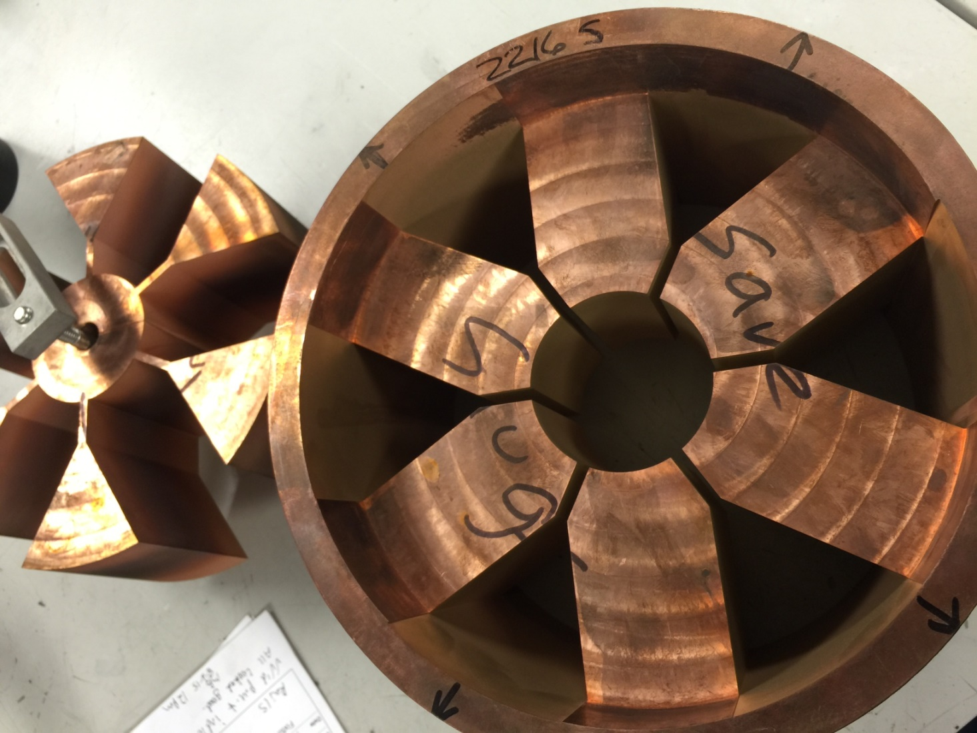
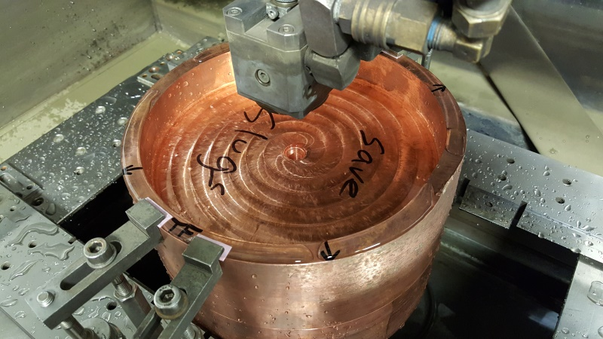
EDM of 350 MHz Magnetron Anode
μ
Muons, Inc.

Slide 28
Results comparison :
“standard” 120C bake vs “N infused” 120C bake
Achieved:
45.6 MV/m → 194 mT
With Q ~ 2e10!
Q at ~ 35 MV/m ~ 2.3e10!
A. Grassellino et al, in submission to SUST rapid
Increase in Q factor of two, increase in gradient ~15%

Slide 29
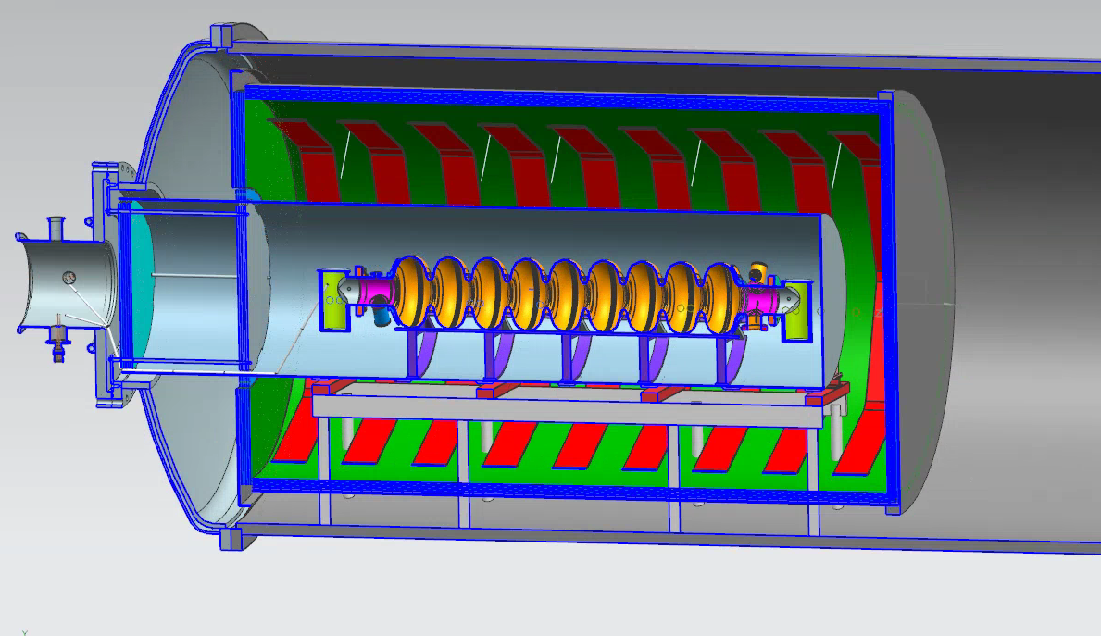
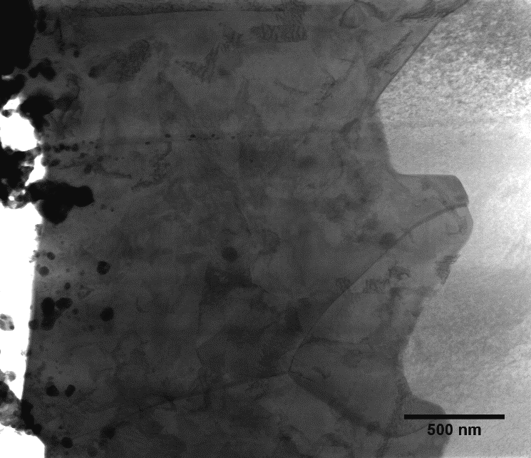
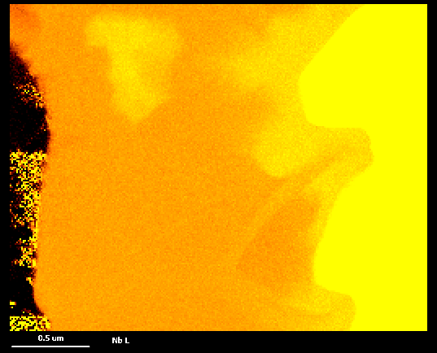
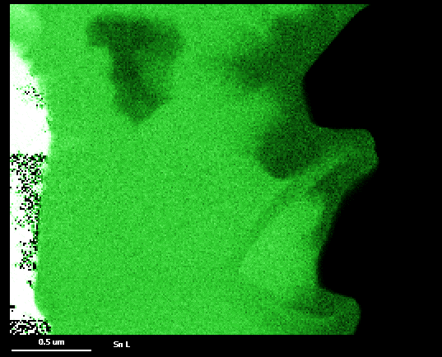
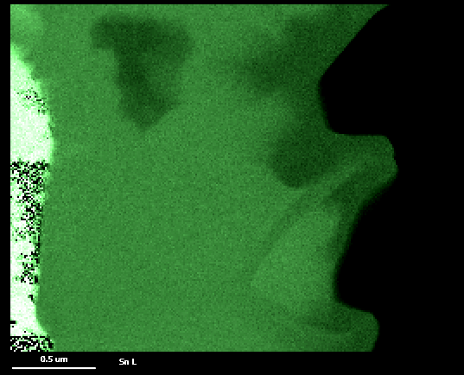
Nb₃Sn SRF Cavities
S. Posen, N. Valles, and M. Liepe, Phys. Rev. Lett., 115, 047001 (2015).
Predicted superheating field 2x as high as niobium: potential to increase reach of SRF accelerators
High Q₀ at high temperature: simpler cryoplant with 3-4x higher efficiency at 4.2 K vs 2 K
New Fermilab program aims to understand and overcome limitation mechanisms in this material and coat multicell cavities
Extrapolation suggests 350 mT ~ 80 MV/m possible if defects can be mitigated
Nb₃Sn
Nb
Largest-ever Nb₃Sn SRF cavity coating chamber in fabrication: coatings for 9-cell 1.3 GHz cavities and 650 MHz 5-cell cavities
C. Becker et al., App. Phys. Lett., 106, 082602 (2015).
0.5 μm
Nb L
0.5 μm
Sn L

Slide 30
A Perfect Storm of Opportunities?
Muons, Inc.
μ
US Plan to use MOX plant and LWRs not working
SRS Plant overspent: $2B -> $5B -> asking for $2B more,
No LWR ready to accept W-Pu MOX fuel =>
Obama MOX budget on hold while alternatives examined
Eliminate W-Pu (State Department-DOE/NNSA)
  Opportunity for Lavrov and Kerry to extend cooperation
  2000 Plutonium Management and Disposition Agreement
    (DOE Secretary Moniz was major proponent of PMDA)
  Navy adds nuclear power expertise, and location for demo
  Solves Navy long-range synthetic fuel need
  Turn $30B liability into $40B Profit (Congress/OMB)

Slide 31
GEM*STAR: ACCELERATOR-DRIVEN SUBCRITICAL REACTOR
FOR IMPROVED SAFETY, WASTE MANAGEMENT,
AND PLUTONIUM DISPOSITION
μ
Muons, Inc.
From Proposal Cover Page
The name of organization: GEM*STAR Consortium, directed by for-profit companies
Funding Opportunity Announcement Number: DE-FOA-0001313 Advanced Reactor Industry Competition for Concept Development
Project Manager: Dr. Rolland Johnson, Muons, Inc.
Chief Scientist: Dr. Charles Bowman, ADNA Corp., BCLF Corp.
Estimated Cost: $50,000,000 over 5 years or less, including $10,000,000 cost share.
FY 2016 Proposed Cost: $7,500,000; with $4,100,000 to industry
(including $1,500,000 cost-share),
$2,400,000 to FFRDC national labs, and $1,000,000 to universities.

Slide 32
GEM*STAR: ACCELERATOR-DRIVEN SUBCRITICAL REACTOR
FOR IMPROVED SAFETY, WASTE MANAGEMENT,
AND PLUTONIUM DISPOSITION
μ
Muons, Inc.
Partners | year 1 | Primary Role | Point of Contact
Muons/ADNA | 2.6 | Project direction, integration | Dr. Rolland Johnson
 |  | Scientific oversight, Fischer-Tropsch | Dr. Charles Bowman
Niowave, Inc. | 1.0 | Commercial Accelerator Manufacturer | Dr. Terry Grimm
Newport News Shipbuilding | 0.5 | Commercial Manufacturer of Nuclear Reactors (for Aircraft Carriers and Subs) | Mr. Phillip Mills Mr. Neil Moravek
ORNL | 2.0 | Reactor Design | Dr. Lou Qualls
 |  | Accelerator Operations (SNS) | Dr. John Galambos
TJNAF | 0.4 | Accelerator Design | Dr. Andrew Hutton
VT | 0.5 | Reactor Design, Simulations | Prof. Alireza Haghighat
 |  | Internal Target Design | Prof. R. Bruce Vogelaar
GWU | 0.5 | Policy Issues, Systems Integration | Prof. Andrei Afanasev
 |  | Simulations, Material Studies | Prof. Philippe Bardet

Slide 33
GEM*STAR: ACCELERATOR-DRIVEN SUBCRITICAL REACTOR
FOR IMPROVED SAFETY, WASTE MANAGEMENT,
AND PLUTONIUM DISPOSITION
μ
Muons, Inc.
CDR→
TDR→
Pilot TDR→
Conceptual Design Report (CDR), Technical Design Report (TDR), and Site Specific Pilot TDR are needed for the DOE/NNSA Critical Decision Management Process.
CD-0 follows from stated need for alternatives to MOX solution at Savannah River.

Slide 34

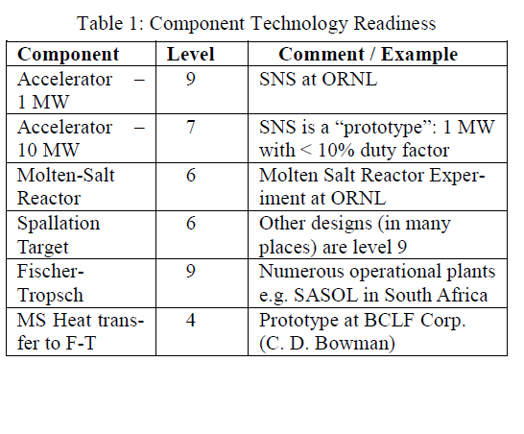
Technology Readiness Review - GEM*STAR needs engineering to merge known technologies (no additional Research needed)
DOE’s Technology Readiness Scorecard (Levels 1 – 9):
Basic principles observed and reported.
Technology concept application formulated.
Analytical and experimental critical function and/or characteristic proof of concept.
Component and/or breadboard validation in a laboratory environment.
Component and/or breadboard validation in a relevant environment.
System/subsystem model or prototype demonstration in a relevant environment.
System prototype demonstration in an operational environment.
Actual system completed and qualified through test and demonstration.
Actual system proven through mission operations.
Detailed lists of year-by-year tasks and deliverables are available

Slide 35
μ
Muons, Inc.
MuSTAR proposes a profitable pilot plant demo of a subcritical molten-salt fueled nuclear reactor driven by a superconducting RF proton linac.
The GEM*STAR multipurpose reactor design features an internal spallation neutron target and high temperature molten-salt fuel with continuous purging of volatile radioactive fission products.
GEM*STAR is a reactor that without redesign will burn spent nuclear fuel, natural uranium, thorium, or surplus weapons material.
The reactor itself, by virtue of its simple modular design and intrinsic safety features, is less expensive than conventional reactors.
While already sufficiently powerful, reliable, affordable, and efficient, SRF linacs are on a steep learning curve with new developments in magnetron power sources, cryostats, and cavity construction techniques that will make SRF systems even more compelling.
We described the design and the proposal and discussed the prospects for funding a profitable pilot plant to burn weapons-grade plutonium.

