Slide 1
Superconducting NbN Thin Films Synthesized by Atomic Layer Deposition
Helmut Baumgart ª, Kai Zhang ª, Mark J. Sowa ^{b}
ª Old Dominion University
Dept. Electrical & Computer Engineering –
and
Applied Research Center at Thomas Jefferson Natl. Accelerator Facility
^{b} Ultratech/Cambridge Nanotech

Slide 2
Introduction
NbN is a Type II superconductor with a T_{c} of about 16K ¹.
NbN thin films were deposited by thermal atomic layer deposition using NbCl₅ and NH₃.
NbN thin films were also deposited by Plasma-Enhanced Atomic Layer Deposition (PEALD) previously ².
  T_{c} = 10.2K, Room T resistivity = 250μΩ-cm
Tc of NbN thin films is very sensitive to the growth conditions. Improvements in PEALD NbN process (parameters) may lead to higher T_{c} and lower resistivity values.
References:
B. T. Matthias, et al., Rev. Mod. Phys. 35, 1 (1963).
M. Ziegler, et al., Supercond. Sci. Technol. 26 (2013) 025008.

Slide 3
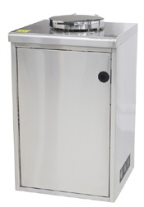
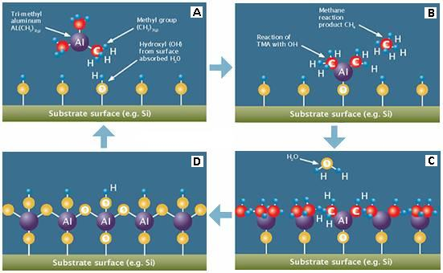
Review of “Multilayer ALD Films for SRF Cavities”
(Phase I)
NbN thin films were successfully deposited by thermal atomic layer deposition (ALD) in the temperature range of 450°C – 500°C by reacting the NbCl₅ precursor with ammonia (NH₃) gas in a first R&D project at the Applied Research Center.
Savannah 100 ALD reactor system
Schematic of Chemical reactions in the ALD process

Slide 4
Four ALD Reactor Systems in Operation at ODU-ARC Labs

Slide 5
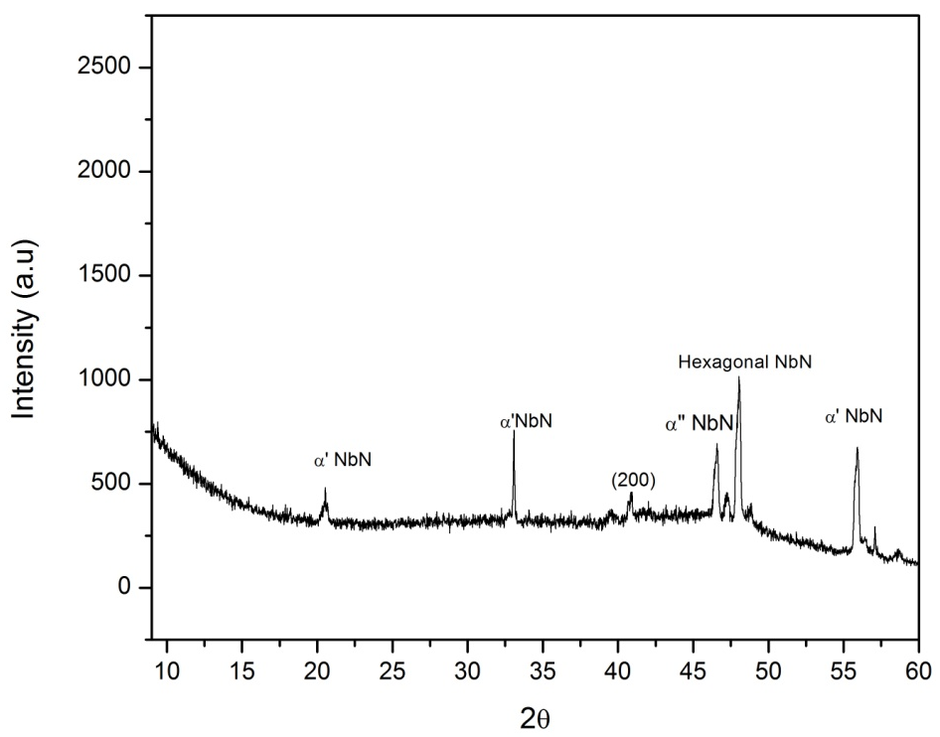
XRD Results of ALD NbN Films
The XRD analysis of the ALD films exhibits the crucial α’ and α” peaks indicative of cubic N_{b}N, which proves experimentally that the superconducting crystalline cubic phase of NbN was achieved.
Crystallization of the resulting NbN films is a sensitive function of ALD deposition temperature. The phase transition to crystalline cubic NbN occurs around 500°C. Furthermore, the feasibility of growing superconductor-insulator-superconductor (SIS) multilayer structures was demonstrated by depositing N_{b}N on ALD Al₂O₃ films.
XRD scan of NbN film deposited on Si substrate at close to 500 °C. The following crystalline phases were observed: cubic phase at 2θ = 20.95, at 2θ = 33.42, at 2θ = 41.24, at 2θ = 46.028 and at 2θ = 55.98; one hexagonal phase peak at 2θ = 48.357.

Slide 6
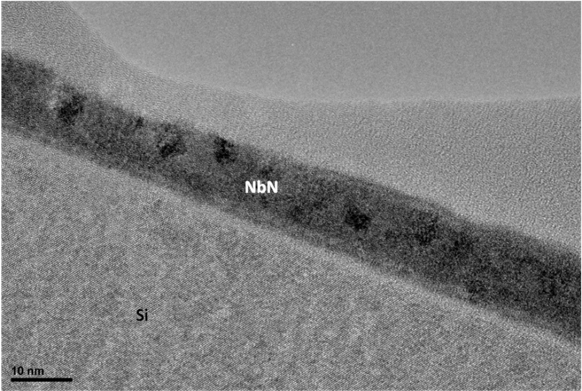
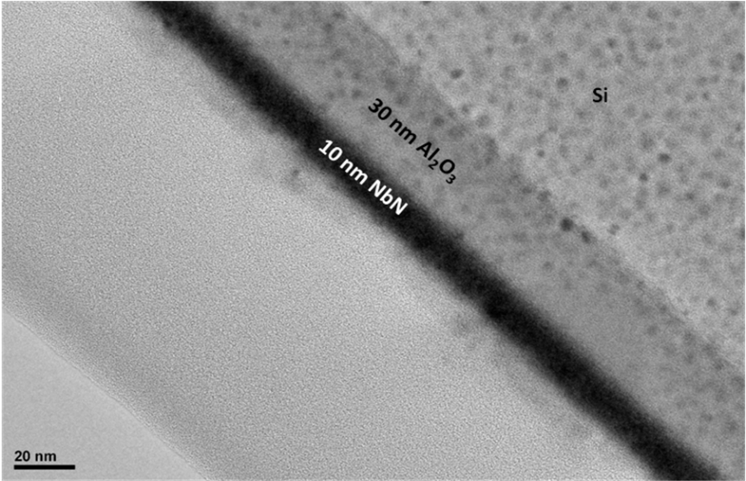
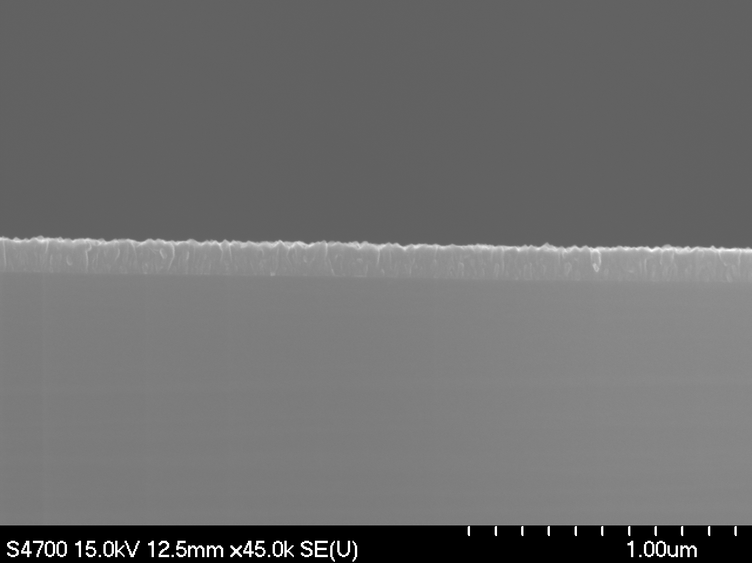
Cross-sectional Micrographs of ALD NbN Thin Films
Figure 1. High resolution cross-sectional TEM image showing a partially crystallized 10 nm ALD NbN thin film on Si substrate deposited by ALD at the relatively low temperature of 450 °C. Large NbN crystallites are visible, which are embedded in amorphous NbN.
Figure 2. Cross-sectional TEM image showing 10 NbN thin film deposited on top of 30 nm ALD Al₂O₃ on Si substrate in order to realize a superconductor – insulator multilayer structure. The NbN film has similar structure as shown in the TEM of Figure 1.
Figure 3. Field emission Scanning Electron Microscopy (FE-SEM) image of thick ALD NbN film on Si substrate. At a film thickness above 100nm the ALD NbN film exhibits a columnar polycrystalline structure.

Slide 7


Disadvantage of the old chemical ALD Precursor of NbCl₅ available for the initial Feasibility Study
While the research goal of superconducting cubic ALD NbN films was achieved with NbCl_{5,} it was felt, that the corrosive nature of the previous old chemical ALD NbCl₅ precursor and of its reaction by-products could be detrimental for large scale technical applications in SRF technology.
NbCl₅
Development of a new chemical precursor for ALD growth of NbN is absolutely crucial in order to greatly advance the field of superconducting radiofrequency (SRF) thin films for particle accelerator technology.

Slide 8
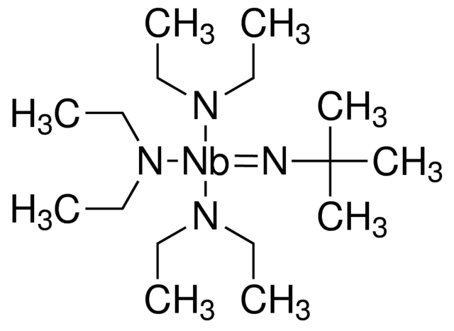
New Developments in Plasma-Enhanced Atomic Layer Deposition (PE-ALD) of Superconducting NbN Films
(t-butylimido) tris(diethylamido) niobium(V) (TBTDEN)
C₁₆H₃₉N₄Nb
Form: liquid
Density: 1.015 g/mL at 25 °C

Slide 9
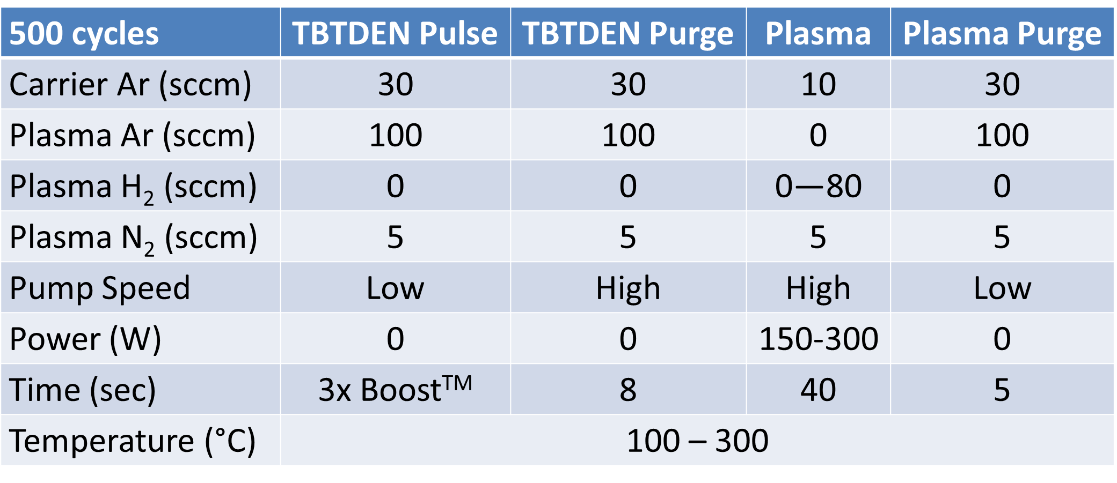
Experimental
Brand new development of PEALD of NbN films on an Ultratech/CNT ALD
With novel chemical ALD precursor (t-butylimido) tris(diethylamido) niobium(V) (TBTDEN) (100°C)
Spectroscopic ellipsometry for film thickness, n, and k
Four point probe technique to assess thin film resistivity
T_{c} measured with Quantum Design PPMS through a Stanford Research Systems SR830 lock-in amplifier
Composition data from PHI Versaprobe XPS
The substrate surface is exposed to TBTDEN, which generates a saturated mono-layer on the substrate.
The residual TBTDEN is purged with argon to avoid additional chemical vapor deposition.
The mono-layer is reduced by a hydrogen plasma to form a mono-layer of NbN.
A second argon purge.
Each cycle produced one mono-layer of NbN.

Slide 10
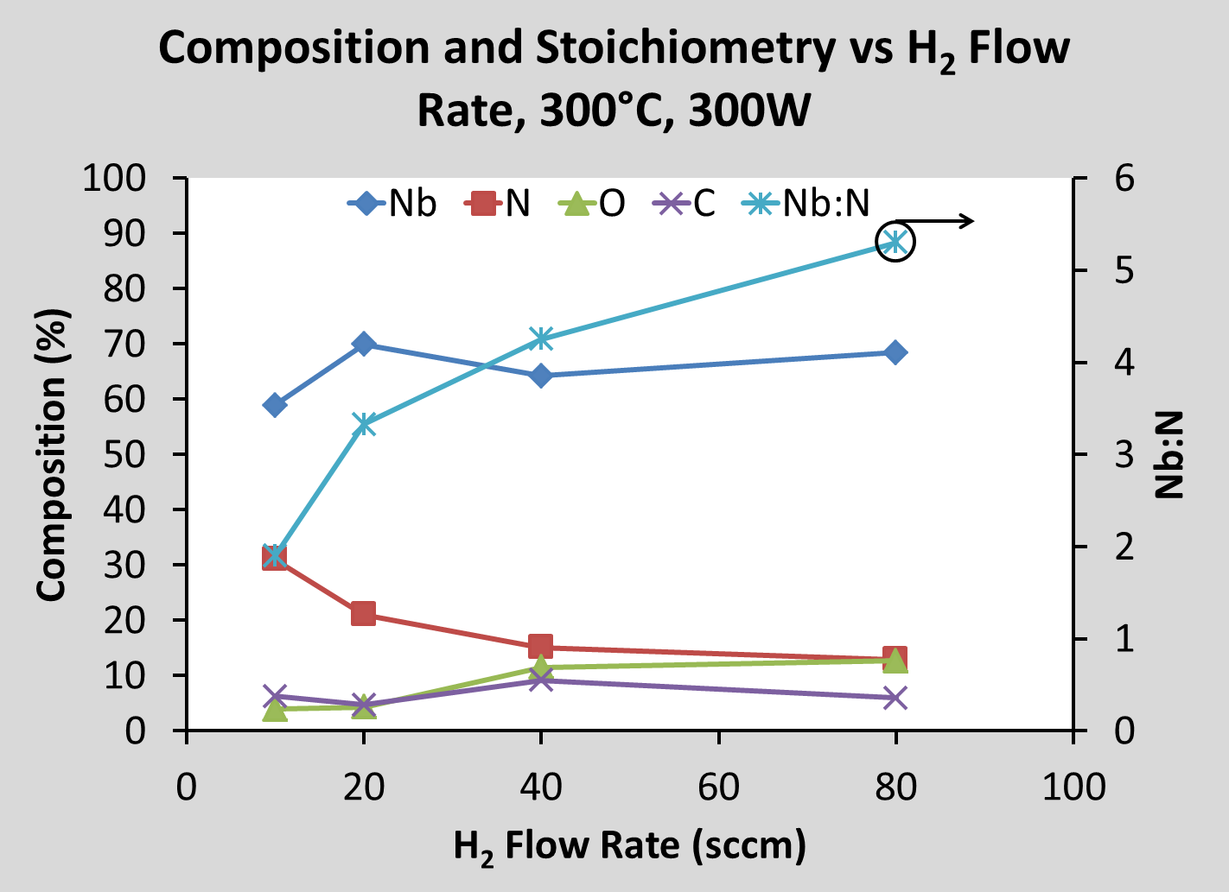
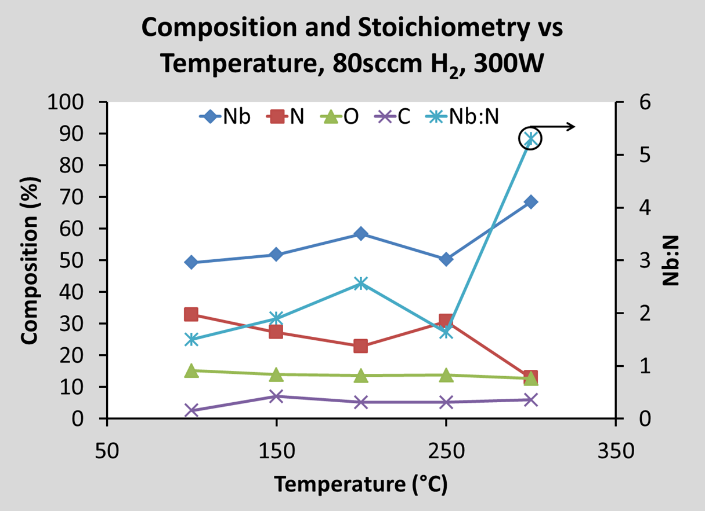
NbN Film Composition using the new ALD Precursor with PEALD Technology
Binding energy of the Nb 3d_{5/2} peak is ~203.5 eV for all samples consistent with NbN (203.5 - 204 eV) or NbO (202.8 - 204.8 eV) but not Nb metal (201.8 - 202.5 eV)⁵
C1s peak at ~282.5 eV suggests presence of NbC⁵
Depositions resulted in Nb-rich films
H-rich plasmas deplete film of N resulting in higher Nb:N
Temperature increase increases Nb and decreases N resulting in higher Nb:N

Slide 11
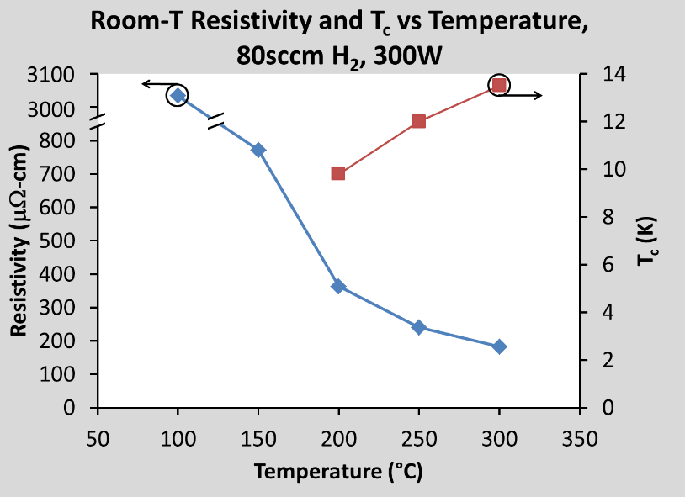
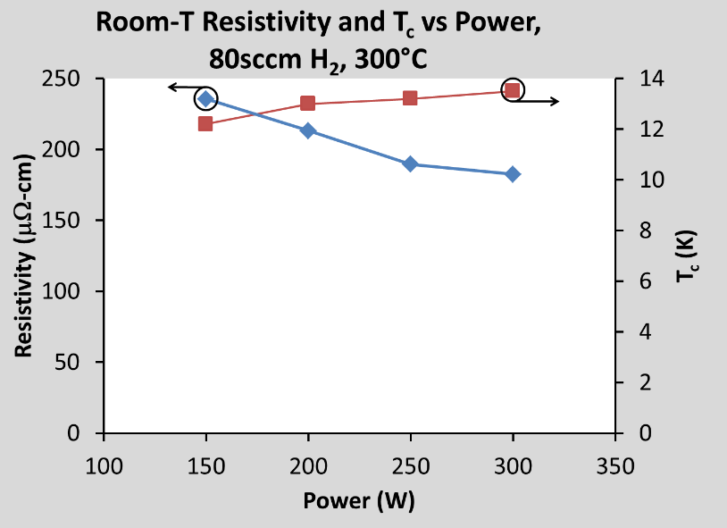
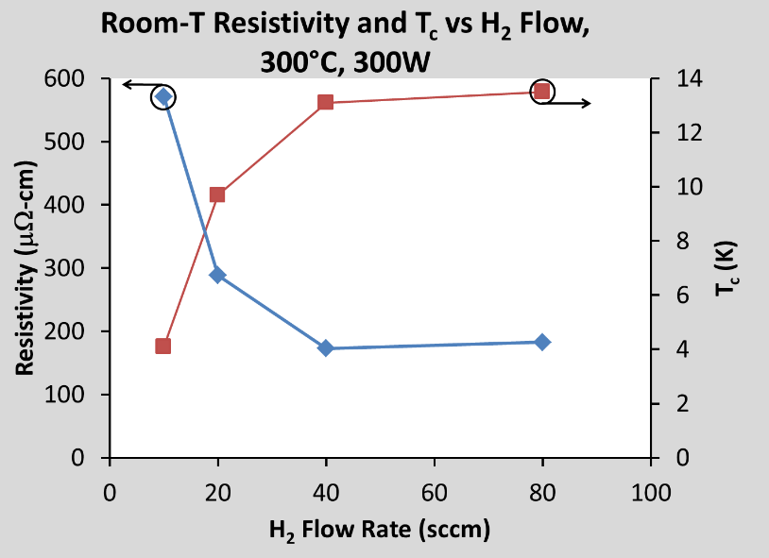
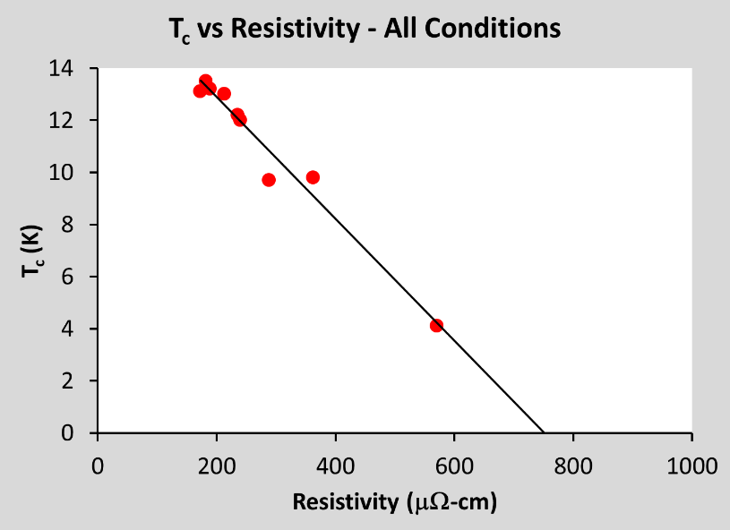
Resistivity and Superconductivity with new ALD Precursor
Resistivity decrease and T_{c} increase depend primarily on temperature and H₂ flow rate increases
Plasma power increase is a secondary influence on decreasing resistivity and increasing T_{c}
Nb-rich films have lower resistivity and higher T_{c}
Negative linear relationship between T_{c} and resistivity predicts 100C (3035μΩ-cm) and 150C (772μΩ-cm) films not superconducting

Slide 12
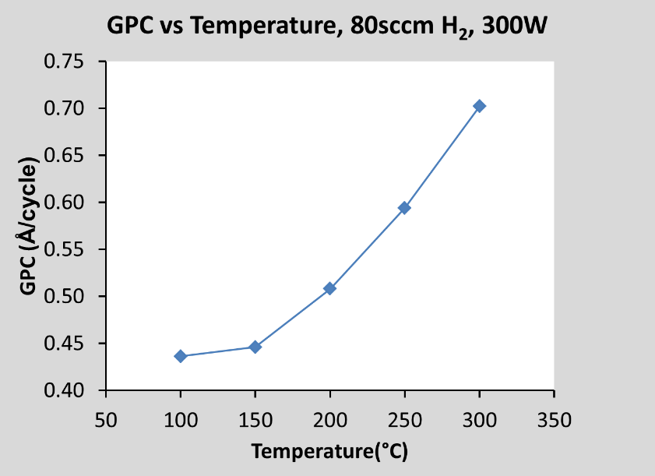
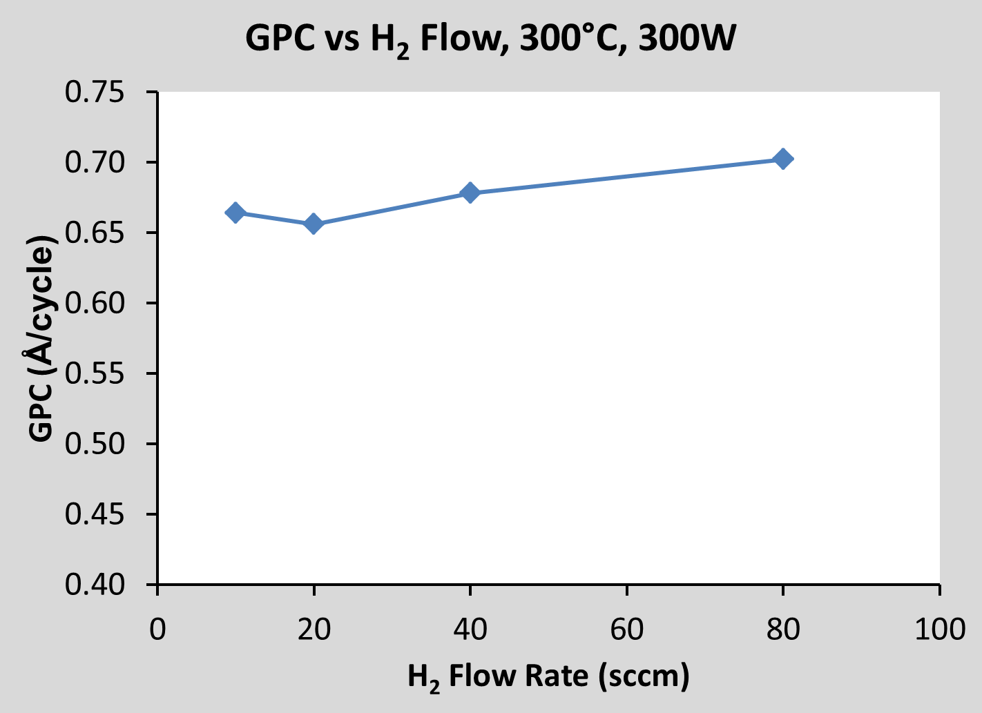
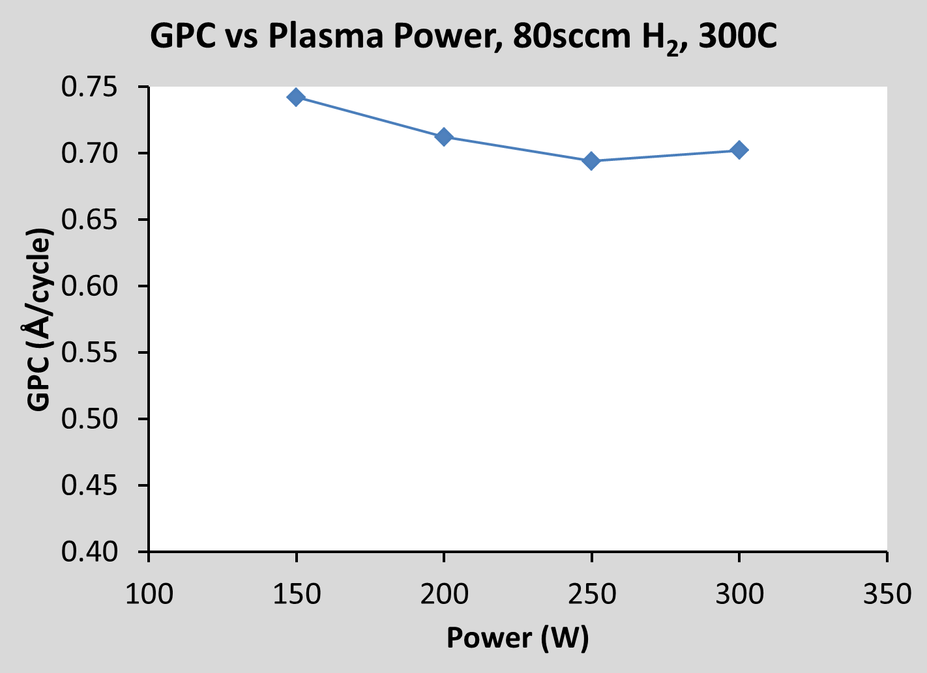
NbN Film Growth Per ALD Cycle with New Precursor
GPC primarily depends on temperature
Small GPC increase with H₂ flow at 300°C/300W
Small GPC decrease over power range at 80sccm H₂/300°C

Slide 13
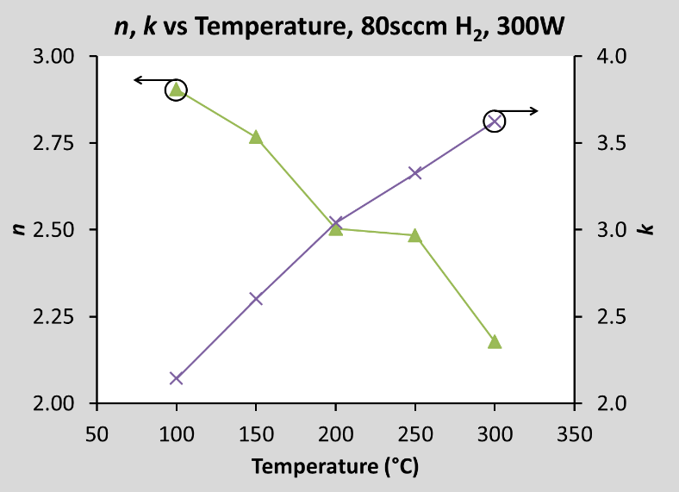
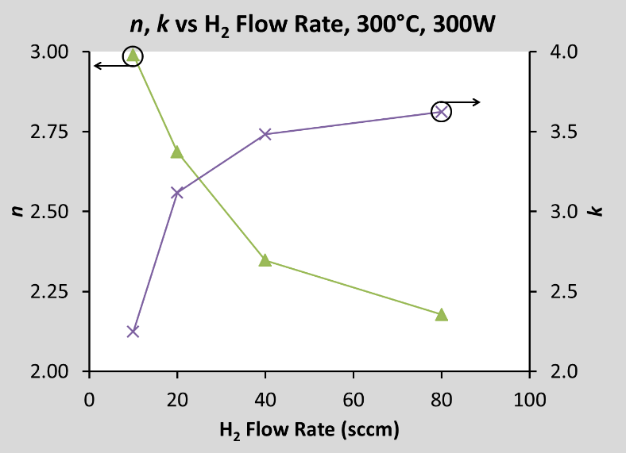
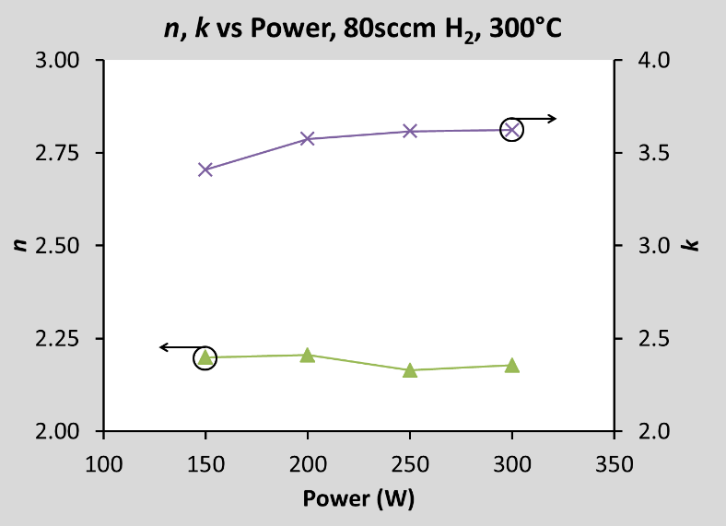
Optical Properties of NbN Films synthesized with new ALD Precursor
Refractive index decreases and extinction coefficient increases depend primarily on temperature and H₂ flow rate increases
Plasma power increase is a secondary influence on decreasing n and increasing k
Higher k and lower n in Nb-rich films

Slide 14

Conclusion
Superconductive NbN thin films could be achieved by PEALD using the newly developed (t-butylimido) tris(diethylamido) niobium(V) (C16H39N4Nb) chemical ALD precursor.
The new PEALD NbN Films exhibit T_{c} values as high as 13.5K showing tremendous potential for further optimization. This is a game changer!
Room-temperature resistivity values as low as 173μΩ-cm.
Resistivity and n decrease, T_{c} and k increase as NbN films become more Nb-rich at high deposition temperature, high H₂ flow rate, and high plasma power.
NbCl₅

