Slide 1


Extreme Electrodynamic and Local Harmonic Measurement of Nb Thin Films
Bakhrom Oripov , Steven M. Anlage
This work is funded by US Department of Energy and CNAM
Notes:
Name
Fund
We built microscope

Slide 2
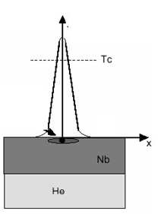
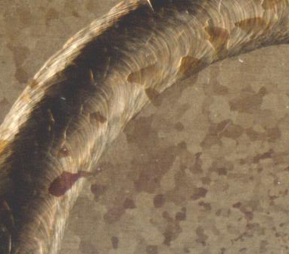
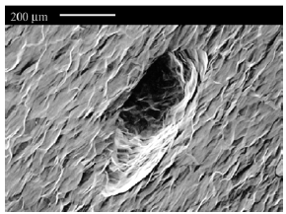
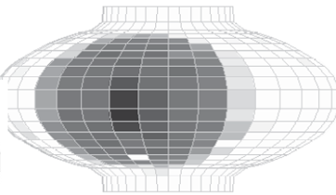
Problem: Defects
T > T_{c}
Defect
Cavity Temperature Map
welds,
500 x 200 μm pit
oxidation,
hydrogen poisoning
A high resolution near field magnetic field microscope can identify those defects and relate which defects results in the breakdown of the cavities is needed.
Notes:
Defects due to manufacturing
Have smaller Tc, Jc
Go to normal act as hotspot
Temperature Map – Heat the area
Solution? Built Microscope

Slide 3
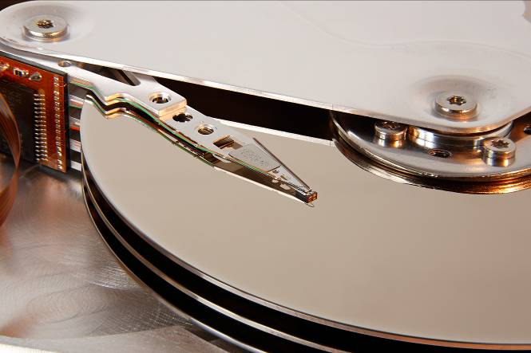
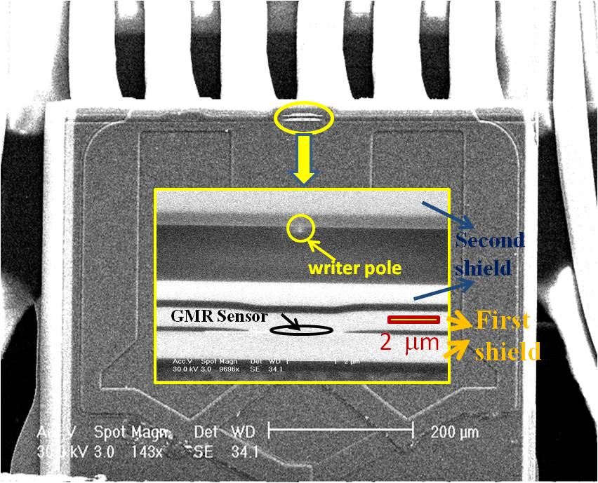
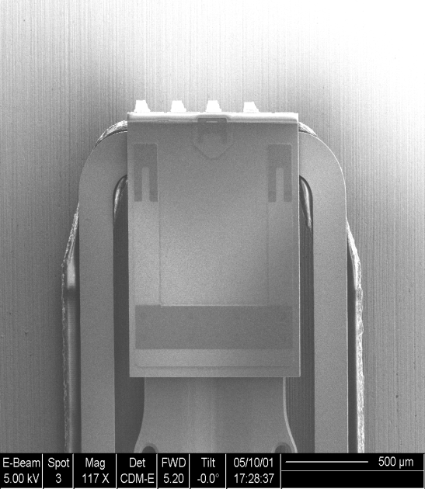
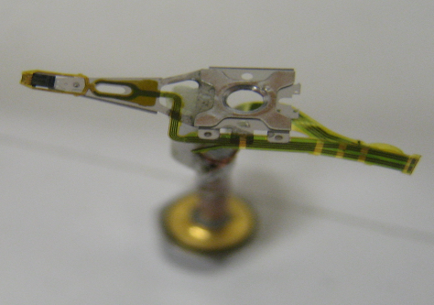
Method: High Resolution Magnetic Probe Scanning
Au bond pads to reader and writer
Read/Write
Head
Air bearing
surface
Thickness
(~1.2 mm)
Reference: IEEE Trans Magn. Vol . 37, No. 2 pp.613-618 2001
500 μ m
B_{RF} ~ 1 Tesla (in gap)
Suspension
Slider with
write coil
Coaxial cable

Slide 4
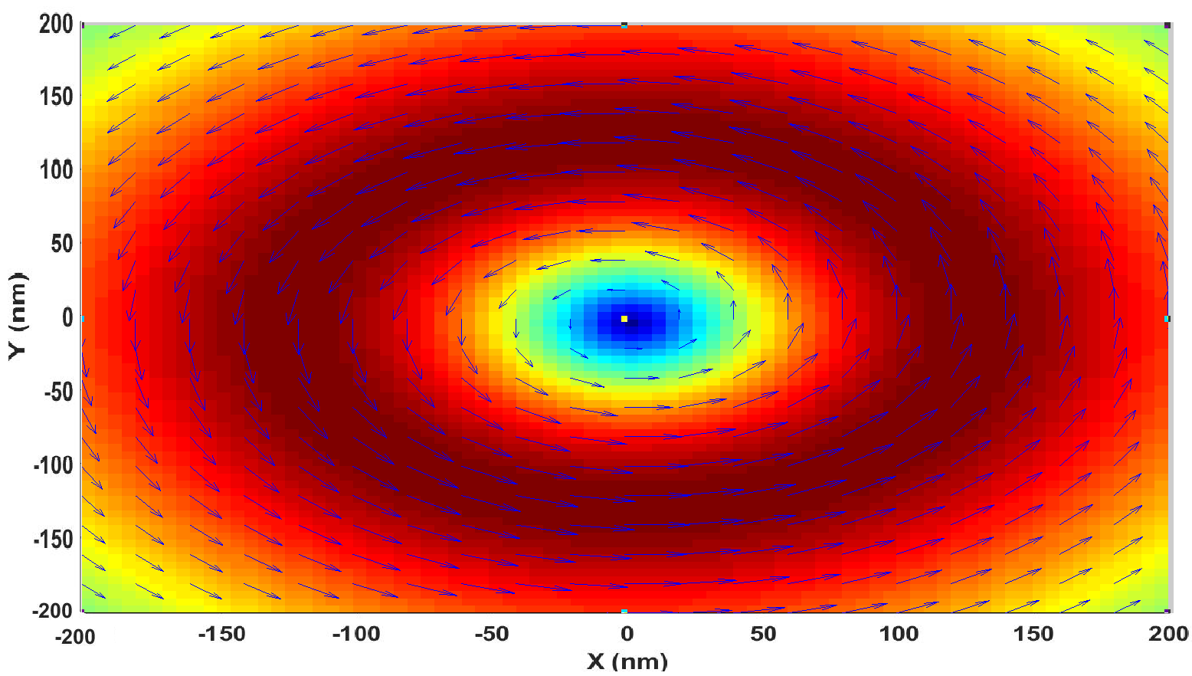



Surface Current Diagram
Low Pass Filter
Microwave Source
Spectrum
Analyzer
V_{f} ⁺
High Pass Filter
J_{surf}
V_{3f} ⁻
Probe-sample separation: 200 nm
Pole gap: 100 nm
Excitation: 50 mA
B_{rf}
M. V. Milosevic,et al
PHYSICAL REVIEW B 66, 174519 ~2002!

Slide 5
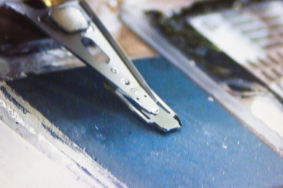
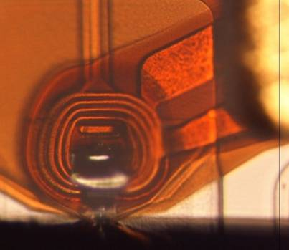
Nonlinear Setup
 | SRF | Our Setup
Temperature | 2K | 3.6K-9.3K
RF Magnetic Field | < 200mT | <200mT
Frequency | 1.3 GHz | 1.2GHz– 2.0GHz
sample
RF Coil
on slider
Superconductor
Notes:
The goal is to diagnose the SRF properties and how they are limited by materials issues.

Slide 6
Why P_{3f} ?
1)
2)
  Superconducting Sample is the only Source
Defects
D. E. Oates, Y. D. Agassi, B. H. Moeckly,
IEEE TRANSACTIONS ON APPLIED SUPERCONDUCTIVITY, VOL. 17, NO. 2, JUNE 2007
Notes:
Sample is main Source
P3f more detailed
Superfluid Carrier density decreased
Js is not linear with B

Slide 7
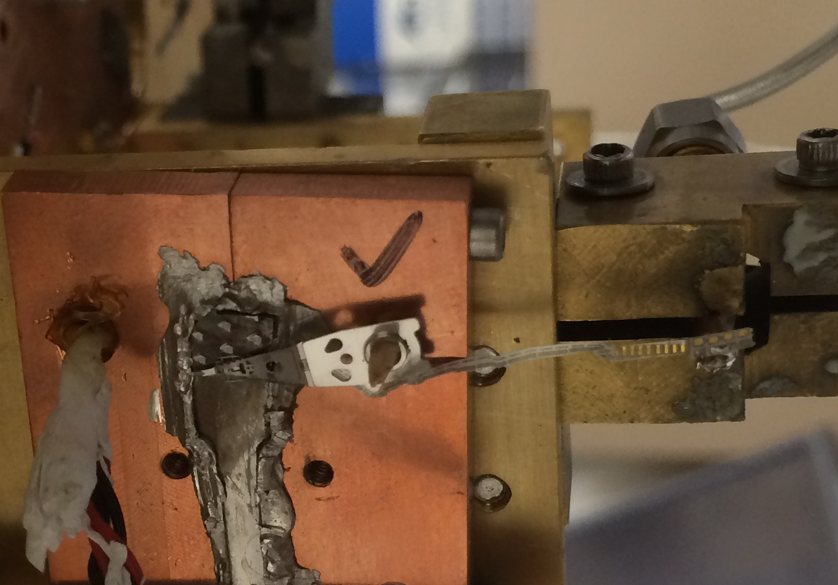
Coaxial Cable
Thermometer
4K Plate
Sample
Transmission Line
Connection to Probe
Probe
T. Bieler, Michigan State University

Slide 8
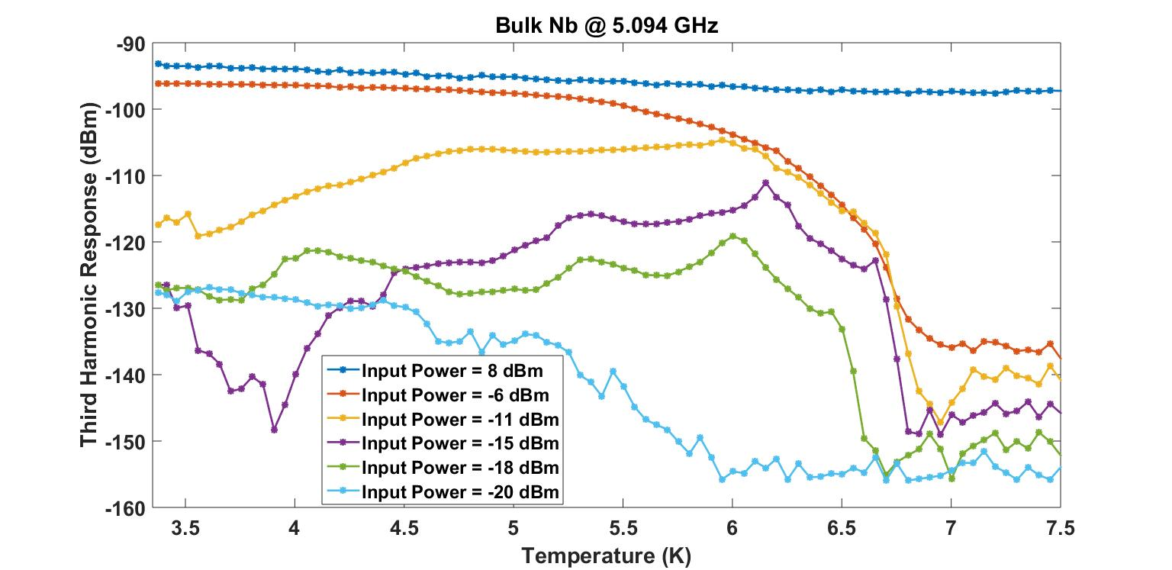
BULK NB

Slide 9
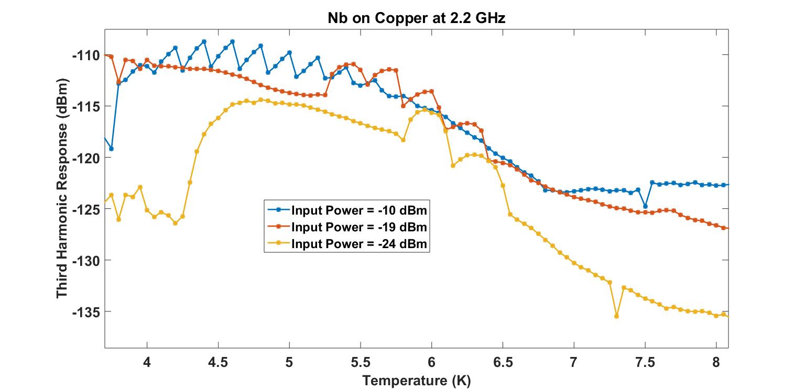
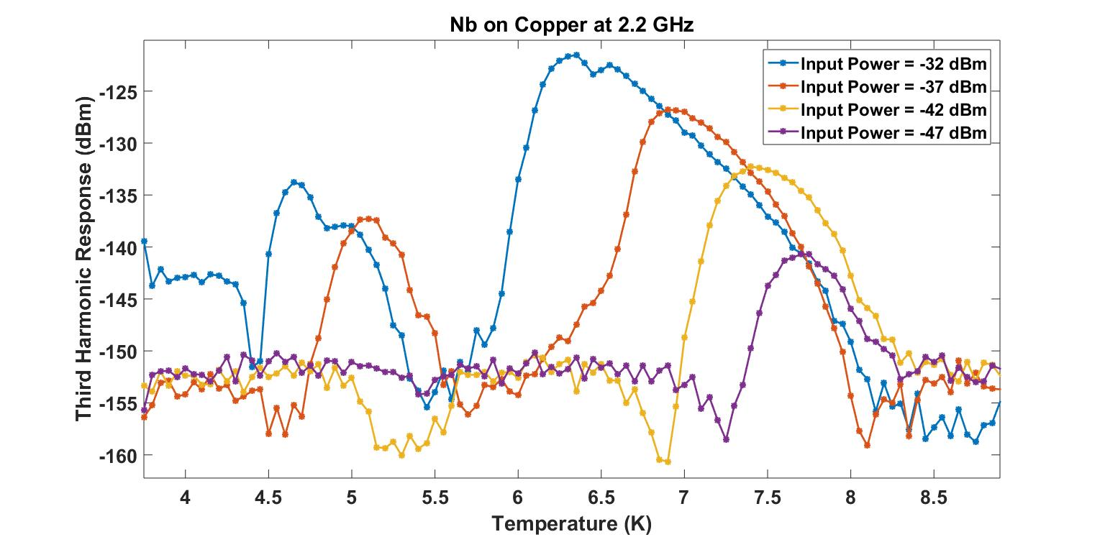
Nb on Copper
Thickness: 1μm

Slide 10
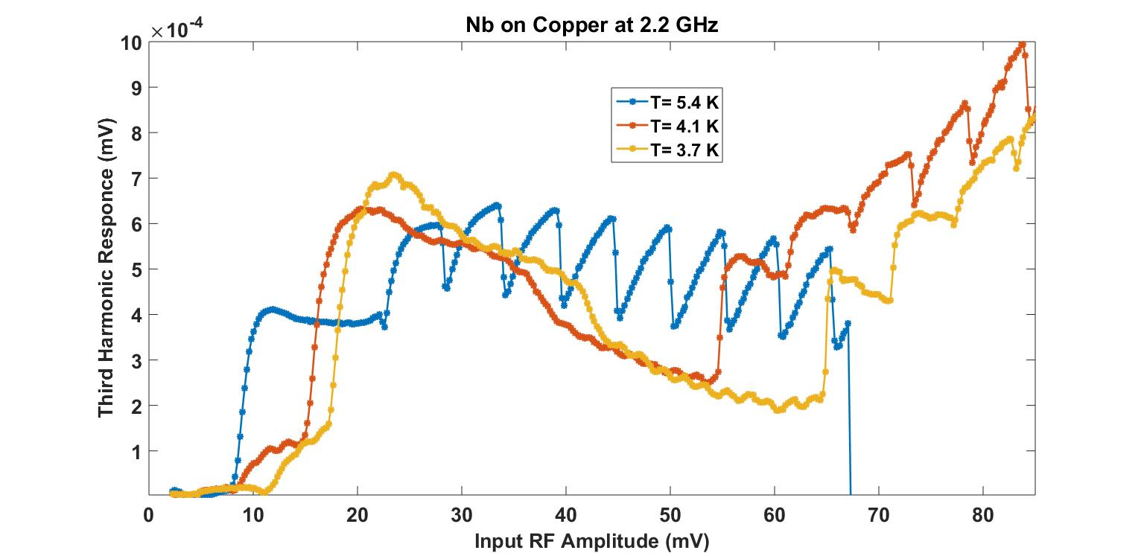
H₀
H₁
H₂
H₃
H₄
H₅
Thickness: 1μm

Slide 11
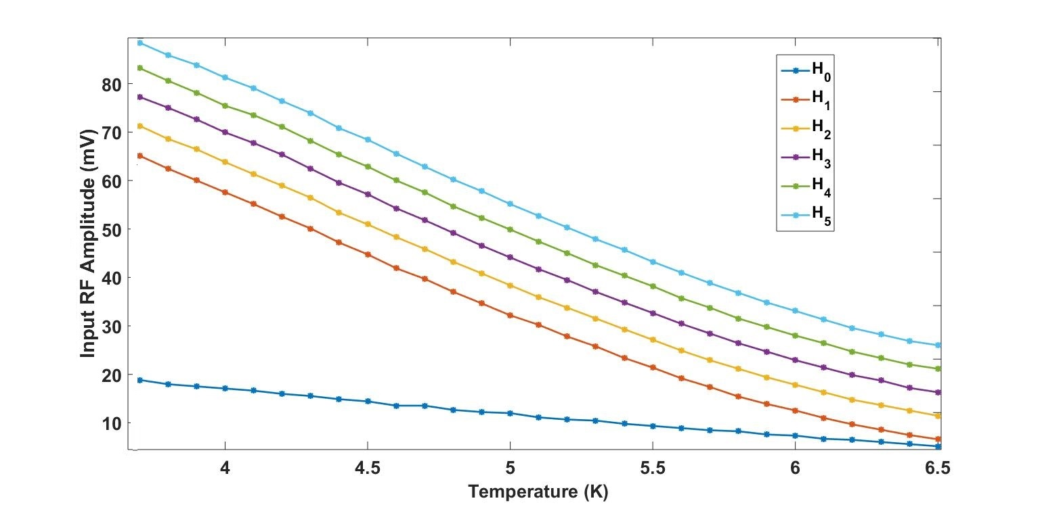
Temperature Dependence of Periodicity

Slide 12
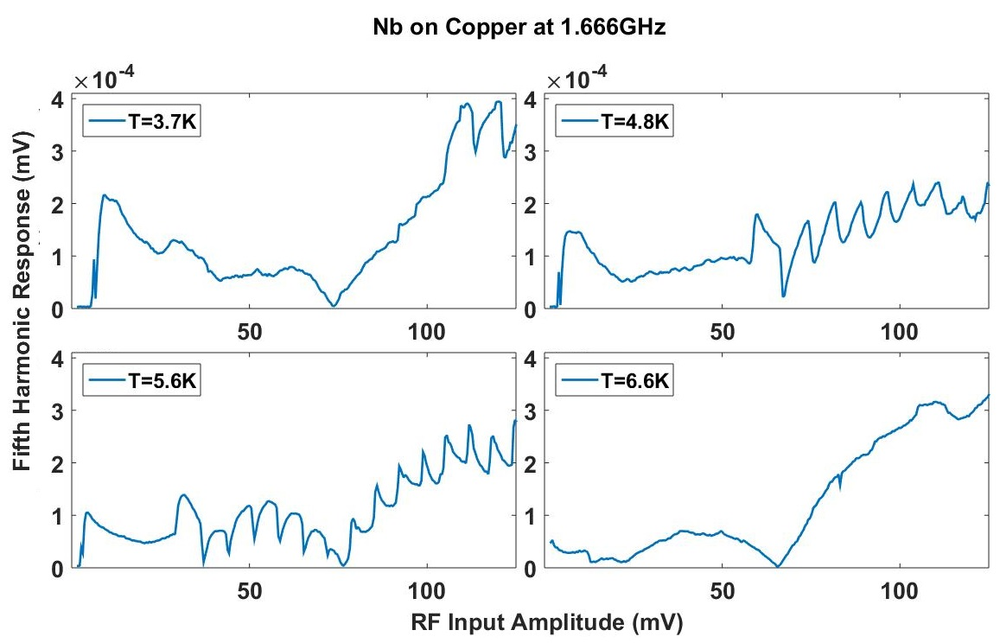
5th Harmonic

Slide 13
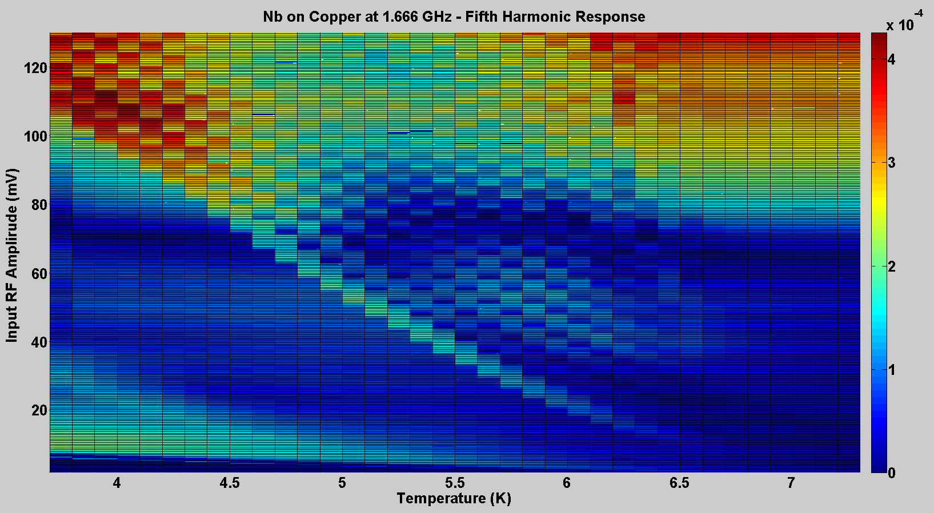


$$V5f$$
$$mV$$

Slide 14
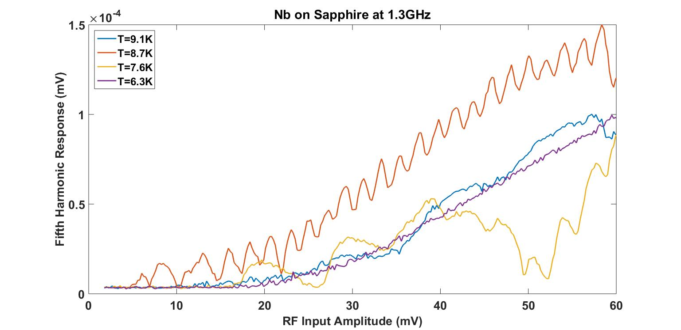
TF-JLAB-ECR-Nb-aAl₂O3-33₂

Slide 15
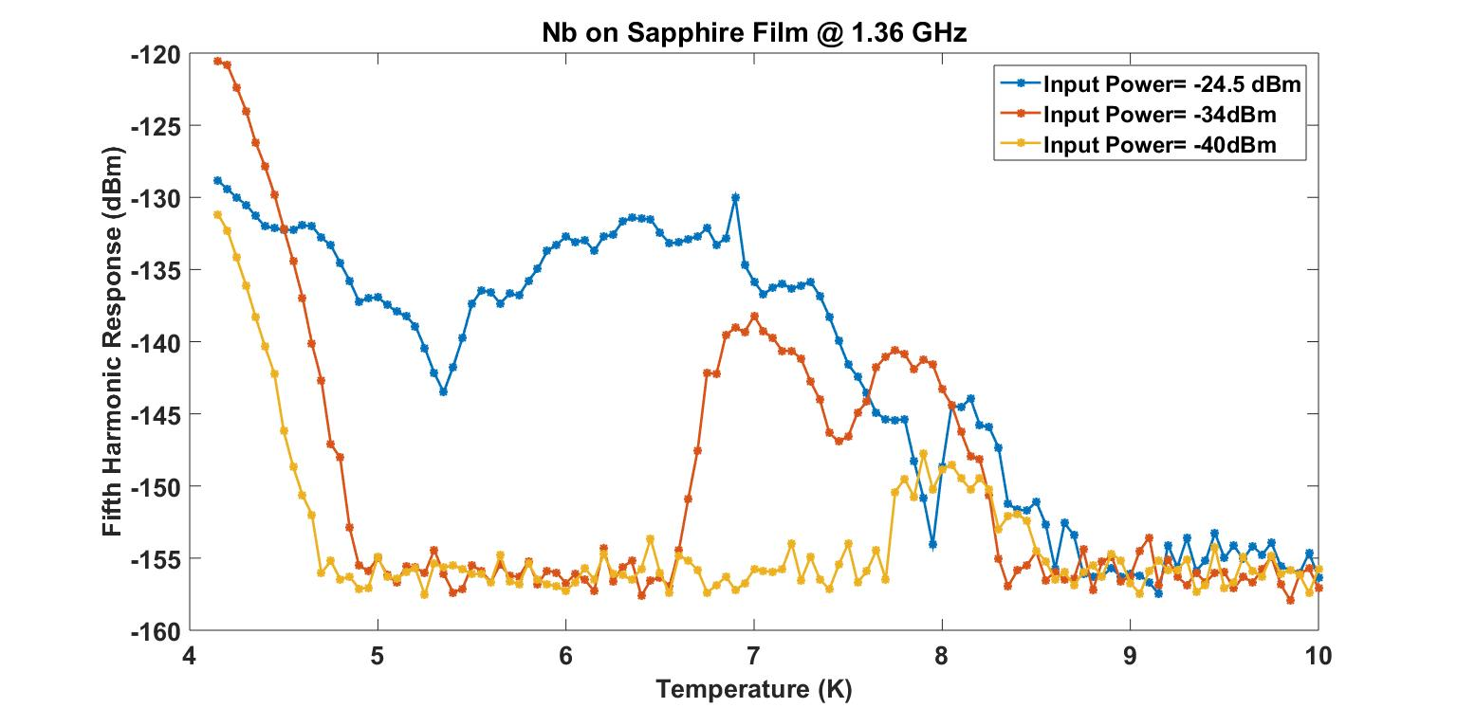
TF-JLAB-ECR-Nb-aAl₂O3-35₃

Slide 16
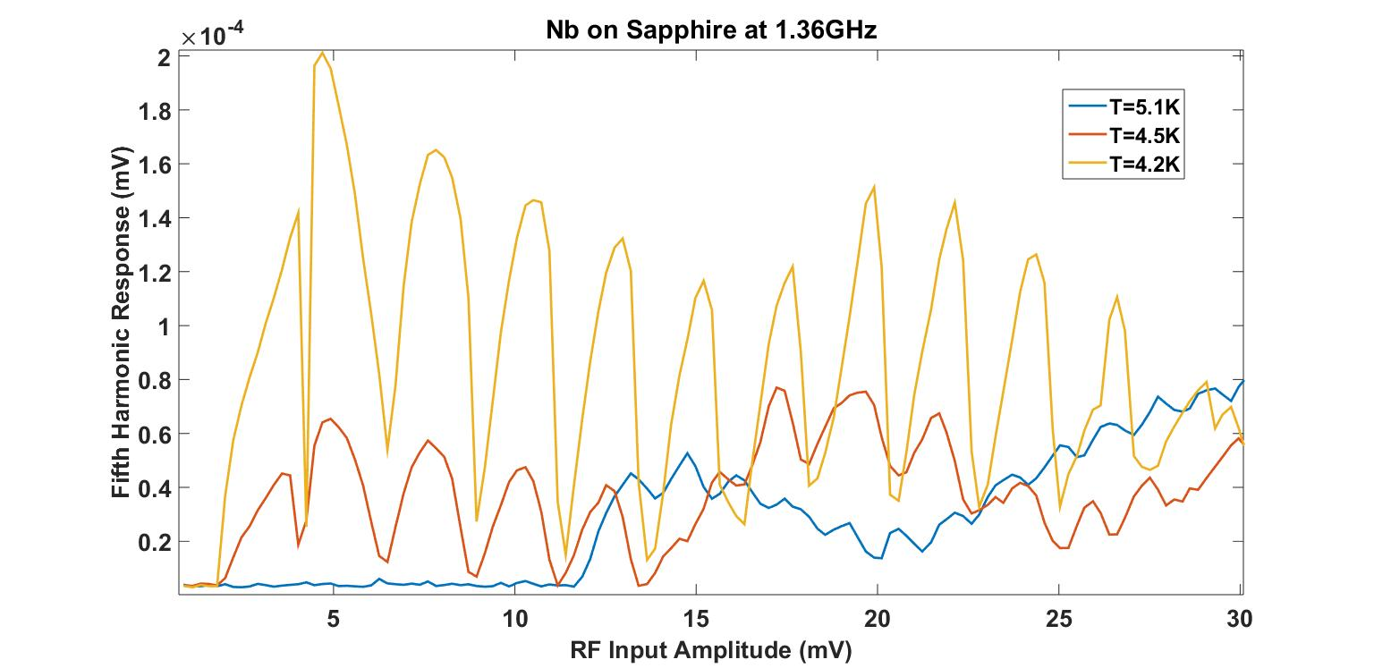
TF-JLAB-ECR-Nb-aAl₂O3-35₃

Slide 17
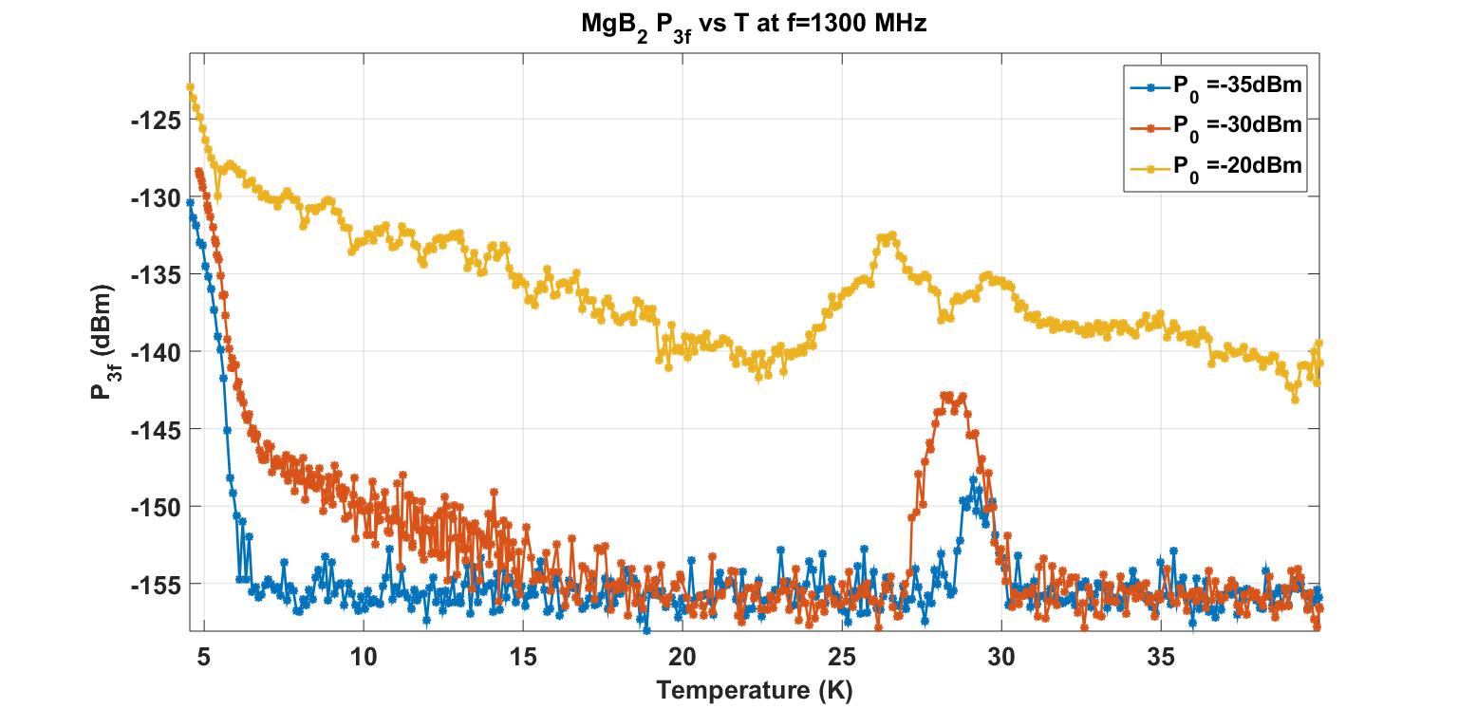
Thickness: 500μm

Slide 18
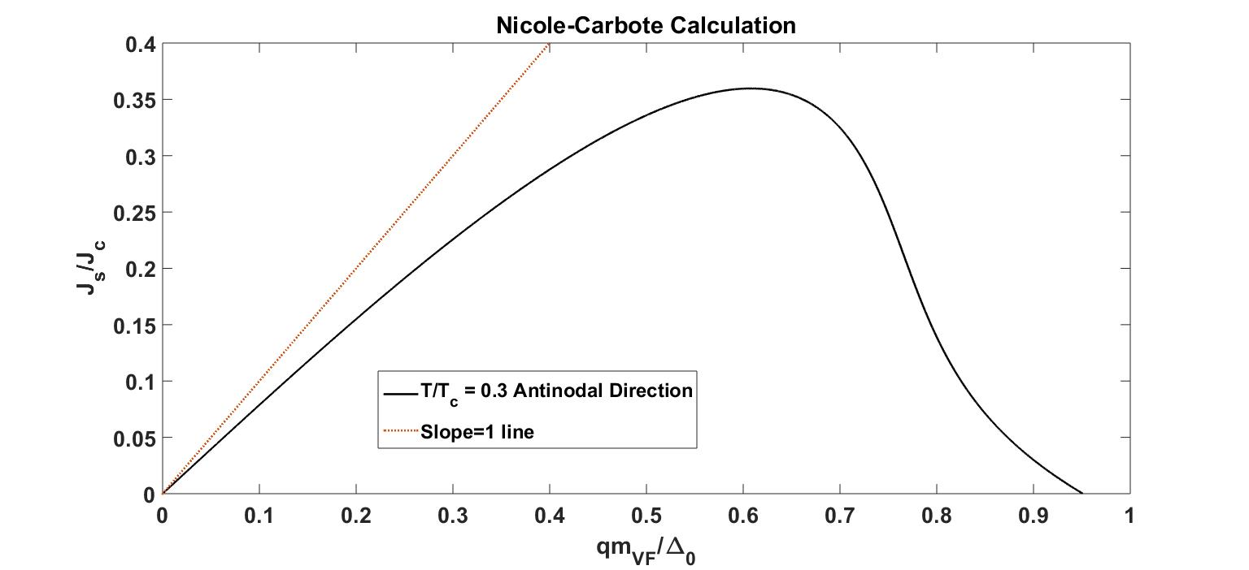

Origins of P_{3f}
Nonlinear Meissner Effect
-Nonlinear current density scale
Defects
$$∝B$$
Sheng-Chiang Lee, Thesis Defense

Slide 19
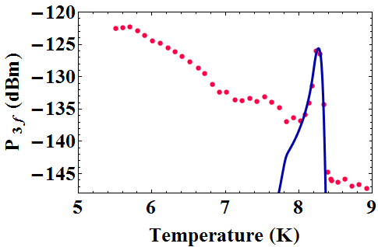
JJ, Vortices
Experiment Data
Curve fitting result (GL model )
Noise floor of spectrum analyzer
Tamin Tai, Behnood G. Ghamsari, and Steven M. Anlage: Nanoscale Electrodynamic Response of Nb Superconductors

Slide 20
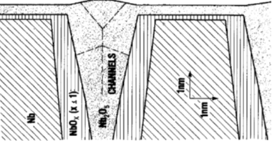


Nonlinearity from JJ between grains
$$Magnetic Field$$
Nb₂O₅
Nb
$$Bulk of Nb$$
NbO_{x} (x<1)
T_{c} < 2K
J. Halbritter, Appl. Phys. A 43, 1-28 (1987)
Notes:
JJ model good agreement at low power

Slide 21
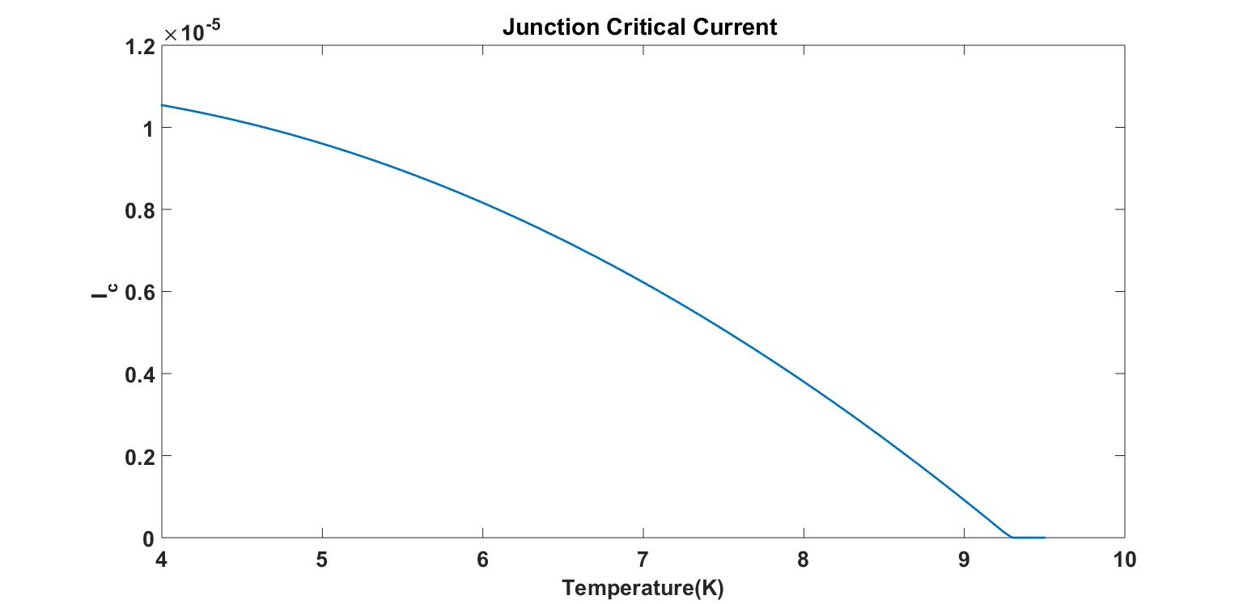
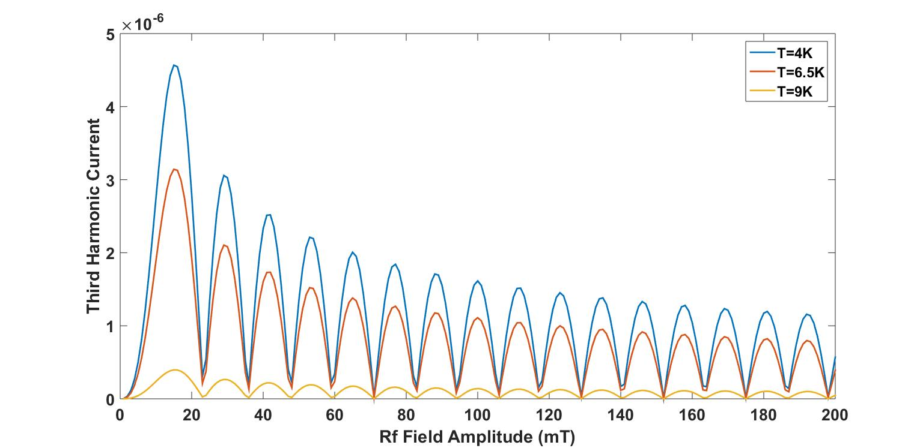


$$A/m^{2}$$
R_{n}=200Ω
S=9x10⁻¹⁴m²
T_{c}=9.25 K
$$A/m^{2}$$
J. Halbritter, “Granular superconductors and their intrinsic and
extrinsic surface impedance,”

Slide 22
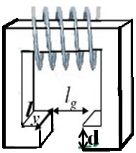
Future Plans
XYZ Pieze Positoin Controller
Resonance Frequency Shift
Driving Signal
Tuning Fork Controller
Response from Sensor
Quartz
Tuning Fork
Microwave Source
V_{f} ⁺
Low Pass Filter
Directional coupler
Spectrum
Analyzer
Interaction
v_{3f}
High Pass Filter
Superconductor
Cryogenic
Environment
Resonance Frequency Shift
Notes:
No Distance Controll and Scanning Capability with good resolution

Slide 23
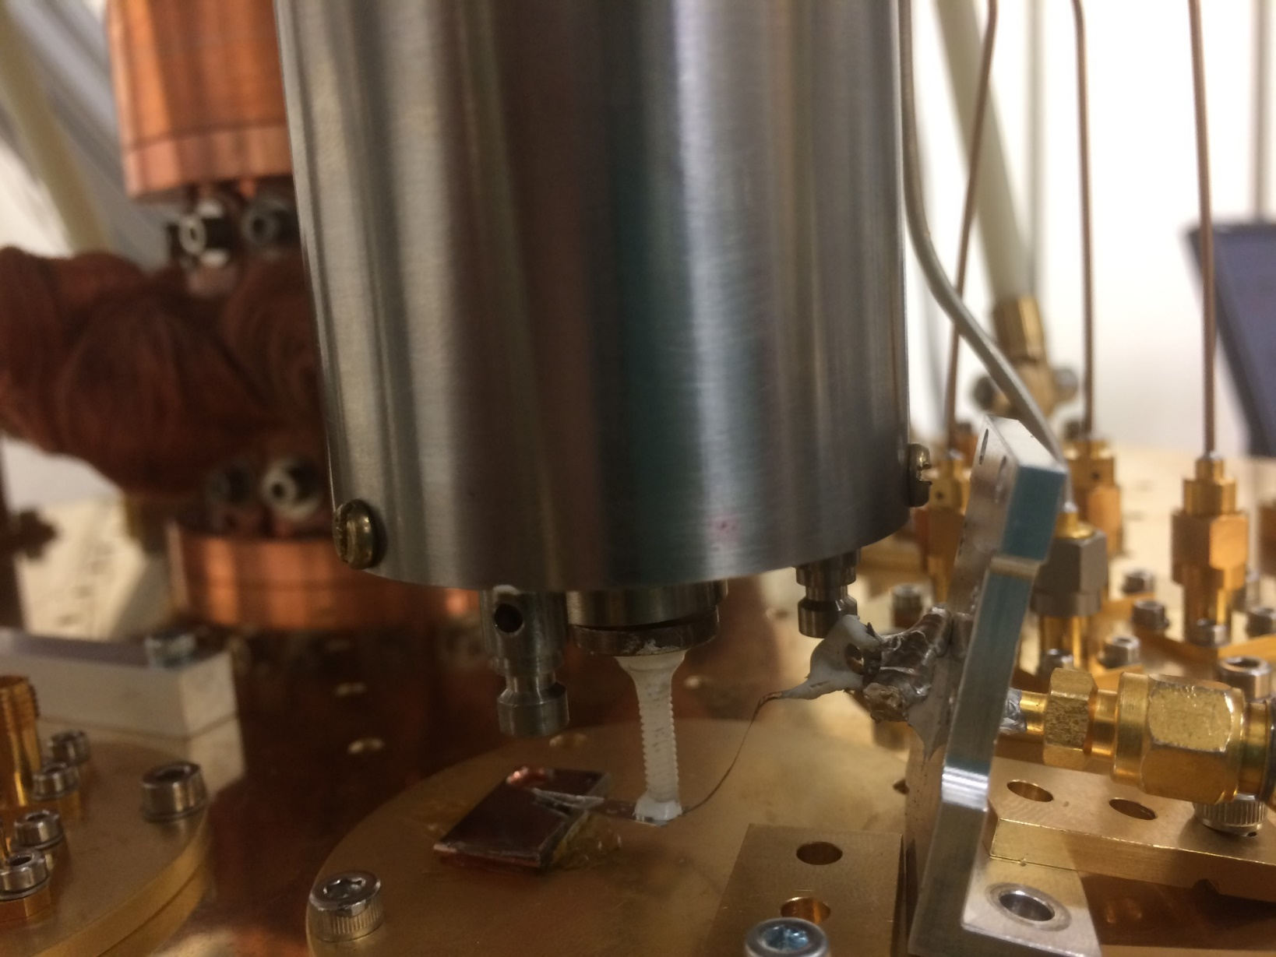
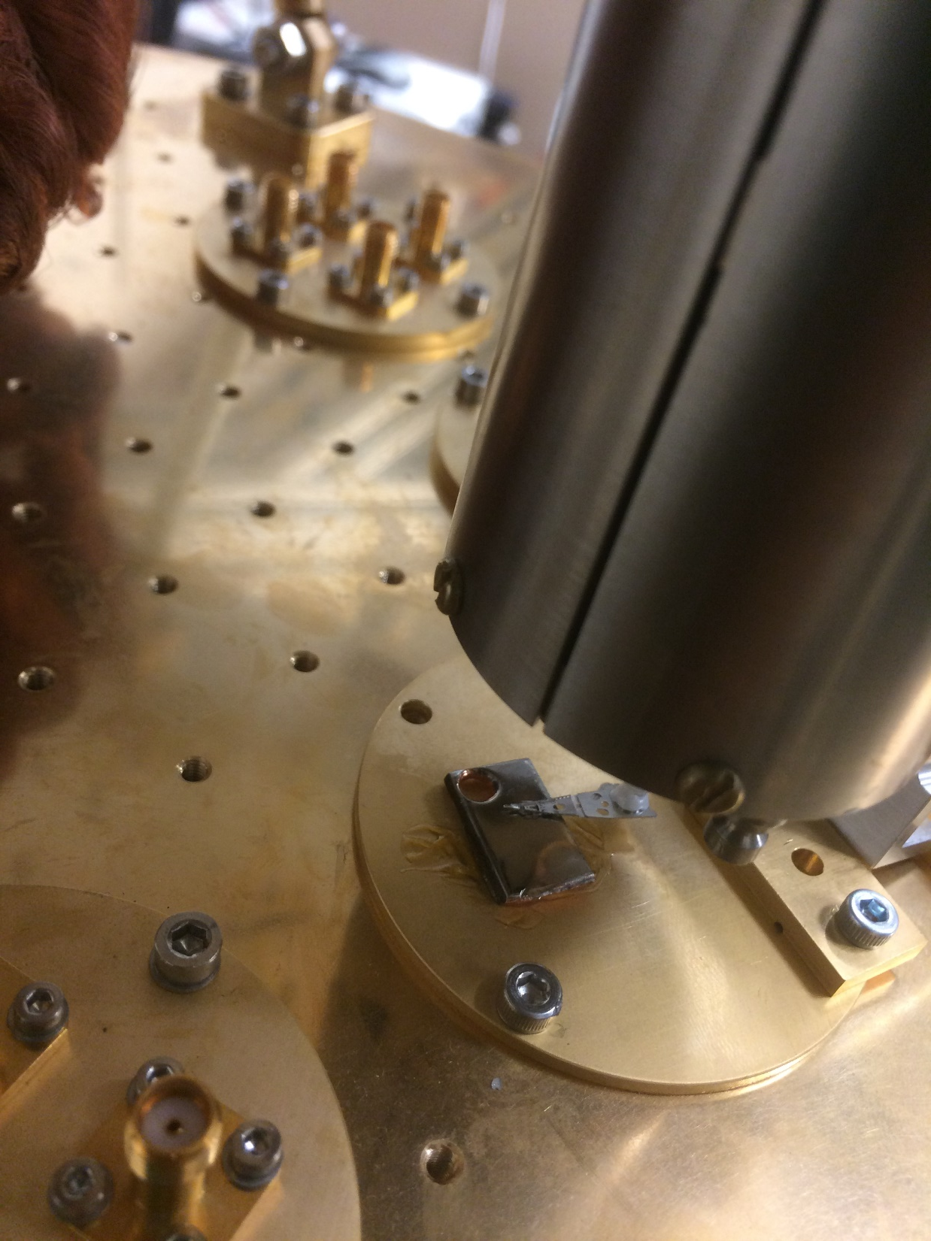
Piezo Scanner
Scanning Stage
Probe
Coaxial Cable
Probe
Sample
Transmission Line
Sample
4K Plate

Slide 24
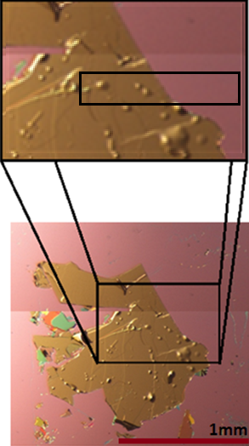
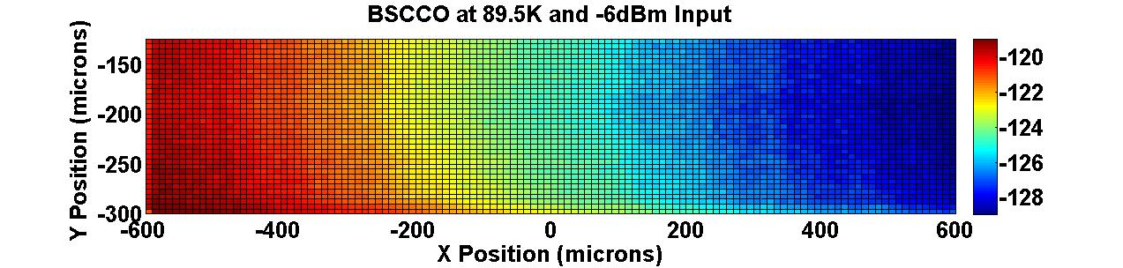
Next Step: Scanning
$${P_{3f}}^{sample}\left(T\right) ∝ \frac{1}{{J_{NL}}^{4}\left(T\right)}$$
S-C. Lee et al. Phys. Rev. B 71, 014507, (2005).
Bi-Sr-Ca-Cu-O
>77K Scanning
P_{3f} (dBm)

Slide 25
Conclusion
  Near-field Microwave Microscope that enables mapping of the local electrodynamic response in the multi-GHz frequency regime at cryogenic temperatures was successfully built.
  Advantages of this Method
  1) RF Characterization
  2) Strongly localized so no edge effects
  Disadvantages of this Method
  1) We don’t measure Q or Rs

Slide 26
  We are looking for Samples and Collaborations.
  Dimensions From 5mm x 5mm Up to 20cm x 20cm
  Flat Surface preferred but not required
  Best Suited : Sample Isolated Defect
  Base Temperature 3.6K , can go down to 100mK if needed
Special Thanks to Dr. Anne-Marie Valente-Feliciano & Dr. tOBIAS Junginger

