Slide 1




Review of muSR studies for SRF applications
Tobias Junginger

Slide 2
Acknowledgement
Experimentalists: D. Bazyl, R. Dastley, M. Dehn, D. Azzoni Gravel, S. Gehdi, Z. He, R. Kiefl, P. Kolb, R. Laxdal, Y. Ma, D. Storey, E. Thoeng, W. Wasserman, L. Yang, Z. Yao, H. Zhang (TRIUMF)
Support from Triumf Centre for Molecular & Materials Science: D. Arseneau, B. Hitti, G. Morris, D. Vyas (TRIUMF)
Support at PSI: A. Suter (PSI)
Sample Providers: D. Hall, M. Liepe, S. Posen (Cornell), A. Valente-Felenciano (JLAB), T. Tan, W. Withanage, M. Wolak, X. Xi (Temple University), G. Terenziani, S. Calatroni (CERN)
Affiliations as of time of collaboration

Slide 3
μSR Facilities Around the World

Slide 4
μSR Facilities Around the World
Summary:
muSR is a technique that allows to measure localized magnetic fields. Using this technique we show:
1. A layer of higher T_{c} material on niobium can push the field of first flux entry from a field consistent with H_{c1} to a field consistent with H_{sh}.
2. For multilayer systems without insulator there is a wide range proximity effect to be considered
3. There is strong evidence for magnetic impurities on the surface of Nb/Cu samples

Slide 5
Outline
Introduction to muSR
Using muSR as a local magnetometer (TRIUMF)
  Inducing superheating in niobium by thin film coating
Low Energy muSR (PSI)
  Proximity effects in NbTiN/Nb and NbTiN/AlN/Nb samples
  Magnetic Impurities in Nb/Cu films
Summary
Outlook
  BetaNMR

Slide 6
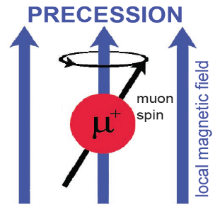
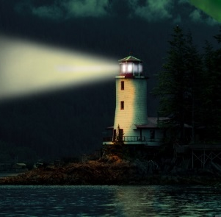
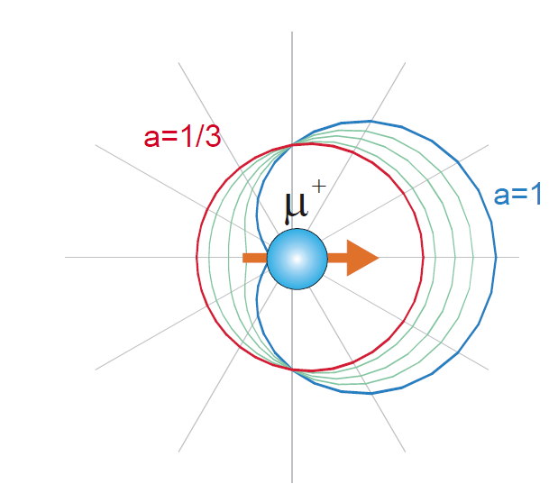
Muon production and decay
Muons are deposited ~100micron deep in a sample (bulk probe) – spin precesses with frequency dependent on local magnetic field
Muon decays in τ_{1/2}=2.2µsec - emits a positron preferentially along the µ⁺ spin direction
Muons are 100% spin polarized with kinetic energy of 4.1MeV

Slide 7
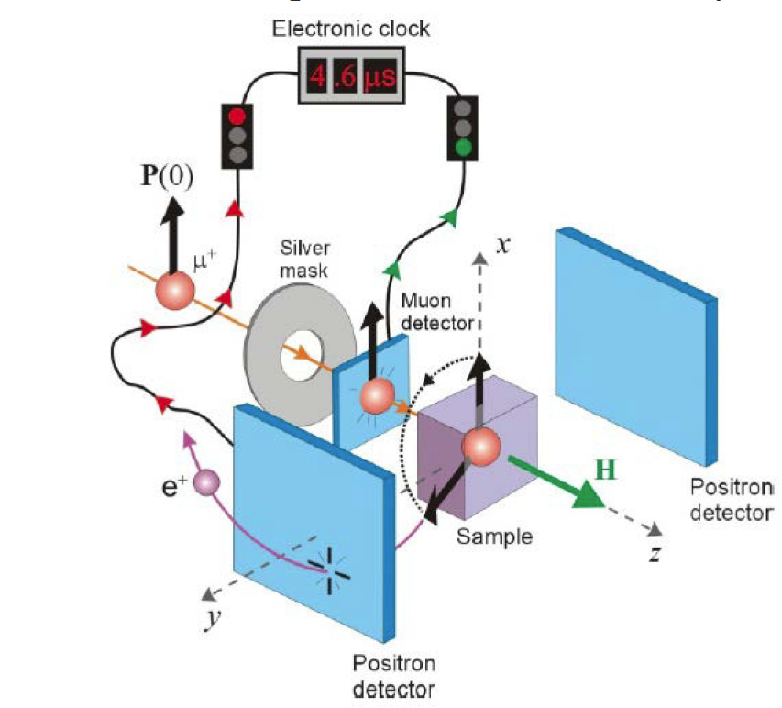
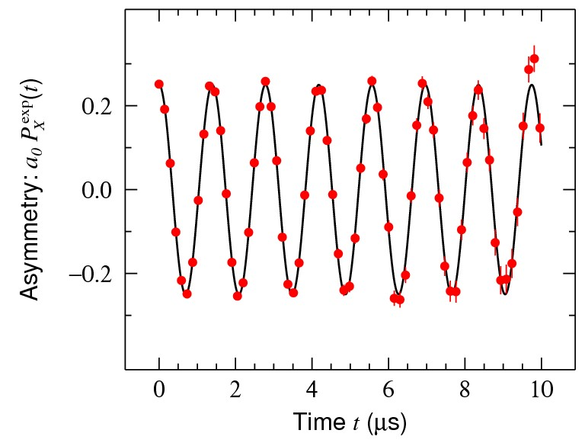
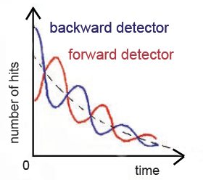
Muon Spin Rotation – muSR
Muons are deposited one at a time in a sample
Muon decays emitting a positron preferentially aligned with the muon spin
Right and left detectors record positron correlated with time of arrival
The time evolution of the asymmetry in the two signals gives a measure of the local field in the sample
Left detector
Right detector

Slide 8
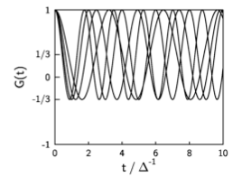
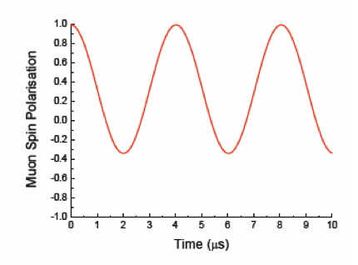
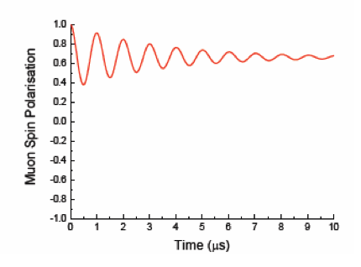
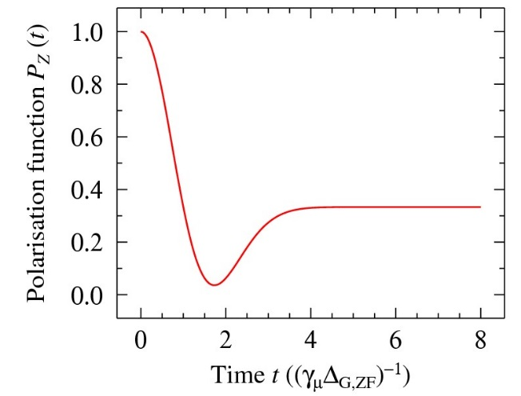
Magnetic Volume Fraction
Uniformly weakly magnetic
Non-magnetic with
magnetic impurities
Static distribution of random fields

Slide 9
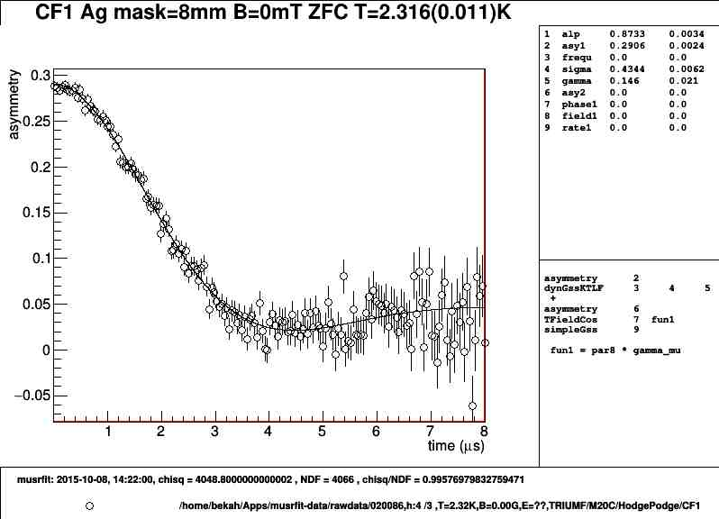
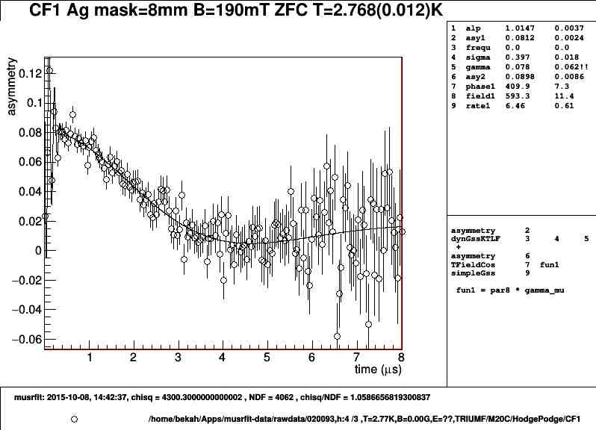
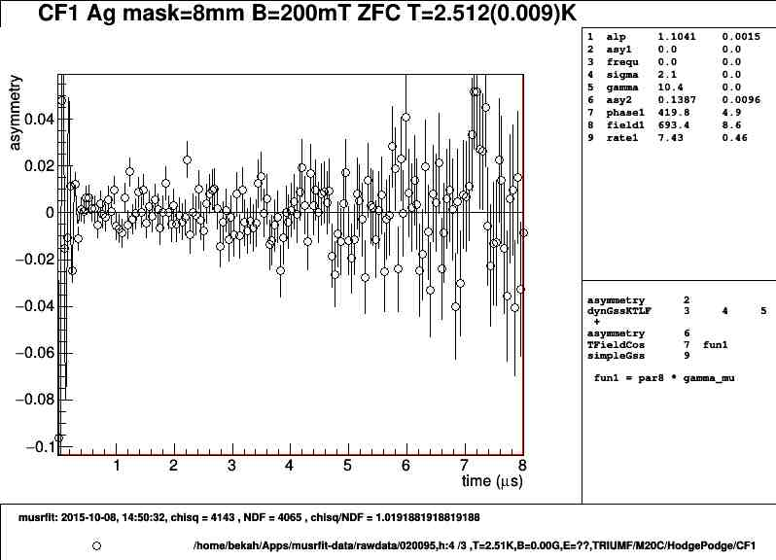
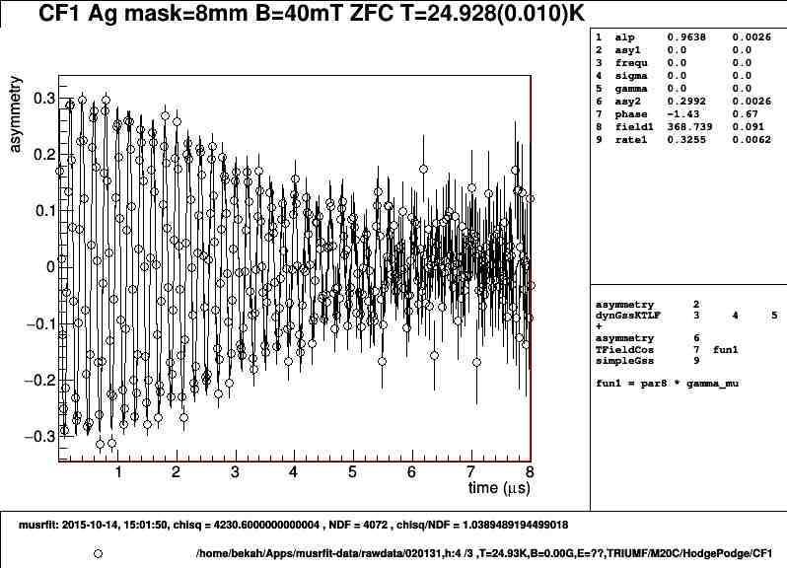
Using muSR as local magnetometer
A sample is cooled in zero field - asymmetry measurements are taken as a function of applied magnetic field
The relative asymmetry at t=0 gives a measure of the volume fraction sampled by the muons that does not contain magnetic field
Meissner state
Intermediate state
A variety of samples and sample geometries have been characterized in this way
Vortex state
Normal state

Slide 10
The field of first entry and the role of pinning in different geometries
Transverse coin samples are sensitive to pinning - delays flux break in to the centre
Parallel coin geometry is insensitive to pinning
Ellipsoid samples are less sensitive
All three geometries are useful to characterize the material

Slide 11
The field of first entry and the role of pinning in different geometries
Stronger pinning
Weak pinning
Effect of pinning
800C baked samples – pinning is clearly seen in different H_{entry} between transverse, parallel coin and ellipsoid geometry
1400C heat treatment for three geometries
virtually eliminates pinning from the Nb
H_{entry} is equal for all geometries
Our baseline substrate for thin film tests is 1400°C annealed niobium
The parallel field configuration is used to determine the field of first entry
Measurements in transverse geometry measure the pinning strength

Slide 12
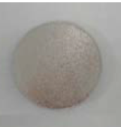
Testing coated samples with muSR as a local magnetometer
Muons are implanted
100 μm deep in the bulk
20mm
Coatings are between 50nm and 3.5µm
Nb
Muons
B
Parallel field configuration. Field will first break in at the corners at 0.82 H_{entry} and move to the center at 0.91 H_{entry}. Only the field in the center is probed
Above Tc of niobium we measure the field of first entry of the coating only, below Tc of niobium we measure the higher H_{c1} or H_{sh}

Slide 13
Nb3Sn on Nb Ellipsoid results
Material | H_{nucleate} (0) [mT] | T_{c} [K]
Niobium | 227 | 9.36
Nb3Sn | 37.1 | 17.3
Below 9.25K we seem to measure Hsh of niobium, above 9.25K Hc1 of Nb3Sn.
→ If the film induces superheating in niobium this should be independent on thickness

Slide 14
Testing coated samples (MgB2)

Slide 15
Testing coated samples (MgB2)
Again temperature dependence as expected for niobium

Slide 16
Testing coated samples (Nb3Sn and MgB2)
Theoretical
H_{sh} of Nb
Factor of 70

Slide 17
Testing coated samples (Nb3Sn and MgB2)
H_{sh}=237(11)
Theoretical
H_{sh} of Nb
Factor of 70

Slide 18
Testing coated samples (Nb3Sn and MgB2)
H_{sh}=237(11)
Theoretical
H_{sh} of Nb
No clear trend for field of first entry on material or thickness.
Conclusion: Superheating is induced in niobium
Factor of 70

Slide 19
Outline
Introduction to muSR
Using muSR as a local magnetometer (TRIUMF)
  Inducing superheating in niobium by thin film coating
Low Energy muSR (PSI)
  Proximity effects in NbTiN/Nb and NbTiN/AlN/Nb samples
  Magnetic Impurities in Nb/Cu films
Summary
Outlook
  BetaNMR

Slide 20
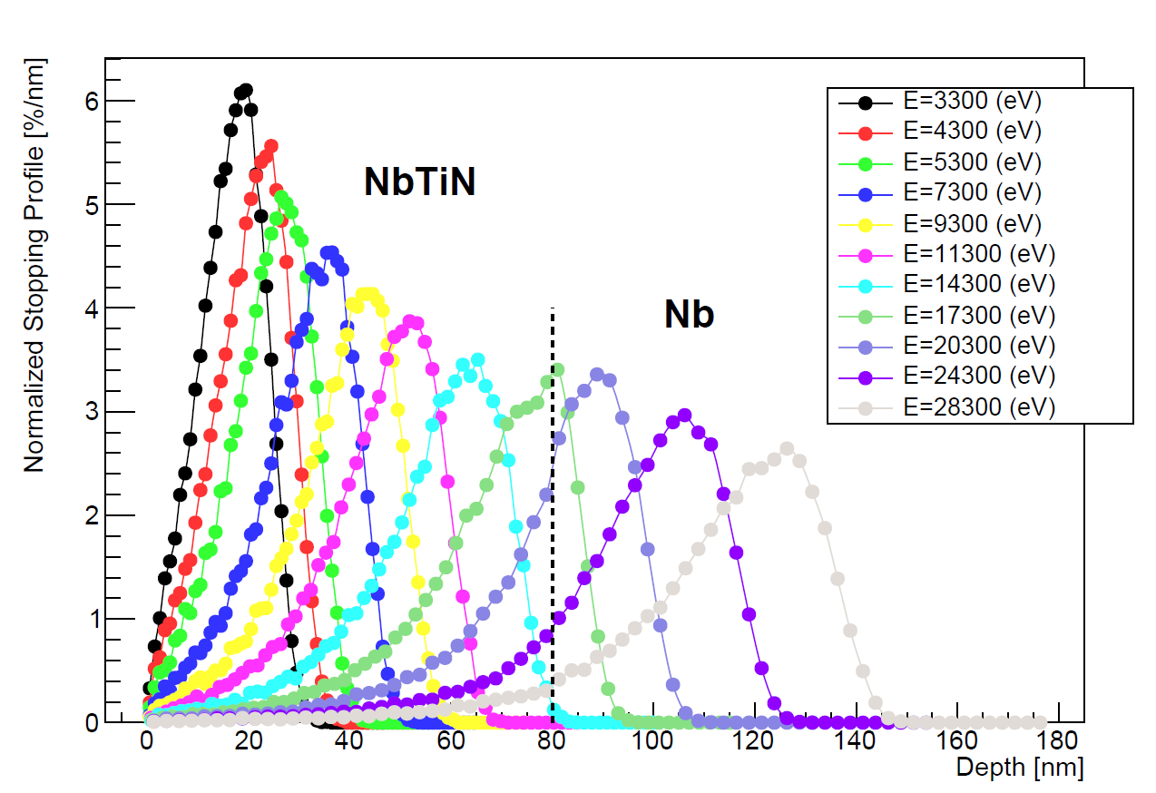
Low energy muons
Low energy muons can be stopped in a variable depth between 0 and ~100nm
Ideal for testing layered structures
Parallel fields limited to 25mT
Has been applied to test two samples
  NbTiN(80nm) on Nb
  NbTiN(80nm)/AlN(20nm) on Nb

Slide 21
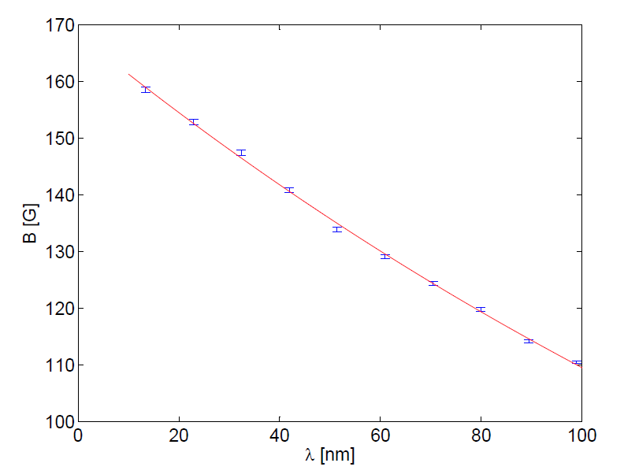
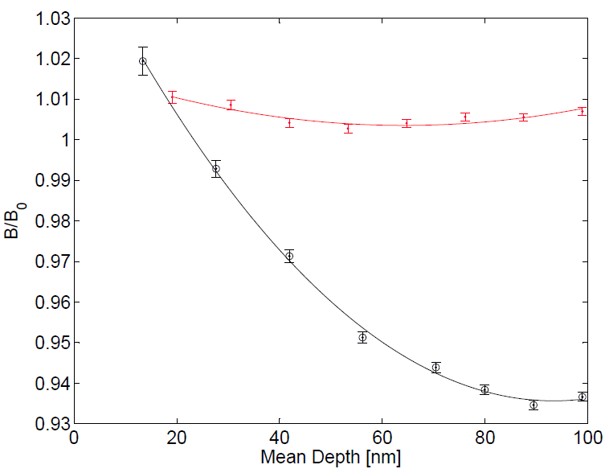

Field parallel to sample surface –
Meissner Screening NbTiN (80nm) on Nb
Magnetic field decays with a single exponential
223(7) nm is short for NbTiN
Proximity effect?
λ=223(7) nm
2.2K
V. Cherkez et al.- PHYSICAL REVIEW X 4, 011033 (2014)
$$λ_{L}∝1/\sqrt{n_{S}}$$

Slide 22
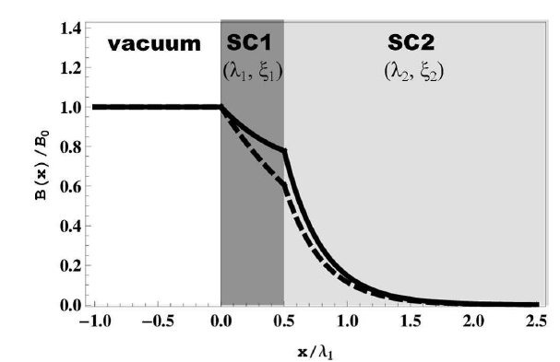
Field parallel to sample surface –
Meissner Screening NbTiN (80nm) on Nb
Magnetic field decays with a single exponential
223(7) nm is short for NbTiN
Proximity effect?
λ=223(7) nm
London theory, no proximity effect
2.2K
Naive treatment
Experiment
T. Kubo arXiv:1410.1248

Slide 23
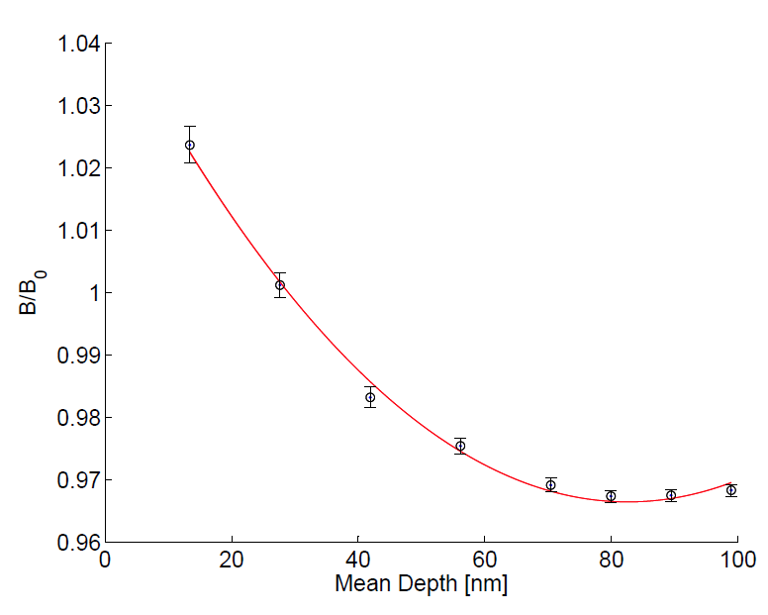
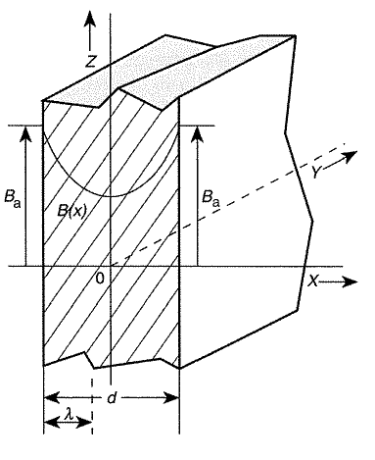
Field parallel to sample surface –
Meissner Screening NbTiN (80nm) on Nb
Either the NbTiN layer is significantly thicker than 80 nm or long range proximity effect
Fit
cosh(x/λ₀)/cosh(d/(2 λ₀))
λ₀=204(18); d=135(11)

Slide 24
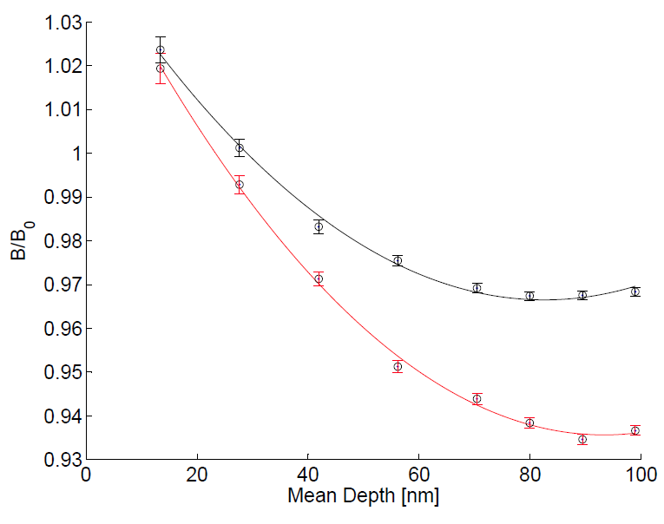
Field parallel to sample surface –
Meissner Screening NbTiN (80nm) on Nb
At 8 K a vortex must have entered the niobium
11 K
λ₀=204(18); d=135(11)
8 K
λ₀=190(15); d=157(13)

Slide 25
Comparison to SIS Multilayer
8 K
λ₀=380(100); d=98(13)
Nb-AlN-NbTiN
For multilayer systems without insulator there is a wide range proximity effect to be considered.
8 K
λ₀=190(15); d=157(13)
Nb-NbTiN

Slide 26
Outline
Introduction to muSR
Using muSR as a local magnetometer (TRIUMF)
  Inducing superheating in niobium by thin film coating
Low Energy muSR (PSI)
  Proximity effects in NbTiN/Nb and NbTiN/AlN/Nb samples
  Magnetic Impurities in Nb/Cu films
Summary
Outlook
  BetaNMR

Slide 27
Fluctuating Random Fields
Slow Fluctuations
Main effect is relaxation of the ⅓ tail at long times, because 1/3 of the muons see a field in spin direction and do not process
Fast Fluctuations
No recovery. For faster fluctuations slower depolarization (motional narrowing)
Polarization function for different fluctuation rates. The “0” function corresponds to a Gaussian distribution of random fields.

Slide 28
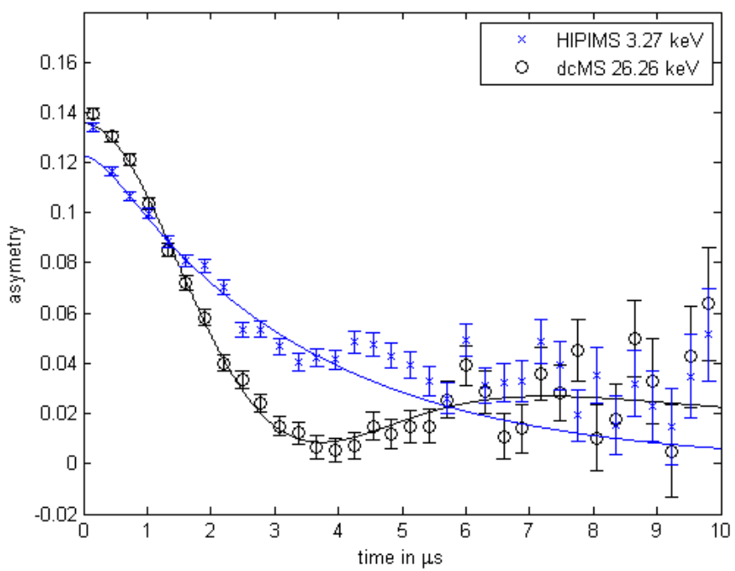
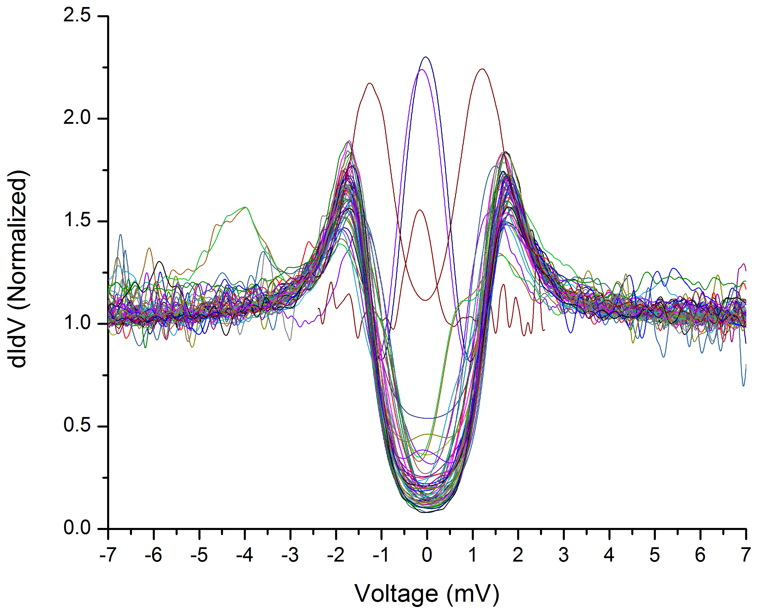
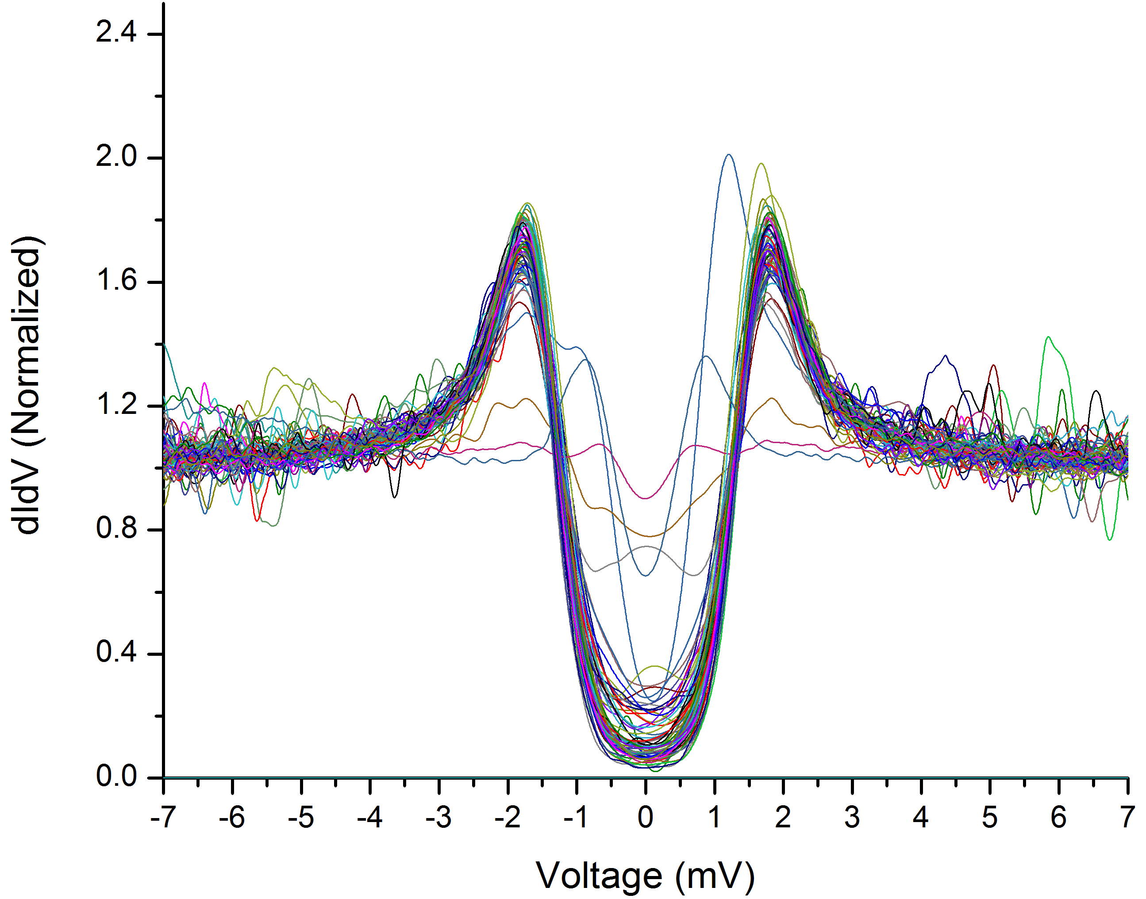
Evidence for Magnetic Impurities in Nb on Cu samples
muSR
PCT
Zero bias peaks
HIPIMS
PCT
HIPIMS shows strong fluctuations
  Muon diffusion?
  Magnetic Impurities?
Magnetic Impurities supported by zero bias peaks observed with point contact tunneling (PCT) from ANL (T. Proslier)
dcMS

Slide 29
Additional tests with a nitrogen overlayer
We grew a nitrogen overlayer on the sample
Stop the muon in the nitrogen but close to the niobum surface
In nitrogen the muon is known to be static
Deviations from the static Kubo-Tuyabe function will give evidence for magnetic impurities

Slide 30
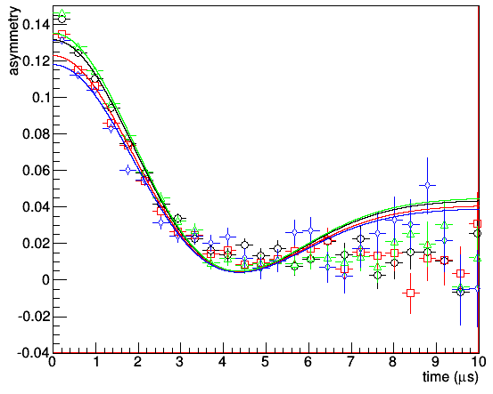
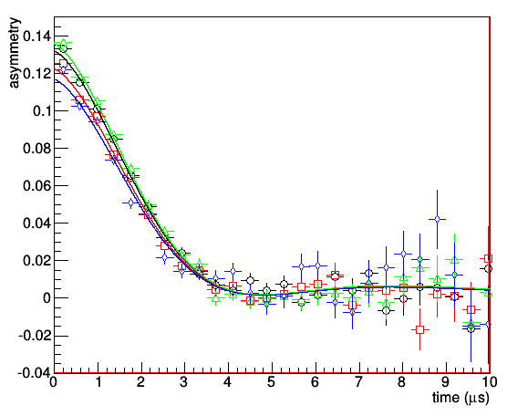
Measurements with N2-overlayer
There is no muon diffusion in the N2-overlayer
If there are no magnetic impurities in the Nb a staticGssKT function would fit the data
Static muon – Gaussian Field Distribution
Static Kubo-Toyube*exp(-λ/t)^{β}
Systematic deviations
No magnetic impurities

Slide 31
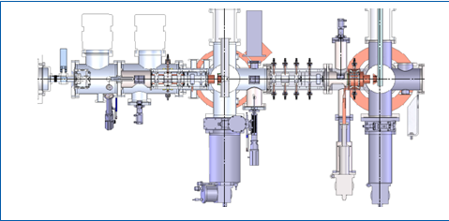
New beta-NMR beamline at TRIUMF for SRF studies
Beta-NMR @ TRIUMF is a unique facility to characterize magnetic properties of materials at surfaces and film interfaces
Similar to muSR but uses radioactive ions like 8Li implanted in bunches not one by one
Like LEmuSR it can probe the superconductor through the London layer and depth profile thin films
New high field spectrometer is being installed to allow high field (near Hc1) parallel to sample face (to replicate rf fields)
TRIUMF will provide a unique facility in the world for diagnosing new treatments (doping), new materials (Nb3Sn) and new structures (SIS layers)
New high field spectrometer
Existing low field spectrometer

Slide 32
Summary
muSR is a technique that allows to measure localized magnetic fields. Using this technique we show:
1. A layer of higher T_{c} material on niobium can push the field of first flux entry from a field consistent with H_{c1} to a field consistent with H_{sh}.
2. For multilayer systems without insulator there is a wide range proximity effect to be considered
3. There is strong evidence for magnetic impurities on the surface of Nb/Cu samples
Questions?

