Slide 1
Increase in vortex penetration field on bulk Nb coated with a MgB₂ thin film without an insulation layer
Teng Tan--Institute of Modern Physics, CAS
M. A. Wolak, X. X. Xi--Temple University
L. Civale, T. Tajima--LANL

Slide 2
Outlines
Motivations
Experiments
Results and Discussions
Conclusions

Slide 3
Outlines
Motivations
Experiments
Results and Discussions
Conclusions

Slide 4
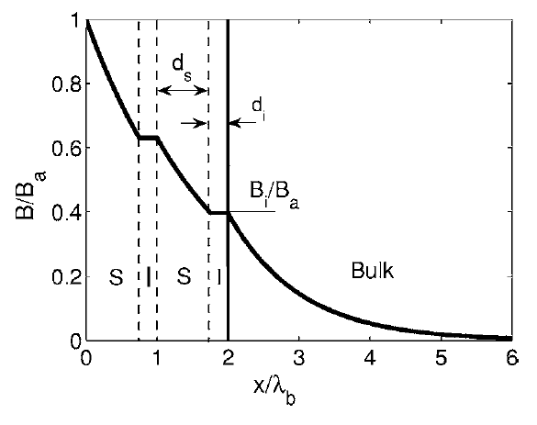
Motivations (VP on Film/Cavity)
Vortex penetration causes loss.
Use thin film/S-I-S structure to protect the SRF cavities from VP.
Prove the effectiveness of thin film: H//, only on one side.
Strong vortex dissipation
H
Gurevich, APL 88, 012511 (2006)
A SC thin film coated ellipsoid can provide such conditions.

Slide 5
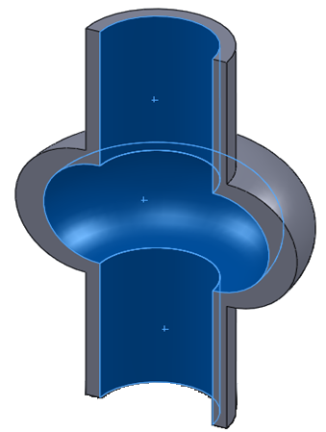
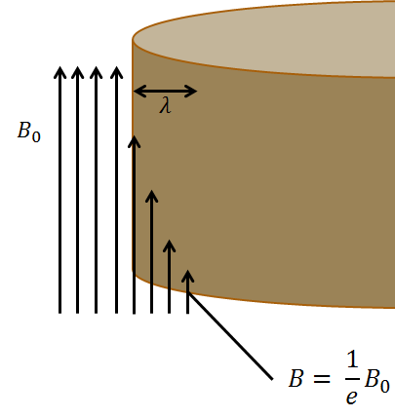
Motivations (Film on an Ellipsoid)
An ellipsoid in H//axis has uniform magnetization.
H//surface everywhere. Mimicking the inner surface of SRF cavities.
Strongest H at equator.
H
H₀
H_{eq}
N is the demagnetization factor
H’ = $\frac{1}{e}H$

Slide 6
Motivations (MgB₂ thin films)
Higher T_{c}, comparing with Nb and Nb₃Sn.
H_{c} and H_{sh} are close to Nb₃Sn, higher than Nb.
Lower H_{c1} is covered by thin film structure.
Larger λ is good for thin film coated SRF cavity.
Material | T_{c} [K] | ρ_{n} (μΩcm) | H_{c}(0) [T] | H_{c1}(0) [T] | H_{c2}(0) [T] | λ(0) [nm] | Δ [meV]
Nb | 9.23 | 2 | 0.2 | 0.18 | 0.28 | 40 | 1.5
Nb₃Sn | 18 | 20 | 0.54 | 0.05 | 30 | 80-100 | 3.1
MgB₂ | 40 | 0.1-10 | 0.43 | 0.03 | 7 | 100~140 on metal | 1.8/7.2

Slide 7
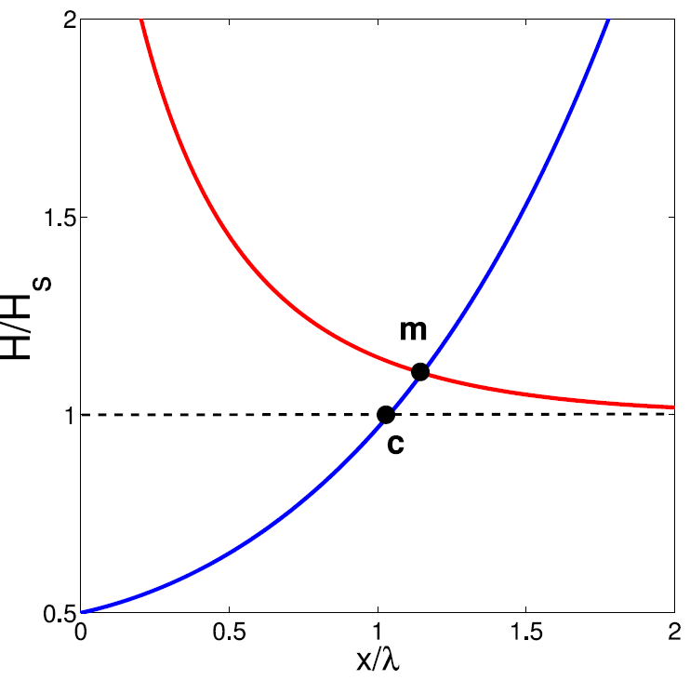
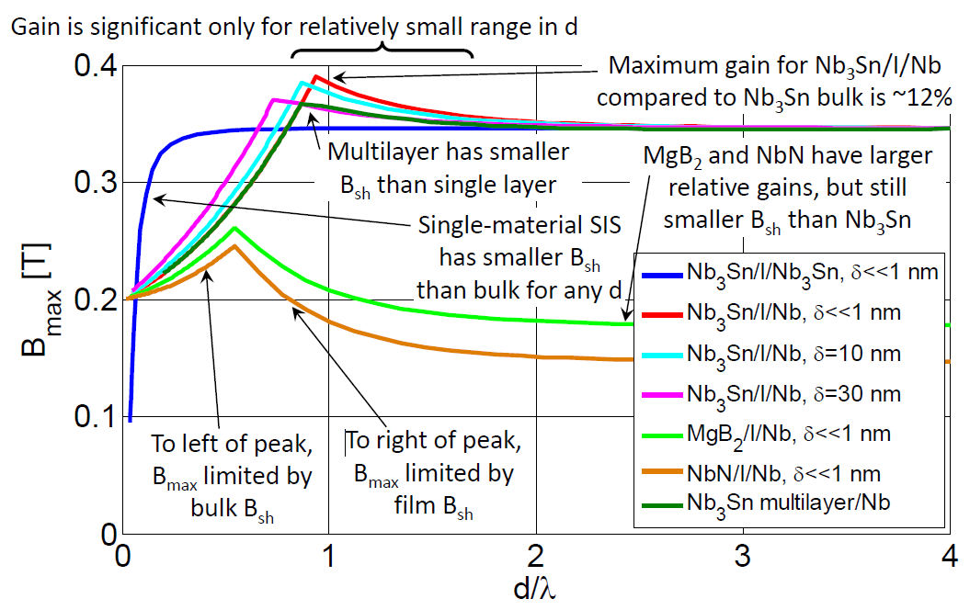
Theory (H// on one side)
H_{c1} limit
J limit
Gurevich, APL 88, 012511 (2006)
Multilayer S-I-S
Gurevich, AIP Advances 5, 017112 (2015);
Optimal d_{m}.
S. Posen PR applied 4, 044019 (2015)
H_{sh} and thin limit

Slide 8
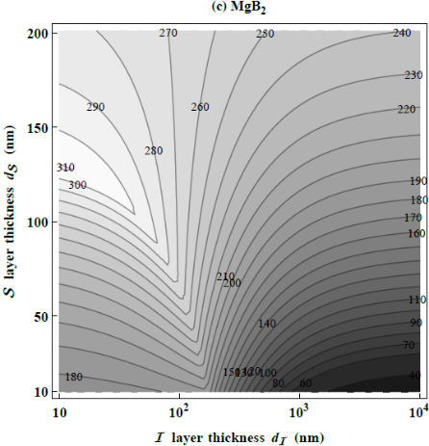
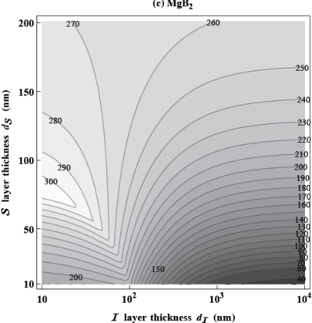
Theory (MgB₂ on Nb)
λ=140nm
λ=100nm
T. Kubo MgB₂/I/Nb, B_{c}^{(MgB2)}=320 mT (2014 private comm.)

Slide 9
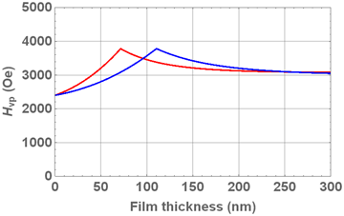
Theory (MgB₂ on Nb no I layer)
λ_{MgB2} = 100 nm
λ_{MgB2} = 140 nm
MgB₂/Nb, B_{sh}^{(MgB2)}=320 mT B_{sh}^{(Nb)}=240 mT

Slide 10
Outlines
Motivations
Experiments
Results and Discussions
Conclusions

Slide 11
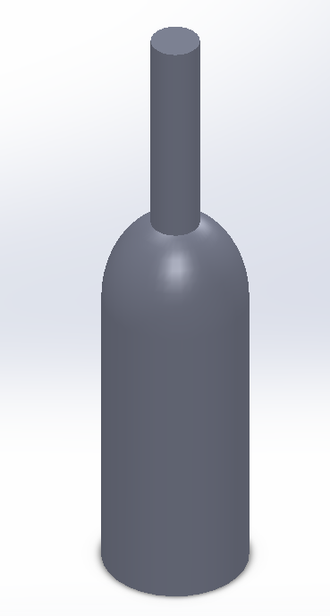
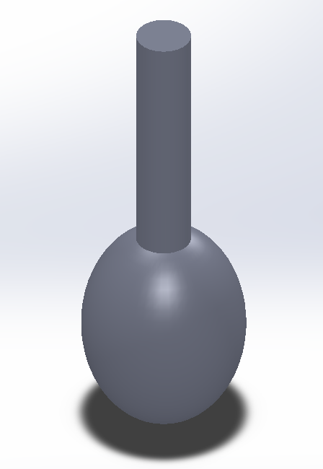
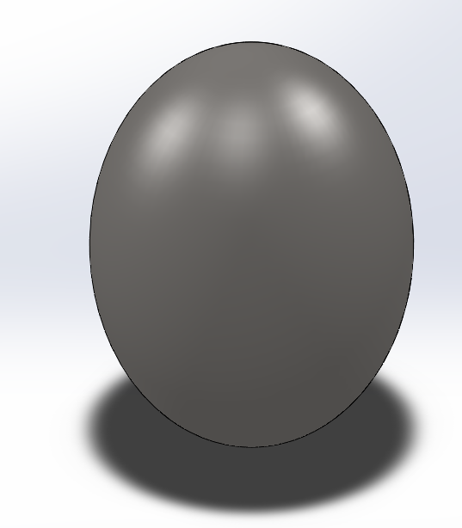
Experiments (Sample preparation)
Ellipsoids are machined from rods.
Calculations:
Demag factor : N_{c} = 0.2186
N_{b}=N_{a}=0.3907
Volume = = 0.01047 cm³
m/H₀ = = 0.01066 emu/Oe
H_{eq}/H₀ = 1.28 when H₀//c axis
1 2 3 4
2c
2c = 8 mm
2a = 2b = 5 mm
2b
2a

Slide 12
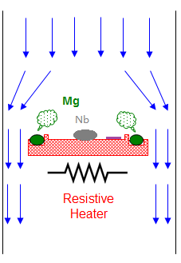
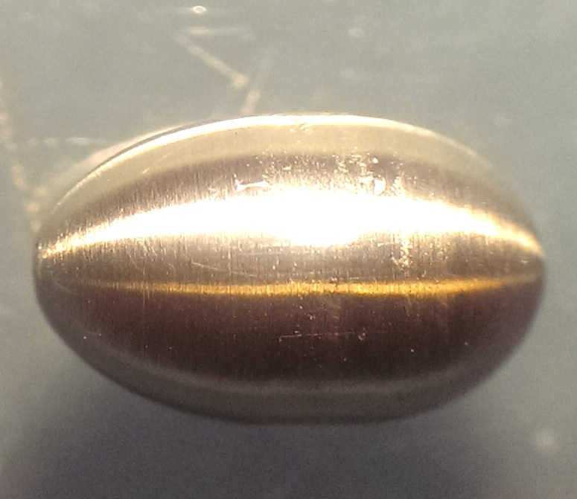
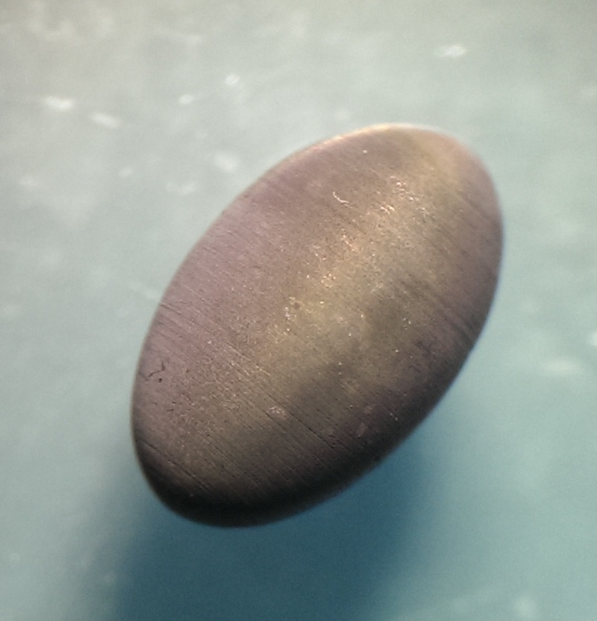
Experiments (Sample preparation 2)
B₂H₆ + H₂
MgB₂ thin films by HPCVD
3 successive depositions to deposit a shell,
A reference sample is put aside of the ellipsoid in the first deposition.
Sample is marked with “Nb + reference sample thickness”. Actual thickness of the shell is expected to be 1~1.5 times larger.
Nb0
Nb200
Ellipsoid
SiC Reference Sample
Samples: Nb0
Nb100
Nb200

Slide 13
Experiments (H_{vp} measurement)
Measurements performed at LANL.
H_{vp} is first measured with m-H method.
Similar to thin film H_{c1} measurement. ZFC then magnetization
Vortex penetration signified by m-H curve deviates from linear relationship.
Example curves: Nb200.
T
VP at H₀ reaches H_{vp}.
H_{vp} ~ 1700 Oe at 5 K for Nb0.
Method idea: Constant T, measure H_{vp}.
H
Nb200 ellipsoid

Slide 14
Experiments (H_{vp} measurement 2)
Sample curve measured on Nb200,
150 mT field applied after ZFC to 3 K.
Sample ZFC then warm up in field.
VP at H_{vp} decrease to H₀. Shown by Δm.
Method idea: Constant H, measure T correspond to the fixed H_{vp}.
T
H
Nb200 ellipsoid
H_{vp} = 1500 Oe at 5.21 K for Nb200

Slide 15
Outlines
Motivations
Experiments
Results and Discussions
Conclusions

Slide 16
Results (H_{vp}-T from M-H)
Nb0 T_{c} 9.3K
Nb200 T_{c} 38.2 K

Slide 17
Results (H_{vp}-T from M-T)

Slide 18
Discussions (method comparison)
M-H has large noise at H > 1500 Oe due to magnet ramping.
M-T is a better alternative.

Slide 19
Discussions (compare with theory)
λ_{MgB2} = 100 nm
λ_{MgB2} = 140 nm
2800 Oe
3000 Oe
2600 Oe
2.3 K
2600 Oe
2.8 K
Measurement
Linear Extrapolation to 0 K
Our results agree with the curves for B_{sh}^{(MgB}₂⁾=320 mT and different λ_{MgB2}. With thicker film closer to the limit.

Slide 20
Supplementary: Field Penetration
Can we prove the shielding effect of S-I-S structure?
MgB₂/Nb structure is not working: no place for the B probe.
B = ?

Slide 21
Supplementary: Field Penetration
Can we prove the shielding effect of S-I-S structure?
MgB₂/Nb structure is not working: no place for the B probe.
If we took out the SC core and only left a SC shell: MgB₂/Mo
Mo100, Mo200, Mo300
B = 4πm/V

Slide 22
m-H measured MgB₂/Mo H_{vp}
H_{vp}: Mo200>Mo100≈Mo300

Slide 23
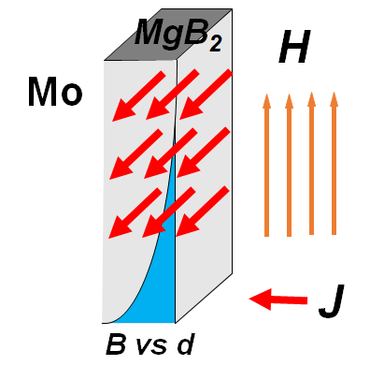
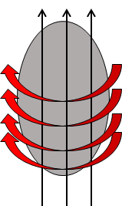
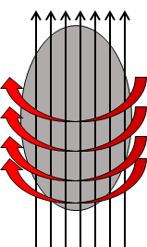
Maximum ΔH
y
x
z
Field cool,
Vortex penetration,
no SC current.
Increase field,
Vortex frozen,
SC current increase until I_{c}
Further increase field,
Vortex enters again,
SC current remain I_{c}
400 Oe over 200 nm, J ~ 10⁷ A/cm²

Slide 24
Maximum ΔH
Field cool,
Vortex penetration,
no SC current.
Increase field,
Vortex frozen,
SC current increase until I_{c}
Further increase field,
Vortex enters again,
SC current remain I_{c}

Slide 25
Outlines
Motivations
Experiments
Results and Discussions
Conclusions

Slide 26
Conclusions
We increase the H_{vp} by ~600 Oe by coating it with a thin superconducting film that screens vortex penetration. H_{sh}(0) of MgB₂ has to be > 3000 Oe.
It is technically possible to deposit a thin MgB₂ film with appropriate properties for this purpose on curved bulk Nb via HPCVD. Making it possible for MgB₂ covered Nb cavity.
The shielding effect of S-I-S structure is proved. Maximum ΔH ∝ J_{d}.
The actual H_{vp} enhancement depends on H_{sh} of the film, depairing J, film quality, and maybe more.

Slide 27
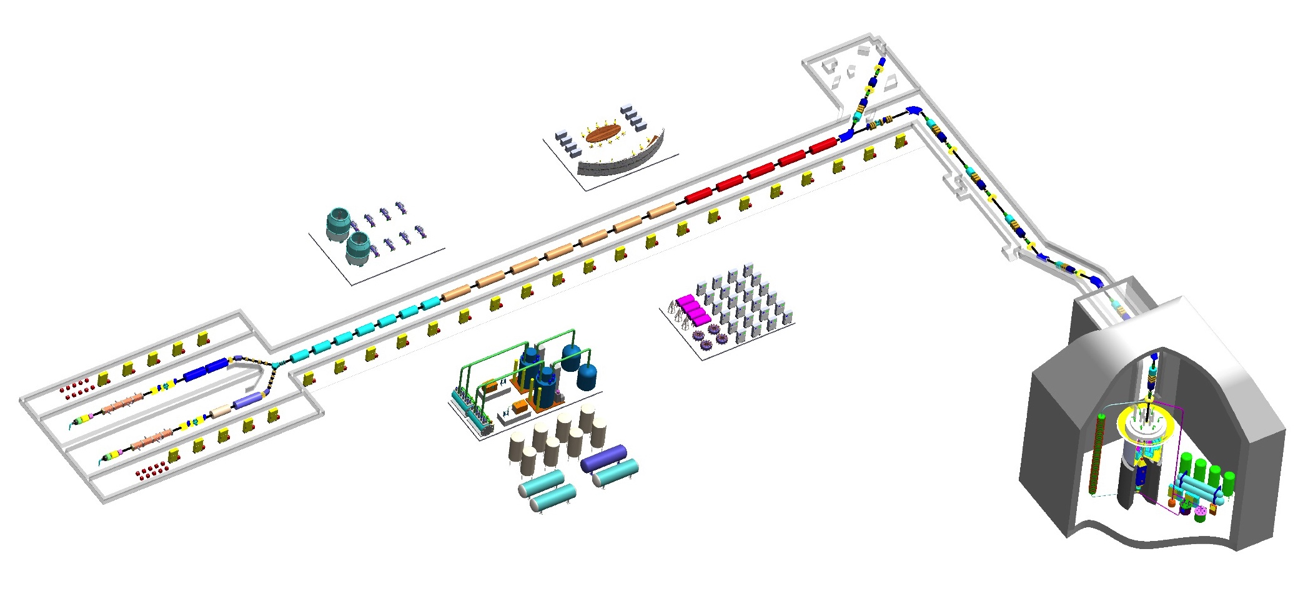
Acknowledgements
Thanks for your attention
Welcome Collaboration!

