Slide 1


Growth of MgB₂ Films on Large Area Cu Discs and RF Characterization
Wenura Withanage
Advisor – Prof. Xiaoxing Xi

Slide 2
Outline
Superconducting MgB₂
Motivation & Goal
Hybrid physical chemical vapor deposition (HPCVD) of MgB₂ at Temple University
MgB₂ growth on metal substrates
MgB₂ growth on 2” ceramic substrates
MgB₂ growth on Cu substrates by other groups
MgB₂ deposition on 2” Cu discs
Results
Summary
References

Slide 3
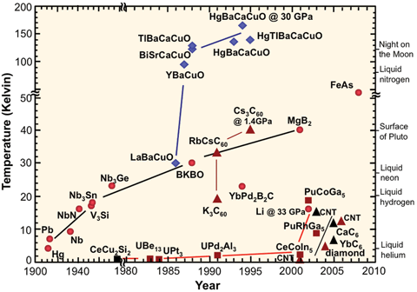
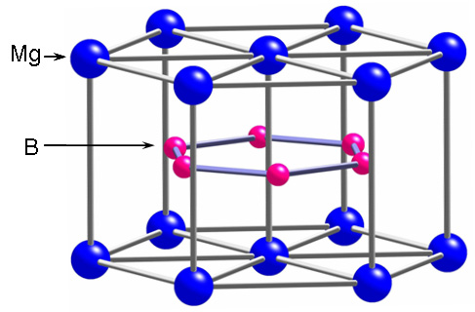
Superconducting MgB₂
Discovered in 2001
High transition temperature(Tc) ~39 K
Has a hexagonal structure
http://www.ccas-web.org/superconductivity/#image1
1 μm
Zeng et.al., Nature Materials, Vol.1, 2002
Hexagonal structure
Xi et al, Physica C 456, 22 (2007)

Slide 4
Motivation & Goals
Motivations
MgB₂ is one of the most promising superconducting material for SRF applications
- high Tc (39 K) - low residual resistance
- non weak link behavior between the grain boundaries
MgB₂ coated Cu cavities will have high thermal conductivity
Less expensive alternate for commonly used Nb bulk cavities
Developing a recipe to grow MgB₂ on large area Cu discs
RF characterization of the MgB₂ coated Cu discs
Coating MgB₂ on the inner walls of a 3 GHz Cu cavity
Goals

Slide 5
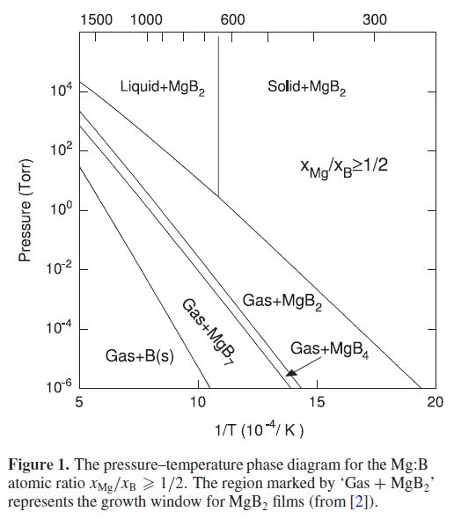

HPCVD of MgB2 at Temple University
Pressure – Temperature phase diagram for Mg – B system
get rid of oxygen
prevent oxidation
make high Mg
pressure possible
H₂ (~40 Torr)
B₂H₆ (~ 2 - 40 sccm)
B supply (B₂H₆ flow rate) controls growth rate
pure source of B
Mg
Substrate
Sample
holder sits
on the
resistive
heater
Pure source of Mg
Liu Z K, Schlom D G, Li Q and Xi X X 2001
Thermodynamics of the Mg–B system: implications
for the deposition of MgB2 thin films Appl. Phys. Lett.
high enough T
for epitaxy ~ 730 C

Slide 6
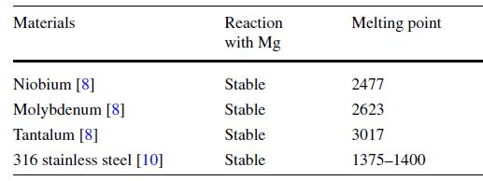
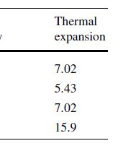
MgB₂ growth on Metal substrates using HPCVD
MgB₂ was grown on metal substrates
Deposition temperature ~ 700 C
300 nm MgB₂ were grown
Tc ~ 39 K
Mg readily reacts with Cu at high temperature
MgCu₂ and Mg₂Cu
Chenggang Zhuang · Teng Tan · Alex Krick ·
Qingyu Lei ·Ke Chen · X.X. Xi
J Supercond Nov Magn (2013) 26:1563–1568

Slide 7
MgB₂ Film growth on
2” ceramic substrates
7
HPCVD setup was scaled up to accommodate 2” substrates
2” sapphire discs were coated successfully
Tc ~ 39 K
Teng Tan, Chenggang Zhuang, Alex Krick, Ke Chen, and X. X. Xi
IEEE TRANSACTIONS ON APPLIED SUPERCONDUCTIVITY, VOL. 23, NO. 3, JUNE 2013

Slide 8
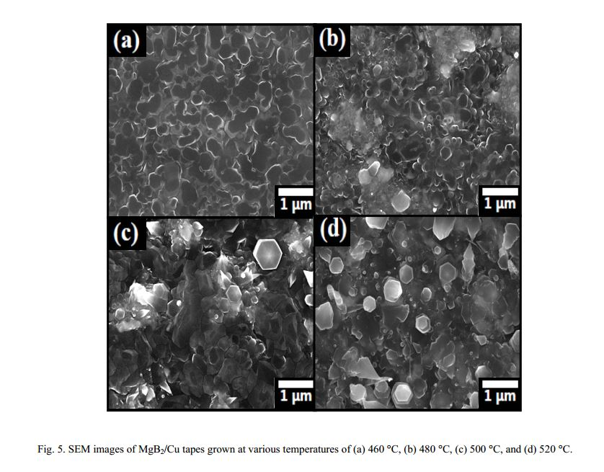
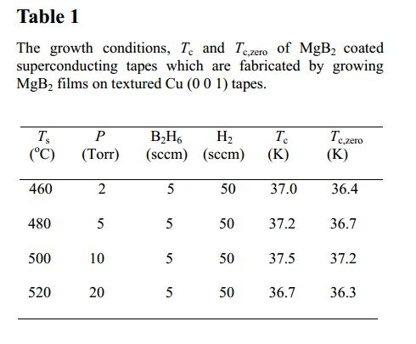
MgB₂ growth on Cu substrates by other groups
MgB2 coated Cu tapes by using HPCVD
M. Ranot and W. N. Kang, Current Applied Physics 12 (2), 353 (2012).
(a)
(b)
(c)
(d)

Slide 9
MgB₂ deposition on 2” Cu discs
Challenges in growing MgB₂ on Cu
Mg vapor reacts and forms alloy with Cu starting around 450 C at 10 Torr ( Copper surface color changes to silverfish)
Mg vapor pressure is low at low temperatures
Coating whole 2” area uniformly challenging
~450 C
H₂(10 Torr)
B₂H₆(10 ~ 20 sccm)
2” copper substrate
Scaling Up for 2” Cu discs and Reducing the growth Temperature
Mg
Molybdenum susceptor
Resistive
heating
HPCVD system is modified to accommodate thick 2” Cu disc
Deposition conditions were optimized for Cu substrates

Slide 10
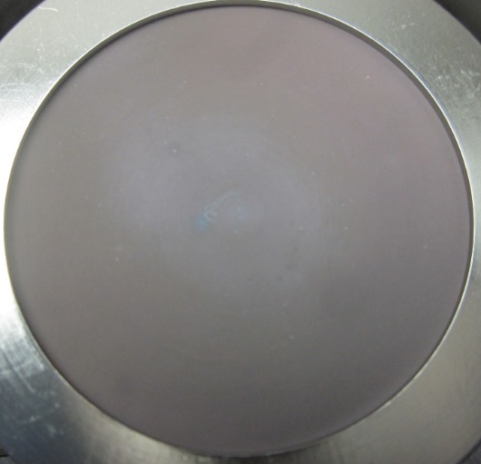
MgB₂ deposition on cu discs
10
1. MgB₂ coatings on Nb buffered Cu discs
100 nm of Nb layer was sputtered on the Cu discs
MgB₂ depositions were carried on Nb buffered Cu discs
XRD data showed the MgCu₂ alloy presence in the samples
SEM images showed the hexagonal structure
Samples showed transition temperature(Tc) close to 38 K
Polished Cu
Unpolished Cu

Slide 11
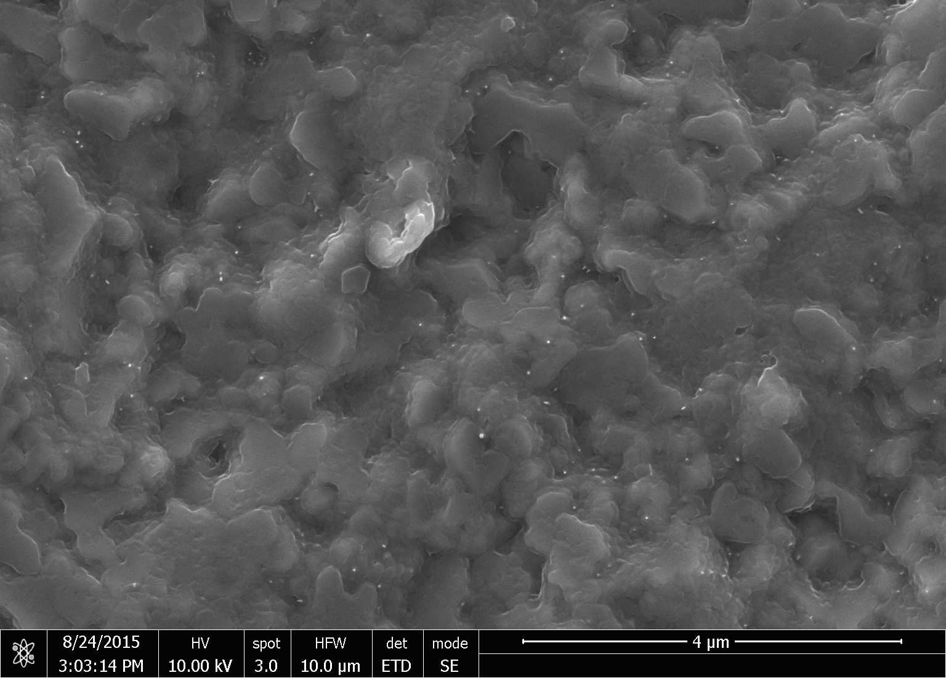
2. MgB₂ Growth on bare Cu discs
11
Mg-Cu alloy formation through the Nb layer
MgCu₂ alloy promotes the growth of MgB₂ phase at low temperature( ~ 400 C)^{1, 2}
MgB₂ was grown on Cu directly
Transition temperature (Tc) ~ 38 K
Polished Cu
Unpolished Cu

Slide 12
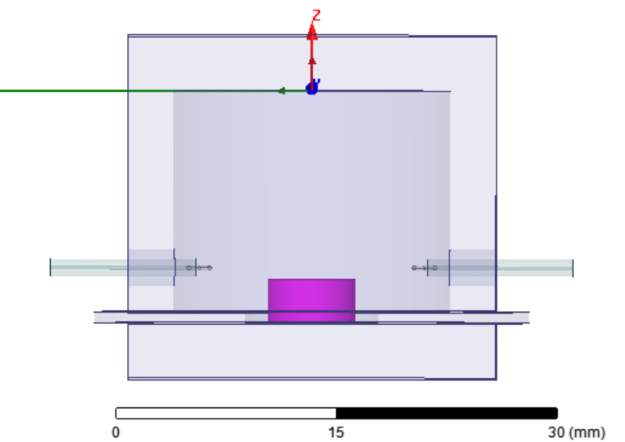
results
Copper cavity
Q vs T graphs gives us information about Tc and indicate the quality in a RF field compared to a reference sample
Sapphire puck
Loop antenna
Sample
MgB₂ films on copper show Tc around 38 K
18.4 GHz

Slide 13
Q vs T and Rs vs T measurements carried out at jlab
13
7.4 GHz
MgB₂ on Nb buffered Cu discs were measured

Slide 14
Q vs T measurements carried out using Cryogenic RF measurement system at SLAC
14
11.4 GHz
Cu cavity results
Nb cavity results
Films showed Tc close to 37.5 K
Best MgB₂ samples on Cu discs shows comparable Q with Nb reference samples and higher Q than copper reference sample.

Slide 15
Future work
Study the cross section and film thickness
Improve the process
Field measurements
Moving to the Cu cavity

Slide 16
Acknowledgement
My advisor and group members
Dr. Alireza Nassiri
Dr. Paul Welander
Dr. Grigory Eremeev
Dr. Anne – Marie

Slide 17
References
M. Ranot and W. N. Kang, Current Applied Physics 12 (2), 353 (2012).
Y. Z. Wang, C. G. Zhuang, J. Y. Gao, X. D. Shan, J. M. Zhang, Z. M. Liao, H. J. Xu, D. P. Yu, and Q. R. Feng, Journal of the American Chemical Society 131 (7), 2436 (2009).
B. P. Xiao, G. V. Eremeev, M. J. Kelley, H. L. Phillips, C. E. Reece Proceedings of LINAC2012, Tel-Aviv, Israel
Jiquan Guo, Sami Tantawi, David Martin, Charles Yoneda Proceedings of 2011 Particle Accelerator Conference, New York, NY, USA
Chenggang Zhuang · Teng Tan · Alex Krick , Qingyu Lei ·Ke Chen · X.X. Xi
J Supercond Nov Magn (2013) 26:1563–1568
Teng Tan, Chenggang Zhuang, Alex Krick, Ke Chen, and X. X. Xi
IEEE TRANSACTIONS ON APPLIED SUPERCONDUCTIVITY, VOL. 23, NO. 3, JUNE 2013

Slide 18
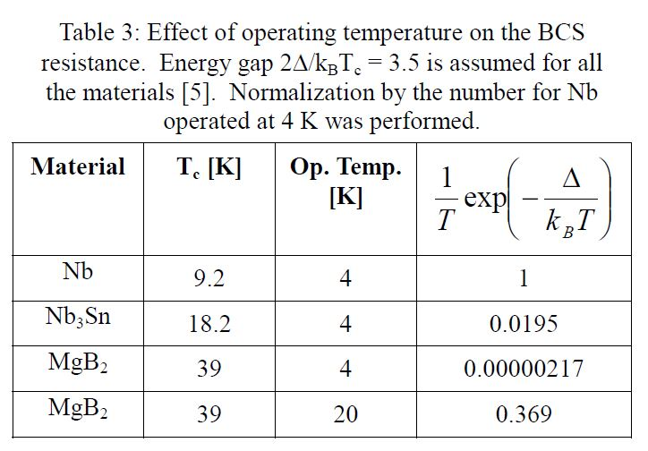


R_{BCS} = $\frac{Af^{2}\exp^{(\frac{−∆ Tc}{kTc T})} }{T}$
Where –
A – is a constant depends on penetration depth, coherence length, Fermi velocity and mean free path
f – Frequency k – Boltzmann constant
T – Temperature $∆$ - Energy gap

Slide 19
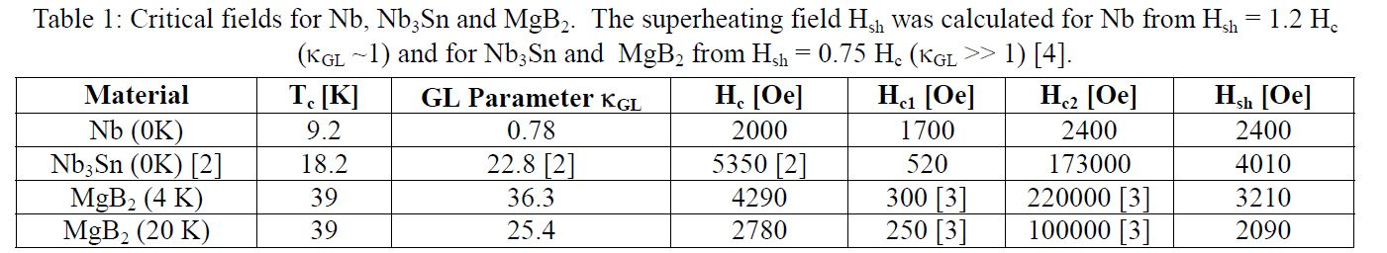
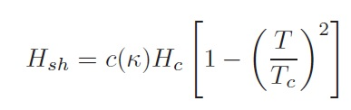
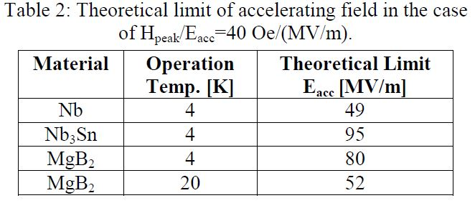

Slide 20
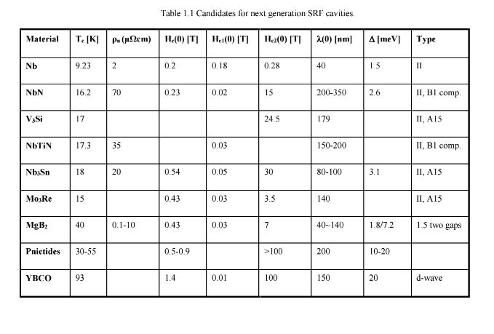

Slide 21
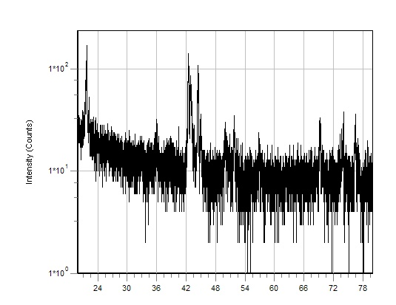
MgCu₂ alloy, MgB2 and Cu peaks overlap
XRD data of MgB2 samples on
Nb buffered Cu discs
MgCu₂ alloy peak
MgCu₂ peak

Slide 22
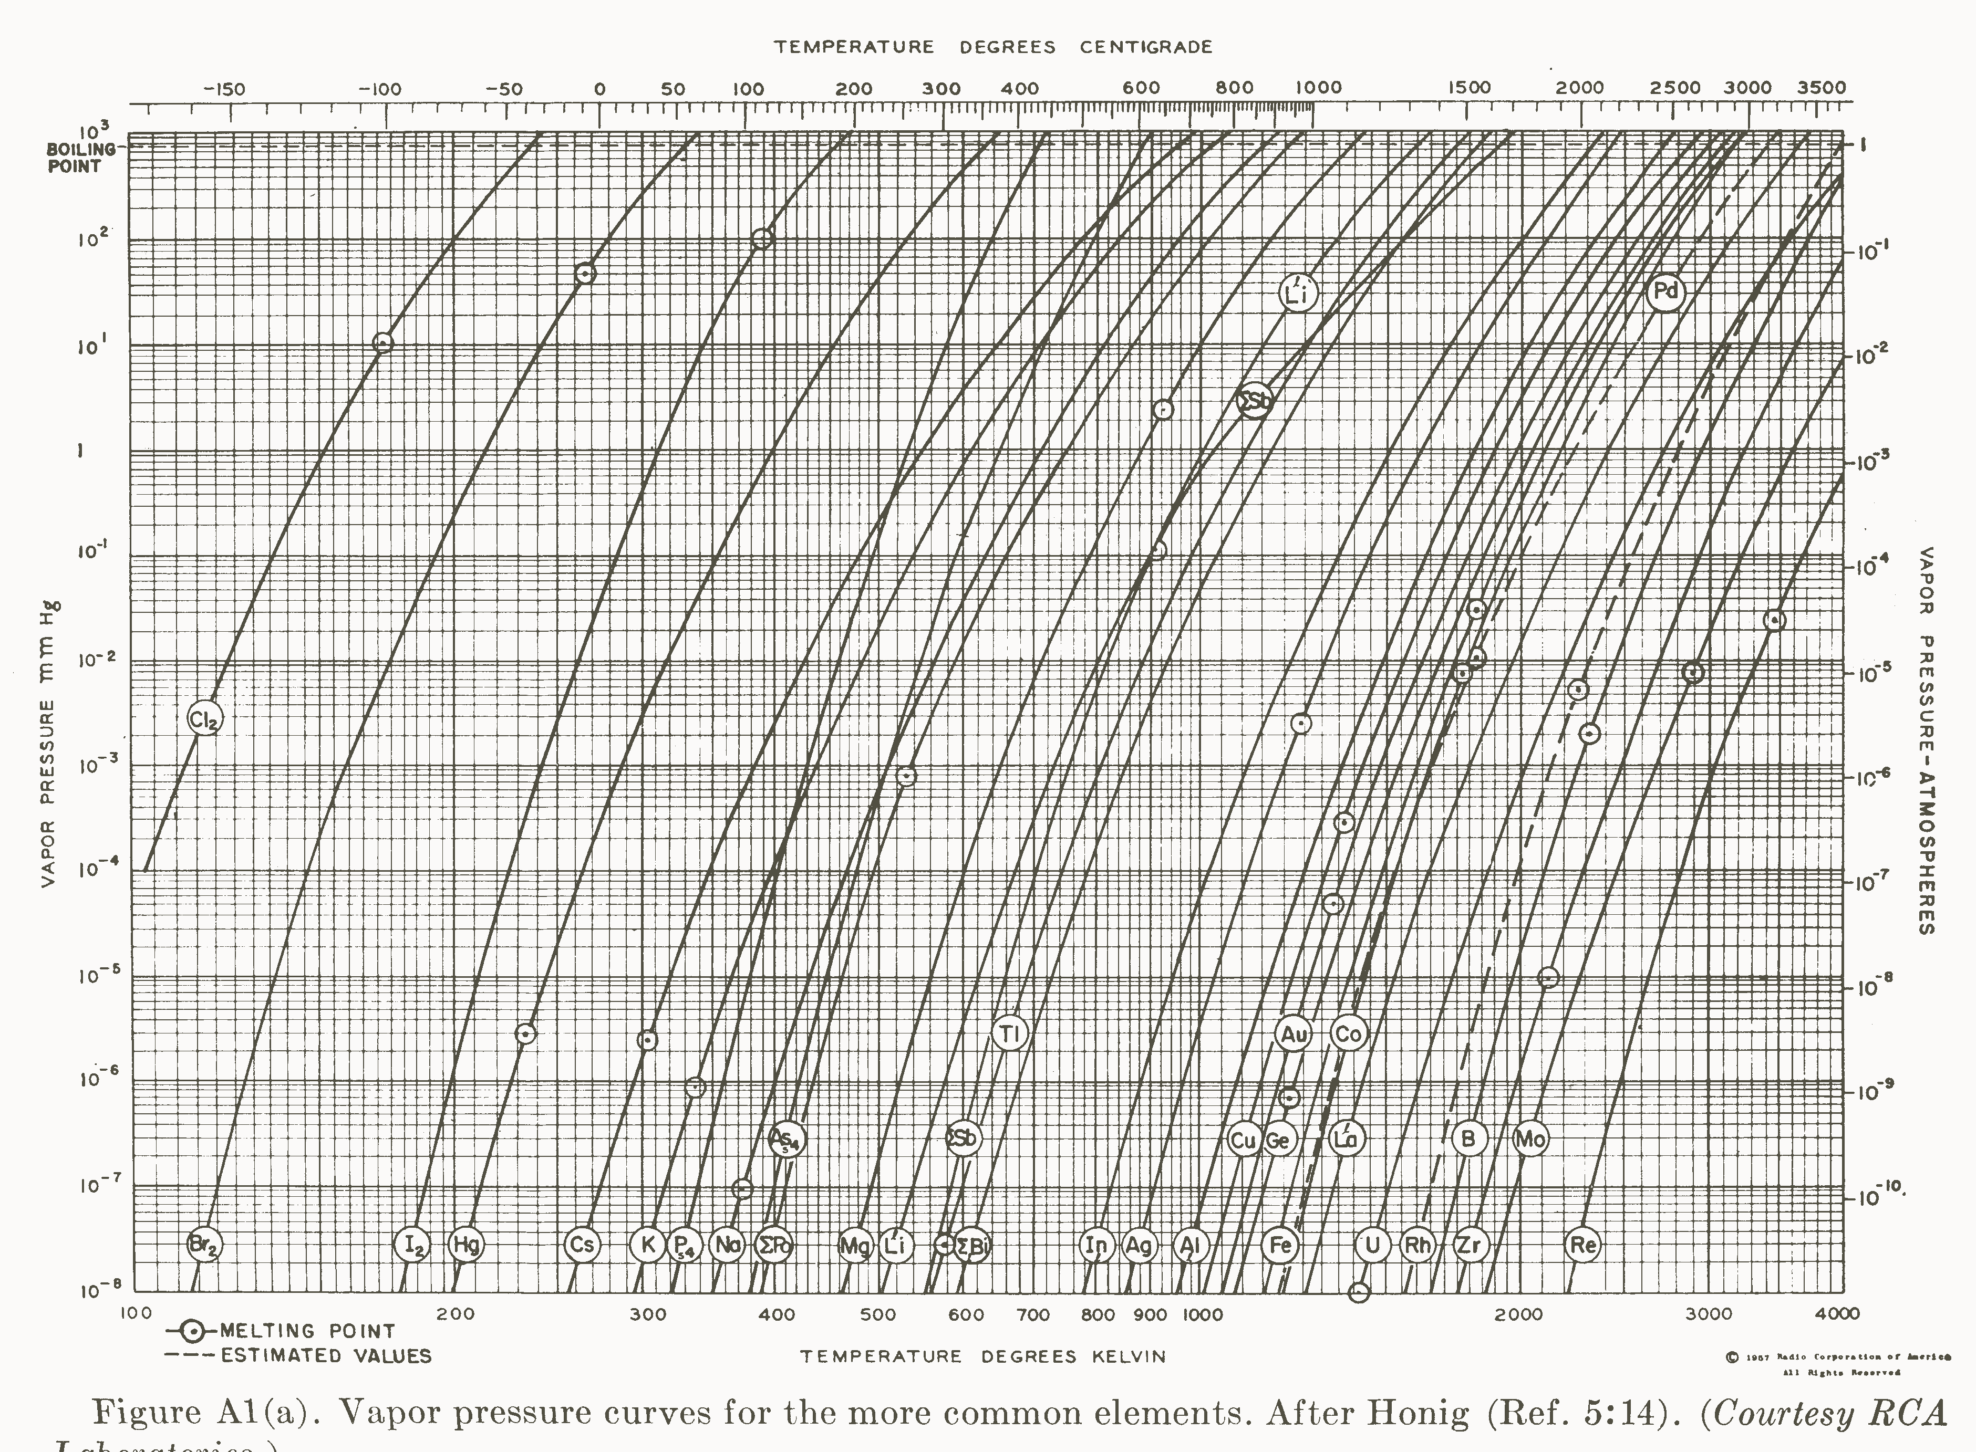
Back to Mg – B phase diagram

Slide 23
SLAC system
Sample being tested
11.4 GHz
H
E
Back to SCLAC results

