Slide 1
CVD / PECVD Superconductive materials for RF cavities
Paolo Pizzol
University of Liverpool / STFC – Daresbury Lab

Slide 2
Outline
Superconductivity Radio Frequencies and Niobium
Chemical vapour depositions
Experimental results and planned work

Slide 3
Outline
Superconductivity Radio Frequencies and Niobium
Chemical vapour depositions
Experimental results and planned work

Slide 4
Niobium - Limits
Niobium SRF cavities are the state of the art for accelerating charged particles, but:
copper has a better thermal conductivity than Nb
à easier to cool down
à cheaper
a thin film of Nb requires less material
...
à cheaper

Slide 5
PhD Topic
Problem:
Modern accelerators have reached the maximum gradient achievable by using Nb as a bulk.
Over the limit of ≈ 45 MV/m the superconductivity breaks down!
Aim of this study:
Developing CVD / PECVD deposition techniques to coat copper cavities with an uniform Niobium superconductive thin layer

Slide 6
Outline
Superconductivity Radio Frequencies and Niobium
Chemical vapour depositions
Experimental results and planned work

Slide 7
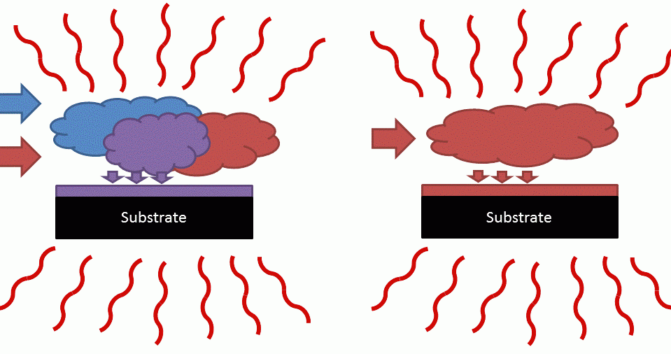
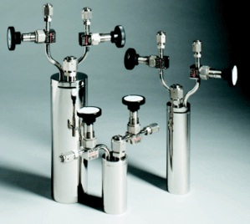
Chemical Vapor Deposition (CVD)
The chemical precursors are introduced together in the reaction chamber
Fast: micrometers thick depositions in a few hours
Challenging to control the film uniformity
Niobium chemistry requires high temperatures to work well
Precursors

Slide 8
The chemical side
Precursors under study
Niobium Pentachloride (V):
Chosen to obtain metallic Nb layer
Reacts with plasma of H⁺ to create thin film
Crystalline solid, vapour pressure at 150 °C to perform ALD
Very sensitive to moisture, hydrolyzes in NbOCl₄
Requires high substrate temperature to reduce Cl contamination in the film (at least 500 °C)
Tris(diethylamido)(tert-butylimido)niobium (V)
Chosen to obtain NbN layer
Reacts with N₂ plasma to create thin film
Liquid, good vapour pressure at 104 °C to perform ALD
Sensitive to heating, start decomposing at 130 °C
Doesn’t require a high deposition temperature (250 °C) à Suitable for deposition on copper

Slide 9
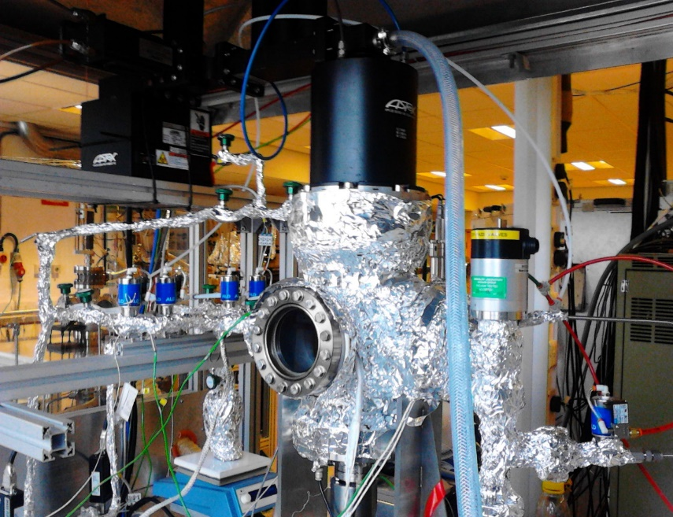
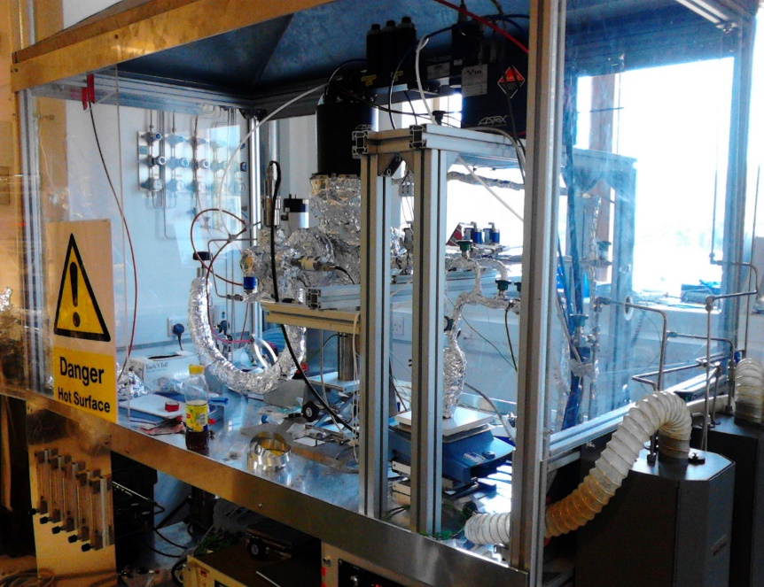
Experimental setup
Cold wall reactor.
Heater capable of T > 700 C.
2 bubbler lines for precursor delivery.
Hydrogen, Nitrogen and Ammonia Gas lines.

Slide 10
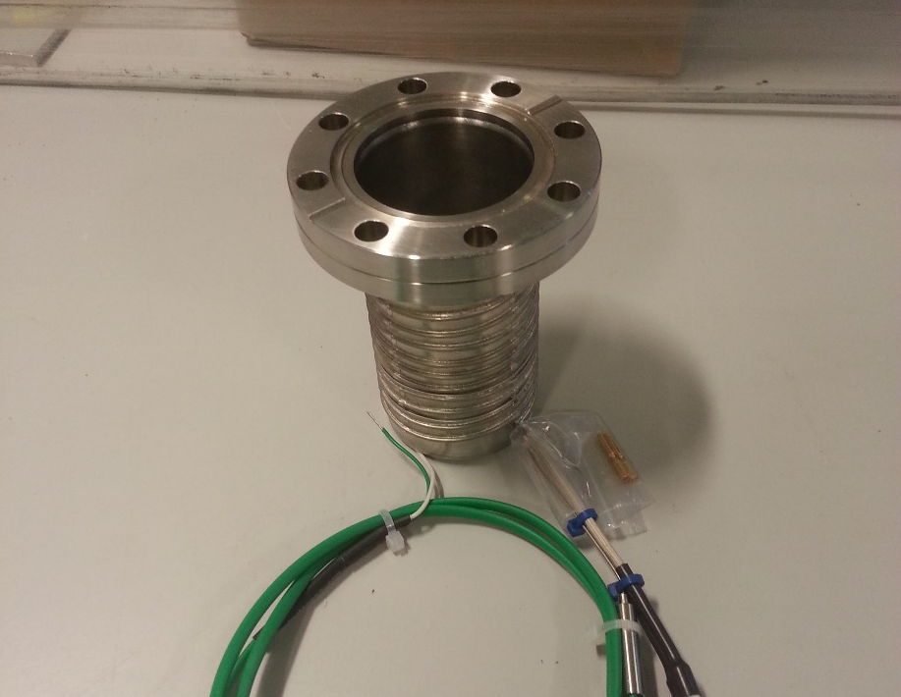
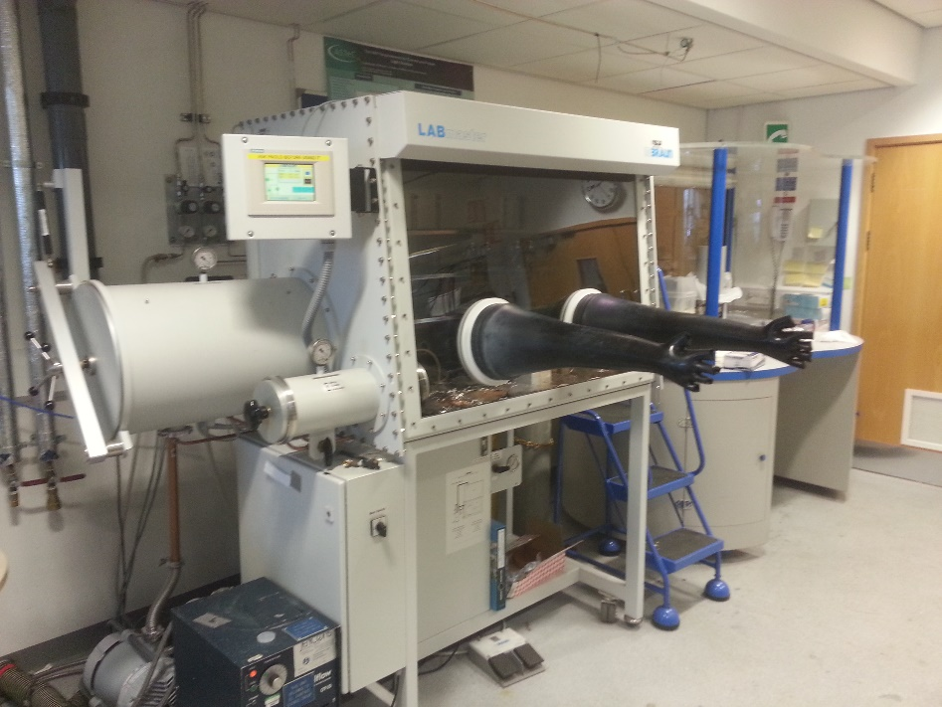
Experimental setup
In house designed bubblers to hold the precursors.
Bubbler preparation and filling done in glovebox on site.

Slide 11
Outline
Superconductivity Radio Frequencies and Niobium
Chemical vapour depositions
Experimental results and planned work

Slide 12
Outline
Superconductivity Radio Frequencies and Niobium
Chemical vapour depositions
Experimental results and planned work
Niobium
Niobium Nitride
Niobium Titanium Nitride

Slide 13
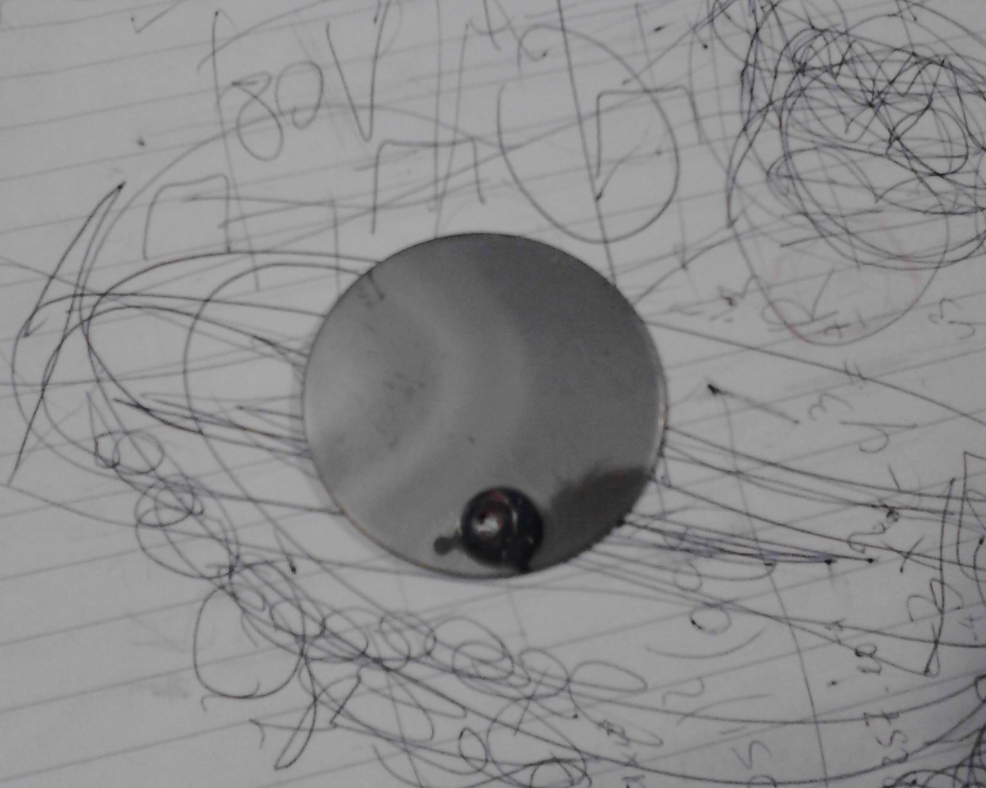
Nb coated Cu disc

Slide 14
Nb coated Cu disc

Slide 15
Nb coated Cu disc

Slide 16
Selected Area e⁻ Diffraction

Slide 17
TEM cross section of Nb film

Slide 18
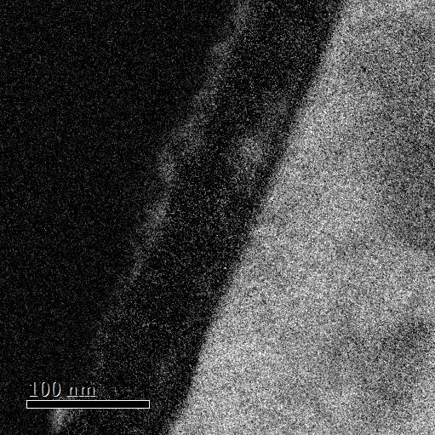
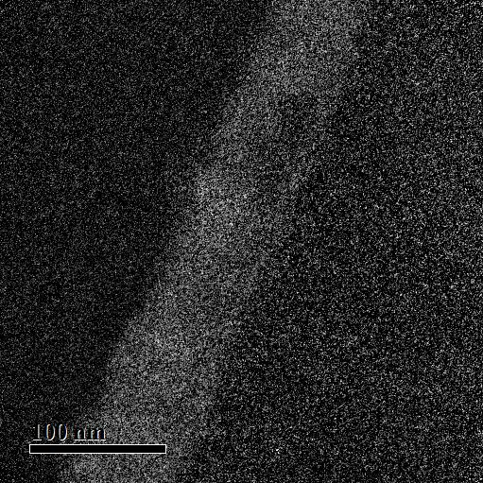
TEM study – Elemental maps

Slide 19
Niobium XRD
Phase: Cubic
Average Grain size: 14 nm
Phase: Cubic
Average Grain size: 26 nm

Slide 20
Nb coated Cu disc
Thicker sample (2 μm)
Superconductive
RRR of best sample of 31 – thin films fall in the 0 – 50 range.

Slide 21
Thin film etched with nitric acid

Slide 22
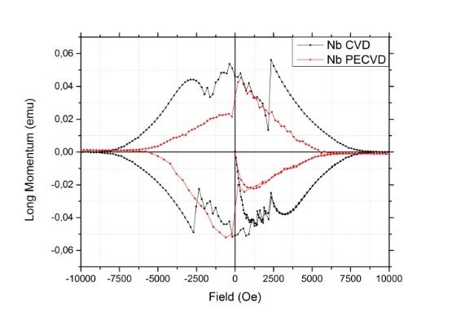
SQUID measurements

Slide 23
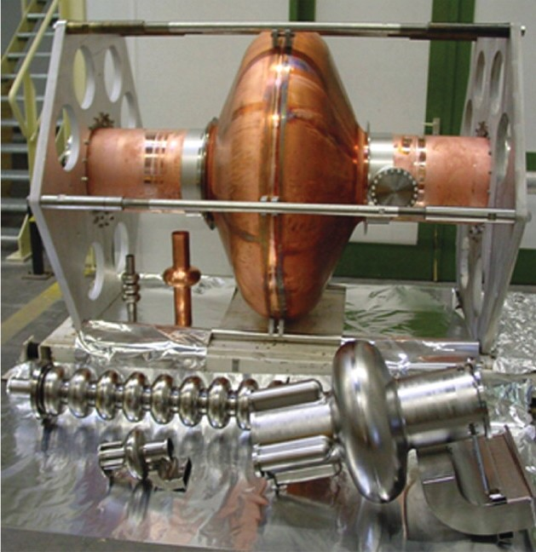
Nitrides of Nb. Why?
To verify the multilayer hypotesis, we decided to explore the deposition of nitrides of Nb.

Slide 24
Niobium Nitride
Attempted to deposit Niobium Nitride with Nitrogen plasma. Maybe successful, but machine failure destroyed the sample.
Installed Ammonia gas line to obtain NbN

Slide 25
Niobium Nitride

Slide 26
Niobium Nitride

Slide 27
Niobium Nitride

Slide 28
Niobium Nitride
Phase: Cubic
Average Grain size: 25 nm

Slide 29
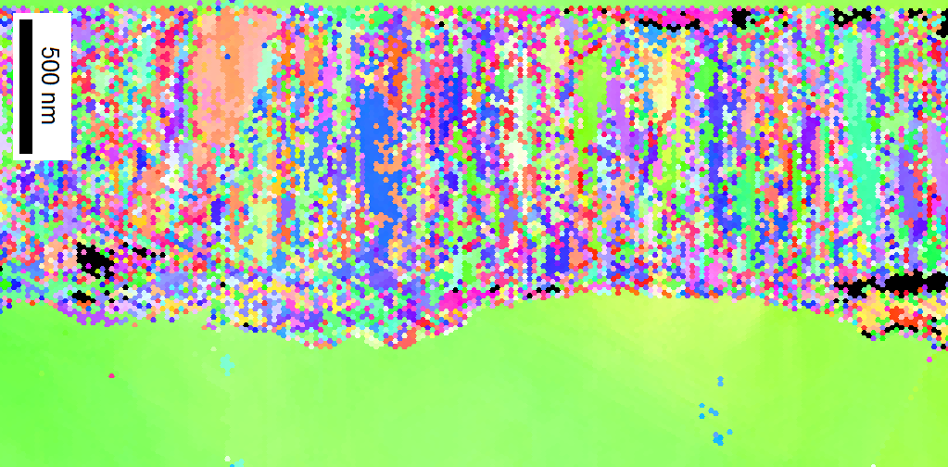
EBSD on NbN
EBSD attempted on NbN film (100μm substrate).
Image looks pixelated due to very small size of grains.
Film
NbN
NbN

Slide 30
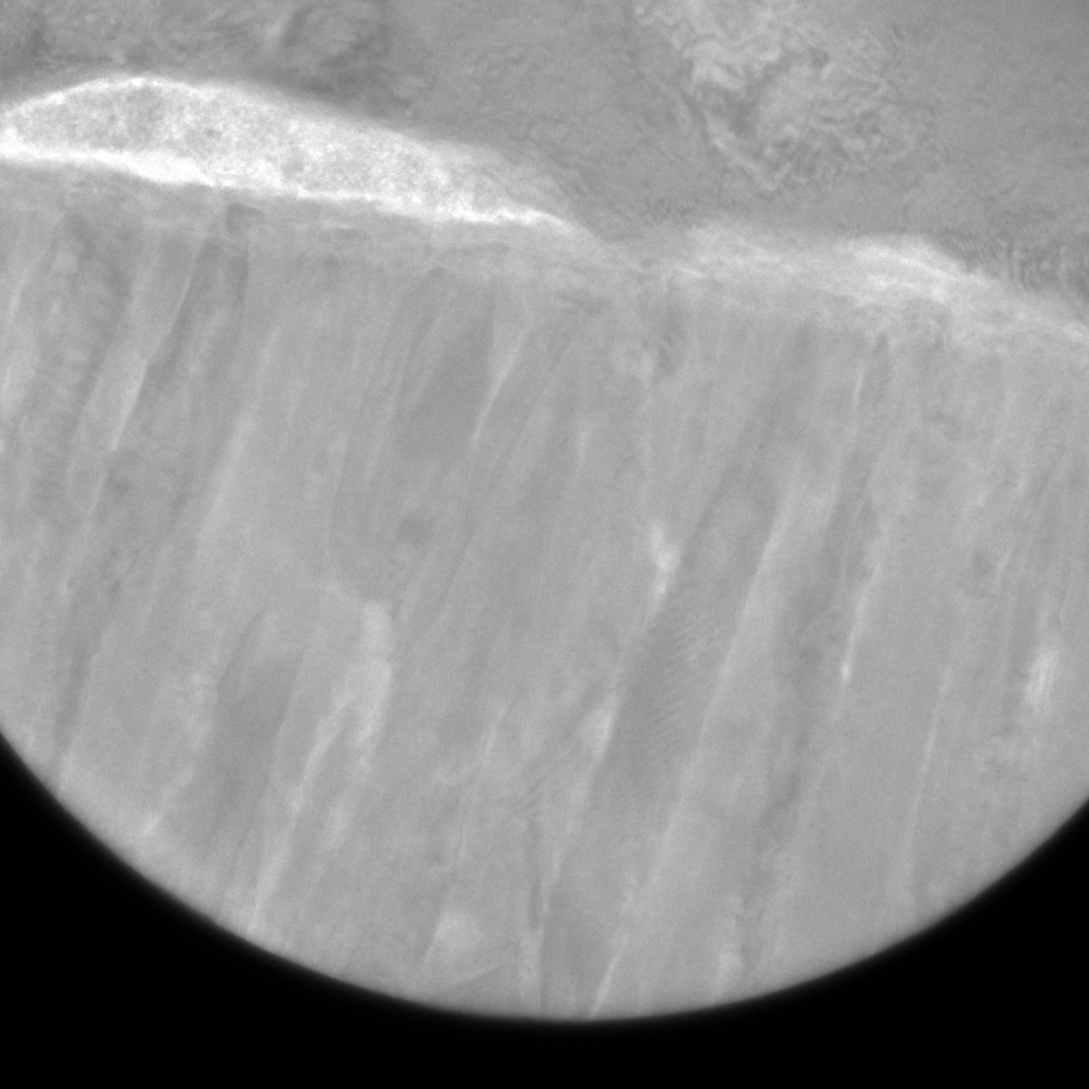
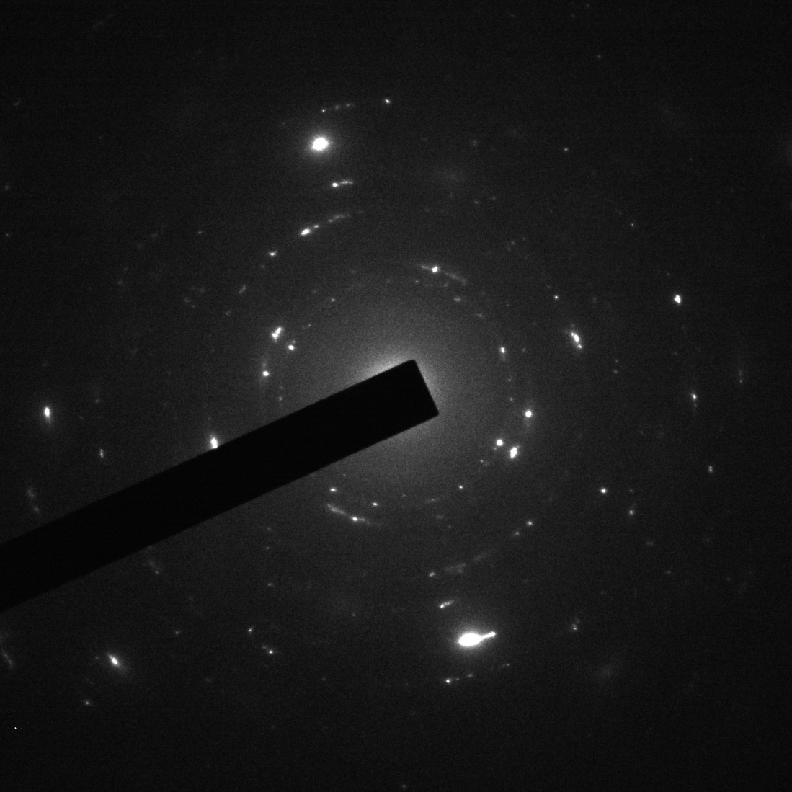
SAED

Slide 31
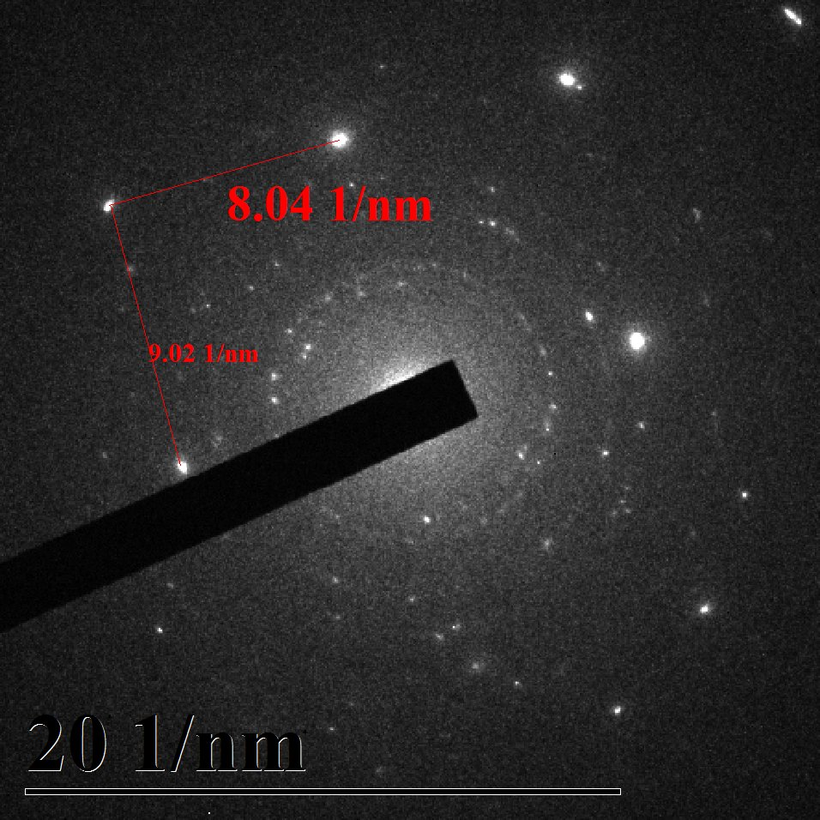
SAED

Slide 32
Niobium Titanium Nitride
Installed second bubbler line to deposit multiprecursor films:
NbTi
NbTiN
Nb₃Sn
Nb₃Ge

Slide 33
Niobium Titanium Nitride

Slide 34
Niobium Titanium Nitride

Slide 35
Niobium Titanium Nitride

Slide 36
Niobium Titanium Nitride
Phase: Cubic
Average Grain size: 21 nm

Slide 37
Planned future work
Install plasma source to reduce deposition temperature.
SRF properties testing.
Upgrade to ALD to verify conformality and multilayering of S-I-S systems.

Slide 38
Thank you for your time

