Slide 2

The surface impedance of Nb/Cu coated QWR cavities for HIE-ISOLDE project
Silvia Teixeira
K. Artoos, A. Miyazaki, G. Rosaz, K.Schirm, A.Sublet, M. Therasse, W.Venturini Delsolaro

Slide 3
Outline
HIE-ISOLDE Project
Quarter-Wave Resonator (QWR)
Cavity Performance
Rs0 and Rs1
Features
  Optical Inspections
  Material Studies
New Cavity Design
Conclusions

Slide 4
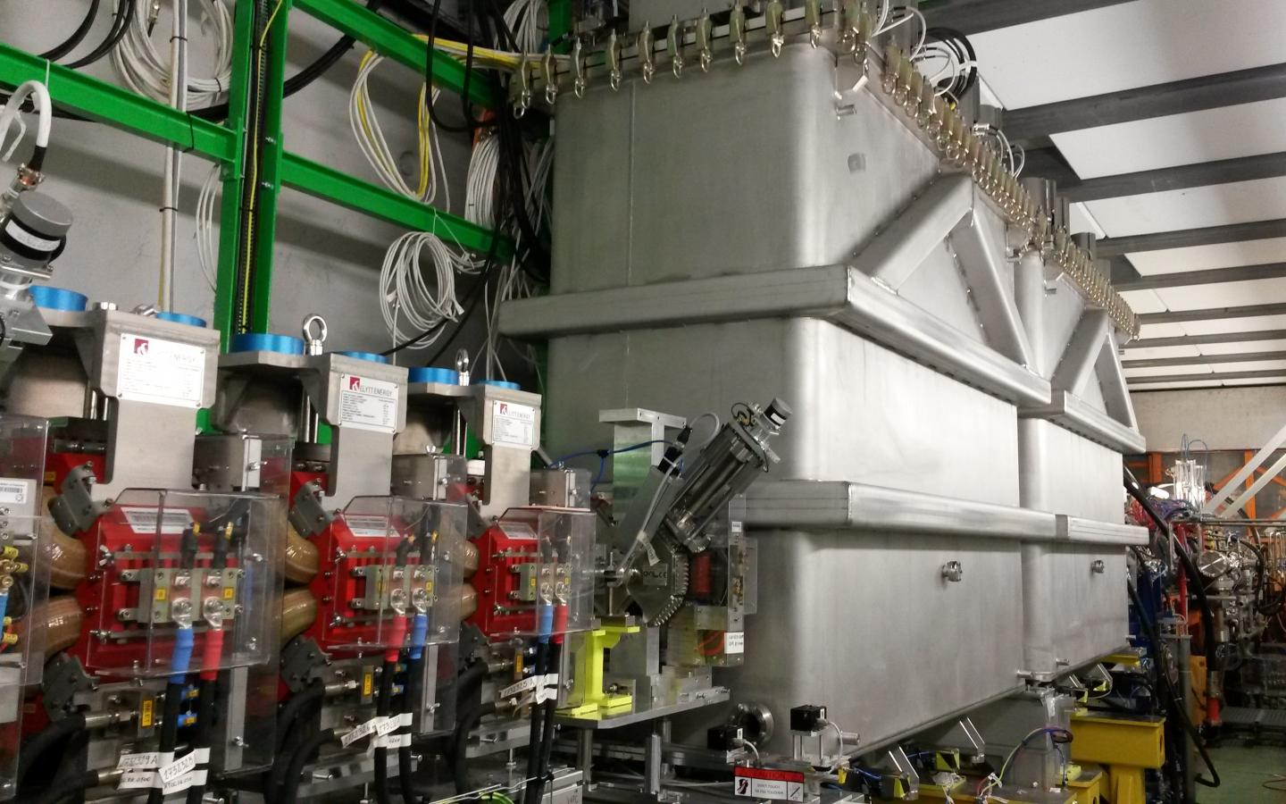
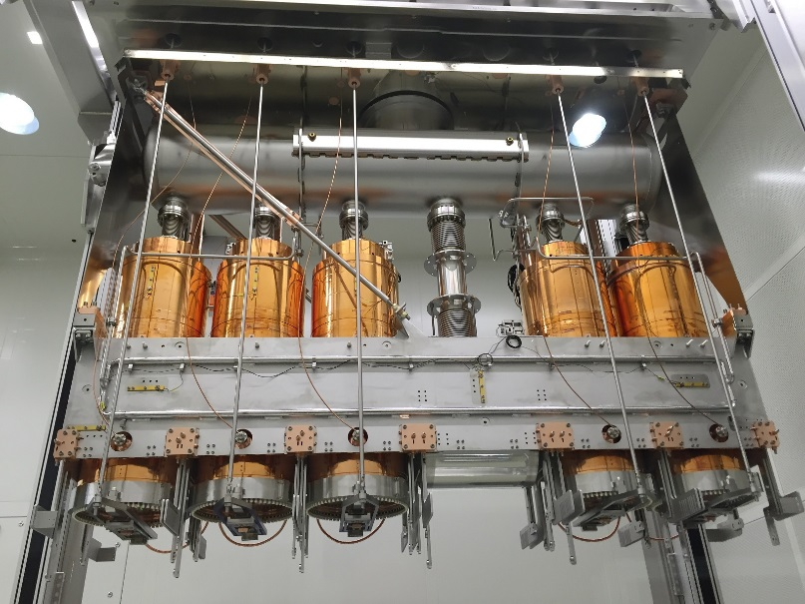
HIE-ISOLDE
The High Intensity and Energy ISOLDE (HIE-ISOLDE) project is a major upgrade of the existing ISOLDE and REX-ISOLDE facilities.
Energy increase of the delivered radioactive ion beam (RIB) from 3 MeV/u to 10 MeV/u.
SC LINAC based on Quarter Wave Resonators (QWRs).
High-β section consists on 4 cryo-modules with 5 cavities each.
Beam direction

Slide 5
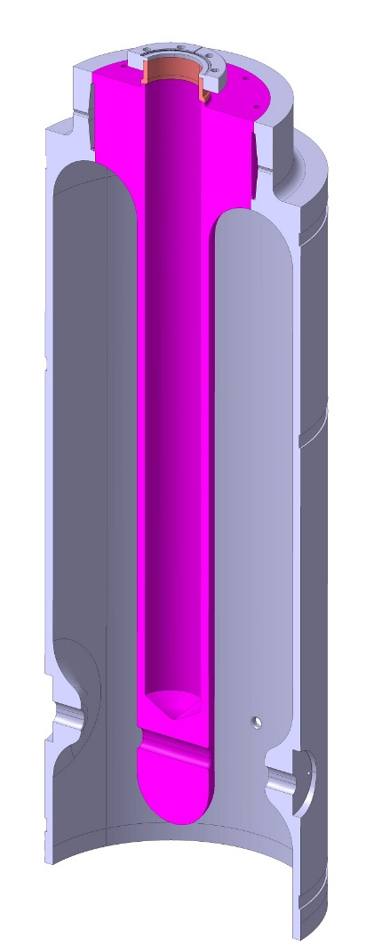
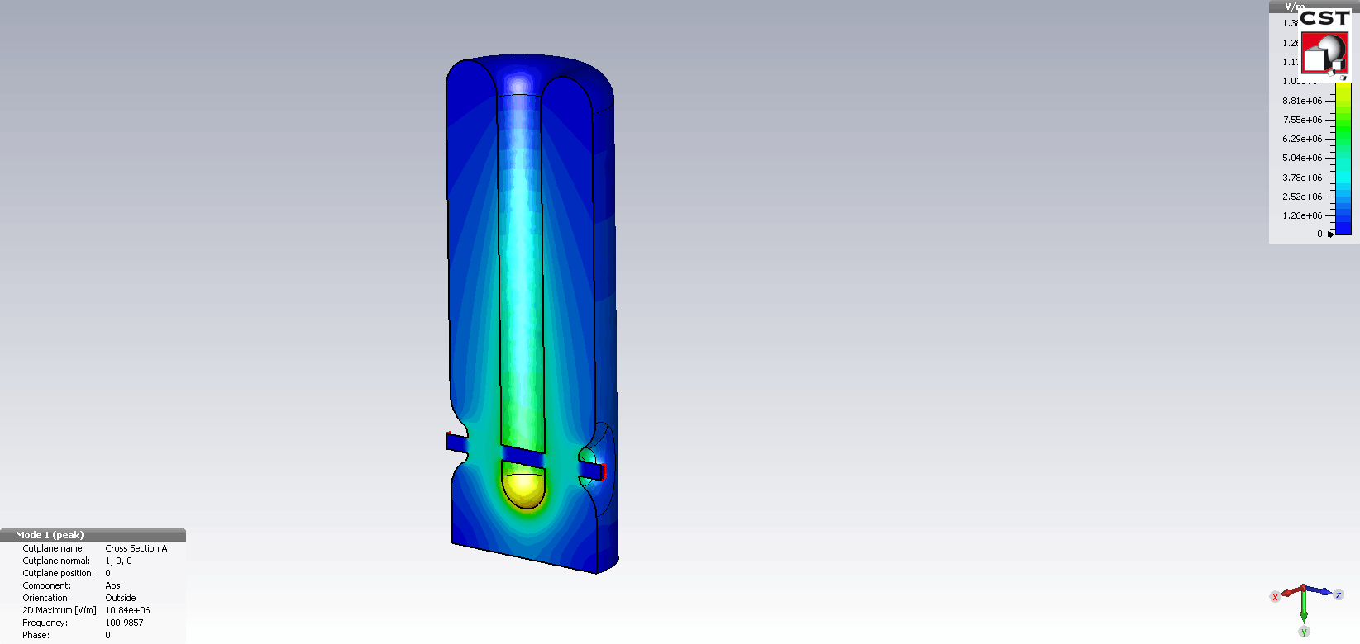
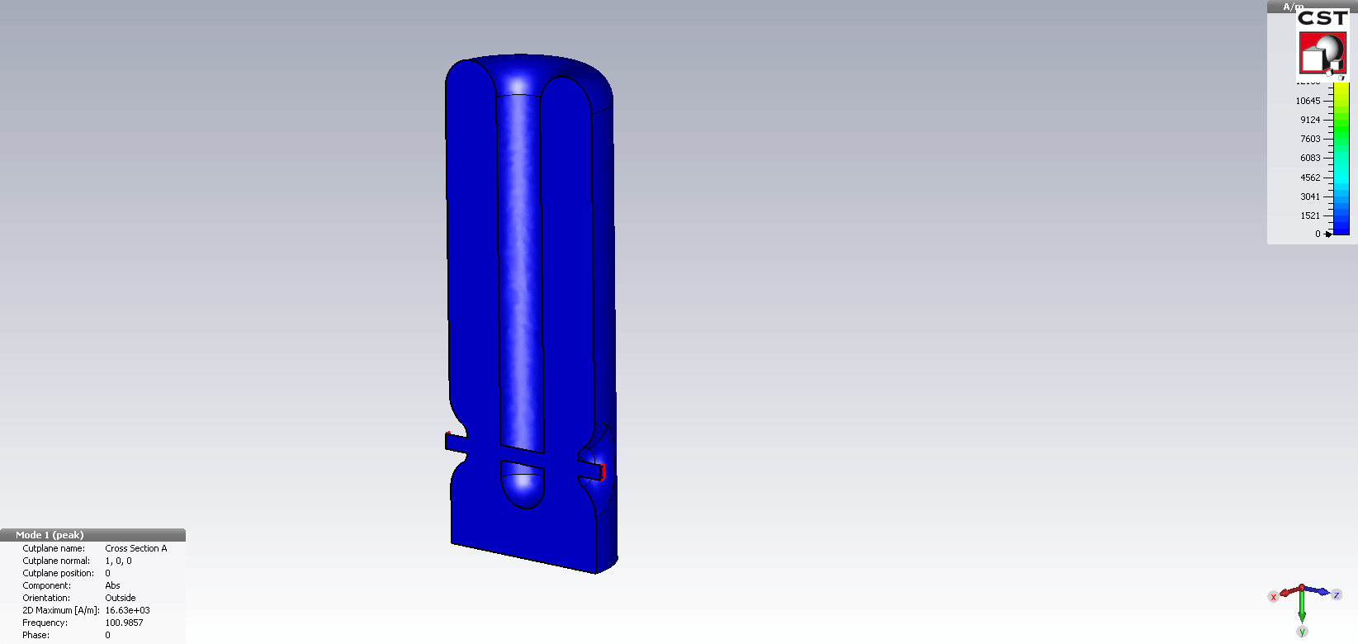

Quarter Wave Resonator (QWR)
Superconducting Nb-film cavity at 4.5 K
Conduction cooling through the copper substrate (good thermal conductivity of Cu)
DC bias sputtering system
Welding in the high magnetic field region
•$Surface resistance Rs$ has non-trivial behavior
L⁴He (4.5K)
E-field
Conduction cooling
Frequency | 101.28 MHz
E_{acc} | 6 MV/m
β_{optimum} | 10.9%
R/Q | 553 Ω
E_{peak}/E_{acc} | 5.4
B_{peak}/E_{acc} | 96 G/(MV/m)
G=R_{s}Q | 30.34 Ω
U/E_{acc}² | 0.207 J/(MV/m)²
P_{c} at 6MV/m | 10W
H-field
Beam axis

Slide 6
Cavity Performance
Raw data

Slide 7
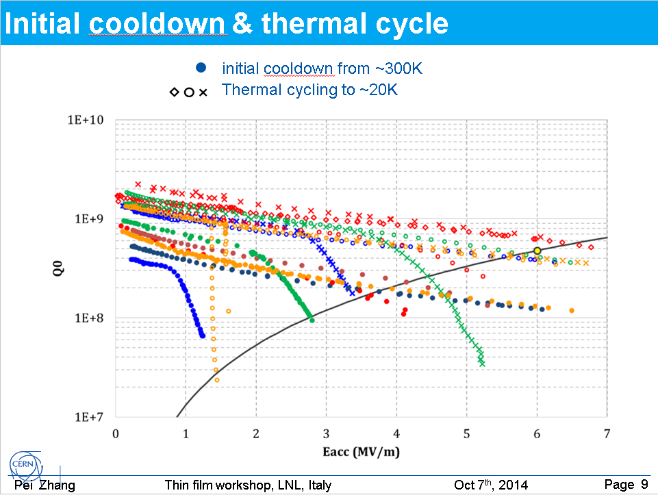
Presented by Pei in 2014

Slide 8
Cavity Performance
Ideal thermal gradient

Slide 9
Cavity Performance
Ideal thermal gradient

Slide 10
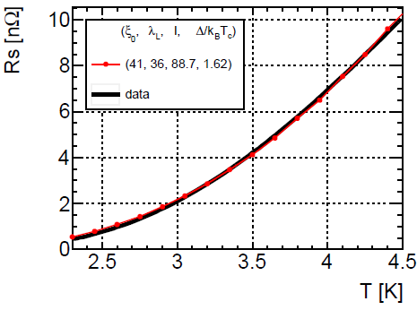
Temperature dependent component
BCS fit at low field

Slide 11
Rs0 and Rs1 to evaluate the cavity
Low-field Q-slope
Linear fit: Rs($E_{acc}$) = Rs0 + Rs1•$E_{acc}$ (0<$E_{acc}$<3 MV/m)
Q-slope

Slide 12
Rs1 vs Rs0 for all cavities
Ideal thermal gradient
Rs0 and Rs1 are weakly but positively correlated (correlation factor 0.3)

Slide 13
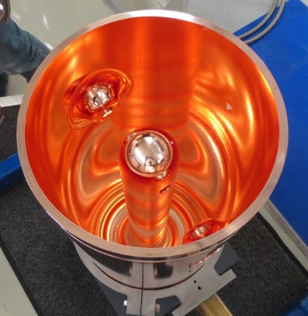
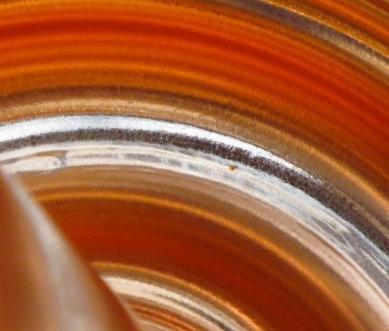
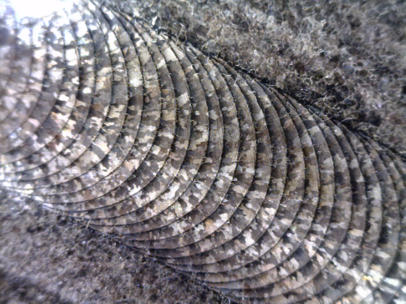
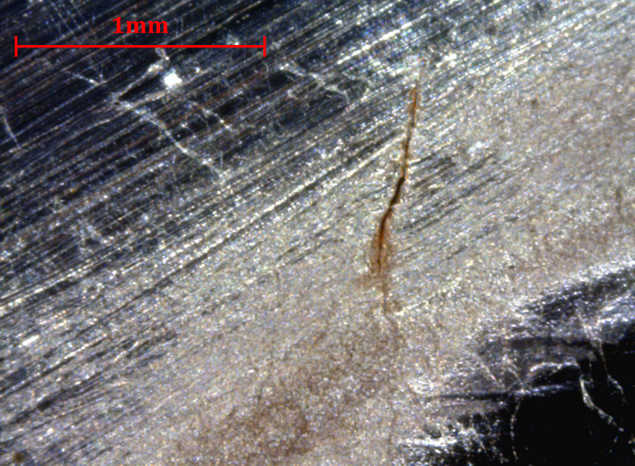
Optical Inspections
In most of the substrates of the series production, cracks were observed mainly near the weld area (in the outer conductor)
In most cases they are identified when revealed by the SUBU (chemical treatment)

Slide 14
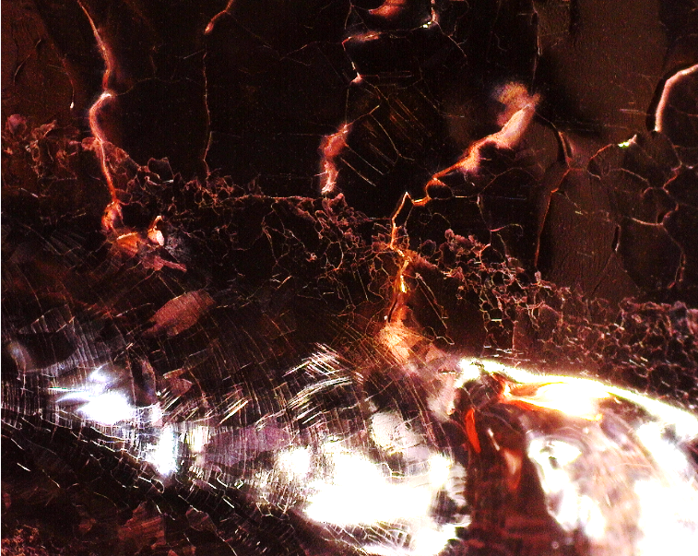
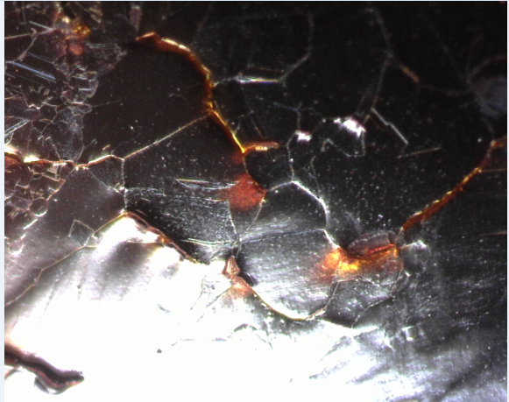
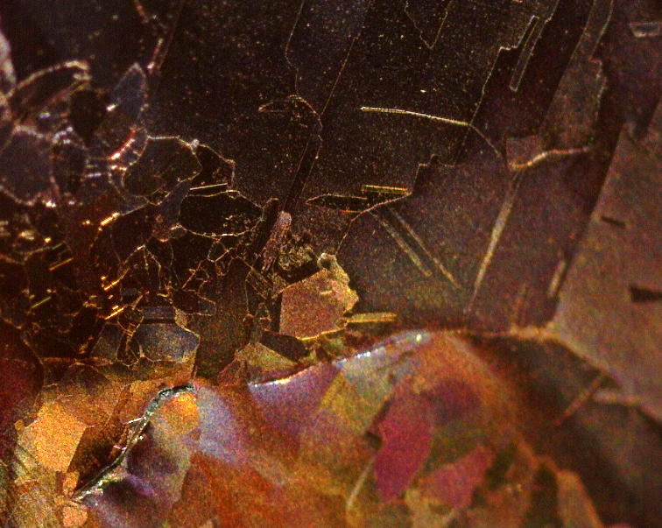
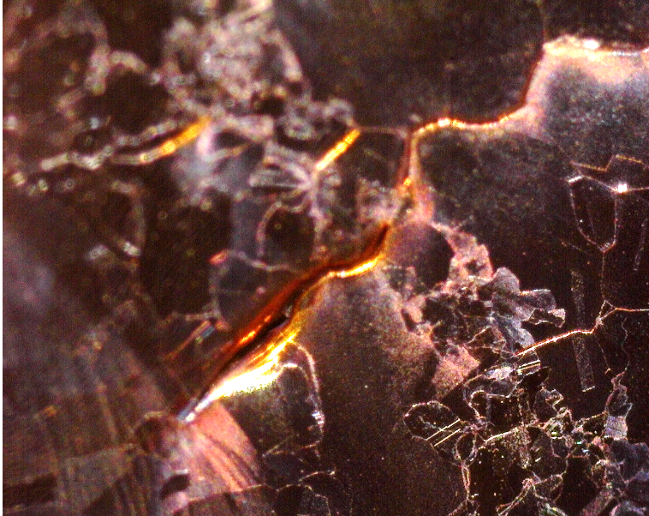
Optical Inspections

Slide 15

Rs1 vs Rs0 for all cavities
cracks
Rs0 and Rs1 are weakly but positively correlated (correlation factor 0.3)
The substrate with the cracks tends to have higher Rs1 (Q-slope)
Removal of the smoothing weld for material investigations

Slide 16
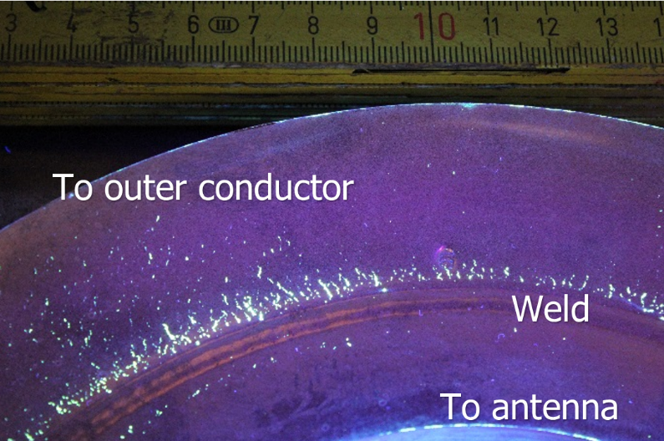
Material Studies
Linear indications (appearing as cracks and voids) at surface were observed after SUBU etching on QS9, especially around the EB weld zone.
Cracks are not only present in the surface, but in the bulk material (OFE copper).
SUBU doesn’t generate the imperfections, but reveals them.
Courtesy of M. Crouvizier
Hydrogen embrittlement was discarded as a possible culprit.
We tried to reproduce the same effect on several kinds of OFE compliant material without succeeding.
Residual stresses and heat have probably contributed to the apparition of these imperfections.

Slide 17
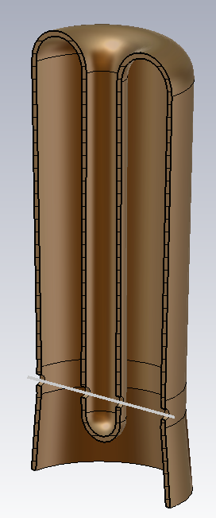
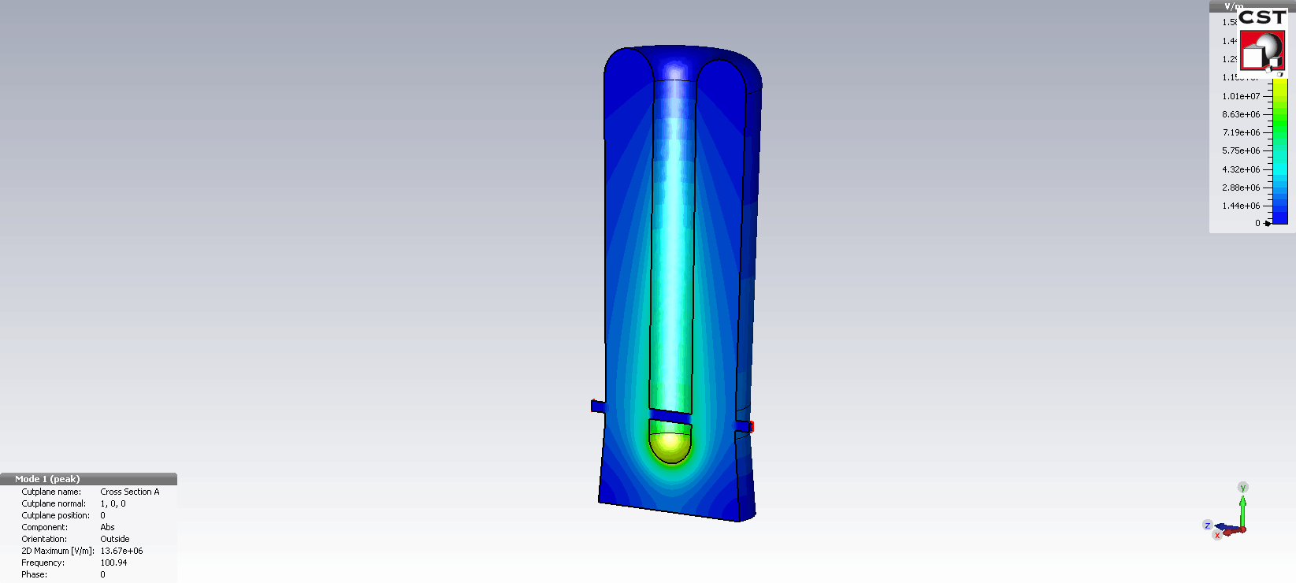
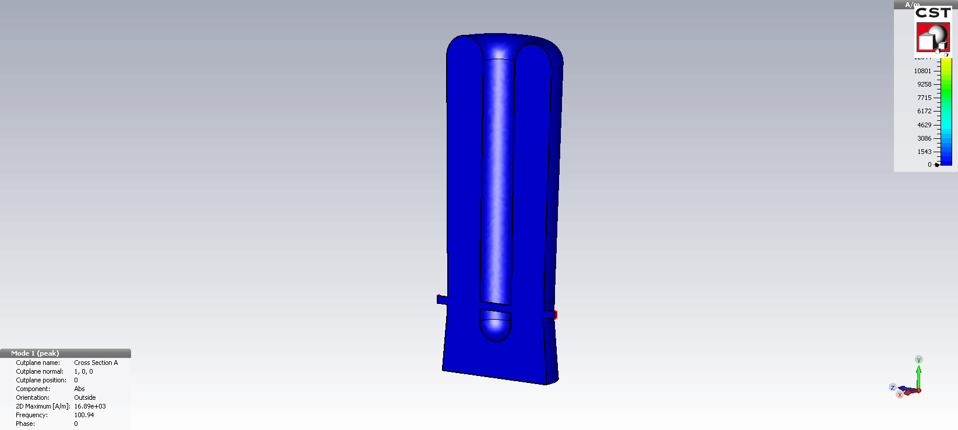
Seamless Cavity
Major changes from previous design:
  Cavity machined from a bulk Cu cylinder.
  Antenna length shorter for frequency tuning
  Thinner inner conductor to recover R/Q
  Cone insertion to avoid leakage through the beam ports
L⁴He (4.5K)
E-field
Frequency | 101.28 MHz
E_{acc} | 6 MV/m
β_{optimum} | 0.12
R/Q | 525 Ω
E_{peak}/E_{acc} | 4.9
B_{peak}/E_{acc} | 98 G/(MV/m)
G=R_{s}Q | 30.79 Ω
U/E_{acc}² | 0.214 J/(MV/m)2
P_{c} at 6MV/m | 10 W
H-field
Beam axis

Slide 18
Conclusions
A set of measurements of 17 HIE-ISOLDE Nb/Cu QWRs have been presented.
Part of the surface resistance has been explained by a BCS fit with ¨reasonable¨ parameters.
Rs0 and Rs1 are weakly but positively correlated.
There is a performance degradation with time on the production of the cavities. The increase in surface resistance looks correlated to the observed cracks at the weld of the Cu substrate.
The material studies concluded that residual stresses and heat might be the origin of the cracks.
A new design of a seamless cavity has been developed in order to avoid the EB welding of the substrate.

Slide 19
SUBU
NIOBIUM COATINGS FOR THE HIE-ISOLDE QWR SUPERCONDUCTING ACCELERATING CAVITIES
N.Jecklin#, S. Calatroni, B. Delaup, L. Ferreira, I. Mondino, A. Sublet, M. Therasse, W. Venturini Desolaro, CERN, Geneva, Switzerland
The polishing agent (SUBU) is a mixture of sulfamic acid (H NO S, 5 g/l), hydrogen peroxide (H O , 5% vol), n- 33 22 butanol (5% vol) and ammonium citrate (1g/l) [4]. Its working temperature is around 72 °C, and the typical removal rate is 0.75 μm/min, as confirmed by a test recently made.

