Slide 1


SUPERCONDUCTING THIN FILMS FOR SRF CAVITIES
Stuart Wilde
STFC Daresbury Laboratory and Loughborough University
Dr Reza Valizadeh and Dr Oleg Malyshev
STFC Daresbury Laboratory
Dr Boris Chesca
Loughborough University

Slide 2
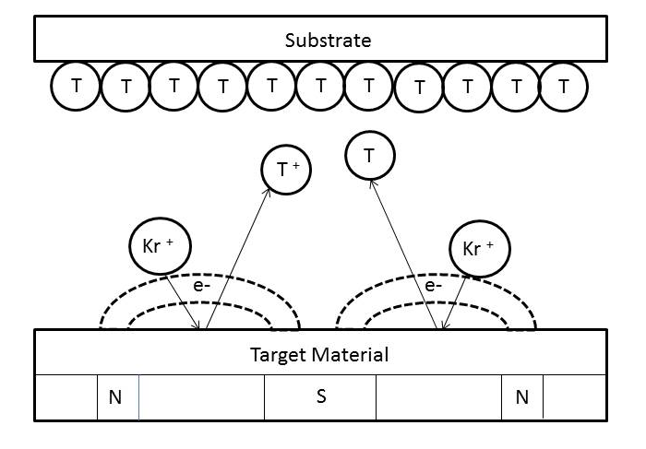
Magnetron Sputtering
Used in industry to produce thin films
Has already been used successfully to coat SRF cavities

Slide 3
High Impulse Magnetron Sputtering
Current on the black axis
Voltage on the red axis
Average current for both DC and HiPIMS is similar
Peak current for HiPIMS up to 2 orders of magnitude higher than DC
Higher plasma current at target surface increases target ion to neutral ratio
Allows for ion assisted deposition

Slide 4
Experiment: To analyse the morphological and superconducting properties of HiPIMS films with changing temperature and / or DC substrate bias
Samples were deposited at room temperature, 500 °C, 700 °C and 800 °C
Films deposited with either a grounded substrate or substrate biased to -20, -50, -80, -100 and -120 V DC at each temperature
Films then analysed using XRD, SEM, EBSD, and DC SQUID magnetometry (support for XRD and DC SQUID provided by G. B. G. Stenning at STFC ISIS Laboratory)

Slide 5
HiPIMS niobium on copper
Niobium thin films were deposited on polycrystalline Cu
Constant HiPIMS settings
Pulse width of 100 μs
Repetition rate of 200 Hz
Average current of 600 mA
Peak current of 40 A
Kr sputter gas constant at 500 mTorr

Slide 6
XRD of all films grown at 500 °C and below have Nb (110) preferred grain orientation
Room temp
500 °C

Slide 7
Nb (200) begins to grow at 700 °C
Largest relative Nb (200) peak sizes occur at 0 V bias
Nb (110) and (200) varies when bias is applied
700 °C
800 °C

Slide 8
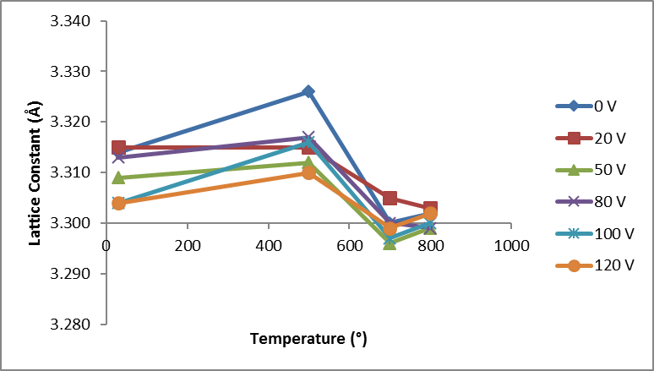
Lattice Constant
Lattice Constant was calculated to be longest for RT and 500 °C
Shorter lattice constants at highest temperatures

Slide 9
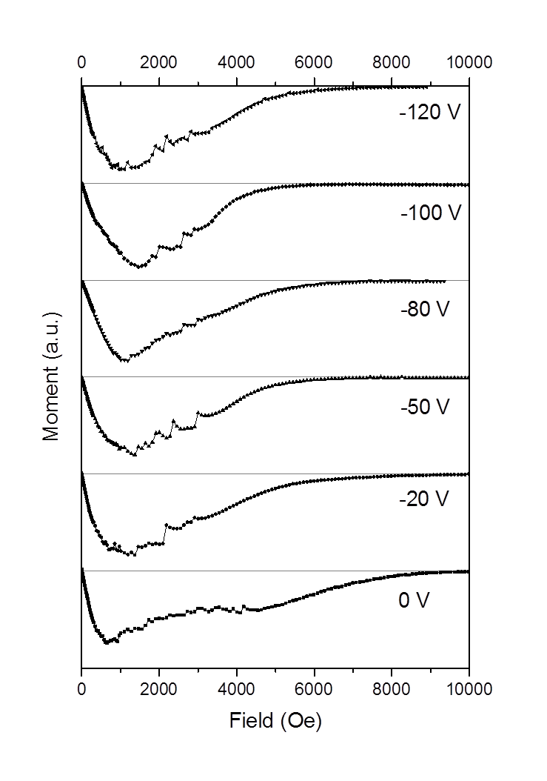
DC SQUID Magnetometry
Room temperature
500 °C

Slide 10
700 °C
800 °C

Slide 11
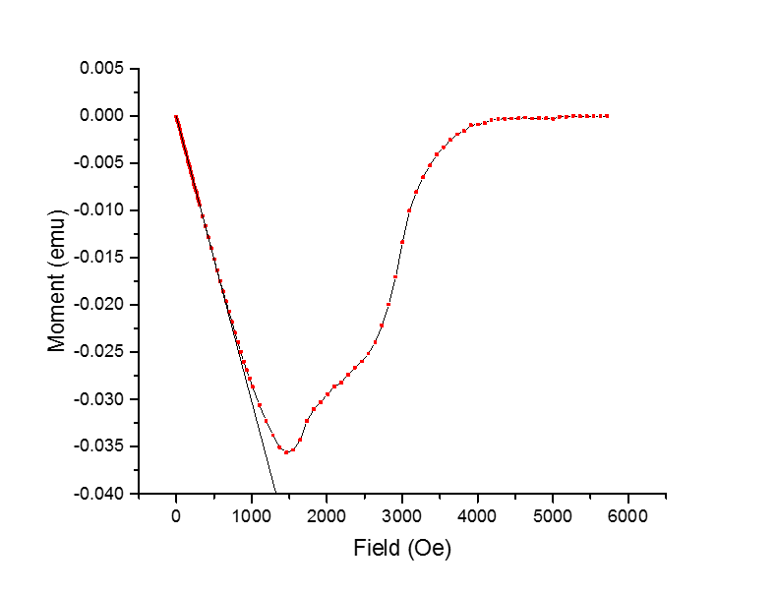
DC SQUID and penetration field
700 °C shows FFP at -80 V. This was also the highest field recorded for any film at 580 Oe

Slide 12
Summary showing peak at 80 / 100 V DC Bias

Slide 13
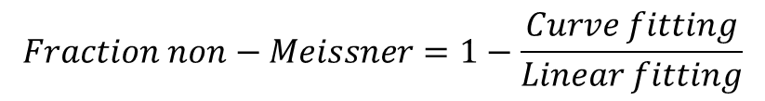
Alternative look at the SQUID curves.
$$Fraction non−Meissner=1−\frac{Curve fitting}{Linear fitting}$$
SQUID curves have been compared to their ideal case with no magnetic penetration
Each measured curve was fitted with a 2nd order polynomial fit
Fraction of the non-Meissner sample volume was calculated
H Field
Measured SQUID curve
Moment
Ideal Meissner state

Slide 14
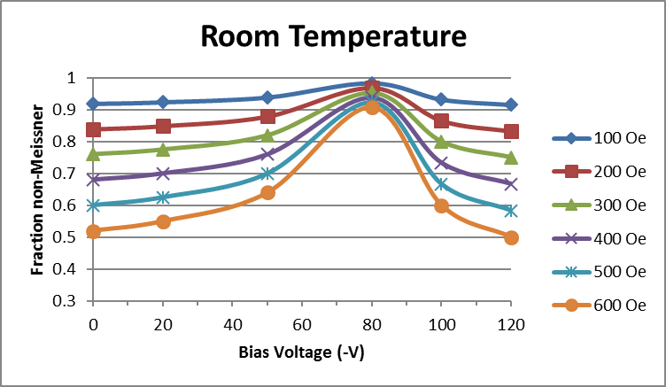
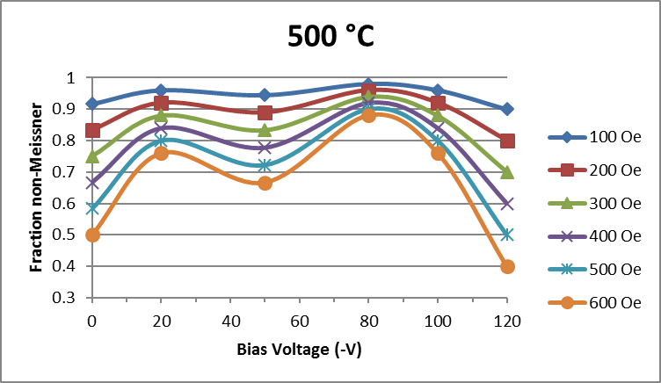
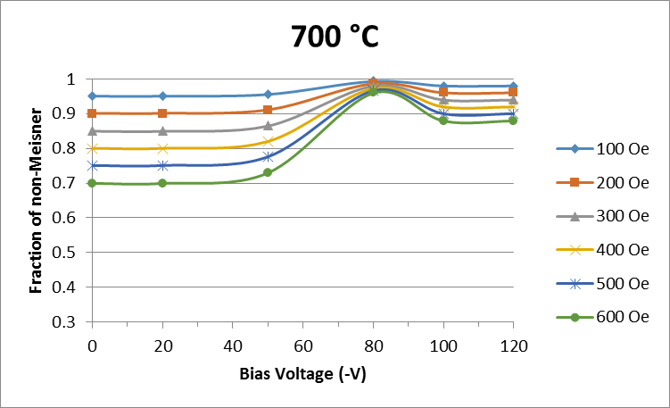
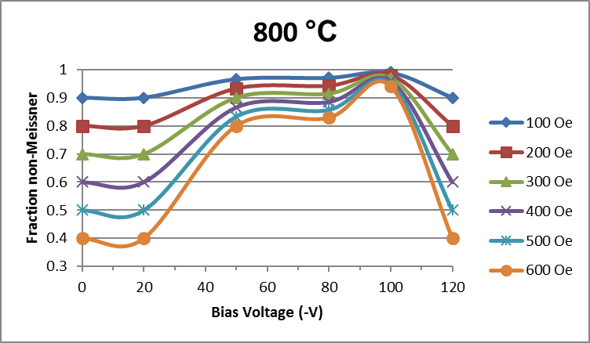

Slide 15
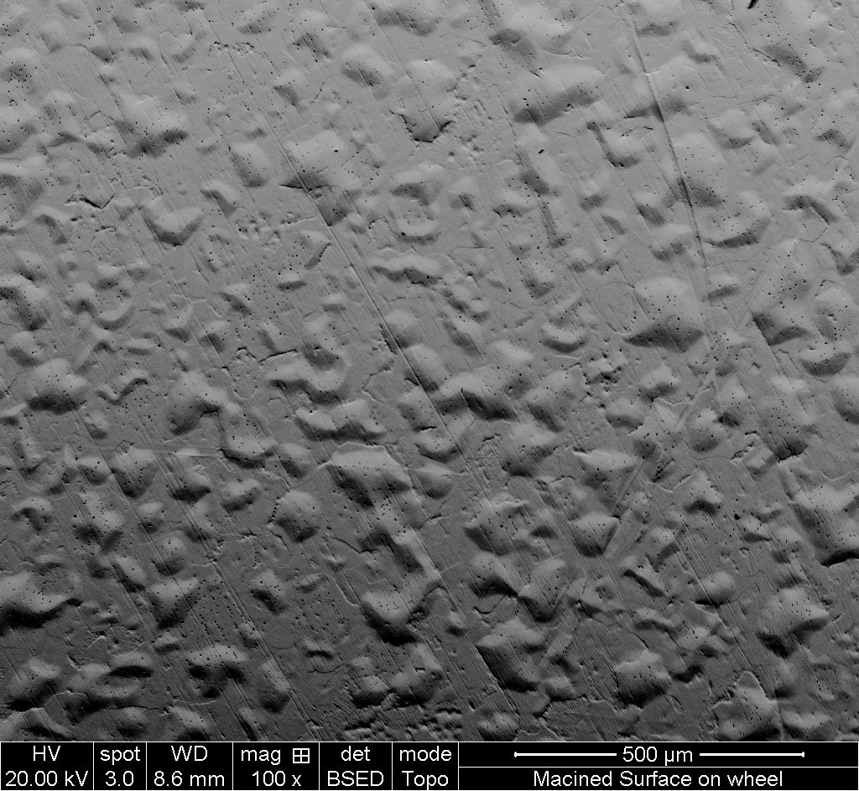
SEM
700 °C and 800 °C at high bias show textured film surface
Possibly pitting of substrate or film delamination
Images of all films required to make definite conclusions
800 °C -120 V Bias

Slide 16
Only 2 films so far imaged in cross section
700 °C -100 Bias
Thickness of both films is approx. 1.3 micron
800 °C – 80 V Bias
Grains appear bigger at 800 °C
No delamination seen in either image

Slide 17
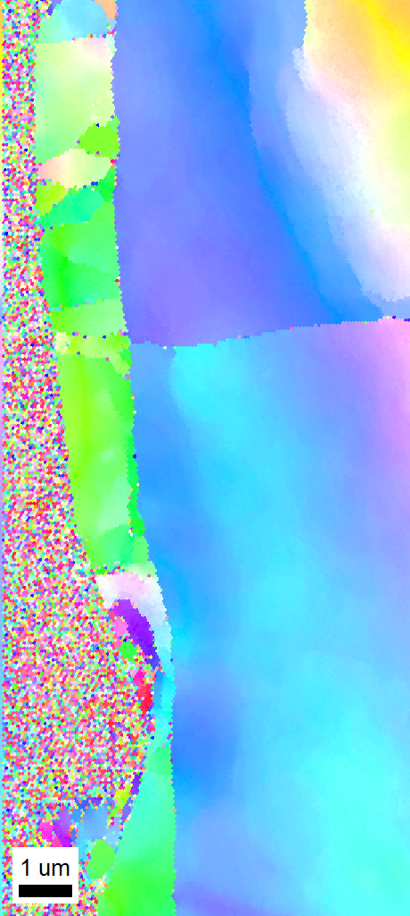
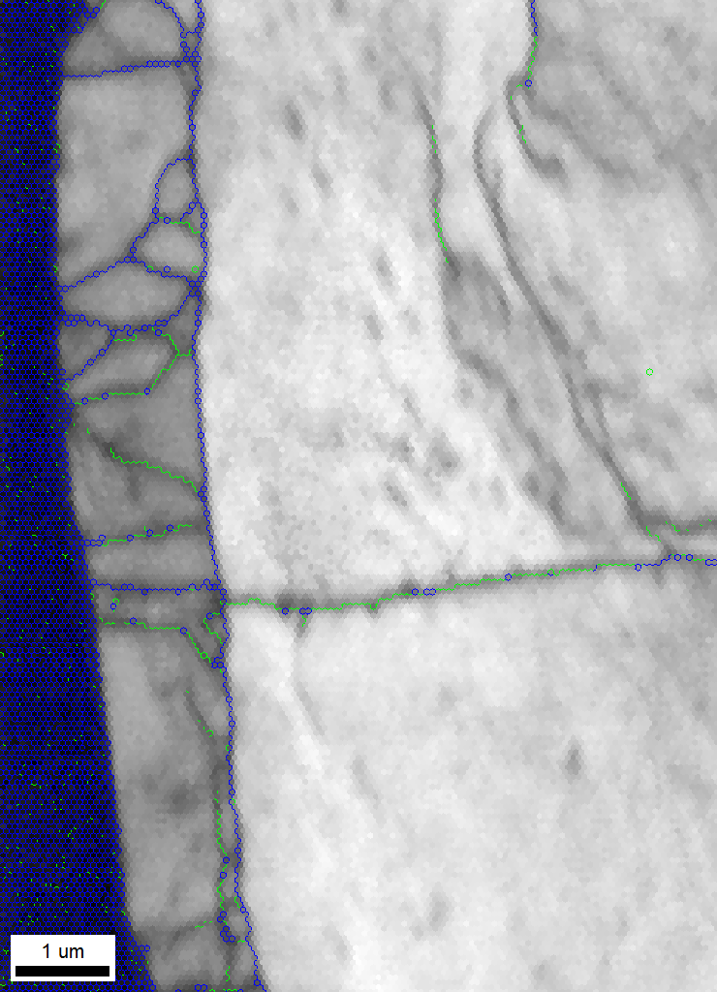
EBSD
Sample deposited at 800 °C with -80 bias
Some single grains are as thick as the film
Largest grains approx. 4 μm
Majority of the grains were in the (110) orientation

Slide 18
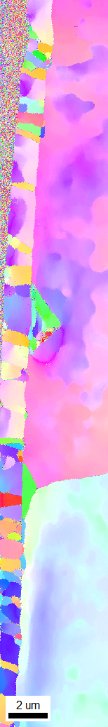
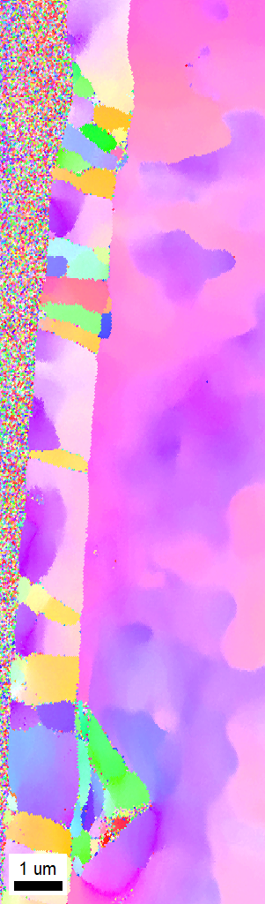
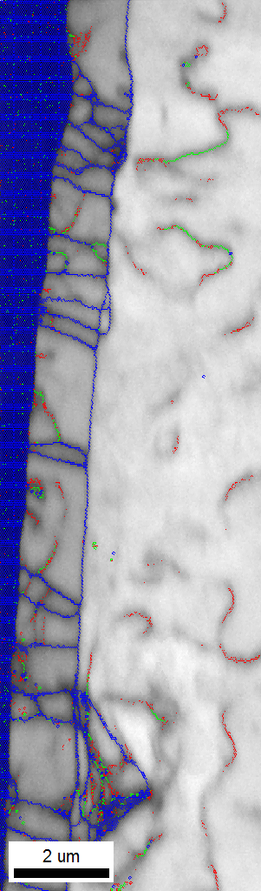
700 °C and -100 V Bias
Grain orientation dictated by the orientation of the underlying copper substrate
EBSD Performed by Dr K. Dawson
The University of Liverpool

Slide 19
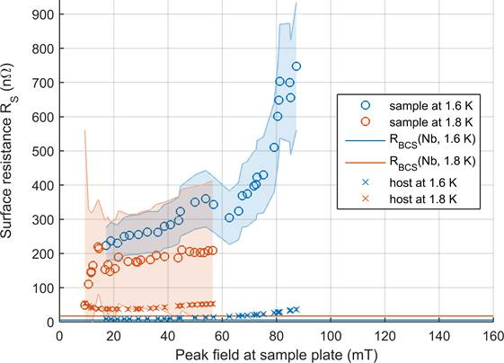
Surface resistance measurements
Sample deposited at 500°C with -100 V Bias.
Sample tested at 3.9 GHz
Thickness of film approx. 4 micron
Surface resistance measurements performed at Cornell University by J. T. Maniscalco

Slide 20
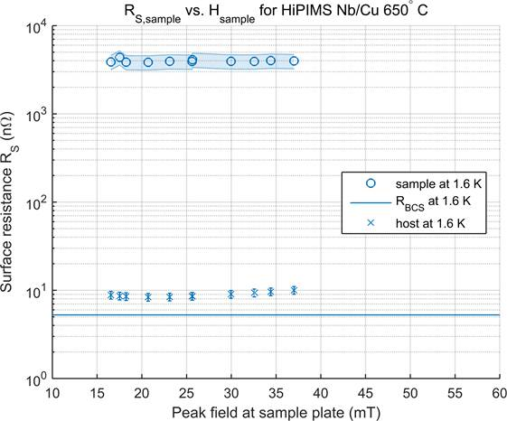
Sample deposited at 800 °C without bias showed very poor RF performance.
Rs was in μΩ region
Superconductivity extinguished at 30 - 40 mT
Unsure of the reason for such poor performance
Further analysis needed!

Slide 21
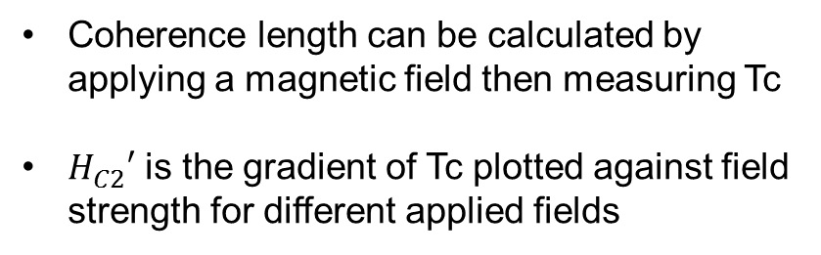
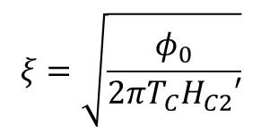
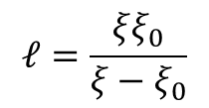
Future Analysis
B Field
Use four point probe in uniform magnetic field to measure mean free path of a superconductor
I⁺
V⁺
V⁻
I⁻
Coherence length can be calculated by applying a magnetic field then measuring Tc
$H_{C2}^{}′$ is the gradient of Tc plotted against field strength for different applied fields
$$ξ=\sqrt{\frac{φ_{0}}{2πT_{C}H_{C2}′}}$$
$$ℓ=\frac{ξξ_{0}}{ξ−ξ_{0}}$$
Mean free path can then be calculated from the coherence length of the sample and that of pure niobium

Slide 22
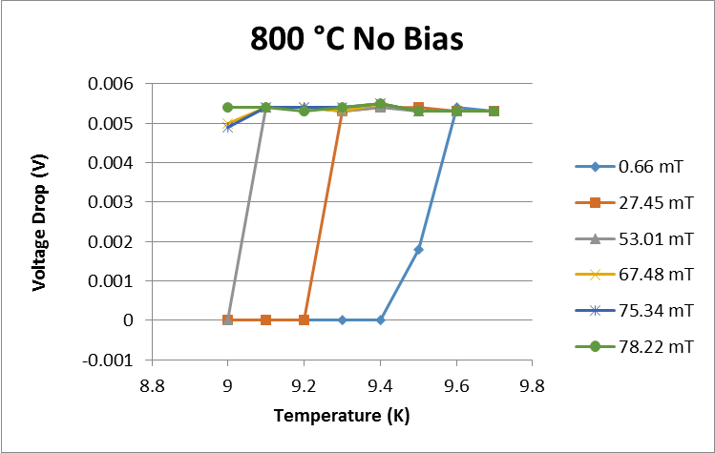
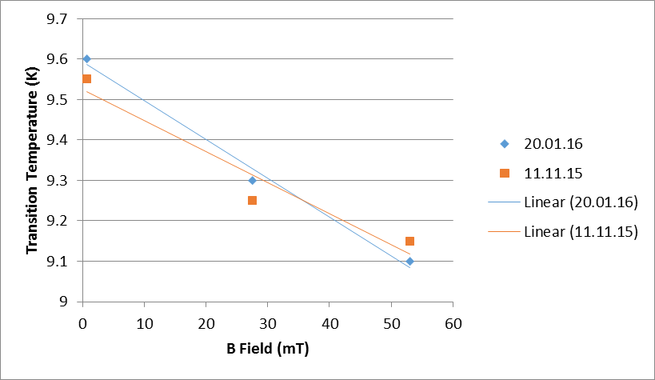
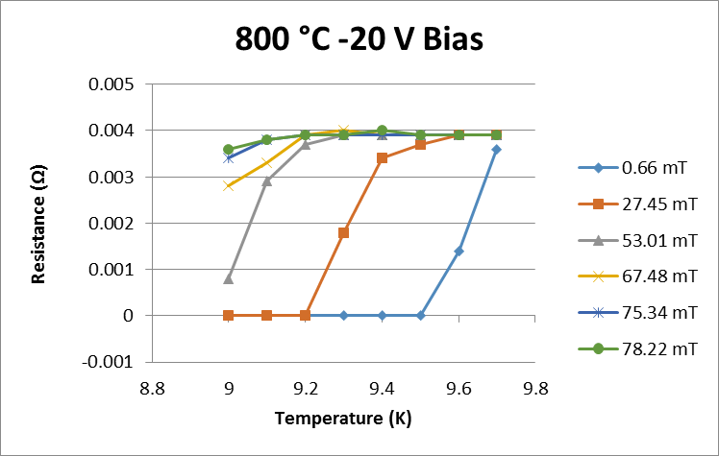
RRR in magnetic field
$$ℓ=350 Å$$
RRR= 43
Mean free path calculated for only 2 samples so far
800 °C no bias = 350 Å
800 °C -20 V Bias = 280 Å
Resistance (Ω)
$$ℓ=280 Å$$
RRR= 39
More data points required to improve accuracy

Slide 23
Acknowledgments
Reza Valizadeh
Oleg Malyshev
Gavin Stenning
Shrikant Pattalwar
Ninad Pattalwar
Adrian Hannah
Boris Chesca
Karl Dawson

