Slide 1
Pulsed Energetic Condensation of Nb Thin Film Cavities at JLab
Matthew Burton
The College of William & Mary
Department of Physics

Slide 2
Acknowledgements
Research Group:
Melissa Beebe (W&M), Ari Palczewski (JLab), Larry Phillips (JLab), Charlie Reece (JLab) and Ale Lukaszew (W&M)
The College of William & Mary
Thomas Jefferson National Accelerator Facility (JLab)
SRF Institute
Olga Trofimova and the Applied Research Center (ARC) at Jefferson Lab

Slide 3
Outline
Background
Energetic Condensation
High-Power Impulse Magnetron Sputtering (HiPIMS)
JLab Deposition System
Current Work with HiPIMS: Nb Thin Film Cavities
Goals
Small Sample Studies
Cavity Results
Future Work

Slide 4
Energetic Condensation
Energetic condensation has been shown to yield films with improved:
Microstructure
Surface morphology
Superconducting properties
New frontier of film deposition that has not been strongly pursued within the SRF field
High Power Impulse Magnetron Sputtering (HiPIMS)
Method which utilizes extremely high peak power densities on sputtering targets
Power densities too high for continuous operation, but can be pulsed
Yields a plasma with a large fraction of the sputtered metal being ionized (up to 90%)
Compared to DCMS with max ion percentage of ~5%
Helmersson et al., Ionized Physical Vapor Deposition (IPVD): A review of Technology and Applications

Slide 5
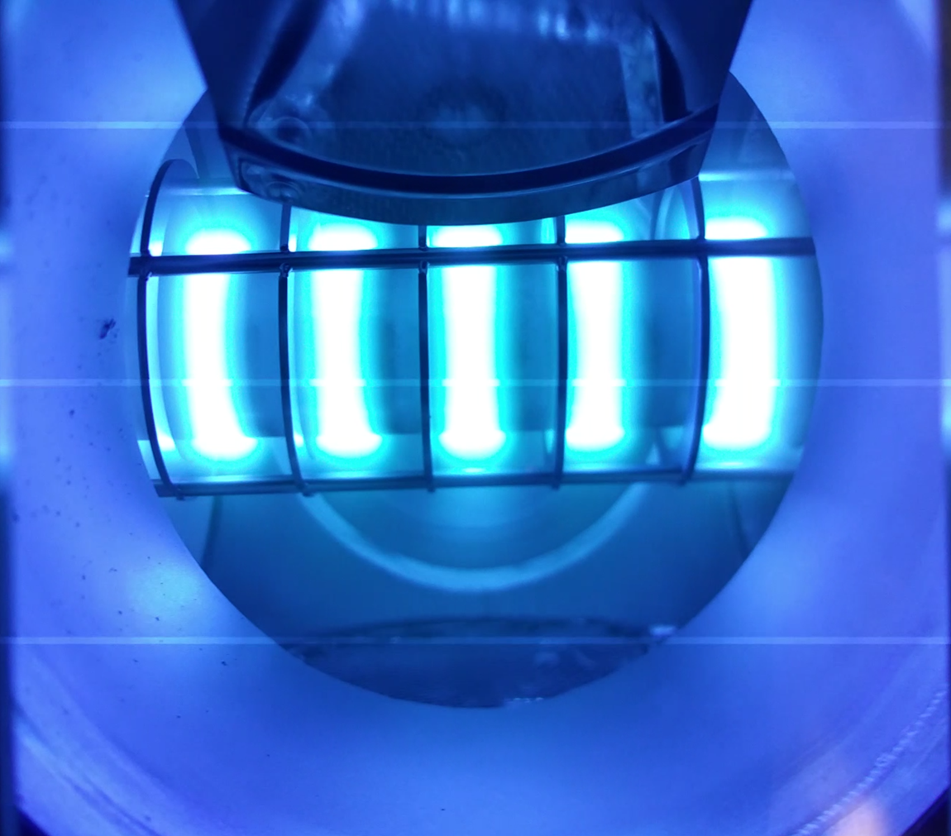
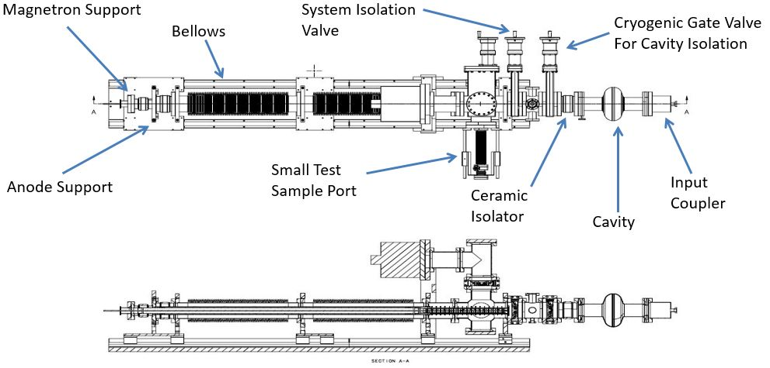
HiPIMS at JLab
Developed a vacuum system specifically designed for cavity depositions
Can isolate cavity from system under vacuum while cleaning sputtering target
Can deposit small samples separate from cavity depositions in order to do measurements
Can remove cavity from system under vacuum and test without ever exposing to air (oxidizing)
Built a custom HiPIMS pulsing system with corresponding power supply
Gives complete control over process
System currently being recommissioned after design upgrade

Slide 6
Current Work
Goals:
Create Nb thin film cavities using HiPIMS technique
Exhibit cavity performance with high quality factor (Q)
Show cavity performance with no or suppressed Q-slope
Small Sample Studies:
Perform measurements not possible on cavities (due to geometrical constraints)
Perform correlation studies between deposition parameters and film properties
Cavity Studies:
Perform RF measurements on Cavities deposited using HiPIMS
Correlate small sample film properties with cavity performance as feedback

Slide 7
Small Sample Studies
Samples grown on Cu substrates
Mechanically and Electrically Polished
X-Ray Diffraction:
Probes microstructure of the film
Gives out of plane lattice parameter (a) and grain size
Atomic Force Microscopy:
Creates an image of the film surface
Gives roughness (R_{q}) information and power spectral density (PSD)

Slide 8
Small Sample Summary
Sample | Voltage (-V) | Peak Current (-A) | Peak Power (kW) | Temperature(°C) | Bias (-V) | Thickness (nm) | Lattice Parameter (nm) | Grain Size (nm) | RMS Roughness (nm)
A | 360 | 115 | 41.4 | 350 | 100 | ~1000 | 0.3318 | 26.748 | 20.44
B | 390 | 185 | 72.15 | 350 | 100 | ~1000 | 0.3326 | 26.6208 | 27.86
C | 411 | 232 | 95.35 | 350 | 100 | ~1000 | 0.3325 | 24.1682 | NA
D | 360 | 304 | 109.44 | 350 | *90 | ~1000 | 0.3309 | 30.5636 | 19.41
E | 435 | 312 | 135.72 | 350 | 100 | ~1000 | 0.3318 | 26.6661 | 20.75
*Bias was setup using a different scheme for this sample to reproduce previously used cavity deposition bias design

Slide 9
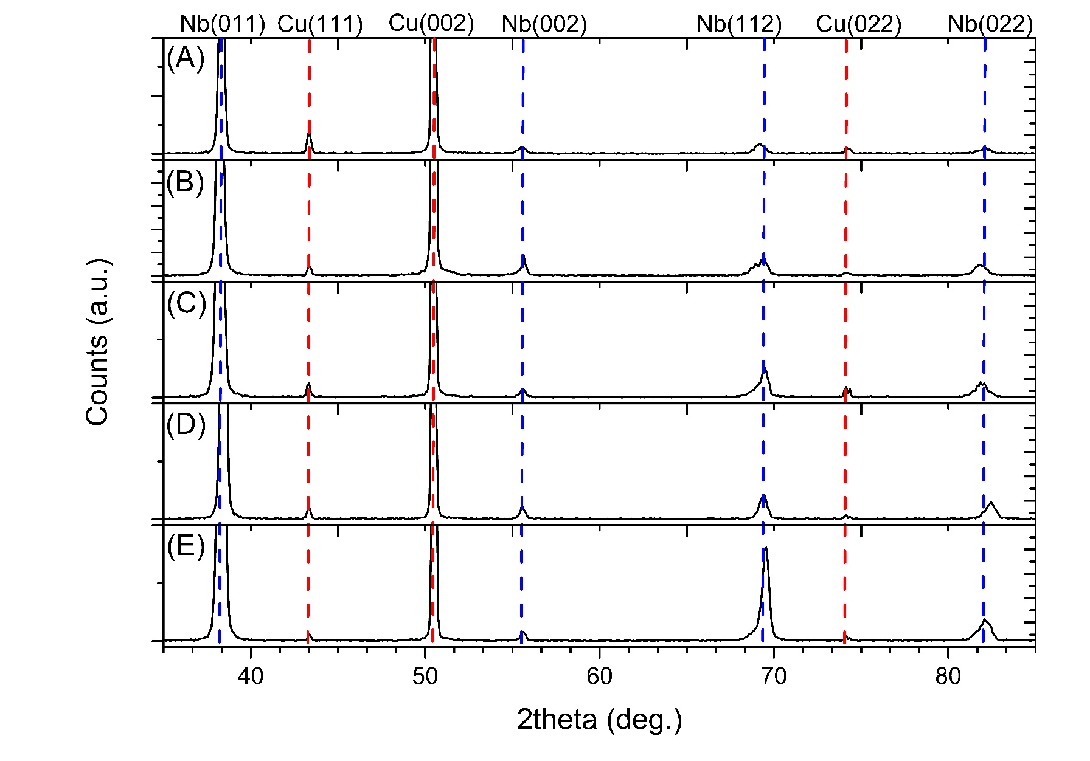
X-Ray Diffraction (XRD)
XRD data courtesy of Melissa Beebe

Slide 10
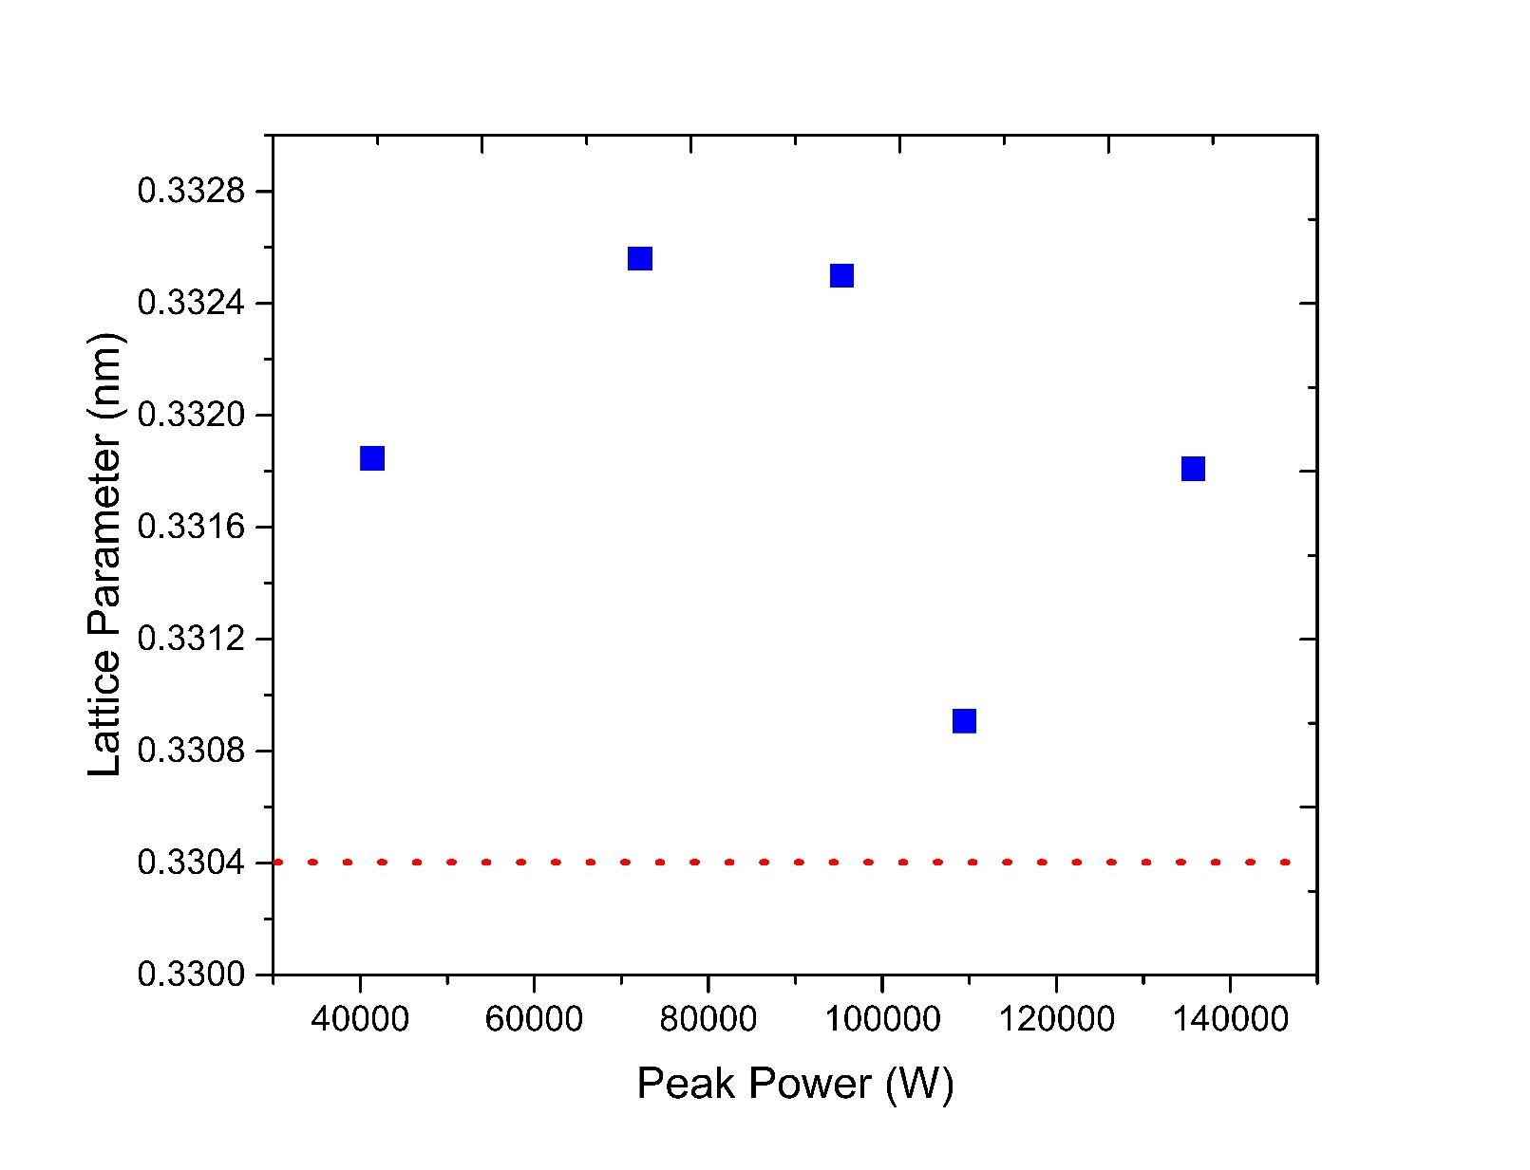
XRD Results
Bulk lattice parameter for Nb is
0.3304 nm (Red Dotted Line)
See most “bulk like” lattice parameter around 110kW peak power
Films exhibit very good microstructural properties
Bulk Nb

Slide 11
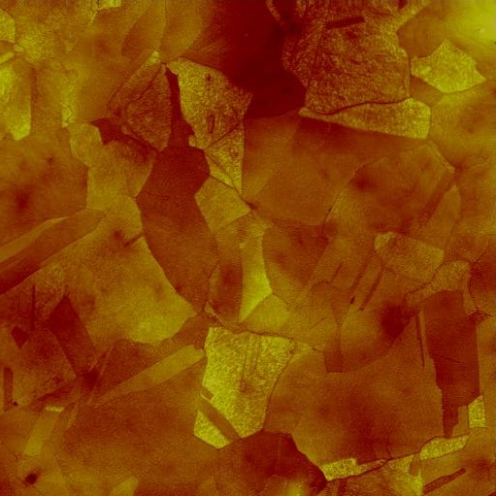
Atomic Force Microscopy (AFM)
AFM scans the surface of a sample using Van Der Waals force between a tip and the sample to create and image
Qualitatively smooth surface with well defined grain texture similar to the copper substrate
Some samples exhibit what appears to be pitting, perhaps from the substrate preparation
AFM Images Courtesy of Olga Trofimova and the ARC

Slide 12
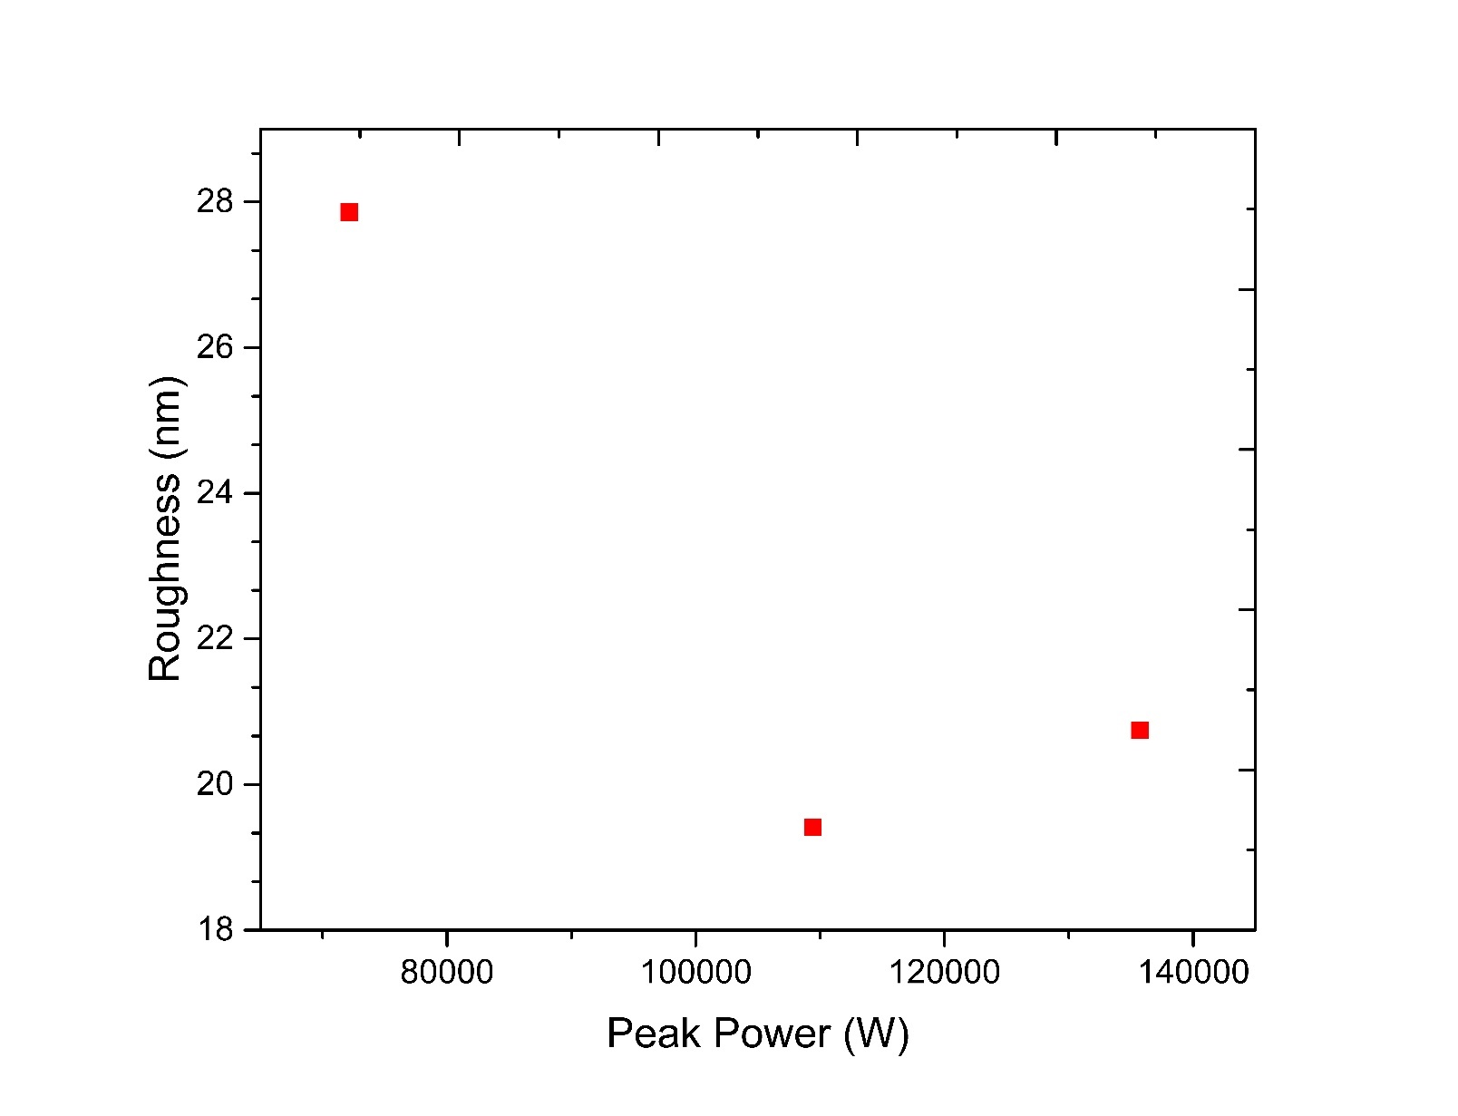
AFM Results
Values taken from 50x50µm scans
Roughness reaches a minimum around 110kW peak power
Overall, the roughness is very low

Slide 13
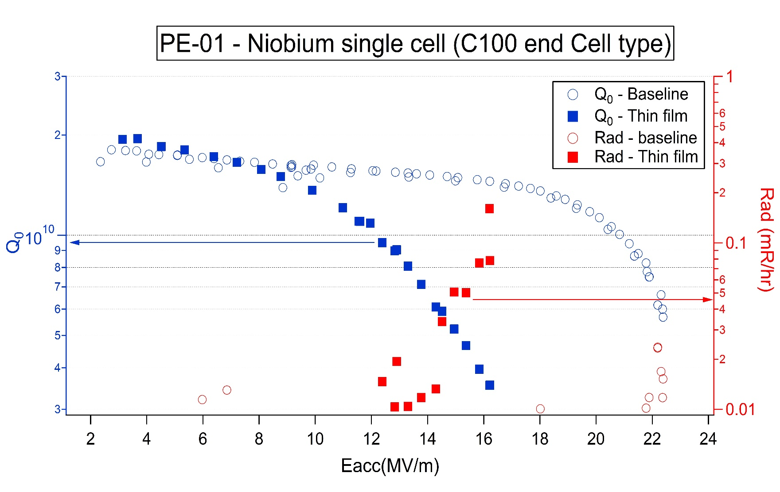
Cavity Results
Nb Cavity Results:
Baseline measurement was after plasma etch and HFx10
Cavity baked at 350C for 24hrs and deposited ~1µm film at 350C
Cavity exhibits high Q greater than or equal to the original bulk Nb cavity
Q-Slope still present in film
Radiation onset expected since cavity had no HPR after coating just a nitrogen blow-off after a dirty vent up
Results confirm capability of system to deposit a high RF performing Nb film
RF Measurements Performed by Ari Palczewski at JLab

Slide 14
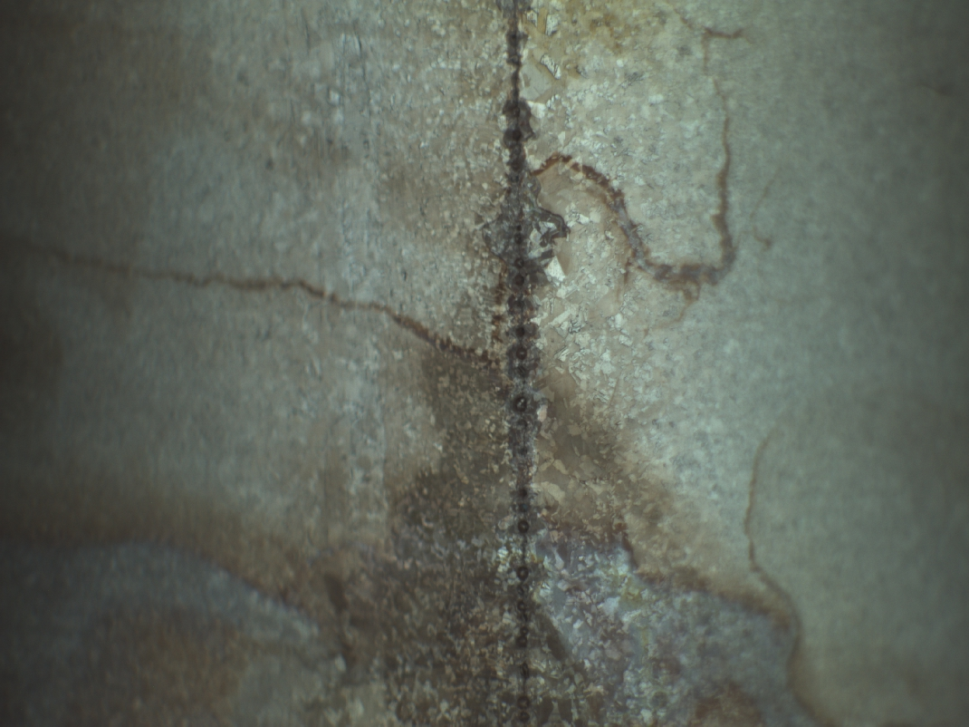
Cavity Issues
One main issue remaining is the quality of the base copper cavities
We have encountered issues with proper preparation and welding of the cavity during its creation
These issues could explain the lower than expected performance of the cavities
Recently finished editing the Cu cavity preparation and welding procedure
New Cu cavities in process of being created using new procedure
See Josh Spradlin’s talk Friday morning for more detailed information

Slide 15
Future Work
Finish recommissioning cavity deposition system & reproduce successful Nb/Nb cavity deposition results using new system design
Deposit Nb films on suitable copper cavities
Perform more small sample studies to determine the effects of other parameters (bias, pulse shape, temperature and pressure) on resulting film properties and their crossover
Deposit cavities at studied parameter areas to determine effect on RF properties of cavities
Perform reactive HiPIMS studies using nitrogen gas to study materials beyond Nb for SRF applications (such as NbN)

Slide 16
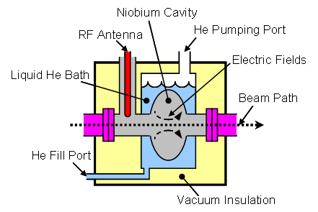
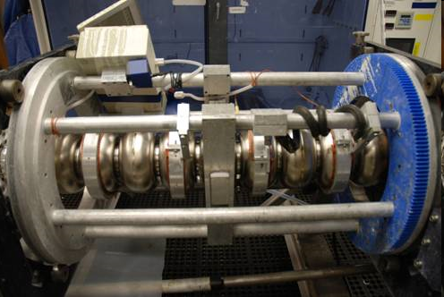
SRF (Superconducting Radio Frequency)
Used at Particle Accelerators (JLab, CERN…etc.)
Utilizes Superconducting Resonant Cavities (Nb)
Antenna Emits at Resonant Frequency of Cavity to establish Mode and Amplify Field
Images: wikipedia.com
Images: jlab.org

Slide 17
Issues with Bulk Nb Cavities
Expensive & difficult to make
Poor thermal conductance (cooling issues)
Complicates overall system by imposing material and design restrictions

Slide 18
Thin Films for SRF Cavities
SRF is a Surface Phenomena with ~1µm surface penetration
Enables cavities to be made of cheaper more suitable materials
Historically, Cu has been material most used due to:
High thermal conductance
Relatively low cost
Easy to manipulate

Slide 19
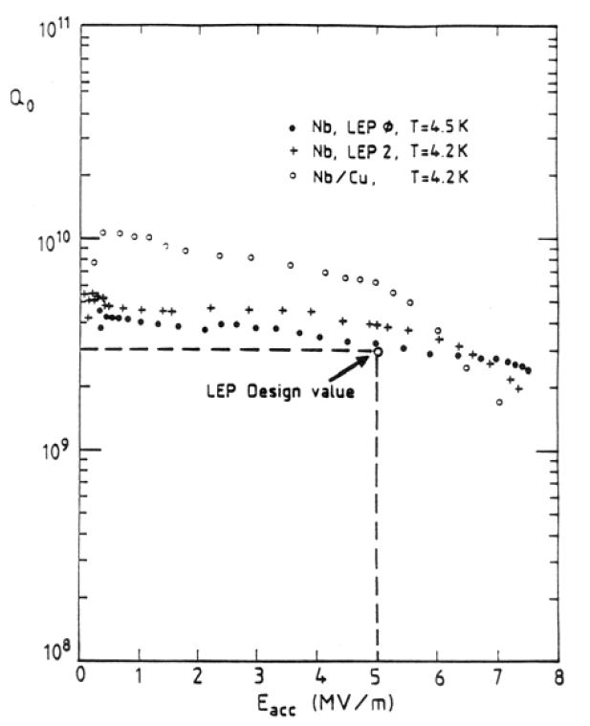
Early Work
S. Calatroni, Physica C 441, 95 (2006).
CERN first to push thin film SRF cavities
LEP accelerator
Deposited Films with DC Magnetron Sputtering (DCMS)
Form of low energy condensation
Cavities had high initial Q value, but suffered from a “Q-slope”
Efficiency of cavity decreased dramatically with increasing applied power
Limited maximum energy of accelerator
If LEP had no Q-slope HIGS found decades earlier

Slide 20
Transition Temperature (T_{c})
Superconductivity is characterized by an abrupt second order transition from a normal conducting state to a superconducting state at the “Critical or Transition” temperature, which is, mainly, material dependent.
Placeholder for future RRR Tc data
T_{c} data courtesy of Josh Spradlin and the SRF Institute at JLab

