Slide 1

Development of thin films for superconducting RF cavities in ASTeC
Oleg B. Malyshev
on behalf of the collaboration team
ASTeC Vacuum Science Group,
STFC Daresbury Laboratory, UK

Slide 2
Outlook
Motivation
PVD deposition
CVD/ALD deposition
Surface analysis
Superconductivity evaluation
RF testing of planar samples
Future plans

Slide 3
Motivation
The aim is to develop the PVD and CVD coating technologies of superconducting materials for RF cavities and apply it on the RF cavities
Objectives:
  a systematic study correlation between
    Deposition condition
    Film morphology, structure, chemistry
    AC and DC superconductivity characteristics such as T_{c}, B_{c}, B_{fp}, RRR, etc.
    RF evaluation of samples
    Cavity deposition and test

Slide 4
Thin film deposition
PVD: DC, pulsed, HIPIMS…
Film characterisation
SEM, FIB, AFM,
Real cavity measurement
Cavity deposition
(PE)CVD, (PE)ALD
XPS, XRD, RBS, TEM…
Superconducting RF properties evaluation
Superconducting properties measurement
RRR, H_{c}, H_{fp}, H_{sh}, …
HW cavity at ASTeC
Nb, NbN, Nb₃Sn, MgB₂, etc.
Surface preparation
Cleaning, etching,
Polishing, passivating
AC/DC magnetic susceptibility,
Penetration facility
Presently, our main emphasis is on a systematic study of correlation between

Slide 5
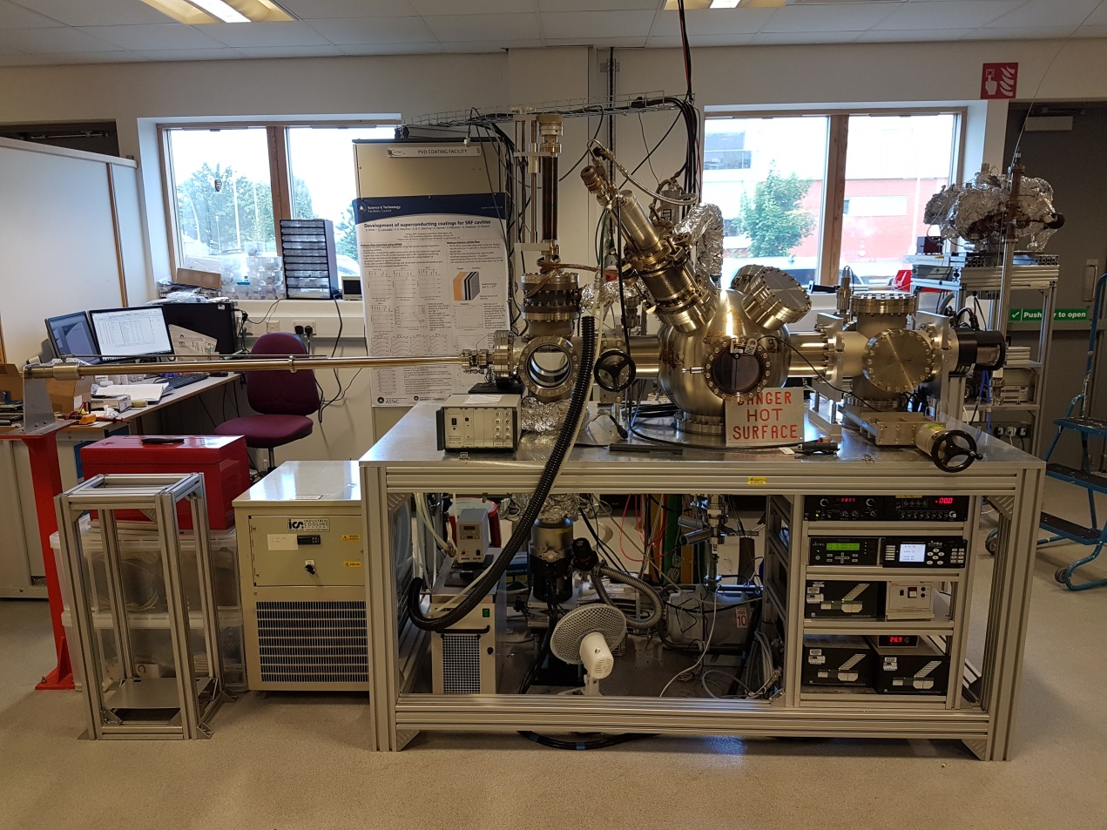
UHV PVD facility
Bakeable
Load-lock chamber
Up to 7 samples
  ≤100 mm diam.
Up to 4 planar concentric targets
  the variable distance to the substrate: 10-15 cm
Substrate rotation
20 ≤ T_{s} ≤ 950 ºC
Differential RGA pumping to analyse the sputter gas.
HiPIMS, DC, Pulsed DC and RF Sputtering using Kr or N2 sputter gas
Nb, NbN and NbTiN deposited
Notes:
Substrate can be set to continuous rotation and uniformly heated from room temperature to 950 ⁰C.

Slide 6
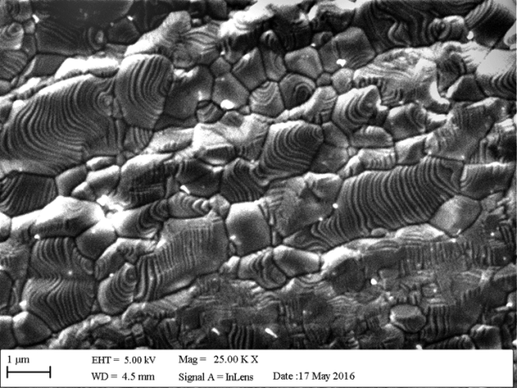
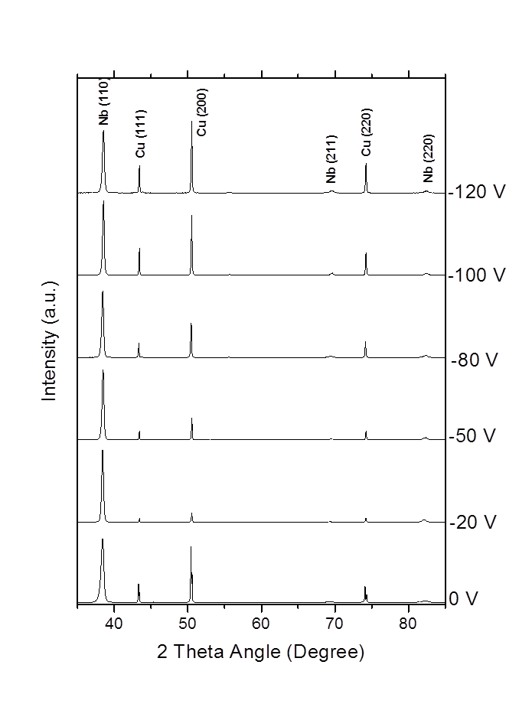
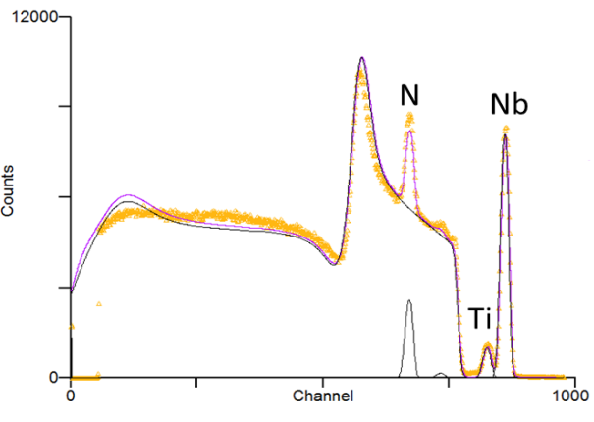
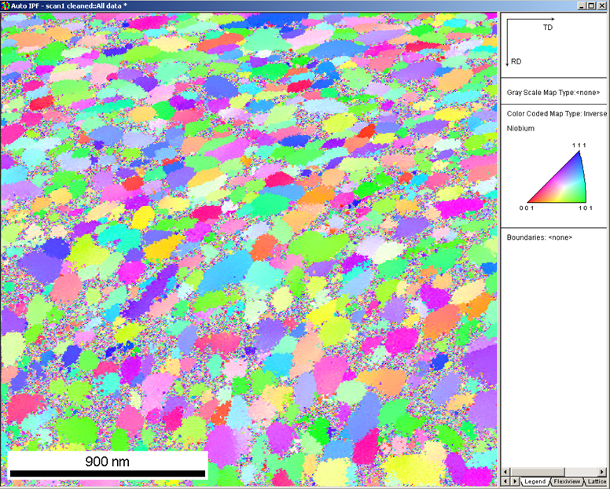
Film characterisation
SEM analysis
  to determine the film thickness and growth rates.
  to give an indication of the type of film that has been deposited i.e., columnar with voids or densely packed grains.
XRD analysis
  average grain size and lattice orientations within the film.
EBSD analysis
  an accurate value for the grain size at the surface of the film.
RBS
  film composition →
XPS analysis
  film composition, chemical bonding and impurity

Slide 7
Superconductivity evaluation
RRR measurements
  have been performed using a purpose built cryostat housing a four point probe.
  Measurements in magnetic field allow to obtain electrons mean free path, l.
DC SQUID measurements
  were performed using a Quantum Design PPMS. The measurements were expected to give values for both the first and second critical fields, H_{c1} and H_{c2}.

Slide 8
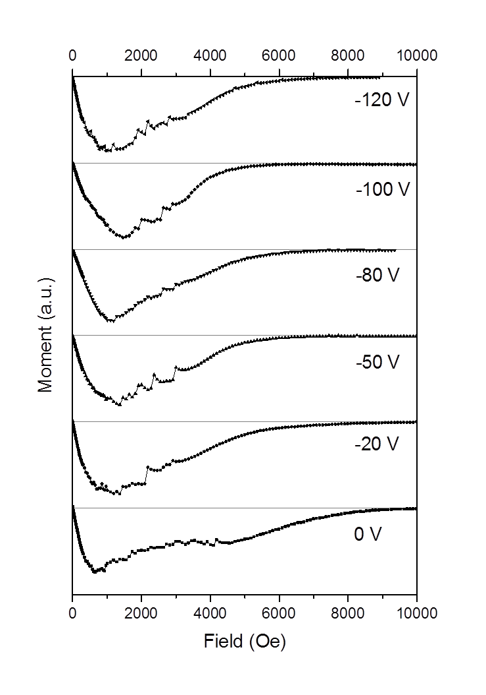
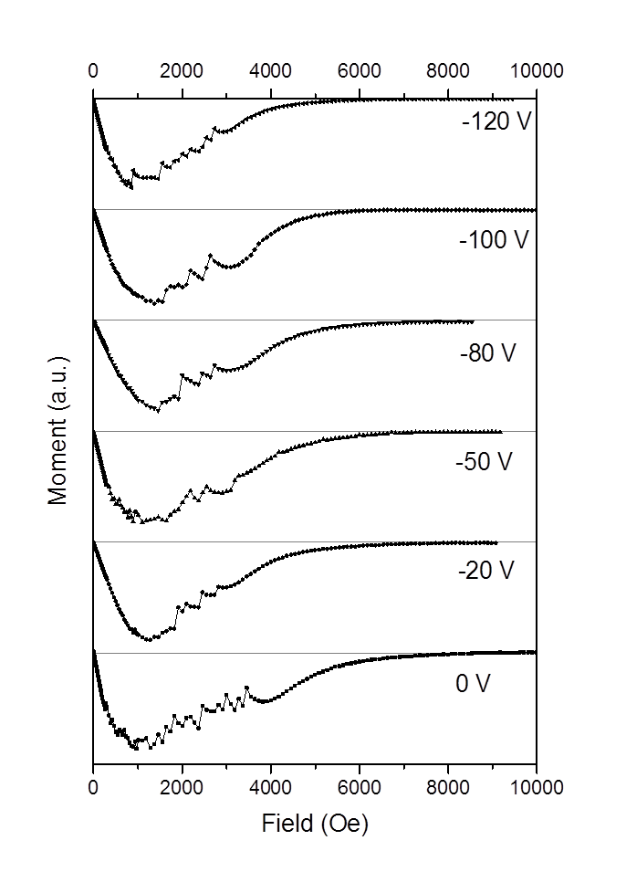
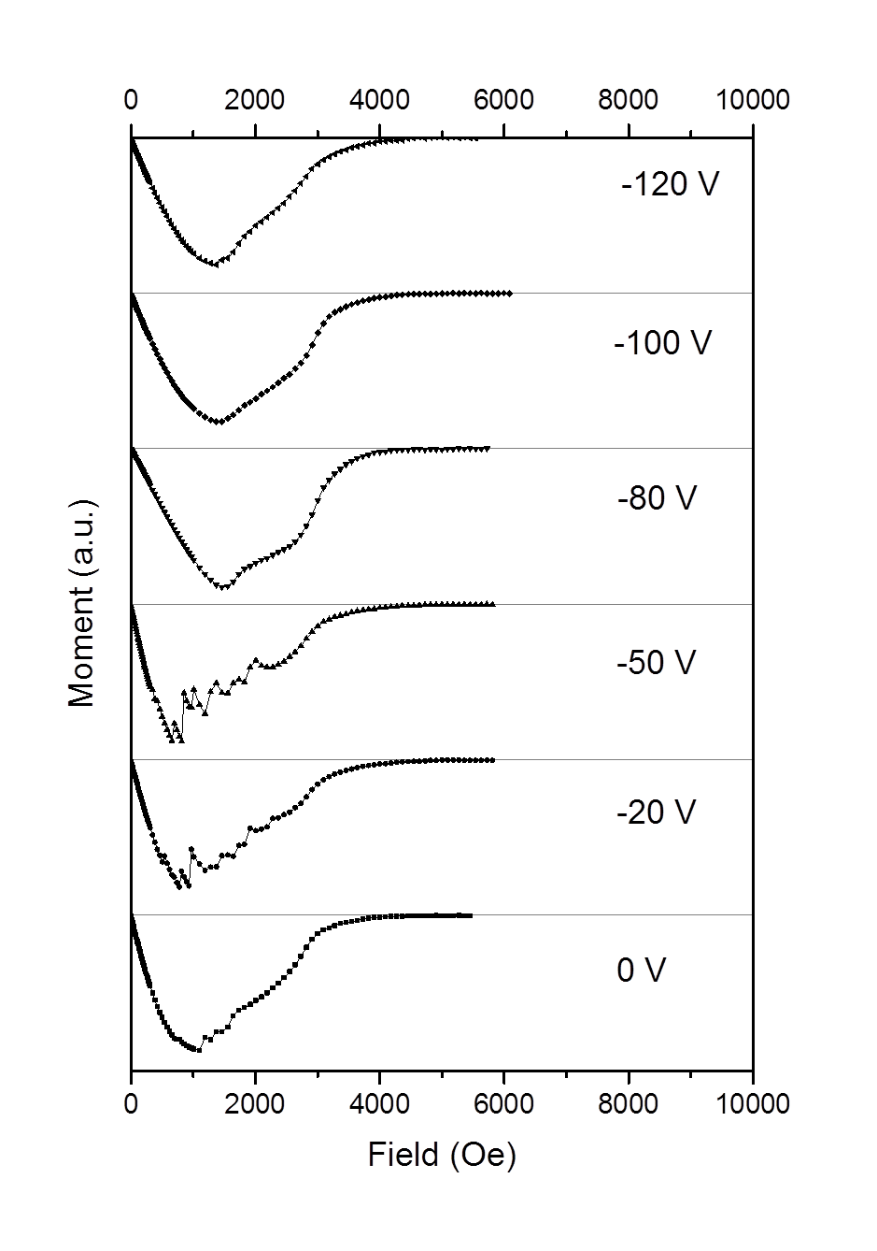
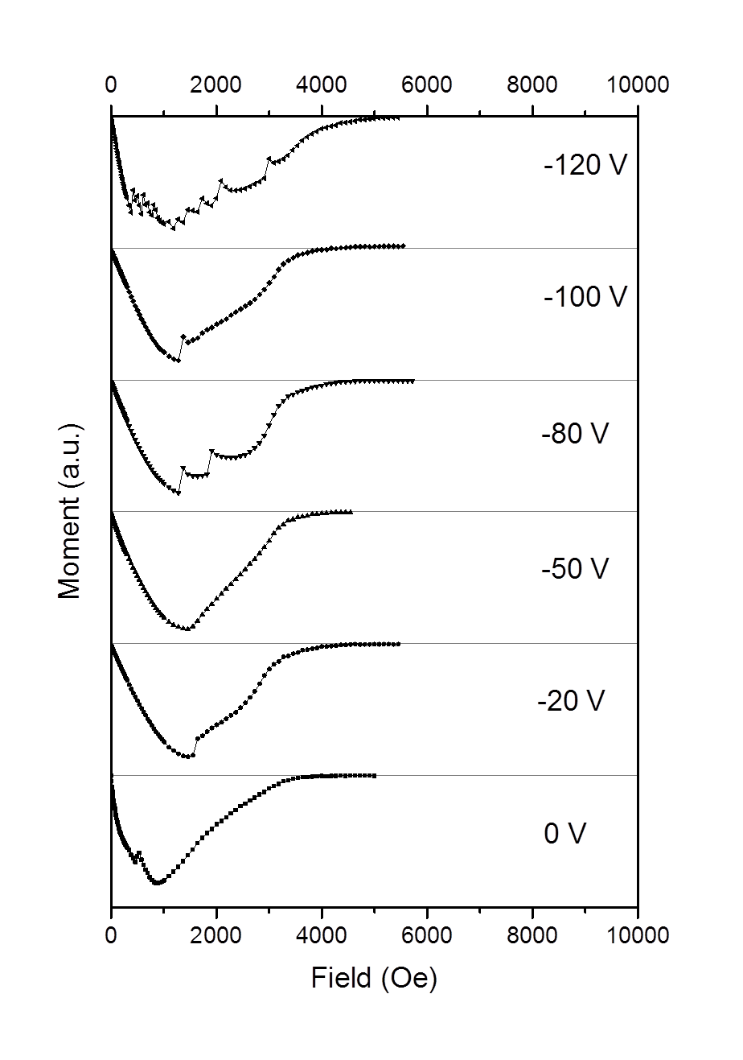
DC SQUID measurements
RT 500 °C 700 °C 800 °C
How to compare the samples?

Slide 9
PVD
More detail on PVD deposition, surface characterisation and superconducting properties are in the following Stuart Wilde’s talk

Slide 10
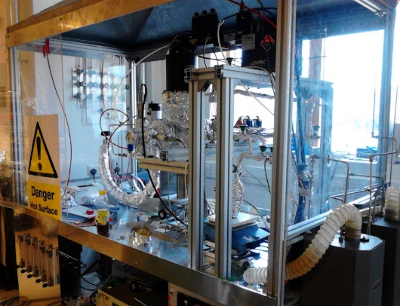
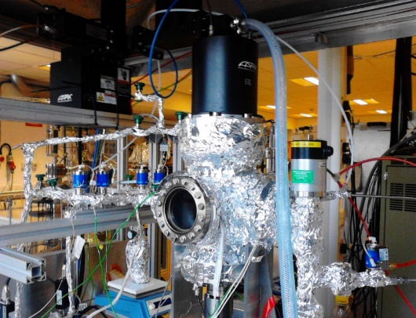
PECVD/ALD deposition
Base pressure:
  ~10⁻⁵ mbar at 120 ºC
Cold wall reactor.
  Heater capable of
    T > 700 °C.
  2 bubbler lines for precursor delivery.
Gas flows (3 gas lines):
  Hydrogen,
  Nitrogen
  Ammonia.

Slide 11
PECVD/ALD deposition
Materials deposited
  Nb
  NbN
  NbTiN
Precursors
  NbCl₅ for Nb films:
    Chosen to obtain metallic Nb layer
    Reacts with plasma of H+
    T_{precoursor} = 150 °C to perform ALD
      Very sensitive to moisture
    T_{substrate} > 500 °C to reduce Cl contamination in the film
  C₁₆H₃₉N₄Nb (tris(diethylamido)(tert-butylimido)niobium for NbN films
    Reacts with N₂ plasma
    T_{precoursor} = 104 °C to perform ALD
      Sensitive to heating, start decomposing at 130 °C
    T_{substrate} = 250 °C. Suitable for deposition on Cu

Slide 12
CVD
More detail on CVD deposition, surface characterisation and superconducting properties are in Paolo Pizzol’s talk today at 15:30.

Slide 13
DC superconductivity evaluation
RRR measurements
  Purity, T_{c}, l
DC SQUID measurements
  H_{c1}, H_{c2}, T_{c}
Magnetic field penetration
  H_{fp}, H_{c1}, H_{c2}

Slide 14
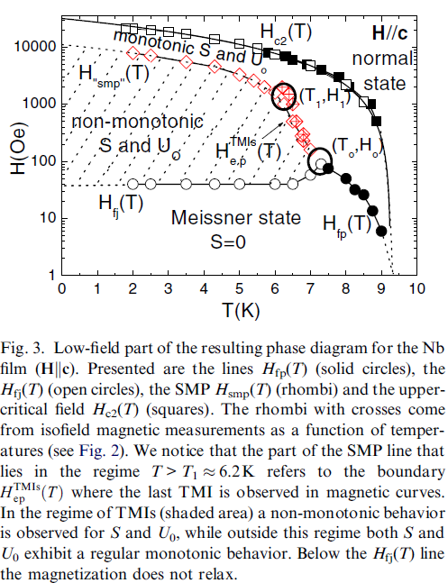
What we are looking for?
Is there a criteria for a simple evaluation of deposited film to predict its behaviour in RF field?
To stay in Meissner state would be ideal (Q₀ conditions)
T<T₁
Should the criteria for a good film be H_{smp}? Is there any correlation to H_{sh}?
What DC measurements would be valid for RF?

Slide 15
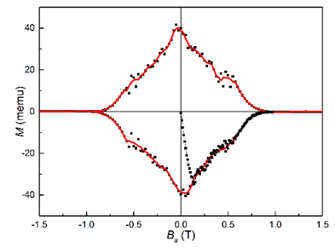
What we can obtain from SQUID measurements?
How to extract H_{c1} from these graphs?
How to compare the samples?

Slide 16
What we can obtain from SQUID measurements?
How to extract H_{c1} from these graphs?
  Taken at max|M|?
  Or the highest H when M=M_{ideal}
Is any of this correct?
H_{c1}
Another way is, do not speculate about H_{c1}, just compare samples by normalising results for each sample:
  M(H)/M_{ideal}(H)

Slide 17
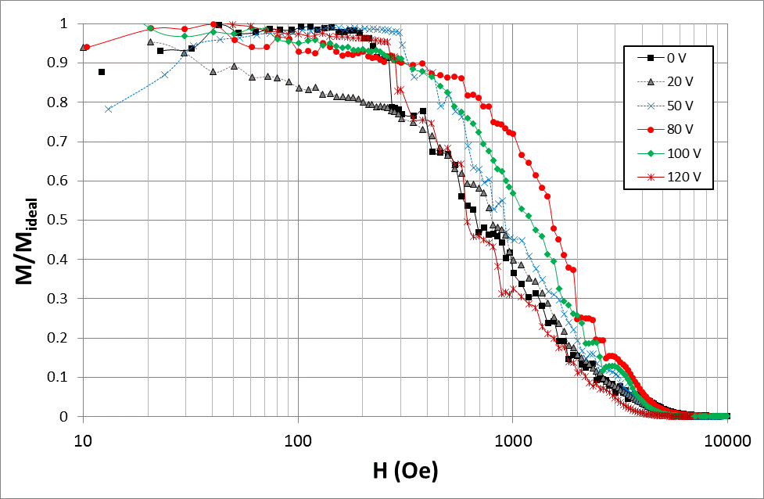
  Normalised magnetisation M(H)/M_{ideal}(H)
Samples can be compared at 500, 1000 or 3000 Oe.
Would it be relevant to behaviour at RF?

Slide 18
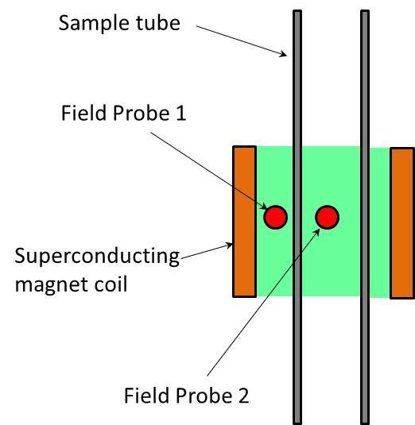
Magnetic field penetration measurements
The field of full penetration, B_{FP}, defined in the Bean model could be measured increasing B1.
  B_{FP} = B1 is a mean value for measurements when B2 last remains zero and the first for which it does not.
  The method is suggested by A. Gurevich
The only tool to study S-I-S multilayer structures.
Tubular samples to be produced

Slide 19
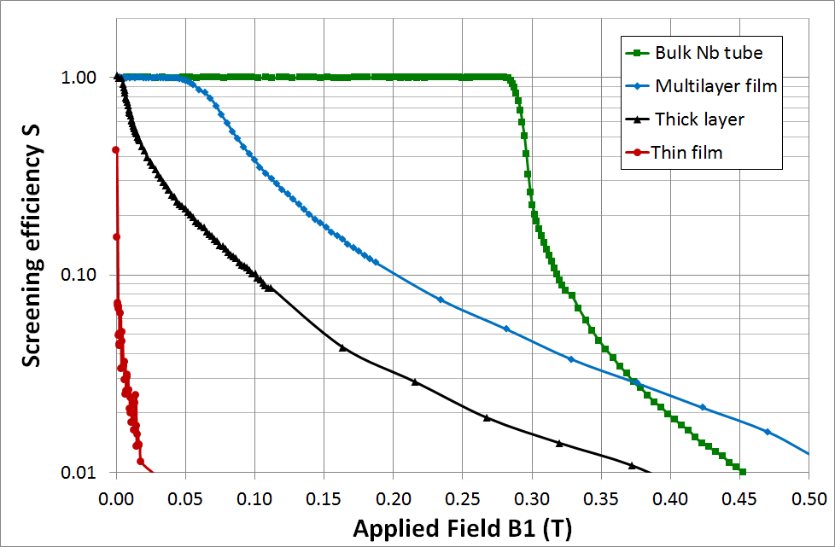
Results for magnetic field penetration measurements
Screening efficiency S plotted against the applied magnetic field B1 for samples.
This facility is ready for more samples

Slide 20
Magnetic field penetration
More detail in Lewis Gurran’s talk on Thursday at 14:00

Slide 21
RF testing of planar samples
Only RF test can provide information:
  How good or bad is a film.
  To prove or disprove all criteria and indicators from film characterisations and DC superconductivity tests.
Planar samples are easy to deposit and characterise.
  Real RF cavity test brings an additional complexity of depositing on curved surface
A few such test facilities exist in SRF labs around the world
  A test preparation takes a few weeks (too long)
  Sample holder assembly could be quite complicated
  Many samples are waiting to be tested

Slide 22
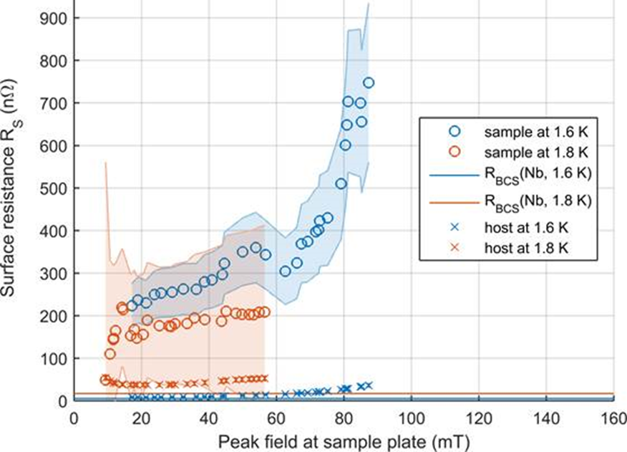
Measurements at Cornell University
Nb Deposited with HiPIMS at 500 °C with -100 V DC Bias
Only 2 sample analysed for RF surface resistance
Measured at Cornell University by J. T. Maniscalco

Slide 23
ASTeC RF testing facility for planar samples: from idea to realisation
Nb plate
Nb cylinder
Nb coated Cu plate
A three-choked 7.8 GHz test cavity
Initial idea
Surface resistance (power loss) measurements at each part at 7.8 GHz.
Nb coated sample comparison to bulk Nb and other samples.
We would like to make a simple RF evaluation of deposited film:
Tangential magnetic field

Slide 24
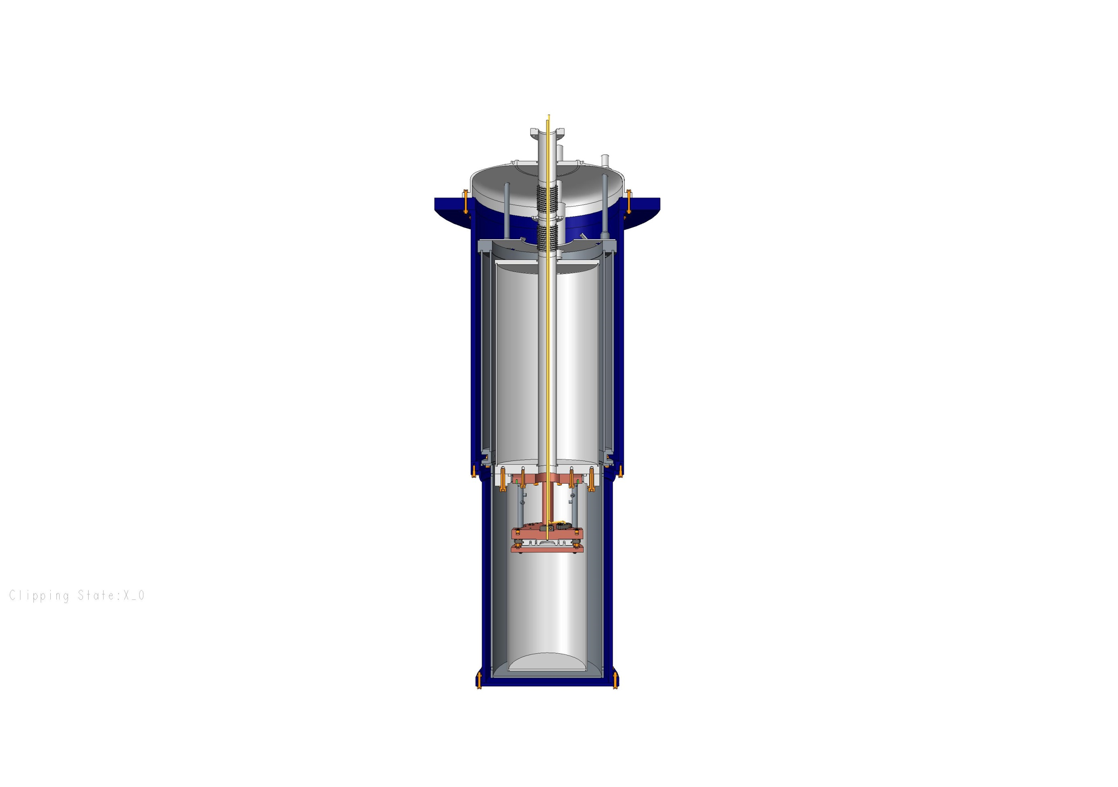
Preparing for an SRF test
A new facility has been designed, build and tested at 78 K.
Number of challenges was met
More details in Philippe Goudket’s talk on Thursday at 15:15.
Schematic of the cryostat.
RF cables and thermometry wiring
Outer Vacuum
Chamber
Liquid Helium
Chamber
Liquid Nitrogen
Chamber
Cradle Assembly
77K Radiation Shield
Sample Chamber

Slide 25
Future plans
Depositing S-I-S structures
Magnetic field penetration measurements of various samples
Testing the SRF characterisation for planar samples at LHe temperature
  SRF characterisation of planar samples
Further development of PVD and CVD to enable 3D deposition
  3D sample (RF cavity) deposition with PVD and CVD
  SRF test of these samples (SRF cavities)

Slide 26




The UK’s SRF collaboration team
S. Wilde, Dr. B. Chesca
P. Pizzol, Prof. P. Chalker
F. Lockwood-Estrin, Prof. J. Bradley
Lewis Gurran, Dr. Graeme Burt
Dr. R. Valizadeh, Dr. O.B. Malyshev,
Dr. P. Goutket, A. Hannah, S. Pattalwar,
N. Pattalwar, K. Dumbell
J. Herbert, A. Wheelhouse,
P. McIntosh
Dr. G. Stenning

