Slide 1

7th International Workshop on Thin Films and New Ideas for Pushing the Limits of RF Superconductivity
July 27-29, 2016
Thomas Jefferson National Accelerator Facility, Newport News, VA
Magnetron sputtering:
New developments of a mature film deposition technique
André Anders
Senior Scientist, Lawrence Berkeley National Laboratory
Berkeley, California
aanders@lbl.gov
Acknowledgments:
This presentation includes results of several members of and visitors to the Plasma Applications Group, including Yuchen Yang, Xue Shoe, Matjaz Panjan, Joakim Andersson, and others. Work at LBNL is supported by the U.S. Department of Energy under Contract No. DE-AC02-05CH11231.

Slide 2
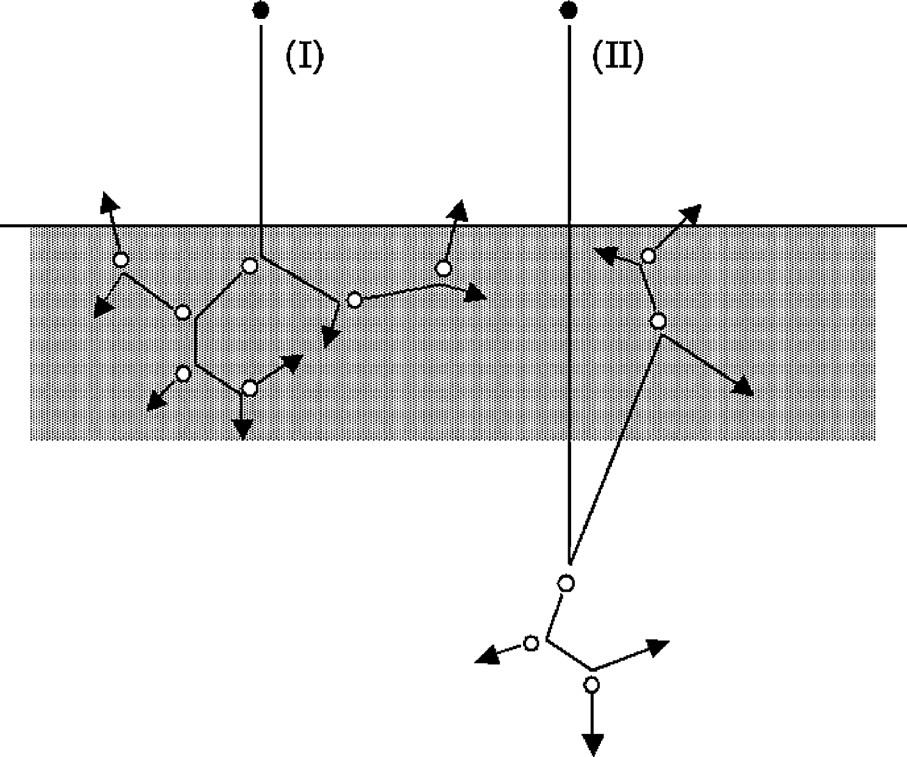
The Sputtering Process
heavy ion
light ion
This image, and the following, are from D. Depla, et al. (Ed.), Reactive Magnetron Sputtering, Springer, 2008

Slide 3
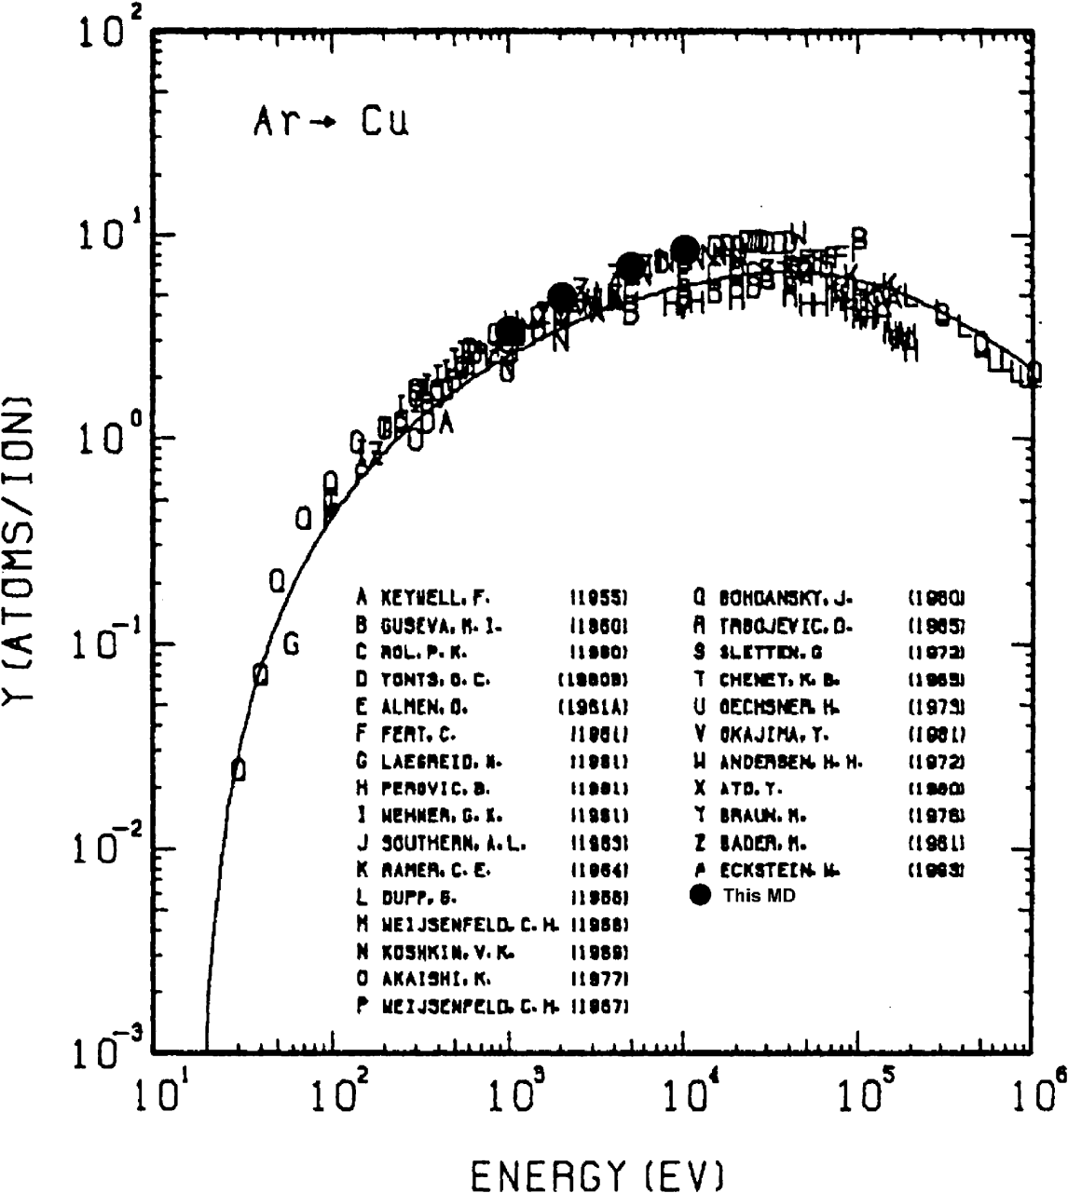
Sputtering Yield
in the relevant ion region between 100 and 1000 eV, yield ~ (ion energy)^{1/2}
Maximum at about 10 keV
Example: Ar⁺ → Cu

Slide 4
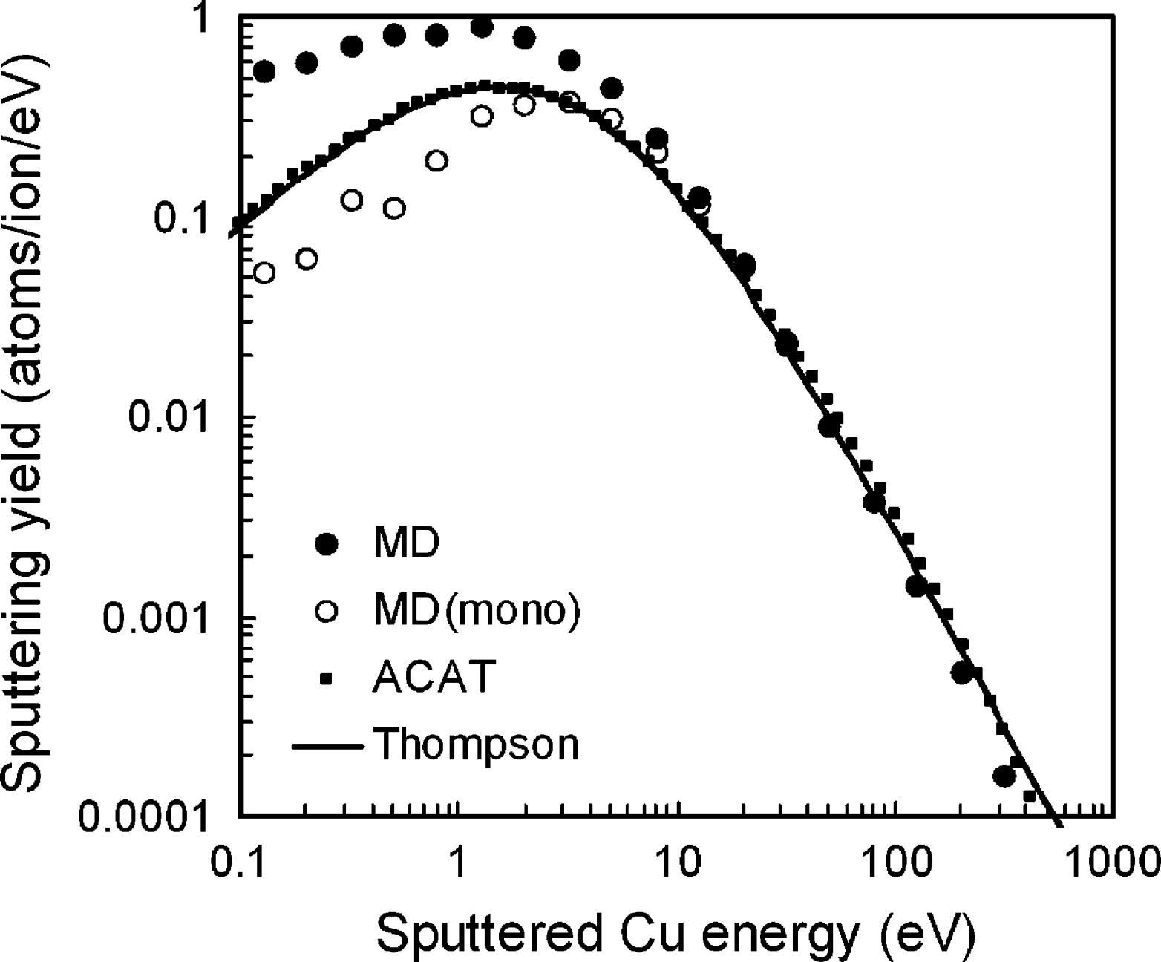
Energy of Sputtered Atoms:
Thompson Distribution: log scale
5 keV Ar⁺ → Cu

Slide 5
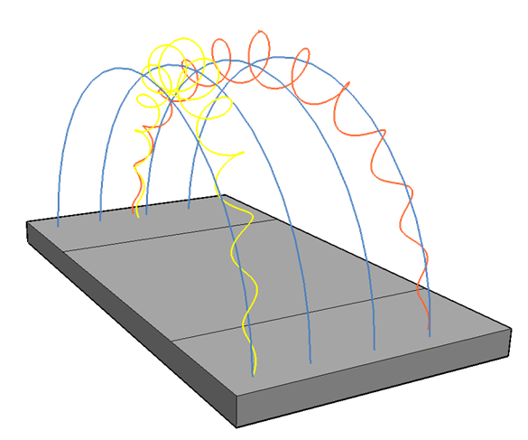



Motion of electrons in a magnetron’s E x B field
$$v_{drift}$$
$$B$$
+
$$E$$
–
−
Slide design by Matjaz Panjan.

Slide 6
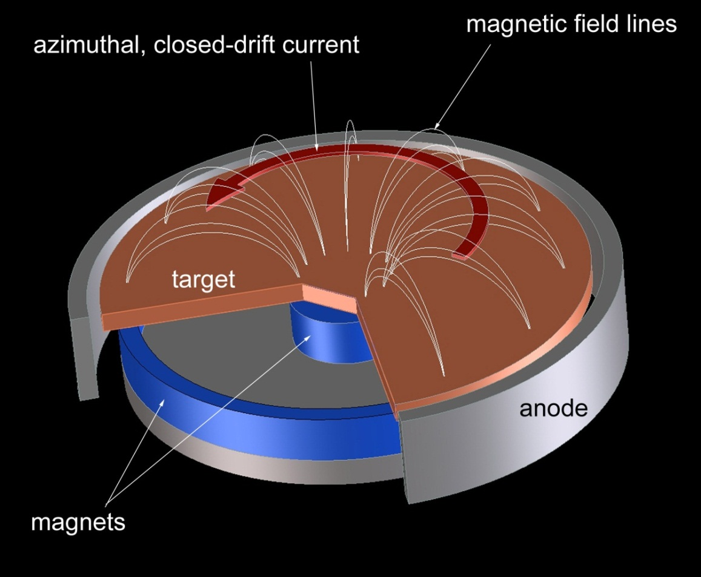
A. Anders, Surf. Coat. Technol. 205 (2011) S1.

Slide 7
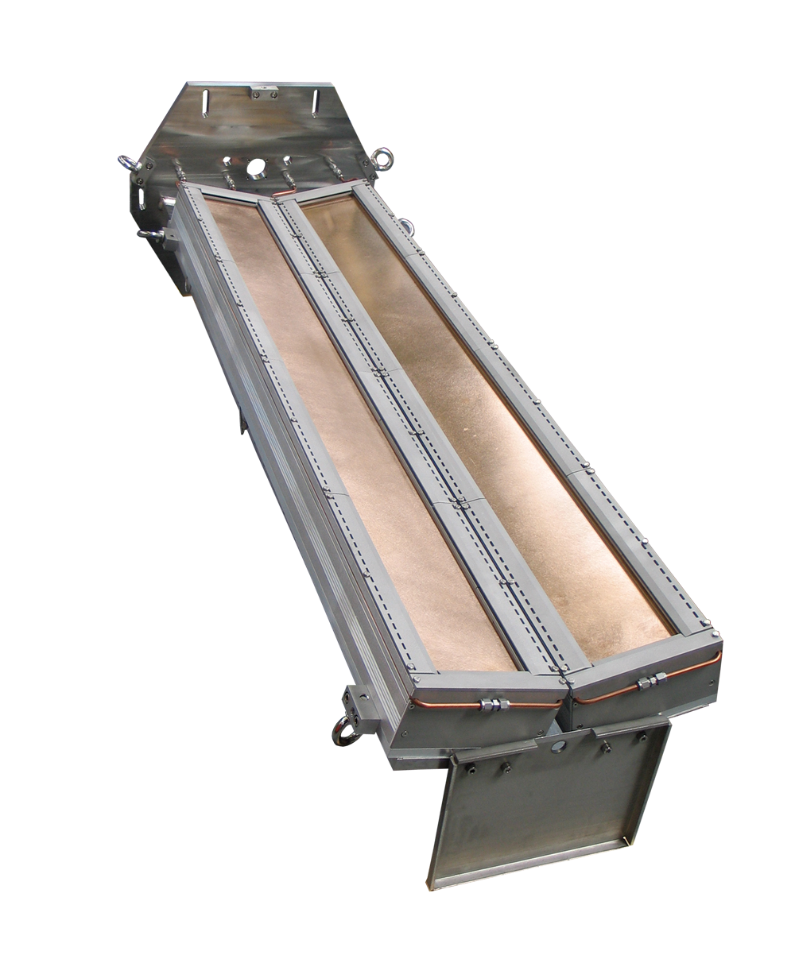
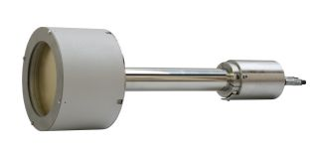
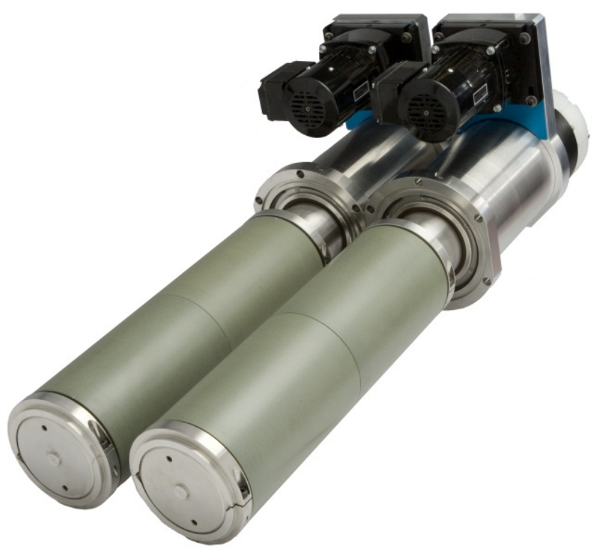
Magnetrons
planar, round
dual, cylindrical, rotating
dual, planar, rectangular
examples are from Gencoa.com

Slide 8
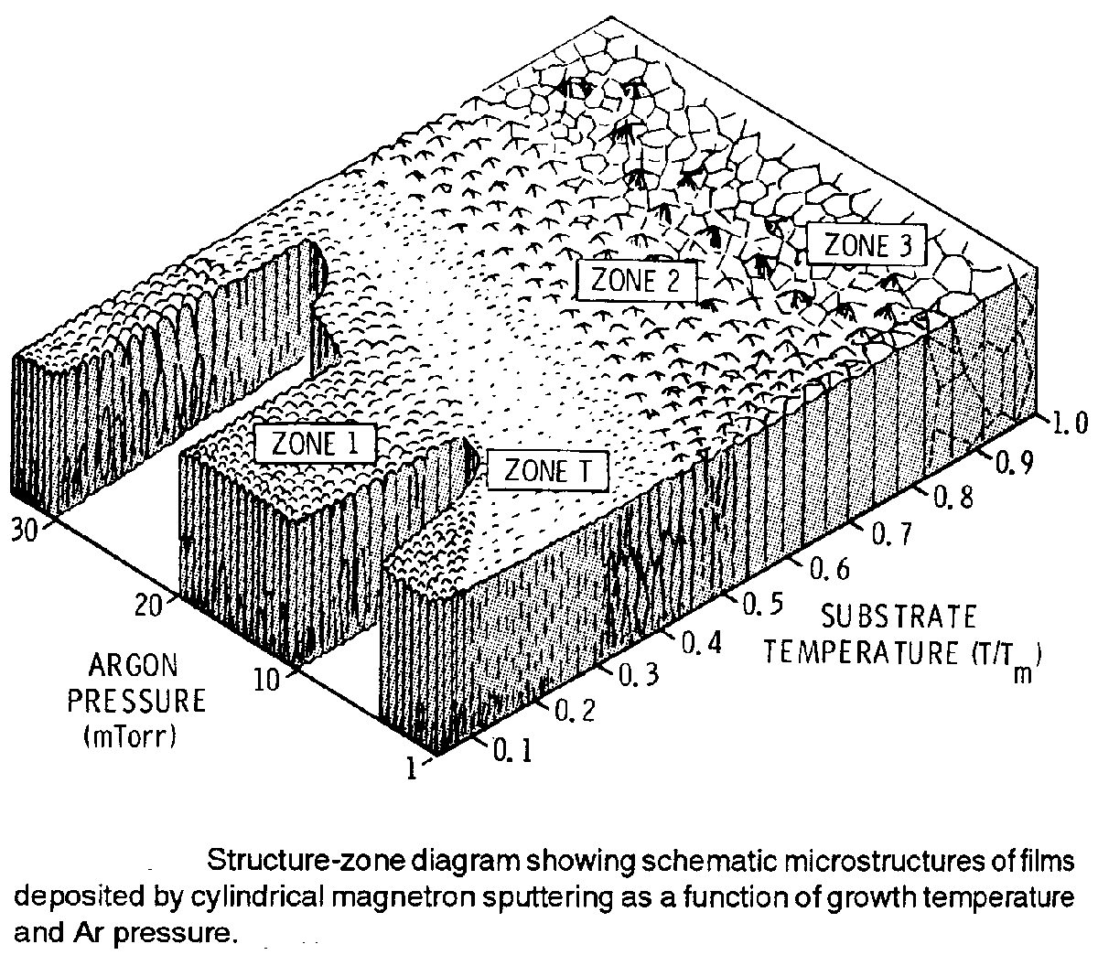
Structure Zone Diagram for Sputtered Films
Thornton, J. Vac. Sci. Technol. 11 (1974) 666

Slide 9
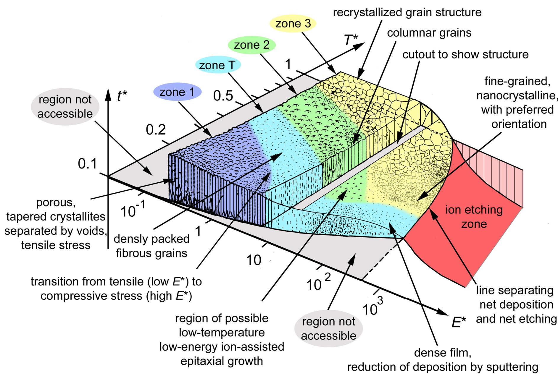
A Generalized Structure Zone Diagram including the Effects of Plasma Assistance to Film Growth
derived from Thornton’s diagram, 1974
T* = normalized temperature and potential energy
t* = normalized film thickness
E* = normalized kinetic energy
A. Anders, Thin Solid Films 518 (2010) 4087

Slide 10
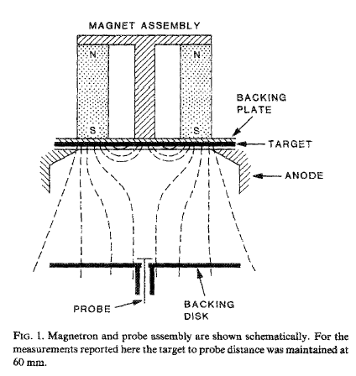
Unbalanced Magnetron:
A first step to using the plasma of the magnetron to assist film growth
Unbalanced magnetic field allows electrons and ions to escape from target region, providing a means of ion assistance to film growth
n_{e} ~ 10¹² cm⁻³, for up to a distance of 10 cm.
6 cm
B. Windows and N.Savvides, J. Vac. Sci. Technol. A 4, 453 (1986)

Slide 11
1990s: i-PVD
Magnetron Discharge with Auxiliary Ionization
ICP
S. M. Rossnagel and J. Hopwood, Appl. Phys. Lett. 63 (1993) 3285-3287
Ionized Physical Vapor Deposition; Vol., ed. by J. A. Hopwood (Academic Press, San Diego, CA, 2000).

Slide 12
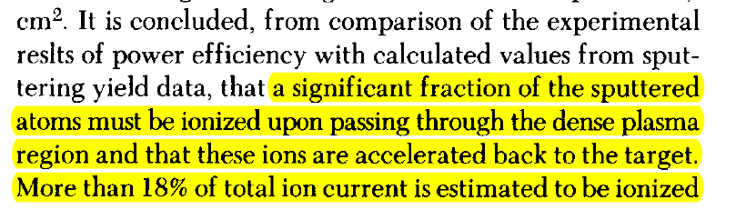
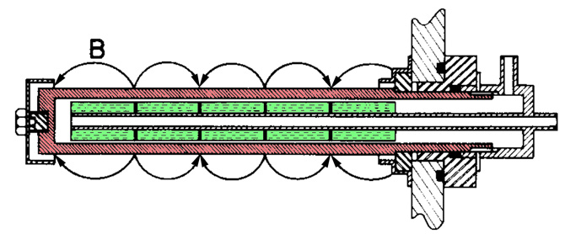
1977: Early Report on Self-Sputtering
Self-sputtering = sputtering of a target by ions of the target material
N. Hosokawa, T. Tsukada, T. Misumi, J. Vac. Sci. Technol. 14 (1977) 143.

Slide 13
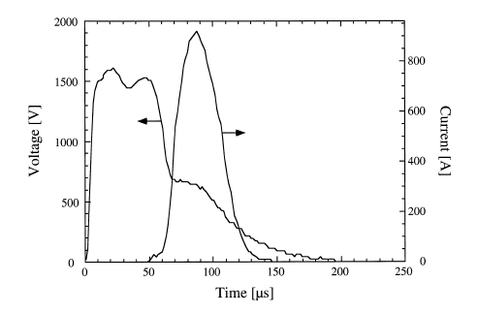
Turning the Magnetron into a Plasma Source
from the seminal (but not first) HiPIMS paper
V. Kouznetsov, et al., Surf. Coat. Technol. 122, 290-293 (1999)

Slide 14
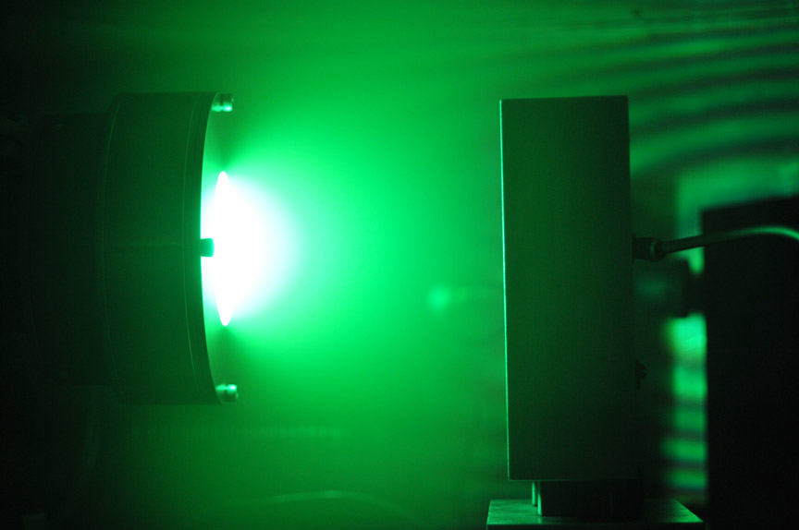
HiPIMS: ionization of the sputtered atoms
ionized copper
Ion collector
2” magnetron
Copper Target in Argon
J. Andersson and A. Anders, Phys. Rev. Lett. 102 (2009) 045003.

Slide 15
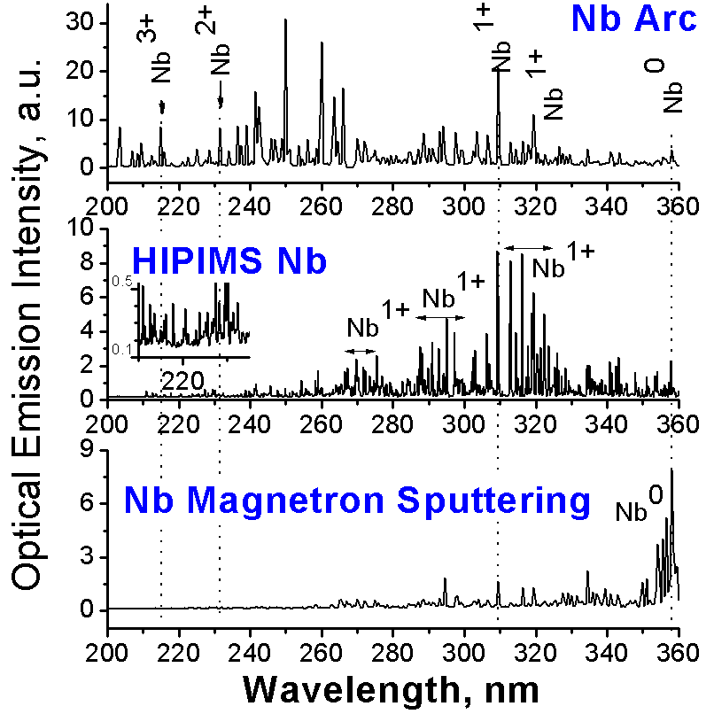
Arc contains multiply charged metal ions
HiPIMS contains mainly singly charged metal ions
Conventional sputtering contains neutral metal atoms
C. Reinhard et al., Thin Solid Films 515 (2007) 3685.

Slide 16
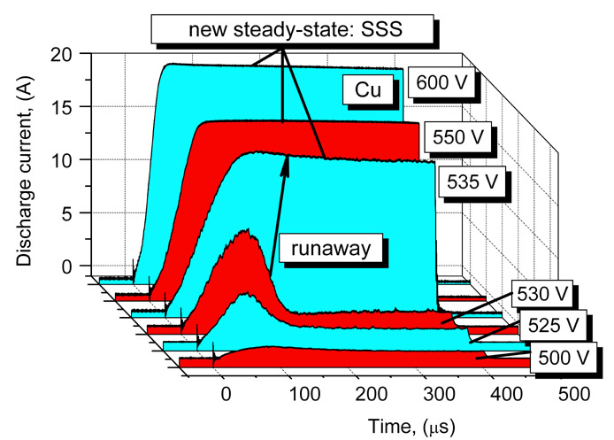
Runaway of Self-Sputtering
Copper target,
2” magnetron
Look for this small change in voltage but huge effect in current!
A. Anders, et al., J. Appl. Phys. 103 (2008) 039901

Slide 17
substrate
ions to substrate
atoms to substrate
Ionization
probability
Probability for ions to return to the target
Self-sputtering runaway
Sustained self-sputtering
target
self-sputtering yield
N. Hosokawa et al., Proc. 8th Vac. Con., (1980) 11; A. Anders, Appl. Phys. Lett. 92 (2008) 201501
A. Anders, Surf. Coat. Technol. 205 (2011) S1.

Slide 18
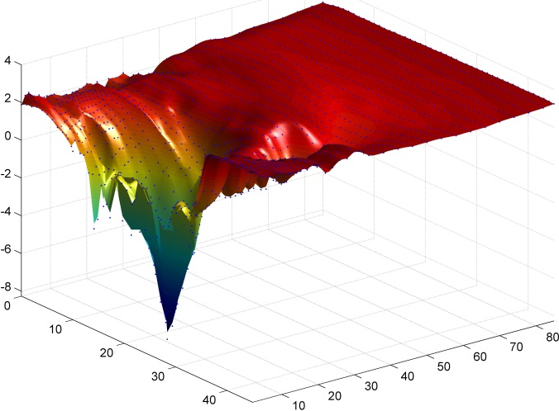
Electric Field in Magnetic Presheath
Leads to High Return Probability
Plasma potential in front of a racetrack of a magnetron (Nb sputtered in Ar), measured with an emissive probe → Average ion acceleration is mostly toward to target
Plasma potential
with respect to ground, (V)
“magnetic
presheath”
“racetrack”
Distance z from
target surface, (mm)
Distance r from
target center, (mm)
J. Sanders, et al., Rev. Sci. Instrum. 82 (2011) 093505; A. Rauch et al., J. Appl. Phys. 111 (2012) 083302.

Slide 19
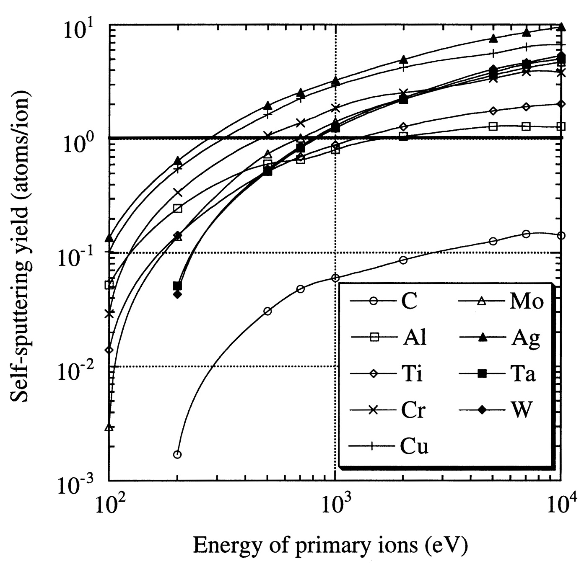
Self-Sputter Yields
Ag
Cu
is a necessary but not sufficient condition for sustained self-sputtering
Note:
carbon cannot go in sustained self-sputtering
(for research on Pseudosparks)
A. Anders, et al., IEEE Trans. Plasma Sci. 23 (1995) 275

Slide 20
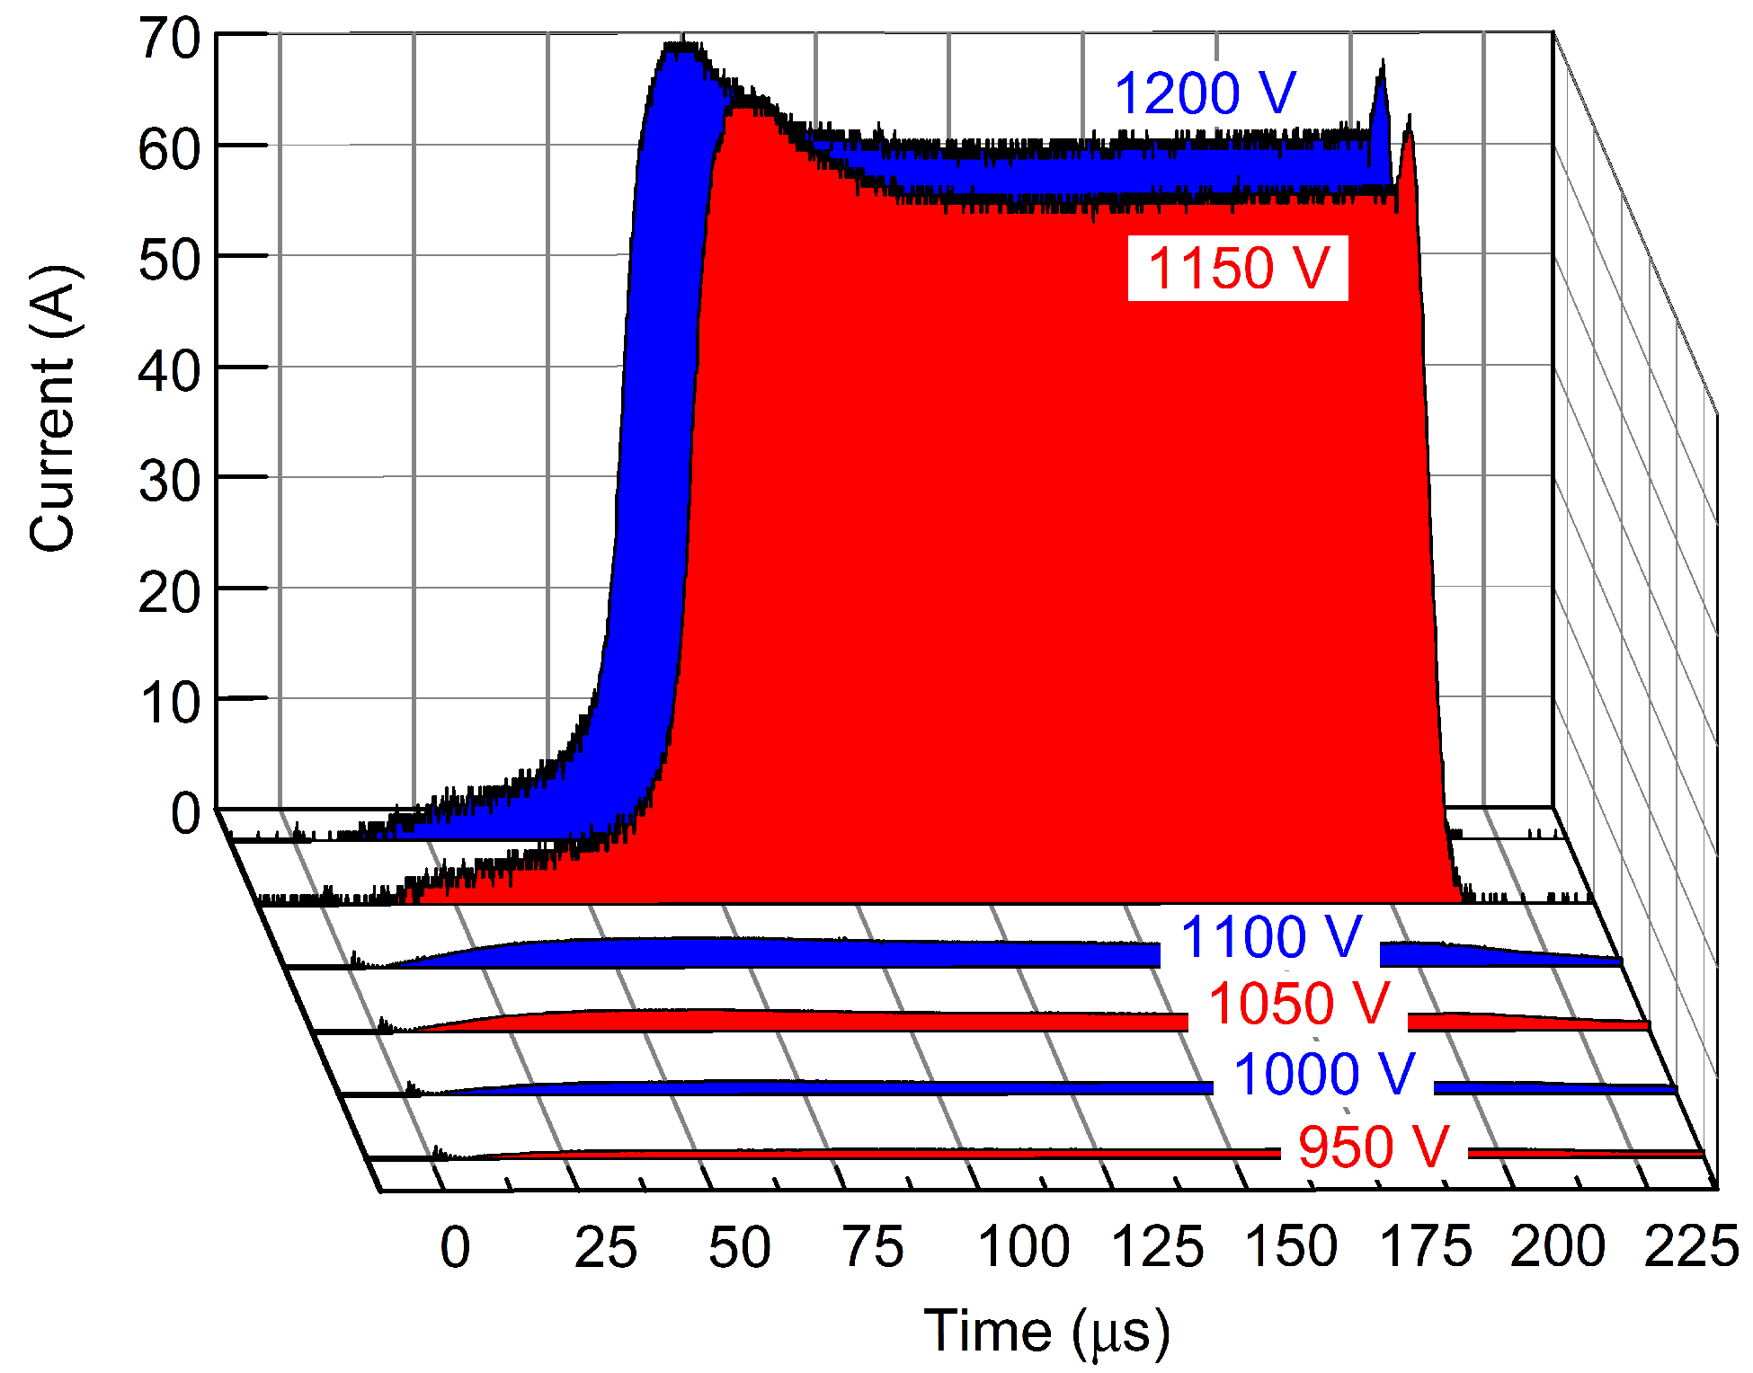
Runaway can be observed for all target materials
Runway in current is observed even for targets with extremely small self-sputtering yield, which initially was unexpected.
graphite target in argon
A. Anders, et al., J. Phys D: Appl. Phys. 45 (2012) 012003.

Slide 21
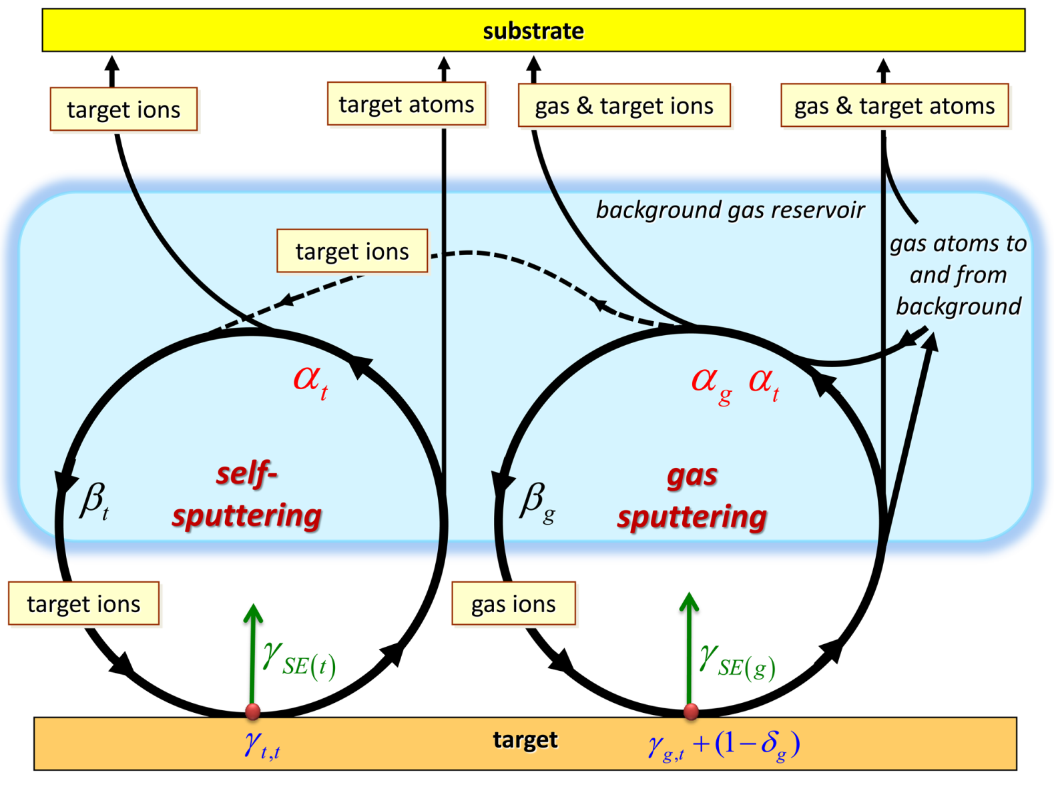
Generalized Flux Model for HiPIMS
A. Anders, et al., J. Phys D: Appl. Phys. 45 (2012) 012003.

Slide 22
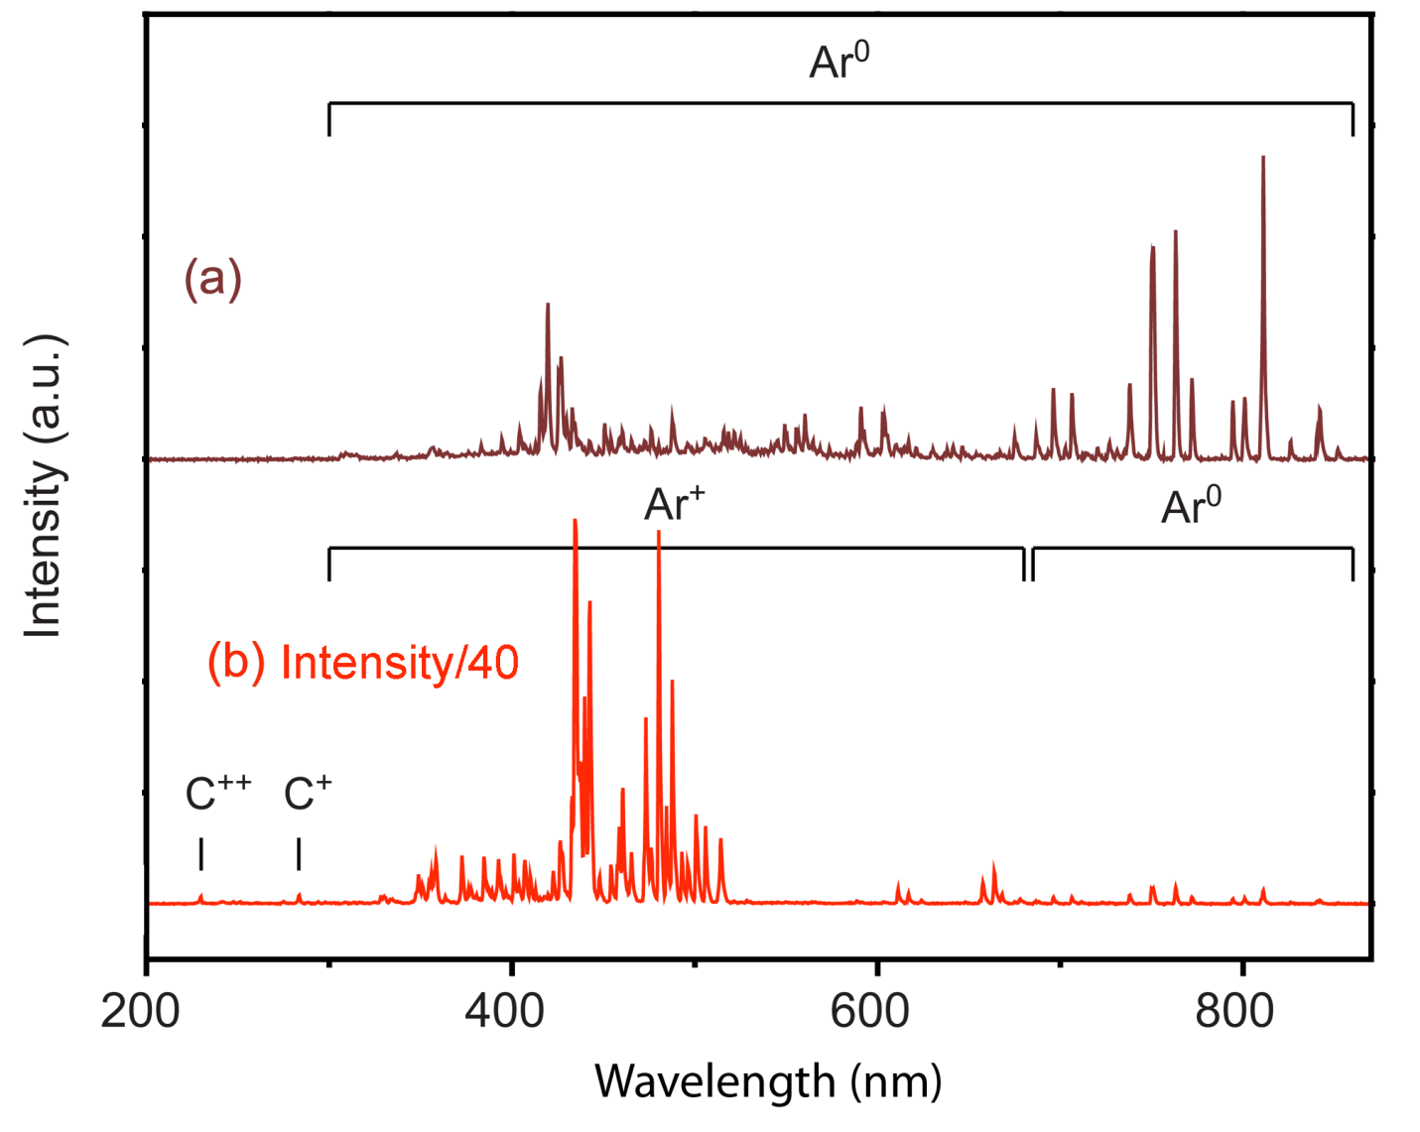
Evidence for Gas-Recycling Model for low yield targets like carbon
after runaway to high power, argon emission remains dominant:
Below runaway, at low power
Look for C⁺/Ar⁺ intensity ratio
above runaway, at high power
A. Anders, et al., J. Phys D: Appl. Phys. 45 (2012) 012003.

Slide 23
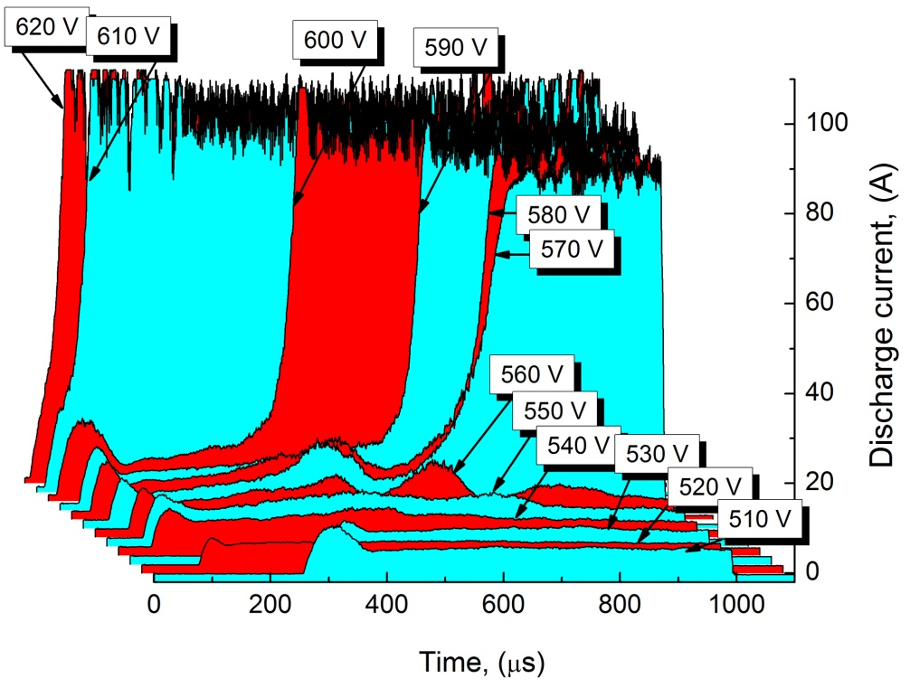
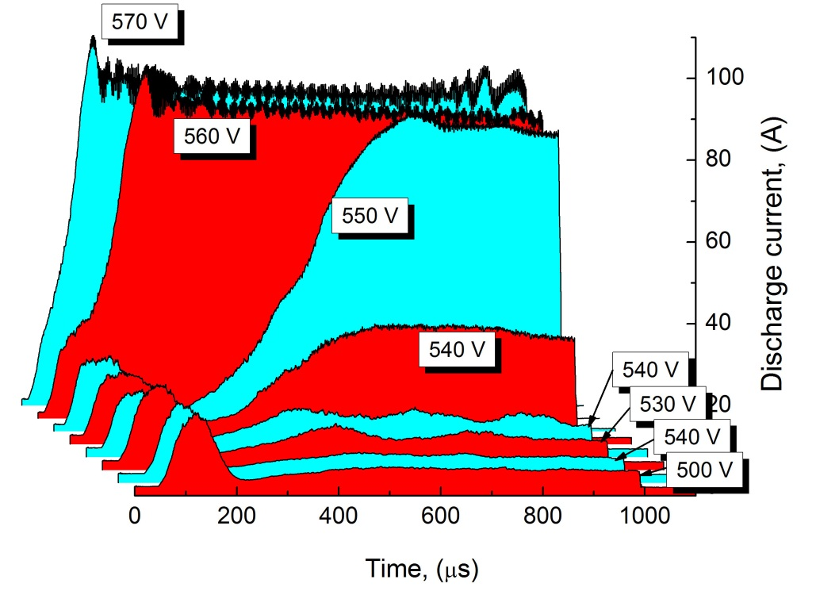
HIPIMS of Niobium: Self-Sputtering AND Gas Recycling
HIPIMS with Nb target , ∅ 5 cm
in 0.25 Pa of Ar
in 0.50 Pa of Kr
A. Anders, Surf. Coat. Technol. 205 (2011) S1.

Slide 24
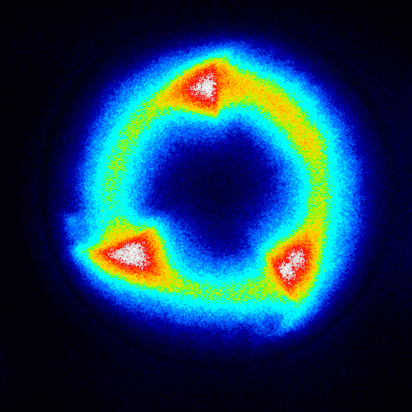
Localization of Ionization and Self-Organization
observed by several groups in the last years
A. Anders, et al., J. Appl. Phys. 111 (2012) 053304

Slide 25
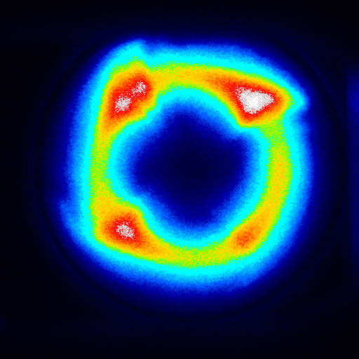
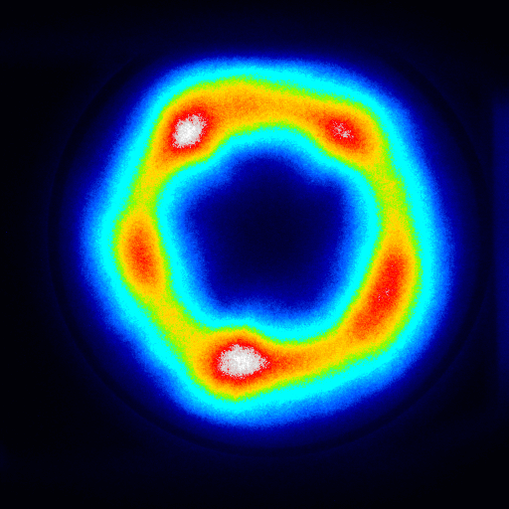
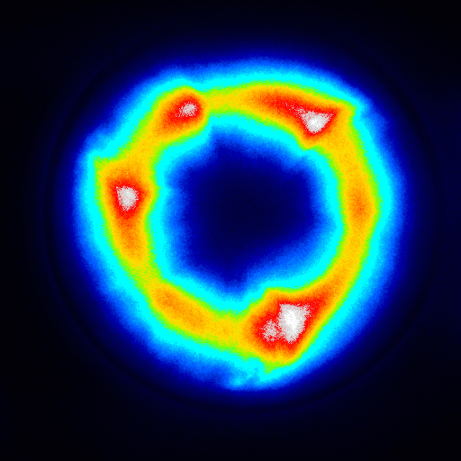
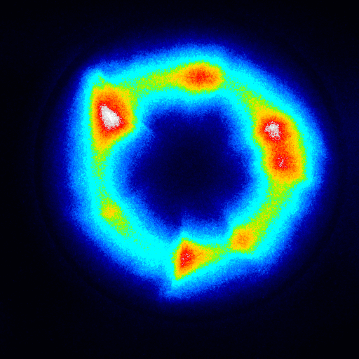
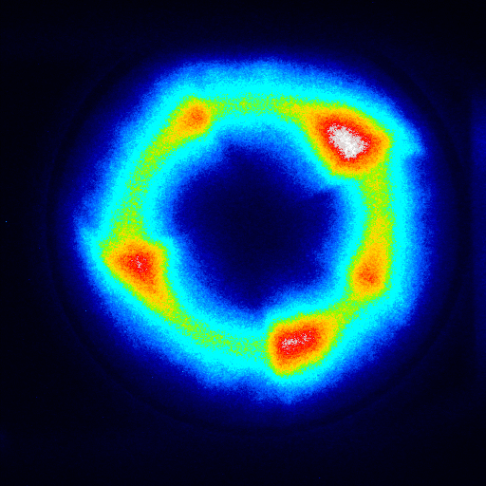
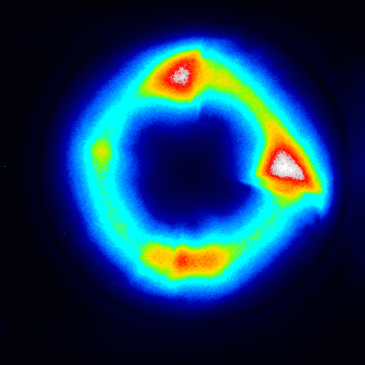
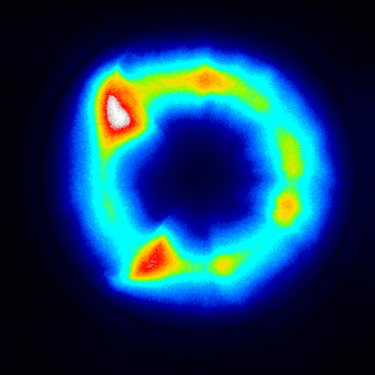
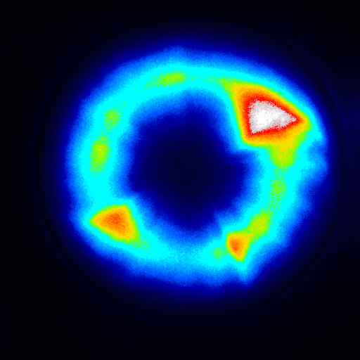
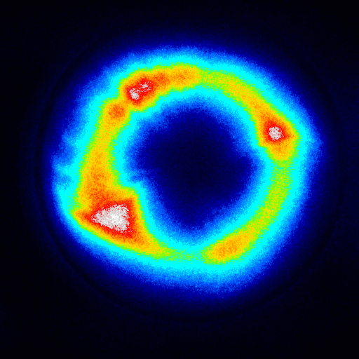
Self-organization and Turbulence
ALL of those images were taken with Nb target, 0.27 Pa Ar, 50 µs pulse, 350 A peak.
Each image is from a different pulse → similarities and differences suggest that structures
show some interaction (self-self-organization)
show strong changes, evolution, turbulence
A. Anders, et al., J. Appl. Phys. 111 (2012) 053304

Slide 26
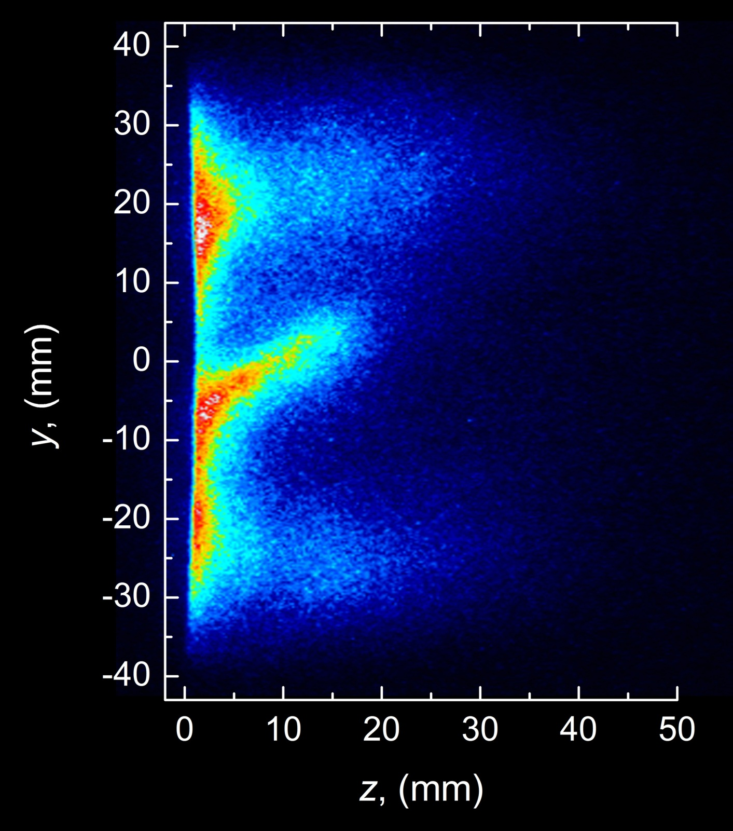
Side-on view frame image
(10 ns snapshot)
plasma flare
trailing the
ionization zone
v
A. Anders, et al., J. Appl. Phys. 111 (2012) 053304

Slide 27
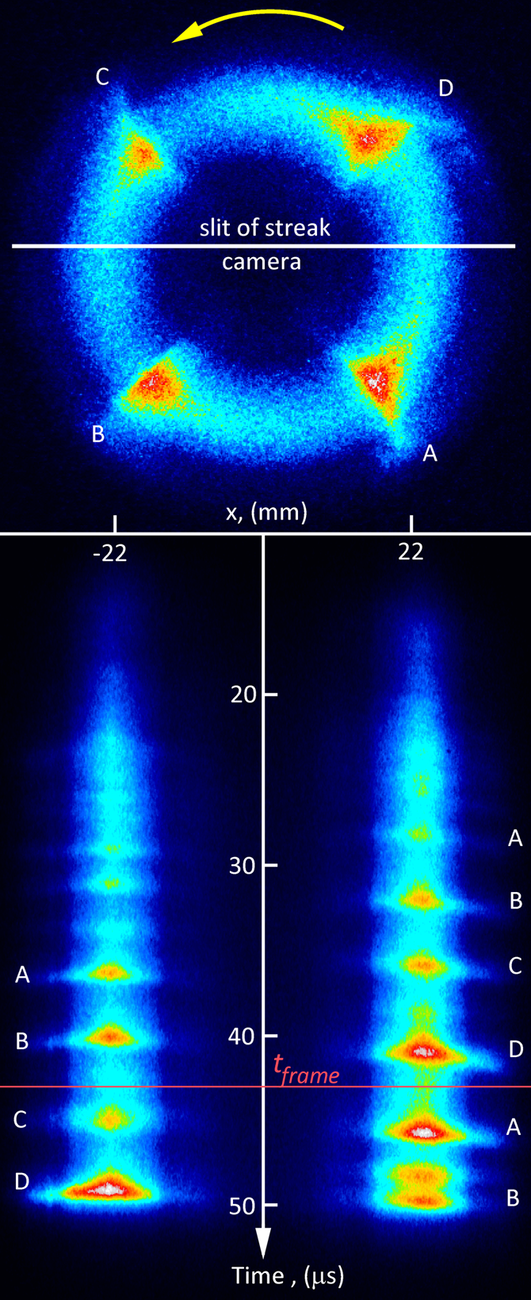
Frame and Streak Camera Combination
end-on view
frame image
end-on view
streak image
velocity of ionization zones:
just under 10,000 m/s,
depends on material.
A. Anders, et al., J. Appl. Phys. 111 (2012) 053304.

Slide 28
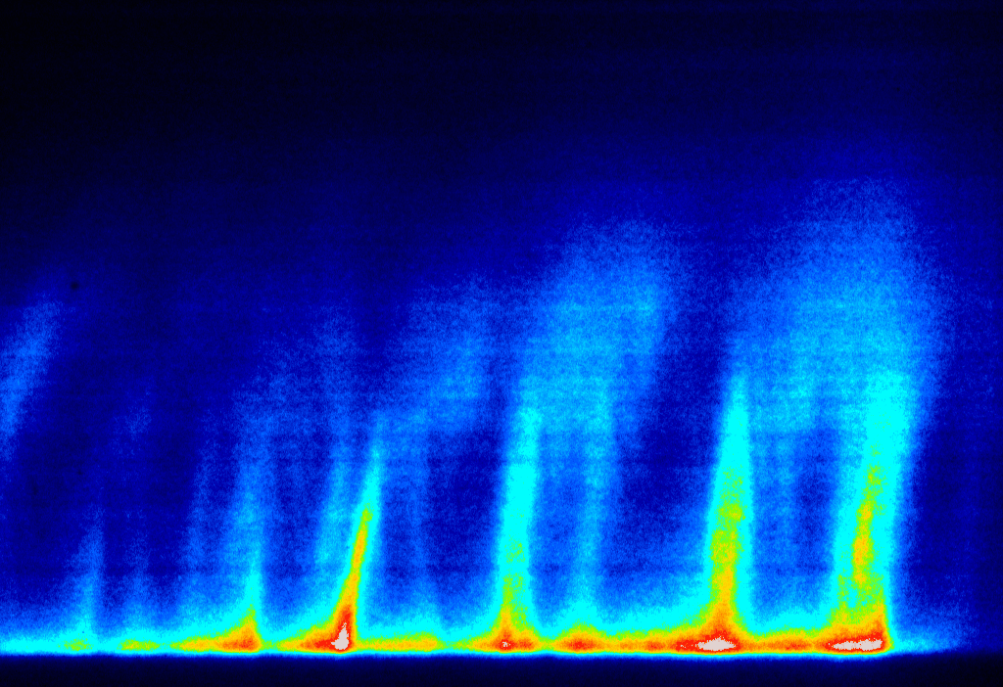
Streak image sequence, 20 μs sweep time
z, (mm)
A. Anders, et al., J. Appl. Phys. 111 (2012) 053304
20
10
0
time

Slide 29

Example of Streak Image, 20 μs sweep time
z, (mm)
flare originates at the ionization zone
often greater tilt early in pulse: lower current, lower plasma density, slower flare
20
10
0
time

Slide 30
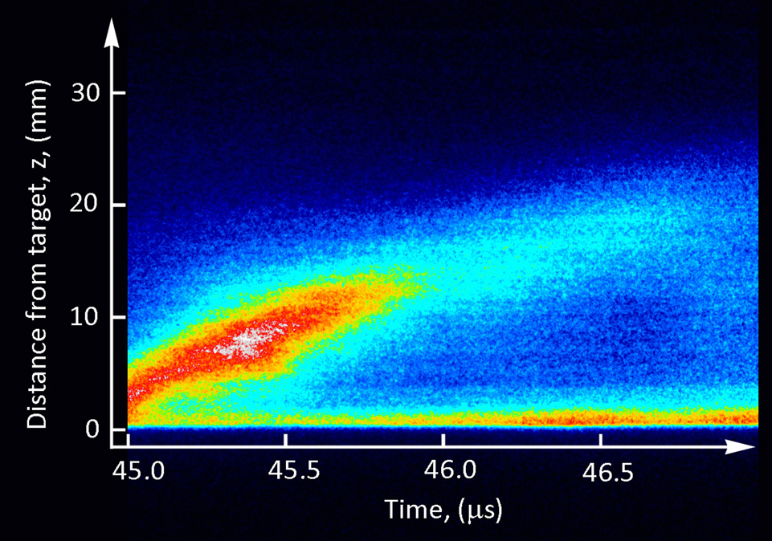
High Resolution Streak Image
the greater the tilt the slower the speed in z-direction
greatest visible light intensity is at about z = 8 mm
P.A. Ni, et al., Appl. Phys. Lett. 101 (2012) 224102.

Slide 31
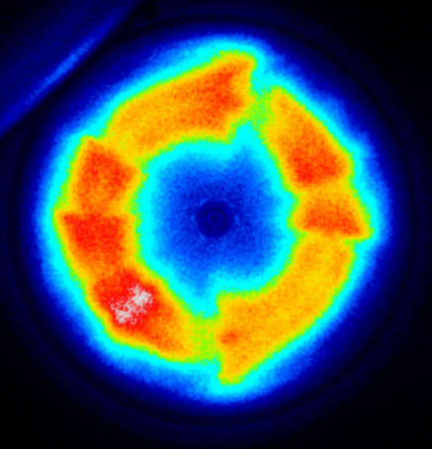
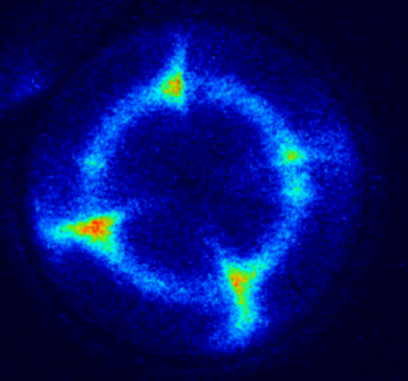
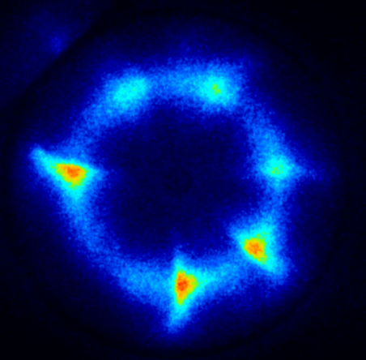
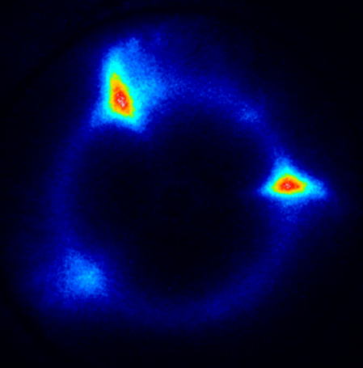
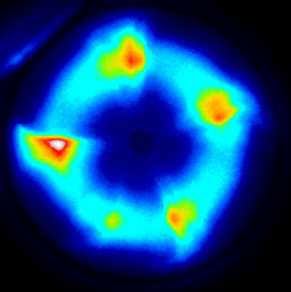
Spectroscopic Imaging:
End-on view through Spectral Filter.
→ Evidence for Concentration of Ionization.
300-800 nm
Al I,
from 3.14 eV
Ar I
from 13.3 eV
Al II,
from 15.06 eV
Ar II,
from 19.22 eV
Al, 0.25 Pa Ar, 100 A, 150 ns snapshots
ionization occurs primarily in the ionization zones, little elsewhere
the higher the upper excitation level the more focussed appears the plasma
A. Andersson, et al., Appl. Phys. Lett. 103 (2013) 054104.

Slide 32
Ionization zones and transport of charged particles
Niobium HiPIMS discharge
U = 390 V
I_{av} = 1.25 A
P = 450 W
top collector
Nb ions
y
drift
z
x
electrons
bottom collector
M. Panjan, et al., Plasma Sources Sci. Technol., 23 (2014) 025007.

Slide 33
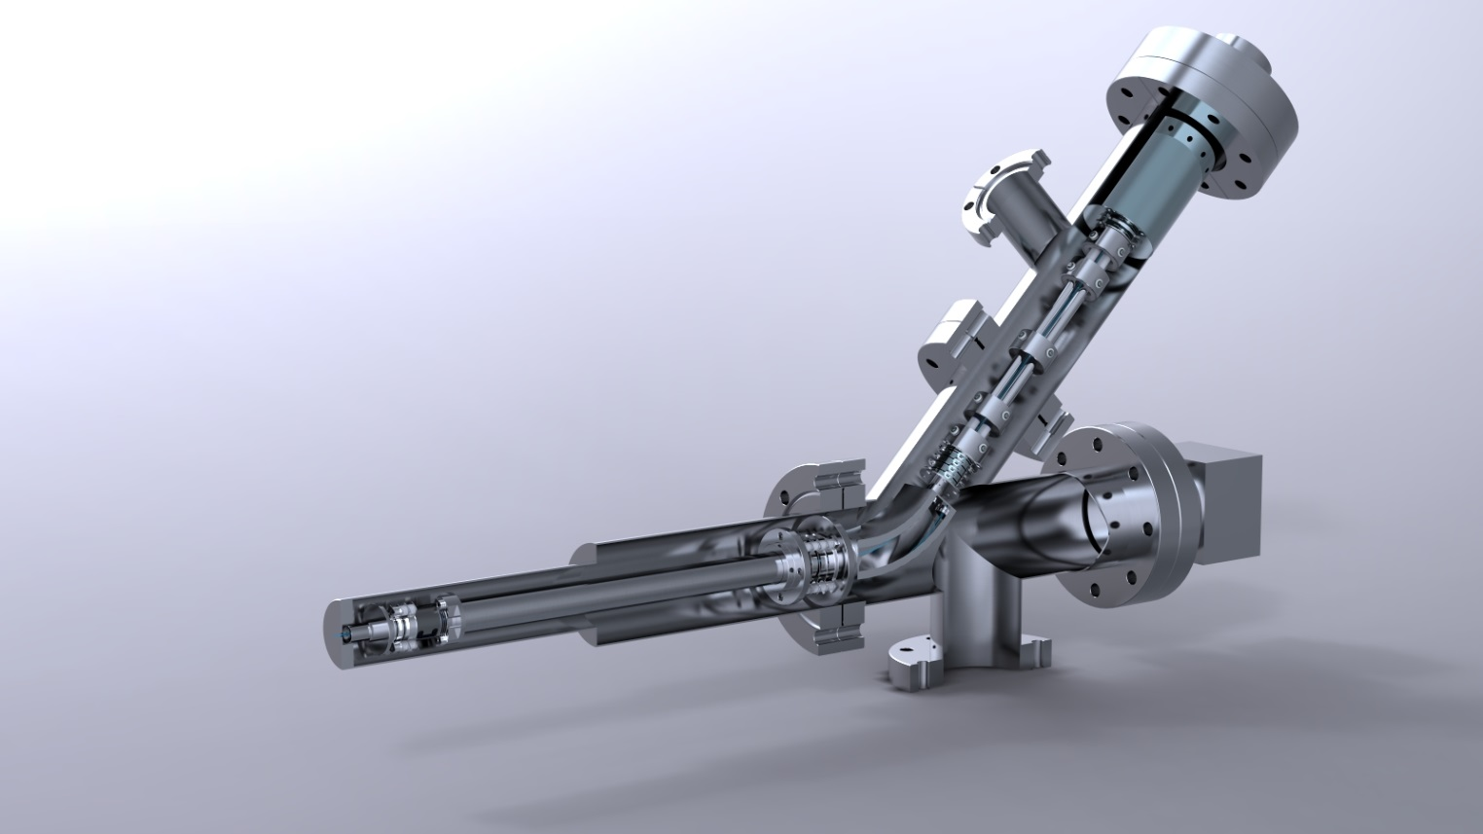
Measurements of Ion Energy Distributions
We use EQP300 by Hiden Ltd.; scan mass up to 300 amu and energies up to 1 keV (neg. and pos. ions)
quadrupole mass spectrometer
ion energy filter
entrance
aperture
acceptance
cone
Instrument transmittance function has a greater acceptance cone angle for small (especially < 10 eV) ion energies

Slide 34
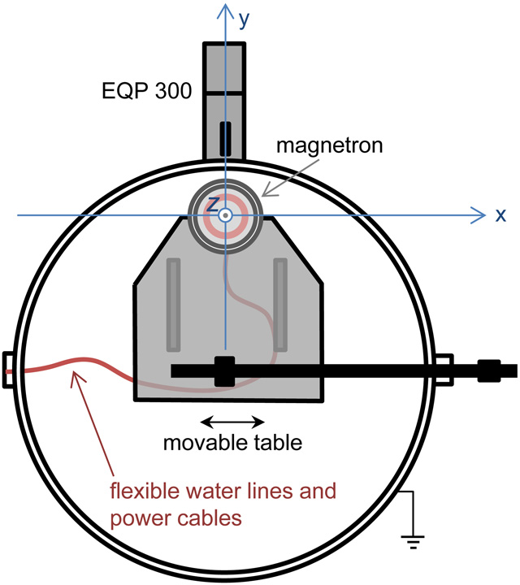
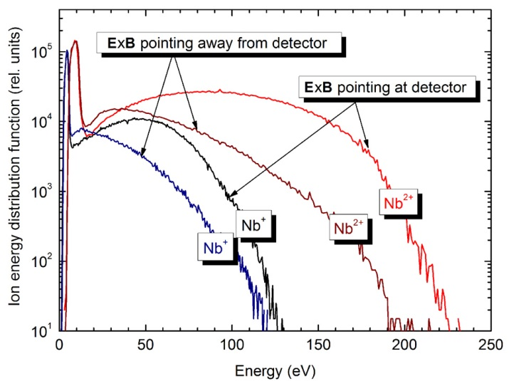
Niobium Ion Energy Distribution Function, measured azimuthally
A. Anders, et al., Appl. Phys. Lett. 103 (2013) 144103;
M. Panjan, et al., Plasma Sources Sci. Technol. 23 (2014) 025007.

Slide 35
Examples of Ion Energy Distribution Measurements
HiPIMS
M. Panjan, et al., Plasma Sources Sci. Technol. 23 (2014) 025007.

Slide 36
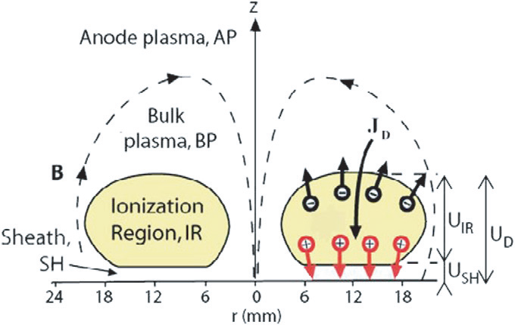
Energizing Electrons in the Sheath Versus in Presheath
Penning-Thornton paradigm: , electron heating from secondary electrons
However, electron current in the presheath is much greater and than in the sheath → energy dissipation and electron heating can be greatest in the presheath
C. Huo, et al., Plasma Sources Sci. Technol. 22 (2013) 045005.
some notable voltage drop here

Slide 37
Localized Energizing of Drifting Electrons
flare
E x B drift
of electrons
equipotential lines
with potential hump
in ionization zone
z
hump
B
target
NOT TO SCALE
direction along racetrack
ξ
electrons drift according to the local E and B fields
ions are not magnetized, therefore follow E-field
A. Anders, Appl. Phys. Lett. 105 (2014) 244104.

Slide 38
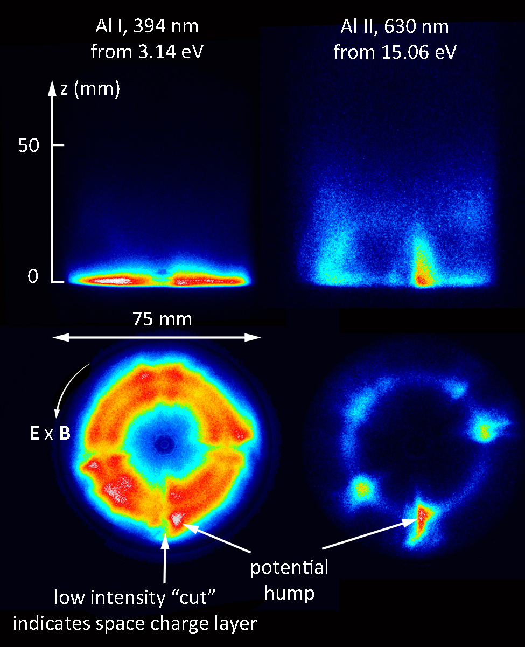
Light can be seen as strongly related to the potential hump structure
side-on view
end–on view
A. Anders, Appl. Phys. Lett. 105 (2014) 244104.

Slide 39
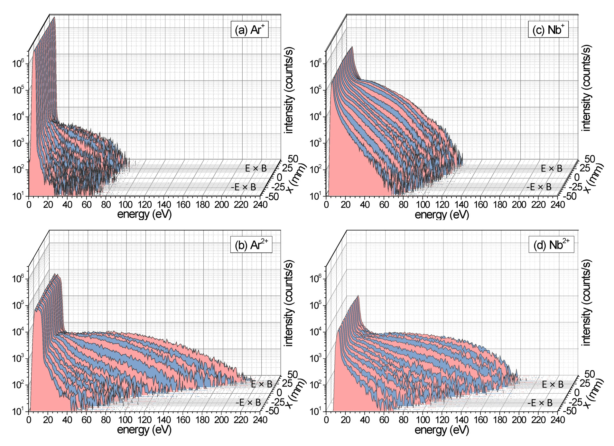
Also in dcMS: Ionization Zones are Regions of Elevated Potential → Ions gain extra energy
dcMS
majority is thermal
energetic tail
(not Thompson distribution!)
M. Panjan, et al., Plasma Sources Sci. Technol. 23 (2014) 025007.

Slide 40
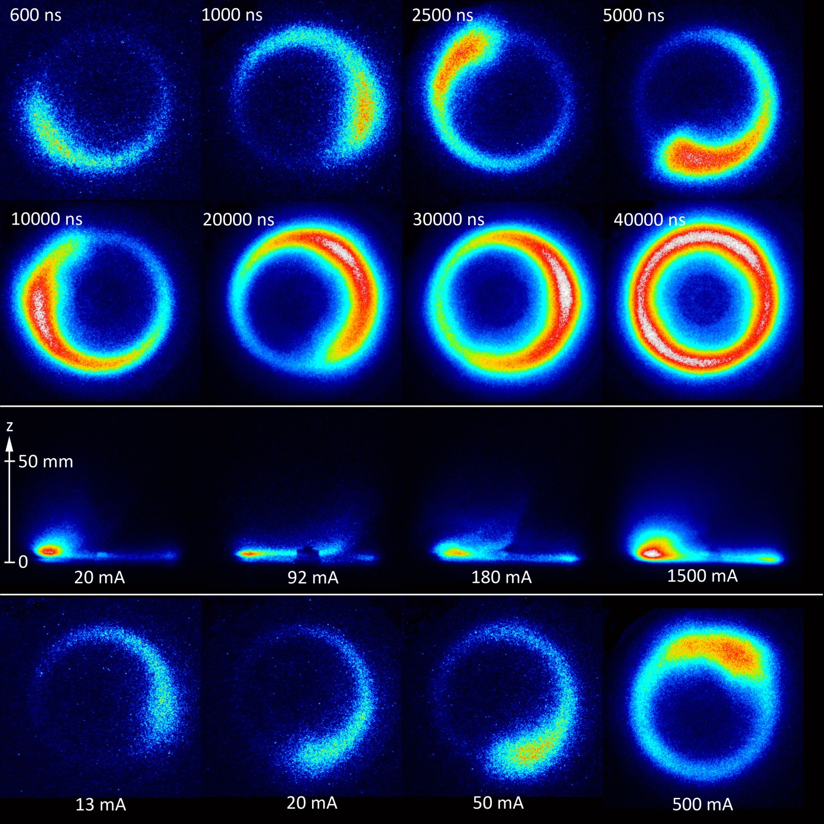
Ionization zones exist:
even DC at low current, all the way to 4 mA!
also in reactive systems
with much slower motion than HiPIMS
Nb in Ar
A. Anders, et al., IEEE Trans. Plasma Sci. 42 (2014) 2578.

Slide 41









Transitions from DC to HiPIMS
$$E×B$$
$$E×B$$
$$E×B$$
$$E×B$$
DCMS
PMS
HiPIMS
HiPIMS
Low, < 1 A
Around 1$\sim$6 A
High, > 6 A
>200 A
Discharge current
Transition region with
quasi-stationary spokes
Transition region of
spoke mode to spoke-free mode
Y. Yang, et al., Appl. Phys. Lett. 106, 124102 (2015); Y. Yang, et al., Appl. Phys. Lett. 105, 254101 (2014)

Slide 42
Multi-Probe Experiment to Measure Instabilities
1
8
2
Front view
Set of floating potential probes
7
Target
3
Port for
Vacuum gauges
6
4
5
Magnetron
N
Fast shutter
ICCD camera
Power
feedthrough
S
N
Probes
Window
with shutter
To camera control
Port for gas inlet
Y. Yang, et al., Appl. Phys. Lett. 108 (2016) 034101.

Slide 43

Detection of Breathing Mode
Cr target, non-reactive PMS, current ~ 6 A
0.1 Pa
All 8 probes show in-phase oscillations of floating potential
0.4 Pa
Y. Yang, et al., Appl. Phys. Lett. 108 (2016) 034101.

Slide 44

Evolution of Ionization Zones
seen for DC Magnetron Discharges (3” Nb in Ar)
sweep 200 µs
time
examples of streak camera images, illustrating zone stability vs. change
Y. Yang, et al., Appl. Phys. Lett. 105 (2014) 254101.

Slide 45

Transition Region between HiPIMS and dc
Au
Reversal of direction!
from E x B to - E x B
at about 6 A.
Y. Yang, et al., Appl. Phys. Lett. 105 (2014) 254101.
Image 20 ns each

Slide 46


Custom Movable, Cylindrical Magnetrons for SRF 1.3 GHz Cavities
A. Anders, et al., 15th Int. Conf. on RF Superconductivity, Chicago, Il, 2011. http://accelconf.web.cern.ch/AccelConf/SRF2011/papers/tuioa06.pdf

Slide 47
Cylindrical Magnetron - Cavity as Anode
sheath
plasma
ion trajectory
cavity
possible collision
magnetron
A. Anders, et al., 15th Int. Conf. on RF Superconductivity, Chicago, Il, 2011. http://accelconf.web.cern.ch/AccelConf/SRF2011/papers/tuioa06.pdf

Slide 48
Dual Magnetron: Most effective for a Biasing Approach: Affecting Ion Energies and Trajectories
cavity
sheath
nearly
perpendicular
incidence!
V_{bias}
plasma
ion trajectory
possible collision
magnetron 1
magnetron 2
A. Anders, et al., 15th Int. Conf. on RF Superconductivity, Chicago, Il, 2011. http://accelconf.web.cern.ch/AccelConf/SRF2011/papers/tuioa06.pdf

Slide 49

CrN Glancing Angle Deposition
DCMS
0.6 Acm⁻²
Inclination of columns is reduced at high target current densities due to high ion-to-neutral ratio
0.1 Acm⁻²
0.9 Acm⁻²
neutral
E
ion
biased substrate
0.2 Acm⁻²
1.7 Acm⁻²
G. Greczynski, et al., Thin Solid Films 519 (2011) 6354.

Slide 50


HIPIMS Coatings Technology for SRF Cavities
dual cylindrical magnetron in at relatively low power sputtering mode
Dominated by argon emission
dual cylindrical magnetron in high power mode (above runaway threshold)
Dominated by niobium emission
Relatively straight forward to include NbN and Nb/NbN multilayers
One could use two different materials with two asymmetrically operating magnetrons to produce Nb₃Sn, NbTi alloys, Mg₂B, and multilayer structures

Slide 51





Summary
Magnetron Sputtering since 1970s
Ionization in “spokes”, transport in flares
For Nb and other targets: self-sputtering AND gas recycling
Kinetic and potential energy affects microstructure
Ionization in HiPIMS affect microstructure
Dual HiPIMS for SRF

