Slide 1
Advances in Materials Characterization for SRF Thin-Films Research and Development
Jay Tuggle*
Grigory Eremeev, Ari Palczewski, Charles Reece, Uttar Pudasaini, Michael Kelley
*Virginia Polytechnic Institute and State University

Slide 2
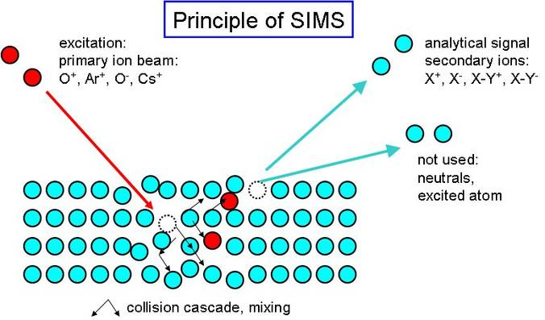
Secondary Ion Mass Spectrometry (SIMS)
What is SIMS
Ion bombardment
Secondary ions can be extracted and detected

Slide 3
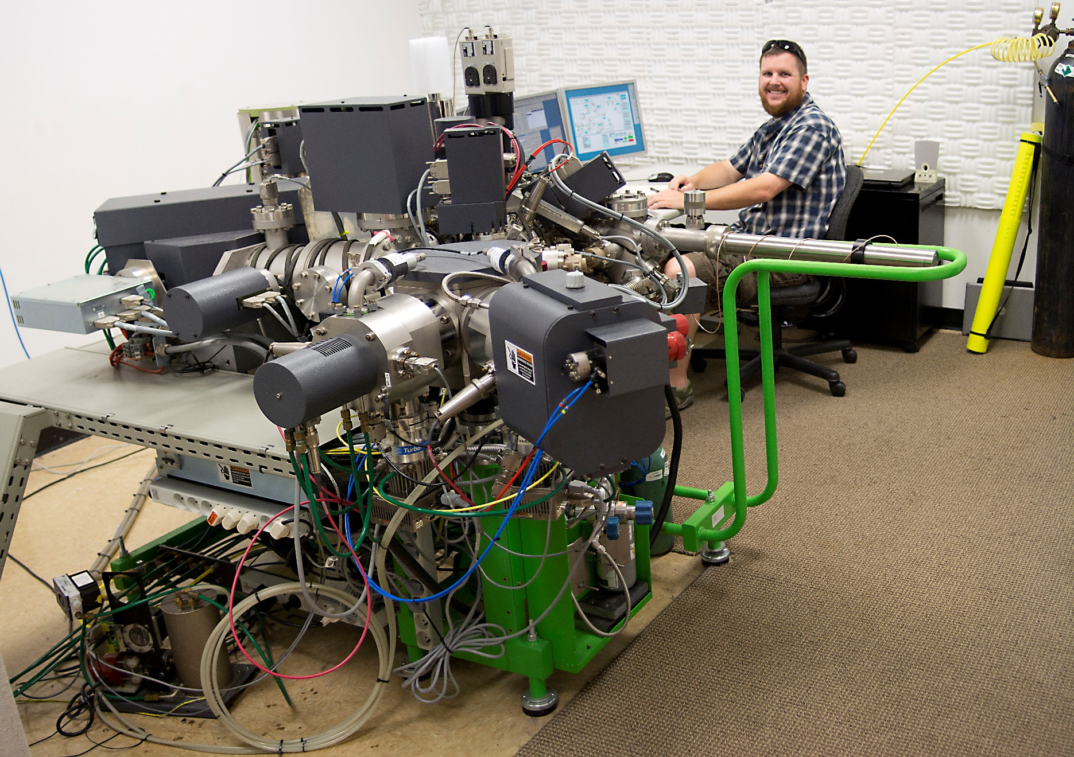
Secondary Ion Mass Spectrometry (SIMS)
Dynamic Magnetic Sector (Cameca 7fGeo)

Slide 4
SIMS-So what’s the hard stuff
Quantification is difficult
Matrix effects
Problem Elements (Atmospherics)
Time
Good Vacuum
Tuning
Preferential sputtering
Depth resolution
BCP vs NP

Slide 5
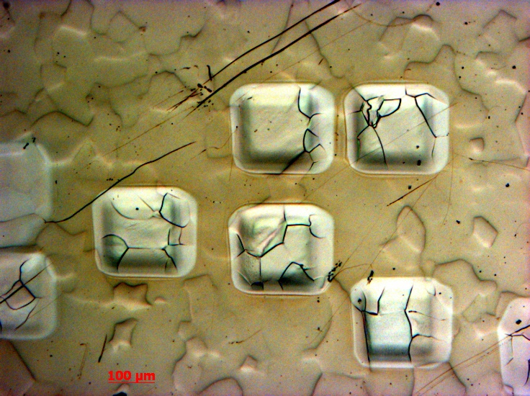
SIMS-So what’s the hard stuff
Quantification is difficult
Matrix effects
Problem Elements (Atmospherics)
Time
Good Vacuum
Tuning
Preferential sputtering
Depth resolution
BCP vs NP

Slide 6
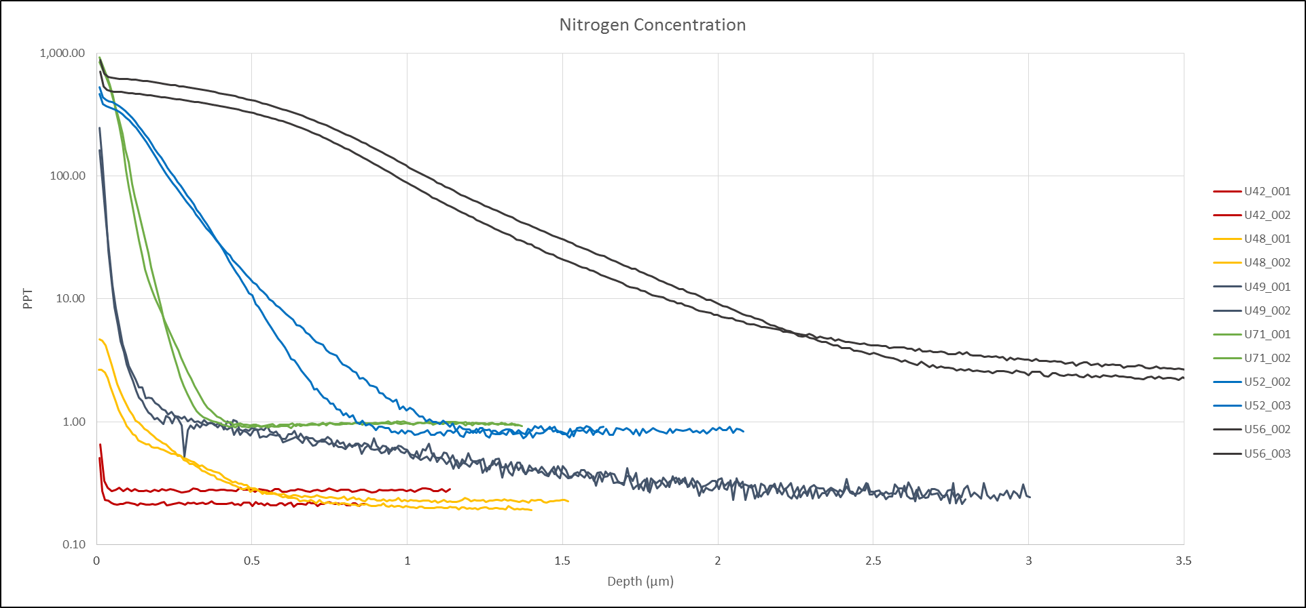
SIMS-Nitrogen Doping
Depth Profiles of nitrogen under different N-Doping conditions

Slide 7
SIMS-Nb₃Sn
Depth profiling Cl after deposition
MCs+ technique

Slide 8
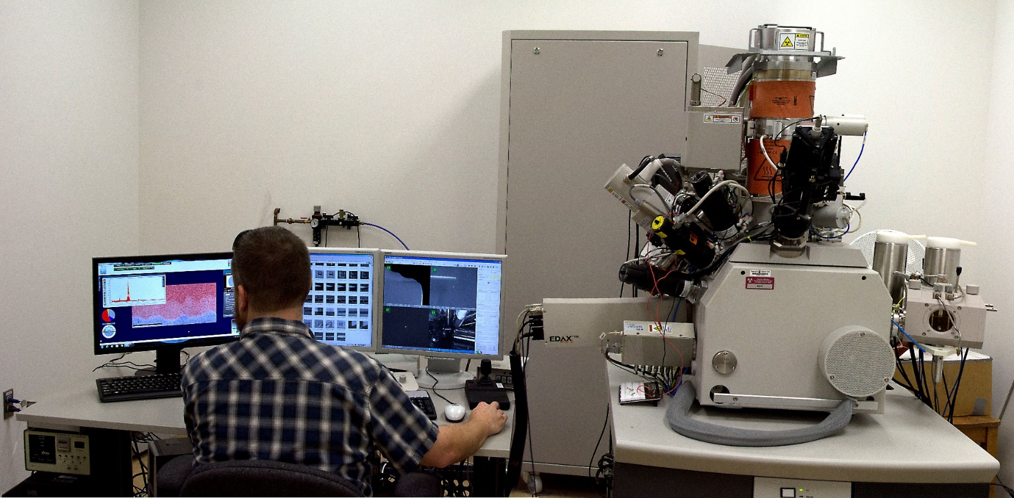
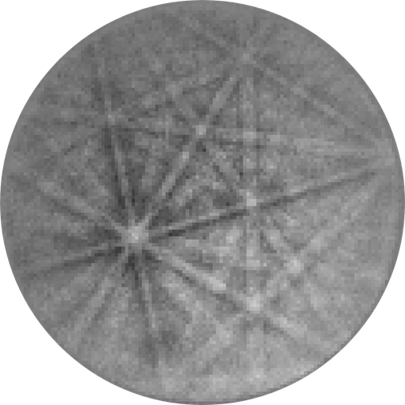
EBSD
What’s it good for?
Phase ID, size and shape of grains, orientation information
Preferred orientation
What’s the hard part?
Time
Insulating materials
Any kind of sample drift
Sample Prep
10nm-20nm information depth
Material dependent

Slide 9
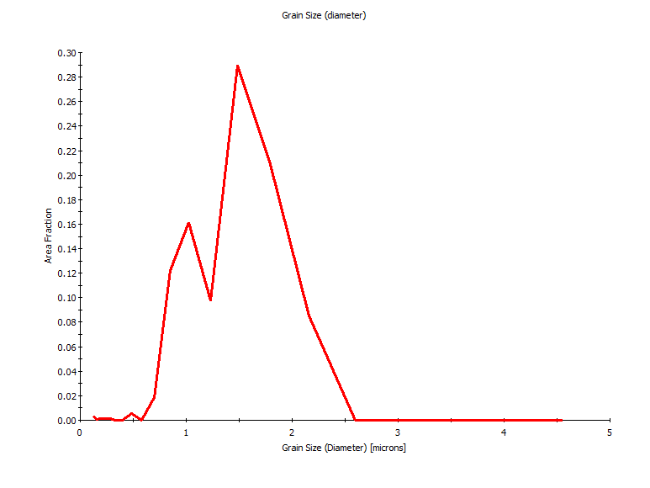
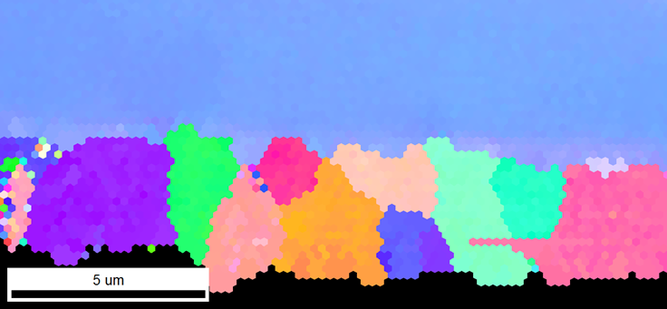
EBSD-Nb₃Sn
Not just qualitative, but quantitative

Slide 10
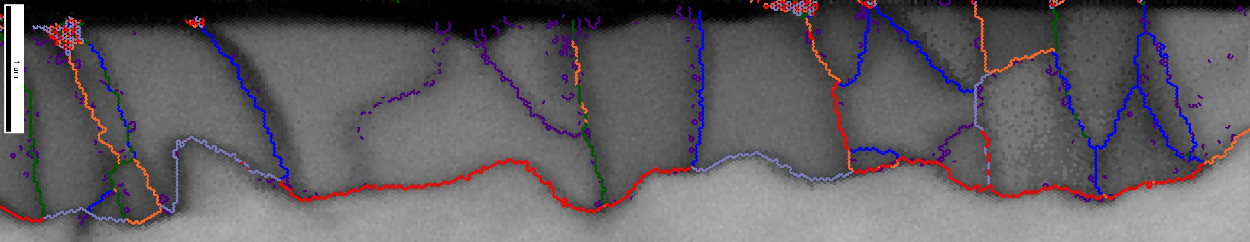
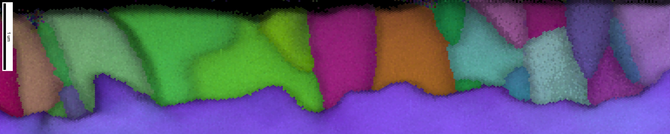
EBSD-Nb₃Sn
Not just qualitative, but quantitative

Slide 11
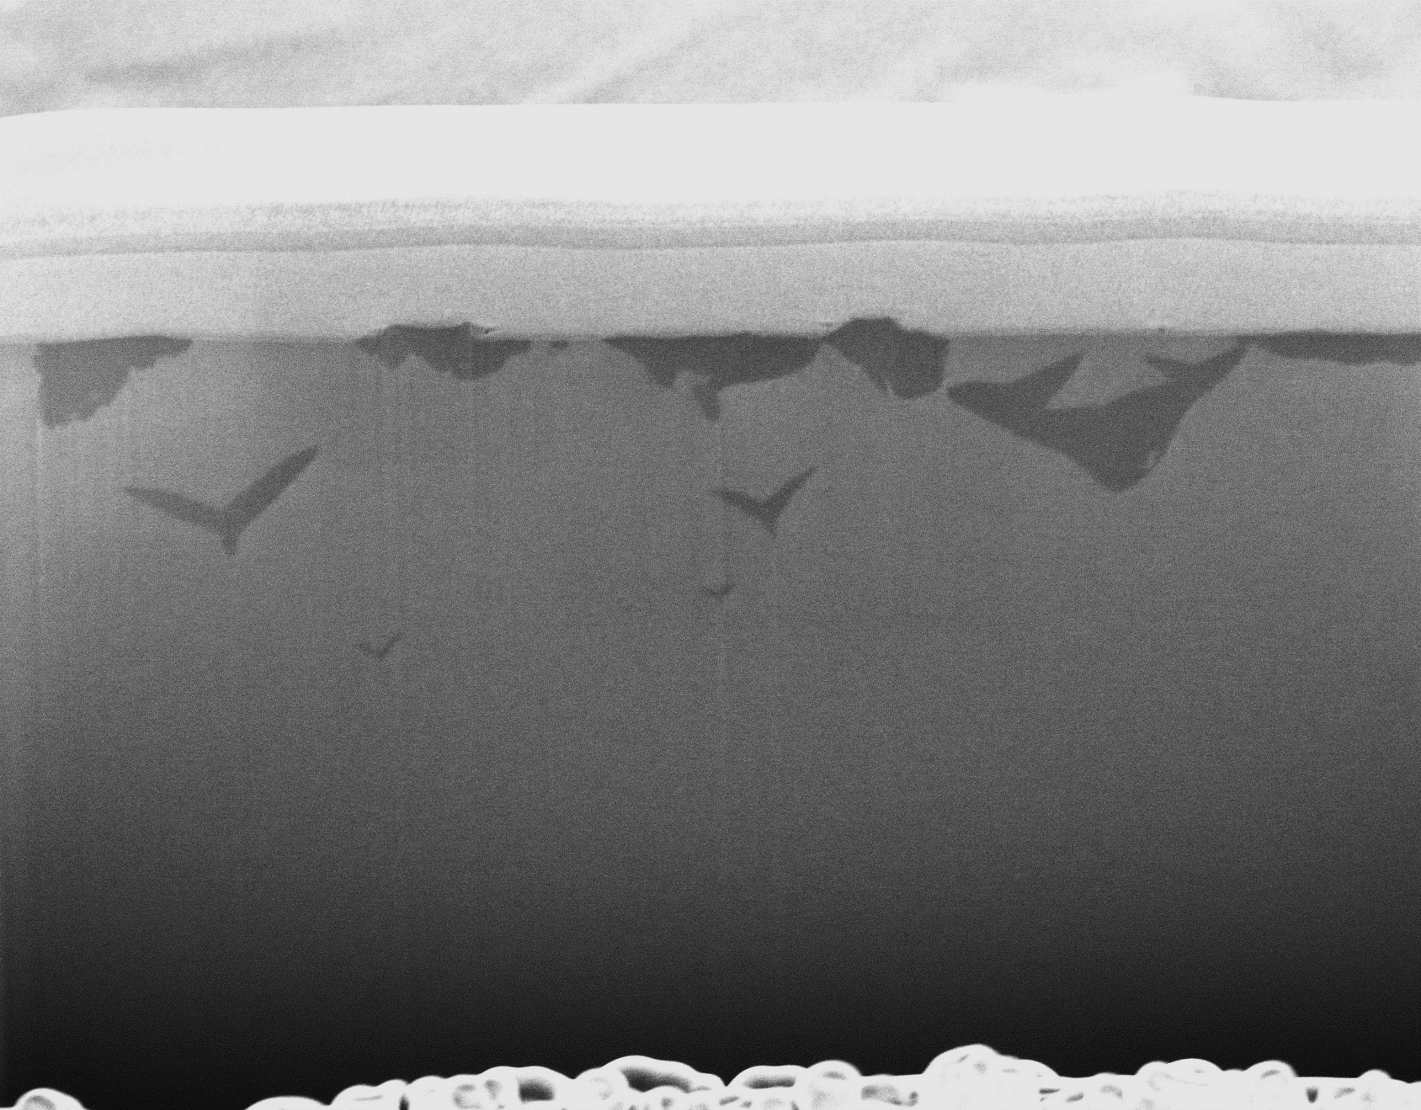
FIB-Nitrogen Doping
Cross section of N-Doped sample
Platinum
3.2µm
Nitrides
Niobium

Slide 12
XPS-Nb₃Sn Depth Profile
-Sputter Argon 5kv 3mmx3mm
200um 50W15kv Analysis Spot

Slide 13
Questions/Comments
Jay Tuggle*
Grigory Eremeev, Ari Palczewski, Charles Reece, Uttar Pudasaini, Michael Kelley
*Virginia Polytechnic Institute and State University
Acknowledgements
Co-Authored by Jefferson Science Associates, LLC under U.S. DOE Contract No. DE-AC05-06OR23177
We are grateful for support from the Oﬃce of High Energy Physics, U.S. Department of Energy under grant DE-SC0014475 to the College of William & Mary.

