Slide 1



Progress of the Commissioning of the Choked Resonator Cavity for SRF Thin Film Measurements
Philippe Goudket
on behalf of the collaboration team
ASTeC RF Group,
STFC Daresbury Laboratory, UK

Slide 2
Motivation
There is an considerable demand for RF Thin Film testing capacity.
We require a system allowing a reasonable turnover of samples in order to serve our TF deposition program.
Initial plans call for the deposition and testing of planar samples.

Slide 3
Design criteria
Avoidance of joins, seals and gaskets
  To increase repeatability and reduce preparation time
Separate cavity and sample
  To allow thermometry and to allow for quick sample rotation
Sample to be as simple as possible
  To minimise cost and complexity. All sample support to be done by a dedicated plate
Initial frequency choice: 3.9 GHz
  As it is a frequency used by real SRF cavities while also restricting dimensions.

Slide 4
Original idea
50.63
3.9 GHz cavity
19.23
25.0
4.0
Top Plate (Al)
50.63
69.86
20.23
19.23
38.0
50.0
8.0
4.0
3.60
29.23
Thru hole
Bottom Plate (Al)
180.0

Slide 5
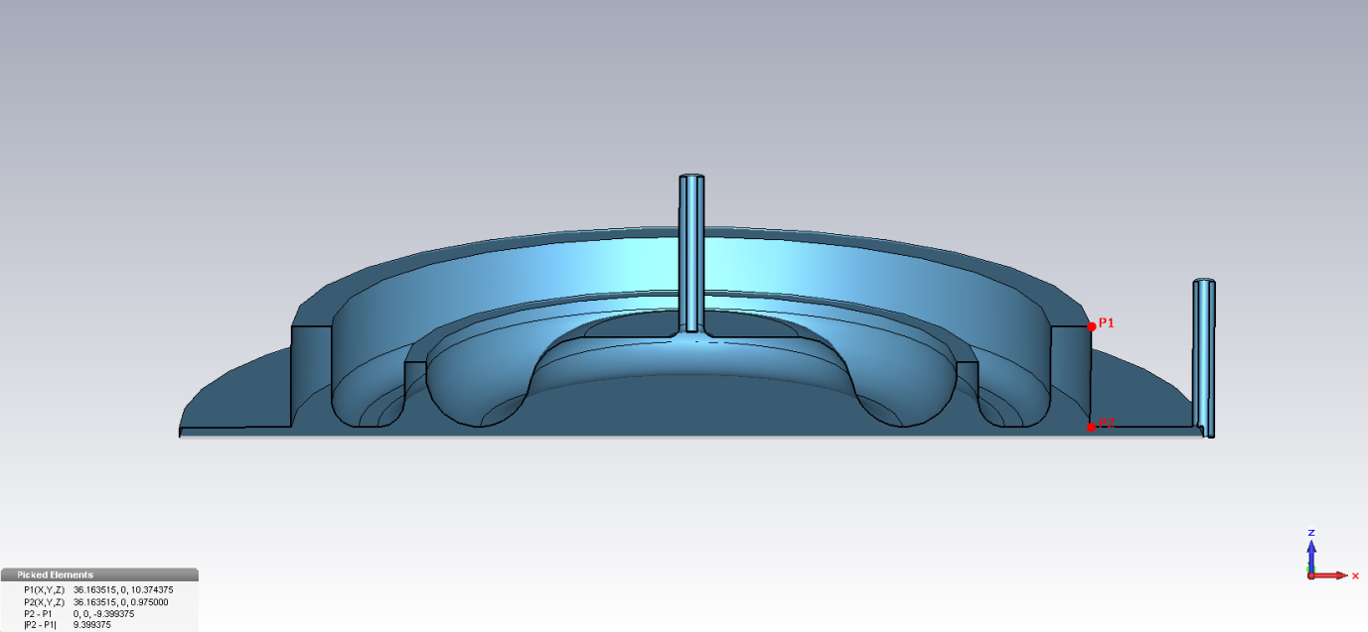
Refinement of the design
7.8 GHz cavity
Sample size limit in deposition chamber
3.9 GHz cavity
Multipactor optimisation

Slide 6
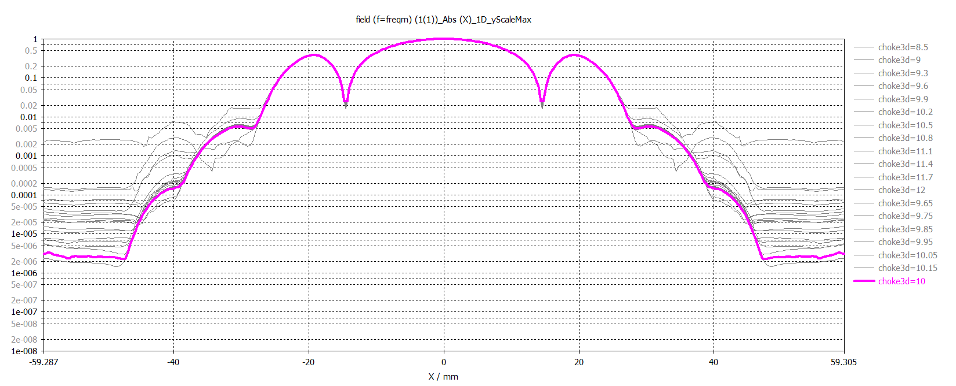
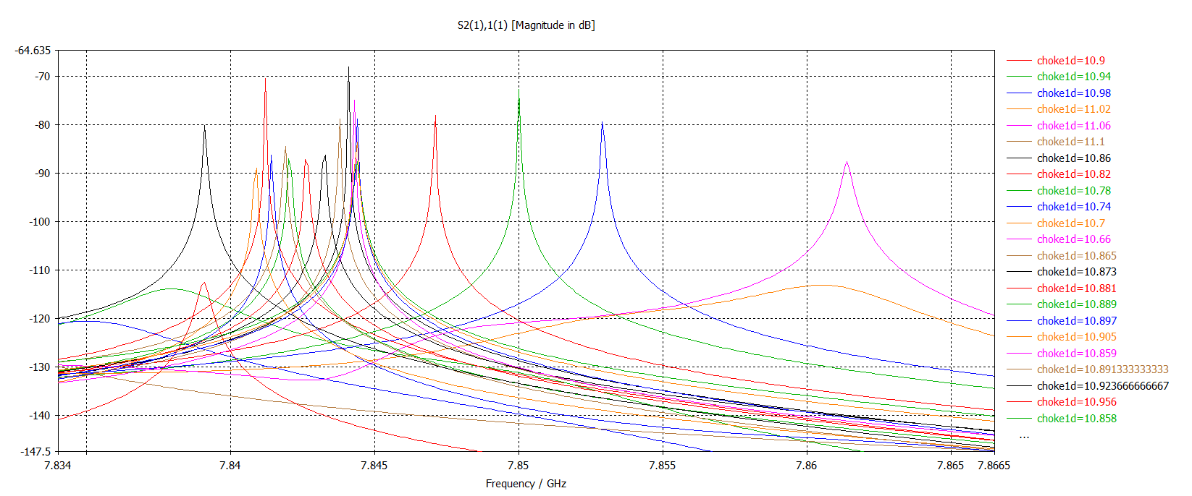
RF optimisation of the design
Optimisation steps:
Sharp S11on resonance
Minimal S21 while showing a narrow bandwidth resonance peak
The lowest possible edge field
The lowest possible absorbed power in the absorber/ loss minimisation

Slide 7
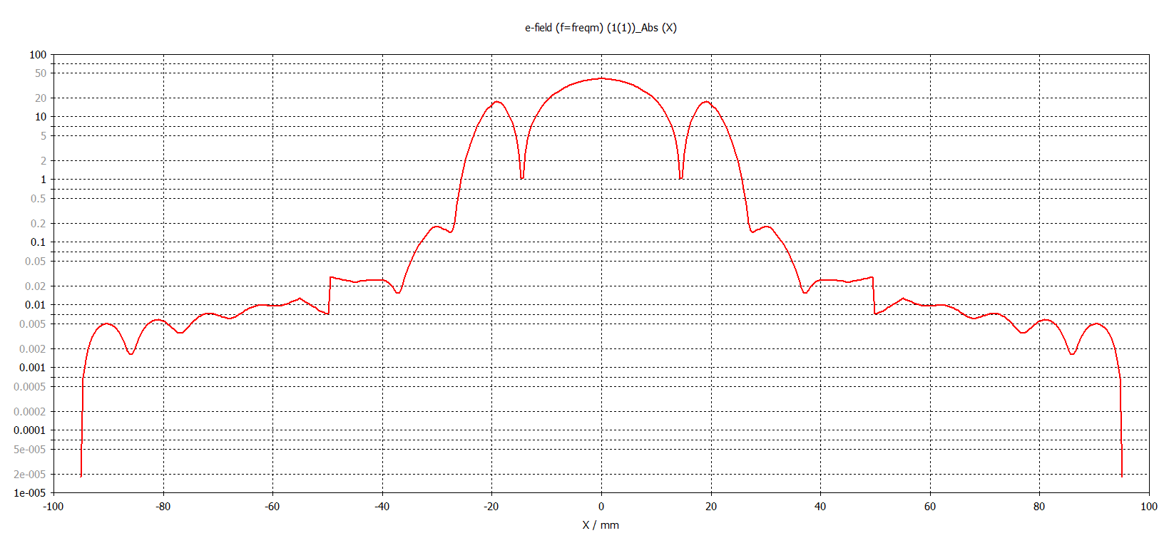
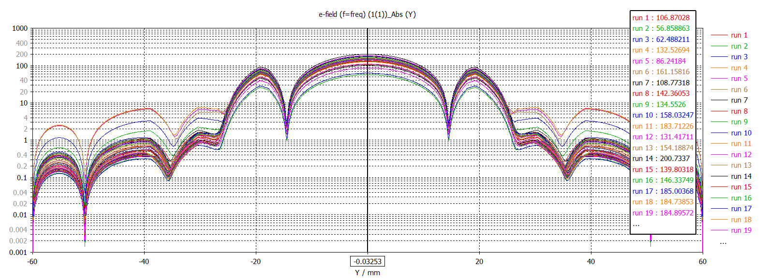
RF optimisation of the design
Optimisation steps:
Low S11on resonance
Minimal S21 while showing a narrow bandwidth resonance peak
The lowest possible edge field
The lowest possible absorbed power in the absorber/ loss minimisation

Slide 8
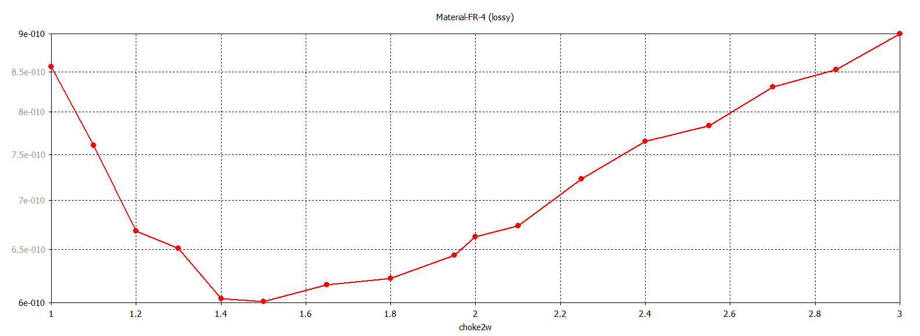
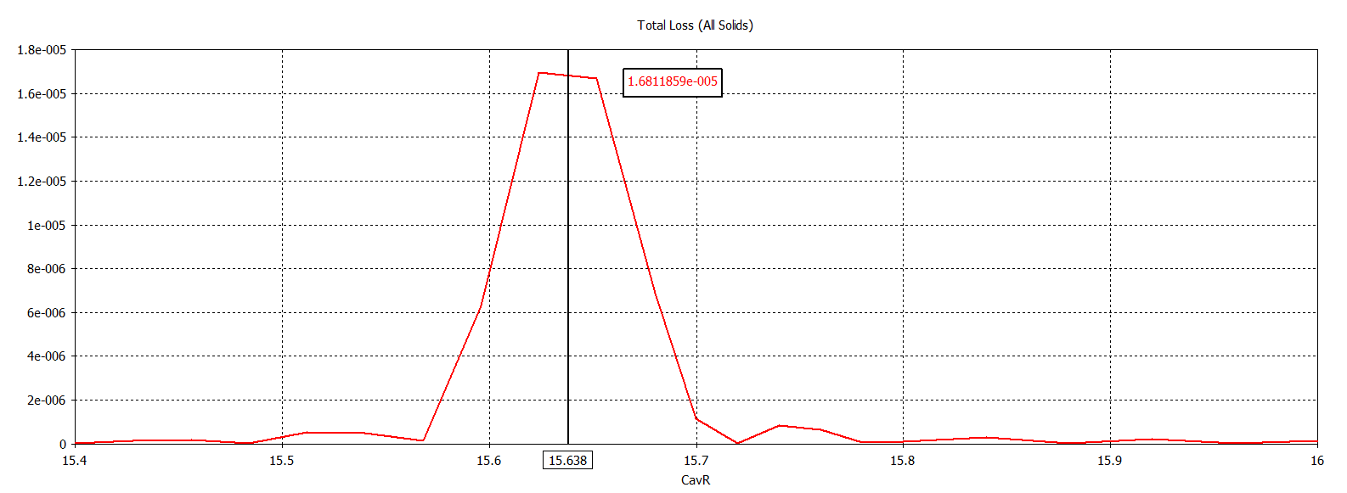
RF optimisation of the design
Optimisation steps:
Low S11on resonance
Minimal S21 while showing a narrow bandwidth resonance peak
The lowest possible edge field
The lowest possible absorbed power in the absorber/ loss minimisation

Slide 9
RF optimisation of the design
Optimisation steps:
Low S11on resonance
Minimal S21 while showing a narrow bandwidth resonance peak
The lowest possible edge field
The lowest possible absorbed power in the absorber/ loss minimisation

Slide 10
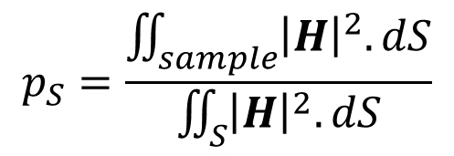
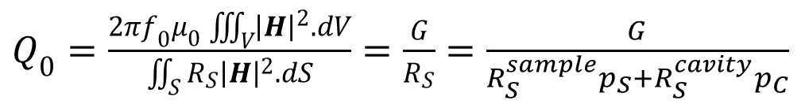
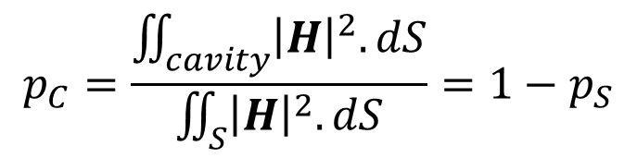
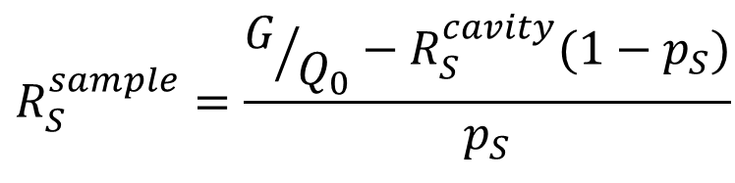
Measurement method (RF)
$Q_{0}=\frac{{2πf}_{0}μ_{0}\iiint_{V}^{ }{{\left|H\right|}^{2}.dV}}{\iint_{S}^{ }{{R_{S}\left|H\right|}^{2}.dS}}=\frac{G}{R_{S}}$ $=$ $\frac{G}{R_{S}^{sample}p_{S}+R_{S}^{cavity}p_{C}}$
$$p_{S}=\frac{\iint_{sample}^{ }{{\left|H\right|}^{2}.dS}}{\iint_{S}^{ }{{\left|H\right|}^{2}.dS}}$$
$$p_{C}=\frac{\iint_{cavity}^{ }{{\left|H\right|}^{2}.dS}}{\iint_{S}^{ }{{\left|H\right|}^{2}.dS}}=1−p_{S}$$
$$R_{S}^{sample}=\frac{G/{Q_{0}}−R_{S}^{cavity}{(1−p}_{S})}{p_{S}}$$
G, p_{s} and p_{c} determined by simulation

Slide 11
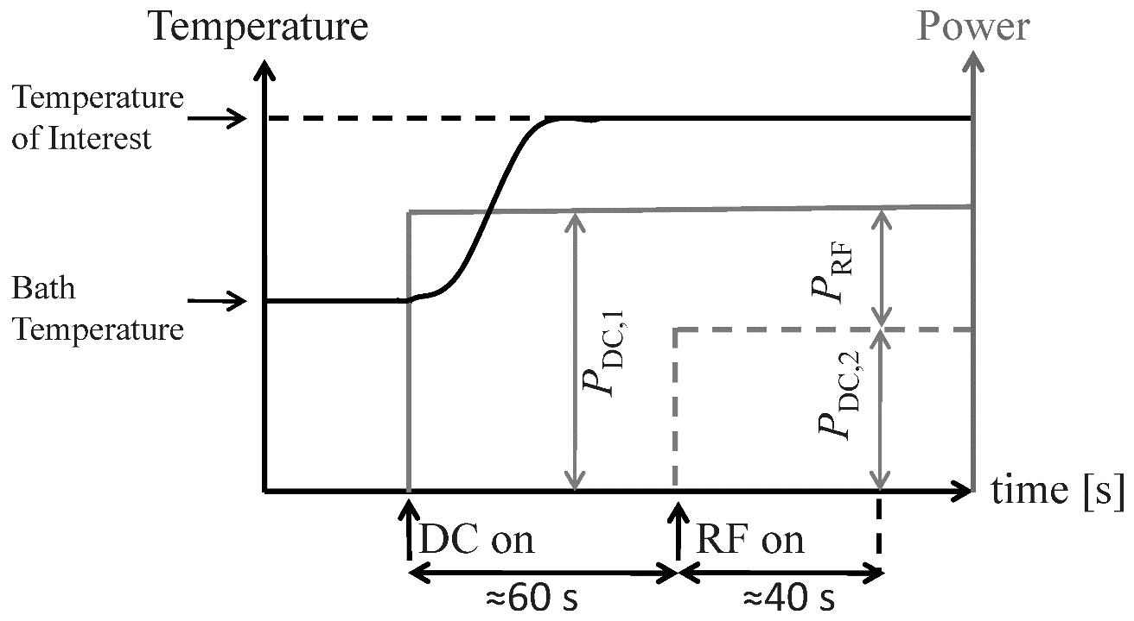
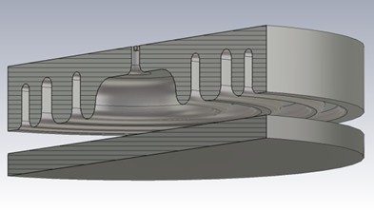
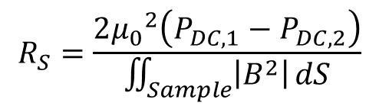
Measurement method (Calorimetry)
Sample temperature
Thermometry
Courtesy B.P. Xiao
$$R_{S}=\frac{2{μ_{0}}^{2}\left(P_{DC,1}−P_{DC,2}\right)}{\iint_{Sample}^{ }{\left|B^{2}\right|}dS}$$
More accurate method
- Can reach sub nΩ resolution

Slide 12
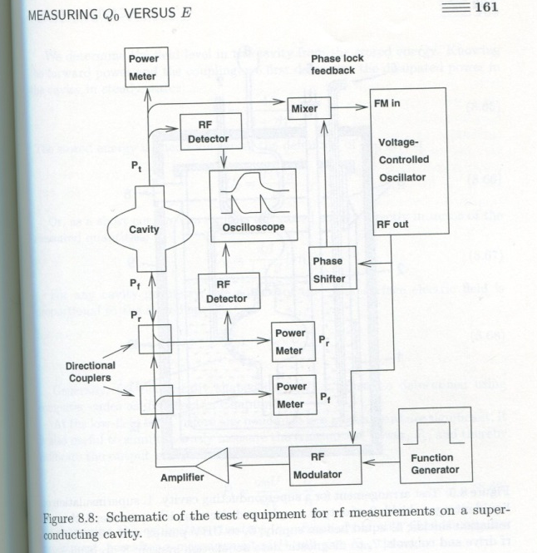
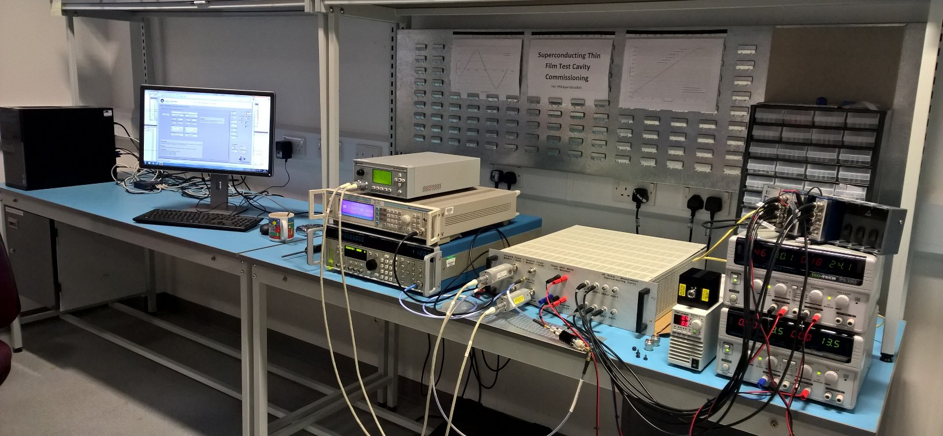
LLRF Control System

Slide 13
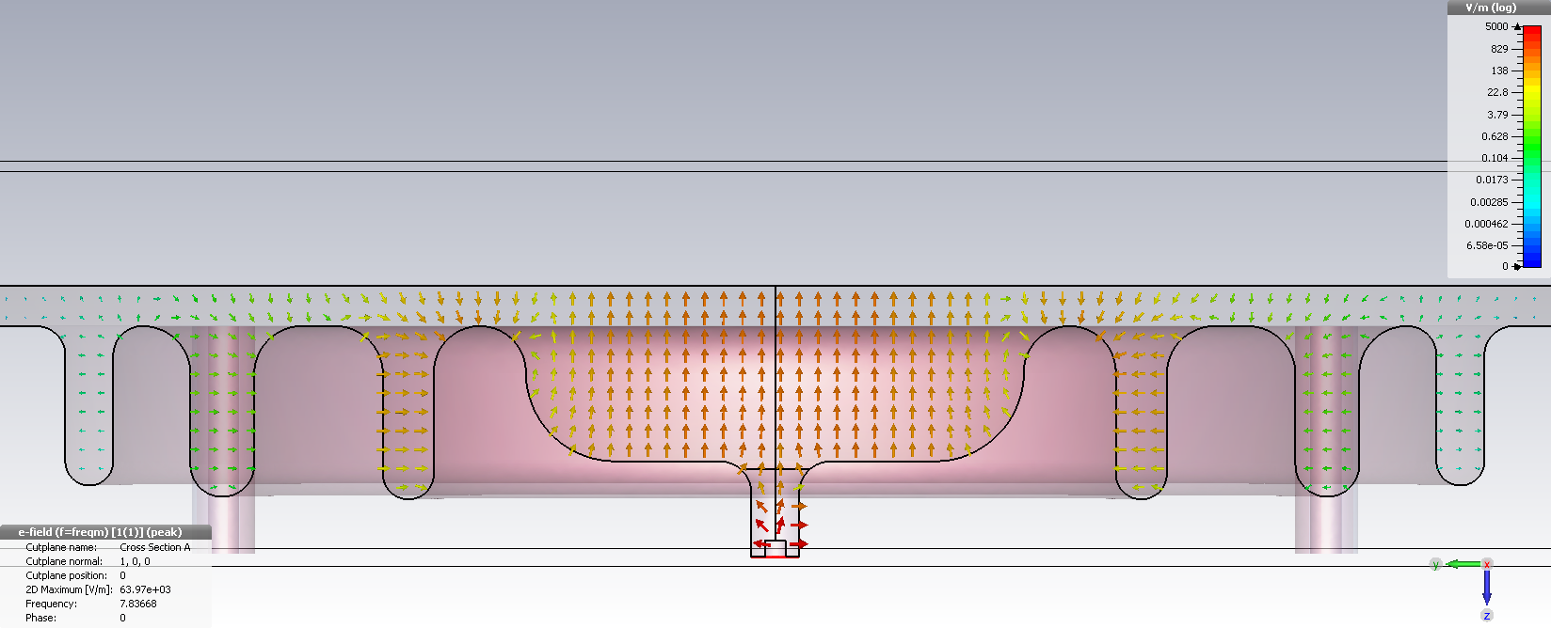
Cavity reoptimisation - 3rd choke added
Normalised E in gap
E-field
Normalised electric field intensity measured through gap between cavity and sample

Slide 14
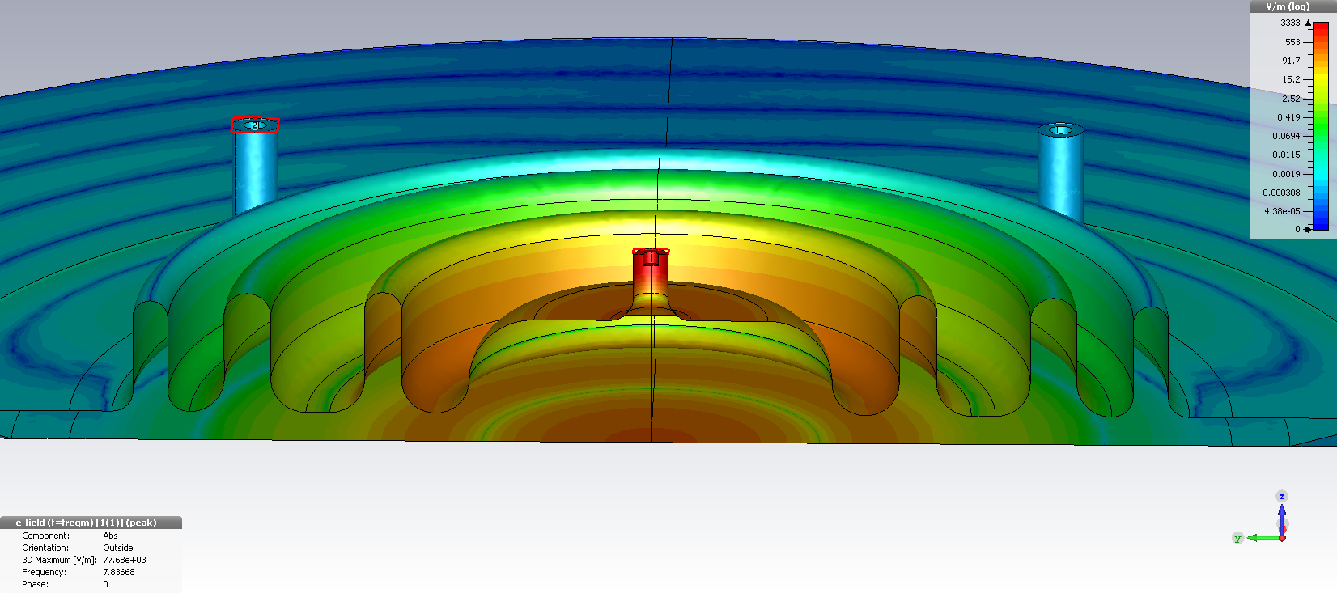
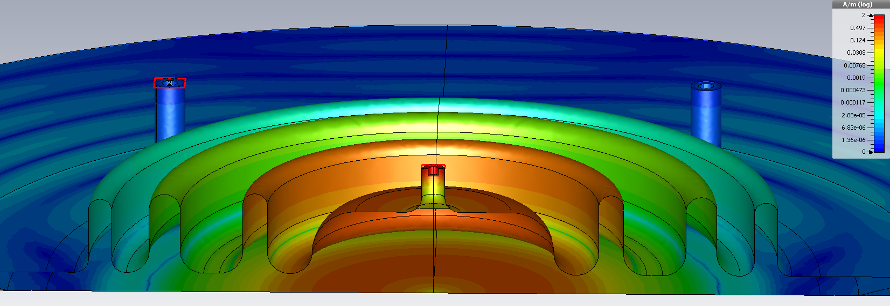
Field Distribution
E-field
H-field
63%
37%

Slide 15
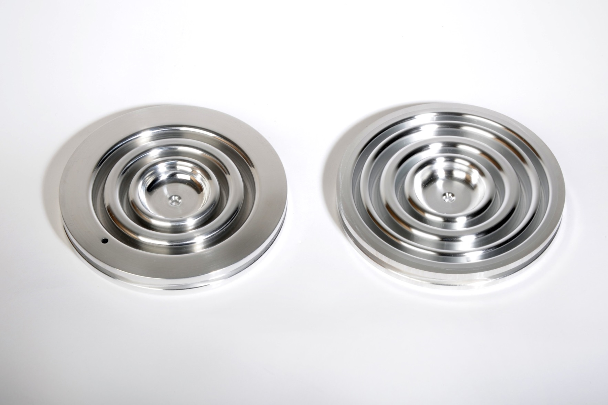

Two and three choke cavities
Fine grain
RRR 200 Nb
Large grain
RRR 400 Nb
Cavities manufactured by

Slide 16
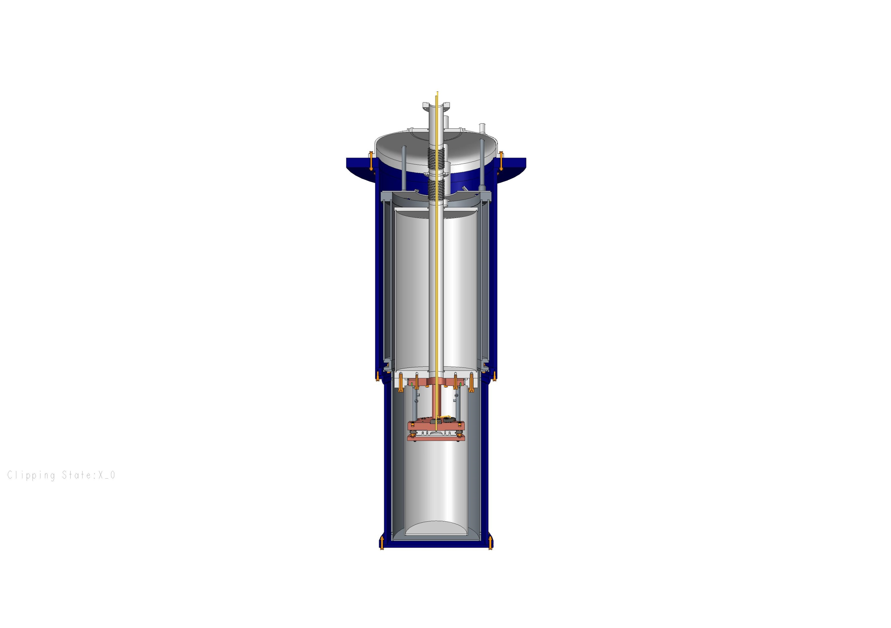
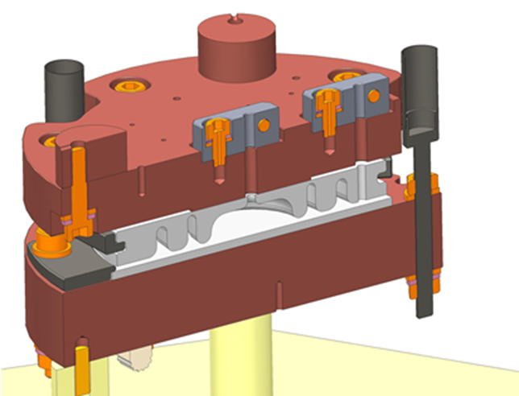
Cryogenic and support design
Schematic of the cryostat.
RF cables and thermometry wiring
Solid copper post (cavity support)
Hollow stainless steel post (sample support)
Outer Vacuum
Chamber
Liquid Helium
Chamber
Liquid Nitrogen
Chamber
Tuneable Input Coupler
Cradle Assembly
77K Radiation Shield
Sample Chamber

Slide 17
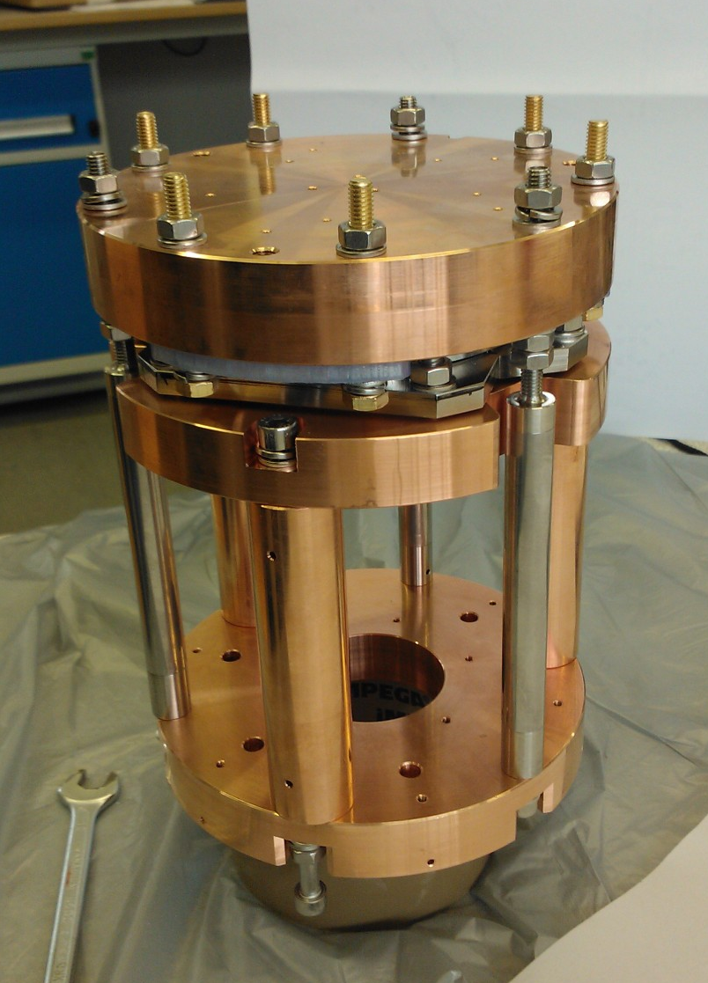
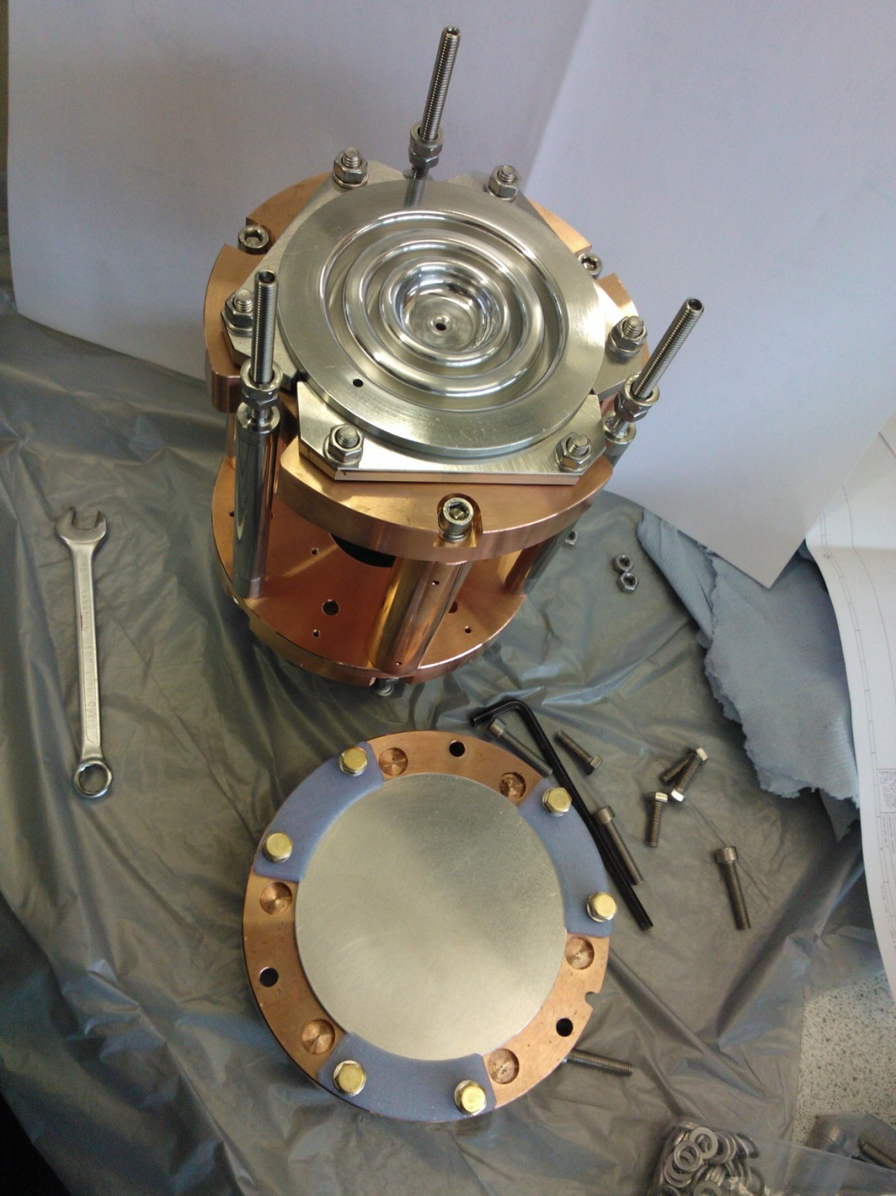
Cradle assembly
DOWN
UP

Slide 18
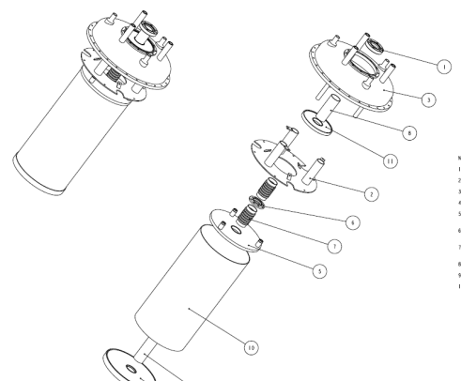
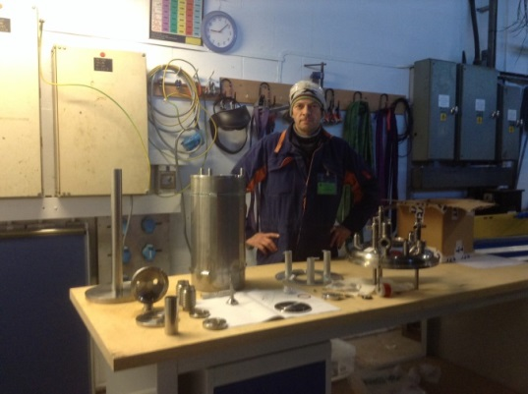
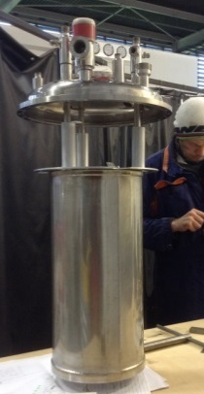
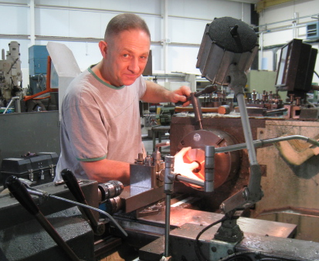
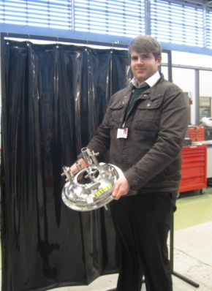
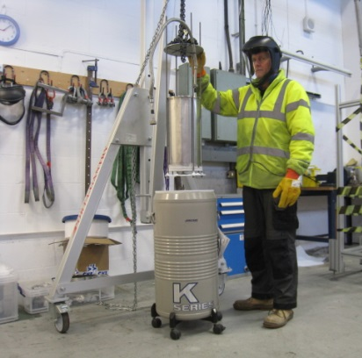
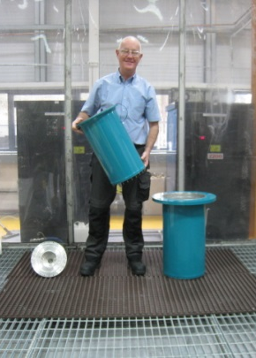
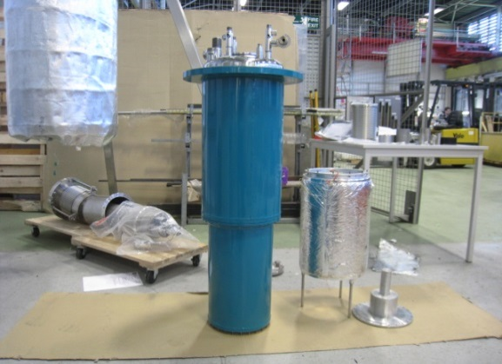
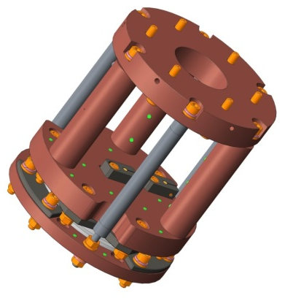
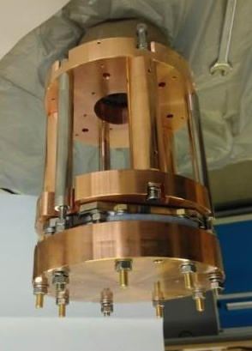
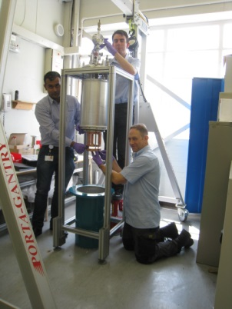
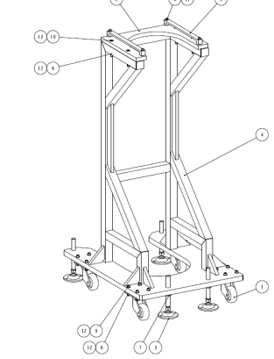
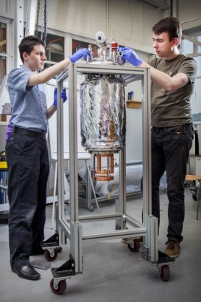
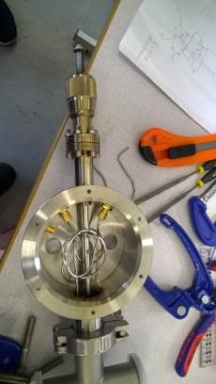
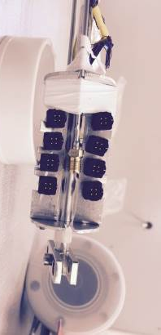
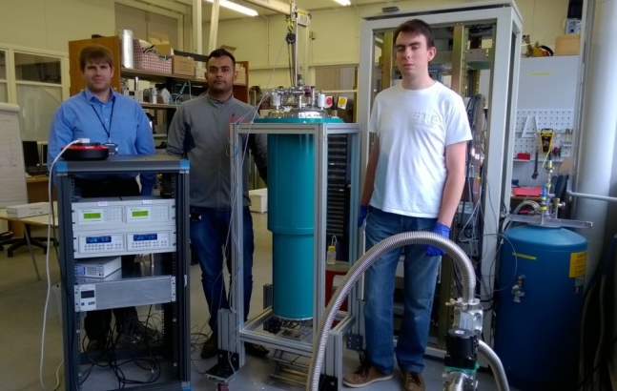
How it came together in 10 months (in house)
Oct 2014 >> Design
Manufacturing >>
>> Quality Control >>
July 2015
>> Assembly Count down to experiments

Slide 19
And then…
First cryogenic test
  Vacuum leak – temperature not reached
Second cryogenic test (LN₂)
  Verification of the vacuum seal – OK!
  Issues with the transmission probe
    Attempt to use a patch antenna – space insufficient in gap
    Modification of the side-coupling probe
  Issues with the tuneable input coupler
    Design adapted

Slide 20
And now…
Reassembly
  RF leakage noticed in inner vacuum chamber
    Room temperature leakage estimated to have a
    Qe ~ 22000
    Identification of leakage mechanism still under investigation!
  Radiation shielded still needs commissioning
On the horizon
  Measure cavity performance with cold test
    Proceed with scientific programme
    (or return to the drawing board)

Slide 21



The UK’s SRF collaboration team
Dr. R. Valizadeh, Dr. O.B. Malyshev,
Dr. P. Goudket, S. Pattalwar,
A. Hannah, N. Pattalwar, K. Dumbell
J. Herbert, A. Wheelhouse,
P. McIntosh
S. Bibby-Trevor, P. Davies,
E. Jordan, T. Jones
Dr. G. Stenning
S. Wilde, Dr. B. Chesca
P. Pizzol, Prof. P. Chalker
F. Lockwood-Estrin, Prof. J. Bradley
L. Gurran, Dr. G. Burt

