Slide 1
Material study results and performance of the Cornell TE-mode sample host cavity
Daniel Hall
James Maniscalco
Matthias Liepe

Slide 2
Talk outline
Motivation and design for the sample host cavity
Commissioning
First results of sample plates from ASTeC

Slide 3
Three generations of cavities
6 GHz
3 inch diameter plate
40 mT peak surface field
TE011 mode
6 GHz
5 inch diameter plate
60 mT peak surface field
TE012 mode
3.95 GHz
5 inch diameter plate
110 mT peak surface field
TE011 mode

Slide 4
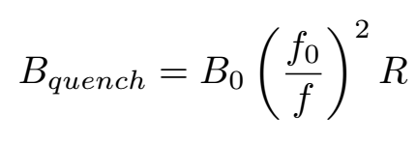
Thermal runaway limitation
R is the ratio of the peak field on the sample plate to the peak field on the cavity
For this cavity, R = 0.893
Issue – if the plate’s quench field is higher than 110 mT, the quench will occur on the cavity wall instead

Slide 5
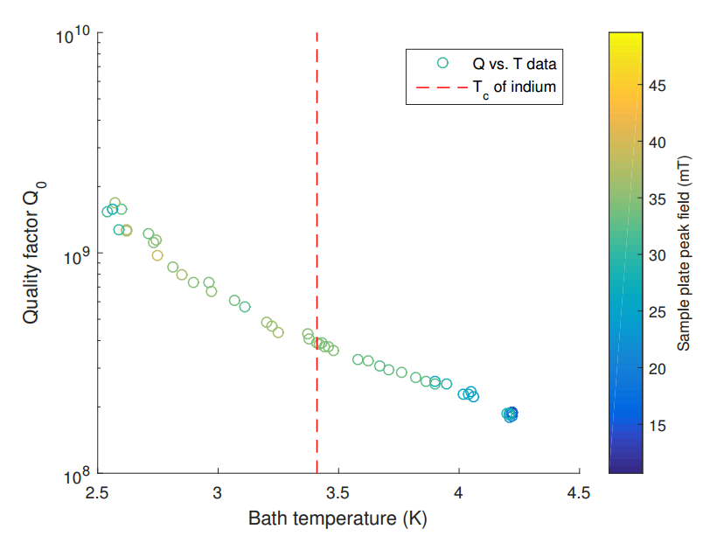
Sample plate mounting
Sample plate is sealed against the cavity using an indium flange. The indium does not appear to impact the cavity performance

Slide 6
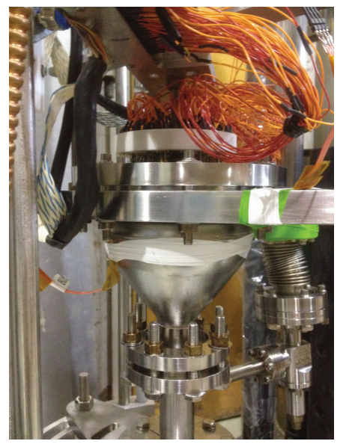
Temperature mapping
An array of 40 Allen-Bradley resistors, operating as cryogenic thermometers, monitor the temperature on the sample plate
The system has room to be expanded to 56 resistors
A high-density mapping system using Ruthenium Oxide resistors is also under consideration

Slide 7
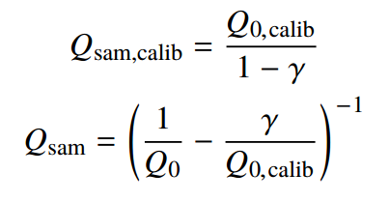
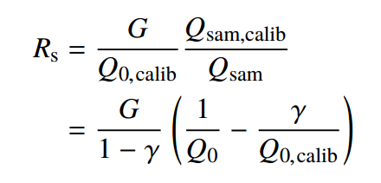
Cavity calibration
Before first using the cavity for science, it must be calibrated to be able to obtain the surface

Slide 8
Cavity calibration

Slide 9
Science results
Two niobium-coated copper disks coated at ASTeC, at Daresbury, UK
HiPIMS coating
Plate 1
Substrate held at 500°C
Plate bias of -100 V
Plate 2
Substrate held at 800°C
No plate bias applied

Slide 10
Results: plate 1

Slide 11
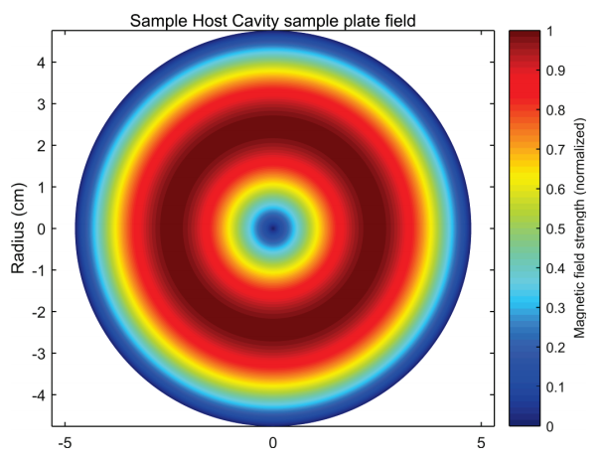
Hot spot seen on sample plate
Temperature mapping of the sample plate reveals a region of increased heating at a point lying on the ring of maximum field of the sample plate

Slide 12
Onset of ohmic heating

Slide 13
Results: plate 2

Slide 14
Further work
Another plate from ASTeC is currently being assembled onto the cavity for testing
Plates coated with Nb₃Sn at Cornell will also be tested
The temperature mapping system is being upgraded for greater sensitivity and higher density of sensors

Slide 15
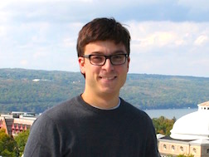
Acknowledgements
Matthias Liepe
James Maniscalco
Yi Xie
Tim O’Connell
James Sears
John Kaufman
Ivaylo Madjarov
Charles Burton
To inquire about testing a sample plate, contact James Maniscalco
Email: jtm288@cornell.edu

