Slide 1
A Test Cavity & Cryostat for
Rapid RF Characterization of Superconducting Materials
Paul B. Welander, Matt Franzi, Sami Tantawi
SLAC National Accelerator Laboratory, Menlo Park, CA 94025
28 July 2016

Slide 2
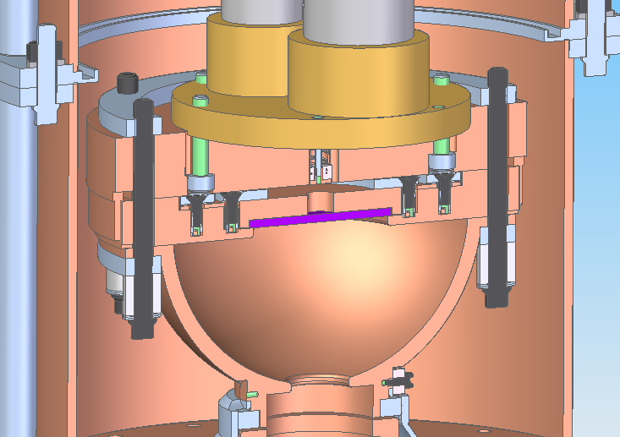
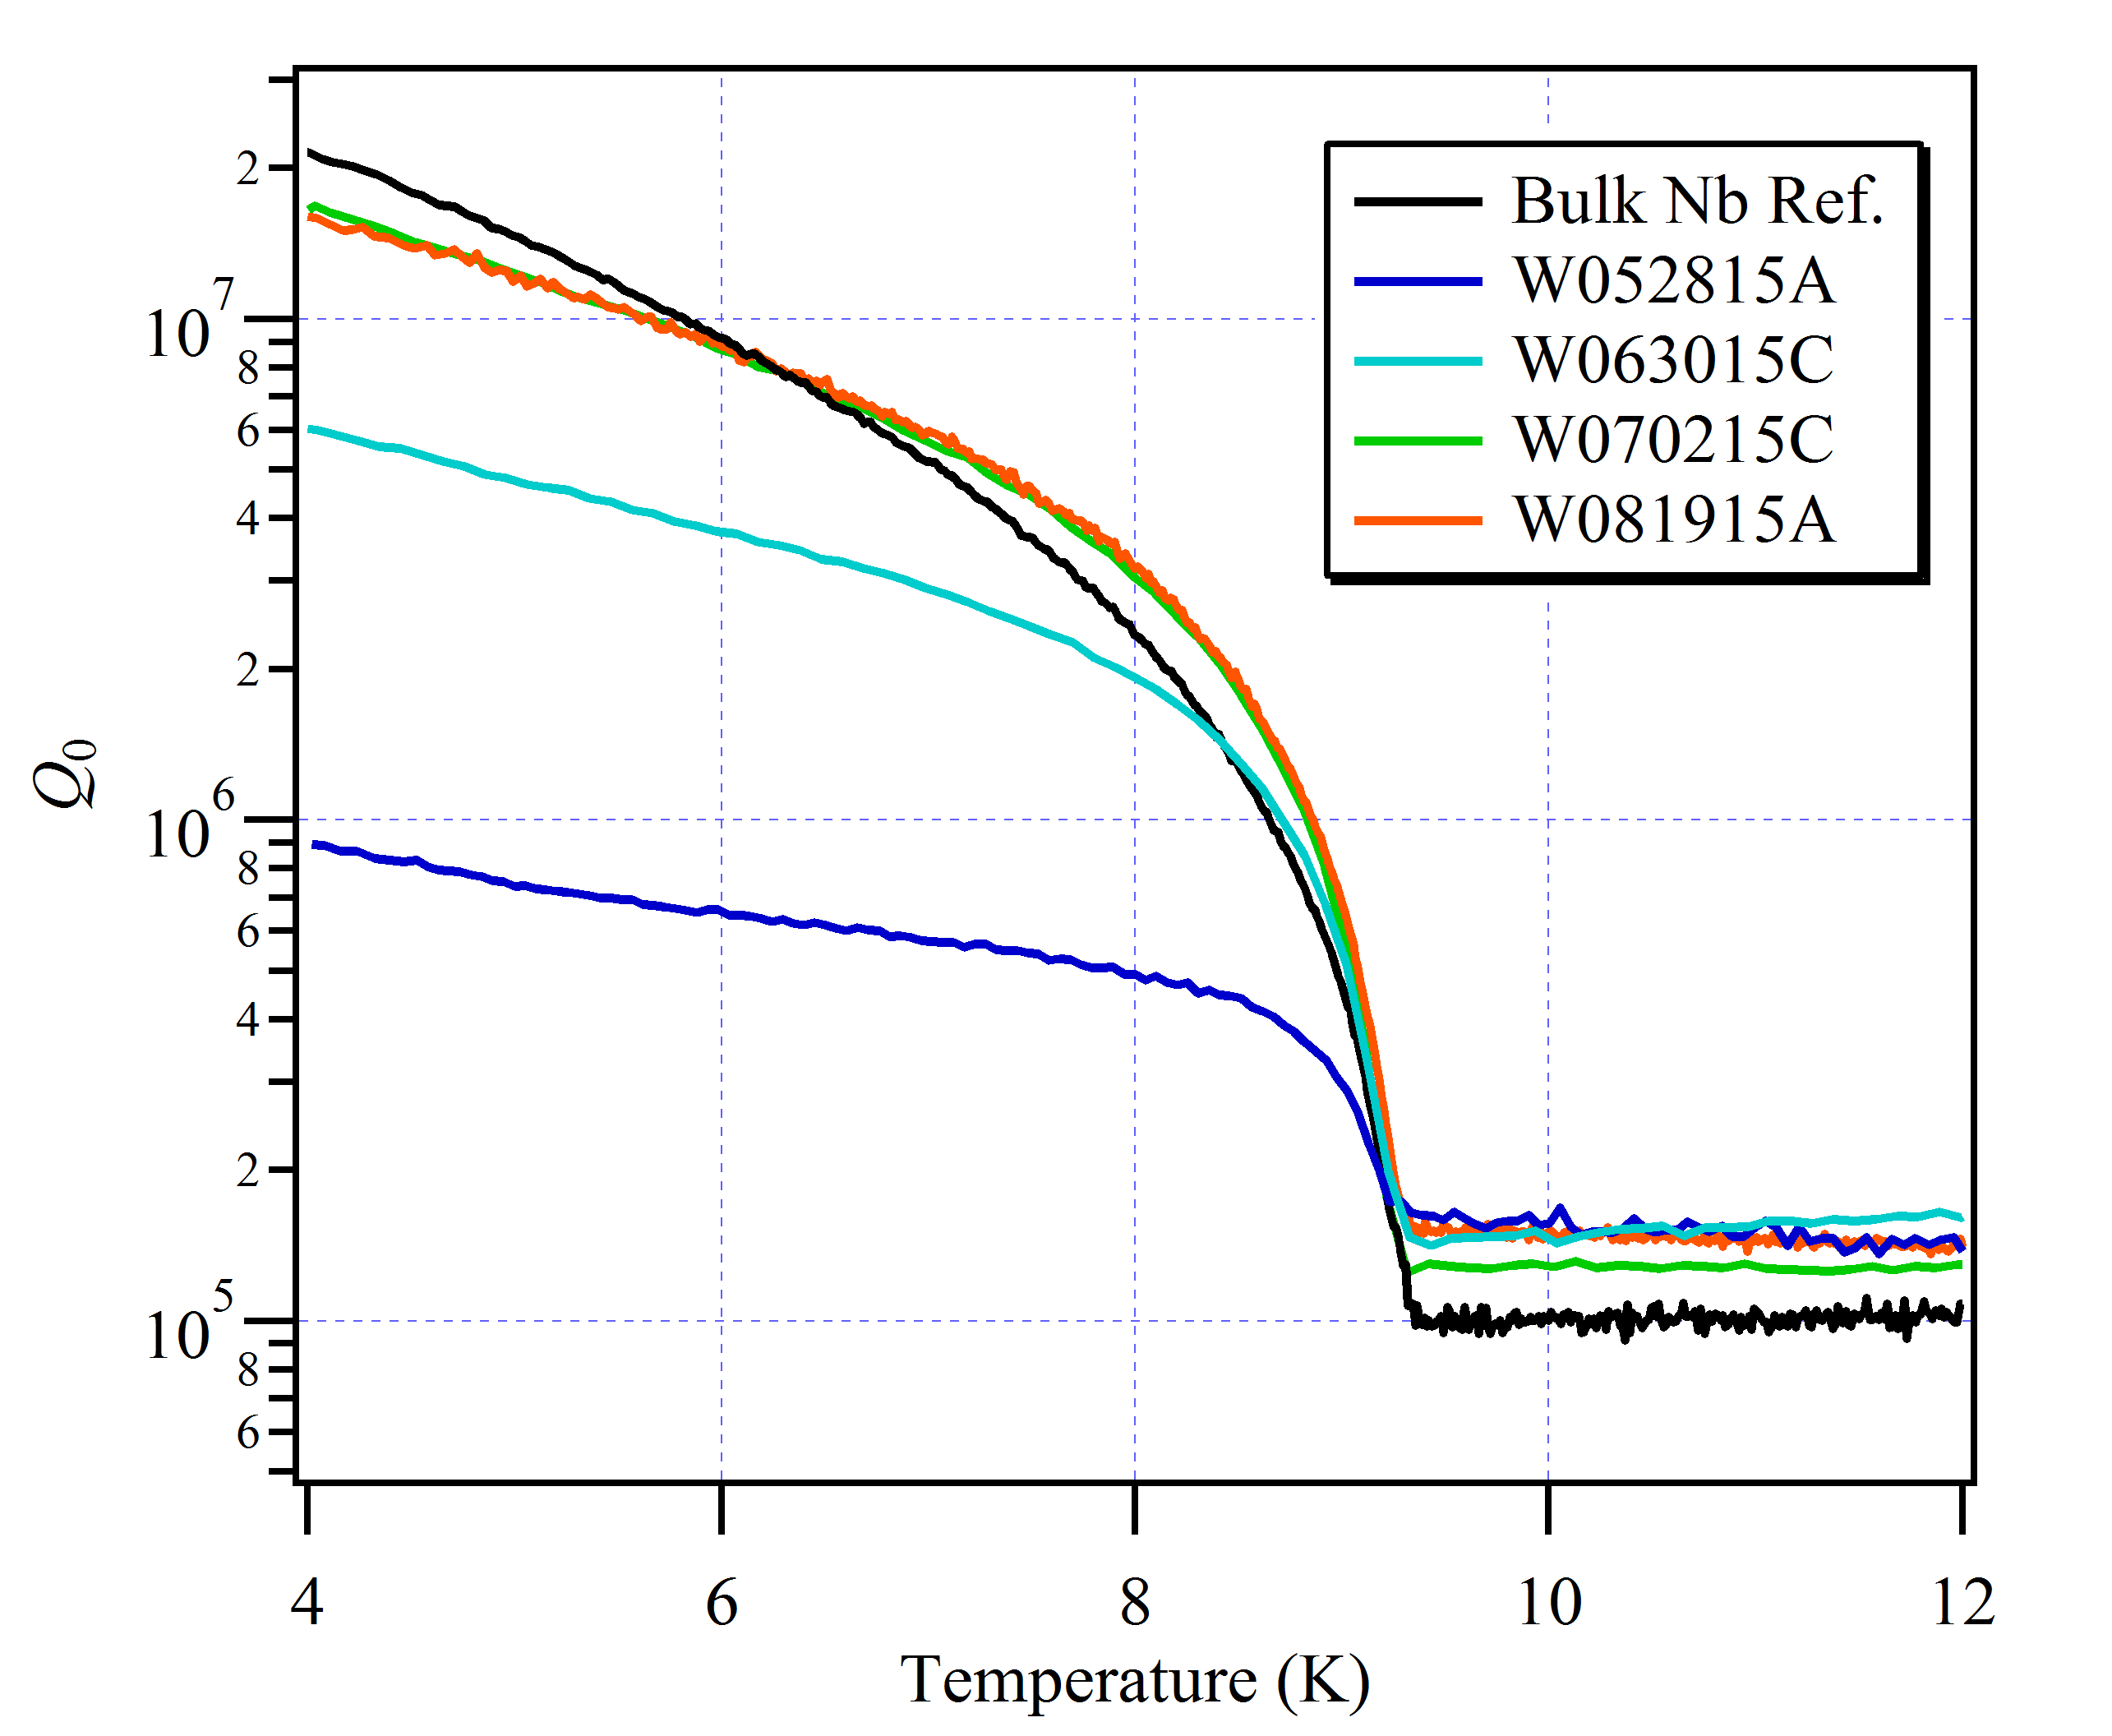
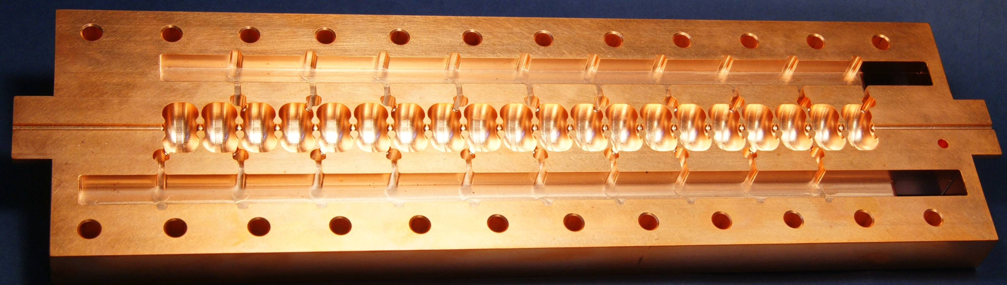
Superconducting RF Materials
Two hemispherical test cavities (one Nb, one Cu) to measure surface resistance & quenching field at 4 K.
X-band operation (11.4 GHz) ⇨ small sample size, 33% of cavity loss from sample surface.
Closed-cycle, pulse-tube cryocooler enables 24-hr. test cycle ⇨ unmatched throughput & rapid feedback.
2” dia. sample
SRF Materials Development
Novel SRF Cavity Fabrication
Collaborate w/ others
in DOE complex and
beyond to advance
state of the art for
SRF materials.
Example: Temple MgB₂
  RF measurement as tool
  for process development
Recent measurements:
  MgB₂ – Temple Univ., Peking Univ.
  Nitrides – Naval Res. Lab, MIT Lincoln Lab
  Nb – Alameda Applied Sciences, JLab
Develop SRF coatings that can be applied to novel accelerator structures being designed and built at SLAC.
Optimize coatings & cavity design for:
  High Efficiency – higher Q, lower dynamic loss, less cooling power required
  High Gradient – higher beam energy
  High Temperature – operation at 4 K
Optimize Q₀

Slide 3
System Capabilities
  SLAC test cavities and cryostat enable rapid (24-hr. cycle) characterization of superconducting RF (SRF) materials.
  Characterize surface impedance by measuring the quality factor, Q₀, of a cavity at 11.424 GHz, down to 4 K.
Capable of low power (PNA) and high power (Klystron) measurements.
Compact design thanks to X-band operation (5.6” diameter).
Interchangeable flat cavity bottom, fits 2” (50.8 mm) diameter samples up to 0.25” (6.25 mm) thick.
Cavity design maximizes H-field and minimizes E-field on the sample surface.
Cu and Nb cavities allow us to measure surface resistance (R_{s}), quenching field (H_{quench}), and transition temperature (T_{c}).
Can achieve H_{peak} ~ 360 mT with 50 MW Klystron.

Slide 4
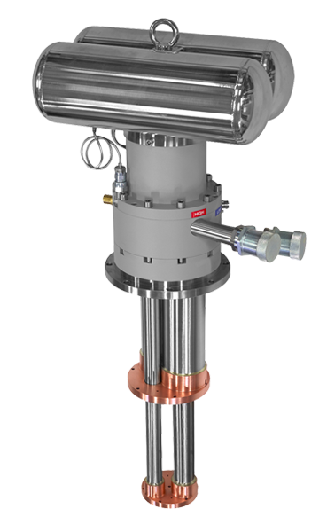
Cryomech Pulse-Tube Cryocooler
Our cavity cryostat utilizes a Cryomech cryorefrigerator.
Two-stage pulse-tube operation
Base temperature of 3.5 K with cooling power of 1.35 W at 4.2 K
Utilize the remote motor version to minimize cavity vibrations.
First stage (40 K) used for thermal shielding and cold section of waveguide.

Slide 5
Cavity Cryostat Assembly – Model View
Cryocooler
2nd Stage
40 K Shield
Sample
Plate
Diode
Temp
Sensors
Sample
Under
Test
Cavity Iris
RF Feed

Slide 6
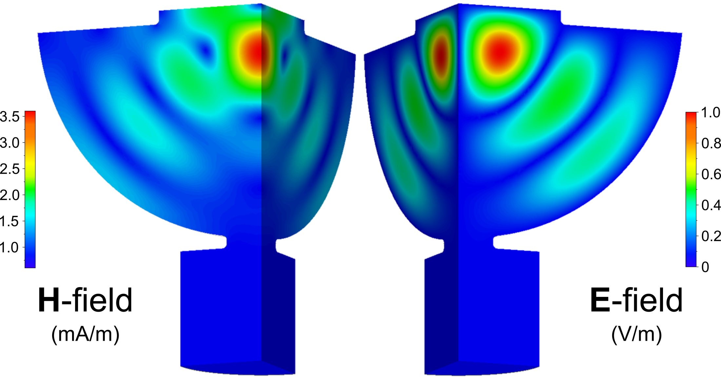
Hemispherical Cavity Design – HFSS Modeling
r = 0.95”
RF Feed
High-Q hemispheric cavity with a TE₀₃₂-like mode at 11.4 GHz
  Maximum H-field (2.5x H_{dome}), zero E-field on sample
  Sample accounts for 8% of cavity area, but 33% of cavity loss
  No radial current on the cavity bottom

Slide 7
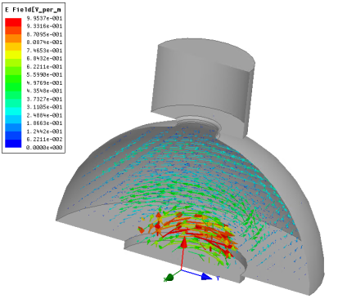
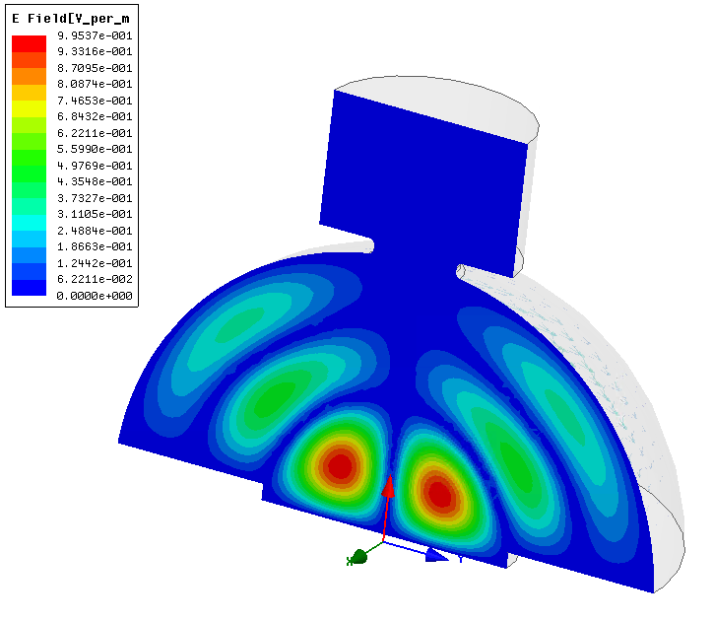
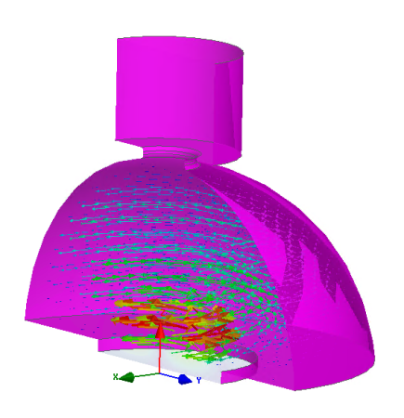
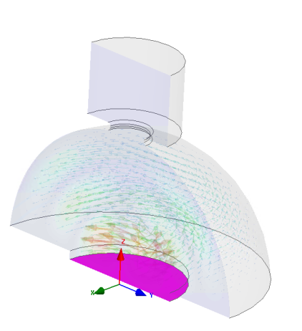
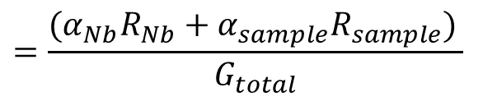
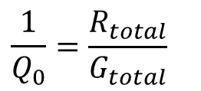
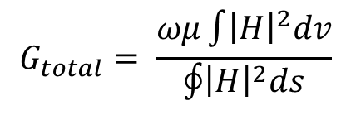


Nb-Coated Cavity Design
f₀ = 11.4 GHz
Q_{total} = 1.6e7
G_{total} = 1416 Ω
G_{Nb} = 2120 Ω
G_{sample} = 4264 Ω
$$\frac{1}{Q_{0}}=\frac{R_{total}}{G_{total}}$$
$$G_{total}= \frac{ωμ\int{{\left|H\right|}^{2}dv}}{\oint{{\left|H\right|}^{2}ds}}$$
$$=\frac{(α_{Nb}R_{Nb}+α_{sample}R_{sample}) }{G_{total}}$$
$$α_{Nb}={G_{total}/G}_{Nb}=0.668$$
$$α_{sample}={G_{total}/G}_{sample}=0.332$$
Hemisphere Surface
Sample Surface

Slide 8
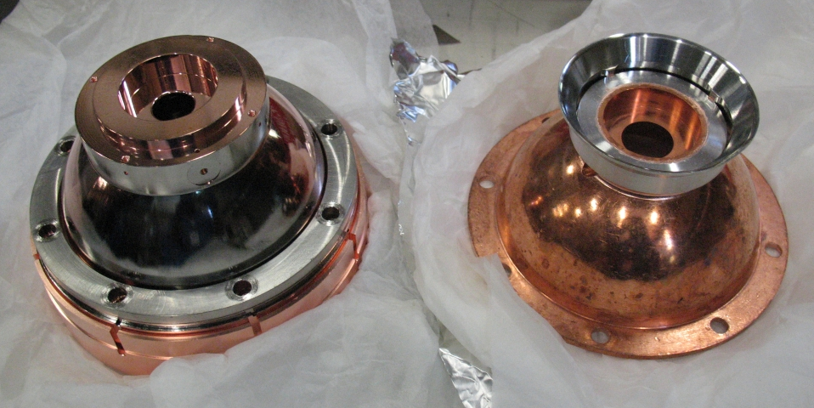
Two Cavities
Coated w/ 5 μm Nb film at CERN (S. Calatroni)

Slide 9
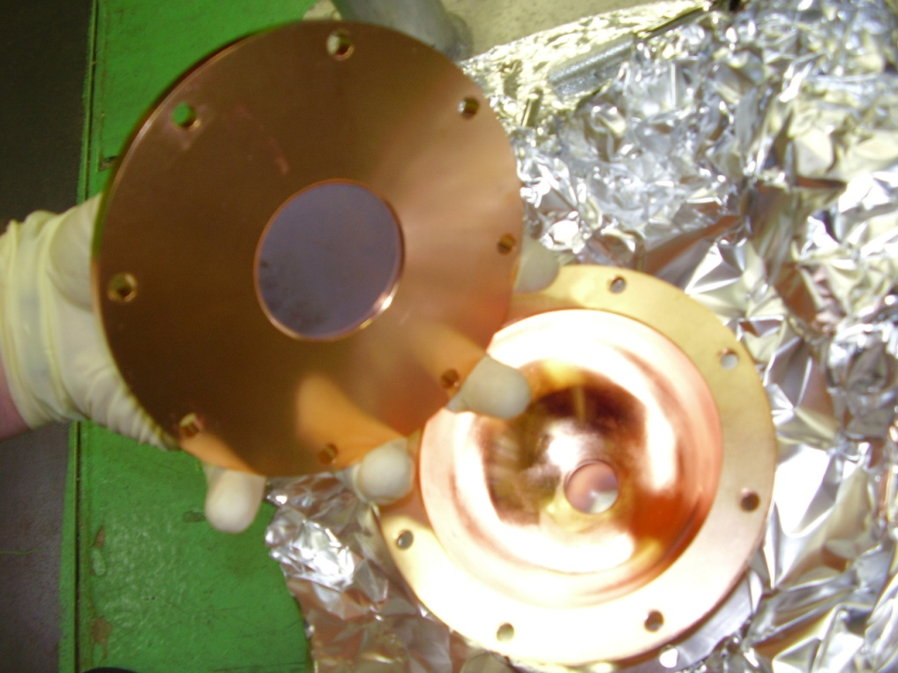
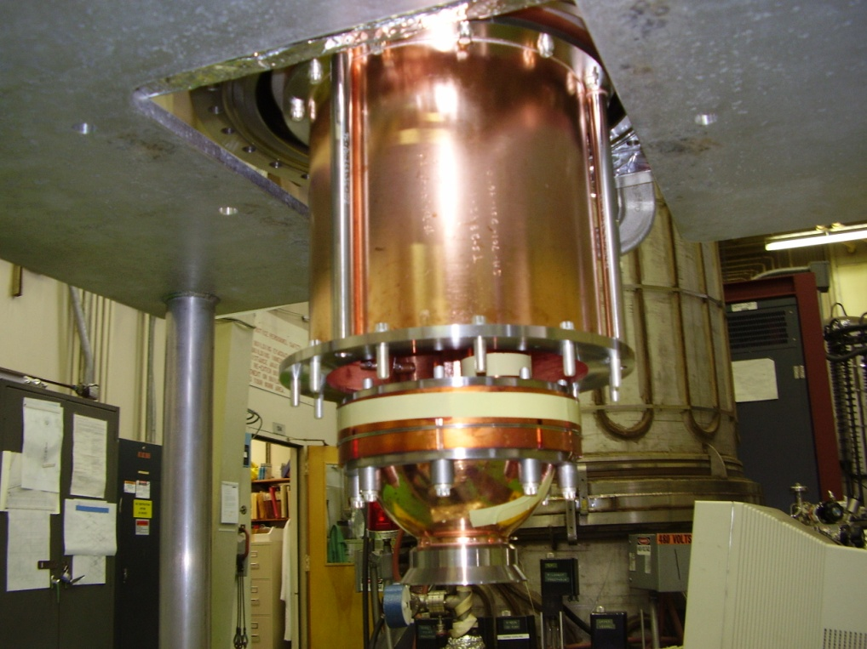
Cavity Assembly
Sample
Plate
Cavity Iris
40 K Shield
Sample
Under
Test
RF Feed

Slide 10
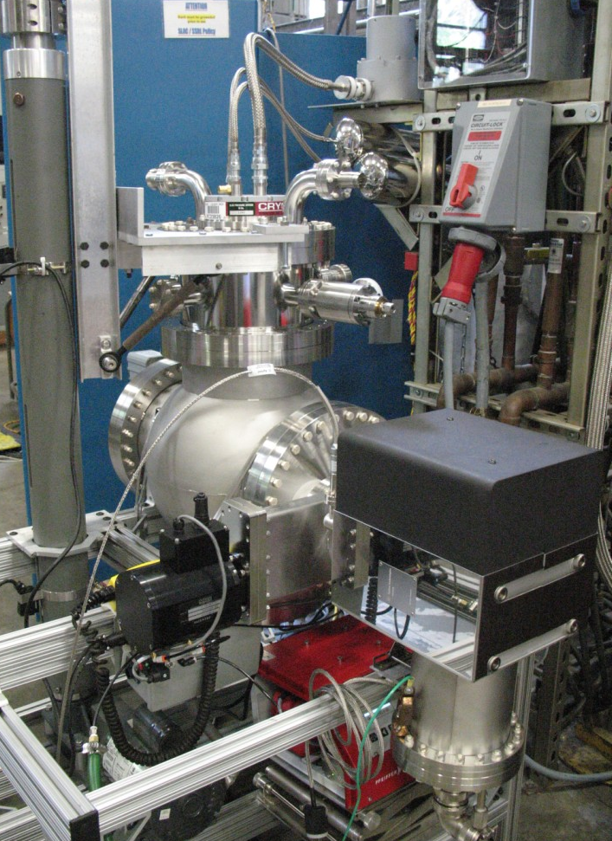
System Photo and RF Measurement Network
Measurement ports:
Forward Power: 5 (and 2)
Reflected power: 4
(Waveform measured by either a peak power meter or a scope with mixers)
Low-power PNA measurement: 3 (or 6)
Klystron
1
Cryostat
Cryostat
55dB
Cavity
2
3
10dB
4
5
7
6
45dB
45dB
Mode converter
Bend
Waveguide to Klystron/NWA
Load
System Diagram

Slide 11
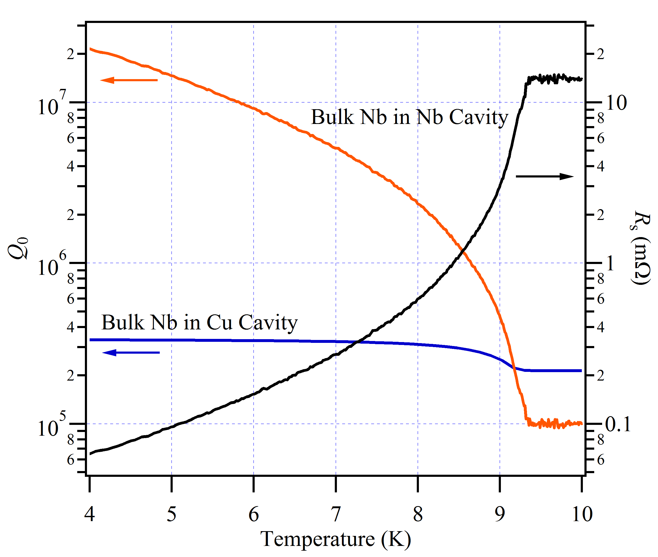
Bulk Nb Reference Sample
Single-crystal bulk Nb from DESY
  Received January 2008
  Baked in 2010, untreated since
Q₀ in Cu limited by cavity materials
In Nb cavity at 4 K, Q₀ translates to R_{s} = 65 μΩ
  Assumes R_{s,sample} = R_{s,cavity}
  Standard deviation of 1%
  Assuming f ² and (T/T_{c})⁴ dependence, → R_{s} = 47 nΩ at 2.0 K and 1.3 GHz
Q₀ vs T for Nb Reference
in both Nb & Cu cavities

Slide 12
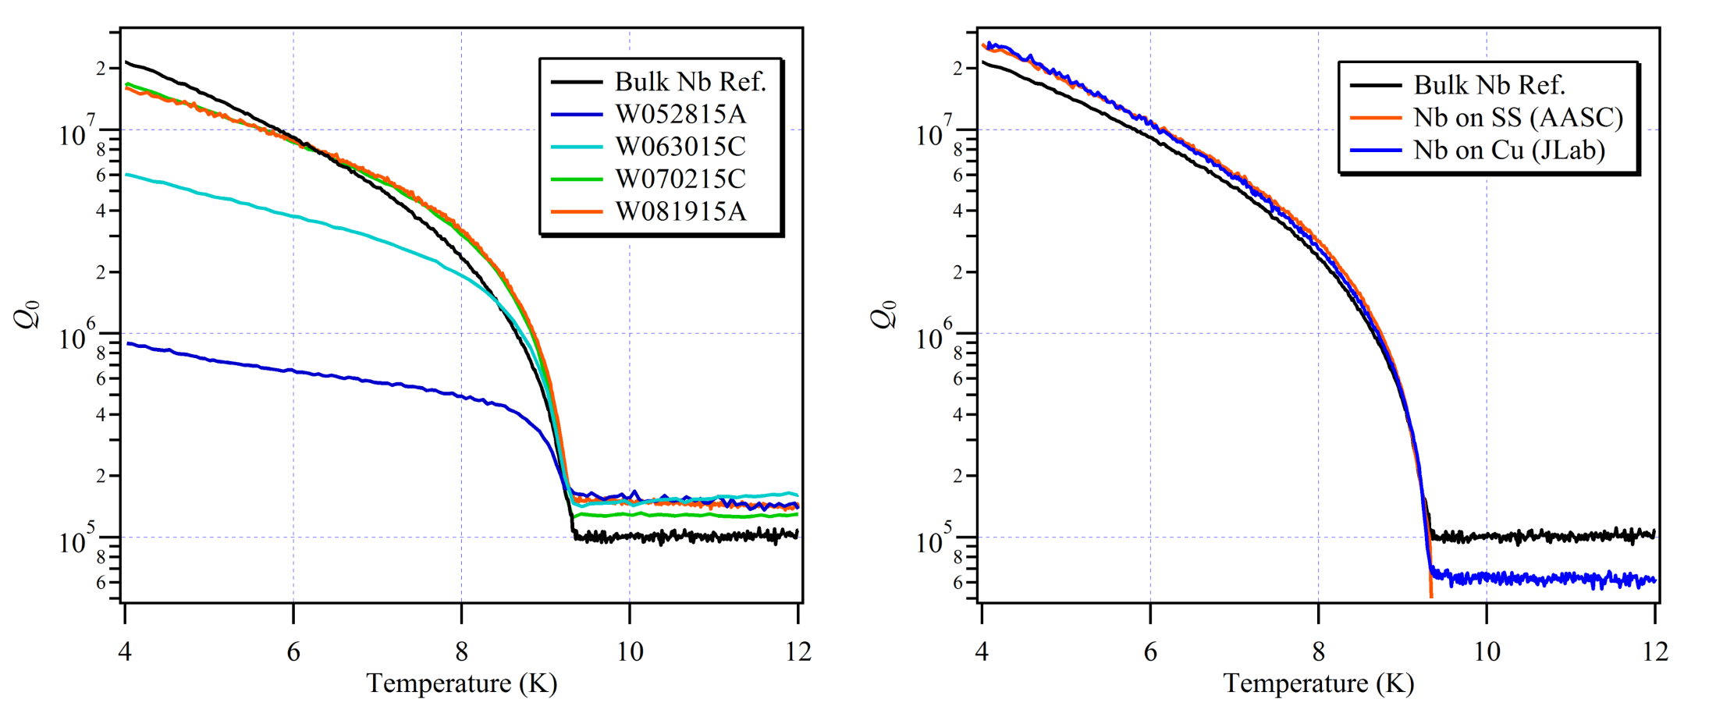
Nb Films from AASC & JLab
Low power measurements in our Nb cavity.
Nb films on copper (JLab, A.-M. Valente-Feliciano) & stainless steel (AASC, K. Velas) compare favorably with our bulk Nb sample.
Assuming a cavity R_{s} of 65 μΩ, both films have R_{s} of about 17 μΩ.

Slide 13
MgB₂ on Copper from Temple Univ.
Series of MgB₂ films grown on copper last summer at Temple Univ. (W. Withanage, X. Xi).
Q₀ measurements served as feed-back to develop growth process, enabling rapid improvement.
T_{c}’s up to 38 K were measured in Cu cavity.

Slide 14
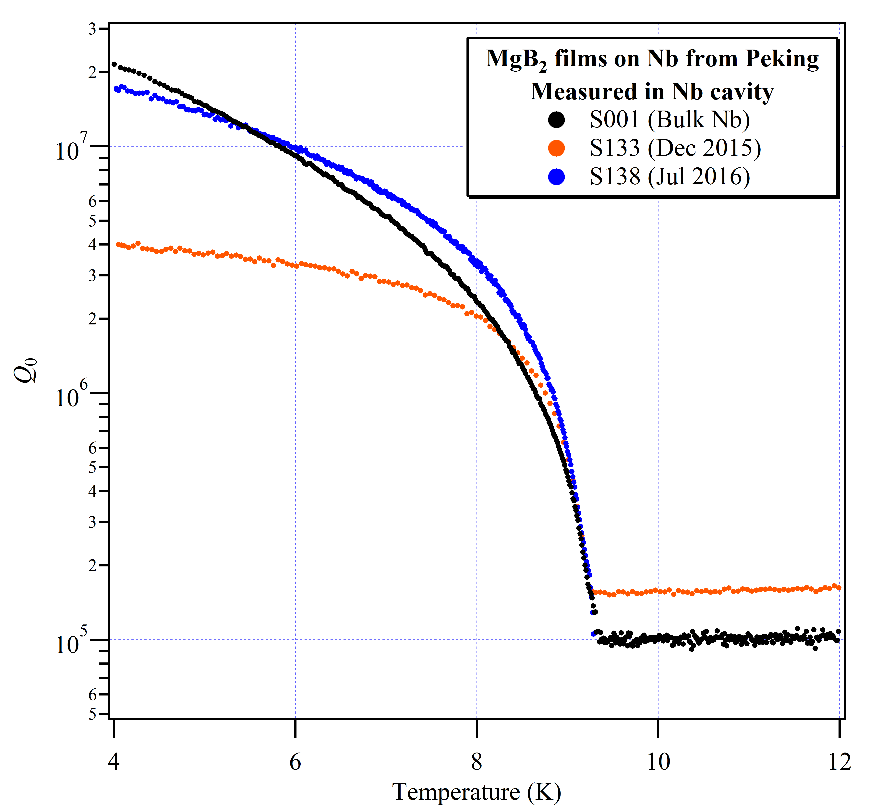
MgB₂ on Niobium from Peking Univ.
Recently measured two MgB₂ films grown on niobium at Peking Univ. (Z. Ni, K. Liu).
Process improvement over past eight months, reducing R_{s} ~ 1 OM

Slide 15
Cavity Cryostat Status & Summary
Cu and Nb cavities allow us to measure surface resistance (R_{s}), quenching field (H_{quench}), and transition temperature (T_{c}).
Low-power Q vs. T takes less than 24 hrs. → rapid feedback for film growth process development.
Currently building up capability to perform high-power testing, and measure H_{quench}.
Built in concurrent capability to measure samples at low power in both cavities.

Slide 16
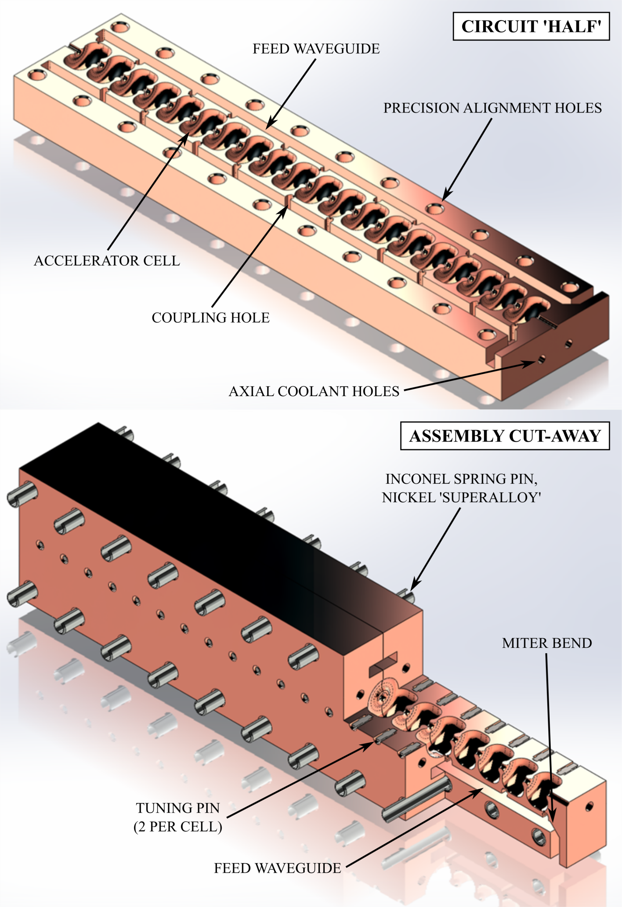
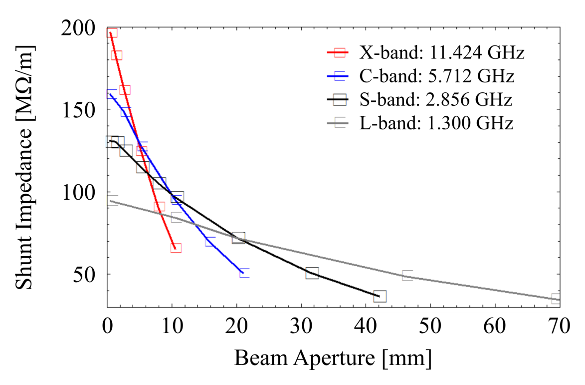
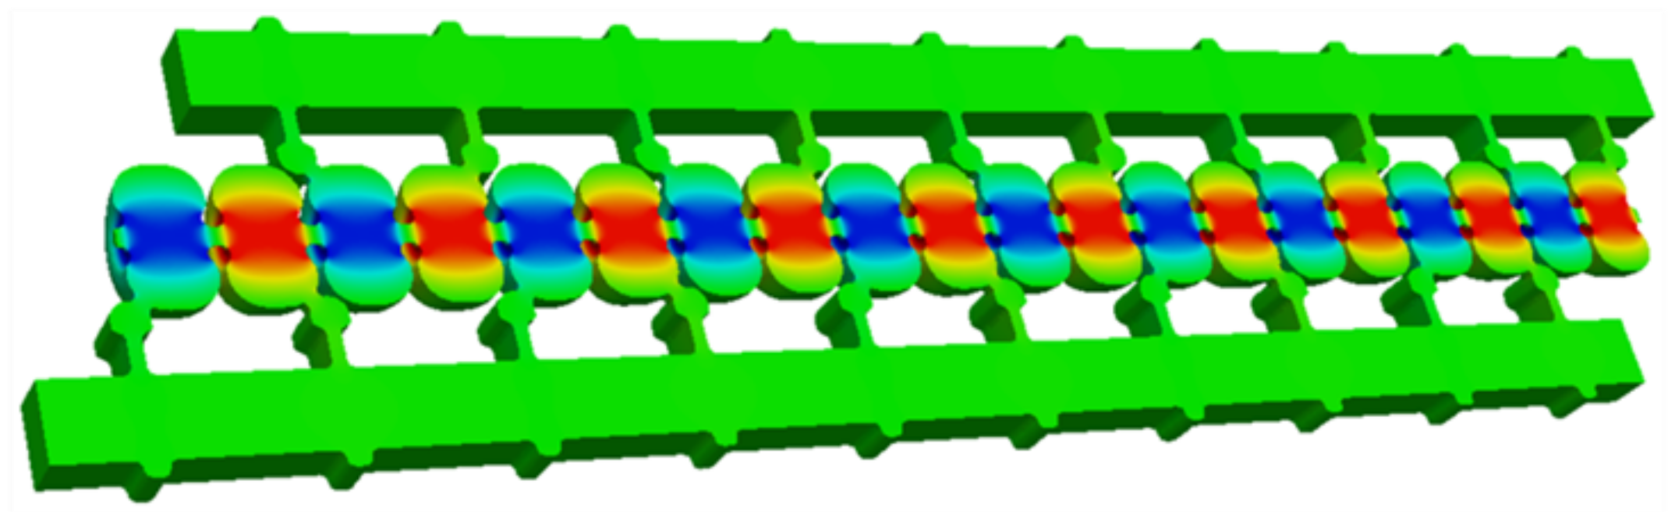
Highly Efficient Direct-Feed Split-Cell Cavity
Z. Li & S. Tantawi

Slide 17
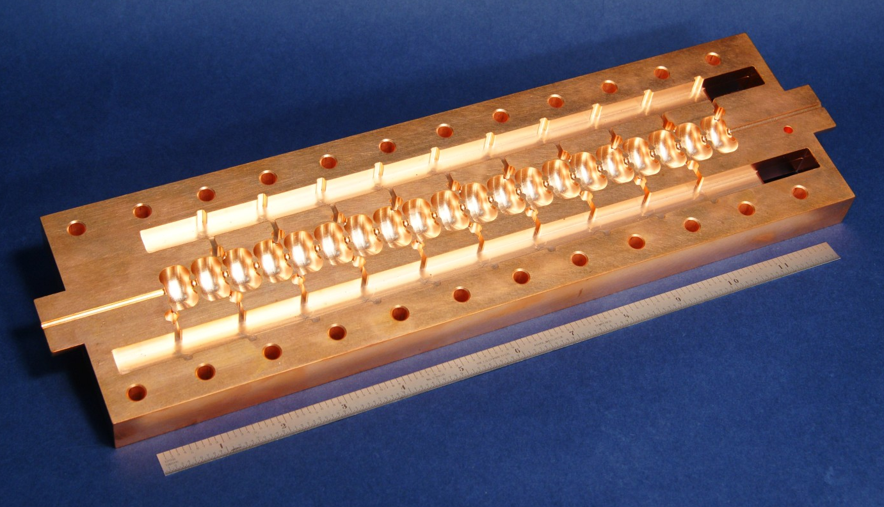
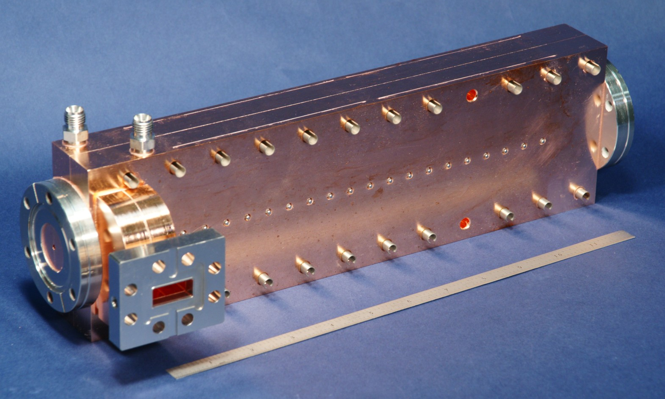
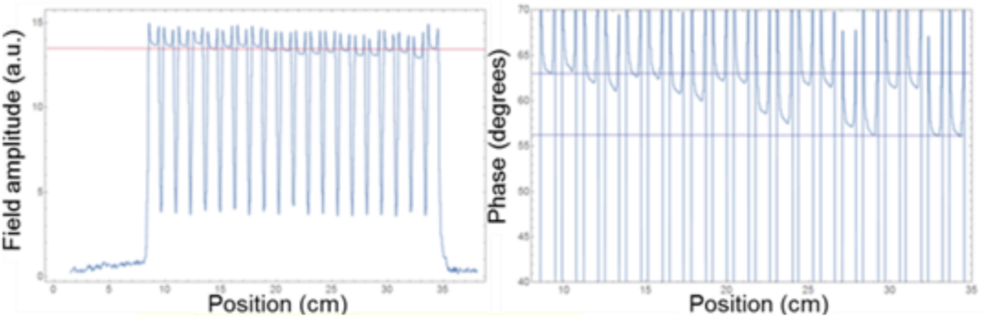
Demonstration in Cu at X-band
20-cell X-band structure fed by two waveguides from a single RF input.
Bead-pull measurement shows uniform field dist.
Currently under test, has exhibited up to 130 MV/m.

Slide 18
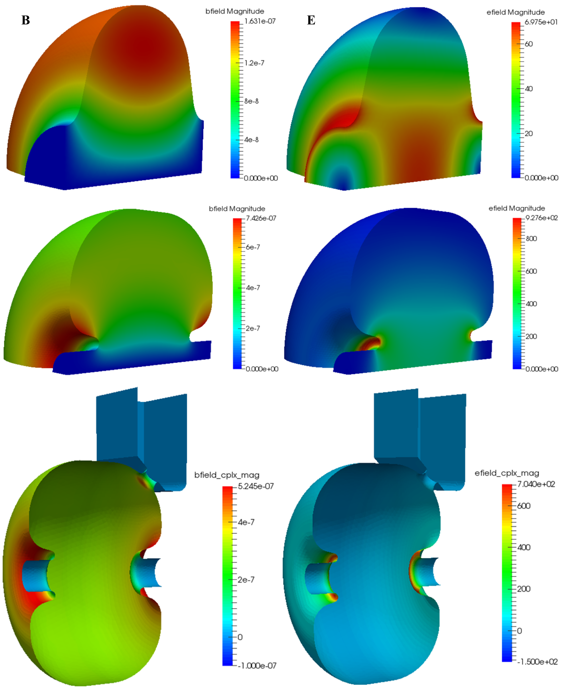
Adapting for SRF
Direct-feed cavity utilizes highly reentrant cell shape, shifting max-H from equator.
RF cavity loss reduced by nearly 60% c.f. TESLA.
 | 1.3 GHz TESLA | 1.3 GHz direct feed
R/Q (ohm/m) | 984.0 | 2571.4
E_{surf}/E_{acc} | 2.02 | 5.32
B_{surf}/E_{acc} (mT/(MV/m)) | 4.17 | 4.04
P_{loss} (W/m/(MV/m) | 0.101 | 0.043
Q₀ | 1e10 | 0.91e10

Slide 19
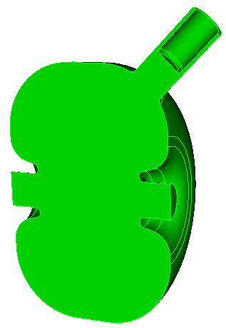
Tuning Isolated Cells
Tuning Isolated Cells
Plunger w/ zero offset from the coaxial center

Slide 20
An Efficient SRF Split-Cell Cavity
Challenge # 1 is how to fabricate:
  Complicated structure precludes PVD – only vapor-phase dep seems plausible.
  Cu structures are brazed. SRF cavity to be welded or bolted.
  Accelerating mode has no azimuthal current, but excitation of HOMs and a lossy joint could kill efficiency.
Current plan is to fabricate a 2-cell S-band structure from bulk Nb:
  Measure low-power Q
  Demonstrate tuning

