Slide 1

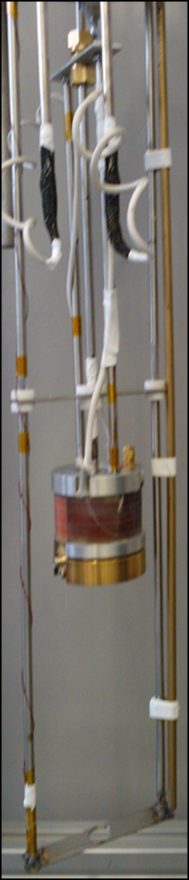




Magnetic Field Penetration Measurements on S-I-S Multilayer Structures
L. Gurran^{1,2}, O.B. Malyshev^{2,3}, S. Pattalwar^{2,3}, K.D. Dumbell^{2,3},
R. Valizadeh^{2,3}, Graeme Burt^{1,2}, N. Pattalwar and A. Gurevich⁴
¹ University of Lancaster, Lancaster, UK
² Cockcroft Institute, Warrington, Cheshire, UK
³ASTeC, STFC Daresbury Laboratory, Warrington, Cheshire WA4 4AD, UK
⁴Old Dominion University, Norfolk, VA 23529, USA
1
Notes:
Good afternoon everyone – (as X said) I’m a PhD student at the University of Lancaster. I’m working in the ASTeC group at Daresbury Laboratory, and working on experimental techniques for SRF Thin Films analysis: one aspect of which I’m going to talk about today.

Slide 2
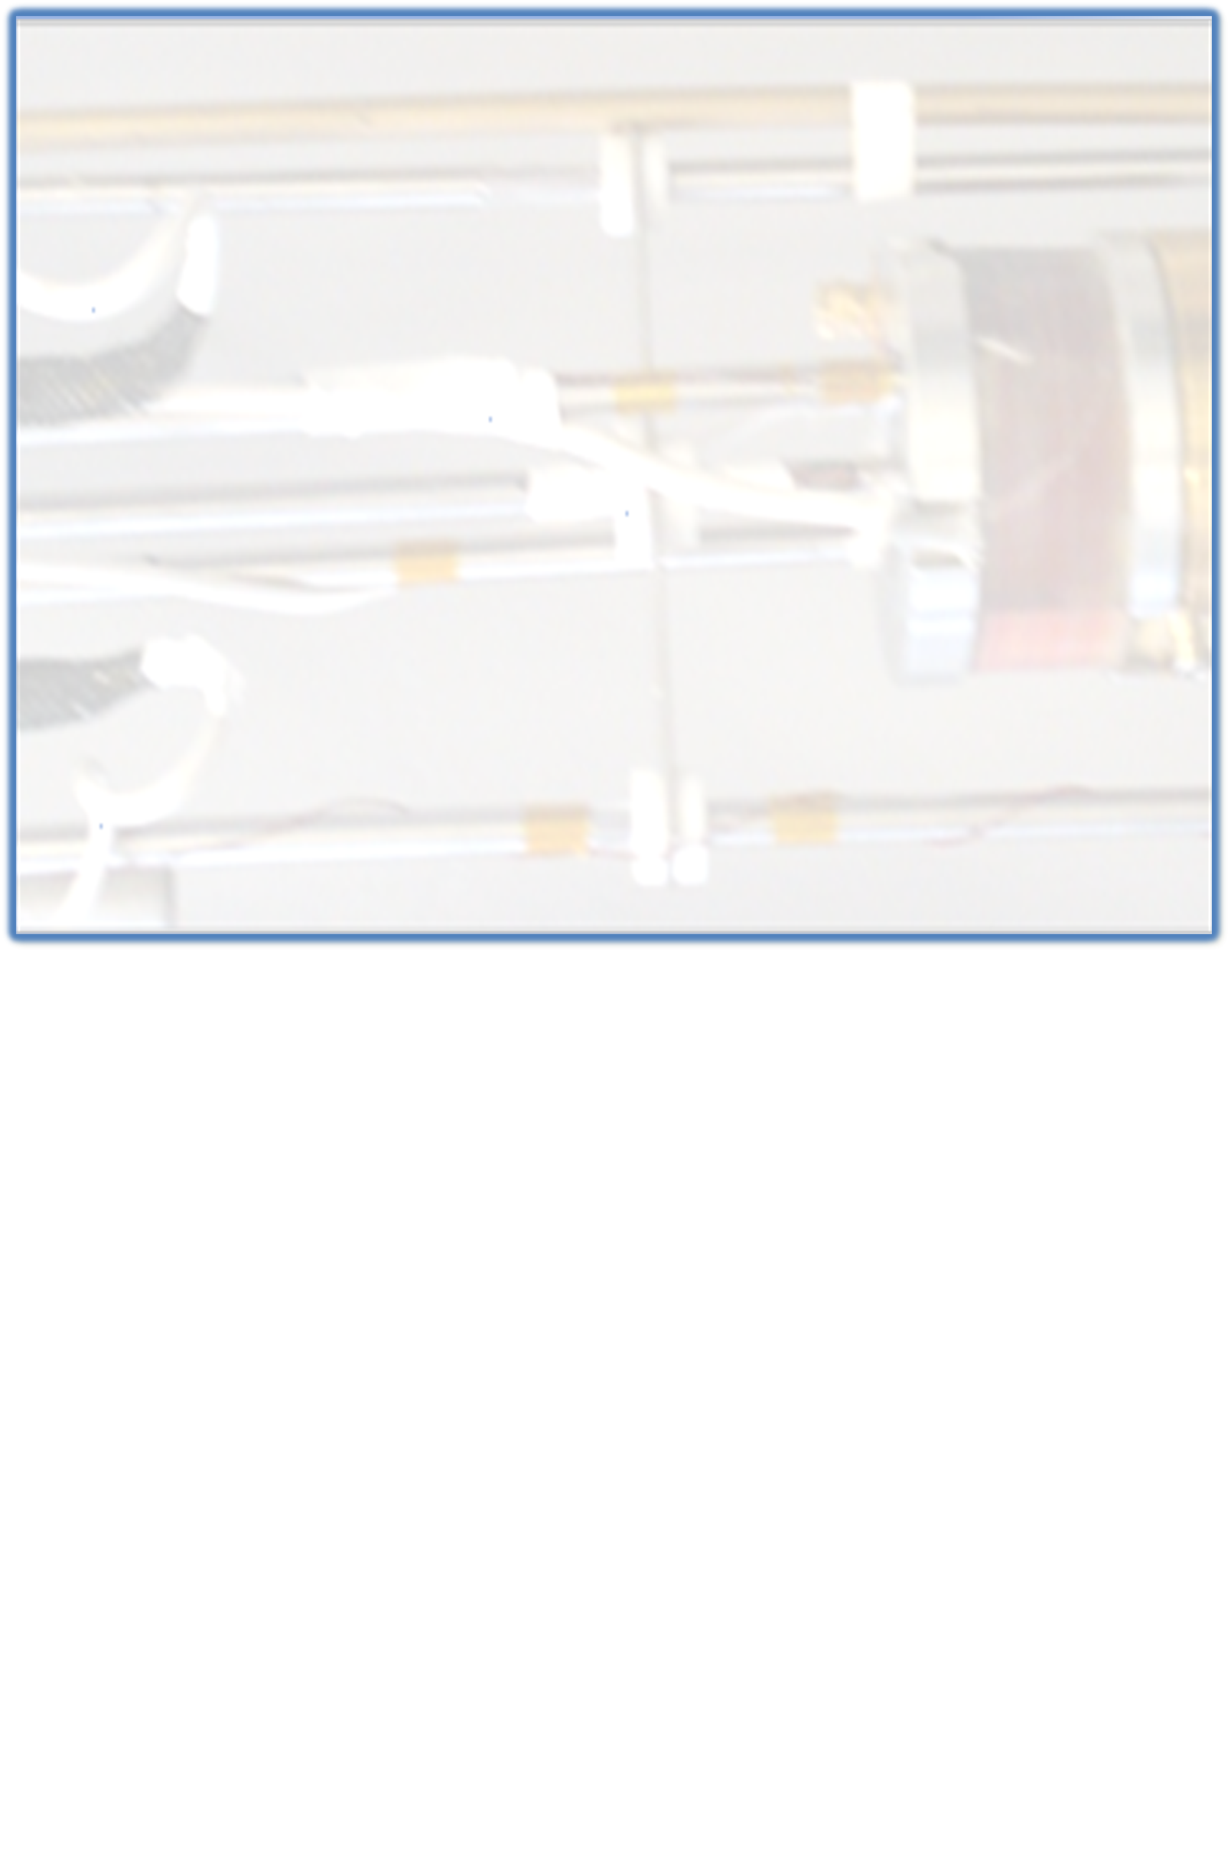
Towards higher quenching fields
1
Primary focus: to investigate Alex Gurevich’s theory of breakdown field enhancement.
Wider focus: to inform optimisation of thin film quenching fields.
2
1. From Gurevich 2006, “Enhancement of RF Breakdown Field of Superconductors by Multilayer Coating”, App. Phys. Lett. 88, 012511
Notes:
This is an experiment designed to measure the penetration of an external magnetic field through a superconducting sample. The first aim of this experiment is to investigate the theory put forward by Alex Gurevich: that by depositing thin superconducting films on top of bulk niobium, separated by thin insulating layers, you can partially screen the bulk from that field and increase the gradient that is achievable before quenching. However, looking at the bigger picture we would like this technique to be applicable, and hopefully useful, to the wider search for higher quenching fields.

Slide 3
Necessary test conditions
The applied magnetic field must be:
  Parallel to the sample surface, as in an accelerating mode of an SRF cavity
  Only on one face of the sample, as on a cavity wall
  Measurable on both sides of the sample
    As uniform, or at least as predictable, as possible near the sample surface
  Deceptively difficult to satisfy all these conditions.
  Having the field source much smaller than the sample is an old solution, revived by Alex Gurevich.
3
Notes:
So to be a useful test of how well a thin film or multilayer screens what is beneath it from an external magnetic field, the experiment must fulfil several important conditions.
* The external field must be parallel to the sample surface, as in a real SRF cavity.
The magnetic field must be incident on the sample only from one direction – i.e. on what would be the inner surface of a cavity.
We must be able to measure the magnetic field on both sides of the sample, and we also need to be able to translate those measurements into what exactly the field is on the sample surface: so the ideal condition would be for it to be uniform (in the absence of anything else) between the two field probes, or at least as predictable as possible. This means that we would want the sensors to be as close to the sample as possible.
It’s deceptively hard to satisfy all these conditions simultaneously - the traditional SQUID setup, for example, is completely unsuited to the task. Although that may generate a beautifully uniform field everywhere, it is…everywhere. Any S-I-S sample put into a SQUID would have all its layers impinged upon simultaneously and its screening capabilities completely negated.
Alex has put forward one solution – or perhaps revived is better, because it’s actually a very old one. This is to have a field source much smaller than the sample – almost a SQUID turned inside out.

Slide 4
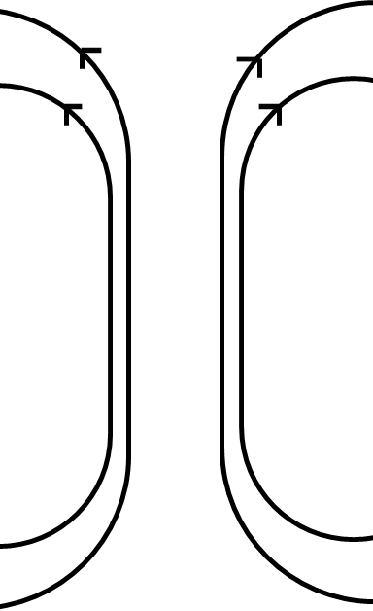
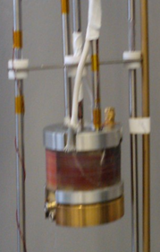
Method 1: Tubular samples
Magnet current ramped to scan B1
0 T → 1 T → -1 T → 1.7 T : a full hysteresis loop.
Afterwards, residual field profile can be mapped by moving magnet assembly relative to sample.
Sample tube, fixed relative to cryostat and coaxial with coil
Field probe 1
(reading: “B1”)
Field probe 2
(reading: “B2”)
SC magnet coil, mounted with the field probes to move freely along the sample length.
The magnet assembly, in schematic and photographic form.
4
Notes:
Solution 1: Tubular sample inside and along axis of superconducting coil.
Hall effect probes fixed relative to magnet, magnet-probe assembly can be moved along sample to map out trapped field profile.
In a LHe bath (but no inherent reason why it couldn’t be cryo-cooled).
Our measurements are automated with a LabView program as follows: the magnet current is stepped up, and once it’s stabilised B1 and B2 are recorded and then the current is stepped up again. It does this until the external field B1 reaches 1 Tesla, then stepped down until it’s -1 Tesla, and then back up to the magnet’s limit, which is 1.7 T. This gives a complete “hysteresis curve” of the sample, which I’ll show you in a minute. Also, since the magnet and probes can be moved independently of the sample, once the current’s been switched back to zero the profile of the remnant field can be mapped by sliding them up and down.

Slide 5
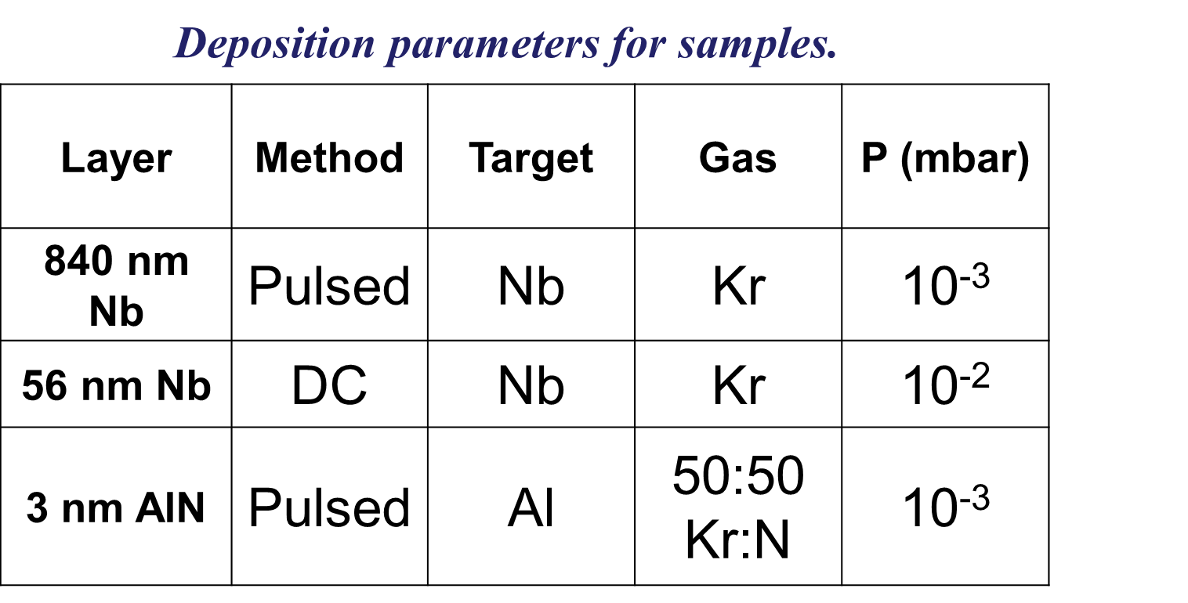
Samples tested
Sample 1: Bulk niobium (RRR = 384) from Niowave Inc.
Three polished copper tubes with thin films on outer surface.
Sample 2 - 840-nm thick Nb film.
Sample 3 - 56-nm thick Nb film.
Sample 4 – S-I-S: 840-nm thick Nb film, then 3-nm thick AlN insulation layer and finally 56-nm thick Nb film.
FIB-SEM cross-sectional images of:
Thick Nb film on Cu (Sample 2)
Thin Nb film on Cu (Sample 3)
Nb-AlN-Nb multilayer on Cu (Sample 4)
5
Notes:
This rig was used to test the following set of samples:
Sample 1, a bulk niobium tube – made from a rod of niobium, RRR of nearly 400, with a cylindrical hole drilled through it. Not chemically treated afterwards.
The other three were tubes of polished copper with thin films deposited on them as follows.
Sample 2 had 840 nm of Nb deposited on it with HiPIMS.
Sample 3 had 56 nm of Nb deposited on it with DCMS.
Sample 4 was an S-I-S multilayer where the superconducting sections were intended to be equivalent to either sample 2 or sample 3 - 840 nm of Nb deposited as for sample 2, then 3 nm of aluminium nitride deposited with HiPIMS, then 56 nm of niobium deposited with DCMS. The sputtering parameters are summarised here.
Important note: inner field probe detected nothing when Nb in Meissner state. For error analysis purposes: if it took that long for the leakage signal (which should increase linearly with magnet current) to become noticed, then even all the way up it should be a vanishingly small fraction of the total signal.
Seems to be clear evidence of Ffp enhancement.

Slide 6
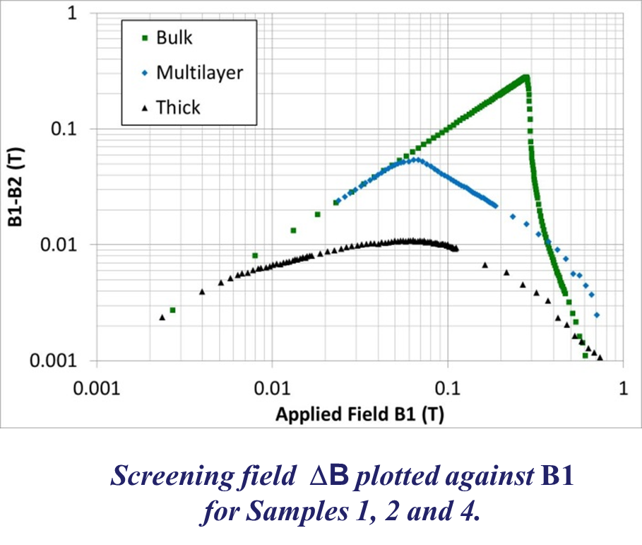
Results 1
Screening Field, ΔB= (B1 – B2)
6
Notes:
Results: Include definitions, all three graphs and conclusions: clearly suggests DC field enhancement “greater than the sum of its parts”.

Slide 7
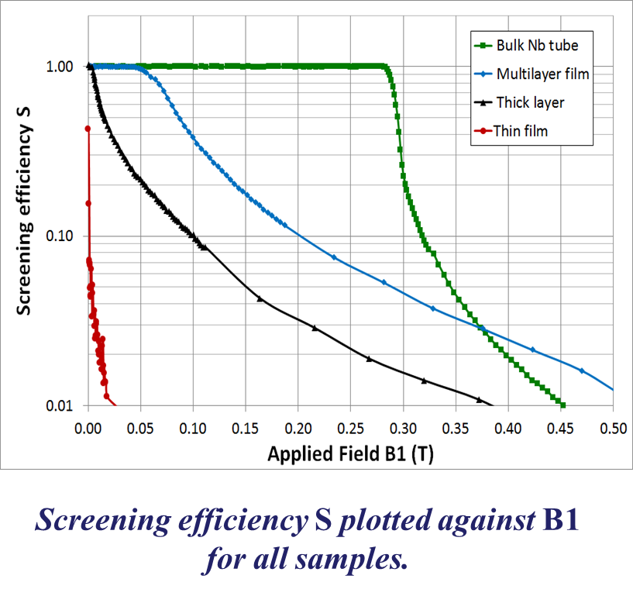
Results 2
Screening Efficiency, S = (B1 – B2)/B1
7
Notes:
Results: Include definitions, all three graphs and conclusions: clearly suggests DC field enhancement “greater than the sum of its parts”.

Slide 8
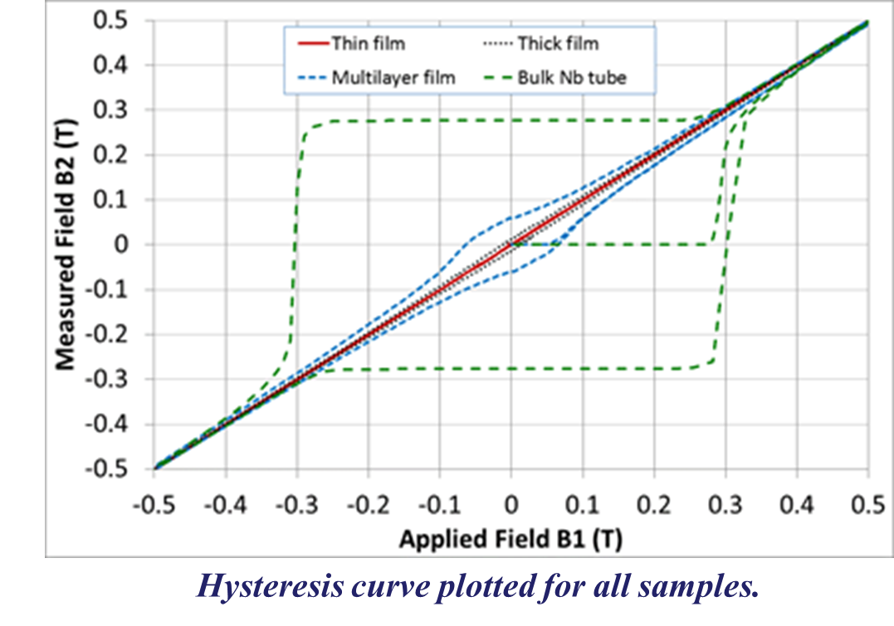
Results 3
8
Notes:
Results: Include definitions, all three graphs and conclusions: clearly suggests DC field enhancement “greater than the sum of its parts”.

Slide 9
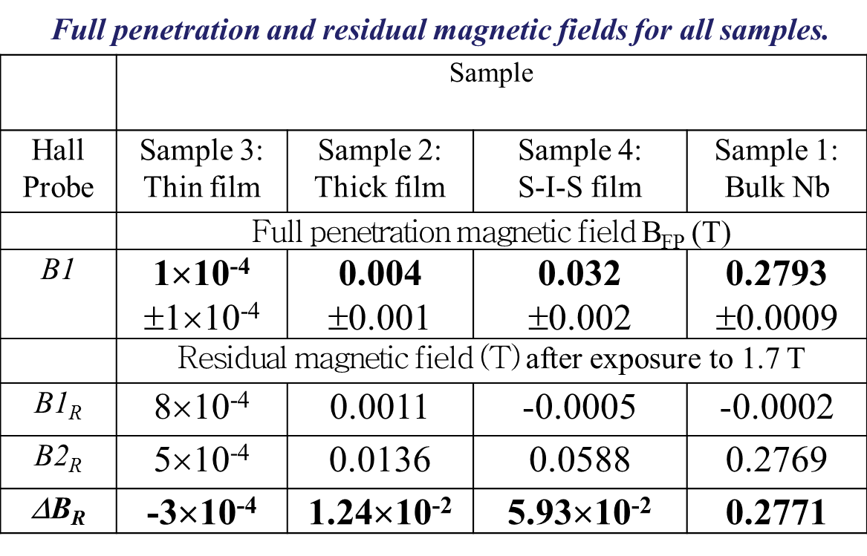
Results 4
B_{FP} = lowest value of B1 for which B2 ≠ 0, S ≠ 1.
B_{R} = Measured after full hysteresis loop, magnet current 0 A.
B1
B2
Clearly suggests enhancement of B_{FP} in S-I-S coatings, much “greater than the sum of their parts”.
9
Notes:
Results: Include definitions, all three graphs and conclusions: clearly suggests DC field enhancement “greater than the sum of its parts”.

Slide 10
Method 2 – Planar samples
C-shaped dipole:
Field parallel to sample in plane of gap centre.
Field strength falls off quickly away from gap.
SC gasket will help keep field away from edges of samples.
Superferric to cut heat load.
Pole arms detachable to make coil as space-efficient as possible.
SC coil
Steel yoke
Field probe
Sample
SC
gasket
Field probe
B normal to sample along this line
10
Notes:
An experiment that could test planar samples would be an improvement in several ways: most importantly, that it would be much easier to put the same sample under both DC and SRF test procedures. Planar samples are also much more “standard” for depositions, which is good news for precise control of parameters. Not needing to order purpose-built high-RRR niobium tubes is also good news for budgets. However, generating an appropriate field on a planar sample is rather more difficult: designing a field source smaller than a 50mm sample is bound to be, really.
Proposed solution: dipole-like c-core magnet.
Along the centre line, field lines normal to pole faces.
Relatively fast fall-off in field strength away from the gap, will help minimise fields at edge of sample.
Superferric (SC coil, steel core) to cut down on heat load to cooling system.
Hall probe between pole faces. 2mm gap leaves enough space. Second one on the far side of the sample.
Spec: must fit within footprint of 50 mm –diameter sample, including the coil, field strength up to 0.5 T on sample face (which we’ll aim to get within 1 mm of the gap), should not fall off to less than 10% 5mm away from the gap (the closest we can get the second Hall probe).

Slide 11
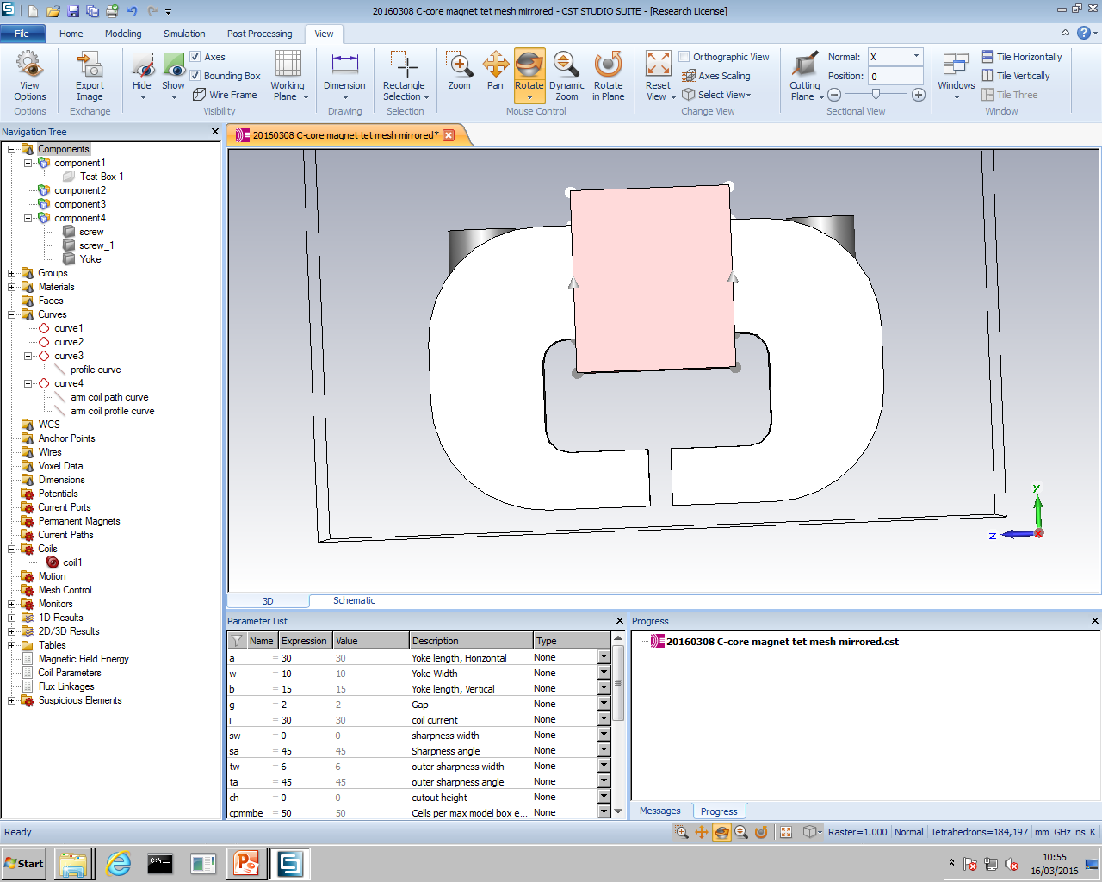
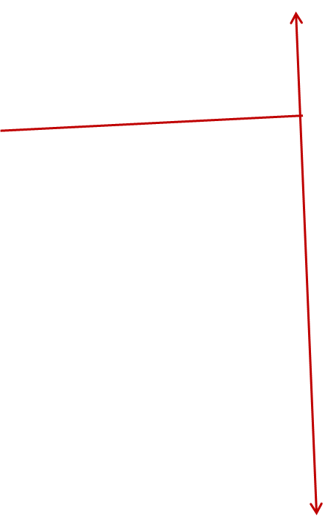
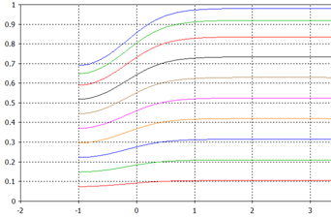
Simulations 1
Can achieve 0.5 T on SC sample face with ~ 1000 A-turns.
Field at sample edge ~ 0.025 T.
y
1680 A-turns
1512
Simulated with SC surface 1mm from gap.
1344
1176
1008
840
|B| (T)
y (mm)
11
Simulations performed with CST EM Studio
Notes:
Planar samples are far more convenient to test, but also a much trickier proposition to generate appropriate fields for.
Proposed solution: dipole-like c-core magnet.
Along the centre line, field lines normal to pole faces.
Relatively fast fall-off in field strength away from the gap, will help minimise fringe fields. Could use a protective SC gasket to keep the field away from the edges.
Superferric (SC coil, steel core) to cut down on heat load to cooling system.
Hall probe between pole faces. 2mm gap leaves enough space. Second one on the far side of the sample.
Spec: fit within a 60mm – ID tube, including the coil, field strength up to 0.5 T on sample face (which we’ll aim to get within 1 mm of the gap), should not fall off to less than 10% 5mm away from the gap (the closest we can get the second Hall probe).
So to investigate the feasibility of this approach I started modelling a c-core in CST Elecromagnetic Studio. The first question was, could a coil we could physically fit in so small a system generate

Slide 12
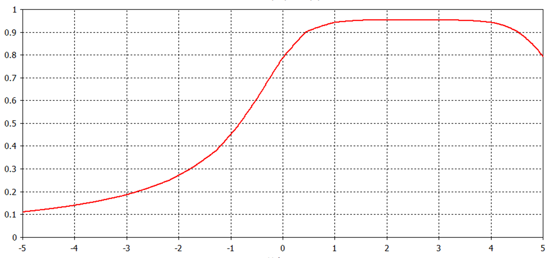
Simulations 2
Along central line, field still at ~ 10 % of maximum 5mm from yoke.
Well within sensitivity range of Hall probes.
Simulated with boundary far from gap.
|B| (T)
y (mm)
Simulations performed with CST EM Studio
12
Notes:
As to the magnetic field strength on the other side, by moving the boundary a large distance away we can approximate the “in vacuo” field distribution of the coil and get an idea of the sensitivity of the measurement on Bfp. At our current estimation, the active component of a Hall probe has to be 4mm from the sample surface. So, as you can see, if we place that surface 1 mm from the gap the second Hall probe gets about a fifth of the field strength as the surface feels. Let’s say we have a sample whose Bfp is around 0.05 T. If we apply that field to the sample surface, distance would drop that to 0.01 at the second probe even if the sample was fully normal. The hall probe series we currently use has a sensitivity of point one milliTesla, so if the sample has a Bfp just under our rough value – even if its screening efficiency is 99%, what it lets through should be enough to get detected. We should be able to measure Bfp more precisely the higher and higher it gets, as the second probe can detect the field at higher and higher screening efficiencies.
That rough calculation does demonstrate one downside to this design: that we can no longer assume that B1 and B2 would be the same if the sample was normal conducting. So thorough modelling of the exact field distribution is necessary, as is scrupulously careful alignment of all the components – you can see how much difference a millimetre makes – and even then it seems almost inevitable that any long range plots of “screening field” and “screening efficiency” will be rougher than for the previous method. As I hope I’ve shown, this experiment should give decent measurements of Bfp but I’d be hesitant in saying exactly what else it could do.
Y: With sample superconducting, 0.5 T on face can be achieved with ~1000 A-turns. Comfortably achievable with these coil dimensions and commercially available SC wire.
With sample normal conducting, B-field still > 10% within 5 mm.
Z, X: Fields well below 0.1 T (0.025 T) around edges of sample. We may well be able to use e.g. Pb rather than Nb for the protective gasket.

Slide 13
Future plans
Tests of S-I-S multilayers on bulk Nb tubular samples.
Assembling and commissioning magnetic field penetration experiment for planar samples.
Building up compressor-cooled rigs for testing tubular and planar samples in gas.
Using both tubular and planar facilities for optimisation of multilayer films.
Investigate alternative analysis methods – if possible, of mechanism as well as effect.
13
Notes:
Future plans:
Cryo-cooled version of tubular and planar penetration experiments.
Investigating effect of multilayer deposition parameters on Ffp.
SRF testing of multilayer surfaces.
Alternative analysis methods: is layer-by-layer analysis possible? This is a relatively complicated SC surface we’re talking about, so it would be good to be as sure as possible what exactly is happening.

Slide 14
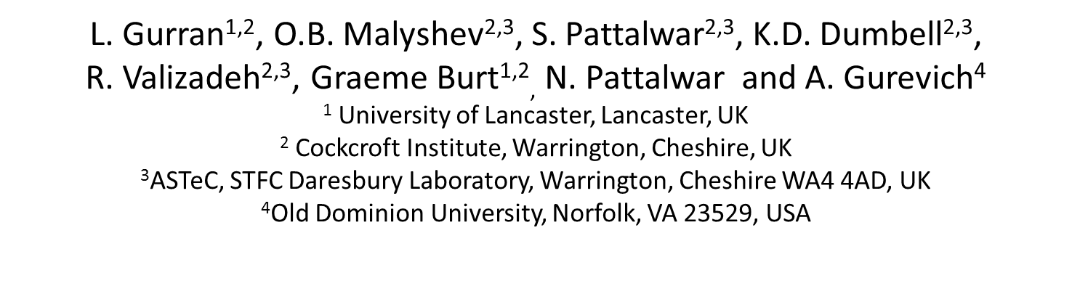
ACKNOWLEDGMENTS
The ASTeC project team would like to acknowledge the support given by the ASTeC management, namely P.A. McIntosh, J.D. Herbert and A.E. Wheelhouse. We also acknowledge the timely support of ETC staff, namely Steve Bibby-Trevor and Phil Davies. L. Gurran would like to thank ASTeC for providing a grant for his PhD studentship. The work at Old Dominion University was supported by the US Department of Energy under contract No. DE-SC0010081.
14
Notes:
So as the list of co-authors makes clear this has been far from a one-man project. Also due thanks are the ASTeC management and the technical staff at Daresbury Laboratory, the grant providers for my PhD studentship and the Department of Energy for supporting the relevant work done at ODU.

