Slide 1
RF dissipation due to nonlinear dynamics of Josephson vortices in polycrystalline TFSRF structures
Sheikhzada, A. and Gurevich, A. Sci. Rep. 5, 17821 (2015)
A. Sheikhzada and A. Gurevich, Physica C 506, 59-68 (2014)
Ahmad Sheikhzada and Alex Gurevich
Physics Department and Center for Accelerator Sciences
Old Dominion University
Supported by U.S. Department of Energy under grant No. DE-SC0010081
7th International Workshop on Thin Films and New Ideas for Pushing the Limits of RF Superconductivity

Slide 2
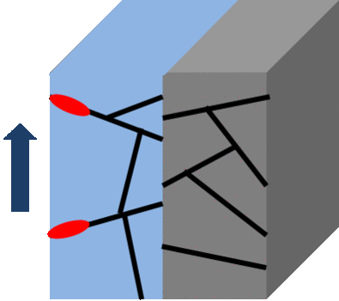
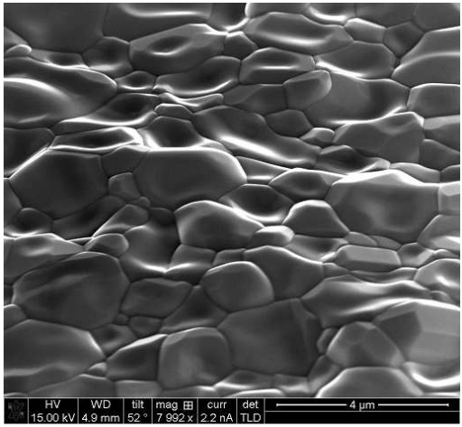
Outline
Grain boundaries are current blocking planar defects which can limit the SRF performance of promising polycrystalline materials Nb3Sn, NbN and pnictides.
Polycrystalline thin film coatings
Reduced field onset of dissipation due to penetration of Josephson vortices under strong rf fields.
Numerical simulation of nonlinear dynamics of Josephson vortices driven by strong rf currents
Rf power as a function of field amplitude
Cherenkov instability of Josephson vortices
Contribution to the high field Q-slope
S. Posen & M. Liepe, TUIOC03 (2014)
SEM of Nb3Sn surface

Slide 3
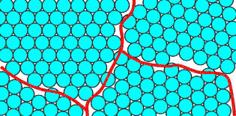
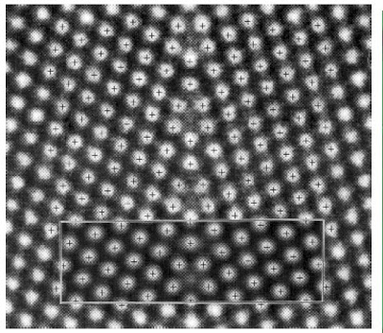
Grain Boundaries as Josephson Junction
2D planar defects between two crystalline grains.
Reduce current density, $J_{c,gb}<J_{d}$
Facilitate flux penetration, $H_{c,gb}<H_{c}$
Interface GB resistance
Bulk depairing current density $J_{d}=H_{c}/λ$ at which the cooper pair breaks.
Ginzburg-Landau parameter $κ=\frac{λ}{ξ}.$
$J_{c}$ decays with misorientation angle.
GB can be modeled as long Josephson junction.
$$J_{c}≪J_{d}, (H_{P}≪H_{c})$$
Weakly coupled GBs
$$J_{d}/κ<J_{c}<J_{d}$$
Strongly coupled GBs

Slide 4
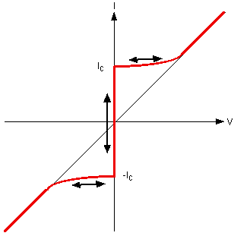
Josephson junction
Two Bulk superconducting electrodes separated by a nonsuperconducting layer.
Cooper pairs may tunnel through barrier layer giving rise to a supercurrent $J_{c}≪J_{d}$.
Weak superconducting region, SIS, SNS,…
Current and voltage across JJ depend on phase difference between electrodes
DC effect ($V=0$)
$$I_{s}=I_{c}\sin{θ}$$
AC effect ($V≠0$)
$$\frac{d(θ)}{dt}=\frac{2e}{ℏ}V$$
$$Ψe^{iφ_{L}}$$
$$Ψe^{iφ_{R}}$$
$$Ψ$$
$$θ(x,t)=φ_{R}−φ_{L}$$
V

Slide 5
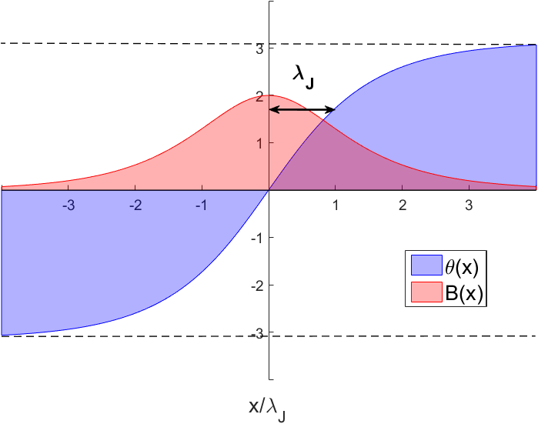
Long Junction(${ J}_{c}≪J_{d}$)
$+\frac{1}{ρ}E\left(x,t\right)+ε\frac{∂E}{∂t}+J_{ext}$
$\frac{∂θ}{∂x}=\frac{2π(2λ+d)}{Φ_{0}}H(x,t)$ & $J=J_{c}\sin{θ}$
Solution is $2π$ kink (Josephson vortex) forming a long current loop along JJ moving with velocity $v$ and subjected to Lorentz contraction.
Josephson magnetic penetration depth $λ_{J}$.
Low $J_{c}$ junction $λ_{J}≫λ, J_{c}≪\frac{J_{d}}{κ}$.
$v≤c_{s}=ω_{J}λ_{J}$ (Swihart velocity of small EM waves)
As $v$ increases the vortex Shrinks at $η≪1$ and Expands at $η>1$
$$λ_{J}^{2}\frac{∂^{2}θ}{∂x^{2}}−\sin{θ}=0$$
$$\ddot{θ}+η\dot{θ}=θ^{′′}−\sin{θ}+β$$
Sine-Gordon Eq.
$$ω_{J}={\left(\frac{2πcJ_{c}}{CΦ_{0}}\right)}^{1/2}$$
$$η=1/ω_{J}RC$$
$$β=J/J_{c}$$
$θ\left(x,t\right)=4\tan^{−1}{exp⁡(±\frac{x−vt}{L})}$
$$L=\sqrt{1−{(v/c_{s})}^{2}}λ_{J}, λ_{J}={\left(\frac{cΦ_{0}}{16π^{2}λJ_{c}}\right)}^{1/2}\sim {\sqrt{ξλ}\left(\frac{J_{d}}{J_{c}}\right)}^{1/2}$$
$$λ_{J}$$
$$λ$$

Slide 6
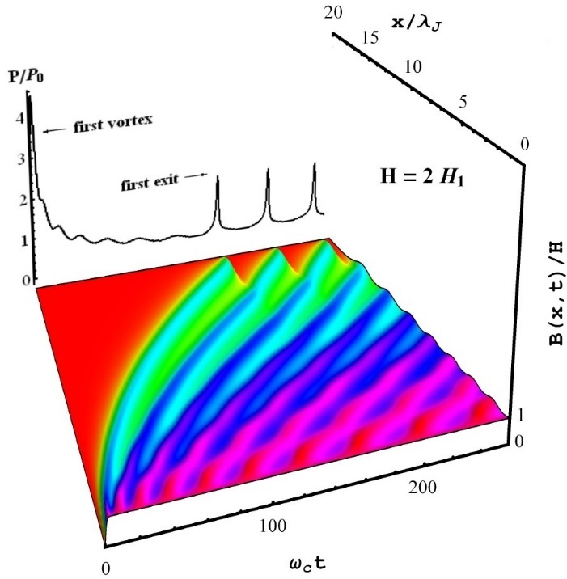
S-G, DC dynamics
$$η>1$$
$$η≪1$$
$$η<1$$

Slide 7
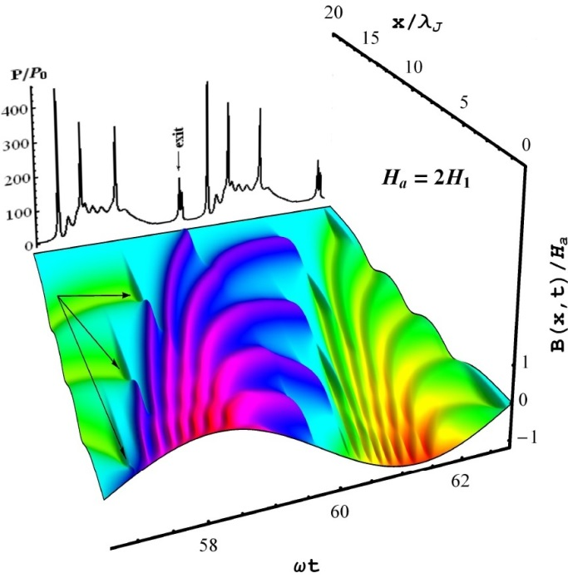
S-G, AC dynamics
$$η>1$$
$$η≪1$$
$$η<1$$

Slide 8
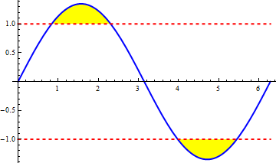
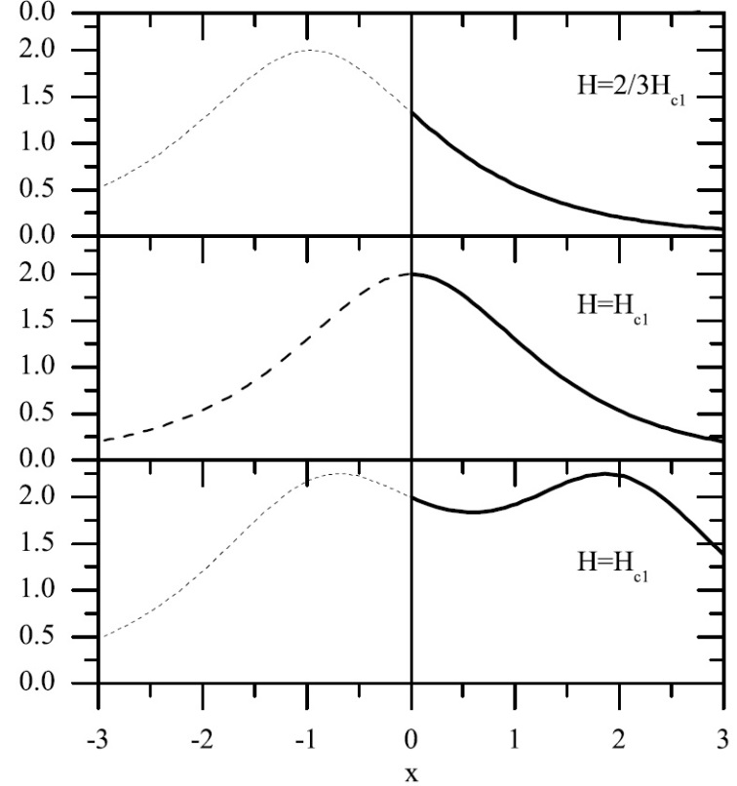
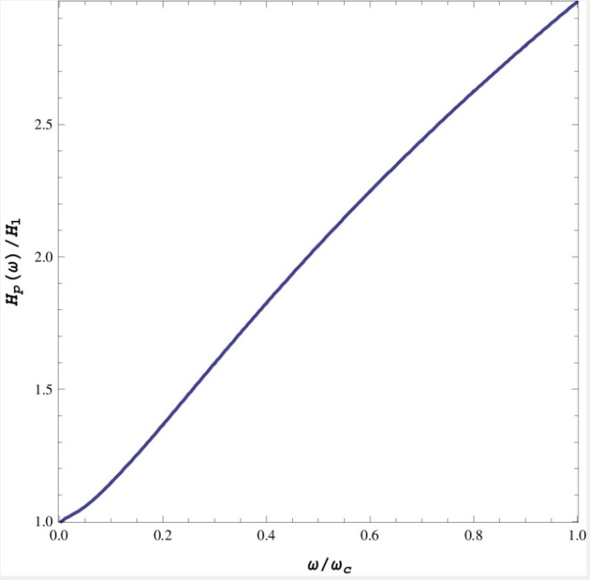
Vortex penetration
DC field application:
${H_{P}=H}_{M}=\frac{8πJ_{c}λ_{J}}{c}$
AC field application:
$H_{a}\sin{ωt}$
$H_{p}>H_{M}$
$H_{p}\left(ω\right)= H_{M}(1+1.4ω/{ω_{c}})$
$$θ′(x)$$

Slide 9
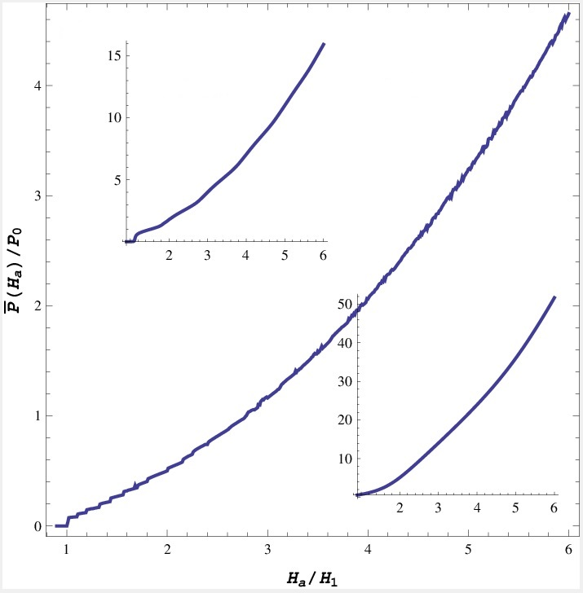
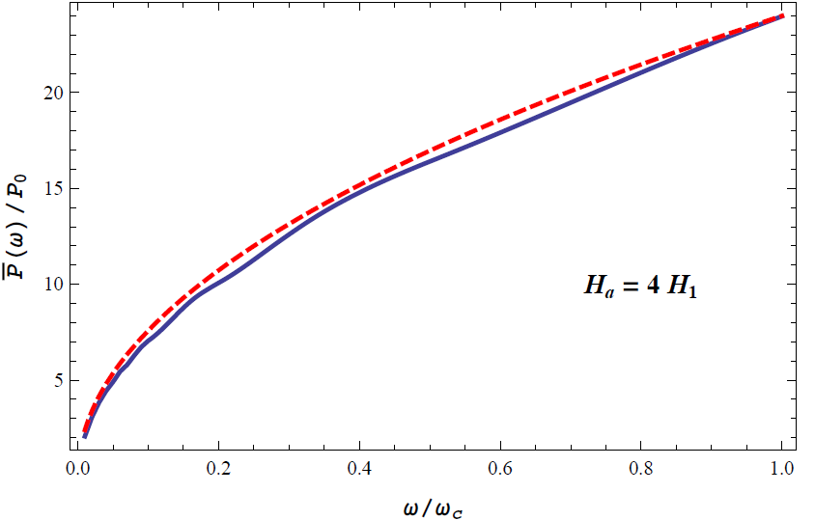
Power Dissipation
Quadratic function of field amplitude, $P∝H^{2}$.
Step-like feature associated to one additional vortex penetration
Power changes with square root of frequency, $P∝\sqrt{ω}$.
$$η=10$$
$$η=3$$
$$η=1$$

Slide 10
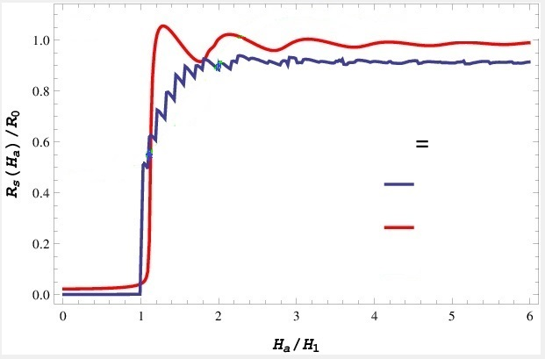
Surface Resistance
JJ junction model by Halbritter (2006):
$$R_{s}\sim \frac{ωB_{P}λ}{LJ_{c}}$$
Simulations show that $R_{s}$ is not linear in $ω$ and $B_{P}$.
$$η$$
1
3

Slide 11
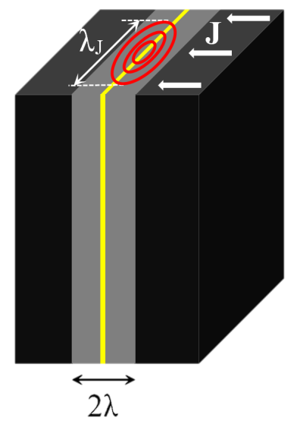
Strongly coupled GBs
For large currents the width of Josephson vortex shrinks and $λ_{J}\sim λ$.
In superconductors with large G-L parameter $κ$, $J_{c}\sim J_{d}$.
GBs for Nb3Sn $J_{c}>J_{d}/κ$
S-G is no longer valid and relation between field $H$ and phase $θ$ in general becomes nonlocal.
New Abrikosov-Josephson (A-J) core length.
$ℓ=λ_{J}^{2}/λ$
logarithmic
$$\ddot{θ}+η\dot{θ}=\frac{ℓ}{π}\int_{−∞}^{ ∞}{K_{0}(\frac{\left|x−u\right|}{λ})}\frac{∂^{2}θ}{∂u^{2}}du−\sin{θ}+β$$
$$K_{0}(x)$$
exponential
$$λ$$
$$x$$

Slide 12
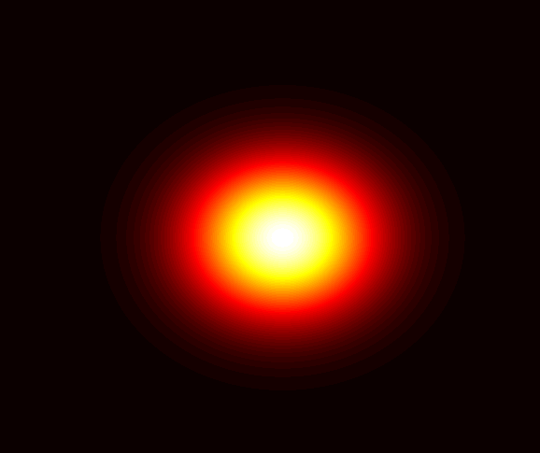
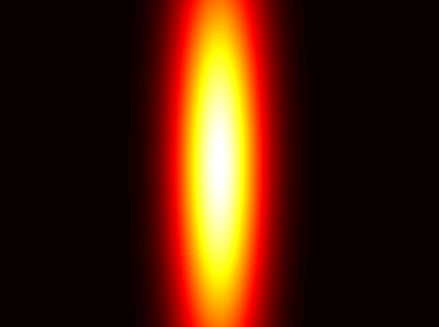
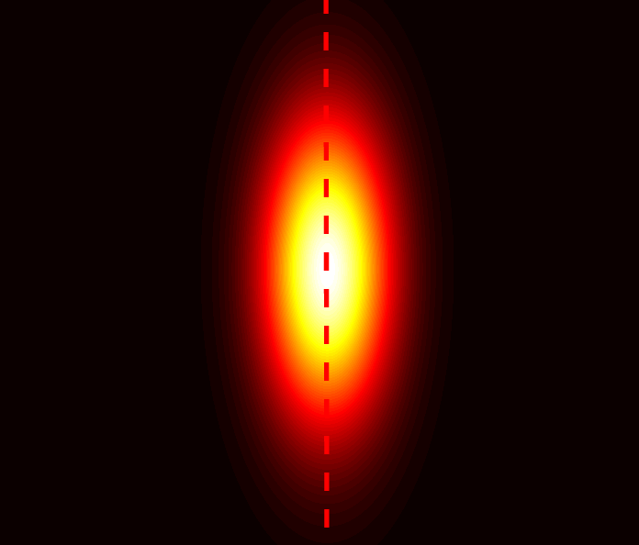
Nonlocal electrodynamics of strongly coupled GBs
$$\ddot{θ}+η\dot{θ}=\frac{ℓ}{π}\int_{−∞}^{ ∞}{K_{0}(\frac{\left|x−u\right|}{λ})}\frac{∂^{2}θ}{∂u^{2}}du−\sin{θ+β}$$
Normal core
A
Extreme nonlocality ($ℓ≪λ$, $J_{c}>J_{d}/κ$):
This describes the important field range
$\frac{H_{c}}{κ}<H_{P}<H_{c}$,
($H_{c}≈540 mT$, $κ≈20$ for Nb3Sn)
Large damping $η≫1$
A-J vortex like J-V expands at large damping and shrinks at small ones.
No core
J
$$\ddot{θ}+η\dot{θ}=\frac{l}{π}\int_{−∞}^{∞}{\frac{du}{u−x}\frac{∂θ}{∂u}}−\sin{θ}+β$$
$$λ_{J}$$
$θ\left(x,t\right)=π+\sin^{−1}{β}+2\tan^{−1}{(\frac{x−vt}{L})} L=\frac{l}{\sqrt{1−β^{2}}}$ $β=J/J_{c}$
J core
A-J
l
Gurevich, Physica C 243, 191(1995)

Slide 13
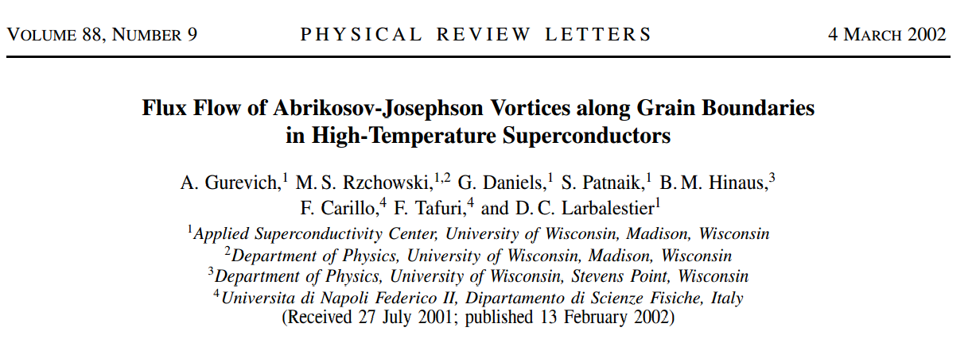
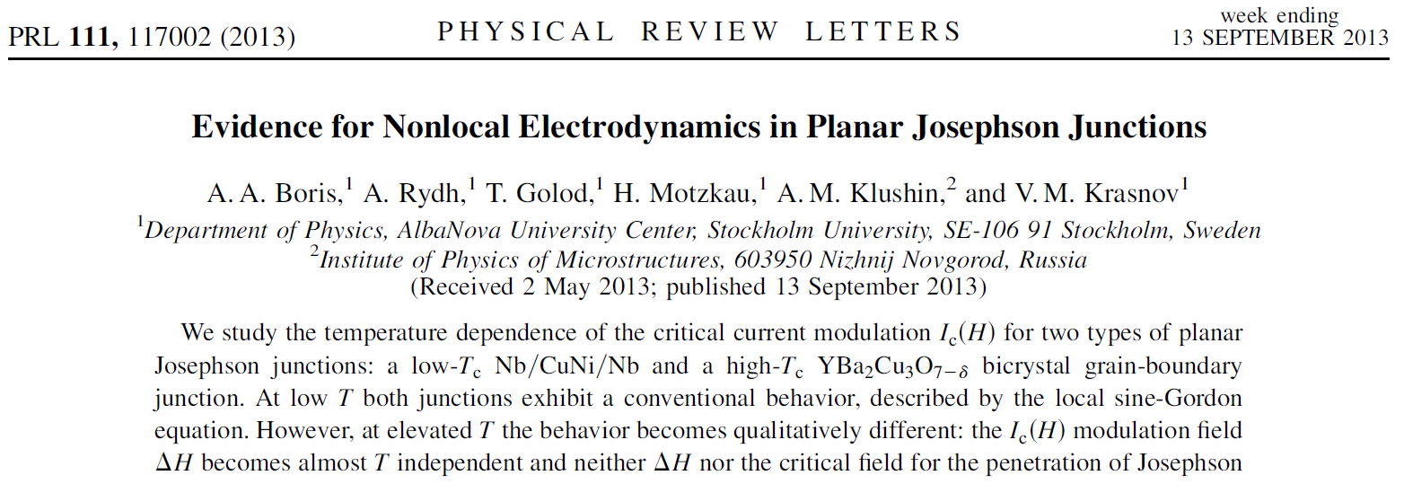
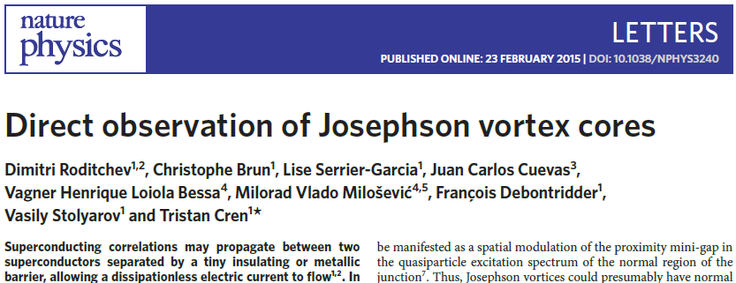
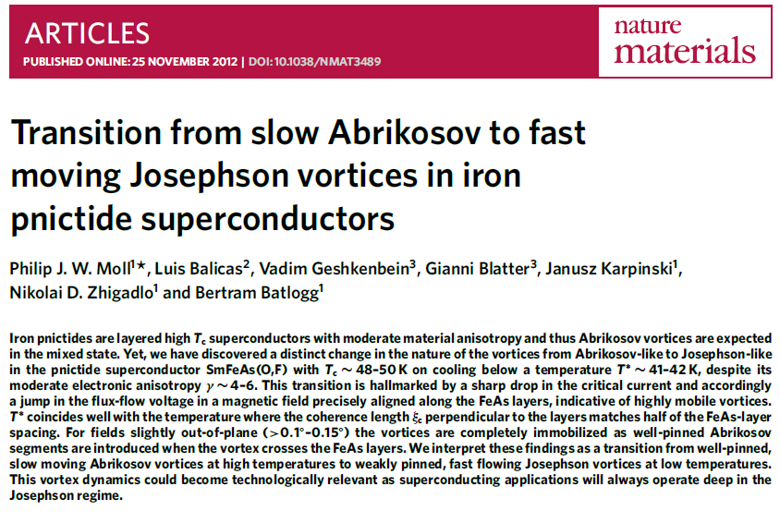
Experimental observations of AJ vortices
Transport measurements on grain boundaries, thin film junctions and layered superconductors
STM imaging of AJ vortices in monolayer step junctions

Slide 14
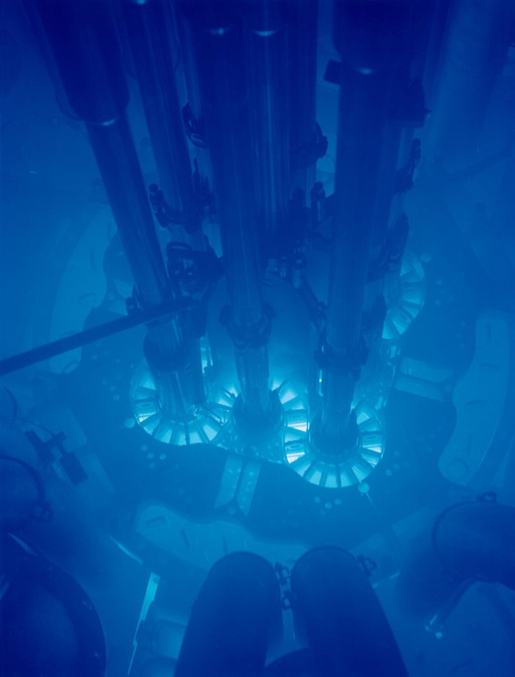
Cherenkov radiation
A charged particle moves with velocity greater than the phase velocity of light in a medium leaves behind electromagnetic radiation.
$$v>v_{Ph}=\frac{c}{n}$$
Electron passes through water in an underwater nuclear reactor emits Cherenkov radiation.
wikipedia.org/wiki/Cherenkov_radiation

Slide 15
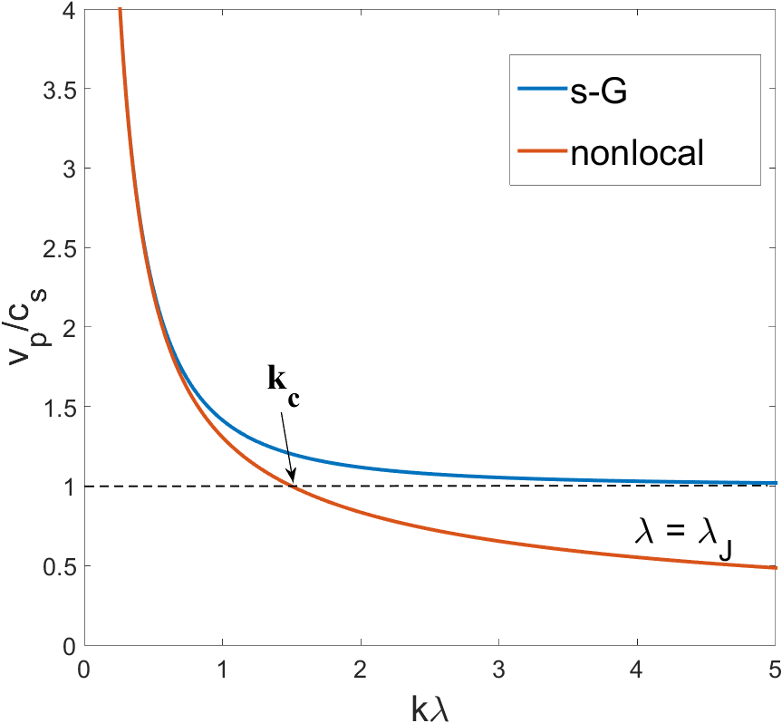
Cherenkov radiation by Vortices
For small perturbations in phase
$δθ\left(x,t\right)\sim e^{i(kx−ωt)}$ at $η=0$,
$$\ddot{θ}=\frac{ℓ}{π}\int_{−∞}^{ ∞}{K_{0}(\frac{\left|x−u\right|}{λ})}\frac{∂^{2}θ}{∂u^{2}}du−\sin{θ+β}$$
$$\ddot{θ}=θ^{′′}−\sin{θ}+β$$
Sine-Gordon equation is Lorentz invariant
$v_{p}= \frac{ω}{k}=c_{s}\sqrt{1+\frac{1}{λ_{J}^{2}k^{2}}}$
$v≤c_{s}$
Nonlocal equation is not Lorentz invariant.
$v_{p}=c_{s}\sqrt{\frac{1}{λ_{J}^{2}k^{2}}+\frac{1}{\sqrt{1+λ^{2}k^{2}}}}$
A vortex moving with a constant velocity $v$ produces Cherenkov radiation.
Radiation occurs for $k>k_{c}$
where $k_{c}$ decreases with $v$.

Slide 16
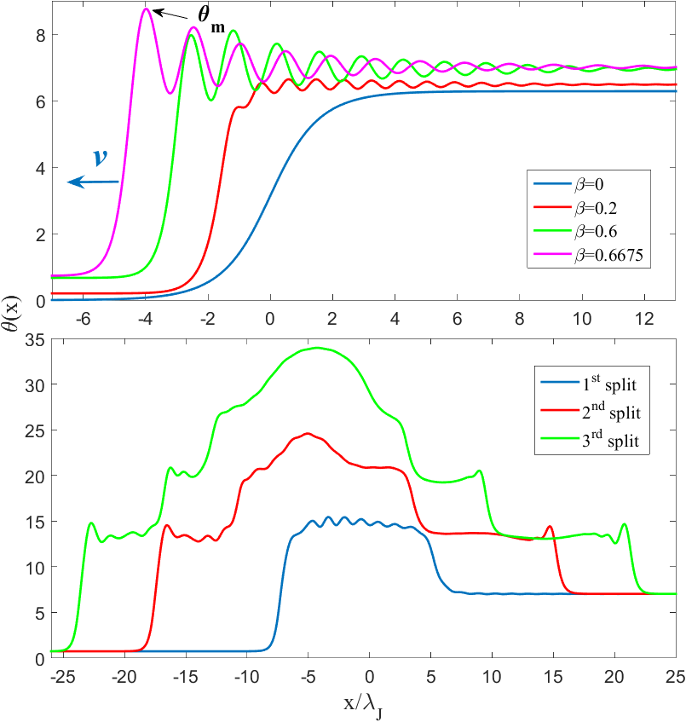
Instability of underdamped J vortex
Trailing tale of Cherenkov radiation with the amplitude increasing with $β$
Instability occurs as a $π$ junction critical nucleus with $5π/2<θ<3π$ appears behind a moving vortex
Cascade of v-av pairs
Formation of an expanding phase pile, initial $2π$ phase difference is preserved
Vortices at the edges move close to Swihart velocity or even higher
$$2π$$

Slide 17
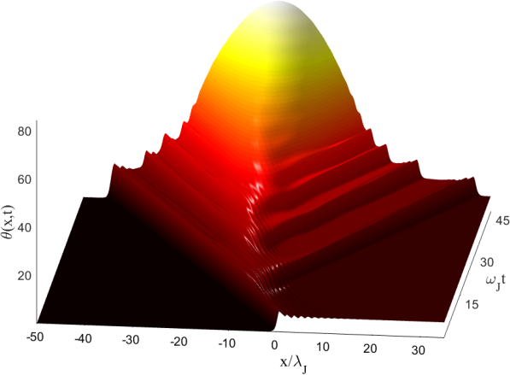
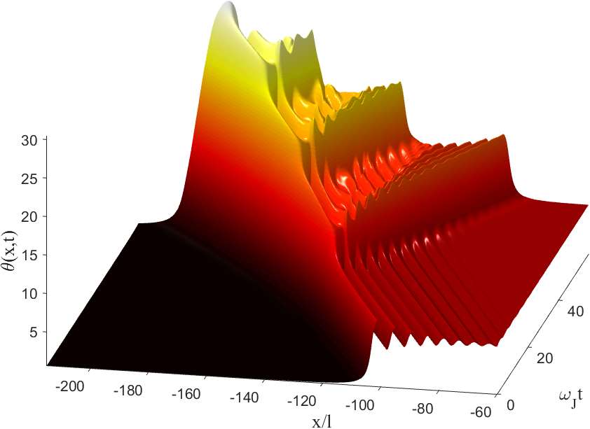
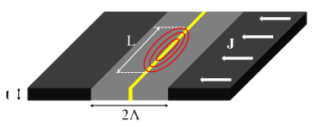
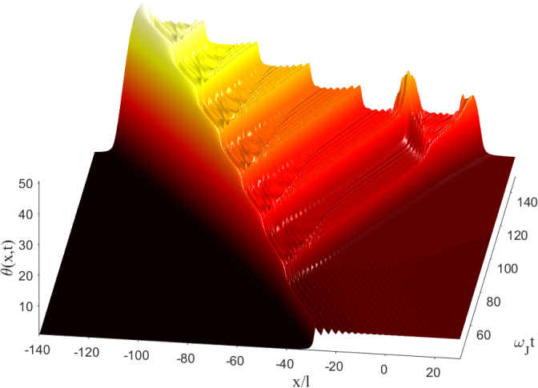
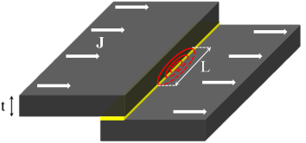
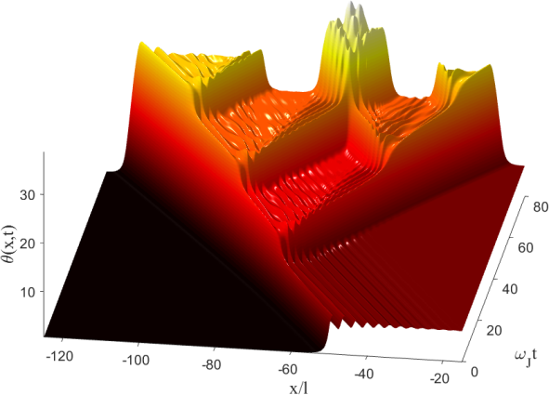
Instability in various geometries
We have observed the vortex fragmentation instability for different JJ geometries.
nonlocal limit of a bulk junction with
$\frac{λ}{λ_{J}}=\sqrt{10},η=0.1$ at $β_{c}\sim 0.61$.
bulk junction, $λ_{J}/λ=10$,
$η=0.05$, and $β_{c}\sim 0.66$
thin film edge junction taken at
$l=Λ/2$, $η=0.1$ and $β_{c}\sim 0.63$.
thin film overlap junction $l=t$, $η=0.1$ and $β_{c}\sim 0.63$.

Slide 18
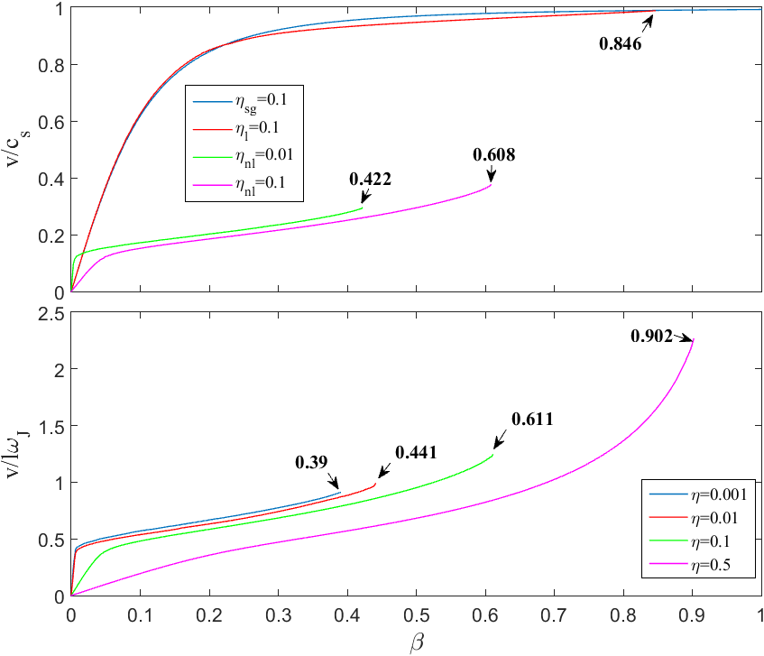
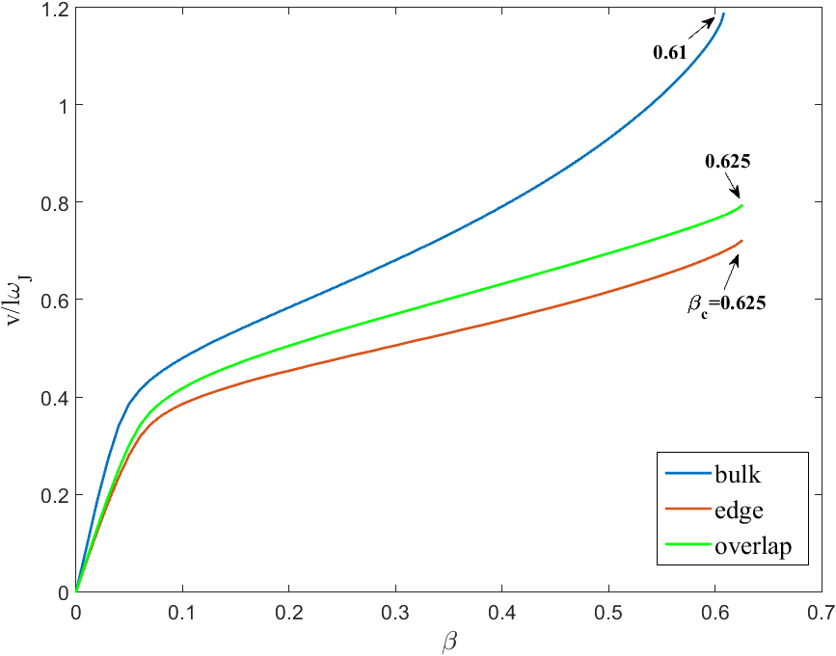
I-V characteristics
Small currents→ Ohmic friction force
Large currents→ Cherenkov radiation friction force
Instability at currents well below $J_{c}$
Similar behavior in different geometries
Ohmic
friction
Radiation friction

Slide 19
Effect of Finite Thickness of SRF Coating
Thin film slab $d≪λ$
Small screening over the thickness
Cherenkov radiation + effect of the edges
When current exceeds $J_{c}$, vortices can penetrate and start moving under the bias current $β$.
Vortices can also be produced by point defects that locally reduces $J_{c}$.
$$\ddot{θ}+η\dot{θ}=\frac{λ_{J}^{2}}{πλ}\int_{−d/2}^{ d/2}{\ln\left|\frac{2}{\sin{\frac{πx}{d}}−\sin{\frac{πu}{d}}}\right|}\frac{∂^{2}θ}{∂u^{2}}du−\sin{θ+β}$$
$$d$$

Slide 20
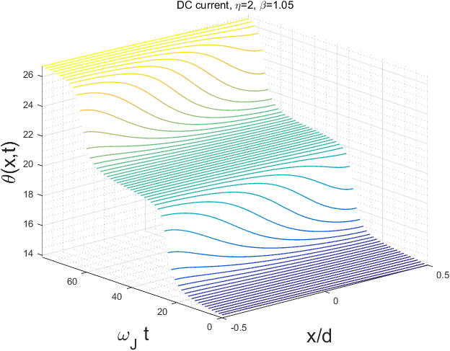
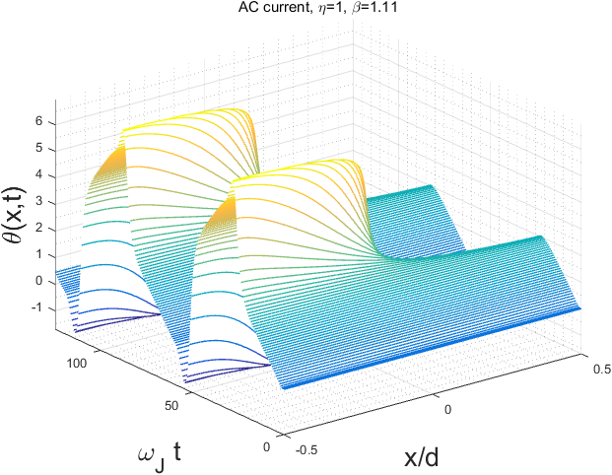
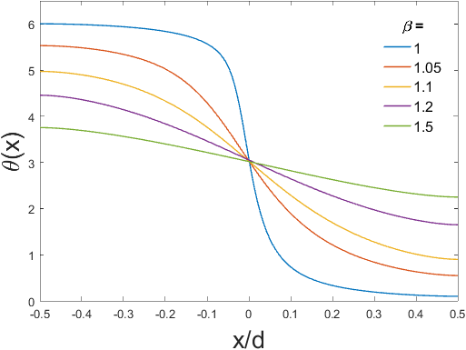
Dynamics
Overdamped $η>1$
Penetration of single vortices
No radiation
Vortex expands as current increases.
At large currents the junction turns to a small contact in which phase slip occur.

Slide 21
DC dynamics
$$η=1$$
$$η=0.5$$
$$η=0.7$$
$η=0.3$-point defect

Slide 22
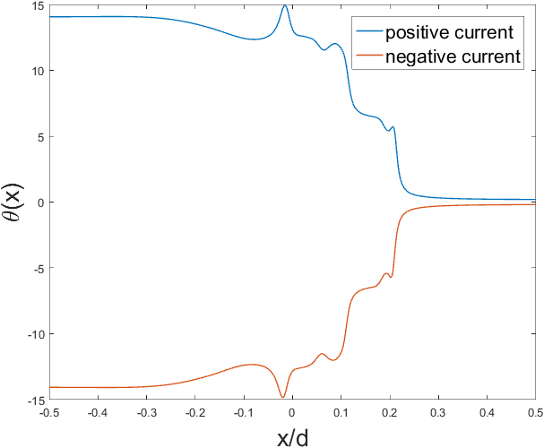
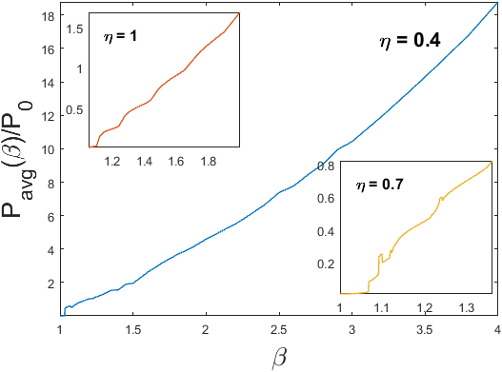
Ac field
Vortex penetration and radiation
dissipation

Slide 23
conclusions
Grain boundaries are current blocking planar defects which can limit the SRF performance of promising polycrystalline materials Nb3Sn, NbN and pnictides.
New instability of JV resulting from Cherenkov radiation ultimately drives the entire GB into resistive state.
Instability happens at currents well below $J_{c}$ and is most pronounced in thin films at low temperatures.
Surface resistance is a nonlinear function of field amplitude and current due to penetration and annihilation of vortices.
Contribution to high field Q-slope.

Slide 24
Thank you!

Slide 25
Numerical estimation
Nb3Sn , $H_{c}=540mT, ξ=3nm, λ=65nm,T_{c}=18K$

Slide 26
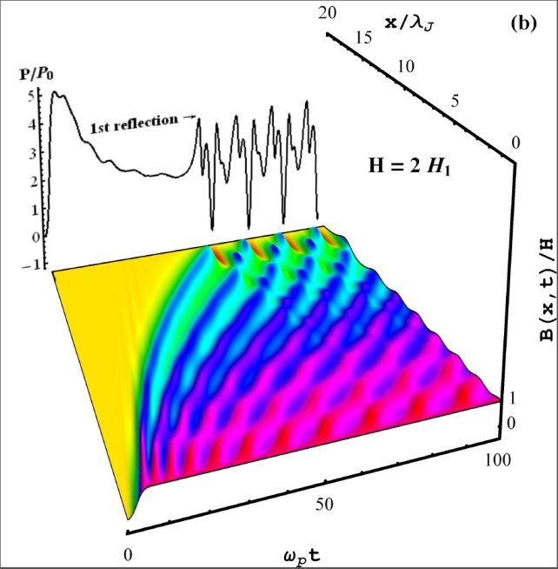
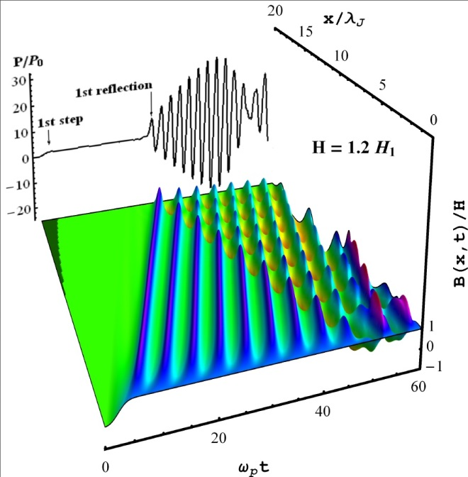
S-G, low damping
Medium damping $η<1$
annihilation
Ohmic dissipation is small
Vortices gain inertia
Low damping $η≪1$
Collision become elastic in such a way that vortices don’t annihilate and simply go through
No vortex exit
$$\ddot{θ}+η\dot{θ}=θ^{′′}−\sin{θ}$$

Slide 27
Surface Resistance
How a vortex dissipates?
When a vortex moves it induces electric field which couples to normal current and results in dissipation of energy.
$$E=B×\frac{v}{c}$$
$$\overline{P}=\frac{1}{R_{n}}\int{V^{2}dx dt}=\frac{1}{R_{n}TL}{(\frac{Φ_{0}}{2π})}^{2}\int_{0}^{T}{dt}\int_{0}^{L}{{\dot{θ}}^{2}}\left(x,t\right)dx$$
Dissipation due to vortex dynamics in GBs contribute to residual resistivity $R_{0}$.
Power dissipation in SRF materials and cavities
$$P=\frac{1}{2}\int_{s}{R_{s}\left(H\right)HdH}$$
$$R_{s}=R_{BCS}(T)+R_{0}$$

Slide 28
