Slide 1
Surface resistance studies as a function of the mean free path
Martina Martinello
High Q TTC Meeting,19 May 2016

Slide 2
Surface Resistance Contributions
$$R_{S} \left( 2 K,B_{Trap} \right)={R_{BCS} \left( 2 K \right)+R}_{0}+R_{Fl} ( B_{Trap},l )$$
$$R_{S} \left( 1.5 K,B_{Trap} \right) \sim R_{0}+R_{Fl} ( B_{Trap},l )$$
BCS surface resistance:
$$R_{BCS}=R_{S}\left(2 K\right)−R_{S}\left(1.5 K\right)$$
Trapped flux surface resistance:
$$R_{Fl}=R_{S}\left(1.5 K,B_{Trap}\right)−R_{0}$$

Slide 3
Trapped Flus Surface Resistance
$$R_{Fl}=R_{S}\left(1.5 K\right)−R_{0}$$
The trapped flux surface resistance $R_{FL}$ depends on:
The amount of trapped flux $(B_{Trap})$
External magnetic field ($B_{ext}$)
Level flux expulsion during SC transition
Surface treatment (mean free path, $l$ )

Slide 4
Trapped Flux Surface Resistance
$$R_{Fl}=R_{S}\left(1.5 K\right)−R_{0}$$
In order to estimate $R_{S}\left({1.5 K,B}_{Trap}\right)$:
Slow cooldown with${ B}_{applied} \sim 10−20 mG$
$$B_{applied }\sim B_{Trap}$$
In order to estimate $R_{0}$:
Cavity cooled in compensated field ( $<1 mG$) OR
Fast cooldown with efficient flux expulsion
$$B_{Trap} \sim 0→R_{Fl} \sim 0→R_{S} \sim R_{o}$$

Slide 5
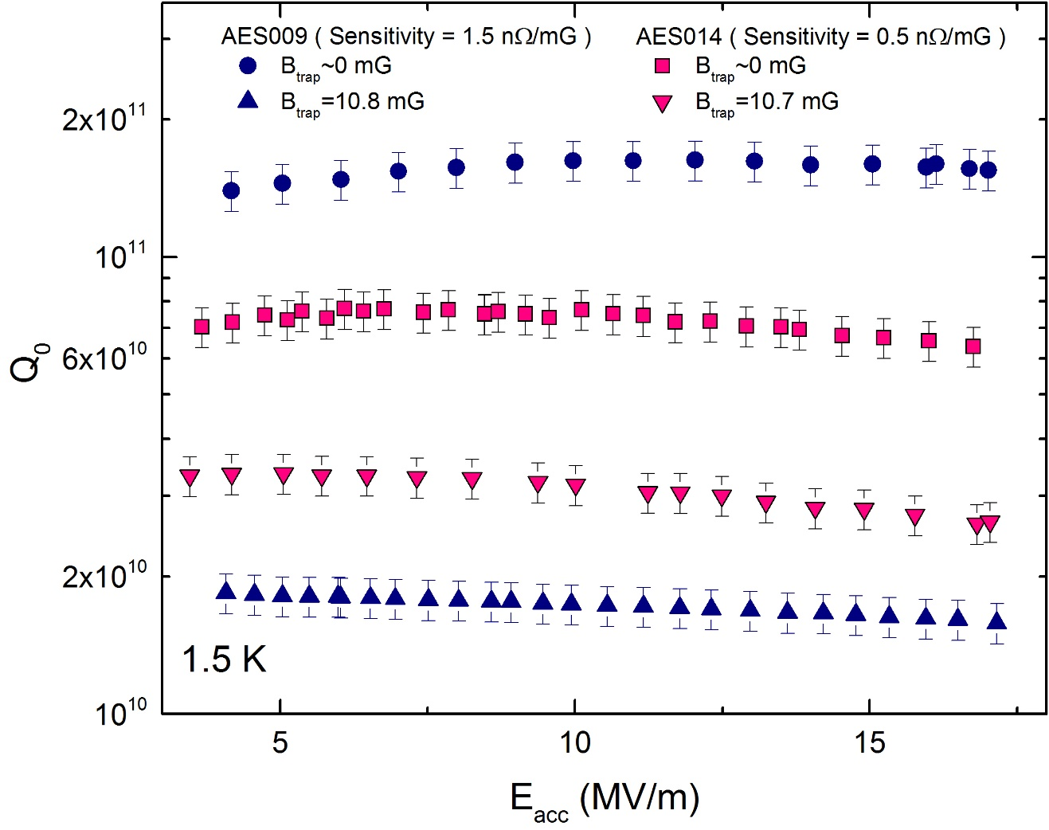
Trapped Flux Sensitivity
How much the cavity dissipated per amount of trapped flux:
$$Sensitivity(l)=\frac{R_{FL}}{B_{Trap}}$$

Slide 6
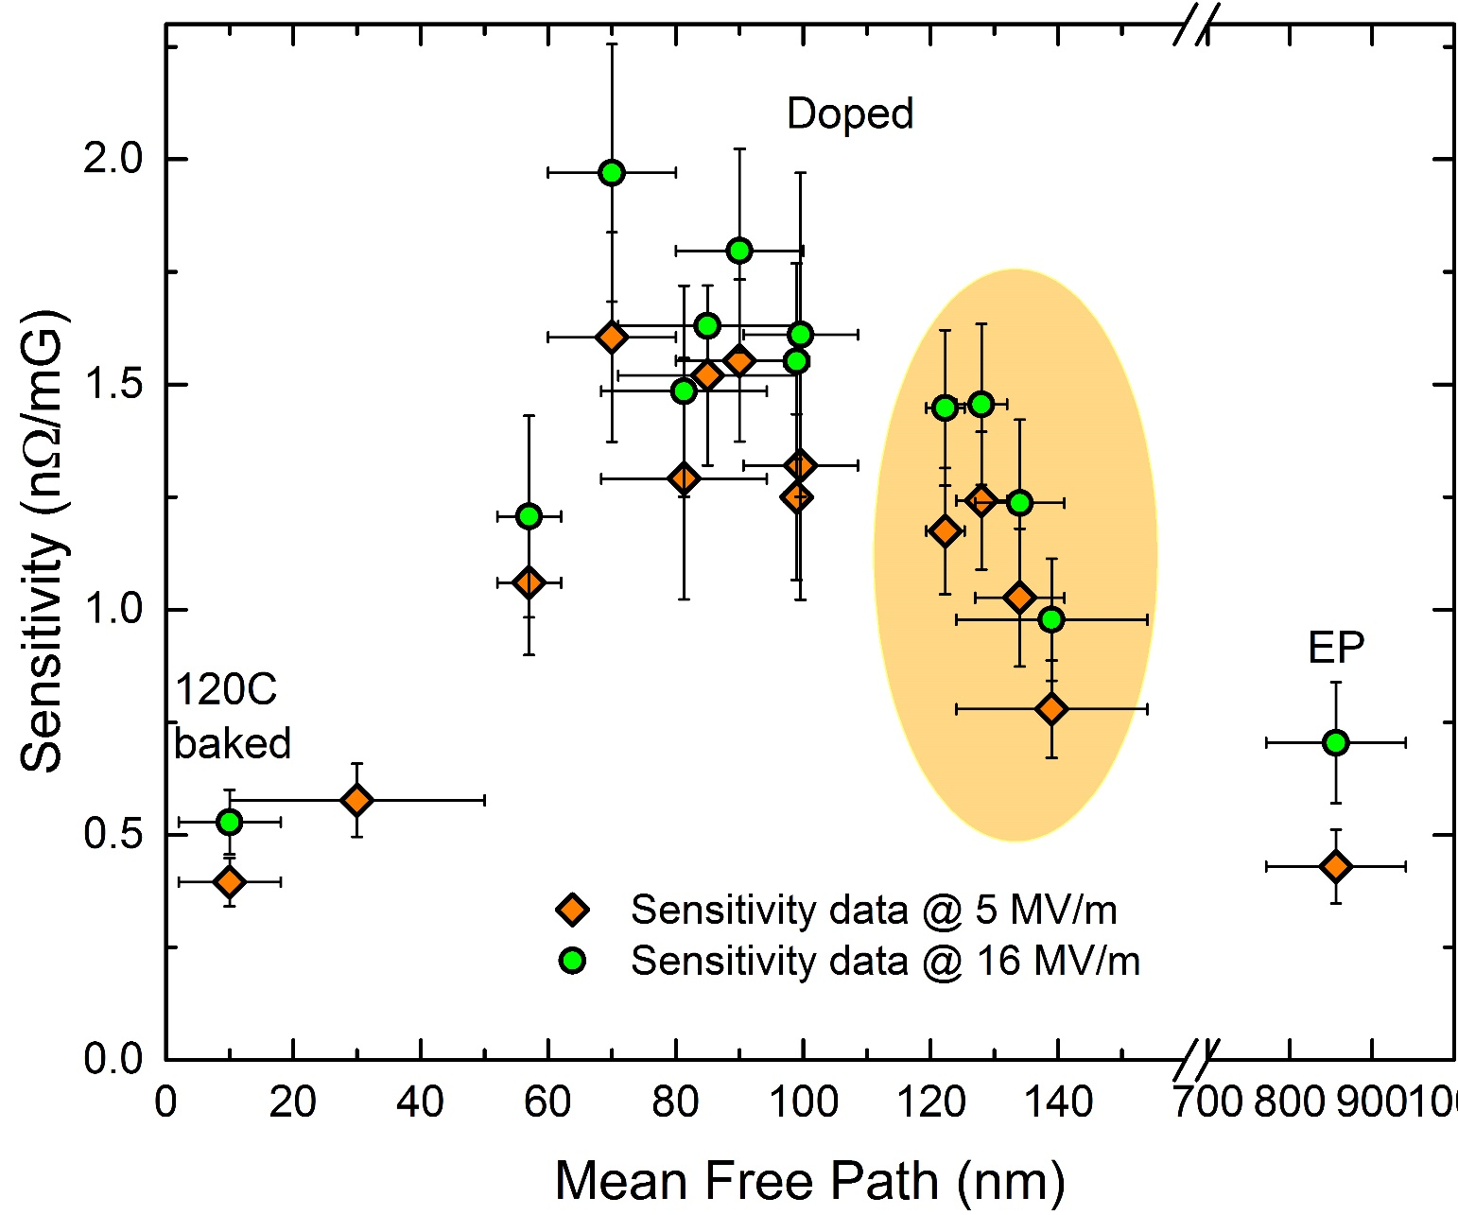
Sensitivity vs mean free path
2/6 N-doping

Slide 7
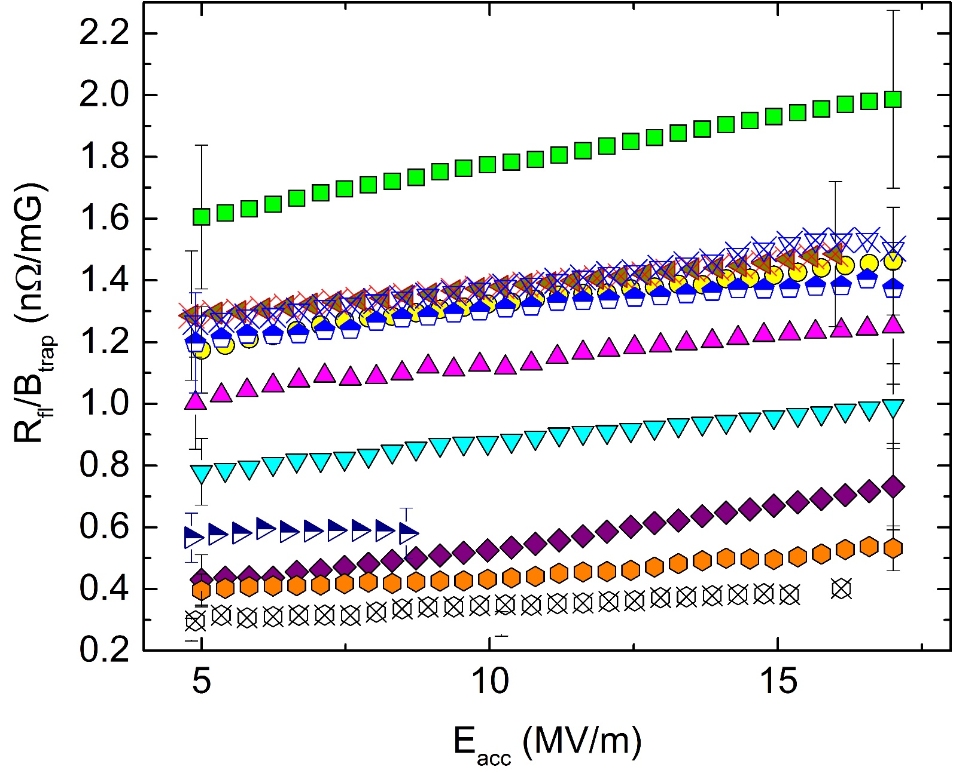
Trapped Flux Sensitivity Field Dependence

Slide 8
Sensitivity Summary
Bell-shaped trend of sensitivity as a function of mean free path
Sensitivity is lower at both very low value (120 C bake) and very large value (EP) of mean free path
Over-doped cavities fall at the maximum of the curve
LCLS-II doping recipe ( 2/6 N-doping ) minimizes trapped flux sensitivity of N-doped cavities
Sensitivity increases with the accelerating field

Slide 9
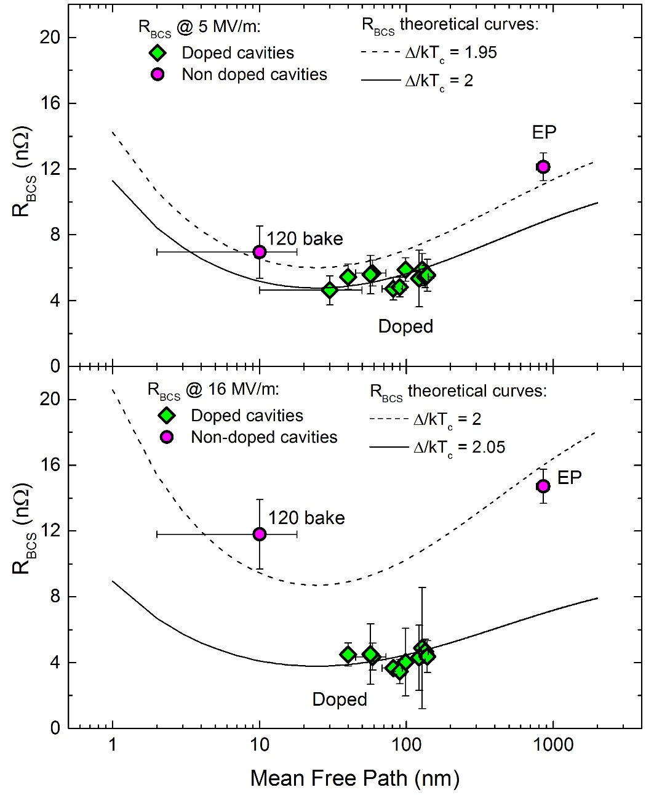
BCS vs mfp
N-doping allows to tune the mean free path and reaching the theoretical minimum of R_{BCS} vs mean free path
Different theoretical curves for standard Nb cavities and N-doped cavities
→ Mean free path is not the only parameter changing with N-doping
→ N-doped cavities may have larger $Δ/{{kT}_{c}}$ than standard Nb cavities

Slide 10
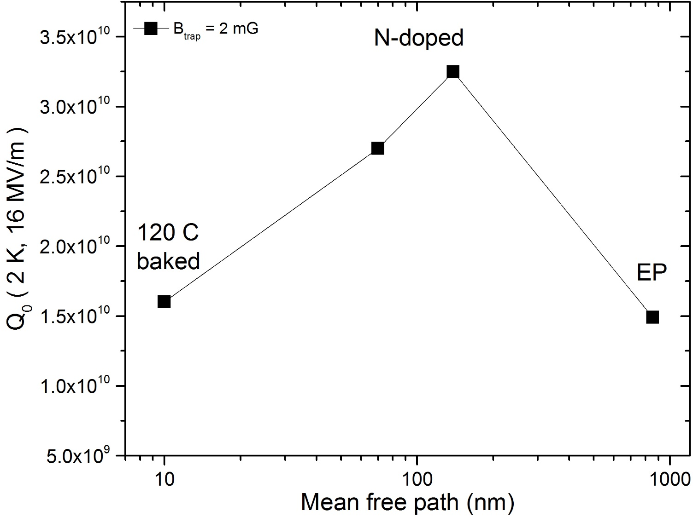
Q-factor vs mfp
Adding together all the $R_{S}$ contributions, it is possible to predict the Q-factor as function of mean free path for different amount of trapped flux

Slide 11
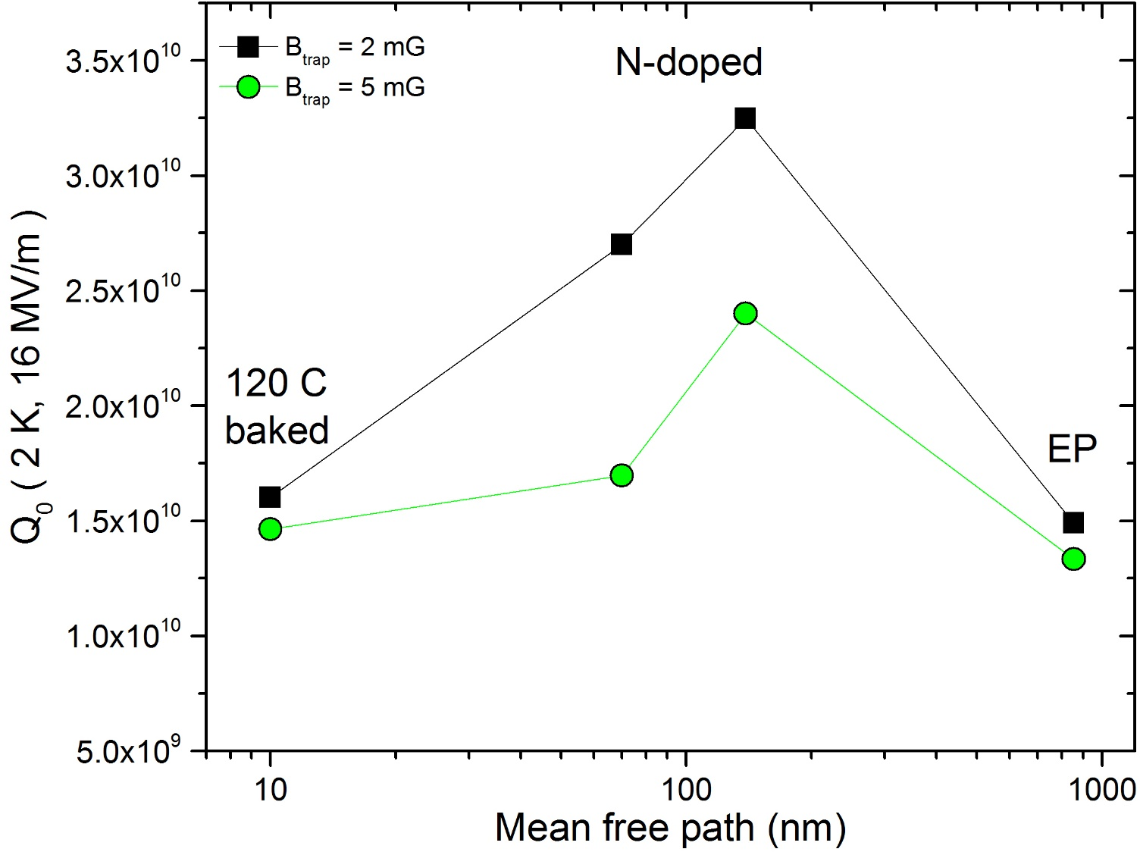
Q-factor vs mfp
Adding together all the $R_{S}$ contributions, it is possible to predict the Q-factor as function of mean free path for different amount of trapped flux

Slide 12
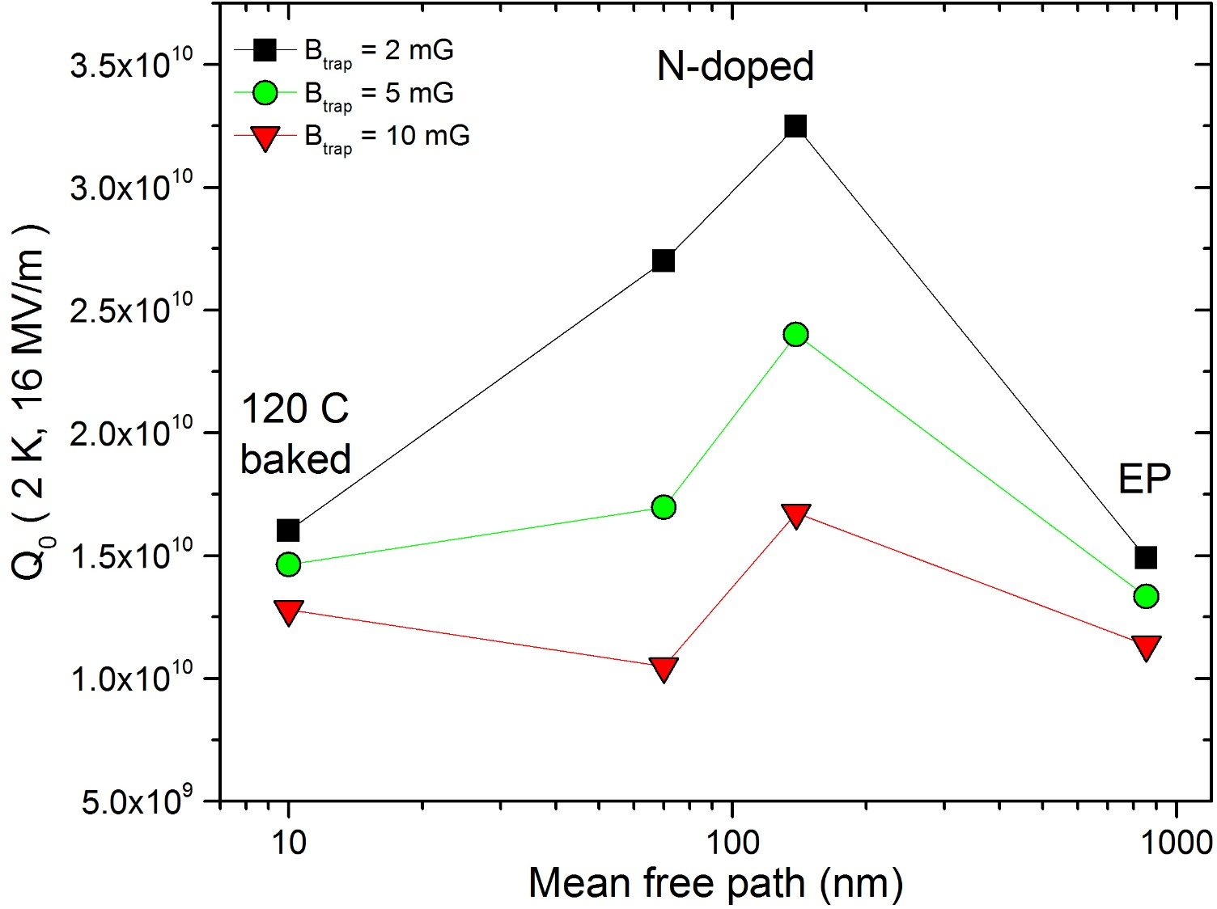
Q-factor vs mfp
Adding together all the $R_{S}$ contributions, it is possible to predict the Q-factor as function of mean free path for different amount of trapped flux

Slide 13
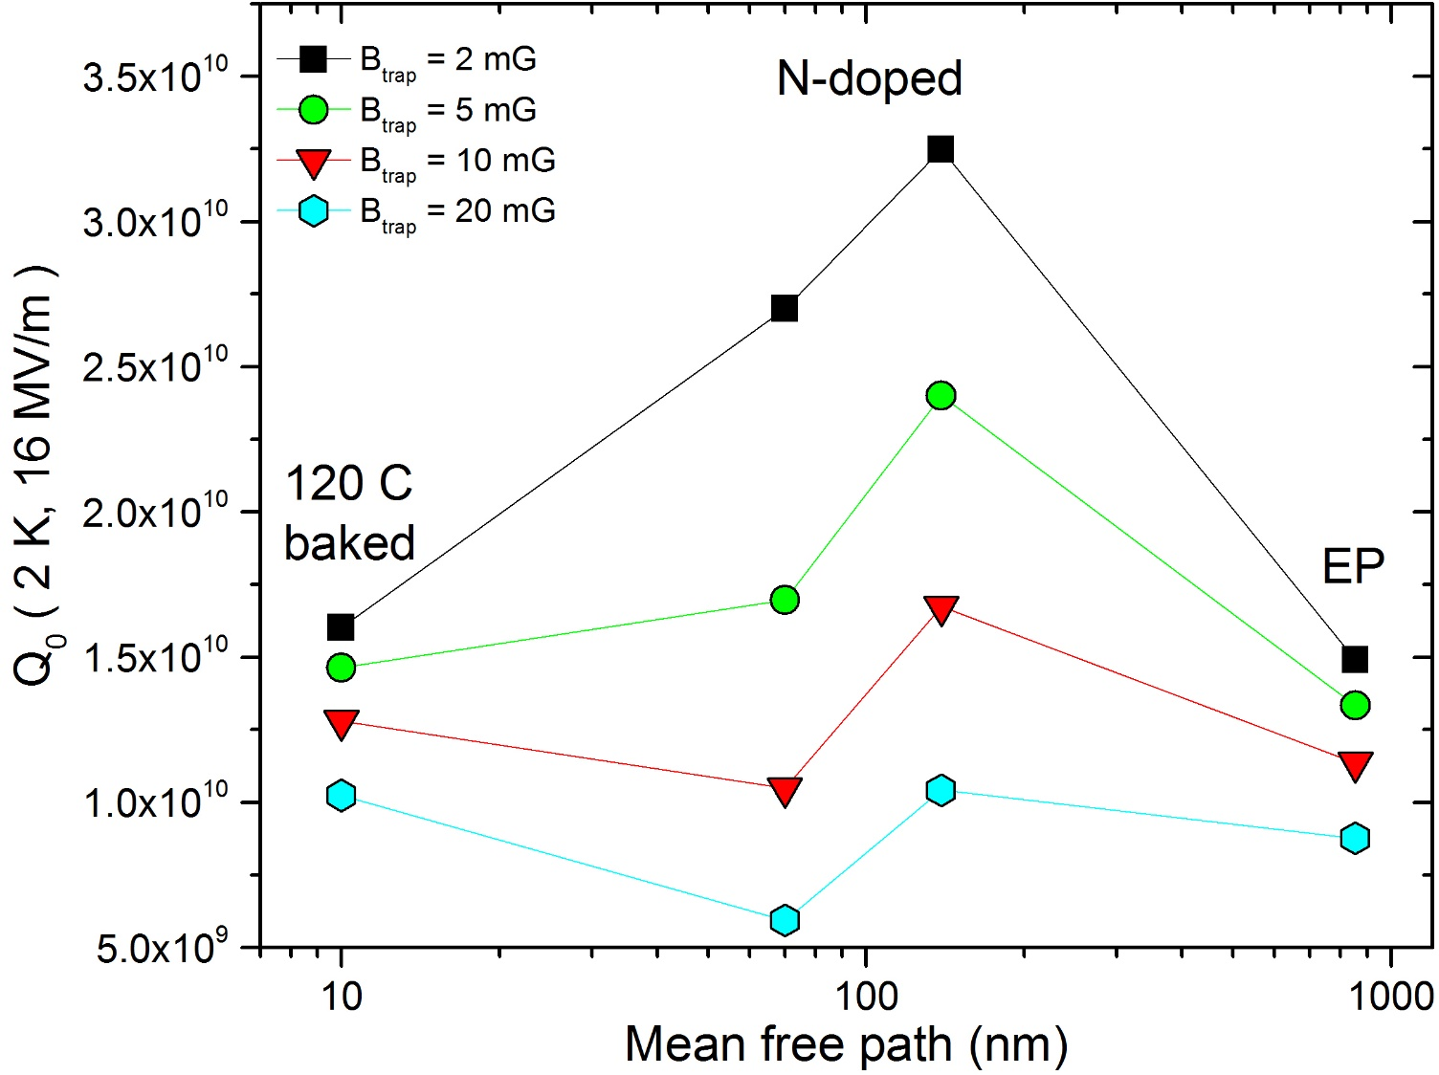
Q-factor vs mfp
Adding together all the $R_{S}$ contributions, it is possible to predict the Q-factor as function of mean free path for different amount of trapped flux

Slide 14
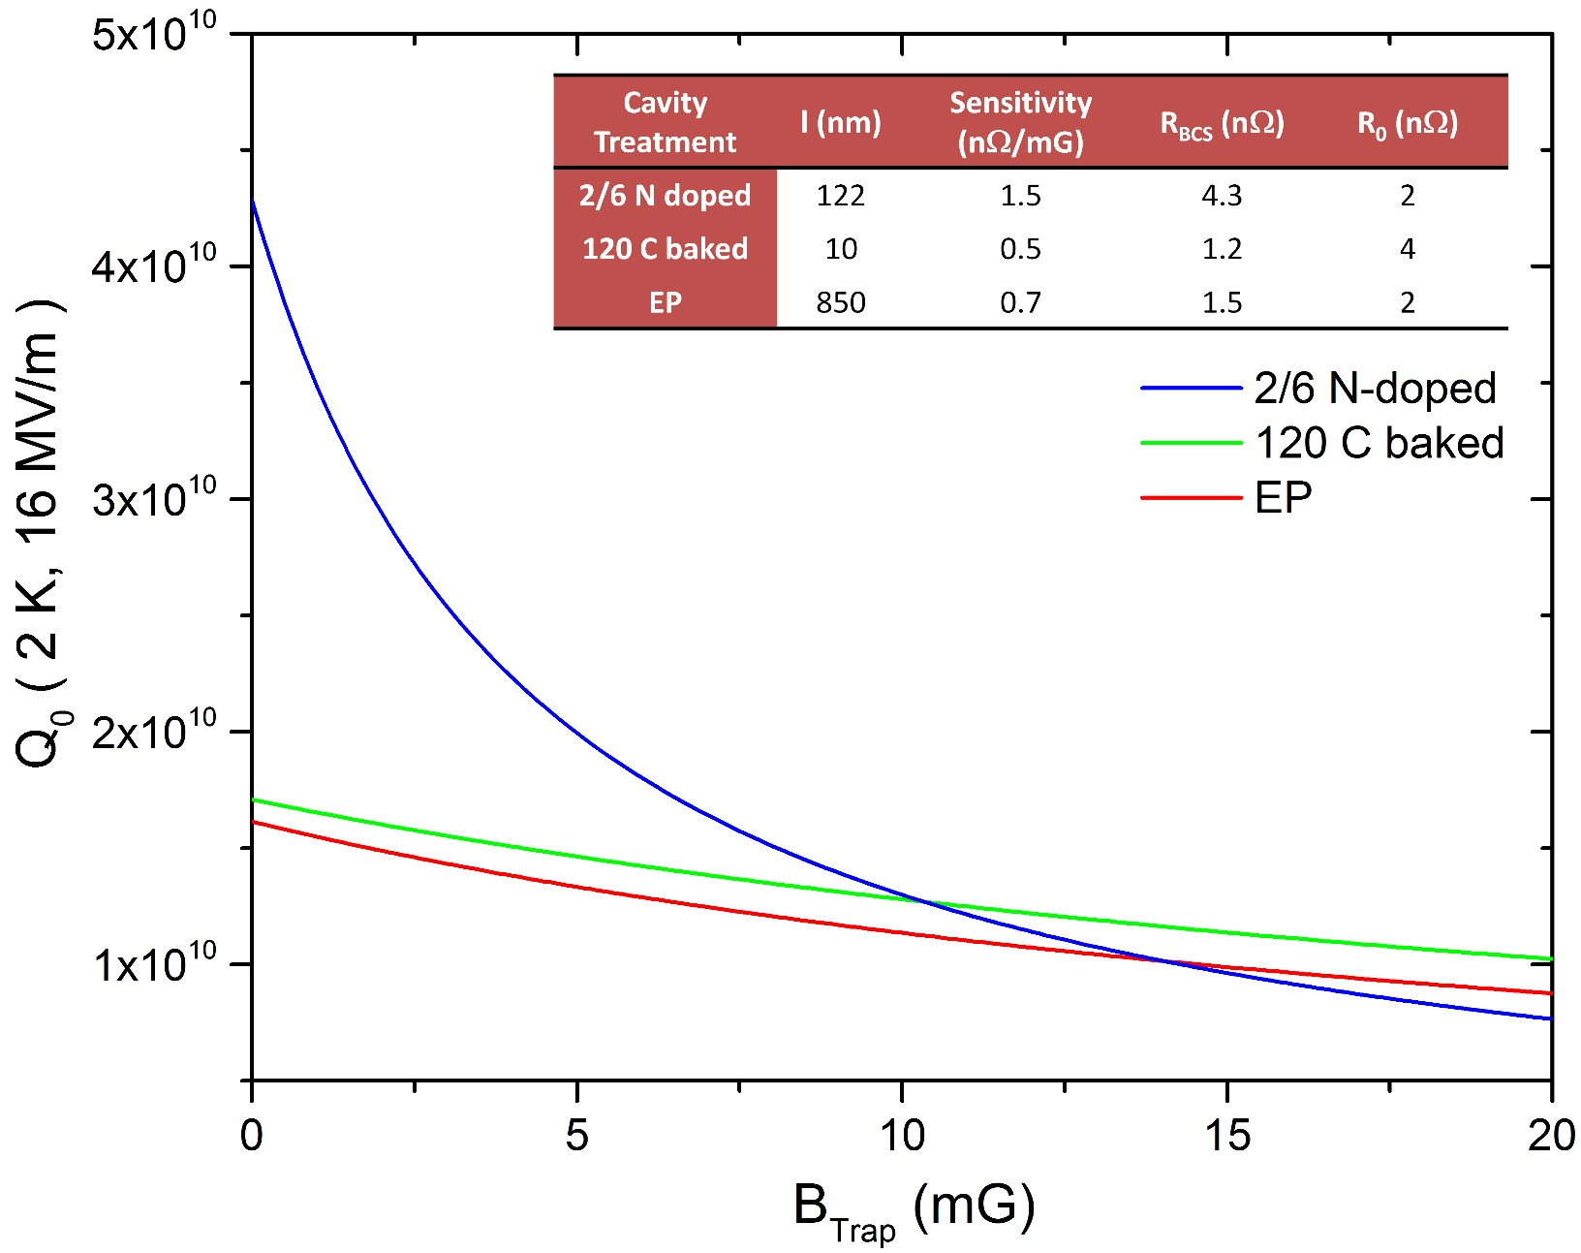
Q-factor vs Trapped Flux for different surface treatments
12
15

Slide 15
Conclusions
N-doped cavities are closed to both minimum of BCS and maximum of sensitivity
Light N-doping allows lower sensitivity and still low BCS
The 2/6 N-doping recipe gives the highest Q-factor at 2 K and 16 hMV/m as long as the trapped field is less than 10 mG
Further optimization still possible towards even lighter N-doping

Slide 16
Thank you for your attention

