Slide 1

4 Laser Upgrade
CEBAF 4 Hall Ops
Joe Grames
June 30, 2016
OPS Staytreat 2016
T. Allison, R. Bachimanchi, M. Bickley, W. Brinton, G. Croke,
M. Diaz, L. Farrish, R. Flood, J. Hansknecht, S. Higgins,
C. Hovater, M. Johnson, P. Kjeldsen, G. Lahti, T. Plawski,
T. Michaelides, H. Robertson, D. Seidman, D. Williams
(1 of 93)

Slide 2
Why????
So, why 4 lasers ?
  Dedicate one laser per Hall to independently control the beam mode (off, pulse, cw), beam intensity (pA-μA), and beam parity quality (PQB)
  Operate lasers at two rep rates (249.5, 499 MHz) in order to simultaneously divide 4 Halls into the 1497 MHz RF structure (=> 750MHz separators)
R. Kazimi, J. Grames, J. Hansknecht, A. Hofler, G. Lahti, T. Plawski, M. Poelker, R. Suleiman, Y. Wang, "Four Beam Generation for Simultaneous Four-Hall Operation at CEBAF”, 7th International Particle Accelerator Conference, BEXCO, Busan Korea, May 8-13, 2016
(2 of 93)

Slide 3
Retrospective
OPS Staytreat 2015 Action Items*
  In FY16 provide 3-lasers with reliable 250/499 MHz bunch structure
  In FY17 provide a 4-laser upgrade with reliable 250/499 MHz bunch structure and commission 4 Hall Operations
*Paraphrased from “Summary Report from the CEBAF OPS 2015 StayTreat”, JLAB-TN-15-033
https://jlabdoc.jlab.org/docushare/dsweb/Get/Document-107190/15-033.pdf
(3 of 3)

Slide 4
OPS Staytreat Action Item #1
In FY16 provide 3-lasers with reliable 250/499 MHz bunch structure
  Reverted from digital to analog gain switching
    Digital switching sensitive to phase lock; worth determining root cause because excellent method to readily create lower rep rates
    Conventional analog switching reliable, worked fine since
  Reliable LLRF at 250/499
    RF group deployed interim solution with 250/499 taps
    Requires manually changing cables in ISB
    Successfully switched ~10 times, takes ~15 min and works reliably
  360 deg phase shifting
    Interim LLRF does not have 360 shifter for @ 250 MHz
    Software solution proved slow 720 deg @ 499 MHz works reliably
(4 of 3.14159…)

Slide 5
OPS Staytreat Action Item #2
In FY17 provide a 4-laser upgrade with reliable 250/499 MHz bunch structure and commission 4 Hall Operations
  Scope of Work defined Fall 2015
    High-level system integration (chalkboard)
    FY16 AWP approved
  Monthly upgrade meetings began January 2016
    System (Laser, Controls, SCAM, PSS, LLRF) planning and logistics
    https://wiki.jlab.org/ciswiki/index.php/Injector_Upgrade_Meetings
  Installation began Summer SAD 2016
    8 Week effort started (Laser, Controls, SCAM, PSS)
    Commission hardware/software, Beam (OPS), Parity Quality (Users)
    4-LLRF re-scoped to Winter 2017 SAD for budget/labor constraints
    4 Hall Test (and contingent OPS) in Spring 2017
(5 of More)

Slide 6
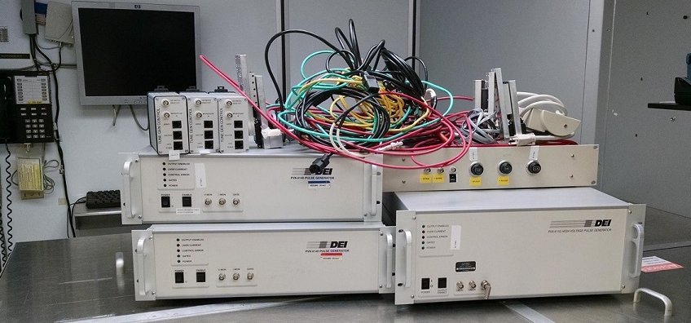
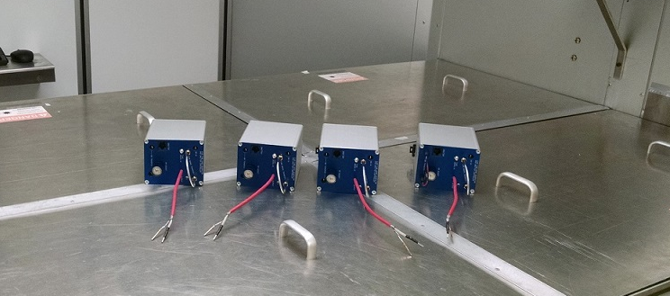
Laser System Upgrade
Early work already completed Summer SAD 2015
  Installed modular 4-laser chassis in ISB
  Installed rack mounted micro-climate chiller in ISB
New electro-optic tune mode generator in Spring 2016
  Test long-term HV application to EO cell (RTP) w/o ion migration
  New JLAB HV switch design
    Replaces costly/bulky commerical DEI switches
    Faster risetime (25 ns vs. 250 ns)
(6 of ∞)

Slide 7
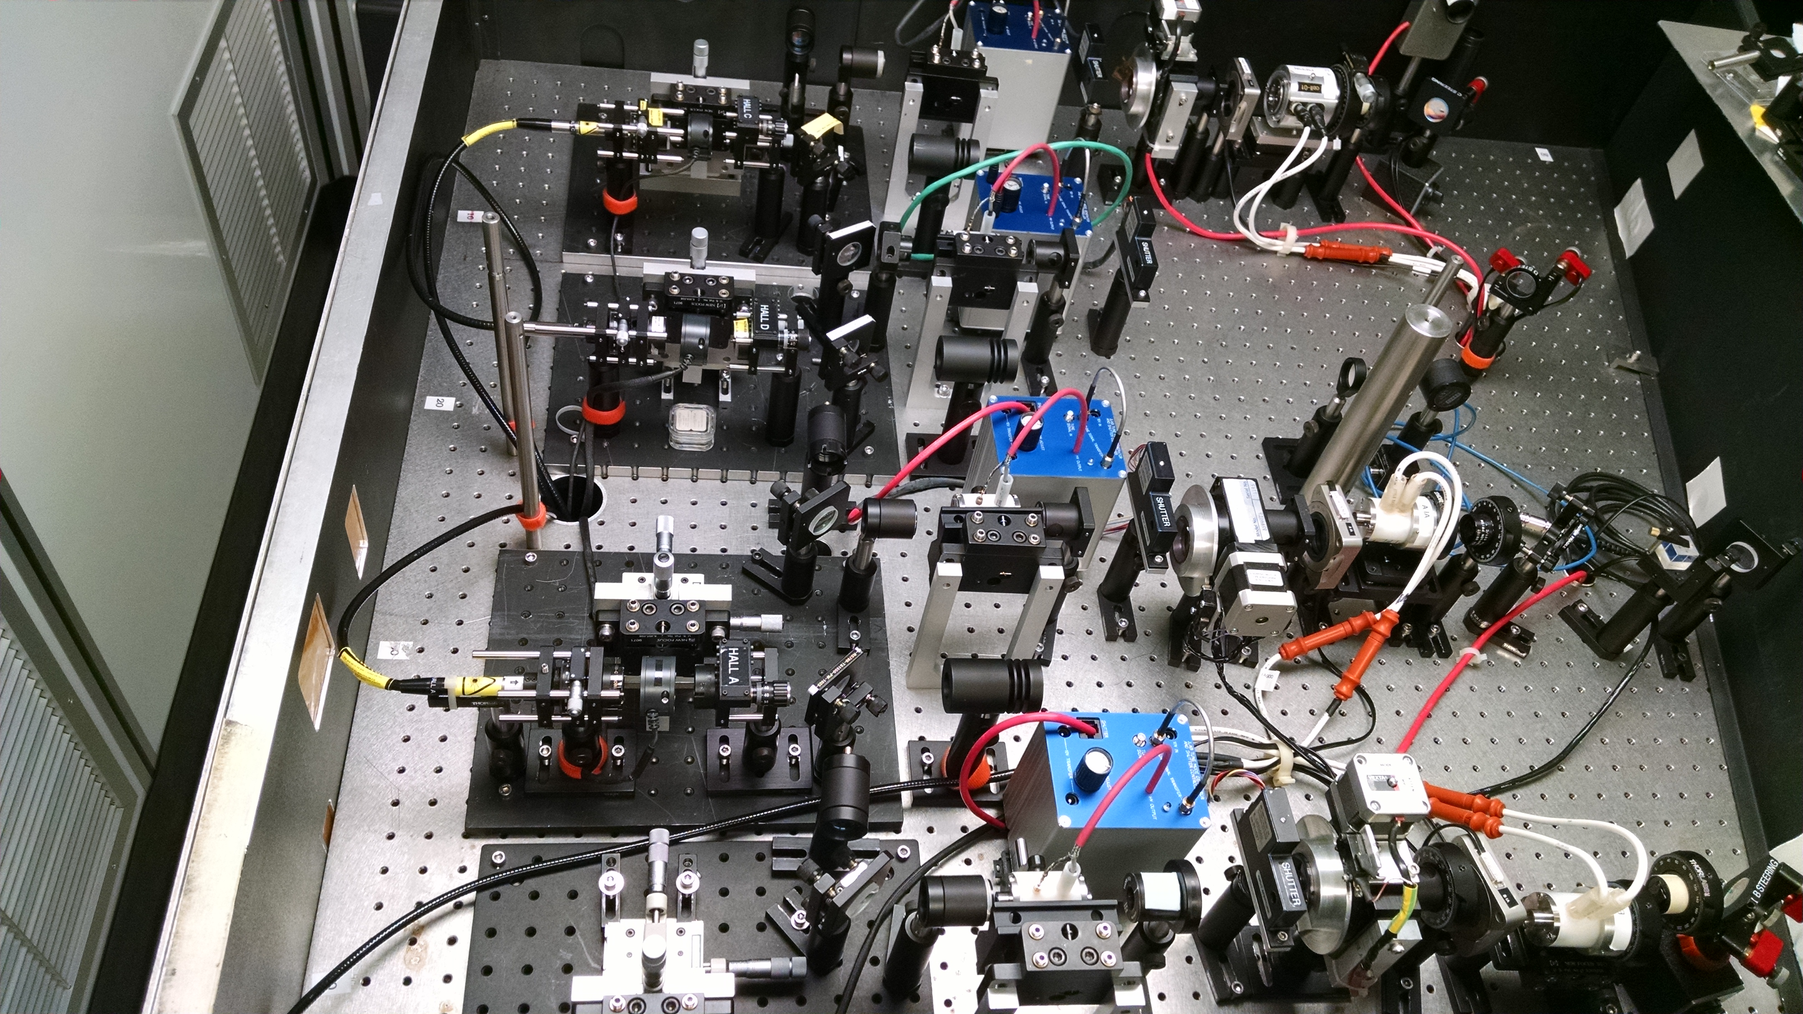
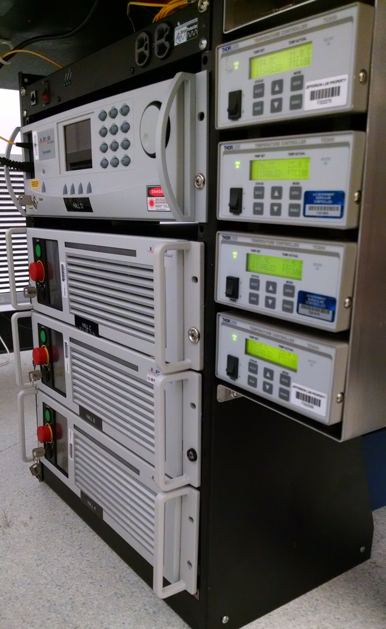
Laser System Upgrade
Rebuilding the laser table started ~1 week ago
  4th laser amplifier purchased (spare ordered in FY17)
  Upgrade communications to fiber laser (PPLN temp / IPG amp)
  Completely rebuild optics layout from 3-laser to 4-laser
Splitter
C
C
IA
Polarizer
D
B
A
RWP
A
RWP
Splitter
Pockels
Cell
B
POCKELS CELL
IA
Tune
IHWP
IHWP
PSS
(7 of 9)

Slide 8
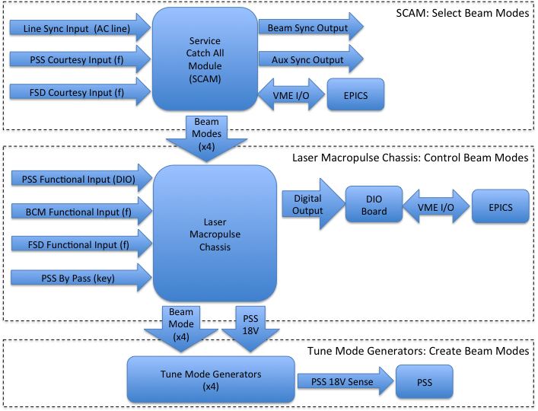
Laser Controls Upgrade
Significant changes to improve functionality, modularity and later, support the Injector Upgrade
SCAM
Laser
Macropulse
Chassis
Tune Mode Generator
(8 of 2⁵)

Slide 9
Laser Controls Upgrade
SSG HVPS/Laser PSS Upgrade
  SCMB approves new mode of gun operation
  HVPS remains ON through Hall accesses
  New method augments PSS to inhibit laser beam
  Benefits high gun voltage operation (Injector Upgrade)
Laser Macropulse chassis Upgrade
  Chassis provide hardware interface of PSS and OPS control to the 4-laser system
  Unnecessary hook to HVPS software and redundant signals removed
(9 of XI)

Slide 10
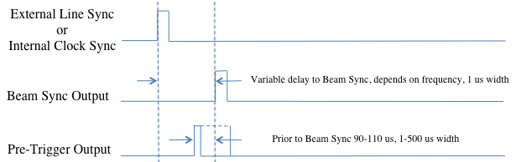
Laser Controls Upgrade
Service Catch-All Module
  Programmable interface to the Laser Macropulse chassis selects the desired laser beam modes
    New SCAM defines beam mode structure in firmware, but ports the parameters to EPICS (greater flexibility)
    New Pre-Trigger Output added for “slower” diagnostics
(10 of Nearly Done)

Slide 11
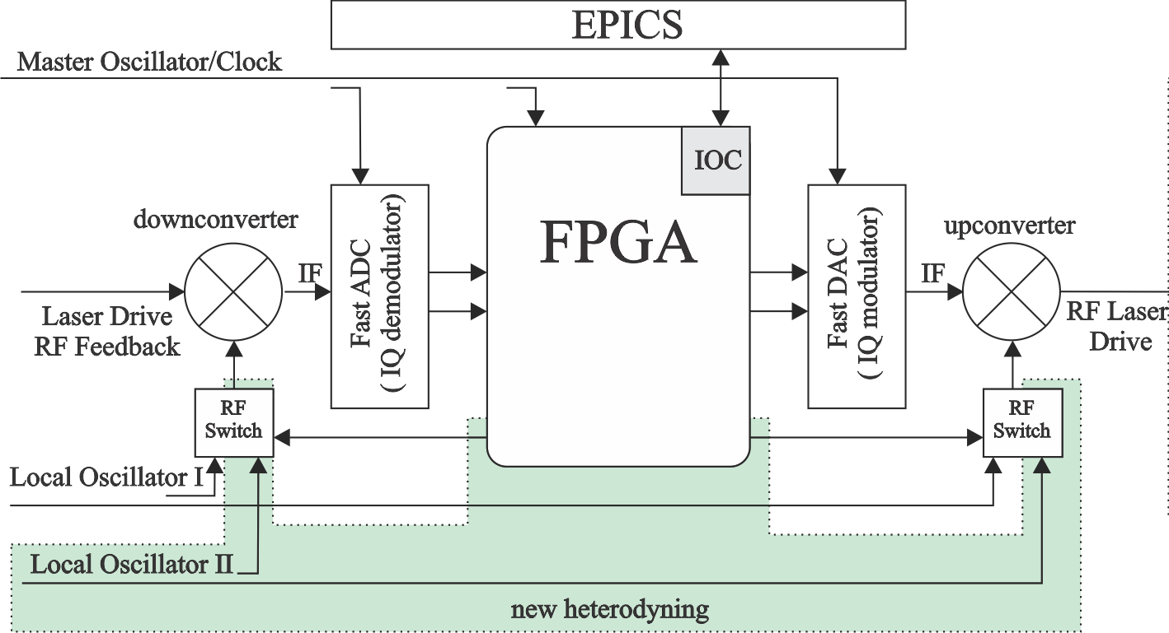
Laser LLRF Upgrade
New Laser LLRF
  Present 3-laser system is based on C100 LLRF CM
  New 4-laser system is dedicated (simplified)
  Each channel provides either 499 or 249.5 MHz
    RF amplitude and phase (360 deg) control
    Remotely selected frequency (no re-cabling)
  Development
    Analog RF (LO)
    Digital RF
    FPGA (controls/EPICS)
    Laser LLRF (front end)
  Installation
    Progressing well
    Re-scoped for FY17 AWP
    Install Winter 17 SAD
(11)

Slide 12
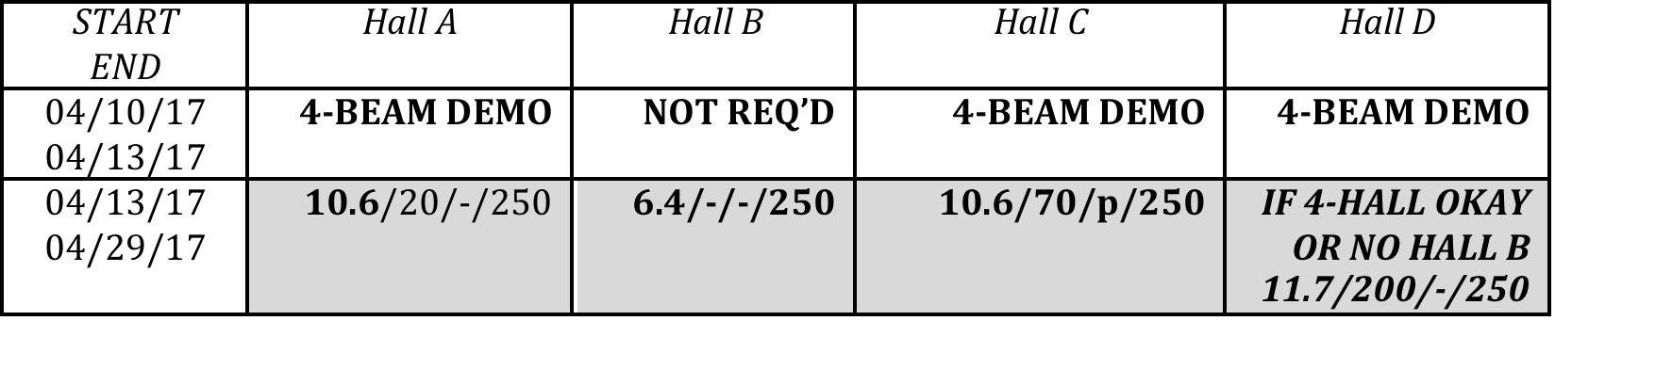
Summary (not my last slide!)
This is a major upgrade of critical and interconnected systems (Laser, LLRF, SCAM, PSS, HVPS)
FY17 milestones
  Summer 2016 – Commission lasers, SCAM, PSS, Controls
  Fall 2016 – 3-beam capable at 250/499 MHz
  Winter 2017 – Install 4-LLRF
  Spring 2017 – Commission 4-Hall Ops (contingent program)
Starting ~6 months earlier may have helped, but actual timeline is mated and on-track for CEBAF program in 2017
Summer 2016 SAD installation has just begun ... cautiously stated: so far, so good !
(12 of 3)

Slide 13
Issues and Open Questions
Chopper Setup – Develop process to deliver two beams to two Halls through one chopping aperture. Explore 4 beam setup (see Reza’s talk)
Bleed through – Lasers create leakage beam. We have same 499MHz cross-leakage, but now experience “new” 250MHz self-leakage (see Matt’s talk)
  Optimize laser settings (mostly preamp settings) to reduce magnitude of bleedthrough
  Develop a procedure that can quickly distinguish the location of the bleedthrough, i.e. chopper vs. separator setup
Bunch timing – RF separators do the job, but we became creative at the injector (space charge, Mott scattering, Brock cavity). Which method to use?
(13 of 14)

Slide 14
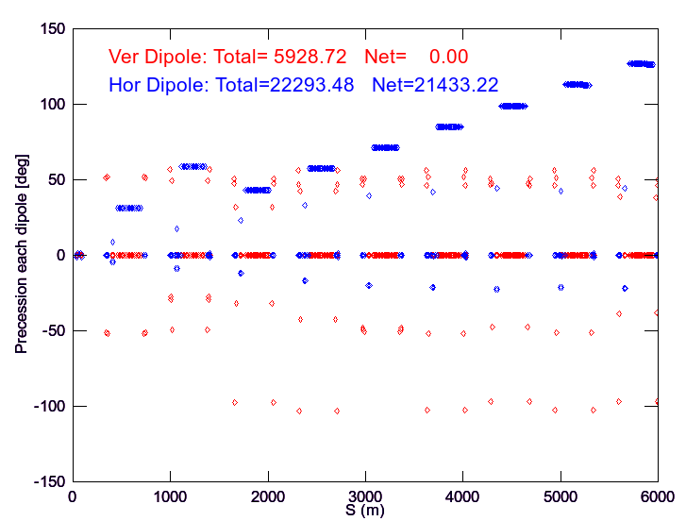
Issues and Open Questions
12 GeV Spin Calculator – Precession requires accurate knowledge of beam energy at each dipole
  Applied method based on Elegant model, measurement of linac energies and spin math to predict Hall A @ 5th pass Spring 2016
  Work with CASA and software to deploy model driven calculator
(15 or 16)

Slide 15

Fin
(Done)

Slide 16
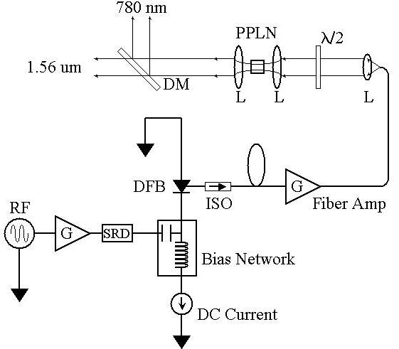
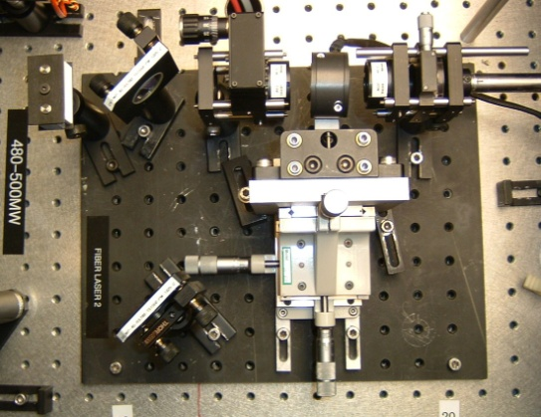
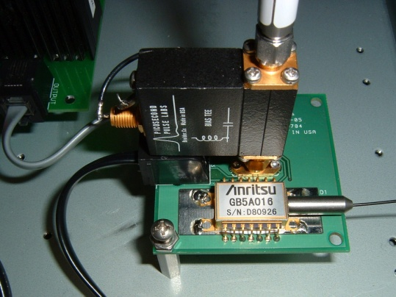
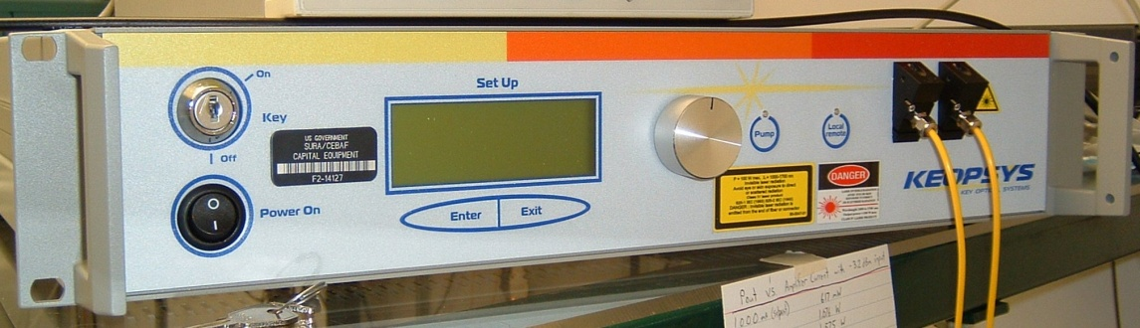
Synchronous Photo-Injection by Fiber Laser
780 nm
Frequency-doubler
1560 nm to 780 nm
30% Efficiency (2 W)
RF Locked Low-Power (1 mW)
1560 nm Fiber Diode
1560 nm
499 MHz
High Power (6 W) 1560 nm Fiber Amplifier

Slide 17
Beam Repetition Rate
We are considering three approaches to producing 499 and 249.5 MHz (also 31 MHz for Mott).
Analog
Gain
Switching
LLRF = 499, 249.5
Laser = 499, 249.5
Electron = 499, 249.5
Digital
Gain
Switching
LLRF = 998
RF Divider =
499, 249.5
Laser =
499, 249.5
Electron =
499, 249.5
Optical
Pulse
Picking
LLRF = 499
Laser = 499
Fast Shutter =
499 (off), 249.5
Electron =
499, 249.5

