Slide 1
Post-CHL Accelerator Start up Process Review, Spring 2016

Slide 2
Outline
Why a team?
What was found?
Who is on the team?
The investigation
Some open questions

Slide 3
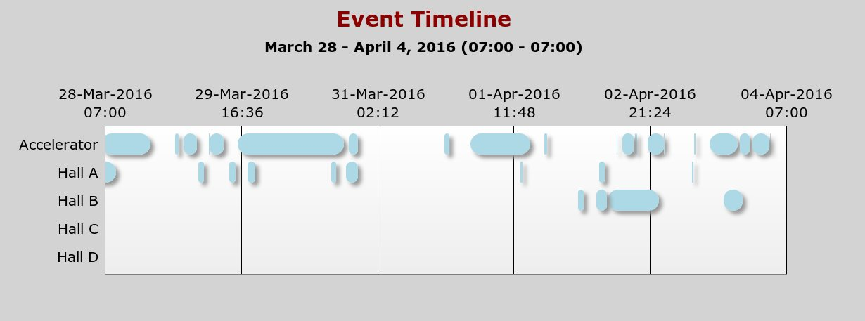
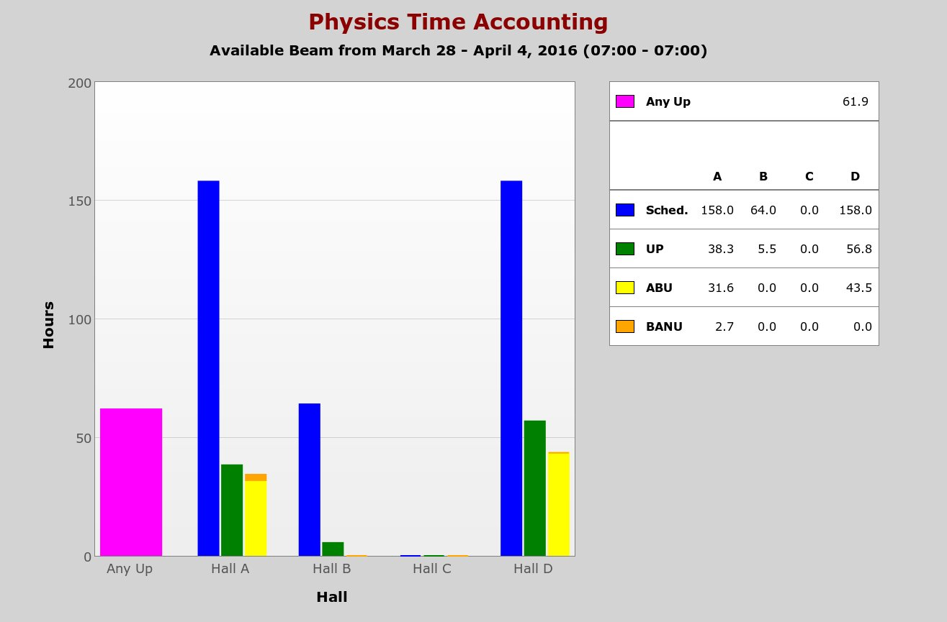
Why a Repair Escalation Report?

Slide 4
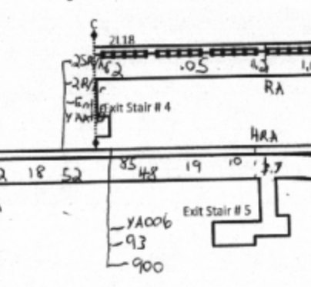
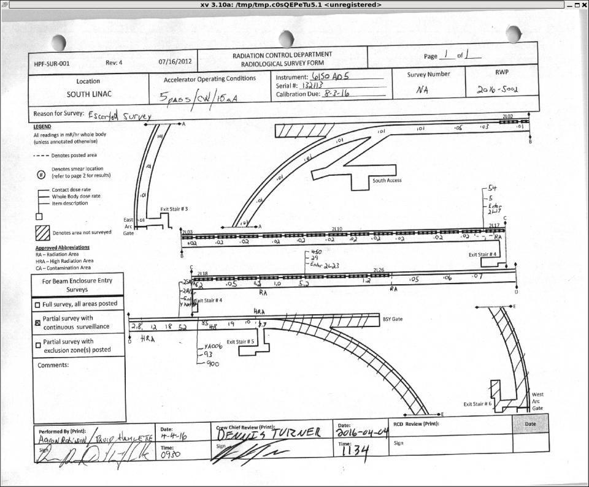
What was found?
The hottest of hot spots
(25R on contact)

Slide 5
RAR Team
Matt Bickley (Team lead)
Todd Satogata (CASA/Bteam)
Brian Freeman (Operations)
Ken Baggett (Engineering)
Joe Gubeli (Knowledgeable objective party)

Slide 6
The Investigation Process
Review of logbook and downtimes
Analysis of optics data collected
Interviews with operations, CASA and engineering staff
RAR team discussion and integration of information

Slide 7
Some of the week’s significant events
Difficulties with separator (3/27 e3392509; 3/29 DTM:2022; 3/30 DTM:2024; 3/30 DTM:2031; 4/3 DTM:2050)
BLM weird behavior (3/27 e3392625)
Vacuum issue (related? 3/28 DTM:2012; 3/29 DTM:2022)
BLM voltage lowered (3/27 e3392641)
BLA investigation (3/31 DTM:2034) Integration limit changed (3/31 e3394022)
BLM trips (4/3 DTM:2050)

Slide 8
Corrective actions
Complete retune of machine [executed successfully starting 4/4]
BLA integrated trip point returned to 1uA
New protocol: no MPS set point changes without approval from director of operations
Get 750MHz separators to produce designed separation
Revive beam troubleshooting guides

Slide 9
Action items
BLM calibration on a test bench (VME) and with beam
Need a policy for reviewing changes to all MPS devices and setpoints
Improve RF separator setup procedure
Complete 750 MHz separator commissioning [already done]

Slide 10
Lessons Learned
Accelerator setup: first principles versus snapshot of prior state
Complete commissioning of hardware
BLM responses (CAMAC vs. VME) not normalized
Not all BLMs have been commissioned with beam
750 MHz separator measurements were not finished
Need to improve management of endstation/operations interactions

Slide 11
Some Questions...
Who owns the role of beam loss hound?
How do we balance programmatic pressures against other pressures that affect reliability (design, test, and commissioning time; documentation)?
Are we effectively communicating risks?
  Engineering->Operations [Hardware readiness]
  Operations->Management [Machine availability]
  Operations->Users [Impact on experiments]
  CASA->Operations [Machine configuration]

